Slide 1
Variational Neural Network Approach to QFT in the Field Basis: Results from Klein-Gordon Theory
Kevin Braga

Slide 2
Overview
Motivation and neighboring work
Physics theory background
Discretization scheme and machine learning
Results
Summary and future work

Slide 3
Overview
Motivation and neighboring work
Physics theory background
Discretization scheme and machine learning
Results
Summary and future work

Slide 4
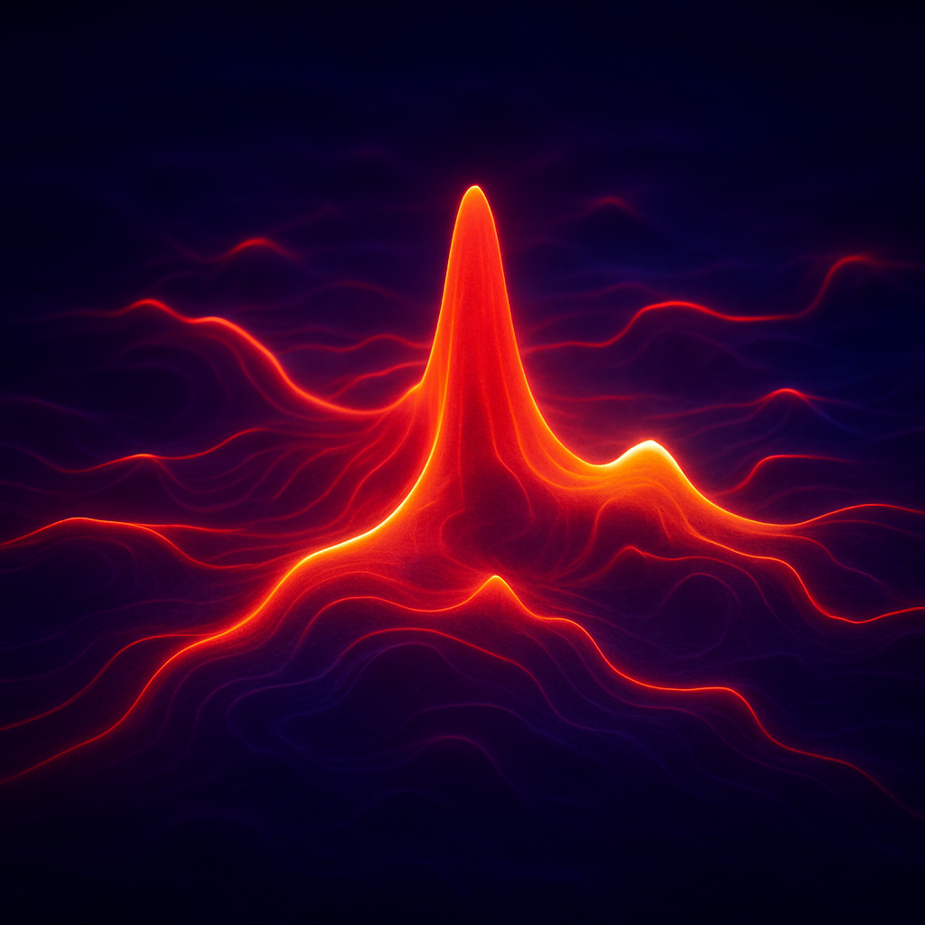
Motivation
Understand QFT states directly through the wavefunctional
Encodes all information about the system
Field basis is an intuitive and useful representation for QFT states
Accessible quantities and structures
Any observable
Entanglement entropy
Field-space probability distributions
Time evolution and real-time dynamics
Excited states via variational methods
Dependence on field-space topology
Approximate the continuum QFT Hilbert space with continuum-inspired operator definitions
Image generated with OpenAI ChatGPT (DALL·E)

Slide 5
Related Applications of Neural Quantum States (NQS)
Seminal work on spin systems
G. Carleo and M. Troyer. Solving the quantum many-body problem with artificial neural networks. Science, 355(6325):602–606, 2017.
Nonrelativistic QFT and Klein-Gordon in the Fock basis
John M. Martyn, Khadijeh Najafi, and Di Luo. Variational neural-network ansatz for continuum quantum field theory. arXiv preprint arXiv:2212.00782, 2022.
Hamiltonian Lattice Klein-Gordon
M. Rovira, A. Parre˜no, and R. J. Perry. A variational approach to quantum field theory. 2024. arXiv:2409.17887 [hep-lat].
Hamiltonian Lattice QED
Zhuo Chen, Di Luo, Kaiwen Hu, and Bryan K. Clark. Simulating 2+1d lattice quantum electrodynamics at finite density with neural flow wavefunctions. December 2022. arXiv:2212.06835 [hep-lat].
Idea: Apply the NQS framework to continuum QFT in the field basis

Slide 6
Overview
Motivation and neighboring work
Physics theory background
Discretization scheme and machine learning
Results
Summary and future work

Slide 7
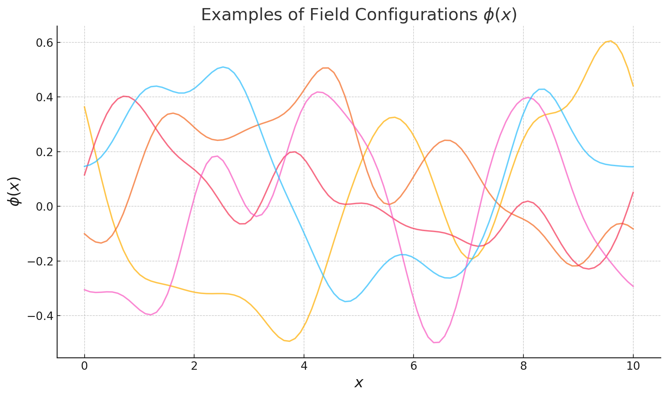
QFT in the Schrodinger Picture (Field Basis)
Field basis
Commutation relations
Momentum operator in the field basis
Image generated with OpenAI ChatGPT (DALL·E)

Slide 8
The (Real) Klein-Gordon Hamiltonian in 1D
x-space
k-space (preferred for preliminary benchmarking)
Symmetrized
Fourier Transform
+ Simplifications

Slide 9
The Variational Problem
Goal: Find the ground state wavefunctional of Klein-Gordon Theory by minimizing the expectation value of the Hamiltonian
Klein-Gordon Hamiltonian in k-space

Slide 10
Overview
Motivation and neighboring work
Physics theory background
Discretization scheme and machine learning
Results
Summary and future work

Slide 11
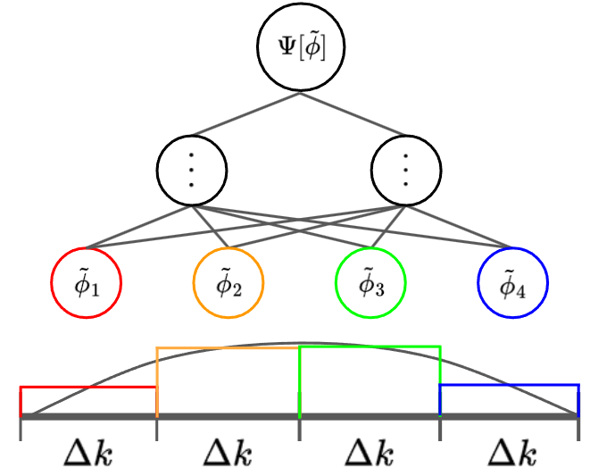
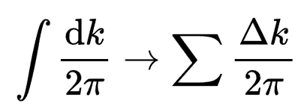
Integral Discretization
Discretize field basis
Operator representations sensitive to integral discretization procedure
Choose central Riemann
Requires Dirac delta discretization:

Slide 12
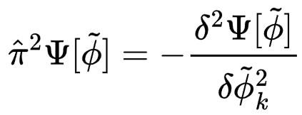
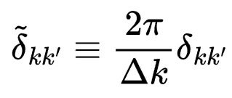
Kinetic Term
Via successive application of the operator:
Note the similarity to finite difference approximations; suggests viability of higher order approximation

Slide 13
Kinetic Term (2)
Use fourth-order (five-point) finite difference stencil
Performing second variational derivative boils down to a series of wavefunctional evaluations

Slide 14
Field Integral
Final, discretized Hamiltonian
Now, we consider the discretization of the field integral

Slide 15
Field Integral
instructs us to sum over all field configurations in the continuum
Thanks to explicit normalization, integration measure prefactors cancel

Slide 16
Setup Summary
Minimize expectation value of the Klein-Gordon Hamiltonian (Python VEGAS) with

Slide 17
Overview
Motivation and neighboring work
Physics theory background
Discretization scheme and machine learning
Results
Summary and future work

Slide 18
Hyperparameters
K-grid
Number of field configurations
Max field amplitude
Neural network architecture
Mass

Slide 19
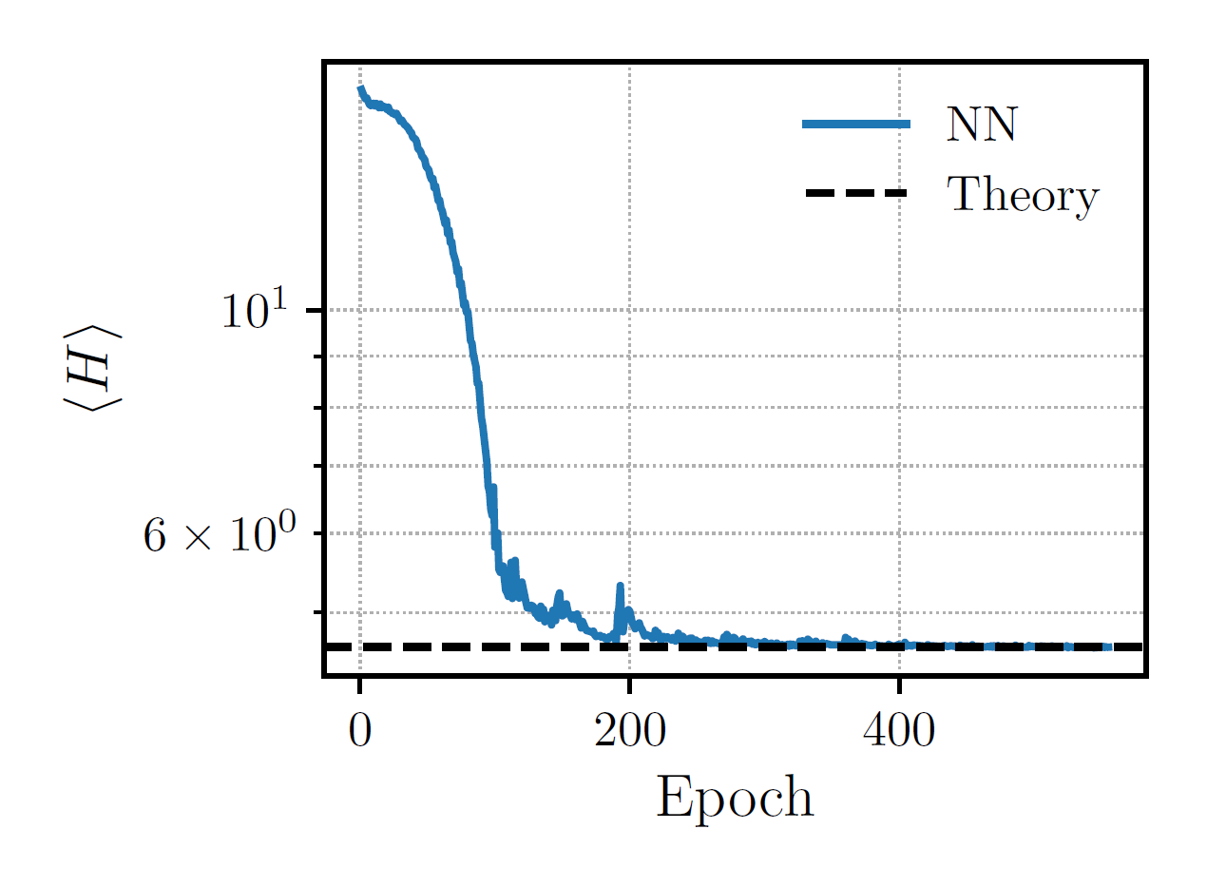
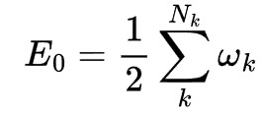
Training
Theoretical ground state energy
New basis of fields generated every epoch (stochastic learning)
Stopping condition

Slide 20
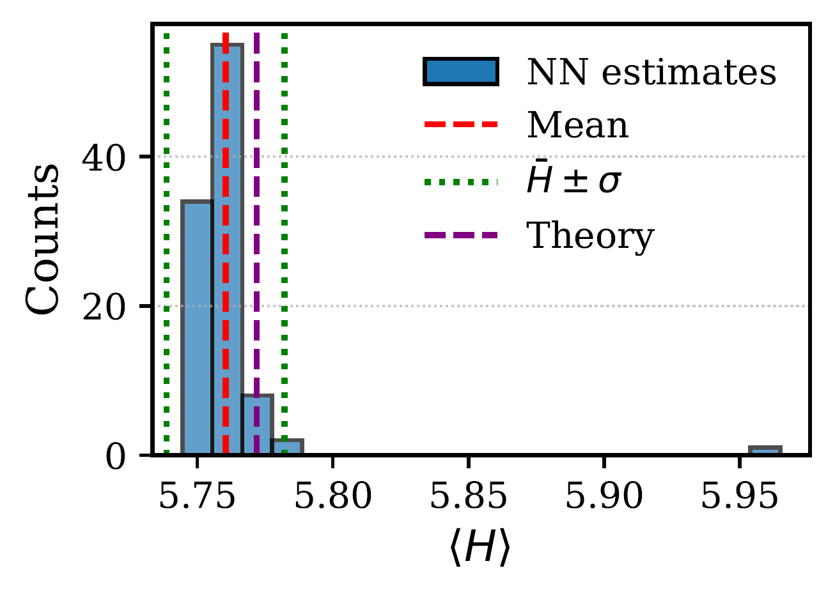
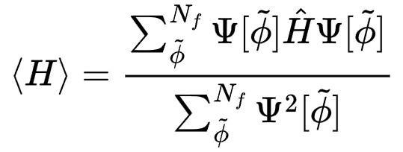
Ground State Energy Estimation
Observables obtained by evaluating For distinct sets of basis fields.
100 trials are performed for all observable estimates in this talk

Slide 21
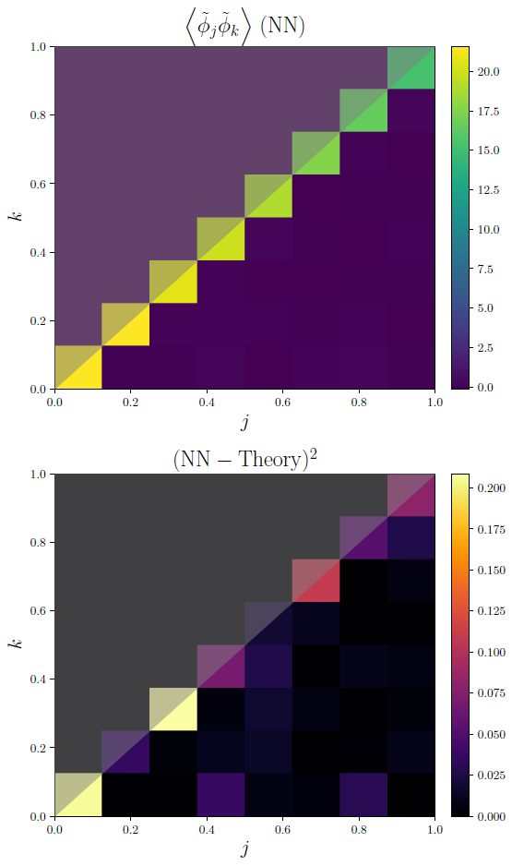
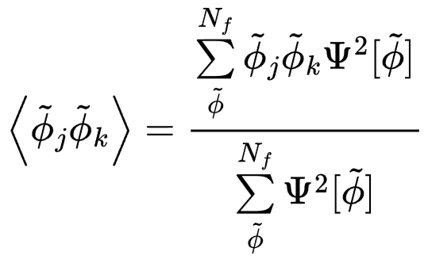
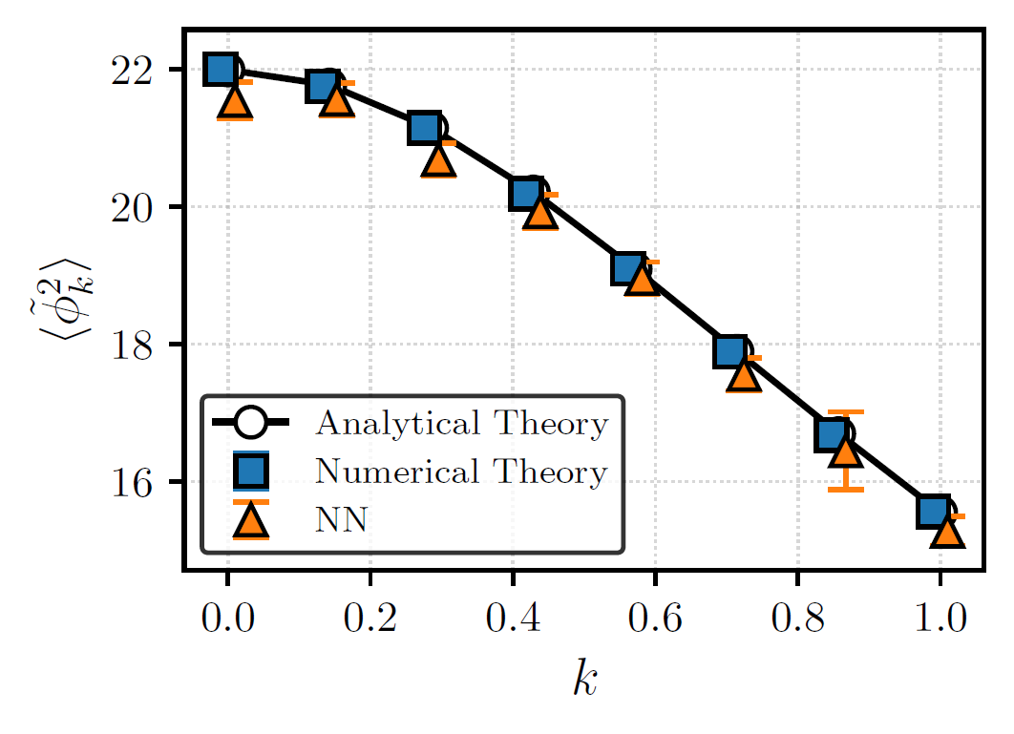
Two-Point Correlators
Theory
Diagonal terms

Slide 22
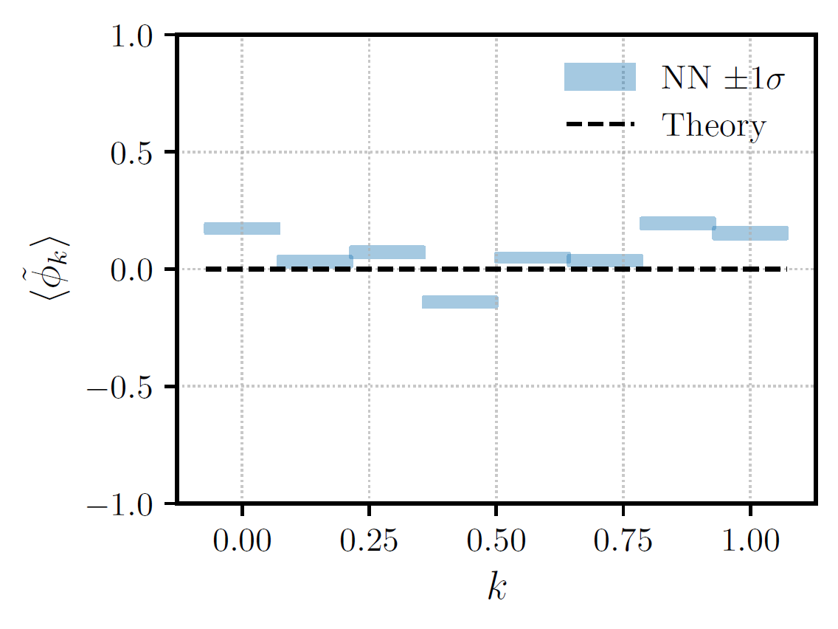
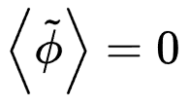
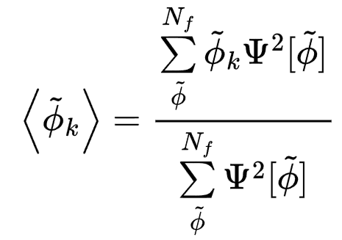
Expectation value of the field
Theory

Slide 23
Visualization of the Klein-Gordon Vacuum
Darker curves more likely; vertices indicate center of Riemann intervals

Slide 24
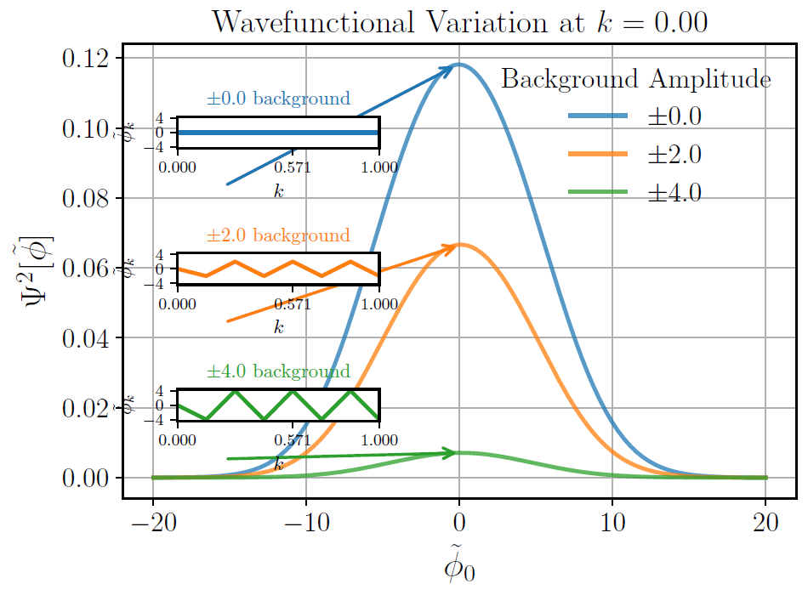
Visualization of the Klein-Gordon Vacuum (2)

Slide 25
Overview
Motivation and neighboring work
Physics theory background
Discretization scheme and machine learning
Results
Summary and future work

Slide 26
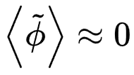
Results Summary
Trained a neural wavefunctional for the Klein–Gordon ground state in momentum space
Accurate recovery of the ground state energy
Full two-point correlator matrix reproduced
Expectation value of the field
Field-space visualizations show expected Gaussian structure

Slide 27
Future Work
Physics
Solve Klein-Gordon in x-space
Add interaction term
Extend to higher dimensions
Gauge theories, multiple field species, etc.
Computational
Memory bottlenecks
Image generated with OpenAI ChatGPT (DALL·E)

Slide 28
Questions?
Thank you!

