Slide 1
Autoencoders for Partial Wave Analysis
AI for Hadron Spectroscopy at JLab
Jefferson Lab, Newport News, VA
June 2025
Trevor Reed
Florida International University
Will Phelps (CNU/JLAB), Carlos Salgado
Lei Guo, Leonel Martinez (FIU)

Slide 2
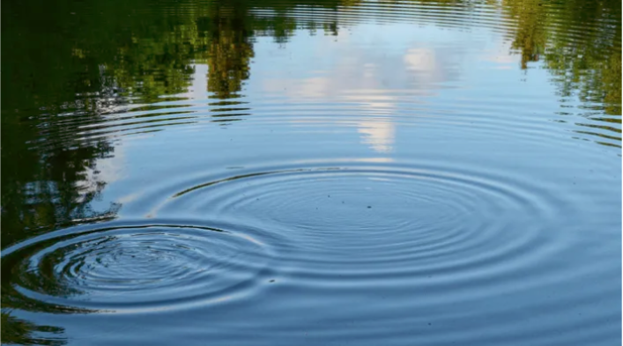
Partial Waves
Apparent complex wave behavior can be described by interaction between simpler, more fundamental waves
We observe cumulative effects
PWA attempts to uncover richer underlying physics

Slide 3
Partial Wave Analysis (PWA) Overview
Decompose (scattering) intensity into partial wave contributions and their interferences
$I(Ω)=\sum_{ε_{R}}{\sum_{l,|m|,l^{′},|m^{′}|}{Y_{l}^{ε_{R},\left|m\right|}}\left(Ω\right) V_{l,\left|m\right|}^{ε_{R}} V_{l^{′},\left|m^{′}\right|}^{ε_{R}∗} Y_{l^{′}}^{ε_{R},\left|m^{′}\right|∗}(Ω)}$
This is a special case of the general expression (2 particle final state)
$V_{l|m|}$are complex numbers
The coefficients of the real and imaginary parts of $V_{l|m|}$ are fit to real data
Decay Amplitudes
Production Amplitudes
$ε_{R}$ (Reflectivity)$=±1$

Slide 4
PWA: Challenges
Large parameter space
Many parameters resulting from complex amplitudes for each partial wave and energy and mass dependence
Ambiguous solutions
The large parameter space tends to result in many local minima
Interference between partial waves further complicates the problem

Slide 5
History of this Project
AI in PWA (~2020) (Will Phelps, Carlos Salgado, et al.)
Jefferson Lab and Christopher Newport University (CNU)
Utilize autoencoders for application of PWA
Continuing development of AI in PWA (late 2024)
Jefferson Lab, CNU, Florida Int’l University (FIU)
Continue building, improving, validating AI in PWA software

Slide 6
What Was Done?
This is some of progress made over the past ~5 years (prior to FIU joining)
We’re still at the stage of mass independent model

Slide 7
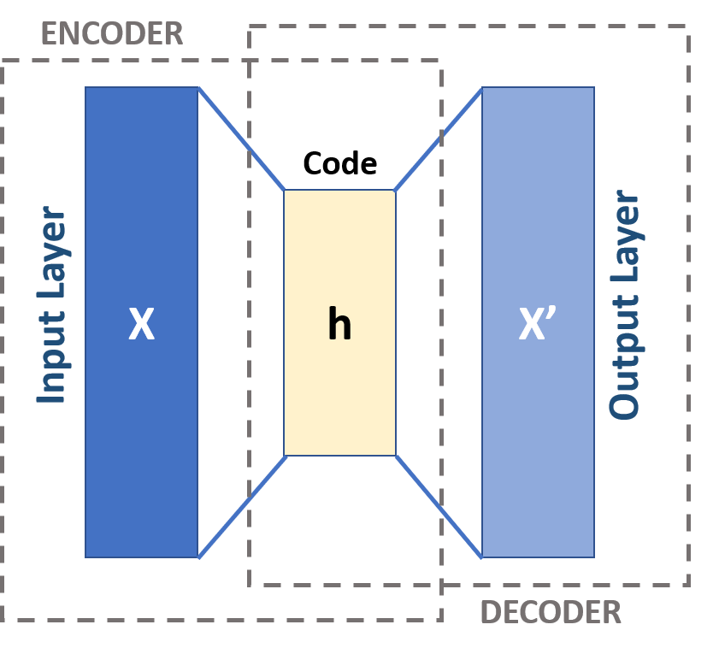
Autoencoders
Unsupervised ML technique
Model learns underlying representations on its own; no ground-truth labels provided
Comprised of two primary components:
Encoder and Decoder
Encoder:
Neural network compresses input to lower dimensional representation (latent space)
Decoder:
Reconstructs the original distributions (input)
Typically also a neural network, but not always (as in our implementation)

Slide 8
The Encoder
Data generated on the fly
Randomly generated amplitudes converted to 128 x 128 angular histograms
Neural Network (encoder)
Fully connected MPL with 6 x 2048 dense layers
Relu activation
Encoder takes angular histogram as input, then outputs production amplitudes

Slide 9
Autoencoder for PWA
Encoder
Decoder
Encoder compresses angular histogram to lower dimensional representation (amplitudes)
Decoder reconstructs $θ,φ$ histograms through physics-based model (not ML)
Loss is computed by difference between input and output histograms
PWA Model

Slide 10
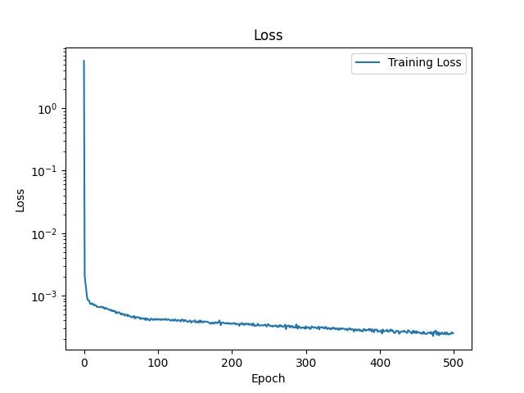
Testing Trained Autoencoder
Trained for 500 epochs
Resolution: 128 x 128
$l_{max}=2$
14 parameters
Real Components
Imaginary Components

Slide 11
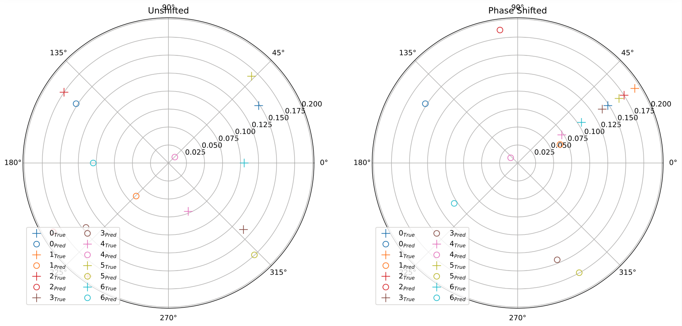
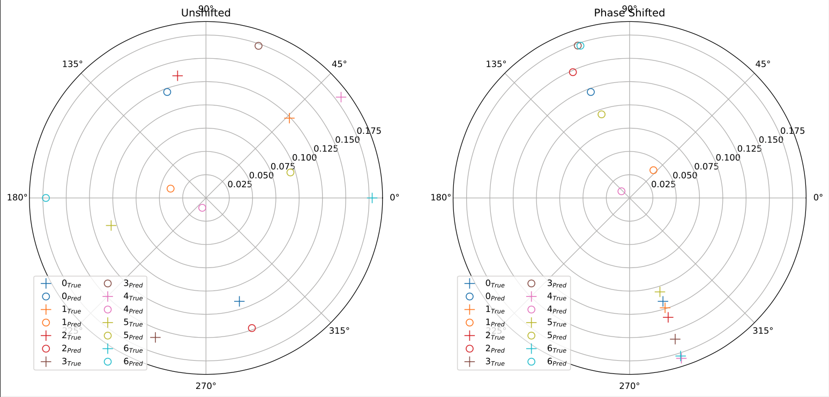
Issues Predicting Wave Amplitudes

Slide 12
AI for PWA: Conclusions
Current state of model demonstrates promising results, but still lots to be done
Resolve discrepancies between generated and predicted wave amplitudes
Include amplitudes in loss, apply physics constraints, …
Reintroduce mass-dependence
Increase number of allowed waves
Incorporate acceptance (efficiency) effects

Slide 13
Thank You!

Slide 14
Backup Slides

Slide 15
Utilizing AI to Solve PWA
AI excels at dimensionality reduction, pattern recognition, global optimization, and noise reduction
All useful characteristics for solving PWA problems
Deep neural network takes angular histogram as input, then outputs production amplitudes

