Slide 1
A Modular Software Stack for A(i)DAPT
Trevor Reed
Florida International University
Steven Goldenberg, Daniel Lersch
Jefferson Lab Data Science Group
A(i)DAPT Group
CLAS Collaboration

Slide 2
A(i)DAPT: AI to Improve CLAS Simulations
A(i)DAPT – AI for Data Analysis and PreservaTion
Broad Goal: Develop a machine learning event generator (simulations)
Much faster than traditional simulations
Could potentially extend measurements to regions outside of acceptance

Slide 3
Data Science Group Contributions to A(i)DAPT
Convert original Jupyter Notebook implementation to modular software stack
Improved readability, maintainability, and scalability
Reduce code redundancies
Stored on GitHub
Reproduce already achieved results in this new framework
Optimize/improve training

Slide 4
Simulations: Understanding the Problem
We use simulations to model all these effects
Reconstruction sequence – several steps of applying sequential software packages
Computationally expensive; slow
Usually need a lot of simulation
Typically want much more simulation than data (factor of ~100)
Event Generator
Only considers the physics
Reconstruction Sequence
Folds in “detector effects”
Generated
Data (GEN)
Reconstructed
Data (REC)

Slide 5
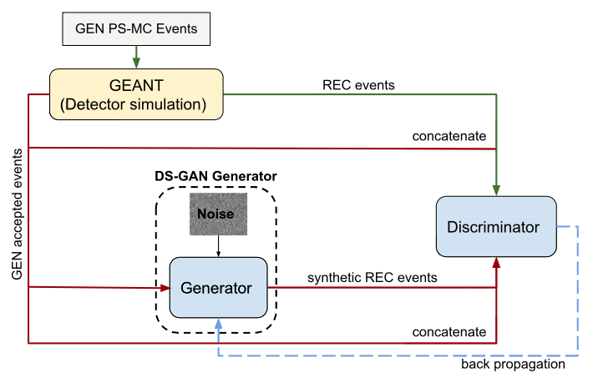
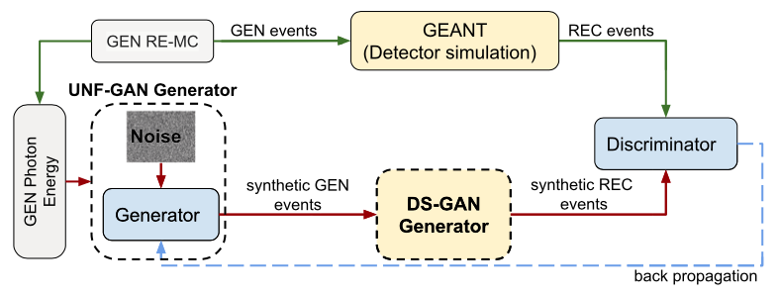
Using GAN’s (Generative Adversarial Networks) to Model Detector Response
T. Alghamdi et al. Toward a generative modeling analysis of CLAS exclusive $2π$ photoproduction. Phys. Rev. D, 108:094030, 2023.
GAN: Two opposing neural networks
Generator: Takes in GEN data and produces “synthetic” REC events
Discriminator: Takes the synthetic REC events and “real” REC events and attempts to distinguish them
Inner (Folding) GAN
Outer (Unfolding) GAN

Slide 6
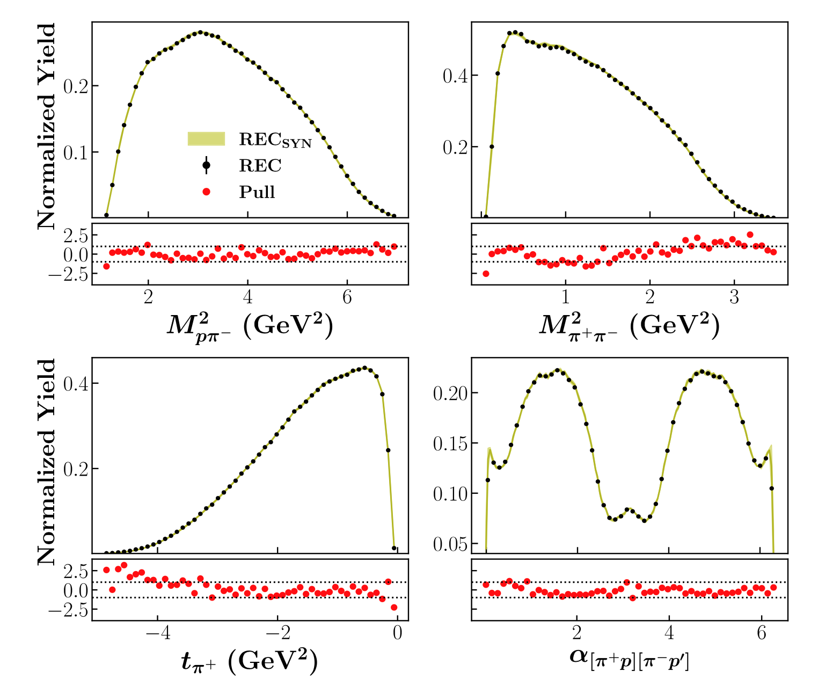
Inner GAN
New
Original
Modified model
discriminator updated 5 times for every generator update
Original implementation
Ensemble of (20) models
T. Alghamdi et al. Toward a generative modeling analysis of CLAS exclusive $2π$ photoproduction. Phys. Rev. D, 108:094030, 2023.

Slide 7
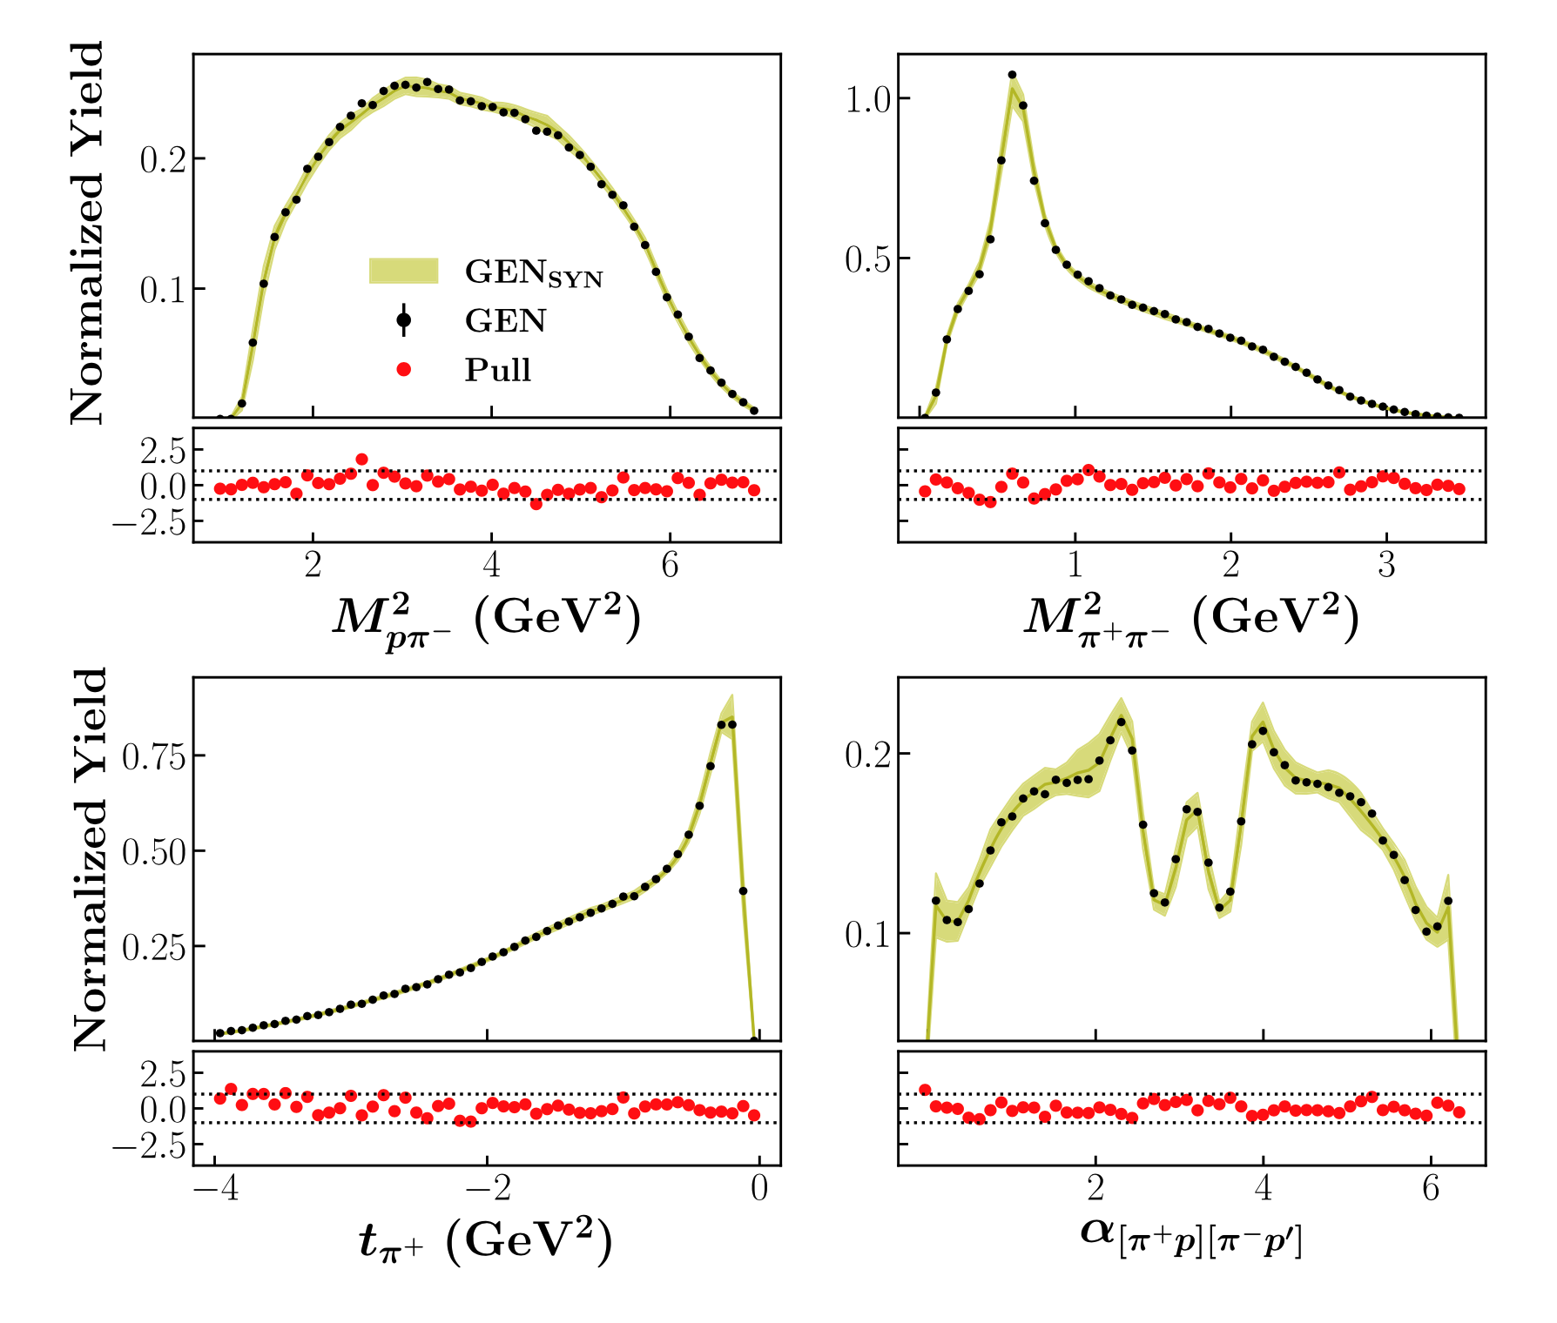
Outer GAN
Model modification: Outer GAN converted to true conditional GAN
Discriminator now “sees” generator input data
Qualitatively similar results with fewer training epochs
As with original inner GAN, original outer GAN uses ensemble of models
New: 120,000 Epochs
Original: 200,000 Epochs
T. Alghamdi et al. Toward a generative modeling analysis of CLAS exclusive $2π$ photoproduction. Phys. Rev. D, 108:094030, 2023.

Slide 8
A(i)DAPT: Summary
Successfully converted framework from Jupyter Notebooks to complete software stack maintained on GitHub
Incorporated additional useful metrics tracking to monitor training
Hydra for configuration management
Specifications (along with model architecture, hyperparameters, etc.) can be modified in config file
Reproduced Inner GAN and Outer GAN results
Improvements to trainings through various model adjustments
These improvements could pave the way for removal of need for ensemble of models

Slide 9
Thank You!

Slide 10
Backup Slides

Slide 11
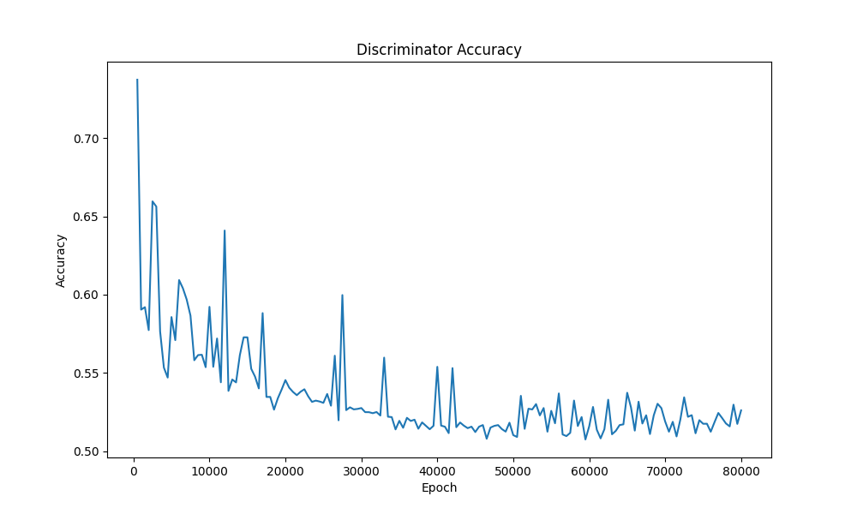
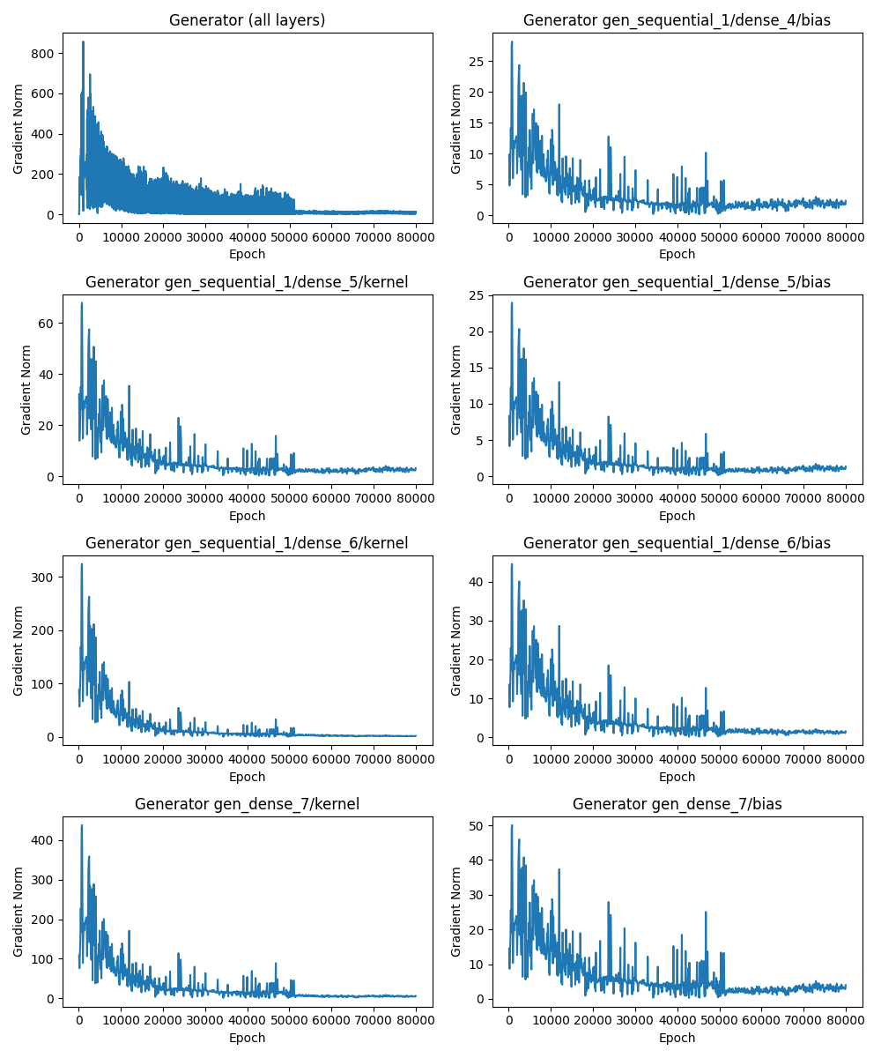
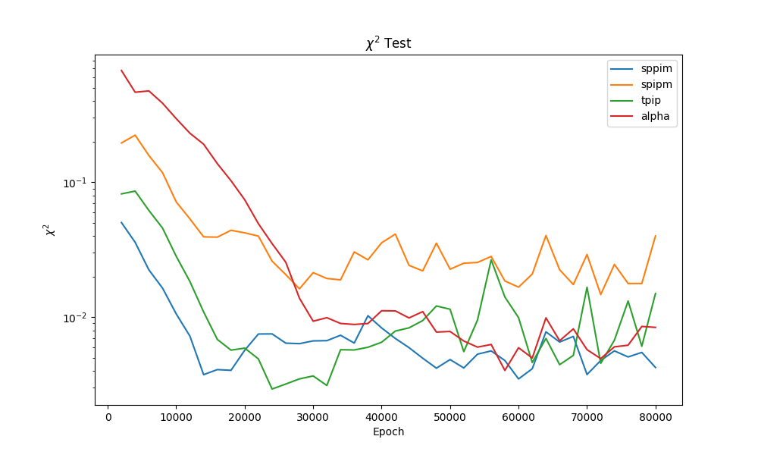
Additional Training Metrics
Layer-specific gradients, accuracy tests, $χ^{2}$tests, and ROC curves
Tracking and saving of all of these can be individually turned on/off
User can specify how frequently these are calculated (every N’th epoch)

