Slide 1
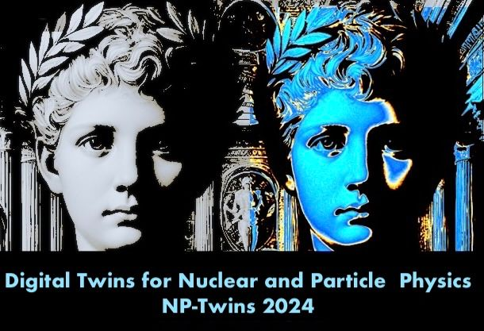
Summary Talk of Digital Twins for Nuclear and Particle Physics (NPTwins 2024)
Yaohang Li and the A(I)DAPT Collaboration
Department of Computer Science
Old Dominion University
Norfolk, Virginia 23529
yaohang@cs.odu.edu
6/4/2025 @ AI for Hadron Spectroscopy at JLab

Slide 2

Digital Twins for Nuclear and Particle Physics (NPTwins 2024)
12/16/2025-12/18/2025, Museo Diocesano di Genova
Motivation: Foster multidisciplinary collaborations
Data
  Nuclear and high energy physics facilities
    CERN, Jefferson Lab, RHIC, and EIC (forthcoming)
  Exabytes of data
Methods
  Data Analysis
  AI/ML
  Applied Mathematics
Understanding Physics
  Elementary particle interactions
  QCD in nonperturbative regime
12/16/2025-12/18/2025, Museo Diocesano di Genova
Organized by Alessandro Pilloni, Carlo Schiavi, Francesco Armando Di Bello, Marco Battaglieri, Riccardo Torre

Slide 3
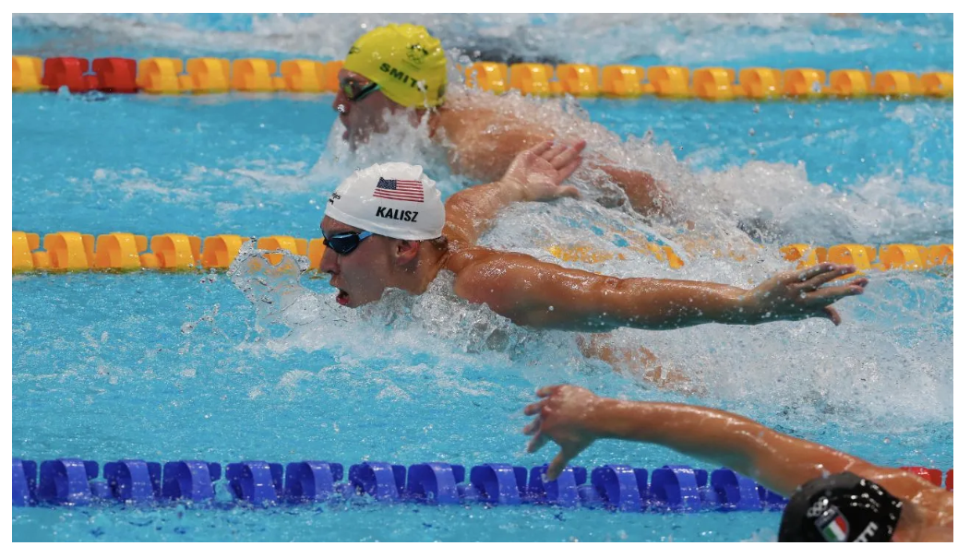
Digital Twins for Nuclear and Particle Physics
A virtual replica of reality
  Simulate complex nuclear and elementary particle process
  Predictive capability
  Enhance physics understanding
https://www.iotworldtoday.com/connectivity/digital-twins-enhance-u-s-swim-team-training-for-2024-paris-olympics

Slide 4
Digital Twins for Nuclear and Particle Physics
Mimicking – Agree with experimental data
Generative AI
Uncertainty quantification
Physics-informed Model
Unfolding – Reveal the underlying truth
Denoising
Correcting distortions
Abnormality detection
Signal vs background
Insight – Enable physics discovery
Underlying law
Solving the mysteries

Slide 5
Digital Twins for Nuclear and Particle Physics
Mimicking – Agree with experimental data
Generative AI
Uncertainty quantification
Physics-informed Model
Unfolding – Reveal the underlying truth
Denoising
Correcting distortions
Abnormality detection
Signal vs background
Insight – Enable physics discovery
Underlying law
Solving the mysteries

Slide 6
Generative AI
Normalizing Flow (NF)
Diffusion Models (DM)
Generative Adversarial Networks (GANs)
Variational Autoencoder (VAE)

Slide 7
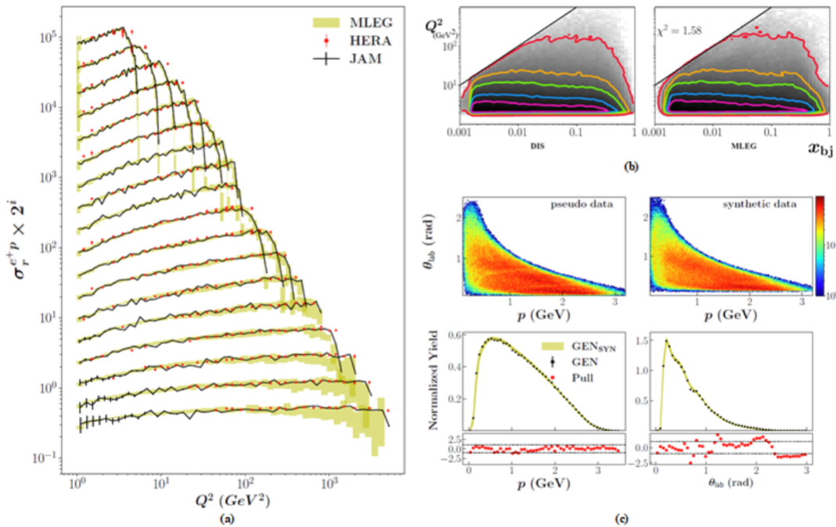
GAN-based Physics Event Generation
GAN-based physics event generation on mimicking (a) HERA, (b) inclusive DIS, and (c) CLAS exclusive DIS 2𝜋 photoproduction. Good agreements are found.
Yaohang Li, Unfolding Particle Detector Effects in HEP with Generative AI

Slide 8

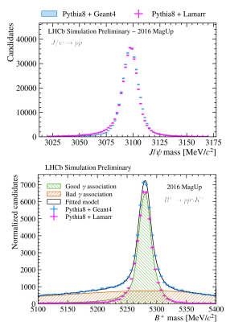

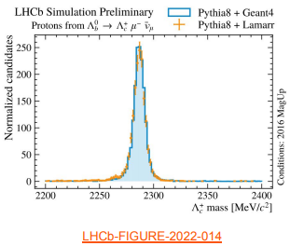
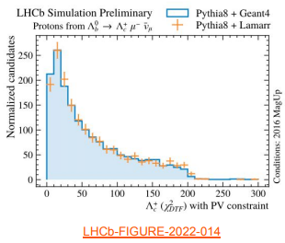
Simulating the LHCb experiment
Lamarr pipeline for parameterizations
  Deep NN as binary classifiers for Acceptance/Reconstruction/Selection efficiencies
  PIDGAN for reconstructed features
Lucio Anderlini, “Simulating the LHCb experiment with Machine Learning”

Slide 9
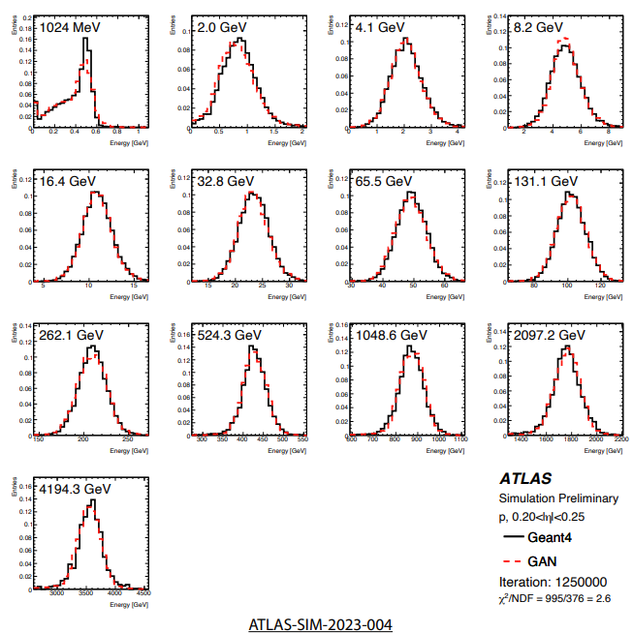
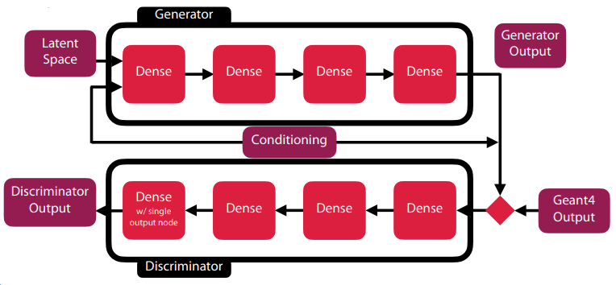
Simulation with ATLAS
FastCaloGAN
  Wasserstein GAN
  “Remarkable Agreement with GEANT4”
  Fast Simulation in ATLAS
Federico A.G. Corchia, Fast Simulation with ATLAS

Slide 10

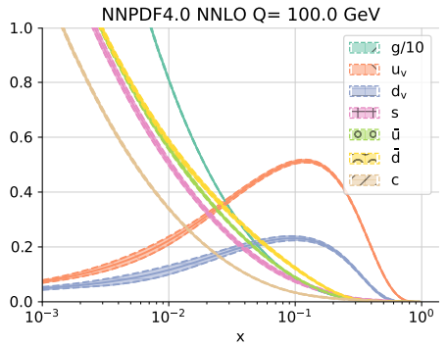
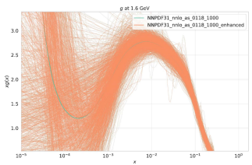
Determining Parton Distribution Functions
Find a subset of replicas that describe the underlying probability distribution as accurately as the original ensemble of replicas
GAN
  Enhance the number of replicas
    Before minimizing ERF
Emanuele R. Nocera, Determining parton distribution functions accurately and precisely with machine learning

Slide 11
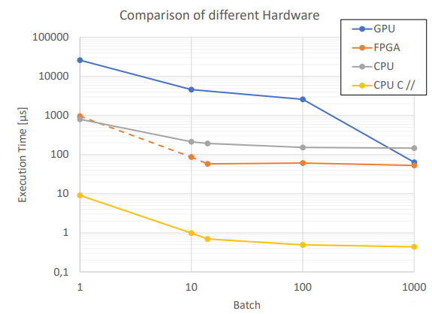
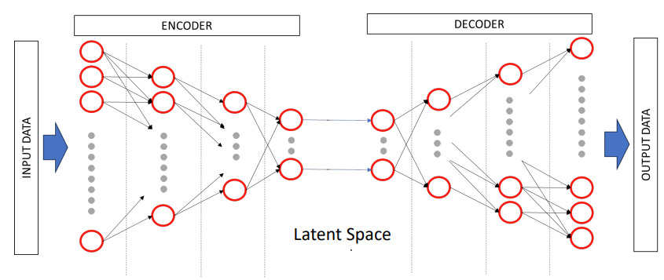
Data Reduction for Real Time Physics Data
Autoencoder for data reduction
Fabio Rossi, AI for real time data-reduction

Slide 12
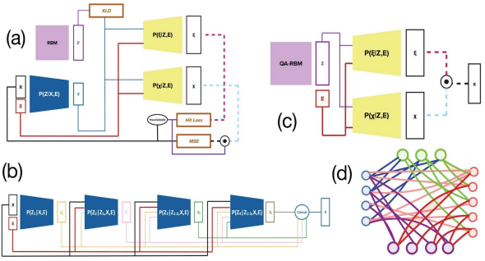
Generative AI as Surrogates
Surrogate
  Find a latent space
  Gaussian sampling the latent space -> events of target distribution
The Need of Generative AI-based Surrogates
  Run a job fast
  Run lots of times
  Evolution Statistics
    Dynamics
    Uncertainty in data
Diffusion Models have the advantages
  Only MSE loss minimization needed
Geoffrey Fox, Generative AI for Digital Twins for Physics and Biology

Slide 13
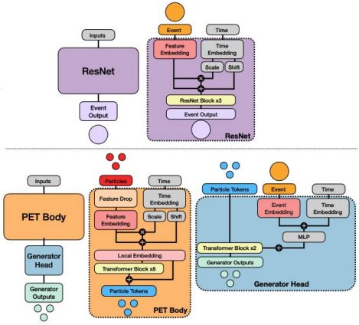
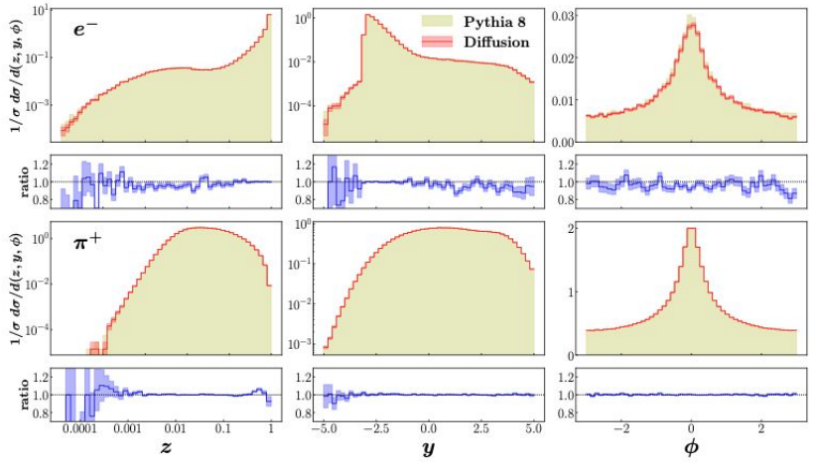
Point Cloud based Diffusion Model
Point-cloud based score-based diffusion model
  Local embeddings
  Transformers
Advantages
  Flexible
    Multiplicity
  Accurate
    “Best generative modeling for EIC”
  Multi-tasking
    Classification
    Regression
    etc.
Nobuo Sato, Point cloud-based diffusion models for Electron-Ion Collider

Slide 14
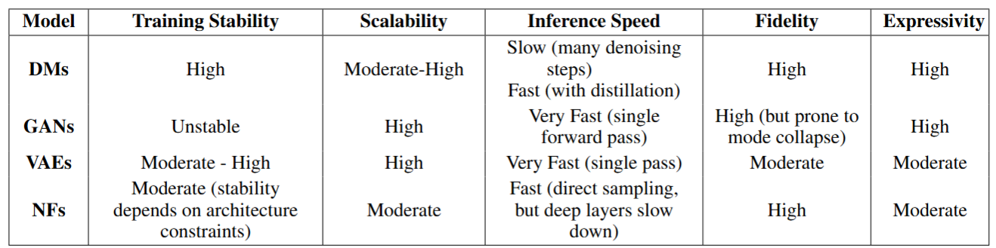
A Comparison of GANs, VAEs, NFs, and DMs
Tareq et al., 2025

Slide 15
Digital Twins for Nuclear and Particle Physics
Mimicking – Agree with experimental data
Generative AI
Uncertainty quantification
Physics-informed Model
Unfolding – Reveal the underlying truth
Denoising
Correcting distortions
Abnormality detection
Signal vs background
Insight – Enable physics discovery
Underlying law
Solving the mysteries

Slide 16
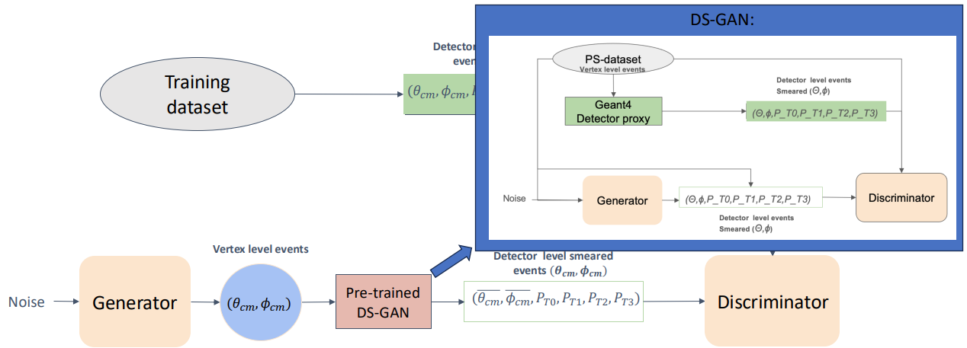
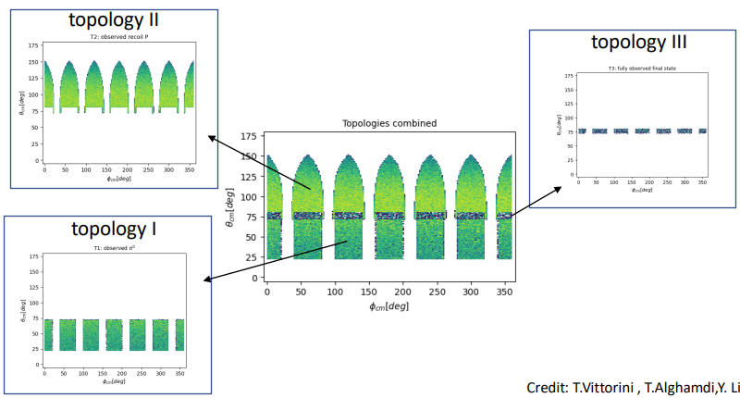
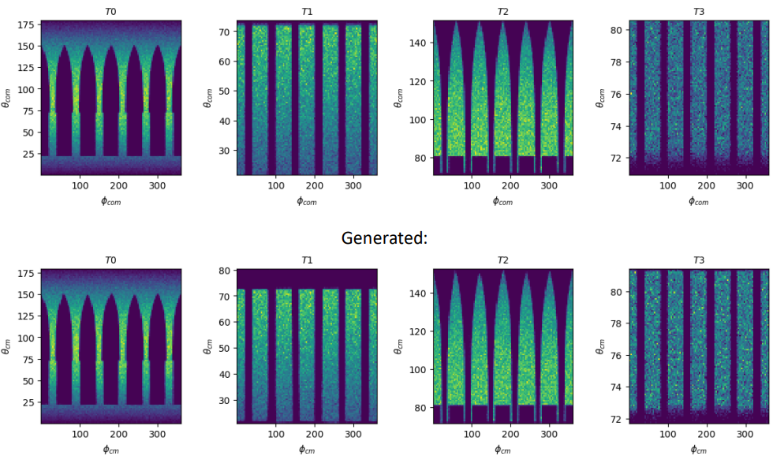
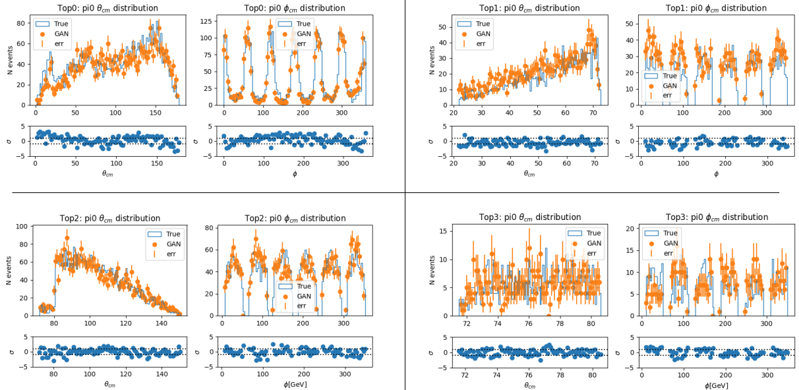
Smearing and Acceptance Correction
Build a single ML model to generate in the full phase space
  According to the correct distributions
Tommaso Vittorini, GANs towards data smearing and acceptance corrections

Slide 17
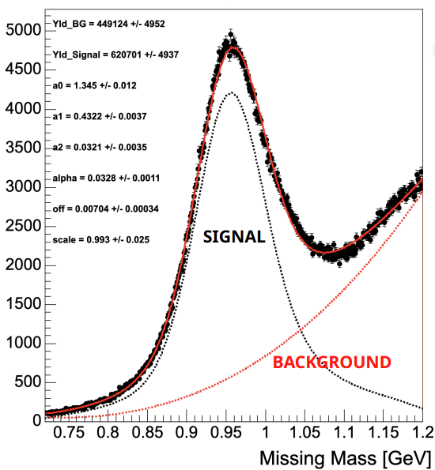
Training Machine Learning Model with Experimental Data
Unfold contribution from different event sources
  Neutron signal
  Background
Method
  Fit a model to a discriminating variable with known distribution for each source
  Calculate statical weights for each event
  Apply weights to the control variables with unknown source distributions to reconstruct the pure signal or background distribution
DEREK GLAZIER and RICHARD TYSON , “Training with Real Rata : Signal Extraction via Density Ratios ”

Slide 18
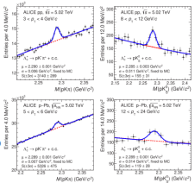
Signal-vs-Background Classification in ALICE Charmed-hadron Reconstruction
Boosted Decision Tree (BDT)
  Signal-vs-Background Binary Classifier
M. T. Camerlingo, Charmed-hadron reconstruction in ALICE using AI/ML

Slide 19
Digital Twins for Nuclear and Particle Physics
Mimicking – Agree with experimental data
Generative AI
Uncertainty quantification
Physics-informed Model
Unfolding – Reveal the underlying truth
Denoising
Correcting distortions
Abnormality detection
Signal vs background
Insight – Enable physics discovery
Underlying law
Solving the mysteries

Slide 20
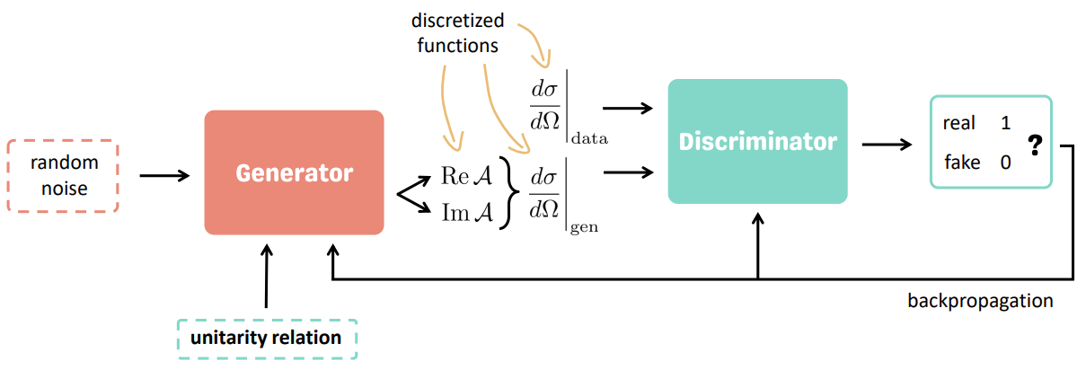
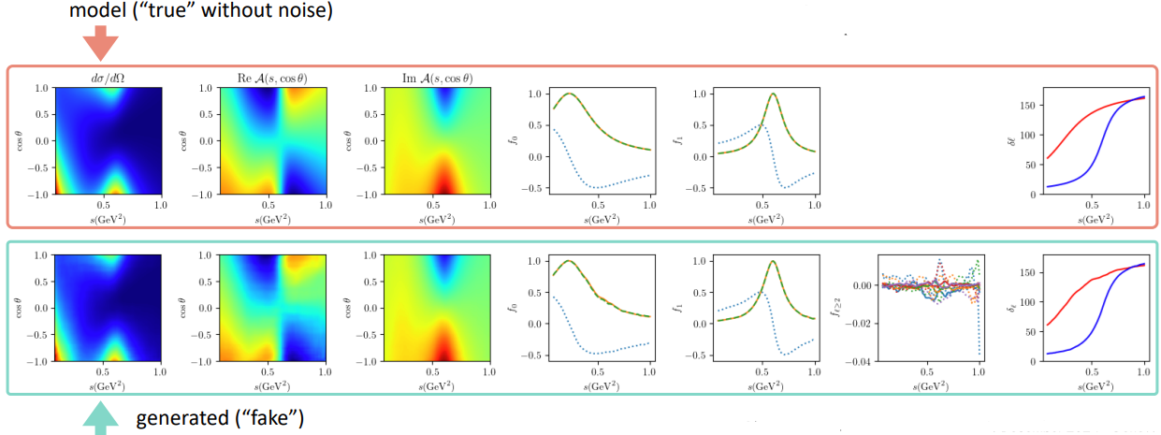
Reconstruction of Amplitude from Cross Section
Gloria Montana, Physics-constrained GAN for amplitude extraction

Slide 21
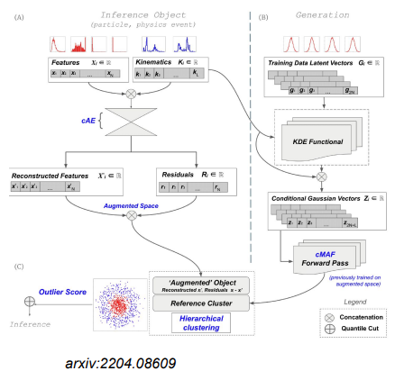
Anomalies Detection in Light Dark Matter Detection
Flux+Mutability
  Generative models
  Unsupervised learning
  Conditional Autoencoder
Patrick Moran, Anomaly Detection for BSM Using AI/ML

Slide 22
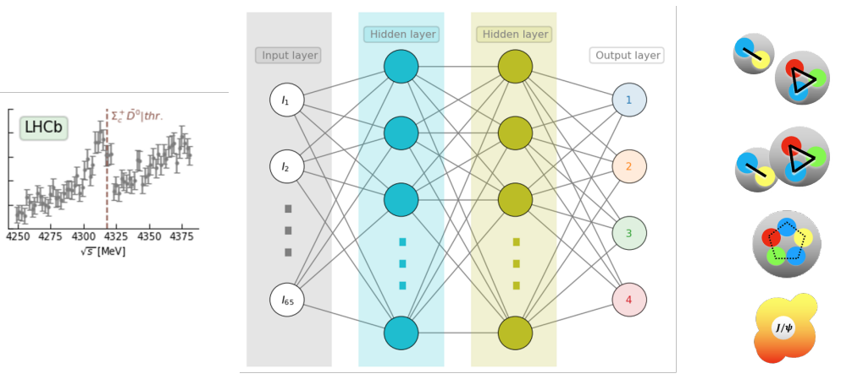
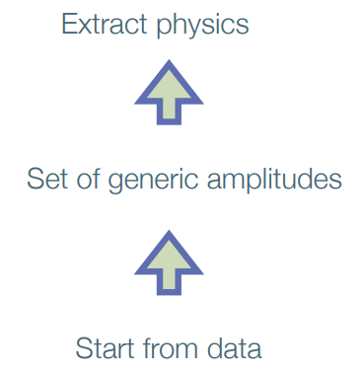
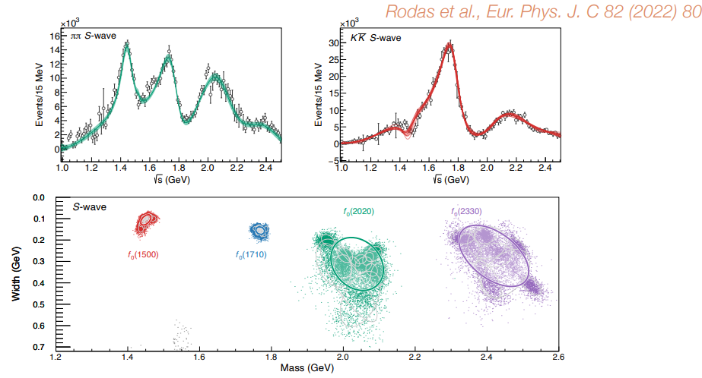
Hadron Spectroscopy
Train a machine learning model to analyze a lineshape and derive the probability of each possible characterization
  A Neural Network
César Fernández Ramírez, “Machine learning for hadron spectroscopy”

Slide 23
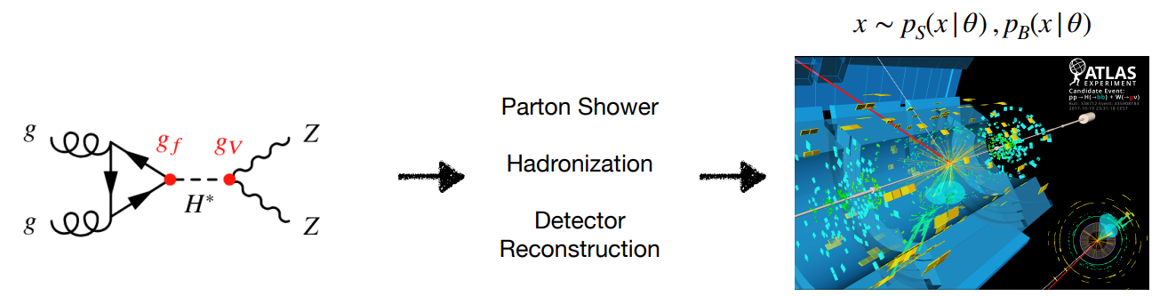
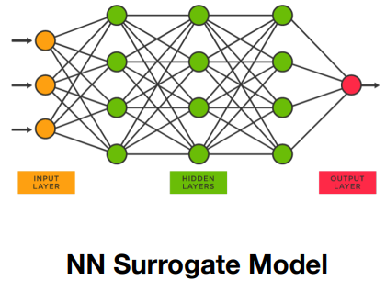
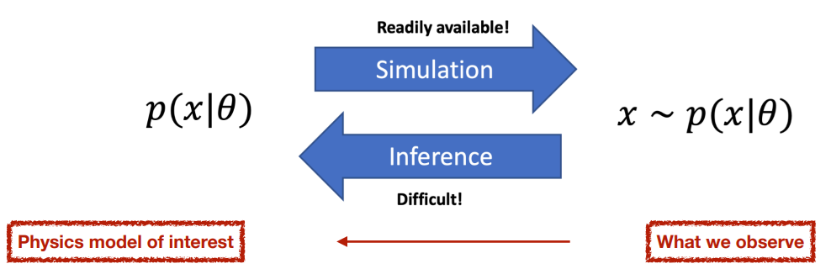
Simulation-based Inference for Parameter Estimation
Neural Simulation-based Inference
  Use fast ML techniques for powerful statistical inference
    Intractable likelihoods
    Computation costly
  Applications in LHC analysis
    Higgs boson width measurement at ATLAS
Jay Sandesara, Neural Simulation-Based Inference for Parameter Estimation at the LHC

Slide 24
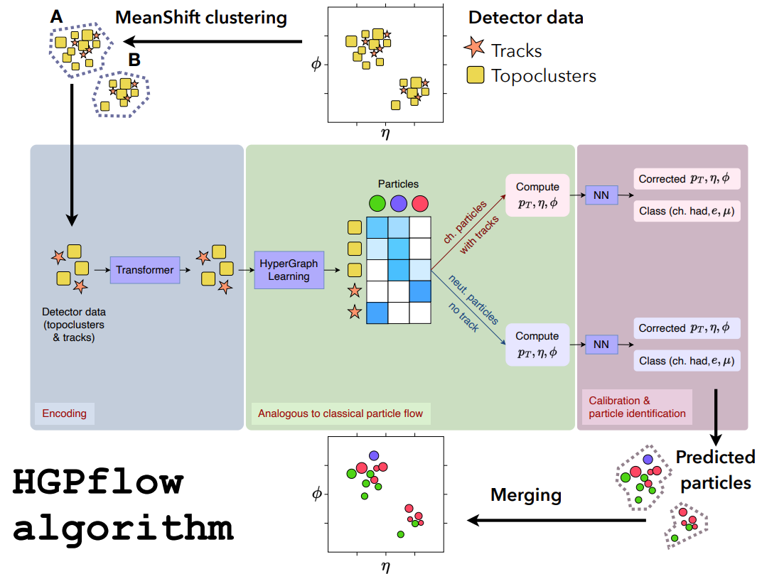
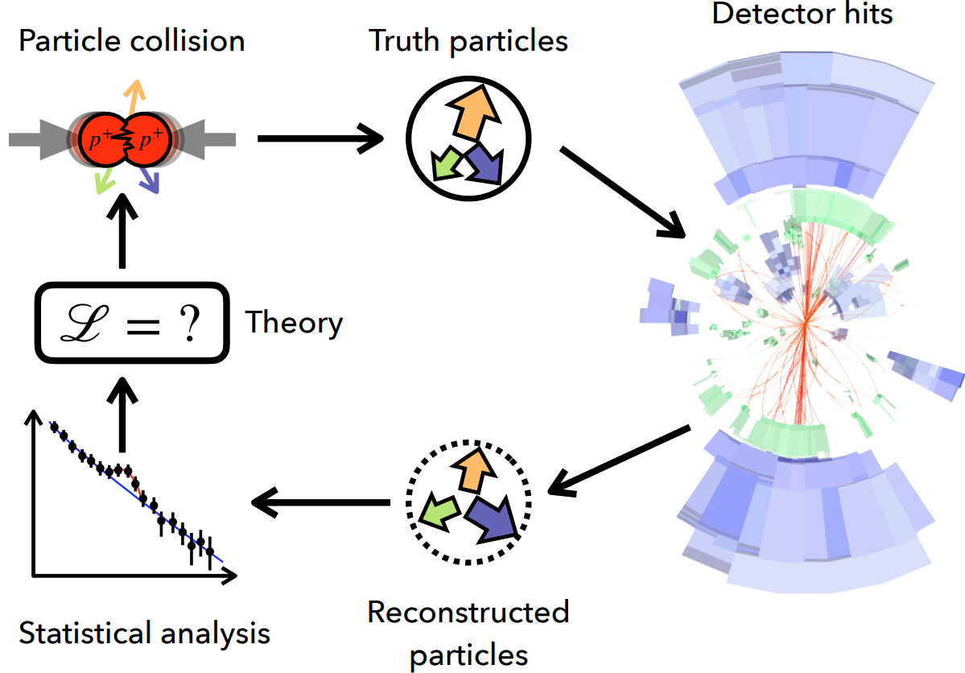
Particle Reconstruction in Collider experiments
Configurable calorimeter simulation for AI (CoCoA)
  Used as “Digital Twins”
Etienne Dreyer, Deep learning for particle reconstruction in collider experiments

Slide 25
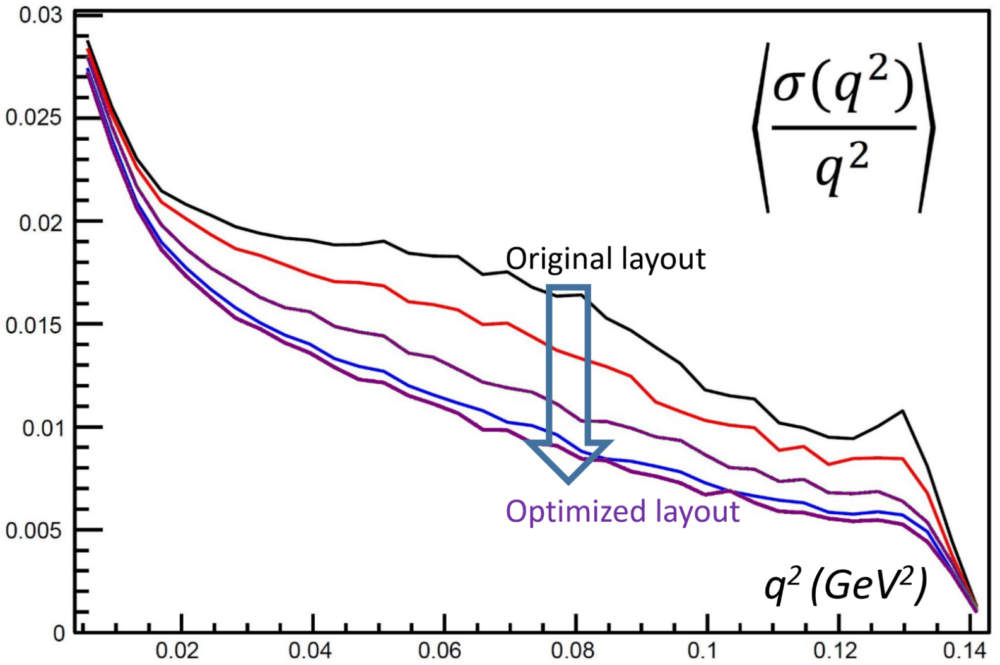
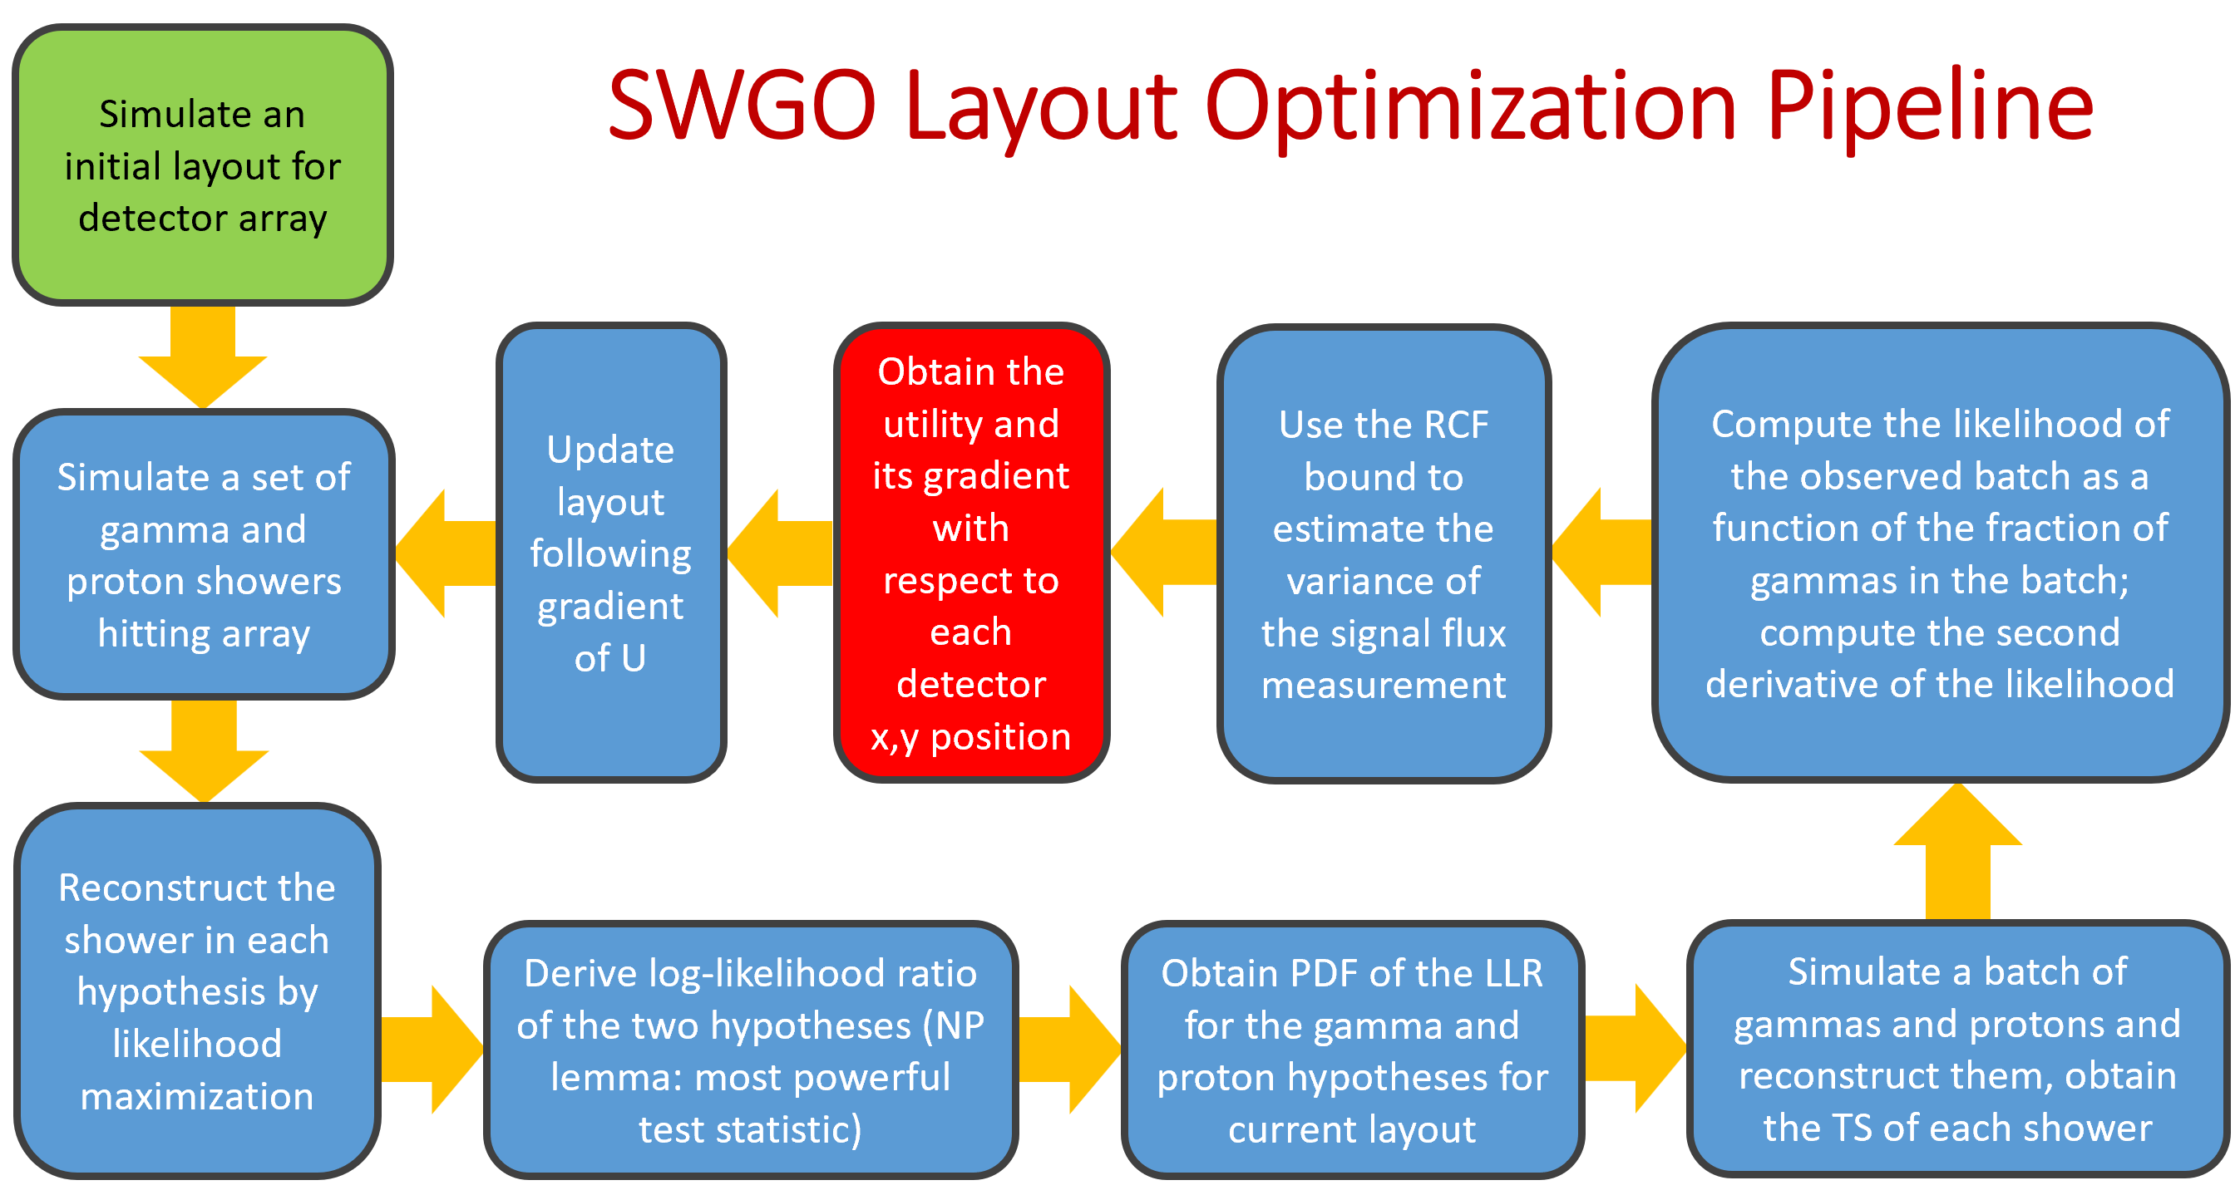
Experiment Optimization
Synergy
  Tailor each part of a system towards a goal
Holistic optimization
  Simultaneous optimization of all parts
Integration
  Bring diverse components together
Tommaso Dorigo, AI For Experiment Optimization

Slide 26
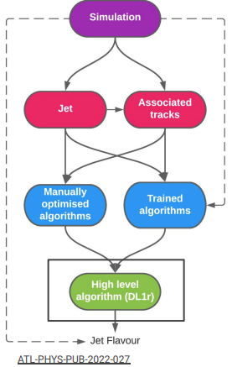
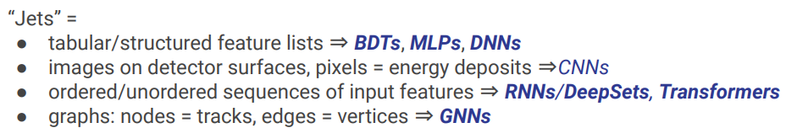
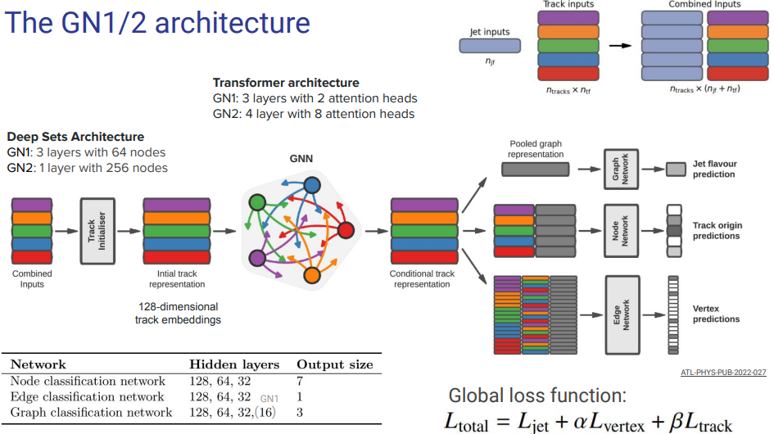
Jet Flavor-tagging and τ-identification
Jet Flavor-tagging (Classification)
  Infer the flavor of the quark/gluon that has initiated the jet
  Separating heavy-flavor jets from light gets
Gabriele D’Anniballe, Machine-learning techniques for jet flavour-tagging and τ-identification in the LHC Run3 era

Slide 27
Challenges in Digital Twins for Nuclear and Particle Physics
The definition of Digital Twins
Uncertainty Quantification
Incorporating Physics into Models
Computational Resources
Algorithms

Slide 28
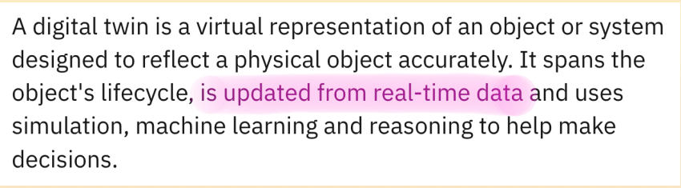
Definition of Digital Twins
Pietro Vischia, Digital twins, inductive bias, and symmetries

Slide 29
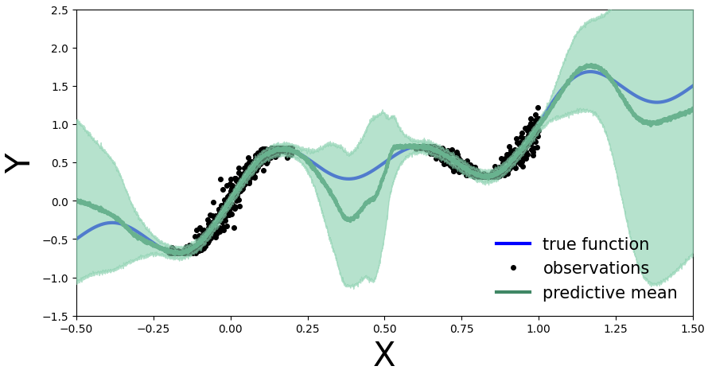
Uncertainty Quantification
Aleatory Uncertainty (Stochastic Uncertainty)
  Inherent random effects
  Not related to the number of data samples
  Not reducible with increasing number of data samples
Epistemic Uncertainty (Systematic Uncertainty)
  Uncertainty due to lack of knowledge
  Reducible with more data samples
ML Model
  When to say “I don’t know”?

Slide 30
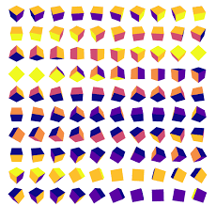
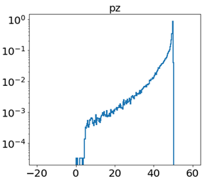
Challenges: Plug physics into AI
Change of Variables
Data Augmentation
  Symmetry
Pietro Vischia, Digital twins, inductive bias, and symmetries

Slide 31

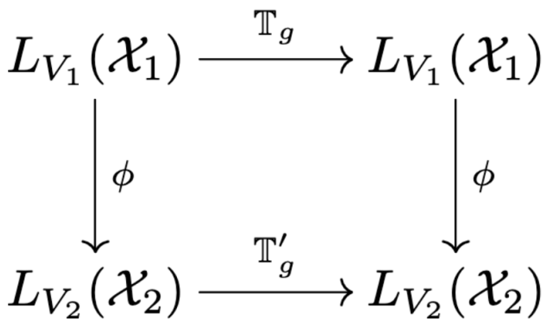
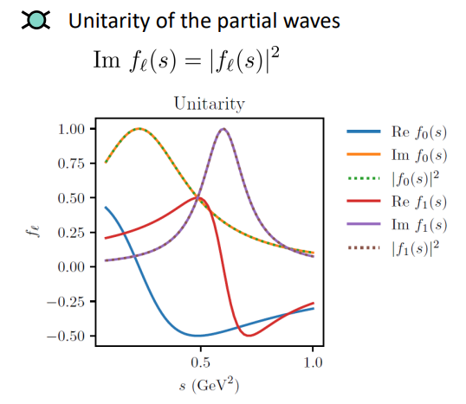
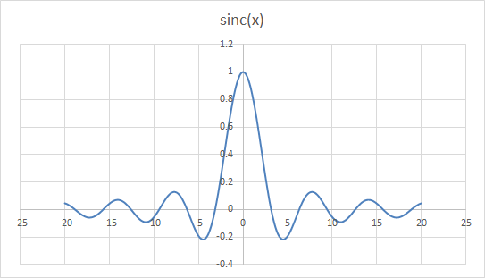
Challenges: Plug physics into AI (cont.)
Architectural Design
  Equivariance under group transformation enforced by convolutional layers
Output Transformation
Loss function penalties
  Encode inconsistency of models inside the loss function as a penalty term
Gloria Montana, Physics-constrained GAN for amplitude extraction
Pietro Vischia, Digital twins, inductive bias, and symmetries

Slide 32
Algorithms
Kernel Methods
  Lorenzo Rosasco, What can kernel methods offer to HeP?
Reinforcement Learning
  Agnese Seminara, Reinforcement Learning
Zeroth-order Optimization Algorithms
  Marco Rando, Recent Developments in Zeroth-order Optimization Algorithms
Signal-Agnostic Searches
  Marco Letizia, The NPLM method: ML for signal-agnostic searches and beyond

Slide 33
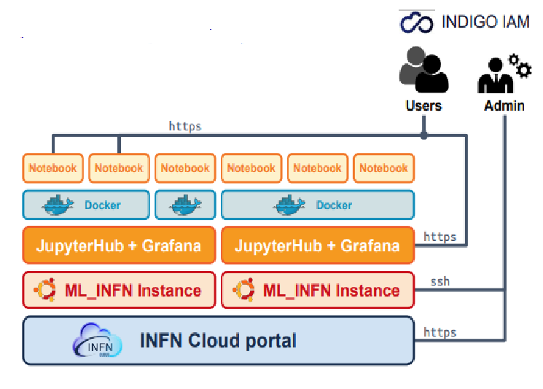
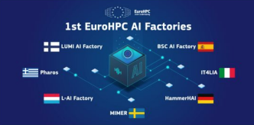

Computing Resources to AI
Italian Center for SuperComputing (ICSC)
AI_INFN platform as bridge from Cloud to ICSC
ICSC
Lucio Anderlini, Artificial Intelligence in the ICSC and Terabit projects
Davide Salomoni, The Italian center for HPC (ICSC)

Slide 34
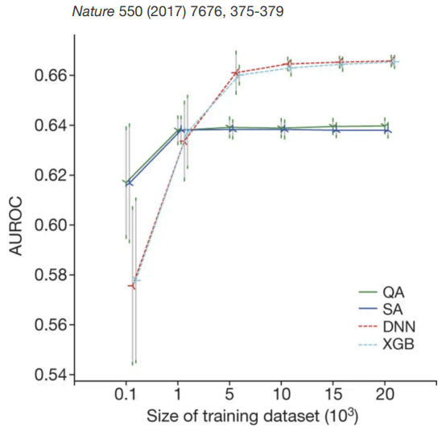
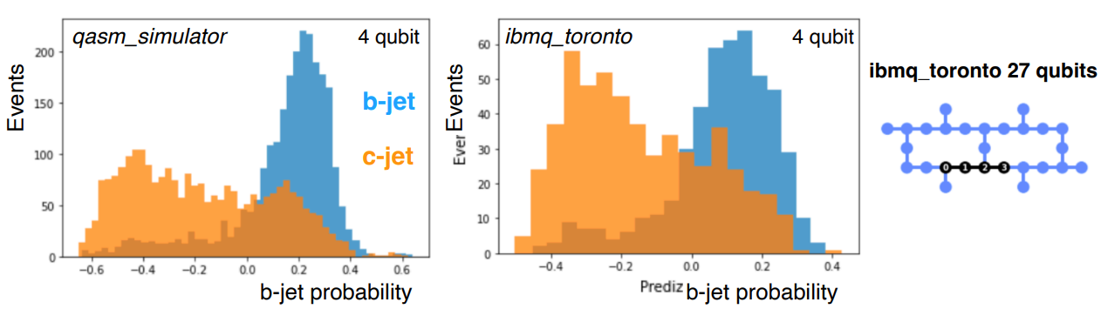
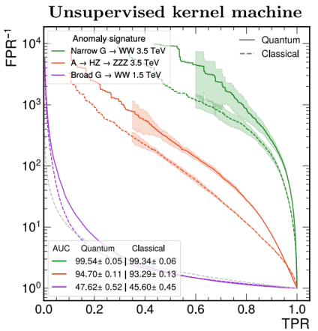


Quantum Computing Applications to High Energy Physics
Classification
Higgs Classification
B-jet Tagging
Anomaly Detection
Tracking
Generative AI
Davide Zuliani, Quantum computing applications for HEP

Slide 35
Summary
Digital Twins for Nuclear and Particle Physics
  Mimicking
    Generative AI
      GAN is popularly used; DM is promising
  Unfolding
    Detector Effect
    Signal vs Background
  Insight
    Extract Physics Properties
    Infer Parameters
    Anomaly Detection
    Estimate Underlying Probability
    Reconstruct Particle Flows
    Experiment Optimization
Challenges
  Definition of Digital Twins
  Uncertainty Quantification
  Incorporating Physics into Models
  Computational Resources
  Algorithms

Slide 36

Acknowledgements
NP-Twins 2024 Organizers
  Alessandro Pilloni
  Carlo Schiavi
  Francesco Armando Di Bello
  Marco Battaglieri
  Riccardo Torre
NP-Twins 2024 Website
https://agenda.infn.it/event/43386/overview

