Slide 1
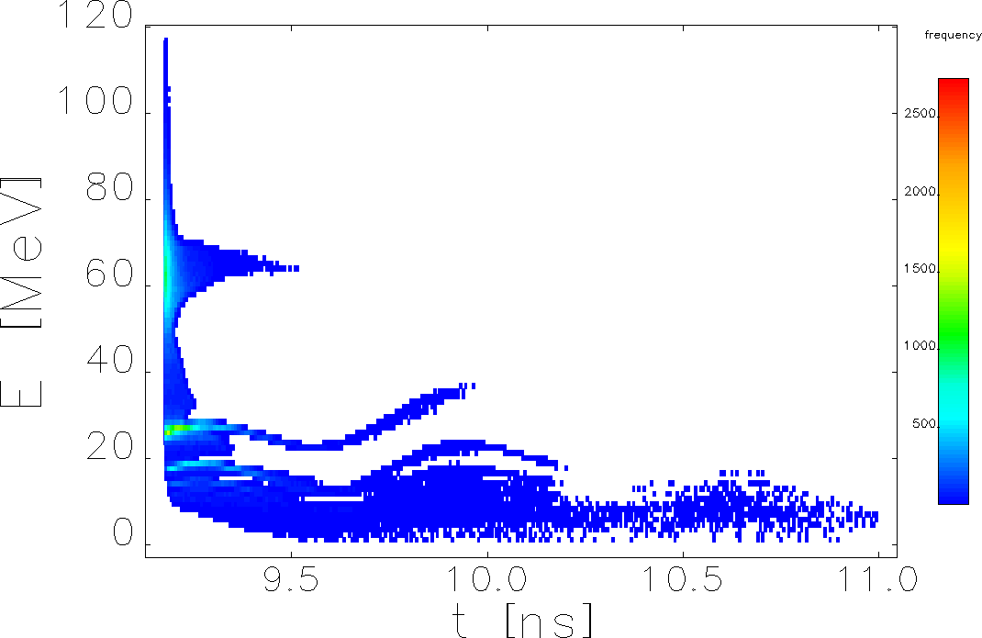
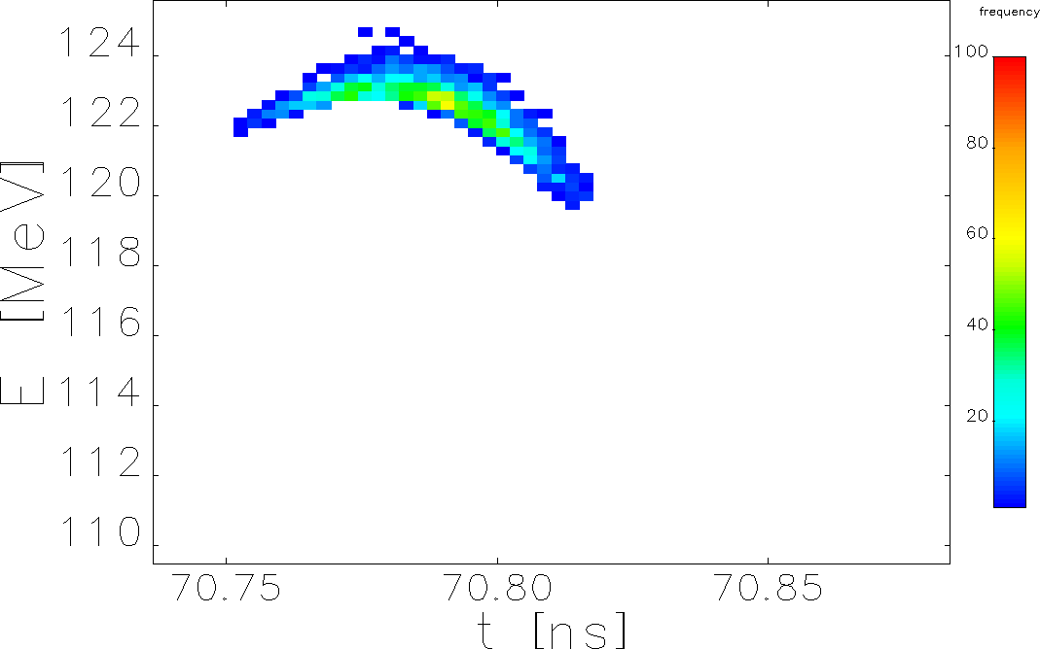
FY25 Q2: LDRD – Positron Injector Model Integrator – Strategic Hire (J. Grames, LD2505)
This work is supported by the Jefferson Lab LDRD program
Select Energy Range
Scheme of Positron Injector
E = 123 MeV
σ_{ΔE/E} < 1%
FY25 Q2 Results
Met with HEP colleagues at JLAB/SLAC/KEK collaboration meeting on e⁺ source projects in February and at Positron Working Group Workshop in March; presented/discussed the capture simulations for Ce⁺BAF injector
Simulated e⁺ capture in the injector with different focusing solenoids: a) normal conducting (NC) solenoids with a 34 cm and 41 cm coil length, field maps from Jay Benesch and b) superconducting (SC) solenoids with length of 25 cm and 5 cm
Adjusted parameters of e⁺ beam line (field strength of focusing solenoid, matching quads, dipoles, etc.) to maximize capture efficiency of e⁺ with different energies, collaborating with Sami Habet
Objectives for FY25 Q3
Calculate e⁺ yield that meet Ce⁺BAF longitudinal and transverse acceptances. Reoptimize target thickness and magnet parameters to increase the efficiency of e⁺ generation and capture for beam with a normalized emittance of 40 mm·mrad, collaborating with Salim Ogur and Yves Roblin. Provide e⁺ data at the end of injector to Salim Ogur for simulations of transport line from LERF to North Linac and beam tracking to experimental halls
Simulate e⁺ injector with 130 MeV, 250 MeV and 370 MeV drive e⁻ beams and capture of 65 MeV e⁺ at target exit
Publish a tech note on comparison of e⁺ injectors with different NC and SC solenoids, collaborating with Sami Habet

Slide 2
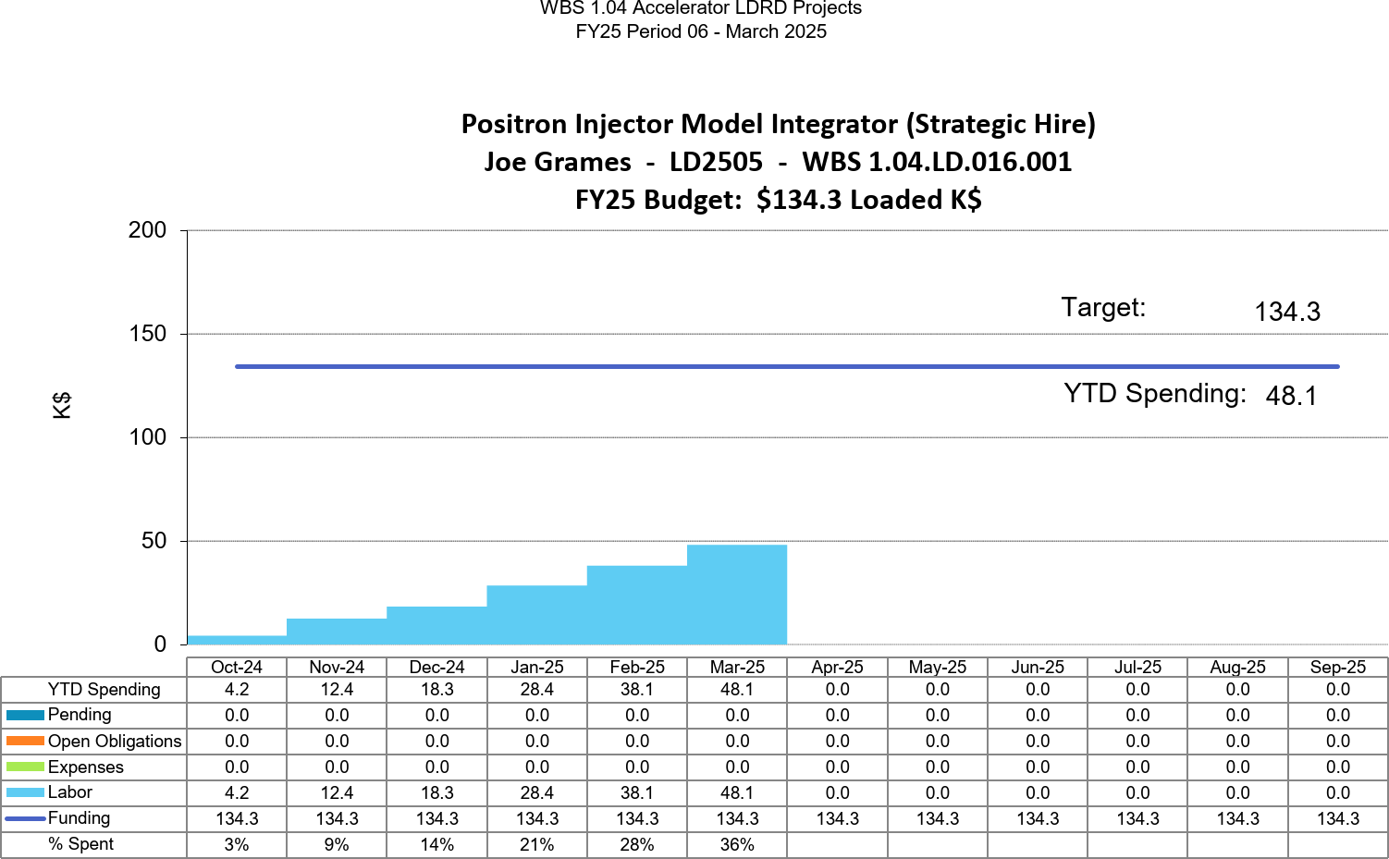
FY25 Q2: LDRD – Positron Injector Model Integrator – Strategic Hire (J. Grames, LD2505)
This work is supported by the Jefferson Lab LDRD program
Labor: PD up to FY25 Q2
Promotion to Scientist II became effective in April

