Slide 1
FFA@CEBAF Permanent Magnet Resiliency in Real Radiation Environment
FY25 Q2 Update
Ryan Bodenstein
Team: Kirsten Deitrick, Edith Nissen, Randika Gamage, Isurumali Neththikumara
2025/05/01

Slide 2
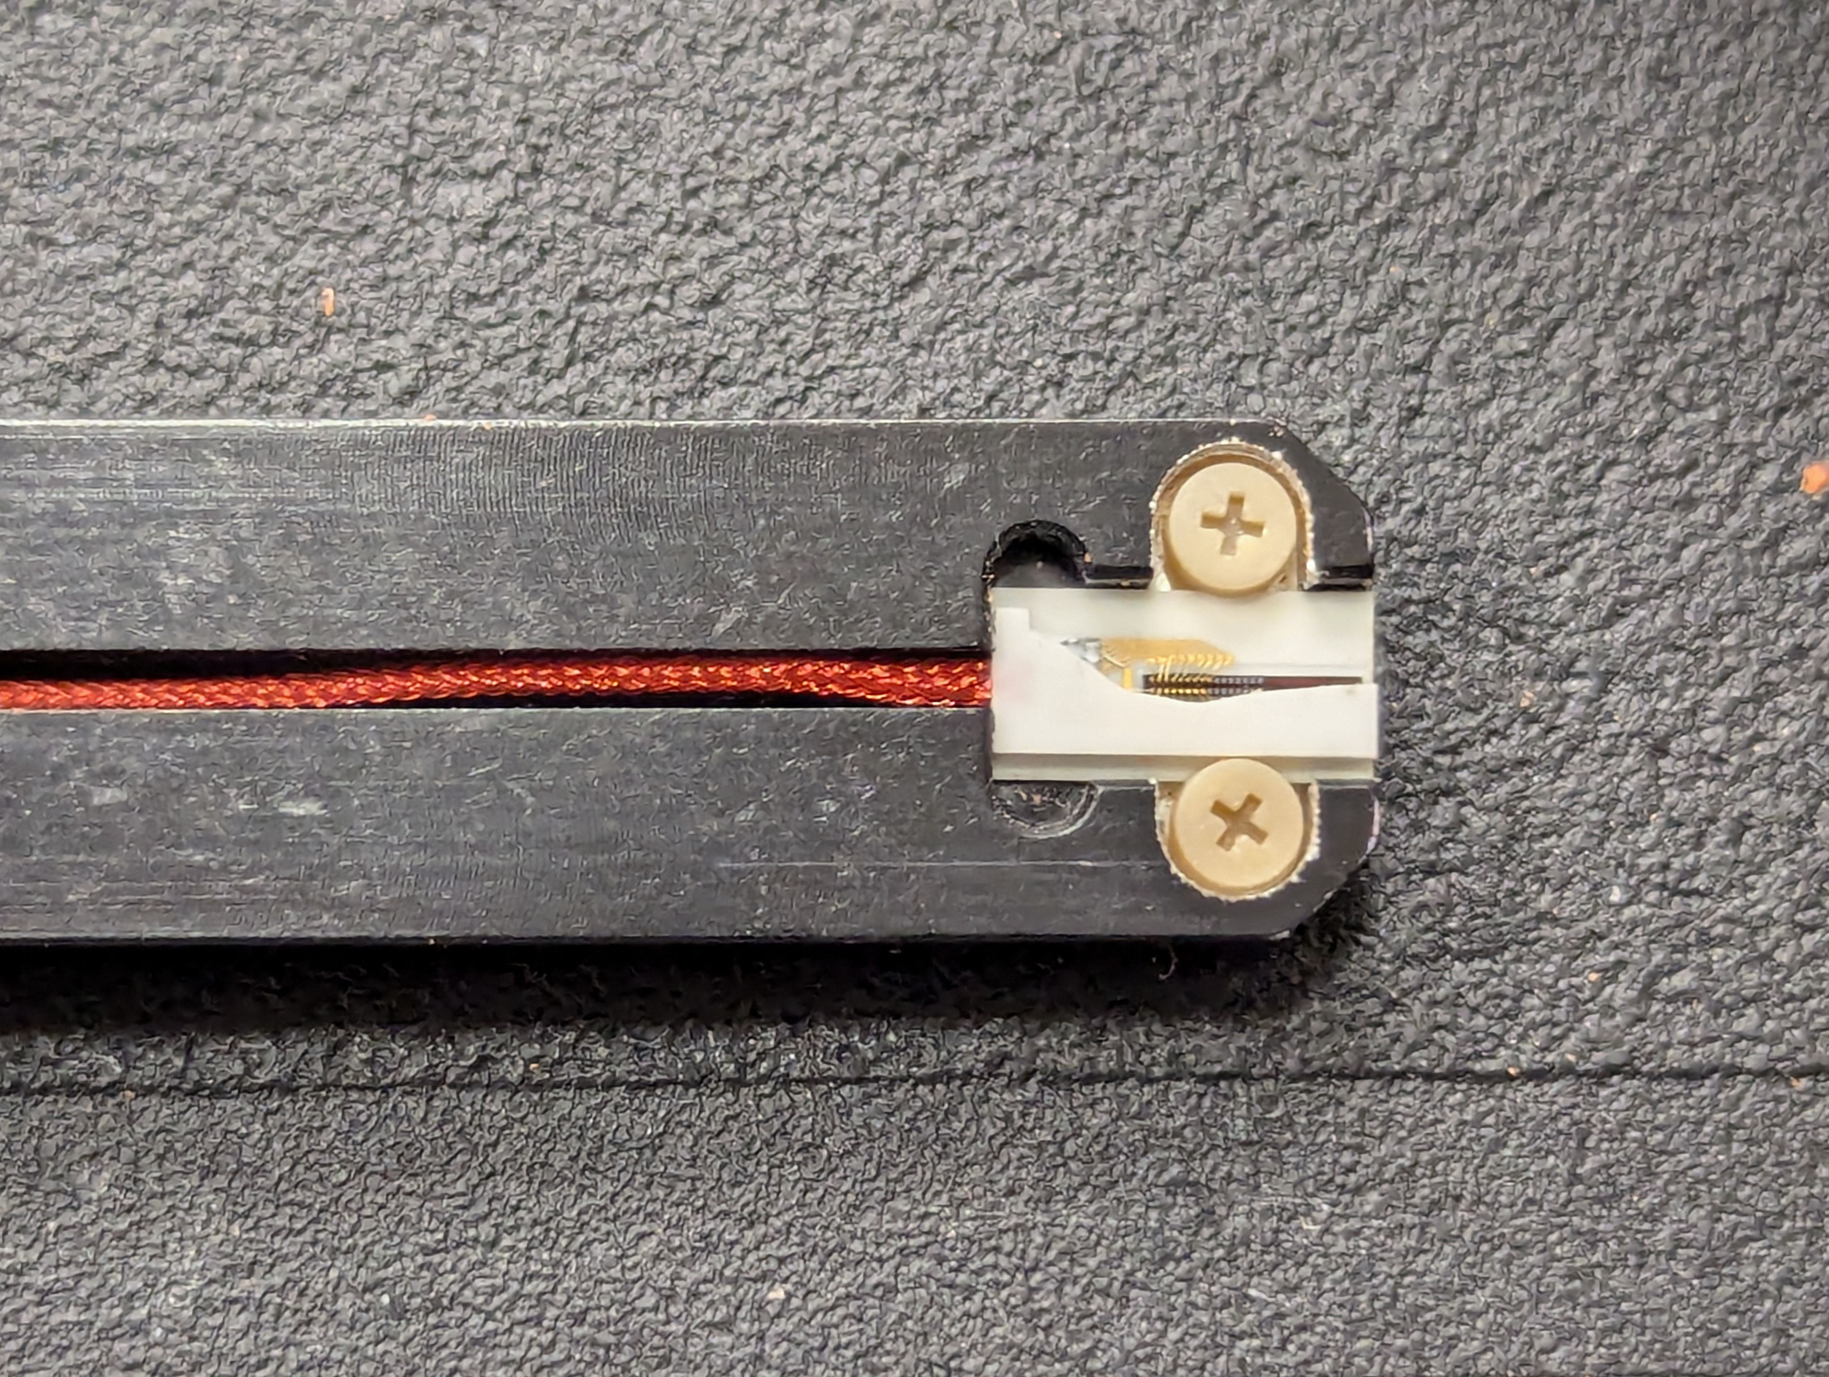
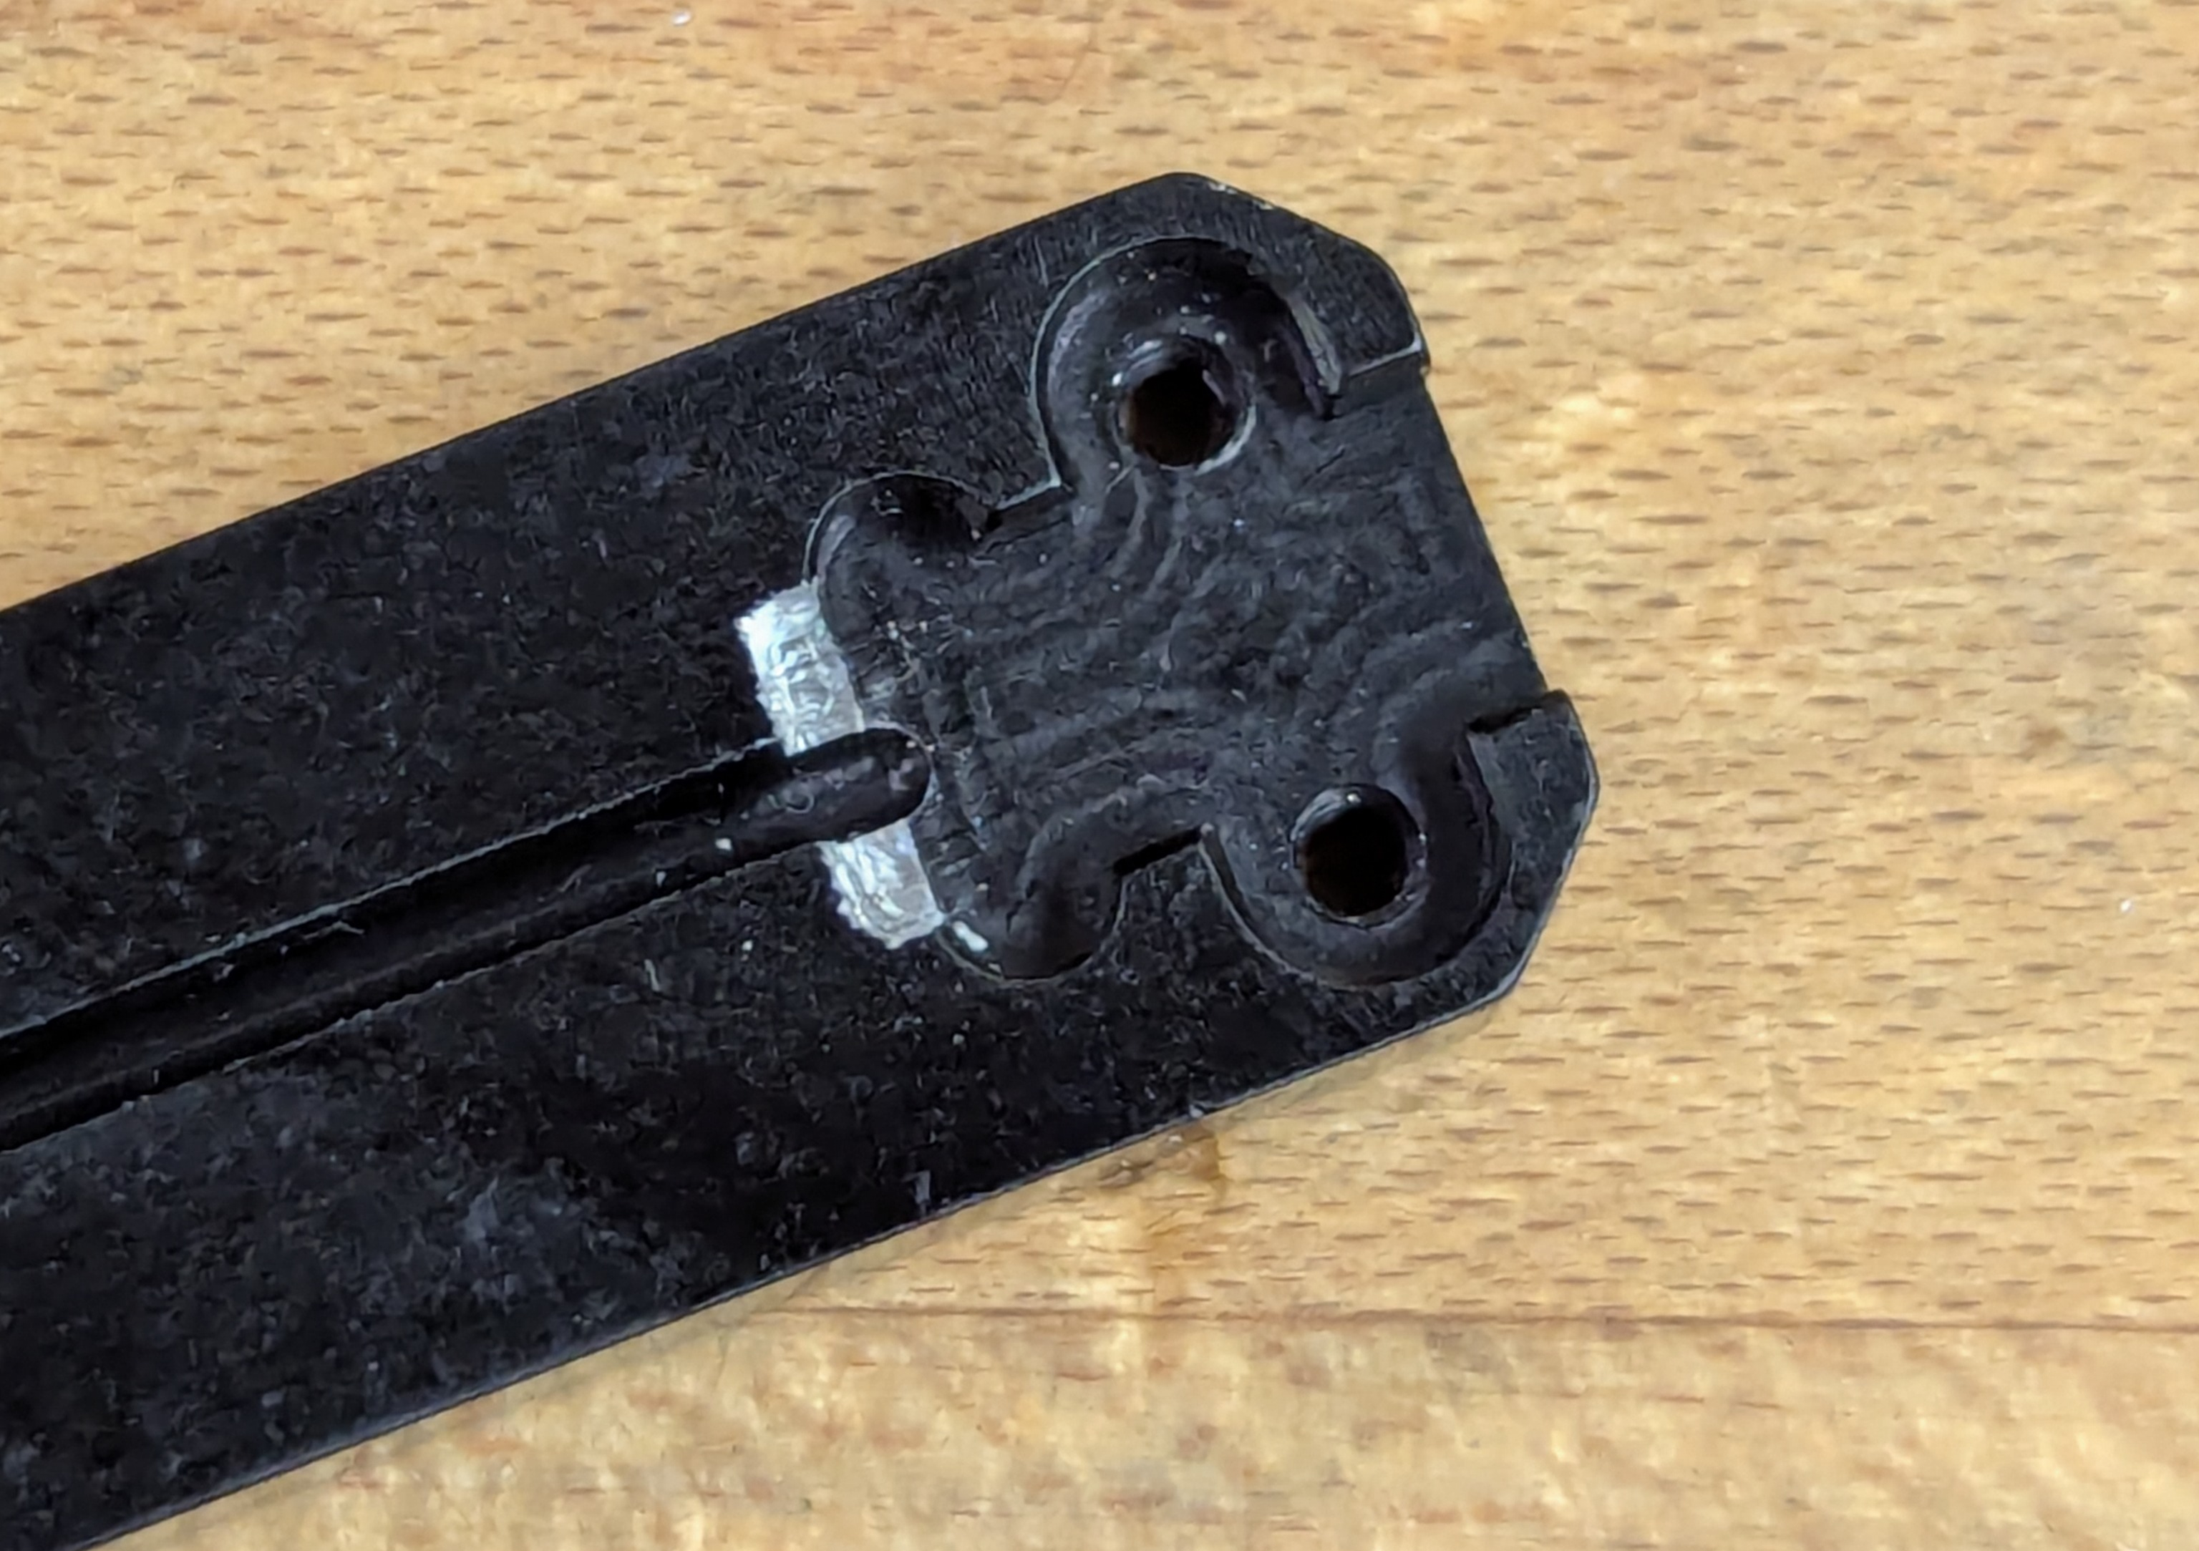
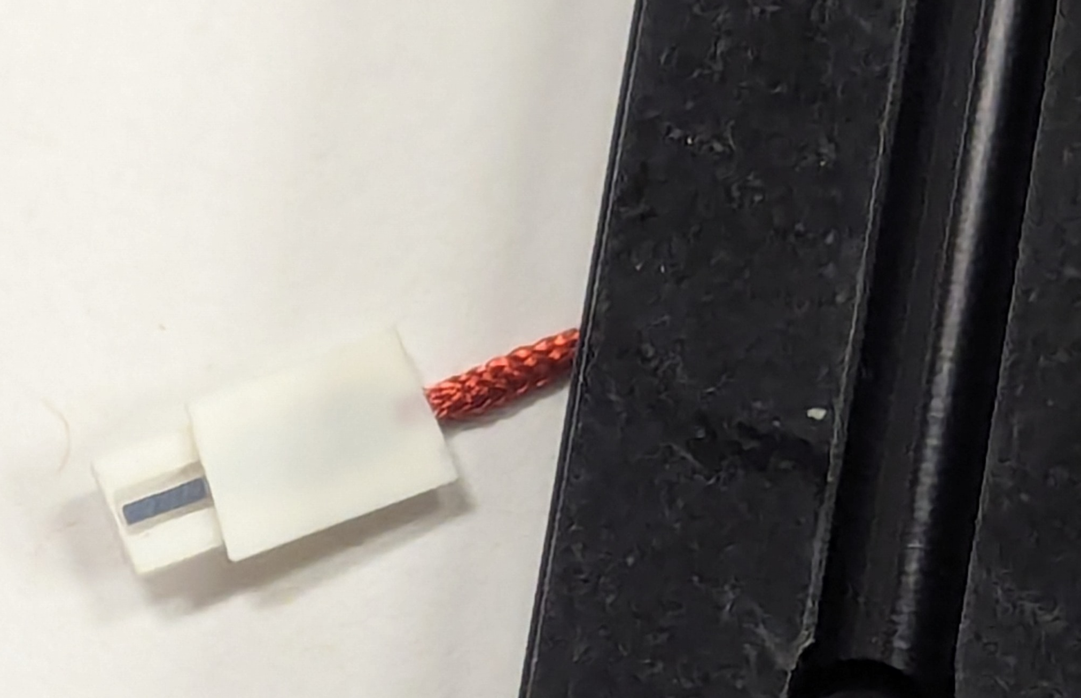
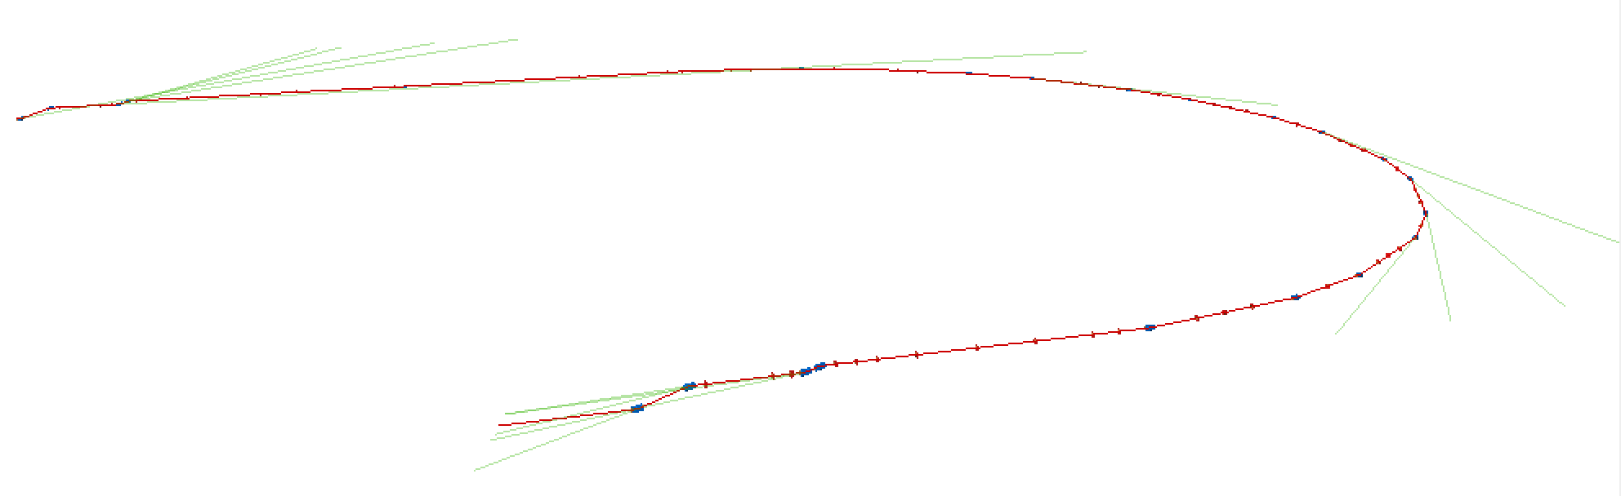
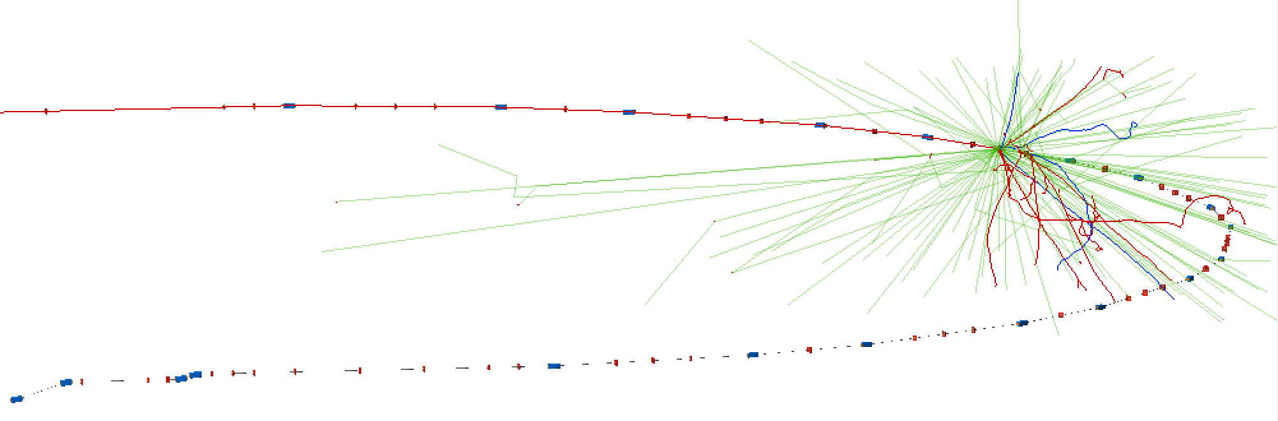
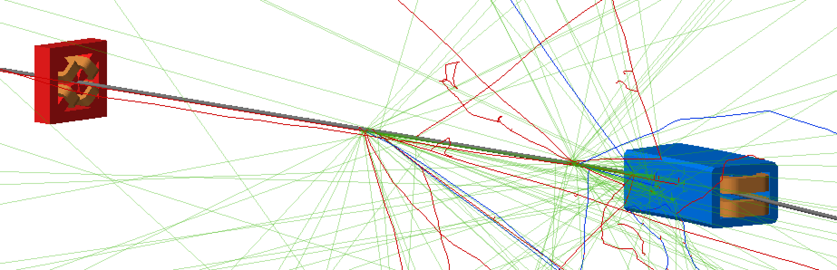
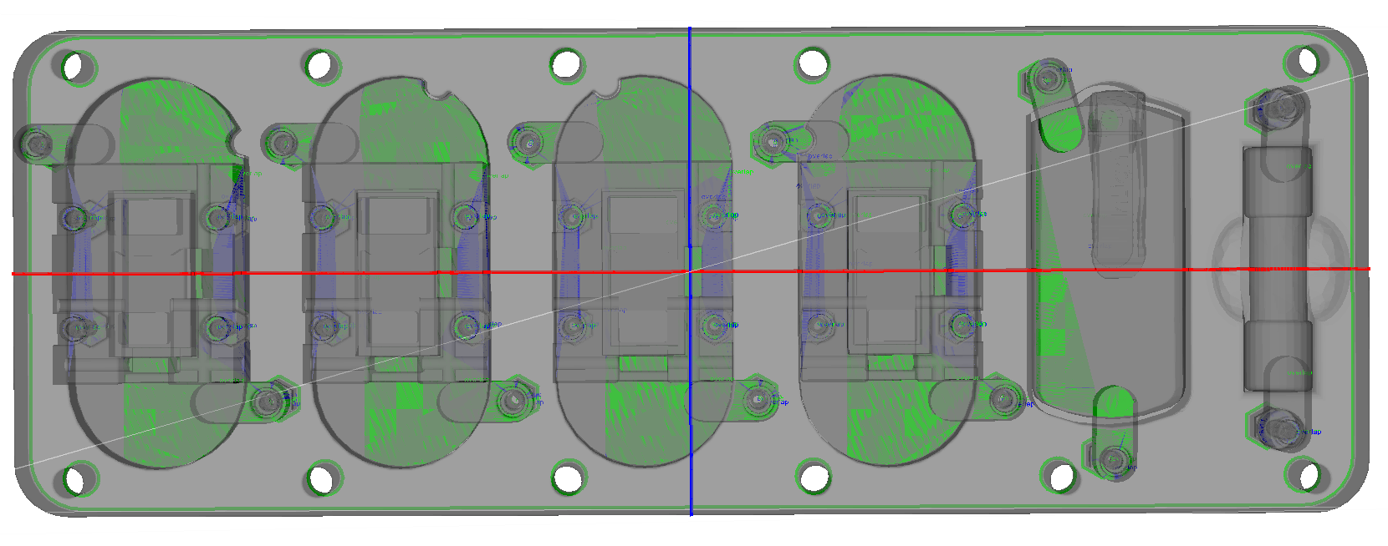
Path to Completion
Tracking quarterly milestones, documenting as we progress
Reduced run time, procurement delays slowing things down, but can get some data
Reduced from 3 plates to 2 per site (still one of largest studies)
Reduce time/measurement and dosimetry cost
Helmholtz Measurements have started!
2 summer students arriving
Isurumali helping with the work
Possible Delays
Simulations – a few issues slowing us down
ANOTHER broken Hall Probe – replacement and spare ordered
Expensive, slow delivery (due end of May)
Looking at new holder with Drew’s group
Need to order more dosimetry for rest of run
Publication Outlook
Cockcroft Institute/RHUL working with us – Director standing at our IPAC poster
JLAAC Presentation
Contributions to workshops/conferences (IPAC, NAPAC, FFA, etc…)
Journal papers: hoping for two - simulation work + full results

Slide 3
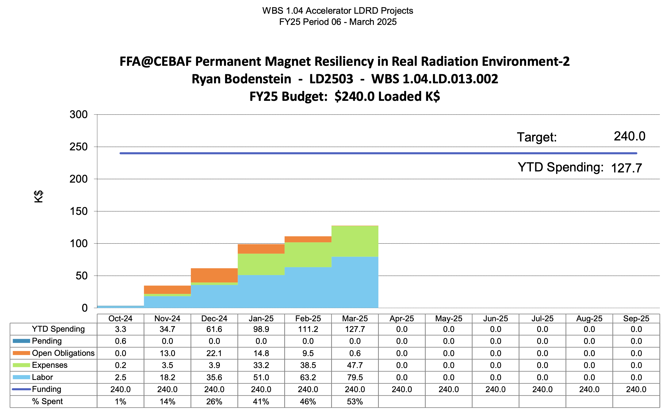
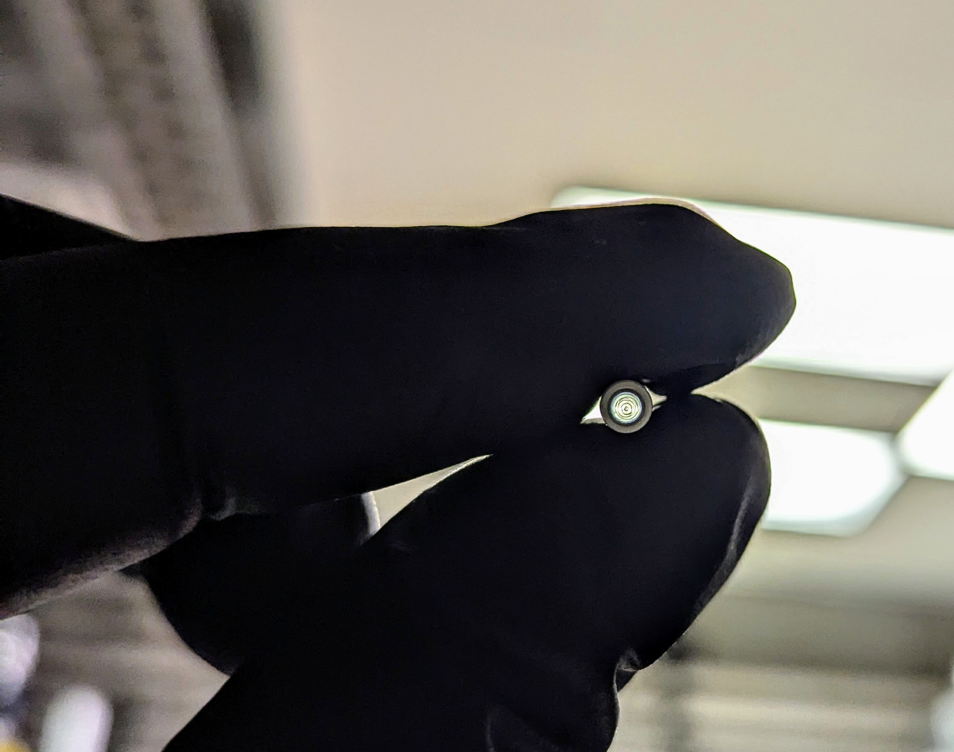
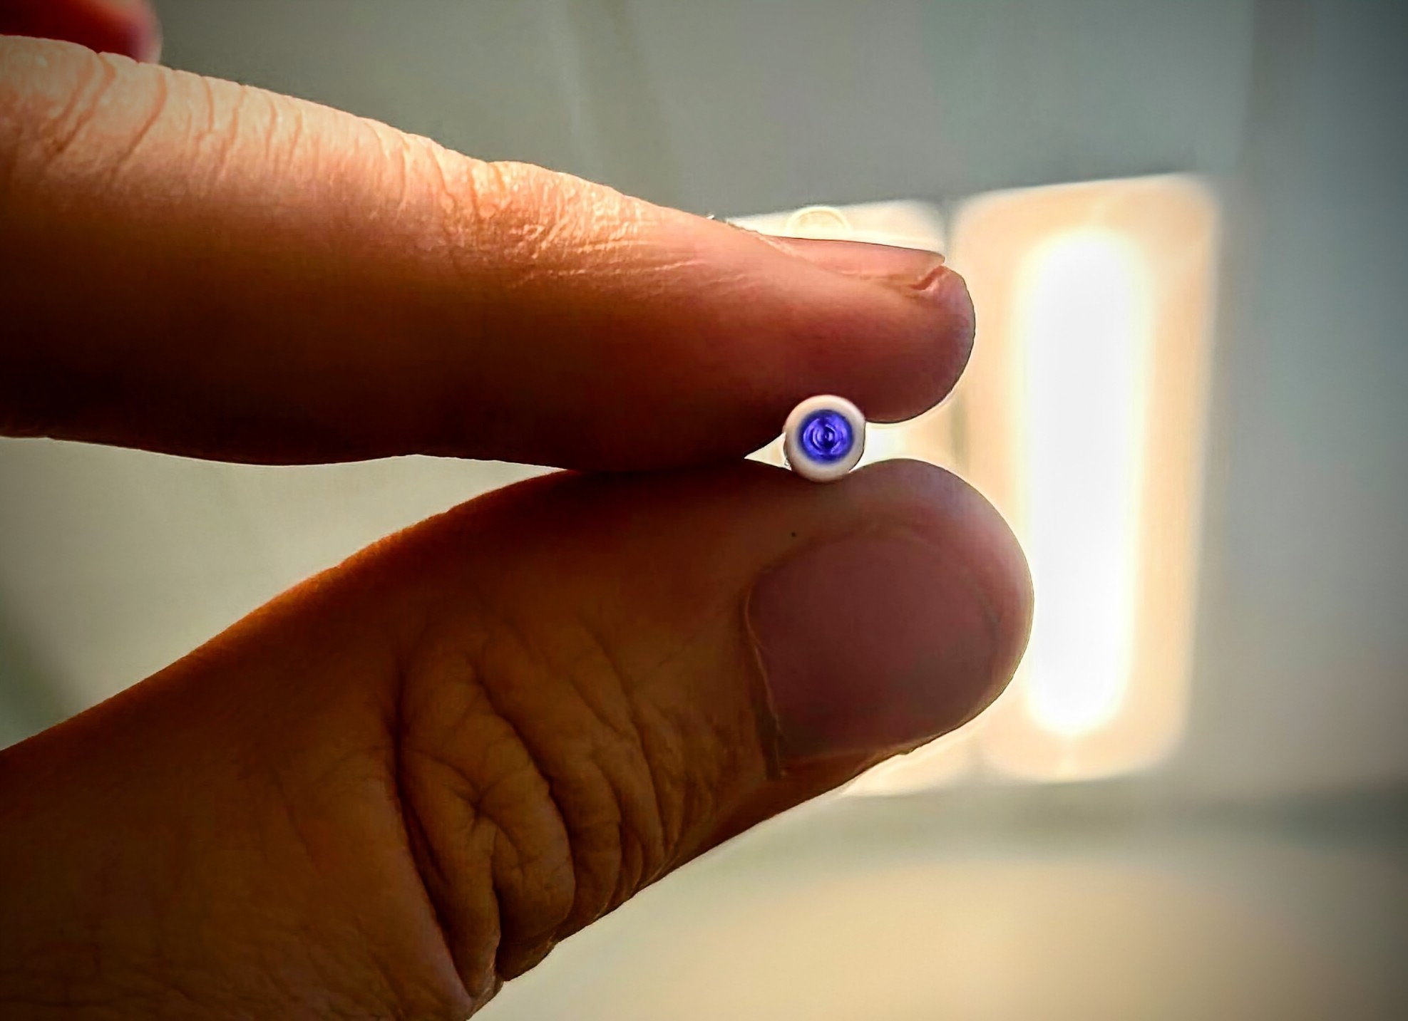
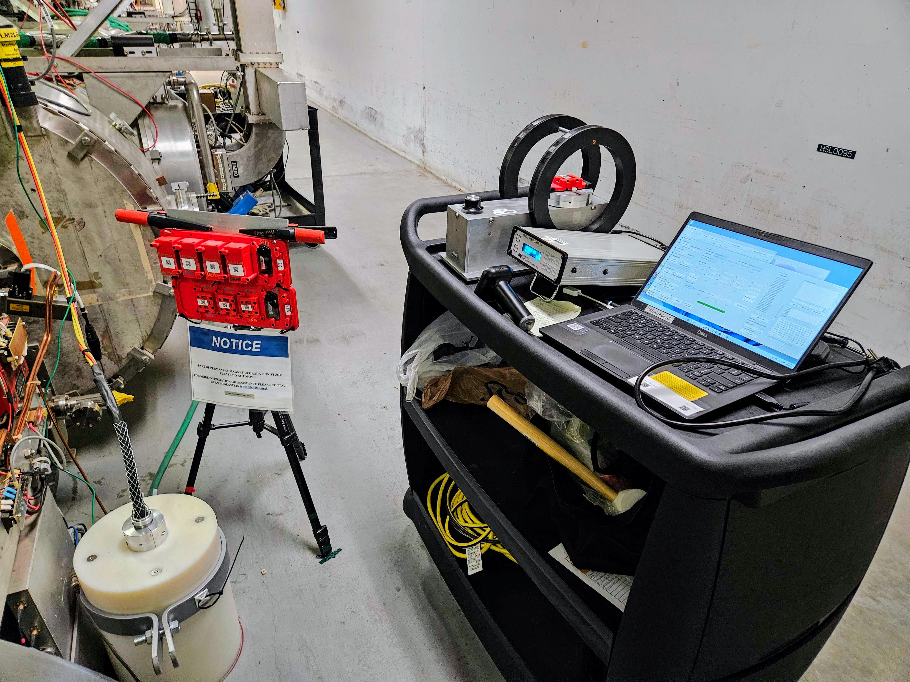
Q2 was frustrating, but still making strong progress:
Simulations re-prioritized:
Delays/complications with code
Re-focusing efforts for integrated dose first, then will expand as needed
Hall probe broken x 2
Replacement + spare ordered, new holder under development
First measurements taken using Helmholtz Coil
Radiation measurements ongoing – initial data
We are trained to read optichromic rods
Lots of background and calibration data to be processed

