Slide 1
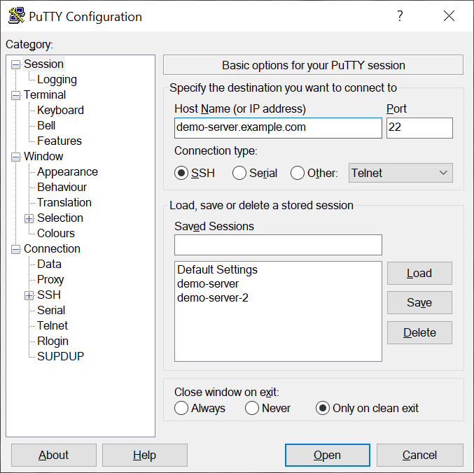
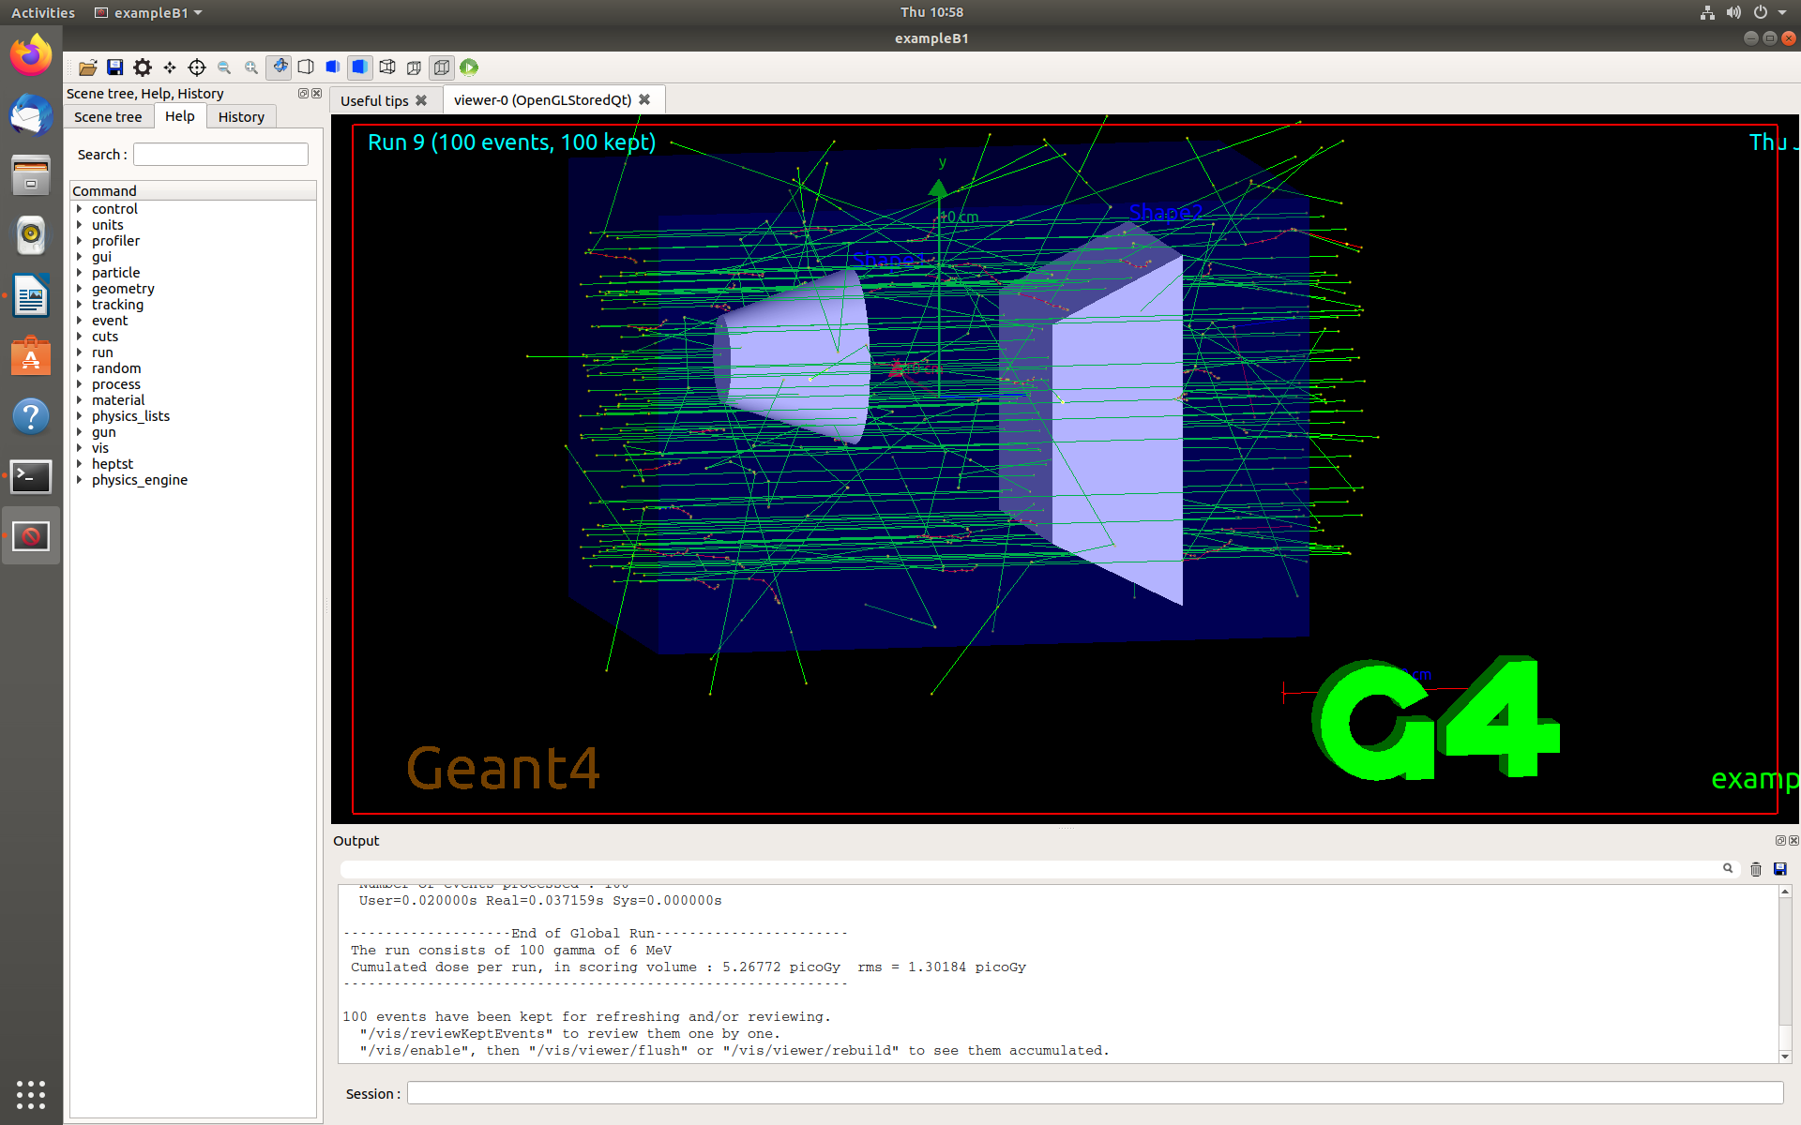
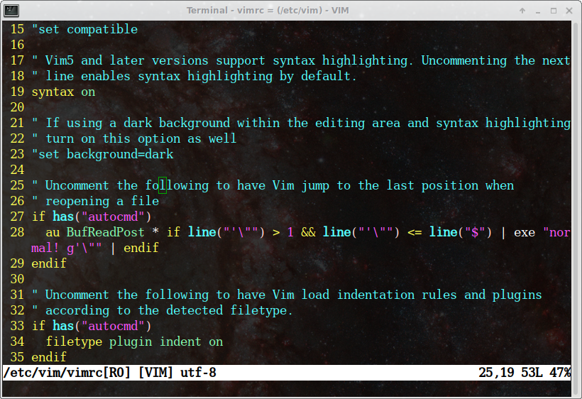
JLab Scientific Computing Access
Access High Performance Computing (HPC) Cluster
Set up scientific computing software on Linux systems
Run physics experiments, simulations, and data analysis
Cameron Clarke
Radiation Detector & Imaging Group, Nuclear Physics, Jefferson Lab

Slide 2
Outline
Slide 4: Logging in to JLab computing resources
Slide 11: Navigating and manipulating files
Slide 16: Intro to Git, Computing Software
  Git shared code
  Shared group installations
  CVMFS
  Conda
  Docker
Hands on exercises to familiarize yourself with all these things!
  Slide 33: Logging In
  Slide 52: Navigating and manipulating files
  Slide 71: Scripting, Software, and Git
JLab Sci-Comp Knowledge Base - Getting Started

Slide 3
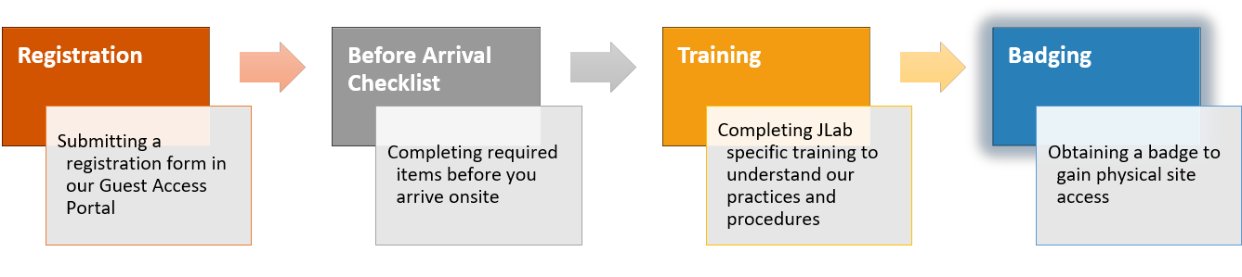
Acquiring an Account
Before you can get an account:
Register – several weeks before visiting, pick a user account you want to have as your permanent email and login
Checklist – fill out necessary information
Training – finish basic safety and computer training, advanced training can be done after joining
Badging – visit the badging office on your first day to get access to JLab buildings
For JLab Farm computing access:
Need to request permissions from your (experimental hall, theory group, detector group) computing coordinator
Need to acquire multi-factor authentication (MFA) credentials from the Computer Center Helpdesk
https://www.jlab.org/facilities/badgingoffice
Computing Coordinators Knowledge Base Article:
https://jlab.servicenowservices.com/kb?id=kb_article_view&sysparm_article=KB0014686

Slide 4
Lecture: Accessing Lab Resources
Access High Performance Computing (HPC) Cluster
Set up scientific computing software on Linux systems
Run physics experiments, simulations, and data analysis
This section

Slide 5
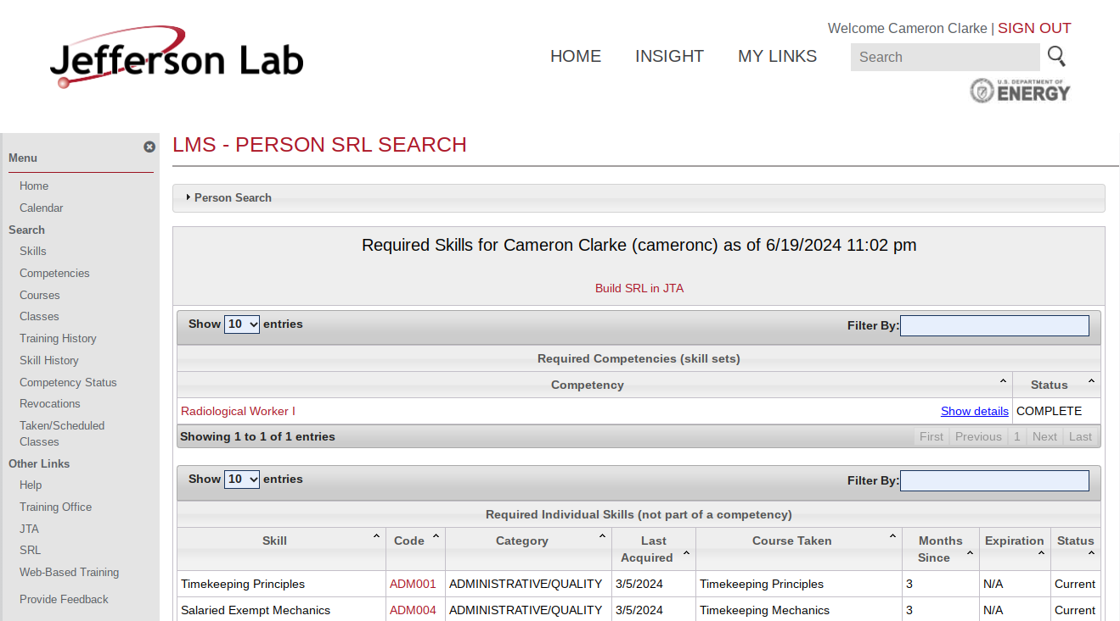
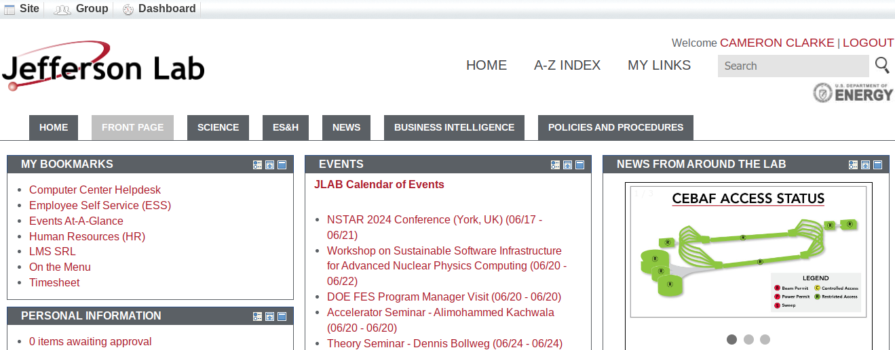
Logging In
Common User Environment (CUE) accounts enable access to many systems at JLab
  JLab Insight Web Portal
    Training (https://misportal.jlab.org/training/people/srl)
    JList (staff directory)
    Help-desk, library, and facilities tickets (https://jlab.servicenowservices.com)
    Requisition system, etc.
misportal.jlab.org/portal/insight
https://misportal.jlab.org/training/people/srl

Slide 6
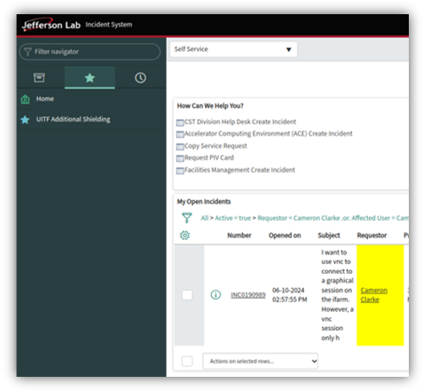
Logging In
Common User Environment (CUE) accounts enable access to many systems at JLab
  JLab Insight Web Portal
    Training (https://misportal.jlab.org/training/people/srl)
    JList (staff directory)
    Help-desk, library, and facilities tickets
    Requisition system, etc.
  Ask your sponsor or support staff at the lab for guidance
  Email helpdesk@jlab.org for computing assistance
  Email library@jlab.org for journal/book access questions
  Use the servicenow portal for facilities and other tickets
https://jlab.servicenowservices.com

Slide 7
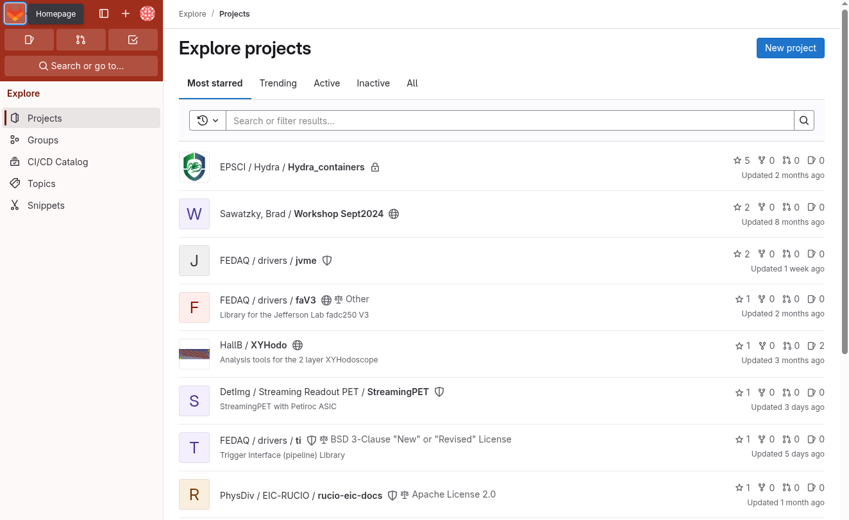
Logging In
Common User Environment (CUE) accounts enable access to many systems at JLab
  JLab Insight Web Portal
    Training (https://misportal.jlab.org/training/people/srl)
    JList (staff directory)
    Help-desk, library, and facilities tickets (https://jlab.servicenowservices.com)
    Requisition system, etc.
  VPN or VDI for Insight protected pages
  Gitlab (https://code.jlab.org/)
  To access interactive computer
  sessions a Multi-Factor Authentication
  token (MFA) is required
  MobilePASS SAS is the JLab login-portal
  access method – Help Desk distributed
  Phone app based
  Can ask for a USB stick button as well
https://code.jlab.org/

Slide 8
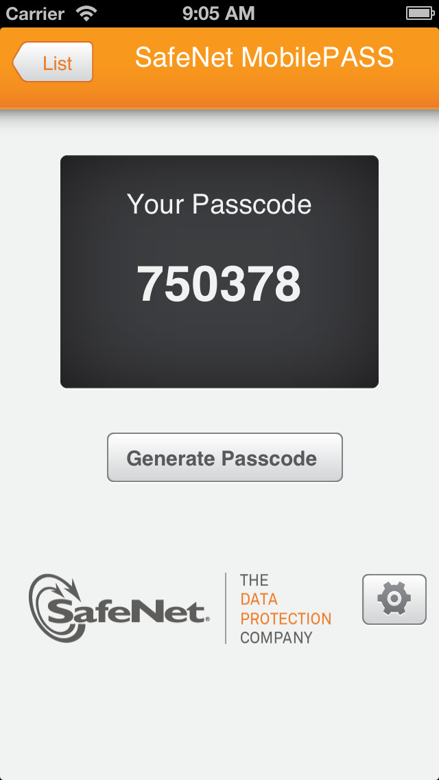
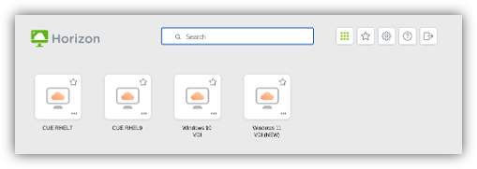
Logging In
Common User Environment (CUE) accounts enable access to many systems at JLab
  JLab Insight Web Portal
    Training (https://misportal.jlab.org/training/people/srl)
    JList (staff directory)
    Help-desk, library, and facilities tickets (https://jlab.servicenowservices.com)
    Requisition system, etc.
  VPN or VDI for Insight protected pages
  Gitlab (https://code.jlab.org/)
  Multi-Factor Authentication (MFA) login
    Public JLab computers (jlabl1, etc.)
    VMWare Horizon VDI (https://vdi.jlab.org/)
    Interactive Farm (ifarm)
    Globus
    Userweb webpage editing
  Secondary secure login portals
    Hall Gateway
    Accelerator Gateway
    JupyterHub (Google Auth)
MobilePass Phone App/USB Code Generator
Uses SafeNet Authentication Service (SAS)
Virtual Desktop Interface https://vdi.jlab.org/

Slide 9
Accessing JLab Filesystems
Your personal computer can mount JLab network drives and ifarm job submission tools
  Requires OS management by JLab central CUE system
  Must be on-site
  Prevents use of local super user permissions
  Ask the Helpdesk if you want to do this
Otherwise - Accessing JLab resources requires remote access via JupyterHub, VDI or SSH
  JupyterHub – Python Jupyter notebook system, with pre-installed virtual environment kernel options
    Need to request Google Authenticator MFA token
  VDI – JLab Virtual Desktop Infrastructure (VDI) Red Hat Enterprise Linux 9 (RHEL) Environment
    Need to request access to non-Windows Virtual machine – ask Helpdesk for RHEL9 access
  Preferred Access Method: SSH – Secure Shell command line interface (CLI) login
    X Windows Forwarding
      Mac – Terminal + XQuartz
      Windows – PuTTy + XMing
      Linux – Terminal
    SSH Tunneling – Manually or with ProxyJump
    File transfers – With manual tunneling, ProxyJump, Userweb, or Globus system

Slide 10
Accessing JLab ifarm
Logging into and accessing the JLab job submission (batch) and interactive farm (ifarm) computing systems can be done in many ways
  Depends on your personal system and needs
  Find the method in the following slides that is most convenient to you
  SSH or Linux RHEL9 VDI is recommended (can persist)
Hands-on session slides give detailed instructions for accessing ifarm with all systems:
Secure Shell (SSH) Protocol and Transferring Files
  Linux
  JLab's Virtual Desktop Infrastructure (VDI), from either html web app or desktop app
  Windows
  Mac
JupyterHub
Tomorrow
  Interactive farm (ifarm) noded with slurm access
  Farm batch submission access
JLab Service Now Article on remote Access:
https://jlab.servicenowservices.com/scicomp?id=kb_article&sysparm_article=KB0015066

Slide 11
Lecture: Navigate/Manipulate Files
Access High Performance Computing (HPC) Cluster
Set up scientific computing software on Linux systems
Run physics experiments, simulations, and data analysis
This section

Slide 12
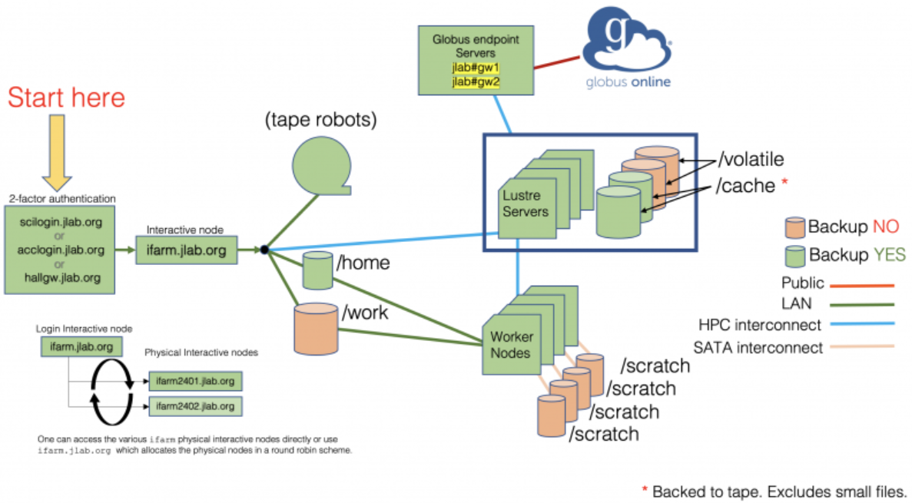
Navigating JLab ifarm
JLab's shared HPC:
Computing cluster "farm"
Has interactive capability through "ifarm"
Two nodes (ifarm2401, ifarm2402)
Provides access points for testing, etc. before sending off to production farm
Interactive nodes:
  AMD EPYC 9554 (Zen 4 "Genoa")
  256 threads (2 sockets × 64 cores × 2 threads/core)
  3.1 GHz base / 3.75 GHz max
  1.5 TB memory
  28 TB striped NVMe /scratch
  HDR (200 Gb/s) IB

Slide 13
Navigating JLab ifarm
Linux CLI functionality
  Basic Unix Commands – what are they?
  Unix philosophy (from Wikipedia):
    Use of plain text for storing data
    A hierarchical file system
    Treating devices and certain types of inter-process communication (IPC) as files
    Use of a large number of software tools, small programs that can be strung together with CLI / as opposed to using a single monolithic program that includes all of the same functionality
JLab network file system features
  /group, /work, /home, /volatile,/scratch, /mss tapes, /cache
  User and group allocations, fairshare between the halls
  CVMFS as a global shared filesystem, CERN and many other science facilities
  File Transfer: SCP, SFTP, Globus
Text editors
  Vim, Gedit, Emacs, Nano, etc.
IDEs (Integrated Development Environment)
  VSCode, Eclipse, IntelliJ, etc. (https://halldweb1.jlab.org/wiki/index.php/How_to_Setup_Visual_Studio_Code_for_the_ifarm)

Slide 14
Shell Scripting
Linux terminals utilize interactive "shell" environments:
There are many acceptable "shells" pre-installed on most linux systems
The Bourne Again Shell "BASH" is most popular
Jefferson Lab scientific computing systems default to the "C" shell, called "tcsh", so called because it is "like" the C language
Most commands have manuals: type `man <command>` without brackets, to learn more, or `<command> --help` usually works too
Any command accessible from the CLI can also be utilized in the exact same way inside of a script, enabling efficient operations
Shells give access to the file system and many system-wide installed commands, such as:
  cd = change directory, move from one folder to another
  ls = list the contents of the directory
  pwd = state the full path of the current working directory (path working directory = pwd)
  cp = copy the first argument file to the location of the second argument
  mv = move the first argument file to the location of the second argument
  rm = remove, delete the file passed in as an argument (be very careful with this command!)
  ln = create a symbolic link, "shortcut"
  cat = concatenate, display the contents of the file passed as an argument to the screen
  which = give the full path of the location for a command passed as an argument
  echo = print back to the screen, this is useful in scripting for printing results to the screen
  grep = a powerful program for searching text strings for sub-strings, and much more
  ps = list all processes running in this terminal shell session
  top = list all processes running on the computer, with useful information and live updating
  less = like cat, but lets you scroll around and do text searching, like Vim text editor
  tmux and screen = convenient shell session preservation and re-attachment tools
  man = show the manual entry for this command

Slide 15
SSH Passkeys
Key and lock pair, where you generate both and distribute the lock to your systems
  https://blakesmith.me/2010/02/08/understanding-public-key-private-key-concepts.html
  Useful as an intra-network stable password, git authentication (main point for our later hands-on session), and multi-system login uniformity strategy
  Generate them on any system, ideally one unique one for each system
  You must place them on systems you want to access with them
  Utilize the known_hosts system to save some time and improve your security confidence - https://www.baeldung.com/linux/public-key-known_hosts
You must maintain their security
  Verify they have the correct permissions - https://www.tecmint.com/set-ssh-directory-permissions-in-linux/
  Never share your private key
  Ideally use unique keys for each system, especially unsecured ones
  Use a password on each one (it is possible to have a no-password key pair, but not safe!)
  Pay attention to known_hosts authentication notifications for changed server identities (especially for untrusted remote servers)

Slide 16
Lecture: Scripting/Software & Git
Access High Performance Computing (HPC) Cluster
Set up scientific computing software on Linux systems
Run physics experiments, simulations, and data analysis
This section

Slide 17
Getting Started with Git
What is Git?
Git is a file management and version control system: https://git-scm.com/book/en/v2/ (Getting started guide)
Git was designed in 2005 to support Linux kernel development by Linus Torvalds
Github is just a website that hosts Git repositories, like Bitbucket, Gitlab, or your local machine operating as a file server
Want to use Git?
https://code.jlab.org GitLab is the preferred remote Git management system at JLab now (Gitlab backend, similar to GitHub, better than BitBucket)
The `git` command line program can do version control locally, even if you do not track projects with a remote server system
Git tools are supported on all OS and in many IDE systems
There is a "gitbash" terminal emulator on Windows (or you can use Linux Subsystem for Windows to run Linux in Windows 10/11)
https://github.com is the standard free service

Slide 18
Git Version Control Basics
Git skills to improve your analysis and software development work:
  Create a local blank repository
  Turn an existing project into a remote git repository
  Clone (download) an existing remote git repository
  Check and change git configuration and safely commit code changes to shared repository
Additional skills to learn before using Git to contribute to a shared project include:
  Using the right branch and managing issues and pull requests with collaborators
  Setting up username and password settings for remote git server access
  Resolving push/pull/merge conflicts
  Writing good commit messages
Before pushing or pulling any commits to/from a remote repository, set up your git ssh key config first:
Github: https://docs.github.com/en/authentication/connecting-to-github-with-ssh/adding-a-new-ssh-key-to-your-github-account
Gitlab: https://docs.gitlab.com/ee/user/ssh.html
More intro to Git: https://www.atlassian.com/git/tutorials/setting-up-a-repository

Slide 19
Accessing, Sharing, and Tracking Software
Software is easily stored:
  CernVM File System (CVMFS) computing resource for standard packages
  JLab people share code in /work, /group, /mss, GitLab, etc.
  Git: code.jlab.org GitLab (preferred), GitHub.com/JeffersonLab
  Accelerator and hall Logbooks, collaboration elogs and DocDBs
Conda and Virtual Environments
  Subject to some version restrictions at JLab
  (Ana)conda and venv can enable rapid software environment build/rebuild and sharing
FAIR = Findable, Accessible, Interoperable, and Reusable
  You will forget how you did your analysis (it doesn't take long) - you will thank yourself
  Always back up your code, your LaTeX files (OverLeaf), your figures, and even your data
  Add dates, version information, comments, and tag numbers too (all git features)
  Software versions aren't always backwards compatible and operating systems go end-of-life
  Virtual machines (Compiled Java, Docker Images, VMWare) are very convenient time-capsule tools!

Slide 20
Hands On: Acquiring an Account
Access High Performance Computing (HPC) Cluster
Set up scientific computing software on Linux systems
Run physics experiments, simulations, and data analysis

Slide 21
Acquiring an Account
When starting at JLab several administrative steps must be taken to gain access to critical lab resources
Get a site access name badge
Get and verify your JLab computer account
Request access to Microsoft Office (JLab staff and interns only), JLab ifarm, ifarm slurm, VDI, and group file access
Necessary training (cybersecurity, oxygen deprivation, radiation training, etc.)

Slide 22
Acquiring an Account
Get a badge:
Register – several weeks before visiting, pick a user account you want to have as your permanent email and login
Checklist – fill out necessary information
Training – finish basic safety and computer training, advanced training can be done after joining
Badging – visit the badging office on your first day to get access to JLab buildings
For student interns:
Mentor needs to finish MGT 202 training
If outside of formal internship programs (specifically Undergraduate Physics Researchship – UPR students):
  Mentor needs to formally request site access, a badge, and a computer account for the student
https://www.jlab.org/facilities/badgingoffice

Slide 23
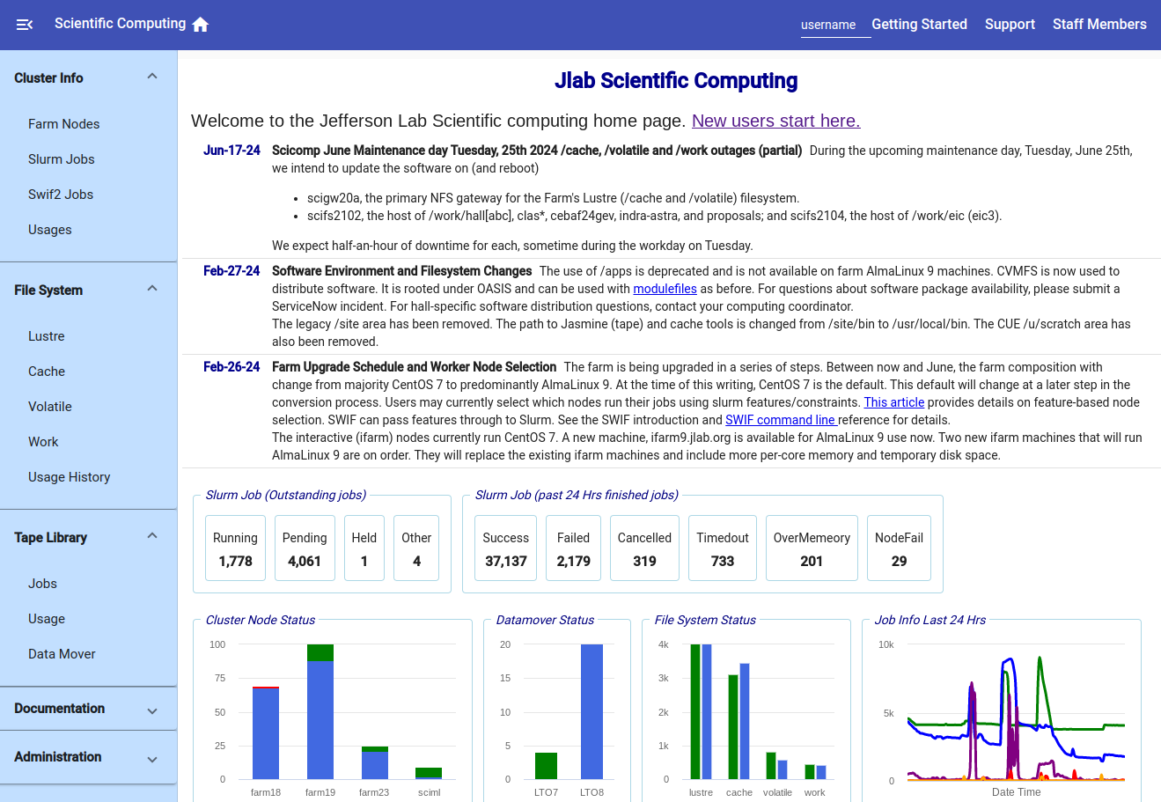
Acquiring an Account
Visit computer center helpdesk on 2nd floor of CEBAF Center F wing to receive your computer account
  Ask for Office 365 access if you are a JLab intern or staff (not available for all users)
  Ask for invitation to MobilePASS SAS MFA for general `login.jlab.org` access
  Ask to be added to relevant computer account user group
  Ask for VDI RHEL CUE access (Linux web-based virtual machine access)
  Reject using "SmartCard" USB access if possible (it is required to access personal JLab-managed Windows OS computers)
  Ask for Jupyterhub Google Authenticator OTP MFA access if you want it
https://scicomp.jlab.org/scicomp/home

Slide 24
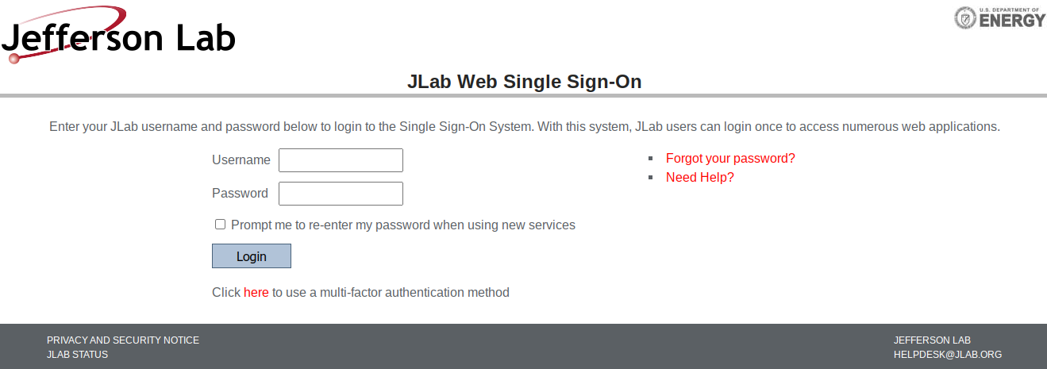
Acquiring an Account
Verify account access
  Go to www.jlab.org, log in to your user account, visit the insight page, and check your skills list
https://jidp.jlab.org/idp/profile/SAML2/Redirect/SSO?execution=e1s2
https://misportal.jlab.org/training/people/srl
https://misportal.jlab.org/portal/insight/frontPage

Slide 25
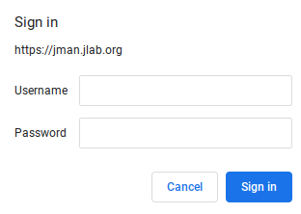
Acquiring an Account
Verify account access
  Go to www.jlab.org, log in to your user account, visit the insight page, and check your skills list
  Change your temporary password, using the website’s password management system or command line `passwd` command
https://jman.jlab.org/jpasswd

Slide 26
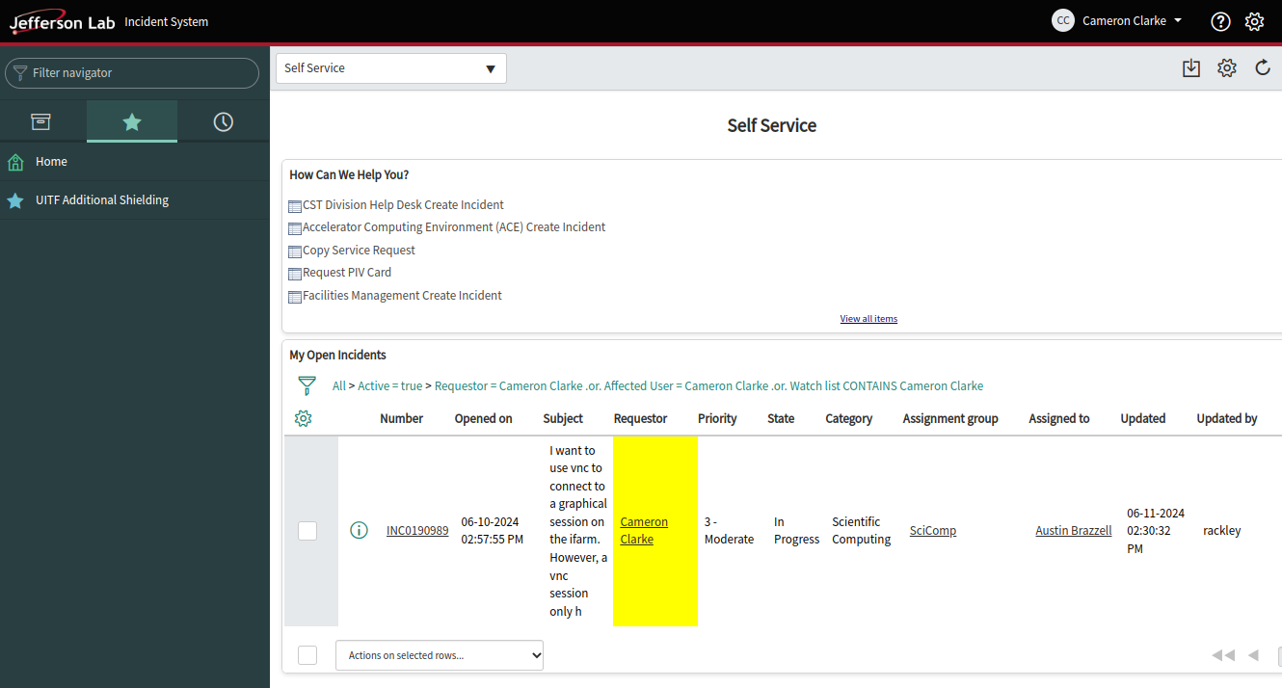
Acquiring an Account
Verify account access
  Go to www.jlab.org, log in to your user account, visit the insight page, and check your skills list
  Change your temporary password, using the website’s password management system or command line `passwd` command
  If you need help:
    For any of these steps, if you have any trouble
    Visiting the help desk in person or calling over the phone (757) 269-7155 works best
    Emailing helpdesk@jlab.org automatically files a support ticket
    Or you can file a helpdesk ticket manually at https://jlab.servicenowservices.com/navpage.do
https://jlab.servicenowservices.com/navpage.do

Slide 27
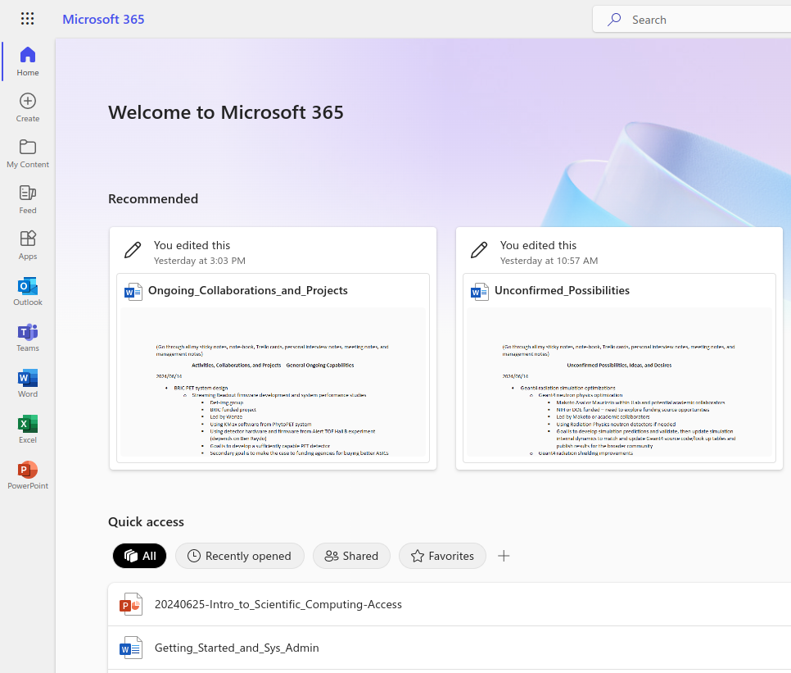
Acquiring an Account
Verify account access
  Go to www.jlab.org, log in to your user account, visit the insight page, and check your skills list
  Change your temporary password, using the website’s password management system or command line `passwd` command
  If you need help: helpdesk@jlab.org tickets
  Verify Office 365 access – log in to www.office.com with JLab credentials, set up Microsoft MFA (if you are staff or an intern)
  Access MS Office + Teams applications (if you are staff or an intern)

Slide 28
Acquiring an Account
Verify account access
  Go to www.jlab.org, log in to your user account, visit the insight page, and check your skills list
  Change your temporary password, using the website’s password management system or command line `passwd` command
  If you need help: helpdesk@jlab.org tickets
  Verify Office 365 access – log in to www.office.com with JLab credentials, set up Microsoft MFA
  Access MS Office + Teams applications
  Set up and verify login.jlab.org access with the SAS MobilePass multifactor app invitation
MobilePass Phone App
Or – USB Code Generator
(not a smart card, just a convenient dongle that you can press to get a code)
Uses SafeNet Authentication Service (SAS)
To test login.jlab.org access:
Ask the helpdesk staff to help you test your login.jlab.org by terminal on their work-station at the helpdesk
Otherwise follow instructions in subsequent set of slides

Slide 29
Acquiring an Account
Verify account access
  Go to www.jlab.org, log in to your user account, visit the insight page, and check your skills list
  Change your temporary password, using the website’s password management system or command line `passwd` command
  If you need help: helpdesk@jlab.org tickets
  Verify Office 365 access – log in to www.office.com with JLab credentials, set up Microsoft MFA
  Access MS Office + Teams applications
  Set up and verify login.jlab.org access with the SAS MobilePass multifactor app invitation
  Set up and verify interactive farm (ifarm) slurm and batch access (optional, can wait until later)
To test ifarm.jlab.org access:
Ask the helpdesk staff to help you test your ifarm.jlab.org access by terminal on their work-station at the helpdesk
Otherwise follow instructions in subsequent set of slides

Slide 30
Acquiring an Account
Interactive farm (ifarm) slurm access pre-requisites:​
Ask scicomp/helpdesk to add you to needed user group
  Check access by logging in to any Linux system and executing `groups <username>`
A slurm account manager will need to add you by executing the following ifarm commands
  `sacctmgr -i create user <username> account=<group name>`
  `sacctmgr show user <username>`
  `sacctmgr list assoc account=<group name>`
Servicenow slurm account manager guide: https://jlab.servicenowservices.com/kb?id=kb_article_view&sysparm_article=KB0014685
To verify complete farm batch job access – log in to ifarm, execute following commands from ifarm node:
  To enable submitting farm jobs you must run `/site/bin/jcert -create` on ifarm
  From (https://jlab.servicenowservices.com/scicomp?id=kb_article_view&sys_kb_id=22d2c5db1b4a09506a9e85dae54bcbcc)
To test ability to submit jobs, then execute:
  ifarm> salloc -p ifarm
  ifarm> srun --pty bash
  bash-4.2$ echo "This is running on host `hostname`"
  From (https://scicomp.jlab.org/docs/farm_slurm_batch_interactive_jobs)
Verify account access
  Go to www.jlab.org, log in to your user account, visit the insight page, and check your skills list
  Change your temporary password, using the website’s password management system or command line `passwd` command
  If you need help: helpdesk@jlab.org tickets
  Verify Office 365 access – log in to www.office.com with JLab credentials, set up Microsoft MFA
  Access MS Office + Teams applications
  Set up and verify login.jlab.org access with the SAS MobilePass multifactor app invitation
  Set up and verify interactive farm (ifarm) slurm and batch access (optional, can wait until later)
To test ifarm.jlab.org access:
Ask the helpdesk staff to help you test your ifarm.jlab.org access by terminal on their work-station at the helpdesk
Otherwise follow instructions in subsequent set of slides

Slide 31

Acquiring an Account
Verify account access
  Go to www.jlab.org, log in to your user account, visit the insight page, and check your skills list
  Change your temporary password, using the website’s password management system or command line `passwd` command
  If you need help: helpdesk@jlab.org tickets
  Verify Office 365 access – log in to www.office.com with JLab credentials, set up Microsoft MFA
  Access MS Office + Teams applications
  Set up and verify login.jlab.org access with the SAS MobilePass multifactor app invitation
  Set up and verify interactive farm (ifarm) slurm and batch access (optional, can wait until later)
  Verify VDI access
Log in to https://vdi.jlab.org (download the app or use the easier html web-version) using your common user environment (CUE) username and password
Once you get to this screen – select CUE RHEL9
When prompted, log in to RHEL9 system welcome screen using your MobilePASS SAS personal PIN plus 6 digit MFA code as the password
(a SmartCard is required for Windows Systems – avoid!)
JLab VDI Support Article: https://jlab.servicenowservices.com/sp?id=kb_article&sys_id=dec16b0ddb7f0410ee4a3889fc961944 ​

Slide 32
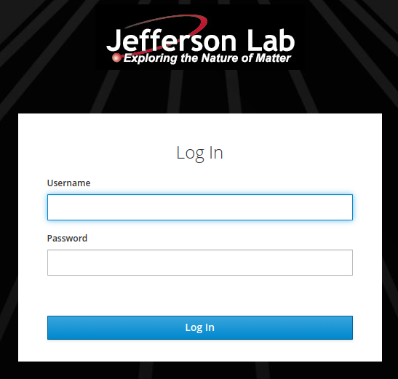
Acquiring an Account
Verify account access
  Go to www.jlab.org, log in to your user account, visit the insight page, and check your skills list
  Change your temporary password, using the website’s password management system or command line `passwd` command
  If you need help: helpdesk@jlab.org tickets
  Verify Office 365 access – log in to www.office.com with JLab credentials, set up Microsoft MFA
  Access MS Office + Teams applications
  Set up and verify login.jlab.org access with the SAS MobilePass multifactor app invitation
  Set up and verify interactive farm (ifarm) slurm and batch access (optional, can wait until later)
  Verify VDI access
  Set up and verify access to JupyterHub
Log in to https://jupyterhub.jlab.org – first using your common user environment (CUE) password – second using your Google Authenticator OTP code

Slide 33
Hands-On: Accessing Lab Resources
Access High Performance Computing (HPC) Cluster
Set up scientific computing software on Linux systems
Run physics experiments, simulations, and data analysis
This section

Slide 34
Accessing JLab ifarm
Hands-On Exercises to master:
SSH to JLab login portal
SSH to jlabl1 public machine
SSH to JLab ifarm
SSH between jlabl1 and ifarm
Verify ifarm group and job submission permissions
Perform a manual SSH ProxyJump into the ifarm
Perform a manual SSH tunnel into the ifarm
Recommended: Set up a permanent SSH ProxyJump
Optional: Connect to JLab JupyterHub – https://jupyterhub.jlab.org
Optional: Connect to JLab VDI system – https://vdi.jlab.org

Slide 35
Accessing JLab ifarm
Logging into and accessing the JLab job submission (batch) and interactive farm (ifarm) computing systems can be done in many ways
  Depends on your personal system and needs
  Find the method in the following slides that is most convenient to you
  SSH or Linux RHEL9 VDI is recommended (can persist)
The following slides cover accessing JLab's ifarm with various systems:
Secure Shell (SSH) Protocol
  Linux
  JLab's Virtual Desktop Infrastructure (VDI), from either html web app or desktop app
  Windows
  Mac
ProxyJump SSH and Port Forwarding
JupyterHub
Tomorrow
  Interactive farm (ifarm) nodes with slurm access
  Farm batch submission access
JLab Service Now Article on remote Access:
https://jlab.servicenowservices.com/scicomp?id=kb_article&sysparm_article=KB0015066
GlueX Wiki on VSCode ifarm access
https://halldweb1.jlab.org/wiki/index.php/How_to_Setup_Visual_Studio_Code_for_the_ifarm

Slide 36


Accessing JLab ifarm with SSH X windows forwarding
SSH with Linux:
Once inside a Linux system
  Click Activities or find an applications drop down menu
  Find the terminal application and open it
  Execute `ssh –Y <username>@login.jlab.org`
    Use MobilePass SAS MFA personal 6-8 digit code + 6 digit encrypted code output in one line as the password
  Then: Execute `ssh –Y <username>@ifarm`
    Use your usual JLab Common User Environment (CUE) password, or your ssh-key if you have set one up
Linux VDI (shown on the right):
  Same as using Linux, managed by JLab
  Accessed using https://vdi.jlab.org login website
  See notes from prior set of slides for instructions
  Then: open a terminal from inside the VDI session
JLab RHEL9 VDI screen – activities button and terminal

Slide 37
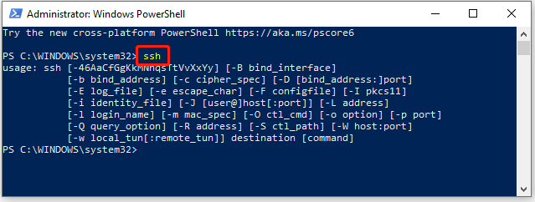
Accessing JLab ifarm with SSH X windows forwarding
SSH with Windows the new way:
There is a ssh client now installed by default in modern Windows operating systems
Open any terminal in Windows: "cmd", PowerShell, or any Windows Subsystem for Linux (WSL) prompt
Execute SSH commands following instructions on prior Linux instructions slide
To Install a Linux operating system in Windows Subsystem for Linux (WSL) utilize Windows official channels
  Ubuntu 20.04.6: https://apps.microsoft.com/detail/9mttcl66cpxj?hl=en-us&gl=en
  These can come in many Linux flavors – Ubuntu and Debian are the same thing and are most newby friendly
  Enable installation of many scientific computing resources such as Python, ROOT, and even Geant4 using package management tools such as "Snap" or "Miniconda"
  Simplify X11 windows forwarding for Linux and gives you the power of Linux within the Windows ecosystem

Slide 38


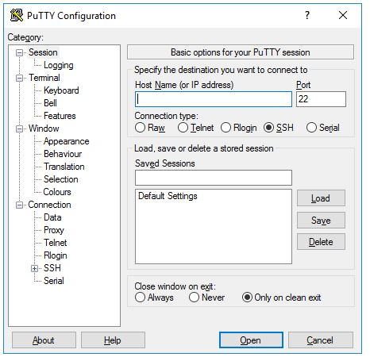
Accessing JLab ifarm with SSH X windows forwarding
SSH with Windows the old way:
Download and Install PuTTY and Xming
  PuTTY: Download the application from the Microsoft Apps store to install PuTTY.
    https://apps.microsoft.com/detail/xpfnzksklbp7rj?amp%3Bgl=US&hl=en-us&gl=US
  Xming: Download from SourceForge – be careful to not click on advertisements – inspect all links first!
    https://sourceforge.net/projects/xming/
    Xming will run in the background, only acting when you try to open GUIs on remote servers via PuTTY
Enter the hostname you want to access in "Host Name (or IP address) field
Port 22 is standard ssh protocol port
IPv4 protocol port numbers range from 0 - 65535 (16 bit integer range)
Host Name for Accessing JLab scientific computing resources is "login.jlab.org"
PuTTY GUI "Session" page

Slide 39
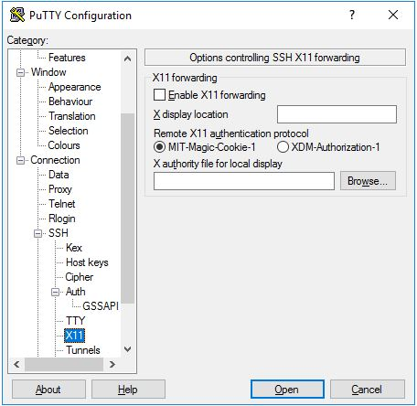
Accessing JLab ifarm with SSH X windows forwarding
SSH with Windows the old way:
Configure PuTTY for X11 window forwarding to work
  Open PuTTY, filling in the IP address or DNS host name
    Type in "login.jlab.org" (no quotes) to access the JLab scientific computing resources from on or off-site
    A specified hostname, like "jlabl1" (no quotes), if ifarm access is not the goal
  Go to the Connection > SSH > Auth > X11 Page menu
    Check the box "Enable X11 forwarding" and type in the "X display location" to be "localhost:0" (no quotes)
  Go back to "Session" page, type some useful name (like "jlab login"), and 'Save' your configuration for later loading
PuTTY GUI "Session" page
Connection > SSH > Auth > X11 Page

Slide 40
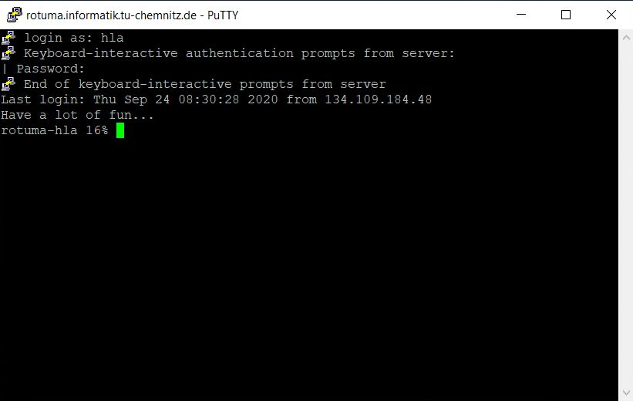
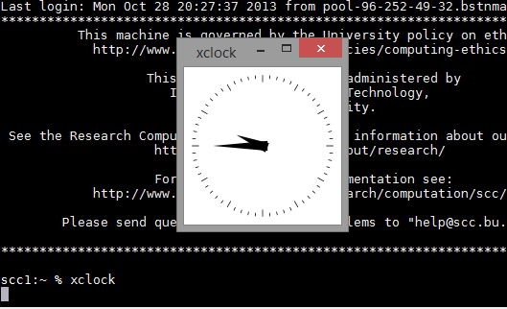
Accessing JLab ifarm with SSH X windows forwarding
SSH with Windows the old way:
Try X11 forwarding with XMing
  You will need to execute the XMing program (double click it's start menu icon) so that it runs in the background
  You may need to allow Window’s firewall access – if so then accept the pop-up request
ssh into the "login.jlab.org" portal
  Connect by using the "open" button on PuTTY
    Use MobilePass SAS MFA personal 6-8 digit code + 6 digit encrypted code output in one line as the password to enter the login portal
  Then: execute `ssh –Y <username>@ifarm` on the command line
    Use your usual JLab Common User Environment (CUE) password, or your ssh-key if you have set one up
<-- A PuTTY prompt after successful logging into a remote host
xclock test-command demonstrating successful windows forwarding -->

Slide 41
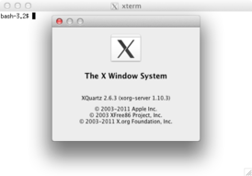
Accessing JLab ifarm with SSH X windows forwarding
SSH with Mac:
Install XQuartz https://www.xquartz.org/
  XQuartz must be run before attempting to open any process with forwarded graphical display (similar to Windows' XMing program, but easier)
Open a standard Mac terminal and SSH the same way as with Linux
  Execute `ssh –Y <username>@login.jlab.org`
    Use MobilePass SAS MFA personal 6-8 digit code + 6 digit encrypted code output in one line as the password
  Then: execute `ssh –Y <username>@ifarm` command
    Use your usual JLab Common User Environment (CUE) password, or your ssh-key if you have set one up
XQuartz splash page and included xterm terminal emulator

Slide 42
Accessing JLab ifarm with SSH X windows forwarding
Farm login and batch submission access:
ssh to ifarm following earlier instructions
Perform an interactive job submission test (instructions on the right)
Batch submission, monitoring, and debugging will be covered later
Successful verification requires your collaboration/group's computing coordinator to have given you permissions (see details on the right)
Interactive farm (ifarm) slurm access pre-requisites:​
Ask scicomp/helpdesk to add you to needed user group
  Check access by logging in to any Linux system and executing `groups <username>`
A slurm account manager will need to add you by executing the following ifarm commands
  `sacctmgr -i create user <username> account=<group name>`
  `sacctmgr show user <username>`
  `sacctmgr list assoc account=<group name>`
Servicenow slurm account manager guide: https://jlab.servicenowservices.com/kb?id=kb_article_view&sysparm_article=KB0014685
To verify complete farm batch job access – log in to ifarm, execute following commands from ifarm node:
  To enable submitting farm jobs you must run `/site/bin/jcert -create` on ifarm
  From (https://jlab.servicenowservices.com/scicomp?id=kb_article_view&sys_kb_id=22d2c5db1b4a09506a9e85dae54bcbcc)
To test ability to submit jobs, then execute:
  ifarm> salloc -p ifarm
  ifarm> srun --pty bash
  bash-4.2$ echo "This is running on host `hostname`"
  From (https://scicomp.jlab.org/docs/farm_slurm_batch_interactive_jobs)

Slide 43
Accessing JLab ifarm with SSH X windows forwarding
Advanced:
SSH command chaining
SSH tunneling through login.jlab.org
SSH ProxyJump with linux SSH config
SSH ProxyJump with Windows PuTTY
Virtual Network Computing (VNC) initialization
VNC port forward tunneling through login.jlab.org and local access

Slide 44
Accessing JLab ifarm with SSH X windows forwarding
Advanced: SSH ProxyJump
SSH command chaining via manual ProxyJump
  `ssh -Y -J <user>@login.jlab.org <user>@ifarm`
  J indicates manual ProxyJump
  Y indicates X forwarding with strict security check (can do –X instead to not check security)
  This is quite convenient: it simplifies to one line and requires entering only the MFA password

Slide 45
Accessing JLab ifarm with SSH X windows forwarding
Advanced: SSH Tunnels
SSH tunneling through login.jlab.org
  This permits only entering the MobilePass SAS MFA key one time and no subsequent authentication is needed
  Set up tunnel: `ssh -L <forwarding port>:ifarm:22 <username>@login.jlab.org`
    <forwarding port> can be 22, or any other unused port number
    Example bashrc: alias tunnellogin="ssh -L 2201:ifarm:22 <username>@login.jlab.org"
  SSH over tunnel: `ssh -p <forwarding port> localhost`
    <use the same forwarding port as set up earlier>
    Example bashrc: alias ifarmssh="ssh -p 2201 localhost"
  What is this doing?
    What you are doing here is attaching a remote port (in this case 22) onto a local port (in this case 2201)
    With this attached port you can now interact with the localhost (your own computer) as if it is the remote (because it is!)
    Primary convenience is you can attach many activities through this one opened port, all without needing to type a password (including additional SSH windows, sftp, scp, VNC, etc.)
  Make sure the terminal executing the tunnel does not close, or else all traffic will fail
  Verify that the port you chose to forward over is allowed (not bind rejected error message after logging in) - it may be occupied by another user or process

Slide 46
Accessing JLab ifarm with SSH X windows forwarding
Advanced: Permanent ProxyJump
SSH ProxyJump – permanent proxy configuration
  General guide:
  https://jlab.servicenowservices.com/scicomp?id=kb_article&sysparm_article=KB0015066
  Specific guide, Linux:
  https://jlab.servicenowservices.com/scicomp?id=kb_article&sysparm_article=KB0014918
  Specific guide, Windows:
  https://jlab.servicenowservices.com/kb?id=kb_article_view&sysparm_article=KB0015113

Slide 47
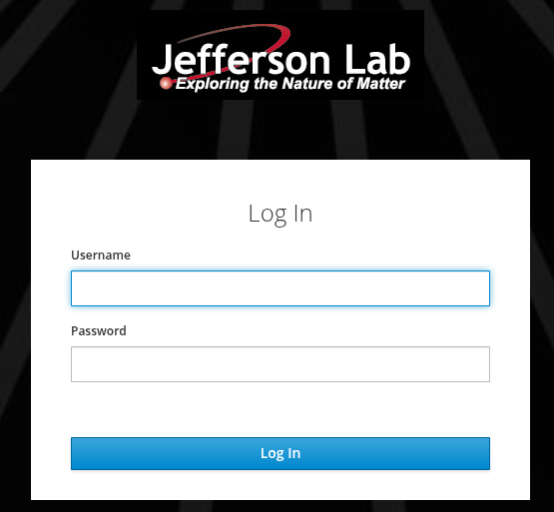
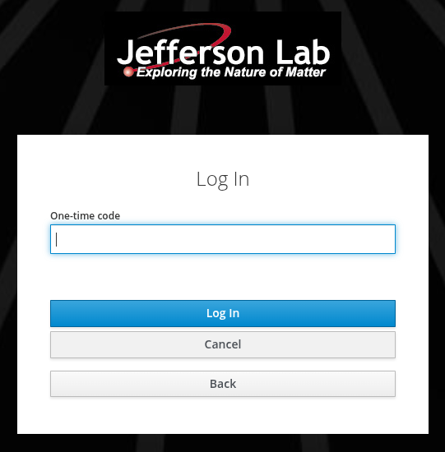
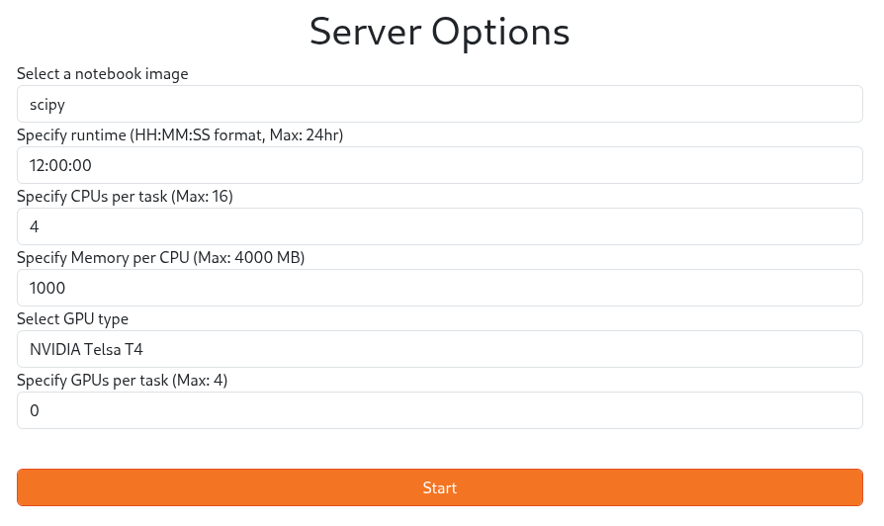
Accessing JLab ifarm with SSH X windows forwarding
You can use the jlab ifarm to hold temp files, home folder, etc.
  Just need to configure symlinks from the main jlabl1 ~/home/<username> folder to point where you want things to go
  To avoid running out of space on your ~/home folder – put them in a /work/ or /group/ space
    .local -> /work/detimg/cameronc/local
    .jupyter -> /work/detimg/cameronc/jupyter
    .cache -> /work/detimg/cameronc/cache
    .conda -> /work/detimg/cameronc/conda
You can use conda virtual environments to set up your own custom designed environments (or just use the ones pre-made by the SciComp team)
To make your own venv-kernel (example case):
  ` conda activate pytorch_env`
  ` python -m ipykernel install --user --name=pytorch_env --display-name="Python (pytorch_env)"`
  Restart your Jupyter Notebook server for the new kernel to appear in the list.
  Select Kernel: In your Jupyter Notebook, go to Kernel -> Change Kernel and select "Python (pytorch_env)".
Advanced: JupyterHub
https://JupyterHub.jlab.org
Provides access to JLab ifarm compute power, GPUs, and file systems
Requires a Google Authenticator MFA token (generated when initially joining JupyterHub – ask Help Desk for help)
You can set up your own Notebook Images using venv Virtual Environment tools (example right)

Slide 48
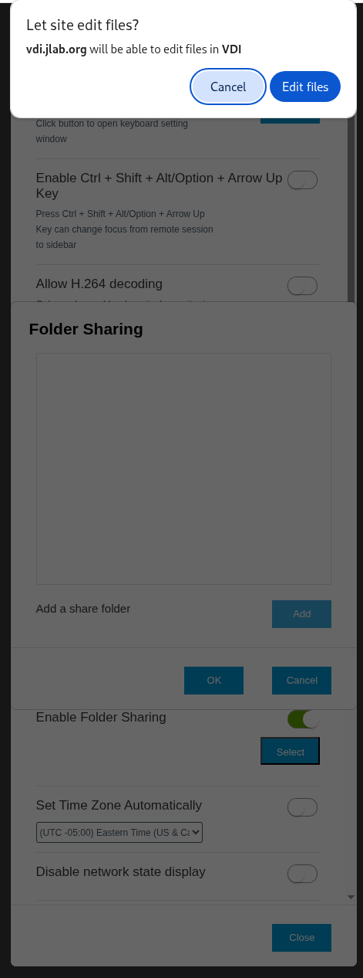
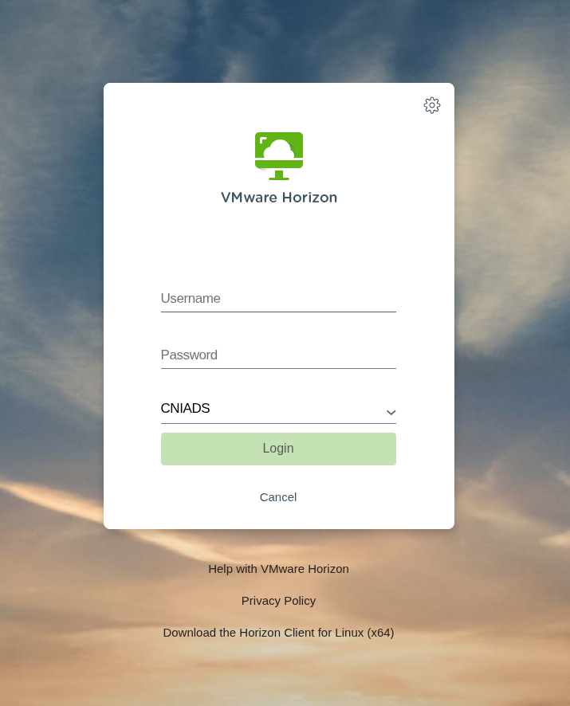
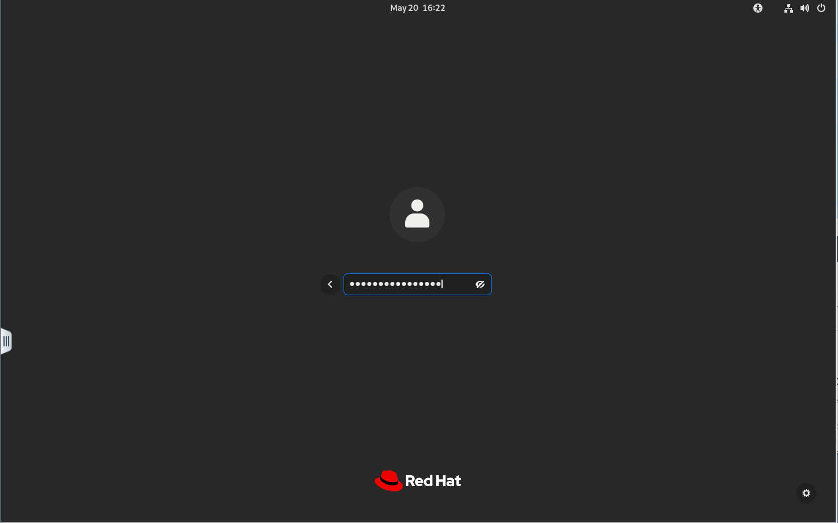
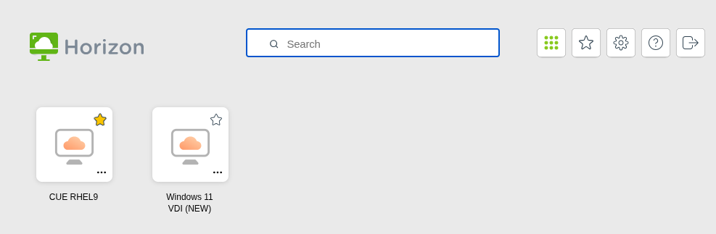
Accessing JLab ifarm with SSH X windows forwarding
Advanced: VDI
VDI is Virtual Desktop Infrastructure – VMWare Horizon Virtual Machine connected to JLab CUE Account shared /home
Must first request Linux RHEL9 access from Computer Center (helpdesk)
File-sharing through VDI -> Under settings enable "edit files" and pick a local folder to share
  Mount <your folder> from your local your computer
  Now accessible inside VDI at ~/tsclient/<your folder> (can copy/paste files, no editing!)
Persistence – closed tab can be reconnected to, within a reasonable time-frame
  Settings and files are persistent, this is == your farm or jlabl1 /home/<username> directory!
https://vdi.jlab.org -> Log in with CUE Username and Password​
Enter CUE Username​
(Password = MobilePASS SAS MFA PIN+Code​)
Select RHEL9 machine (Windows requires SmartCard!!)​

Slide 49
Accessing JLab ifarm with Virtual Network Computing (VNC)
Advanced: VNC
Virtual Network Computing (VNC) initialization
  Old JLab instructions (requires sudo access): https://jlab.servicenowservices.com/sp?sys_kb_id=d4520b731b2f2d106a9e85dae54bcbe6&id=kb_article_view&sysparm_rank=1&sysparm_tsqueryId=9a6ccb0c478fca10281bbd51026d4392
  Hall A wiki instructions (a bit old, but still works):
  https://hallaweb.jlab.org/wiki/index.php/Using_a_VNC_Server/Client#Setting_up_the_VNC_Server
  Official instructions (requires sudo):
    Read /usr/share/doc/tigervnc/HOWTO.md
    Set user defaults in /etc/tigervnc/vncserver.users - set default VNC session number "y" (should be y=1 for primary user)
    `systemctl start vncserver@:1`
    `systemctl enable vncserver@:1`
    Or as sudo replace 1 with "x" to start all users
  Without sudo: just do
    `vncserver :1`
    `vncserver -kill :1`
    Replace 1 with whatever number is available

Slide 50
Accessing JLab ifarm with Virtual Network Computing (VNC)
Advanced: VNC
VNC port forward tunneling through login.jlab.org and local access
  For Mac: https://jlab.servicenowservices.com/sp?sys_kb_id=63d78ae2dbc888107d37365e7c961986&id=kb_article_view&sysparm_rank=2&sysparm_tsqueryId=eeab4bc8478fca10281bbd51026d4361
  For Windows: https://jlab.servicenowservices.com/sp?sys_kb_id=ab0602eadb844810ee4a3889fc961942&id=kb_article_view&sysparm_rank=6&sysparm_tsqueryId=eeab4bc8478fca10281bbd51026d4361
  For Linux:
    Similar to Mac, or follow these instructions
    <vnc port> = 5900 + VNC session ID number (typically 1 is available) = 5901
    `ssh -L <vnc port>:localhost:<vnc port> <username>@<remote host name>`
    `vncviewer localhost:<vnc port>`
    Advanced, 3 terminal system to access ifarm
    with login.jlab.org tunnel included:
    (recommend to use ProxyJumps instead)
    (<forwarding port> is anything free other than 22)
Terminal 1: `ssh -L <forwarding port>:ifarm:<ssh port> <username>@login.jlab.org`
Terminal 2: `ssh -p <forwarding port> -L <vnc port>:localhost:<vnc port> <username>@localhost`
Terminal 3: `vncviewer localhost:<vnc port>`

Slide 51
Accessing JLab ifarm with Virtual Network Computing (VNC)
Advanced: VNC
VNC port forward tunneling through login.jlab.org and local access
  For Mac: https://jlab.servicenowservices.com/sp?sys_kb_id=63d78ae2dbc888107d37365e7c961986&id=kb_article_view&sysparm_rank=2&sysparm_tsqueryId=eeab4bc8478fca10281bbd51026d4361
  For Windows: https://jlab.servicenowservices.com/sp?sys_kb_id=ab0602eadb844810ee4a3889fc961942&id=kb_article_view&sysparm_rank=6&sysparm_tsqueryId=eeab4bc8478fca10281bbd51026d4361
  For Linux:
    Similar to Mac, or follow these instructions
    <vnc port> = 5900 + VNC session ID number (typically 1 is available) = 5901
    `ssh -L <vnc port>:localhost:<vnc port> <username>@<remote host name>`
    `vncviewer localhost:<vnc port>`
    Advanced, 3 terminal system to access ifarm
    with login.jlab.org tunnel included:
    (recommend to use ProxyJumps instead)
    (<forwarding port> is anything free other than 22)
Example alias for bashrc. Assumes you ran `vncserver :2` on the ifarm2402 server and your local username is the same as the jlab one (otherwise tag <username>@ in front of login.jlab.org and localhost) and assumes ports 2201 and VNC:2 are available:
alias tunnelscilogin="ssh -L 2201:ifarm2402:22 login.jlab.org"
alias tunnelifarm="ssh -p 2201 -L 5902:localhost:5902 localhost"
alias ifarmvnc="vncviewer localhost:5902"

Slide 52
Hands-On: Navigate/Manipulate Files
Access High Performance Computing (HPC) Cluster
Set up scientific computing software on Linux systems
Run physics experiments, simulations, and data analysis
This section

Slide 53
Navigating ifarm Filesystems
Hands-On Exercises to master:
Test a round of ssh and scp/sftp/globus of a simple example file
Generate an SSH key (with password protection)
Look at your SSH key, using the text editor of your choice
Tweak your .*shell rc (Run Commands) and .login files to your taste
Edit the comment, contact information, computer identity of the SSH Pub-Key as needed
Place SSH keys in the right place on your local and remote computers filesystems
Modify and verify r/w/x and global/group/user security for your ~/ home folder, .ssh/ folder, and contents
Practice parsing of the example-file, change the scripts to your taste
  bash
  tcsh
  Python
  ROOT

Slide 54
Navigating ifarm Filesystems
JLab computing cluster "farm" has interactive capability through "ifarm", with two nodes (ifarm2401, ifarm2402) providing access points for testing, etc.
  AMD EPYC 9554 (Zen 4 "Genoa")
  256 threads (2 sockets × 64 cores × 2 threads/core)
  3.1 GHz base / 3.75 GHz max
  1.5 TB memory
  28 TB striped NVMe /scratch
  HDR (200 Gb/s) IB
Basic Unix CLI Commands
JLab network file system features
SFTP, SCP, Globus file transfers
Text editors – Vim, Gedit, Emacs, Nano
IDEs – VSCode, Eclipse, IntelliJ
In this set of slides we will go over how to utilize Linux for scientific computing:
Shell scripting
Text editors
Environment setup
Basic scripting example
Exercises
Place your SSH public key on remote and local computers​
Verify security, explain chmod, chgrp, ls, bits, etc.​
Test a round of ssh and scp/sftp/globus(?)​

Slide 55
Accessing JLab ifarm Files Remotely
Transferring files: The Easy Way – Download from the internet with `wget`
wget – Linux command, download a known internet file to your local machine
Please download the example text file and bash, tcsh, python, and ROOT scripts for later use!
Execute these commands in a folder you want to work out of, try executing those scripts (if you know how!):
wget https://userweb.jlab.org/~cameronc/files/Talks/20250522-SciComp_Workshop/raw/lorem.txt
  wget https://userweb.jlab.org/~cameronc/files/Talks/20250522-SciComp_Workshop/raw/print_first_and_every_45th.py
  wget https://userweb.jlab.org/~cameronc/files/Talks/20250522-SciComp_Workshop/raw/print_first_and_every_45th.tcsh
  wget https://userweb.jlab.org/~cameronc/files/Talks/20250522-SciComp_Workshop/raw/printFirstAndEvery45th.C
  wget https://userweb.jlab.org/~cameronc/files/Talks/20250522-SciComp_Workshop/raw/print_first_and_every_45th.sh
  (/work/<groupname>/<username>/SciComp_Examples/ would be a good starting place, or just use your home directory)
Next task:
  Copy the lorem.txt file between the ifarm folder and your local personal computer using your preferred method (full instructions for each method are described in the following few slides)

Slide 56
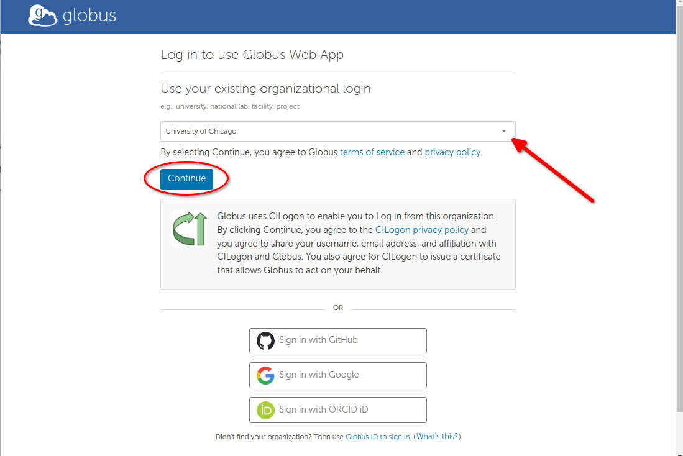
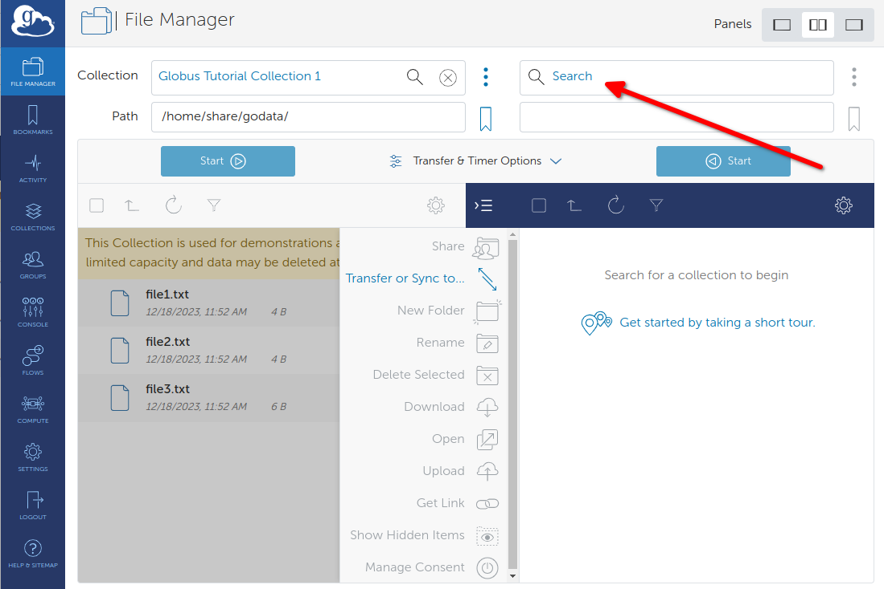
Accessing JLab ifarm Files Remotely
Transferring files:
Globus – standalone software: file transfer system that can be operated from a browser
  Requires CUE login
  Requires software installation in order to transfer files to and from your personal computer
  Works for Mac, Windows, and Linux
  https://jlab.servicenowservices.com/scicomp?id=kb_article&sysparm_article=KB0014843
  https://docs.globus.org/guides/tutorials/manage-files/transfer-files/

Slide 57

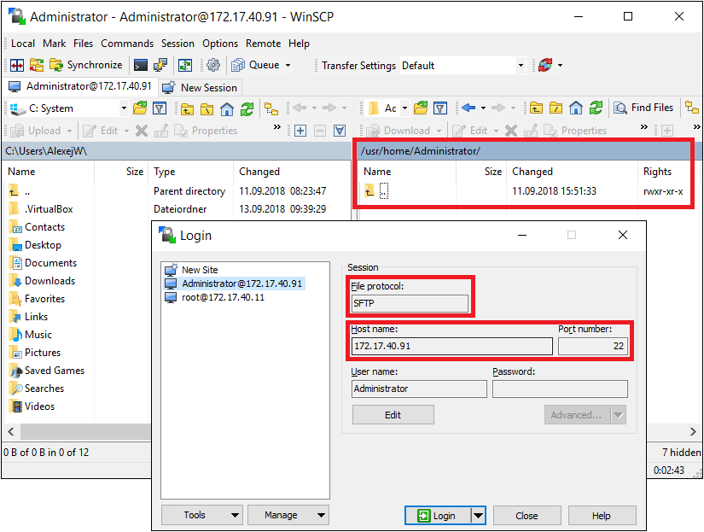
Accessing JLab ifarm Files Remotely
Transferring files:
Windows:
  Download WinSCP: https://winscp.net/eng/index.php
  To tunnel through login.jlab.org and access jlabl1 or ifarm computers
    From your command prompt ("cmd", PowerShell, or WSL)
    Execute: `ssh -L 23:ifarm:22 <username>@login.jlab.org`
  Then open WinSCP to localhost:23 and login with JLab account to ifarm
WinSCP across the login portal from outside JLab network requires​ ProxyJump or SSH port forwarding tunneling
Port "23" here is chosen for convenience, it may be already occupied, in which case chose another unoccupied port
Example WinSCP GUI screenshot
Left is your local computer file tree
Right is the remote computer file tree

Slide 58
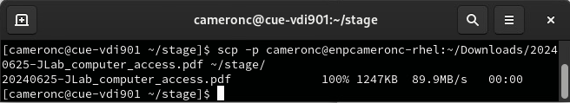
Accessing JLab ifarm Files Remotely
Using Manual ProxyJump though Login portal:
Upload: scp -J <user>@login.jlab.org. file_to_upload <user>@ifarm:/dest/path/
Download: scp -J <user>@login.jlab.org. <user>@ifarm:/file/to/download ./
Transferring files:
From terminals (any Operating System)
Secure Copy Protocol: `scp -rp <files to copy> <destination>`
  "-r" allows recursive copy, meaning all sub-folders and their contents will be copied as well
  "-p" allows preserving permissions and meta-data like date of file creation, etc. when copying (recommended)
  You can copy from the local computer to a remote destination, then:
    <destination> = <username>@<remote host name>:<path on remote computer>
    <path on remote computer> should be something like ~/Downloads/ (where ~ means "my home folder")
    <files to copy> would be the path to the files, or just the file's name if it is in the current directory
  You can copy from a remote computer if you know the exact path, then:
    <files to copy> would be <username>@<remote host name>:<path on remote computer>
  Example: `scp –p cameronc@enpcameronc-rhel:~/Downloads/20240625-JLab_computer_access.pdf ~/stage/`
    ` ` tick marks denote a block of code
    < > brackets denote something you
    should replace with your own choice
    scp through login portal requires
    ProxyJump or tunneling

Slide 59
SSH Passkeys
History and what they are
Why they are useful (intra-network stable password, git authentication, multi-system login uniformity)
How to generate them (multi-system)
How to place them (multi-system, and git)
How to maintain security (permissions, never share private key, unique keys, passwords, authentication notifications)

Slide 60
SSH Passkeys
Key and lock pair, where you generate both and distribute the lock to your systems
  https://blakesmith.me/2010/02/08/understanding-public-key-private-key-concepts.html
  Useful as an intra-network stable password, git authentication (main point for our later hands-on session), and multi-system login uniformity strategy
  Generate them on any system, ideally one unique one for each system
  You must place them on systems you want to access with them
  Utilize the known_hosts system to save some time and improve your security confidence - https://www.baeldung.com/linux/public-key-known_hosts
You must maintain their security
  Verify they have the correct permissions - https://www.tecmint.com/set-ssh-directory-permissions-in-linux/ , https://portal.perforce.com/s/article/6210
    .ssh directory should be 700 (drwx------), The public key (.pub file) should be 644 (-rw-r--r--). The private key (id_rsa) on the client host, and authorized_keys on the server, should be 600 (-rw-------).
  Never share your private key
  Ideally use unique keys for each system, especially unsecured ones
  Use a password on each one (it is possible to have a no-password key pair)
  Pay attention to known_hosts authentication notifications for changed server identities (especially for untrusted remote servers)

Slide 61
Accessing JLab ifarm with SSH Keys
SSH Key Generation: Generate your SSH key
SSH key generation and installation: Linux and Mac (including Windows Subsystem for Linux)
  GitHub guide (useful for github access instructions): https://docs.github.com/en/authentication/connecting-to-github-with-ssh/generating-a-new-ssh-key-and-adding-it-to-the-ssh-agent
  nixCraft guide (preferred): https://www.cyberciti.biz/faq/how-to-set-up-ssh-keys-on-linux-unix/
SSH key generation and installation: Windows ("cmd", PowerShell)
  Microsoft guide: https://learn.microsoft.com/en-us/windows-server/administration/openssh/openssh_keymanagement
  Atlassian guide: https://support.atlassian.com/bitbucket-cloud/docs/set-up-personal-ssh-keys-on-windows/
PuTTY ssh keys in Windows:
  DigitalOcean guide: https://docs.digitalocean.com/products/droplets/how-to/add-ssh-keys/create-with-putty/
Register your key with the ssh-agent: (use ssh-add command: https://support.atlassian.com/bitbucket-cloud/docs/set-up-personal-ssh-keys-on-linux/)
Verify security, utilize chmod, chgrp, ls -lsa, etc., and amend the comment information on the pub-key
  verify you have the correct permissions - https://www.tecmint.com/set-ssh-directory-permissions-in-linux/ , https://portal.perforce.com/s/article/6210
  .ssh directory should be 700 (drwx------), The public key (.pub file) should be 644 (-rw-r--r--). The private key (id_rsa) on the client host, and authorized_keys on the server, should be 600 (-rw-------).
  Always verify the permissions bits before proceeding – 3 digt numbers correspond to read, write, execute access: 1+2+4 = 7
Place .ssh key on the remote server, test a round of ssh and scp/sftp/globus

Slide 62
Shell Scripting
Linux terminals utilize interactive "shell" environments:
There are many acceptable "shells" pre-installed on most linux systems
The Bourne Again Shell "BASH" is most popular
Jefferson Lab scientific computing systems default to the "C" shell, called "tcsh", so called because it is "like" the C language
  Please read the Ubuntu website beginner's guide: https://ubuntu.com/tutorials/command-line-for-beginners#1-overview
  You may find the FreeCodeCamp guide additionally informative: https://www.freecodecamp.org/news/command-line-for-beginners/

Slide 63
Shell Scripting
Linux terminals utilize interactive "shell" environments:
There are many acceptable "shells" pre-installed on most linux systems
The Bourne Again Shell "BASH" is most popular
Jefferson Lab scientific computing systems default to the "C" shell, called "tcsh", so called because it is "like" the C language
Most commands have manuals: type `man <command>` without brackets, to learn more, or `<command> --help` usually works too
Any command accessible from the CLI can also be utilized in the exact same way inside of a script, enabling efficient operations
Shells give access to the file system and many system-wide installed commands, such as:
  cd = change directory, move from one folder to another
  ls = list the contents of the directory
  pwd = state the full path of the current working directory (path working directory = pwd)
  cp = copy the first argument file to the location of the second argument
  mv = move the first argument file to the location of the second argument
  rm = remove, delete the file passed in as an argument (be very careful with this command!)
  ln = create a symbolic link, "shortcut"
  cat = concatenate, display the contents of the file passed as an argument to the screen
  which = give the full path of the location for a command passed as an argument
  echo = print back to the screen, this is useful in scripting for printing results to the screen
  grep = a powerful program for searching text strings for sub-strings, and much more
  ps = list all processes running in this terminal shell session
  top = list all processes running on the computer, with useful information and live updating
  less = like cat, but lets you scroll around and do text searching, like Vim text editor
  tmux and screen = convenient shell session preservation and re-attachment tools
  man = show the manual entry for this command

Slide 64
Shell Scripting
Linux terminals utilize interactive "shell" environments:
There are many acceptable "shells" pre-installed on most linux systems
The Bourne Again Shell "BASH" is most popular
Jefferson Lab scientific computing systems default to the "C" shell, called "tcsh", so called because it is "like" the C language
Shells give access to the file system and many system-wide installed commands
Now, login to the JLab ifarm to proceed to practice using text editors
  ssh to through the login.jlab.org portal, then on to ifarm
  Find your group's work folder and make yourself a sub-directory:
    `cd /work/<group name>/`
    `mkdir <my username>` (no < > brackets)
    `cd <my username>`
    `touch helloworld.txt`
    `<editor> helloworld.txt` where <editor> = vim, gedit, or emacs as you prefer – described on the follow slides

Slide 65
Text Editors
Text Editors – Vim vs. Gedit vs. Emacs:
StackShare has a guide to the three and their differences: https://stackshare.io/stackups/emacs-vs-gedit-vs-vim
Vim (my preferred): https://thevaluable.dev/vim-commands-beginner/ - Or just type the `vimtutor` command at the terminal!
Gedit: https://help.gnome.org/users/gedit/stable/index.html.en
Emacs: http://www.jesshamrick.com/2012/09/10/absolute-beginners-guide-to-emacs/
Learn about the three of them (or throw in nano as a fourth option) and pick the one you would like to learn
  This is a personal choice
  You can stick to GUI based Integrated Development Environments (IDE's) line Eclipse or VSCode if you chose
  However, knowing how to use one of these is critical
  Just in case you need to access a system with no GUI or software installation capabilities or need to quickly edit code

Slide 66
Environment Setup
Setting up your shell environment:
There is a "rc" = "run commands" file for each kind of shell
  tcsh uses ~/.tcshrc
  They are executed at each new shell open, new terminal, or new remote login
  They can be relied upon, along with a ~/.login file and other more niche configuration files, to set up your environment
For the JLab ifarm: to successful set up a user environment that gives access to ROOT and Geant4
  Load modules stored in the /cvmfs system
  /cvmfs is the CernVM File System, which gives global access to scientific collaborations to scientific computing software
  Edit your .tcshrc on the jlabl1 or ifarm server to contain, at the bottom:
  set hostnamex="`hostname`"
  if ( $hostnamex =~ *'farm'* ) then
  module use /cvmfs/oasis.opensciencegrid.org/jlab/scicomp/sw/el9/modulefiles
  module load root
  endif
Once satisfactorily set up – next few slides: execute the every 45th line scripts on the lorem.txt (or your own .txt file)

Slide 67
Basic Scripting Example
Scripting in Linux allows for complex chains of shell commands to accomplish your goals
Let's work on an example to learn the basics of using Bash, tcsh, Python, and ROOT on the JLab scientific computing systems
Go to your "work" folder: `cd /work/<group name>/<my username>`
Bash – parse an example text, skip lines and print each 45th line to the screen
Open a blank text file print_first_and_every_45th.sh with your text editor
Paste in the following bash code
#!/bin/bash
# Check if a file was provided as an argument
if [ "$#" -ne 1 ]; then
echo "Usage: $0 filename"
exit 1
fi
# File to read
file=$1
# Check if the file exists
if [ ! -f "$file" ]; then
echo "File not found!"
exit 1
fi
# Counter for lines
count=1
# Read the file line by line
while IFS= read -r line
do
# Check if the current line number is the first line or every 46th line thereafter
if [ $(( (count - 1) % 45 )) -eq 0 ]; then
echo "$line"
fi
# Increment the counter
count=$((count + 1))
done < "$file"
chmod +x print_first_and_every_45th.sh
./print_first_and_every_45th.sh yourfile.txt
To generate a text file to parse, first execute the following (from the ifarm or your local computer, depending on vim version number):
cat /usr/share/vim/vim82/tutor/tutor >> yourfile.txt

Slide 68
Basic Scripting Example
Scripting in Linux allows for complex chains of shell commands to accomplish your goals
Let's work on an example to learn the basics of using Bash, tcsh, Python, and ROOT on the JLab scientific computing systems
Go to your "work" folder: `cd /work/<group name>/<my username>`
tcsh – parse an example text, skip lines and print each 45th line to the screen
Open a blank text file print_first_and_every_45th.tcsh with your text editor
Paste in the following tcsh code
#!/bin/tcsh
# Check if a file was provided as an argument
if ( $#argv != 1 ) then
echo "Usage: $0 filename"
exit 1
endif
# File to read
set file = $argv[1]
# Check if the file exists
if ( ! -f $file ) then
echo "File not found!"
exit 1
endif
# Counter for lines
set count = 1
# Read the file line by line
foreach line ( `cat $file` )
# Check if the current line number is the first line or every 46th line thereafter
if ( ( $count - 1 ) % 45 == 0 ) then
echo $line
endif
# Increment the counter
@ count++
end
chmod +x print_first_and_every_45th.tcsh
./print_first_and_every_45th.tcsh yourfile.txt

Slide 69
Basic Scripting Example
Scripting in Linux allows for complex chains of shell commands to accomplish your goals
Let's work on an example to learn the basics of using Bash, tcsh, Python, and ROOT on the JLab scientific computing systems
Go to your "work" folder: `cd /work/<group name>/<my username>`
Python – parse an example text, skip lines and print each 45th line to the screen
Open a blank text file print_first_and_every_45th.py with your text editor
Paste in the following python code
import sys
def print_first_and_every_45th_line(filename):
try:
with open(filename, 'r') as file:
for count, line in enumerate(file, start=1):
if (count - 1) % 45 == 0:
print(line.strip())
except FileNotFoundError:
print(f"File {filename} not found!")
if __name__ == "__main__":
if len(sys.argv) != 2:
print(f"Usage: {sys.argv[0]} filename")
sys.exit(1)
filename = sys.argv[1]
print_first_and_every_45th_line(filename)
python print_first_and_every_45th.py yourfile.txt

Slide 70
Basic Scripting Example
Scripting in Linux allows for complex chains of shell commands to accomplish your goals
Let's work on an example to learn the basics of using Bash, tcsh, Python, and ROOT on the JLab scientific computing systems
Go to your "work" folder: `cd /work/<group name>/<my username>`
ROOT (interpretted C++) – parse example text, skip lines and print each 45th line to the screen
Open a blank text file printFirstAndEvery45th.C with your text editor
Paste in the following ROOT C code
#include <iostream>
#include <fstream>
#include <string>
int printFirstAndEvery45th(const char* filename) {
std::ifstream file(filename);
if (!file.is_open()) {
std::cerr << "File not found!" << std::endl;
return 0;
}
std::string line;
int count = 1;
while (std::getline(file, line)) {
if ((count - 1) % 45 == 0) {
std::cout << line << std::endl;
}
count++;
}
file.close();
return 1;
}
root -l 'printFirstAndEvery45th.C("yourfile.txt")'

Slide 71
Hands-On: Scripting/Software & Git
Access High Performance Computing (HPC) Cluster
Set up scientific computing software on Linux systems
Run physics experiments, simulations, and data analysis
This section

Slide 72
Scripting/Software and Git
Hands-On Exercises to master:
Clone a software repository
Set up your user information in your git configuration
Set up ROOT module from CVMFS
Practice executing scripts in bash, tcsh, python, and ROOT
Try to debug the tcsh script problem
Either create your own branch with the bugfix or checkout the bugfix-tcsh branch
Fork the repository to your personal code.jlab.org account
Create a pull-request in your personal account for the bugfix-tcsh branch
Approve the PR and merge

Slide 73
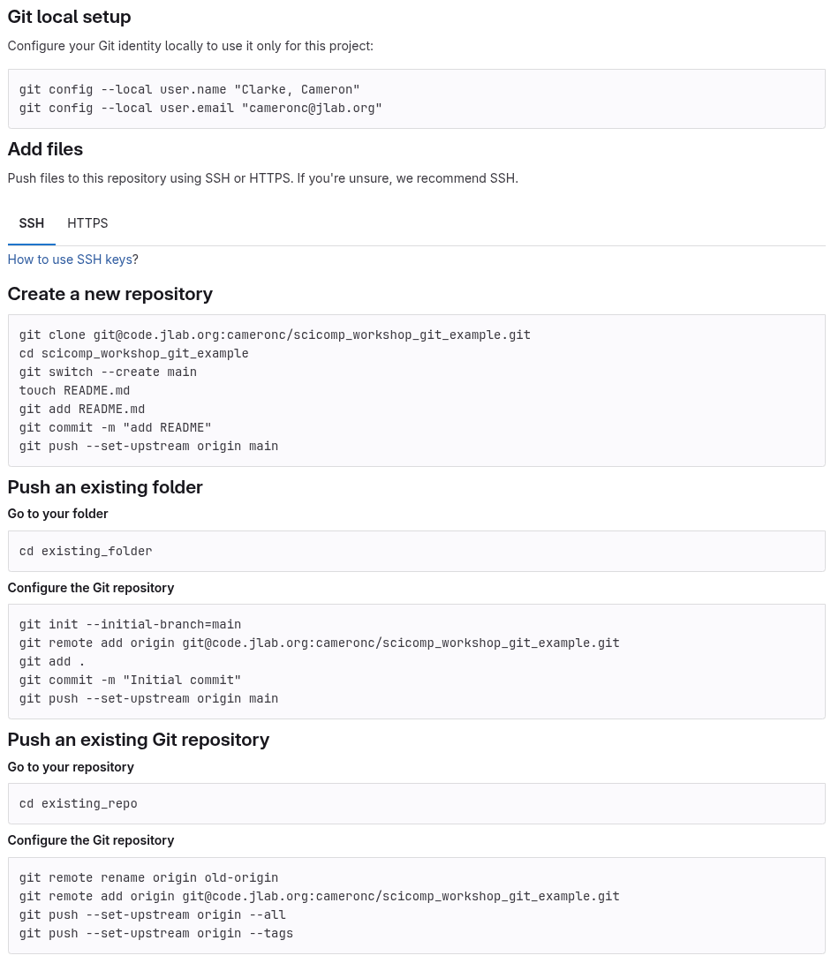
Typical Git Version Control Example
Code.jlab.org repo-creation instructions
You can create an empty new repository
You can create a repository on your computer and push it into code.jlab.org ("Push an Existing Folder")
  We will use this later, plus creating an empty repository on code.jlab.org, to hold the results of your "fork"
Can clone an existing repository and push it to your personal space (manual "Forking")
You can also do these actions from the code.jlab.org website interface (sometimes takes more effort)
Note: Web interface enables CD/CI tools (commits, PRs, etc.)
Assignment: Clone my example repo with every-45th line parsing scripts in it
First set up your ssh key on code.jlab.org, following these instructions: https://docs.gitlab.com/user/ssh/#add-an-ssh-key-to-your-gitlab-account
Execute git clone command (easiest approach):
`git clone git@code.jlab.org:cameronc/SciComp_Workshop_Git_Example`

Slide 74
Typical Git Version Control Example
To create a local blank repository:
$ git init
$ cat "Hello World" >> README.md
$ git add README.md
$ git commit -m "initial commit"
To turn an existing project into a remote git repository:
Do the same steps above for creating a local repository, then attach it to a remote host like Gitlab as follows:
Create an empty repository on Gitlab: fill out information on https://github.com/new with <reponame>
$ git remote add origin git@code.jlab.org:<username or organization name>/<reponame>.git
$ git remote –v (verify)
$ git branch –a (to find default initial branch-name, can be changed with `git branch -m <branch-name> <new branch-name>`)
$ git config --global user.name <username>
$ git config --global user.email <email>
$ git push --set-upstream origin <branch-name>
$ git remote show origin (verify)
To clone (download) an existing remote git repository:
$ git clone git@code.jlab.org:<username or organization name>/<reponame>.git
Before pushing or pulling any commits to/from a remote repository, set up your git ssh key config first:
Github: https://docs.github.com/en/authentication/connecting-to-github-with-ssh/adding-a-new-ssh-key-to-your-github-account
Gitlab: https://docs.gitlab.com/ee/user/ssh.html (This is what code.jlab.org runs)
More intro to Git: https://www.atlassian.com/git/tutorials/setting-up-a-repository

Slide 75
Typical Git Version Control Example
Example sequence of commands to check git configuration and safely commit changes:
git remote show origin (verify your local repository is connected to the remote you think it should be)
git branch -a
git fetch
git pull --ff-only (use this to avoid unwanted merge conflicts and better monitor recent remote changes)
git checkout -b <new branch name here>
git status (can also pass the folder of file of interest as an argument to simplify outputs)
git log -N (N = number of recent commit logs to read)
git diff [some local file that has changes]
git blame [some local file you want change history of]
git add [some local file that has changes you want to push]
git commit --author=[your git remote server username]
git push -u [origin name] [your branch name] (the origin names – typically “origin” or “remote” - are set in .git/config)
Additional challenges to plan to address before using Git to contribute to a project include:
Using the right branch and managing issues and pull requests with collaborators
Setting up username and password settings for remote git server access
Resolving push/pull/merge conflicts
Writing good commit messages

Slide 76
Accessing Shared Software
Shared software can reside in many places
  /group/ disks
  /mss/ tapes
  More recently: CVMFS (CernVM File System)
Load ROOT from CVMFS
  From the command line, execute:
    module use /cvmfs/oasis.opensciencegrid.org/jlab/scicomp/sw/el9/modulefiles
    module load root
  Or, add that line to your .tcshrc file (in ~/ your home folder, use `ls –lsa` to see the "hidden" . files)
  set hostnamex="`hostname`"
  if ( $hostnamex =~ *'farm'* ) then
  module use /cvmfs/oasis.opensciencegrid.org/jlab/scicomp/sw/el9/modulefiles
  module load root
  endif

Slide 77
Scripting
Execute the scripts from the Git Repo you cloned earlier
  Simply type ./<script name> <filename> for .sh and .tcsh (bash and C-shell scripts)
  Use `python3` to run the .py python scripts, also with <filename> as an argument
  Use `root –l –b –q <script name>.C'("<filename>")' ` to execute ROOT scripts
Identify the bug (with the tcsh script)
Try to debug it
Create your own branch with your bug fixes, or `git checkout` the bugfix-tcsh branch
Fork the repository to your personal account
  (Or you can create an empty repository and push it there, as in the prior example)
Create a Pull Request on the code.jlab.org website (personal repository) and approve

Slide 78
JLab Scientific Computing Access
Access High Performance Computing (HPC) Cluster
Set up scientific computing software on Linux systems
Run physics experiments, simulations, and data analysis
Feel free to ask any follow up questions: cameronc@jlab.org
Tomorrow

Slide 79
Outline
Different ways of using the farm - VNC, ssh, VDI, VSCode, etc, Introduce scp, sftp, globus
Walk people through accessing the farm and making their own work directory
  Navigating the farm using Linux commands
  Make sure people can use at least the following commands
  Proxy jump
  Help people set up globus or scp or sftp
  If time, make git ssh key
    Sanitation permissions, gitlab intro, etc.
Git repo on your work directory, make changes and pull request, execute script
  Git basics! Clone repository to your work directory, Edit a script or text file within the cloned repository, Add, commit, push change to the forked repo, Create a pull request for the change
Load some basic modules, CVMFS
  Write a “Hello World!” script and execute it - use ROOT/C++, Building software and debugging

