Slide 1
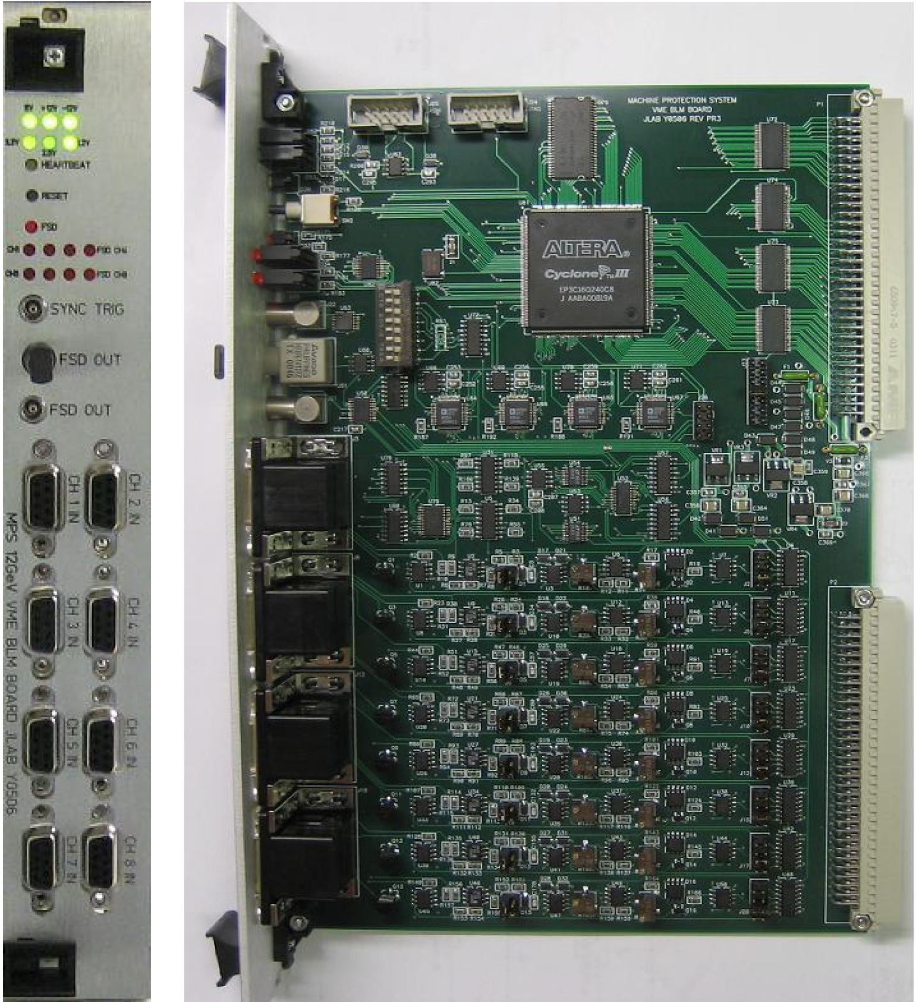
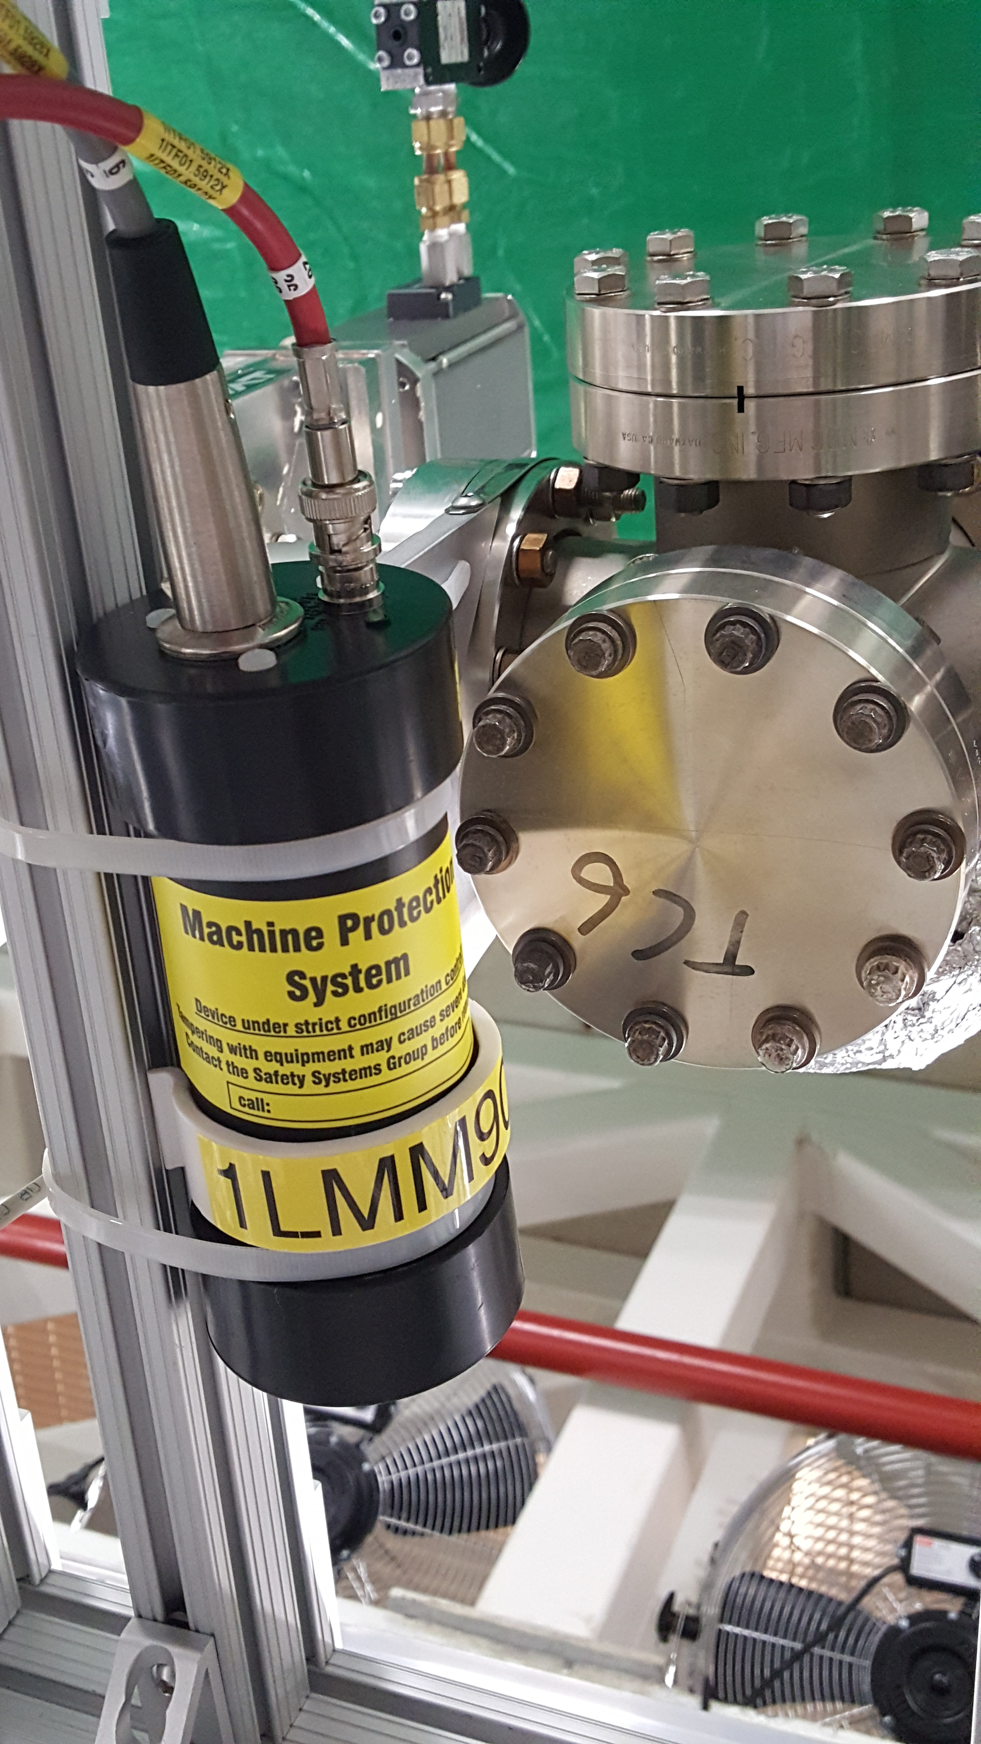
BLM Workshop 2025
BLM Specification & Calibration
J. Kowal

Slide 2
Beam Loss Monitoring - Concerns
Equipment protection
Low level ~ 1kW
Leads to activation (ALARA)
Heats up beam components
Acute
> 1kW
Component damage
Burn Through (limit ~25,000 µA- µs)
High current – fast <100 µs
Low current – slower
Beam Tuning
Beam Quality
Diagnostics

Slide 3
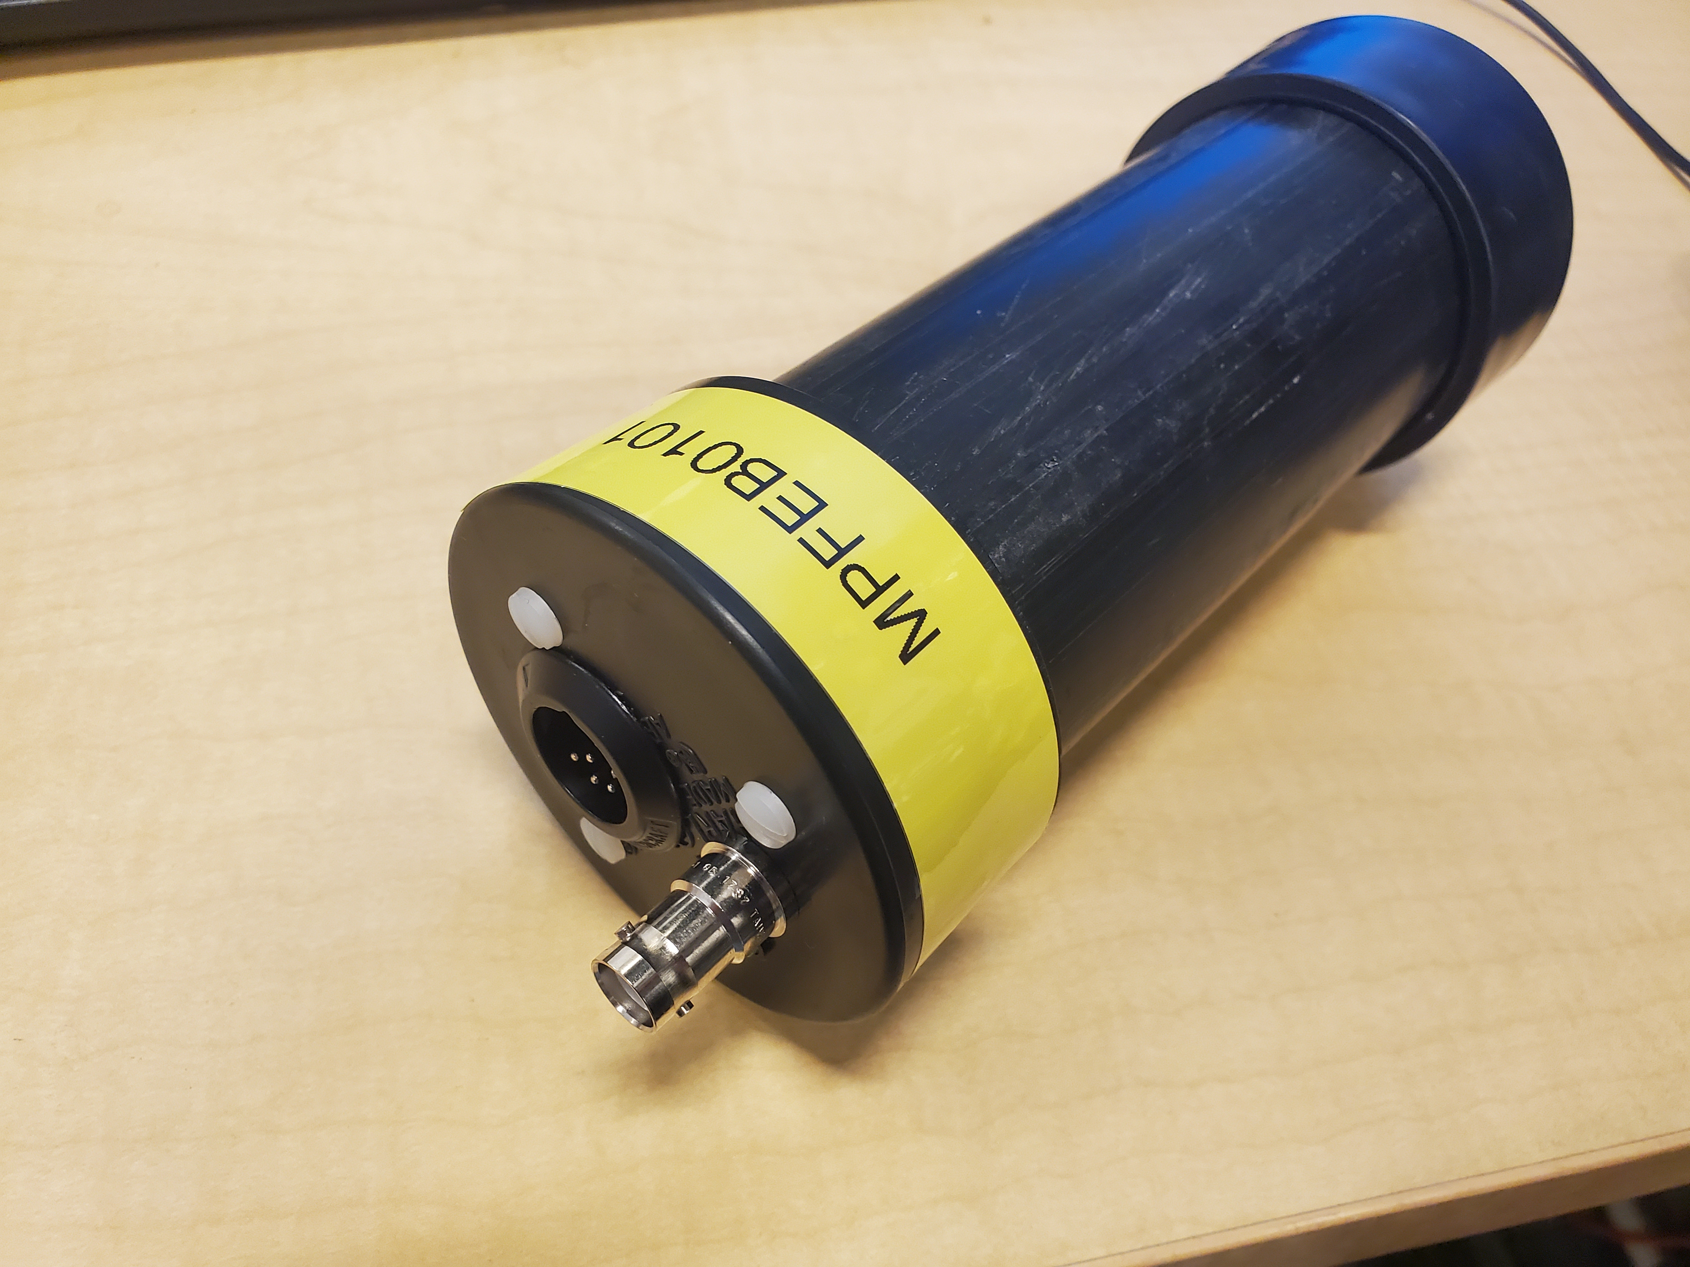
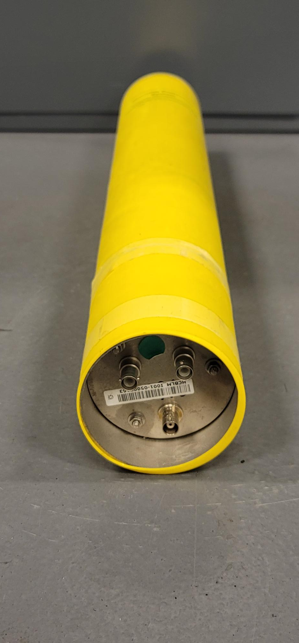
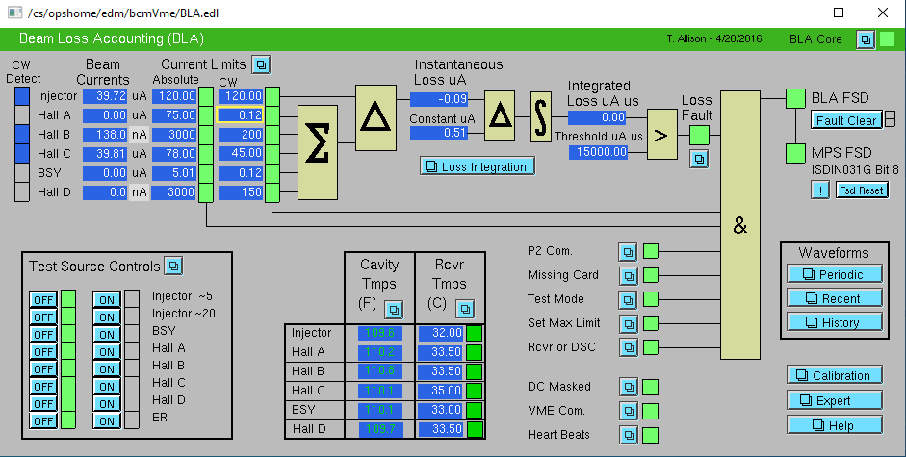
Beam Loss Monitoring - Introduction
BLM – wider meaning
A collection of different systems designed to detect beam loss in the accelerator
PMT based detectors and dedicated interface boards (referred to as ‘BLM’)
Ion Chamber based detectors and dedicated interface boards (BLIC)
Beam Loss Accounting (BLA) system (differential current measurement source/destination)
Detectors
Individual channels configurable as Diagnostic or MPS
PMT based - Diagnostic (103), MPS (68)
Ion Chambers - based Diagnostic (0), MPS (20)
MPS types connected to FSD network

Slide 4
Beam Loss Monitoring - Specification
TN92-046 Sinclair, Time Response Requirements for the BLM/FSD System
Methodology
Calculate power deposited in the material under worst case scenario
Demonstrate that heat radiation cannot prevent material melting
Calculate time to material melting point
Demonstrate that in this time (very short) conductive cooling is ineffective
Beam parameters
200 µA CW
100 µ beam diameter
Thin stainless steel bellows (0.015 cm)
Power deposition 40.2 W (~ 0.5 MW/cm²)
Temperature rise 5760 °K (melting point SS 1700 °K, radiation only)
Assessed melting time ~100 µs

Slide 5
Beam Loss Monitoring - Specification
Note’s conclusions:
Given that basic time scale of concern is 100 µsec, we should require that the BLM/FSD system respond in a time safely less than this number. A response time of 50 µsec is a realistic and conservative design goal, and will provide some margin for uncertainties such as non-uniform beam profiles, burn through temperatures somewhat lower than the melting temperature, and the possibility that the beam spot might be smaller than 100 µ in diameter. The lower limit for the response time is given by the fact that in principle, beam could persist for 20 µsec after a beam loss was detected.
FSD/BLM response time requirements
21 µs stored beam
10 µs detection time (faster on FPGA based cards)
10 µs logic functions (faster on FPGA based cards)
4 µs FSD propagation (~3 µs for 5 levels)
= 45 µs total time to detect and extinguish beam
11 µs to extinguish beam (TMG – laser table)

Slide 6
Beam Loss Monitoring - Specification
TN94-024 Sinclair, Beam Loss Monitor Performance Requirements
Methodology
Min. melt through time for Niobium 128µs
Beam current 200µA
Integrated beam current 25600 µA-µs (128µs * 200µA)
BLM trip threshold set at 2500 µA-µs (~10% of 25600 µA-µs)
Validating specs
FSD response 50µs (from TN92-046)
Beam current 200µA
Integrated beam current 10000 µA-µs (50µs * 200µA)
BLM trip threshold set at 2500 µA-µs
Total integrated beam current 12500 µA-µs (less than 50% of 25600 µA-µs)

Slide 7
Beam Loss Monitoring - Calibration
Process:
Utilizes Tune Beam set to specific safe parameters (pulse width and current),
Requires missteering of the beam to create radiation around protected component/location,
Sensitivity set by adjustment of the PMT high voltage,
Functional calibration based on observation of system response,
Used for low beam energy levels <GeV, typically in the Injector segment,
Subjective method but still relies on the built in characteristics of the on-board integrator,
Calibration based on measurements of response signal level,
Used for higher beam energy levels >MeV,
Measurement requires use of the scope in the field,
Difficulties:
Requires beam time,
Time consuming, 69 MPS BLMs x 20-30min = 20-35hrs,
Requires “pairing” of each BLM with dedicated electromagnet used for calibration,
“Pairing” limits tested beam loss scenarios,
Requires missteering beam in all directions to find the least sensitive direction,
BLM placement and orientation as well as set up critical for effective protection,

Slide 8
Beam Loss Monitoring – Calibration Improvements
Review placement of the BLMs in the field,
Identify electromagnets suitable for calibration for each of the BLMs,
Create list of “paired” BLMs and electromagnets,
Automate the calibration process through the EPICS script(s):
Find lowest beam loss signature (direction of loss in which peak signal value is lowest),
Find minimal HV level for each BLM at which that channel trips,
Eliminate the use of the oscilloscope with the modified BLM card firmware/hardware:
Solution available only for VME cards (presently only one MPS card needs upgrade),
Back-calculate the linear signal of each channel for signal level evaluation (replaces scope),
Provide new tools for signal analysis,
If not possible to implement in FPGA, then modify hardware and implement above:
More powerful FPGA,
Direct Linear signal readback into FPGA,

Slide 9
Beam Loss Monitoring – Charge Questions
BLM system specifications
Are specifications appropriate to prevent damage, activation?
Burn-through calculations for worst case scenario (thin bellows)
Assumed 200µA beam but in the Linacs up to 375µA
Burn-through time for 6 GeV ~100µs but for 12 GeV down to ~60µs
Is beam spot assumption correct?
Do we need new assessment?
Do we understand impact of losses (damage, activation) sufficiently well?
Jay & Kitty’s effort to analyze beam loss scenarios around the machine
Jay & Kitty’s effort to compile critical beamline components requiring protection
Didn’t model beam loss for critical components
Activation was never a primary concern for design of the BLM system

Slide 10
Beam Loss Monitoring – Charge Questions
Calibration procedure
Are our calibration procedures appropriate (not too lax or conservative)
Might be too conservative
Sensitivity (HV level) set for direction with lowest radiation signature but is it a most probable direction of beam loss?
Available correctors might not be suitable for simulation of realistic beam loss (too low signature) resulting in higher sensitivity setting (HV level) than necessary
There is no consideration for overall increase in background radiation around the machine. Should we use BIAS setting to reduce background effect? Do we need to change electronics?
Different categories of protected devices
Critical components – more frequent setup, better analysis, understanding, placement…..
Wide area loss (typically in the arcs) – less critical, general protection
Diagnostic – no calibration needed but assure consistent and matched performance around the machine

Slide 11
Beam Loss Monitoring
Questions?

Slide 12
BLM Capabilities
Local and directional (needs PMT angle) detection of beam loss,
High sensitivity (beam loss <<0.1uA) adjustable by PMT high voltage,
Fast response << 1 us,
Configurable function of individual channels:
MPS using integrating amplifier (trip set at 15,000 uA-us loss),
Diagnostic using logarithmic amplifier,
Linear signal available on the DSUB-9 connector (not available to FPGA now),
Glass of the PMT tubes darkens with high exposure leading to sensitivity reduction,
PMT noise level can be reduced through Dark Aging,
Safe calibration with use of Tune Beam,
Low cost ~ $600 per channel,
Deployment flexibility,

Slide 13
BLM Diagnostics and Testing
Monitoring
HV and Card setpoints stored in and updated from CED,
PMT HV setpoint verification via Alarm Handler,
PMT HV readback verification via Alarm Handler,
High Voltage PS faults via FSD,
BLM card faults via FSD,
Built-in test functions
Card test of the front-end electronics with signal injection,
Performed always during cards commissioning and repairs,
Performed as need for hardware function verification in the field,
Detector response test with remotely controlled built-in LED,
Performed always during HCO,
Performed for troubleshooting purposes as needed,

Slide 14
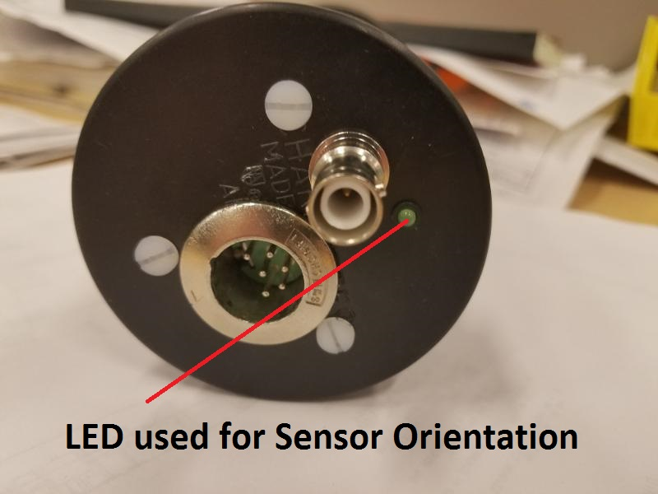
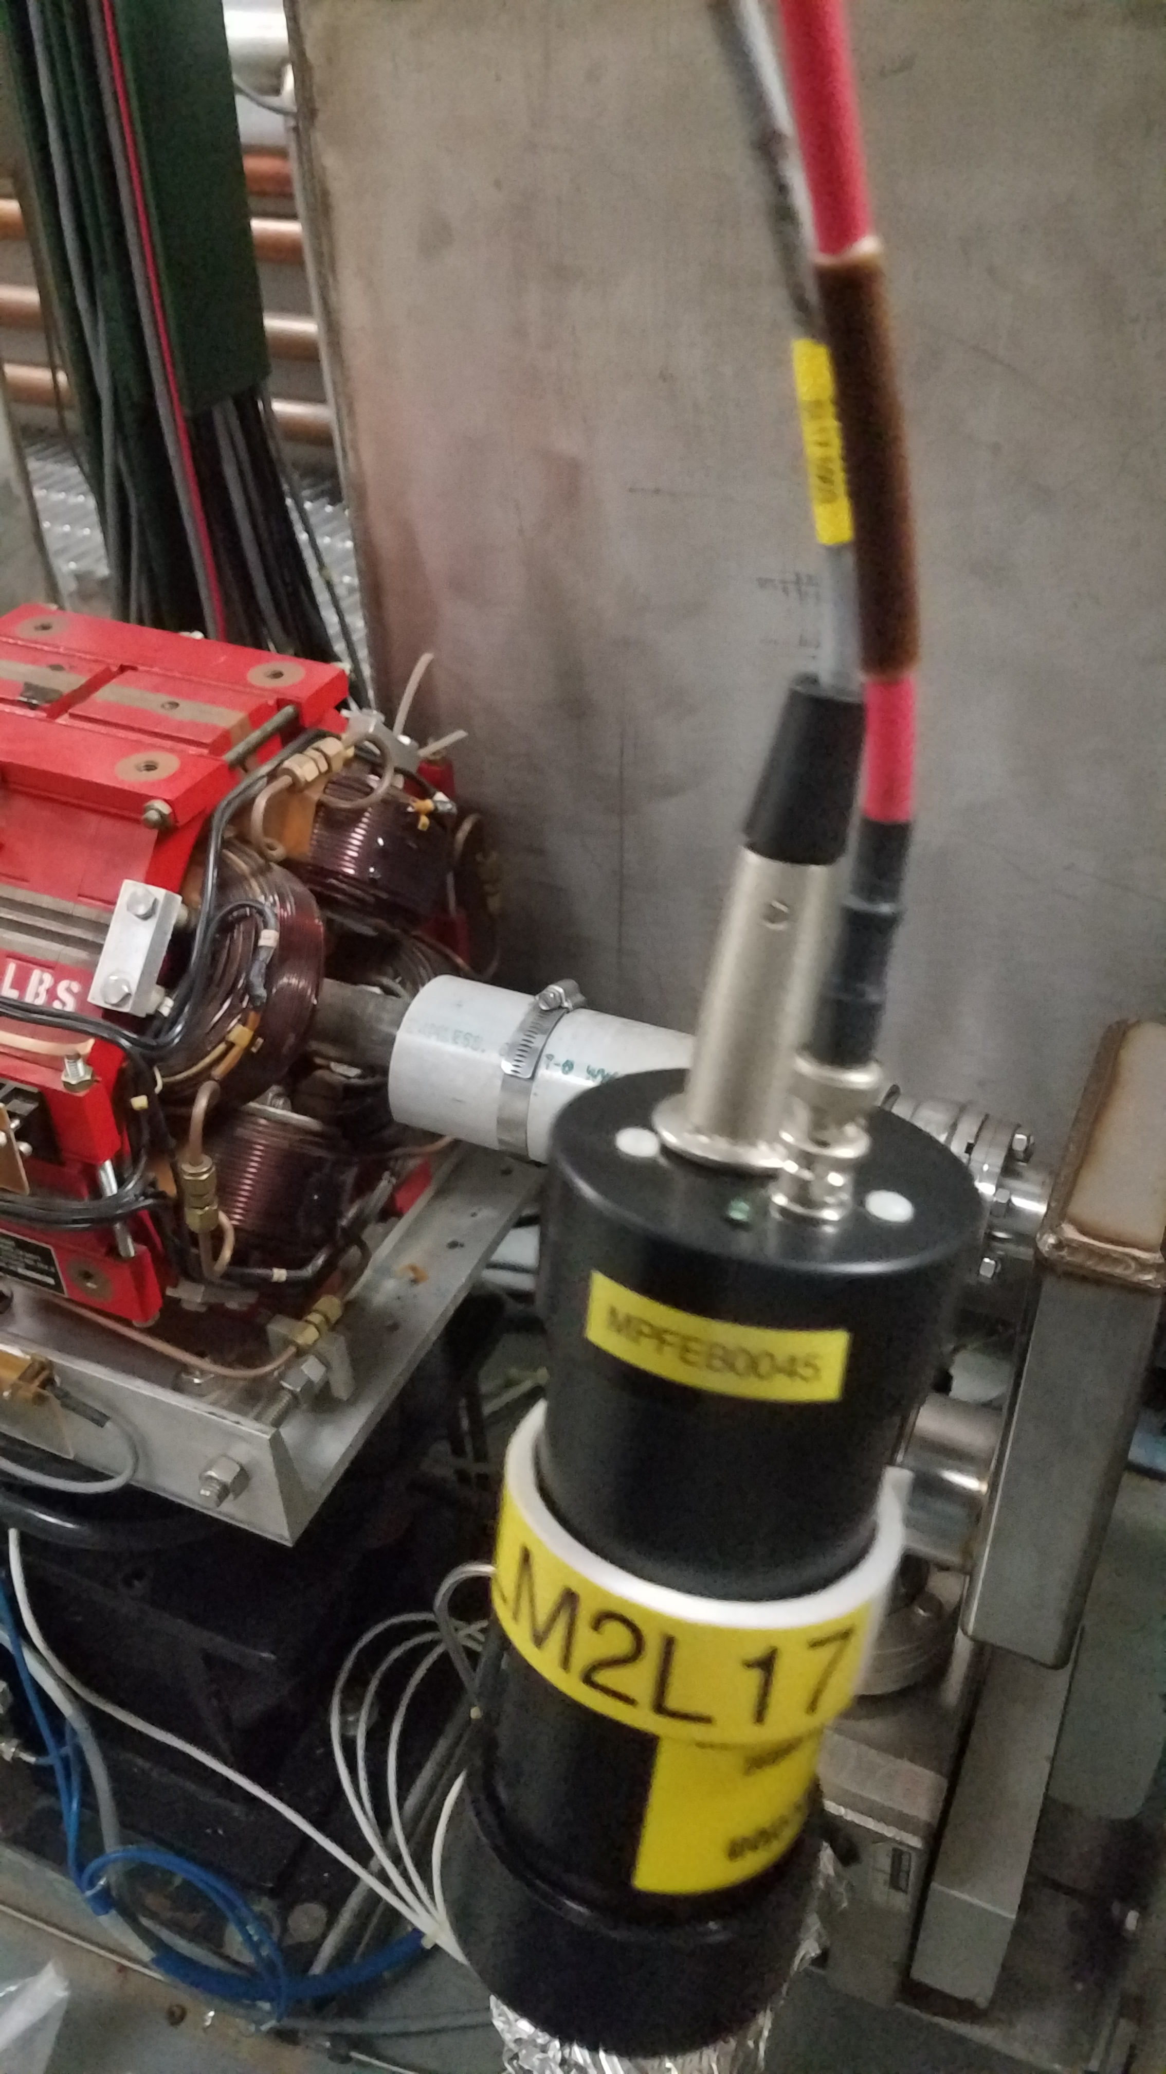
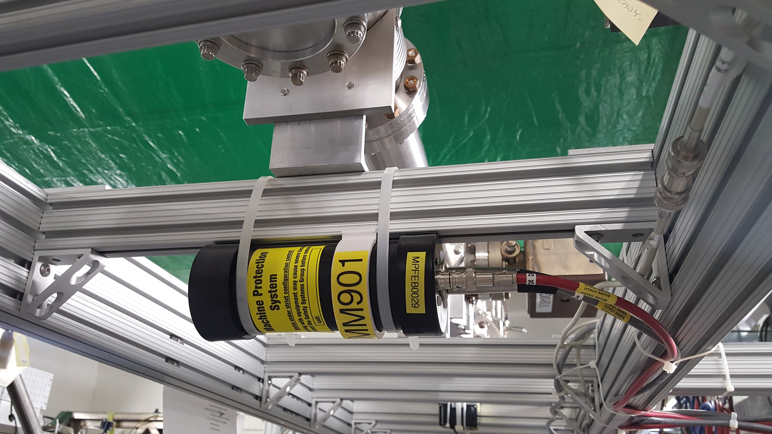
Bonus Slides
Typical BLM detector placement

Slide 15
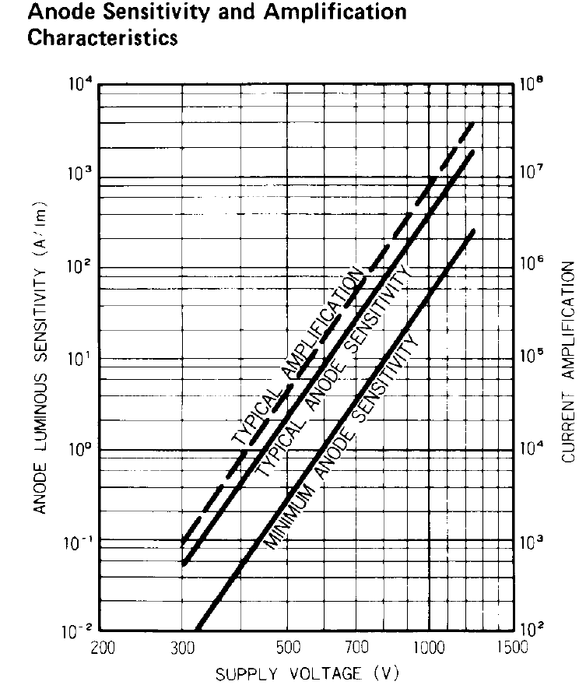
Bonus Slides
Voltage/Current Curve

