Slide 1
CEBAF beam loss, causes and remedies
Yves R. Roblin

Slide 2
Scope
Beam Loss mechanisms contributing to downtime
What do we know ? (i.e analysis, evidence, radiation maps)
What do we do not know
What do we need to know
Specific beam transport issues contributing to beam losses

Slide 3
Beam loss mechanisms ?
Transverse mismatches at high beta locations
Longitudinal mismatches at dispersive points
Chromatic effects/ beam off momentum
Synchrotron rad effects
Field Emission from SRF cavities
RF instabilities

Slide 4
Review of past radiation surveys with high CW beam
From 2021 to 2024, as high as 150 uamps CW (1pass) to Hall A.
Link to the document here.
Most hotspots are at the following locations:
Extraction YA,YR. ->
dispersive location in arcs ( e.g 6A03,1A21,etc..) -
Dogleg (a few instances)
Lambertson entrance and downstream of it
Linac (vast majority of hot spots)
Need to:
Review extraction procedures, alignment of magnets and bpm offsets.
Make use of diagnostic blms in arcs to reduce loss in dispersive locations, check gangphase and longitudinal beam optics.

Slide 5
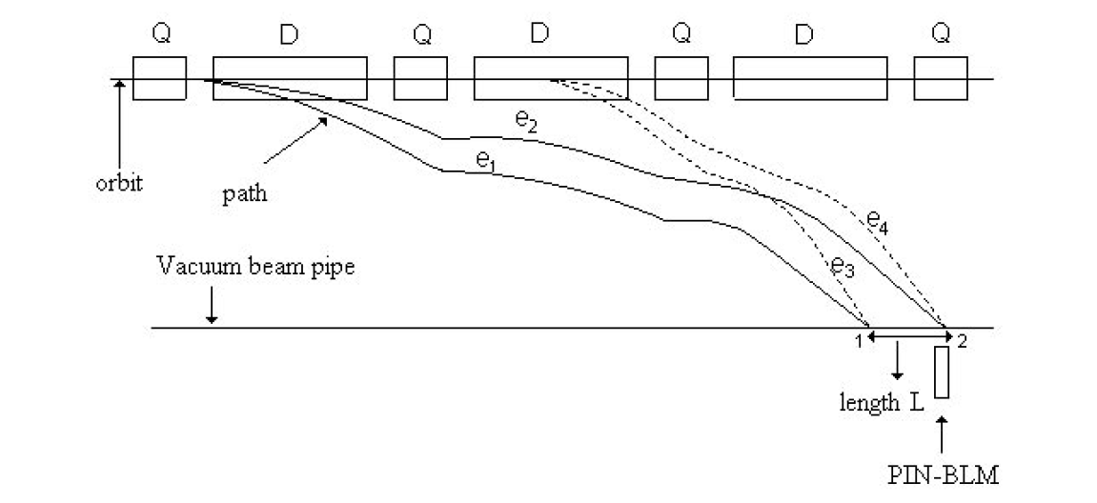
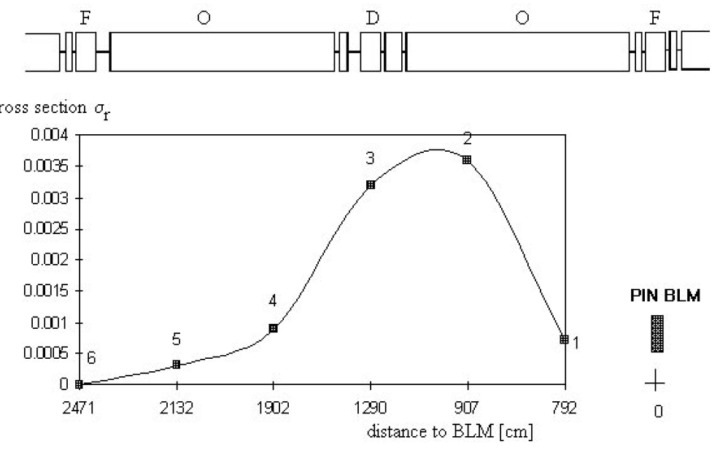
Effect of momentum error in ARC fodo lattices
EXPERIENCE WITH THE ELECTRON AND PROTON BEAM LOSS
MONITOR (BLM) SYSTEMS AT HERA, K .Wittenburg et al, IPAC 96
We see similar issues in our machine when energy is wrong (bad pathlength, initial setup, RF excursion, excessive RF kick from FOPT/30hz, etc..).
The optimal BLM location should be optimized and where to place it depends on the lattice and usually is not near what we want to protect.

Slide 6
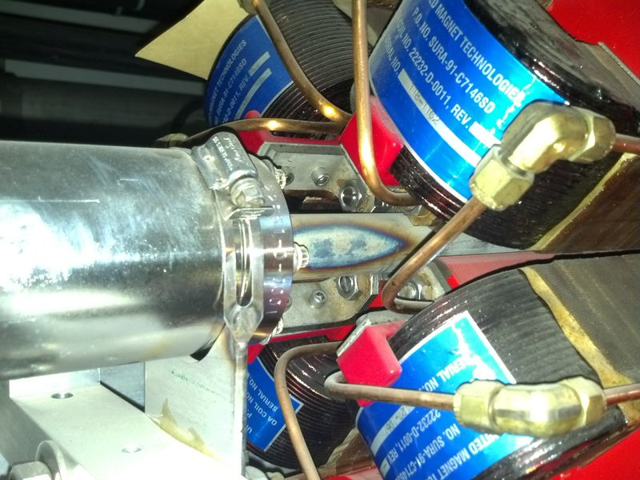
Suboptimal placement of BLMs
ILM6A31 (Diag BLM) is 2 arcs above, likely shielded from anything coming from ARC6.
Burn mark at 6A25
Need a review for location of all the BLMS.

Slide 7
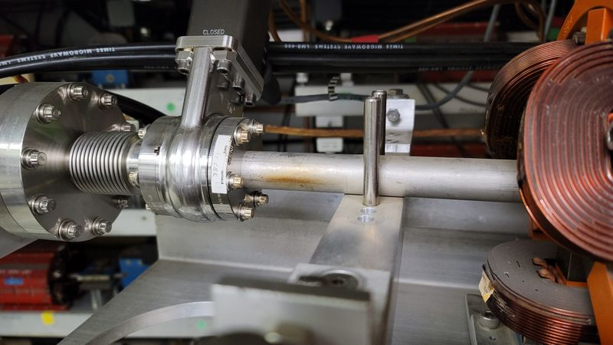
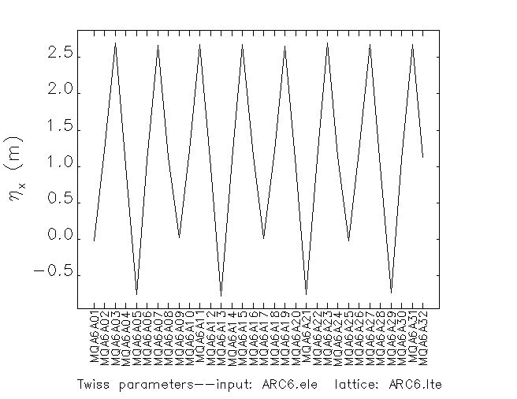
Energy tail at dispersive locations
Burn mark at 6A03
We also see that in the halls, specifically, HALLA at the Compton chicane.
Do we have adequate BLM coverage? Where would it needs to be ?
Use longitudinal diagnostics to assess beam quality.

Slide 8
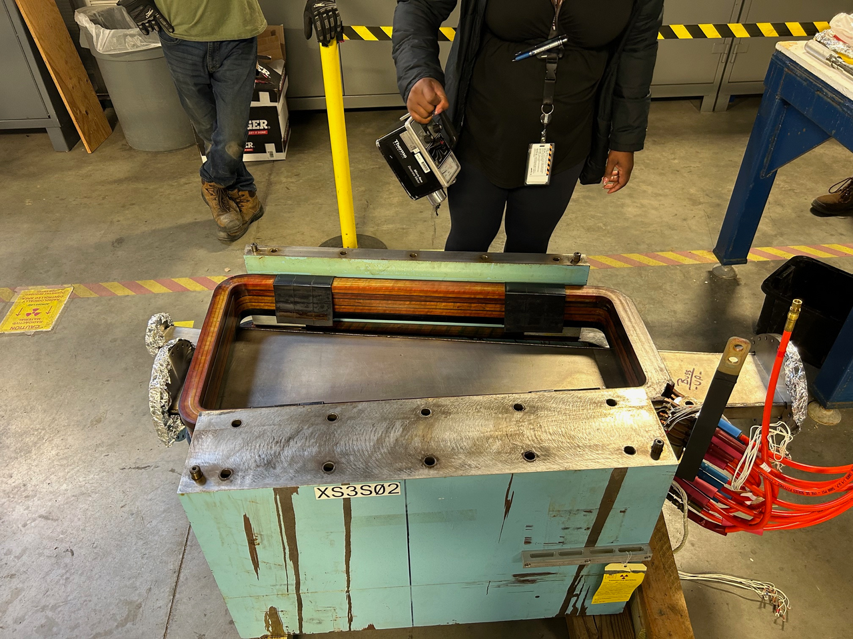
Synchrotron radiation fan in spreaders/recombiners
This is consistent with a synchrotron radiation fan with beam bending up.
Implication as to where we need to place BLMS. We also can compare with the diagnostic IDX.

Slide 9
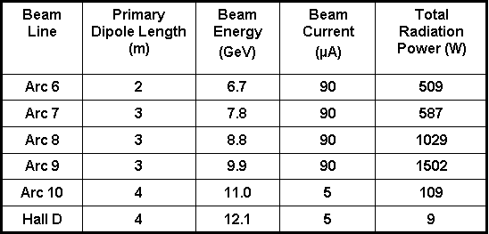
Beam loss due to vacuum degradation
If the vacuum degrades, e- beam or synchrotron radiation photons can interact with gas and produce losses.
Effect will be most prevalent in ARC9 where load is highest.

Slide 10
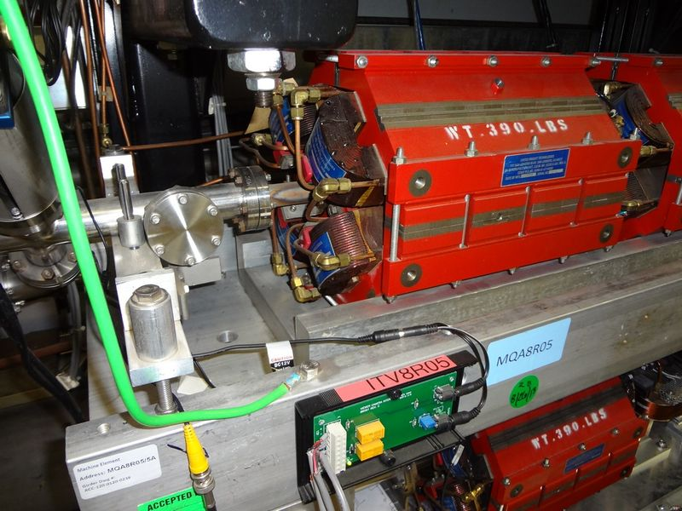
Matching errors at high beta locations
Often manifests itself in upper arcs/linacs. This is due to the nature of the optics. Linac focusing becomes nil at the higher passes and small focusing errors at end of recombiners generate large error to the next arc. Symptom is beam loss at 7S, 8E BLMS.
We have IDX detectors on the extraction side (E region).
There is an opportunity to cross-correlate with the BLMS.
e.G see utility of IIXs and NDXs | Jefferson Lab Electronic Logbook

Slide 11
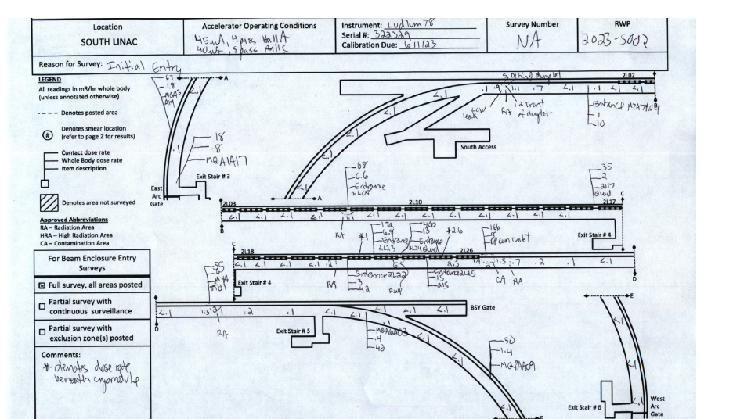
Beam loss patterns
MQA1A17
FE
MYA8T01.
2/6/23
MQA6A03
MQPAA09

Slide 12
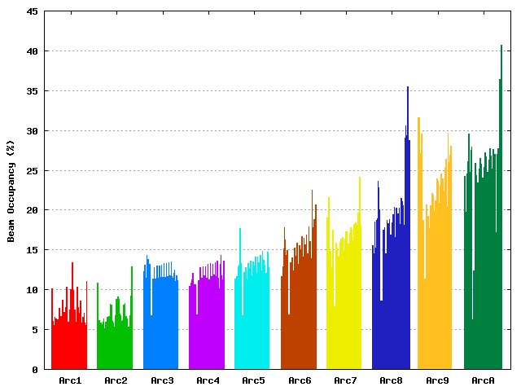
Beam occupancy 12GeV specs
Max allowed was 50 %.
$$Occupancy=\frac{4σ+0.001}{0.02}$$
Likely can go higher with positron beam
12GeV Lehman review in 2005

Slide 13
Size at extraction corners
Beam is about 5mm from nose. So, clearance is up to 10 sigmas. We know from experience that extracting in ARCA with a e- beam bigger than 600 microns (around 8 sigmas) shows signs of beam loss.
Review extraction procedures and adequacy of diagnostics. Correlate with the IDX detectors.

Slide 14
Field emission from SRF cavities
Often seen at the end of the NL and SL. We have new NDX detectors allowing for optimization of the cavity gradients to reduce it.
How much does this affect the 1S00,3S00,7S00 etc.. blms ?
A systematic study of NDX/IDX versus BLM should be performed.

Slide 15
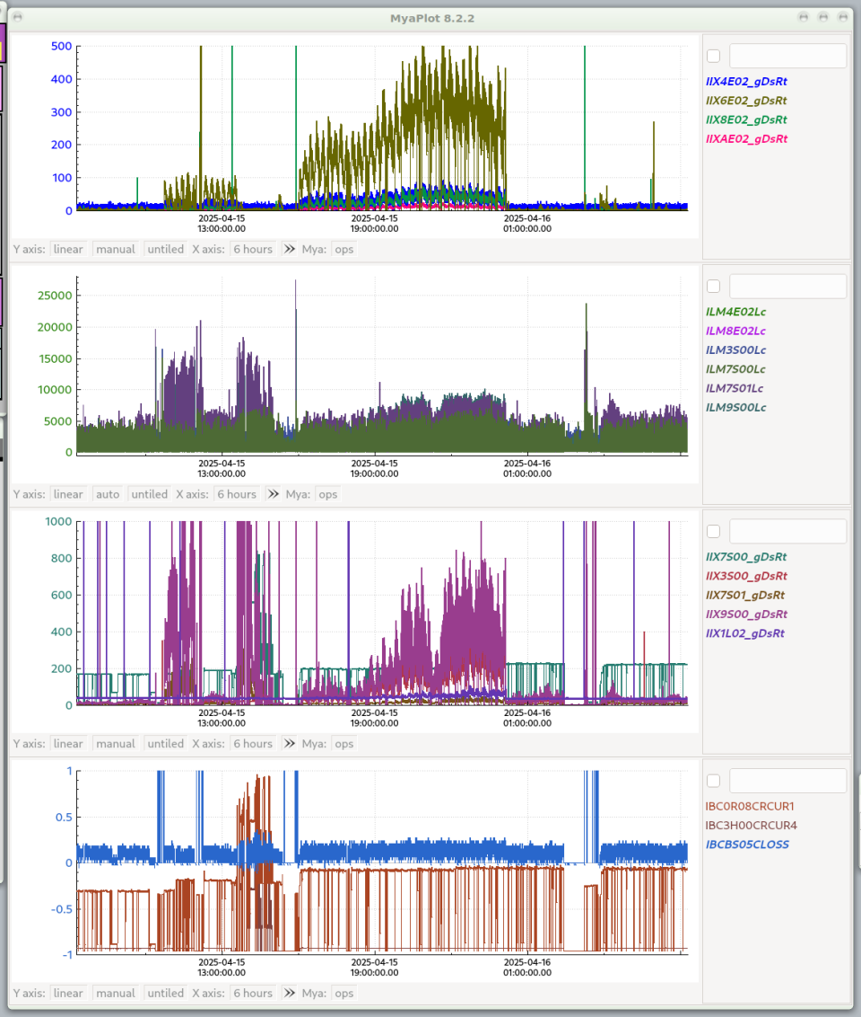
IDX (Xenon chambers) vs BLMS
Notes:
9S00 sees the FE from the linac. Its 1/3 of the diag BLM threshold.

Slide 16
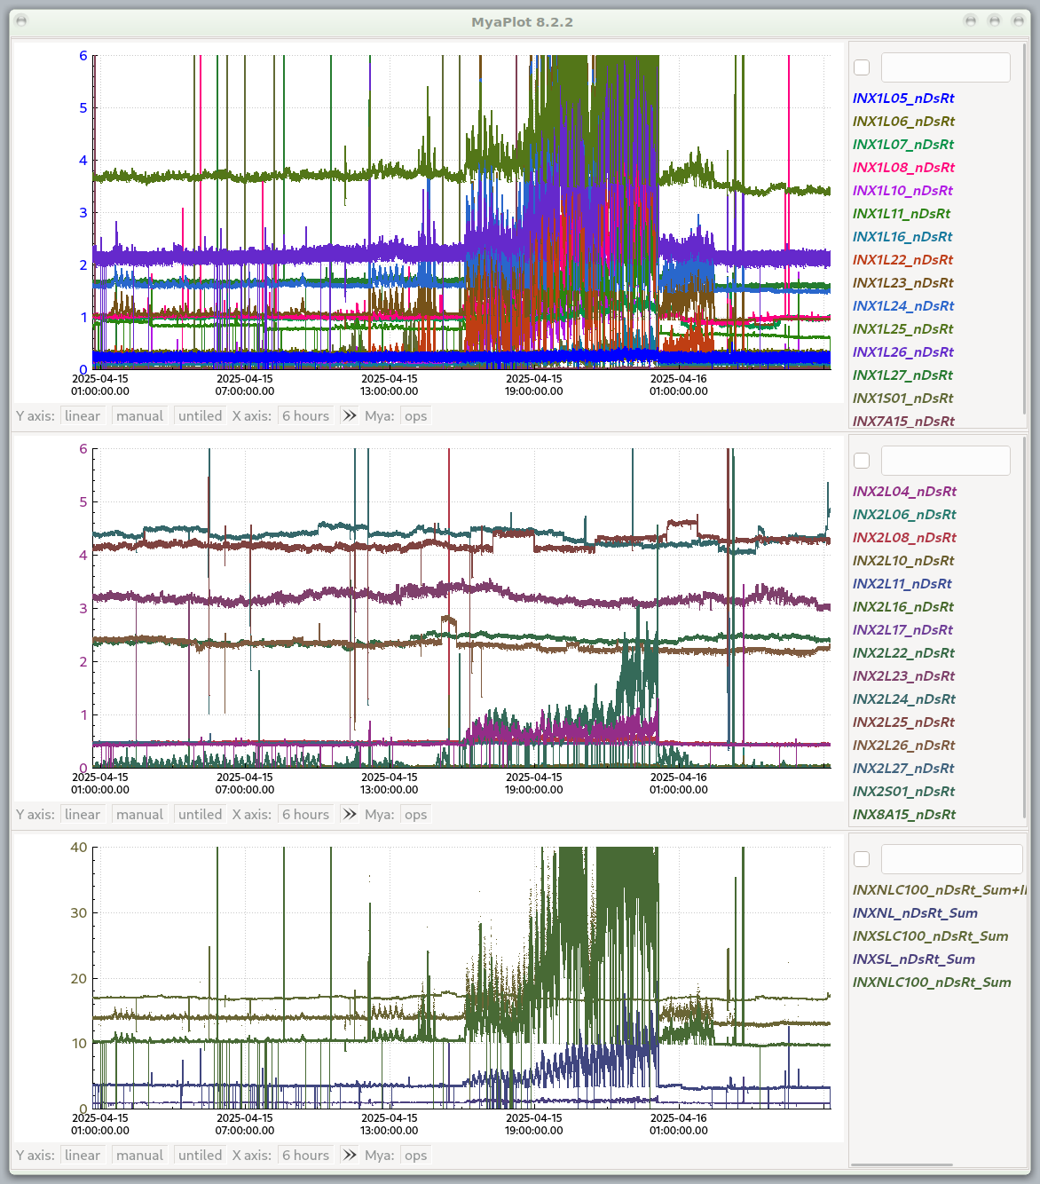
NDX (neutron detectors)
Notes:
Can see in the NDX detectors the effect of FE.

Slide 17
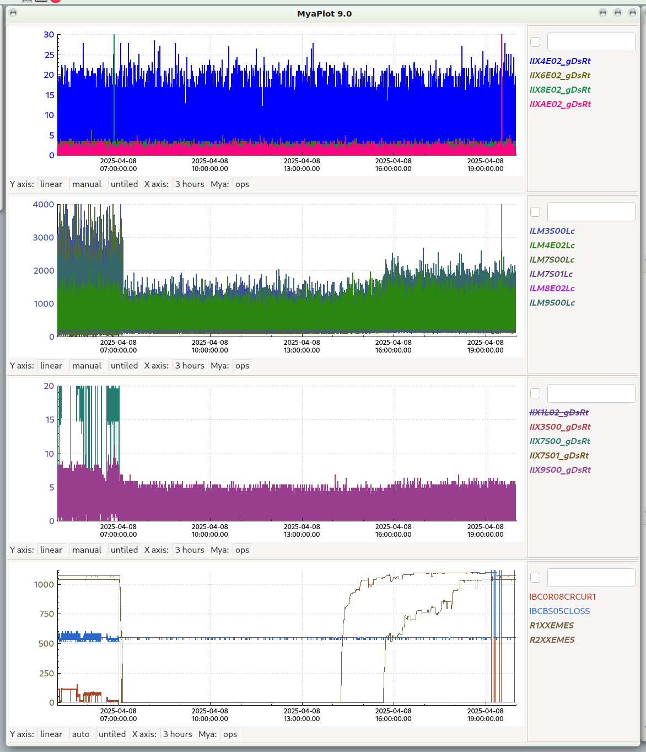
BLM sensitivity to field emission from SRF cavities
The BLMs in the spreader see field emitted photons. 9S00 which is almost in direct view sees the most.
HV gain and trip threshold for these should include allowance for FE.
IDXs and NDXs 4.8.25 | Jefferson Lab Electronic Logbook

Slide 18
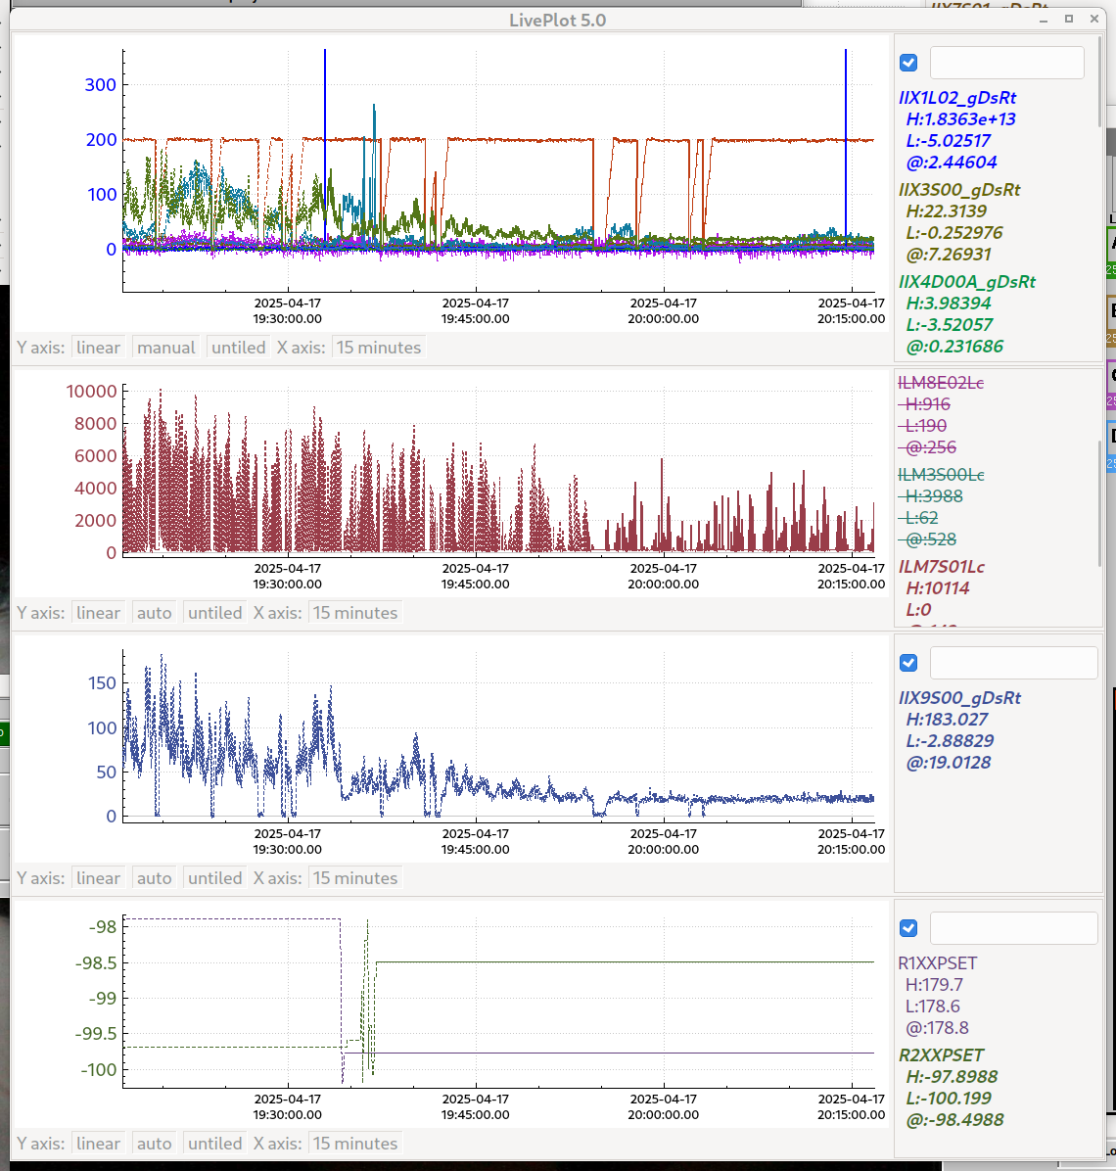
Effect of gang phase error on beam loss
Adjusting gang phase quieted the rad monitors | Jefferson Lab Electronic Logbook
Keeping machine on gang phase is beneficial. Maybe resurrect MOMOD ?

Slide 19
RF Amplitude and Phase Stability Requirements
 | Fast ( < 1 sec) | Slow (> 1 sec)
Phase Stability (correlated) | 0.24º | infinite
Phase Stability (un-correlated) | 0.5º | 3.0º
Amplitude (correlated) | 2.2 * 10⁻⁵ | NA
Amplitude (un-correlated) | 4.5 * 10⁻⁴ | NA
Narrow bandwidth and large Lorentz detuning
Q_{external} ≥ 2x10⁷
Stiffness ≈ 1.5 Hz/(MV/m)²
Very tilted detuning curve
RF control is a challenge
Digital RF control system being prototyped.
Successful technology demonstration at JLab, in collaboration with Cornell
From original review in 2005.
Notes:
Correlated phase stability is ensured by fast feedback.
Up to Q~10^8.
MoMod corrects keeping CM crested as close as possible.
Fast feedback in the hall lines in (A or C line): Effectively feedback to a CM in the end of the linac, to maintain maximum energy gain.
Gobbles phase by 0.5 degree and uses a BPM, and maximes the signal by changing the phase: Auto-crest
Infinite phase stability because it is corrected.

Slide 20
How to study it ? Model vs Measurement
We have:
Radiation maps
extensive work done by Ryan B and collaborators in the context of the LDRD on radiation hardness of permanent magnets
What we do not have (for CEBAF):
Comprehensive model of aperture limitations (in progress)
Beam loss modeling
Leveraging the use of AI systems in a production environment ?
Resurrecting MOMOD for uncorrelated phase stability

Slide 21
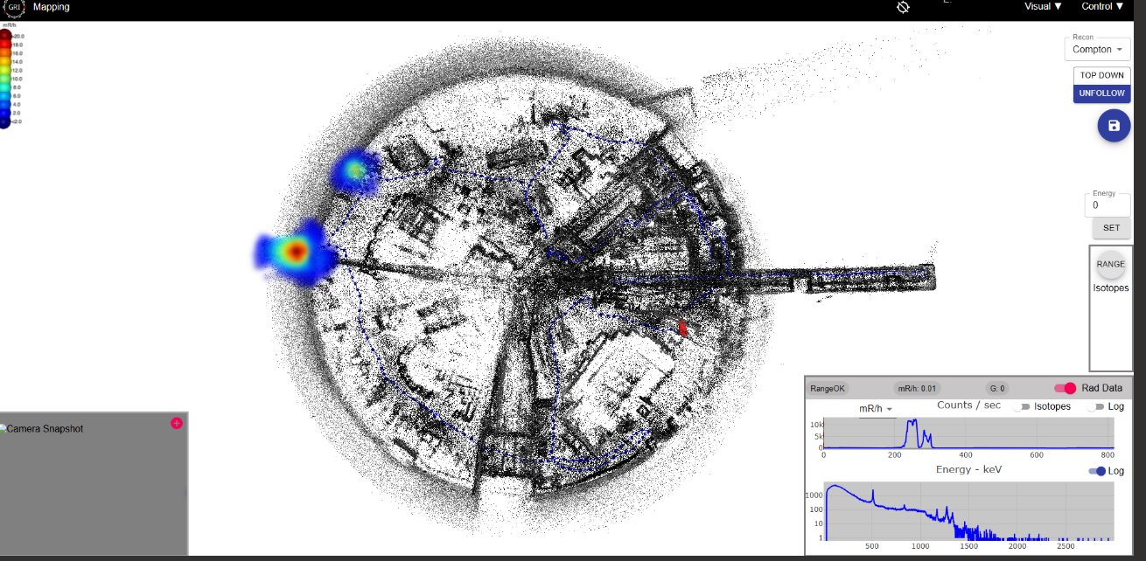
Path forward for initial efforts ?
Mainly focus on these two topics:
Develop a model for apertures (heuristics, beamline survey)
Develop a model for beam loss (bdsim, geant, etc..) for a short section of beamline and compare simulation with meas.
Example of a radiationmap:

Slide 22
Other actions recommended
Undergo a review of the location of each BLM.
Develop a model for assessing “sensitivity” of BLM relative to location. Given the lattice patterns, there is likely a rule that can be developed.
Develop a strategy for calibrating BLM sensitivity.
Make use of the diagnostic IDX detectors for cross-comparisons.
Write procedures for the use of the IDX detectors for machine tuning.

Slide 23
BACKUP SLIDES
BACKUP SLIDES

Slide 24
From original 12 GeV design studies (2006)

