Slide 1
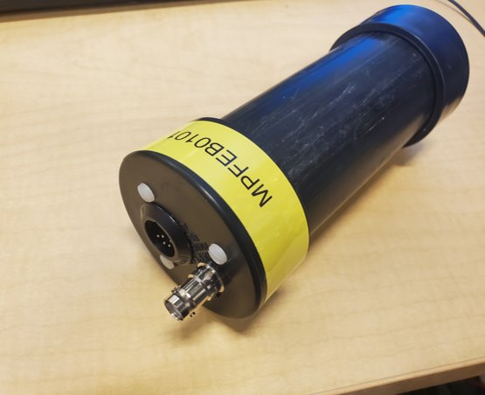
BLM System Introduction
Internal BLM Workshop
Brian Freeman

Slide 2
BLM Overview Purpose
Introduce System
Purpose
Some Design
Use of MPS vs. Diagnostic
Requirements
Calibration
Operational Experience
Potential Improvements

Slide 3
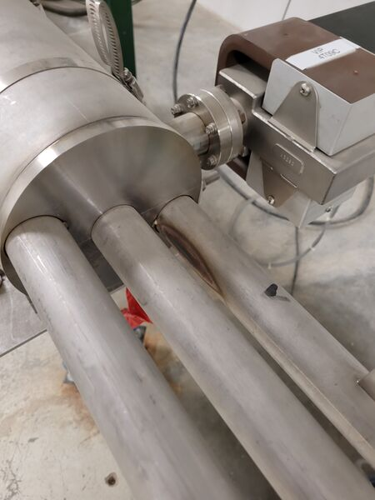
Beam Loss Monitor (BLM)
Beam Loss Monitors Purpose:
Machine Protection - Sense beam loss, which may cause physical damage to the accelerator or accelerator equipment and cause unwanted downtime.
Diagnostic - detect beam loss for beam quality issues
BLMs interface to the Fast Shutdown System:
Turns off the beam within 50 usec

Slide 4
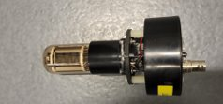
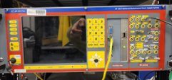
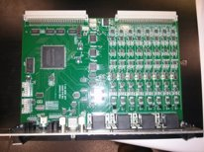
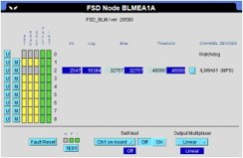
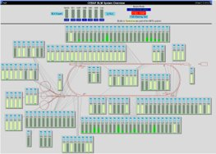
Beam Loss Monitor – Hardware and Ops Interface
Detector used - PMT (Photo Multiplier Tube)
HV supply – affects gain of the PMT,
BLM interface card (VME), 8 channels:
linear pre-amp,
logarithmic circuit – used for diagnostics read backs,
integrating circuit – used for MPS,
BIAS used to filter out background radiation,
THRESHOLD used to set trip point,
PMT test functionality,
EPICS screens
Read backs for logarithmic and integrated signals
Adjustable BIAS and THRESHOLD
Activation of Test function
Channel masking
Signals archived as well, for viewing of history
Slide from "BLM Overview", RSR Strategic Meeting , Jerry Kowal 9/27/21

Slide 5
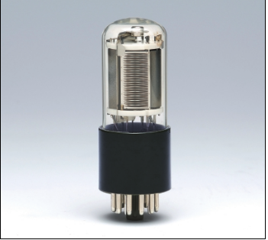
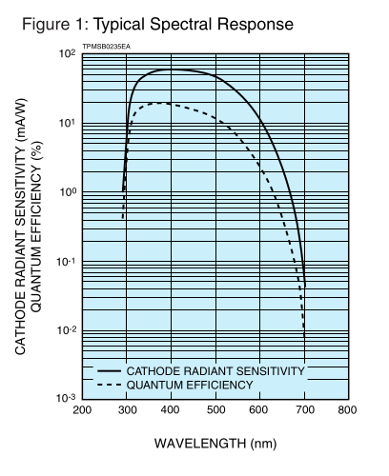
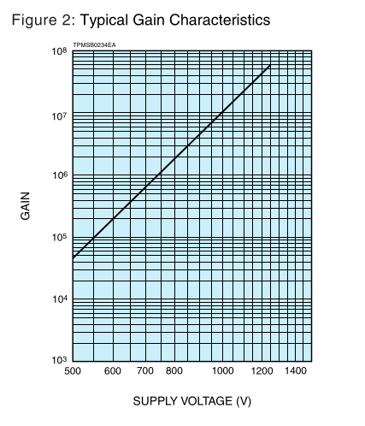
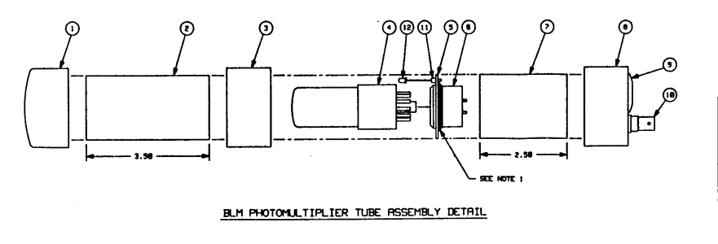
PMT Specs

Slide 6
BLM Capabilities
Local and area protection detection of beam loss
High sensitivity (beam loss <<0.1uA) adjustable by PMT high voltage,
Fast response << 1 us,
Configurable function of individual channels:
MPS using integrating amplifier (trip set at 15,000 uA-us loss)
Diagnostic using logarithmic amplifier
Linear signal available on the DSUB-9 connector (not available to FPGA now)
Glass of the PMT tubes darkens with high exposure leading to sensitivity reduction
PMT noise level can be reduced through Dark Aging
"Safe" calibration with use of Tune Beam
Low cost ~ $600 per channel
Deployment is very flexible
Slide from "BLM Overview", RSR Strategic Meeting , Jerry Kowal 9/27/21

Slide 7
Card Design
CAMAC Card:
Discussed in CEBAF-TN-92-003 (John Perry and Eric Woodworth)
Operational Limitation – this older card only had a diagnostic interface or MPS interface.
MPS only tripped, no readout of signal level over time – improved in the 12 GeV VME design
VME card designed for 12 GeV Upgrade
Not sure where or if design specifications exist for the upgraded card.
As of just a few years ago, these are all converted to VME … I think?

Slide 8
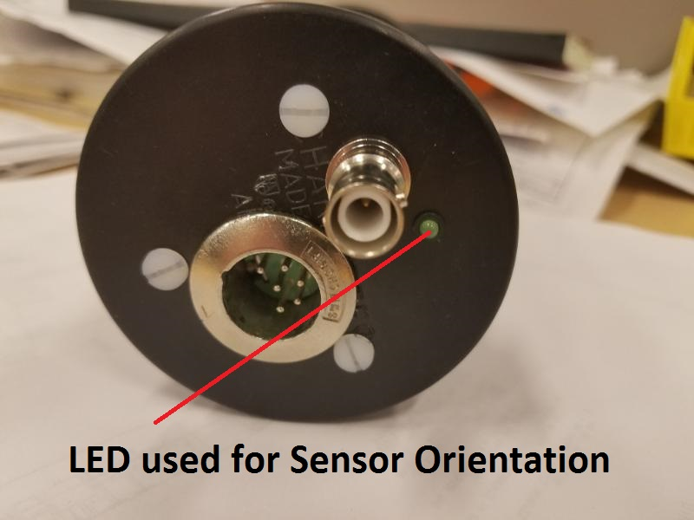
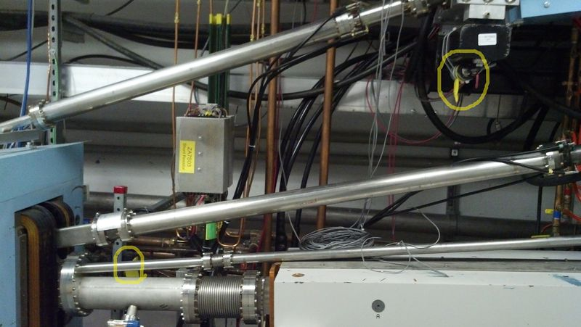
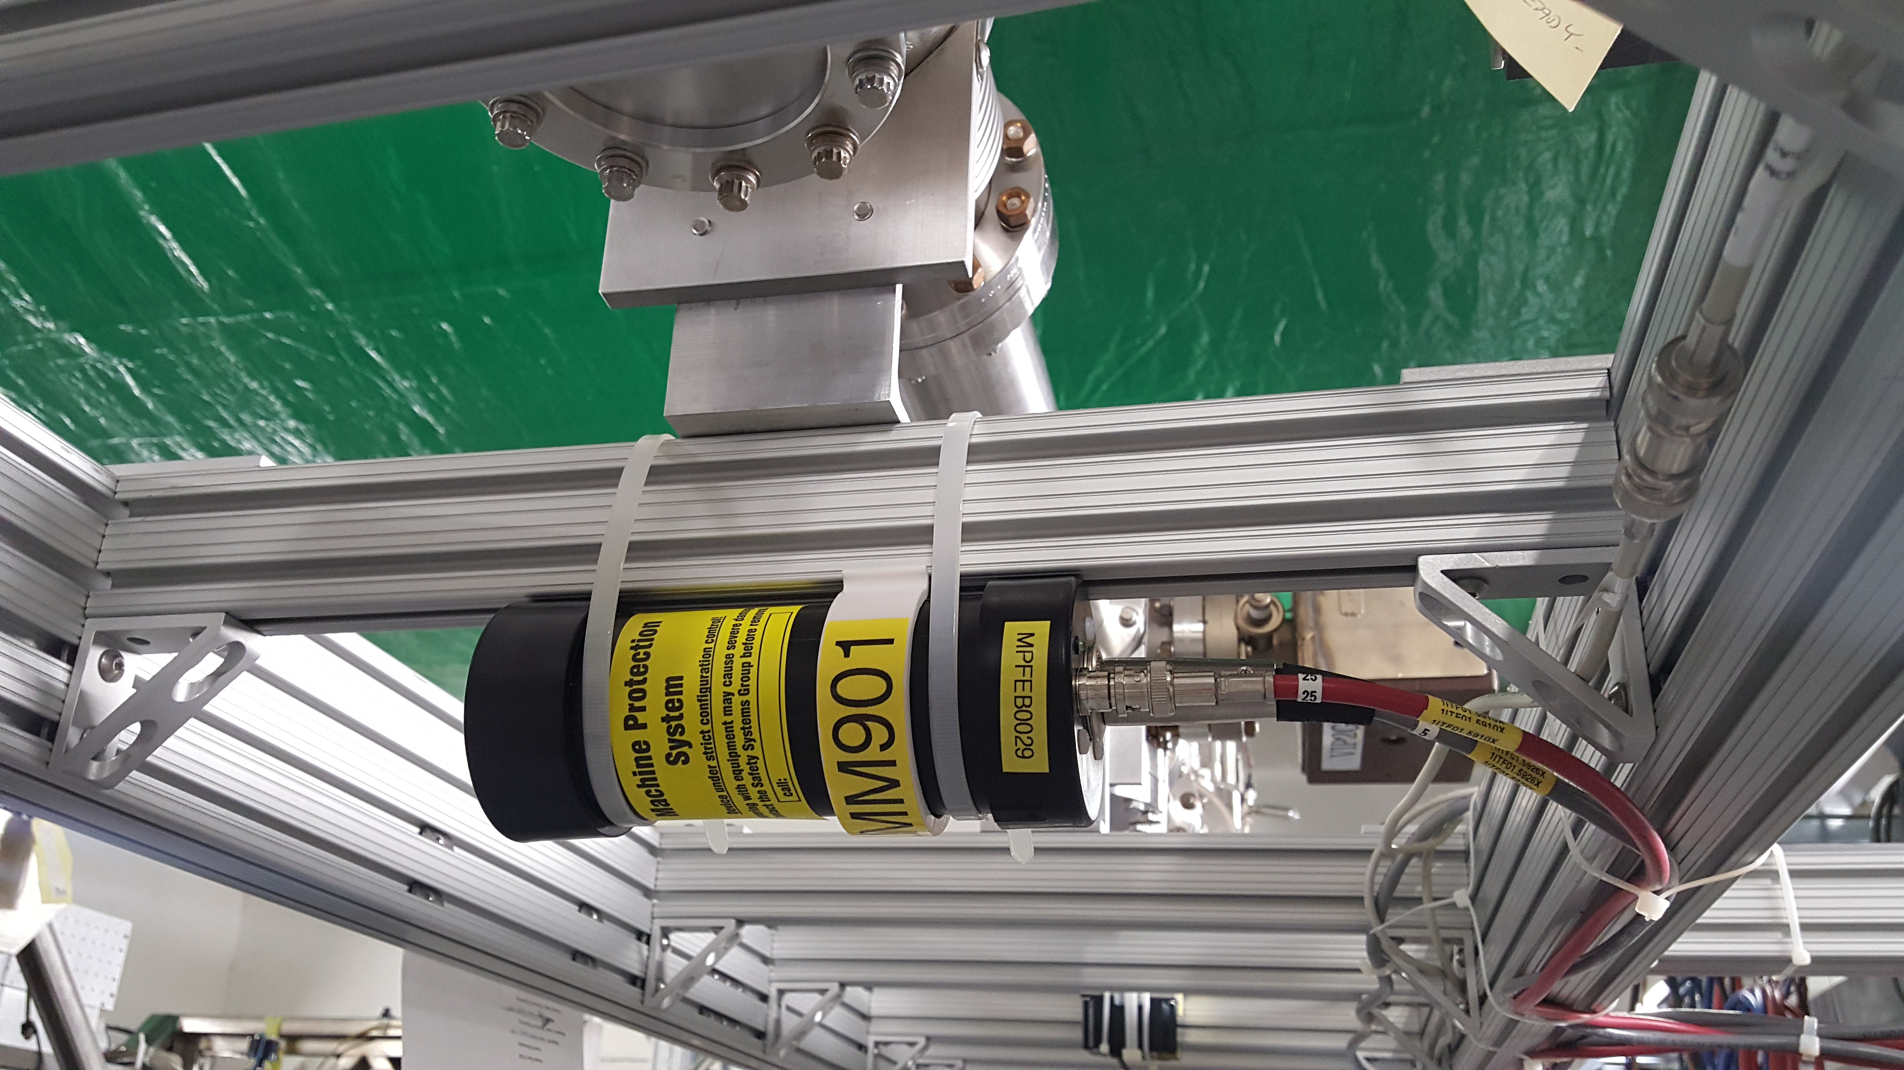
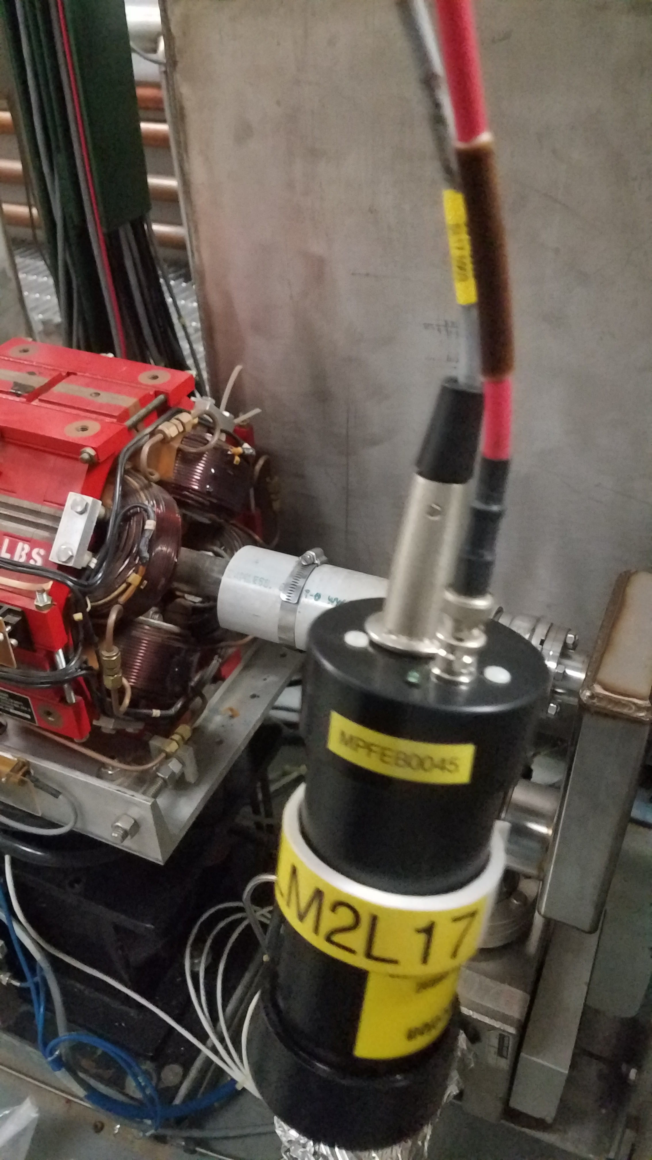
Machine Locations

Slide 9
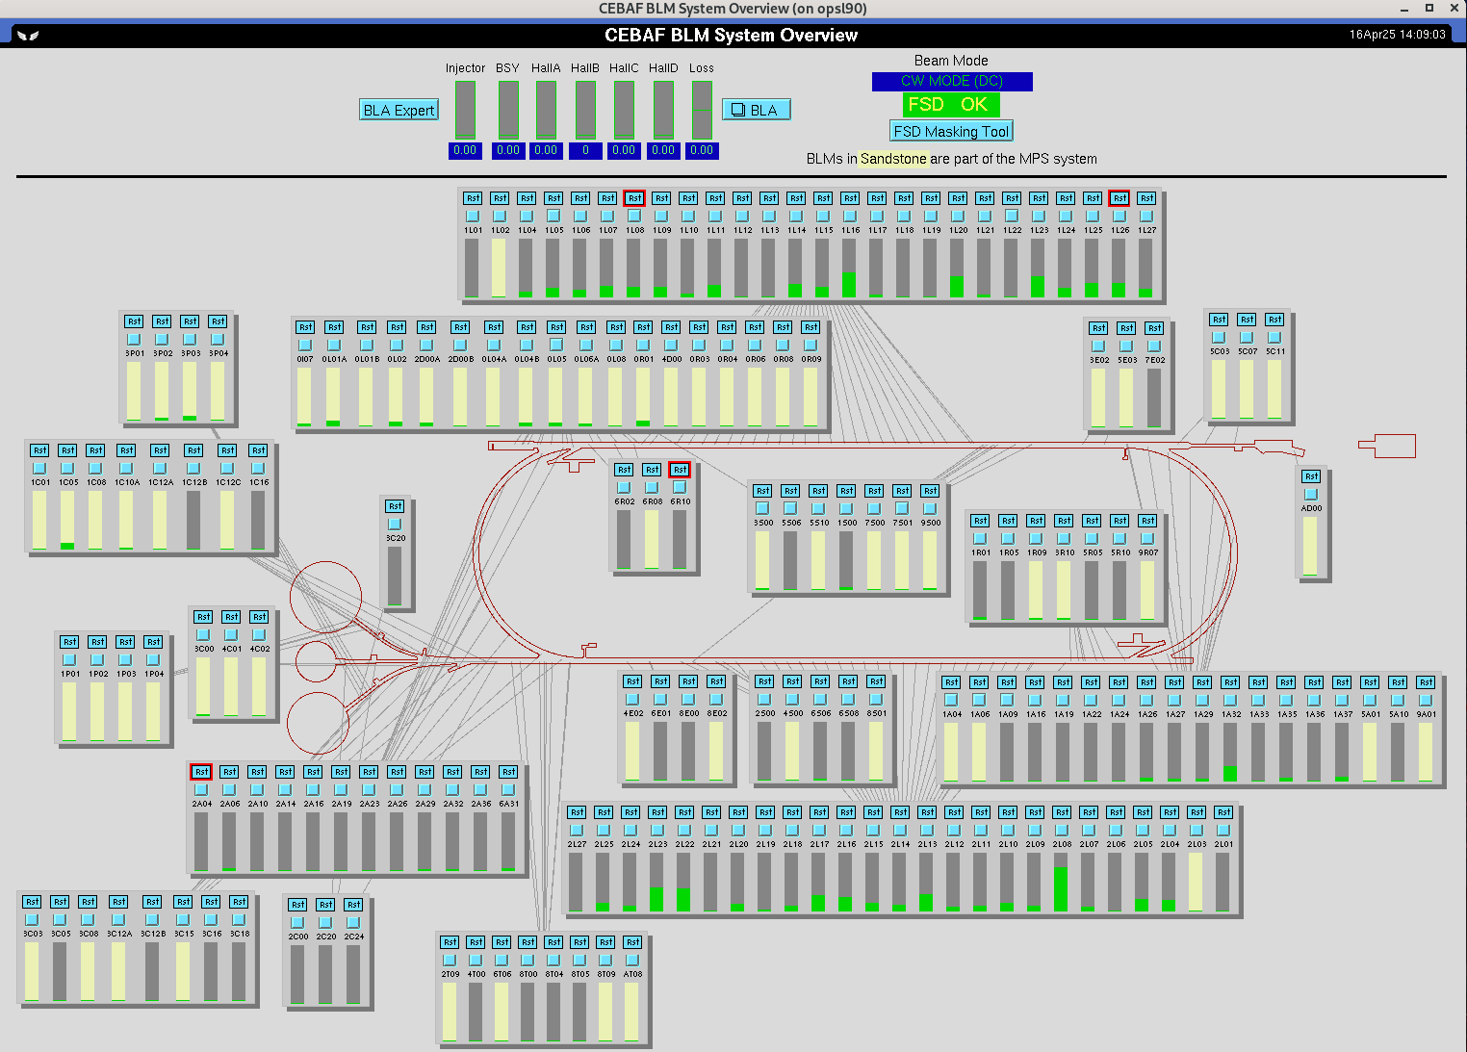
Machine Locations
MPS Locations:
68 Locations with ~%22 in the Injector (No BLA protection in the Injector)
Placement
likely loss scenarios
protect equipment that had lack of spares (ex. ZA Septa vacuum chamber)
Some locations?? Legacy!
Diagnostic:
103 BLMs are Diagnostic
Spread out through out the machine
Linacs are all diagnostic, except for beginning of each
Image above - Ops screen show MPS locations as yellow bars, and grey bars are diagnostic BLMs.

Slide 10
BLM Diagnostics and Testing
Monitoring
HV and Card setpoints in CED
PMT HV setpoint and readback in the Alarm Handler
High Voltage PS and BLM card faults FSD
Built-in test functions
Card test of the front-end electronics with signal injection,
Detector response test with remotely controlled built-in LED
Slide from "BLM Overview", RSR Strategic Meeting , Jerry Kowal 9/27/21

Slide 11
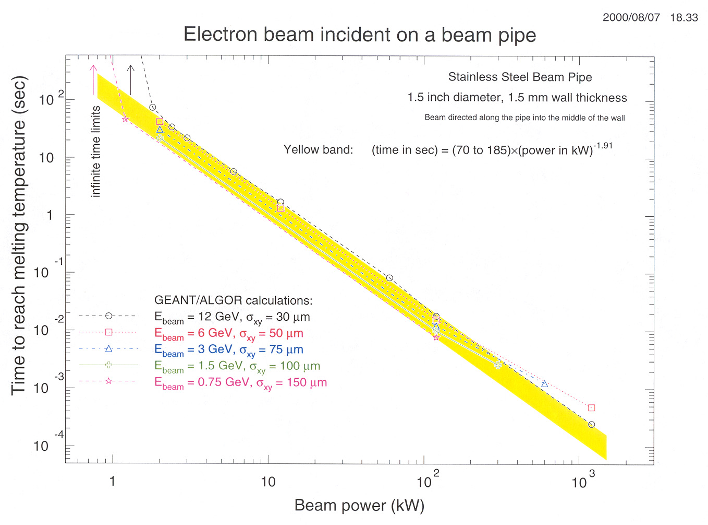
System Requirements – C.K. Sinclair TN-92-046/ TN-94-024
System designed around 2 main performance requirements:
How fast - 50 usec (TN-92-046)
Threshold for Acceptable Loss (BLM) – 2500 uA-usec (TN-94-024)
Basis of documents - calculated power deposition with beam normal to a thin-walled stainless bellows
Above is an analysis that was done for 12 GeV – From a talk by Kelly Mahoney in 2007.

Slide 12
Threshold for Loss– C.K. Sinclair TN-94-024
Minimum melt through times calculated:
Integrated beam current of 25600 uA-usec to burn through
Assume 10%, acceptable beam allowable loss yields ~2500 uA-usec
Assuming the 50 usec previously calculated, corresponds to 10000 uA-usec of beam loss
This yields a total of 12,500 uA-usec or %50 of the integrated beam current burn through scenario

Slide 13
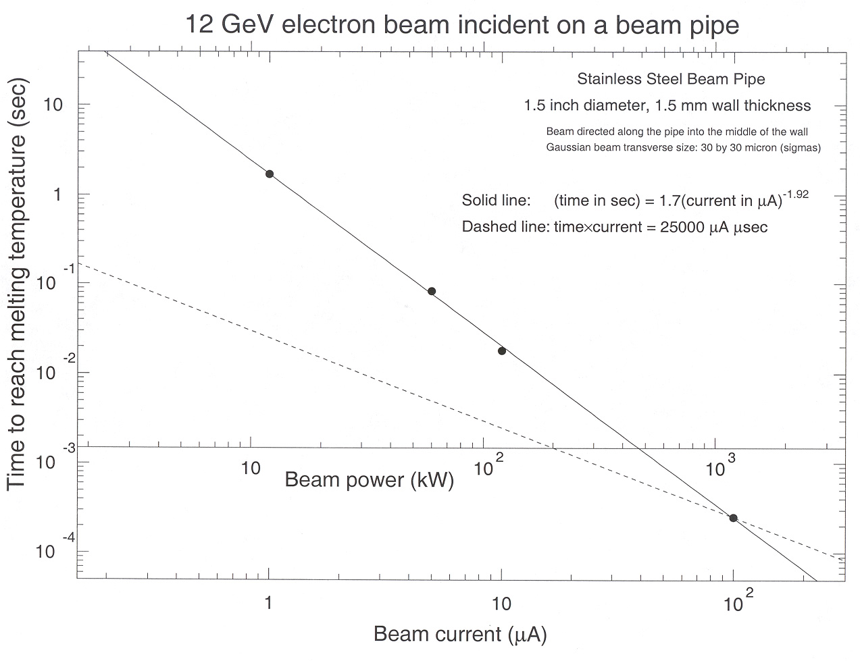
12 GeV Beam @ 30 um beam size
Above is an analysis that was done for 12 GeV – From a talk by Kelly Mahoney in 2007.

Slide 14
BLM Calibration
Calibration is crucial to get HV setpoints that meet the specification
Beam Loss Monitor Setup Procedure, John Perry 10/28/94
SSG maintains the official procedure now which is,
SSG-PR-10-001, Beam Loss Monitor (PMT based BLM) Calibration Procedure
Process:
Use Tune mode beam, to mis-steer and direct radiation to sensor
Adjust PMT gain using an O'Scope in the field

Slide 15
BLM Calibration
Limitations:
Requires beam time
Time consuming, 68 MPS BLMs x 30min = 34hrs (at least)
Requires “pairing” of each BLM with dedicated magnet used for calibration
Requires missteering beam in all directions to find the least sensitive direction
BLM placement and orientation as well as set up critical for effective protection
Difficult to calibrate upper passes
Hard to direct beam long enough without vacuum consequences

Slide 16
Operational Experience
The Machine Protection BLM system works
to protect the Machine from burn through
In my time here (~20 yrs), we have had NO burn through incidents in the CEBAF Accelerator
We have had flanges and vacuum connections heated up and cause a loss of vacuum.
Some caused from inadequate BLM coverage (we added some) (ex. 1S00 and 2S00)
or not an optimal location chosen (we moved it).
Works "too" well, threshold is too sensitive?? - More from Jay

Slide 17
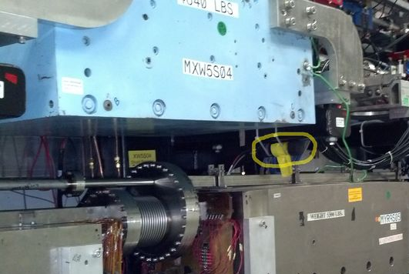
Operational Experience – So we have loss?
Single BLM can "see" loss from multiple passes. So which pass?
Many times, when we know we have loss, it is difficult to diagnose where.
Loss is hard to tune out:
BLMs sometimes do not have the dynamic range to see the loss in Tune Mode.
Unless the loss is bad enough
Ww will always have to tune out losses in the machine, even if we decrease BLM sensitivity.

Slide 18
Improvements
Requirements
Diagnostics –
Lots of time lost to finding and improving loss
Hard to detect pas-by-pass loss
RF vs. MPS BLMs – RF Diagnostics
Fold in additional protection
New BLMs, more discrete protection
Calibration Improvements
Software – Diagnostics
Procedural

Slide 19
Improvements - Requirements
Revisit assumptions and calculations made
Are all of Charlie's assumptions valid today?
Which assumptions should we revisit and why?
Brainstorm any new requirements?
Decreasing the BLM sensitivity will have consequences,
we should be prepared
What threshold of activation should we allow for?
Start fresh on locations – what do want or need to protect now vs. 30 yrs. ago?
Incorporate the additional protections, like BLA and vacuum system that can also work to protect the machine.
Document this.

Slide 20
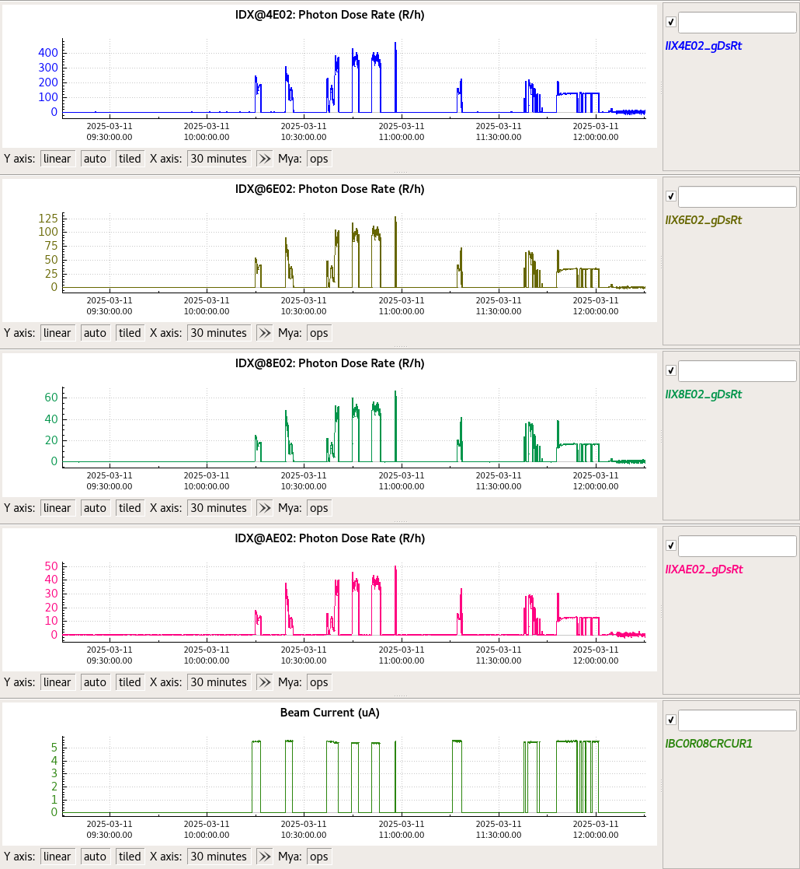
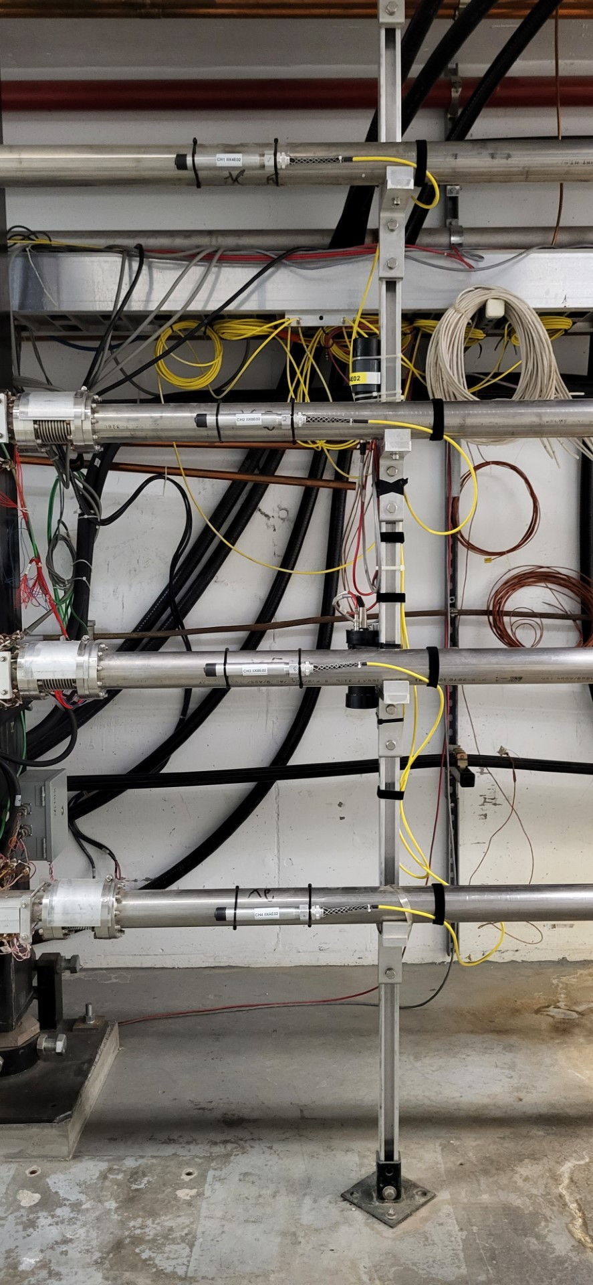
Additional Diagnostic Loss detection
Continue to supplement additional diagnostics (NDX/IDX) - More from Pavel
Images to the right show an example of the IDX detectors after the YA septas.
Theses detectors/electronics have a better dynamic range
Show signal in Tune Mode
Pass-by-pass loss detection possible when stacking sensors in a row (see images to the right).
Better halo monitoring and control throughout the machine

Slide 21
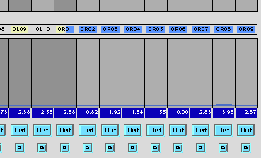
Diagnostics – Calibrated Wiresums
Loss detection through BPM wire sums
All the BPMs are inherently current detectors
If we had a better sense of calibrated wire sums from sensor to sensor, we could easily tell where the loss is
Image shows the Injector wiresums, how accurate is this from BPM to BPM? If we can establish some trust in these, it could help to diagnose and improve loss.

Slide 22
Diagnostics – Global Timing and Synchronization
Global timing and synchronization of diagnostics BLMs, vacuum, BPMs, etc...
If diagnostics and their electronics were synchronized with the beam and data readouts though EPICS were all synchronized
we could easily correlate signals to help find pass-by-pass loss more efficiently.

Slide 23
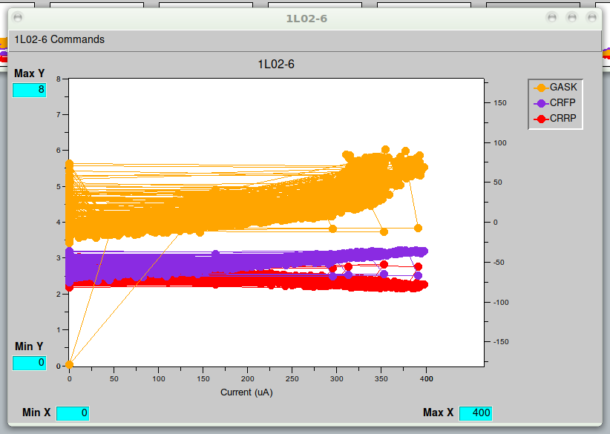
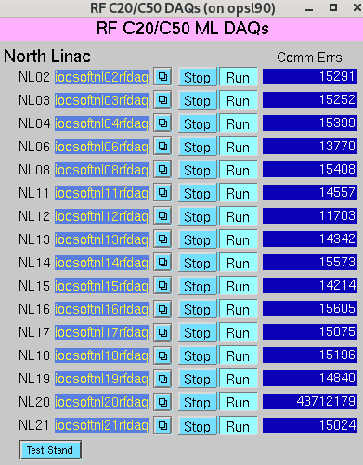
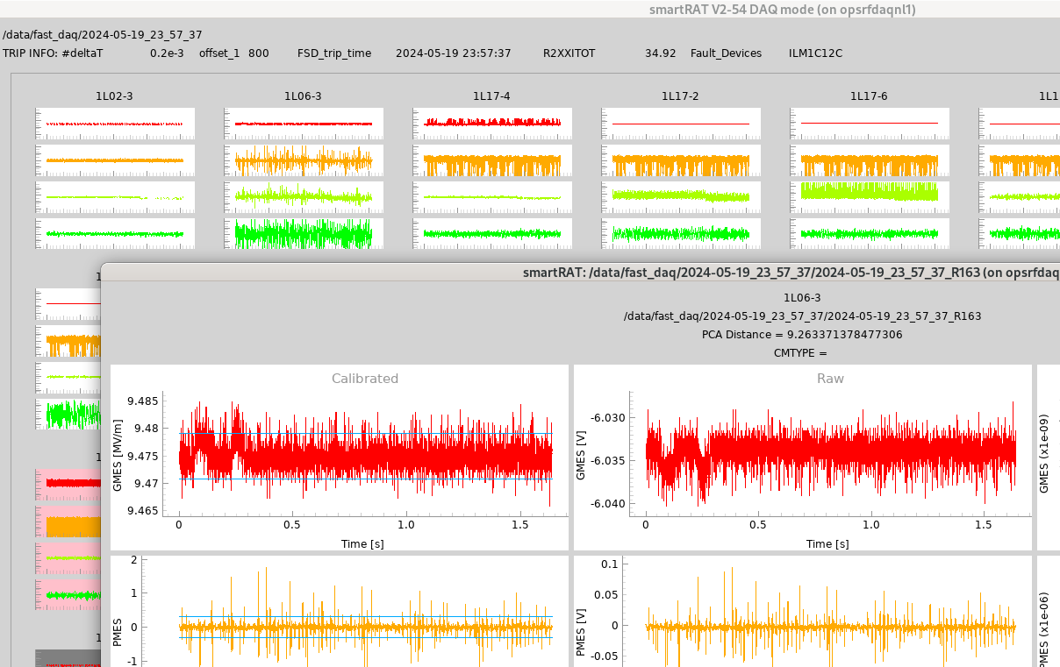
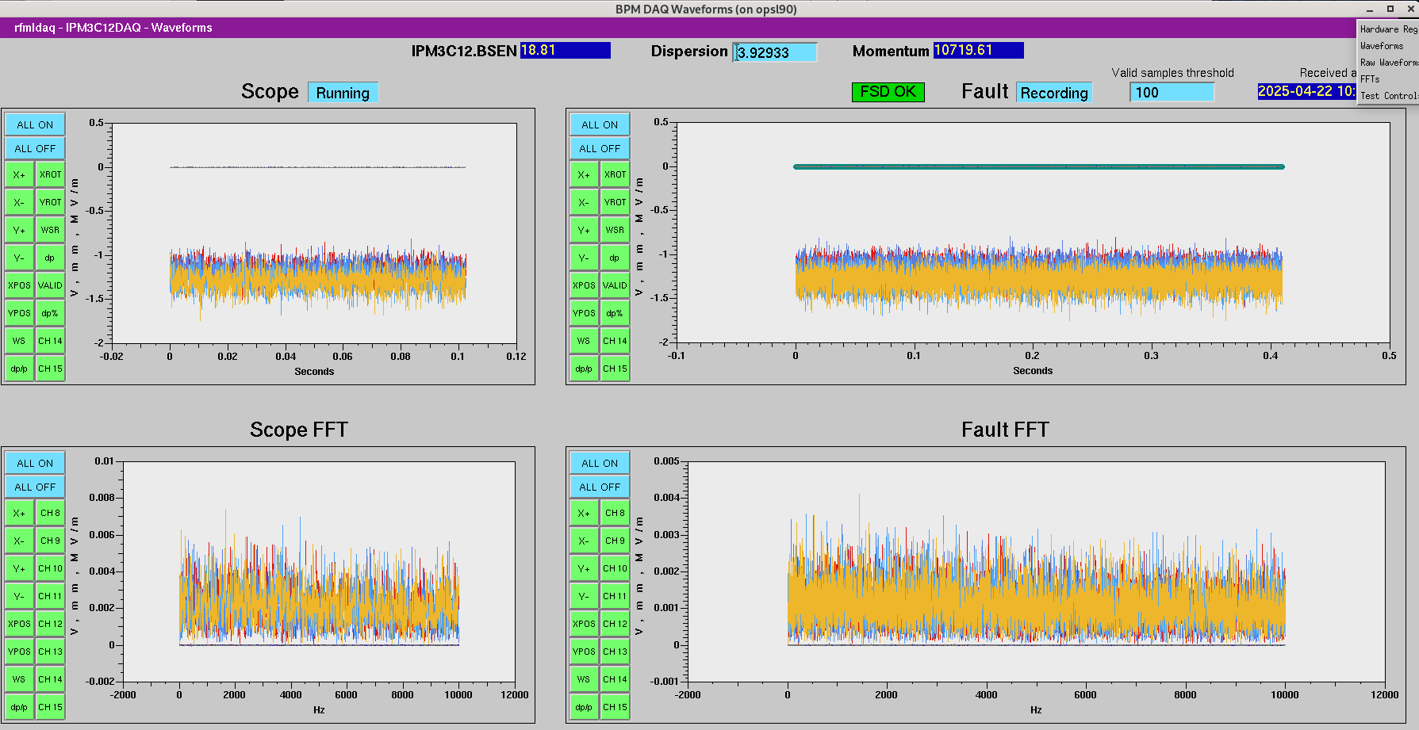
BLMs vs. RF - RF Diagnostics
Beam Loss or Angry RF?
Improvements in diagnosing and distinguishing between bad performing RF is a benefit.
Newer and improved tools will help:
RF Health Check - w/ appropriate guidance
RF Analyzer Tool ( RAT )
smartRAT with C25 and C50 fast DAQ – NL Only as of now
LAB Jack BPMs at Dispersive BPMs
Guidance from experts to tune RF systems under full beam loaded conditions

Slide 24
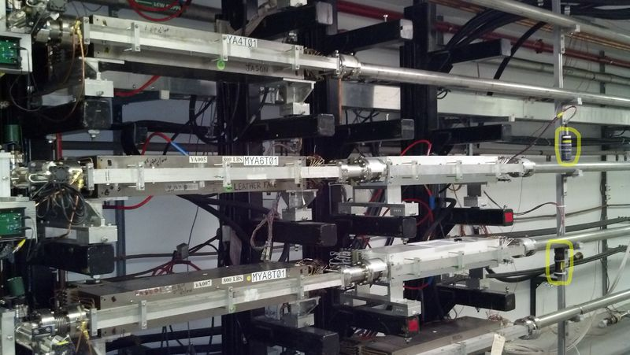
Fold in additional layers protection
We have chosen not to interlock magnets to FSD
We could add a layer of protection and interlock magnets to the FSD system, increasing our protection.
This would add defense in depth and potentially allow us to allow for more beam loss, as the devices that we are trying to protect, will protect themselves.
Imag shows that 2 PMTs protect a stack of magnets. If magnets were interlocked, we could be more conservative with allowable loss

Slide 25
More BLMs – Device Protection vs. Area Loss
Look at back scatter from front of magnets, opposed to forward cone of radiation
Protect the device only, instead of loses from all passes.
< 1m
Example of device monitoring, discrete coverage protecting the magnet
< 1m
< 7m
Example of area monitoring, more coverage from forward cone of radiation
Instead of area monitoring, move PMTs upstream, and add one per stack.

Slide 26
Calibration Improvements
Review placement of the BLMs are MPS BLMs appropriate?
Pre-identify magnets for calibration for each BLM
Simulate loss scenarios and calculate magnet settings ahead of time
Automate the calibration process with software
Eliminate the use of the oscilloscope with the modified BLM card firmware/hardware
Digital Scope mode
FPGA change needed?
Some slide content from "BLM Overview", RSR Strategic Meeting , Jerry Kowal 9/27/21

Slide 27
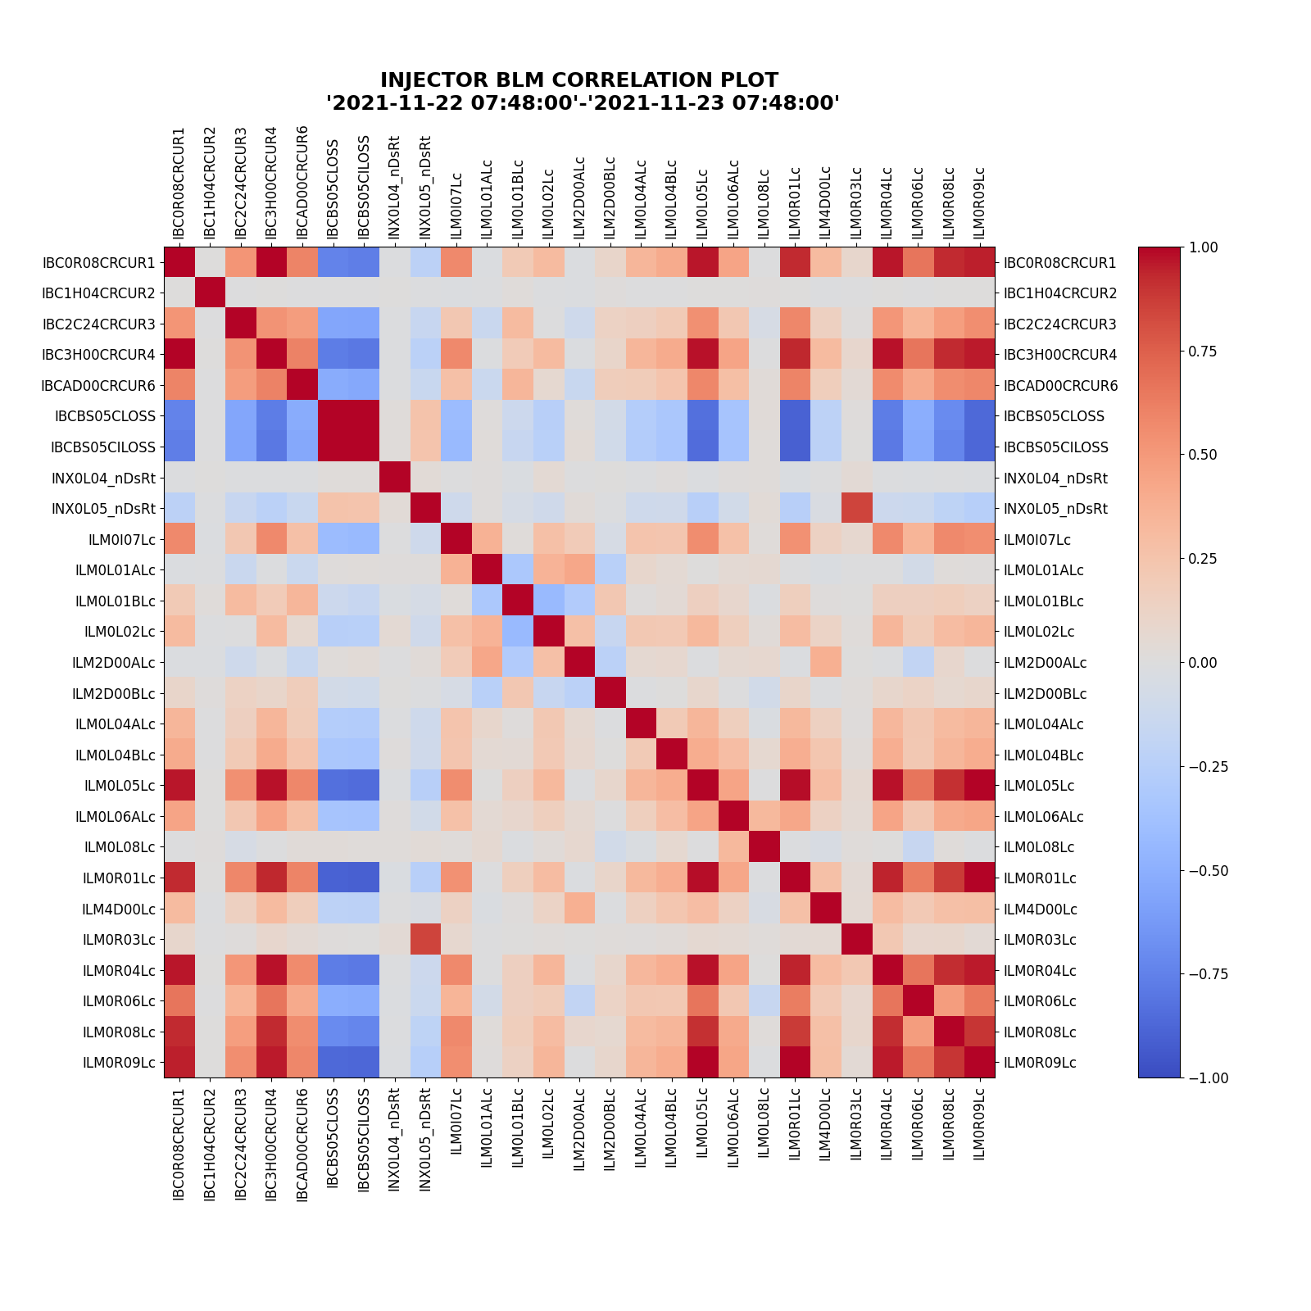
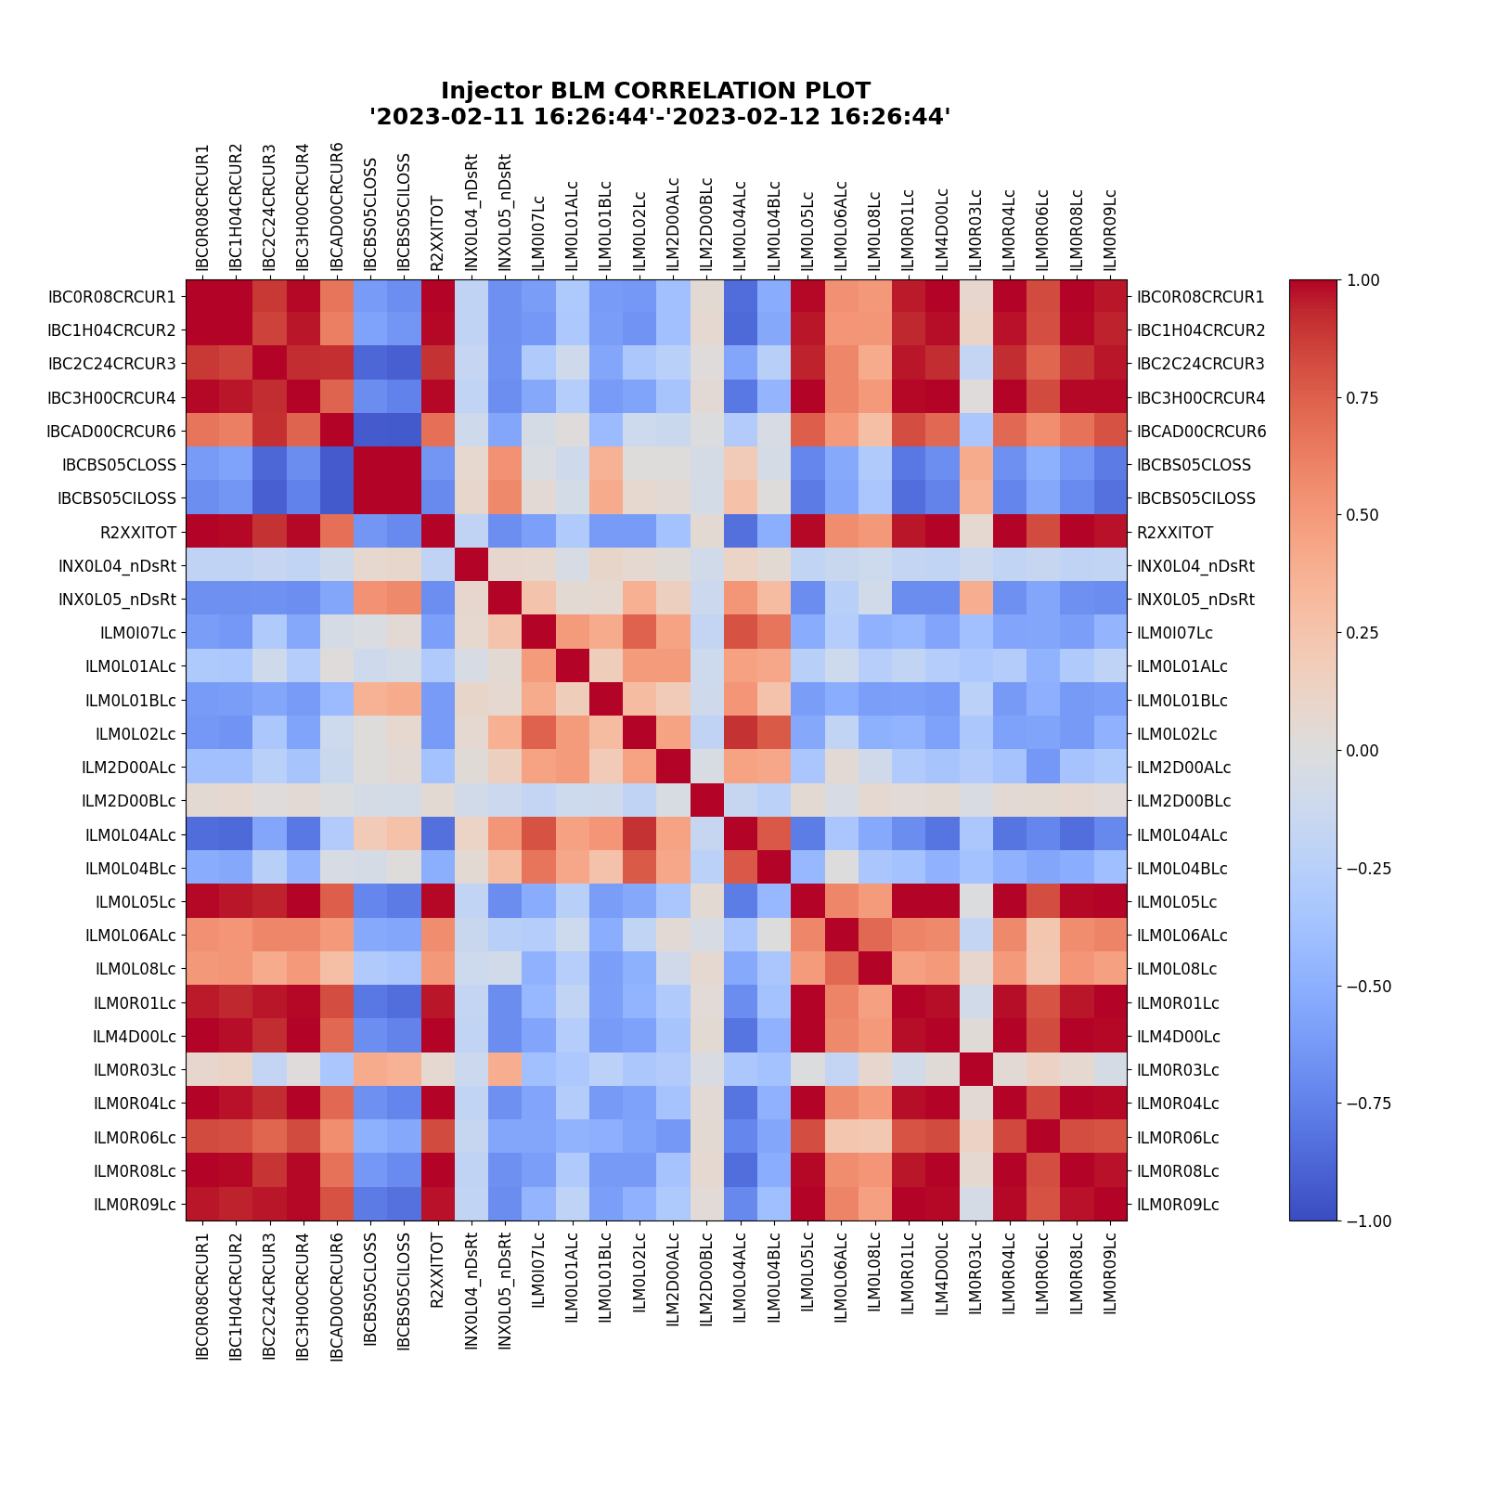
Software
Develop software that will analyze signal correlations and report "areas" of concern.
Diagnostic synchronization would be useful in such software
BLM heat maps, looking at the degree of linear correlation of BLM signals.
1 dark red, and –1 dark blue shows a high degree on linearity
Left image shows less loss, and right image shows more loss
Could do the same with BLMS , Vacuum, and BPMs to further pinpoint loss

Slide 28
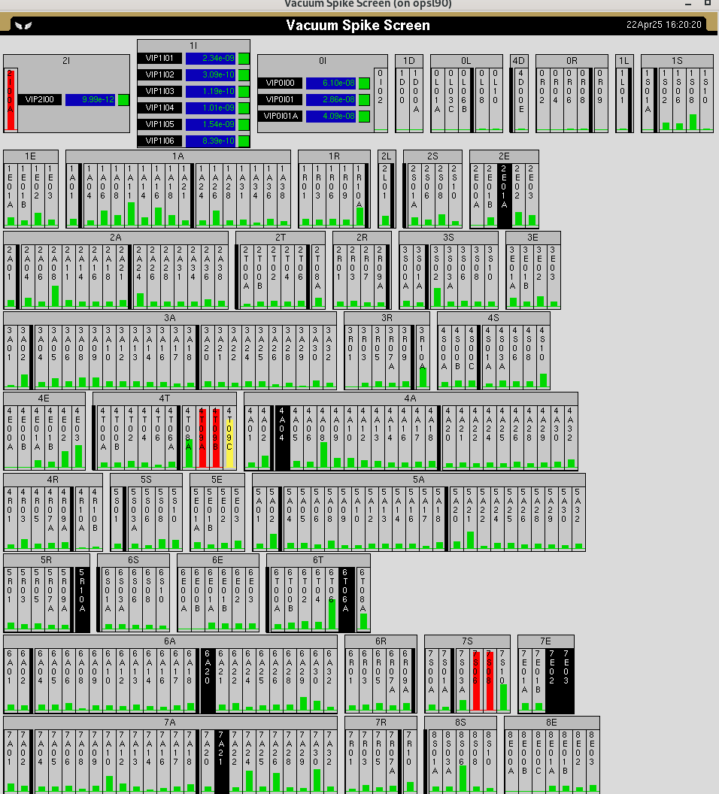
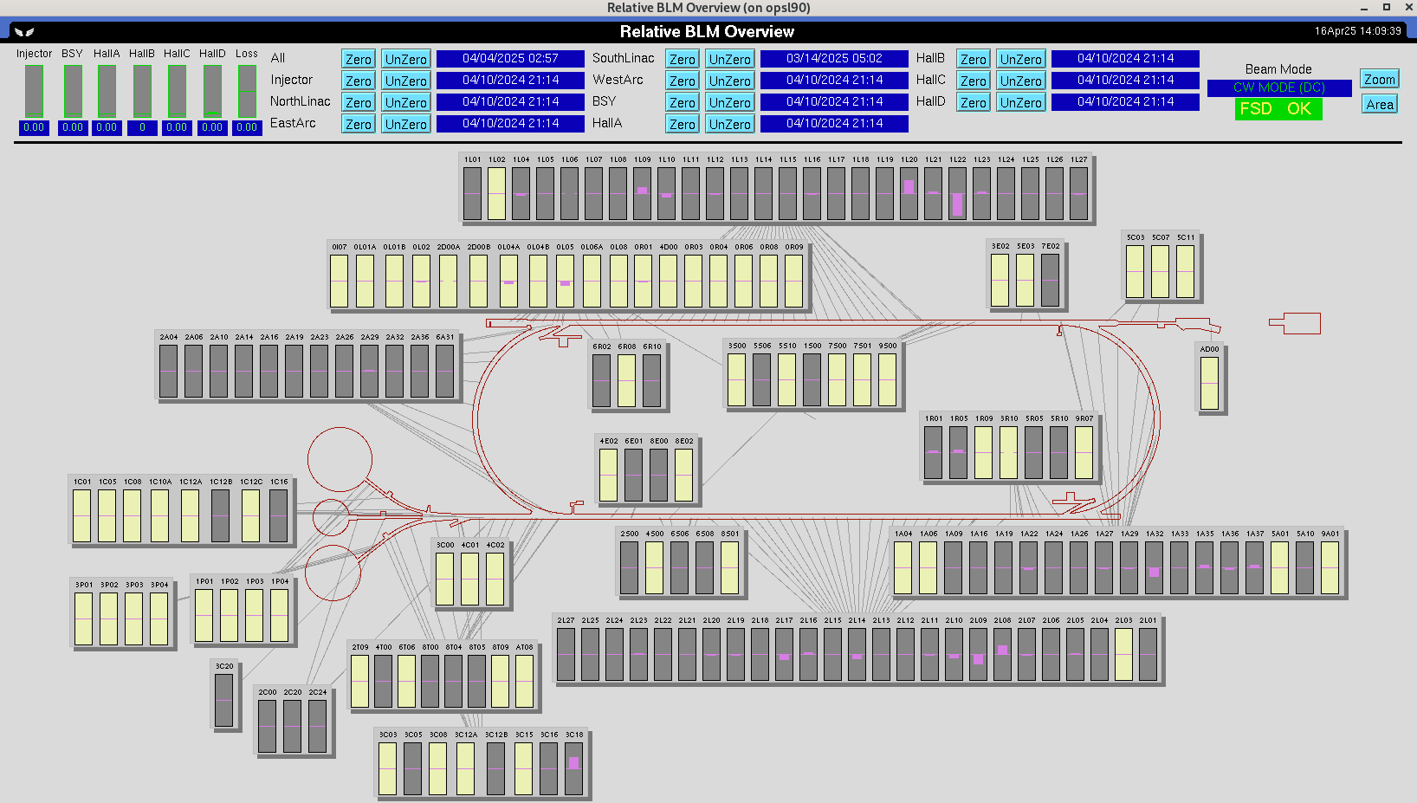
Software – Relative signals
Lots of work went into, allowing us to take a snapshot of loss and then show relative loss
Very useful in visualizing loss
Could do the same for vacuum signals, to allow further troubleshooting of loss areas

Slide 29
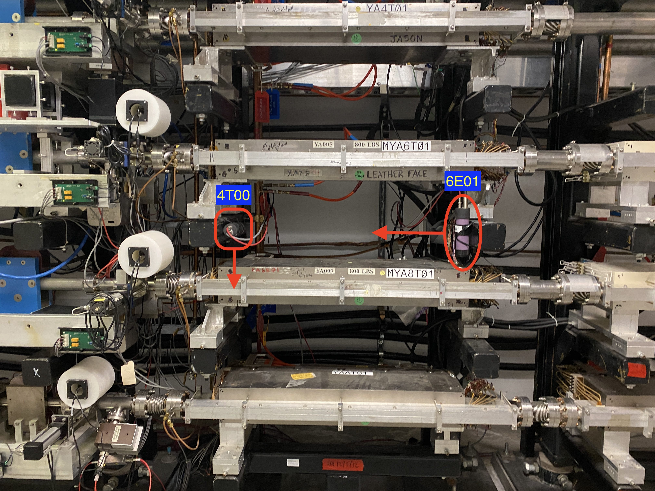
Procedural
Produce machine safe process for temporarily decreasing BLM voltages
Could help diagnose loss
Allow other things to trip first.
Don't be afraid to move BLMs, if we identify weaknesses, or test better locations
Proposed locations and equipment protection list would be useful to inform decisions
Procedurally, use other diagnostics to inform our decisions about setting HVs for the BLMs (IDX, NDX, etc...)
Use Bias and Threshold settings to further tune desired response
All MPS BLMs are currently the same.
Image shows new monitoring setup to test new locations for YA MPS BLMs

Slide 30
Questions?
Brian Freeman
Introduction to BLMs
Some Operational Experience
My view on some improvements

Slide 31
Some Links
SSG Docushare - https://jlabdoc.jlab.org/docushare/dsweb/View/Collection-27505
BLM Locations - https://opswiki.acc.jlab.org/wiki/BLM_List

Slide 32
How Fast– C.K. Sinclair TN-92-046
Power deposition calculated using:
200 uA of beam current
Uniform beam size of 100 microns
Stainless Steel Density of 7.9 gm/cm^3
Thickness size of small stainless steel bellows wall = 0.006" or 0.015 cm
DE/dx for minimum ionizing particles = 1.67 MeV/(gm/cm^2)
P = (dE/dx)*density*thickness*current = 40.2W of power deposited, with initial deposition area of 0.785X10^-4 cm^2

Slide 33
How Fast - More details – C.K. Sinclair TN-92-046 (Cont.)
Estimate is temperature reached where radiation is the only heat loss
Assumptions used:
1 mm emitting area, which is ten times larger than the 100-um beam size
Emissivity of 0.4
Used 2 surfaces to a 0K surface
Approach used yields 5760K to dissipate the 40 W (304 Stainless melts ~1400 Celsius)
Next Charlie calculates the instantaneous temperature rise, using:
Specific Heat of Stainless = 0.50 j/gm-K
And for the 40 W and 100 um beam size yields:
DT/dt=8.6X10^6 K/sec
Melting time would be 166 usec
Melting time would of course be different
Beam not uniformly 100 um
Hole may occur faster due to atmospheric pressure
Some radial conduction (not much)

Slide 34
How Fast (Cont.) – C.K. Sinclair TN-92-046 (Cont.)
Copper estimated using the same assumptions – 98 usec
Niobium also considered, but not listed in the TN
In conclusion and a little hand waving -
Estimated time to burn through is 100 usec
Thus, a conservative and realistic time response of the FSD system is 50 usec, with an assumption that the beam could persist for 20 usec after a shutdown.
Design goal for MPS FSD -
10 usec from FSD logic
10 usec from BLM logic
4 usec for signal transmission
~21 usec of beam in the machine

Slide 35
Threshold for Loss – Cont.– C.K. Sinclair TN-94-024
A further discussion is made, and Charlie's conclusion is that for niobium at 4K, there is no reasonable beam loss scenario that would result in quickly burning through.
For this reason, there are no MPS BLMs in the Linacs, only diagnostic?
Final parameters are a time of 50 usec, and an integrated current threshold of 2500 uA-usec for loss detection.
Charlie warns specifically about RF Seperator power loss, that would damage the extraction septas in a much shorter time than the 21 usec time specified for beam dwell time after a trip.

