Slide 1
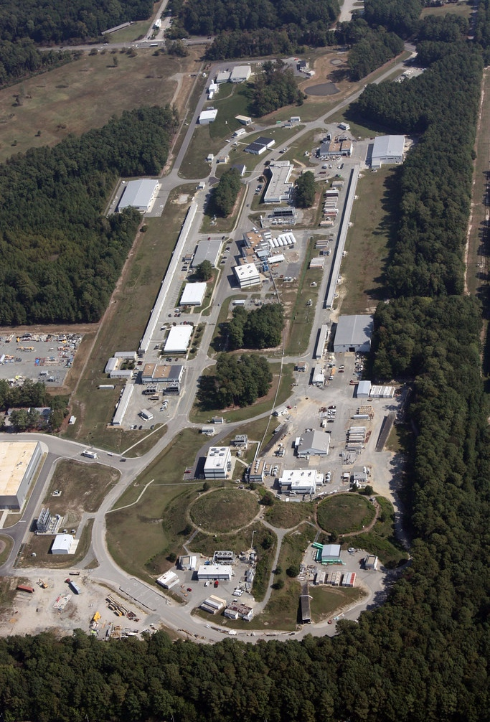



Muon-philic Dark Sector search at the BDX facility
Marco Spreafico
on behalf of the BDX collaboration
Secondary Beams at Jefferson Lab Workshop (BDX & Beyond)

Slide 2
Outline
Muon-Philic DS BDX Outlook
Muon-philic Dark Scalar
BDX experiment
Conclusions

Slide 3





Muon-philic Dark Scalar
Dark Sector could be invoked to solve SM anomalies, for example ${\left(g−2\right)}_{μ}$ anomaly
Simplest possibility: Muon-philic Dark Scalar (coupled only to muons)
Model parameters:
Dark Scalar ($S$) mass: $m_{S}$
$S−μ$ coupling: $g_{μ}$
$$μ$$
$$μ$$
$$S$$
$$S$$
$$μ$$
$$μ$$
$$Z$$
$$Z$$
$⇒$Not viable candidate for thermal DM but poorly explored
Phys. Rev. D 110 (2024) 5, 055032

Slide 4
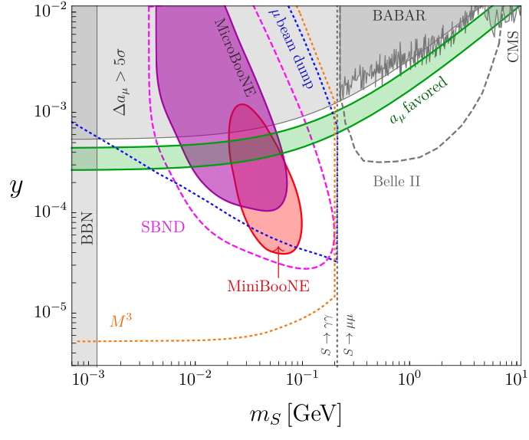
Muon-philic Dark Scalar
Dark Scalar searches require high-intensity muon beams
Model poorly explored
Accelerator based experiments at the intensity frontier could be exploited to search for Dark Scalar
Current experiments with muon beam not intense enough to set strong constraints
Phys. Rev. D 110 (2024) 5, 055032

Slide 5

Beam dump experiments
Beam dump experiments: direct detection of LDM produced by a medium energy beam impinging on a fixed target
Dirt
Shielding
Beam dump
Detector
$$S$$
$$S$$
Beam
Concrete
Phys. Rev. D. 110 (2024) 5, 055032; Phys. Rev. D 98 (2018), 115022

Slide 6
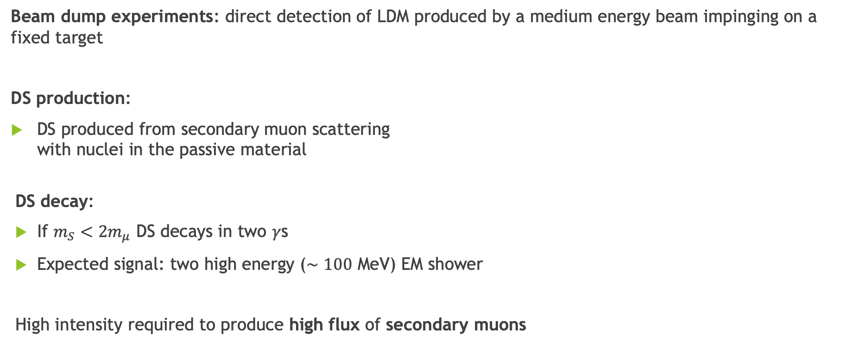
Beam dump experiments
Beam dump experiments: direct detection of LDM produced by a medium energy beam impinging on a fixed target
DS production:
DS produced from secondary muon scattering
with nuclei in the passive material
DS decay:
If $m_{S}<2m_{μ}$ DS decays in two $γ$s
Expected signal: two high energy ($∼100$ MeV) EM shower
High intensity required to produce high flux of secondary muons
Phys. Rev. D. 110 (2024) 5, 055032; Phys. Rev. D 98 (2018), 115022

Slide 7
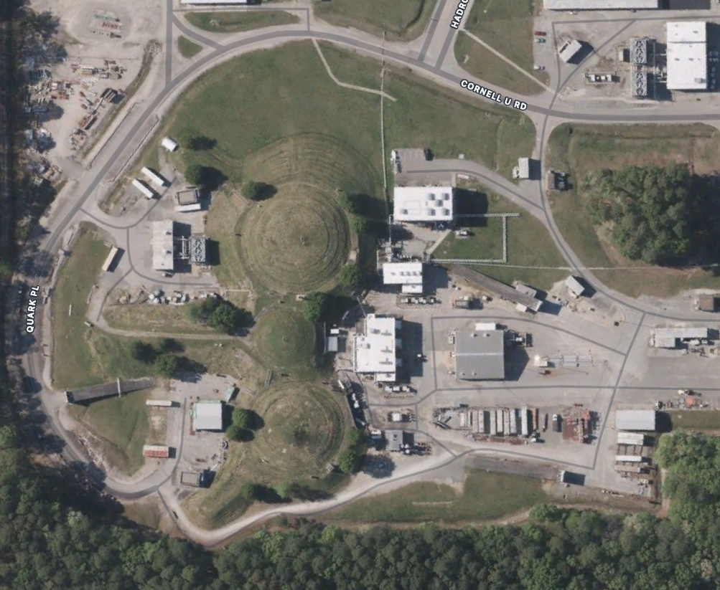

Experimental Setup
BDX is a JLab experiment approved by PAC46
Run time: 2027-2029
Expected statistics of 10²² EOT
Setup fully optimized for LDM searches
JLab offers the best conditions for a beam dump experiment:
Medium-high energy beam (up to 11 GeV)
High electron beam current (up to 65 μA)
Secondary muon beam of $∼{10}^{−6}μ/EOT$
Parasitic run WRT lab main physics program
CEBAF
Hall A
BDX
arXiv:1607.01390

Slide 8
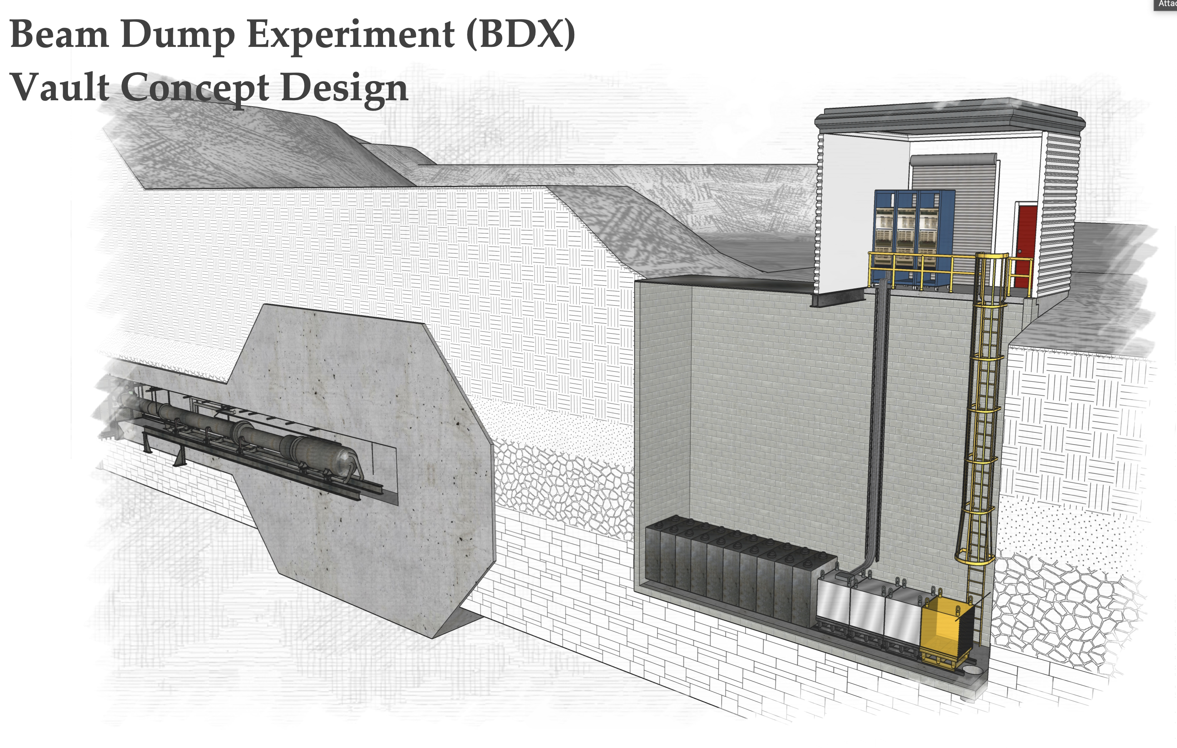
Experimental Setup
Detector hosted inside a vault ~20 m downstream Hall-A beam dump
5.5 m concrete + 8 m dirt + 5.5 m steel shielding
  Rule out most of SM beam background (except neutrinos)
No sizable overburden
  No shielding from cosmogenic background

Slide 9
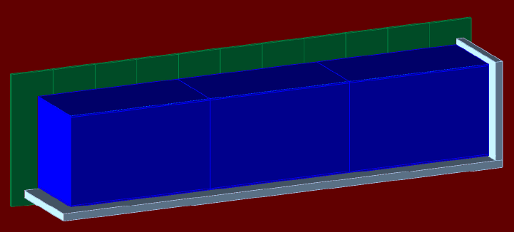
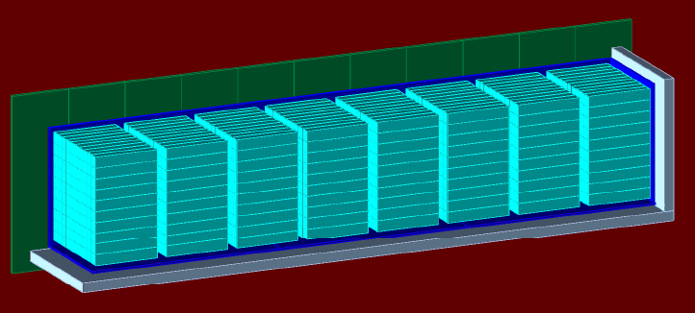
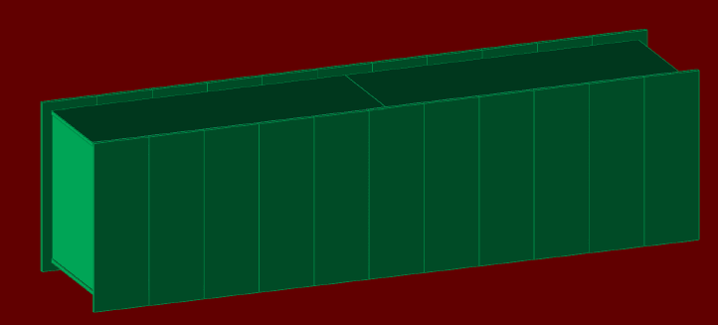
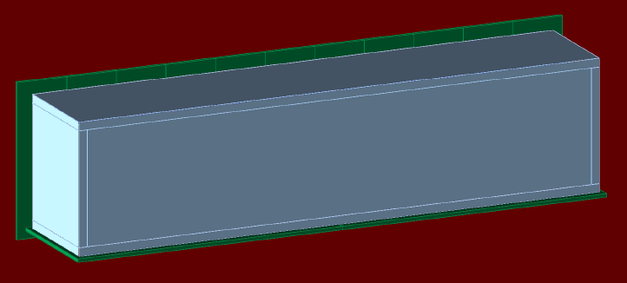
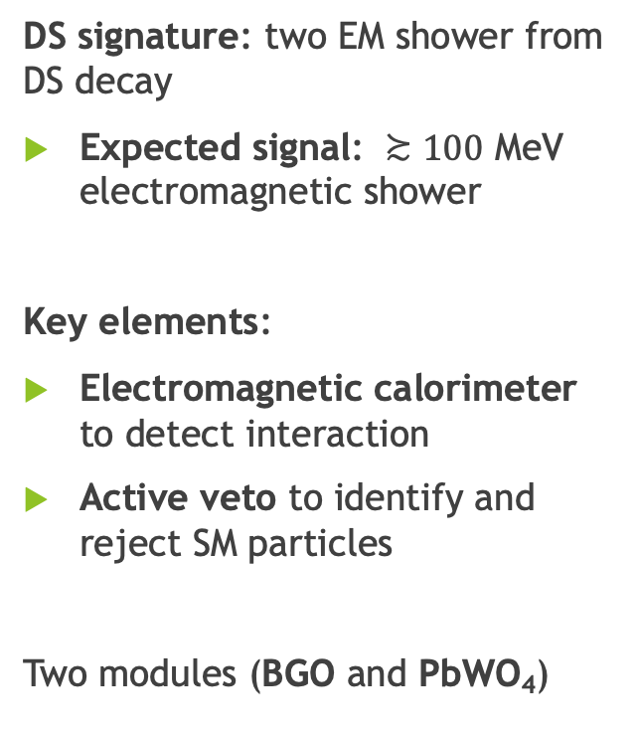
Detector
DS signature: two EM shower from DS decay
Expected signal: $≿100$ MeV electromagnetic shower
Key elements:
Electromagnetic calorimeter to detect interaction
Active veto to identify and reject SM particles
Two modules (BGO and PbWO₄)
arXiv:1607.01390

Slide 10
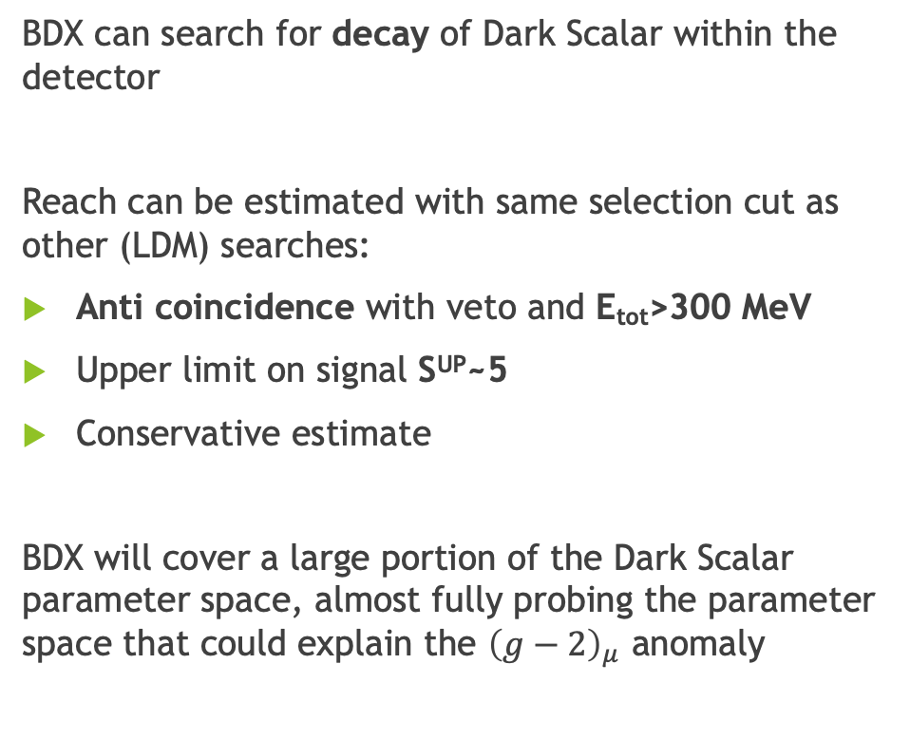
Results
BDX can search for decay of Dark Scalar within the detector
Reach can be estimated with same selection cut as other (LDM) searches:
Anti coincidence with veto and E_{tot}>300 MeV
Upper limit on signal S^{UP}~5
Conservative estimate
BDX will cover a large portion of the Dark Scalar parameter space, almost fully probing the parameter space that could explain the ${\left(g−2\right)}_{μ}$ anomaly

Slide 11

Conclusions
Muon-philic Dark Scalar is a simple explanation to the muon ${\left(g−2\right)}_{μ}$ anomaly
$$μ$$
$$μ$$
$$S$$
$$S$$
$$μ$$
$$μ$$
$$Z$$
$$Z$$

Slide 12

Conclusions
Muon-philic Dark Scalar is a simple explanation to the muon ${\left(g−2\right)}_{μ}$ anomaly
Model poorly explored due to the necessity of high intensity muon beams

Slide 13
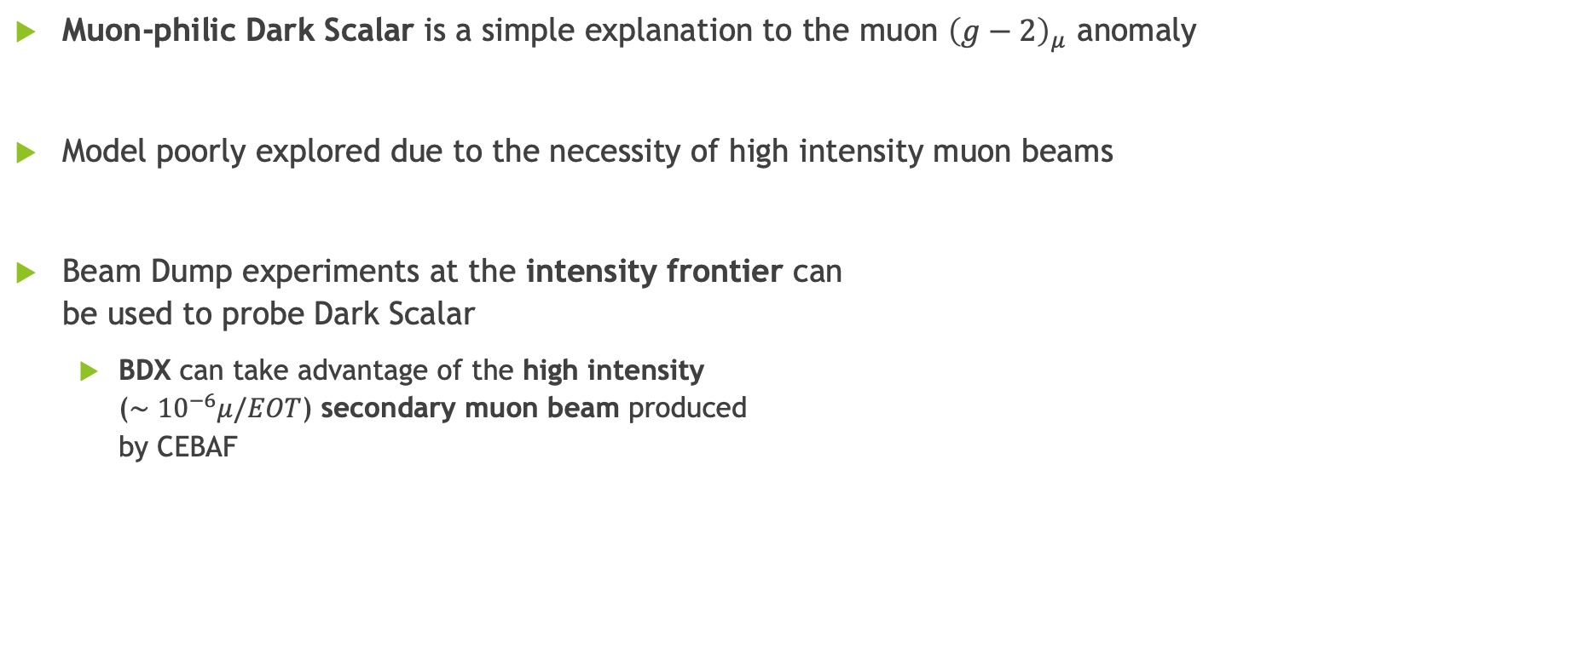
Conclusions
Muon-philic Dark Scalar is a simple explanation to the muon ${\left(g−2\right)}_{μ}$ anomaly
Model poorly explored due to the necessity of high intensity muon beams
Beam Dump experiments at the intensity frontier can
be used to probe Dark Scalar
  BDX can take advantage of the high intensity
  ($∼{10}^{−6}μ/EOT$) secondary muon beam produced
  by CEBAF

Slide 14
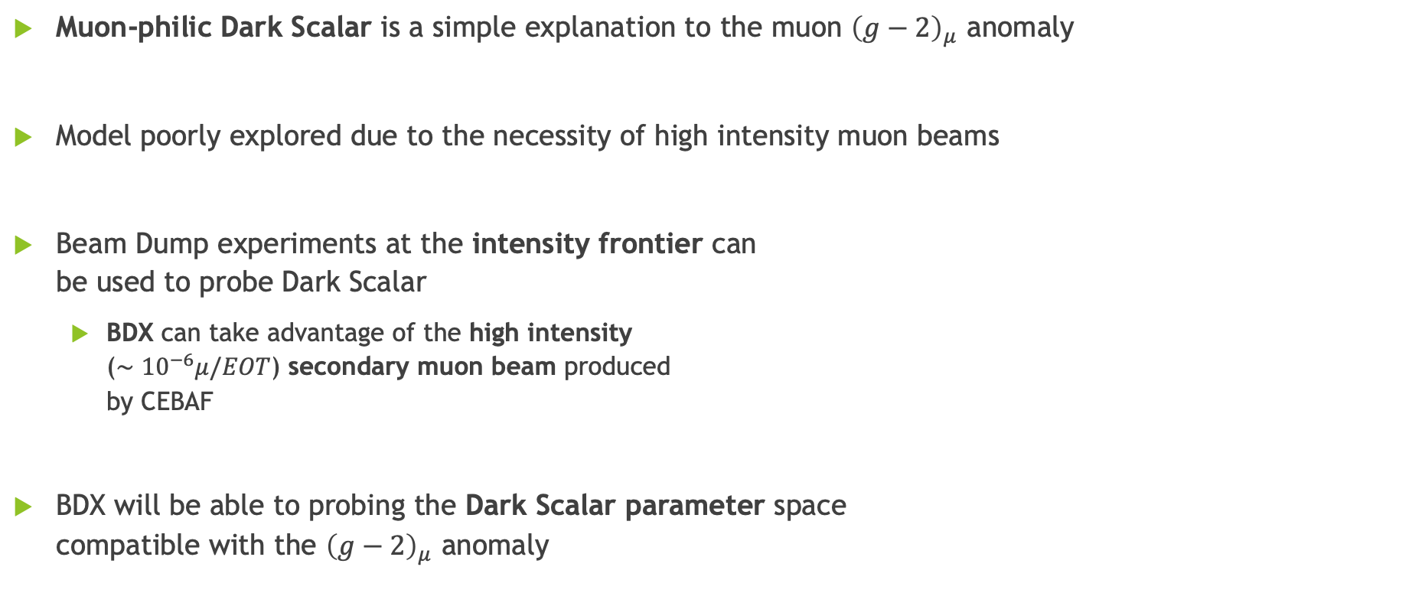
Conclusions
Muon-philic Dark Scalar is a simple explanation to the muon ${\left(g−2\right)}_{μ}$ anomaly
Model poorly explored due to the necessity of high intensity muon beams
Beam Dump experiments at the intensity frontier can
be used to probe Dark Scalar
  BDX can take advantage of the high intensity
  ($∼{10}^{−6}μ/EOT$) secondary muon beam produced
  by CEBAF
BDX will be able to probing the Dark Scalar parameter space
compatible with the ${\left(g−2\right)}_{μ}$ anomaly

Slide 15
THANK
YOU

Slide 16
BACKUP SLIDES

Slide 17
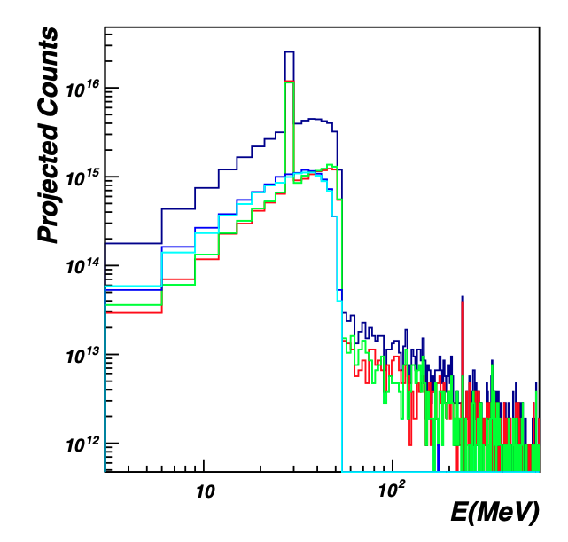

BDX Background
Main contribution to BDX background:
Beam muons
  Rate of Hz but energy below threshold
Neutrinos
  Irreducible beam background
  With selection cut main background contribution (O(10) events)
Cosmic muons
  Estimated from prototype (in situ measurement needed)
  Expected rate of Hz but removed with anti coincidence with veto
Neutral cosmic background
  Irreducible background, estimated from prototype
  With selection cut estimated to be removed
Total
$$ν_{e}$$
$${\overline{ν}}_{e}$$
$${\overline{ν}}_{μ}$$
$$ν_{μ}$$

