Slide 1
Strategy and Plans for the
Future Experimental Program
Cynthia Keppel
BDX and Beyond Workshop
Newport News, VA, September 4-5, 2025

Slide 2
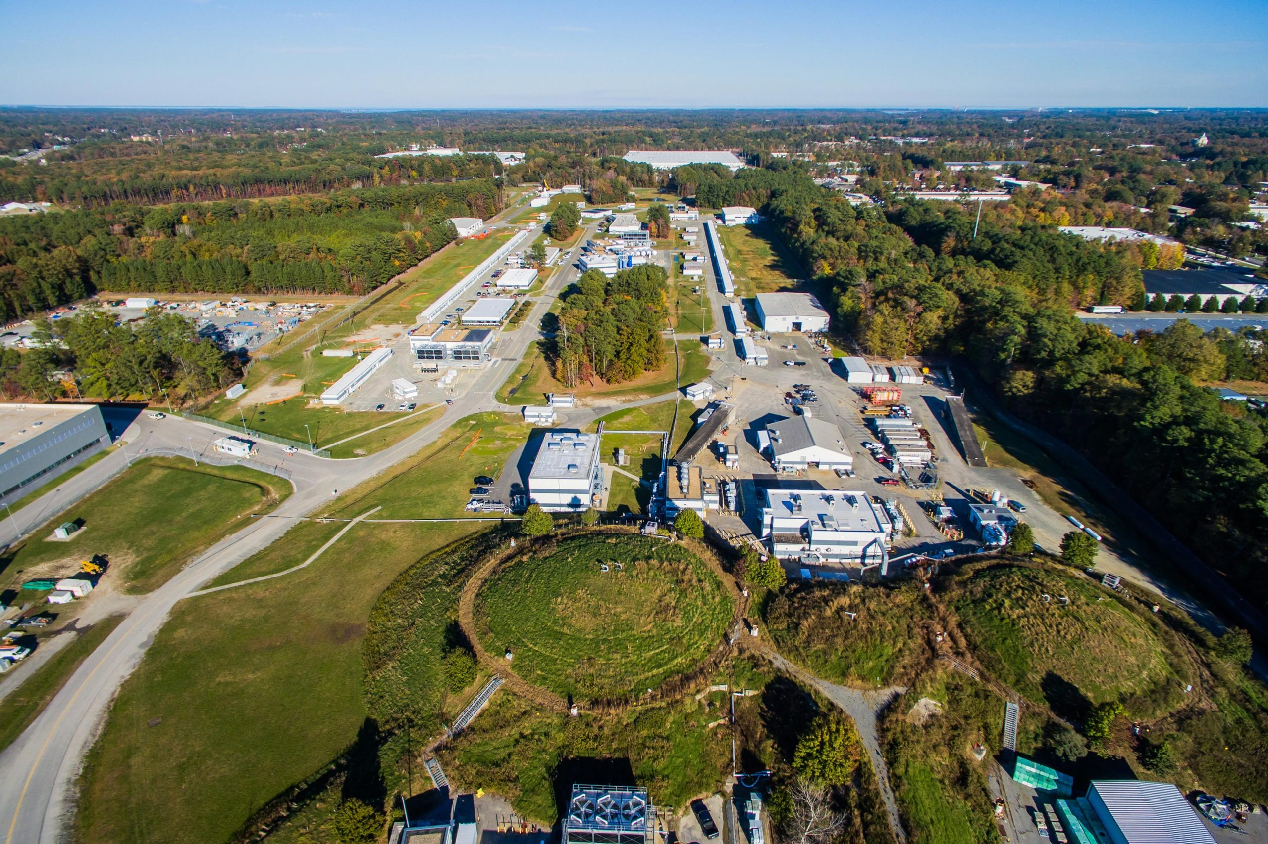
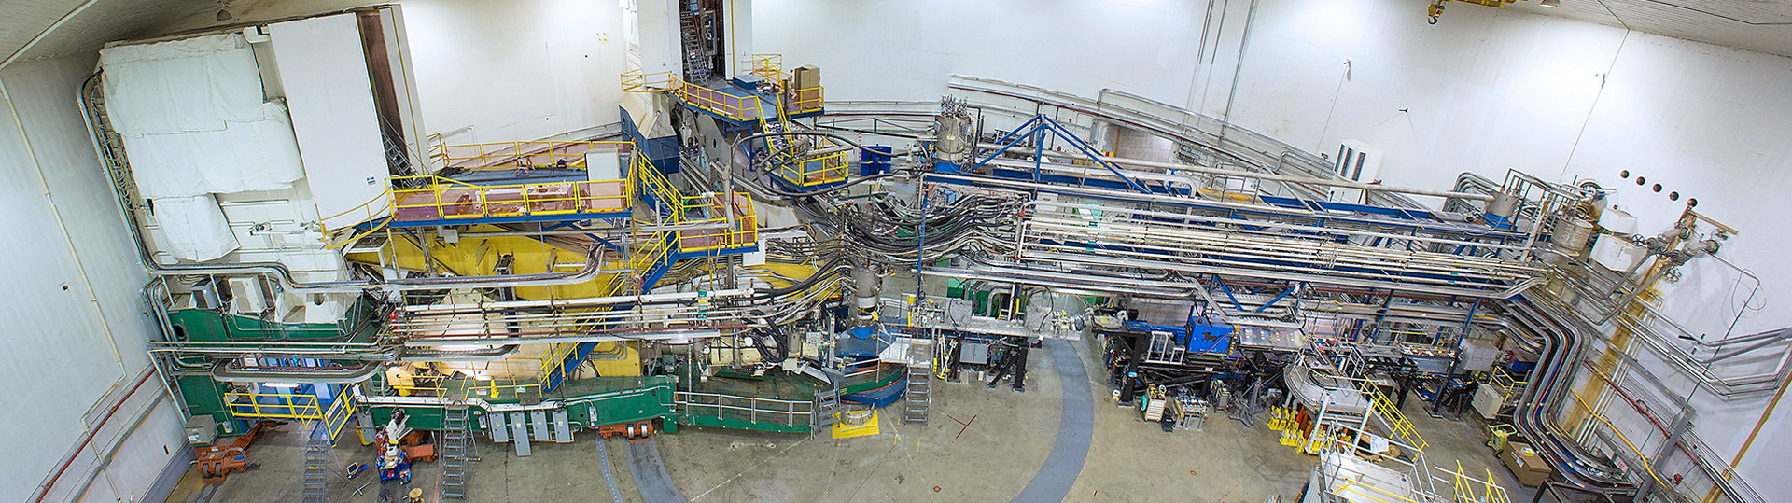
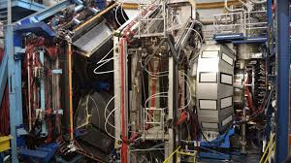
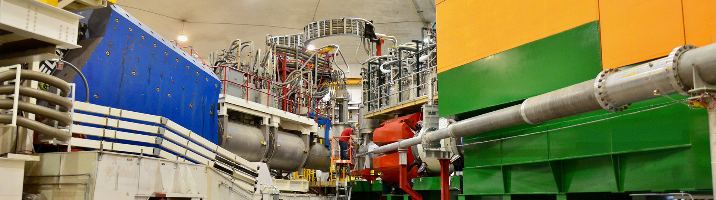
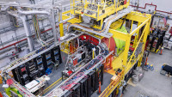
Jefferson Lab - a Cornerstone of Modern Hadron Physics Research
Explore the fundamental nature of confined states of quarks and gluons → Non-pQCD
Explore hadronic structure and interactions in nuclei
Discover evidence for physics BSM
A Facility at the LUMINOSITY Frontier
(up to 10³⁹ cm-² s-¹ )
World-Class Electron Beam
CEBAF provides a precision, 12 GeV continuous electron beam with:
High Intensity
High Polarization
Unique Experimental Facilities
CEBAF supports 4 cutting-edge experimental halls with:
State-of-the-art detectors
Versatile experimental setups
Advanced targets, data acquisition
Hall A
Hall B
Hall C
Hall D

Slide 3
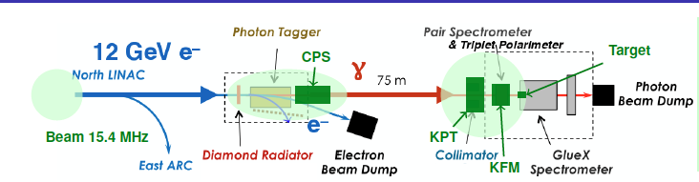
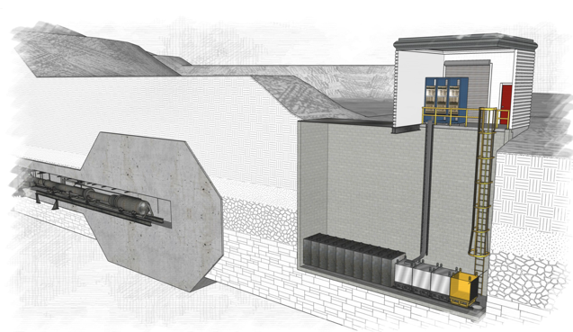
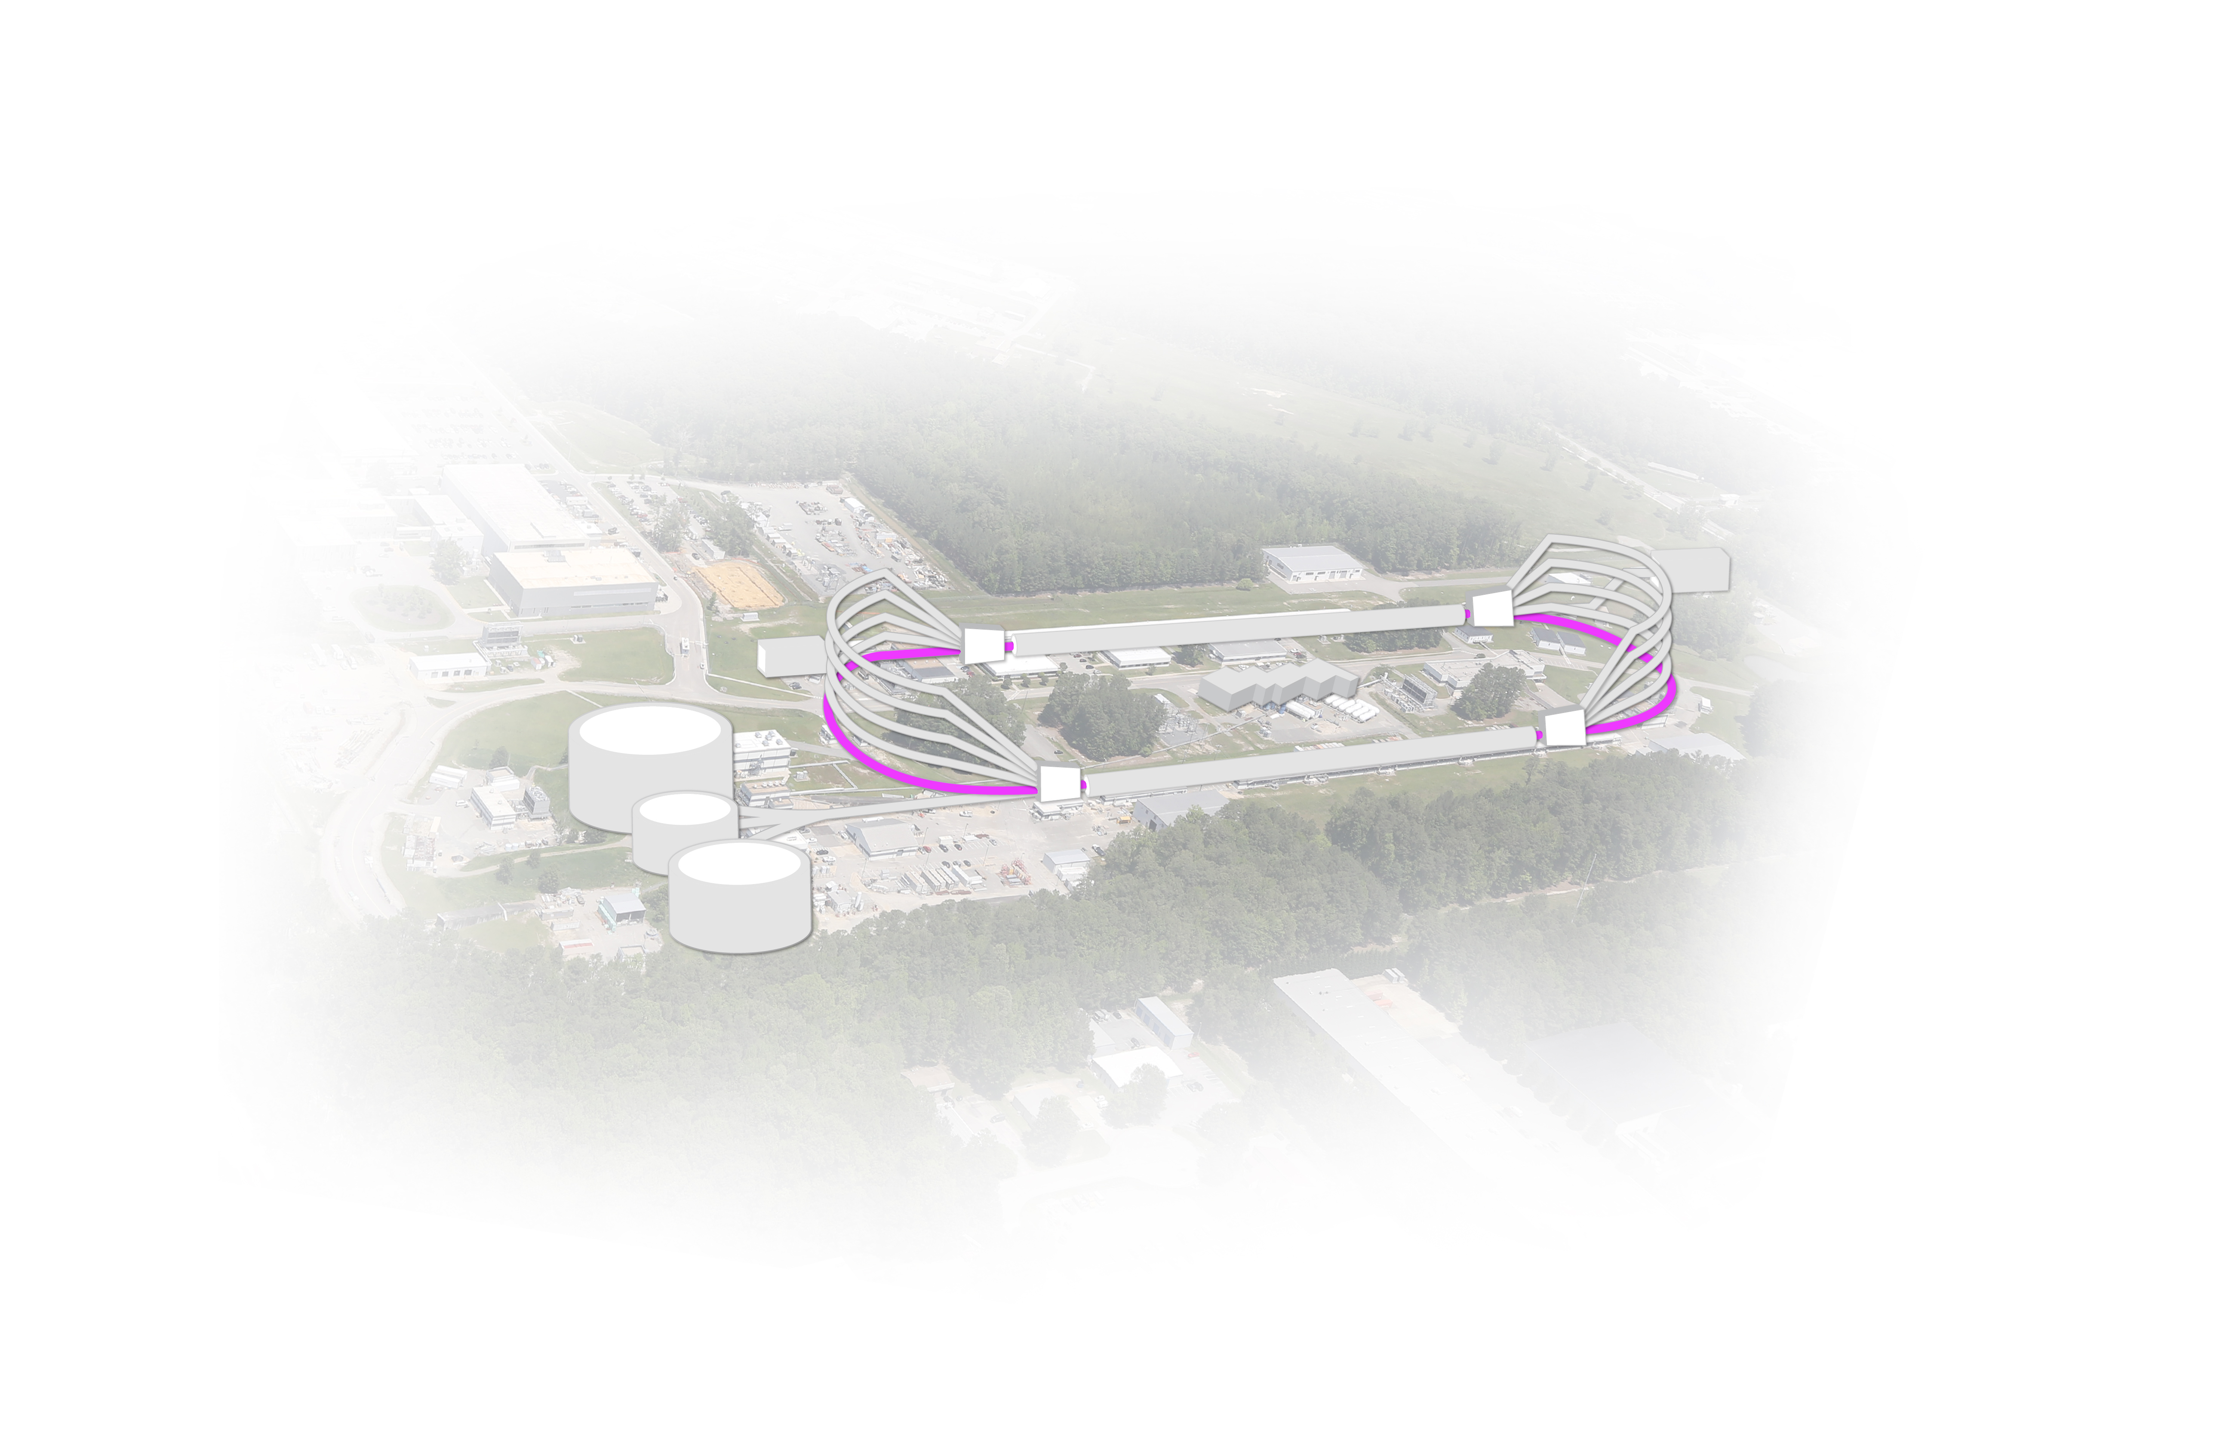
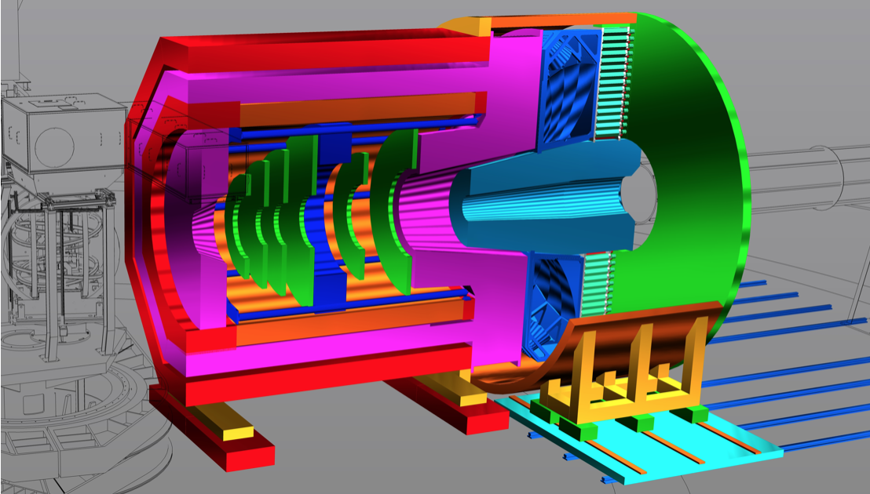

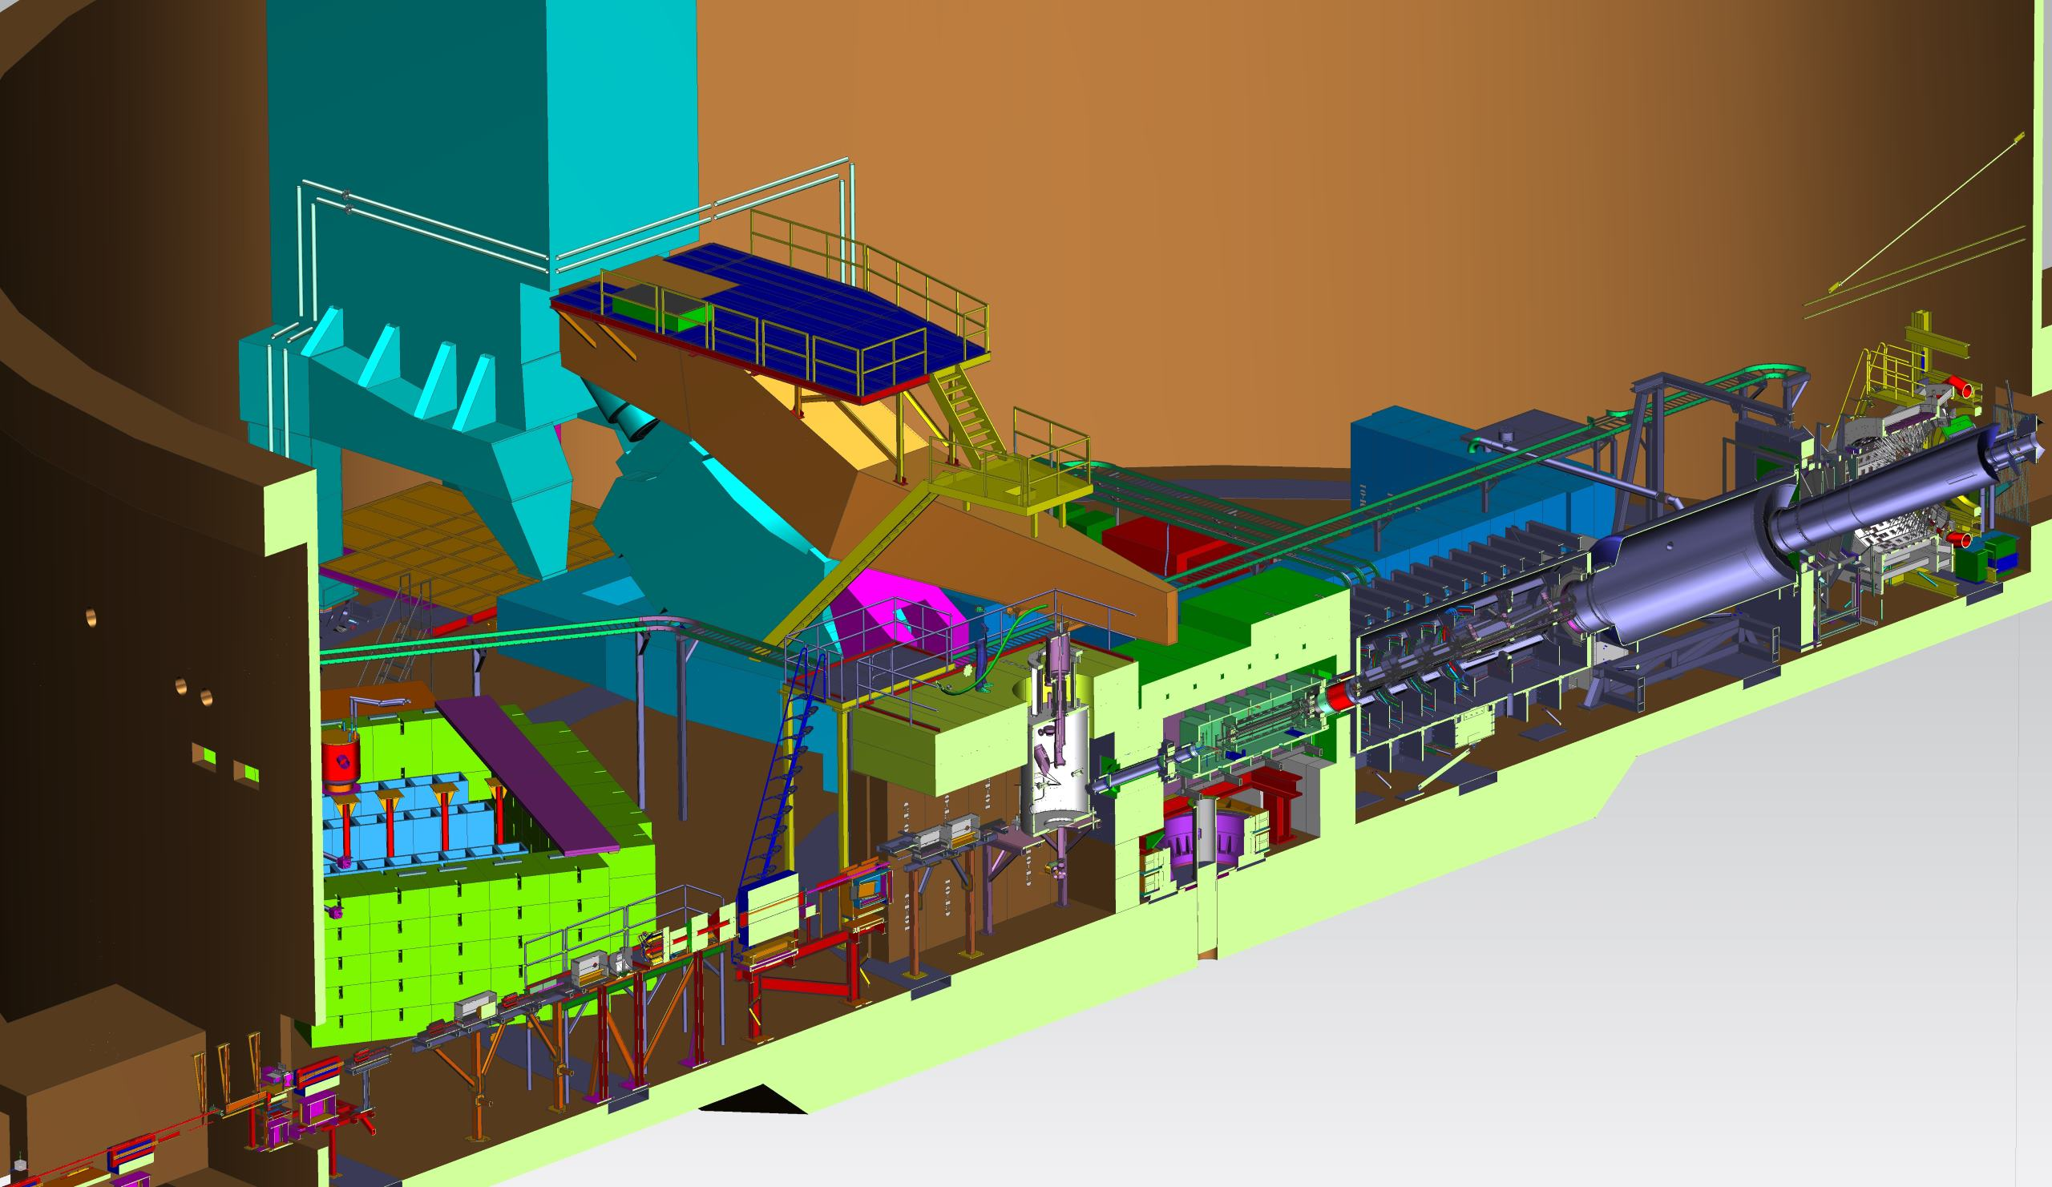
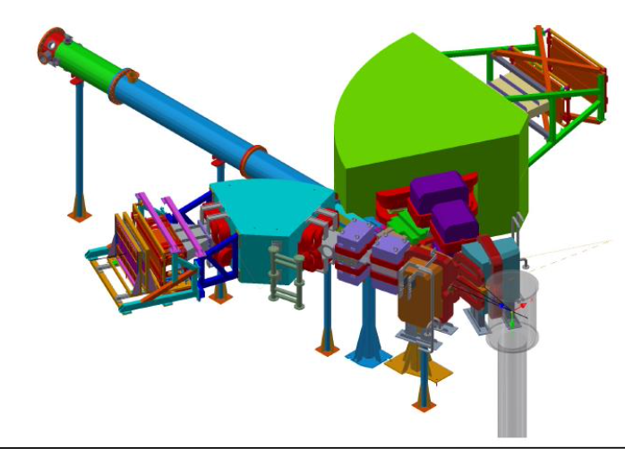
What’s next?
KLF: High Intense Kaon beam
Strangeness Spectroscopy
BDX: Beam Dump Exp.
Search for light dark matter particles
Intense secondary μ and ν beams
D
SoLID
High luminosity (10³⁷-10³⁹ cm⁻²s⁻¹) + large acceptance
FFA arcs
Precision nucleon 3D imaging
Origin of the proton mass and gluonic force
BSM searches & nucleon structure
A
B
e+ @ 12 GeV
Ultra-precise measurement of the weak charge of the electron
Sensitive to BSM physics
MOLLER
e- @ 22 GeV
C
Hypernuclear Spectroscopy

Slide 4
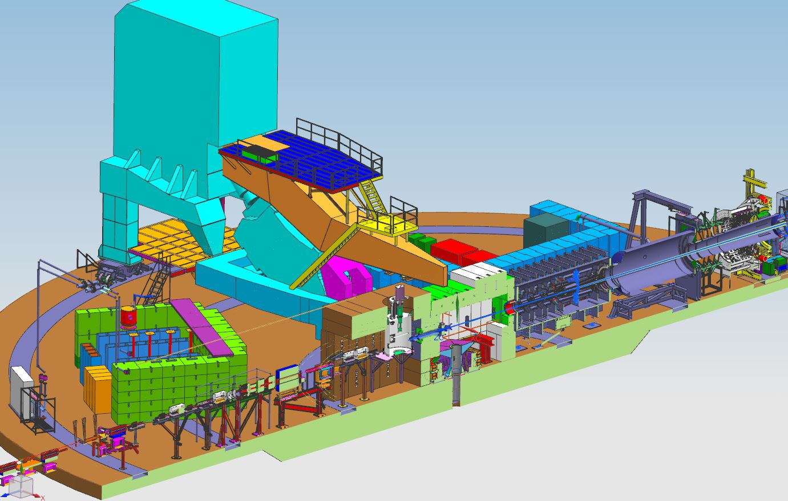
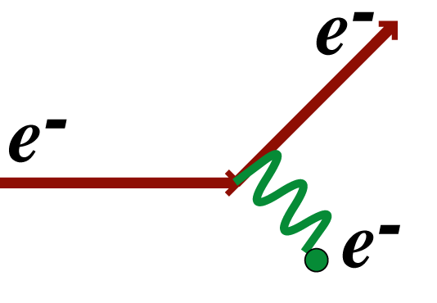

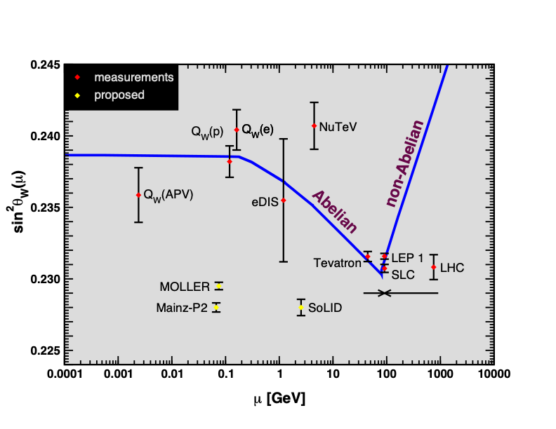

MOLLER: Precision Electroweak Physics
δ(sin²θW) = ± 0.00023 (stat.) ± 0.00012 (syst.)
~ 0.1%
Unique (purely leptonic) new physics reach
Special opportunity with 12 GeV high luminosity
Search for new flavor diagonal neutral currents
Look for tiny but measurable deviations from precisely calculable predictions for SM processes
Only e-e measurement: SLAC E158
A_{new}
MOLLER Reach
Unique discovery space: beyond that of a 500 GeV lepton collider
Precursor to HiLumi LHC sin²θW – complementary precision electroweak physics
Impacts the current discrepancy on the W mass (Fermilab vs LHC)
JLab Measurements
MOLLER: improve QW(e) by a factor of 5

Slide 5
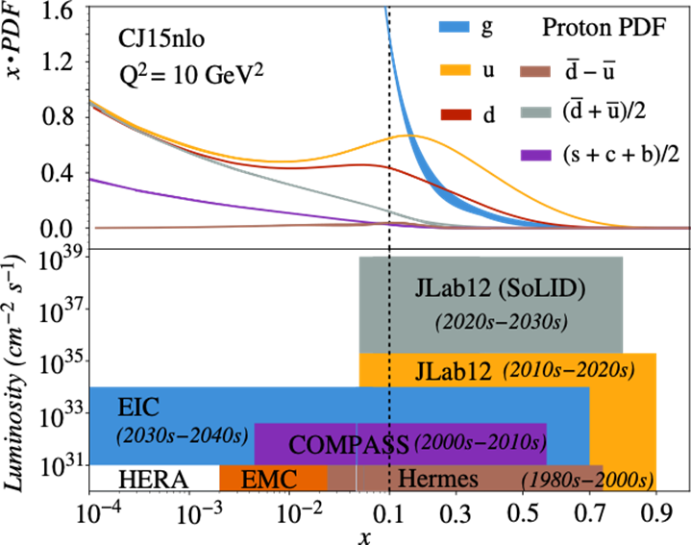
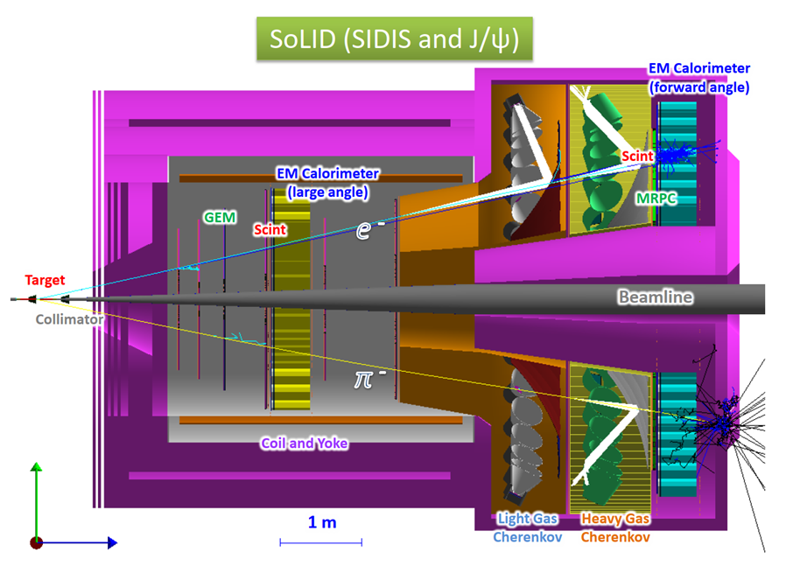
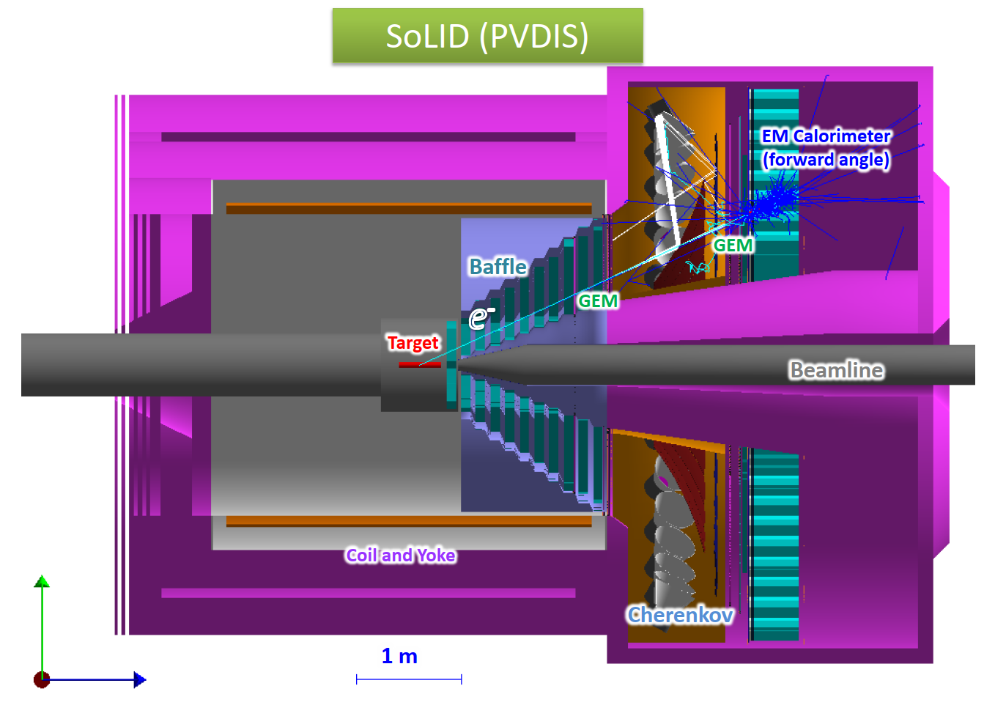
SoLID: Three major physics programs
Maximize the science return of the 12-GeV CEBAF upgrade by combining high luminosity and large acceptance
SoLID was highlighted in the 2023 DOE Long Range Plan in recommendation 4 and throughout the document
Three main physics programs:
  SIDIS
    Valence quark tomography with precision in 4D
  Precision J/𝜓 production near threshold
    Origin of proton mass
  PVDIS
    Test of Standard Model
    Search for new physics
…and more!

Slide 6
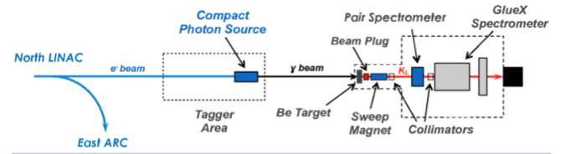
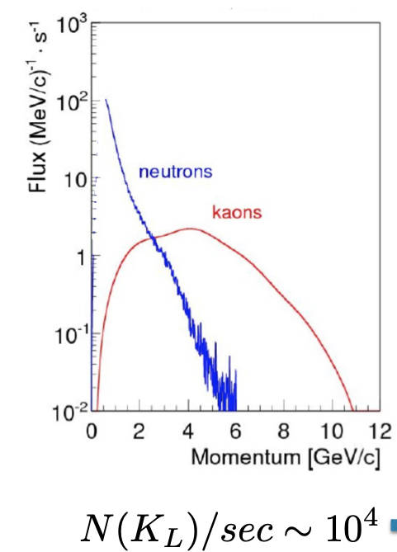
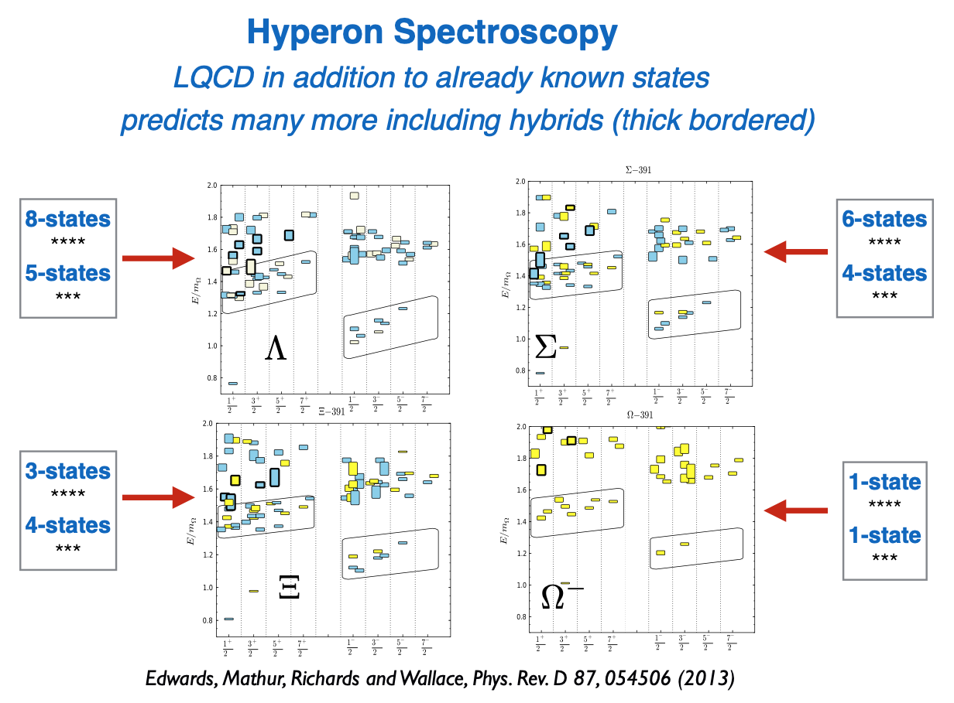
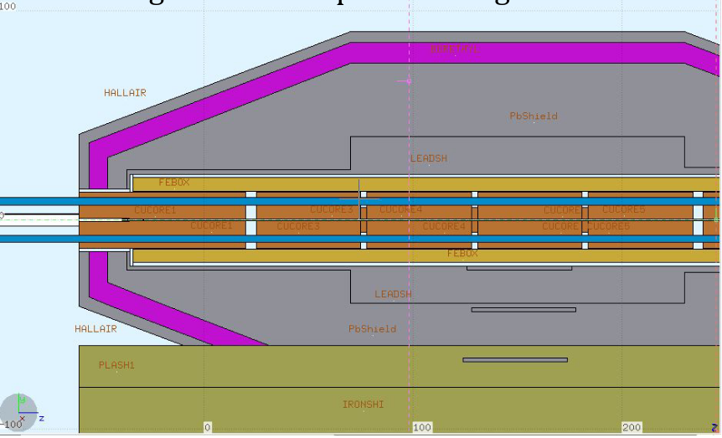
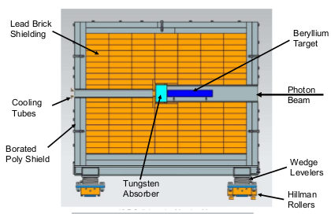
K-Long Facility: Spectroscopy in K_{LONG} beam
Comprehensive studies of strange baryons and mesons with a KL beam at Hall D
Unique opportunities in the hadron spectroscopy field
K_{L} beam
Compton Photon Source (CPS): Engineering design is advanced
Be target for KL production:
Engineering design is (nearly) complete
Realization on - going
Big overhead: requires about 2 years for installation and >1 year for de-installation
Schedule under discussion
6

Slide 7
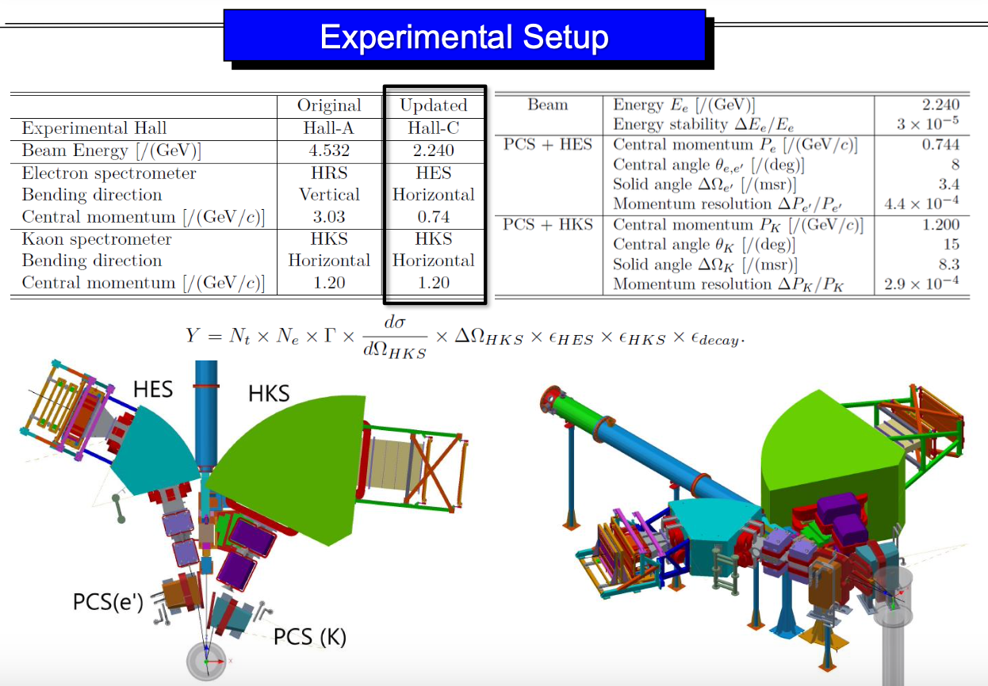
Hypernuclear Physics in Hall C
Study of the isospin dependence in medium-mass hyperisotopes, Λ interactions in nuclear matter, and more!

Slide 8
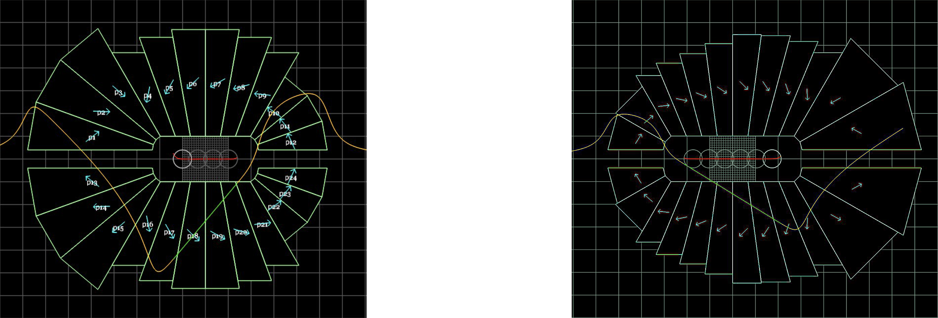
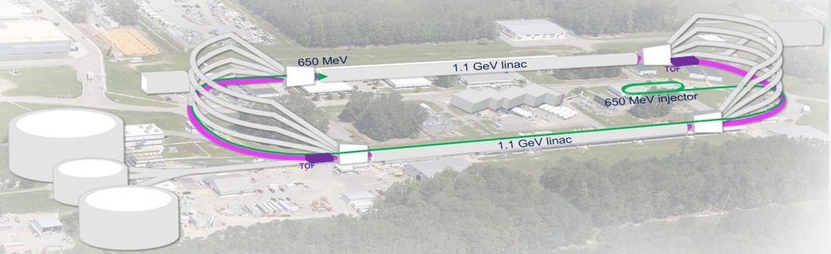
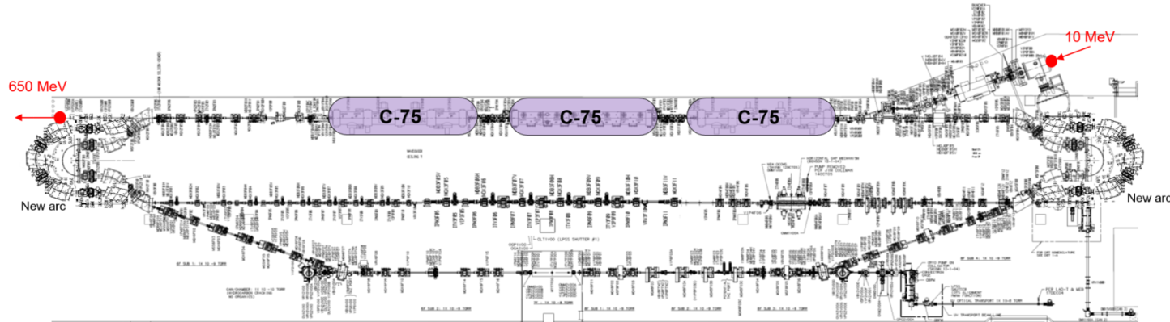
CEBAF e+ and 22 GeV accelerator design
Increase the energy without additional RF
Increase the number of recirculation passes with Fixed Field Accelerator (FFA) technology
  Remove the highest recirculation pass (Arc 9 & A) and replace them with two compact FFA arcs
  Include time-of-flight (TOF) Splitter bend systems.
  New 650 MeV recirculating injector
Permanent Magnets for FFA arcs
Focusing Magnet BF
Defocusing Magnet BD
FFA arc
FFA arc
650 MeV Recirculating Injector
S. Brooks

Slide 9
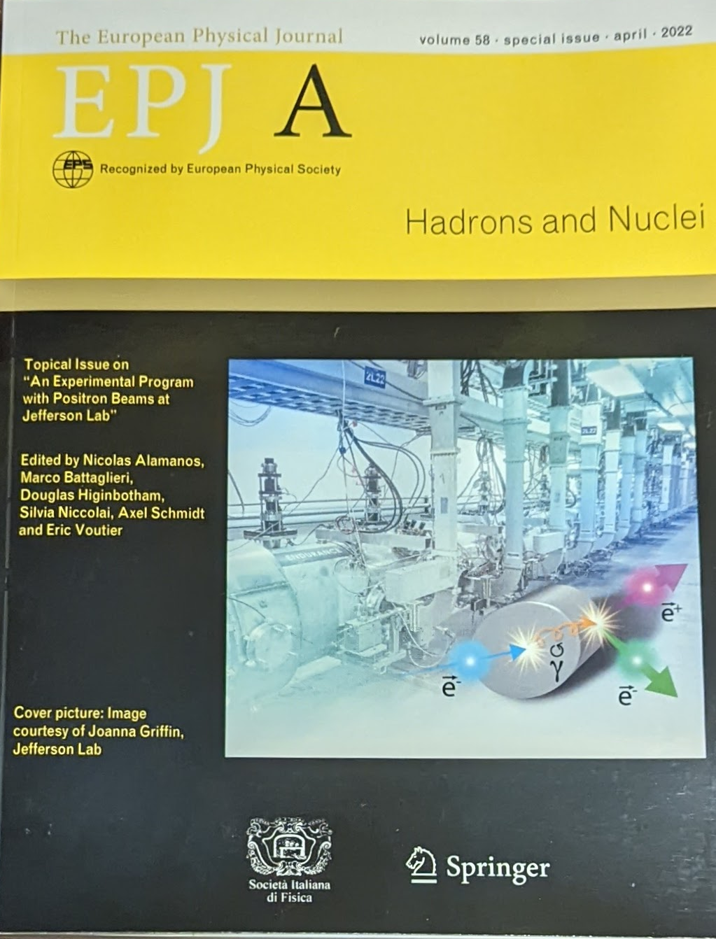
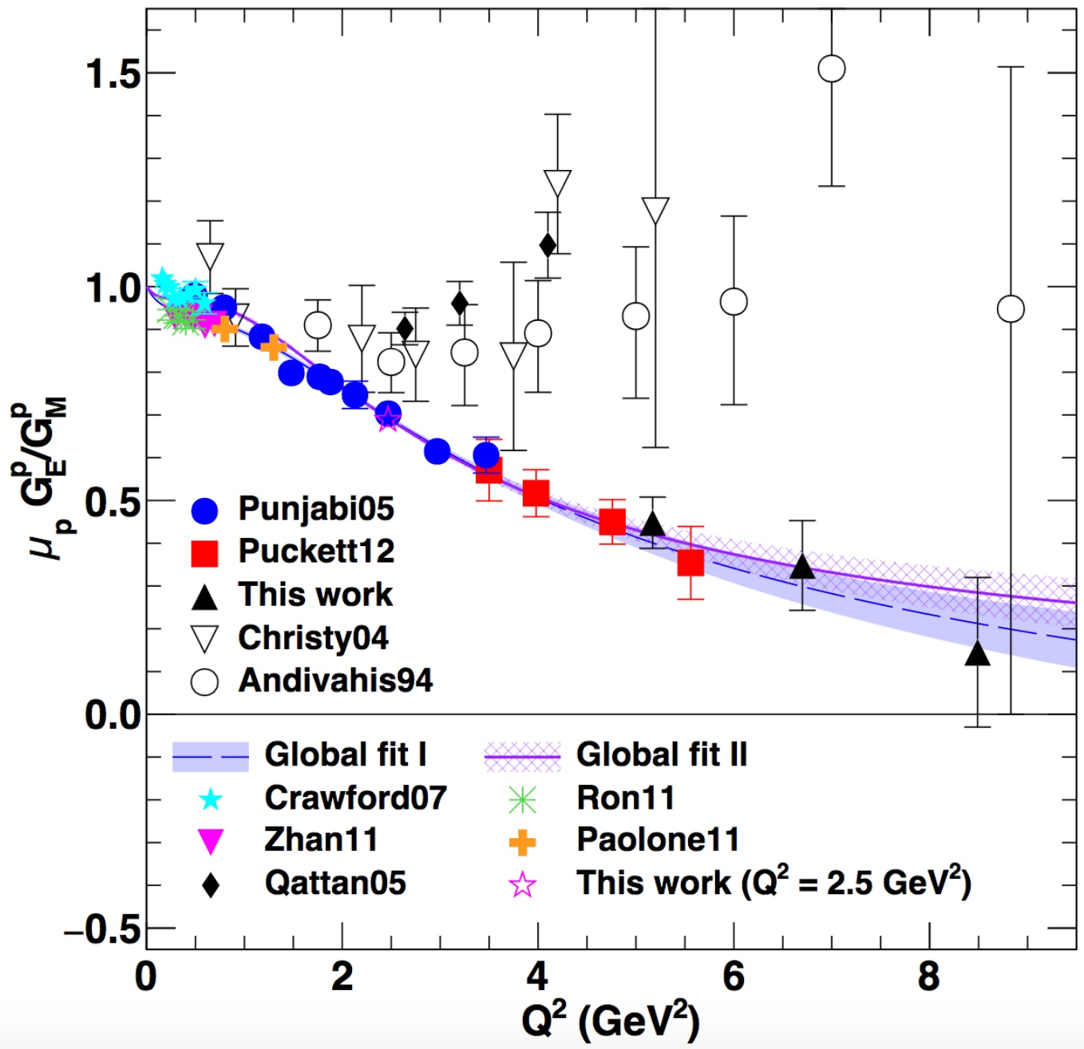

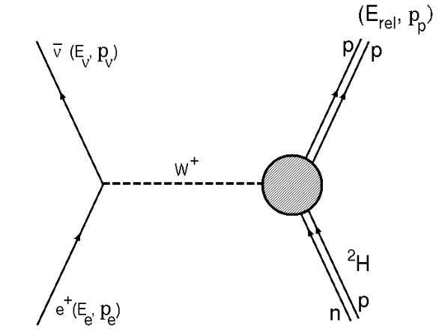
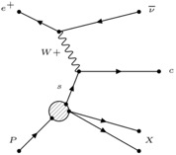
Compelling Physics Program with Ce+BAF
Beam charge asymmetries
  Two-photon exchange
  Deeply Virtual Compton Scattering
Annihilation processes
  Light dark matter searches
Charged-current processes
  Inverse beta-decay
  Access strangeness with charm-tagging
  Charged lepton flavor violation
  Axial Form Factor
Q² (GeV²)
Is the 2-γ exchange the cause of the proton FF discrepancy?
Annual in person working group meeting next March 24-26 at JLab
PAC approved experiments (as of September 2025)
“C2” approval of 7 experiments for a total of 406 total PAC days (Hall A & C)
(PAC day = two calendar day)
9
9

Slide 10
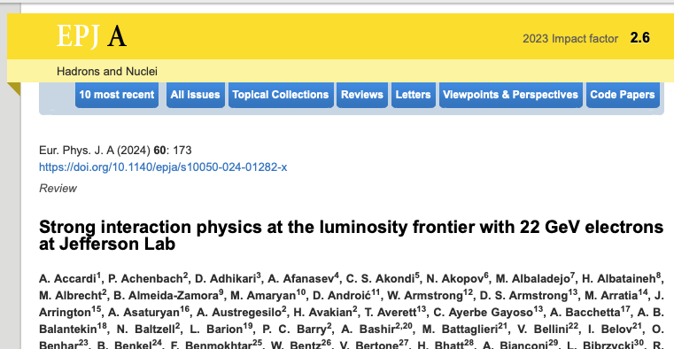
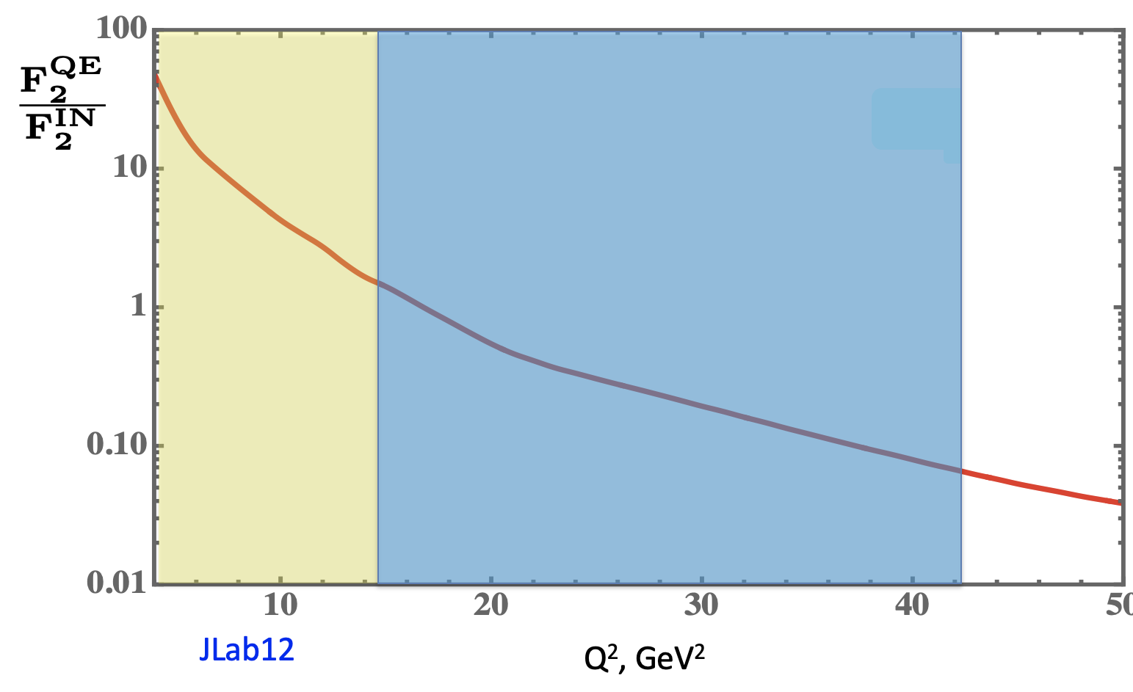
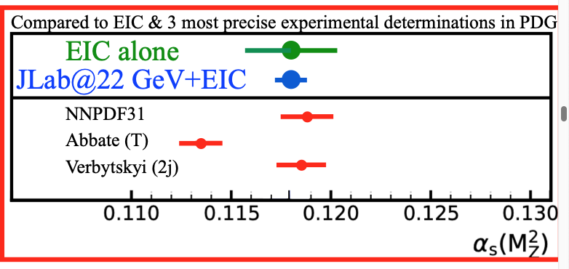
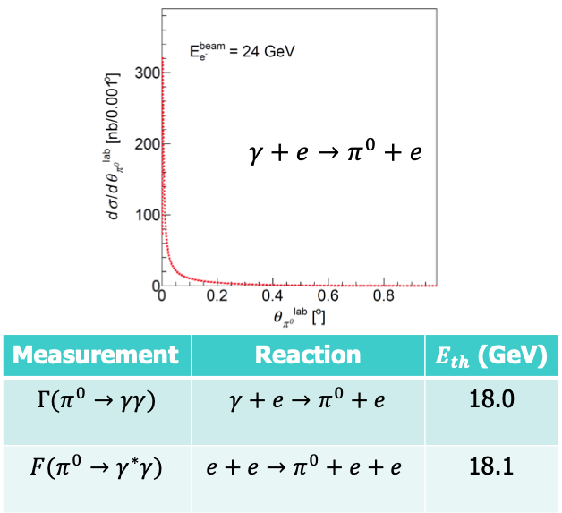
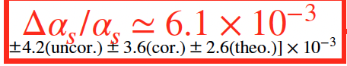
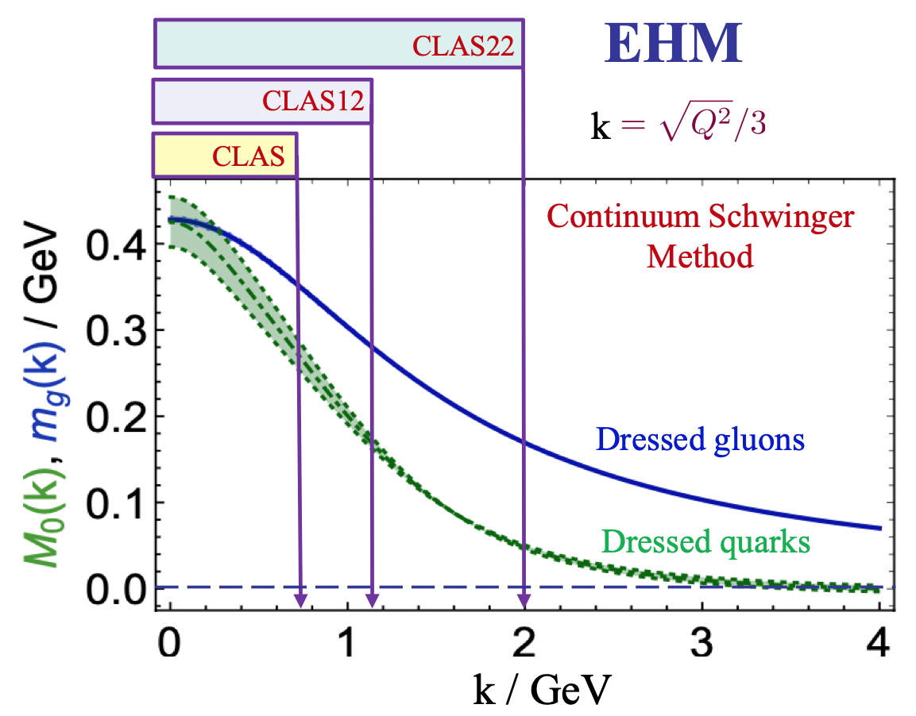
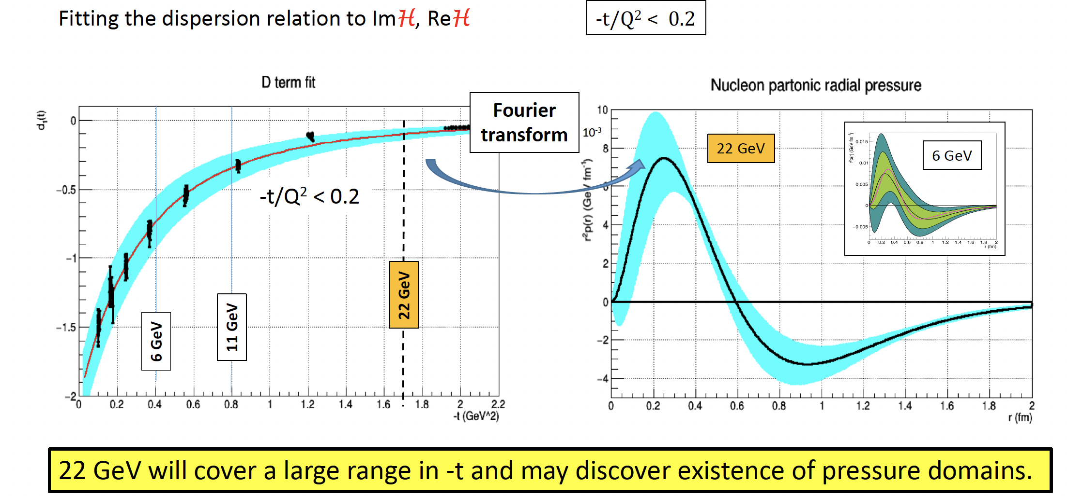
A Broad and Exciting Physics Program at 22 GeV
Super-fast Quarks in Nuclei
Nuclear core forces
~450 authors
Jlab12
Jlab22
A new document outlining the progress of the scientific case will be available soon
Primakoff on an e- target
Tests of Fund. Symm.
N* γvpN* electr. Emergence of Hadron Mass
DVCS @ 22 GeV
Mechanical Property of the proton

Slide 11
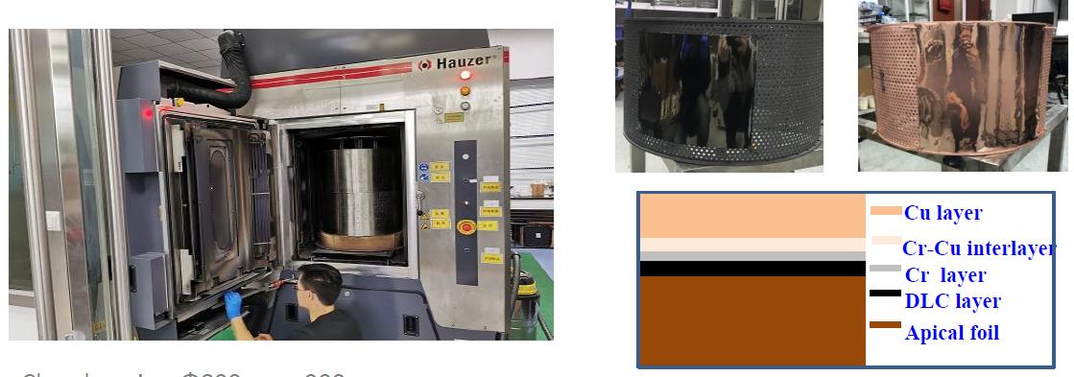
MicroPattern Gaseous Detector Center:
A Proposed Community User Facility
Need for US-MPGD center for NP, HEP, BES, Medical applications and beyond:
Large number of US institutions (~50+) engaged in MPGD activities
Community needs a dedicated US-based MPGD User Facility with a:
  Prototype detector production workshop similar to the SiDet Facility at FNAL
  Detector R&D Lab like the RD51 / GDD Lab at CERN
Jefferson Lab is an excellent place for an MPGD center in the US:
  At the forefront in both the deployment and development of large MPGDs in NP experiments
  Experience in high background, high rate deployment
  In-house MPGD expertise expanding
  Beam test capabilities
Large area resistive MPGD
Magnetron sputtering machine
Proposed MPGD Center
MPGDs detector R&D/prototyping
Fabrication of large MPGDs (µRWELLs, GEMs, …)
In-house and external users' space with technical and scientific support
Equipment for detector assembly, testing, irradiation, high-rate and aging studies..
Advanced readout R&D
11

Slide 12
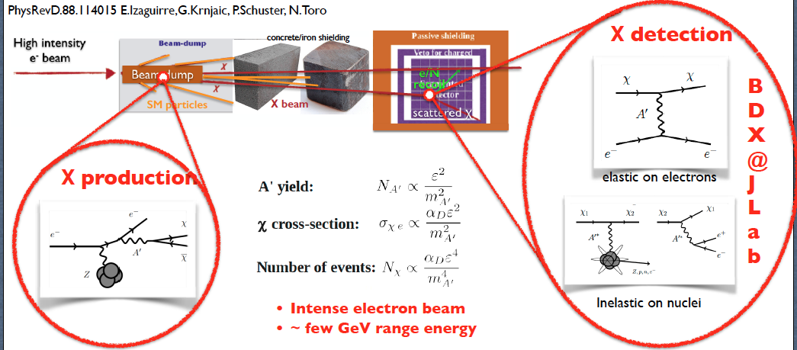
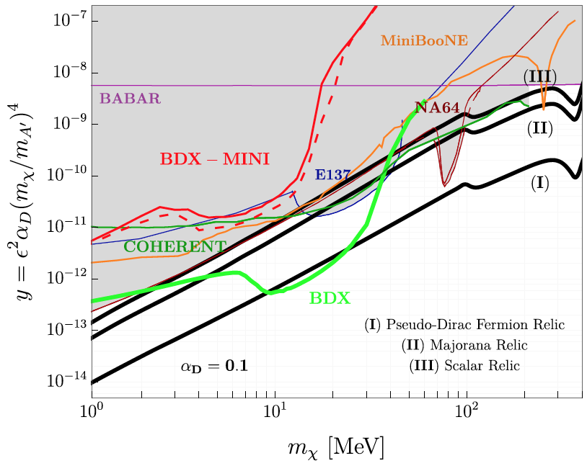
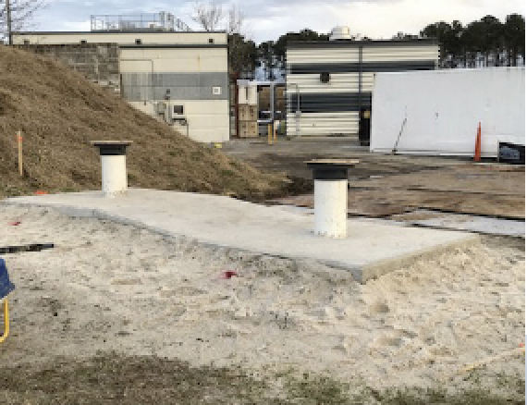
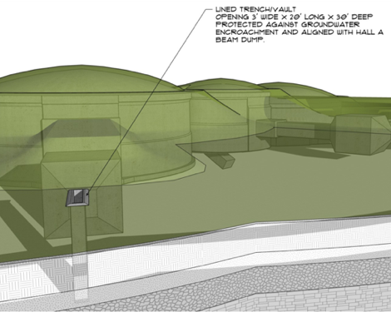
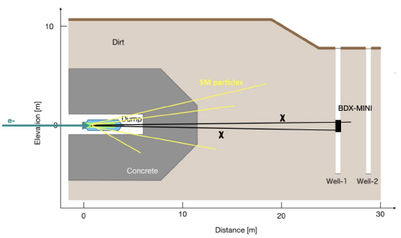
Beam Dump Experiment (BDX)
A cutting-edge experiment designed to search for light dark matter
Two step process
  An electron radiates an A’ and the A’ promptly decays to a χ (DM) pair
  II) The χ (in-)elastically scatters on a e-/nucleon in the detector producing a visible recoil (GeV)
Experimental signature in the detector:
Χ-electron → EM shower ~GeV energy
BDX-MINI: pilot experiment to prove the validity and feasibility of the BDX exp
Accumulating 10²² EOT in ~2y BDΧ sensitivity is 10-100 times better than existing limits on LDM
Two wells dug for bg muon tests
E_{beam}=2.2 GeV, no muons
Limited reach but first physics result!
Funds for the construction of the first module of the calorimeter secured.
Engineering design studies for the construction of the hall are ongoing.
M.Battaglieri et al. PRD 106, 072011
Collected 4e21 EOT (40% BDX!) in ~4 months (+ cosmics)
12

Slide 13
Conclusions and Outlook
Jefferson Lab offers an exceptional environment for exploring QCD in the non-perturbative regime, combining high luminosity with state-of-the-art experimental facilities.
Innovative experiments such as MOLLER, SoLID, BDX, Hall C Hypernuclear and studies at the K-Long Facility will deepen our understanding of nucleon structure, dark sectors, and the role of strangeness in QCD.
Strategic upgrades, like the 22 GeV energy enhancement will expand our reach into uncharted regimes of hadronic physics.
The development of positron beams is essential to isolating and quantifying two-photon exchange effects, while also enabling symmetry tests and rare process searches that deepen our exploration of the Standard Model and beyond.
Advanced detector technology development, such as made possible by the proposed MPGD center, fuels new experiments broadly by allowing for enhanced measurement capabilities with improved resolution and high rate.
Together, these opportunities signal a dynamic future, one that bridges precision measurements with bold exploration, and keeps Jefferson Lab at the forefront of discovery.

Slide 14
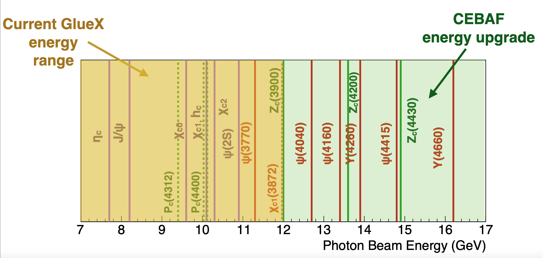
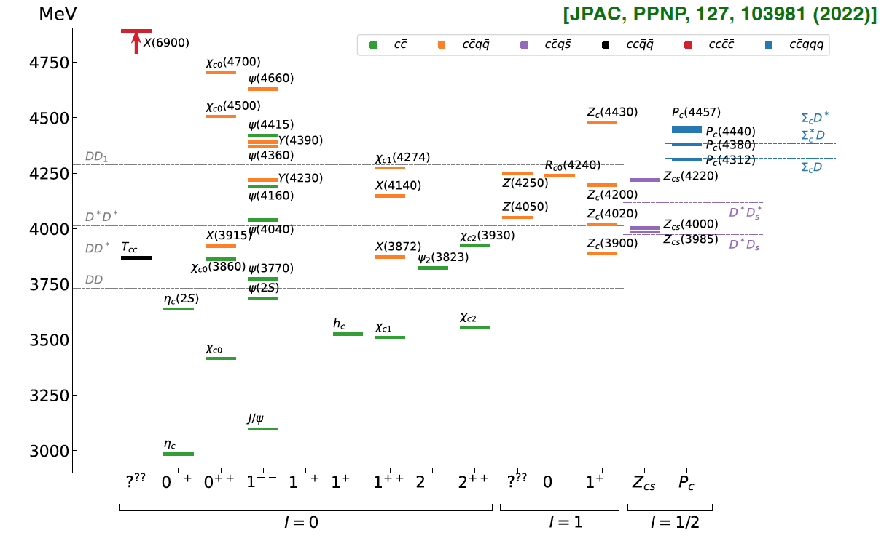
22 GeV: A New Window into the World of XYZ States
This program suits perfect the 22 GeV upgrade: Thresholds for XYZ states open just above 12 GeV
πJ/ψ
ππJ/ψ
ωJ/ψ
-
Many non-qq candidate states observed in in B decays, e⁺e- colliders
No XYZ state uncontroversially seen so far (tetraquark, molecule, virtual state, triangle singularity, ... ?)
Crucial to confirm these states in other production processes
→ never directly produced using γ/lepton beam → free from re-scattering mechanisms

