Slide 1
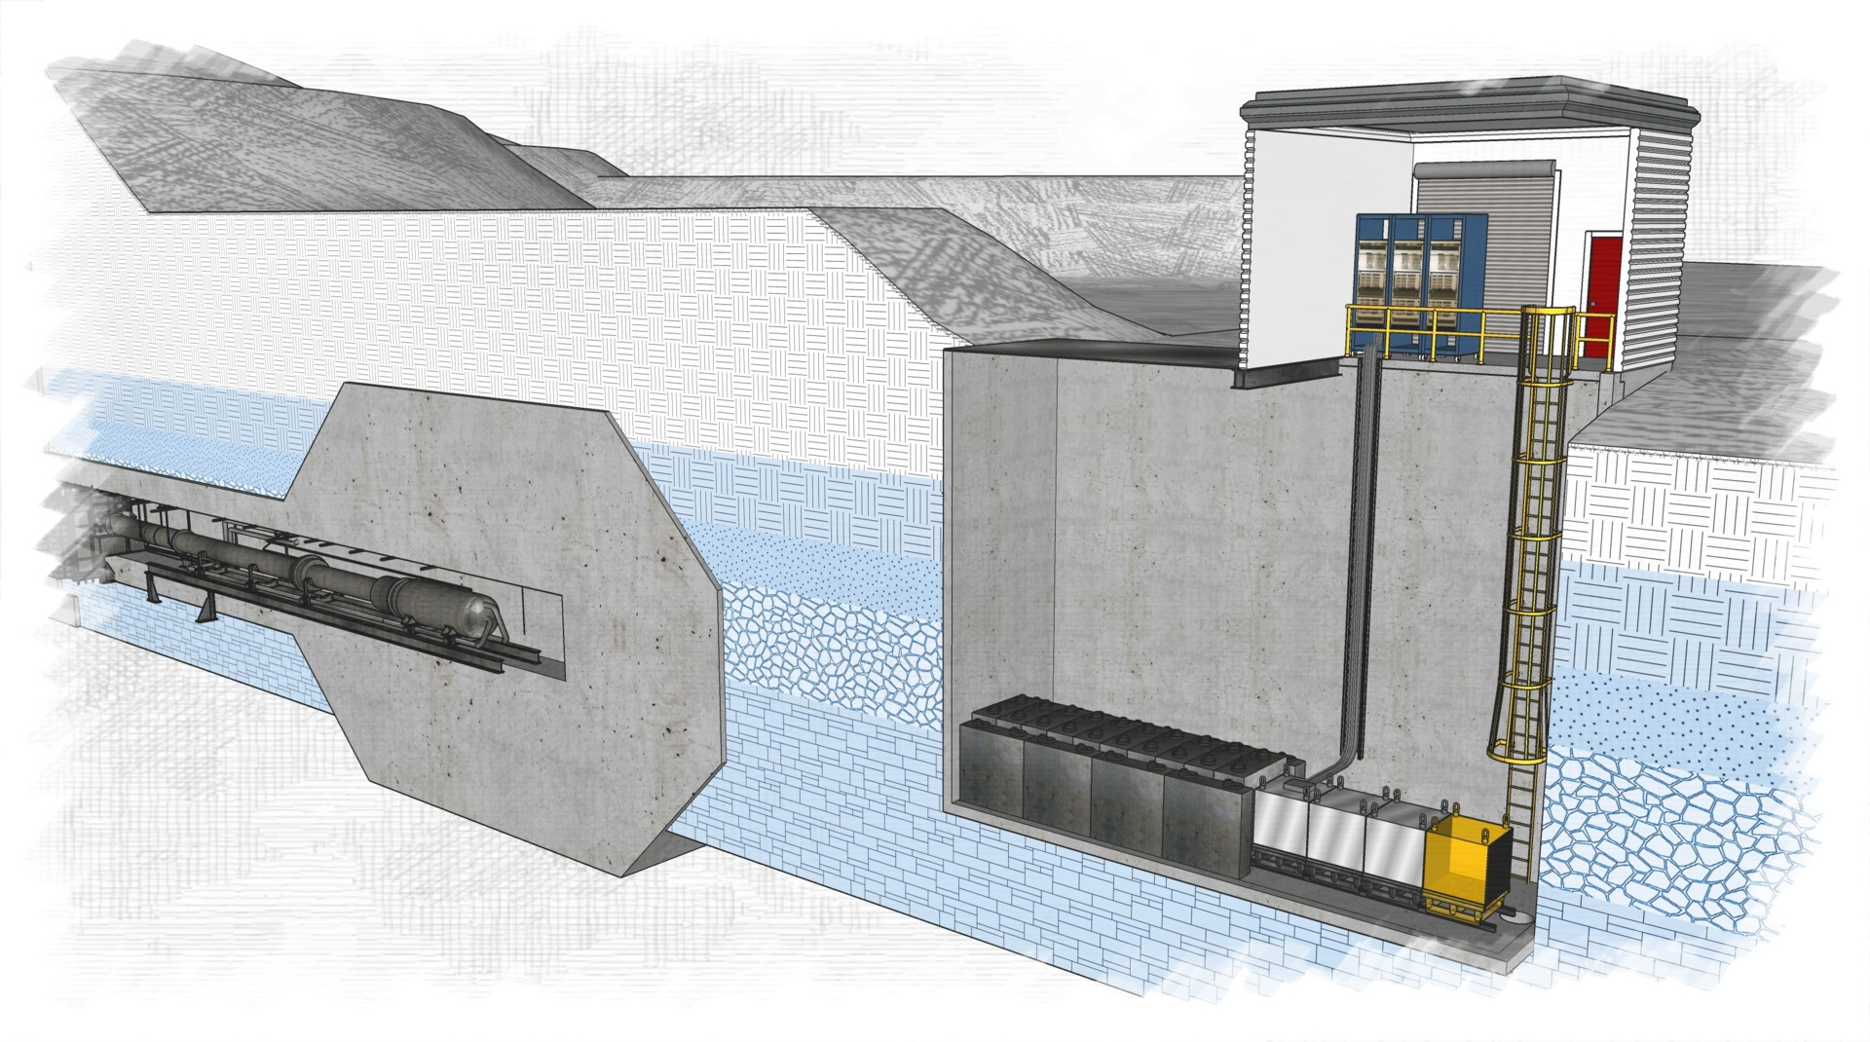
BDX Infrastructure
Walt Akers, Systems Engineer
Thomas Jefferson National Accelerator Facility September 4, 2025

Slide 2
Overview
Site Description
Elevations of Existing and Proposed Structures
Site Conditions
Vault Characteristics:
Dimensions
Structural Requirements
Access
BDX Superstructure:
Dimensions
Amenities
Infrastructure Resources:
Electrical
Mechanical
Communications
Safety Systems
Cost and Schedule

Slide 3
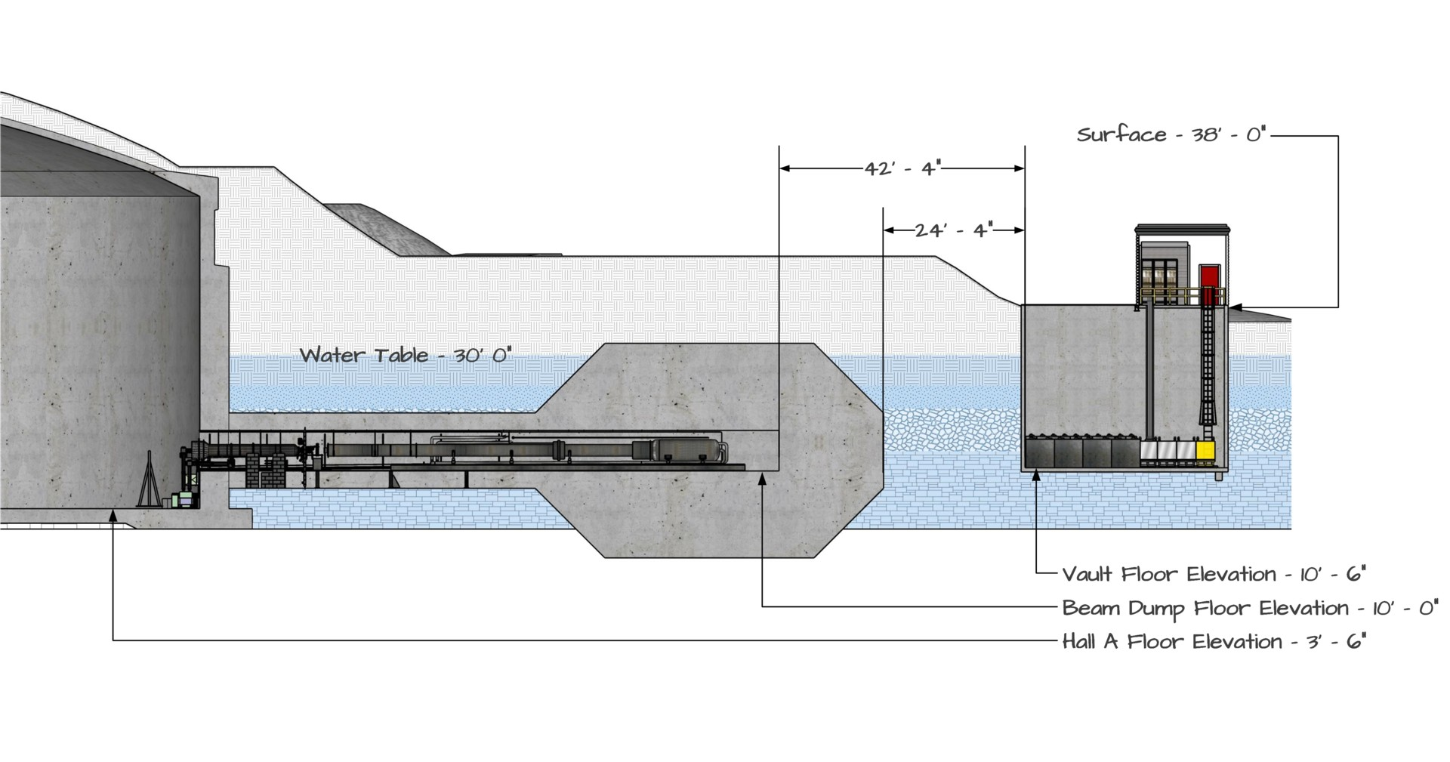
Site Description
Site Elevations and Conditions
The floor elevation in Hall A is 3’ – 6” above sea level and the beam dump floor elevation is 10’.
The proposed BDX vault will have a floor elevation of approximately 10’ – 6”.
The interior of the vault will be positioned 42’ – 4” from the interior of beam dump (24’ – 4” from the exterior of the beam dump shielding).
The floor of the vault is significantly below the water table, which will require waterproofing and a mechanism for removing accumulated water (sump pump).
The overall weight of the vault concrete will have to be adequate to prevent water pressure from lifting it (floating).

Slide 4
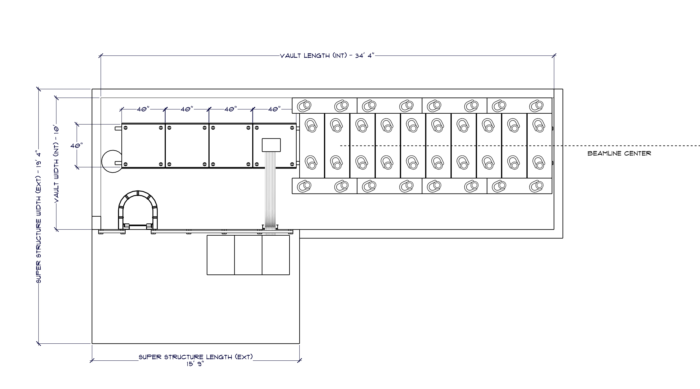
Vault Characteristics
Vault Dimensions
The interior of the vault will be 34’ – 4” long and 10’ – 0” wide.
This accommodates the installation of the shielding and detectors while still allowing personnel to enter and navigate the vault.
The back section of the vault (15’ – 9”) is covered by the superstructure which contains electronics and an access ladder.
The vault is approximately 28’ feet deep. However, the exact depth will must be determined to allow proper alignment with the Hall A beamline.

Slide 5
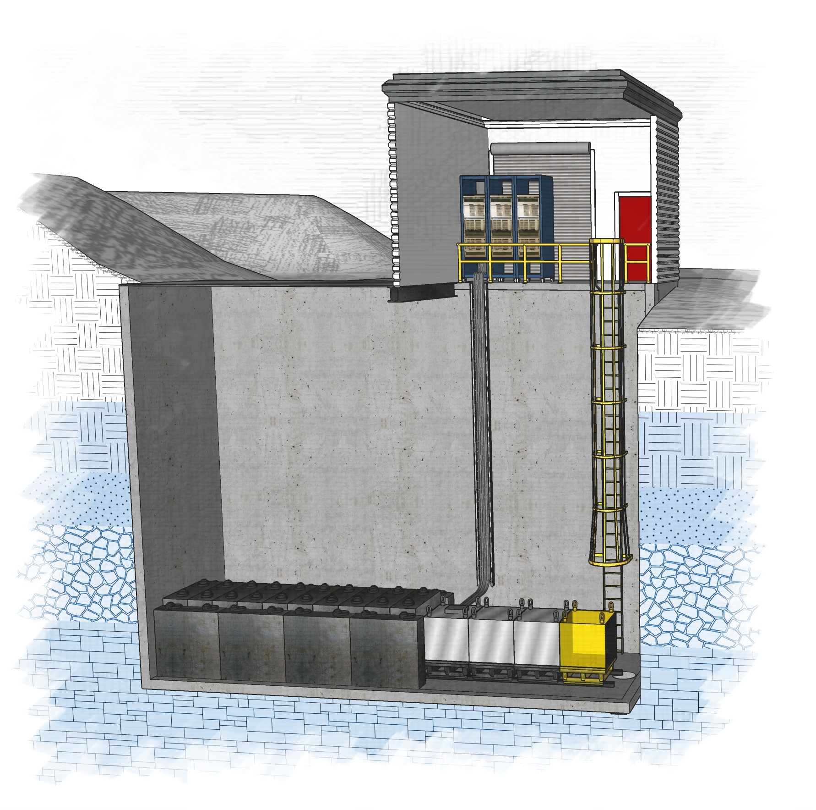
Vault Characteristics
Structural Requirements
The BDX vault floor slab is expected to be monolithic with a consistent thickness throughout.
In addition to the detectors, 1070 square feet of shielding steel weighing 524,000 pounds (262 tons) will be installed.
To accommodate this load the vault floor must be able to support 2550 pounds per square foot.
Because of the length of the walls, additional reinforcement may be required at the center to prevent buckling. This may be accomplished with a partial interior partition or an exterior support (soldier piles).

Slide 6
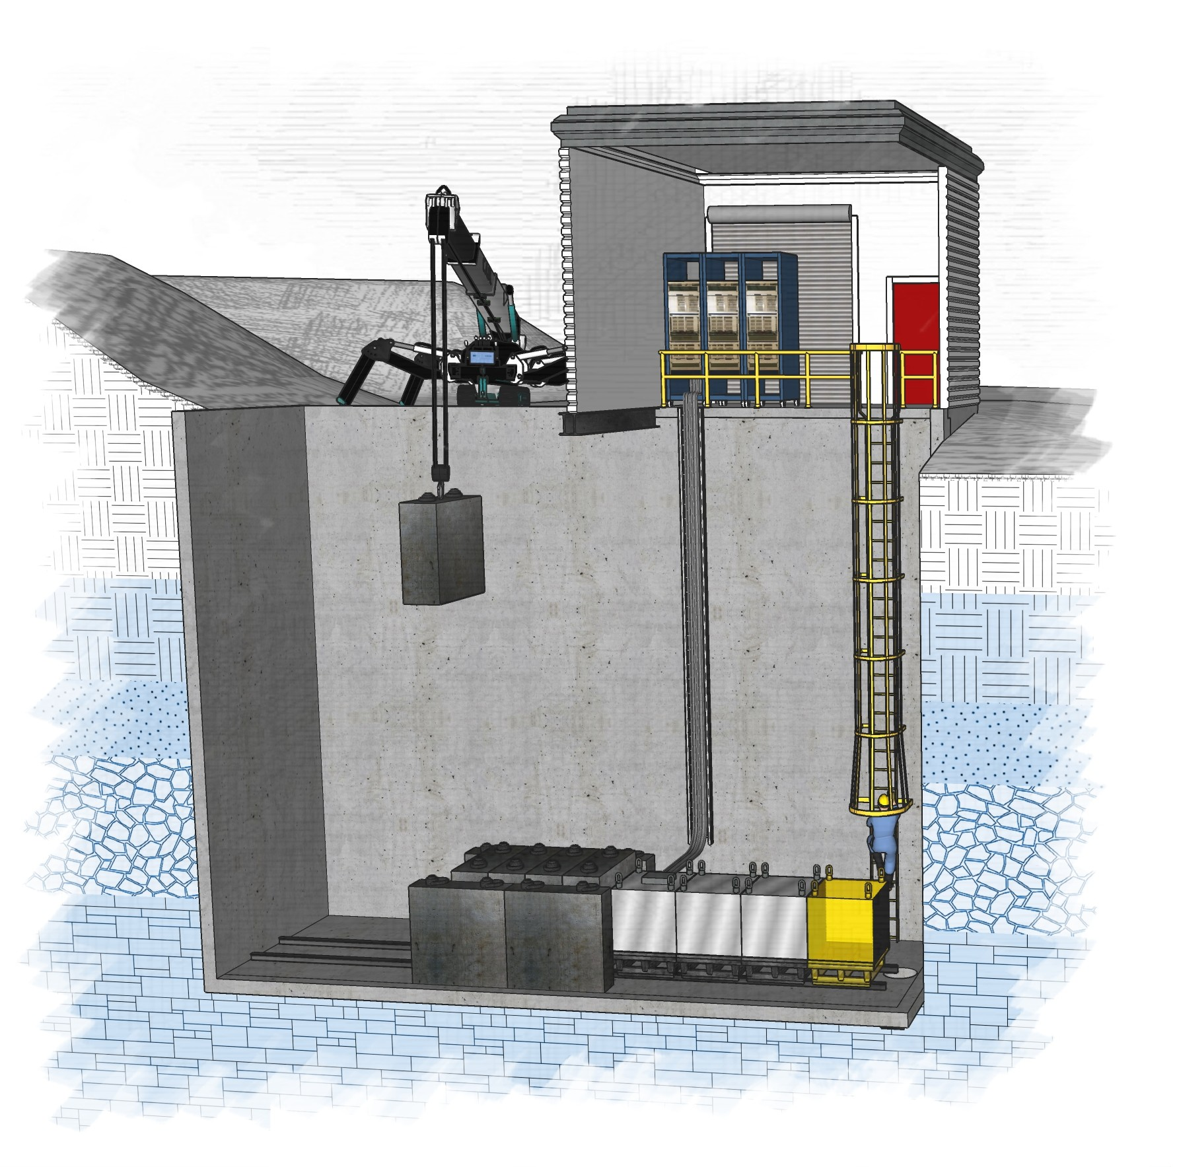
Vault Characteristics
Personnel and Material Access
A vault access panel will be installed immediately adjacent to the superstructure. This will minimize or eliminate the crane requirement within the superstructure.
Shielding and detectors will be lowered into the vault through the access panel onto supporting rails mounted on the floor.
Once in place, the shielding and detectors can be placed in their final positions by sliding them along the rails using mechanical jacks or winches.
Personnel access is accomplished using a ladder with a protective cage.
Because of the height of the ladder, additional fall protection may also be required.

Slide 7
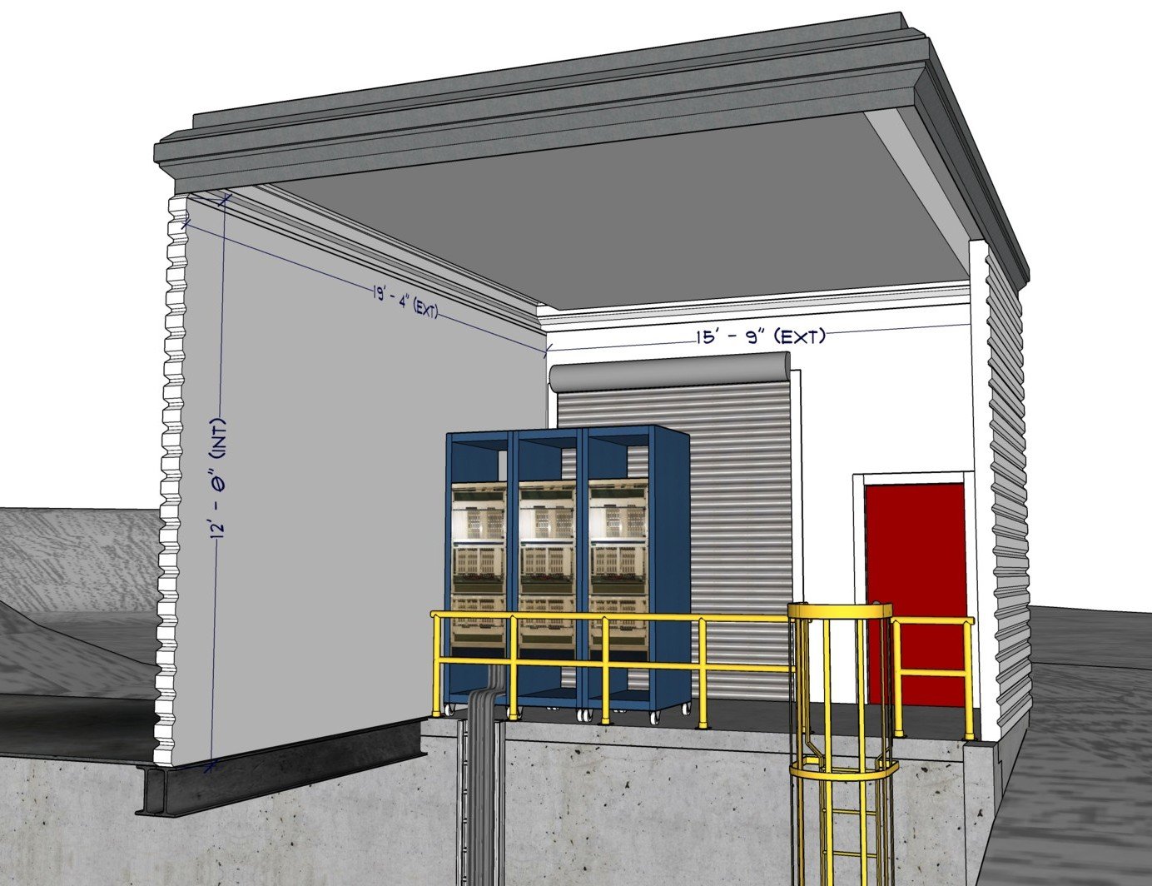
BDX Superstructure
Superstructure Size and Amenities
The superstructure will have exterior dimensions of 19’ 4” long and 15’ – 9” wide.
The interior height of the superstructure will be 12’ – 0”, but the full height may be obstructed by supporting girders.
Because the superstructure extends over the vault, the useable floor space will be 8’ – 8” long and 15’ – 9” wide.
A personnel door and a 10’ tall / 8’ wide roll-up door will be provided.
Electrical power and minimal cooling will be provided as required by the electronic systems.

Slide 8
Infrastructure Resources
Infrastructure Resources
Electrical
The BDX superstructure will receive 480V, 3-phase electrical service and will have a step down transformer as necessary for 110V loads.
The main feeder will be protected with a surge protector.
A reliable ground will be provided by a busbar installed in the superstructure. Grounding will be extended to a similar busbar in the vault.
The electrical infrastructure will also support lighting, cooling systems, and convenience receptacles.
Mechanical
Air conditioning will be provided that is adequate to maintain the superstructure at 75 degrees. The vault will not be cooled and an isolating barrier may be installed to separate the two regions.
A dewatering pump will be installed in the vault, and will be equipped with an alarm to signal pump failure.
Communication
Two 4” conduits will be provided that connect the superstructure to the manhole at Building 92. These will be used to provide network and other signal cables to the BDX facility.
A 24-strand fiberoptic cable will connect the BDX superstructure to the Counting House second floor.
Safety Systems
Fire protection systems will be installed in the BDX vault and superstructure.
A lightning arrest system will be installed on the BDX superstructure.

Slide 9
Cost and Schedule
Current Cost and Schedule Estimates
Estimated Cost
The estimated costs of construction are preliminary and will rely on the final design.
The following estimate has been provided by Facilities Management:
Estimated Schedule
These estimates are based on the current concept design, and the final design may result in different estimates.
Construction: | $ 1,537,237
JSA Labor for Management: | $ 150,000
Contingency (20%) | $ 337,447
Final Design: | 90 days | Complete January 2026
Procurement: | 60 days | Complete April 2026
Construction: | 145 days | Starts with June 2026 SAM
Expected Completion: |  | Complete December 2026

