Slide 1


Overview and Future Upgrades at CERN's North and East Areas
D. Banerjee (CERN)
Date: 09.07.2024

Slide 2
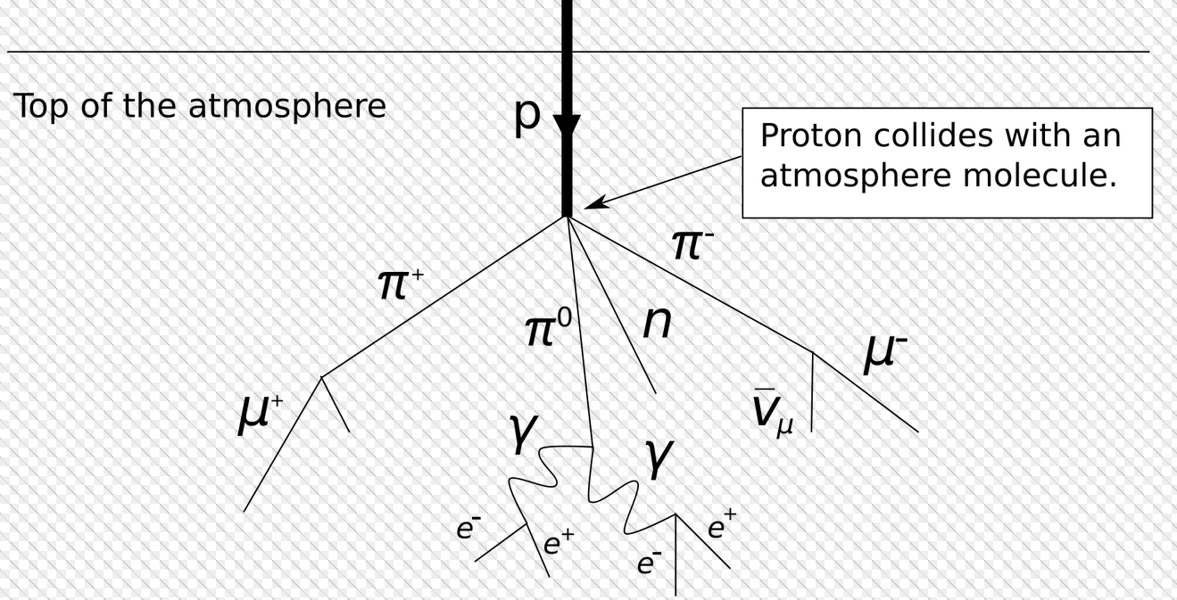
CERN Accelerator Complex
SPS : protons/ions @ 400 GeV/c/Z
PS: protons /ions @ 24 GeV/c/Z
Generation of secondary beams: Principle from the cosmic rays:
Protons from SPS/PS hits a target (Be) creating showers of particles.

Slide 3
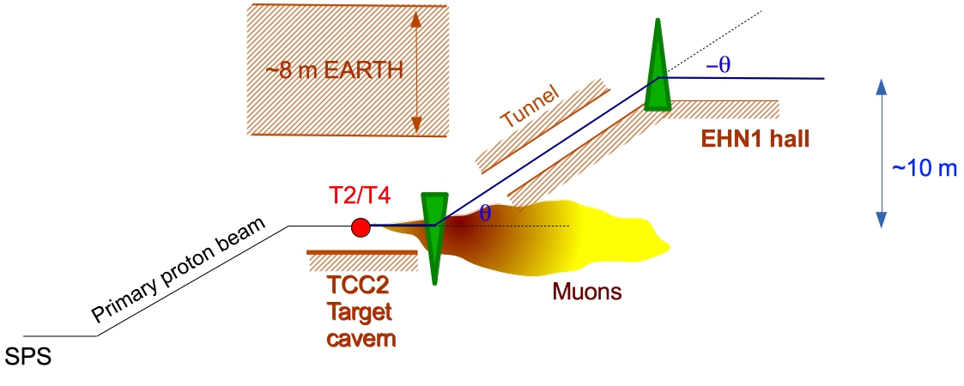
Secondary Beams Generation
Initial geometric acceptance defined by the XTAX – blocks of iron or copper (water cooled).
Further selection done with collimators – adjustable jaws with blocks of iron.
Selected particles transported via dipoles and quadrupoles to the experimental halls on surface.
Selection of momentum not particles.
Possibility of changing the beam composition exploiting different absorbers along the beam line as well as synchrotron radiation for pure electron beams.
XTAX
Cleaning
collimator
Acceptance collimator

Slide 4
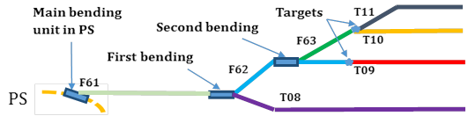
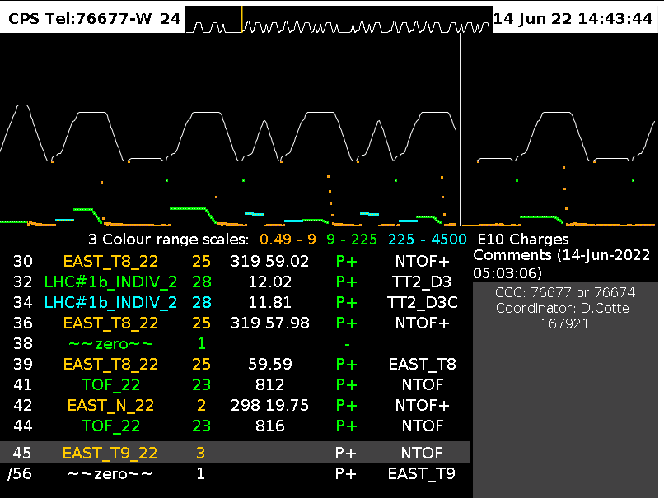
East Area Secondary Beamlines
PS beam @ 24 GeV/c
Parameter | Value
Spill Length | 2.4 s with 0.4 s flat-top (beam extraction)
Proton beam momentum [GeV/c] | 24 (requests to go lower for longer spills → 15 GeV/c tested at 0.8 s flat top)
Maximum flux per PS spill | 3E11 for T09-T11 8E11 for T08
Maximum # protons per second (individual limits for Radiation Protection) | 3.3E10 for T09-T11, 6.6E10 for T08

Slide 5
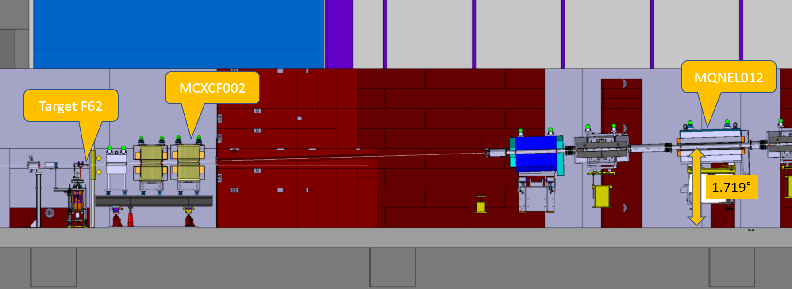
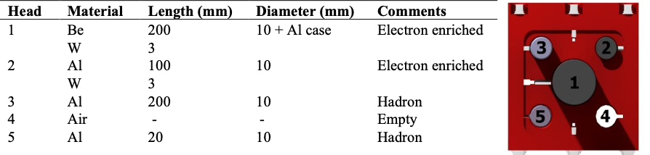
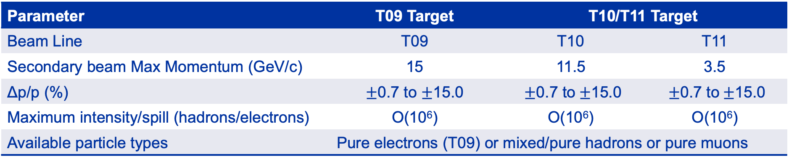
Characteristics of the Secondary Beams
Parameter | T09 Target | T10/T11 Target
Beam Line | T09 | T10 | T11
Secondary beam Max Momentum (GeV/c) | 15 | 11.5 | 3.5
Δp/p (%) | $±$0.7 to $±$15.0 | $±$0.7 to$±$15.0 | $±$0.7 to$±$15.0
Maximum intensity/spill (hadrons/electrons) | O(10⁶) | O(10⁶) | O(10⁶)
Available particle types | Pure electrons (T09) or mixed/pure hadrons or pure muons
T11 serves the CLOUD experiment which is a permanent installation.
30-35 mrad vertical production angle
Multi-target configuration

Slide 6
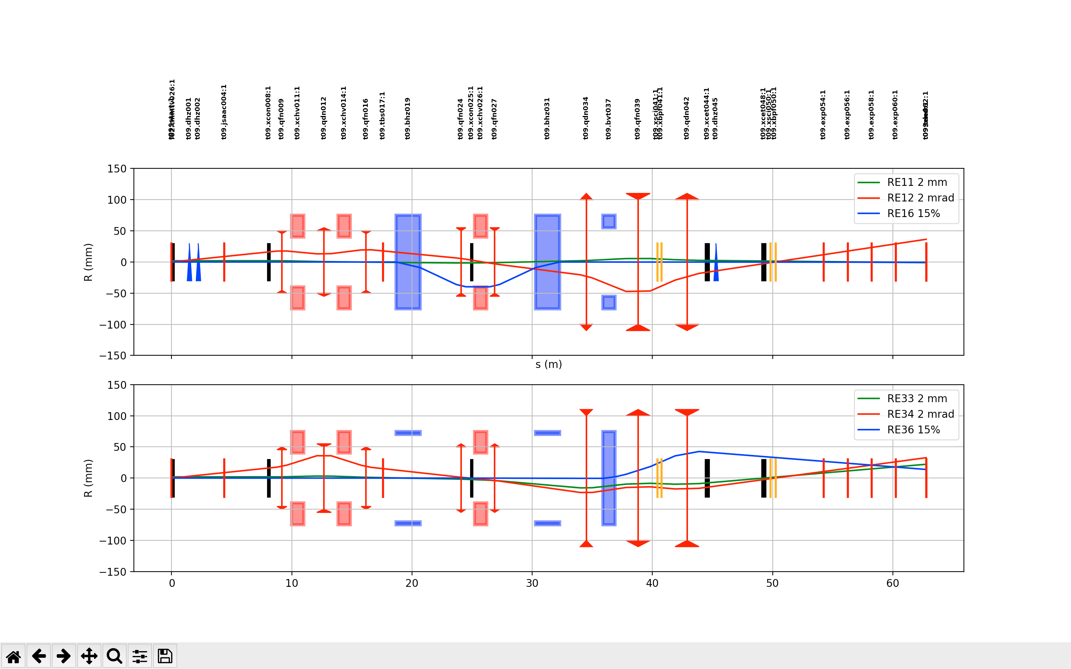
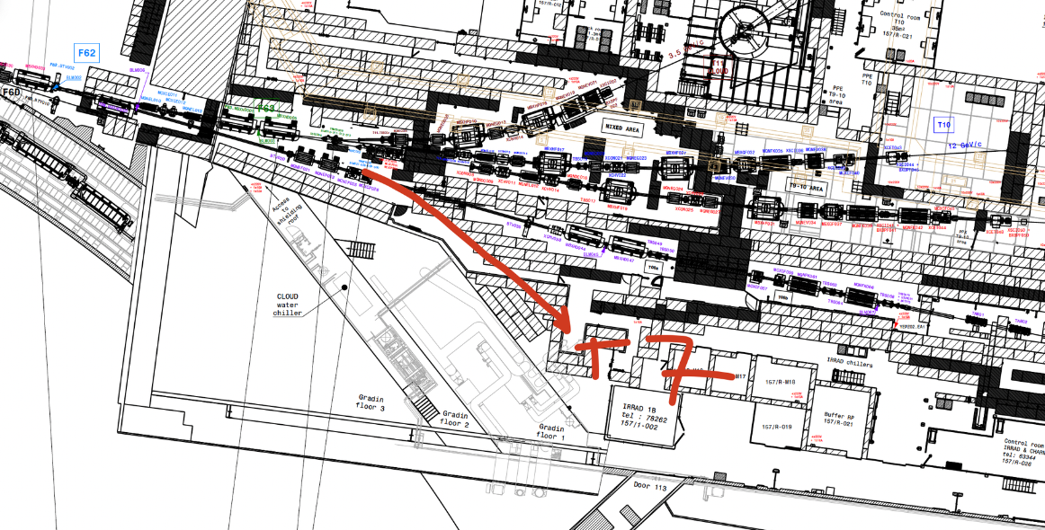
Some Future requests and studies at the East Area
Currently only T09 has the possibility to have pure electrons. Studies are ongoing to have pure electrons in T10 as well to provide high purity electron beams to future test beams and experiments.
  T09.DHZ01&2 sweeps all charged particles to the dump and the photons make it through to the beamline. Photon conversion on the converter for e±. Upto 6 GeV/c.
Addition of a new beamline (T07) for the CHIMERA/HEARTS project for electronics testing with heavy ions.
Possibilities being checked to host a Kaon / flavour physics experiment with low momentum kaon beams.
Pure e± beams
Horizontal plane

Slide 7
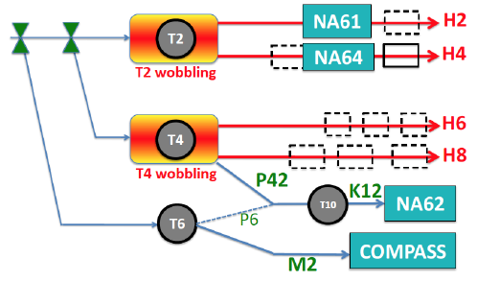
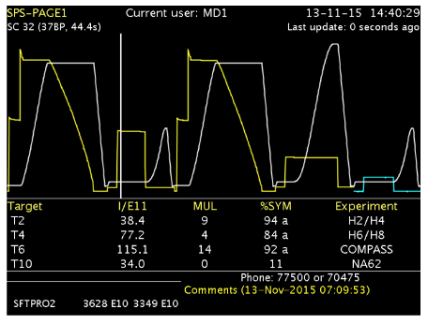
North Area Secondary Beamlines
The 400 GeV/c primary beam is slowly extracted to 3 primary targets → T2, T4 and T6
E
SPS beam @ 400 GeV/c
EHN1
ECN3
AMBER
EHN2
Parameter | Value
Spill Length | 14.4 s with 4.8 s flat-top (beam extraction)
Proton beam momentum [GeV/c] | 400
Maximum flux per SPS spill | 150E11 (1E11 – 1 unit)

Slide 8
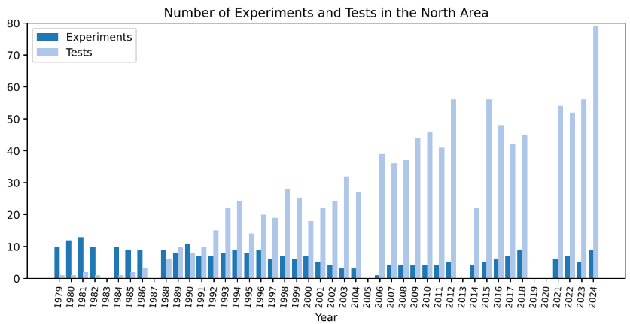
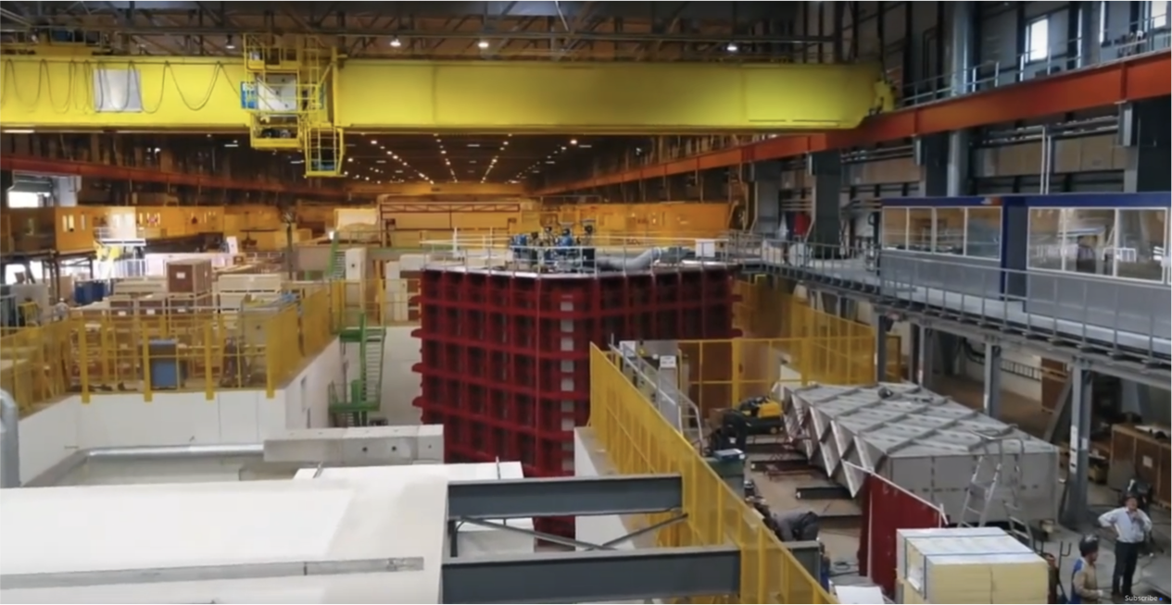
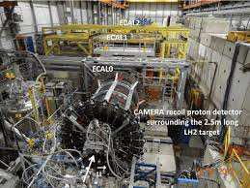
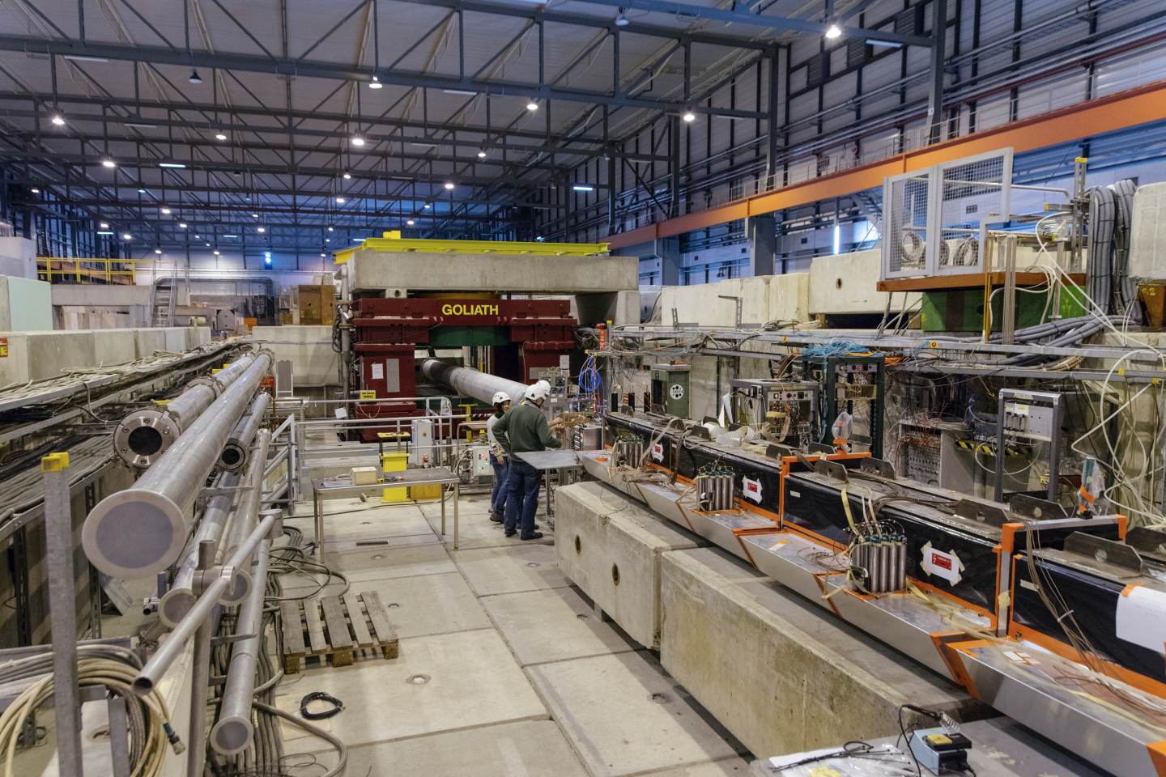
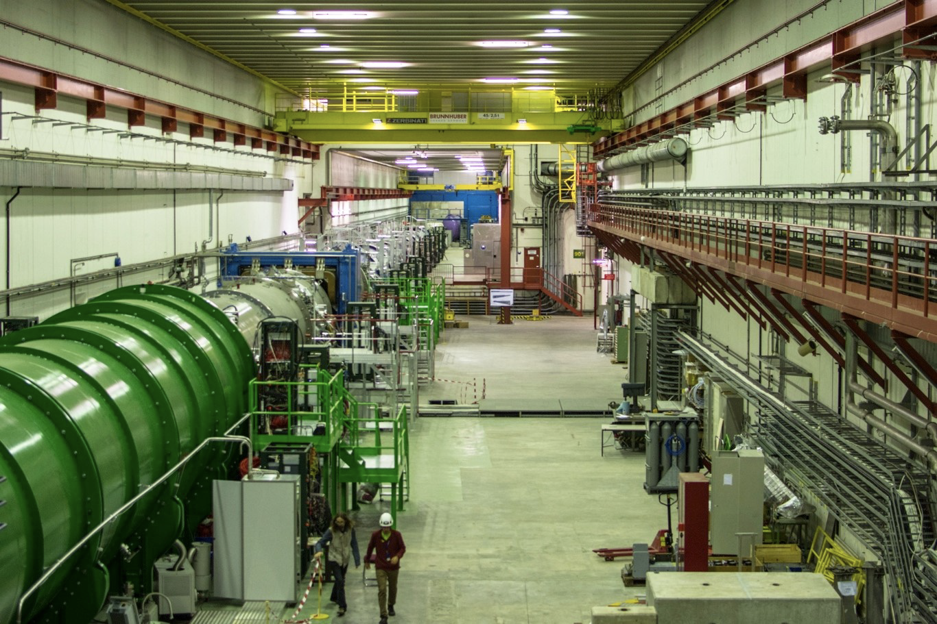
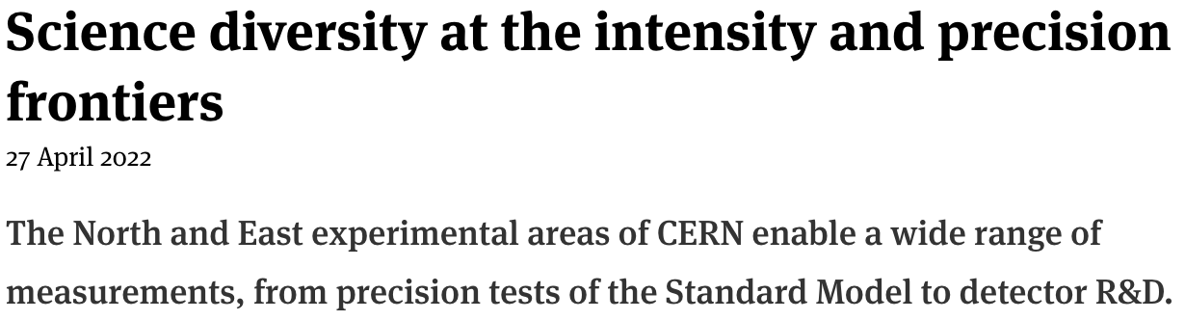
Science Diversity at the CERN
North Area
The North Area at CERN is one of the most diverse experimental facilities that currently exists, serving proton, hadron, electron, muon, and ion beams to yearly over 200 user teams for detector R&D and to the NA61, NA62, NA64e, NA64mu, and NA66/AMBER experiments, the two large neutrino platform cryostats, as well as to the GIF++ and CERF irradiation facilities, with combined more than 2000 users.
Link

Slide 9
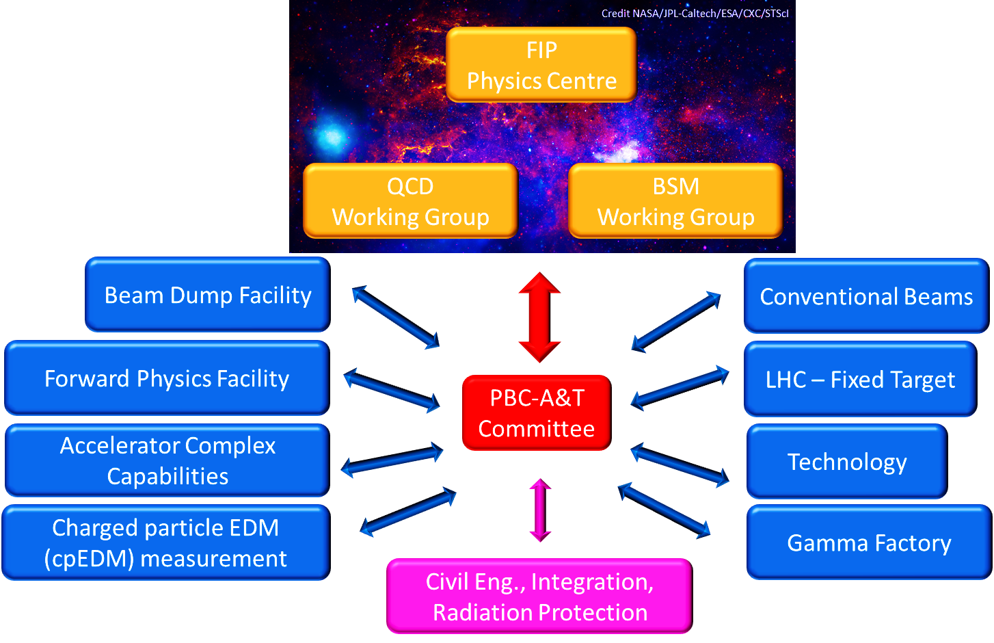
Physics Beyond Colliders Phase 2
Physics Beyond Colliders (PBC) is an exploratory study aiming at exploiting the full scientific potential of CERN's accelerator complex and its scientific infrastructure through projects complementary to the LHC, HL-LHC and other possible future colliders.
Given the success of the first PBC initiative, the mandate was renewed and extended in 2021.
Many new requests and ideas have been put forward in this context for runs beyond LS3 (2026-2028) to exploit the scientific potential at the CERN beamlines.
Various studies have been launched and are ongoing to evaluate, support and test the feasibility of these proposals.

Slide 10
EHN1 Proposals
E
SPS beam @ 400 GeV/c
EHN1
ECN3
EHN2

Slide 11
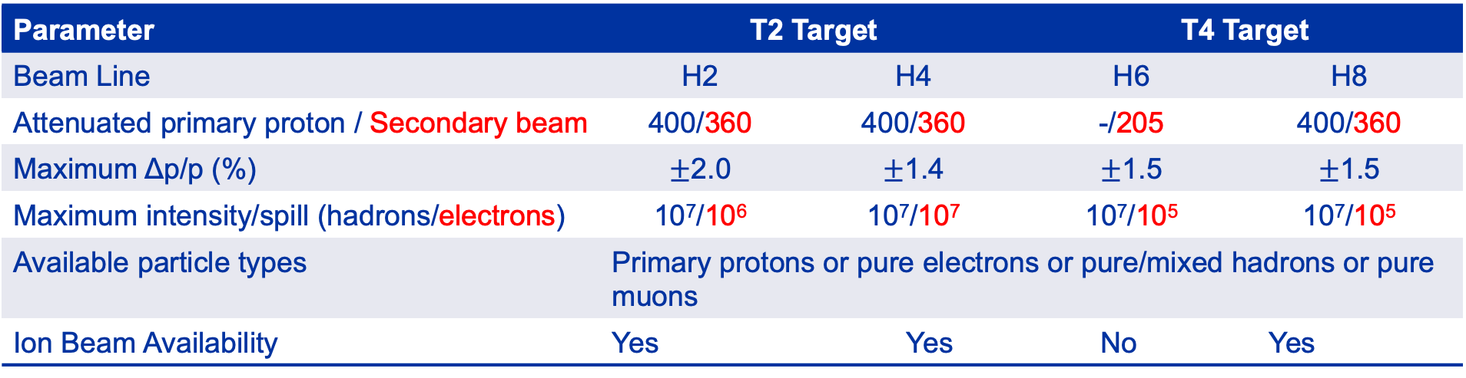
Characteristics of the EHN1 Beam
Parameter | T2 Target |  |  | T4 Target | T4 Target
Beam Line | H2 | H4 | H4 | H6 | H6 | H8 | H8
Attenuated primary proton / Secondary beam | 400/360 | 400/360 | 400/330 | -/205 | -/205 | 400/360 | 400/360
Maximum Δp/p (%) | $±$2.0 | $±$1.4 | +-1.4 | $±$1.5 | +-1.5 | $±$1.5 | +-1.5
Maximum intensity/spill (hadrons/electrons) | 10⁷/10⁶ | 10⁷/10⁷ | 10⁷/10⁵ | 10⁷/10⁵ | 10⁷/10⁵ | 10⁷/10⁵ | 10⁷/10⁵
Available particle types | Primary protons or pure electrons or pure/mixed hadrons or pure muons
Ion Beam Availability | Yes |  | Yes |  | No |  | Yes
H2/H4 has the possibility to have very pure, high intensity electron beams generated from the neutral channel - 𝛾 → e⁺e⁻
Primary and Fragmented Ion beams are available in the North (H2/H4/H8) and the East Area (T08).

Slide 12
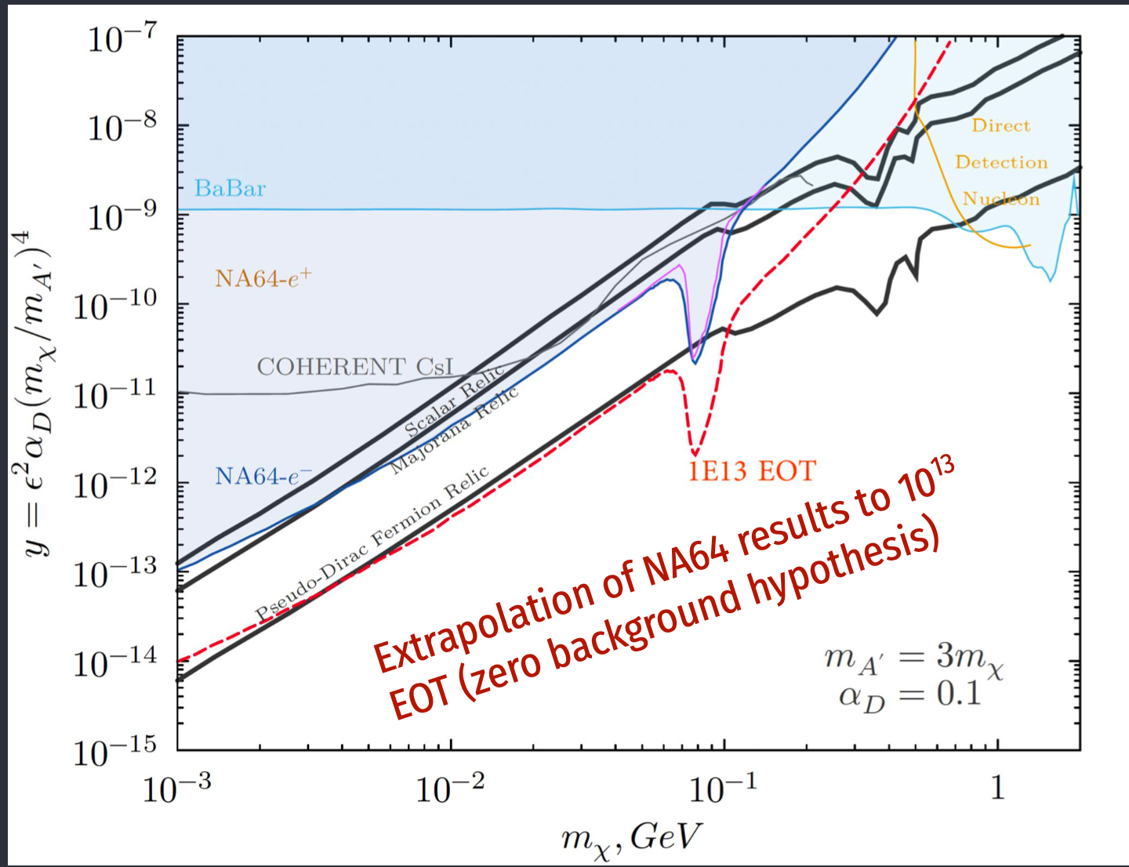
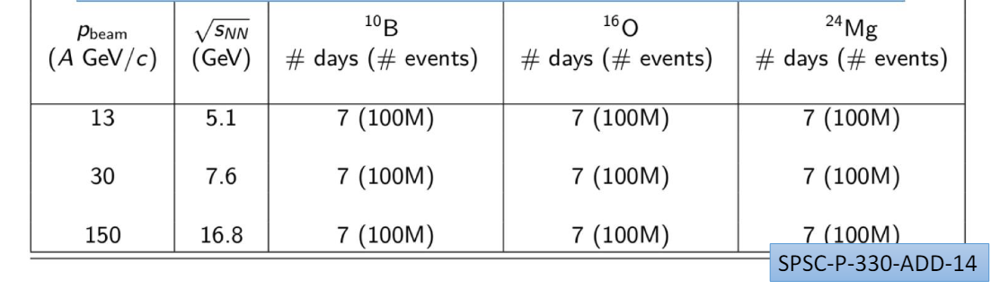
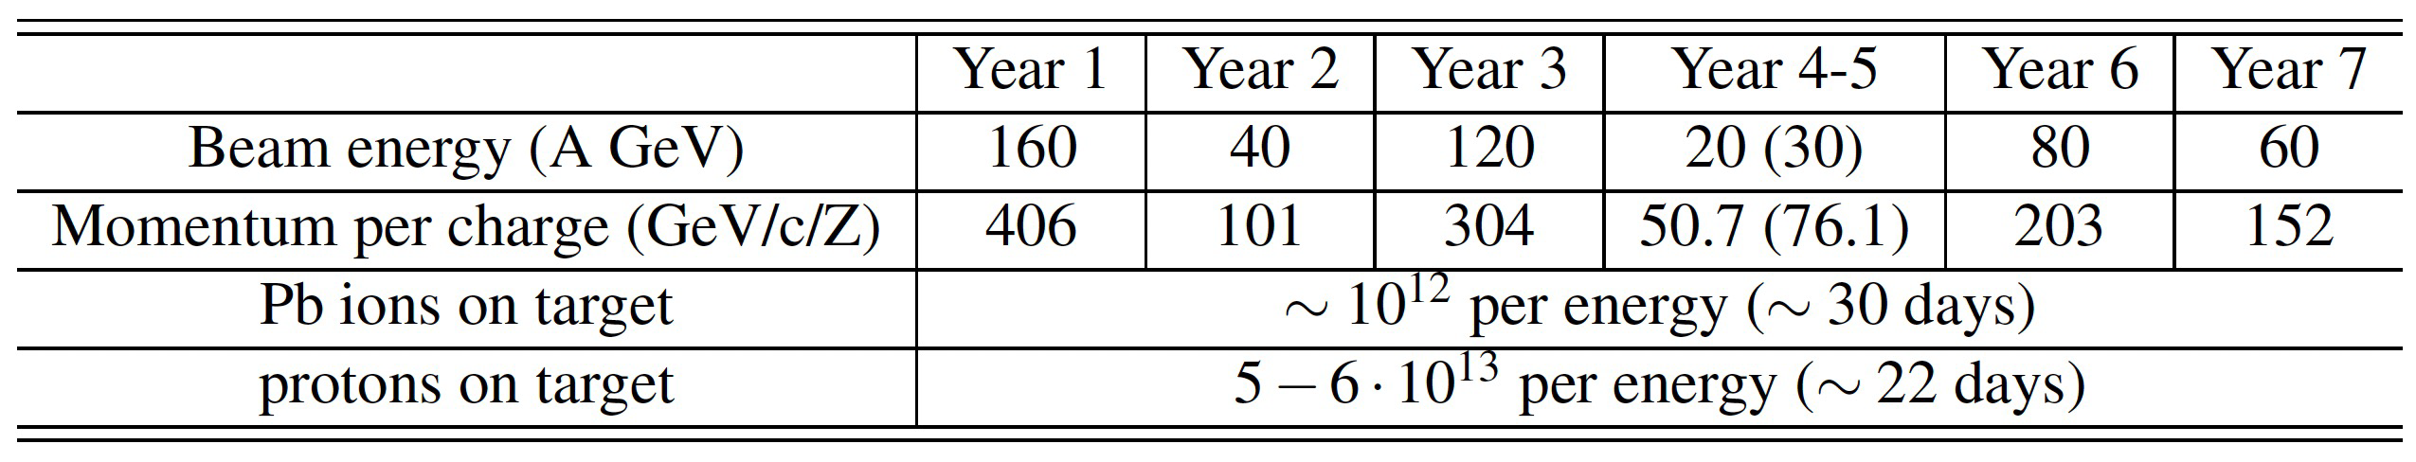
Some Future requests at EHN1
NA64
NA64 a fixed target dark matter search experiment.
  Collected 1.5E12 electrons on target (EOT) since 2016 at 1E6 electrons/spill intensity.
  Aims to 2 X statistics post-LS3 and a total of 1E13 EOT at 1E7 electrons/spill.
  Complementary studies with positrons (2E11 e+ on target) and hadron beams also planned post-LS3.
NA61 a multipurpose facility to study the phase diagram of strongly interacting matter in hadron-nucleus and nucleus-nucleus collisions at high energies.
  Onset of fireball part of post-LS3 program. The two main requested ion species are ¹⁶O and ²⁴Mg
NA60+ study of dileptons and heavy quark production in Pb-Pb collisions.
  Requests Pb beam at 1E7 primary lead ion/spill with the beam fitting within a 4mm hole in the detector to collect 1E12 Pb ions on target/run.
  Several control measurements with proton beams at different momenta to collect 5-6E13 per energy.
NA61
NA60+

Slide 13
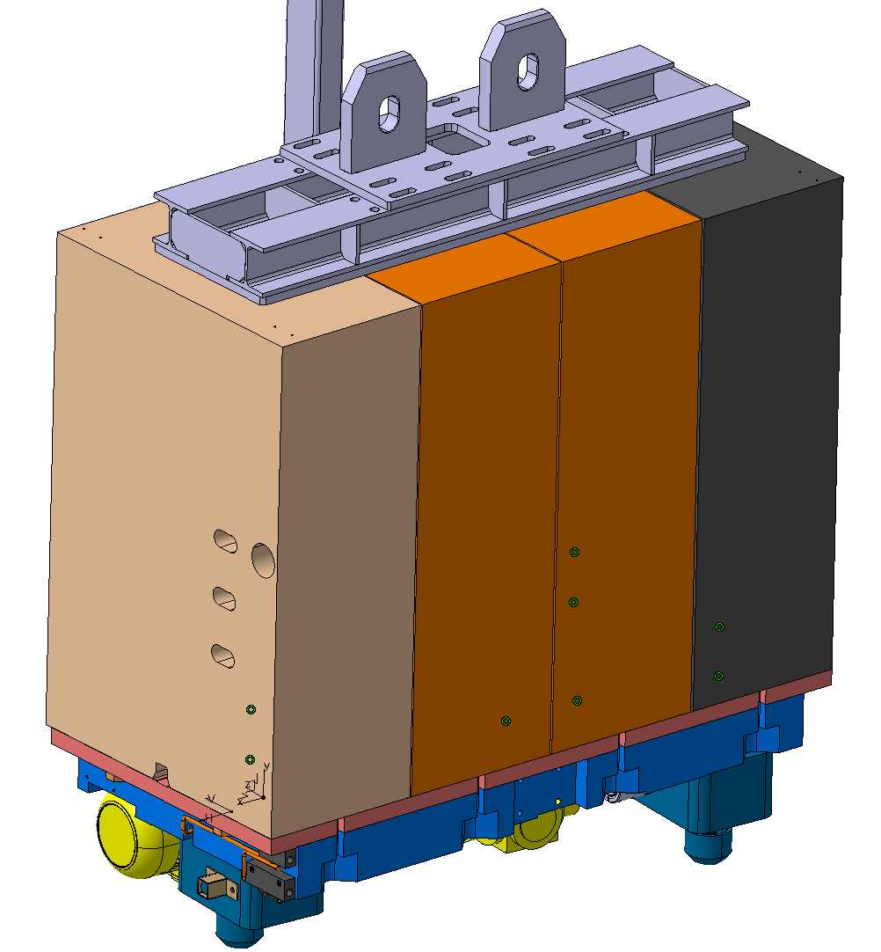
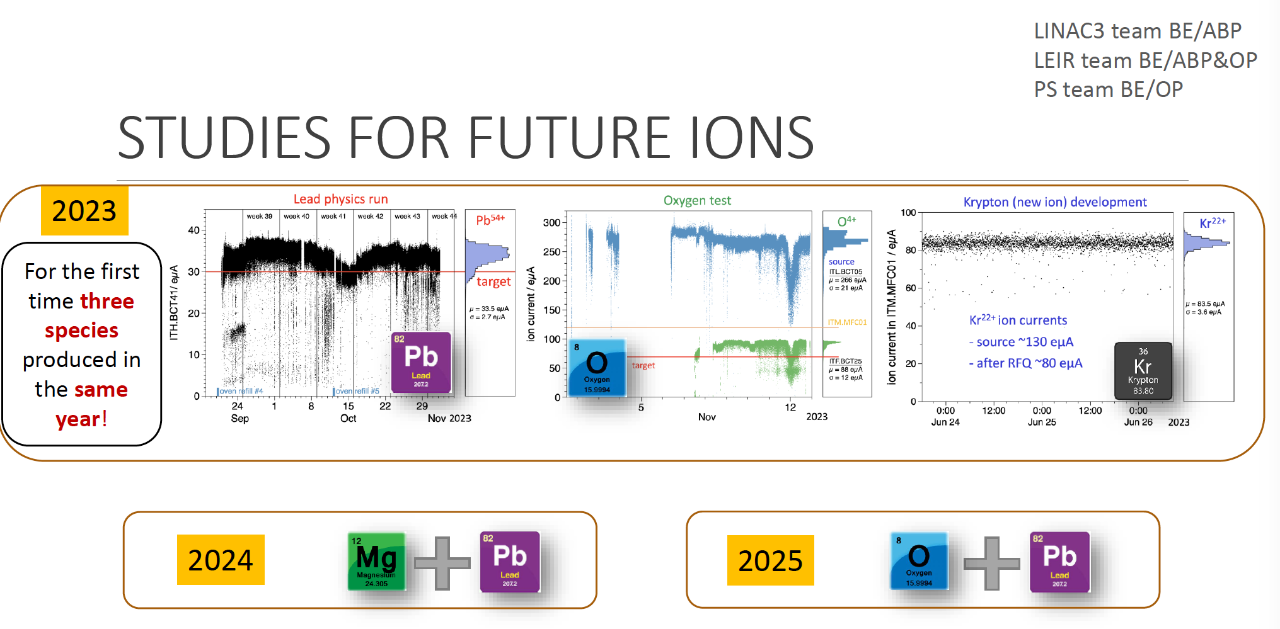
Planned studies and upgrades
BE-EA, SY-STI, HSE-RP
Studies to increase the electron intensity to 1.5E7 e⁻/spill for NA64.
  Considerations to increase the proton intensity on T2 target to 200 – 250 units of protons per spill.
  TAX to be upgraded to withstand these intensities – included under the NACONS project.
  Optics studies to improve transmission through the beamline ongoing → Reached factor 2 for electrons in H4 beamline.
Feasibility studies for the NA60+ and NA61 ion requests.
  Proper safety procedure to mitigate chemical hazards.
  Mitigation of radiation hazards for light ion operation in LEIR.
  Improving understanding of beam dynamic effects to better predict future performance.
  Beam time arbitration optimisation between proton and ion beam users.

Slide 14
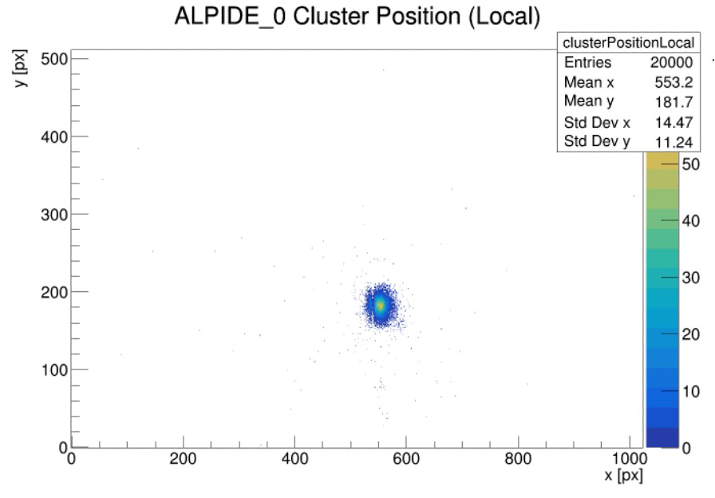
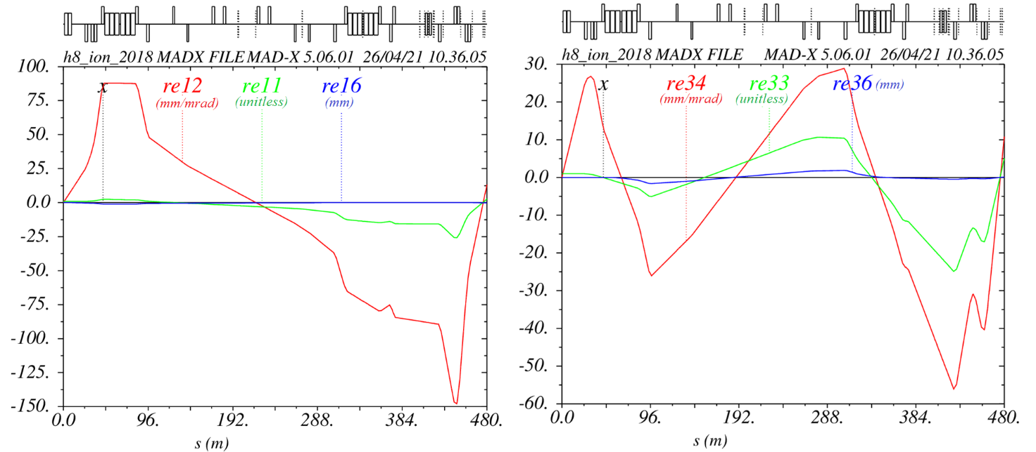
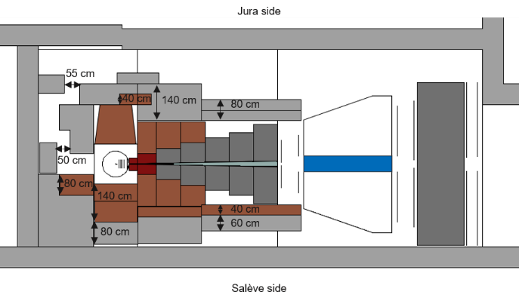
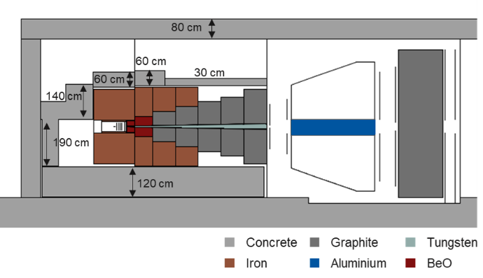
Planned studies and upgrades
BE-EA, HSE-RP, BE-OP, BE-ABP
Optics studies for NA60+ beam spot - at 2.4E6 /spill beam spot size 280 x 280 μm2 achieved.
Low energy primary Pb beam to be checked where emittance will be larger.
Radiation studies performed to be able to reach higher intensities in NA60+. New shielding design proposed, and implementation/installation being finalised.

Slide 15
EHN2 Proposals
E
SPS beam @ 400 GeV/c
EHN1
ECN3
EHN2

Slide 16
The M2 Beam
The M2 beamline is ~ 1.1 km long transporting secondary particles from the T6 target to the EHN2 hall.
It has a 700 m long hadron section to allow hadron decays to muons followed by 9.9 m Be inside a bend to absorb the hadrons with the muons passing through.
A 400 m long muon section selects the final muon momentum and cleans the muon beam halo.
M2 has three main operation modes:
  High-energy, high-intensity muon beam. Normally for muon momenta up to 160 GeV/c. Higher momenta up to 220 GeV/c are possible, but the flux drops very rapidly with beam momentum.
  High-intensity secondary hadron beam for momenta up to 280 GeV/c with radiation protection constraints.
  Low-energy, low-intensity (and low-quality) in-situ electron calibration beam.
Beam Mode | Momentum (GeV/c) | Max. Flux (ppp / 4.8s) | Typical Δp/p (%) | Typical RMS spot at COMPASS target | Polarisation | Absorber (9.9 m Be) | XCIO (5 mm Pb)
Muons | +208/190 +172/160 | ~10⁸ 2.5 10⁸ | 3% | 8 x 8 mm | 80% | IN | OUT
Hadrons | +190 -190 Max. 280 | 10⁸ (RP) 4 10⁸ (with dedicated dump) | ₋ | 5 x 5 mm | ₋ | OUT | OUT
Electrons | -10 to -40 | < 2 10 ⁴ | ₋ | > 10 x 10 mm | ₋ | OUT | IN

Slide 17
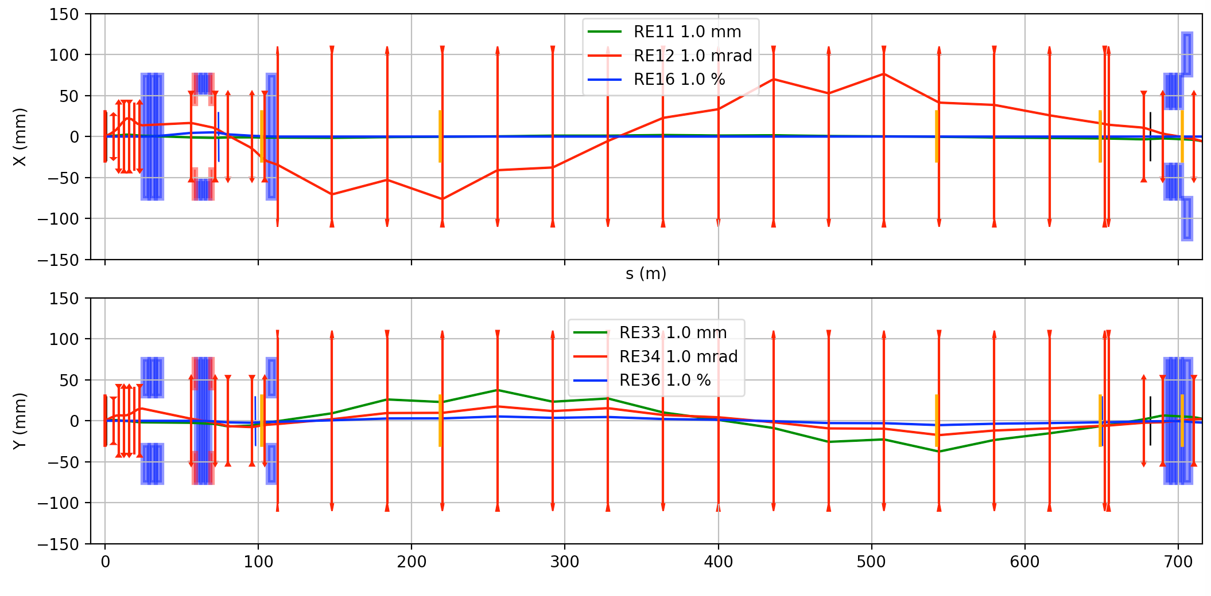
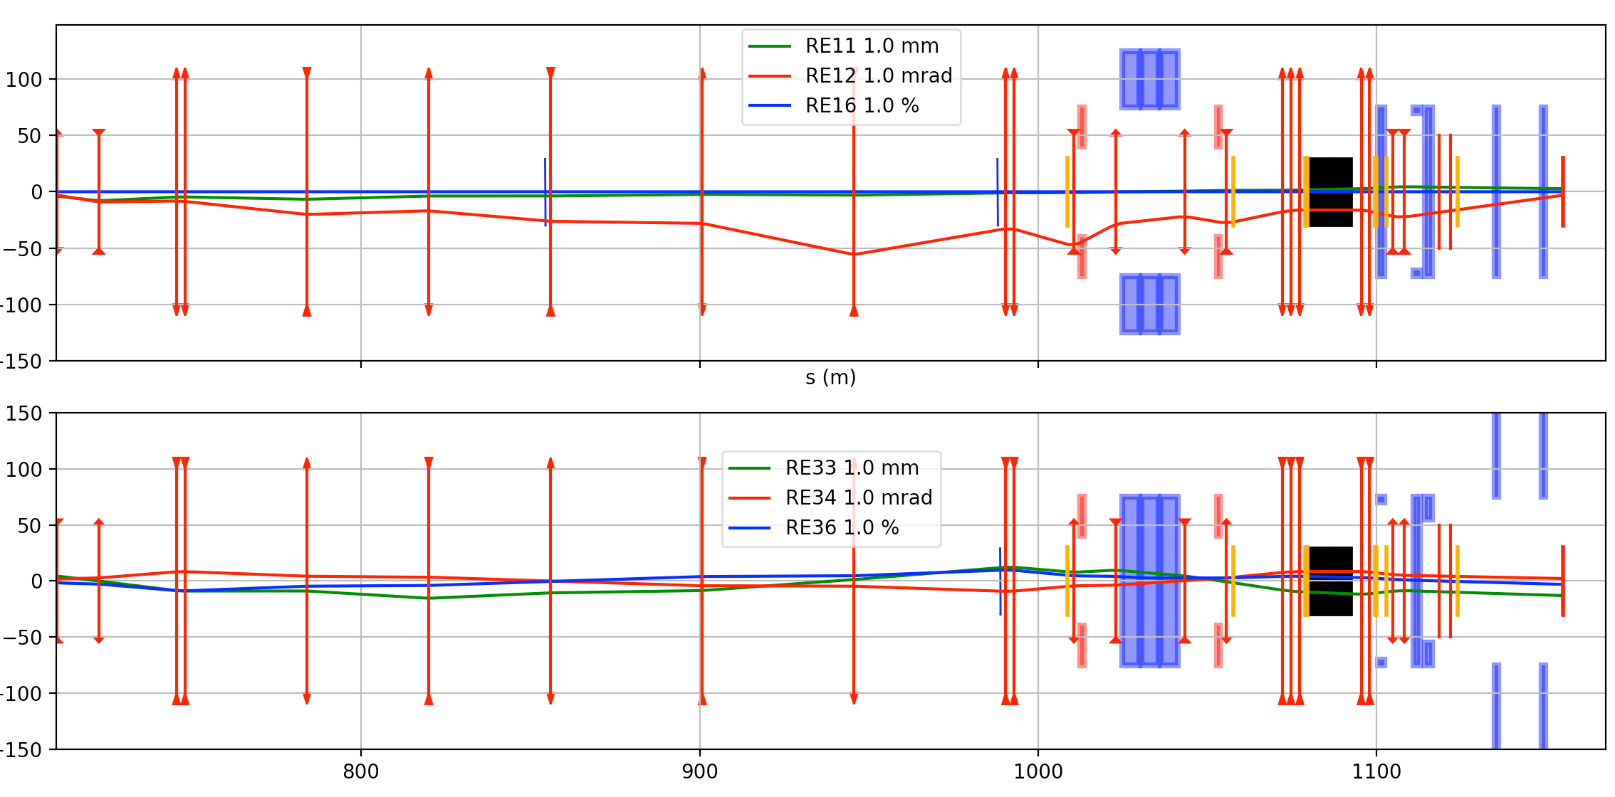
The M2 Beam
CEDARs
AMBER
Hadron
absorber
Scrapers
(160 ± 5) GeV/c
(172 ± 17) GeV/c
p
π,K
µ
BEND 6
700 m
400 m
Hadron Decay Section
Muon Cleaning Section

Slide 18
The M2 Beam
CEDARs
AMBER
Hadron
absorber
The switching between the modes is fast and does not require additional installation (except installation of the CEDARs for the hadron runs).
In the hadron mode an optional pair of differential Cherenkov counters (CEDARs) are available to tag a specific type of particle in the beamline.
Scrapers
(160 ± 5) GeV/c
(172 ± 17) GeV/c
p
π,K
µ
BEND 6
700 m
400 m
Hadron Decay Section
Muon Cleaning Section

Slide 19
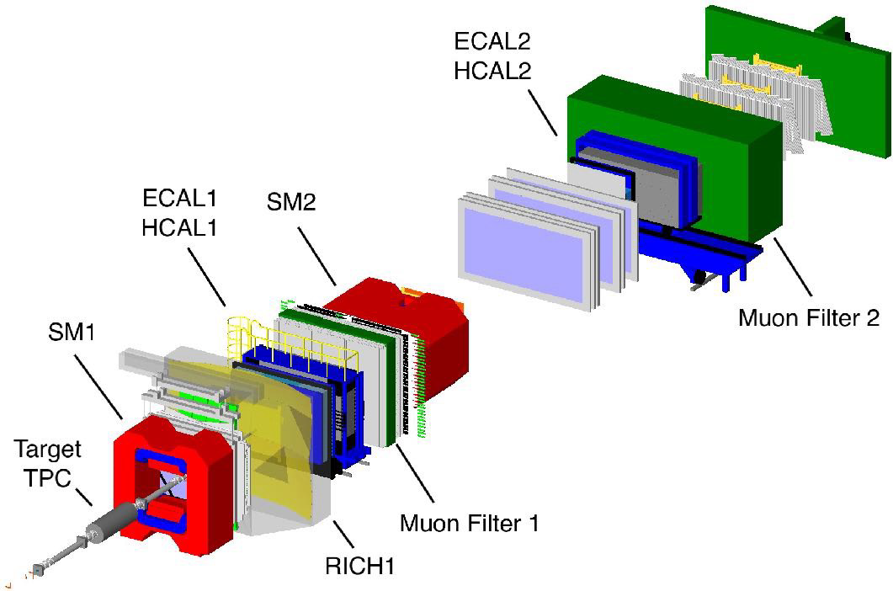
Future requests at EHN2
Several projects for the ENH2 beamline in the CERN North Area have been proposed:
NA64µ - Muon Program for dark sector physics
  Requires 5E7 muons/spill at 100 GeV/c – 160 GeV/c muon beam.
MuOnE - aiming to investigate the hadronic contribution to the vacuum polarisation in context of (g-2)_{µ}.
  Requires 2E8 muons/spill at160 GeV/c, low divergence muon beam.
Successor to the COMPASS experiment - A QCD Facility (AMBER)
  Requires high intensity kaon beams for Drell Yan measurements, prompt-photon measurements and K-induced spectroscopy.
AMBER
Experiment

Slide 20
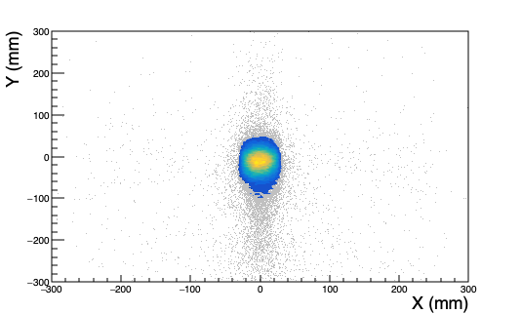
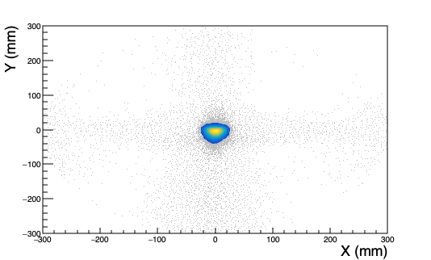
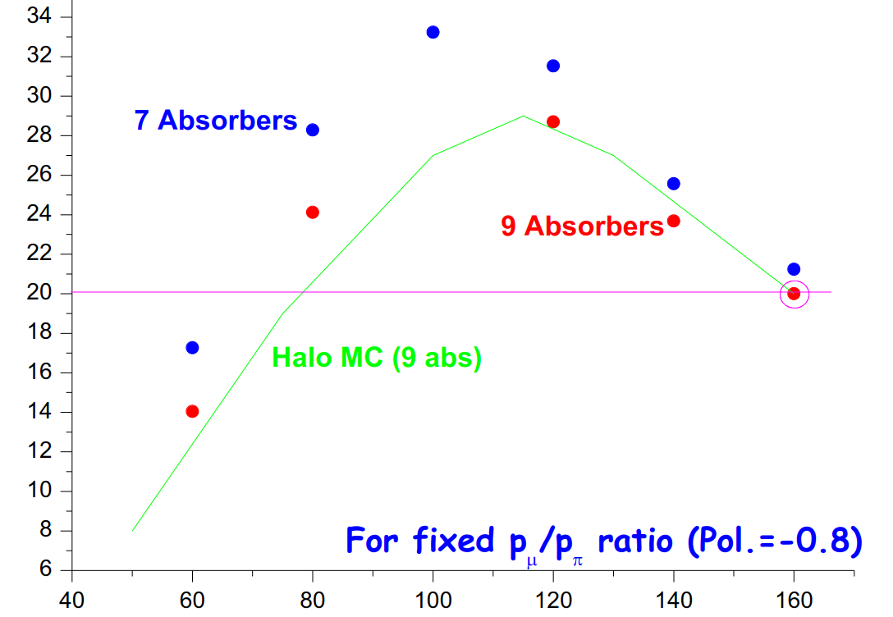
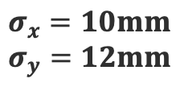
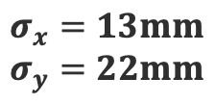
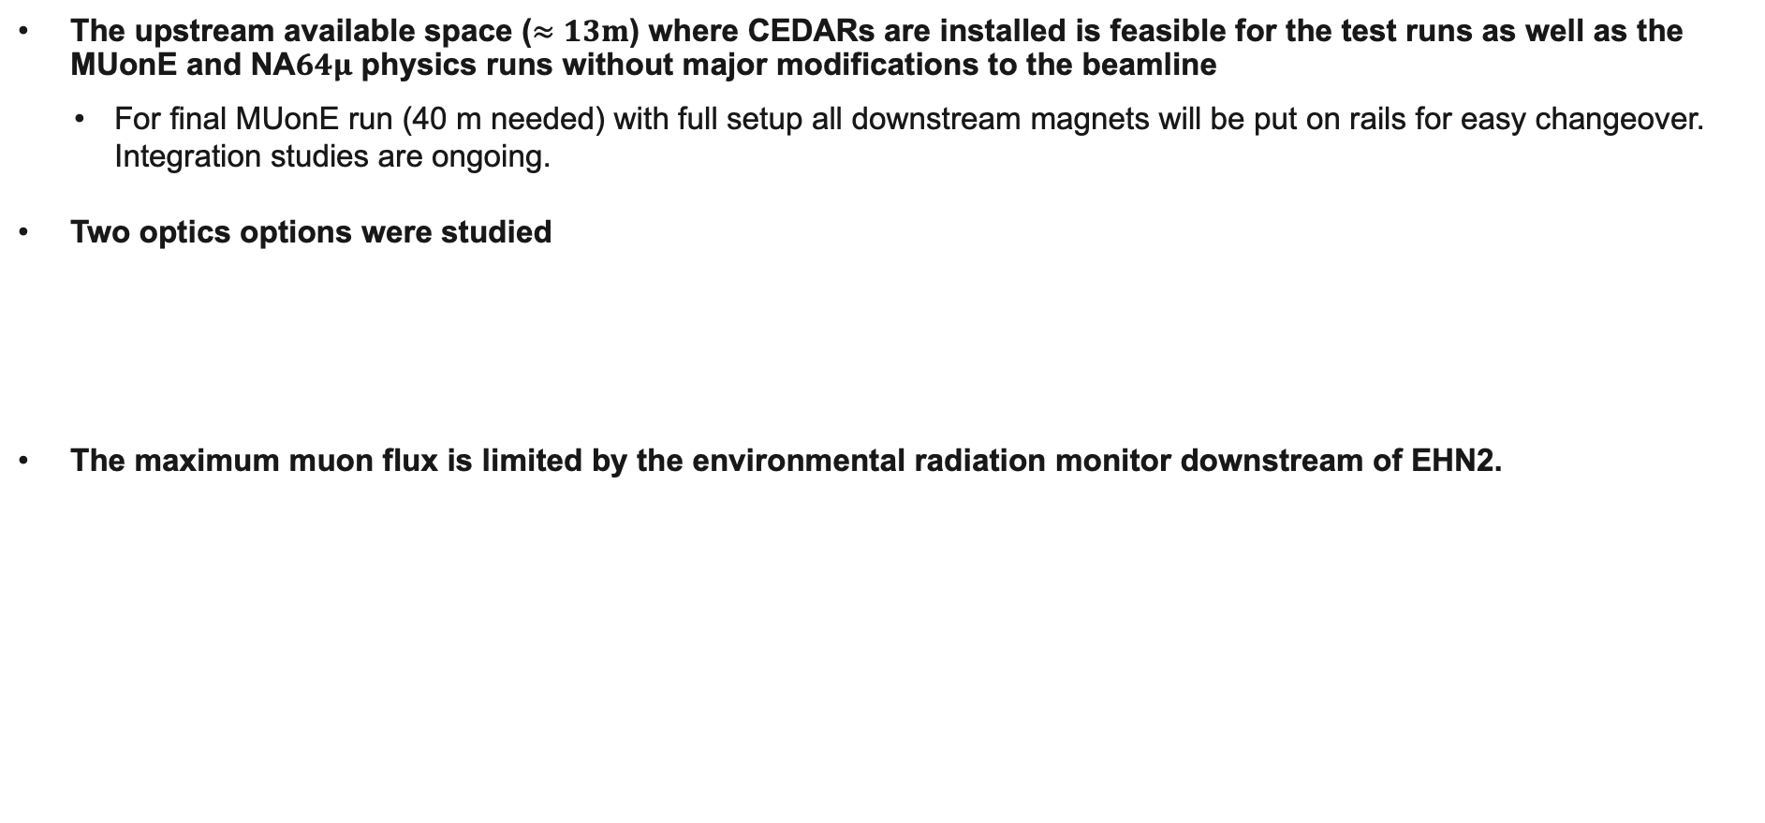
Planned Studies and upgrades for the muon beam
BE-EA, HSE-RP
The upstream available space ($≈13m$) where CEDARs are installed is feasible for the test runs as well as the MUonE and NA$64μ$ physics runs without major modifications to the beamline
  For final MUonE run (40 m needed) with full setup all downstream magnets will be put on rails for easy changeover. Integration studies are ongoing.
Two optics options were studied
The maximum muon flux is limited by the environmental radiation monitor downstream of EHN2.
Parallel beam
Focused beam
$$σ_{x}=13mm$$
$$σ_{y}=22mm$$
$$σ_{x}=10mm$$
$$σ_{y}=12mm$$
Muon Flux (x 10⁷)
Flux for µ⁺ at 1.3 10¹³ ppp and for fixed p_{µ}/p_{π} ratio (polarisation = 0.8)
Muon momentum [GeV/c]

Slide 21
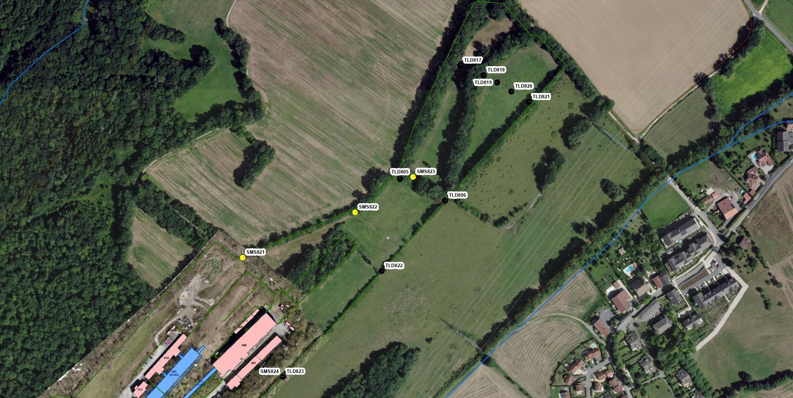
CERN Prevessin site – EHN2
HSE-RP, BE-EA
Test performed with RP in 2024 showed deflecting the beam downwards into the Earth reduces the dose by almost factor 3.
Optics optimisation done to improve the acceptance by a factor 1.6. Finalisation of the optics ongoing.
Downstream of EHN2 (SMS823)
Dose due to muons
Decision to add TLDs at end of site in 2018
EHN2
Lateral to EHN2 (SMS824)
Dose due to neutrons (skyshine) relevant for hadron beam
2018: Shielding had been increased to mitigate neutron dose, however experimental program also required higher beam intensity than in 2015.
Amongst others, objective was to remain < 1 mSv at the fence (CERN code F)
Stray radiation monitoring stations
TLD (some TLDs added since 2015)

Slide 22
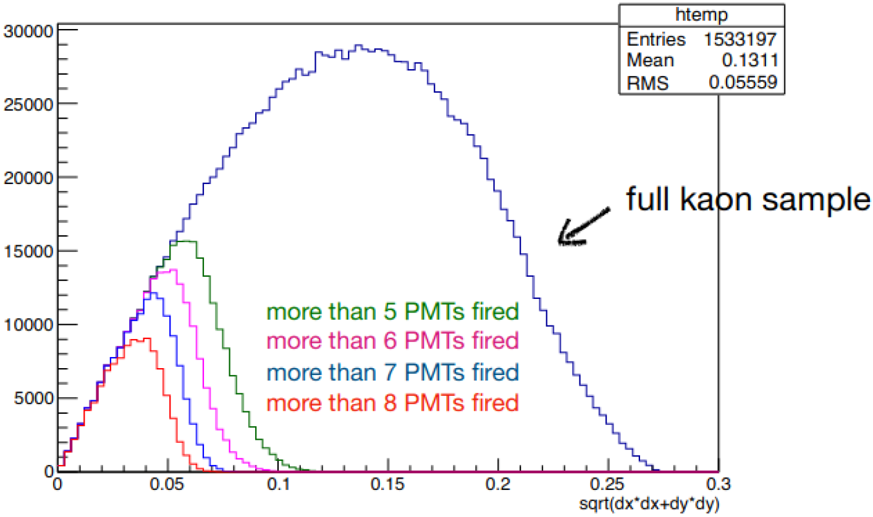
Planned Studies and upgrades for the hadron beam
Currently for specific conditions the instantaneous intensity of the hadron beam can be increased to 4.8x10⁸ particles/spill (limited by RP) → only allowed for Drell Yan runs with target absorber and, the muon filter (3 iron blocks) must be removed.
The conventional hadron beam contains about 2.4% kaons corresponding to ~ 10⁷ kaons/spill.
High kaon tagging efficiency for the CEDARs is therefore required for the K-induced DY measurement.
The tagging efficiency is dependent on the the beam divergence at the CEDARs.
To improve the number of identifiable kaons at AMBER the options checked are:
  Optimising the hadron beam in terms of divergence to increase the tagging efficiency of the CEDARs.
  Increasing the number of accumulated hadrons on the AMBER target to 3x10¹⁴ per year → RP considerations
Plot by C. Quintans
AMBER DY-Meeting 30.11.2021

Slide 23
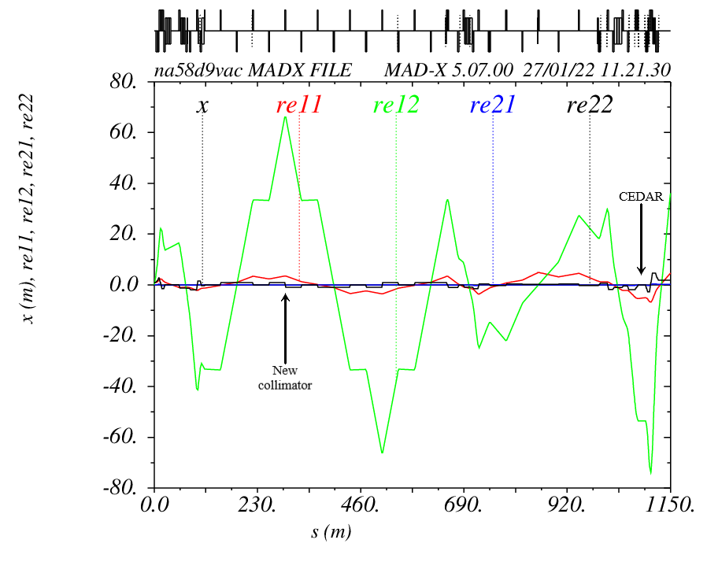
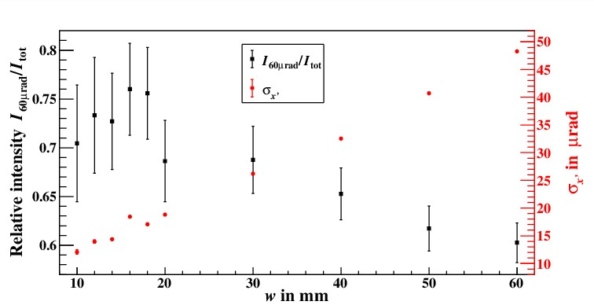
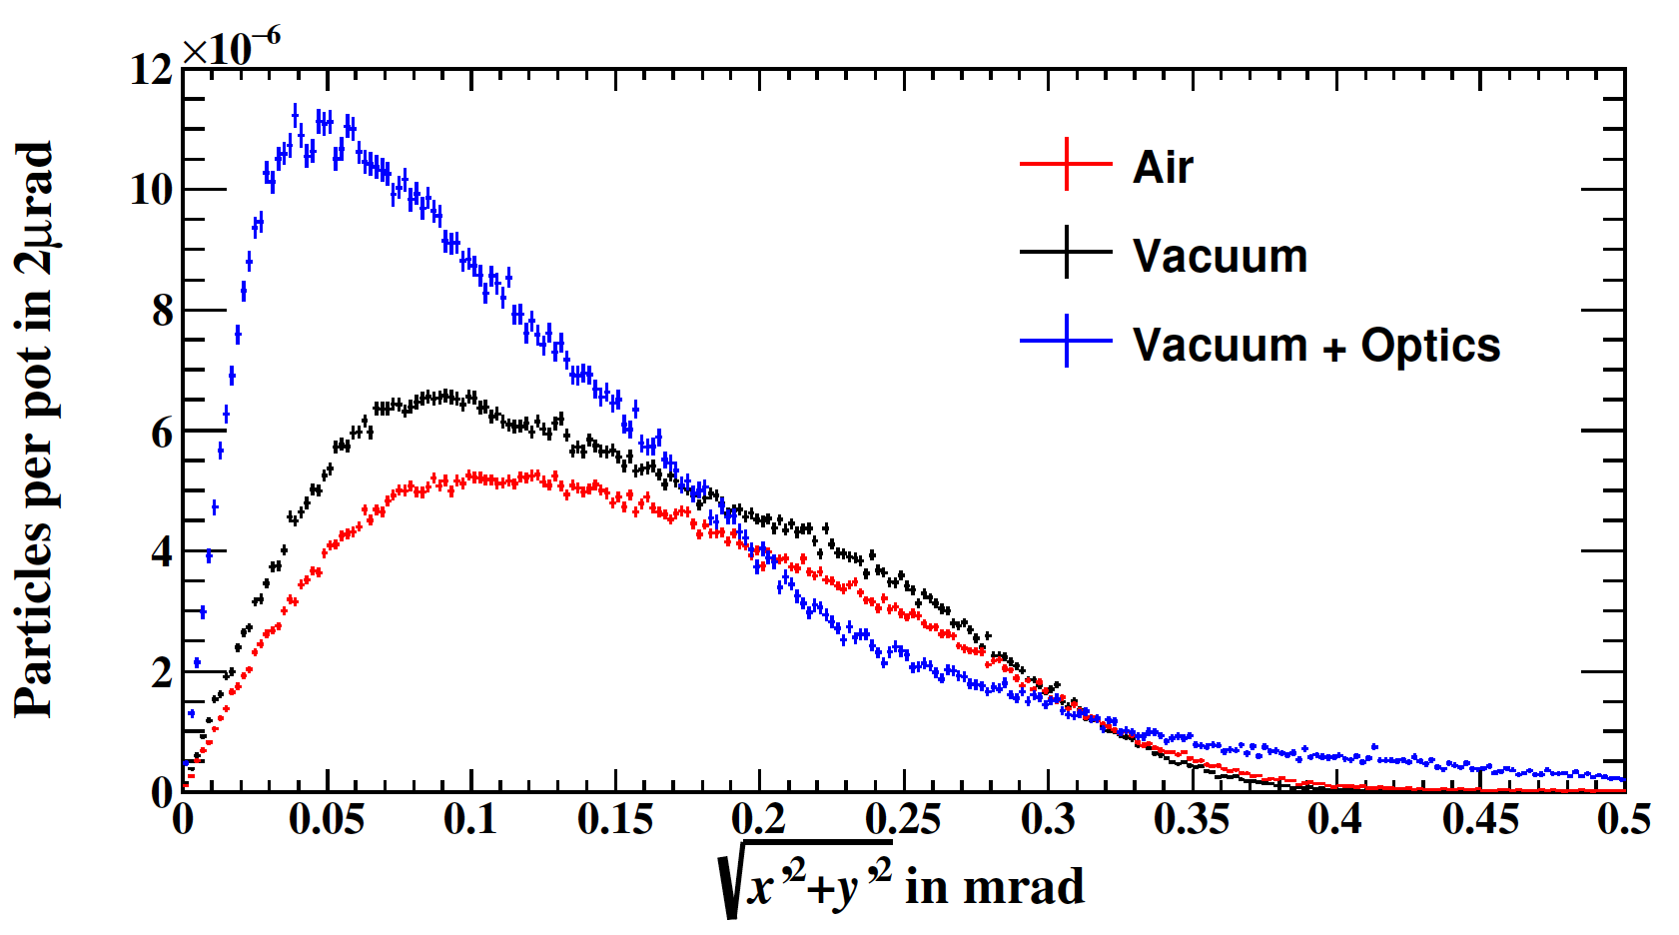
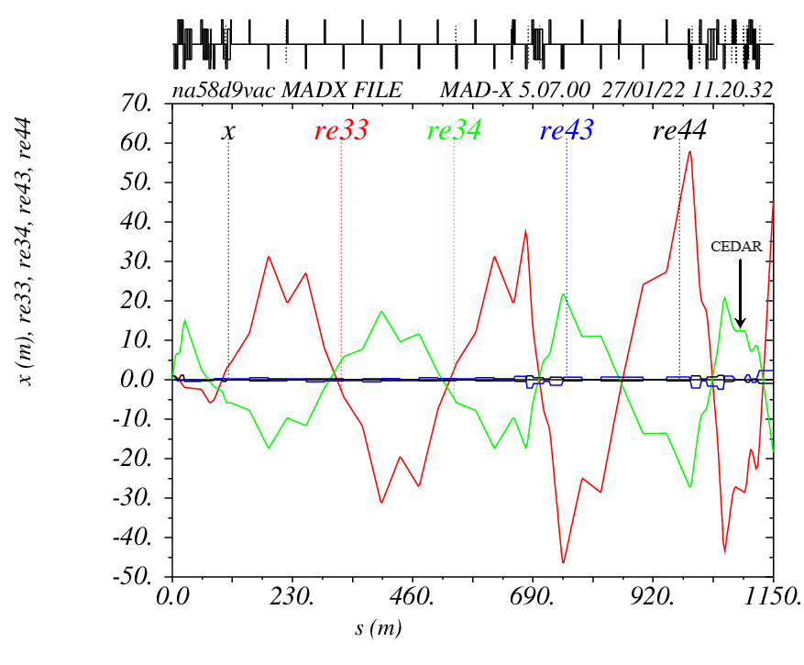
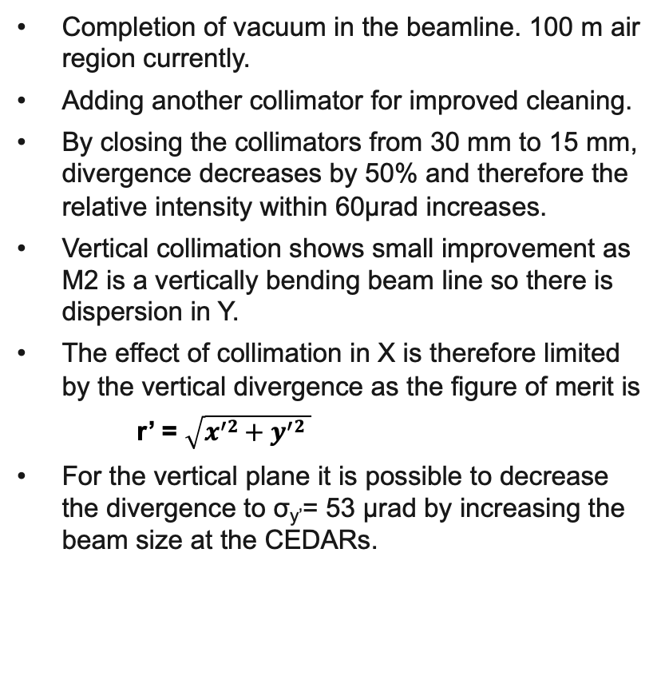
Improvements to the divergence
F. Metzger, PhD 2024
Completion of vacuum in the beamline. 100 m air region currently.
Adding another collimator for improved cleaning.
By closing the collimators from 30 mm to 15 mm, divergence decreases by 50% and therefore the relative intensity within 60µrad increases.
Vertical collimation shows small improvement as M2 is a vertically bending beam line so there is dispersion in Y.
The effect of collimation in X is therefore limited by the vertical divergence as the figure of merit is
r’ = $\sqrt{x^{′}2+y^{′}2 }$
For the vertical plane it is possible to decrease the divergence to σ_{y’}= 53 µrad by increasing the beam size at the CEDARs.

Slide 24
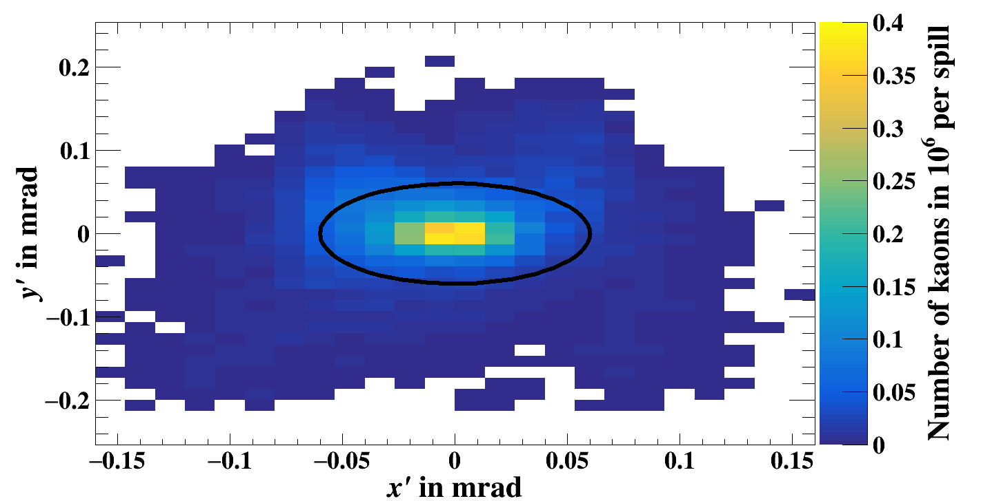
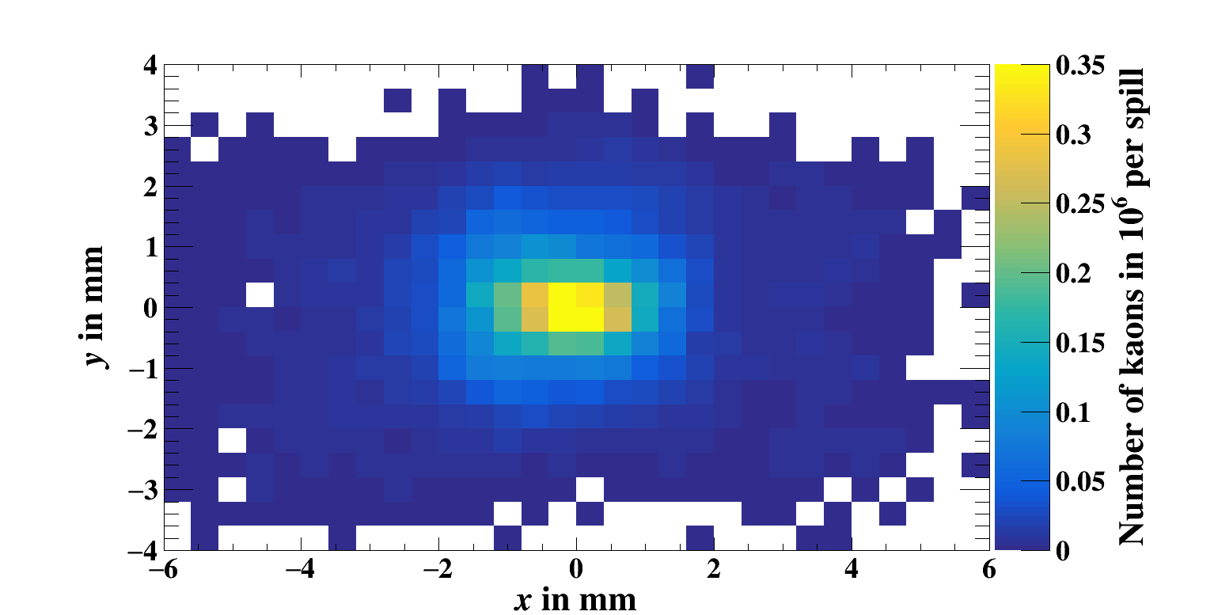
Results from the divergence improvement
F. Metzger, PhD 2024
With the improvements in the horizontal collimation and larger beam size in the y-plane (for full vacuum):
6 x 10⁶ kaons per spill within 60 µrad
(from 2.7 x 10⁶ in the current scenario)
This is for about 10⁹ hadrons per spill and 120 units on the T6 target.
Up to 150 units on T6 target possible and better collimation can lead to better relative intensity within 60 µrad.
Upgrade to 200-250 units also being studied.
Focussing of the beam at the AMBER target has also been checked
σ_{x}= 1.4 mm σ_{y}= 1 mm
CEDAR
AMBER Target

Slide 25
ECN3 Proposals
E
SPS beam @ 400 GeV/c
EHN1
ECN3
EHN2

Slide 26
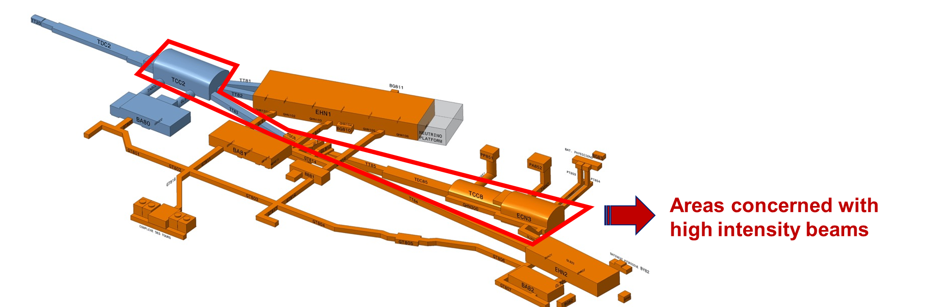
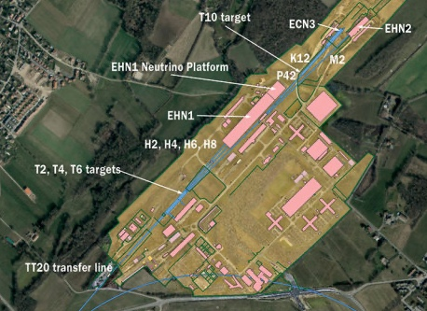
HI-ECN3 Project
The currently running NA62 experiment is scheduled to conclude their physics run end of 2025.
Various proposals were brought forward requiring high intensity beam in the underground cavern of ECN3.
 | PoT/spill | Spill duration [s] | PoT / nominal operation year | # nominal operation years | Total PoT
HIKE Phase 1 (K⁺) | 1.2 x 10¹³ | ≥ 4.5 | 0.72 x 10¹⁹ | 5 | 3.6 x 10¹⁹
HIKE Phase 2 (K⁰) | 2.0 x 10¹³ | ≥ 4.5 | 1.2 x 10¹⁹ | 6 | 7.2 x 10¹⁹
HIKE/SHADOWS BD | 2.0 x 10¹³ | ≥ 4.5 | 1.2 x 10¹⁹ | 4 | 5 x 10¹⁹
BDF/SHiP | 4.0 x 10¹³ | ≥ 1.0 | 4 x 10¹⁹ | 15 | 60 x 10¹⁹

Slide 27
HI-ECN3 Project
The currently running NA62 experiment is scheduled to conclude their physics run end of 2025.
Various proposals were brought forward requiring high intensity beam in the underground cavern of ECN3.
 | PoT/spill | Spill duration [s] | PoT / nominal operation year | # nominal operation years | Total PoT
HIKE Phase 1 (K⁺) | 1.2 x 10¹³ | ≥ 4.5 | 0.72 x 10¹⁹ | 5 | 3.6 x 10¹⁹
HIKE Phase 2 (K⁰) | 2.0 x 10¹³ | ≥ 4.5 | 1.2 x 10¹⁹ | 6 | 7.2 x 10¹⁹
HIKE/SHADOWS BD | 2.0 x 10¹³ | ≥ 4.5 | 1.2 x 10¹⁹ | 4 | 5 x 10¹⁹
BDF/SHiP | 4.0 x 10¹³ | ≥ 1.0 | 4 x 10¹⁹ | 15 | 60 x 10¹⁹
Following the decision of the research board to recommend the BDF/SHIP case the HI-ECN3 study project is working to finalise the technical studies and present a coherent upgrade proposal in the form of a TDR in close collaboration with the experiment

Slide 28
Today: Shared Beam Delivery to TCC2
C. Ahdida et al., Findings of the Physics Beyond Colliders ECN3 Beam Delivery Task Force, CERN-PBC-REPORT-2023-001
G. Arduini, C. Vallée, J. Jaeckel (eds.), Post-LS3 Experimental Options in ECN3, CERN-PBC-Report-2023-003
LSS2
TT21
TT22
TT23
T2
H2
H4
SPS
EHN1
H6
TT24
T4
H8
Shared delivery: splitting
P4
P41, P61
Deflected right by B field
Losses
~ 5%
ECN3
TCC8
P42
B
T10
Target
TT25
T6
M2
EHN2
Continues straight, undeflected
M. Fraser Beam requirements of BDF/SHiP at the HI-ECN3 facility IPP meeting 12th April 2024

Slide 29
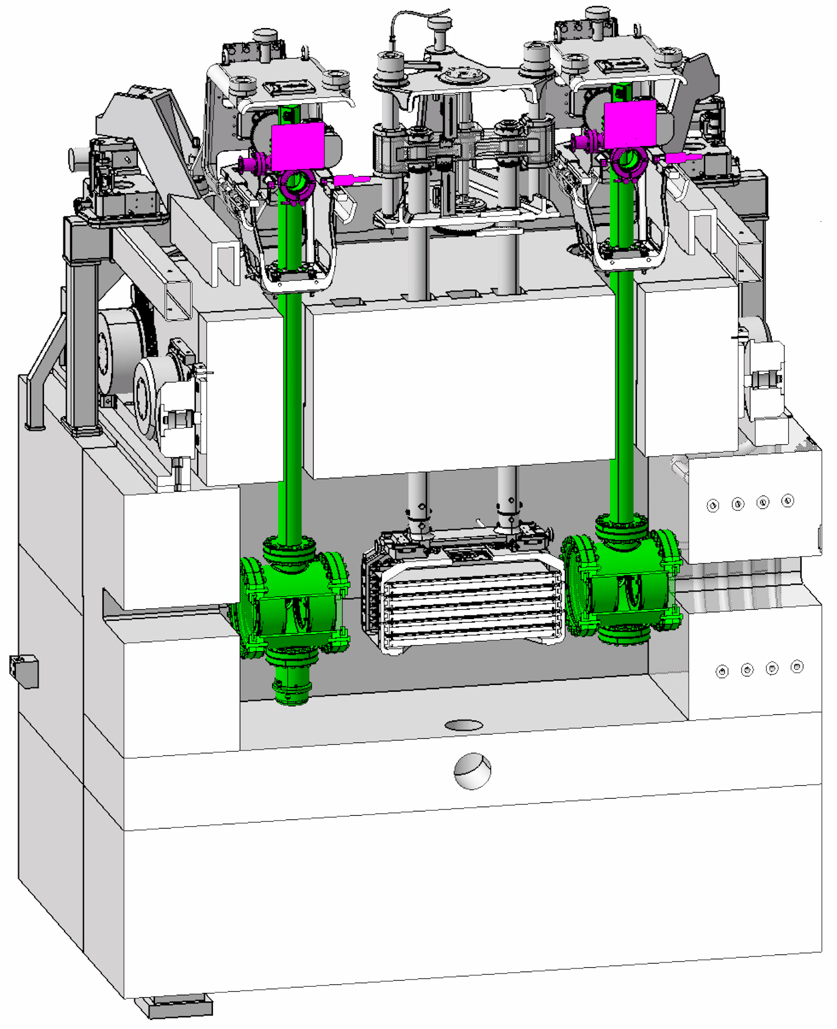
Dedicated Beam Delivery to SHiP
C. Ahdida et al., Findings of the Physics Beyond Colliders ECN3 Beam Delivery Task Force, CERN-PBC-REPORT-2023-001
G. Arduini, C. Vallée, J. Jaeckel (eds.), Post-LS3 Experimental Options in ECN3, CERN-PBC-Report-2023-003
LSS2
TT21
TT22
TT23
T2
H2
No splitting
in TDC2
H4
SPS
EHN1
H6
TT24
T4
H8
Dedicated delivery: no splitting
P4
P41, P61
No interaction with TCC2 Target
ECN3
No Losses
TCC8
P42
B
TT20 optics changed to transport beam through splitter aperture
BDF/SHiP
Target
TT25
T6
M2
EHN2
M. Fraser Beam requirements of BDF/SHiP at the HI-ECN3 facility IPP meeting 12th April 2024

Slide 30
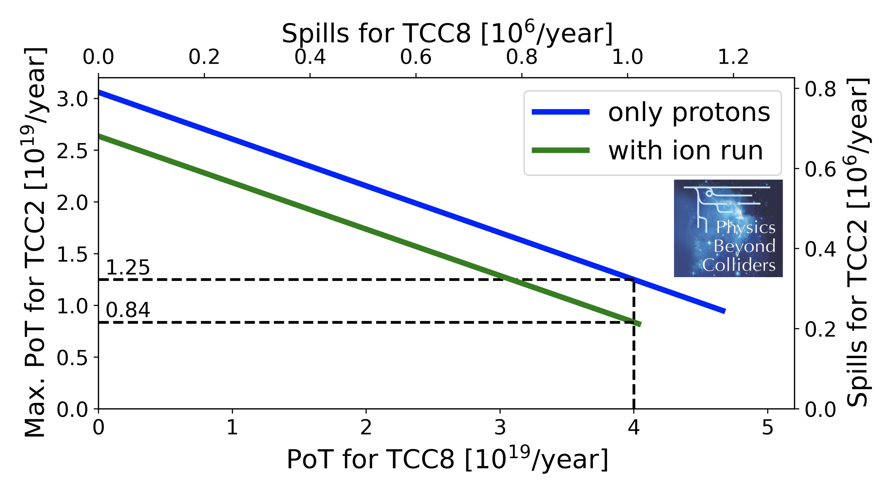



Proton Sharing
T. Prebibaj et al., SPS Operation and Future Proton Sharing Scenarios for the ECN3 facility, CERN-PBC-Notes-2023-001
Dedicated 1.2 s
NA
4.8 s
Dedicated
4.8 s
NA 4.8 s / 9.6 s
Dedicated extraction to TCC8 only, interleaved with extractions to all NA experiments and test beam users.
Proton sharing computed to max. TCC2 PoT: SFTPRO with 4.2×10¹³ ppp and with 4.8 s FT
M. Fraser Beam requirements of BDF/SHiP at the HI-ECN3 facility IPP meeting 12th April 2024

Slide 31

Planned upgrades and studies
This is an extensive project with many ongoing studies and upgrades being planned in close synergy with the NACONS project.
The changes will include:
  Optimised beam delivery of slow extracted high intensity beam with shorter spill.
  Reduced beam losses along the beamline for the zero-background search of SHIP.
  A new target complex in ECN3 capable to accumulate 4E19 protons per year.
  Dumping the unused protons from the shared cycle before it can create background downstream.
  Civil engineering works to prepare the ECN3 cavern for the BDF/SHIP installation.
The TDR is scheduled to be submitted by end of 2025. Changes for the first part of the beamline to be installed during LS3, followed by commissioning during Run4 and completion of the rest of the beamline during the Year End Stops until 2030. Physics run post-LS4.
M. Fraser Beam requirements of BDF/SHiP at the HI-ECN3 facility IPP meeting 12th April 2024

Slide 32
Summary
In the context of PBC various new fixed-target beam requests have come forward to run post-LS3 at the CERN North Area.
Many feasibility and technical studies have been launched in this context which are ongoing with an implementation phase planned for LS3.
The list presented here is far from exhaustive and features some highlights.
With the end of Run 3 imminent in August 2026, we have the privilege to look forward to a rich and diverse physics program being at the frontier of unprecedented high intensities at the North Area.

Slide 33
Backup

