Slide 1
Liquid argon-based technologies for neutrino and dark matter detection
C. Montanari
FNAL – INFN Pavia
BDX & Beyond Workshop
September 4, 2025

Slide 2
Outline
  Neutrino fluxes and neutrino rates in liquid argon
  Double-phase liquid argon TPC
  Backgrounds and background rejection
  Conclusions

Slide 3
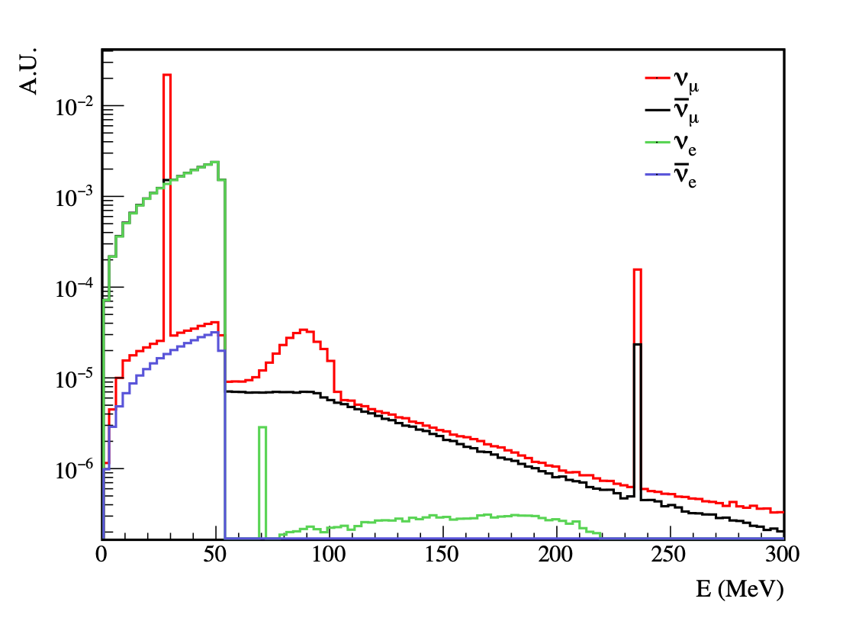
Neutrino fluxes at BDX
Most of the flux is concentrated at low energies (E_{ν} < 55 MeV), with known spectrum and composition from muon’s and pion’s decays at rest.
At higher energies, event rates per unit target mass will be extremely low and would require very massive detectors to be exploited.
Battaglieri, M.; et al. Secondary Beams at High-Intensity Electron Accelerator Facilities. Instruments 2024, 8, 1. https://doi.org/10.3390/instruments8010001

Slide 4
Neutrino cross-sections: coherent ν-⁴⁰Ar scattering
For practical targets, in the low energy range under consideration, the neutrino interaction cross-section is dominated by neutrino-nucleus coherent scattering.
The resulting signature is a nuclear recoil of a given energy.
CEνNS
ν_{e} CCQE
NCQE
Van Dessel, N.; Pandey, V.; Ray, H.; Jachowicz, N. Cross Sections for Coherent Elastic and Inelastic Neutrino-Nucleus Scattering.Universe 2023, 9, 207. https://doi.org/10.3390/universe9050207 - arXiv:2007.03658v2 [nucl-th] 26 Apr 2023

Slide 5
Neutrino cross-sections: other relevant interaction channels
For a comprehensive review of neutrino cross-sections see: J.A. Formaggio and G.P. Zeller, From eV to EeV: Neutrino across sections across energy scales, Rev. Mod. Phys. 84, 1307, DOI: https://doi.org/10.1103/RevModPhys.84.1307
I. Gil-Botella and A. Rubbia, Oscillation effects on supernova neutrino rates and spectra and detection of the shock breakout in a liquid Argon TPC. https://arxiv.org/abs/hep-ph/0307244v2 and references [20], [21], and [22] therein

Slide 6
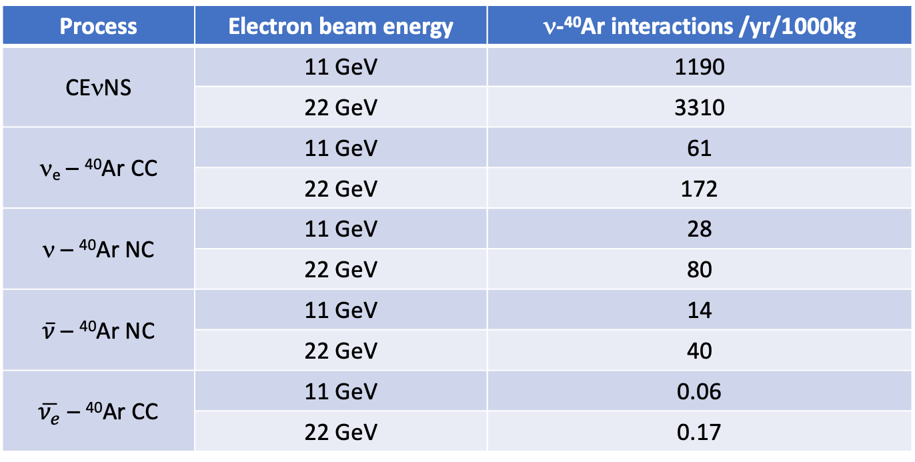
BDX neutrinos interaction rates – off-axis
Process | Electron beam energy | ν-⁴⁰Ar interactions /yr/1000kg
CEνNS | 11 GeV | 1190
 | 22 GeV | 3310
ν_{e} – ⁴⁰Ar CC | 11 GeV | 61
 | 22 GeV | 172
ν – ⁴⁰Ar NC | 11 GeV | 28
 | 22 GeV | 80
$\overline{ν}$ – ⁴⁰Ar NC | 11 GeV | 14
 | 22 GeV | 40
$\overline{ν_{e}}$ – ⁴⁰Ar CC | 11 GeV | 0.06
 | 22 GeV | 0.17
E_{ν} < 55 MeV
E_{ν} < 100 MeV
Interaction rates are for 0 energy threshold.

Slide 7
Neutrin-⁴⁰Ar coherent scattering: recoil energy
Coherent scattering cross-section scales as the atomic mass squared. Consequently, higher atomic mass targets (e.g. xenon) provide significantly larger interaction rates. On the other hand, the maximum transferrable energy between the neutrino and the nucleus scales as the inverse of the atomic mass. Typical recoil energies range from few keV to some tens keV, depending on the target atomic mass.
Argon is an ideal compromise that ensures a substantial interaction rate at a detectable recoil energy.
Van Dessel, N.; Pandey, V.; Ray, H.; Jachowicz, N. Cross Sections for Coherent Elastic and Inelastic Neutrino-Nucleus Scattering.Universe 2023, 9, 207. https://doi.org/10.3390/universe9050207 - arXiv:2007.03658v2 [nucl-th] 26 Apr 2023

Slide 8
The double phase LAr TPC technology for nuclear recoils detection
  The double-phase LAr TPC technology was specifically developed, starting from the early 2000’s, as a tool to detect and identify and separate nuclear recoils from electrons- or gamma-induced backgrounds, with nuclear recoils being a potential signature of galactic Dark Matter in the form of Weakly Interacting Massive Particles (WIMPs).
  The combination of temporal distribution of LAr scintillation light (pulse shape discrimination) with the ratio between scintillation and ionization signal amplitudes, leads to an extremely powerful discrimination between nuclear recoils and gamma/electron-induced backgrounds (in excess of 1 in 10⁸, for reasonably large signals).
  Over the years, the detector operational parameters, such as the energy scale for nuclear and electron recoils, quenching factors, light gain vs applied field in the gas phase, etc., have been determined with good accuracy. The readout technology has been concurrently developed together with methods to maximize the light collection efficiency.
  The initial tests and studies on the double-phase LAr TPC were conducted in the context of the ICARUS experiment, while the first detector technology developments were carried out by the WArP Collaboration, which built the first demonstrators between 2003 and 2009. Most of the later developments and studies were led by the DarkSide Collaboration, which is constructing a detector with a fiducial mass of 20 metric tons (mton), a total active mass of about 50 mton of ultra-low-activity LAr, and a LAr active shield of about 600 mton.
  Among other technologies capable to efficiently detect and discriminate nuclear recoils, none offers comparable exposure or discrimination power at a reasonable cost.

Slide 9
Liquid Argon as Radiation Detection Medium
Atomic Mass 40 (spin 0)
Atomic Number 18
Density: 1.4 g/cm³
Temperature LAr @ 1bar -185.7 ºC (87K)
dE/dx (m.i.p.) 2.1 MeV/cm
Radiation Length 14 cm
Nucl. Coll. Length 80 cm
Electron’s Mobility 535 cm²/V/s → v_{drift} ≈ 1.5 mm/µs @ E=500 V/cm
Ionization Potential 15.76 eV
W_{ion} (m.i.p.) 23.6 eV → ≈ 8800 e⁻ Ar⁺ pairs / mm
W_{ph} (m.i.p.) 25.1 eV → ≈ 8400 γ / mm
λ(scintillation) 128 nm
τ(scintillation) 6 ns (30%) , 1.5 μs (70%) → ratio is ionization density dependent
Light Attenuation Length 0.8 m @ 128 nm

Slide 10
Double-phase LAr TPC – principle of operation
Two simultaneous criteria to discriminate potential WIMP recoils from backgrounds:
  Simultaneous detection of prompt scintillation and drift time-delayed ionisation in Liquid Argon:
    pulse height ratio strongly dependent from columnar recombination of ionizing tracks.
    3D reconstruction of event position.
  Pulse shape discrimination of primary scintillation:
    wide separation in rise times between fast (≈ 10 ns) and slow (≈ 1.6 µs) components of the emitted UV light.
Double Phase Argon Chamber
Only detector with double discrimination technology.
Largest discrimination of γ/β-induced backgrounds.

Slide 11
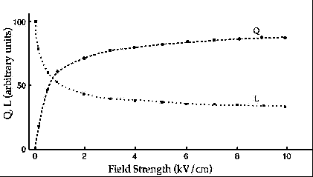
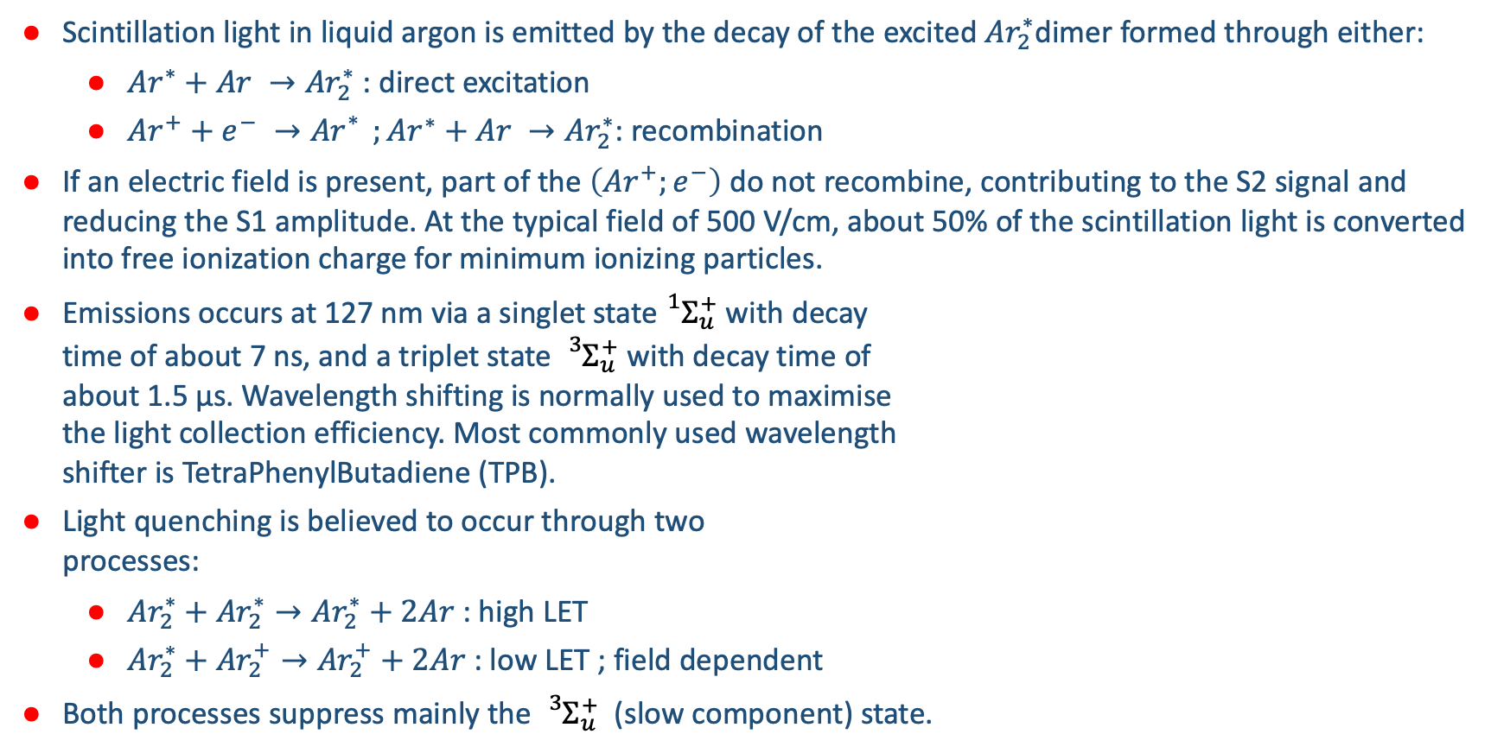
Scintillation light in LAr
Scintillation light in liquid argon is emitted by the decay of the excited ${Ar}_{2}^{∗}$dimer formed through either:
  ${Ar}^{∗}+Ar →{Ar}_{2}^{∗}$ : direct excitation
  ${Ar}^{+}+e^{−} →{Ar}_{}^{∗} ;{Ar}^{∗}+Ar →{Ar}_{2}^{∗}$: recombination
If an electric field is present, part of the $\left({Ar}^{+};e^{−}\right)$ do not recombine, contributing to the S2 signal and reducing the S1 amplitude. At the typical field of 500 V/cm, about 50% of the scintillation light is converted into free ionization charge for minimum ionizing particles.
Emissions occurs at 127 nm via a singlet state${}_{}^{1}{Σ_{u}^{+}}$ with decay
time of about 7 ns, and a triplet state ${}_{}^{3}{Σ_{u}^{+}}$ with decay time of
about 1.5 µs. Wavelength shifting is normally used to maximise
the light collection efficiency. Most commonly used wavelength
shifter is TetraPhenylButadiene (TPB).
Light quenching is believed to occur through two
processes:
  ${Ar}_{2}^{∗}+{Ar}_{2}^{∗}→{Ar}_{2}^{∗}+2Ar$ : high LET
  ${Ar}_{2}^{∗}+{Ar}_{2}^{+}→{Ar}_{2}^{+}+2Ar$ : low LET ; field dependent
Both processes suppress mainly the ${}_{}^{3}{Σ_{u}^{+}}$ (slow component) state.
500 V/cm
Electron recombination (E-dependent) contributes to scintillation light

Slide 12
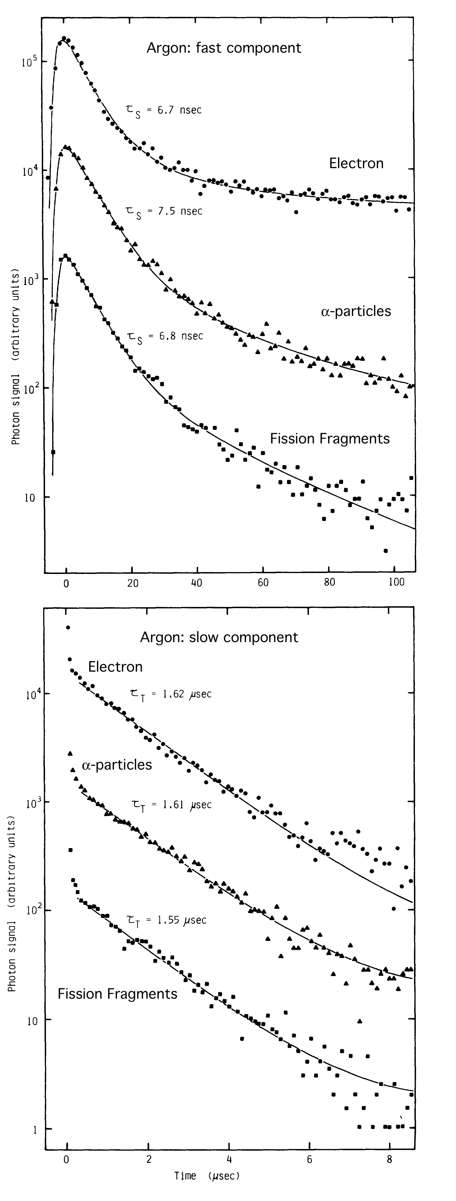
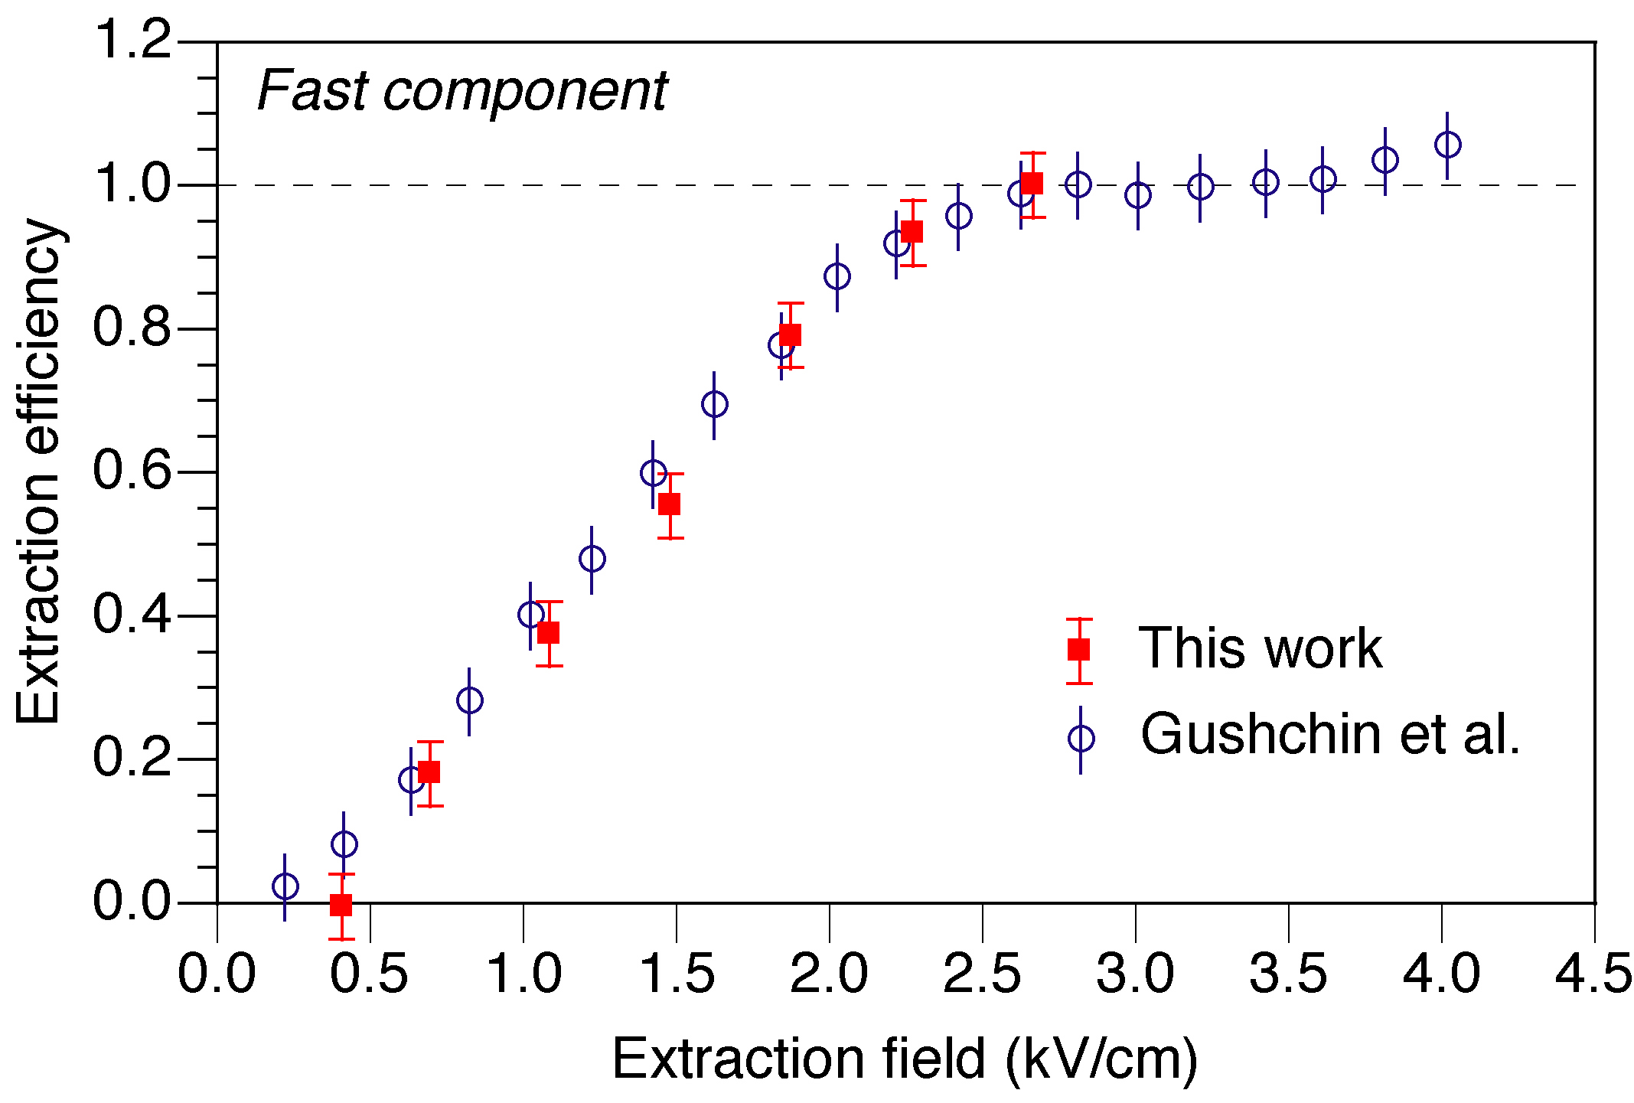
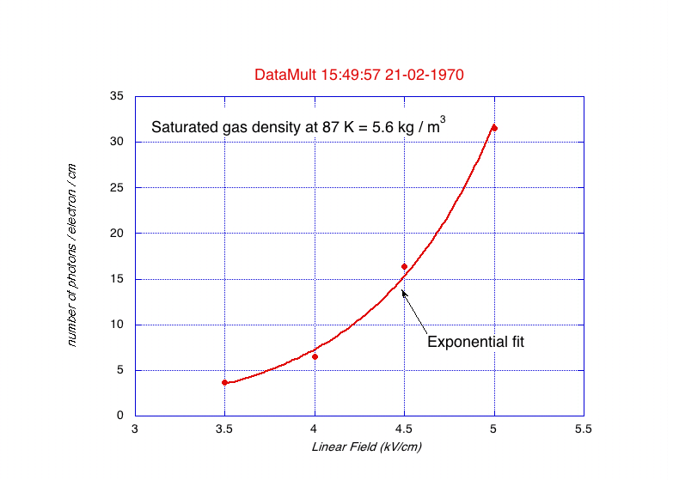
Double-phase LAr TPC – basic technical elements
τ_{singlet} = 7ns
Electrons extraction from liquid to gas
Primary Scintillation in LAr
Secondary Light Production
τ_{riplet} = 1.6 µs
At the chosen light multiplication fields, no charge multiplication occurs → no positive feedback on S2 signal.

Slide 13
Scintillation yield in LAr for nuclear recoils
  Due to the high LET, the scintillation light from nuclear recoils is significantly quenched w.r.t. electron-like recoils.
  The quenching results in the strong suppression of the long-lived (triplet) component of the scintillation light.
  At no field, the relative yield between nuclear recoils and electron-like recoils is about 0.25 and it decreases at increasing electric fields.
  Knowledge of the relative light yield is fundamental to determine the energy scale.
Graphs from: H. Cao, et al., Measurement of scintillation and ionization yield and scintillation pulse shape from nuclear recoils in liquid argon. PHYSICAL REVIEW D 91, 092007 (2015)

Slide 14
Relative Ionization yields in LAr between nuclear and electron recoils
  Down to few tens keV the relative ionization yield between nuclear and electron-like recoils is < 1/10, due to the strong recombination of the slow nuclear recoils.
  At very low deposited energies the ionization yield of electron-like recoils also becomes significantly suppressed by recombination.
  The DarkSide Collaboration has made a significant effort to measure the relative ionization yield between nuclear and electron-like recoils down to 0.5 keV.
Graph from: P. Agnes, et al., Search for low-mass dark matter WIMPs
with 12 ton-day exposure of DarkSide-50. PHYSICAL REVIEW D 107, 063001 (2023)

Slide 15
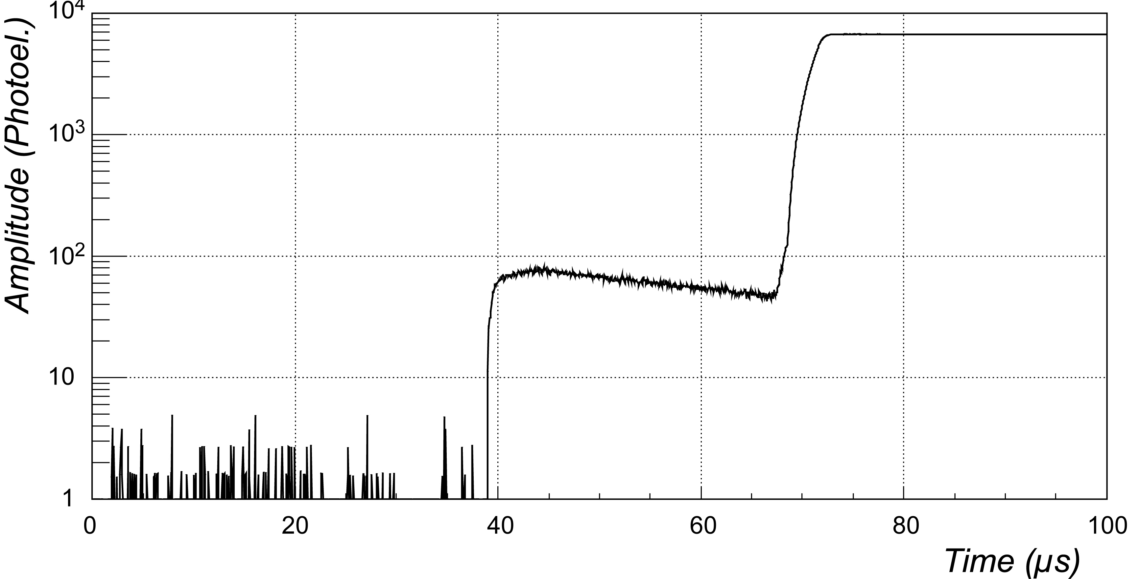
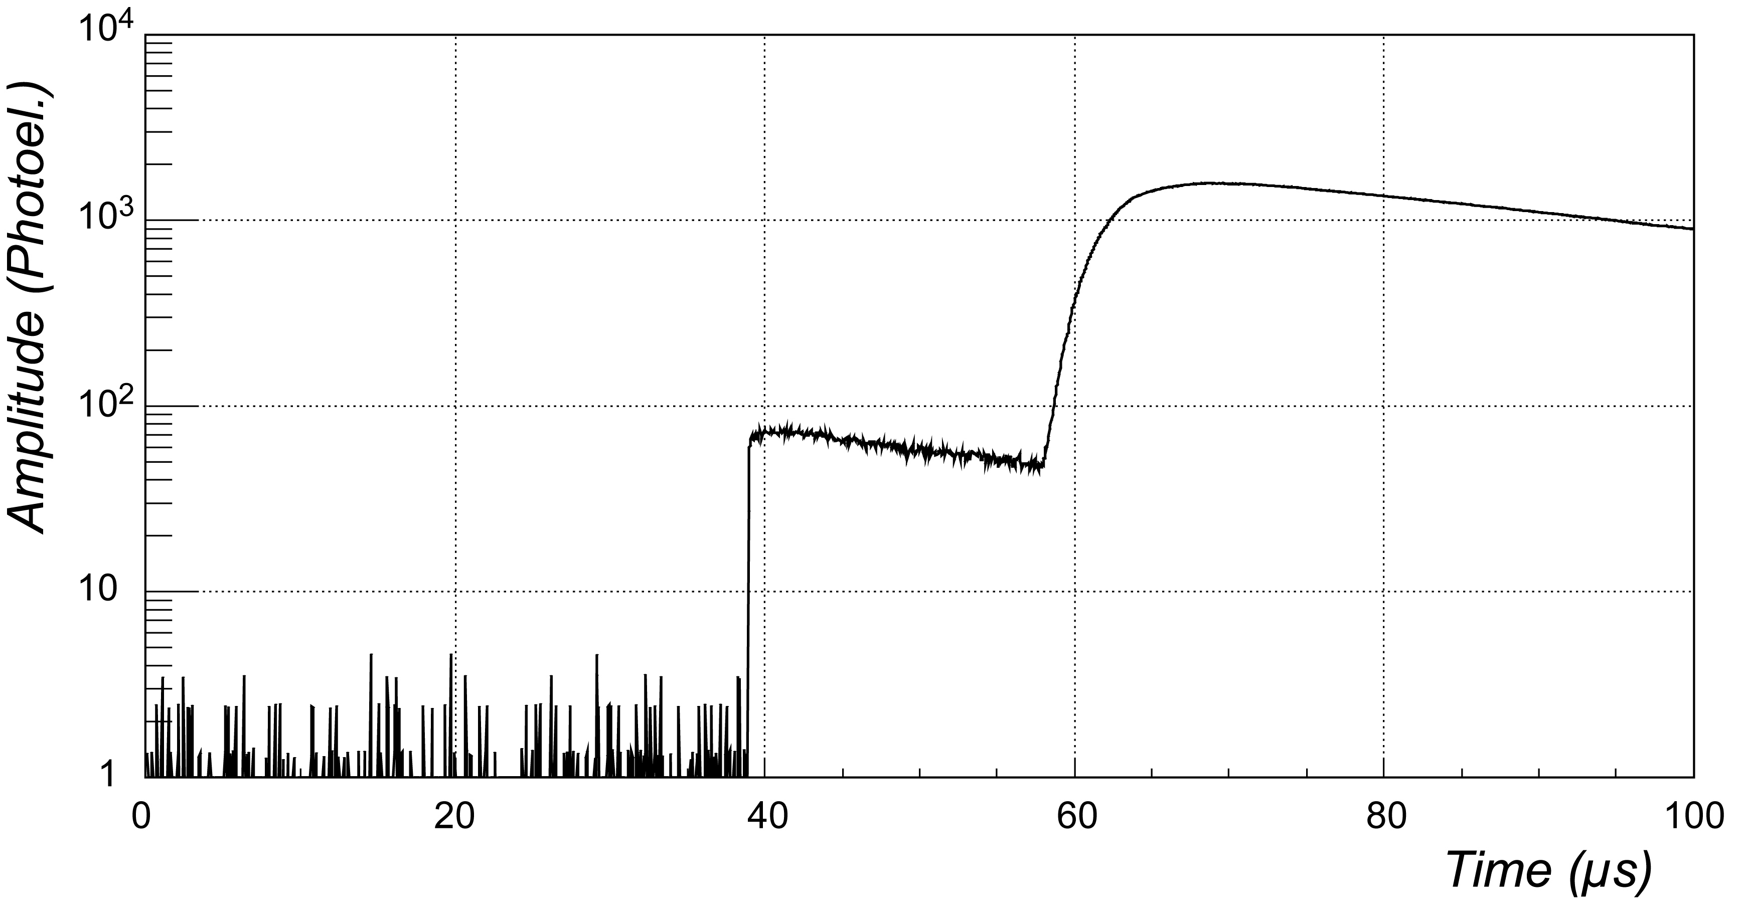
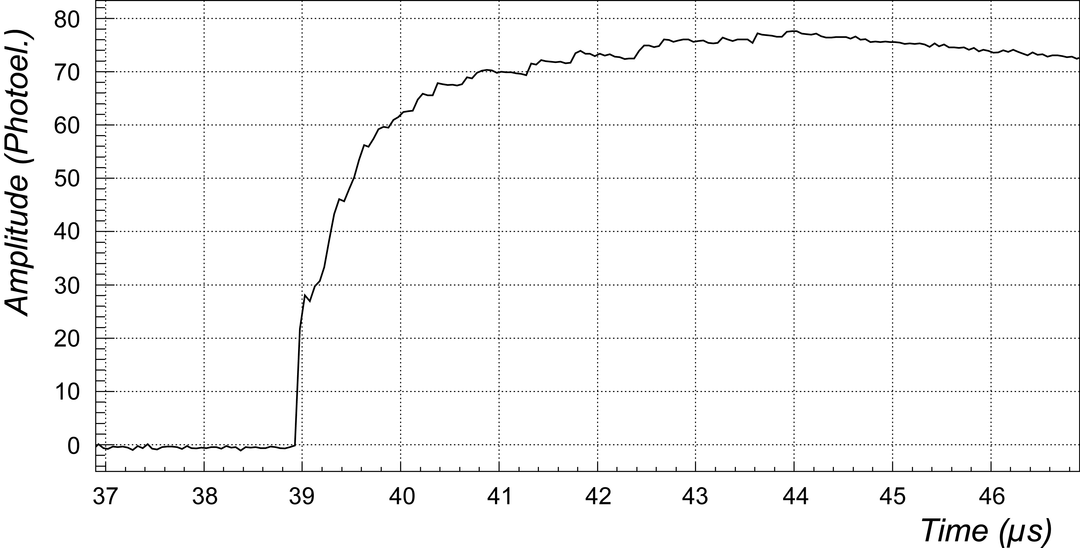
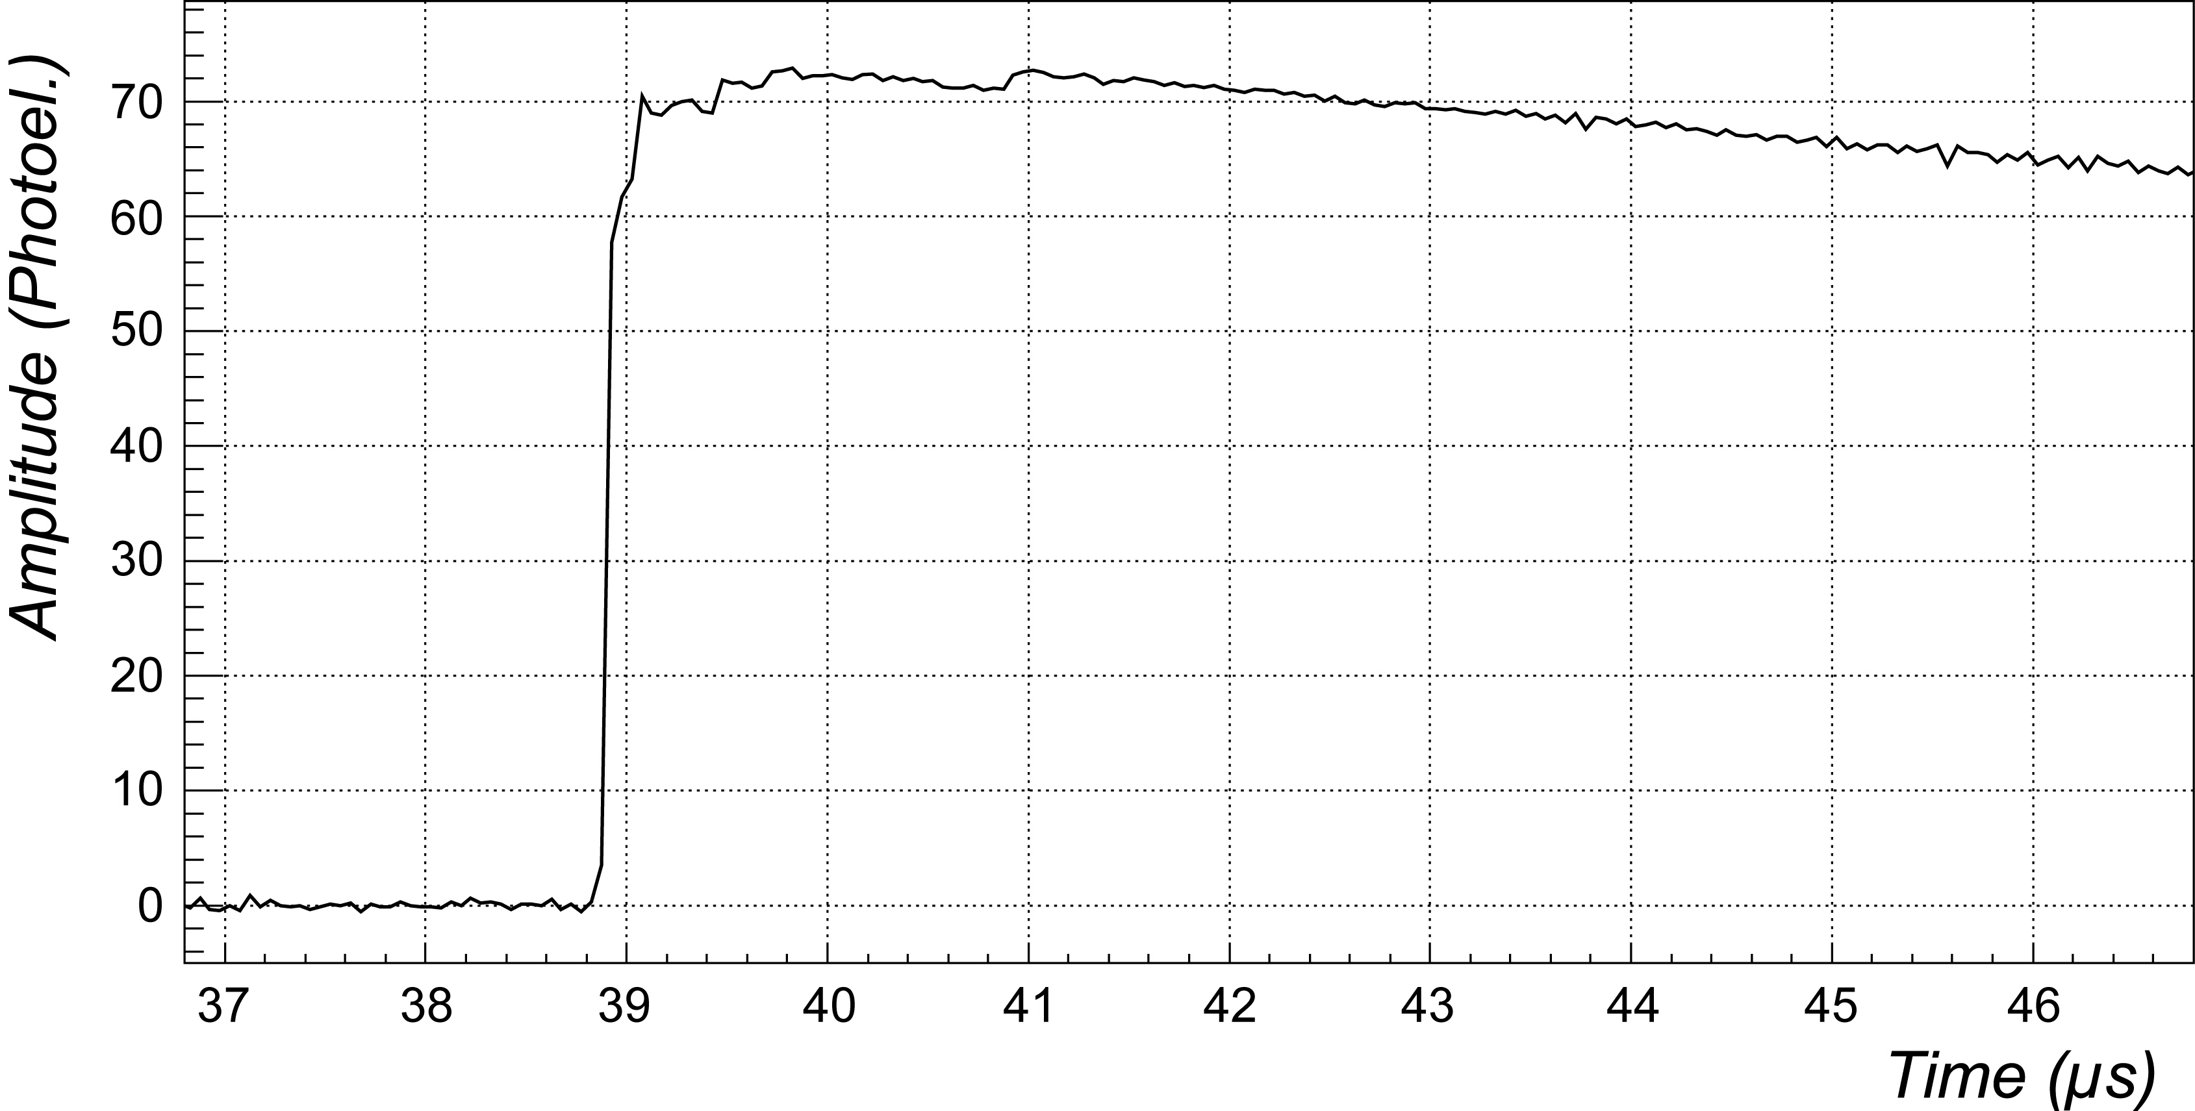
Double-phase LAr TPC – Discrimination Technique
Minimum ionising particles: high S2/S1 ratio (~100) + slow S1 signal.
α particles and nuclear recoils (R-like events): low (<30) S2/S1 + fast S1.
  S1 = primary (prompt) scintillation signal
  S2 = secondary (delayed) scintillation signal (proportional to ionization)
(A)
Electron
(B)
Argon recoil
S2
S2
S1
S1
Drift time
S1
S1

Slide 16
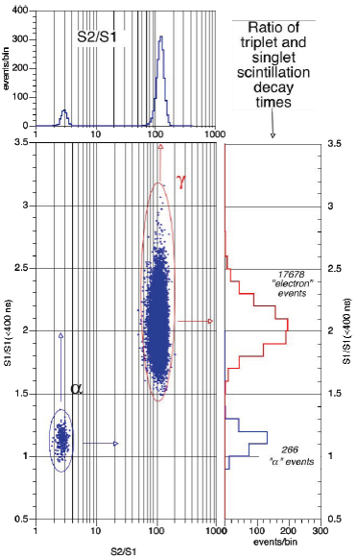
Discrimination Technique
Combined selection based on S2/S1 ratio and rise time of primary scintillation
γ’s and β’s
No event outside the two circled regions
Complete agreement up to an observed level of ≈ 1/20000 ⇒ combined rejection < 1/10⁸
α’s
16

Slide 17
Early results from the WArP experiment (2008)
Neutron Induced Ar recoils
WIMP Exposure = 96.5 kg • day
Selection regions

Slide 18
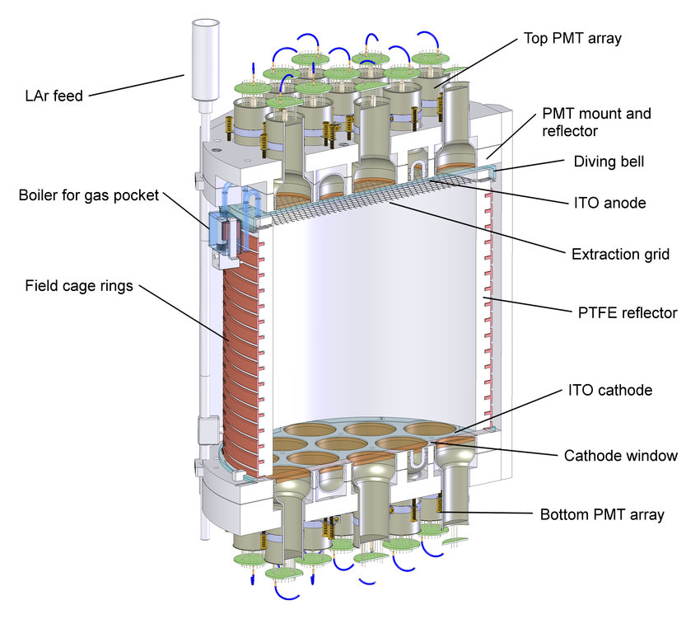
The importance of a high light collection efficiency
  Pulse shape discrimination critically depends on the signal amplitude.
  Significant efforts have been devoted to maximize the light
  collection efficiency in LAr-based Dark Matter experiments
  (WArP, DEAP, MiniCLEAN, DarkSide).
  The strategy tackles the problem from several sides:
    Maximize the photodetectors quantum efficiency
    Maximize the photodetectors coverage
    Use of a combination of wavelength shifter (TPB)
    plus reflective materials (Vikuiti/VM2000, PTFE).
  The technology requires use of low radioactivity
  components.
  Reflective materials must be dielectric for compatibility
  with the drift / light multiplication fields.
  The highest light collection efficiency has been achieved by DarkSide-50, with about 9 photoelectrons collected per keV deposited by a minimum ionizing particle.
DarkSide-50 Central detector

Slide 19
Backgrounds: electron-like events
  Electron or gamma induced backgrounds are rejected by the powerful discrimination technique of the double-phase LAr TPC.
  Given the large rejection capability ( > 10⁸), relatively high rates can be tolerated, but they must be compatible with the relatively long integration time of the time projection chamber. For a cylindrical volume of, say, 2500 kg sensitive masse (about 1400 kg fiducial mass) and aspect ration 1:1 between diameter and height, the drift length would be about 65 cm. The corresponding maximum drift time at 500 V/cm drift field is about 400 µs. To avoid significant pile-up, the limit on the maximum rate is < 1 kHz for energy depositions above the desired threshold (≈ 10 keV nuclear recoils → ≈ 5 keV electron-like events).
  Atmospheric argon contains the isotope ³⁹Ar, a pure beta emitter with an end point at 565 keV, produced by interaction of cosmic rays in the upper portion of the atmosphere. The typical decay rate of ³⁹Ar in commercial LAr is ≈ 1 Hz/kg. This limits the size of a single-volume double phase LAr TPC to ≈ 1000 kg.
  The DarkSide Collaboration has developed a supply of argon coming from underground, with much lower ³⁹Ar contamination, and has developed radio-purification methods based on isotopic separation techniques. The process is expensive and extremely time consuming. A practical alternative, much cheaper and appropriate for the application at BDX, is to optically segment the sensitive volume into sub-volumes ≲ 500 liters.
  Other radioactive contaminants, e.g. from ²³²Th and ²³⁸U chains, may produce substantial rates and types of radiation more impacting (neutrons, nuclear recoils from alpha decays). Careful materials selection is a necessity.

Slide 20
Background spectrum measured in WArP at LNGS
Low energy background spectrum measured with a double-phase LAr TPC at LNGS
³⁹Ar β-decay spectrum
J. Kostensalo, J. Suhonen and K Zuber, Spectral shapes of forbidden argon decays as background component for rare-event searches. arXiv:1705.05726v1 (May 2017)
Credit: Benetti et al (2007). Measurement of the specific activity of Ar-39 in natural argon.

Slide 21
Backgrounds spectrum measured in WArP at LNGS
Low energy background spectrum measured with a double-phase LAr TPC at LNGS
³⁹Ar β-decay spectrum
J. Kostensalo, J. Suhonen and K Zuber, Spectral shapes of forbidden argon decays as background component for rare-event searches. arXiv:1705.05726v1 (May 2017)
Credit: Benetti et al (2007). Measurement of the specific activity of Ar-39 in natural argon.

Slide 22
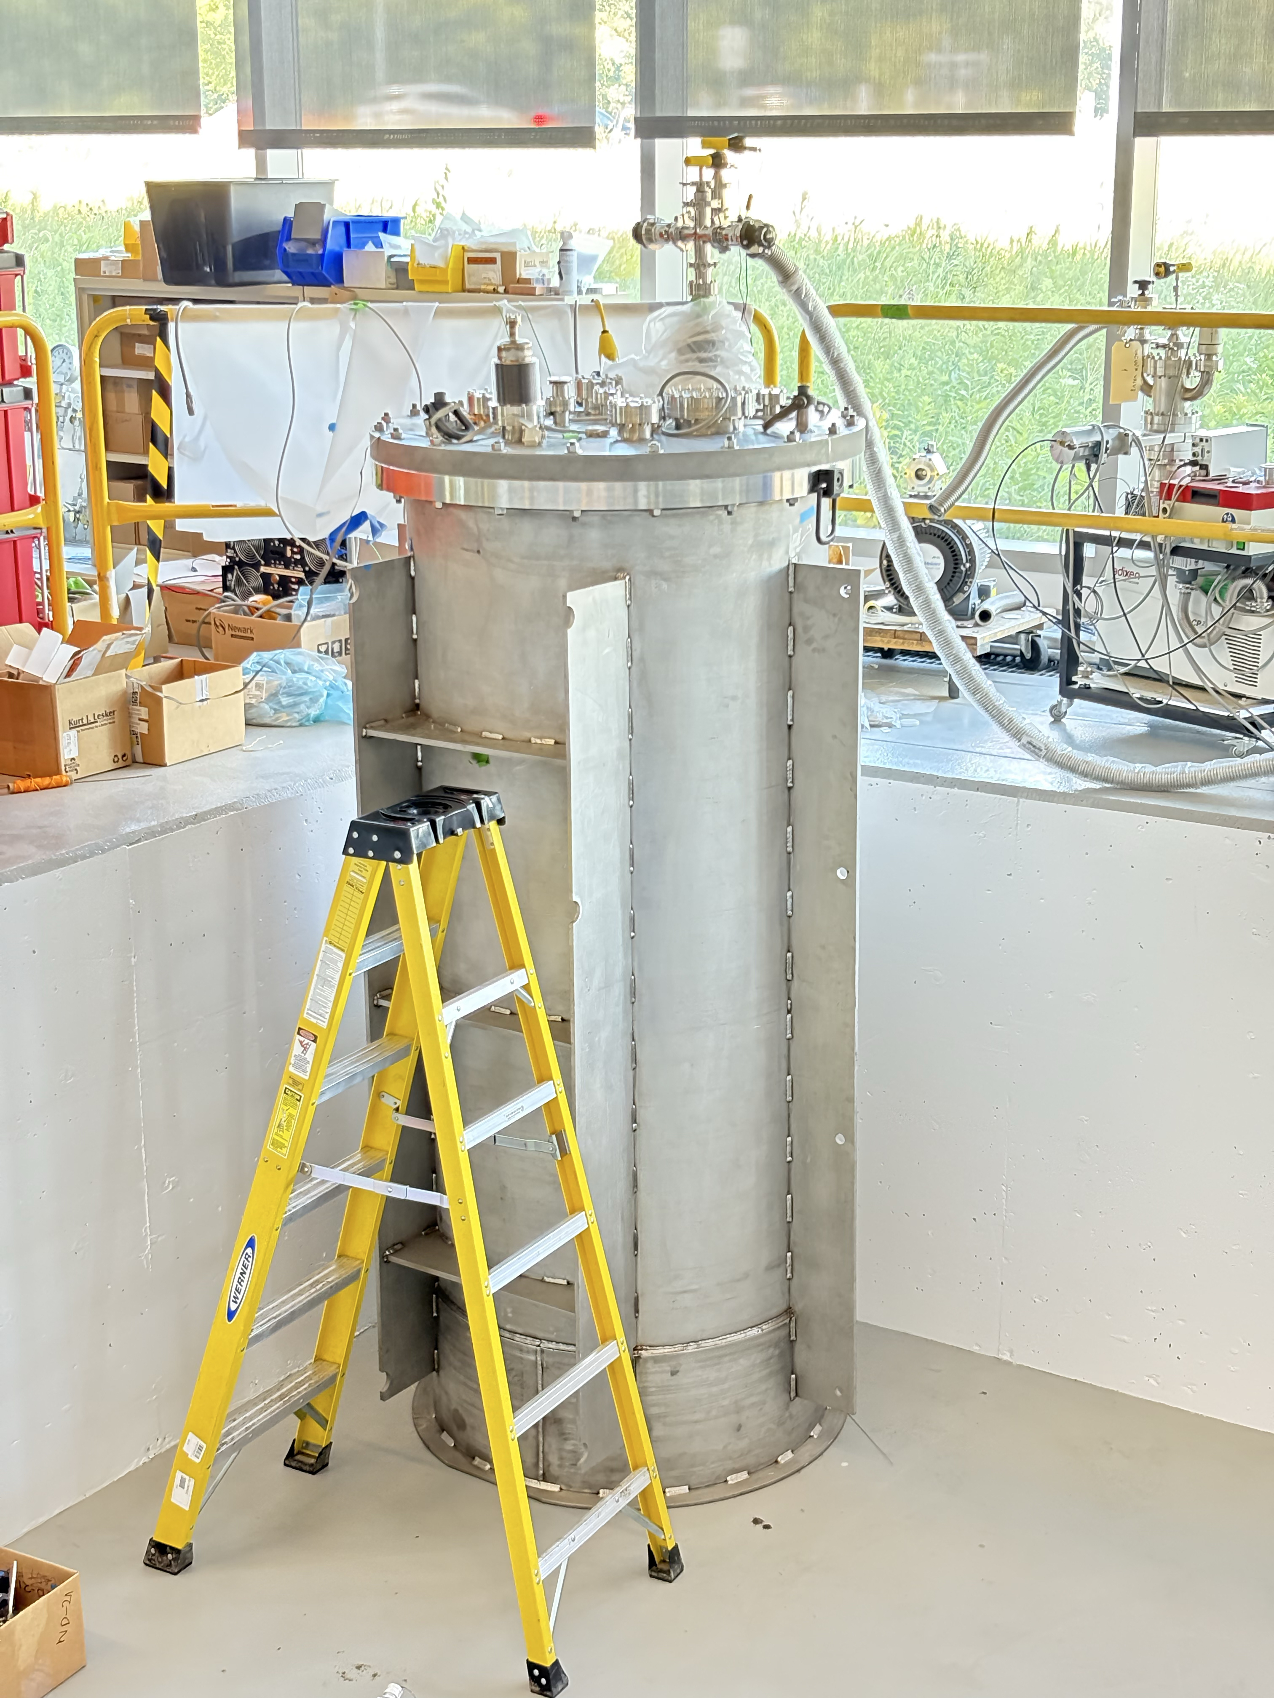
Example of cryostat for LAr TPC (≈ 500 kg sensitive mass)

Slide 23
Backgrounds: neutrons and others
  Neutrons are a particularly dangerous source of background.
    Their interaction produces nuclear recoils → indistinguishable from CEνNS events.
    At relatively high energy the mean free path of neutrons in LAr is ≈ 85 cm → identification through multiple scatters has low efficiency.
  Neutrons can be associated with the beam, cosmic rays, and natural radioactivity.
  For the present application, the following strategy can be studied:
    passive shielding with highly hydrogenated materials (e.g. polyethylene) to thermalize neutrons from external sources: beam, cosmic rays, external radioactivity.
    Material selection for internal components.
  The target is to have a neutron-induced background rate ≤ 3 events/day
  Another source of background are recoiling nuclei from alpha decays (e.g. from 232Th, 238U or 222Rn chains). If the decaying nucleus is at the surface of a material surrounding the active volume and the alpha is penetrating the material (unseen) the recoiling nucleus would produce a signal undistinguishable from a CEνNS event. These events can be efficiently rejected through fiducialization.

Slide 24
Conclusions
  Neutrinos from BDX are characterized by a low energy spectrum from pions and muons decay at rest with very well-known spectral shape and composition.
  The anticipated intensity allows for a substantial rate of CEνNS events.
    A 1000 kg liquid argon target would accumulate several hundreds of CEνNS events / yr: a statistics significantly larger than the one available from existing studies.
  The most appropriate technology to detect these events at BDX would be the double-phase LAr detector, developed in the past 20 years for direct Dark Matter searches.
  The anticipated detector would be relatively compact (a footprint of 4 x 4 m² would be sufficient).
  Shielding from beam and cosmic rays associated neutrons must be carefully studied, but a 1m thick polyethylene shield should be largely sufficient (≈40 collision lengths).

