Slide 1
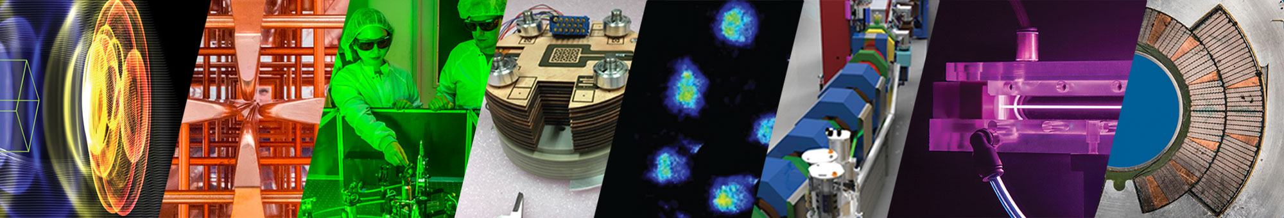
Davide Terzani
Directional muon beams using Laser-Plasma Acceleration at the BELLA Center
Secondary Beams at Jefferson Lab Workshop (BDX & Beyond)
September 4, 2025
This work was supported by DARPA, and by the U.S. Department of Energy (DOE) Office of Science under Contract DE-AC02-05CH11231

Slide 2







Contributors
Theory and modeling (BELLA center)
D. Terzani, S. Kisyov, C. Benedetti
LPA electrons (BELLA center)
A. Picksley, J. Stackhouse, H-E. Tsai, R. Li, K. Nakamura, A. J. Gonsalves
Muon detection (Physical Science)
S. Greenberg, L. Le Pottier, M. Mironova, T. Heim, M. Garcia-Sciveres
Supervision (BELLA center and LBNL)
J. Valentine, J. van Tilborg, C. B. Schroeder, E. Esarey, C. G. R. Geddes
LPA electrons and supervision
E. Rockafellow, B. Miao, J. Shrock, H. Milchberg
Other team members:

Slide 3
Outline
Motivations
Overview of the experimental setup
Muon identification from the scintillator’s signal
Numerical analysis of the muon production
Summary and next steps

Slide 4
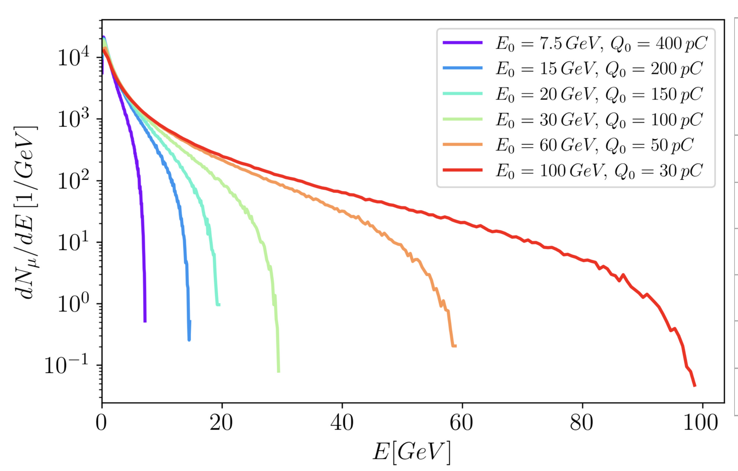
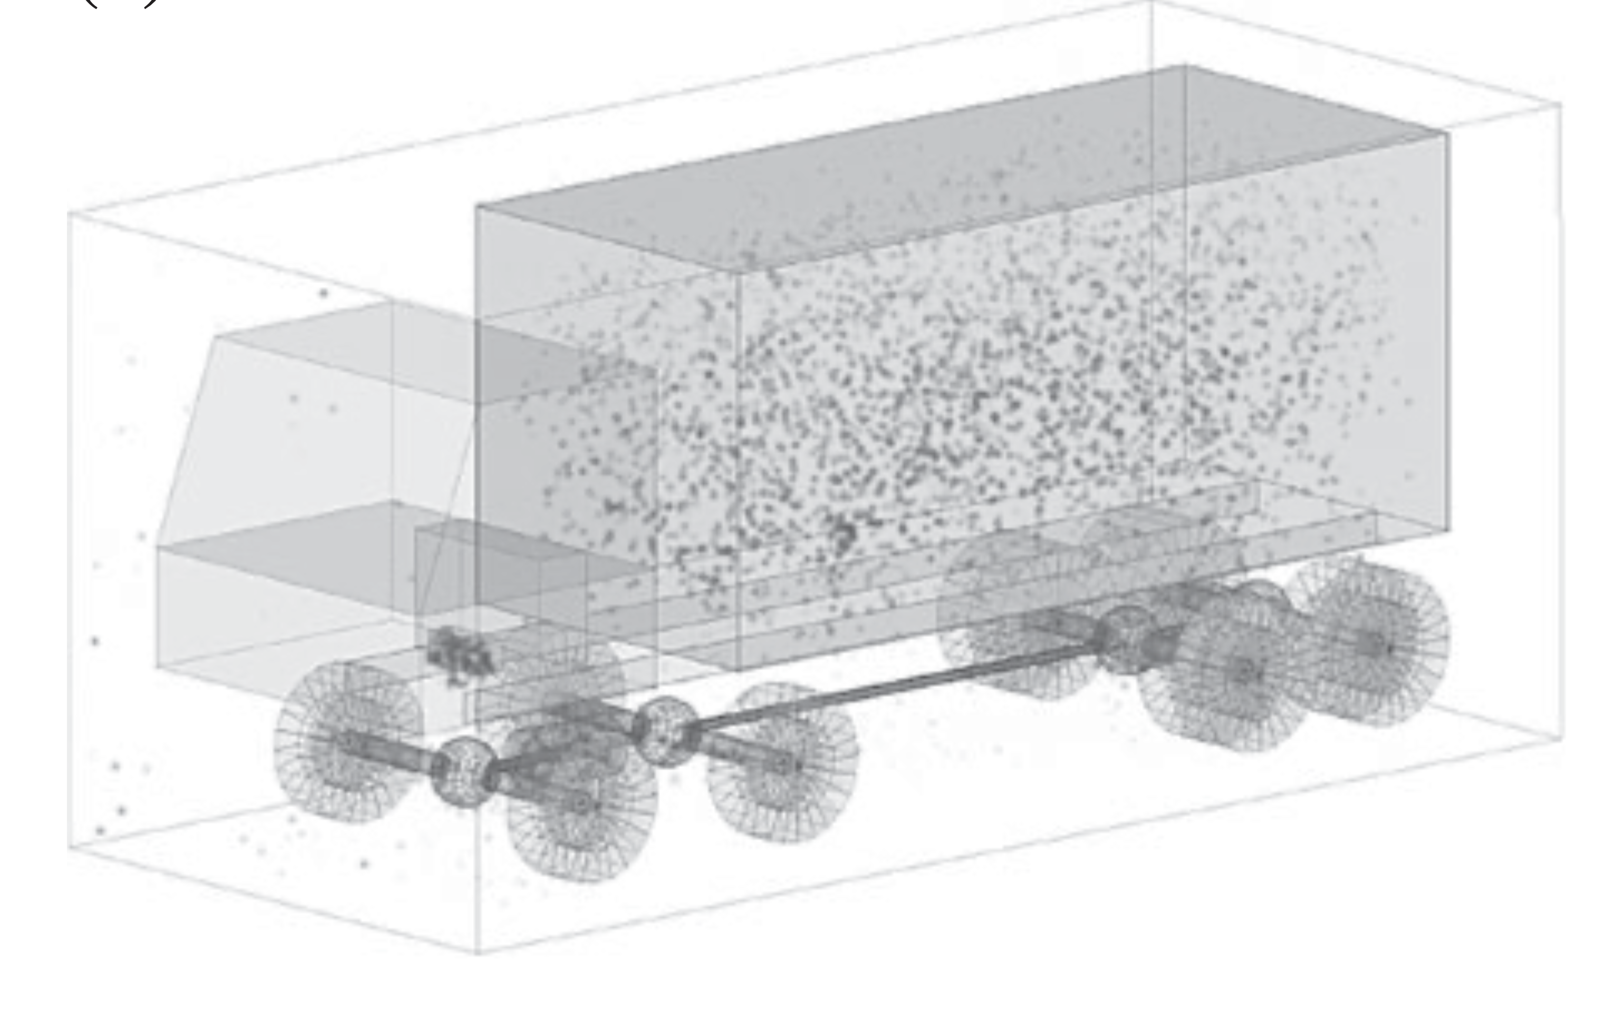
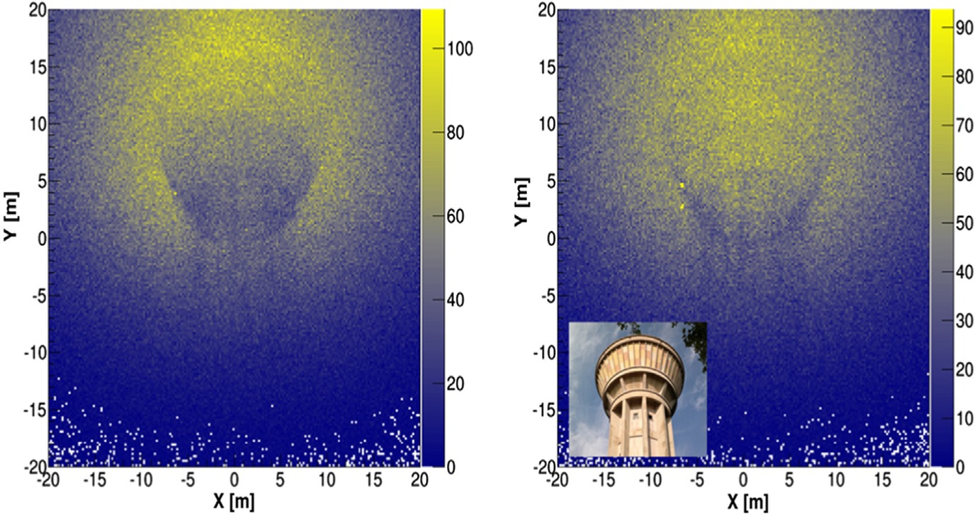
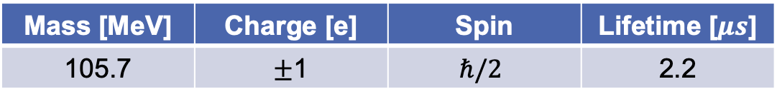
Imaging applications benefit from a compact muon source
Muon
Mass [MeV] | Charge [e] | Spin | Lifetime [$μs$]
105.7 | $±$1 | $$ℏ/2$$ | 2.2
Reduced Bremsstrahlung
Interacts with detectors
Limited spatial reach due to decay
At the present time, only few facilities (e.g., MICE, Fermilab, J-PARC, etc) produce muons, other applications rely on cosmic rays $→$ ~1 particle/(min cm²)
Muography
Muon spectra from e- beams
Penetration of high-Z materials
Imaging of large objects
[S. Vanini, et al., Philosophical Transactions of the Royal Society A377, 20180051 (2018)]
[S. Bouteille, et al., Nucl. Instrum. Methods A 834 (2016) 223]

Slide 5
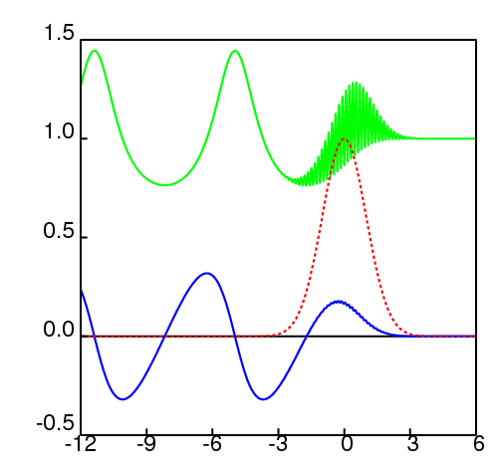
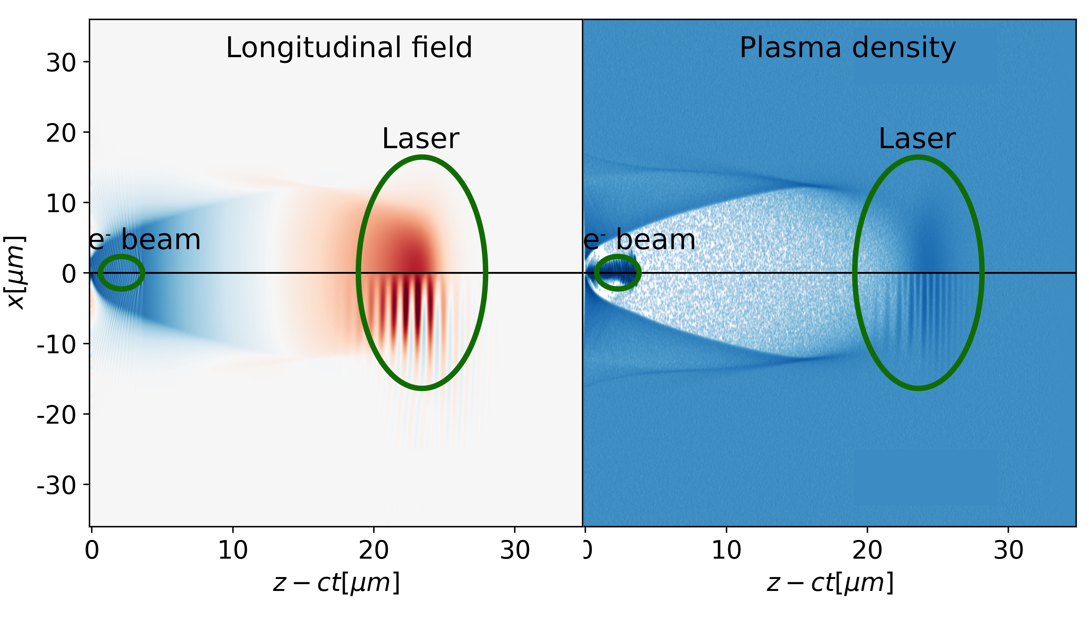
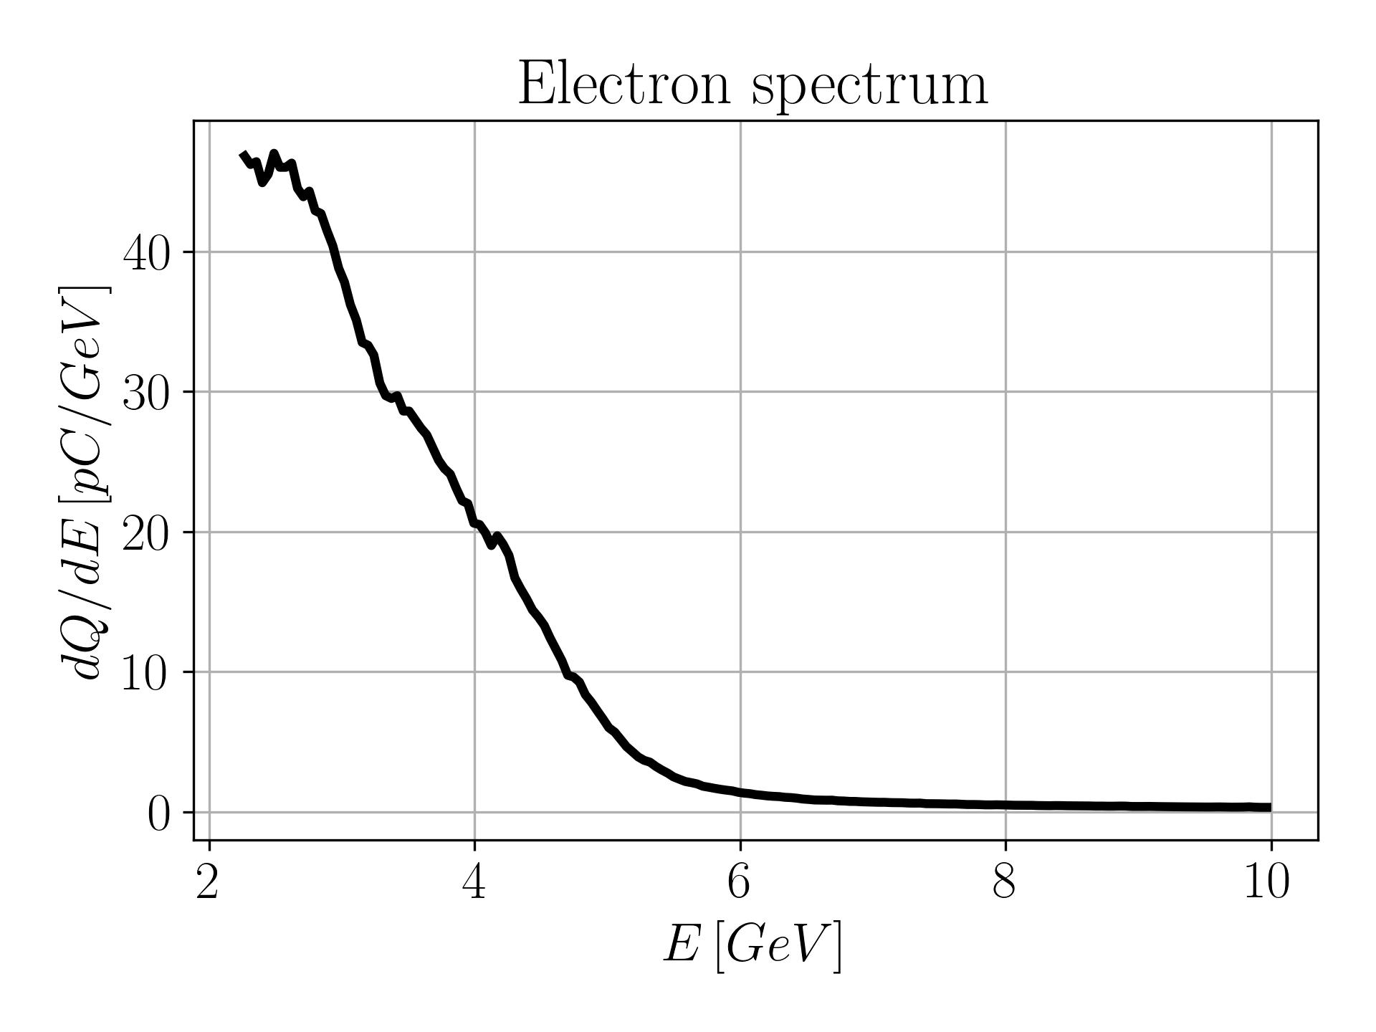
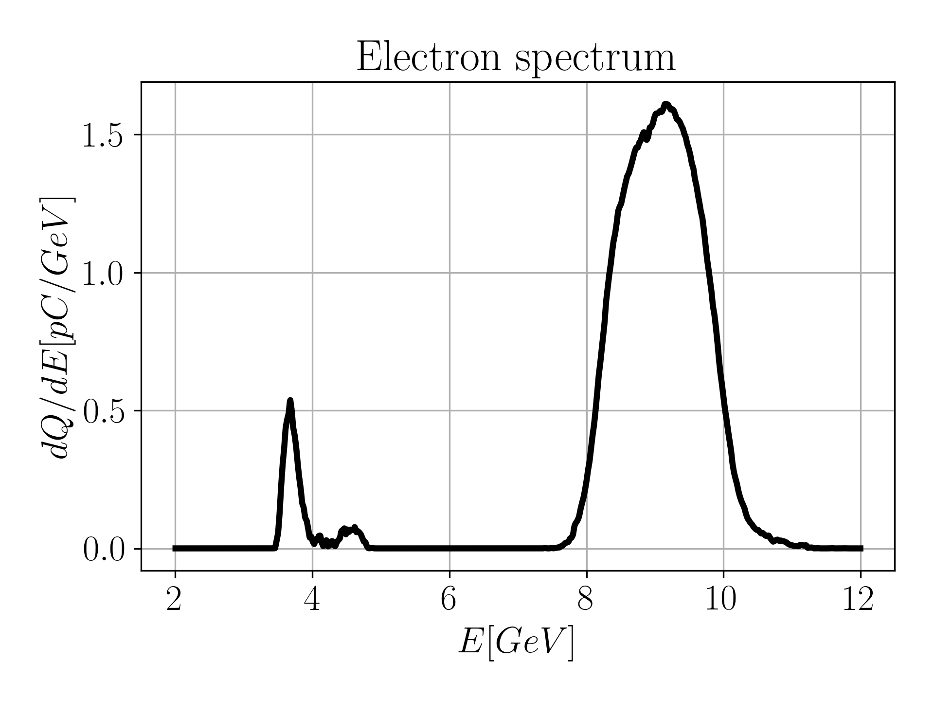
Laser-Plasma acceleration in plasma channels demonstrated accelerating gradients E > 30GV/m
Plasma density
Laser pulse:
Ultrashort (~30 fs)
Thightly focused (~50 μm)
High intensity (>10¹⁸ W/cm²)
When travelling in an underdense plasma (n~10¹⁷ – 10¹⁹ cm⁻³) its ponderomotive force displaces the electrons, creating a wakefield
Laser driver
Wakefield
Example of Laser-Plasma acceleration: background electrons are expelled and generate a wakefield, where an e- beam is accelerated
Courtesy of C. Benedetti
Electron energy spectra from 2023 BELLA experiments
(30 cm acceleration length)
Full-length dopant
Localized dopant
E_{z} > 30 GV/m
Electrons expelled
[Picksley et al., PRL 2024]

Slide 6

Laser pulse guiding prevents diffraction and enables electron beam acceleration up to and above the 10 GeV scale
Plasma channel
Diffraction length ~ 1 cm
Meter-scale accelerating stage
HOFI-channel enables pulse guiding for densities ~ 10¹⁷cm⁻³
A few ns later…
Expanding cylindrical shock
Low-loss, low-density plasma channel
As laser ionizes…
Axicon lens
Line focus forming long plasma column
Hot initial plasma column formed by laser
Ionized Neutral gas collar
HOFI channels lower the energy requirements for the laser pulse
[Durfee C., et al., PRL, 1993]
[Shalloo R. J., et al., PRE, 2018]
[Morozov A., et al., PoP, 2018]
[Lemos N., et al., Sci. Rep, 2018]
[Shalloo R. J., et al., PRAB, 2019]
[Picksley A., et al., PRAB, 2020]
[Picksley A., et al., PRE, 2020]
[Feder L., et al., PRR, 2020]
[Miao B., et al., PRL, 2020]
[Picksley A., et al., PRL, 2024]
[Shrock J., et al., PRL, 2024]
Courtesy of A. Picksley

Slide 7

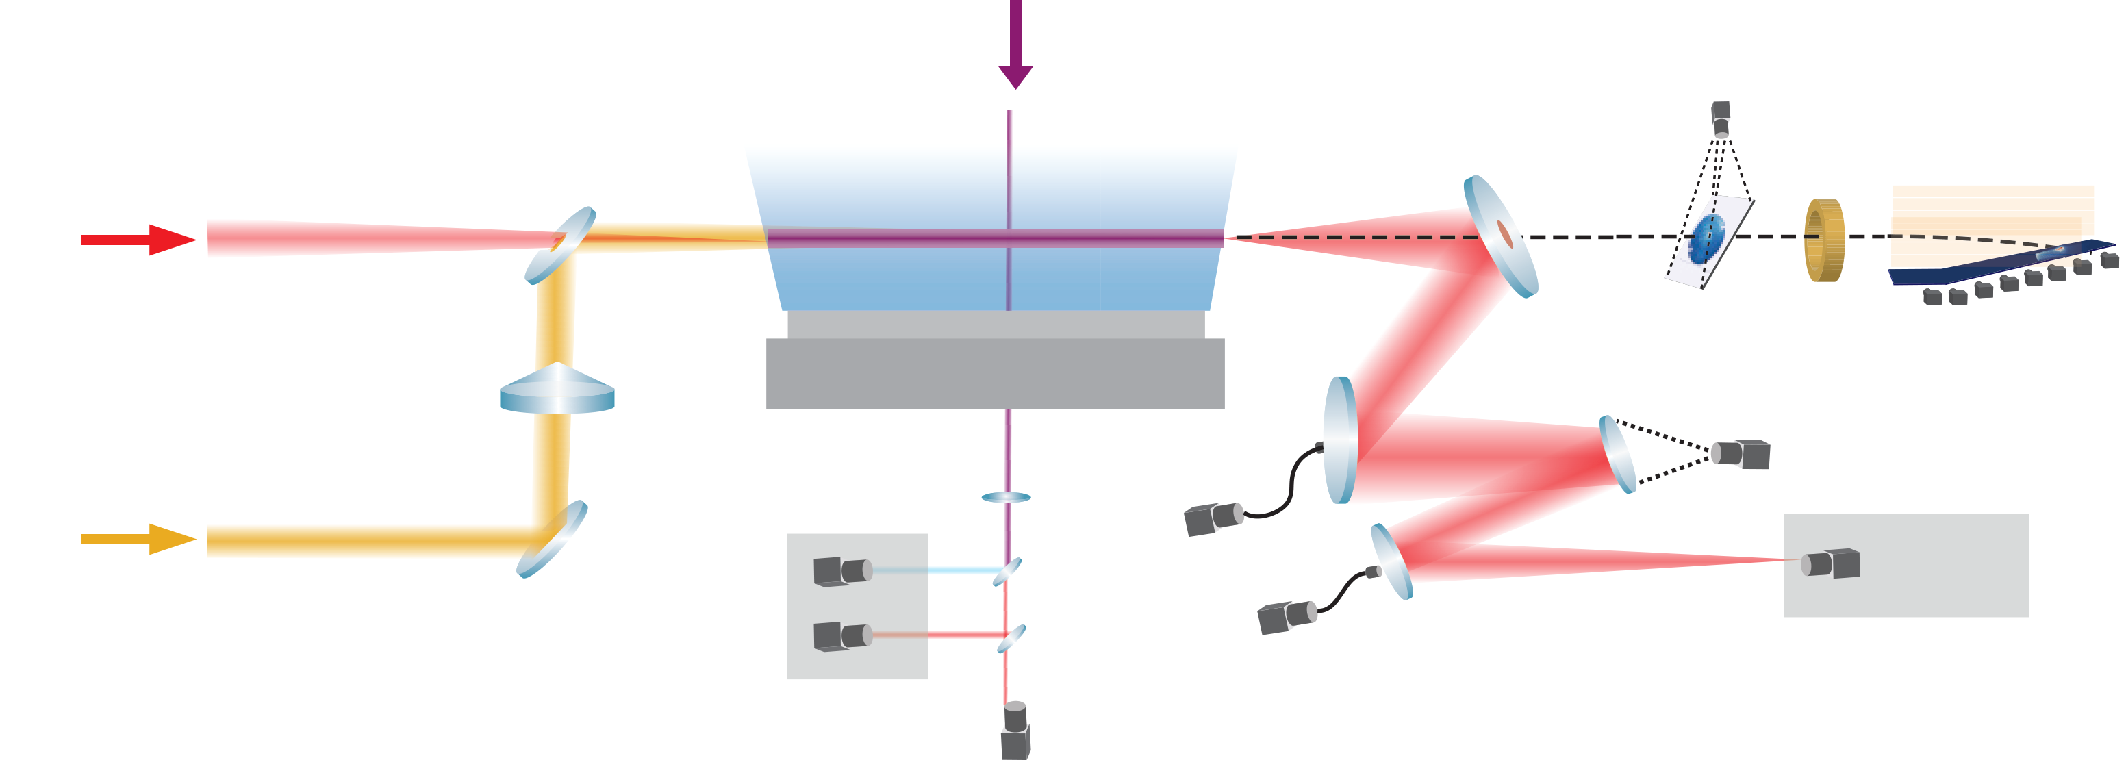
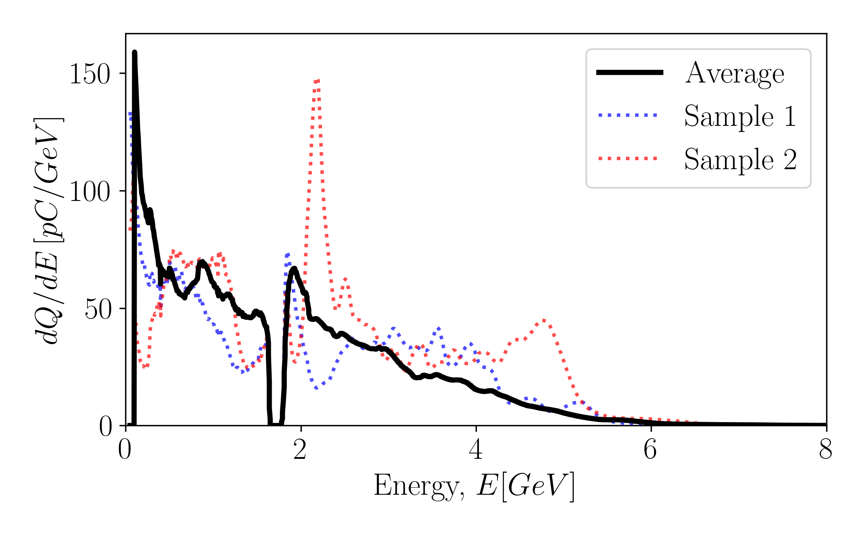
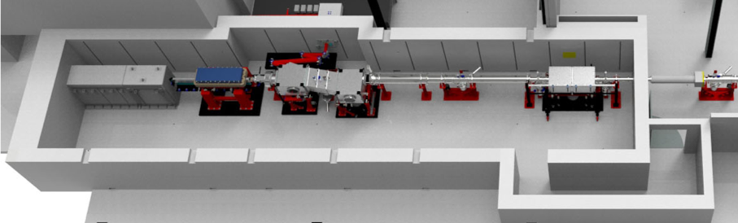

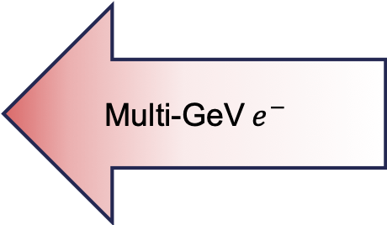
We used the electron beam dump as a muon converter target
$$\sim 3.5m$$
HOFI Plasma Channel
UMD gas-jet
Drive beam
Multi-GeV$e^{−}$
30 cm gas jet
Channel-forming beam
Muon
detectors
Two modes of operation:
High-charge, broad spectrum (used for muon measurements)
e⁻ beams with mono-energetic energies up to 10 GeV
[Picksley et al., PRL, 2024], in collaboration with UMD

Slide 8
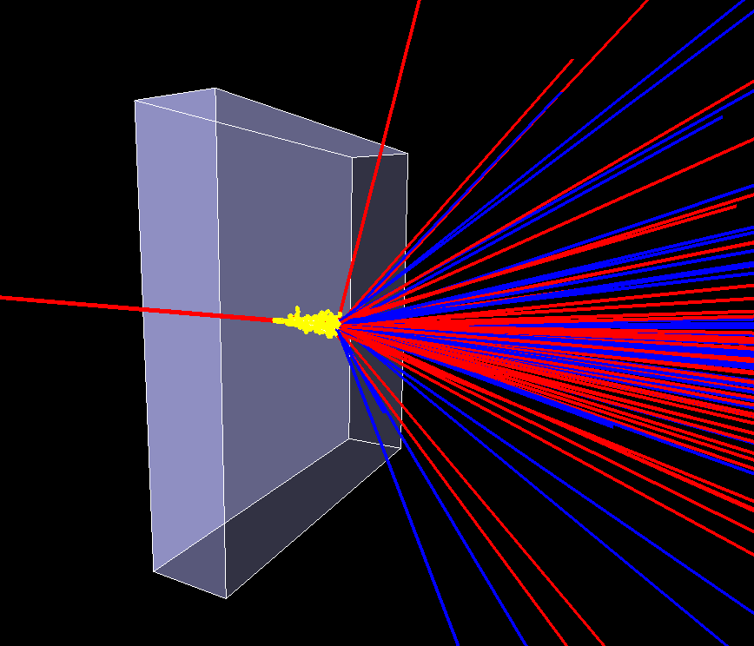
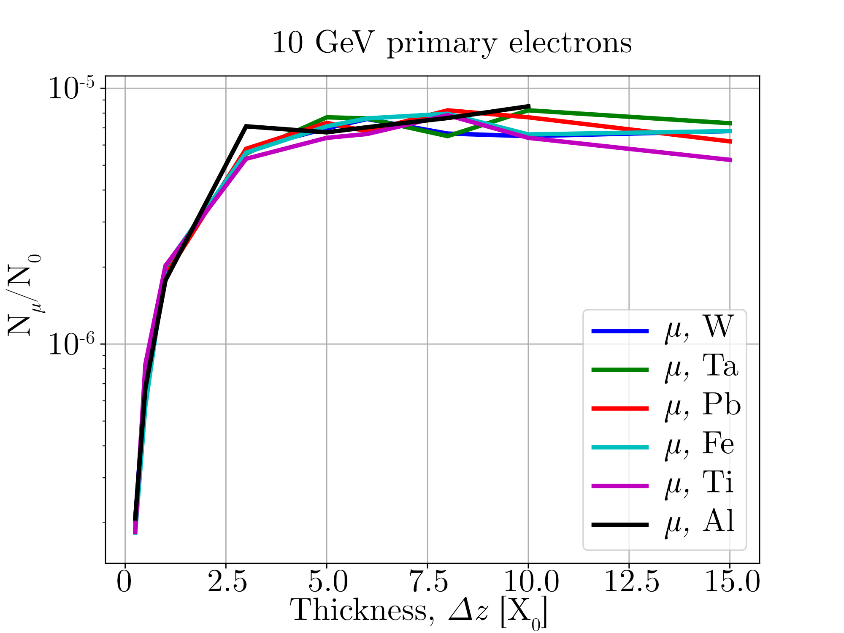
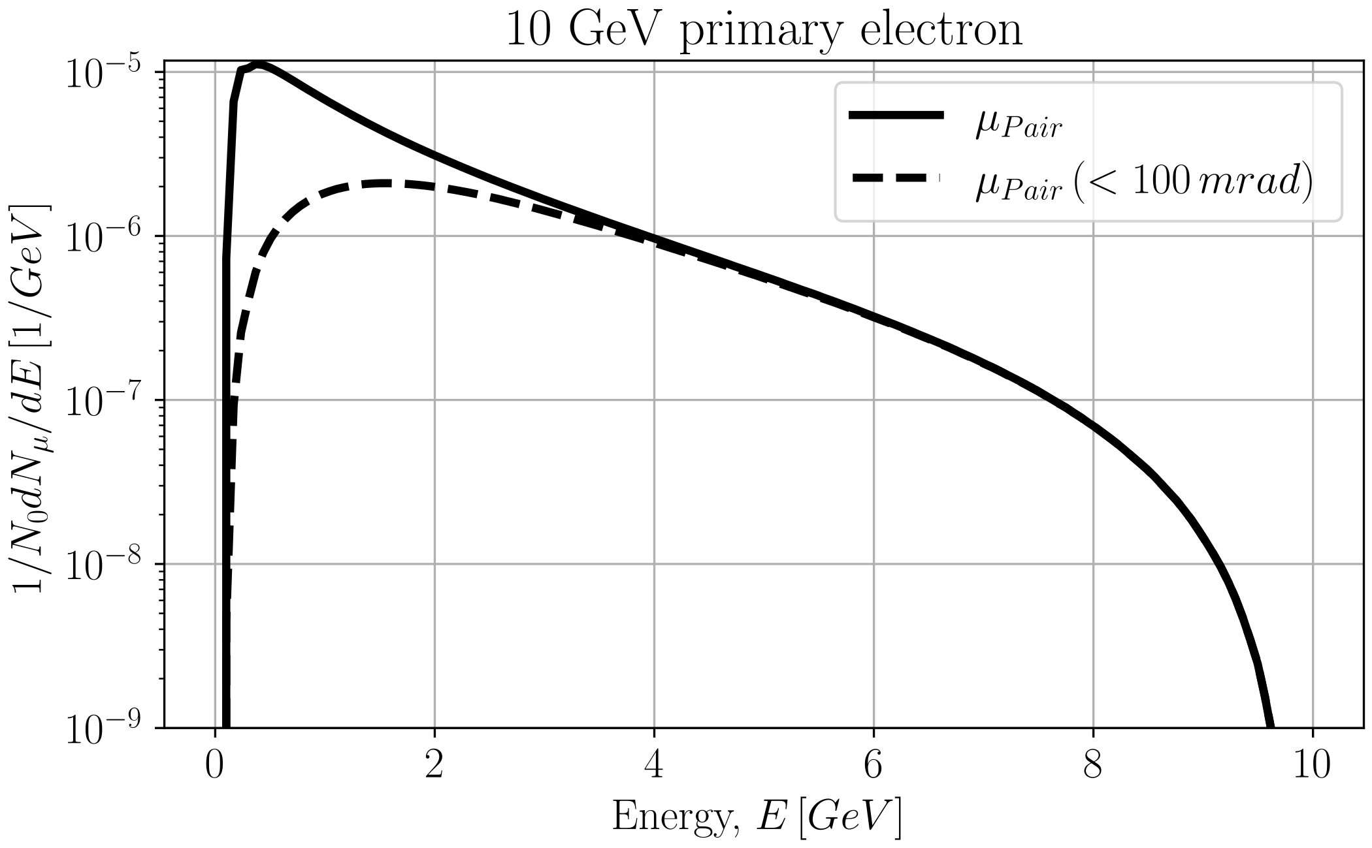
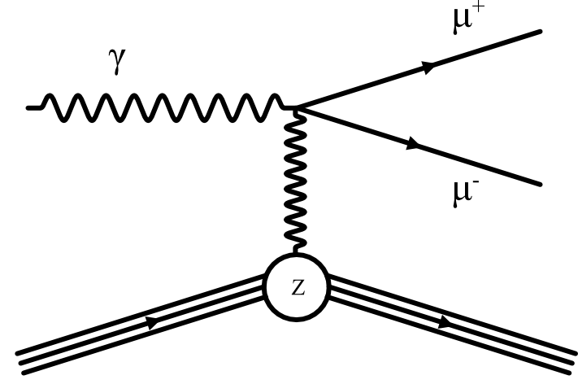
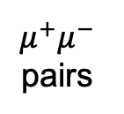
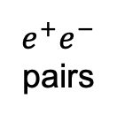
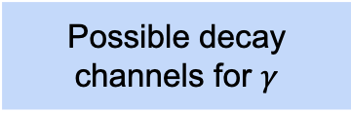
High-energy electron beams produce muons in high-Z materials
$X_{0}$ Radiation length: the mean distance over which an electron loses all but $1/e$ of its energy by Bremsstrahlung
The dominating process is the production of gammas via Bremsstrahlung
Muon yield produced in different materials as a function of the thickness
Possible decay channels for $γ$
$e^{+}e^{−}$ pairs
$μ^{+}μ^{−}$ pairs
photoproduction of pions
Sources of muons via different channels (but pion propagation is quickly suppressed for large thickness)
Pairs are produced over a 1/γ (<< 0.1 rad) cone
Bethe-Heitler process

Slide 9
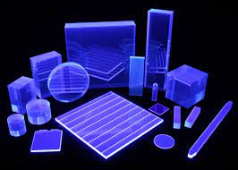
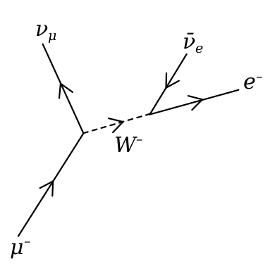

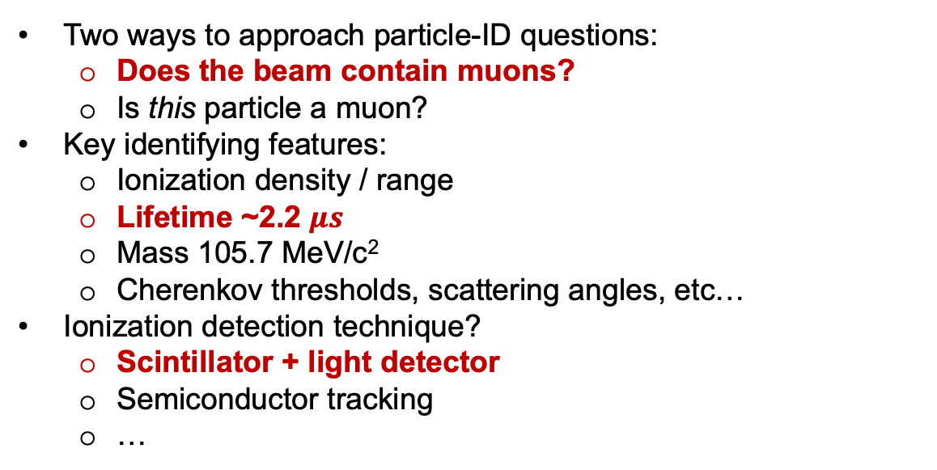
Plastic scintillators enable particle identification through signal timing
Two ways to approach particle-ID questions:
  Does the beam contain muons?
  Is this particle a muon?
Key identifying features:
  Ionization density / range
  Lifetime ~2.2 $μs$
  Mass 105.7 MeV/c²
  Cherenkov thresholds, scattering angles, etc…
Ionization detection technique?
  Scintillator + light detector
  Semiconductor tracking
  …
Scintillators identify muon candidates by checking the time difference between two hits
$$<Δt>≃2.2 μs$$

Slide 10
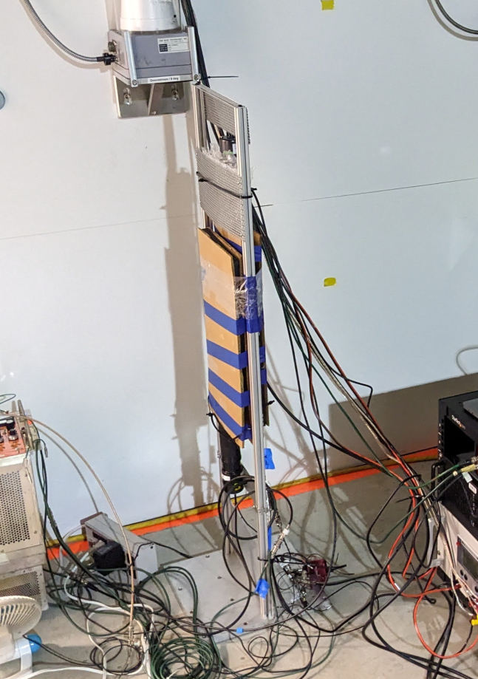
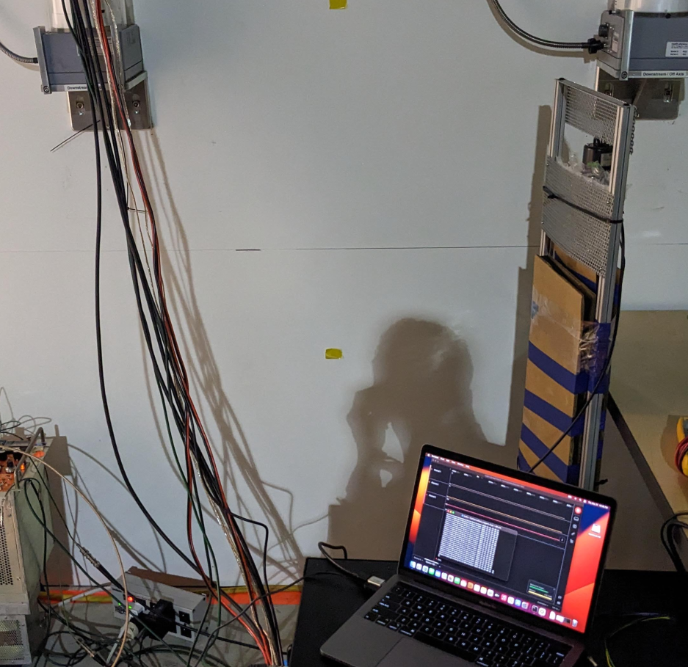
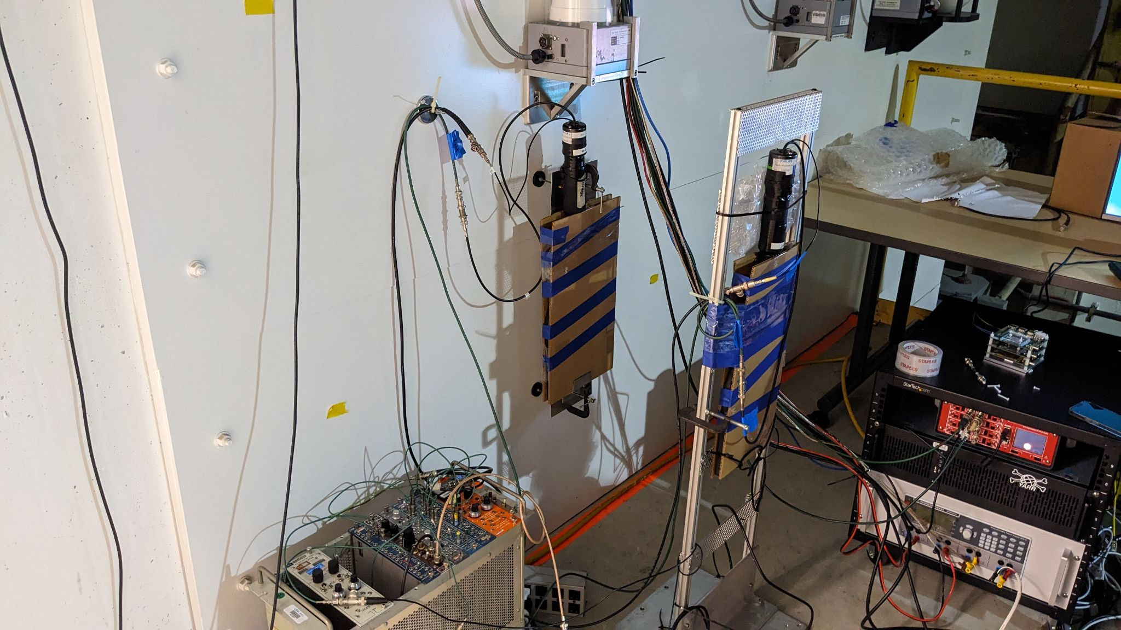
We positioned the scintillators in the hallway behind the wall of the experimental cave
Offset ~ 1m
Beamline
Beam axis
PMT
Beam dump
Scintillator Paddles
Offset ~ 1m

Slide 11
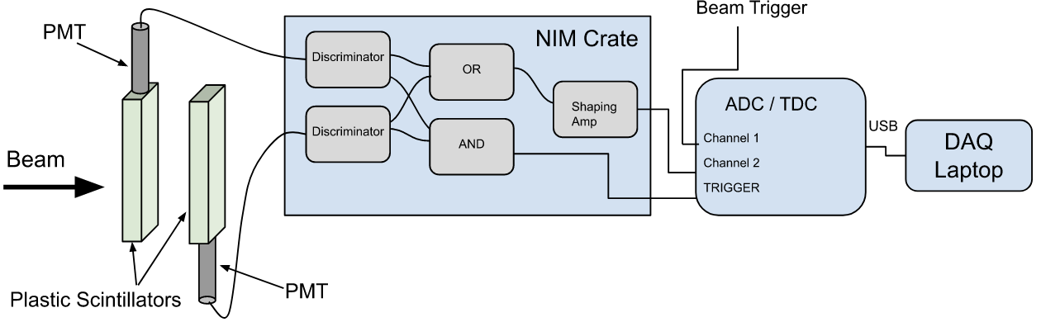
A pair of scintillators was used to trigger measurements on simultaneous detection
Two ~80 in.² scintillating plastic “paddles” with photomultiplier tubes (PMTs)
Readout by ADC triggered by “hit” coincidence on both paddles
Beam trigger stored, can be matched to beam logbook offline

Slide 12
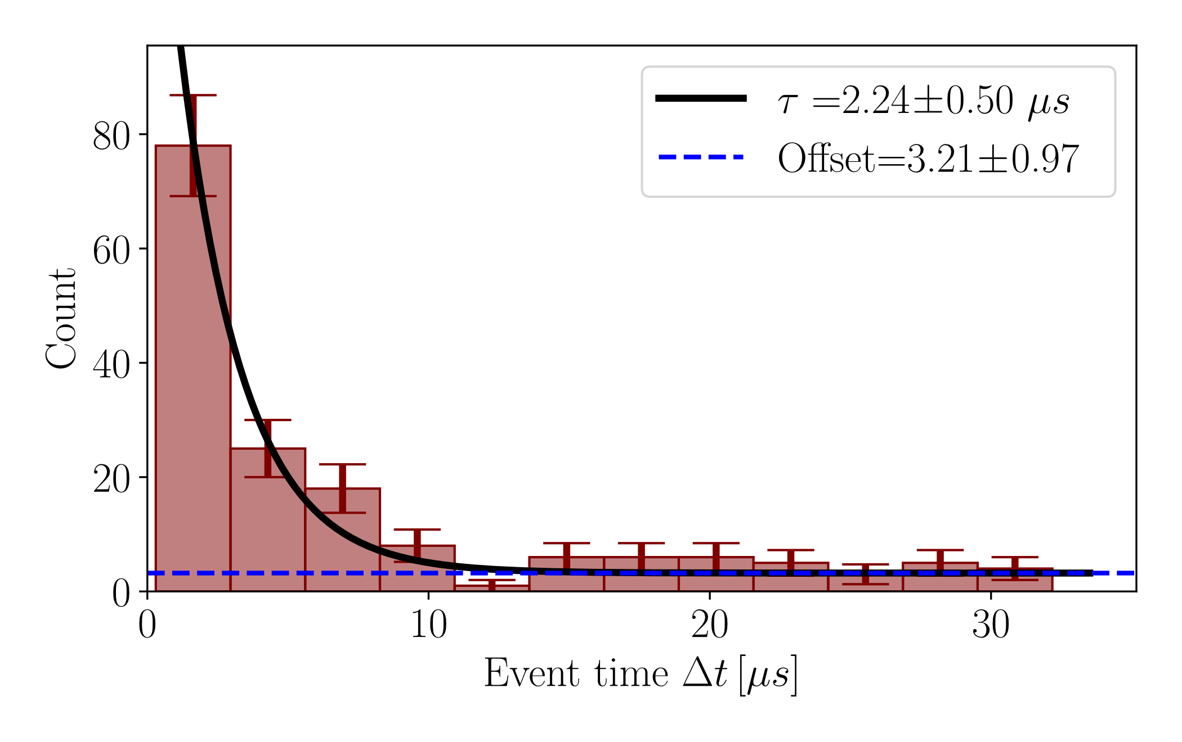
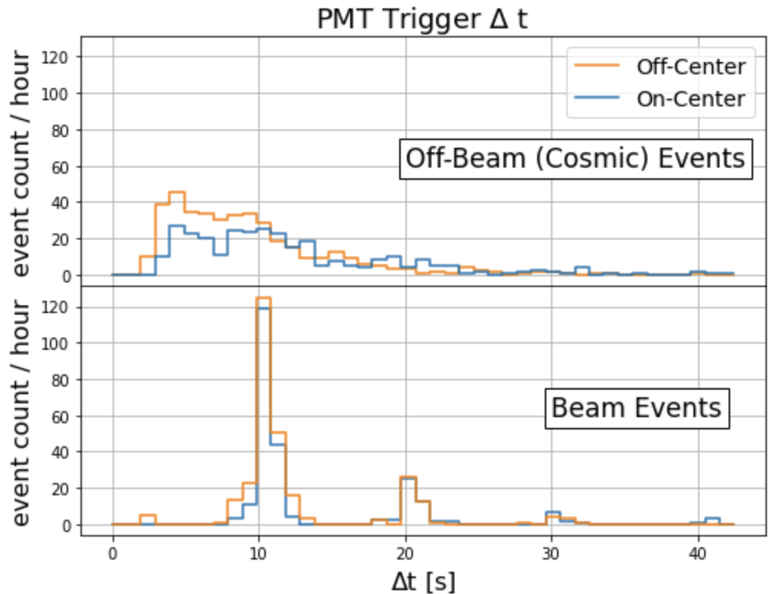

Measurements show unambiguous muon detection following the passage of the BELLA electron beam
Detector calibration with cosmic events shows that the number of hits with the beam on is much higher than background
Fitting all the data collected by the scintillators with an exponential distribution + a constant background
Data show muon decay ($τ≃2.2 μs$)
μ Candidates | Background
126 ± 12 | 39 ± 12
[Terzani et al., accepted PRAB]

Slide 13
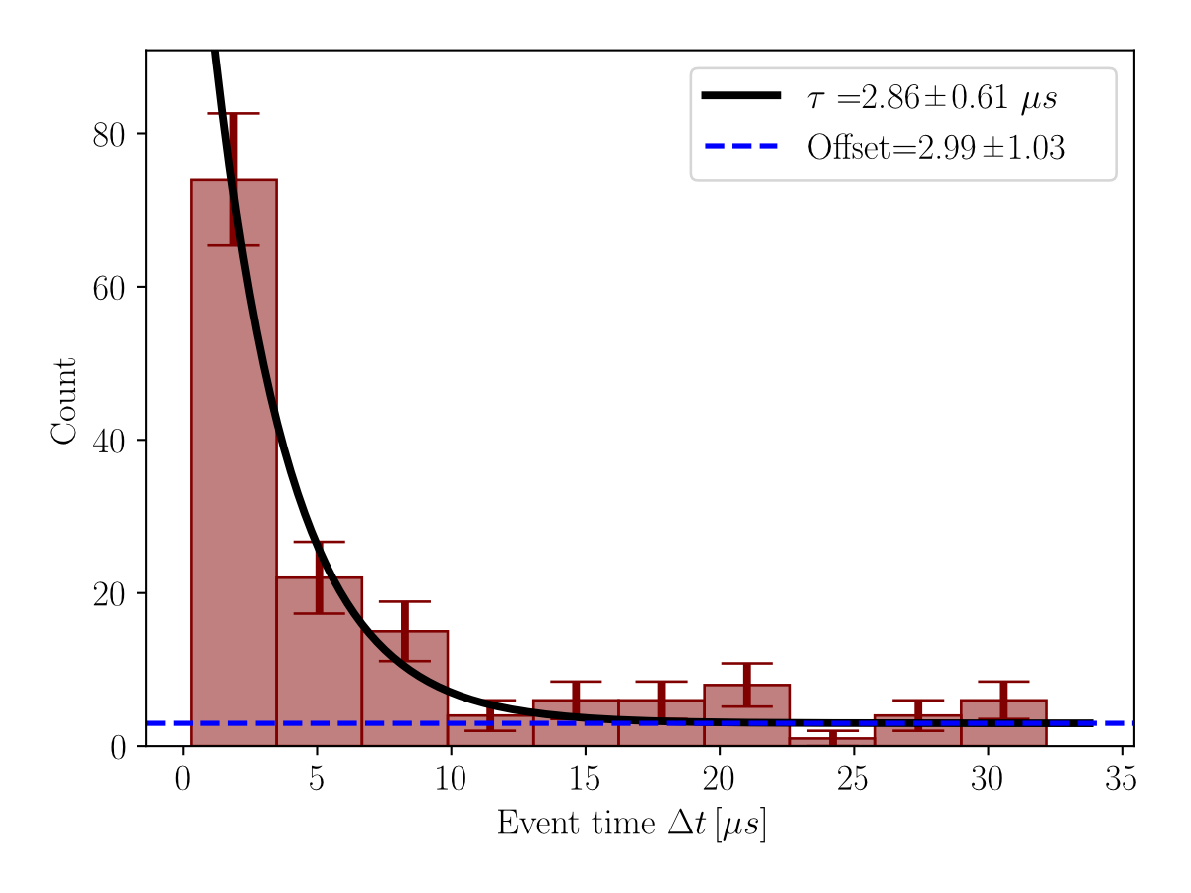
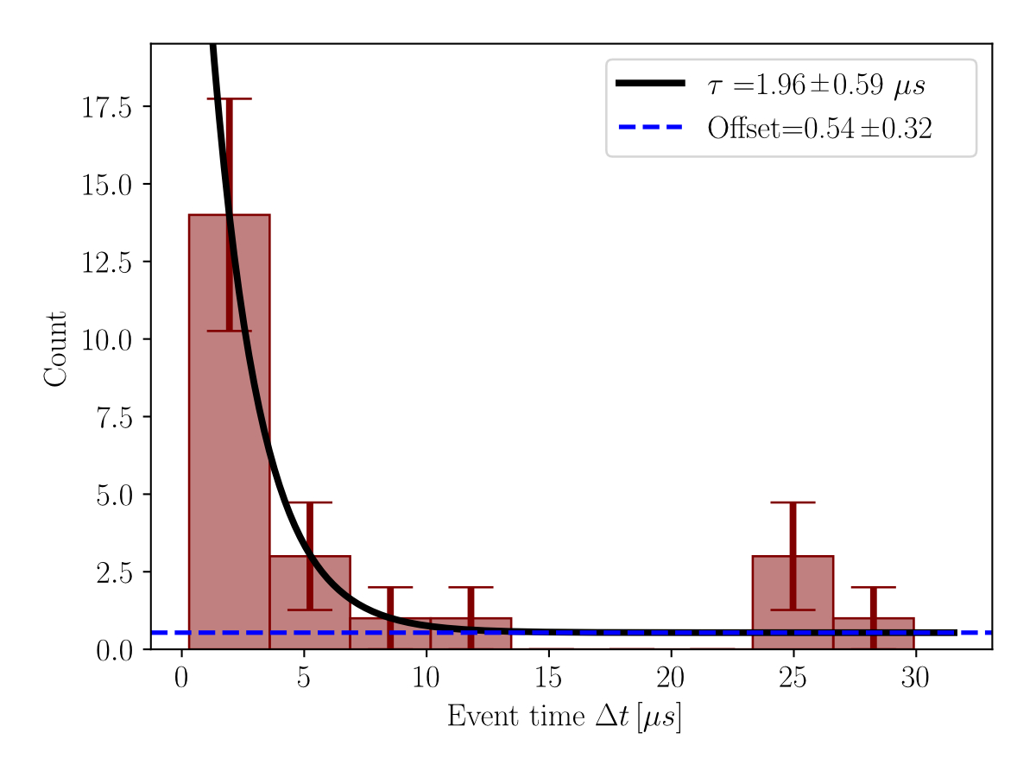
Displacing the scintillator off-axis provides us with insights into the process and the background
Both Off-axis and On-axis scintillators measure muons, but Off-axis records more events
Off-beam axis
On-beam axis
Should we expect muon events off-axis?
The angle is >> 1/γ
Investigate two aspects of the measurements:
Off-axis the detector records muon decay more often
Signal is characterized by a constant background

Slide 14

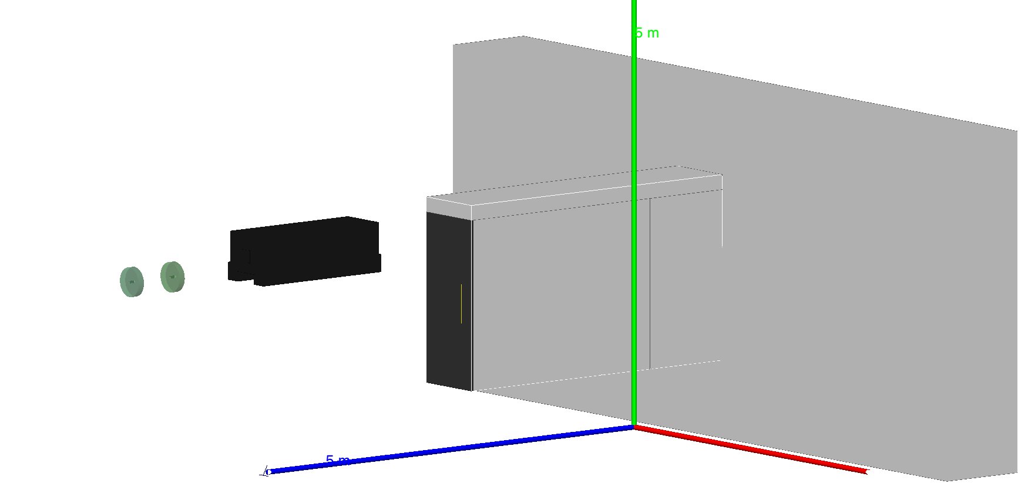

Simulations included critical elements along the beamline
to identify noise and muon sources
Beyond the zeroth-order approximation (i.e., only modeling a beam dump):
We included high-Z elements along the beamline
We extended particle detection to a surface area 8x4 m (>> 1/γ cone)
Top view
Glass/ Power meter
Beamline
Magnet (Steel)
We performed simulations including all the cave walls and they didn’t show significant differences. Following slides show that elements along the beamline suffice to reproduce experiments.
Side view
[Terzani et al., accepted PRAB]

Slide 15
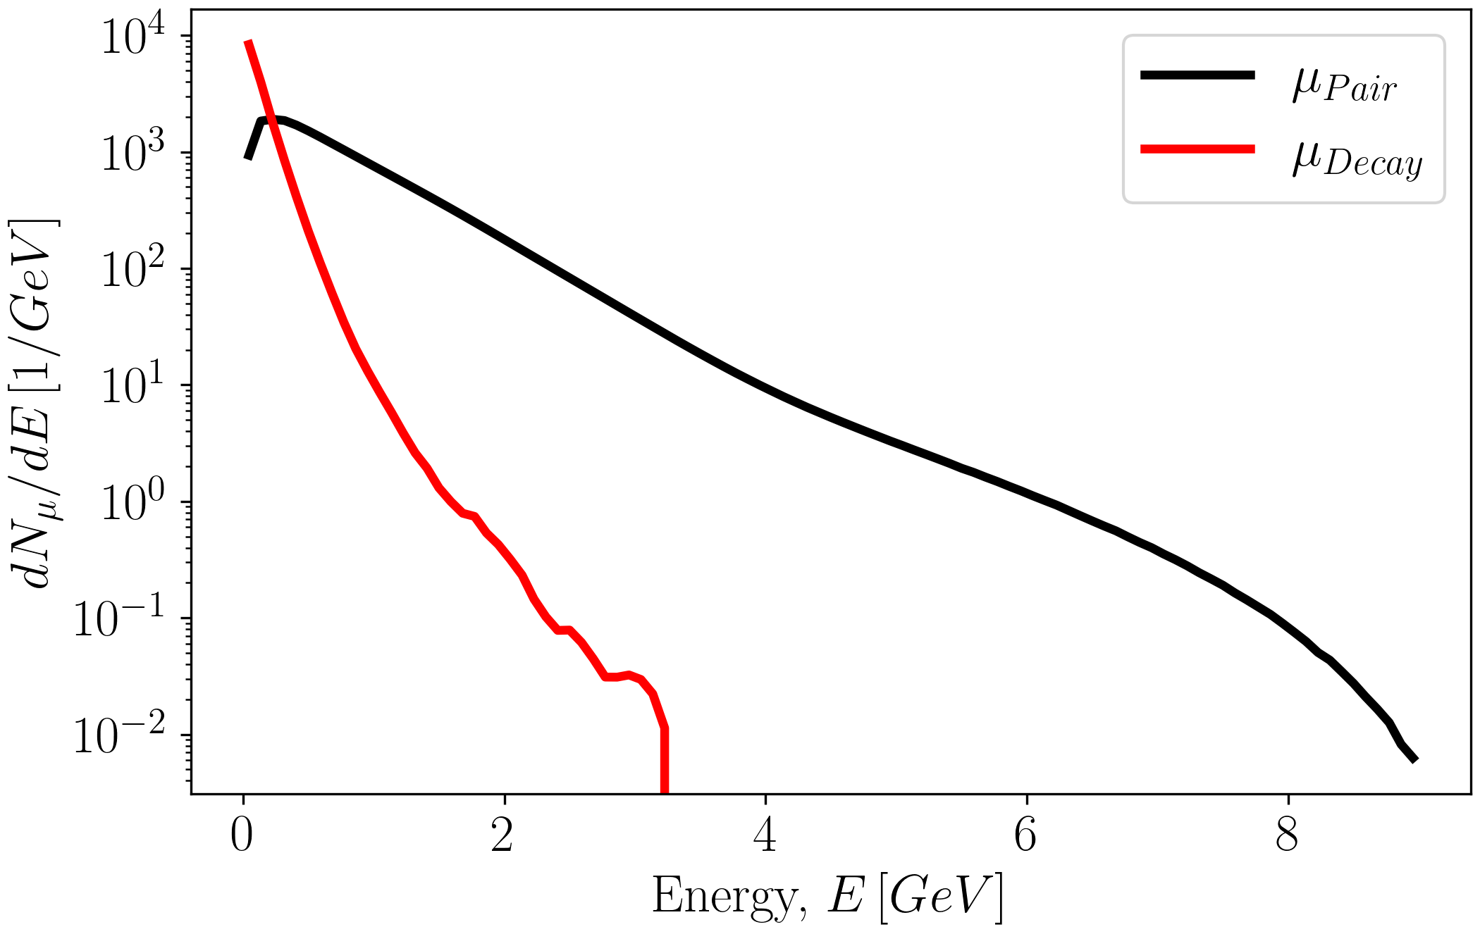
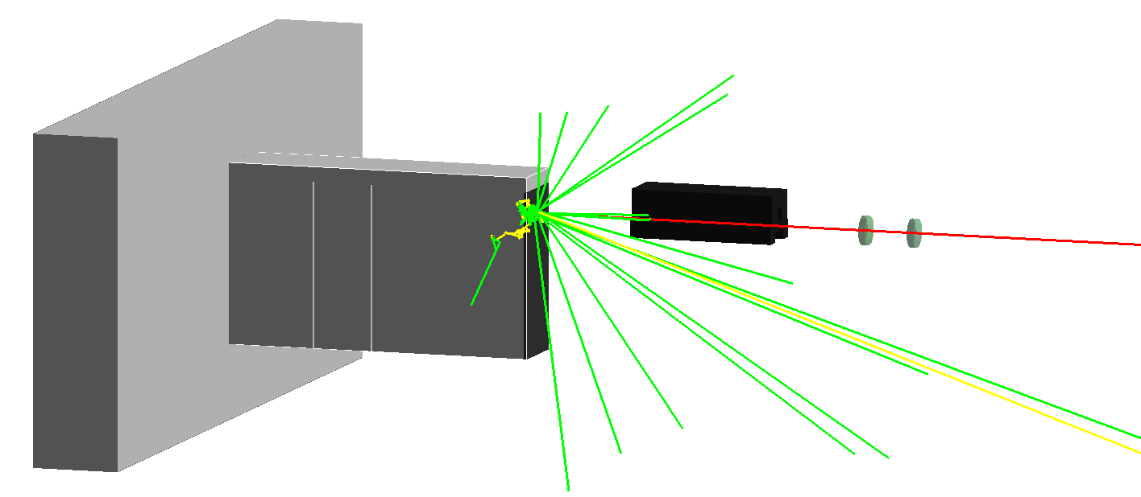
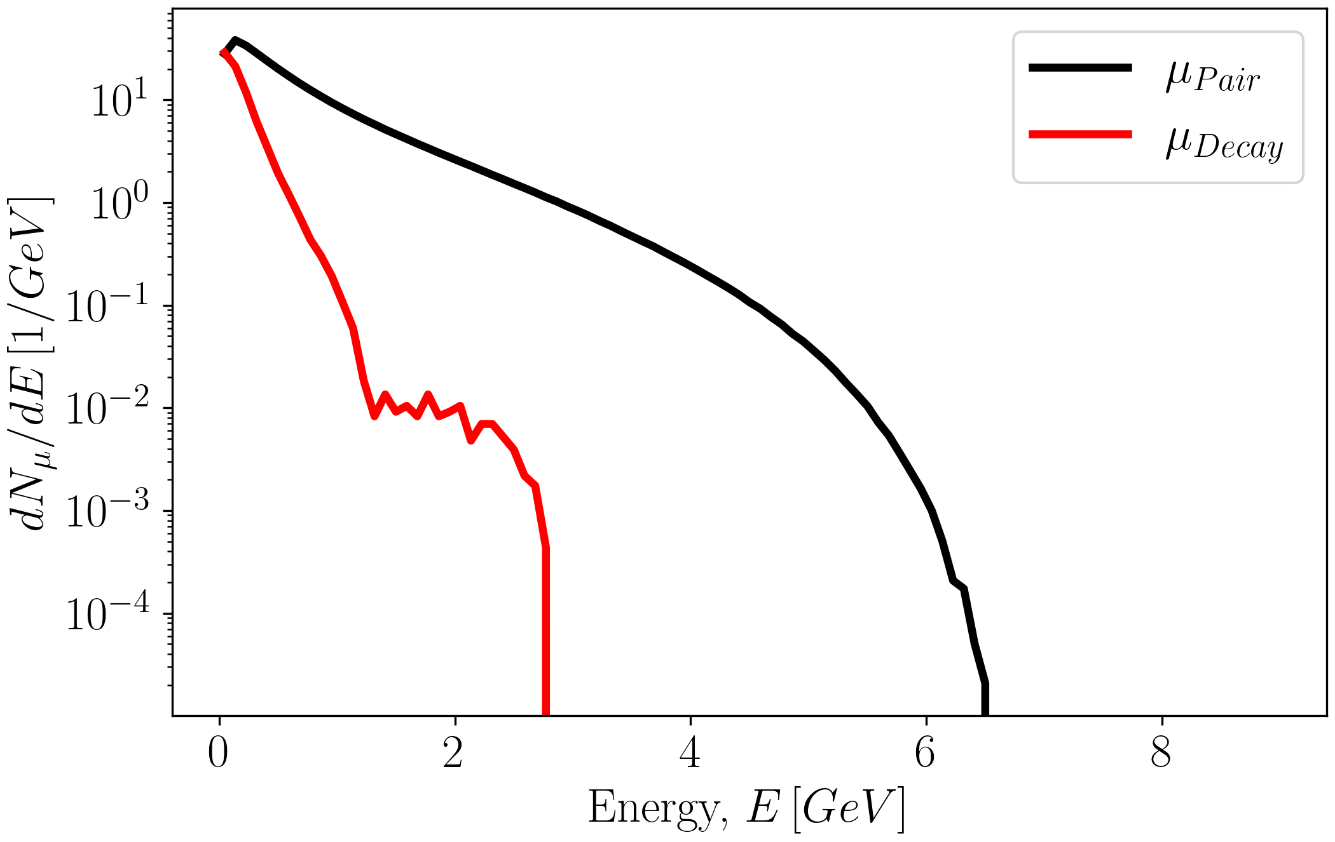
For a well aligned electron beam, a directional (on-axis) muon beam produced with highest energy ~E_{e-}
Main interaction point
Spectrum at IP
Spectrum in the hallway (including energy losses)
Muon production channels
Bethe-Heitler
Pion decay
Pion production (mostly isotropic and low energy)
Pions decay into muons

Slide 16
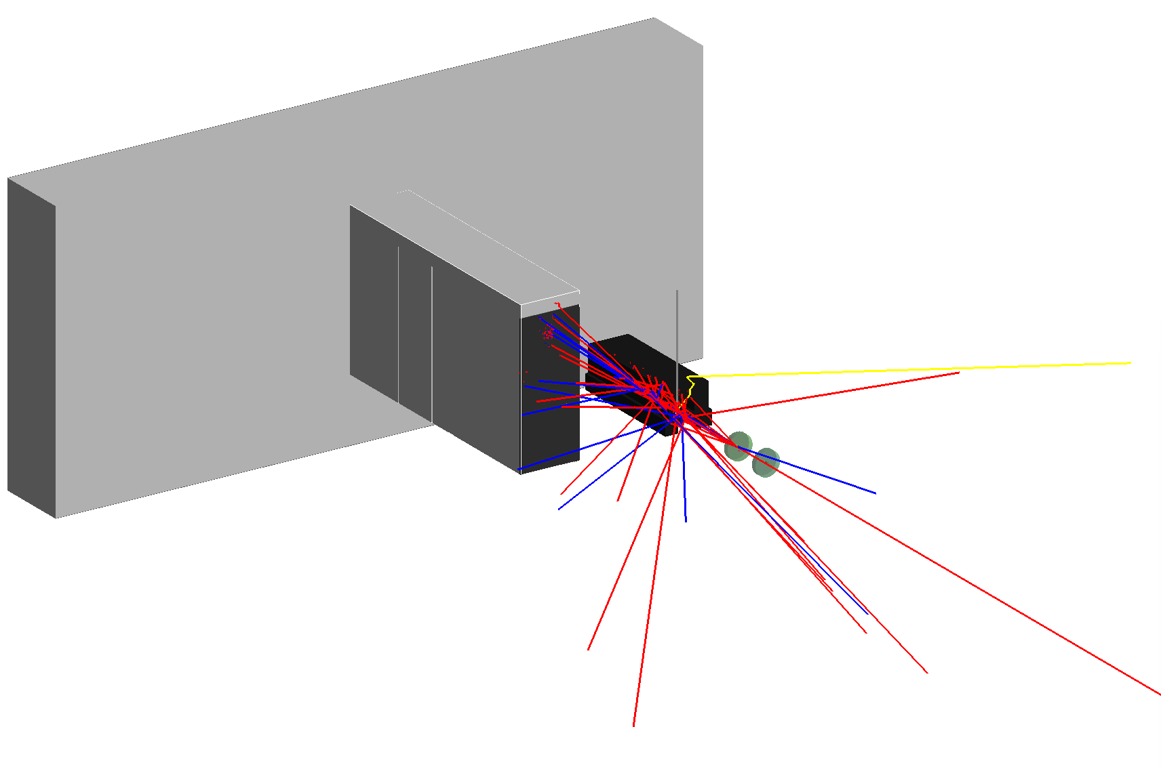
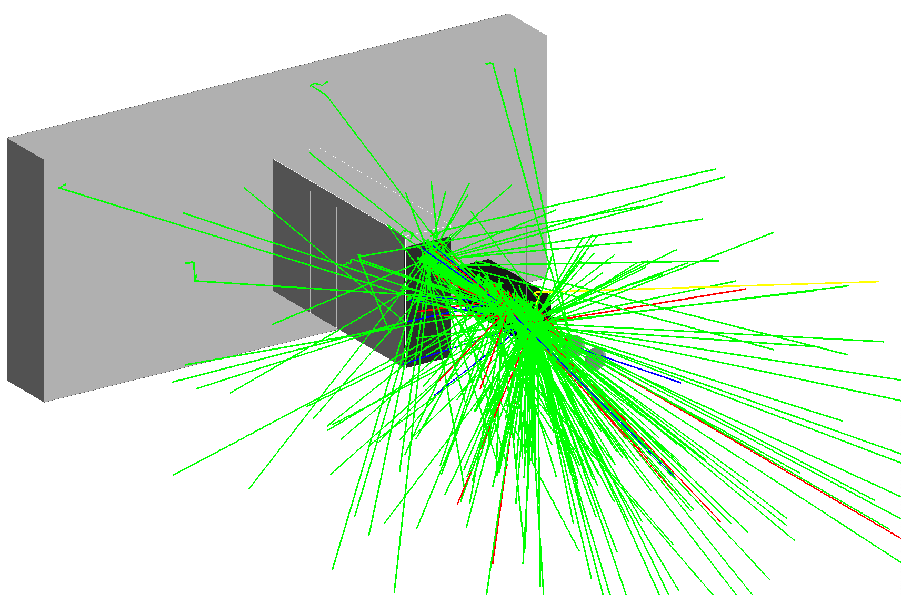
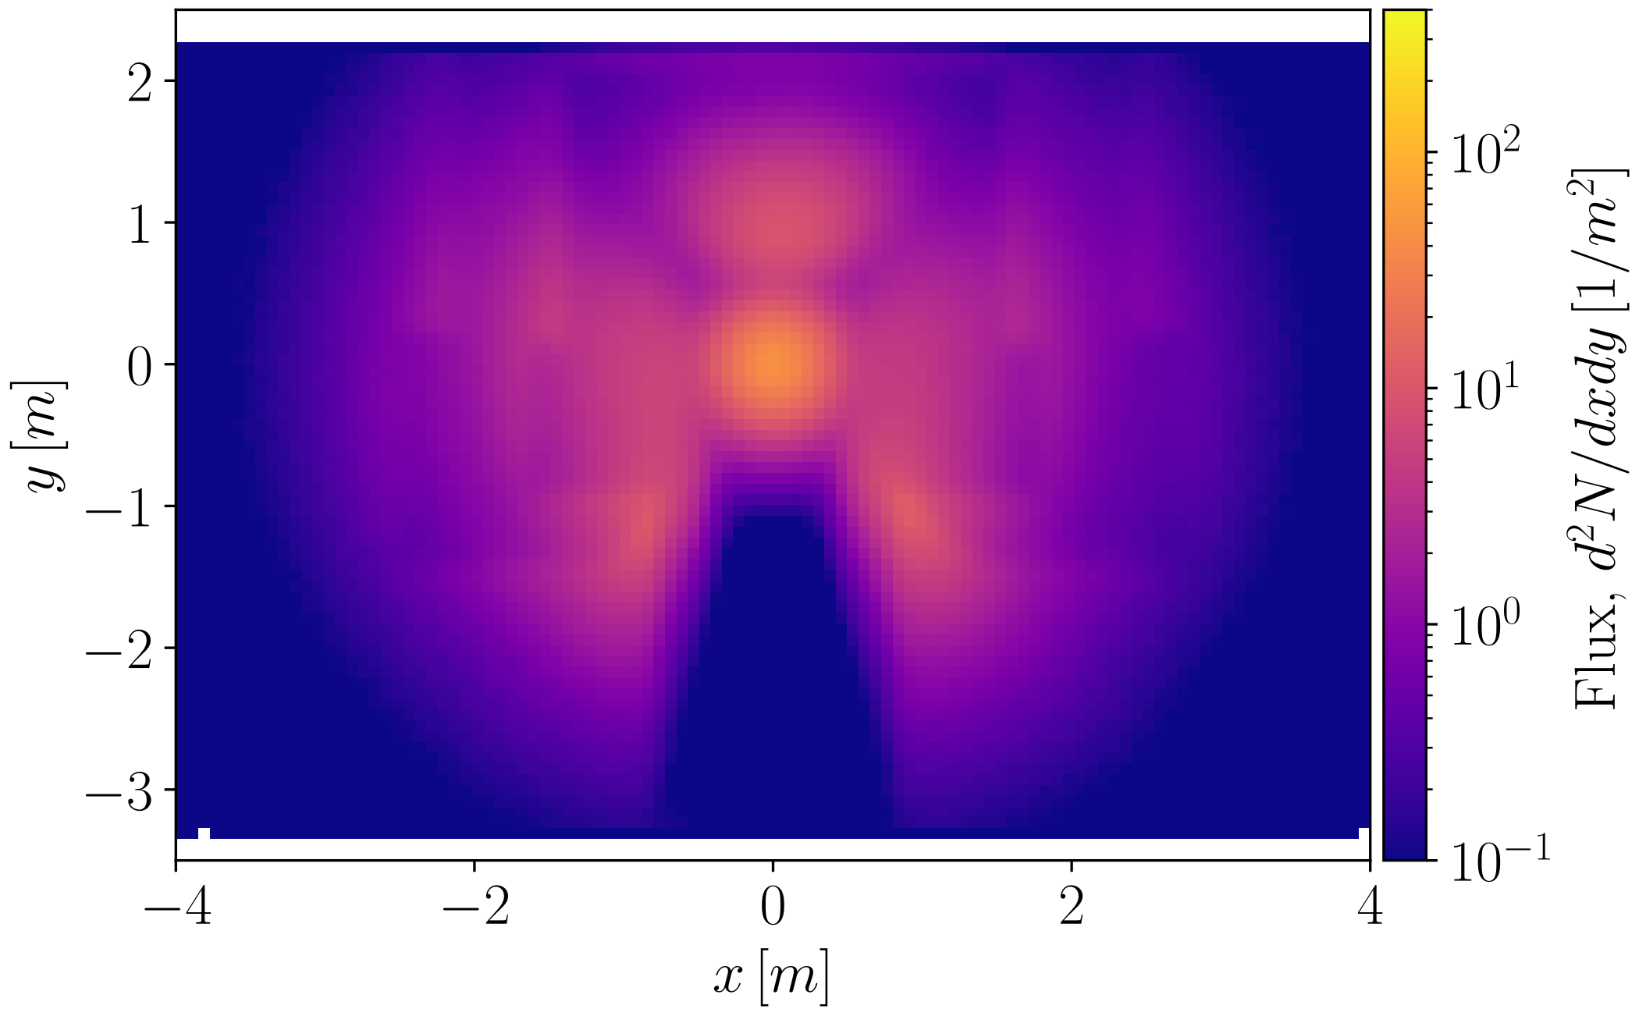
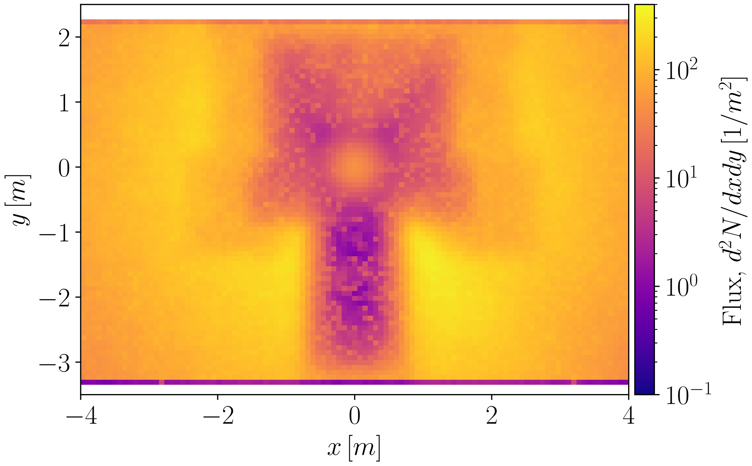
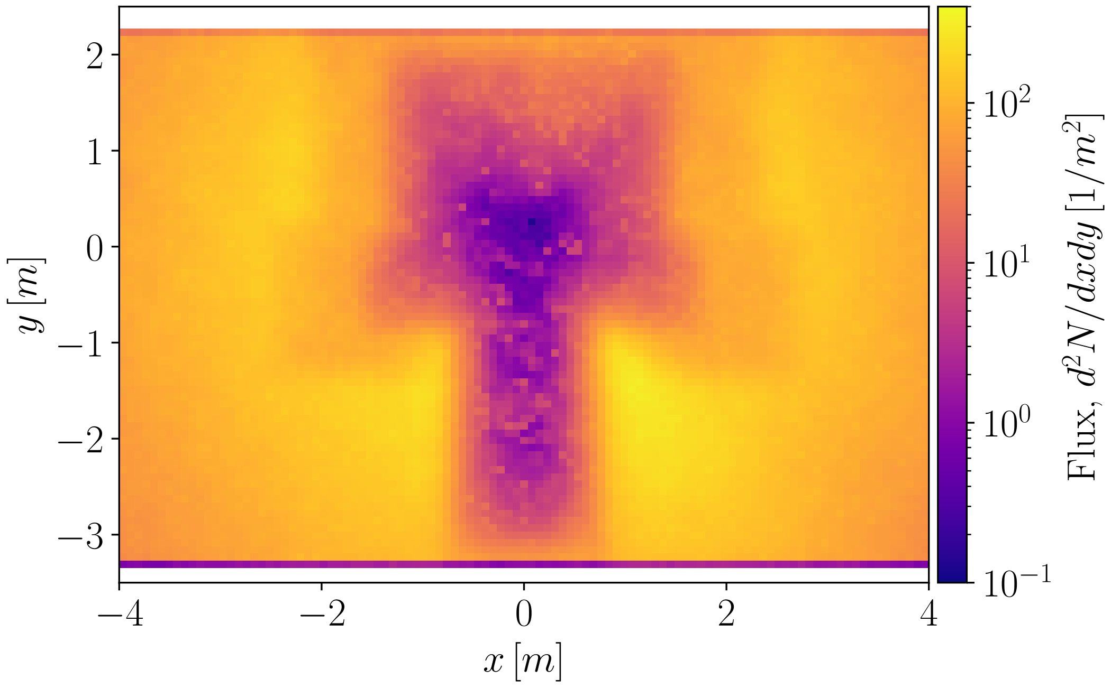
Beam interaction with high-Z elements leaves muon beam unaffected and produces additional low-energy muons around the beam dump
The electron beam hits the elements along the beamline when θ=1.5mrad
X₀ Radiation length:
proportional to photon mean free path - pair production length scale
Photons removed for clarity
High energy muon beam from pairs not affected: material independent and collimated
Elements:
Absorbers (Glass): X₀ = 9.37cm
Magnet (Steel): X₀ = 1.54 cm
Pair-produced
Additional low energy muons visible due to off-axis production from pions (not absorbed)
From decay
[Terzani et al., accepted PRAB]

Slide 17
Experimentally observed higher muon count off-axis can be explained by the lower energy muons from pion decay
Muons at IP (up to initial e- energy)
Muons from decay:
Almost isotropic
Peaked at low energy because emitted by low energy pions
Passage through beam dump and wall
Energy loss in beam dump
The two muon species are spatially separated therefore the measurement is selective depending if the detector is on/off axis.
Muons from pairs:
Mainly forward directed
Exponential-like energy distribution (Bremsstrahlung)

Slide 18
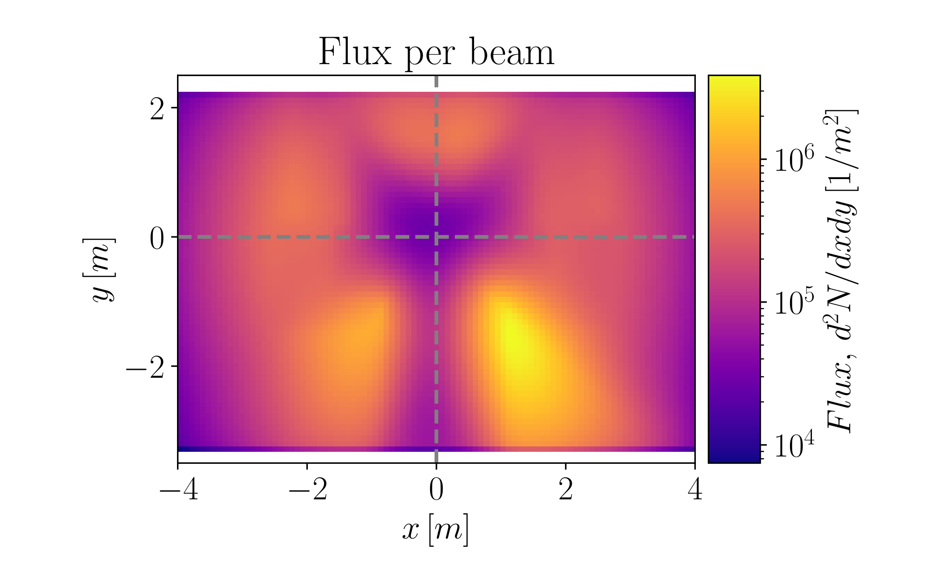
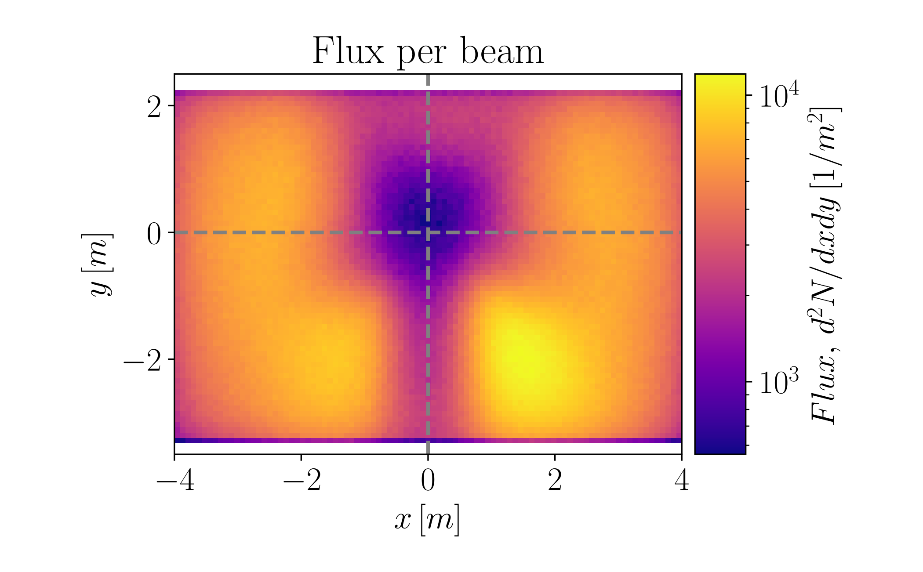
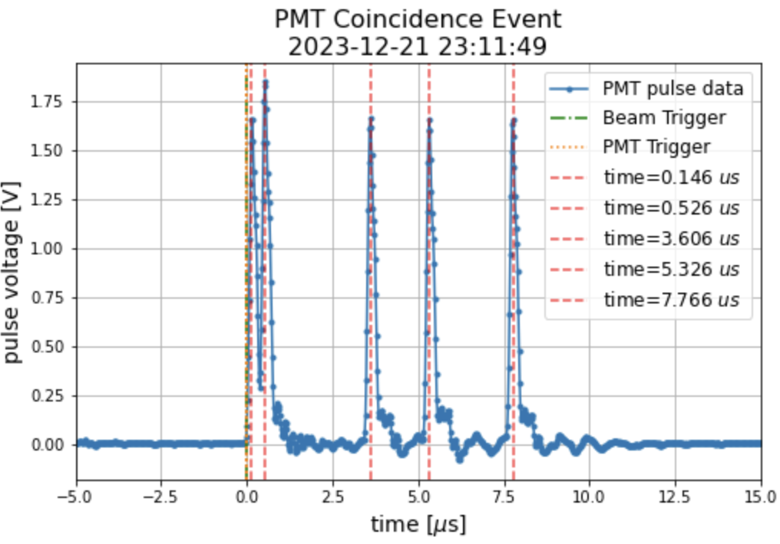
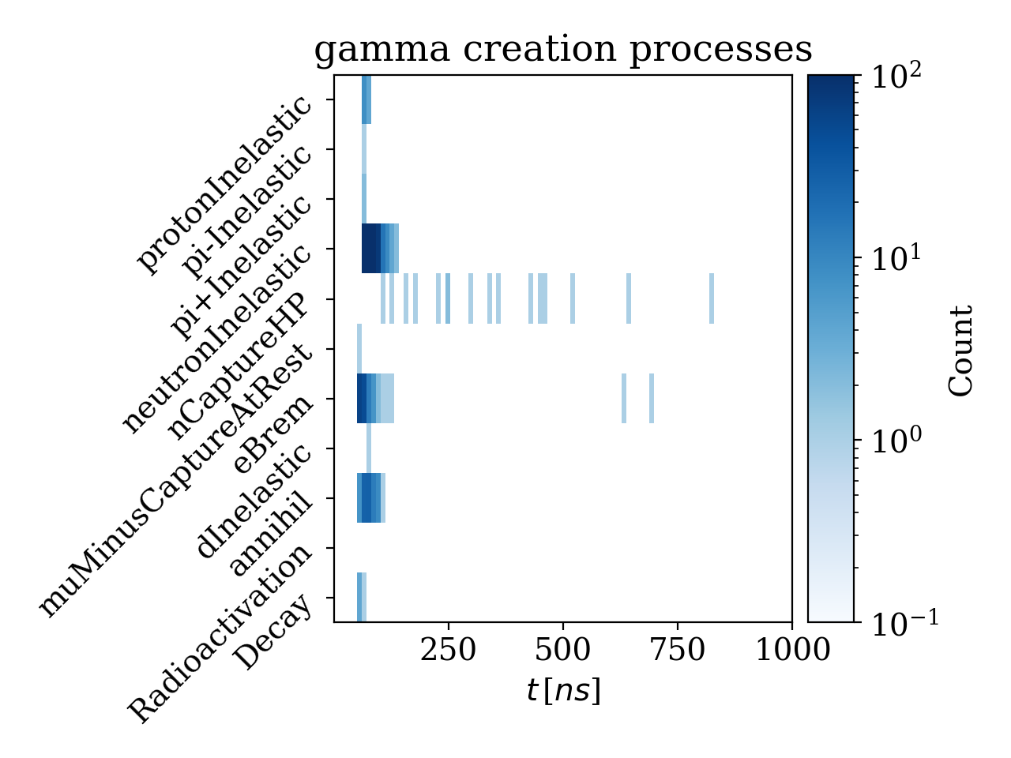
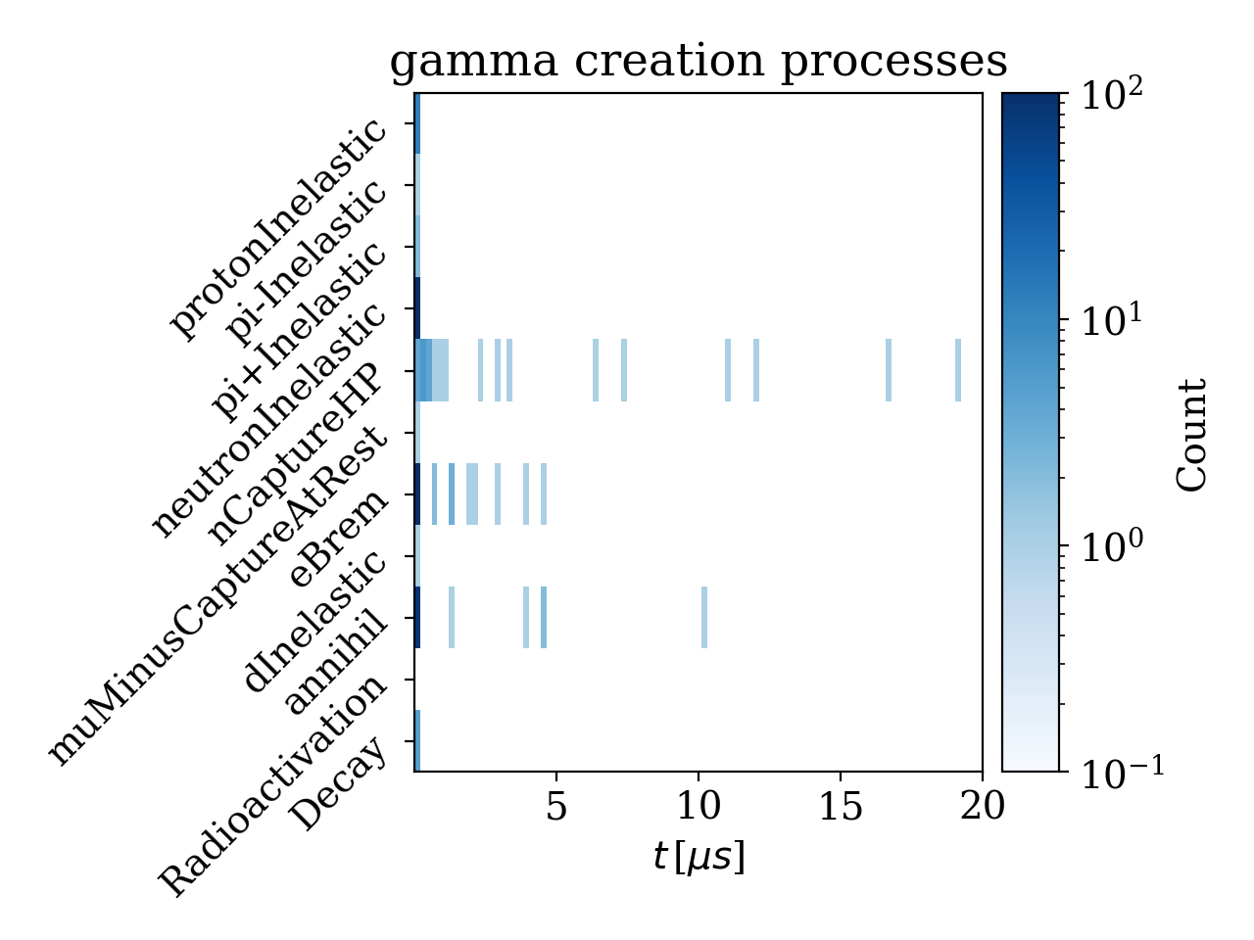
Understanding photon background is essential to design additional shielding for the tracking detectors
[Terzani et al., accepted PRAB]
Photon flux on the virtual detector
Neutron flux on the virtual detector
Lower background behind the beam dump
Scintillator revealed gamma background around the beam dump (distinguished from muons)
Short time scale (ns)
Medium time scale (μs)

Slide 19
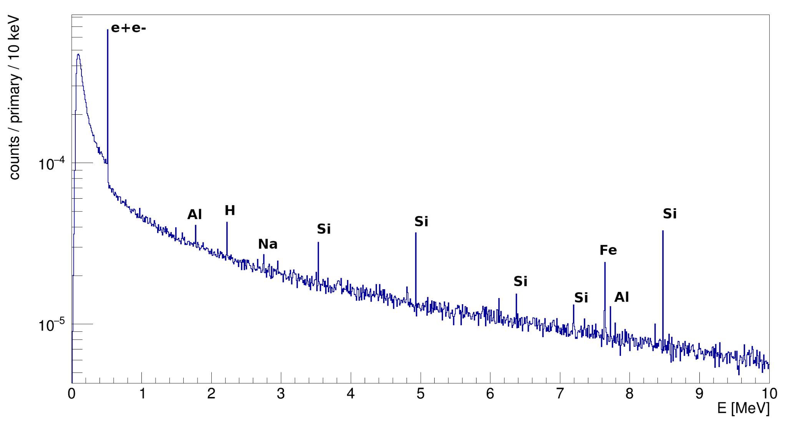
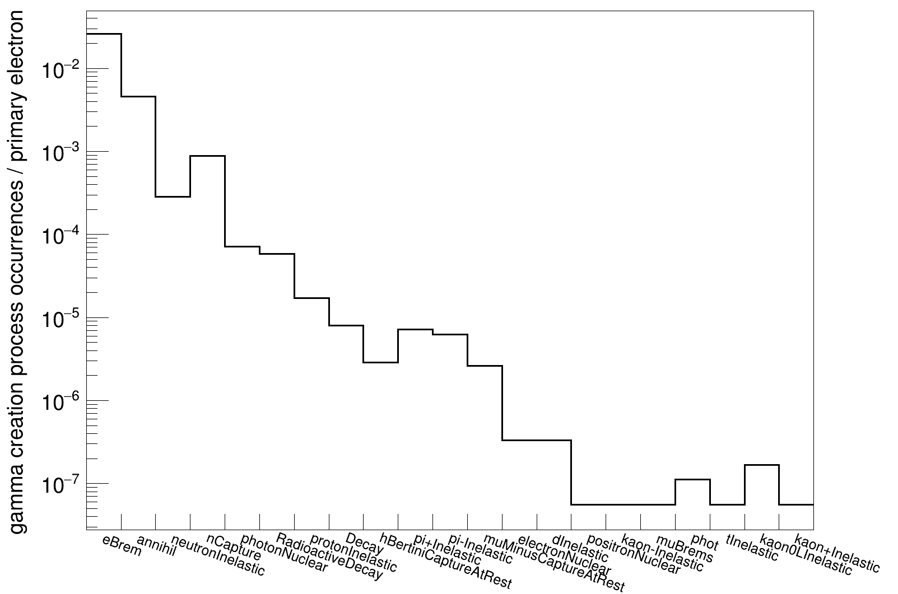
The γ-ray spectrum shows signatures of
neutron absorption and e⁺e⁻ annihilation
Energy distribution of gamma rays at the PW area hallway:
multiple occurrences of neutron capture and inelastic scattering (only measured in scintillators and distinguished from muons)
e⁺e⁻ annihilation gammas at short time scales could hit trackers, but possible to shield since E<1MeV
Short time scale (ns)
Medium to long time scales (μs-ms)

Slide 20
Summary and next steps
We produced e⁻ beams with tails beyond 8 GeV
We used our electron beam dump (several layers of high-Z materials) as a converter target
Pairs of scintillators measured unambiguously muons in correspondence to the beam passage
Numerical analysis confirmed the measurements and provided us with insights into the signals we recorded
We recognized two separated sources of muons distinguished by the angle and the typical energy
We identified the main sources of background noise (i.e., neutron capturing)
Next steps
We are now working with silicon-based detectors in addition to scintillators to track muons before and after a sample
We are developing single-muon energy measurements
We are designing appropriate shielding for the detectors

