Slide 1



Yining Liu 06/12/2025
Supervisor: Professor Haiyan Gao
Duke University
The PRad Experiment Overview &
A Blind Analysis For PRad-II in Hall B
Page 1

Slide 2
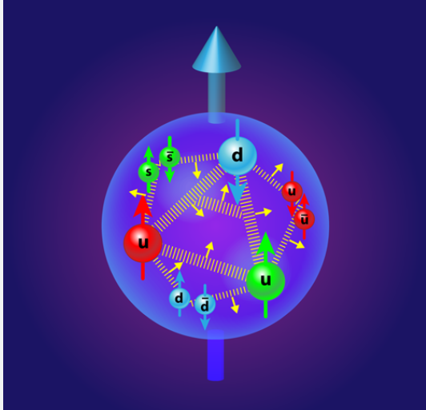
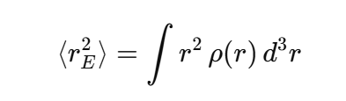
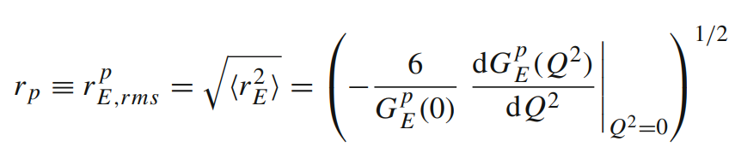
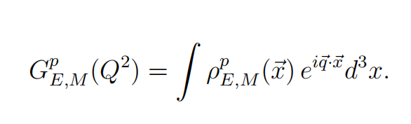

What is Proton Charge Radius?
The proton charge radius is a measure of the spatial extent of the proton’s electric charge distribution.
=1
At Q² goes to zero,
Electrons see the proton as a whole.
Page 2

Slide 3
Why Does the Proton Charge Radius Matter?
- Non-perturbative QCD benchmark
The charge radius gives insight into the charge distribution of the quarks inside the proton
and deepens our understanding of the strong force in the QCD non-perturbative region.
- Ultra-high-precision test of bound-state QED
Finite-size effects of the proton shift S-state energy levels in hydrogen and, even more sensitively, in
muonic hydrogen by an amount Δ E_{fs} ∝ r_{P}² . Comparing the measured Lamb shift with QED predictions
probes the theory with ultra-high precision.
- Key constraint in the determination of the Rydberg constant (one of the most precisely known constants)
Finite-size corrections enter every high-precision hydrogen transition frequency, so the rms charge
radius r_{P}² is strongly correlated with the Rydberg constant R∞ in global hydrogen spectroscopy fits.​
Lepton-Proton Elastic Scattering
Two Traditional Methods to Measure Proton Charge Radius:
Hydrogen spectroscopy
Page 3

Slide 4
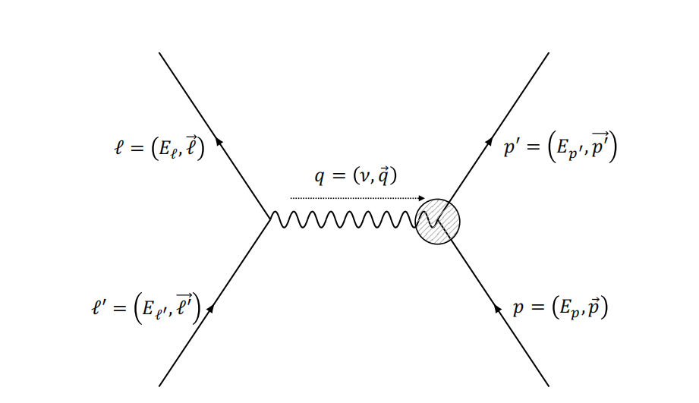
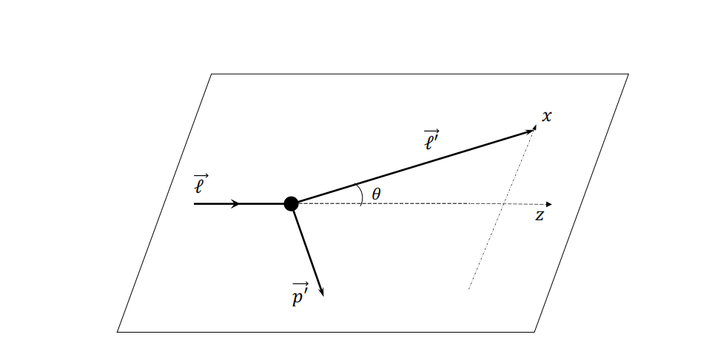
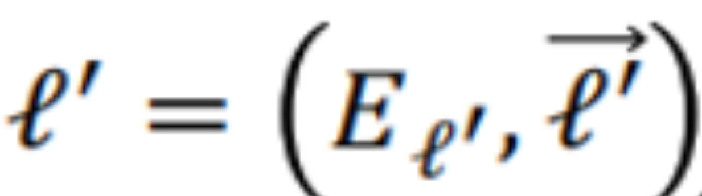

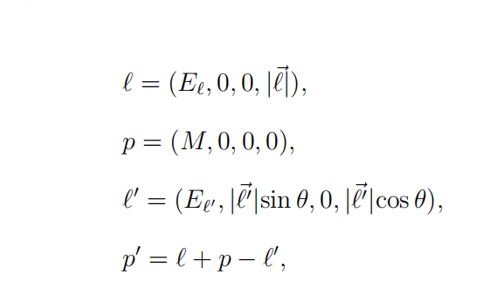
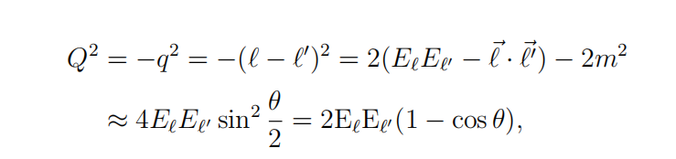

(one photon exchange level)
Electron-Proton Elastic Scattering
Xiong, Weizhi (2020). A High Precision Measurement of the Proton Charge Radius at JLab. Dissertation, Duke University.
Page 4

Slide 5
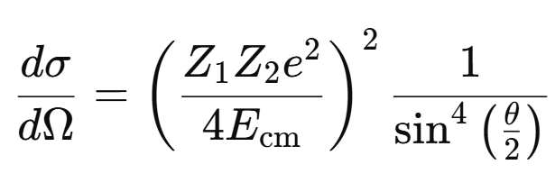
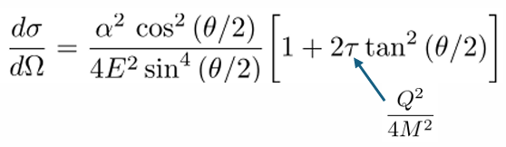
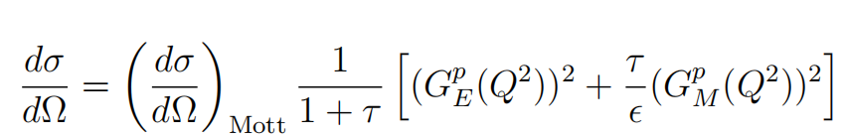


Elastic Electron-Proton Scattering
Experimental goal: to measure differential scattering cross section
Rutherford formula:
MOTT FORMULA:
ROSENBLUTH FORMULA:
Non-relativistic, spinless charged particle scattering off a heavy, point-like Coulomb nucleus.
relativistic,spin-½ electron scattering off
a point-like spin-0 nucleus
relativistic, spin-½ particle scattering off structured spin-½ proton
Page 5

Slide 6
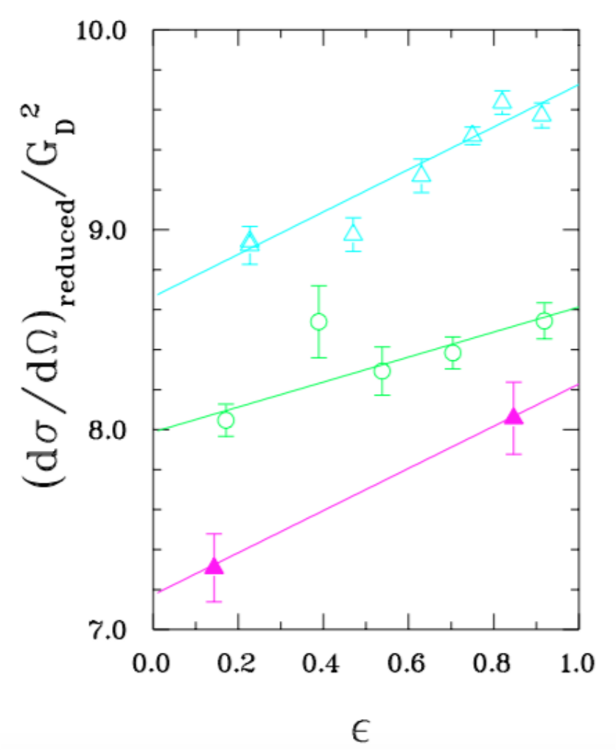

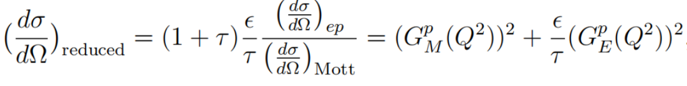
Rosenbluth Separation
Goal: to disentangle the squared proton electric factor from the squared magnetic form factor
Method: requires multiple measurements of the
unpolarized cross section at the same Q² but
with different values of ε . This can be achieved
by using different beam energies and scattering
angles.
Rearrange
Xiong, Weizhi (2020). A High Precision Measurement of the Proton Charge Radius at JLab. Dissertation, Duke University.
Page 6

Slide 7
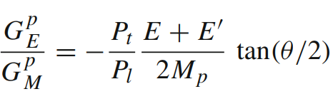
Rosenbluth Separation: not accurately extracting electric form factor at high Q² and magnetic form factor at low Q²
Polarized e − p elastic scattering:
which allows one to measure directly the form factor ratio.
Example: Polarization transfer measurement:
Longitudinally polarized electron beam scatters off an unpolarized proton target,
and then measures the polarization transferred to the recoil proton.
Page 7

Slide 8
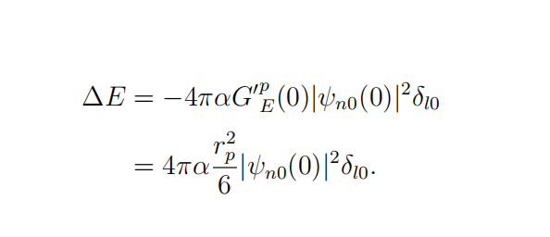
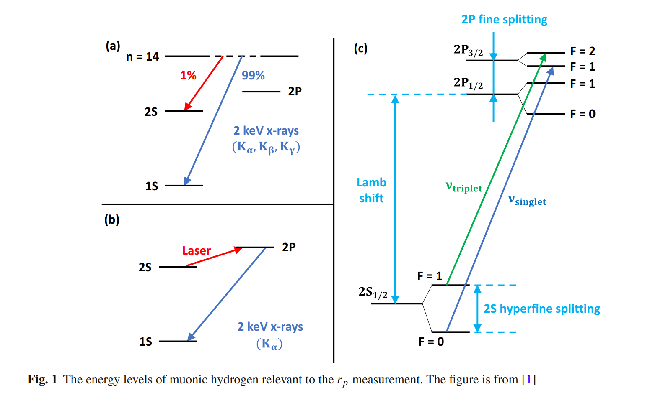
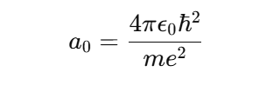
Second Method to Measure Proton Charge Radius
Hydrogen Spectroscopy: measurement of atomic transition frequencies to determine energy‐level separations, including the Lamb shift.
: Bohr radius
2013: R_{p} = 0.84087(39) fm, A. Antognini et al., Science 339, 417 (2013)
Page 8

Slide 9
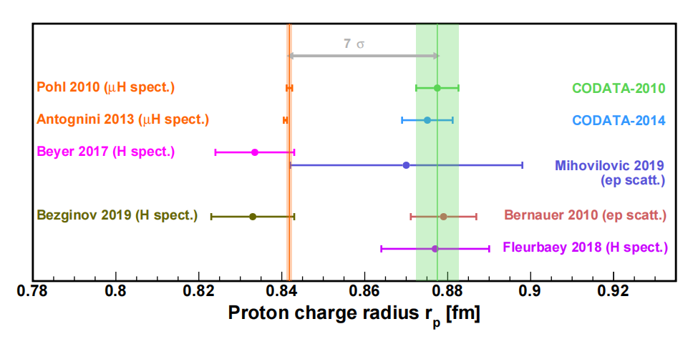
The 'Proton Radius Puzzle'
Discrepancy between measurements from lepton elastic scattering and hydrogen spectroscopy.
- Historically(Before 2010) accepted value: ≈ 0.88 fm (femtometers).
- Muonic hydrogen measurements(2010) suggested a smaller radius: ≈ 0.84 fm.
Xiong, Weizhi (2020). A High Precision Measurement of the Proton Charge Radius at JLab. Dissertation, Duke University.
Page 9

Slide 10
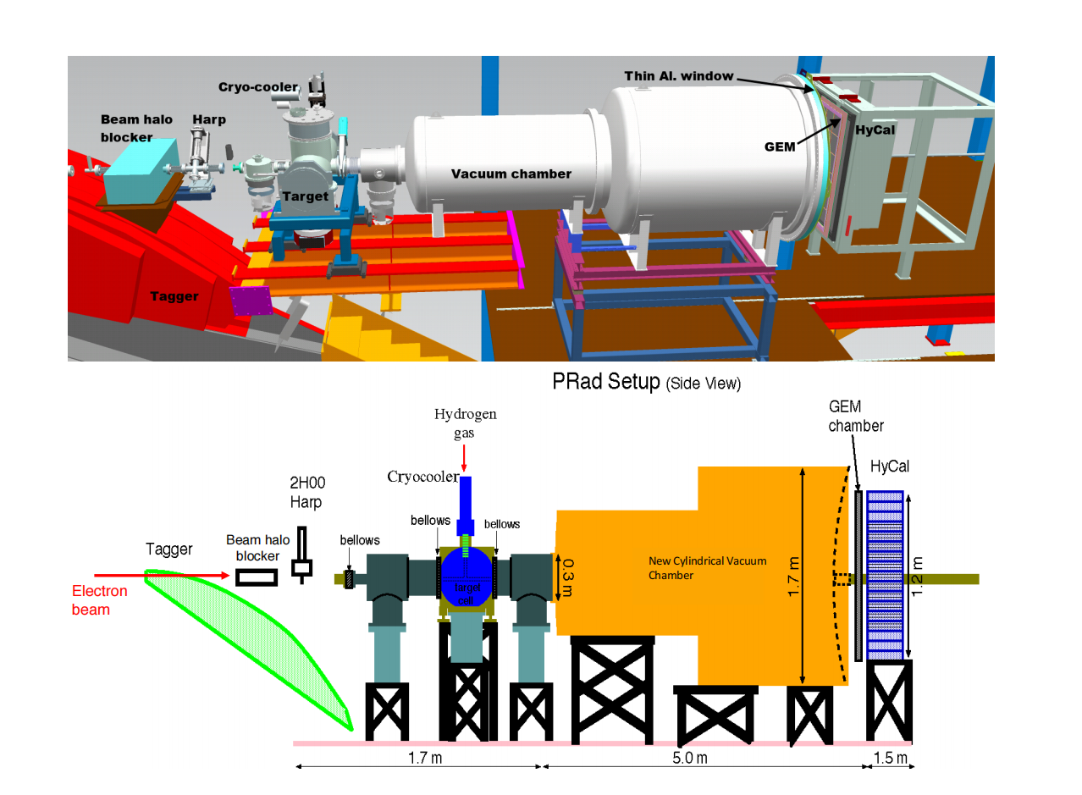
PRad Experiment in Hall B at JLab: A new type of electron scattering experiment free of magnetic spectrometers
1. Using a hybrid EM calorimter and a
GEM detector, data points at
different Q² were recorded with this
same detector setting during the
experiment
2.Scattering angle: 0.7°-7.0°
corresponding to low Q² region:
2 x 10⁻⁴ - 6 x10⁻² (GeV/c)²
Lowest Q² among e–p measurements available at
the time of the PRad experiment, minimized the
proton magnetic form factor contribution
3. used a windowless, cryogenic-cooled hydrogen
gas-flow target to suppress background
4. the absolute e − p elastic scattering
cross section was normalized to that of the
Møller scattering process
Page 10

Slide 11
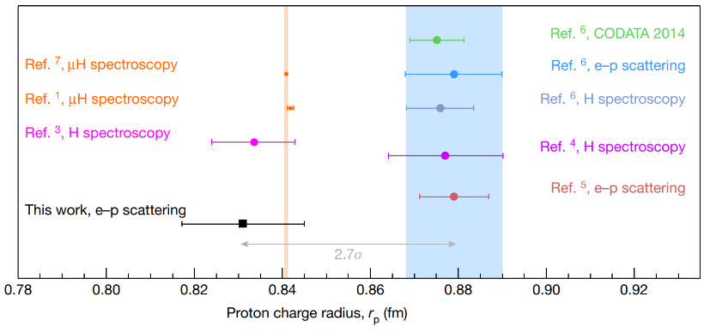
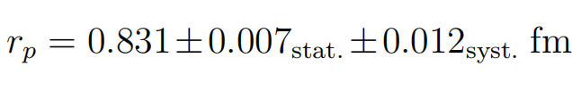
Result of the PRad Experiment
PRad Experiment
(JLab Hall B, 2016)
PRad:
Two independent
analyses
No blind analysis
Xiong et al., Nature 575, 147–150 (2019)
Favored the smaller radius &
supports the muonic hydrogen spectroscopy result
Page 11

Slide 12

Why do we need PRad-II?
Measure electric form factor data in an even lower Q² region, reaching approximately Q² ~ 10⁻⁵ (GeV/c)²
Two planes of tracking detectors for better tracking of the scattered electrons
A new cross-shaped scintillator detector will be positioned inside the target chamber.
separation between elastic e−p events and Møller e-e events within the scattering angular range of 0.5◦ −
0.8◦
Using a flash-ADC-based readout to increase the data-taking rate.
improve uncertainty by a factor of ~3.0 compared to that of PRad
Blind Analysis!!!
Page 12

Slide 13
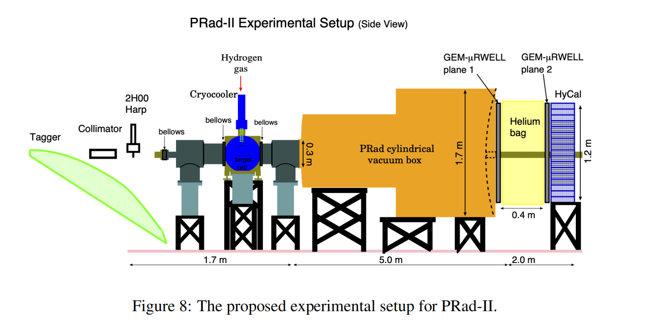

A Blind Analysis for PRad-II Experiment
Goal of this blind analysis study:
Test the proposed approaches and apply the blind analysis for PRad-II to enhance objectivity.
Page 13

Slide 14
Goal: Blind analysis for extraction of r_{p} for PRad-II
Plan A
(Proposed in PRad-II C1 review)
Blinding
Event Reconstruction
Calibration
Event Selection
(Analysis started here)
Event Reconstruction
Elastic e-p
differential cross section
Background
Subtraction
e-p / e-e Ratio
Proton Electric Form Factor
Proton Charge
Radius Extraction r_{p}
Unblind the Analysis
True Radius r_{p}
Page 14

Slide 15
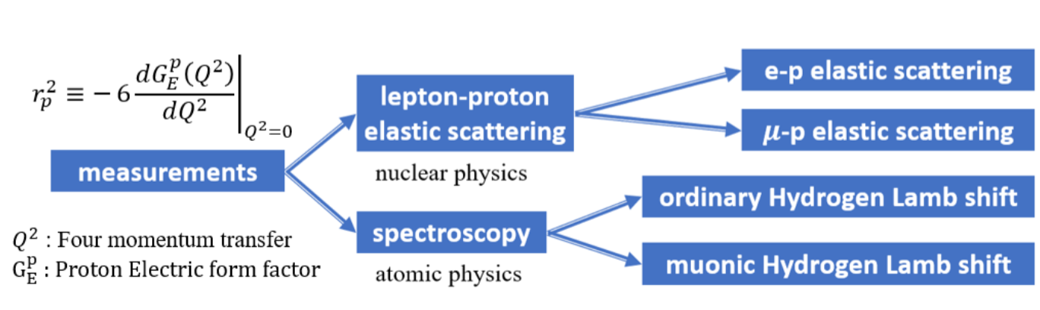
Conclusion
PRad & PRad-II
The proton charge radius is a fundamental quantity that benchmarks non-perturbative QCD, enables ultra-high precision tests of bound-state QED, and constrains the precisely known Rydberg constant in hydrogen spectroscopy.
The PRad experiment was innovatively designed to use a magnetic-spectrometer-free, calorimeter-based method; Its result supports the smaller radius ~ 0.84 fm.
PRad-II will be taking data in spring, 2026.
ordinary Hydrogen spectroscopy
muonic Hydrogen spectroscopy
This study is in collaboration with Weizhi Xiong, Jingyi Zhou, Chao Peng, and Haiyan Gao and partly supported by the Dept of Physics of Duke and Nuclear Physics, the Office of Science of the DOE under Contract No. DE-FG02-03ER41231
Page 15

Slide 16
Thank you!
Questions?
Page 16

Slide 17
Back-Up Slides

Slide 18
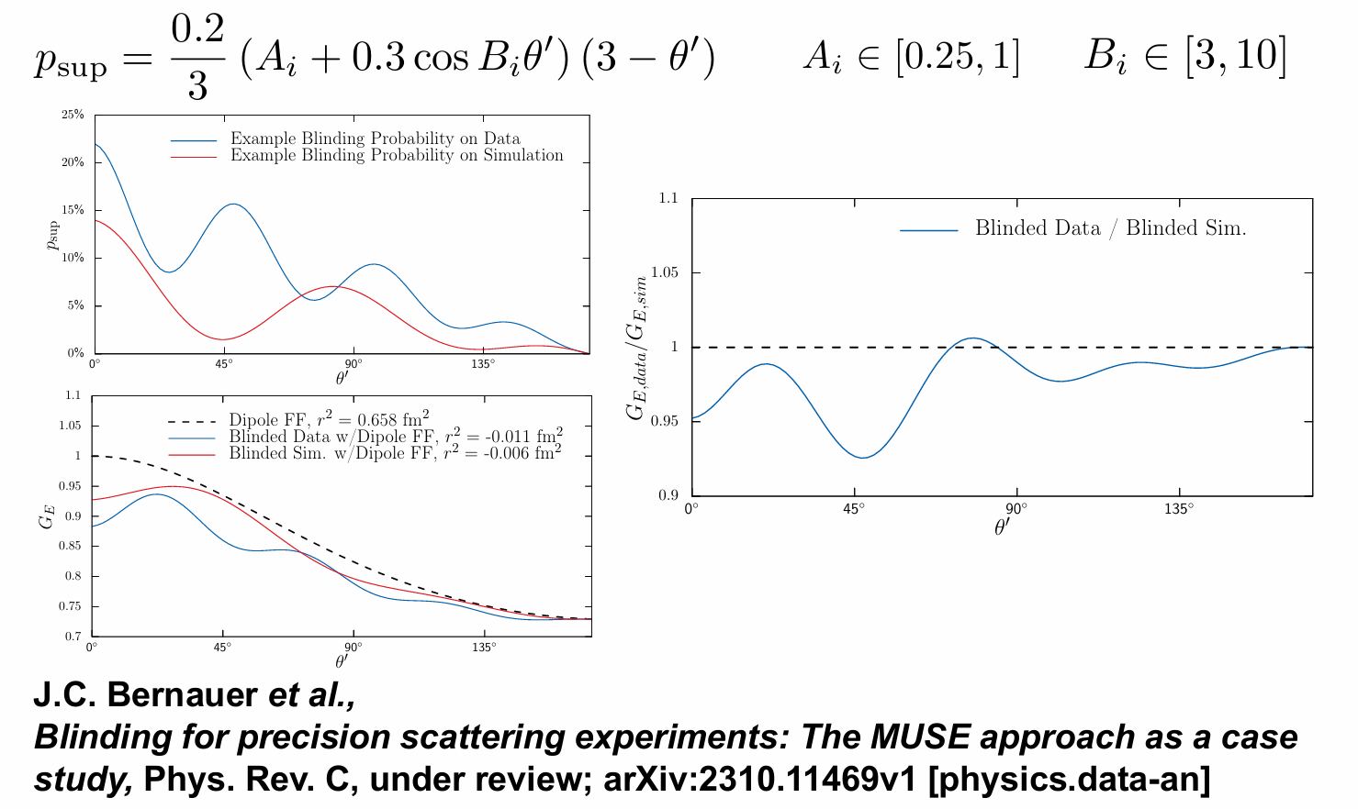
Case Study and Example:
MUSE Experiment
citation: https://indico.lns.tohoku.ac.jp/event/255/contributions/2094/attachments/788/1103/Talk_MUSE_LEES2024_MichaelKohl.pdf

Slide 19

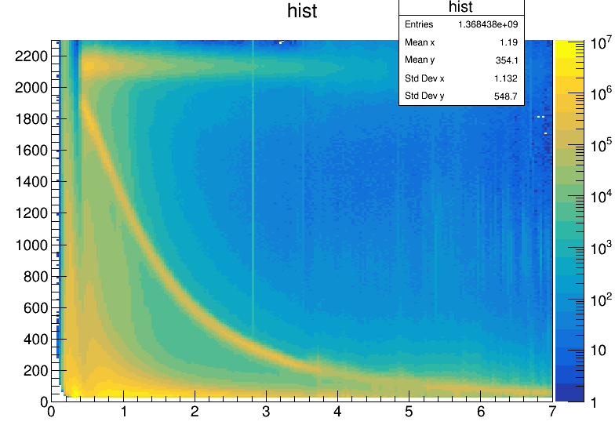


Event Selections
1. Matching hits between GEMs and HyCal.
Remove Dead Modules on HyCal.
edges of HyCal modules cut.
2. For selecting both e-p and e-e events,
Apply angle-dependent expected
energy cuts based on kinematics.
(Cut sizes depend on detector’s resolution)
e-p scattering
e-e scattering

Slide 20

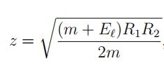

Event Selections
3. In addition to 2, we apply additional cuts
to find the double-arm e-e events:
• Co-planarity:
• Reconstructed Vertex z:
( R_{1,2} is the transverse distance between the
hit position on the detector and the beam-line
of the scattered electron.)
• Elasticity :
e-p scattering
e-e scattering

Slide 21
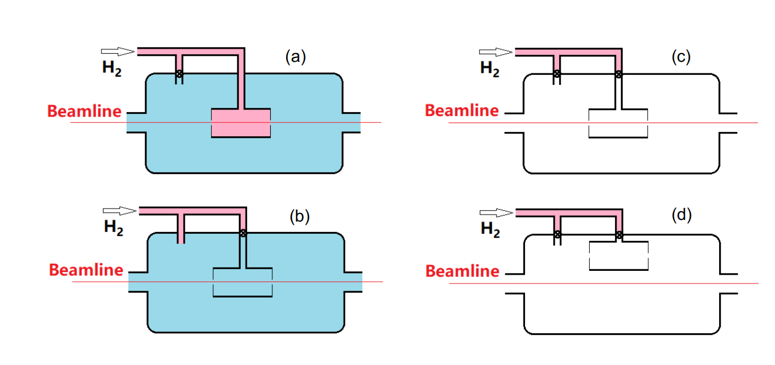
Background Subtraction
a) Full Target run: H₂ gas was filled directly into the target cell
b)Empty Target run: H₂ gas was flled directly into the chamber

Slide 22
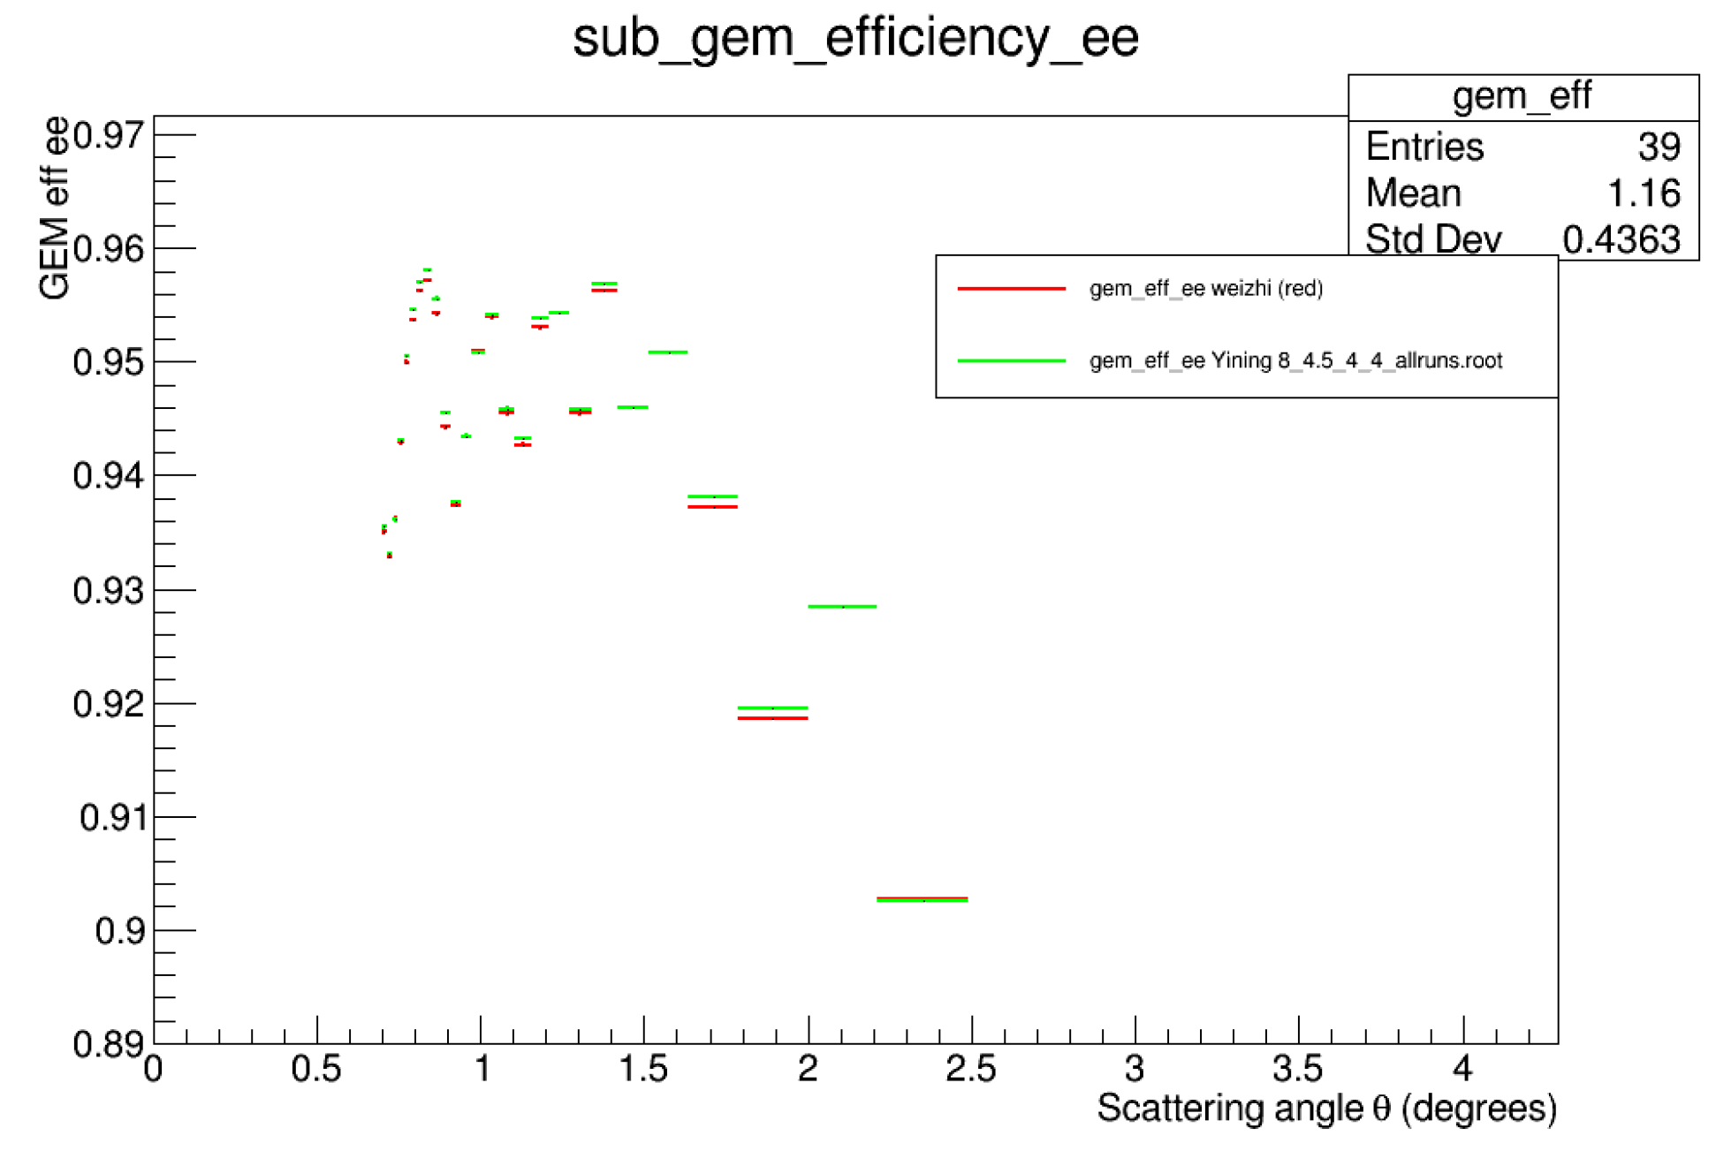
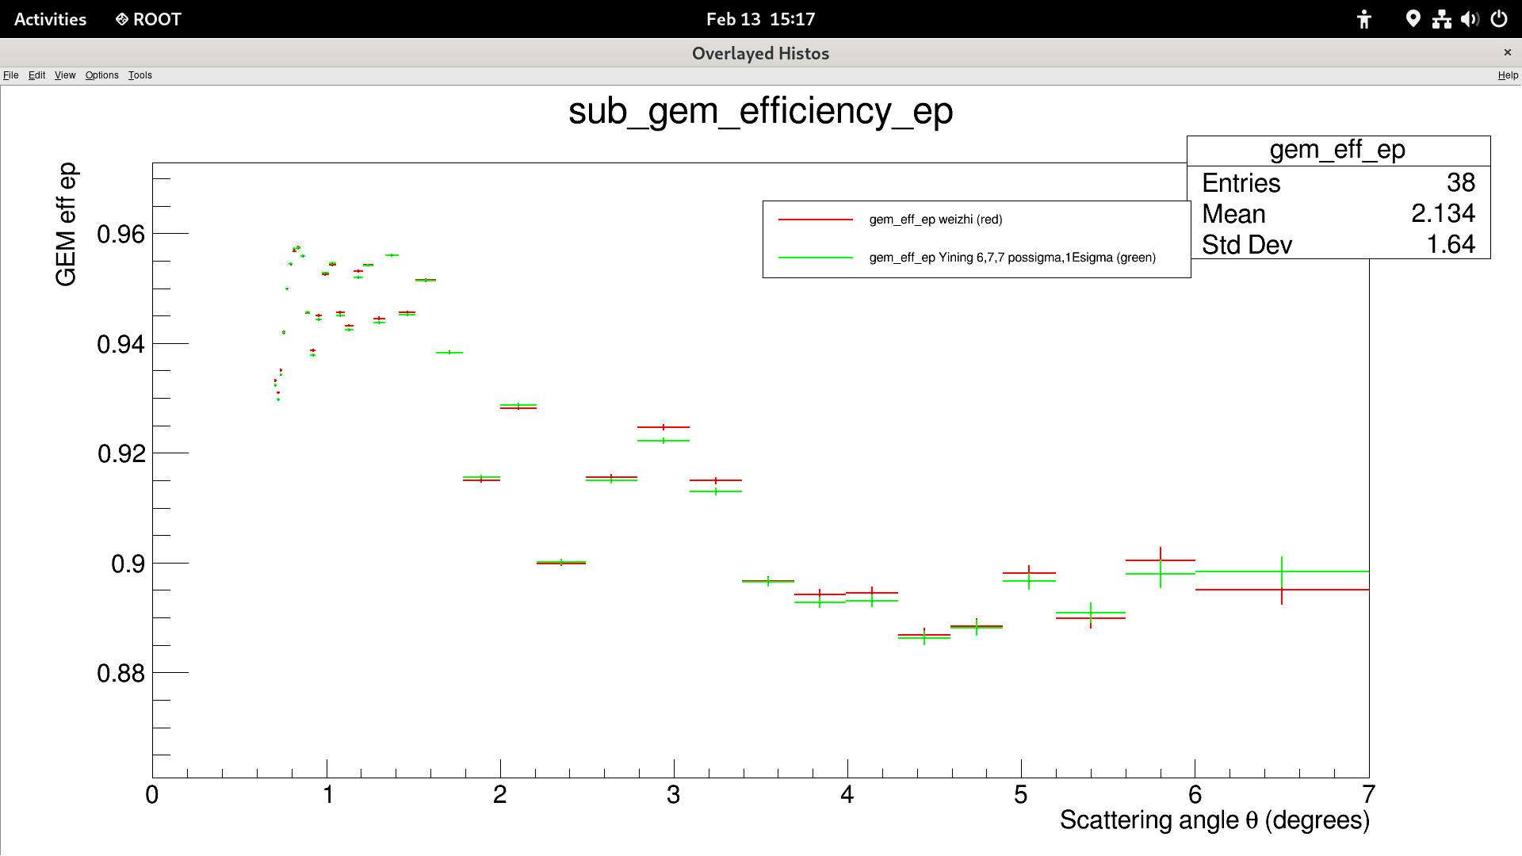

GEM Efficiency Study
e-e: 0.0498494 | RMS Value for difference between 2 sets(%) | e-p: 0.105699
Statistics: 100% Beam Energy: 2.143(GeV)

