Slide 1



Yining Liu 06/12/2025
PRad Experiment Overview &
A Blind Analysis For PRad-II in Hall B
Page 1

Slide 2
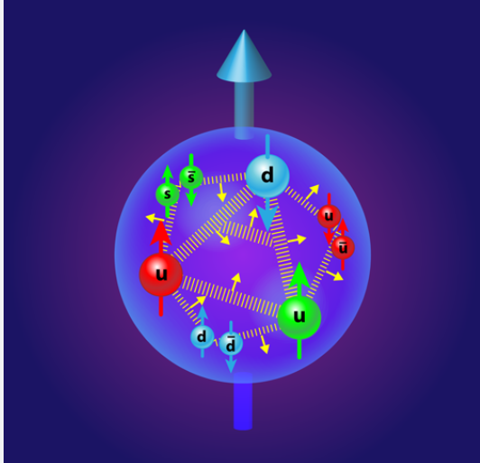
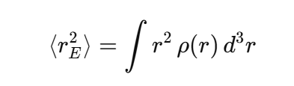
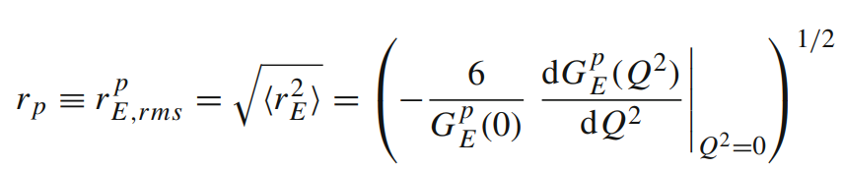
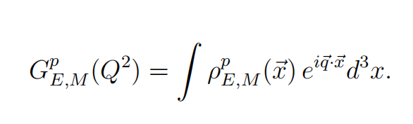

What is Proton Charge Radius?
The proton charge radius is a measure of the spatial extent of the positive electric charge within the proton.
=1
At Q² goes to zero,
Electrons see the proton as a whole.
Page 2

Slide 3
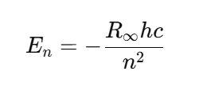
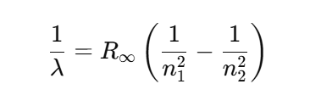
Why Does the Proton Charge Radius Matter?
Impacts our understanding of the strong nuclear force
--The charge radius gives insight into the spatial distribution of the quarks
-Rydberg constant :determine the energy levels of atoms and molecules and also to calculate the
wavelengths of emitted light.
-Testing QED Predictions: Comparing experimental measurements (like the Lamb shift) with
theoretical predictions to validate QED.
2 traditional Methods to Measure Proton Charge Radius
Lepton-Proton Elastic Scattering
Hydrogen spectroscopy
Page 3

Slide 4
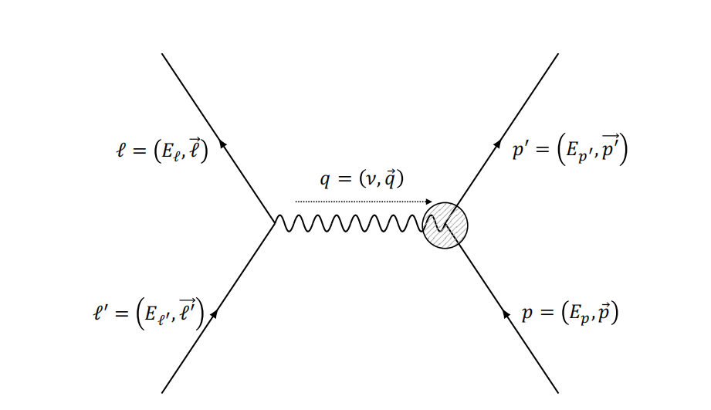
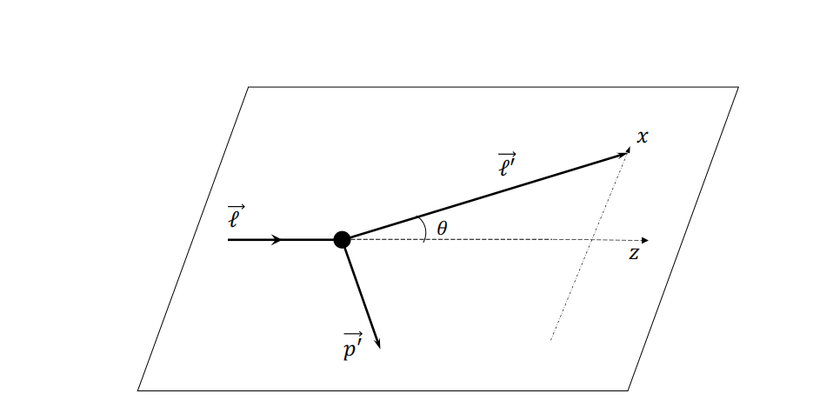
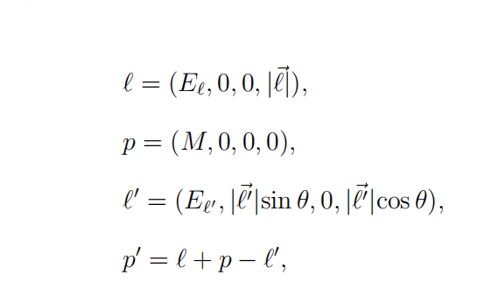
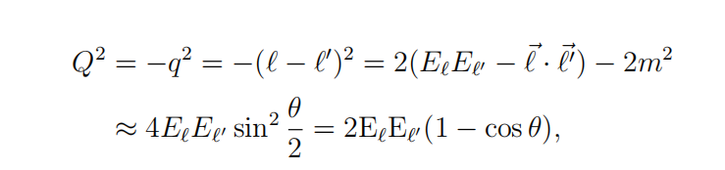
(one photon exchange level)
Electron-Proton Elastic Scattering
Page 4

Slide 5
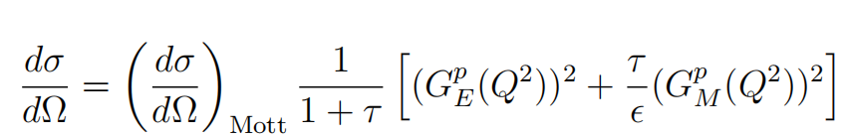
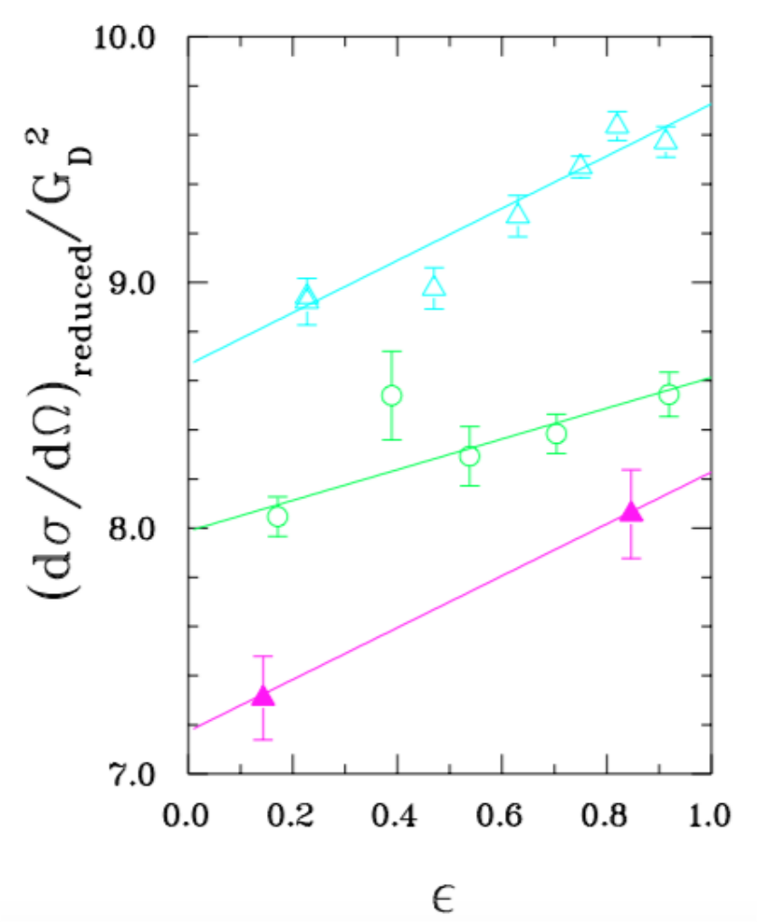
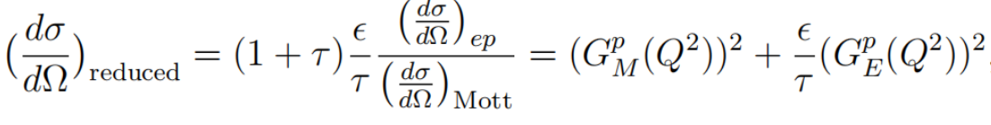


Rosenbluth Separation
. And then, one can obtain
(G p M) 2 and (G p E ) 2/τ from the intersection and slope of a linear fit to the reduced
cross sections at the same Q2 but with different values of epislon . This can be achieved
by using different beam energies and scattering angles.
Goal: disentanglement of the squared proton electric and magnetic form factors.
Method: requires multiple measurements of the
unpolarized cross section at the same Q² but
with different values of ε . This can be achieved
by using different beam energies and scattering
angles.
Page 5

Slide 6
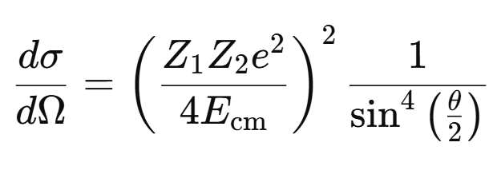
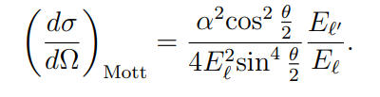
Elastic Electron-Proton Scattering: measures differential scattering cross-sections
Rutherford formula:
MOTT FORMULA:
ROSENBLUTH FORMULA:
low-energy, spinless, non-relativistic scattering.
relativistic, spin-1/2 particle scattered
on spinless structureless proton
relativistic, spin-1/2 particle scattering with proton that has spin and structure
Page 6

Slide 7
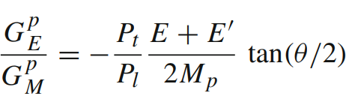
Rosenbluth: not accurately extracting electric form factor at high Q² and magnetic form factor at low Q²
Polarized e − p elastic scattering:
which allows one to measure directly the form factor ratio.
Example: Polarization transfer measurement:
A longitudinally polarized electron beam and an unpolarized proton target, and then measures the polarization transferred to the recoil proton.
Page 7

Slide 8
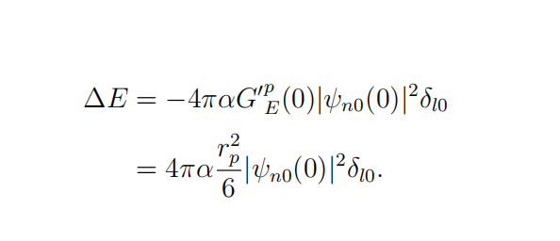
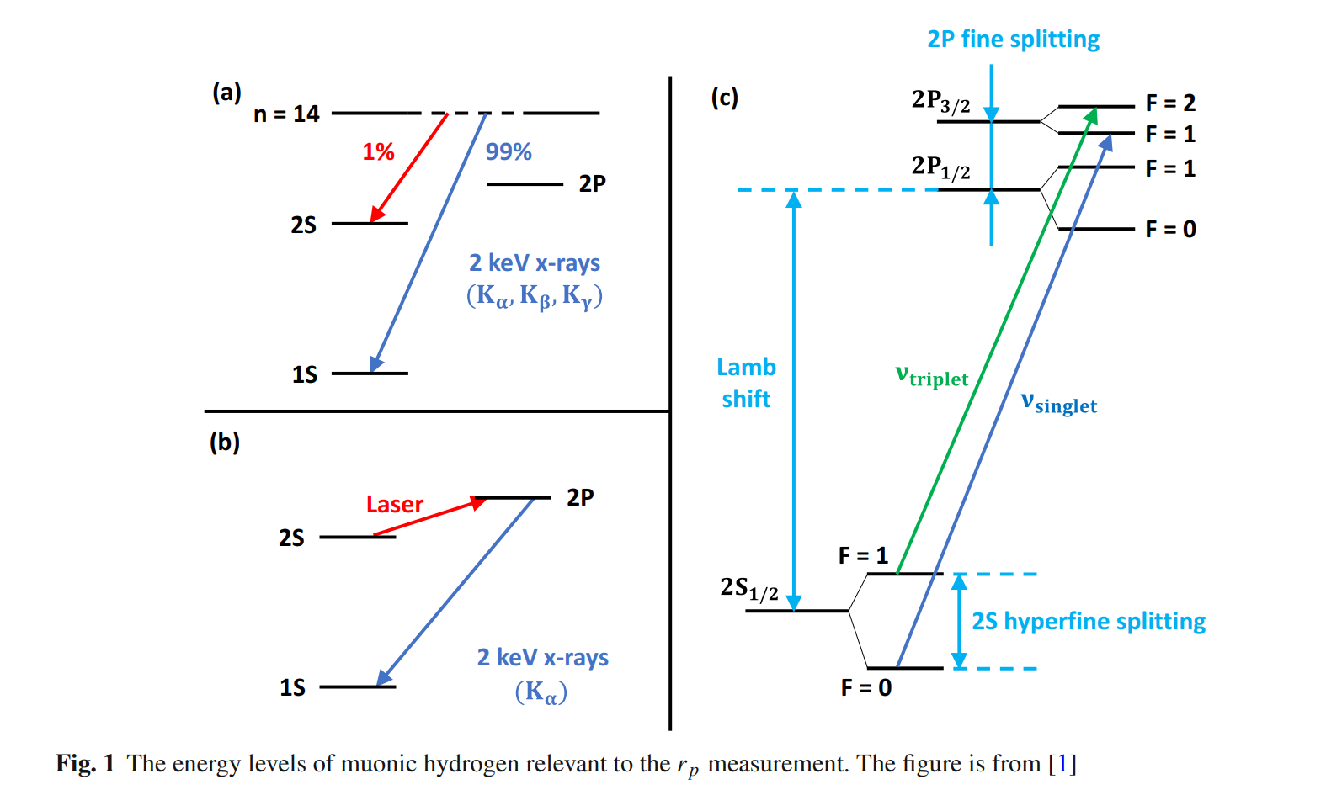
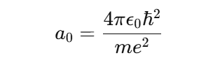
Second Method to Measure Proton Charge Radius
Hydrogen Spectroscopy: Determines the energy levels of hydrogen atoms, particularly the Lamb shift.
: Bohr radius
Page 8

Slide 9
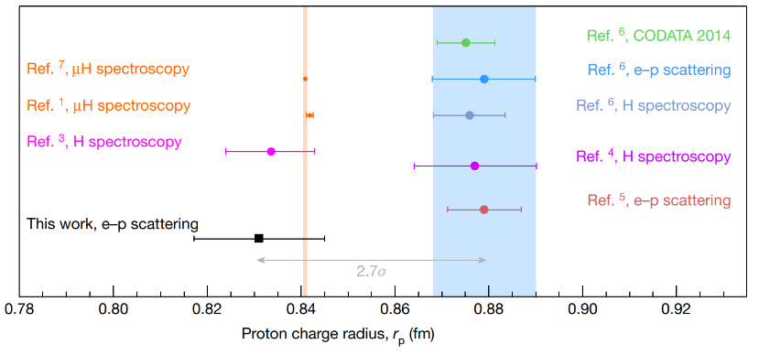
The 'Proton Radius Puzzle'
Discrepancy between measurements from lepton scattering and hydrogen spectroscopy.
- Historically(Before 2010) accepted value: ≈ 0.88 fm (femtometers).
- Muonic hydrogen measurements(2010) suggested a smaller radius: ≈ 0.84 fm.
Page 9

Slide 10
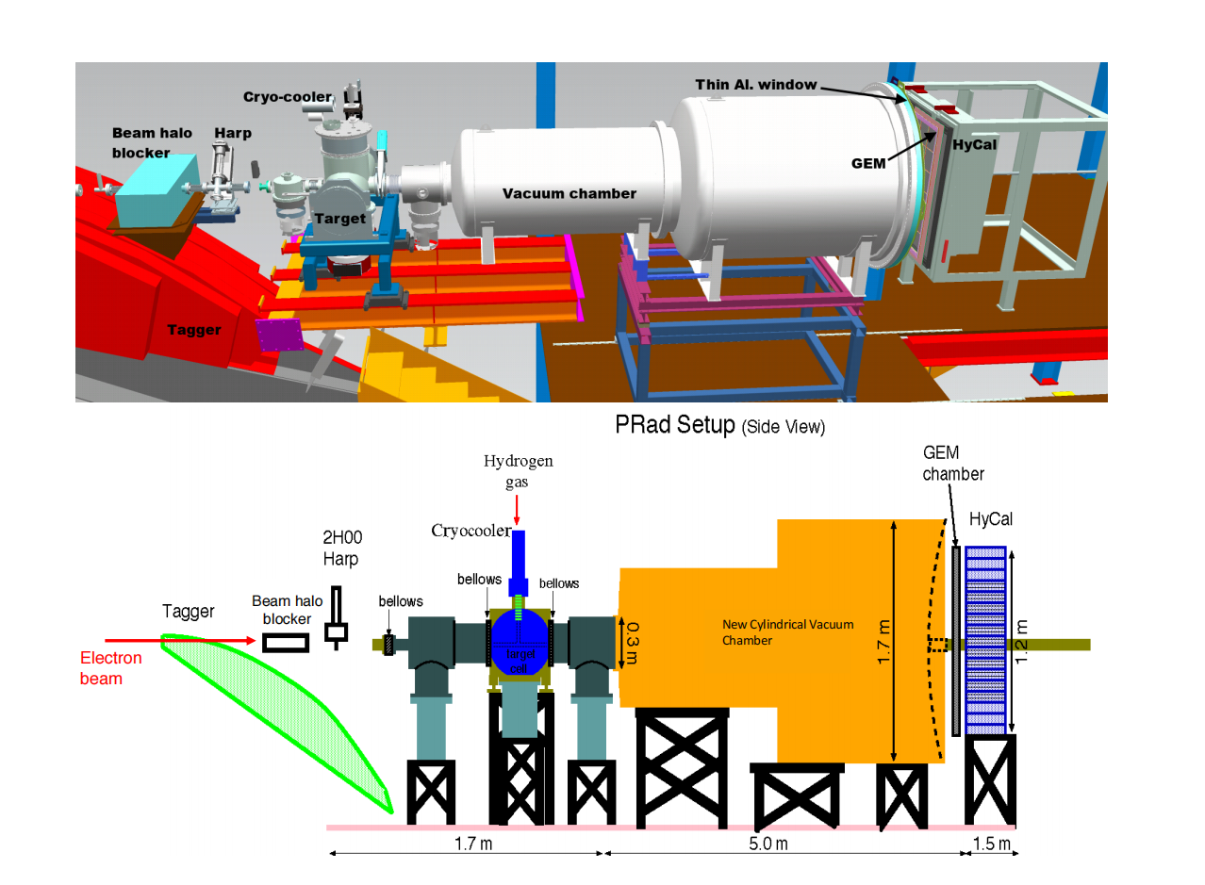
PRad Experiment (electron scattering): Improved precision and supports the smaller value(~0.84fm).
2. Scattering angle: 0.7°-7°
1.data points at different Q²
were recorded with the same
detector setting during the
experiment
low Q² region :
2 x 10⁻⁴ - 6 x10⁻² (GeV/c)²
Lowest Q^2 in all e-p experiment
minimized the proton magnetic form
^{factor contribution}
3. used a windowless, cryogenic-
cooled hydrogen gas-flow target
4. the absolute e − p elastic scattering
cross section was normalized to that of the Møller
scattering process
Page 10

Slide 11
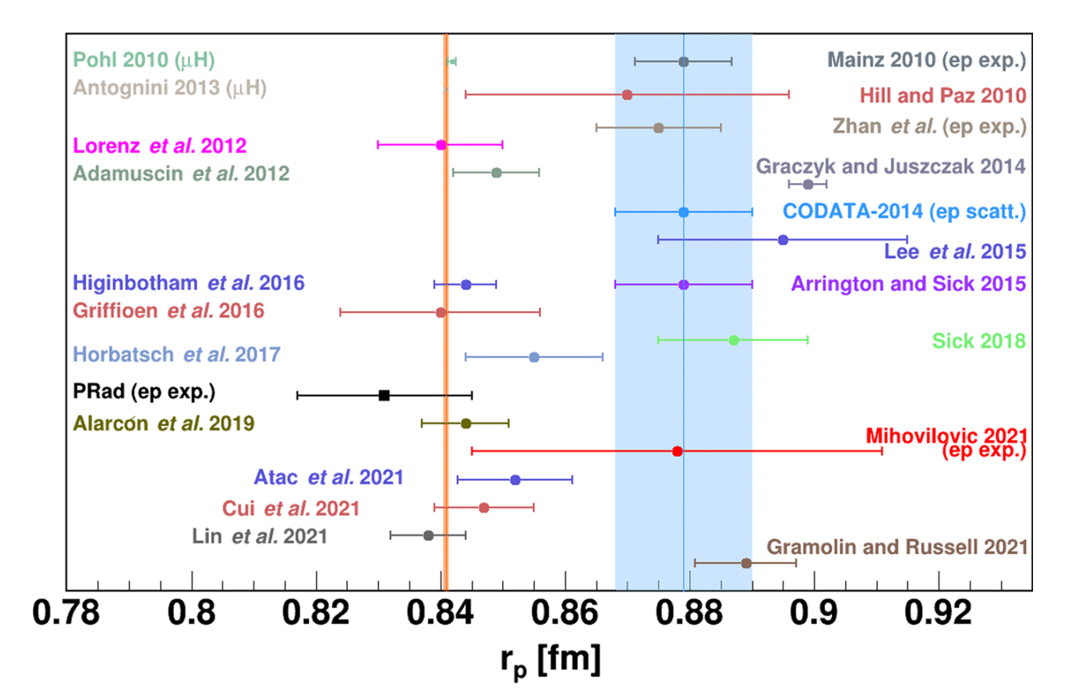
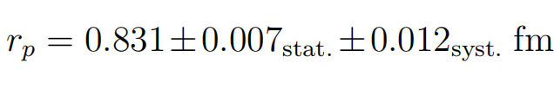
Result of the PRad Experiment
Xiong et al., Nature 575, 147–150 (2019).
PRad:
Two independent analyses
No blind analysis
Favored the smaller radius &
supports the muonic hydrogen result
Page 11

Slide 12

why do we need PRad-II?
measure electric form factor data in an even lower Q² region, reaching approximately Q² ~ 10⁻⁵ (GeV/c)²
Two planes of tracking detectors for better tracking of the scattered electrons
A new cross-shaped scintillator detector will be positioned inside the target chamber.
separation between elastic e−p events and Møller e-e events within the scattering angular range of 0.5◦ −
0.8◦
Using a flash-ADC-based readout to increase the data-taking rate.
improve uncertainty by a factor of ~3.0 compared to that of PRad
Blind Analysis!!!
Page 12

Slide 13
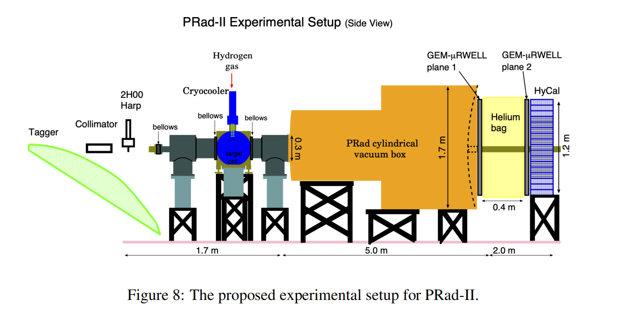
A Blind Analysis for PRad-II Experiment
• Goal of this blind analysis study:
Test the proposed approaches and apply the blind analysis for PRad-II to enhance objectivity.
Page 13

Slide 14
Goal: Blind analysis for extraction of r_{p} for PRad-II
Plan A
(Proposed in PRad-II C1 review)
Blinding
Event Reconstruction
Calibration
Event Selection
(Analysis started here)
Event Reconstruction
Elastic e-p
differential cross section
Background
Subtraction
e-p / e-e Ratio
Proton Electric Form Factor
Proton Charge
Radius Extraction r_{p}
Unblind the Analysis
True Radius r_{p}
Page 14

Slide 15
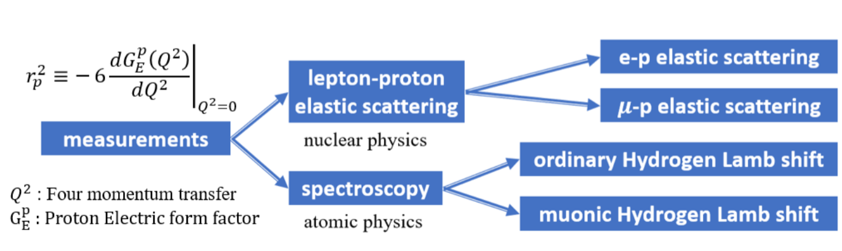
Conclusion
PRad & PRad-II
PRad supports the smaller radius ~0.84fm and PRad-II will be taking data in spring, 2026.
Accurate knowledge of the proton charge radius is essential for refining models of atomic structures.
Impacts the accuracy of fundamental physical constants and tests our understanding of QED.
This study is in collaboration with Weizhi Xiong, Jingyi Zhou, Chao Peng, and Haiyan Gao and partly supported by the Dept of Physics of Duke and Nuclear Physics, the Office of Science of the DOE under Contract No. DE-FG02-03ER4123
Page 15

Slide 16
Thank you!
Question?
Page 16

Slide 17
Back-Up Slides

Slide 18
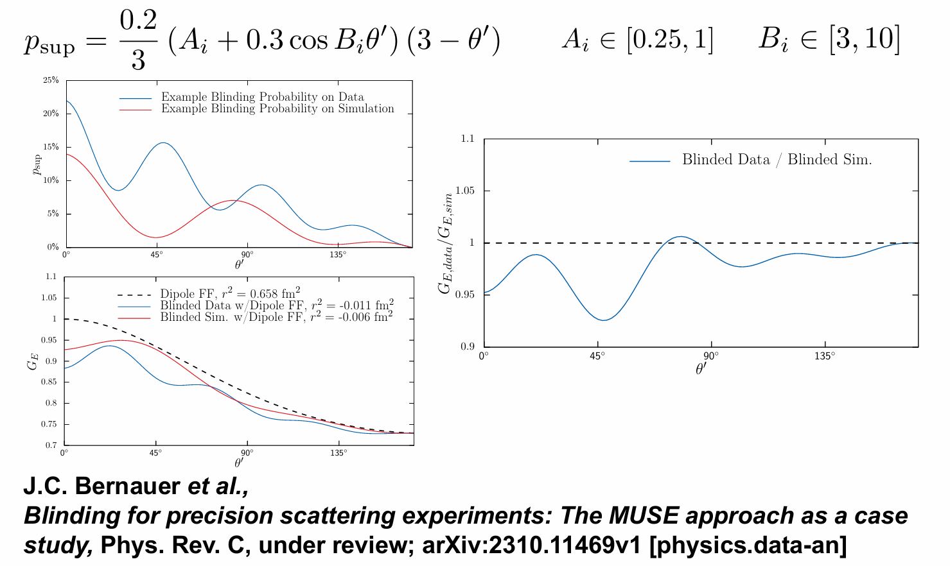
Case Study and Example:
MUSE Experiment
citation: https://indico.lns.tohoku.ac.jp/event/255/contributions/2094/attachments/788/1103/Talk_MUSE_LEES2024_MichaelKohl.pdf

Slide 19

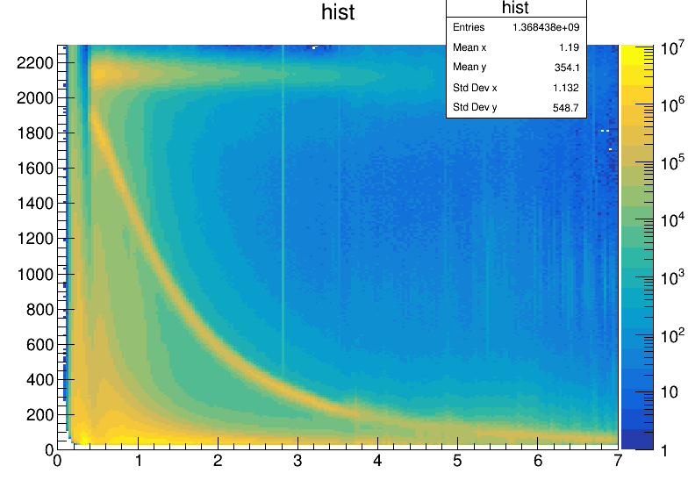


Event Selections
1. Matching hits between GEMs and HyCal.
Remove Dead Modules on HyCal.
edges of HyCal modules cut.
2. For selecting both e-p and e-e events,
Apply angle-dependent expected
energy cuts based on kinematics.
(Cut sizes depend on detector’s resolution)
e-p scattering
e-e scattering

Slide 20

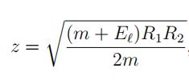

Event Selections
3. In addition to 2, we apply additional cuts
to find the double-arm e-e events:
• Co-planarity:
• Reconstructed Vertex z:
( R_{1,2} is the transverse distance between the
hit position on the detector and the beam-line
of the scattered electron.)
• Elasticity :
e-p scattering
e-e scattering

Slide 21
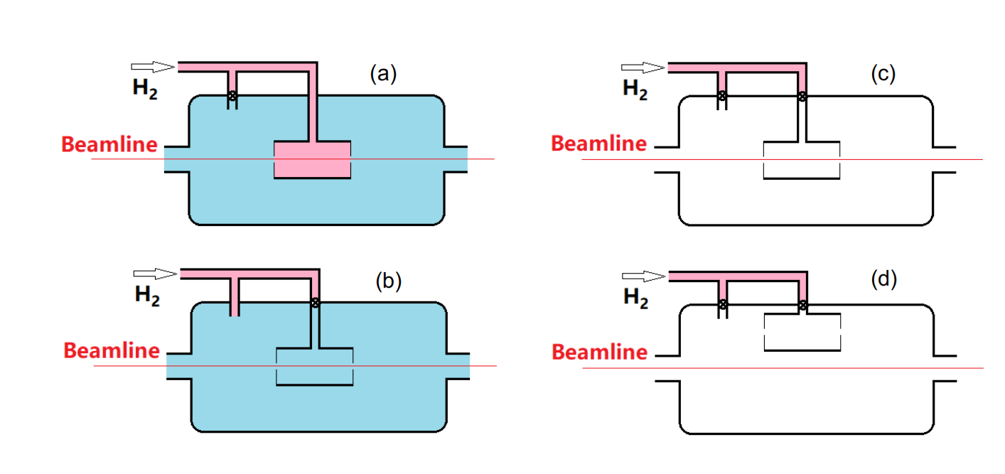
Background Subtraction
a) Full Target run: H₂ gas was filled directly into the target cell
b)Empty Target run: H₂ gas was flled directly into the chamber
Page 8

Slide 22
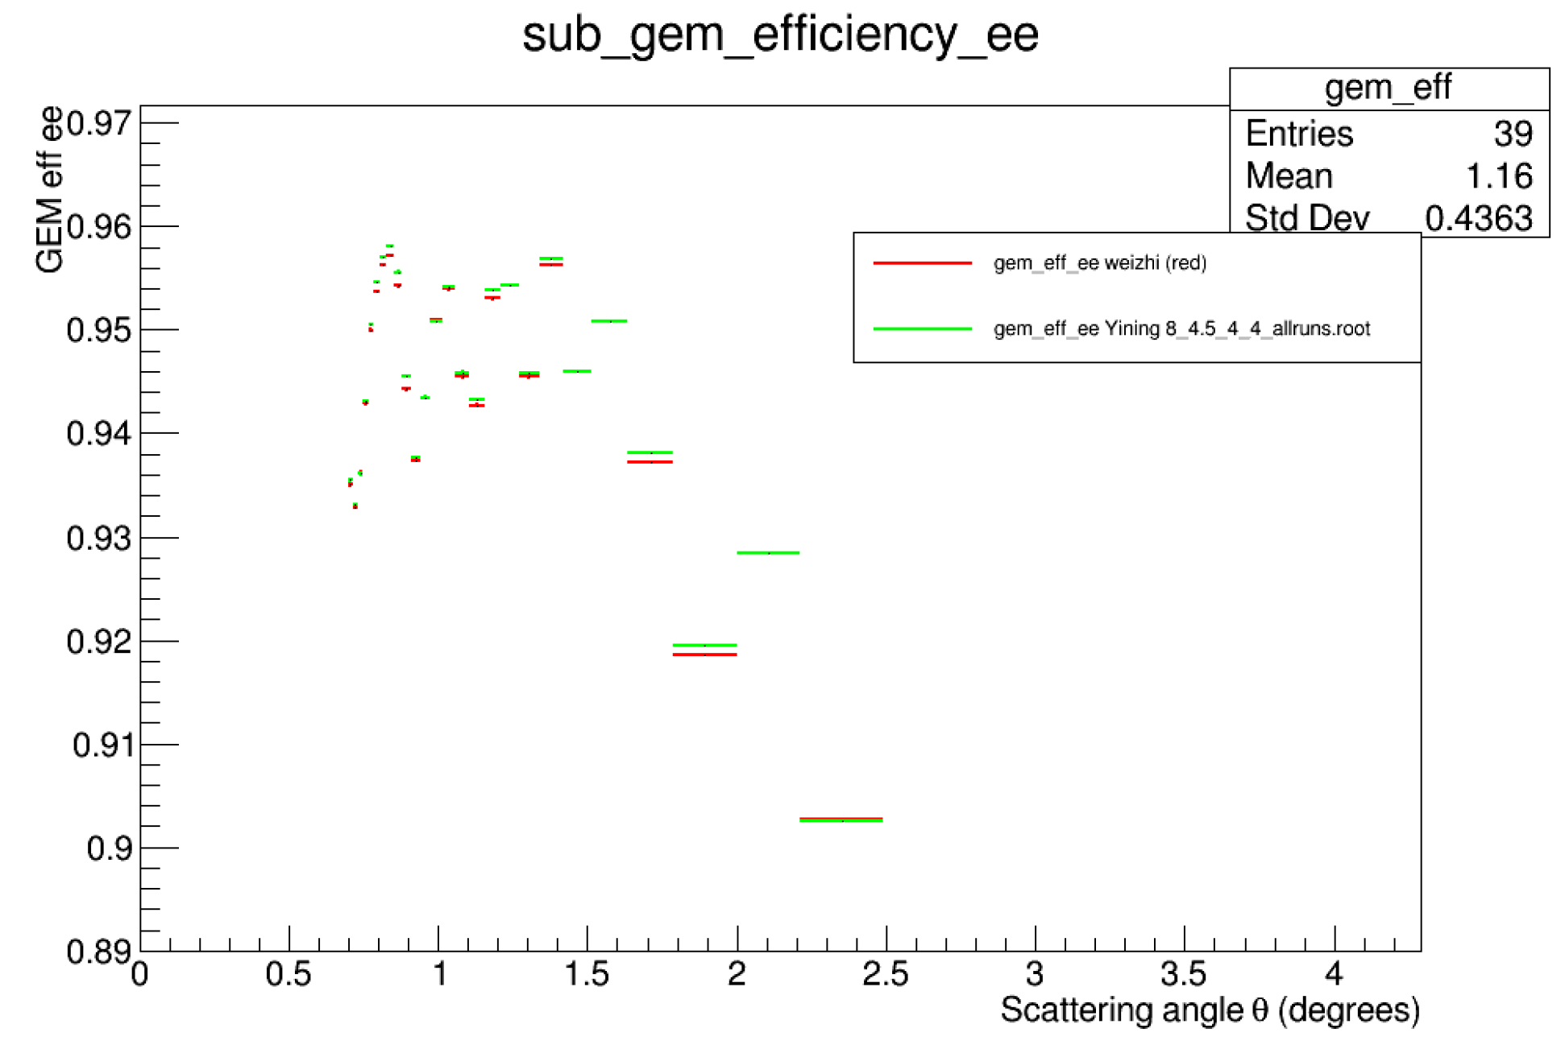
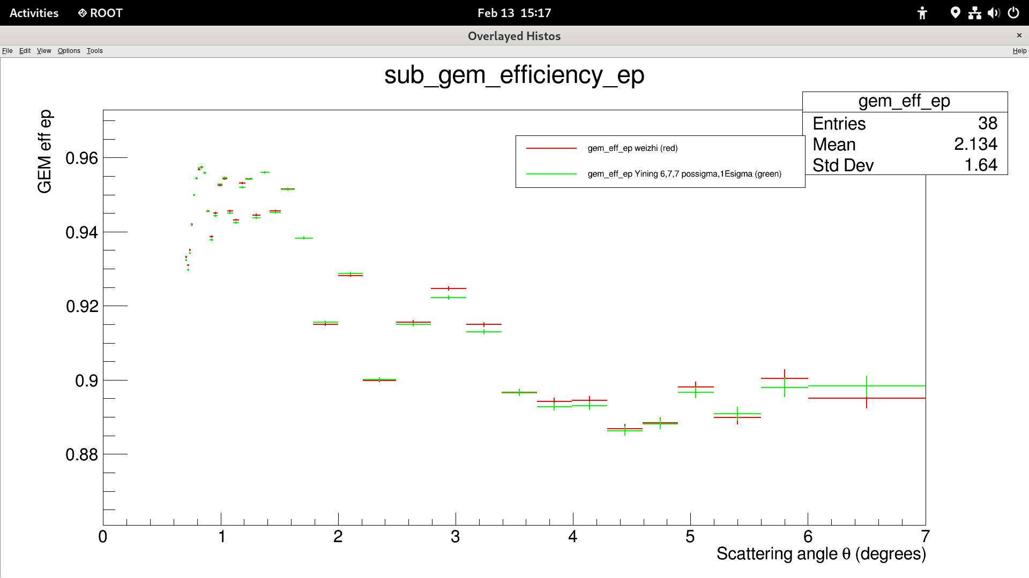

GEM Efficiency Study
e-e: 0.0498494 | RMS Value for difference between 2 sets(%) | e-p: 0.105699
Statistics: 100% Beam Energy: 2.143(GeV)

