Slide 1
Analysis of pion-SIDIS events with CLAS12 Data toward the Tensor TMDs Studies on Deuteron
Hector Chinchay
HUGS 2025 The 40th Annual Hampton University Graduate Summer Workshop at Jefferson Lab
May 27 – June 13, 2025

Slide 2
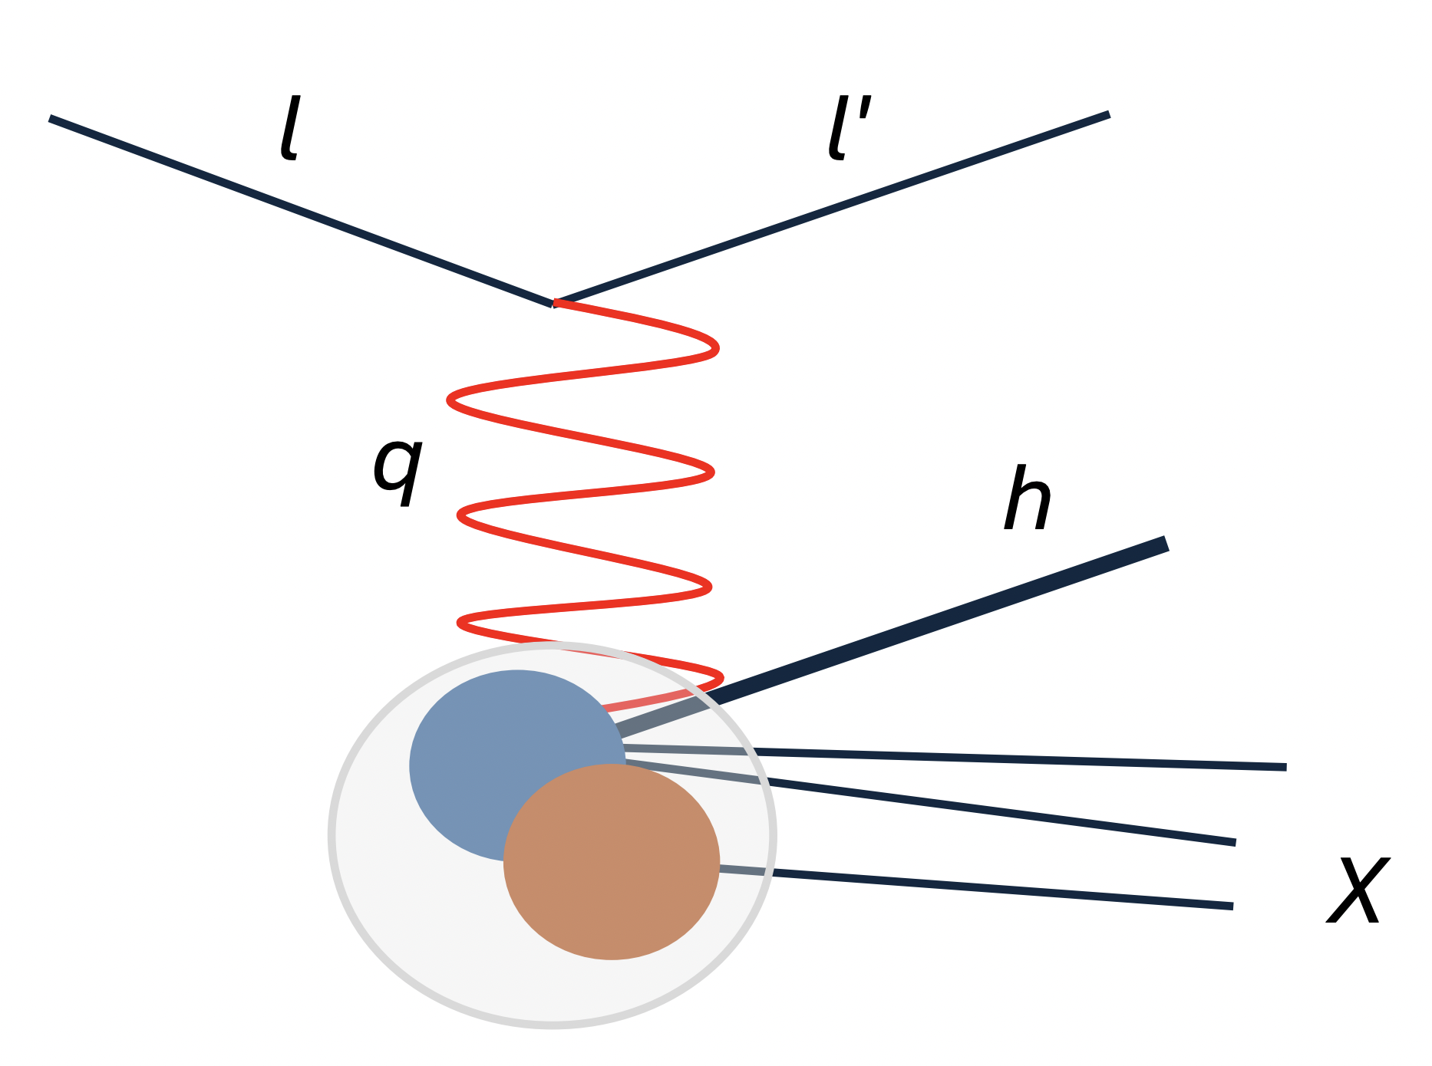
SIDIS (Semi-Inclusive Deep Inelastic Scattering)
An electron with momentum $l$ scatters off a deuteron target. In the final state, the scattered electron with momentum $l^{′}$ is measured together with one hadron $h$ ($π^{+}/π^{−}$) with momentum $P_{h}$.
$$π$$
$$e\left(l\right)+d\left(P_{d}\right) →e\left(l^{′}\right)+h\left(P_{h}\right)+X$$
SIDIS is a way to access TMDs.

Slide 3
Target Tensor polarization of deuteron
Spin-1/2 system splits into 2 energy levels in magnetic field (Zeeman effect)
m = +1/2 and -1/2 energy states with population $n_{+}$ and $n_{−}$
Vector polarization ${(S}_{||})=(n_{+}−n_{−})/(n_{+}+n_{−})$
Spin-1 system splits into 3 energy levels in magnetic field
m = +1 , 0 and -1 energy state with population $n_{+}$ , $n_{0}$ and $n_{−}$
Vector polarization ${(S}_{||})=(n_{+}−n_{−})/(n_{+}+n_{0}+n_{−})$
Tensor polarization ${(T}_{|| ||})=(n_{+}−n_{−}−{2n}_{0})/(n_{+}+n_{0}+n_{−})$
The spin system follows the Boltzmann distribution at thermal equilibrium, then
$$T_{|| ||}=2−\sqrt{4−3S_{||}^{2}}$$

Slide 4
Tensor TMDs
Considering longitudinal polarization only, we could express the differential cross-section for SIDIS as:
In this exploratory analysis, we will attempt to access the $F_{U\left(LL\right),T}^{ }$ and $F_{U\left(LL\right)}^{{cos2φ}_{h} }$structure functions, which provide access to the $f_{1LL}^{ }$ and $h_{1LL}^{⟘ }$ TMDs

Slide 5
How to extract Tensor structure functions
Total cross section
$${σ=σ_{U}+S}_{||}σ_{V}+T_{|| ||}σ_{T}$$
Vector polarization contribution suppressed with the data on both vector polarity of target.
Tensor part extracted from the linear fit of unpolarized + tensor polarized cross-section
$σ^{∗}=\left({ σ(h_{e}=0,S}_{||},T_{|| ||})+{σ(h_{e}=0,−S}_{||},T_{|| ||}) −2σ_{U} \right)$
Angular modulation to extract different tensor structure functions.
Poudel, J., Bacchetta, A., Chen, J.-P., & Santiesteban, N. (2025). Experimental study of tensor structure function of deuteron. The European Physical Journal A, 61(4), 1–8. https://doi.org/10.1140/epja/s10050-025-01558-w

Slide 6
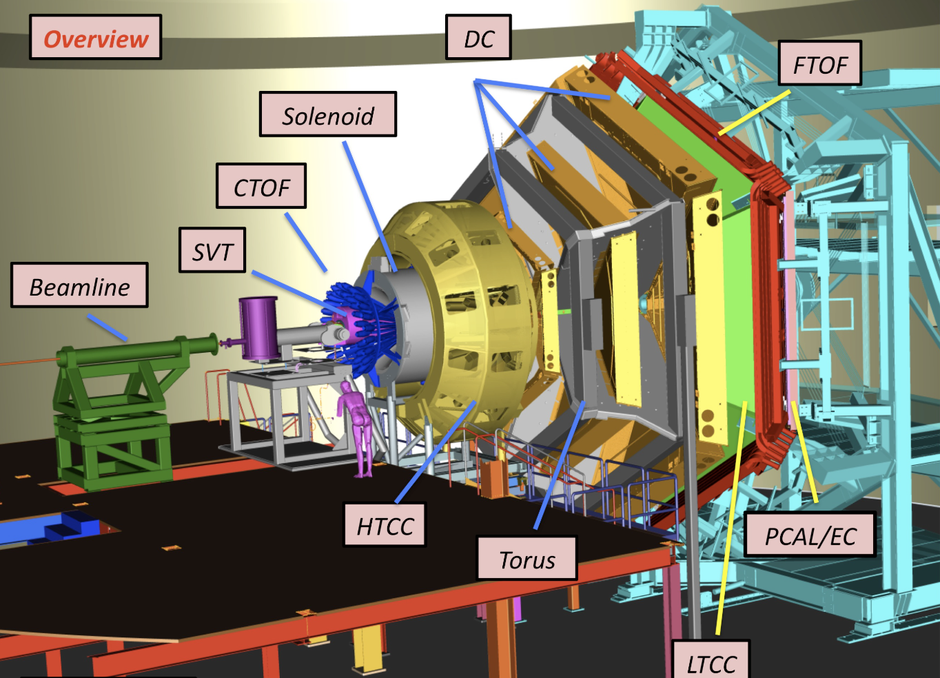
Clas12 detector
Central Detector (CD)
SVT: Silicon Vertex Tracker
CTOF: Central Time of Flight
HTCC: High Threshold Cherenkov Counter
DC: Drift Chamber
LTCC: Low Threshold Cherenkov
FTOF: Forward Time of Flight
PCAL/EC: Pre-Shower/Electromagnetic calorimeter
Forward Detector (FD)
We will analyze the data from the CLAS12 Run Group C (RG-C), which took data on longitudinally vector polarized deuteron target with polarized electron beams during 2022 and 2023.

Slide 7
Clas12 offline software – Event reconstruction
Event Builder: It has the last services in the reconstruction algorithm, and performs a series of functions
Particle Identification
For charged particles in the forward detectors, the Event Builder first assigns e-/e+ (11/-11) if a particle satisfies all corresponding HTCC and ECAL requirements (and has an associated FTOF hit):
2.0 photoelectrons in HTCC
60 MeV in PCAL
5-sigma cuts on a parameterized momentum-dependent sampling fraction
For charged particles with an associated TOF hit that don’t satisfy e-/e+ criteria, the Event Builder assigns p/K/$π$
(2212/321/211).
This is based purely on minimizing the difference between its vertex time and the event start time.
For pions is assigned $π^{+}/π^{−}$ (211/-211)

Slide 8
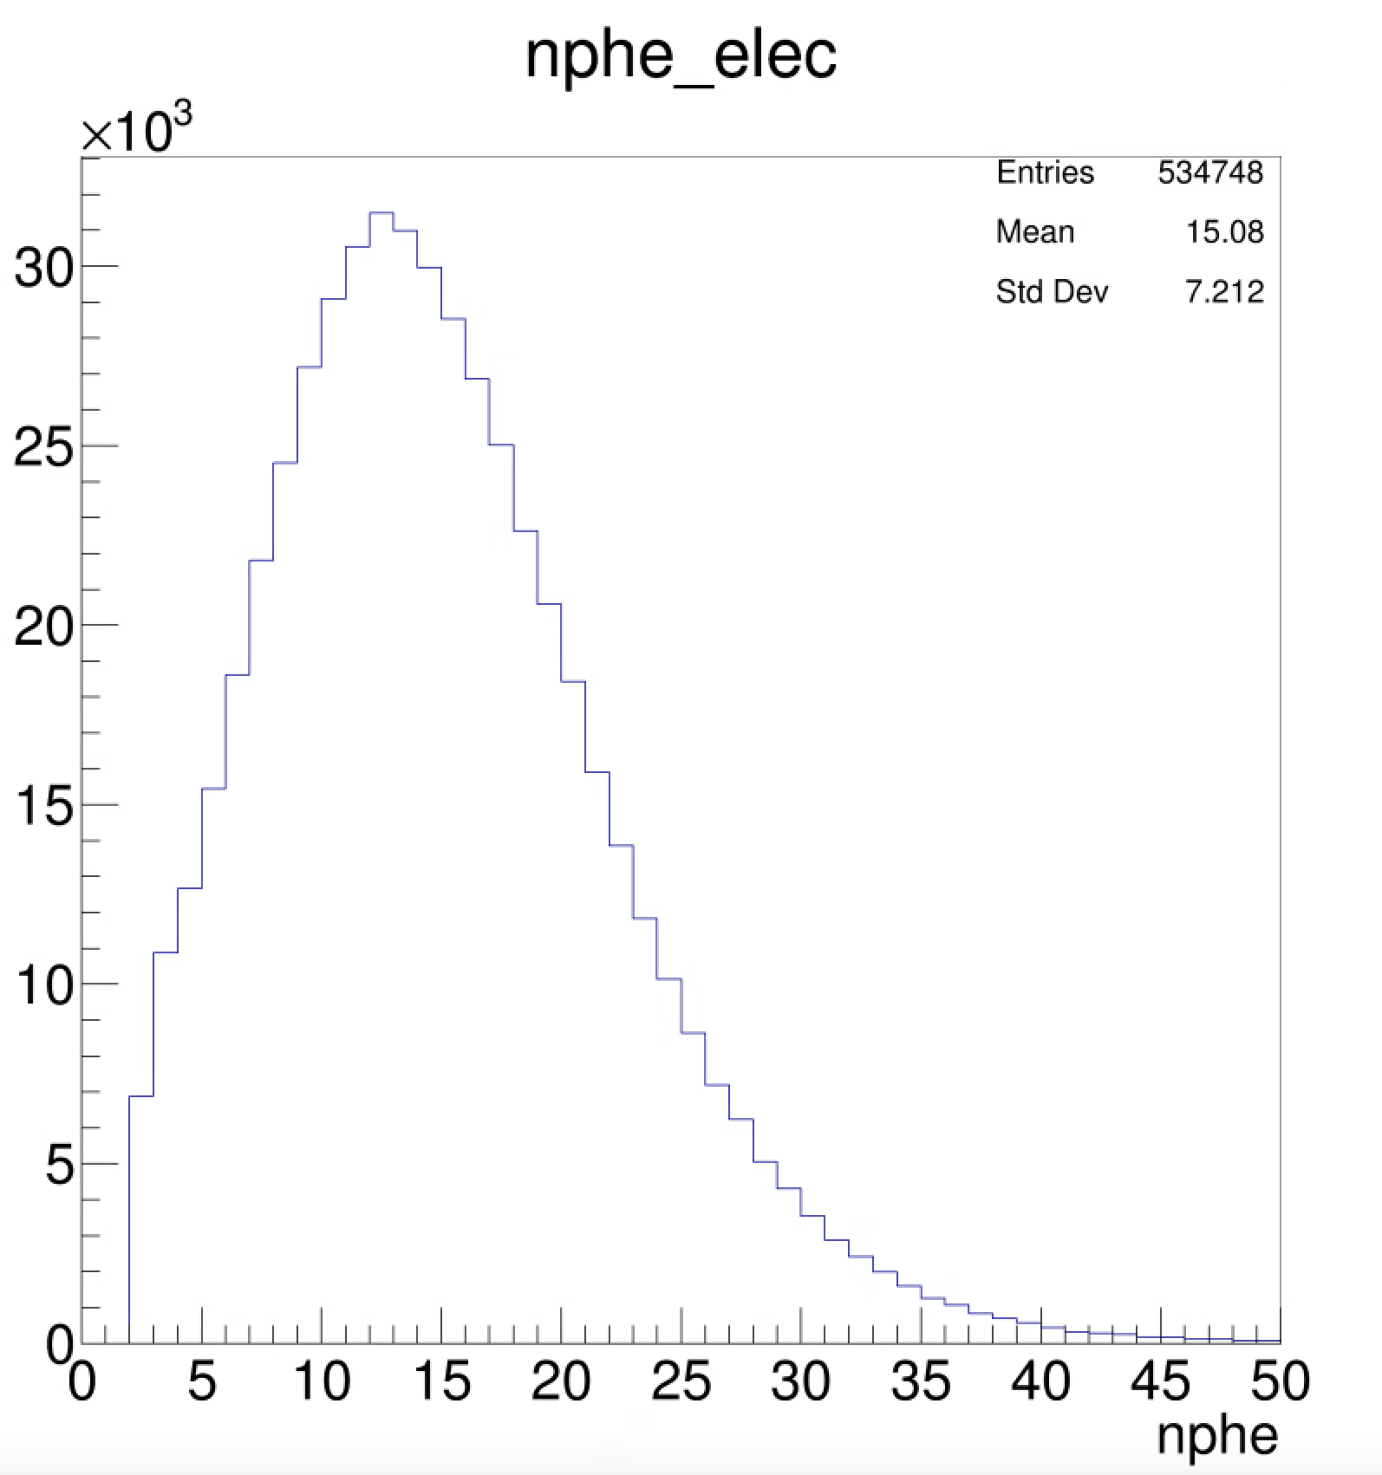
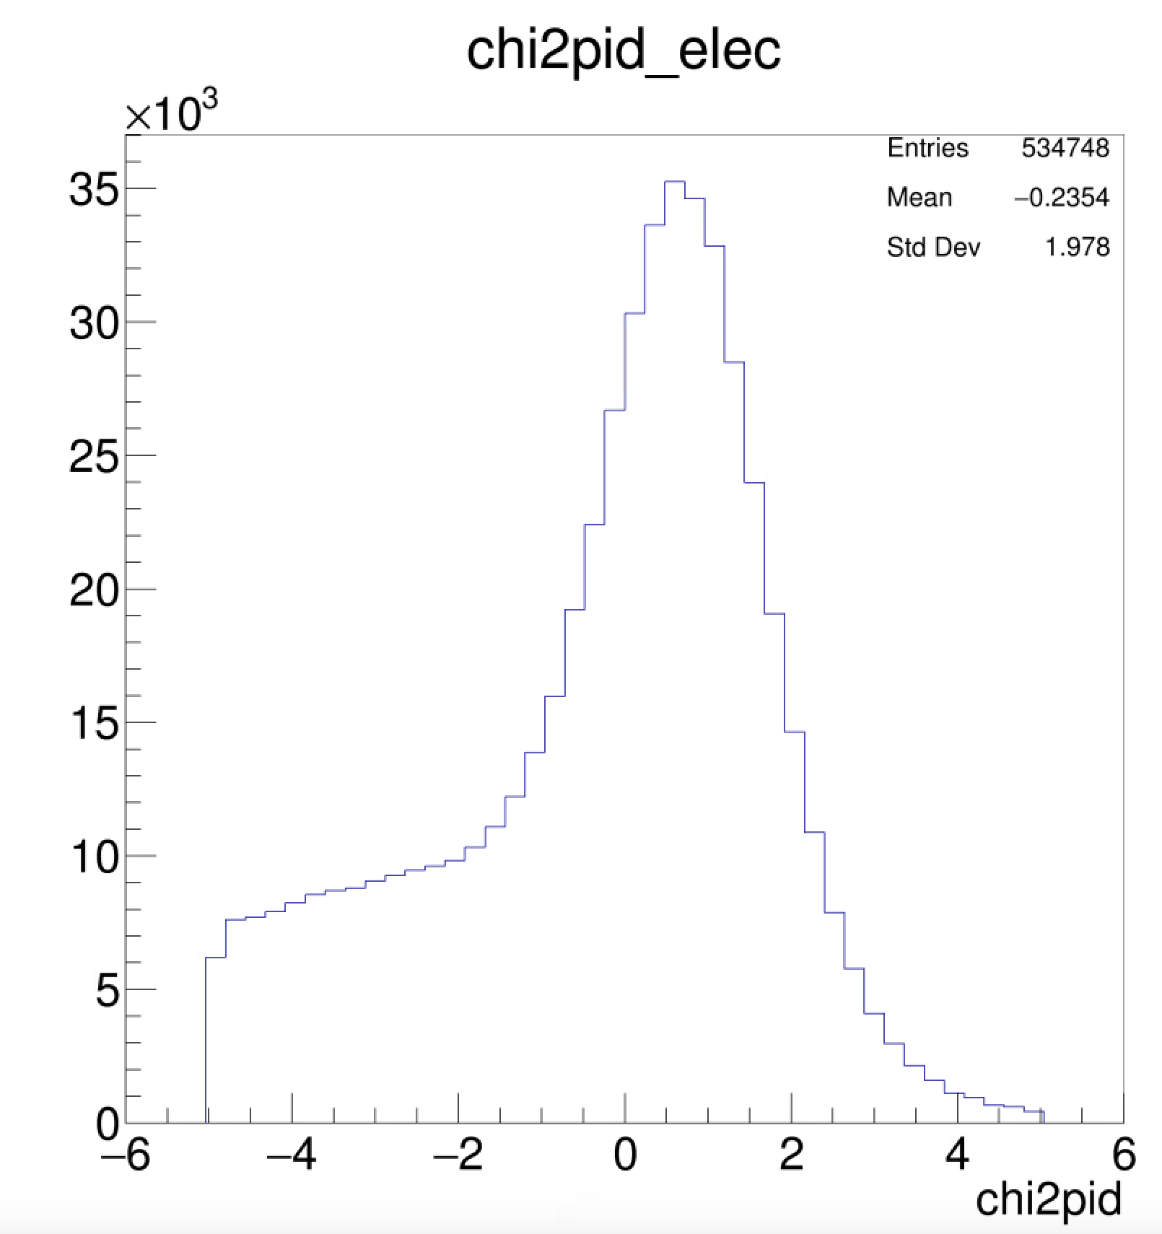
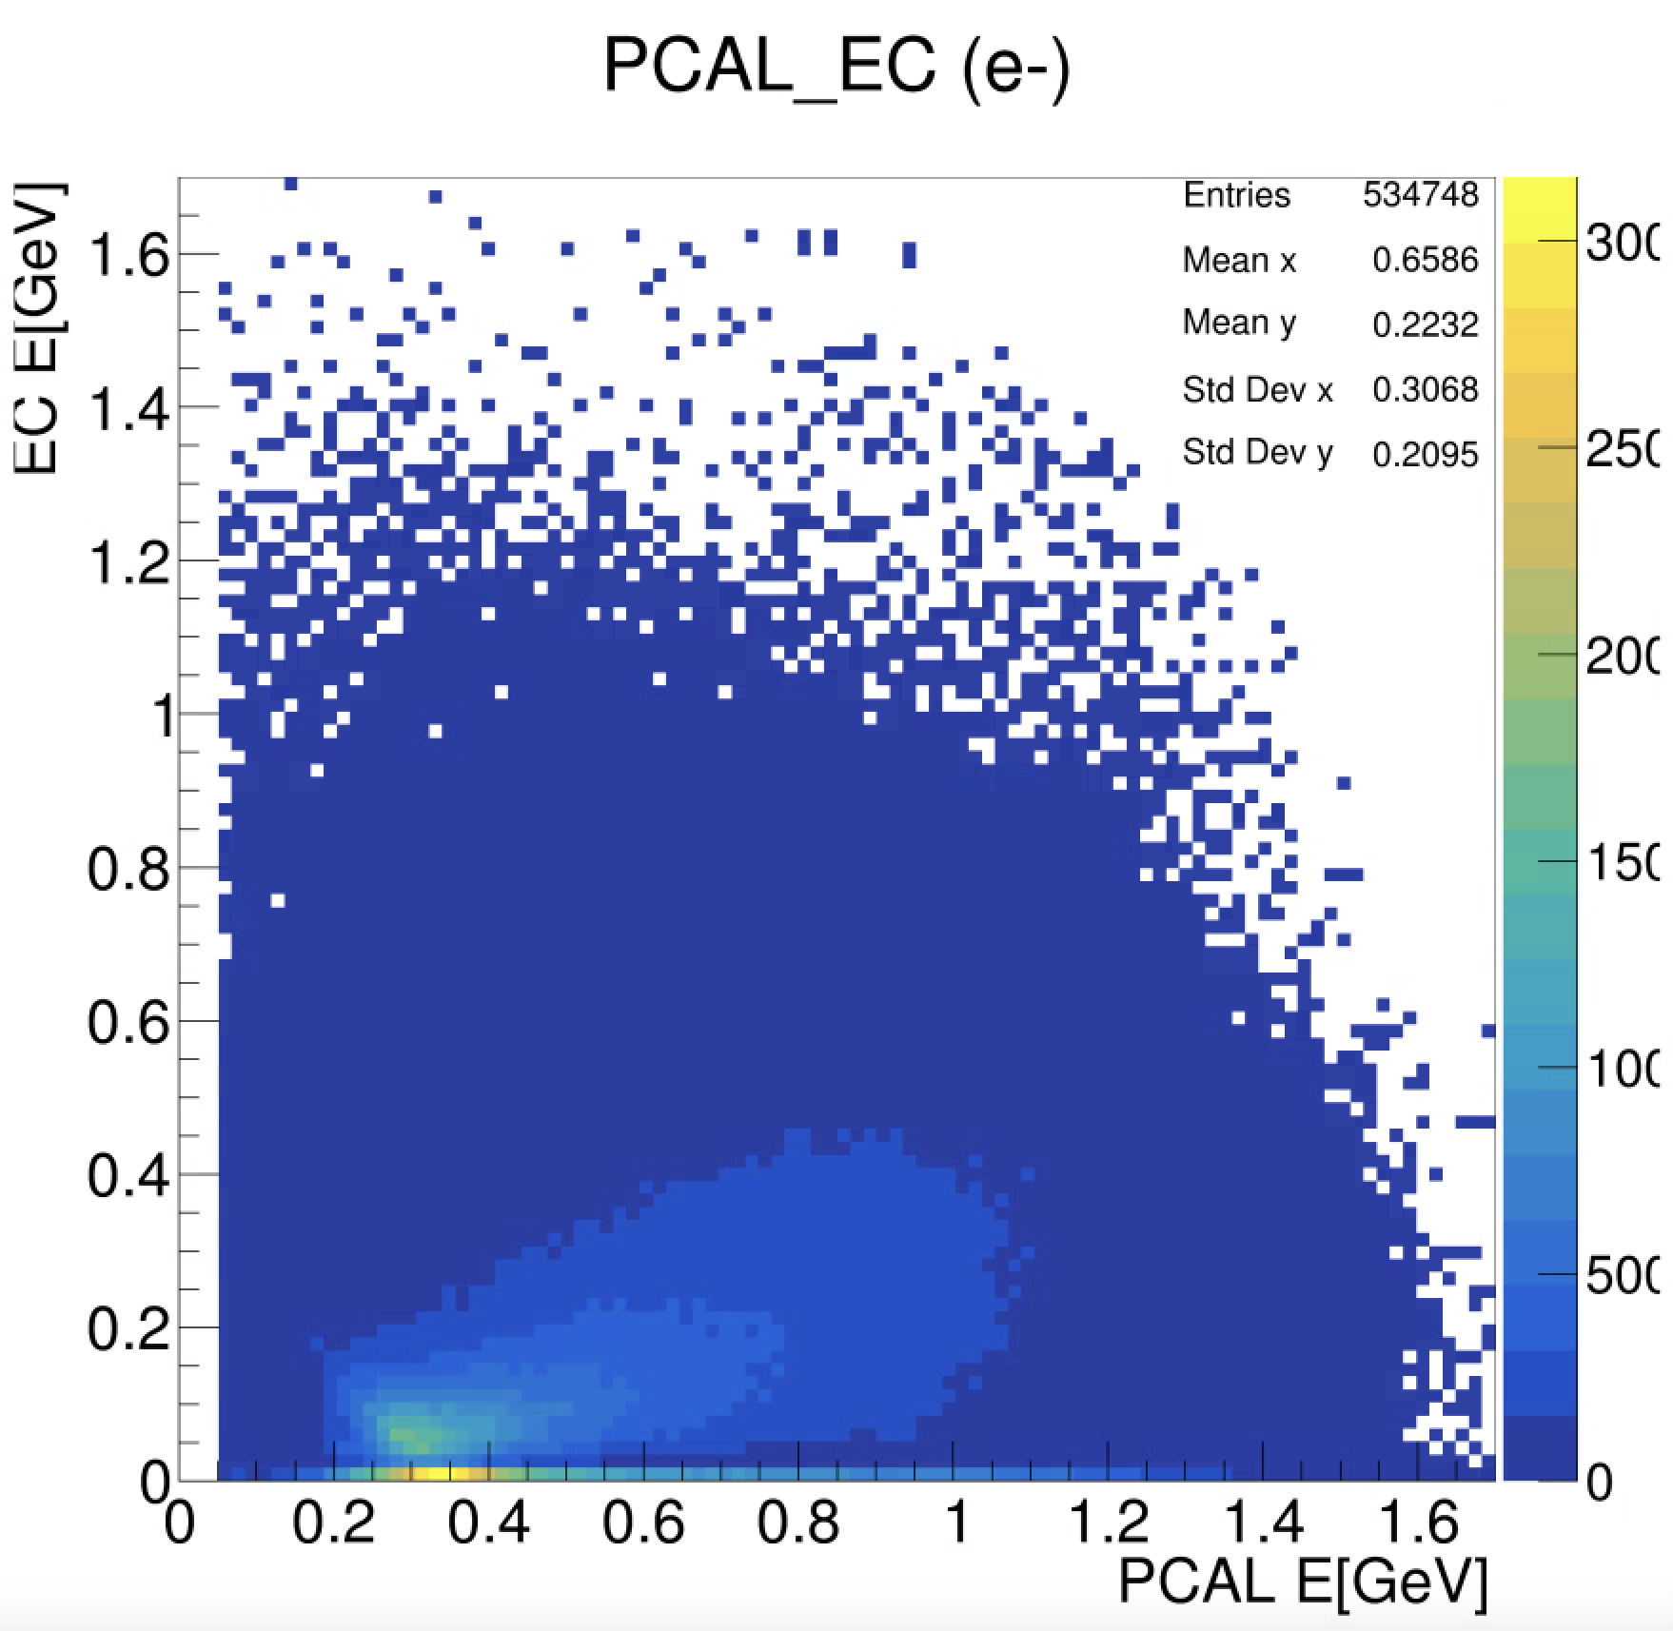
Electron distributions in CLAS12
1) 2.0 photoelectrons in HTCC
2) 60 MeV in PCAL
3) 5-sigma cuts on a parameterized momentum-dependent sampling fraction
Data from RGC Summer22 run number : 016401

Slide 9
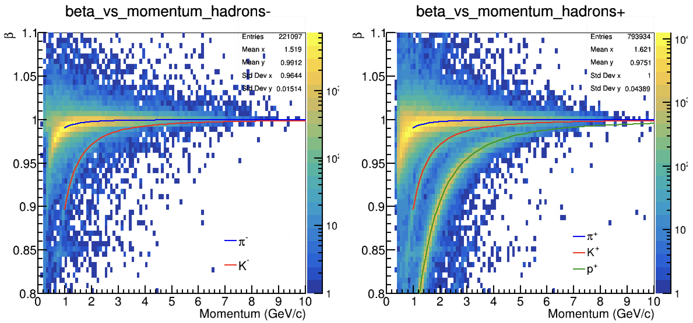
Hadron identification
$$β=\sqrt{\frac{p^{2}}{m^{2}+p^{2}}}$$
Data from RGC Summer22 run number : 016401

Slide 10
$π^{+}$ distributions in CLAS12
Data from RGC Summer22 run number : 016401

Slide 11
Quality cuts based on chi2pid
Electron Identification
PCAL + EC = ECAL
$$χ^{2}=\frac{{SF}_{meas}(E)−{SF}_{calc}(E)}{σ_{p}}$$
$$SF=\frac{E_{total}}{p}$$
$$σ_{p}:resolution of the sampling fraction$$
Hadron Identification
$$χ^{2}=\frac{Δt}{σ}$$
$$Δt:vertex time difference$$
$$σ:expected timing resolution$$

Slide 12
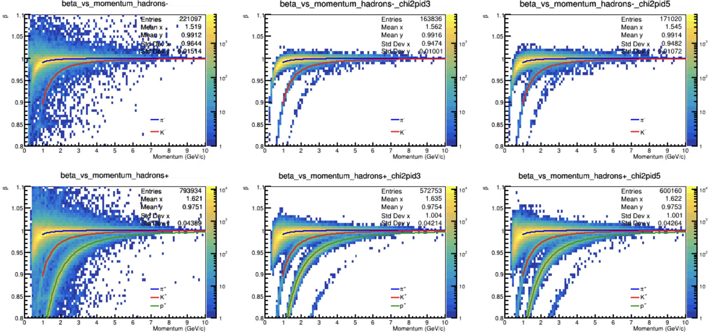
Quality cuts based on chi2pid - Hadrons
PID
PID

Slide 13
Remarks and future work!
An approach to refine the event builder PID has been developed.
Study kinematic distributions of Q², z, x_{B}, P_{T}.
Study with simulations.
Extract yields.
Perform full uncertainty analysis.
This analysis will enable the extraction of tensor structure functions of the deuteron, first ever via SIDIS analysis.

Slide 14
References
Poudel, J., Bacchetta, A., Chen, J.-P., Keller, D., Fernando, I., Long, E., Ruth, D., Santiesteban, N., & Slifer, K. (2025). Spin 1 transverse momentum dependent tensor structure functions in CLAS12. En arXiv [hep-ph]. http://arxiv.org/abs/2502.20044
Poudel, J., Bacchetta, A., Chen, J.-P., & Santiesteban, N. (2025). Experimental study of tensor structure function of deuteron. The European Physical Journal A, 61(4), 1–8. https://doi.org/10.1140/epja/s10050-025-01558-w
“RG-C Experiments.” https://clasweb.jlab.org/wiki/index.php/List_of_RGC_Experiments.
Ziegler, V., Baltzell, N. A., Bossù, F., Carman, D. S., Chatagnon, P., Contalbrigo, M., De Vita, R., Defurne, M., Gavalian, G., Gilfoyle, G. P., Glazier, D. I., Gotra, Y., Gyurjyan, V., Harrison, N., Heddle, D., Hobart, A., Joosten, S., Kim, A., Markov, N., … Ungaro, M. (2020). The CLAS12 software framework and event reconstruction. Nuclear Instruments & Methods in Physics Research. Section A, Accelerators, Spectrometers, Detectors and Associated Equipment, 959(163472), 163472. https://doi.org/10.1016/j.nima.2020.163472
Burkert, V. D., Elouadrhiri, L., Adhikari, K. P., Adhikari, S., Amaryan, M. J., Anderson, D., Angelini, G., Antonioli, M., Atac, H., Aune, S., Avakian, H., Gayoso, C. A., Baltzell, N., Barion, L., Battaglieri, M., Baturin, V., Bedlinskiy, I., Benmokhtar, F., Bianconi, A., … Ziegler, V. (2020). The CLAS12 spectrometer at Jefferson laboratory. Nuclear Instruments & Methods in Physics Research. Section A, Accelerators, Spectrometers, Detectors and Associated Equipment, 959(163419), 163419.
https://doi.org/10.1016/j.nima.2020.163419
contact: hectorch@jlab.org

