Slide 1
GEn-RP: Neutron Electric Form Factor Measurement at 4.4 GeV² via Charge-Exchange Recoil Polarimetry
Student presentation @HUGS 2025
Andrew Cheyne
a.cheyne.1@research.gla.ac.uk
updated 10/06/2025
Notes:
Or title like, pushing the form factor to high Q2

Slide 2
JLab Codenames
This talk
CLUE: ______________
GEn
Deuterium
GEp
Unpolarised target
EMFFs
TMDs
SBS
Hall B
CLAS12
Analysing Power
Polarised target
GPDs
P_{transverse}
Recoil-Polarisation
EIC
Charge-Exchange
Hall A
ECal
Hall D
P_{longitudinal}
Helium-3
GlueX
Bjorken-x
J/ψ
Andrew Cheyne – HUGS 2025
a.cheyne.1@research.gla.ac.uk

Slide 3
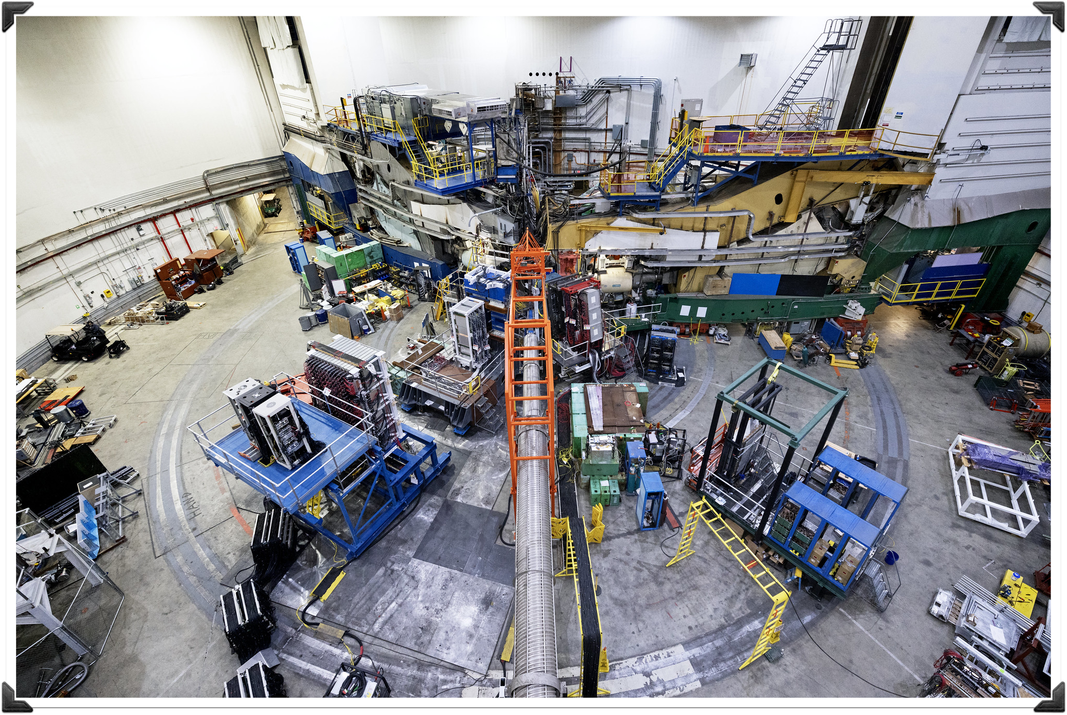
Talk Outline
GEn-RP:
Neutron Electric Form Factor Measurement at 4.4 GeV² via Charge-Exchange Recoil Polarimetry
Motivation
Form factors
SBS-program at Jefferson Lab
Double Polarisation method
Two-arm elastic experiments
The GEn-RP experiment
Experiment components
Recoil Polarimetry
Current Status
Detector calibrations
Asymmetry

Slide 4
Motivation
Form Factors and the SBS program at Jefferson Lab

Slide 5
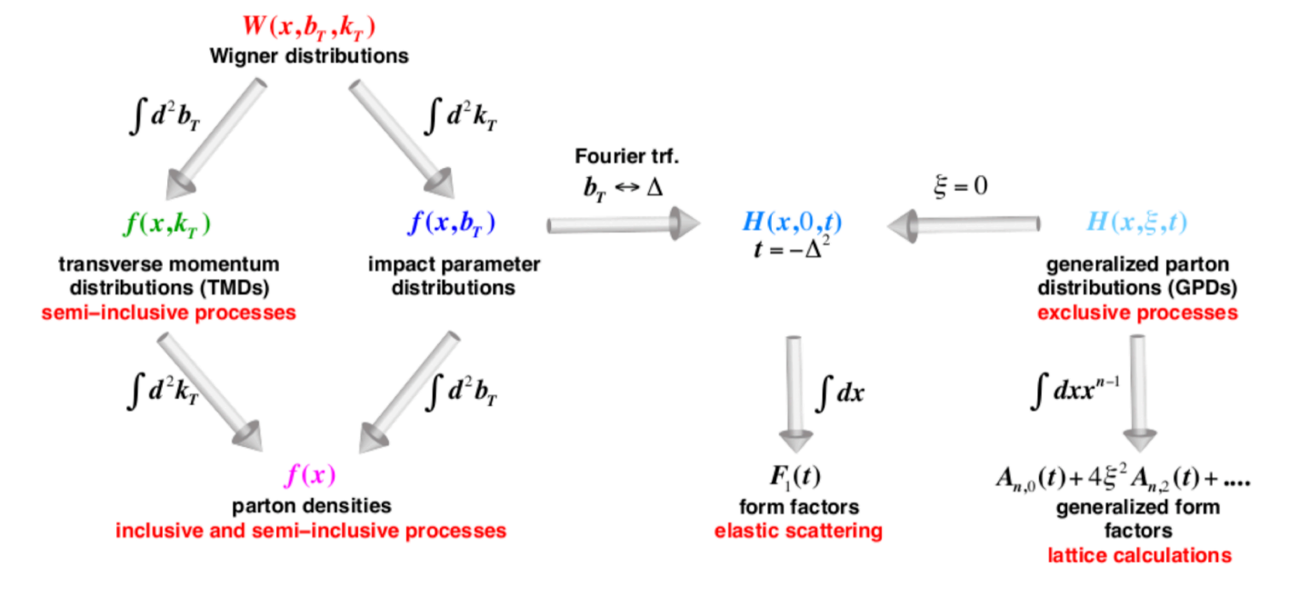
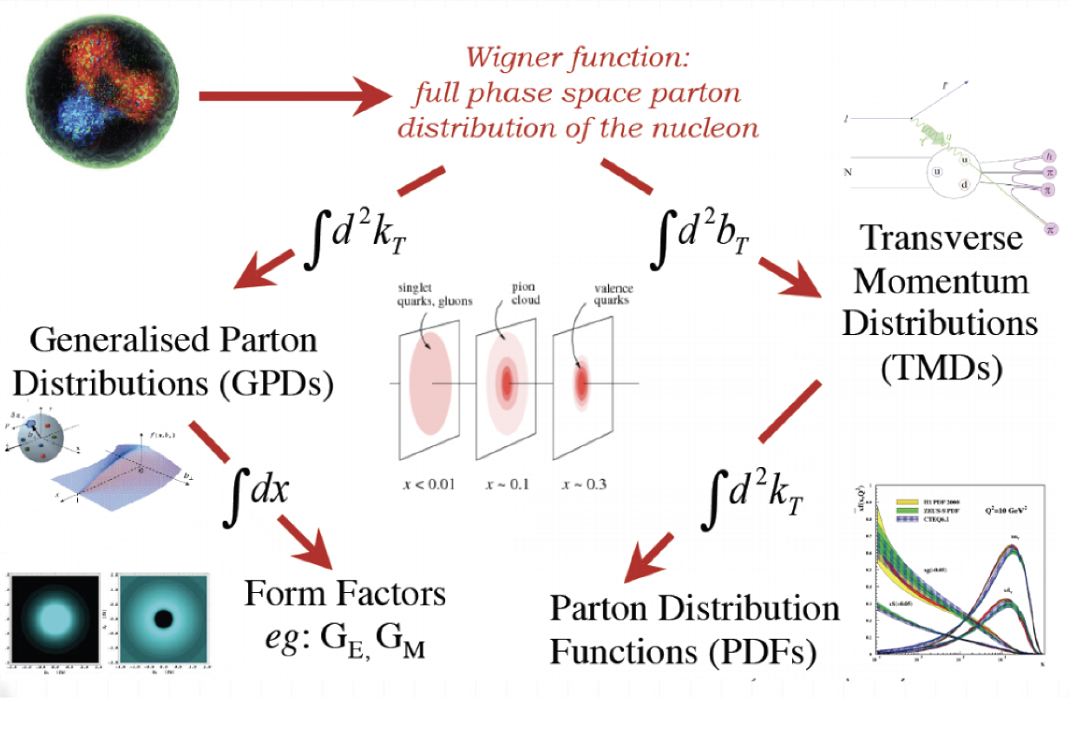
Motivation: Electromagnetic Form Factors (EMFFs)
Hadron structure landscape
A full description has two pillars of measurement:
Inelastic measurements → TMDs/PDFs(momentum,kt)
Elastic measurements → Form Factors (spatial,bt)
Commonly expressed as G_{E} and G_{M}.
These describe the electric and magnetic distribution inside the nucleon
W(x,k_{T}b_{T})
Notes:
Full 5D phase space
Relativstic so (x, bt, kt)
PDFs accessed via inclusive scattering (gives 1d x distribution of partons inside)
TMD via semi-inclusive (gives transverse as fn of x)
F1 and F2 encode information about the sub-structure of the hadron
In the background

Slide 6
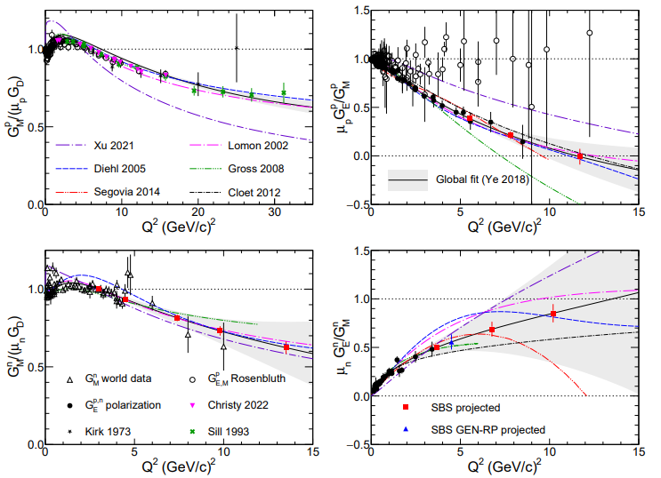
Motivation: Form Factors world data
Explanation of
Super BigBite Spectrometer (SBS) in Hall A at Jefferson Lab
GM
GE
Suite of experiments aiming to measure GMn, GEn, and GEp at high 4-momentum transfer (Q²)
A range of techniques for form factor extraction:
GMn – cross-section ratio measurement (run completed)
GEn-II – polarised He3 target (run completed)
GEn-RP – charge-exchange recoil polarimetry (run completed)
GEp-V – recoil polarimetry (running now)
Proton
Neutron
See Mahmoud Gomina talk Thu 10:15
Current world Form Factor data. Red/Blue points marks SBS predicted.
Credit: Andrew Puckett
Figure from “50 Years of QCD” (EPJ C, in press): https://arxiv.org/abs/2212.11107
Notes:
NEED to do:
Explanation about y-axis scales
Other experiments
nTPE
Why was GMn a cross section measurement?
All polarisation observable meansurements require large FOM = luminosity * polarisation *acceptance

Slide 7
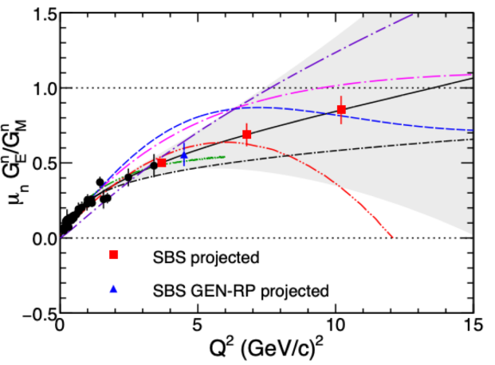
Motivation: Form Factors world data
Explanation of
Super BigBite Spectrometer (SBS) at Jefferson Lab
Suite of experiments aiming to measure GMn, GEn, and GEp at high 4-momentum transfer (Q²)
A range of techniques for form factor extraction:
GMn – cross-section ratio measurement (run completed)
GEn-II – polarised He3 target (run completed)
GEn-RP – charge-exchange recoil polarimetry (run completed)
GEp-V – recoil polarimetry (running now)
GE
Neutron
Lack of GEn information at higher Q2
Notes:
NEED to do:
Explanation about y-axis scales
Other experiments
NTPE (neutron two photon exchange)
No RP above 1.5 GEV2

Slide 8
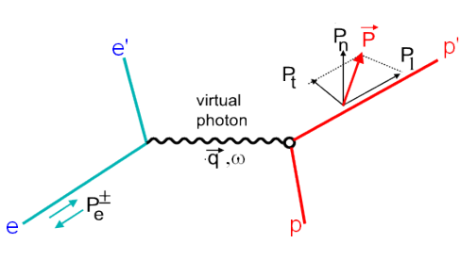
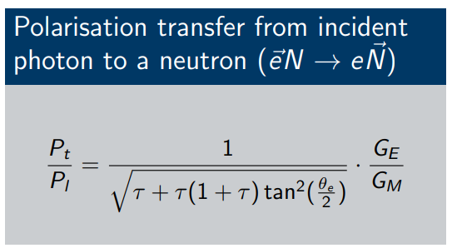
Motivation: Double polarisation
Extraction G_{E} through with a polarised electron beam
Measuring the transverse and longitudinal polarisations gives direct access to the EMFF ratio G_{E} / G_{M}.
More sensitive to G_{E} at large Q2 vs other methods.
N'
N
Polarisation transfer from a polarised electron to an unpolarised nucleon. Recoiling nucleon then has polarisation components Pt and Pl.
E12-17-004 PAC 45 proposal
$$\frac{P_{t}}{P_{l}}=\frac{1}{\sqrt{τ+τ(1+τ)\tan^{2}(\frac{θ_{e}}{2})}}\frac{G_{E}}{G_{M}}$$
Notes:
Advancements in polarised beam and targets allowed for a polarisation experiments.
Double polarisation method
2017 Bonner prize Perdrisat experiment
Nucleon-nucleon interaction is polarisation dependent.
Modern polarised beam and target advancements made it possible
By measuring Pt and Pl you can take the ratio and extract GE
Cancelling many of the systematics
Tau = q^2 /4M^2
Less sensitive to two-photon contributions than Rosenbluth separation method

Slide 9
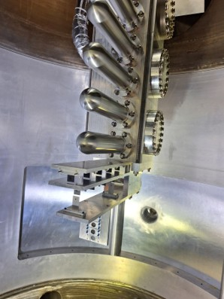
Motivation: SBS Experiments
Two-Arm spectrometers
Polarisation transfer from a polarised electron to an unpolarised nucleon. Recoiling nucleon then has polarisation components Pt and Pl.
View inside the target chamber.
Incoming beamline hole can be seen in the background.
Notes:
Double check these energy/q2 values
Measure GEn/GMn at Q2 = 4.4 (GeV/c)2 using charge-exchange recoil neutron polarimetry
Beam:
4.3 GeV/c Energy, Pbeam ~80%
30µA on a 15cm LD2 target
Compare F.O.M. for charge-exchange (np→ pn) scattering and the more standard (np→ np)
Demonstrate the feasibility of detecting low-energy recoil protons from an active analyser at large angles in an unshielded environment
Originally proposed to “piggy-back” on the GMn experiment at the 4.5 (GeV/c)2 kinematic

Slide 10
GEn-RP: SBS Experiments
Two-Arm spectrometers in Hall A
View inside the target chamber.
Incoming beamline hole can be seen in the background.
Notes:
Double check these energy/q2 values
Measure GEn/GMn at Q2 = 4.4 (GeV/c)2 using charge-exchange recoil neutron polarimetry
Beam:
4.3 GeV/c Energy, Pbeam ~80%
30µA on a 15cm LD2 target
Compare F.O.M. for charge-exchange (np→ pn) scattering and the more standard (np→ np)
Demonstrate the feasibility of detecting low-energy recoil protons from an active analyser at large angles in an unshielded environment
Originally proposed to “piggy-back” on the GMn experiment at the 4.5 (GeV/c)2 kinematic

Slide 11
GEn-RP: SBS Experiments
Two-Arm spectrometers
View inside the target chamber.
Incoming beamline hole can be seen in the background.
https://github.com/agcheyne/helpDocs/
Notes:
Double check these energy/q2 values
Measure GEn/GMn at Q2 = 4.4 (GeV/c)2 using charge-exchange recoil neutron polarimetry
Beam:
4.3 GeV/c Energy, Pbeam ~80%
30µA on a 15cm LD2 target
Compare F.O.M. for charge-exchange (np→ pn) scattering and the more standard (np→ np)
Demonstrate the feasibility of detecting low-energy recoil protons from an active analyser at large angles in an unshielded environment
Originally proposed to “piggy-back” on the GMn experiment at the 4.5 (GeV/c)2 kinematic

Slide 12
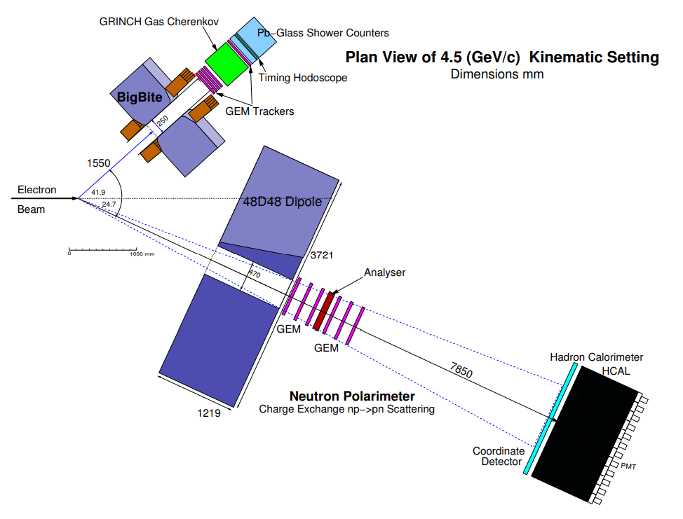
GEn-RP
Experiment Aim
Measure the ratio G_{E}^{n}/G_{M}^{n} at Q² 4.4 (GeV/c)² using recoil polarimetry.
Beam Energy (GeV) | Beam Current (µA) | Electron arm angle (°) | Electron Calorimeter dist. (m) | Q2 (GeV/C)² | Hadron arm angle (°) | Hadron Calorimter dist (m)
4.3 | 10-12 | 42.5 | ~1.5 | 4.4 | 24.7 | 9.0
Experiment schematic from GEn-RP proposal
(charge exchange only)
View inside the target chamber.
Incoming beamline hole can be seen in the background.
Lack of GEn information at higher Q2
Notes:
Double check these energy/q2 values
Measure GEn/GMn at Q2 = 4.4 (GeV/c)2 using charge-exchange recoil neutron polarimetry
Beam:
4.3 GeV/c Energy, Pbeam ~80%
30µA on a 15cm LD2 target
Compare F.O.M. for charge-exchange (np→ pn) scattering and the more standard (np→ np)
Demonstrate the feasibility of detecting low-energy recoil protons from an active analyser at large angles in an unshielded environment
Originally proposed to “piggy-back” on the GMn experiment at the 4.5 (GeV/c)2 kinematic

Slide 13
The GEn-RP experiment
Experiment setup, and recoil polarimetry

Slide 14
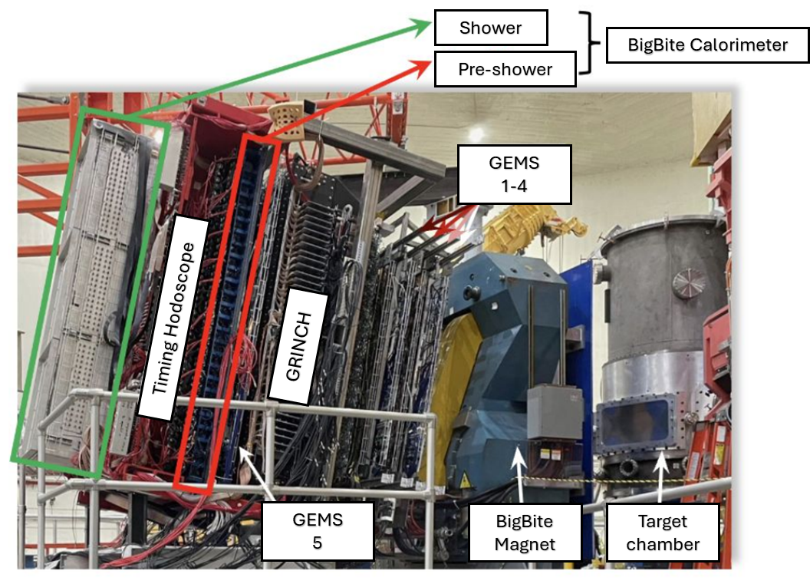
GEn-RP: Target chamber
Cryogenic Target Ladder
Moveable cryogenic target cells allows us to use multiple targets
No free neutron target → liquid deuterium (LD2),
Liquid Hydrogen (LH2),
other targets for calibration/alignment
Electron arm
Hadron arm
View inside the target chamber.
Incoming beamline hole can be seen in the background.
Notes:
As mention in lectures: need various calibration targets
(empyty)
(proton)
Aligment

Slide 15
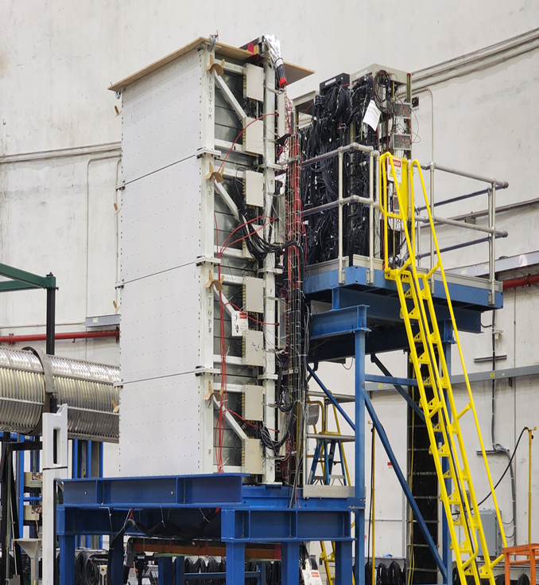
GEn-RP: Electron arm
BigBite spectrometer - kinematic and vertex reconstruction
BigBite magnet - deflects charged particle
5 layers of GEM trackers - track/momentum reconstruction
GRINCH - particle identification (PID)
Timing hodoscope - precision timing
BBCal (shower and pre-shower calorimeters) - energy
Electron arm
Hadron arm
Notes:
90-1 bars in hodo L/R pmt on each
bbcal: 241 PMTs
shower 27rows*7 col lead glass (8.5*8.5*34cm)
preshower 26*2col (9*9*29.5cm) rad hard lead glass

Slide 16
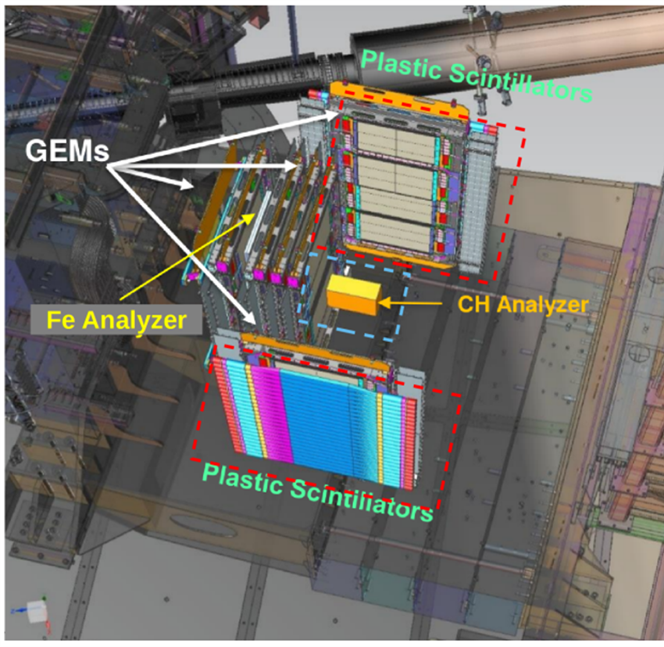
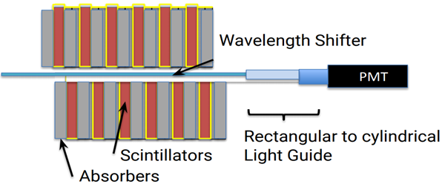
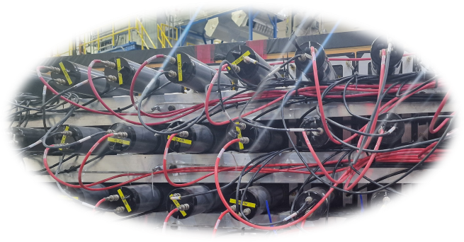
GEn-RP: Hadron arm
Hadron Calorimeter (HCal)
288 blocks of steel/scintillator in a 12col*24row grid.
Allows for:
Hadron energy,
Position reconstruction,
and timing.
Diagram showing layering inside a single block
Electron arm
Hadron arm
Notes:
each module is 40 layers
goes into wavelength shifter at the center of each module
lightguide -> PMT
48cm*122cm -> 1.8m * 3.6m
Hcal block and detector sizes:
Scint material?
Expectation​:
Time resolution ~1 ns​
Energy resolution ~30%​
Position resolution ~ 4cm​

Slide 17
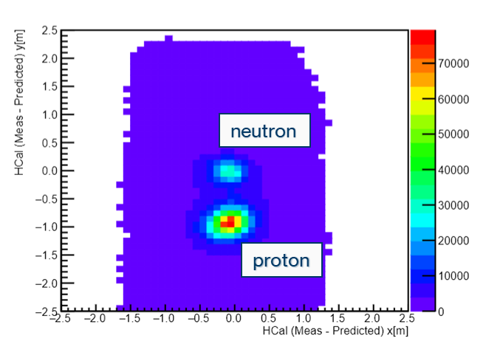
GEn-RP: 2 Arm Analysis
Δx/Δy
Information from both arms used for analysis
E.g. – proton/neutron event selection.
Electron arm
Hadron arm
Example of proton-neutron separation from Gen-RP
Notes:
each module is 40 layers
goes into wavelength shifter at the center of each module
lightguide -> PMT
Expectation​:
Time resolution ~1 ns​
Energy resolution ~30%​
Position resolution ~ 4cm​

Slide 18
GEn-RP: Hadron Polarimeter
2 Polarimeter packages
Charge Exchange (np→pn)
Removable steel plate analyser
sandwiched between 8 layers of GEMs
Wide-angle (np→np) scattering.
Active CH Analyser
side plane hodoscope
Not used
Electron arm
Hadron arm
The polarimeter for GEn-RP with both charge-exchange and wide-angle components..

Slide 19
Bonus: Recoil Polarimetry
Producing an asymmetry
N-N interaction in the analyser causes a spin-dependent deflection in secondary scattering distribution
$$p$$
$$S$$
- p X S
Electron arm
Hadron arm
$$F_{LS}=−\overset{^}{r} \frac{dU_{LS}\left(r\right)}{dr}r ∙\left(p ×S \right) − U_{LS}\left(r\right) p×S$$

Slide 20
Bonus: Recoil Polarimetry
Producing an asymmetry
N-N interaction in the analyser causes a spin-dependent deflection in secondary scattering distribution
Electron arm
Hadron arm
$$F_{LS}=−\overset{^}{r} \frac{dU_{LS}\left(r\right)}{dr}r ∙\left(p ×S \right) − U_{LS}\left(r\right) p×S$$
$$f(p,θ,φ)=\frac{ε(p,θ)}{2π}(1+A_{y}(p,θ)S_{y}cos(φ)−A_{y}(p,θ)S_{x}(sin(φ))$$

Slide 21
Bonus: Recoil Polarimetry
Producing an asymmetry
N-N interaction in the analyser causes a spin-dependent deflection in secondary scattering distribution
Electron arm
Hadron arm
$$F_{LS}=−\overset{^}{r} \frac{dU_{LS}\left(r\right)}{dr}r ∙\left(p ×S \right) − U_{LS}\left(r\right) p×S$$
$$f(p,θ,φ)=\frac{ε(p,θ)}{2π}(1+A_{y}(p,θ)S_{y}cos(φ)−A_{y}(p,θ)S_{x}(sin(φ))$$

Slide 22
Bonus: Recoil Polarimetry
Producing an asymmetry
N-N interaction in the analyser causes a spin-dependent deflection in secondary scattering distribution
S_{y}
S_{x}
y
θ
x
Φ
z
Electron arm
(p, θ, Φ)
Hadron arm
$$f(p,θ,φ)=\frac{ε(p,θ)}{2π}(1+A_{y}(p,θ)S_{y}cos(φ)−A_{y}(p,θ)S_{x}(sin(φ))$$

Slide 23
Bonus: Recoil Polarimetry
Producing an asymmetry
Scattered particle distribution be described as x/y sinusoidal terms in Φ
Results in a spin dependent asymmetry in Φ
Electron arm
Hadron arm
$$f(p,θ,φ)=\frac{ε(p,θ)}{2π}(1+A_{y}(p,θ)S_{y}cos(φ)−A_{y}(p,θ)S_{x}(sin(φ))$$

Slide 24
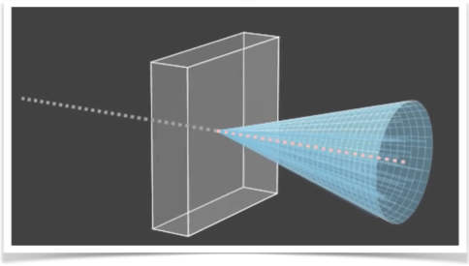
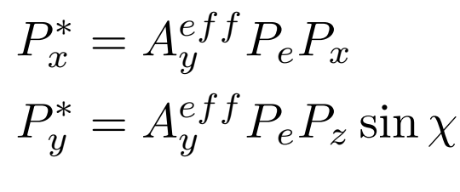
Bonus: Obtaining polarisation components
From the asymmetry
e⁻
e⁻
We measure both +/- beam helicity and take their difference to remove many false asymmetry contributions
Then the polarisation in x*,y* can be extracted
$$A = \frac{f^{+}−f^{−}}{f^{+}+f^{−}}={hA}_{y}{(P}_{x}^{∗} \sin{θ}−P_{y}^{∗}\cos{θ})$$
$$f(p,θ,φ)=\frac{ε(p,θ)}{2π}(1+A_{y}(p,θ)S_{y}cos(φ)−A_{y}(p,θ)S_{x}(sin(φ))$$

Slide 25
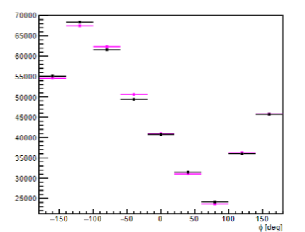
GEn-RP Polarimeter
Charge-exchange
HCal
Passive analyser sandwiched between layers of GEM charged particle trackers
Look for events where you have neutron into the analyser that undergoes charge exchange
Plot counts vs Φ angle
y
Neutron
x
Φ
Electron arm
Analyser
Proton
Hadron arm

Slide 26
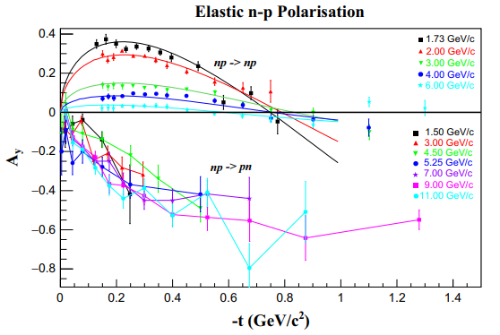
Why Charge-Exchange?
Charge-Exchange channel
Standard recoil-polarimetry becomes less effective at higher energies
Charge-exchange channel look to be the only viable method at larger energies.
First measurement of GEn using charge-exchange recoil polarimetry
Open the door to higher Q² measurements
Analysing power of recoil polarlimetry of the neutron. Credit: JINR Dubna
$$\frac{P_{t}}{P_{l}}=\frac{1}{\sqrt{τ+τ(1+τ)\tan^{2}(\frac{θ_{e}}{2})}}\frac{G_{E}}{G_{M}}$$
Notes:
One problem for recoil polarimetry is that as you increase the energy (different coloured data points)
The analysing power Ay (a measure of the ability for a polarimeter to seperate spin states) goes towards 0 for traditional np->np scattering
If we instead look at Charge-exchange np->pn scattering (where we measure a neutron in and proton out of our polarimeter) the analysing power seems to not show this drop off.

Slide 27
Current status
Calibrations, preliminary results, and future work

Slide 28
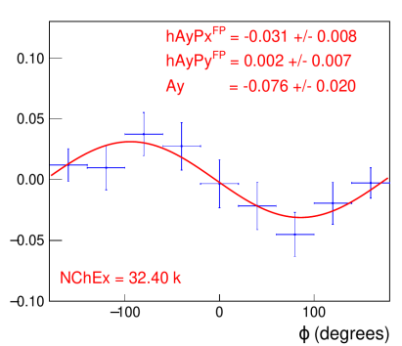
Current Status: Asymmetry from the Data
First look at the asymmetry
Plotting the difference in counts between +/- helicity states vs azimuthal angle.
fit with:
$f_{diff}(φ)=\frac{hA_{y}}{π}(P_{x}^{fpp}cos(φ)−P_{y}^{fpp}sin(φ))$
Analysis done during the experiment on the first ~70% of data shown on the right.
Charge-exchange channel shows the expected asymmetry in azimuthal distribution.
Plotting the difference in counts between +/- helicity states vs azimuthal angle.
fit with:
Analysis done during the experiment on the first ~70% of data shown on the right.
Charge-exchange channel shows the expected asymmetry in azimuthal distribution.
$$A = \frac{f^{+}−f^{−}}{f^{+}+f^{−}}={hA}_{y}{(P}_{x}^{∗} \sin{θ}−P_{y}^{∗}\cos{θ})$$
Preliminary
Plot credit to David Hamilton.
Notes:
• Neutron transverse polarization component Pt = 0.13 • Neutron longitudinal polarization component Pl = 0.79
Expected Analysing power used in simulations was 0.07

Slide 29
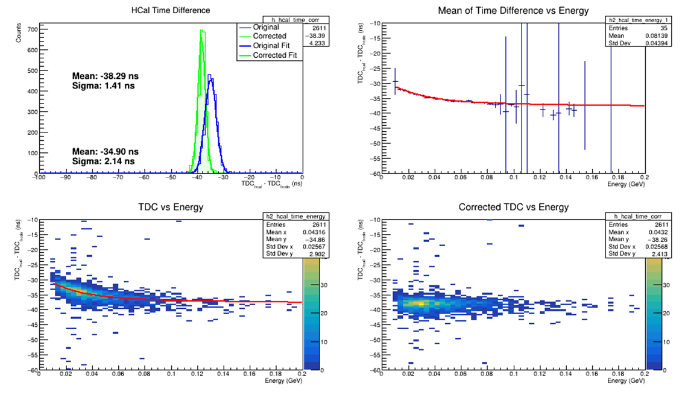
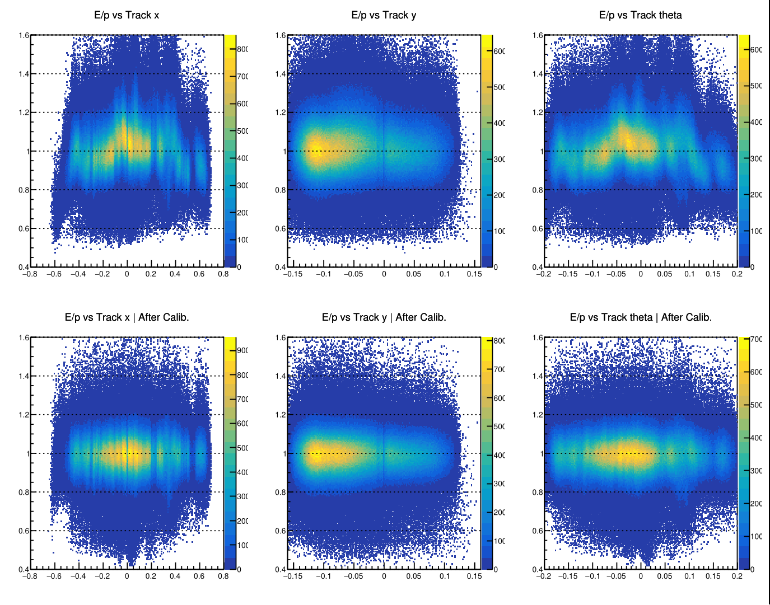
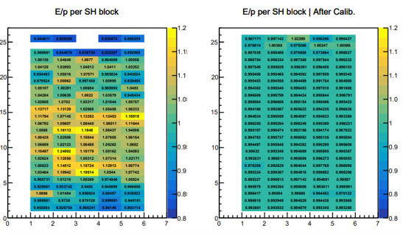
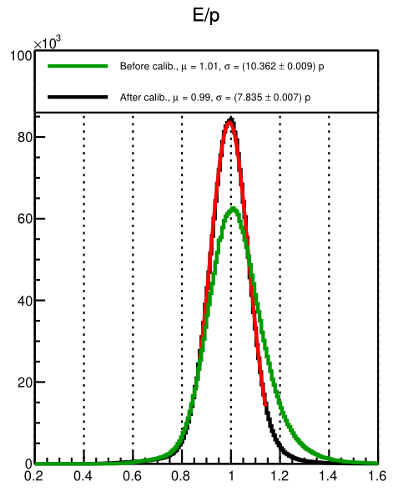
Current Status: Detector Calibrations
Both arms need kinematic specific calibrations
Timing Calibrations
Energy calibrations
Remove timewalk and alignment effects due to difference in individual detector components (e.g. cable length, scintillation speed)
PMT-gain matched against reconstructed particle momentum
Example Bigbite E/p resolution improved by ~10% -> ~7% across all runs
Map of average block E/p for preshower showing more uniform distribution after calibrations
Example of timewalk correction for an individual PMT of the hadron arm calorimeter.
Notes:
Looking to ensure uniformity across the detector and track variable.

Slide 30
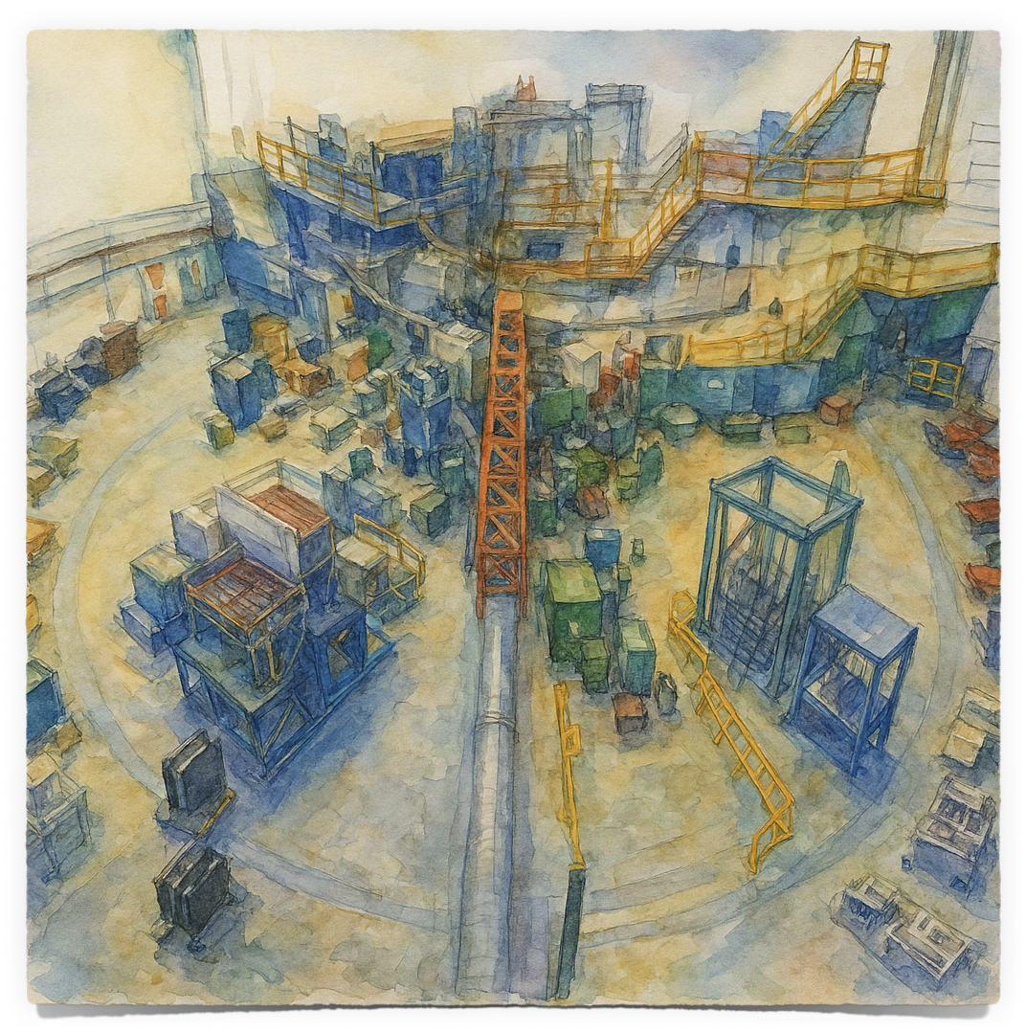
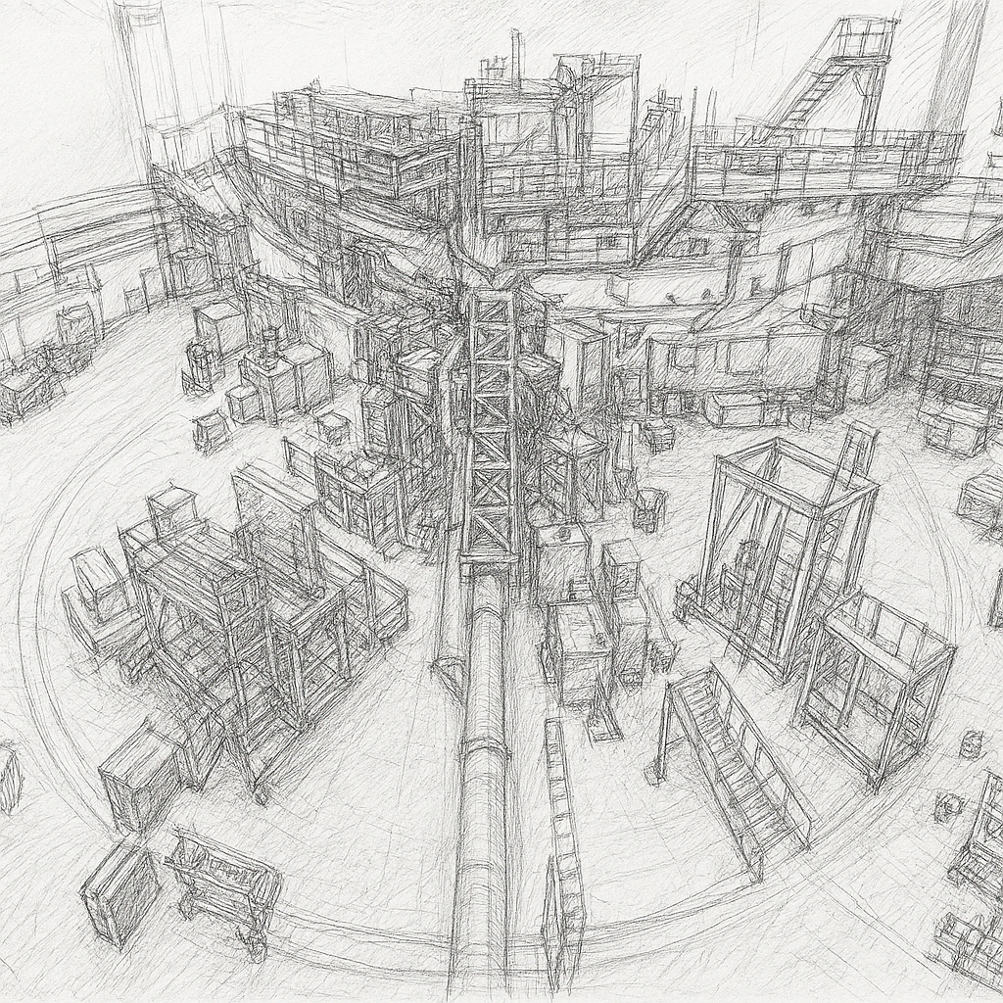
Summary
SBS program
SBS taking new FF data at high Q2
Particularly needed for the Neutron
The GEn-RP experiment
Successfully took data April-May 2025
Asymmetry is showing but needs work
Future
Calibrations well underway
Hope to show charge-exchange double polarisation is the method for the future

Slide 31
Thank you
PhD Supervisors: David Hamilton, and Rachel Montgomery
Experiment spokespersons: David Hamilton, Michael Kohl, Andrew Puckett, William Tireman, Bogdan Wojtsekhowski
GEn-RP students: Bhasitha Dharmasena, and Saru Dhital
SBS Collaboration: Jiwan Poudel, Provakkar Datta, Gerry Penman…
University of Glasgow NHP group
Many more…

Slide 32
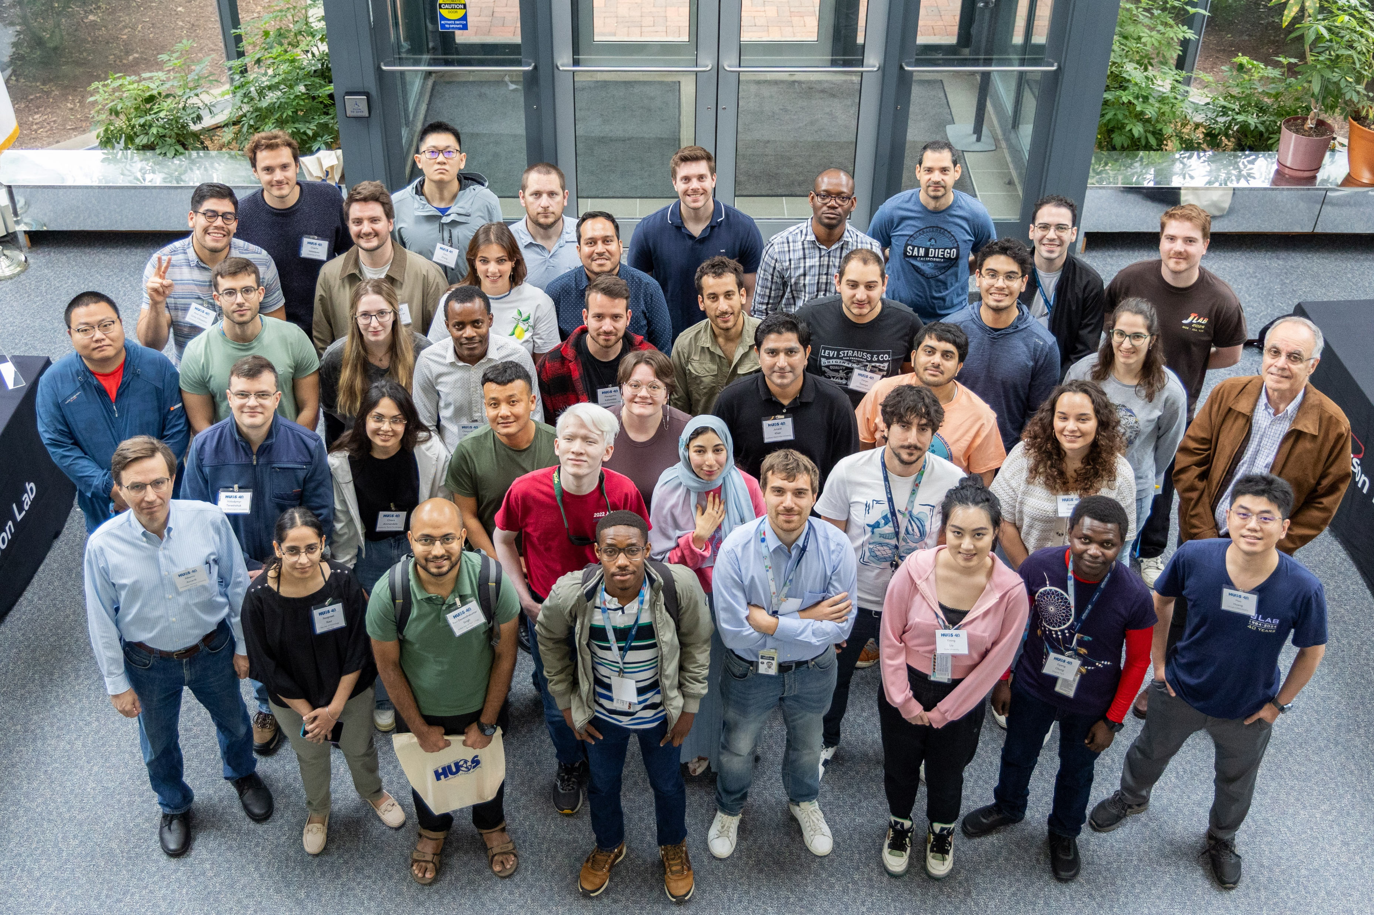
Thank you
Any questions?
Thank you

Slide 33
JLab Codenames - ANSWERS
This talk, 10
CLUE: ______________
GEn
Deuterium
GEp
Unpolarised target
EMFFs
TMDs
SBS
Hall B
CLAS12
Analysing Power
Polarised target
GPDs
P_{transverse}
Recoil-Polarisation
EIC
Charge-Exchange
Hall A
ECal
Hall D
P_{longitudinal}
Helium-3
GlueX
Bjorken-x
J/ψ
Andrew Cheyne – HUGS 2025
a.cheyne.1@research.gla.ac.uk

Slide 34
Backups
Other things

Slide 35
Summary
Charge-Exchange channel
The SBS: GEn-RP successfully took data in April-May 2024
First experiment to measure GEn using recoil polarimetry at high Q²
Charge-Exchange channel has been the main focus
Initial plots show asymmetry without specific calibrations
Calibrations are well underway with 1st full data replay expected soon
$$\frac{P_{t}}{P_{l}}=\frac{1}{\sqrt{τ+τ(1+τ)\tan^{2}(\frac{θ_{e}}{2})}}\frac{G_{E}}{G_{M}}$$
Notes:
One problem for recoil polarimetry is that as you increase the energy (different coloured data points)
The analysing power Ay (a measure of the ability for a polarimeter to seperate spin states) goes towards 0 for traditional np->np scattering
If we instead look at Charge-exchange np->pn scattering (where we measure a neutron in and proton out of our polarimeter) the analysing power seems to not show this drop off.

Slide 36
Form facpt
Slide Credit: Andrew Puckett @EINN2023
APuckett - EINN2023

Slide 37
Proton FF data
Rosenbluth vs Polarisation
Proton data using Polarisation Transfer disagrees with Rosenbluth separation method
Rosenbluth relies on a one photon approximation
Radiative corrections do not account for hard two-photon-exchange
Figure from PRC 96, 055203 (2017)

Slide 38
Polarisation components

Slide 39
Backup – experimental assumptions
Expected QE rate Assumptions:
BigBite solid angle dΩ = 47 msr
Luminosity Len = 5.3 × 1036 cm−2 s −1µA−1
Neutron electric form factor Gn E = 0.0073 (Alberico 2009)
Neutron magnetic form factor Gn M = 0.035 (Alberico 2009)
QE cross section dσ/dΩ = 7.7 × 10−36 cm2 sr−1
Polarimeter analyzing power (ChEx)Ay = 0.07
Polarimeter efficiency (ChEx) ϵ = 0.05
Polarimeter figure of merit (ChEx) F 2 = 2.5 × 10−4
Electron beam polarization Pe = 0.8
Expectations:
QE rate = 1.9 Hz µA−1
Neutron transverse polarization component Pt = 0.13
Neutron longitudinal polarization component Pl = 0.79

Slide 40
Systematic Uncertainties - <3% predicted
Error Budget
Beam polarisation (negligible)
Analysing Power
Azimuthal angle acceptance non-uniformity
Variations in magnetic field. Neutron path reconstruction (to correct magnetic field non-uniformity [Pz->Px mixing])
Variation in the angle of spin precession
Dilution of asymmetry by accidental background (subtracted without significant error)
Contamination of quasi-elastic by inelastic processes. Cleaner than 3He. 1.5% based on MC calc.
Notes:
Beam polarization estimated at 80%, can get from Moller measurements during run
Analysing power uncertainty cancels by taking the Px/Py ratio, assuming Ay is the same for x or y components. Simulations do not show any variation, estimate a max size of error on this is ~1%
Azimuth acceptance non-uniformity. Helicity flip and precession angle reversal to account for this. Only did 1.. MC simulations consistent with this and limits the size to a max of ~1%
Magnetic field. Measuring Px and Pz(Pz->Py) at the same time avoids this. Non uniformity can result in Pz->Px mixing. We use neutron hit position on the analyzer to reconstruct the neutron path through the dipole and can be corrected with overall uncertainty of 1%
Spin precession revesal reproduction??
Variation of angle of spin precession through dipole – path can be reconstructed such that can be corrected event by event. Uncertainty 0.25%
Vertical distribution of counting rates. Helicity flip and (NOT) dipole flip helps to remove significant effects.
Dilution of asymmetry by accidental background. Background estimated at 1% level, subtracted without significant error.
Inelastic contamination. Cleaner rejection than He3, MC calcs estimate ~1.5%.
Overall expect 3% systematic error or better.

Slide 41
Experimental Precision
Error Budget
Expected electron beam polarisation
Acceptance of BB and polarimeter for QW 2H(e,e’n)
Detection efficient and acceptance of polarimeter
Analysing power -> FOM -> Polarisation uncertainty.
Counting rate and polarisation uncertainty are based on estimates of elastic cross section and polarisation use Galster and Kelly parameterisation. For Gen and GMn respective. Weak dependence on estimated precision.

Slide 42
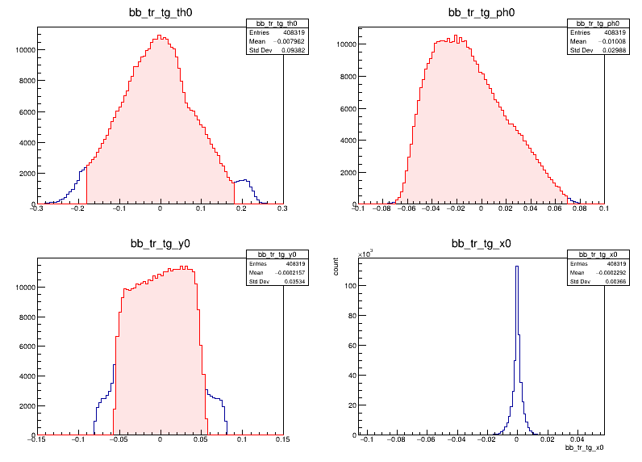
Event selection
Fiducial cuts
Fiducial cuts
Quasi-elastic cuts
Δy/Δx
Track veto
Pion cuts

Slide 43
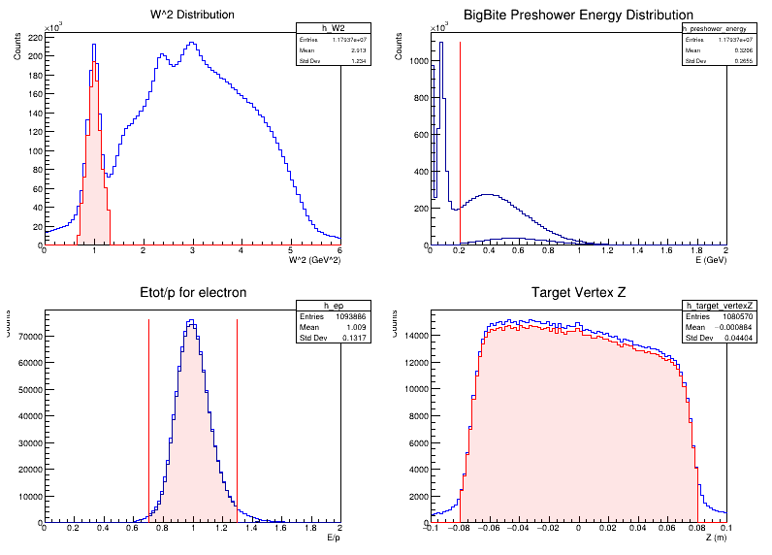
Event Selection
Quasi-elastic cuts
Fiducial cuts
Quasi-elastic cuts
Δy/Δx
Track veto
Pion cuts

Slide 44
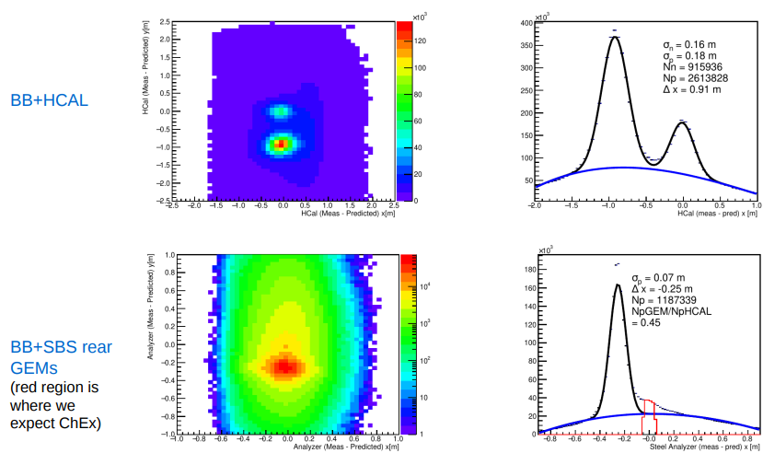
Event Selection
Δy/Δx
Fiducial cuts
Quasi-elastic cuts
Δy/Δx
Track veto
Pion cuts

Slide 45
Event Selection
Track Veto
Fiducial cuts
Quasi-elastic cuts
Δy/Δx
Track veto
Pion cuts
Plot credit to Bhasitha Dharmasena

Slide 46
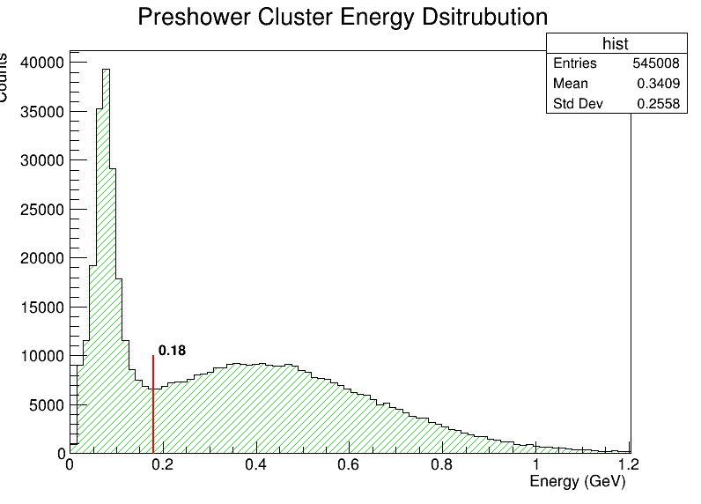
Event Selection
Pion cut (preshower)
Fiducial cuts
Quasi-elastic cuts
Δy/Δx
Track veto
Pion cuts

Slide 47
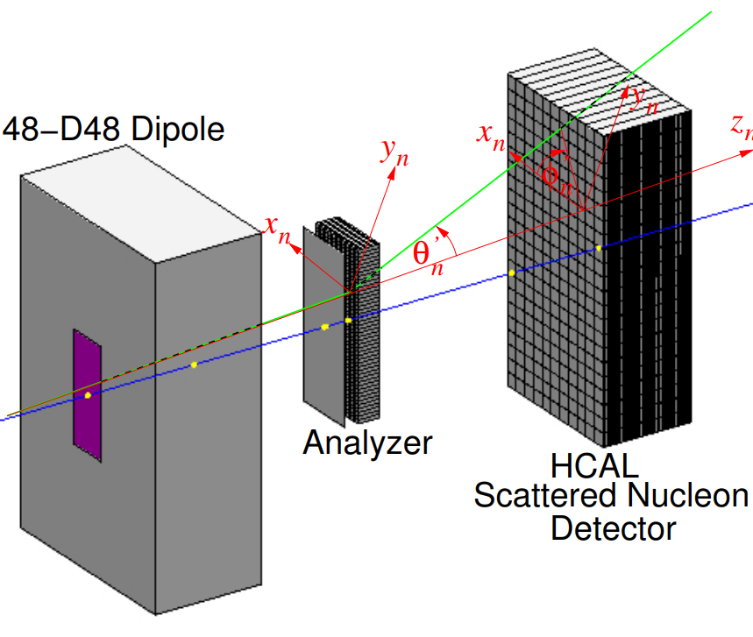
Hadron arm
Analysis
HCal dy/dx
Nucleon-nucleon interaction in the analyser causes a deflection
The azimuthal distribution of outgoing nucleon is then asymmetric due to this spin dependent deflection

Slide 48
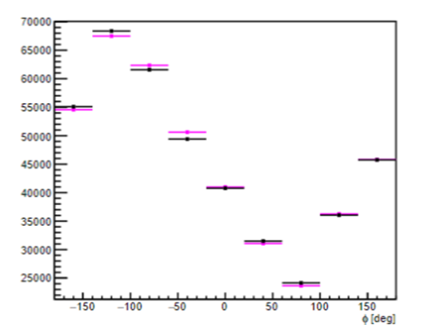
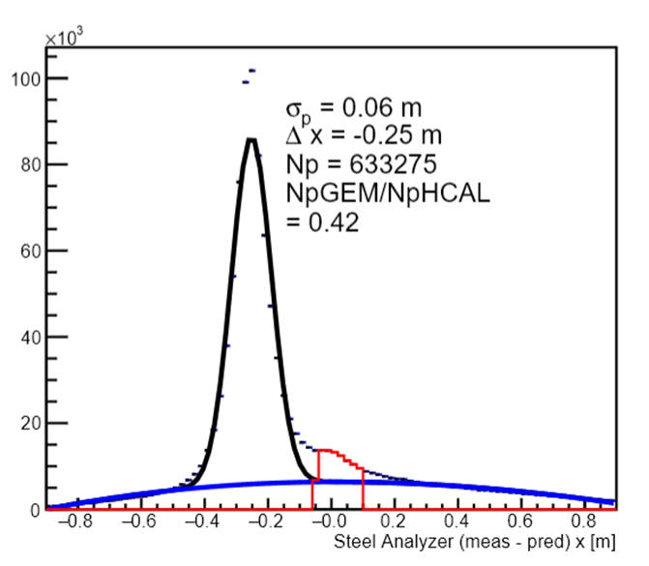
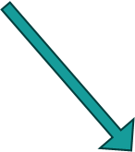
Preliminary Checks
Plot credit to David Hamilton.

Slide 49
Recoil asymmetry
$$F_{LS}=−\overset{^}{r} \frac{dU_{LS}\left(r\right)}{dr}r ∙\left(p ×S \right) − U_{LS}\left(r\right) p×S$$
The deflecting force arising from the spin-orbit potential gives rise to an azimuthal asymmetry
Andrew Cheyne - GEn-RP seminar

Slide 51
Recoil asymmetry
$$F_{LS}=−\overset{^}{r} \frac{dU_{LS}\left(r\right)}{dr}r ∙\left(p ×S \right) − U_{LS}\left(r\right) p×S$$
1st term is always directed radially but magnitude scaled by projection onto p x S
2nd term always reinforces this
Andrew Cheyne - GEn-RP seminar

Slide 52
Recoil asymmetry
$$F_{LS}=−\overset{^}{r} \frac{dU_{LS}\left(r\right)}{dr}r ∙\left(p ×S \right) − U_{LS}\left(r\right) p×S$$
Now looking at opposite spin and contribution of 2nd term.
Andrew Cheyne - GEn-RP seminar

Slide 53
Spin Asymmetry
Andrew Cheyne - GEn-RP seminar

Slide 54
Hadron arm
Terminology
Blue line: reconstructed path from electron arm
Red: deflected path due to magnet (defined as z_n)
Green: Deflected path due to interaction in analyser
Theta is the deflection from z_n
Phi is the angle in the x-y plane

Slide 55
HCal facts
Both ADC and TDC are used to record HCAL data (2 cable lines from front-end to back-end)​
Front-End (HCal upper platform) ​
10 x amplifier, fADC patch panel, TDC split panel​
TDC discriminator ​
Summing modules (4x4 and then 8x8), Sum trigger discriminator​
Back-End (DAQ bunker)​
fADC patch panel, fADC 250 in VXS crate​
TDC discriminator, f1TDC in VXS crate​

Slide 56
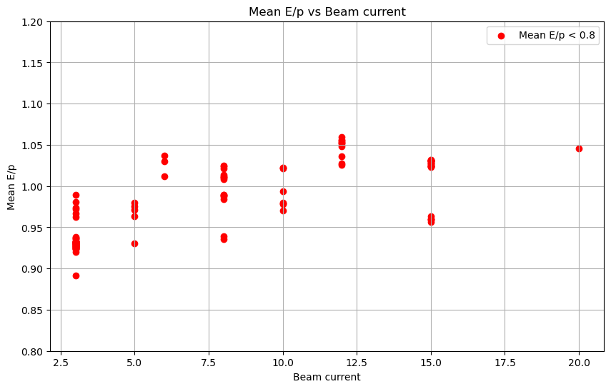
BBCal energy
The change in calorimeter threshold during running can be seen in the E/p vs run number
Run groups separated at these dates
There also appears to be large changes when no changes are made
This appears to be a beam current effect due to misaligned GEMs and other detectors.

Slide 57
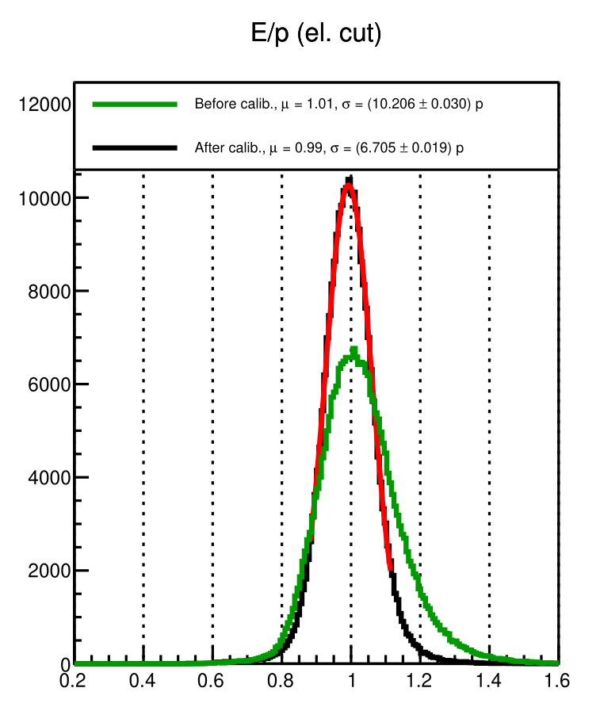
BBCal energy calibrations results
Without optics calibration parameters, the improvement to E/p resolution is from around 10->7.5 %
Values similar for all run groupings
Similar to what was seen in previous experiments

Slide 58
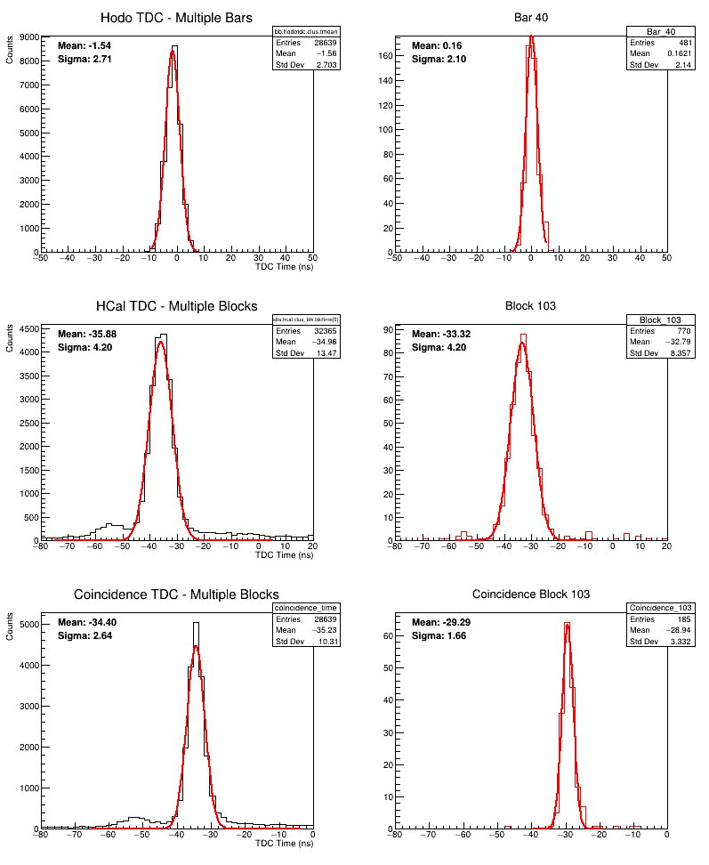
TDC timing
Both arms have TDC timing information
Ultimate goal is to do the full global minimisation of all parameters as discussed previously and shown here: (https://sbs.jlab.org/DocDB/0005/000540/001/PucketGENweekly_Mar14_2024.pdf)
Implemention described this week (ongoing):
https://sbs.jlab.org/DocDB/0006/000670/001/hodonotes.pdf

Slide 59
TDC timing problems
1. Missing HCAL tdc information
2. Trigger resolution
Previous SBS experiments had a large number of missing TDC information (-1000 above)
This was due to a TDC threshold being too high
Poor resolution trigger widens timing distribution when looking at a single time variable
If you subtract two (shown above for horoscope bars) you subtract the wide reference and resolution improves to expected

Slide 60
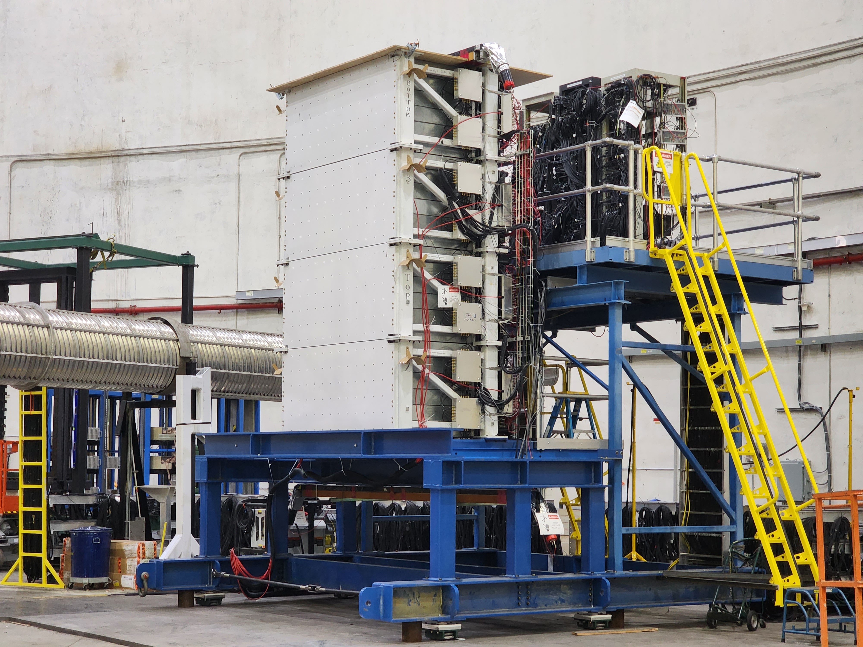
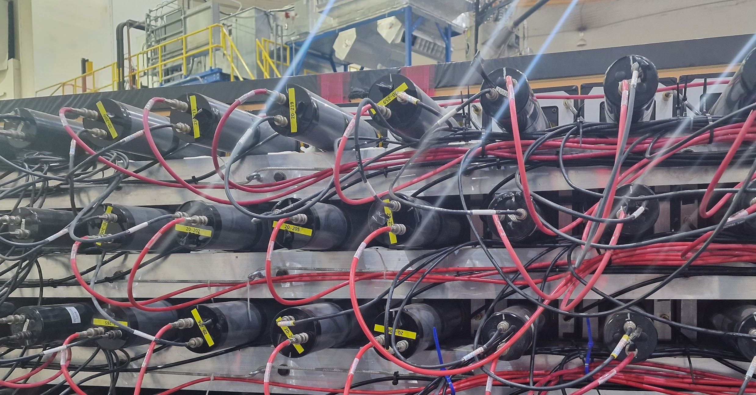
Hadron arm timing
Both ADC and TDC are used to record HCAL data (2 cable lines from front-end to back-end)​
Front-End (hcal upper platform) ​
10 x amplifier, fADC patch panel, TDC split panel​
TDC discriminator ​
Summing modules (4x4 and then 8x8), Sum trigger discriminator​
Back-End (DAQ bunker)​
fADC patch panel, fADC 250 in VXS crate​
TDC discriminator, f1TDC in VXS crate​
Expectation​
Time resolution ~1 ns​
Energy resolution ~30%​
Position resolution ~ 4cm​

Slide 61
TDC timing problems

Slide 62
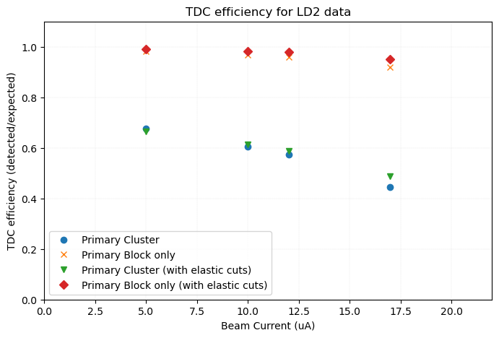
Hadron arm timing – LH2 (elastic cuts)

Slide 63
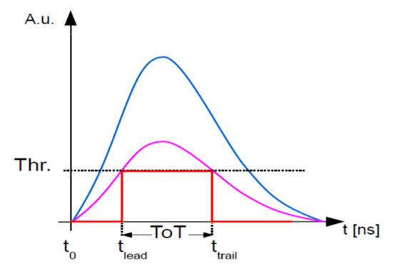
Calibrations: Timing
Timewalk corrections
Both the Hadron and Electron arms have a significant timewalk in their that needs corrections
Image from J. Hu, et al. Time Walk Measurements. CERN. https://indico.cern.ch/event/143033/contributions/

Slide 64
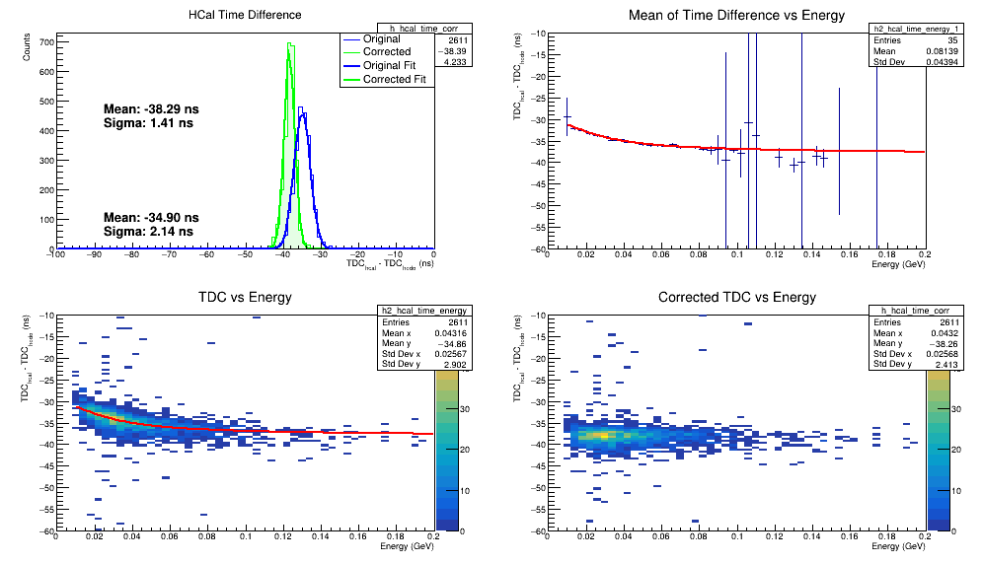
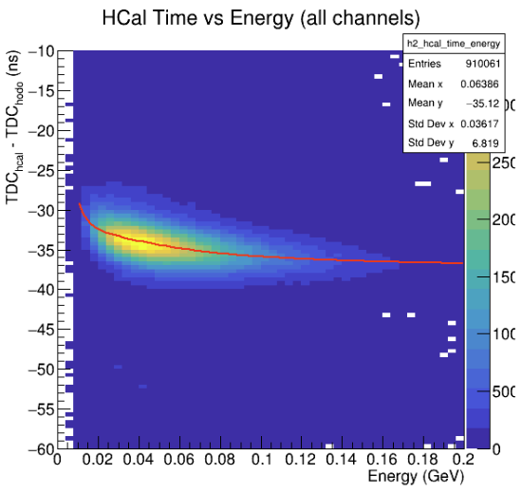
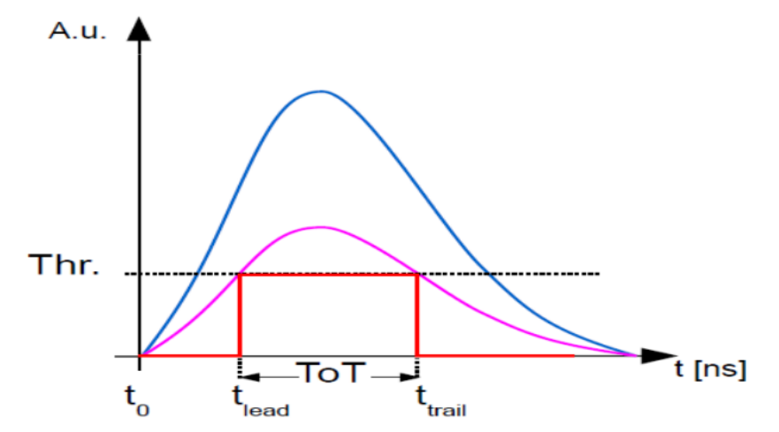
Timewalk in HCal
Significant walk effect in Hcal
Filter for a single channel, extract fit parameters and correct
Image from J. Hu, et al. Time Walk Measurements. CERN. https://indico.cern.ch/event/143033/contributions/

Slide 65
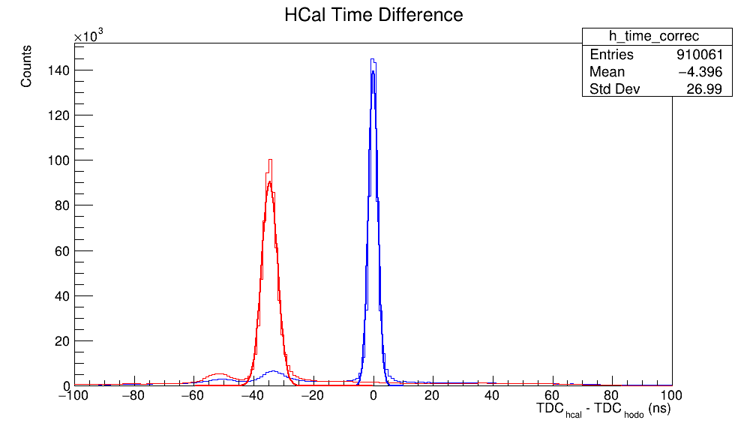
Timewalk in HCal
2.58 -> 1.4 ns resolution after timewalk on coincidence time
HCal expected resolution ~1 ns
Unexplained bump at -40 ns
Not a rigorous treatment, just to understand the timwalk contribution

Slide 66
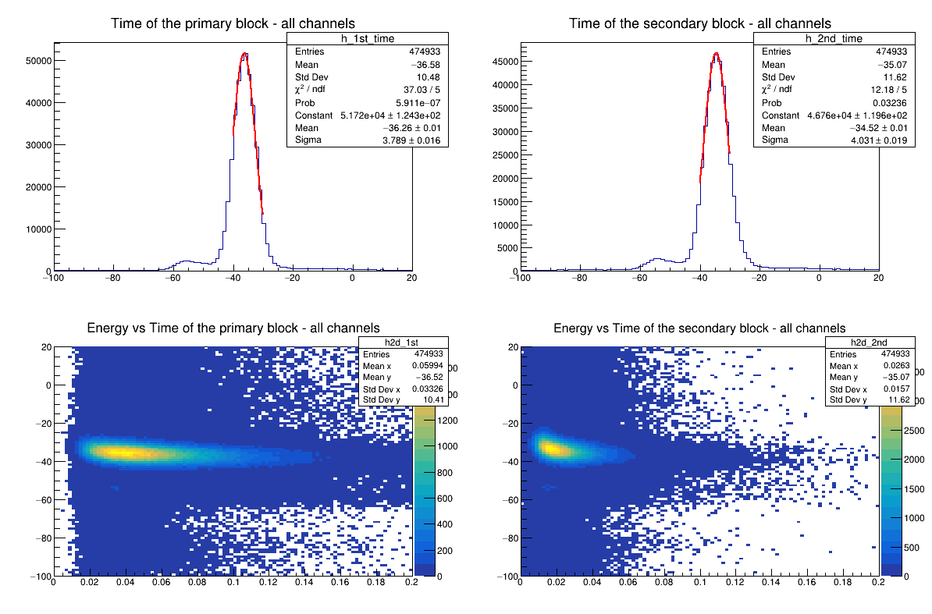
HCal TDC calibrations
hcal_clus_size2 > 1: pass=713149 all=844438 -- eff=84.45 % cumulative eff=7.30 %
Time cut_1: pass=677507 all=713149 -- eff=95.00 % cumulative eff=6.94 %
Time cut_2: pass=474933 all=677507 -- eff=70.10 % cumulative eff=4.86 %

Slide 67
HCal TDC calibrations

Slide 68
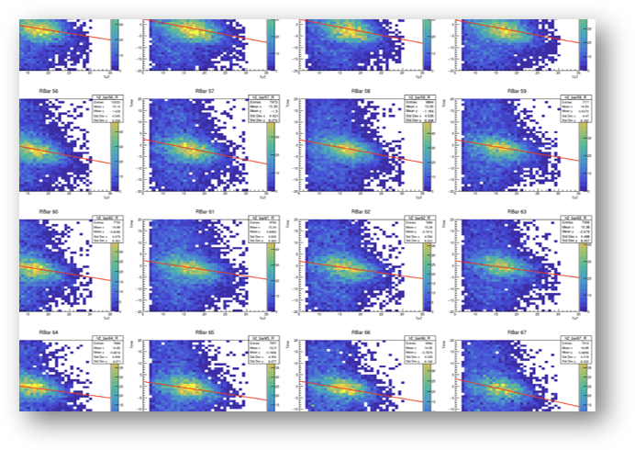
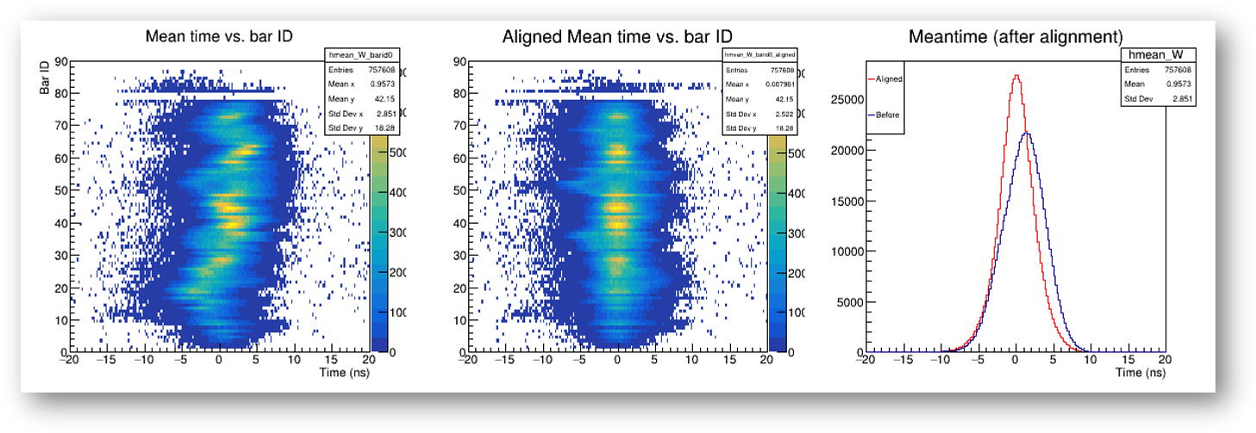
Electron arm timing
Timing hodoscope calibration procedure:
Timewalk
Meantime align
GEM track match
Scintillation speed correction
Time of Flight corrections

Slide 69
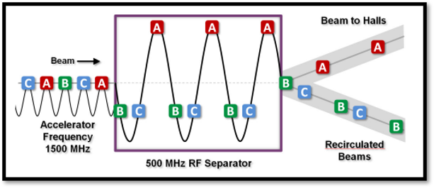
Electron arm timing
As mentioned there is a significant effect of the poor trigger resolution on the hodoscope
Andrew Puckett P & Gary Penman showed for GMn and GEn it is possible to observe the beam RF structure in the hodoscope
Could be used instead of trigger
Figure credit to Andrew Puckett

Slide 70
RF beam structure in GEn-RP
Fold this over by 2.004ns
Adjust bar meantime to align all peaks at the same time
All bars mod(2.004)
Vs bar id
Bar 53 mod(2.004)

Slide 71
Instead of modulus folding I tried fitting the whole distribution
Where:
Gaussian​ part
[0] = amplitude, [1] = mean/center, [2] = sigma/width​
Modulation​ part
[3] = modulation amplitude, [4] = phase shift, [5] = modulation sigma/width

Slide 72
These offsets align the RF structure well
It is unclear what to do with these rf offsets at present (work ongoing)

Slide 73
Two independent methods of looking at hodoscope resolution without reference time contribution.
Both show around 570ps resolution.

Slide 74
Expected resolution
500 ps resolution is as expected for Gen-RP kinematics
Plot credit to Ralph Marinaro.

Slide 75
Colleagues

