Slide 1
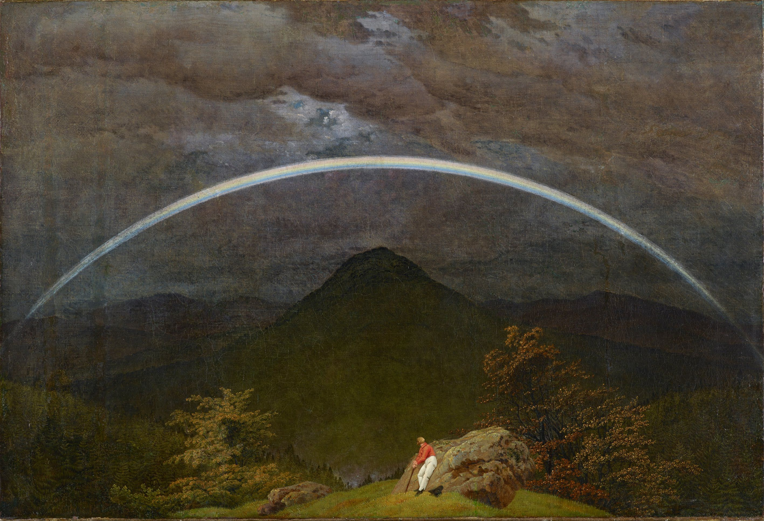
All-charm tetraquark and its contribution to two-photon processes
Based on Phys. Rev. D 111, 094033
Panagiotis Kalamidas, 11.06.2025

Slide 2
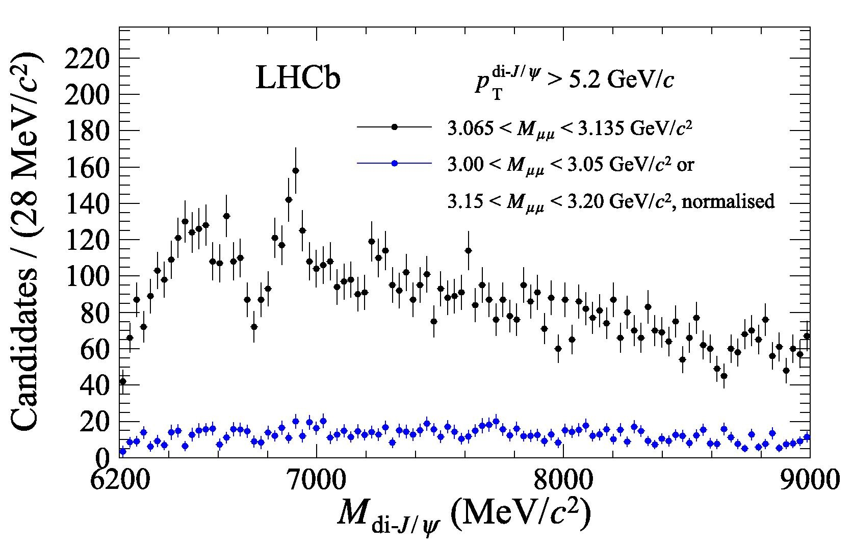
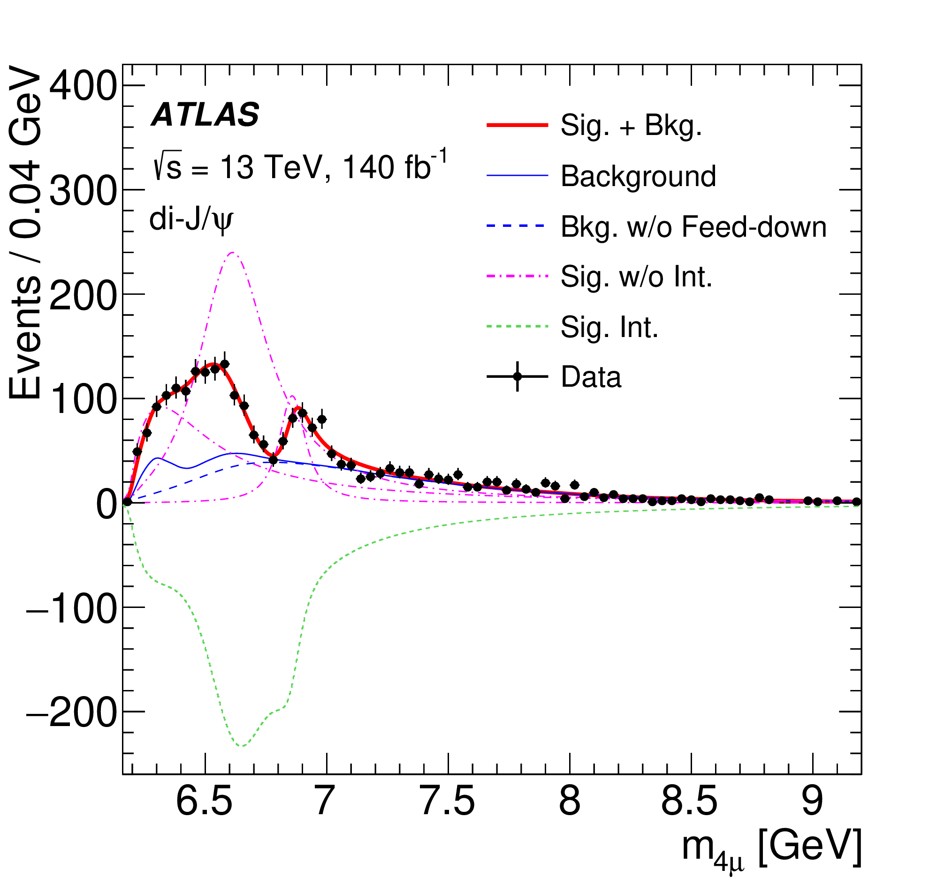
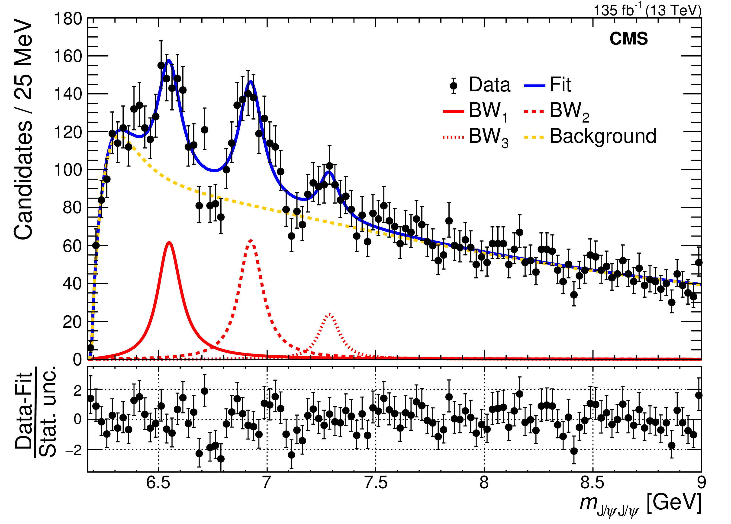
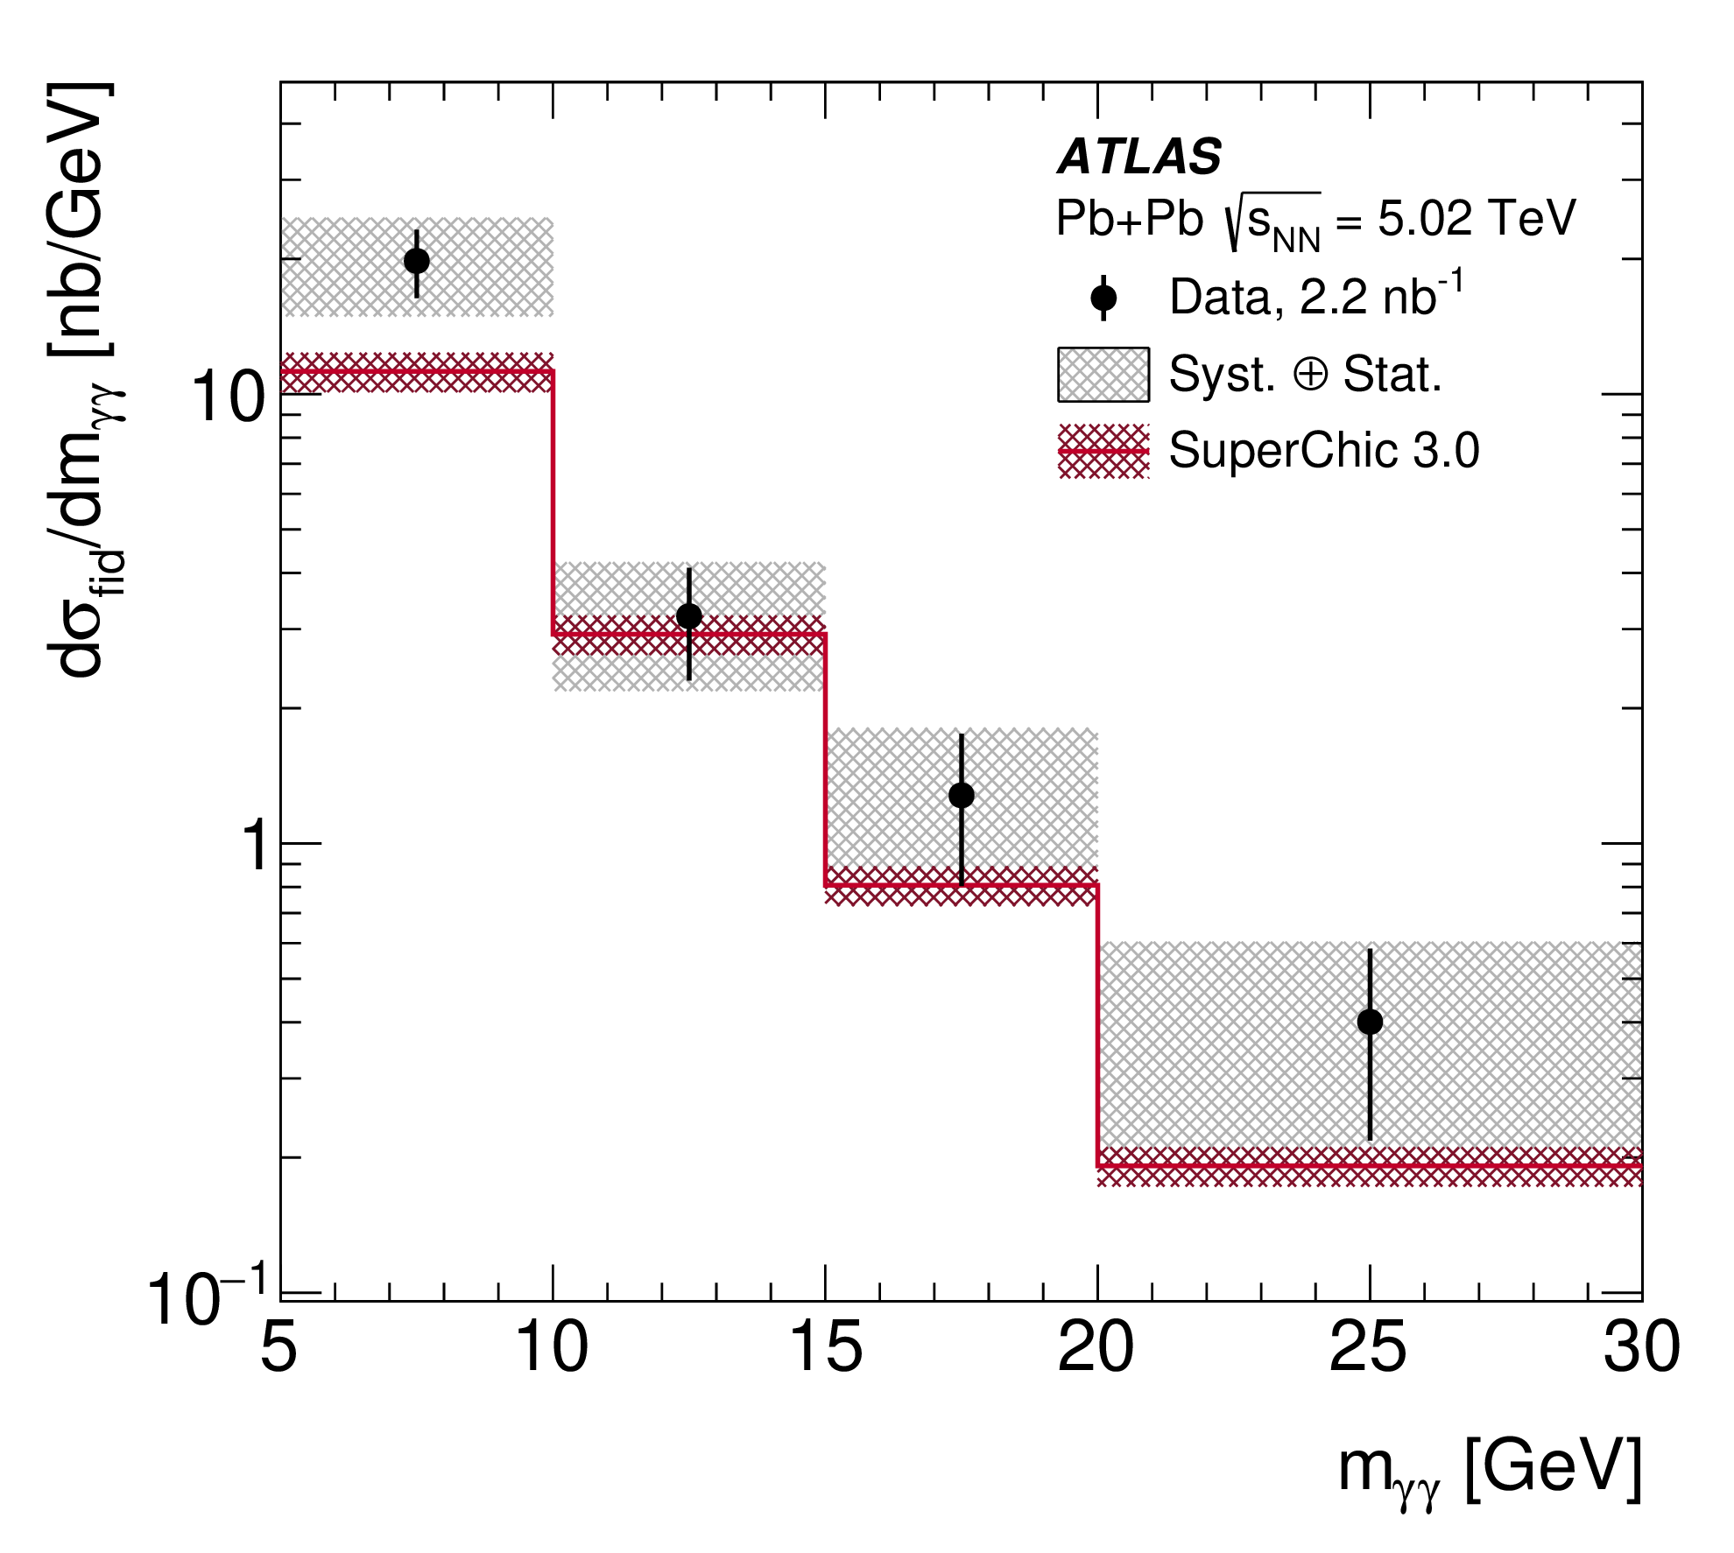
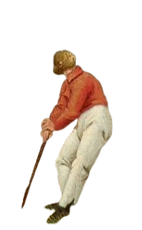
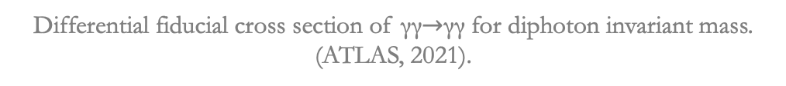

Motivation
Discovery of new exotic states in di-J/ψ, J/ψ, Ψ(2S) spectra.
X (6900) in di-J/ψ spectrum.
Considered a $cc\overline{c}\overline{c}$ state.
Light by light (LbL) scattering excess compared to SM in the region 5-10 GeV.
Potential connections…
Di-J/ψ candidates invariant mass spectrum. (LHCb, 2020)
Differential fiducial cross section of γγ$→$γγ for diphoton invariant mass. (ATLAS, 2021).
Di-J/ψ invariant mass spectrum. (ATLAS, 2023)
Di-J/ψ invariant mass spectrum. (CMS, 2024)

Slide 3
Complicated four-body problem
Three two-body problems

Slide 4


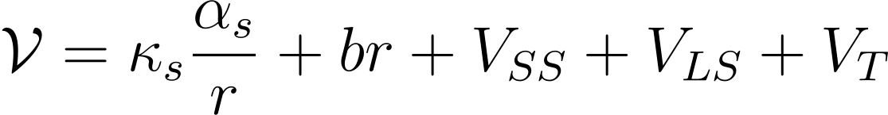
Model Parameters
SU(3) colour symmetry
,
Cornell Potential (Debastiani, Navarra, 2019)
Four “free„ parameters,
Diquark Picture

Slide 5
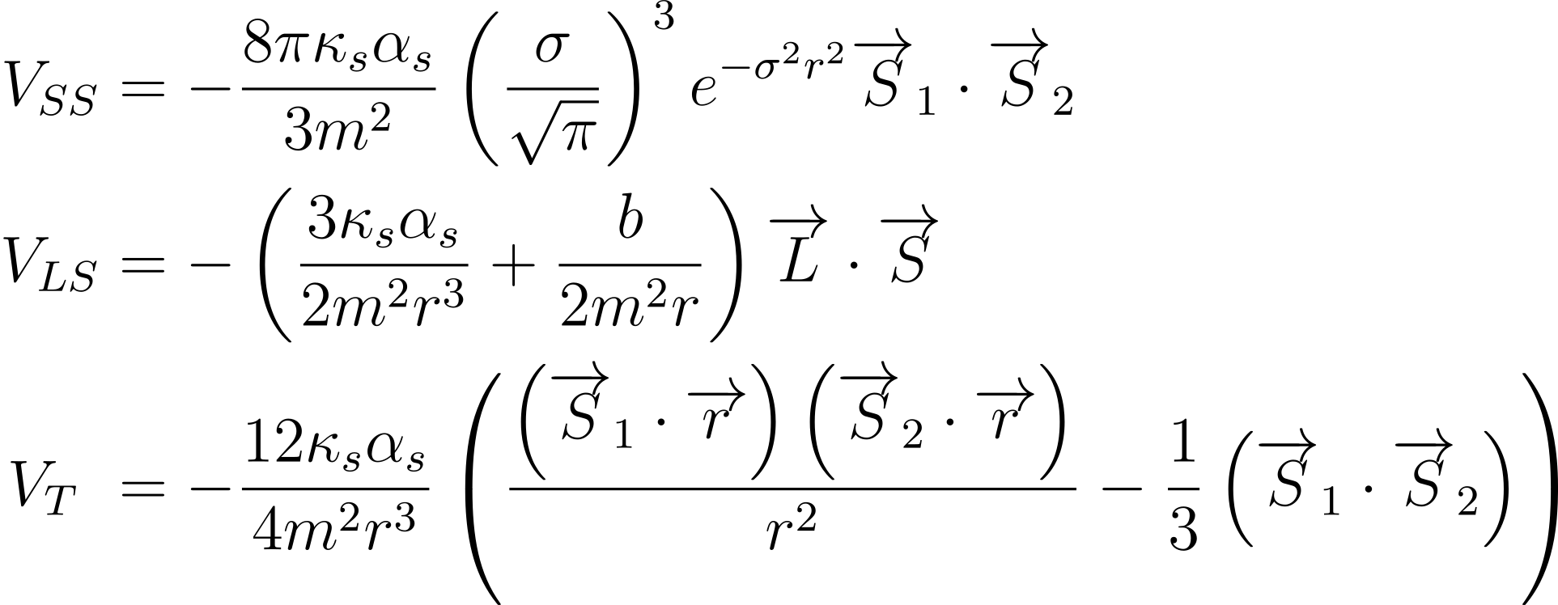

Potential Contributions
Notation same as in (Debastiani, Navarra, 2019),
Surprisingly accurate for $c\overline{c}$ spectrum.

Slide 7
Some light at last…

Slide 8

Two-Photon Decay
Diquarks are spin 1, coupling like SM W boson.
Allowed states have $C=+1$ and $J≠1$ (Landau-Yang theorem)
Question: how to connect model and perturbative calculations?

Slide 9
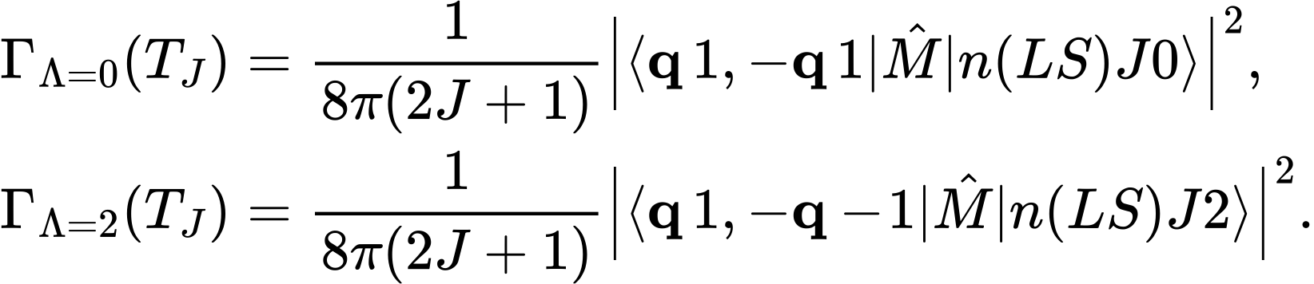
Calculation
After pain…a lot of pain…
Here it is:
Plug into simple formulas and get two-photon widths

Slide 10
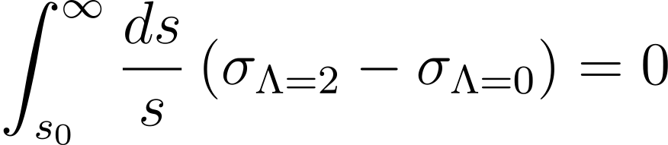
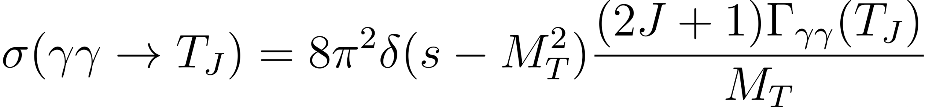
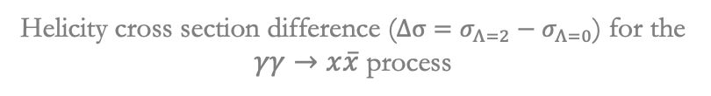
Sum rule implications
Real-photon sum rule:
Perturbative calculation easy!
For individual resonances:
Does it still hold after the model?
Helicity cross section difference ($Δσ=σ_{Λ=2}−σ_{Λ=0}$) for the $γγ→x\overline{x}$ process

Slide 11
Results from paper
Helicity-2 sum rule contribution is already compensated to ~ 90% by helicity-0 contribution

Slide 12

Fitting of states
Alter sum rule contribution,
States in di-J/ψ experiments favoured to be spin-2 particles (Hong-Fei Zhang and Yan-Qing Ma, 2020).
Spin-2 states seem to dominate, so more likely candidates.
With this in mind,
State identification: Preliminary fit parameters:

Slide 14
Results from our fit
Sum rule nearly perfectly satisfied for sum of first three shells ($n=1,2,3$)

Slide 15
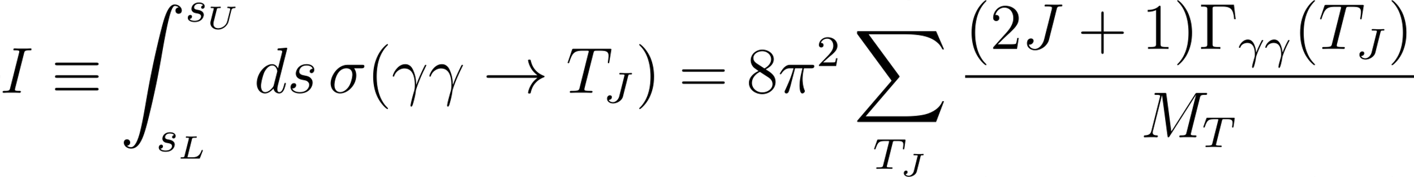
Comparison
Sum rule contribution
Comparison with Biloshytskyi et al. (2022)
Seems pretty good!

Slide 16


TL;DR
Spectrum of $cc\overline{c}\overline{c}$ was calculated using the diquark picture,
Two-photon widths computed,
Real photon sum rule in satisfied relatively well within each energy shell,
New fit performed, improving sum rule consistency,
Signs of sizable contribution to light-by-light scattering excess.
More data and better statistics are vital for progress…forthcoming LHC data to the rescue

Slide 18
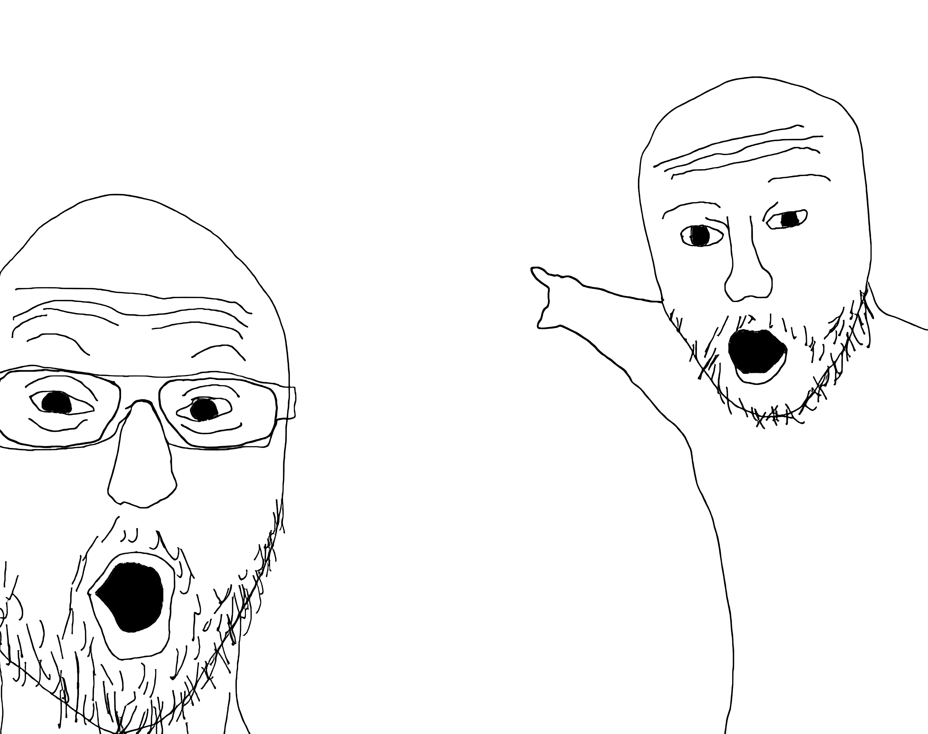
Questions?

