Slide 1
Measuring Valence Quarks Lecture 4: Strange Quarks
Arun Tadepalli – Jefferson Lab

Slide 2
$$s\left(x\right),\overline{s}\left(x\right)$$
$$Δs\left(x\right), Δ\overline{s}(x)$$
Cute but not a clean situation to be in!

Slide 3
Strange comparisons…
Naively due to SU(3) symmetry the strange sea was always assumed to be equal to the other light quarks u(x) and d(x)
Strange quarks will be redistributed to regions where there are plenty of gluons
Measurements tend to compare the strangeness content to the non-strange sea and the total non strange content in the nucleon

Slide 4
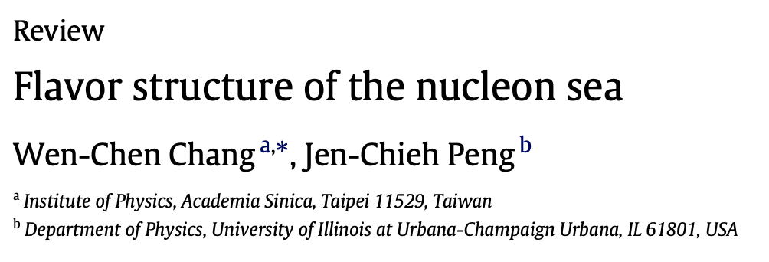
Table for 𝛋_{s} and η_{s} for various experiments
Experiments evaluate a ~30% momentum fraction of non strange sea and 5-10% for the non-strange content

Slide 5
CHORUS + CMS + ATLAS

Slide 6
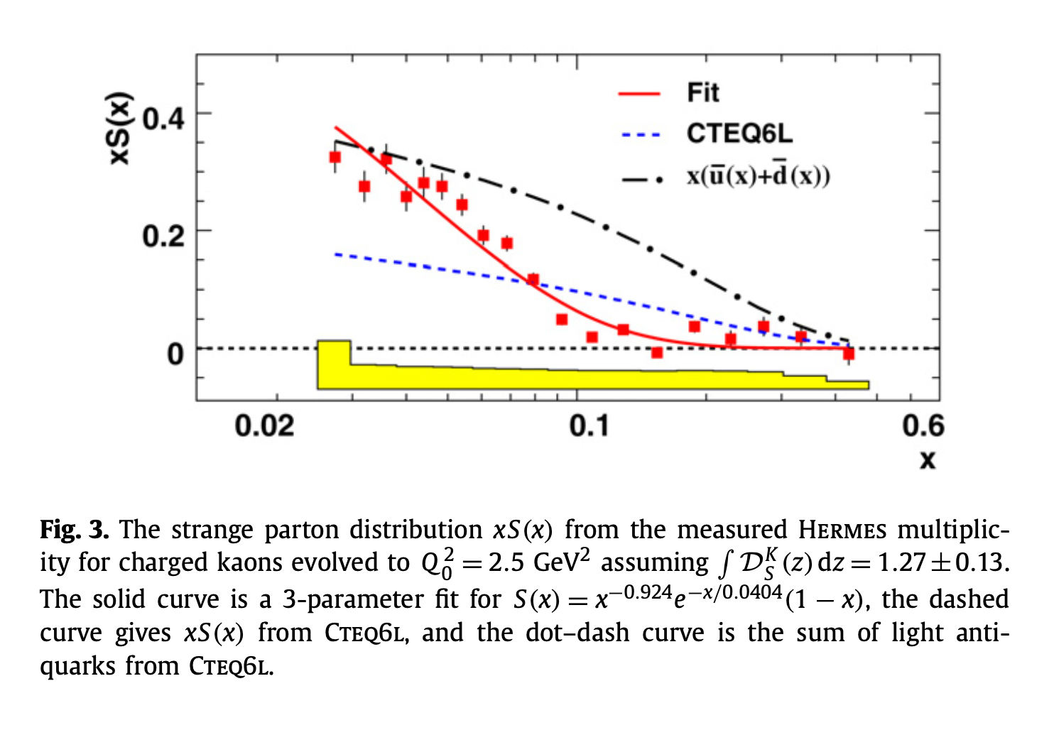
HERMES data reevaluated but strongly depends on the fragmentation function

Slide 7
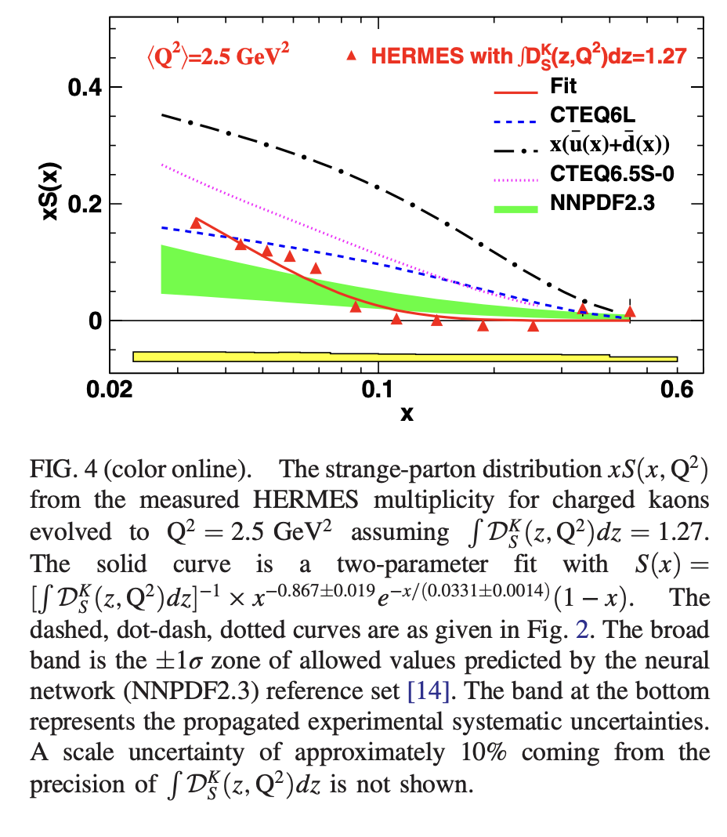
HERMES data trend
The trend of the data points from a LO extraction of HERMES data interpreted two components operating in the regions
below 0.1 which recovers SU(3)
above 0.1 which seems relatively small and independent of x

Slide 8
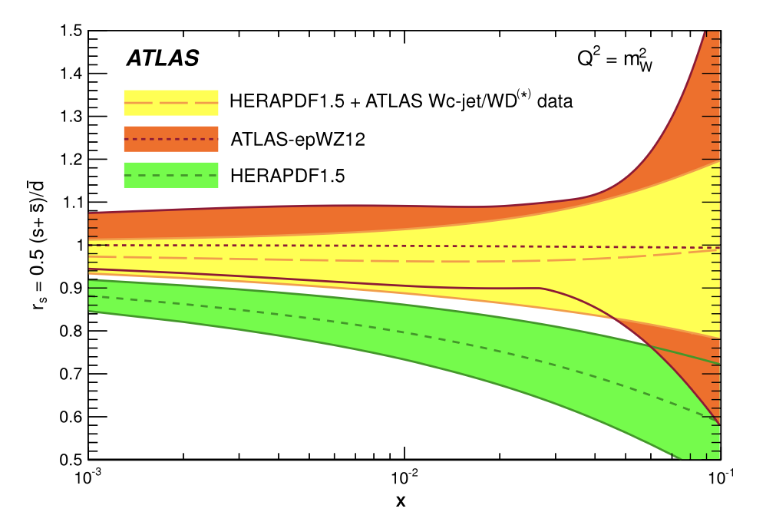
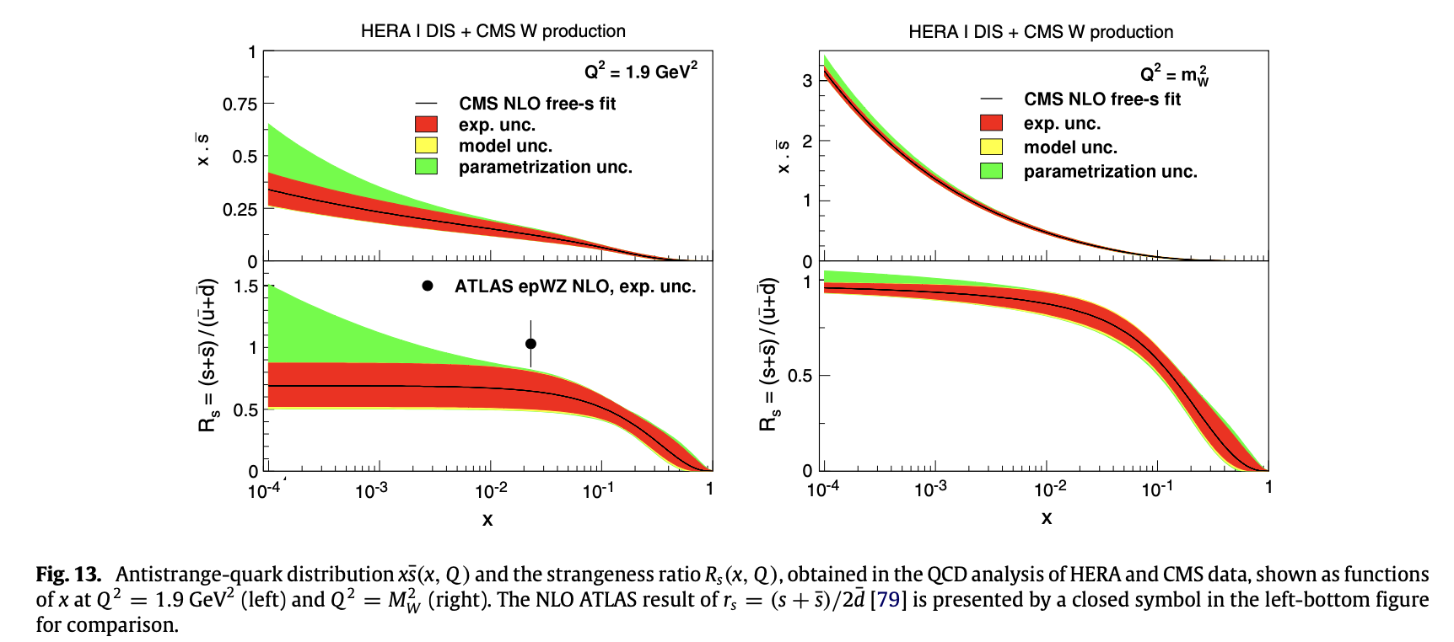
ATLAS, HERA, CMS data suggests a ratio of R_{s} = ~1 for low values of x suggesting a transition back to SU(3)

Slide 9
NuTeV data suggests a positive $s\left(x\right)−\overline{s}\left(x\right)$ however no obvious known mechanism is responsible for this trend

Slide 10
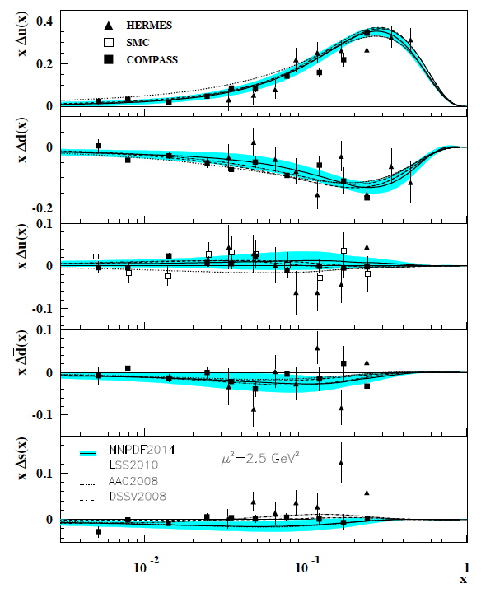
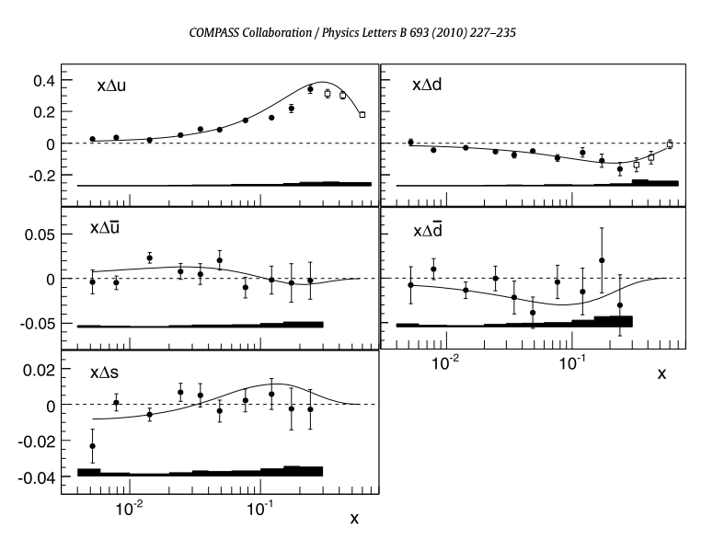
HERMES and COMPASS measurements indicate a value consistent with 0 for strange quark polarization $x∆s(x)$

Slide 11
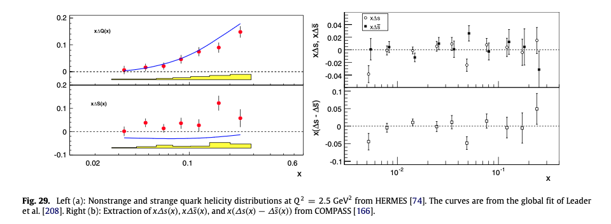
Comparison of strange and non-strange polarization components for HERMES and COMPASS

Slide 12
What’s next?
What’s needed for strange quarks?
More precise data?
Revisit of all assumptions made in each extraction?
Re-analysis in terms of global fits?

Slide 15
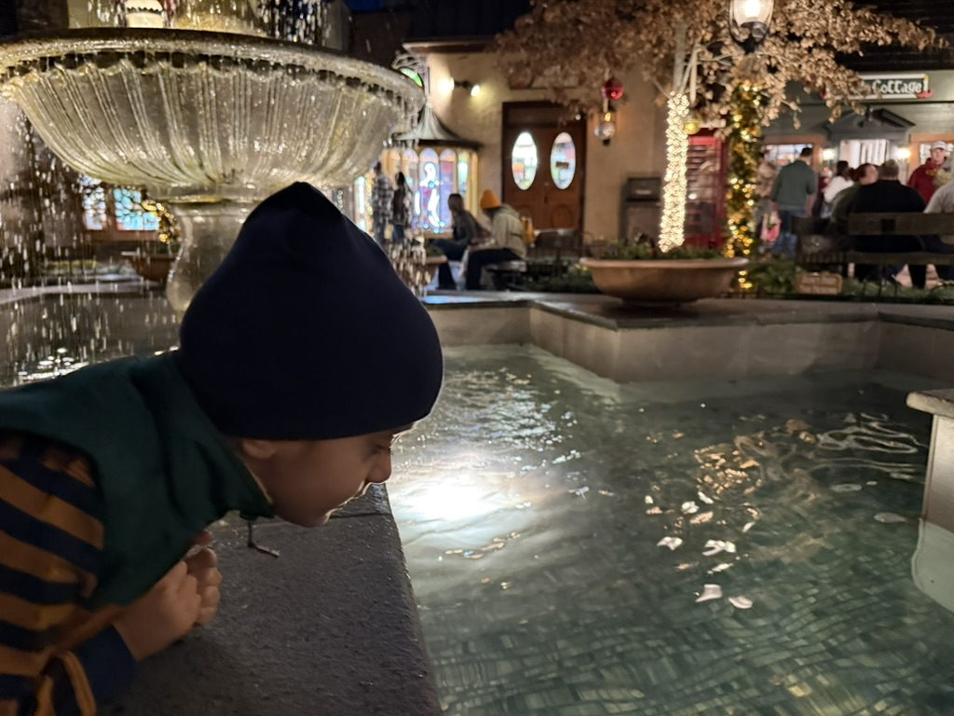
Hope you enjoyed the sneak peek!
Exciting times!

Slide 17
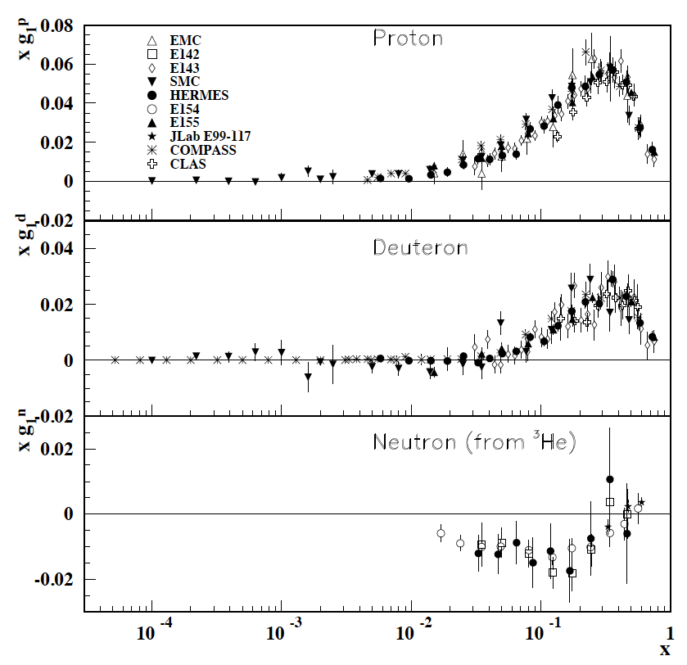
Polarized Structure Functions from PDG

