Slide 1

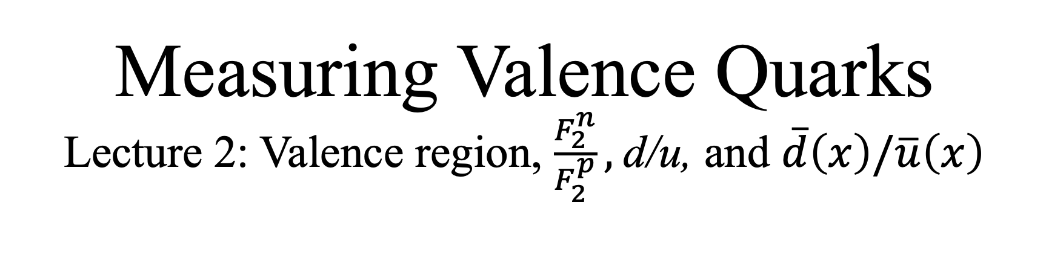
Measuring Valence Quarks
Lecture 2: Valence region, $\frac{F_{2}^{n}}{F_{2}^{p}},$d/u, and $\overline{d}\left(x\right)/\overline{u}\left(x\right)$
Arun Tadepalli – Jefferson Lab

Slide 2
Why go high in x?
Busch Gardens, Williamsburg 2025

Slide 3
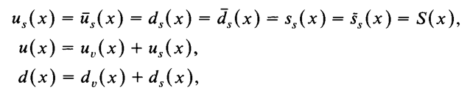
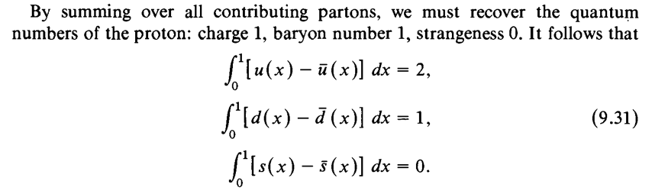
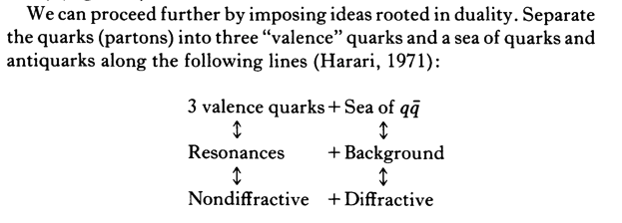
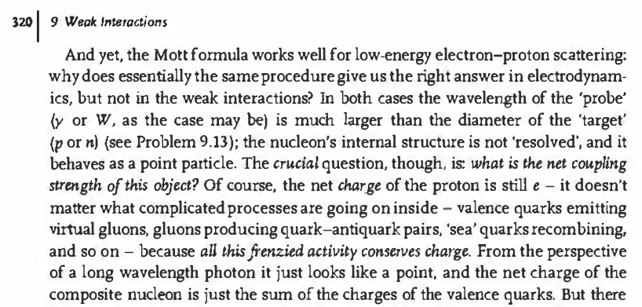
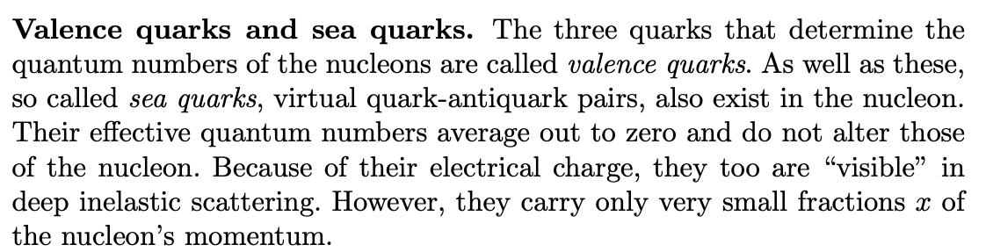
What is the “Valence” region?
Quarks and leptons, Halzen and Martin
A particular kinematic region from DIS scattering which is x > 0.3
The quarks from which the quantum numbers (baryon number = 1, charge = 1, strangeness = 0) of can be recovered
Close, Intro to Quarks and Partons
Griffiths, Elementary particles
Povh et al, Particles and Nuclei

Slide 4
Why the “Valence” region?
Clean testing ground for models of nucleon structure
  Free from “sea” effects
Necessary to pin down the contributions of valence quark to the global properties of the nucleon such as spin, OAM, etc..
Direct comparison with Lattice QCD

Slide 5






Unpolarized
Polarized
Constraining PDFs, duality, diquark correlations, pQCD, DSE etc..
Role of OAM, flavor decomposition of valence spin structure to constrain helicity distributions, pQCD, DSE etc..
Valence PDFs
Anti-Quarks
Non perturbative mechanisms, total anti-quark content, spin contribution to the sea

Slide 6

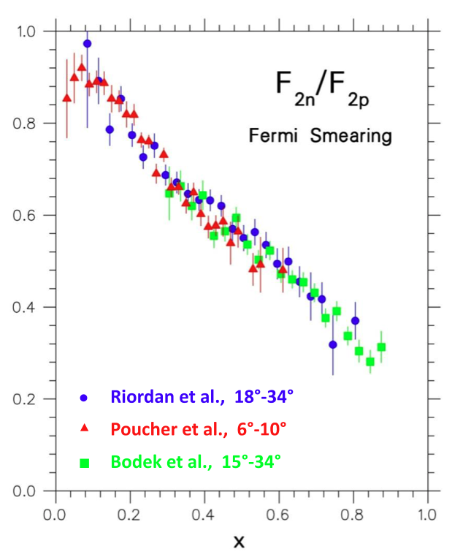
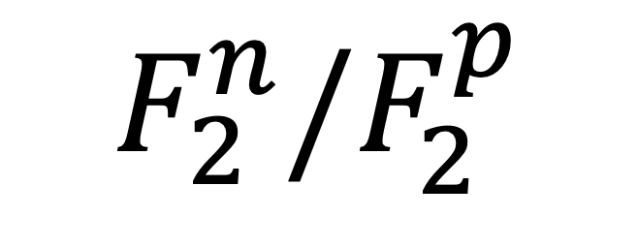
$$F_{2}^{n}/F_{2}^{p}$$

Slide 7
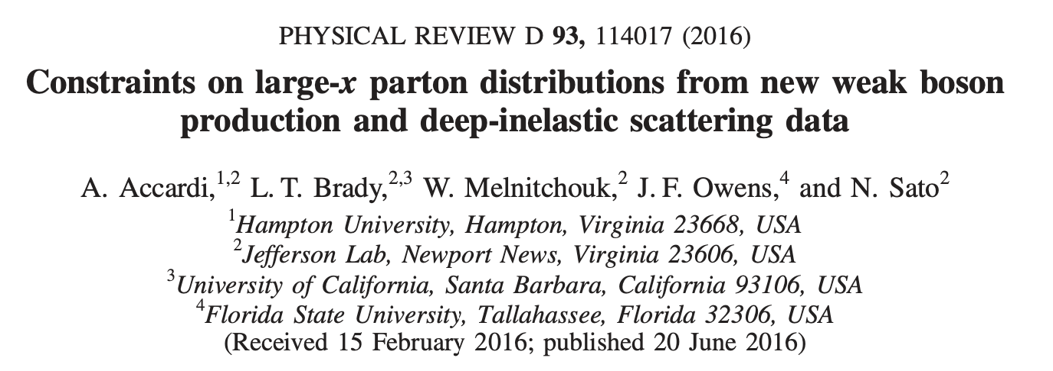
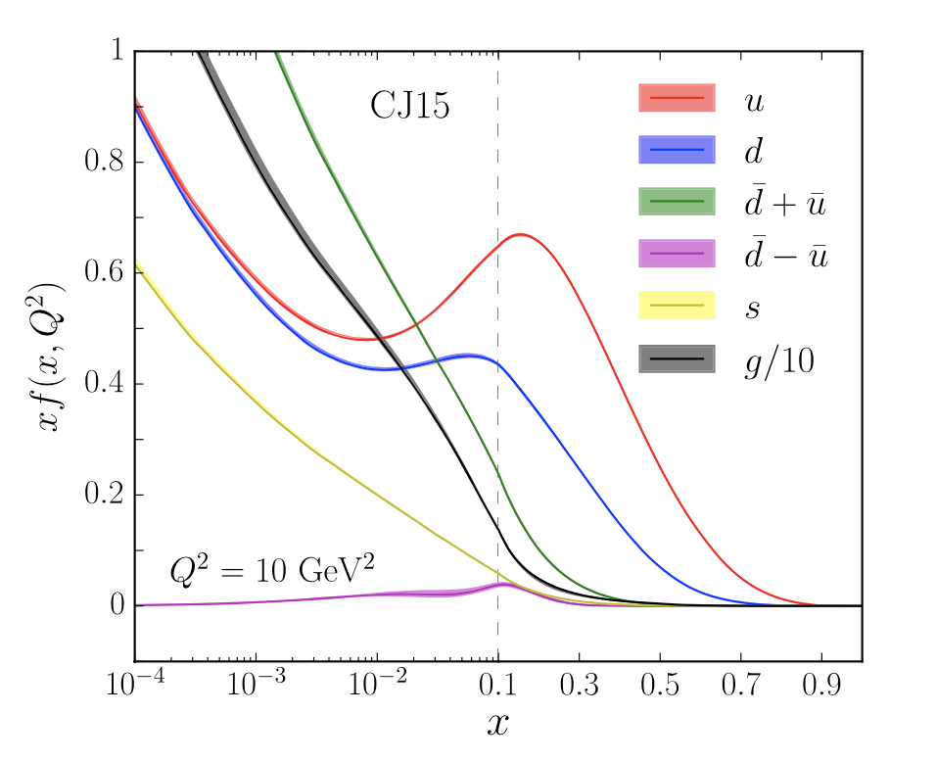
Status of unpolarized PDFs
Large uncertainties in the high-x region
Need precision data
Challenging measurements due to rapidly falling off cross sections
https://www.jlab.org/theory/cj

Slide 8

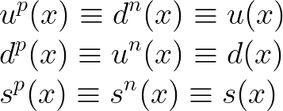
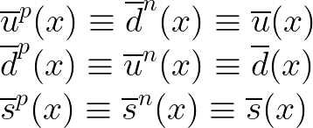
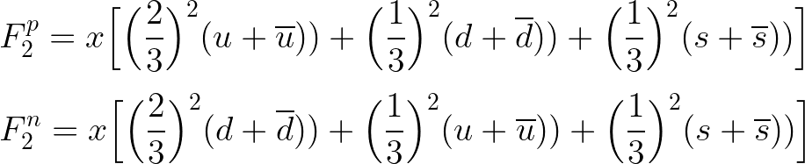

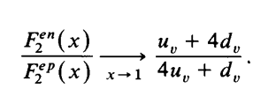
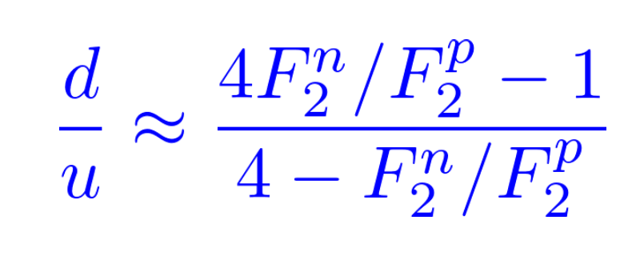
in the Quark Parton Model
In the QPM, assuming isospin symmetry:
Proton and neutron structure functions:
Nachtmann inequality
and
*Solved problem in Halzen & Martin

Slide 9
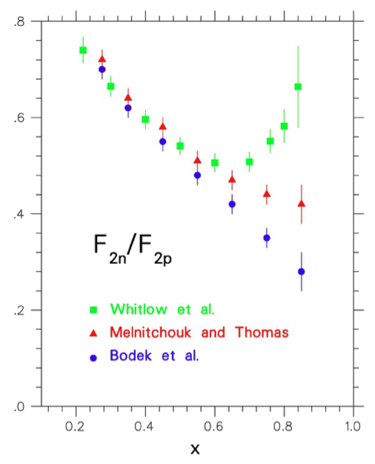
extraction
Significant dependence on inclusion of nuclear corrections to “un-smear” the deuteron in the high-x region

Slide 10
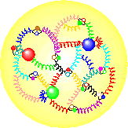

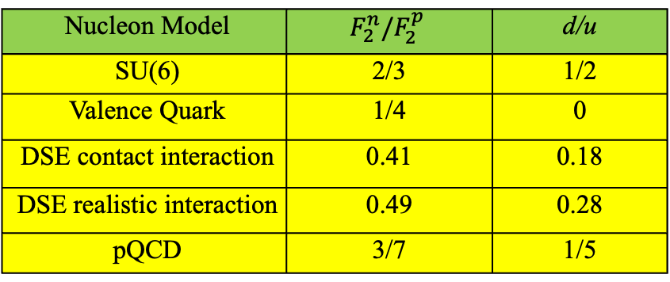
Predictions at high-x
1
1
1
p
=
u
(
ud
)
+
u
(
ud
)
−
u
↓
(
ud
)
2
S
=
0
18
S
=
1
3
S
=
1
1
2
−
d
(
uu
)
−
d
↓
(
uu
)
3
S
=
1
3
S
=
1
Nucleon Model | $$F_{2}^{n}/F_{2}^{p}$$ | d/u
SU(6) | 2/3 | 1/2
Valence Quark | 1/4 | 0
DSE contact interaction | 0.41 | 0.18
DSE realistic interaction | 0.49 | 0.28
pQCD | 3/7 | 1/5
A Longstanding Problem!
Numerous Review Articles:
N. Isgur, PRD 59 (1999)
S Brodsky et al NP B441 (1995)
W. Melnitchouk and A. Thomas PL B377 (1996)
R.J. Holt and C. D. Roberts, Rev. Mod. Phys. 82 (2010)
I. Cloet et al, Few Body Syst. 46 (2009) 1.

Slide 11


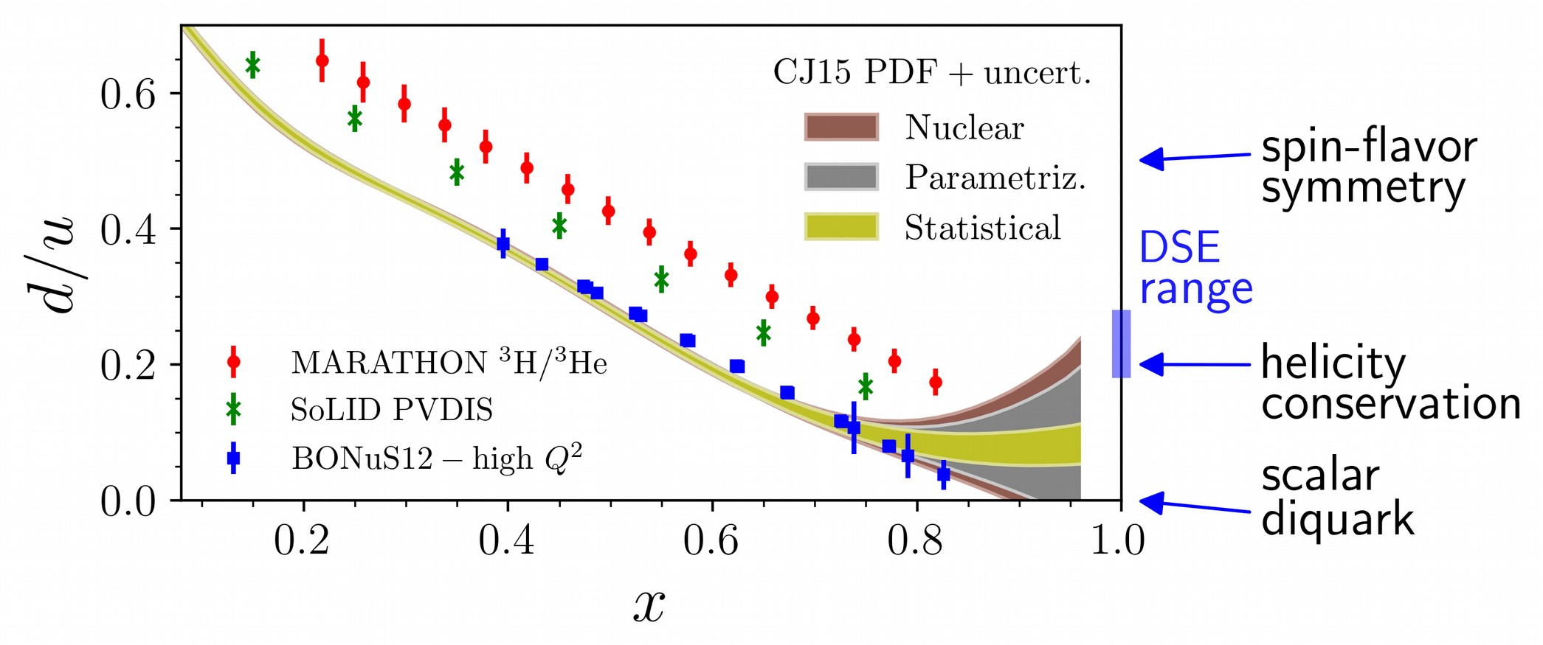
BONUS6, BONUS12, TDIS-n: Tagged approach which tags a low momentum recoil proton with DIS reactions on deuteron
1/3
PVDIS with SOLID
2/3
3/3
MARATHON
Super ratios using 3H and 3He targets

Slide 12
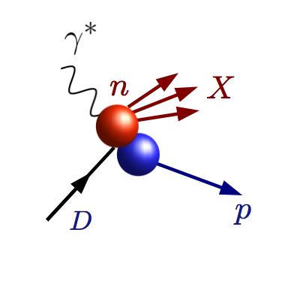
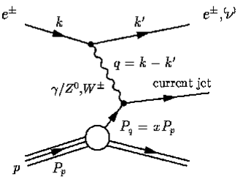
Tagged Approach to Neutron Structure
Measure DIS electron in coincidence with proton tag
n
p
“Hard” scattering inelastic event (high Q, W)
Proton remains intact
Low momentum proton = nucleons barely off shell
Neutron target!
p
Deuteron target
BONUS6, BONUS12, TDIS, TDIS at EIC..

Slide 13
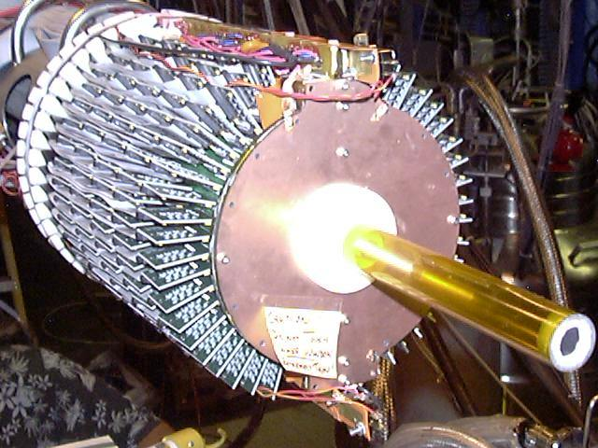
TDIS technique
Use low mass radial TPC detector / target in magnetic field
TAG “spectator” proton at (very) low momenta (~65 MeV/c)
And large angles (> 90º in lab)
Target fragmentation
negligible
Bound / free neutron structure
O (1%)
Final state interactions
O (5%)

Slide 14
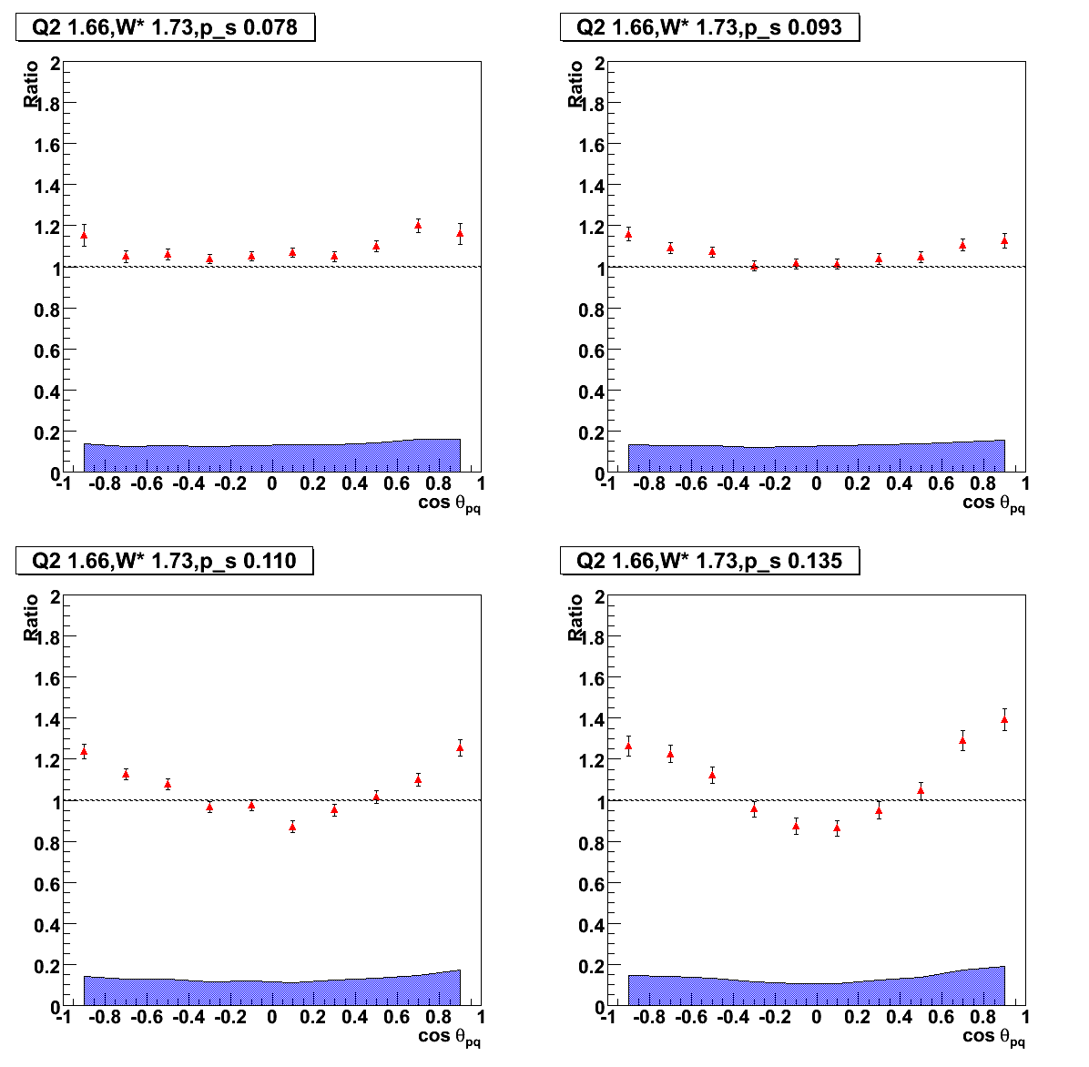
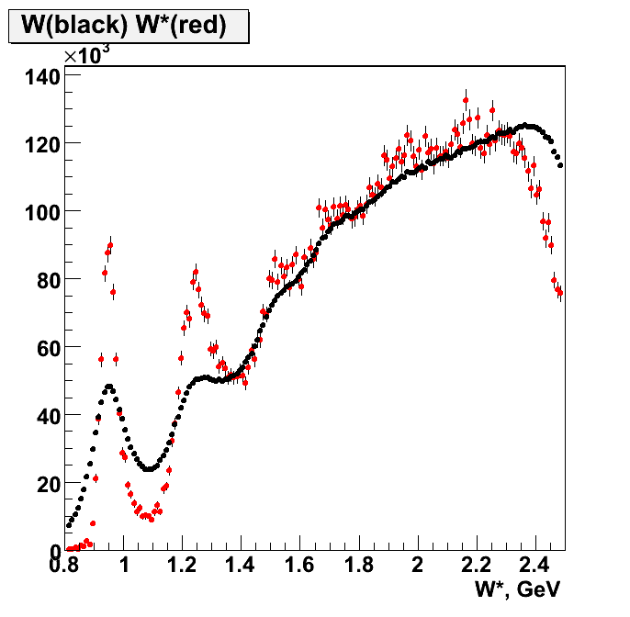
Tagging technique works!
angle - momentum dependence
78 MeV/c
93 MeV/c
110 MeV/c
135 MeV/c
cosθ_{pq}

Slide 15
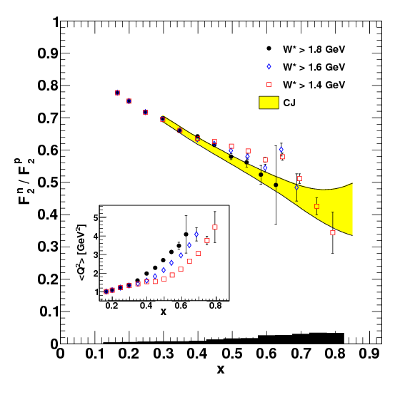
BONUS effective neutron target via TDIS achieved!
Phys.Rev. C92 (2015) no.1, 015211
Phys.Rev. C91 (2015) no.5, 055206
Phys. Rev. C89 (2014) 045206 – editor’s suggestion
Phys. Rev. Lett. 108 (2012) 199902
Nucl. Instrum. Meth. A592 (2008) 273-286
Not quite high enough x, Q² in 6 GeV era
Nonetheless still powerful as input for global PDF fits…

Slide 16
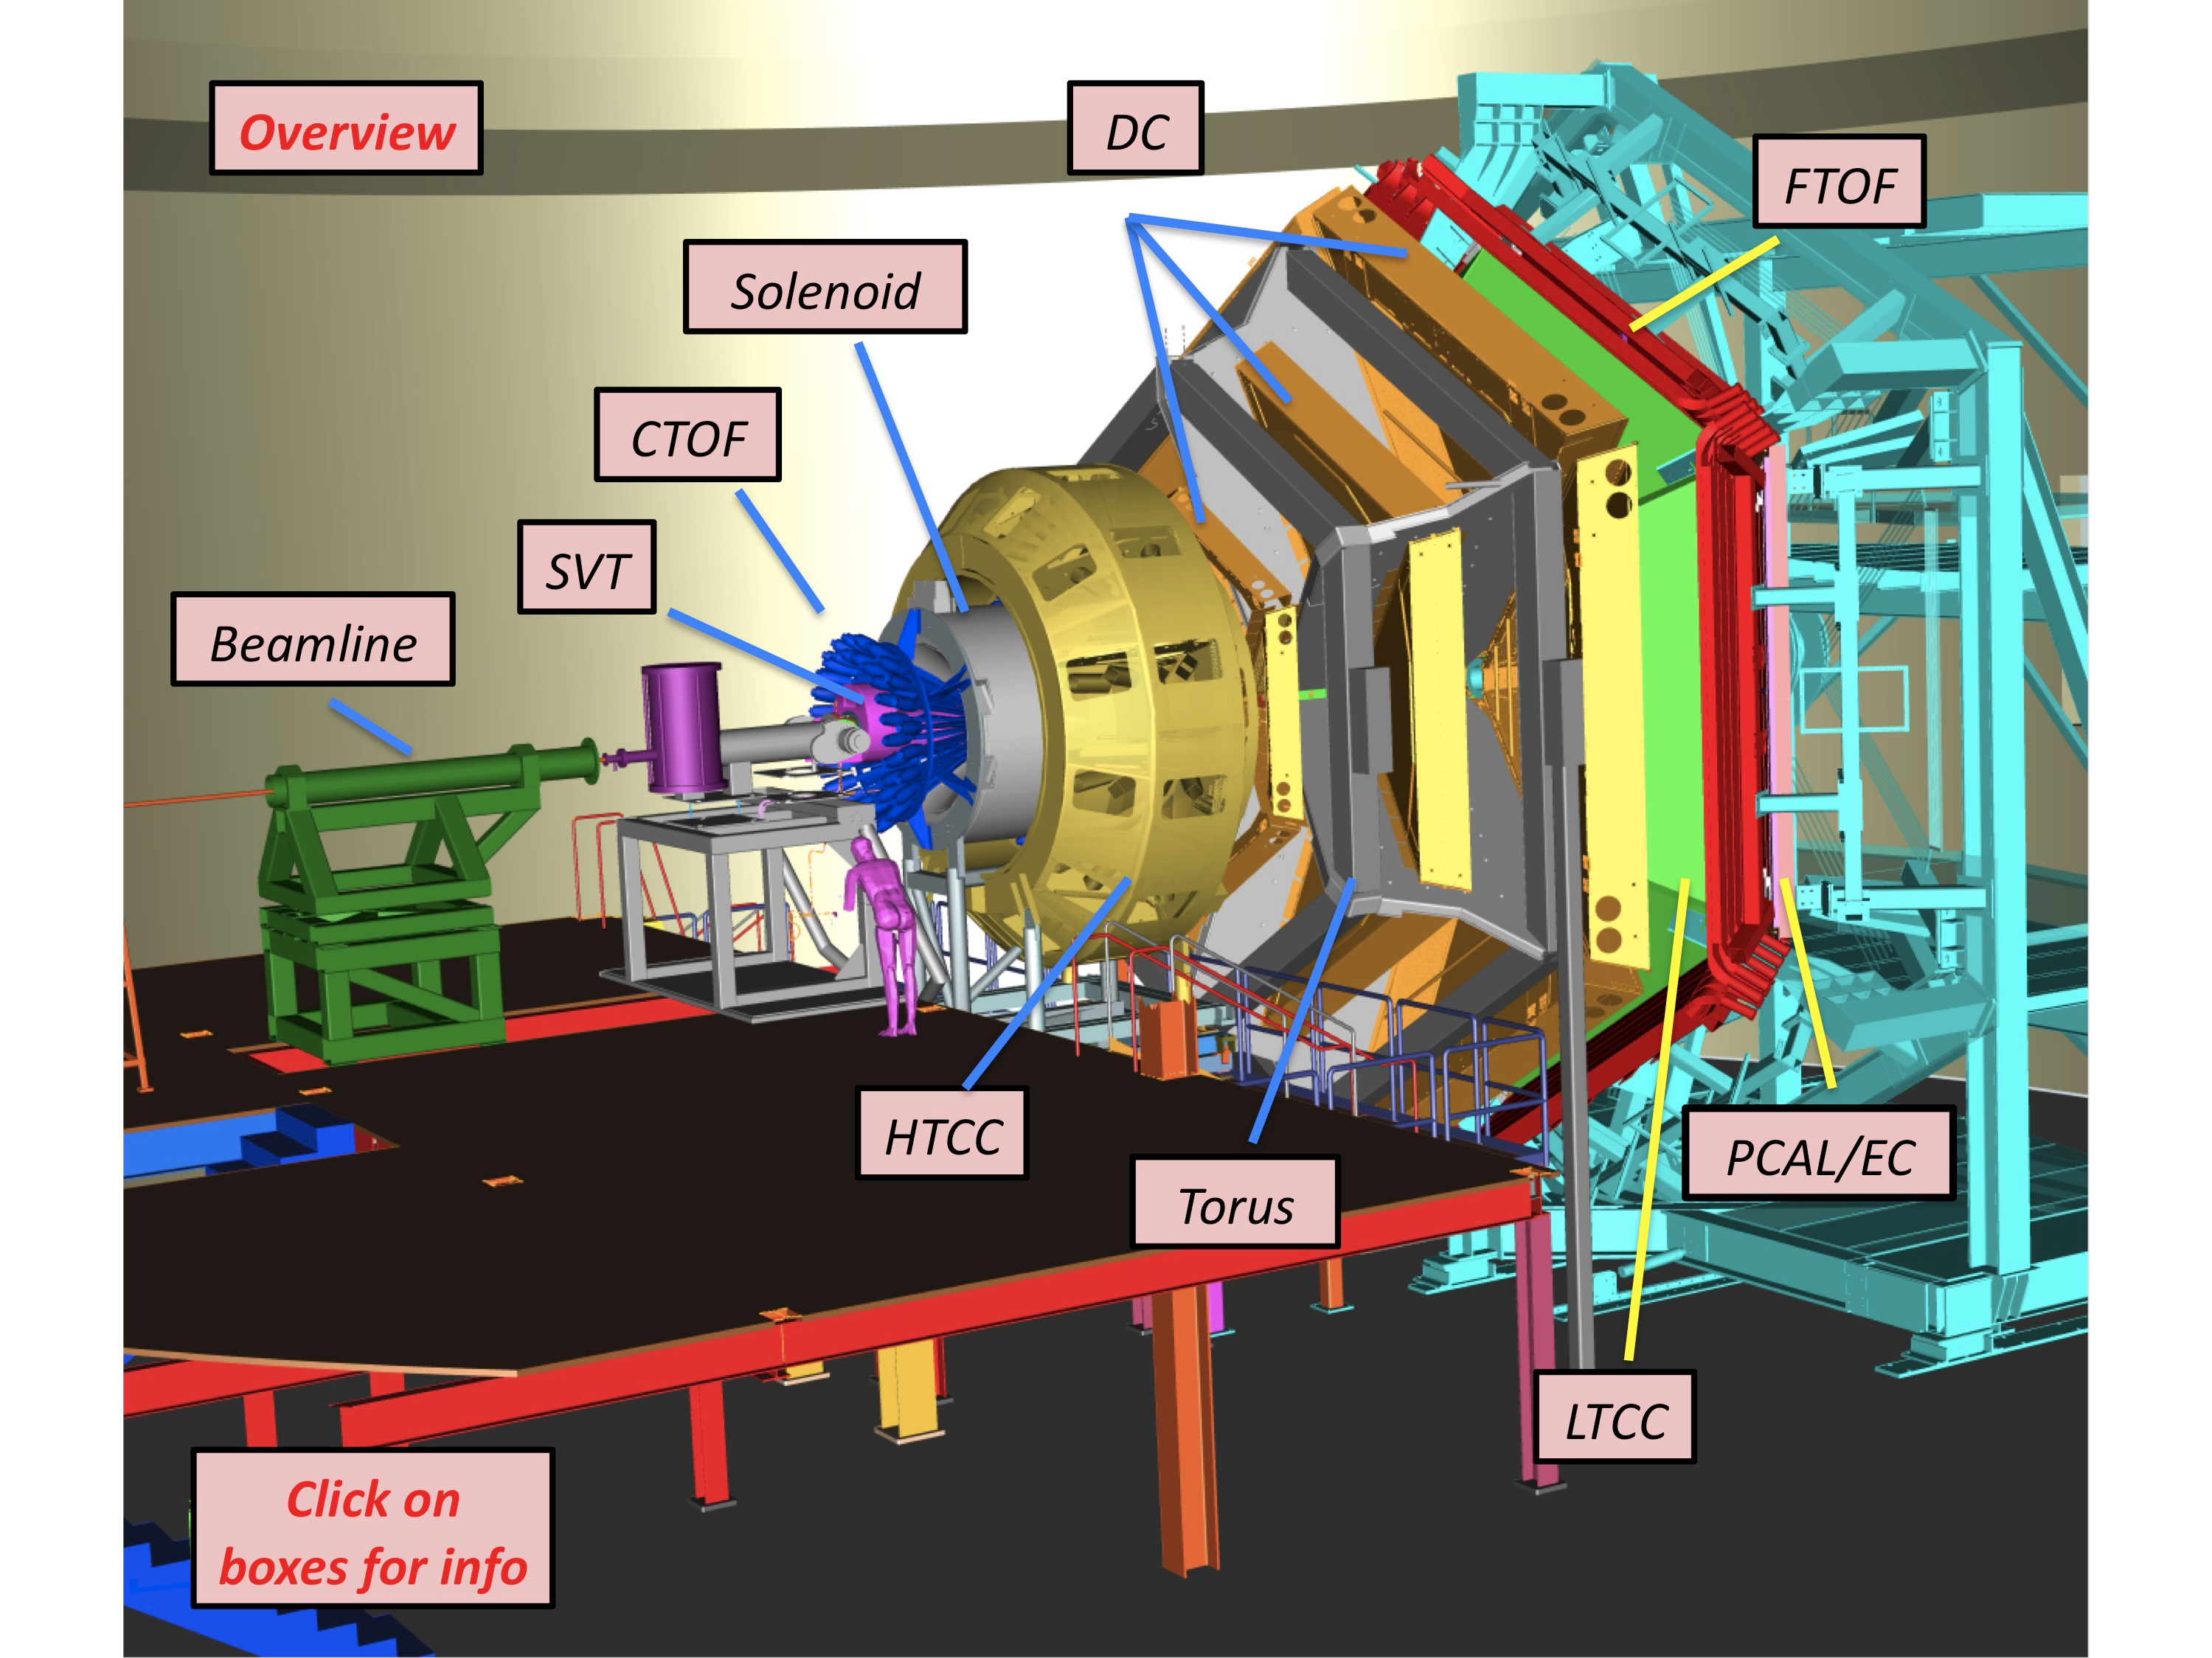
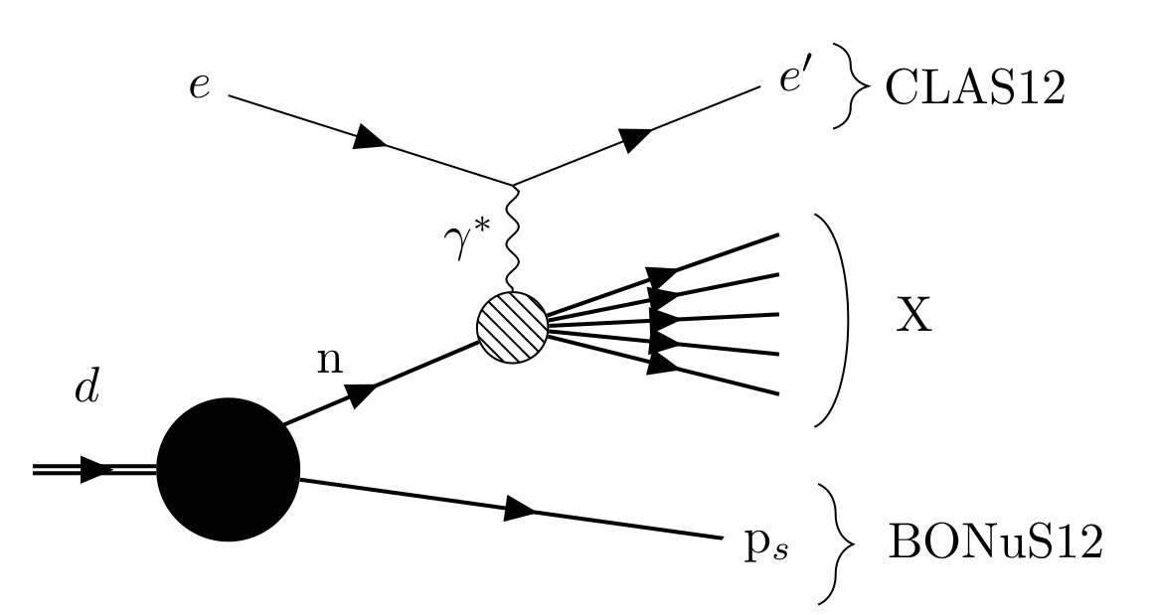
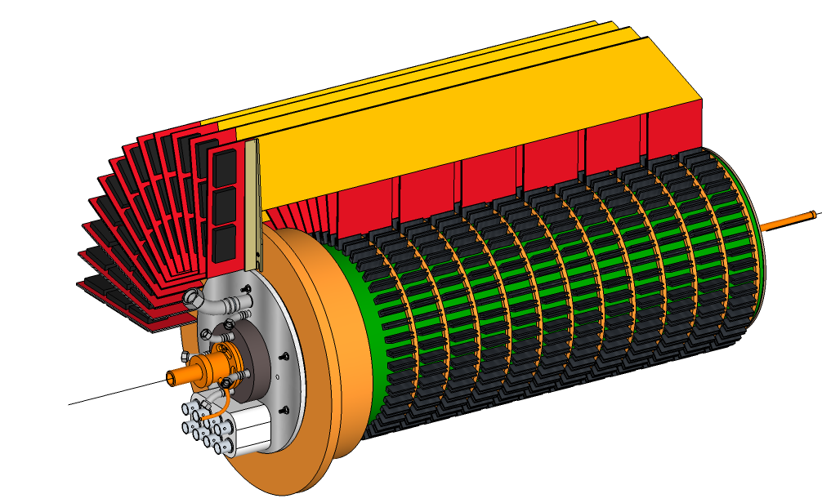
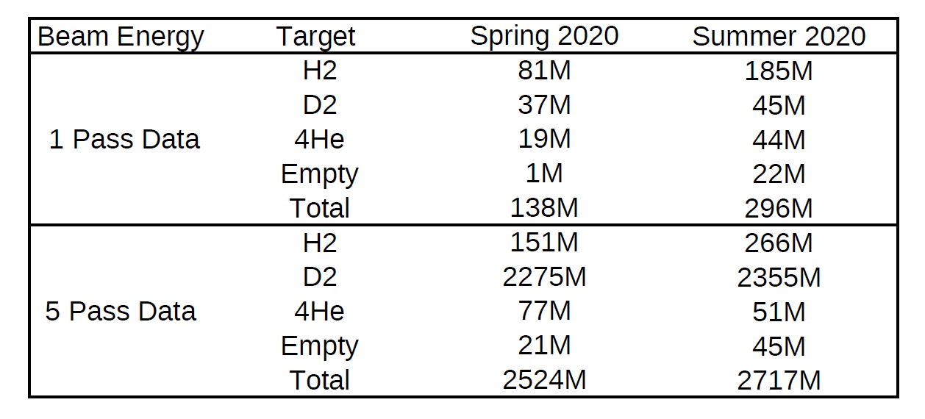
BONuS12 Experimental Setup
10.4 GeV
RTPC
February – March 2020 | MEDCON6 | August-September 2020

Slide 17
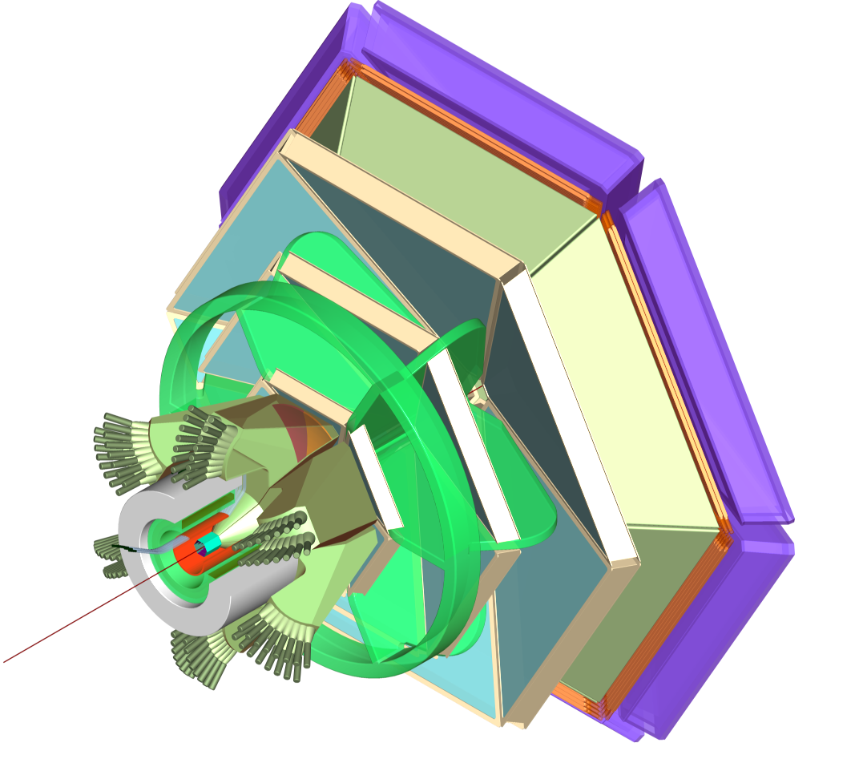
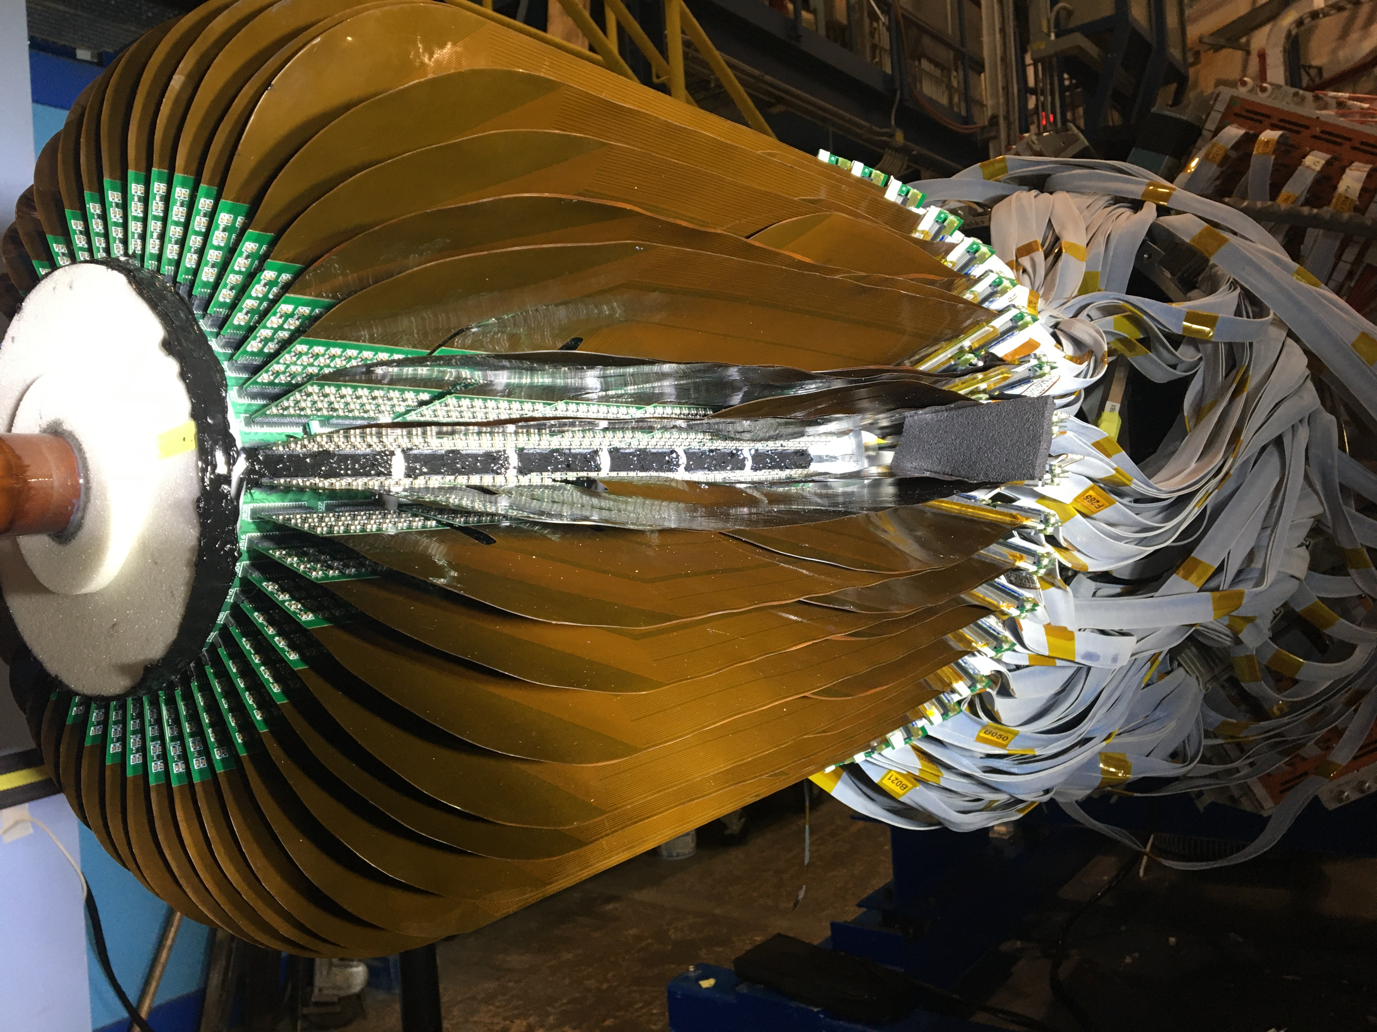
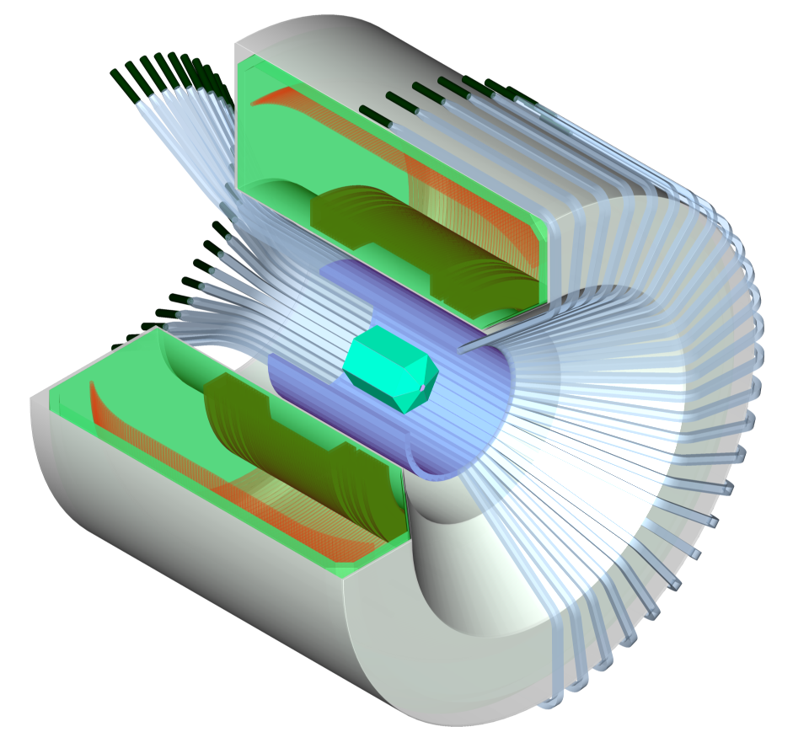
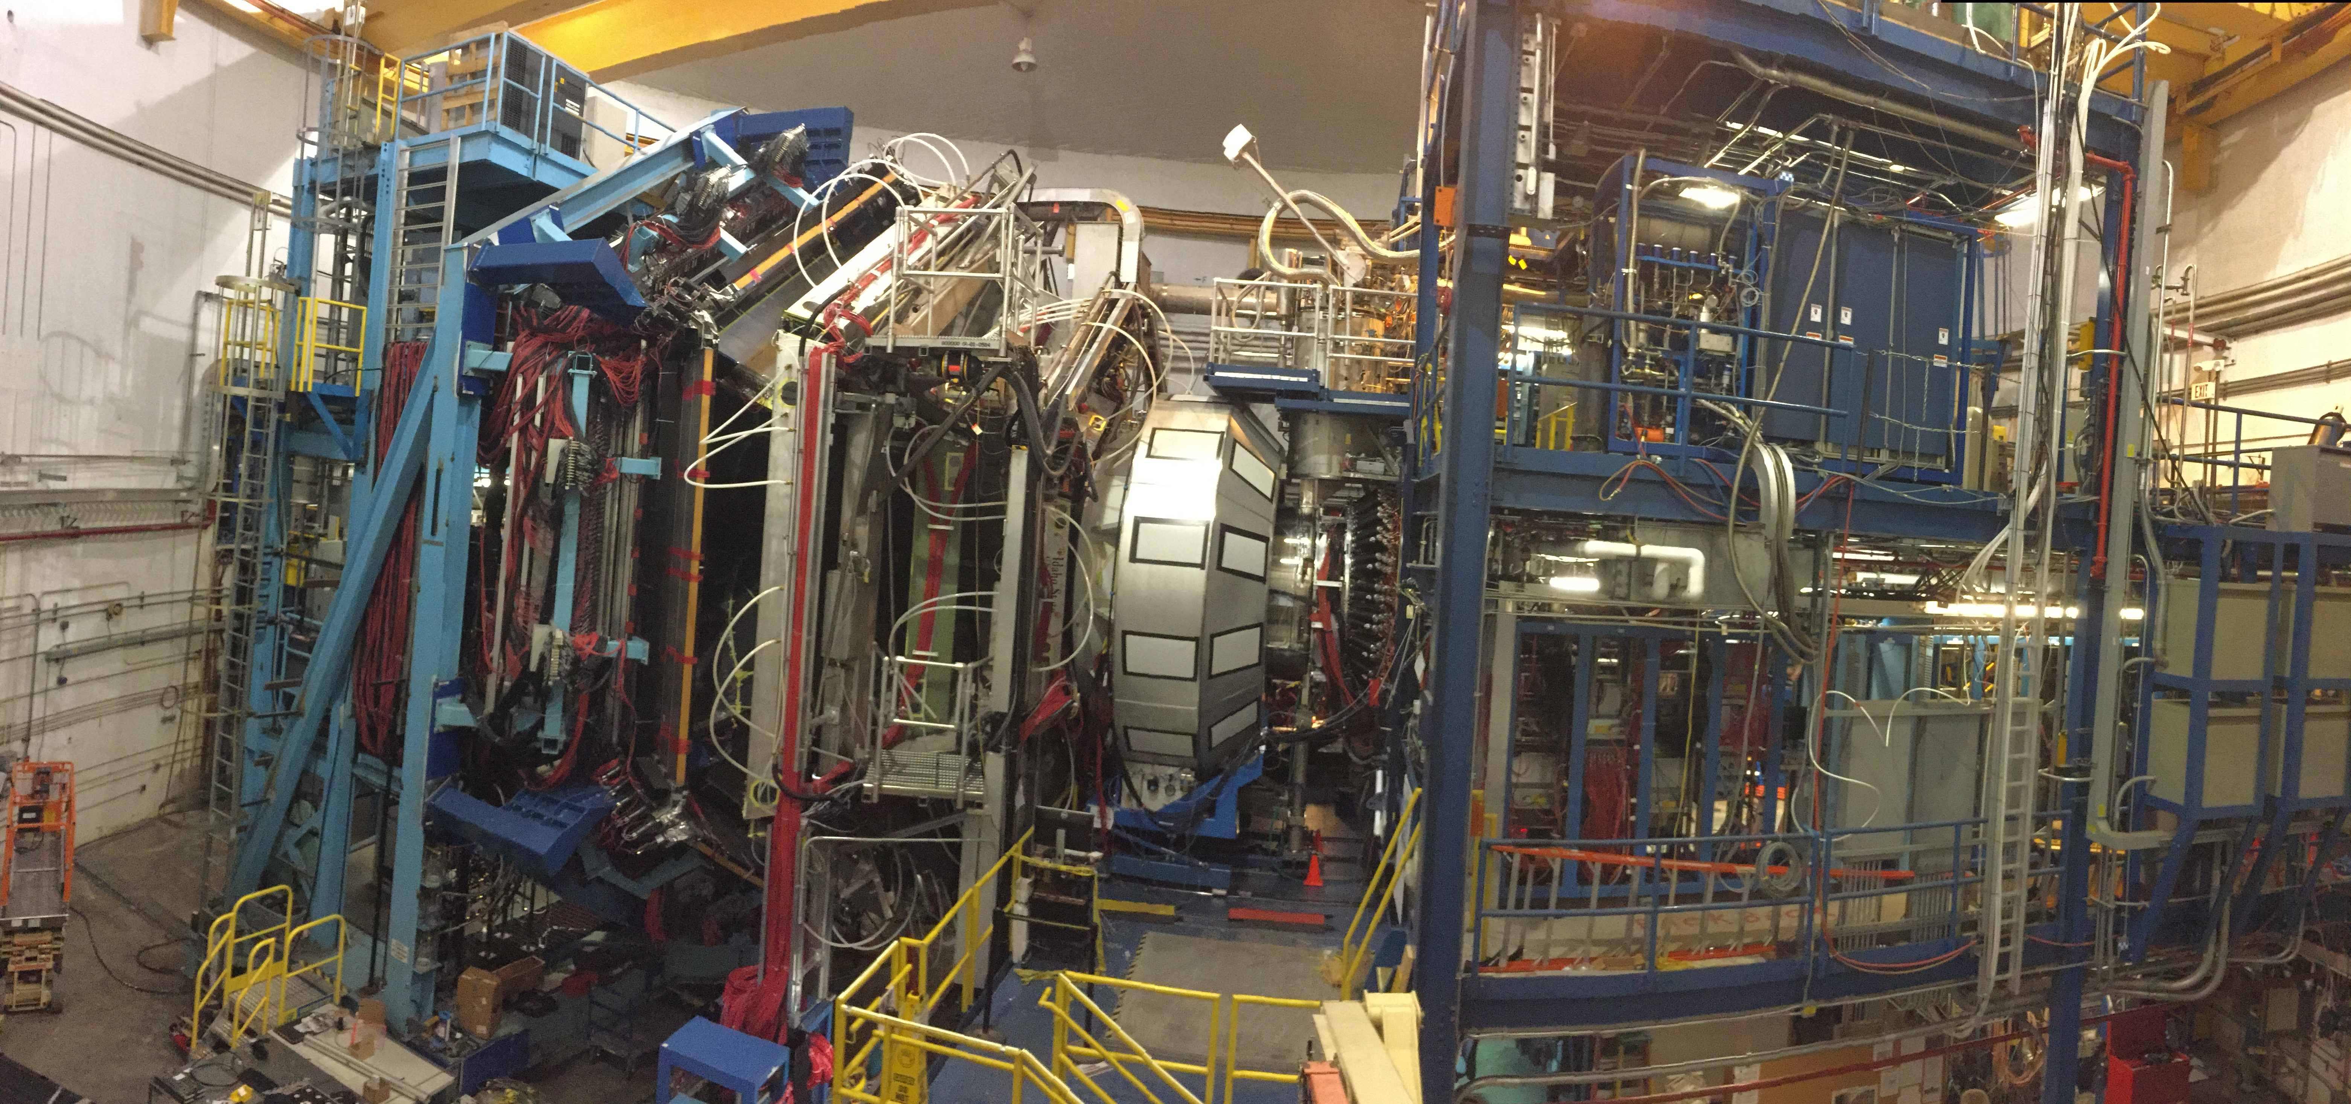
2020 E12-06-113 “BONUS12”: Larger x and higher Q²
CLAS12
Central
Detector
High Impact
New rTPC
Hall B CLAS12 Spectrometer
Notes:
17

Slide 18
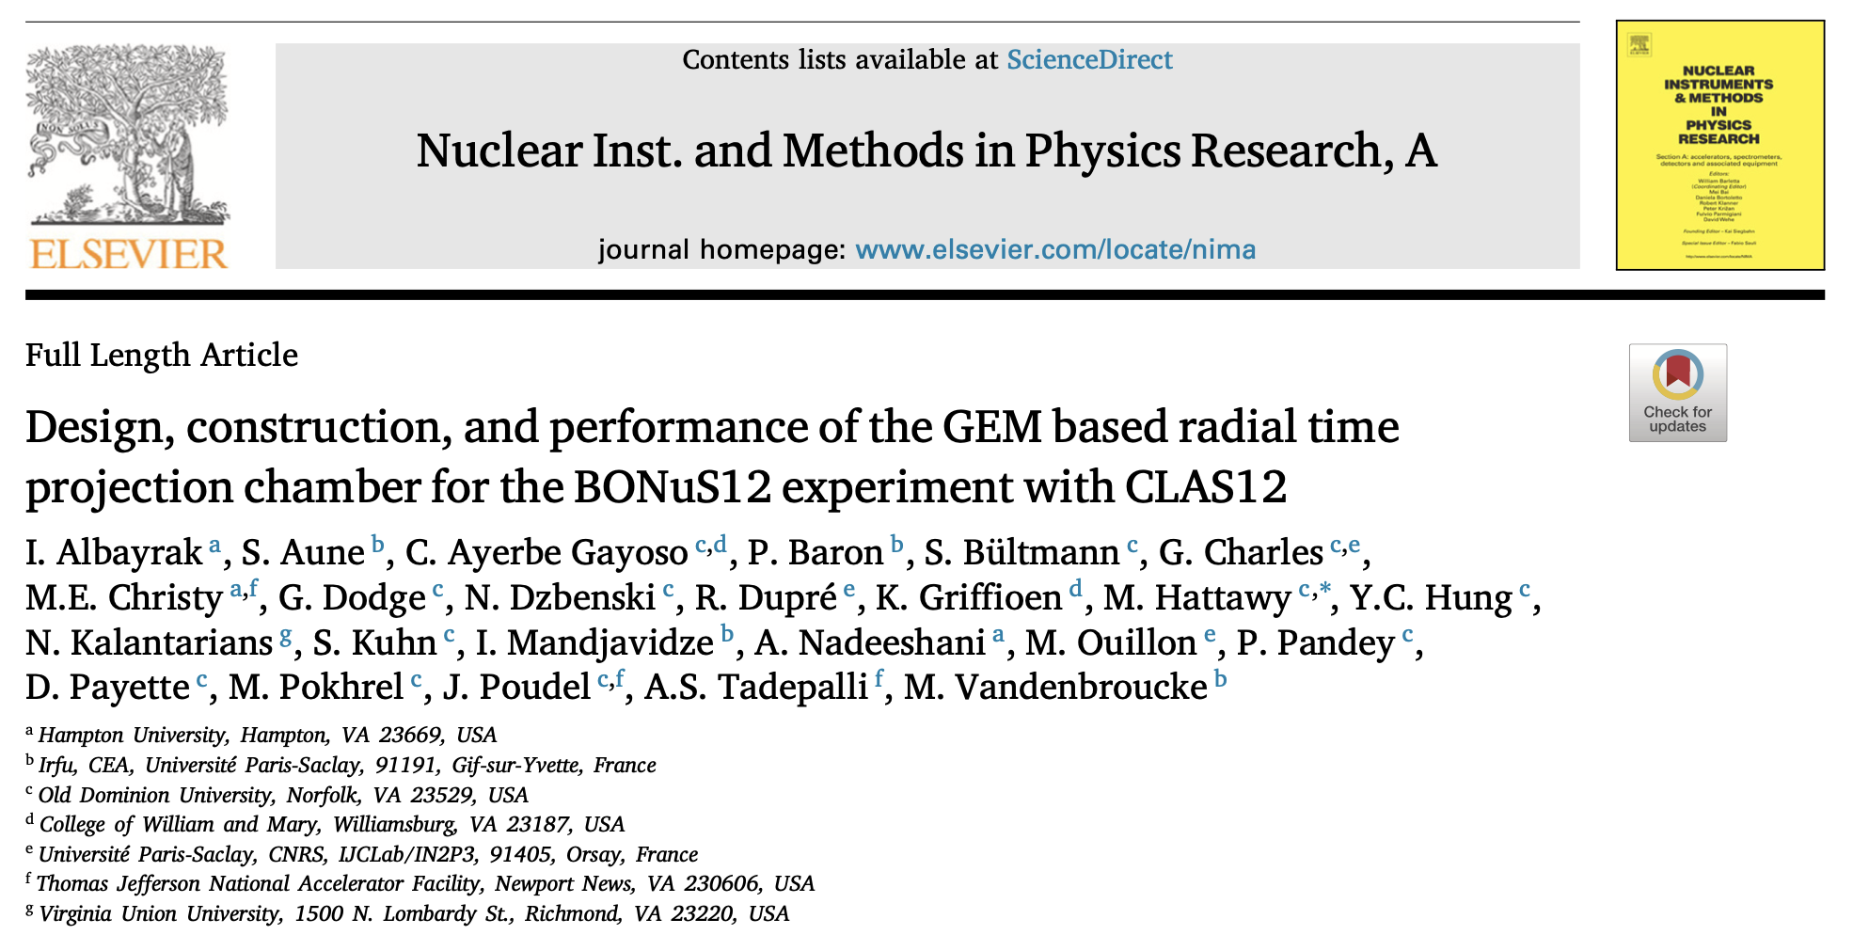
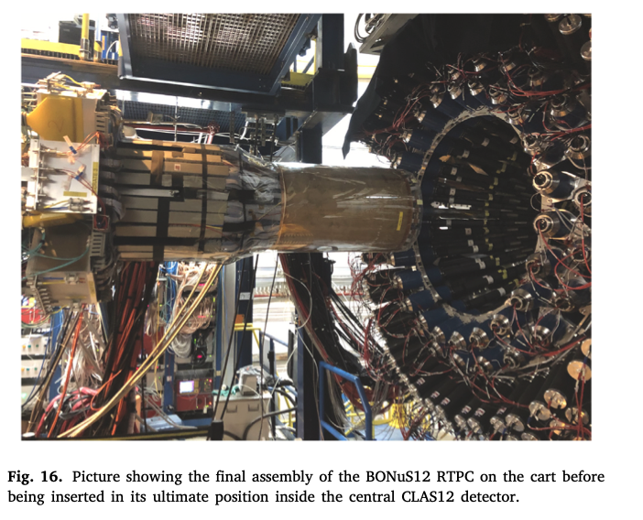
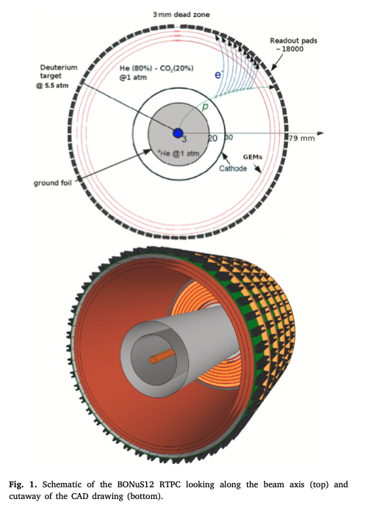
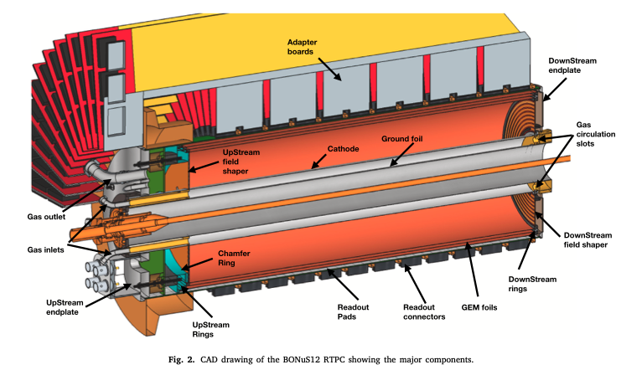

Slide 19
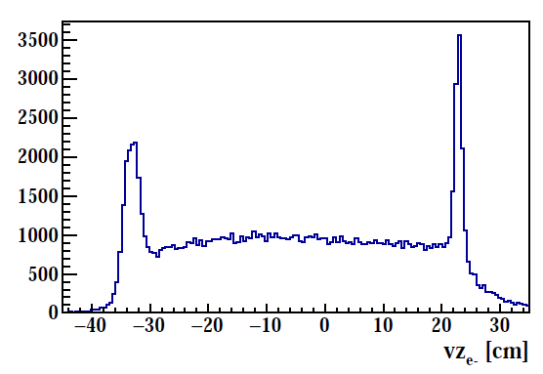
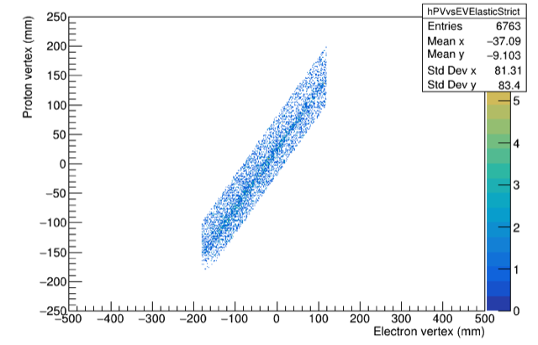
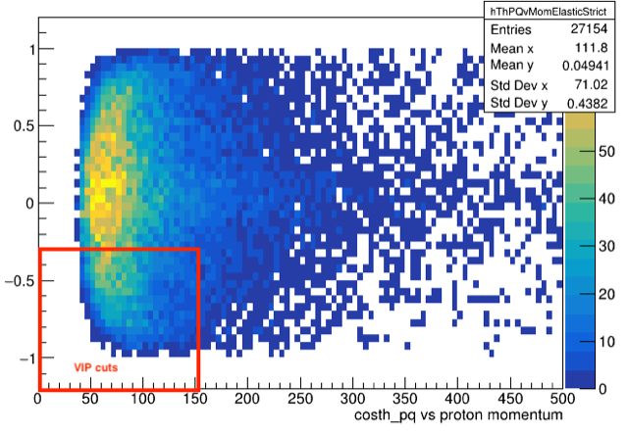
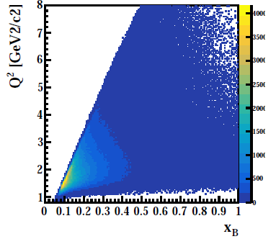
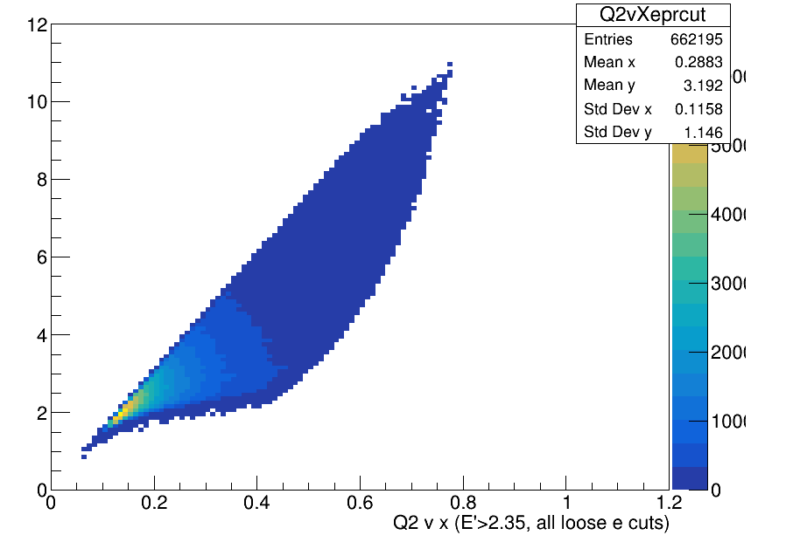
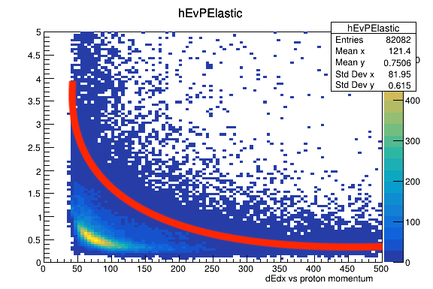
Preliminary Analysis – 5 Pass Data (subset)
e⁻ @10.4 GeV beam on D₂ target
Proton Selection on D₂ target
BONuS12 completed successfully in Summer 2020 with large fraction of proposed data set
→ New RTPC performed very well, major improvements over previous generations
→ Calibrations in progress

Slide 20
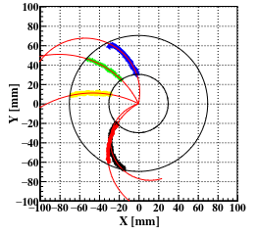
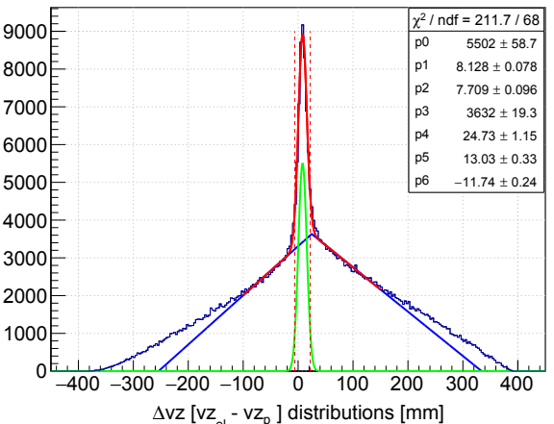
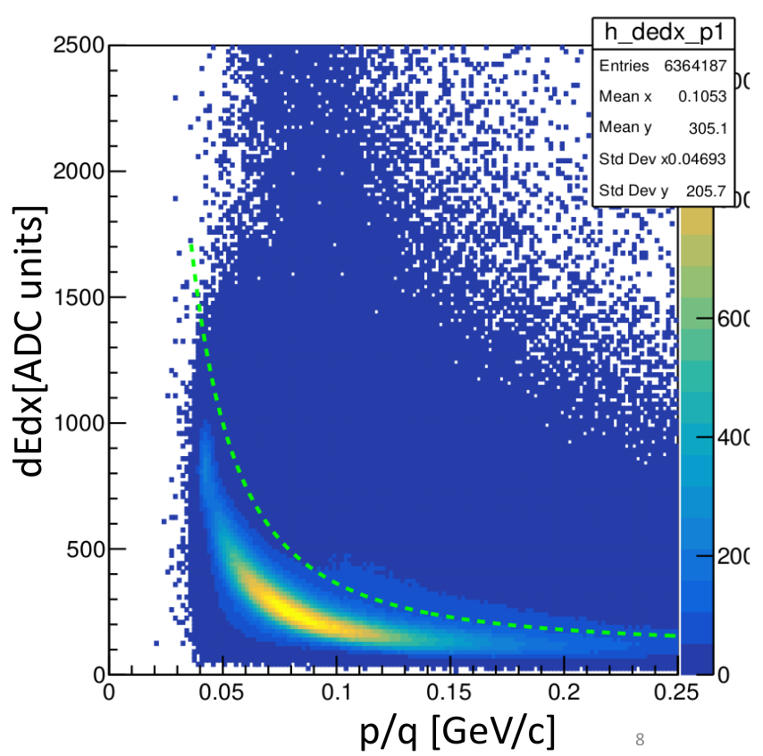
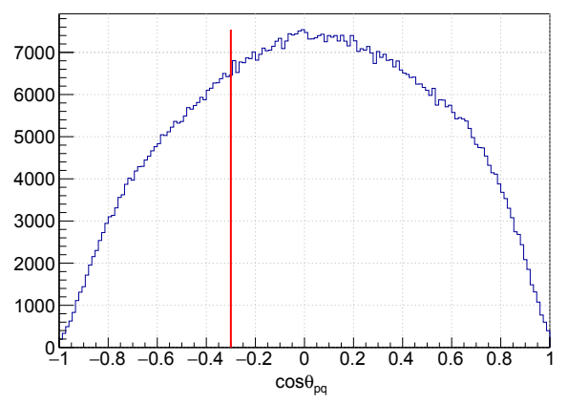
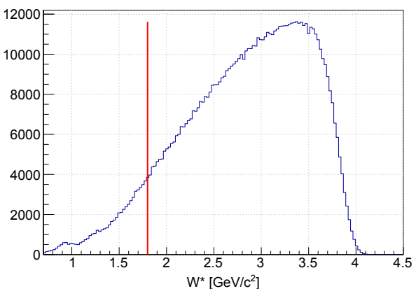
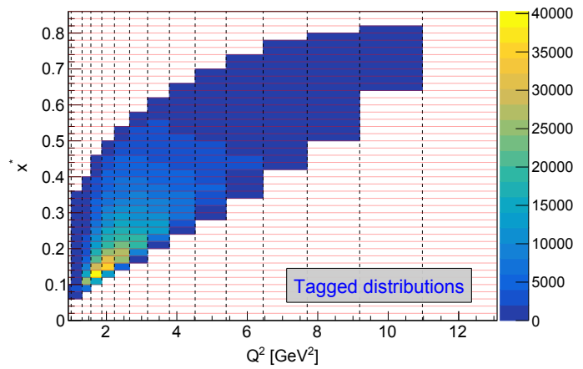
Tagged-Proton nDIS Selection @10.4 GeV
Tagged-Proton Selection from D₂ Data
RTPC track quality cuts:
• The radius of curvature of tracks (< 0)
• Cut on χ² of helix fitter (< 5)
• Number of hits in a track (> 10)
• Cut on the maximum radius (67-72) mm
• Fiducial cut (vz: (-210, 180)mm )
Coincidence cuts
• Vertex coincidence cuts
• Timing coincidence
PID Cuts:
• Cuts on dEdx vs. p/q
band for proton selection
DIS & VIP cuts
• W* > 1.8 GeV
• 0.07 < p < 0.1 GeV/c
• cos(θ_{pq})< -0.3

Slide 21
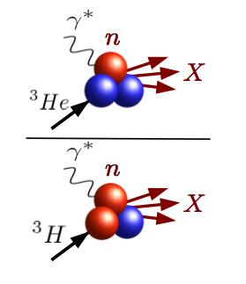



Deep Inelastic Scattering from A=3 Nuclei
Mirror symmetry of A=3 nuclei
  Extract F₂^{n}/F₂^{p} from ratio of measured ³He/³H structure functions
R = SUPER ratio of “EMC ratios” for ³He and ³H
- Relies only on difference in nuclear effects in ³H, ³He
- Calculated to within 1%
- Most systematic and theoretical uncertainties cancel
I. Afnan et al, PRC 68 (2003)

Slide 22

Hall A MARATHON experiment designed to extract F2n/F2p
Used LHRS and RHRS to collect dis e⁻
10.6 GeV electron beam
  0.19 < x < 0.83
  3 < Q2 < 12 (GeV/c)2 1.8 < W < 3.5 GeV/c2
Slide courtesy: Makis Petratos

Slide 23




MARATHON targets
³H, ²H, ¹H, ³He High Pressure Gas Cells Target Ladder structure
Tritium target installed in Hall A after three decades!
Low activity (∼ 1k Ci)
Sealed cell
40K gas
Beam current ≤ 22.5 uA

Slide 24



Results
Data consistent with SLAC E139 & BONUS but extends the measurement to a higher Bjorken-x value
KP model in excellent agreement with data
The highest x points are consistent with the ratio tending to a value between 0.4 and 0.5 at x = 1 (consistent with predictions of pQCD, quark counting rules and DSE)

Slide 25

HMS Production Settings
Setting (deg) | P₀ (GeV/c)
21 | 3.3, 4.0, 4.5, 5.1, 5.7
59 | 1.05, 1.18, 1.35, 1.5
E12-10-002 F2 Experiment in Hall C
JLab12 GeV Commissioning Experiment in Hall C
• Data taken in Spring 2018
• Single Arm (Inclusive) measurement
• Scattered e- detected in spectrometers
• Hydrogen and Deuterium Liquid Targets
SHMS Positron Settings
Setting (deg) | P₀(GeV/c)
21 | 2.7
29 | 2.0, 2.7
39 | 1.3, 1.8
SHMS Production Settings
Setting (deg) | P₀ (GeV/c)
21 | 2.7, 3.3, 4.0, 5.1
25 | 2.5, 3.0, 3.5, 4.4
29 | 2.0, 2.4, 3.0, 3.7
33 | 1.7, 2.1, 2.6, 3.2
39 | 1.3, 1.6, 2.0, 2.5

Slide 26


Excellent agreement between SHMS and HMS data
Vast improvement in statistical precision from SLAC data
arXiv:2409.15236v

Slide 27


Additional constraints for global PDF fits
Testing ground for hybrid models like new Kulagin-Petti
Extends precision quark-hadron duality studies to higher Q² than before
Will facilitate comparison to lattice calculations by extracting non-singlet moments
arXiv:2409.15236v

Slide 28


Slide 29




Let’s enter the Nucleon Sea of quarks and anti-quarks!
$\overline{d}\left(x\right)/\overline{u}\left(x\right)$
$\overline{d}\left(x\right)− \overline{u}\left(x\right)$
$\overline{d}\left(x\right)+ \overline{u}\left(x\right)$
Yorktown beach, VA

Slide 30



Nucleon sea (Flavor symmetric?)
Nucleon sea naively assumed to be flavor symmetric
Gluons don’t couple to flavor
Masses of u and d quarks are small and similar, compared to QCD scale
Perturbative contributions calculated to be small!
quark anti-quark pair
gluon splits
recombine into a gluon
D. A. Ross and C. T. Sachrajda, Nucl. Phys. B149, 497 (1979)

Slide 31

NMC (1991)
Gottfried Sum Rule gives insight into the relative light quark flavor content of the nucleon
Symmetric sea implies S_{G} = 1/3
NMC experiment (LD2, LH2, 90 GeV and 280 GeV muon beam)
After extrapolation to 0 and 1
Amaudruz et. al. Phys. Rev. D 66, 21
Arneodo et. al. Phys. Rev. D 50, 1

Slide 32

E866 (1998)
  Mapped out the x dependence
  Overturn at 0.2
  Drop in the ratio below 1 at x_{B} = 0.25 (limited statistical uncertainty and bin on edge of acceptance)
  This asymmetry has to come from a non-perturbative origin!
R.S. Towell et. al. Phys. Rev. D 64, 244-250

Slide 33


Origin of the Nucleon sea
Symmetric (perturbative and non-perturbative) component cancels away in the difference
HERMES explored this region with modest precision
Non-perturbative models are motivated to explain the observed difference
D.F. Geesaman, P.E. Reimer Rept.Prog.Phys. 82 (2019) 4, 046301
Peng et al. Phys. Rev. D 58 092004

Slide 34


SeaQuest $\overline{d}\left(x\right)/\overline{u}\left(x\right)$ results
SeaQuest results show that nature prefers dbar over ubar in the proton sea
Non-perturbative mechanism other than gluon splitting must be the source
Good agreement with meson baryon model and statistical parton distribution functions
Dove et. al. Nature 590, 561 – 565 (2021)

Slide 35



SeaQuest $\overline{d}\left(x\right)− \overline{u}\left(x\right)$ results
Results of $\overline{d}\left(x\right)− \overline{u}\left(x\right)$ for SeaQuest experiment
Extends the kinematic reach beyond 0.35
In agreement with NuSea about contribution coming from a non-perturbative component
Dove et. al. Nature 590, 561 – 565 (2021)

Slide 36


Absolute cross sections from p+d interactions
The proton deuterium data can be used to investigate $\overline{d}\left(x\right)+ \overline{u}(x)$ at intermediate x, where the sea quark distribution is poorly known.
To calculate $\overline{d}\left(x\right)− \overline{u}(x)$ from $\overline{d}(x)$/$\overline{u}(x)$ knowledge of $\overline{d}\left(x\right)+ \overline{u}(x)$ is required
$\overline{u}(x)$ well known at intermediate-x . On the contrary $\overline{d}\left(x\right)+ \overline{u}(x)$ has huge uncertainties for x > 0.3
u(x) uncertainty
NNPDF3.0, Q = 5 GeV
uncertainty

Slide 37

$\overline{d}\left(x\right)+ \overline{u}\left(x\right)$ from SeaQuest
Data taken on LD2 target being studied for absolute cross sections
Analysis in progress
Expected Statistical uncertainty
LD2
x
x2 distribution
~25% collected data

Slide 38


W⁺/W⁻ cross sections and ratios at RHIC
p + p collisions at RHIC at c.m. energies of 500 and 510 GeV
W⁺/W⁻ cross section ratios
Complimentary measurements to NuSea and SeaQuest
J. Adam et al. (STAR Collaboration) Phys. Rev. D 103, 012001

Slide 39



Slide courtesy: Chris Cocuzza

Slide 40

End of Lecture 2!

Slide 42
Some review articles
"The theory and phenomenology of polarized deep inelastic scattering", M. Anselmino, A. Efremov, E. Leader, Physics Reports 261 (1995) 1-124.
"Spin physics and polarized structure functions", B. Lampe, E. Reya Physics Reports 332 (2000) 1-163.
"The spin structure of the nucleon", B.W. Filippone and X. Ji, Advances in Nuclear Physics 26 (2001) 1.
"The spin structure of the proton", S.D. Bass, Reviews of Modern Physics 77 (2005) 1257-1302.
"Review of structure functions", B. Foster, A.D. Martin, M.G. Vincter, Review of Particle Properties 2009, chapter 16.
"Spin structure of the nucleon – status and recent results", S.E. Kuhn, J.-P. Chen, E. Leader, Progress in Particle and Nuclear Physics 63 (2009) 1-50.
"Understanding the proton's spin structure", F. Myhrer and A.W. Thomas, Journal of Physics G. Nuclear and Particle Physics 37 (2010) 023101.

Slide 43

https://indico.jlab.org/event/520/contributions/9390/attachments/7696/10742/Petratos-JLab24-Messina.pdf

