Slide 1

Measuring Valence Quarks
Lecture 1: Elastic scattering,
Deep Inelastic Scattering and Structure Functions
Arun Tadepalli – Jefferson Lab

Slide 2
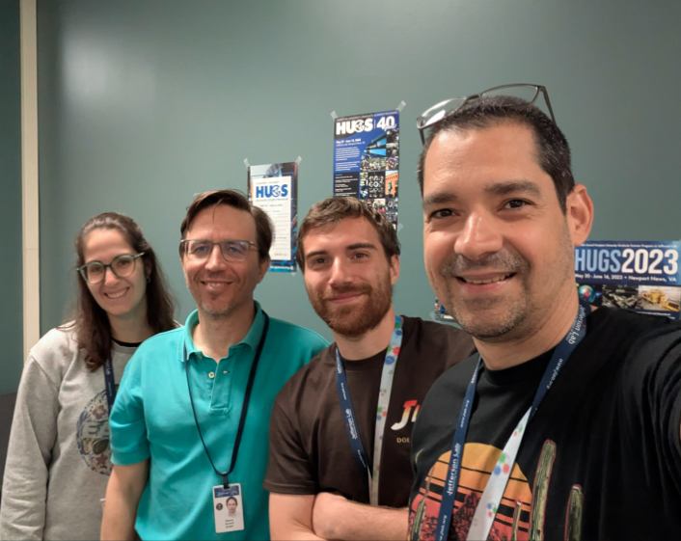
Thank you, HUGS40 Avengers!

Slide 3



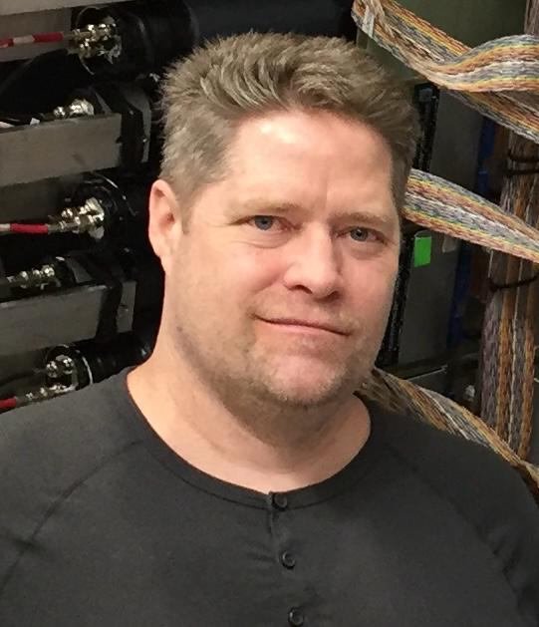

Special thanks for sharing slides
William Henry
JP Chen
Xiaochao Zheng
Sebastian Kuhn
Mohammad Hattawy
Mark Dalton
Provakar Datta
John Arrington
Cynthia Keppel
Paul Reimer
Eric Christy
Hanjie Liu

Slide 4
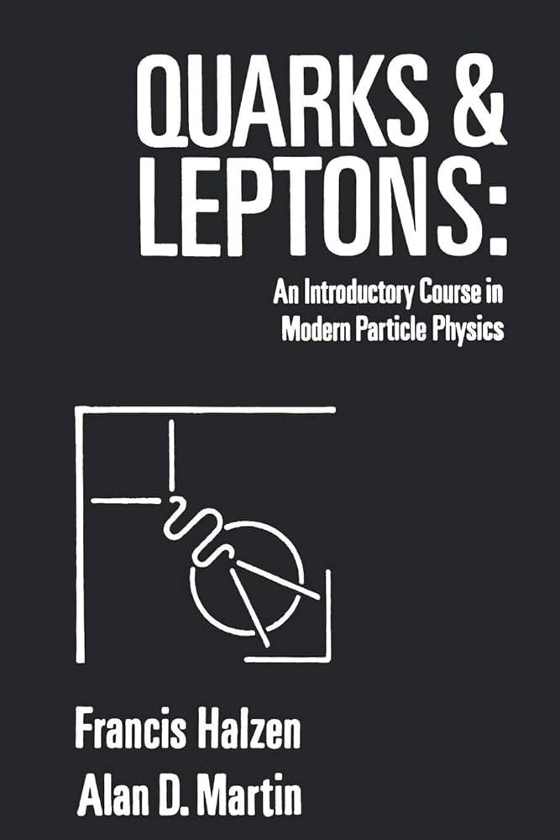
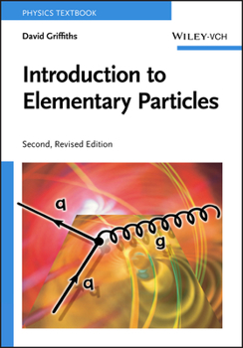
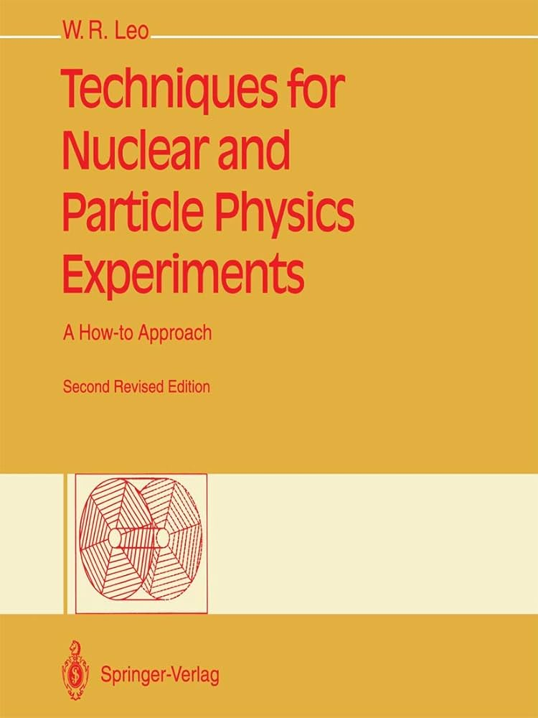
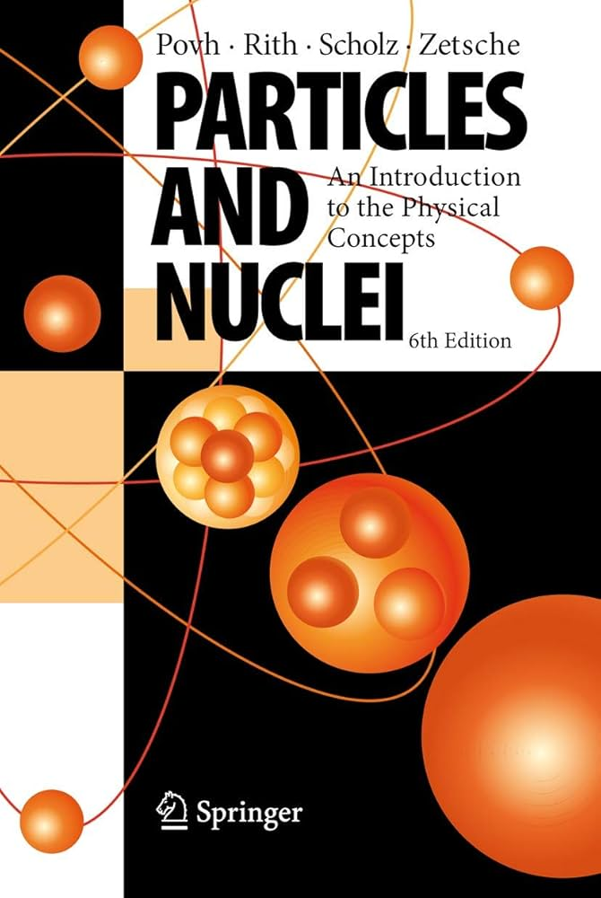
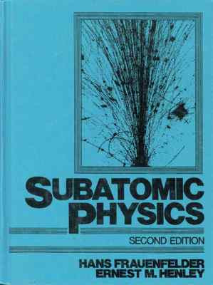
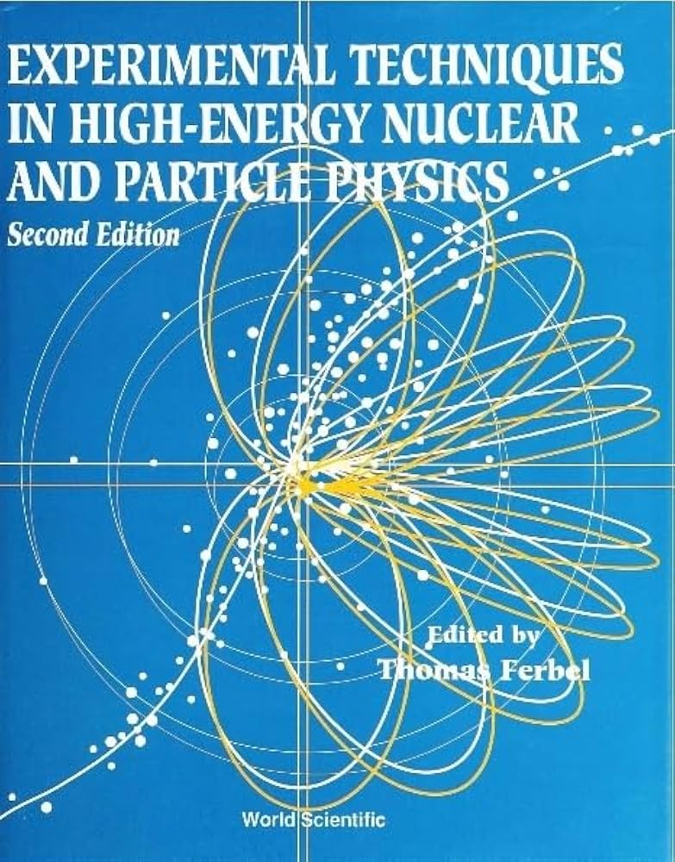
Textbooks that have been lifelong friends…
Your PhD
thesis advisor
(Favorite Mentor, Hall Leader)

Slide 5
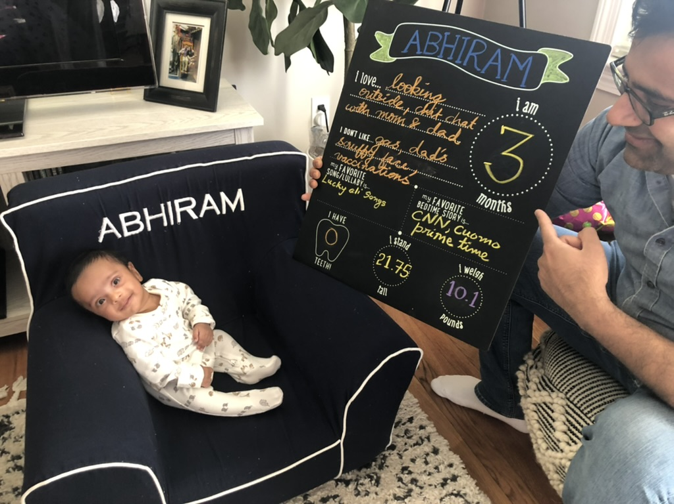
Let’s begin the journey!

Slide 6
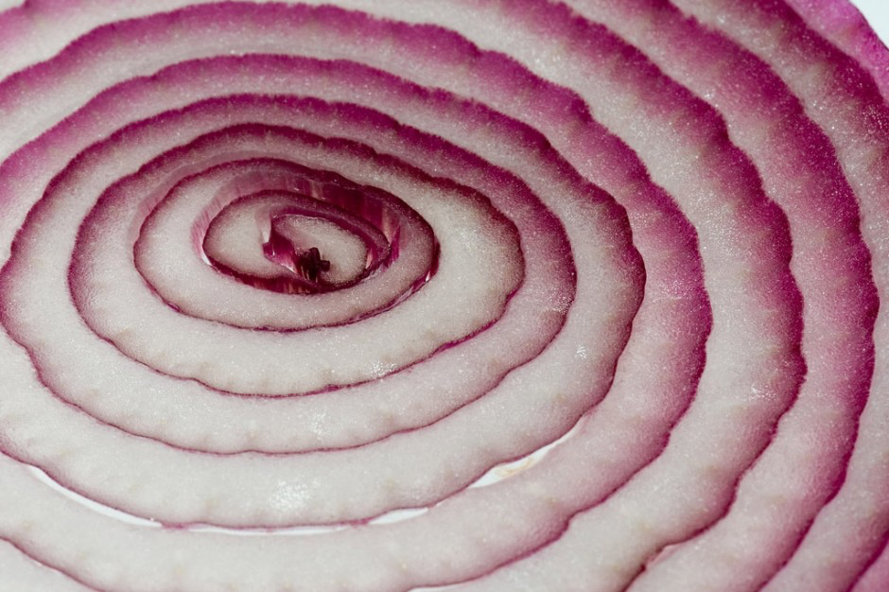
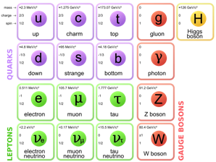
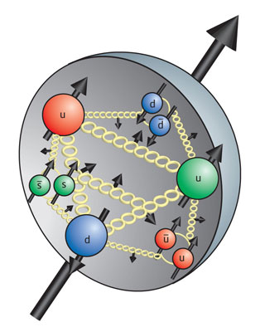
Standard Model of Particle Physics
Constituent Quark picture
Current quark picture
Nucleus
u
p
n
u
d
Experiments all over the world continue to peel the layers of the rich inner substructure!

Slide 7
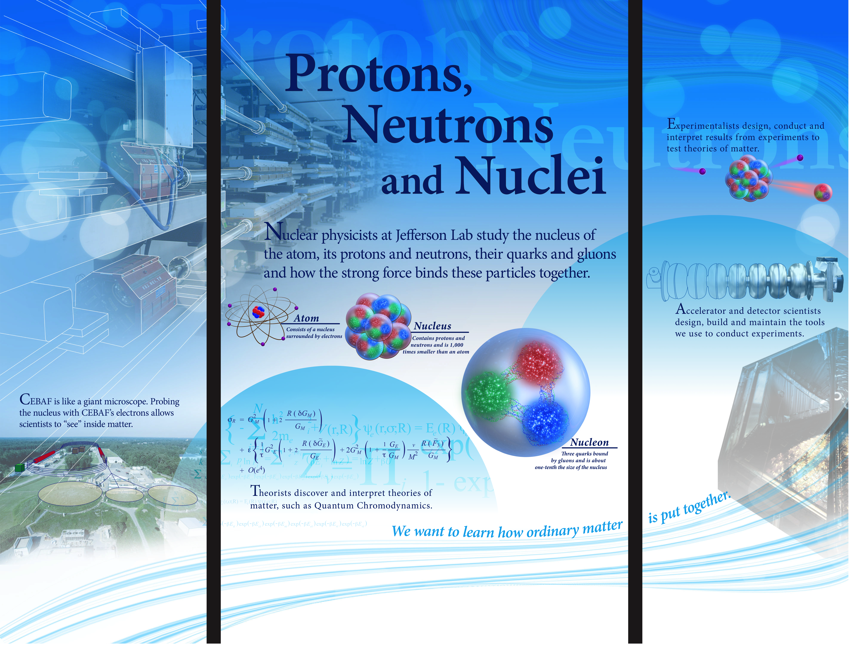
BEAM
TARGET
DETECTORS

Slide 8
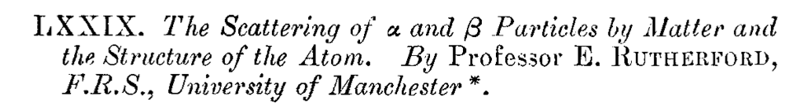
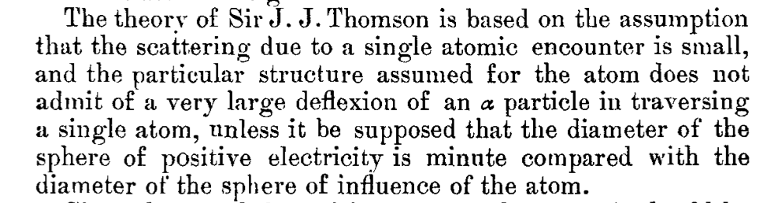
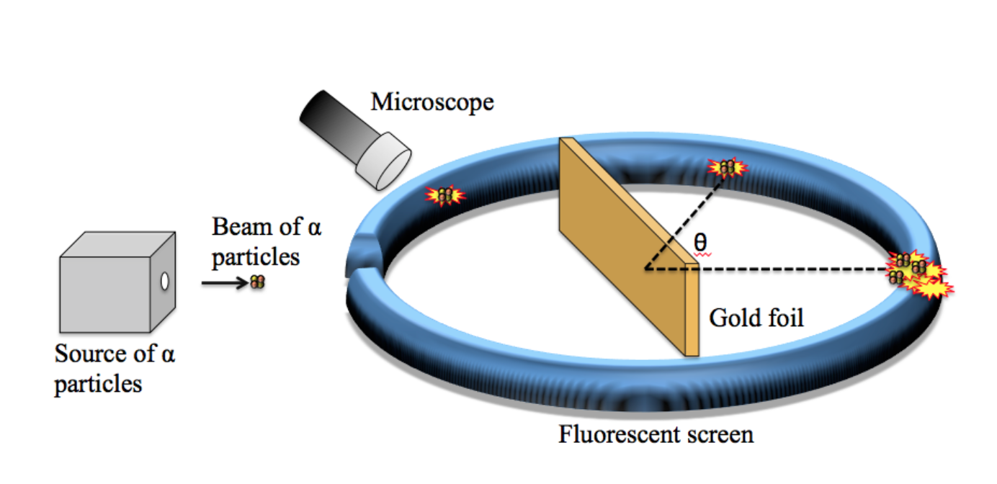
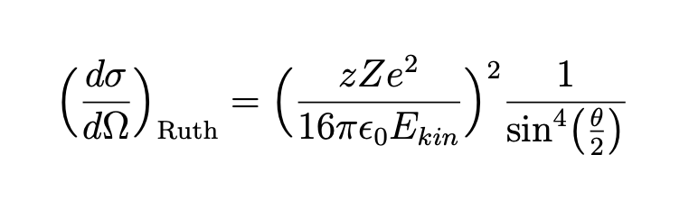
Rutherford’s Gold Foil Experiment
Non-relativistic structureless point particles with spin 0
Rutherford’s gold foil experiment

Slide 9
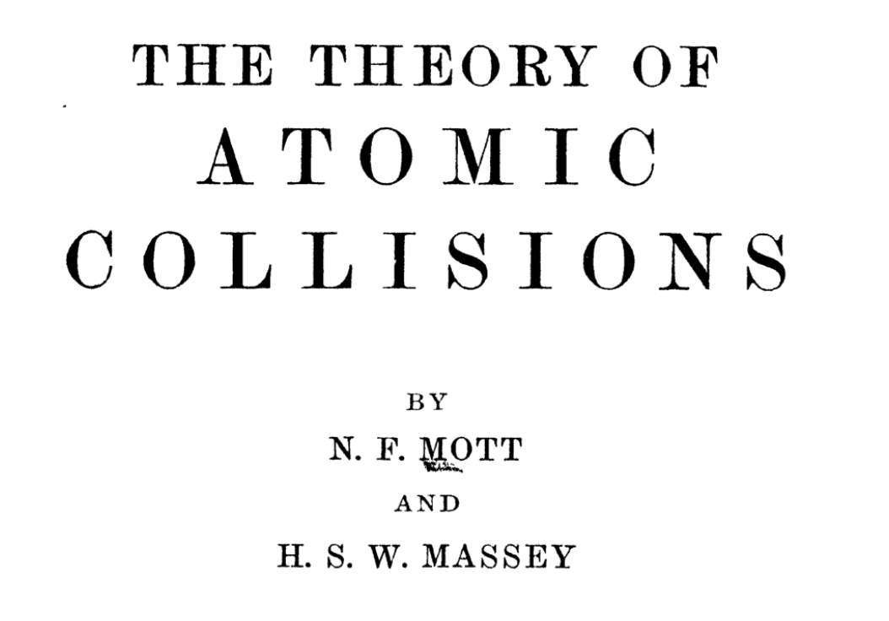
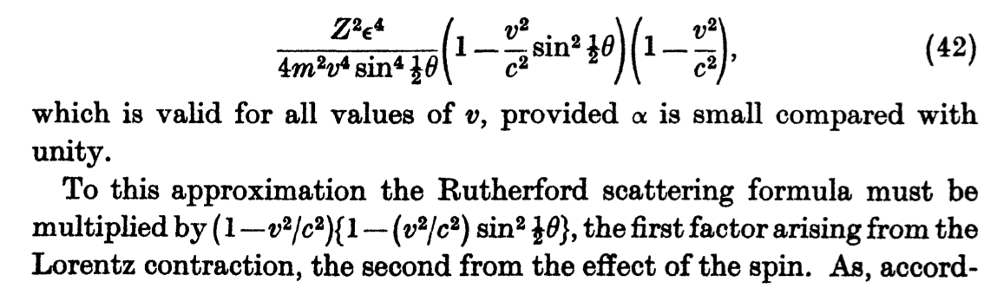
Mott cross section
Page 81
Adding relativistic effects and electron spin
Nevil F. Mott

Slide 10
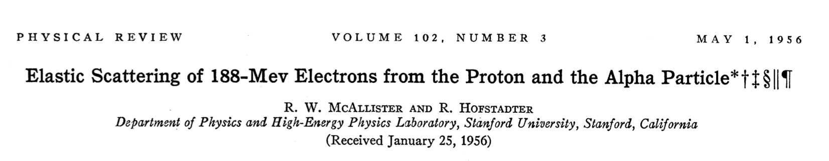
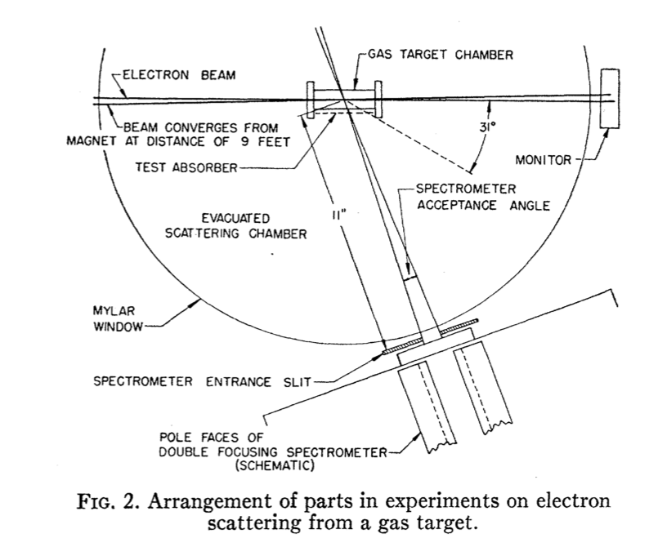
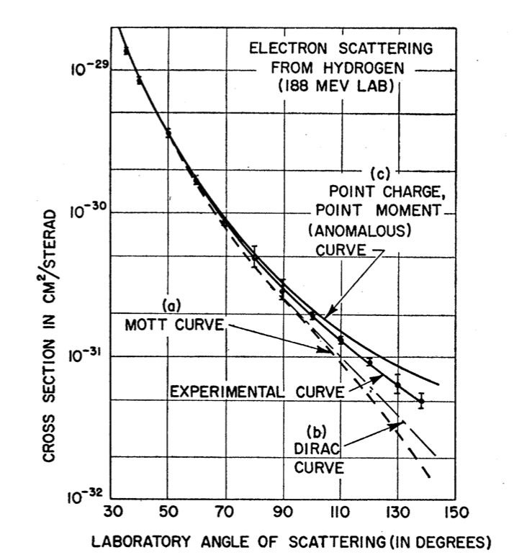
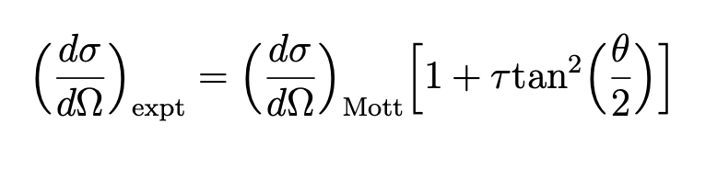

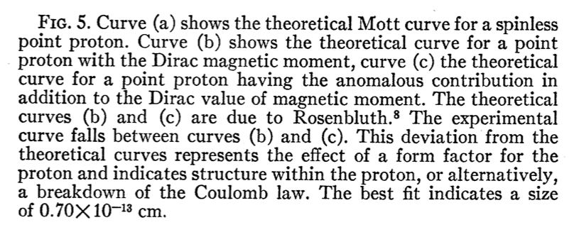
Elastic scattering from Hydrogen
Add nucleon structure F(Q²)
where
Mott curve for a spin-less point
Mott curve for proton with 𝜇_{p} = 2
Mott curve for proton with anomalous 𝜇_{p}
None of the above. Proton has an extended structure!

Slide 11
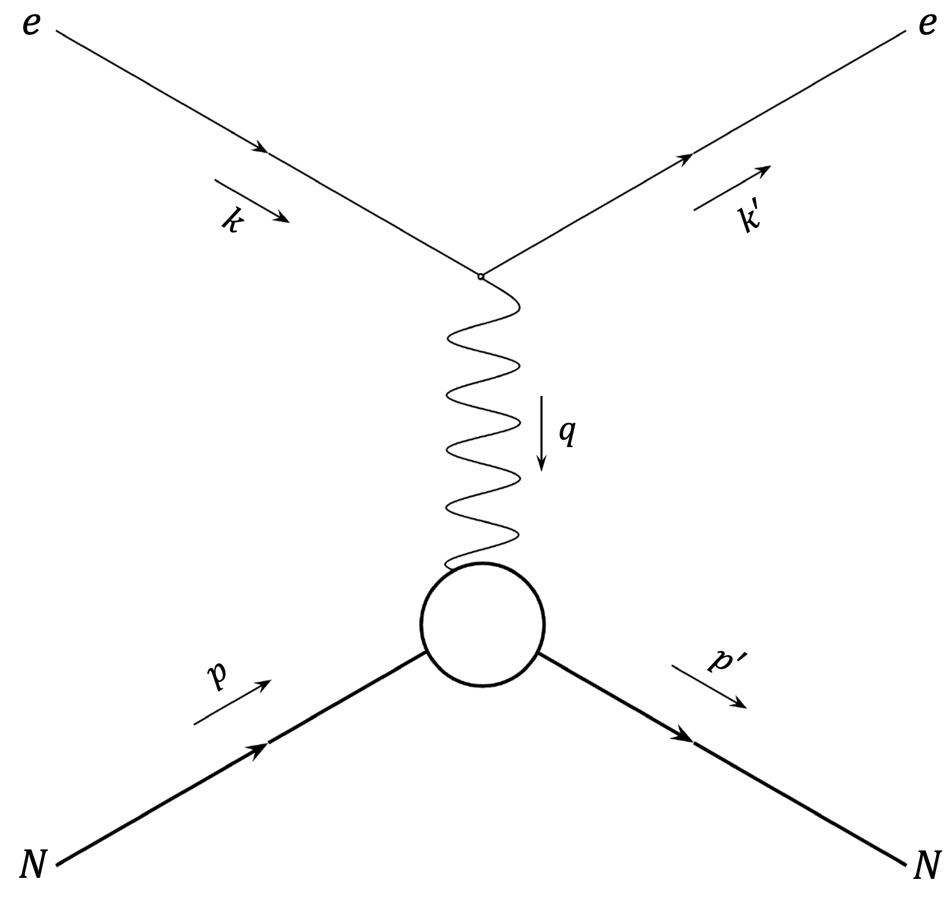
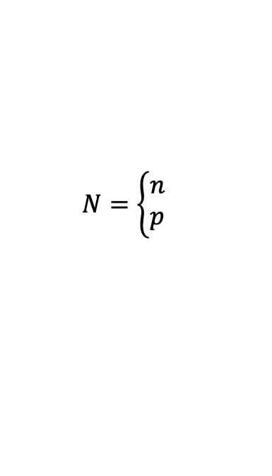


Elastic e-N scattering and Nucleon Form Factors
Leptonic Vertex
Hadronic Vertex
$$N=\left\{\begin{aligned}n \\ p\end{aligned}\right.$$
$⇒$ neutron
$⇒$ proton
The clean leptonic vertex is well understood in QED. The hadronic vertex, characterized by nucleon form factors $F_{1}^{N}$​ and $F_{2}^{N}$, encodes the nucleon’s electromagnetic structure. They are real functions of $Q^{2}$, extracted experimentally.

Slide 12
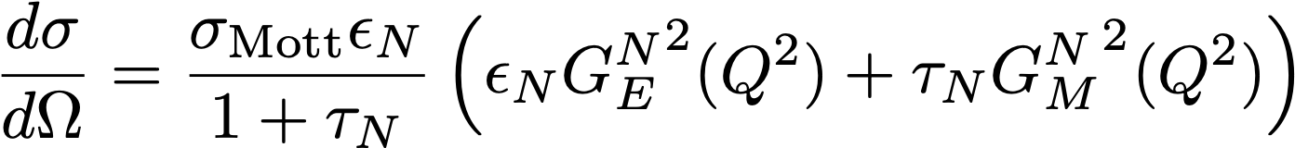
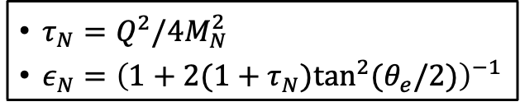
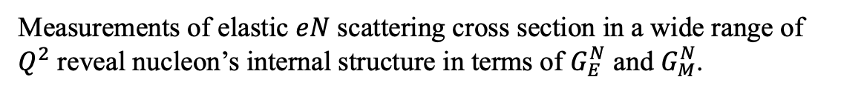
Sach’s Form Factors
Sachs Electric Form Factor
Sachs Magnetic Form Factor
Differential Cross Section in OPE Approx. (Rosenbluth Formula):
$τ_{N}=Q^{2}/4M_{N}^{2}$
$ε_{N}={\left(1+2(1+τ_{N})\tan^{2}(θ_{e}/2)\right)}^{−1}$
Measurements of elastic $eN$ scattering cross section in a wide range of $Q^{2}$ reveal nucleon’s internal structure in terms of $G_{E}^{N}$ and $G_{M}^{N}$.

Slide 13
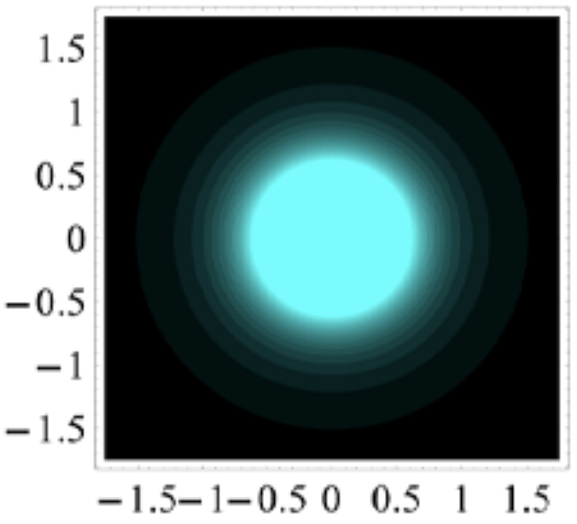
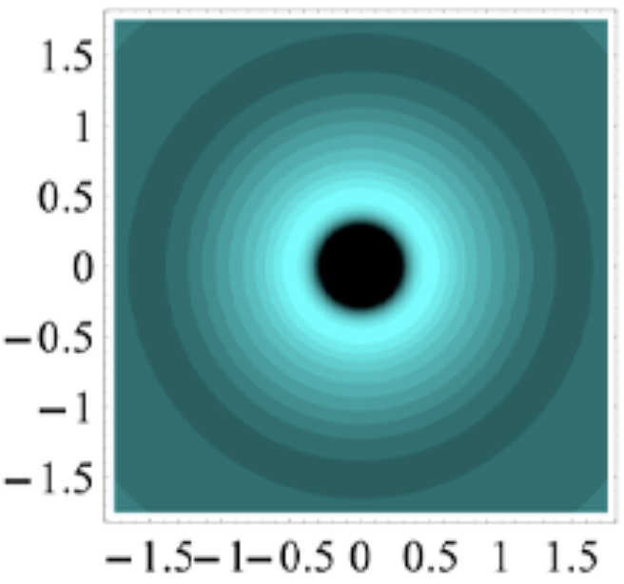
3D Imaging of the Nucleon
“Lightfront” density of Longitudinally Polarized Proton
“Lightfront” density of Longitudinally Polarized Neutron
Negatively charged core!
b_{y} (fm)
b_{y} (fm)
b_{x} (fm)
b_{x} (fm)
Ref: Carlson et al: Phys. Rev. Lett. 100, 032004 (2008)​
At very low $Q^{2},$ where target recoil can be neglected, $G_{E}^{N}$ and $G_{M}^{N}$represent 3D Fourier transform of the spatial charge and current distributions within the nucleon.
At higher $Q^{2}$, $|p_{f}|≠|p_{i}|$ invalidates such a probability or density interpretation. However, the nucleons “lightfront” density interpretation can then be drawn by relating the form factors to the Generalized Parton Distribution (GPD) moments.
Notes:
.. Breaks down and the density interpretation that we can draw in the Breit frame is model dependent. In the IMF however, we can still draw ..which gives us means to visualize the charge distributions inside proton and neutron in the transverse plane.

Slide 14
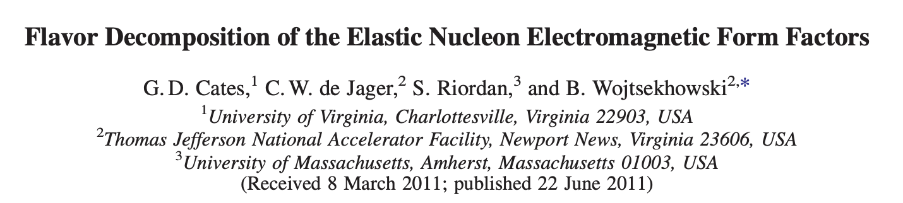
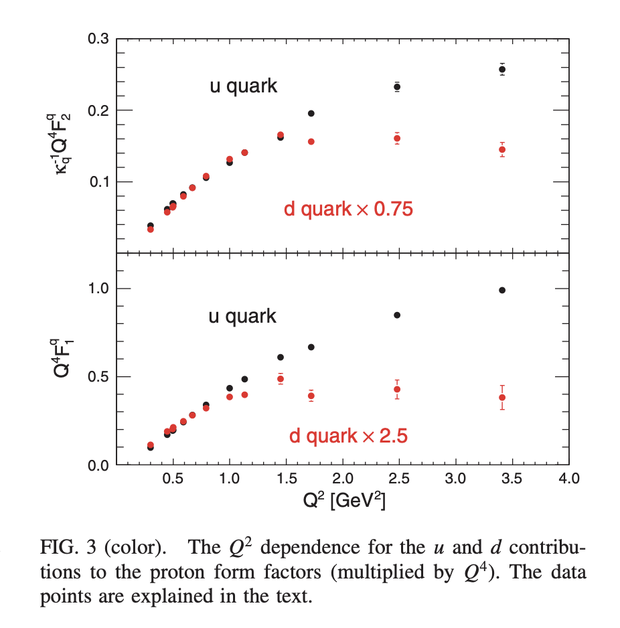

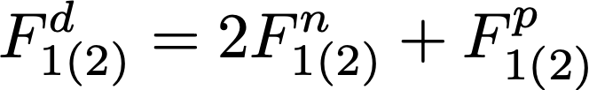
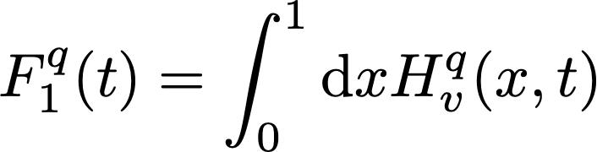
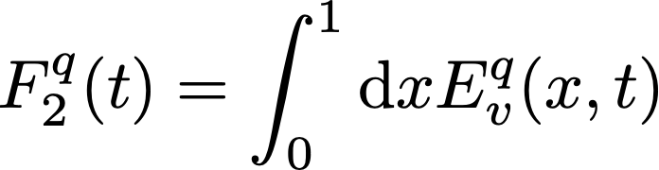
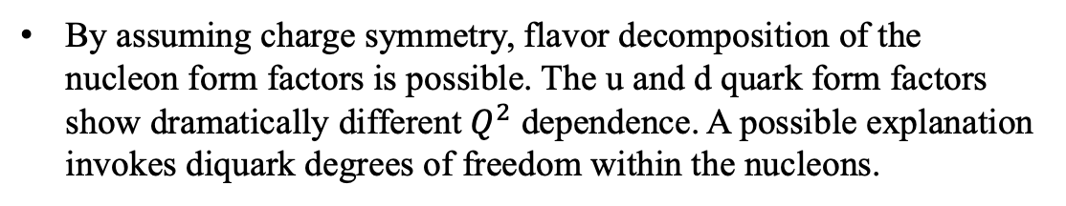
Flavor Decomposition of the Elastic Nucleon Form Factors
By assuming charge symmetry, flavor decomposition of the nucleon form factors is possible. The u and d quark form factors show dramatically different $Q^{2}$ dependence. A possible explanation invokes diquark degrees of freedom within the nucleons.
Nucleon form factors constrain GPDs through sum rules and enables their extraction from hard exclusive processes.
Notes:
Not just 2D charge distribution, EMFF data is crucial for unveiling the 3D structure of nucleons as well.

Slide 15
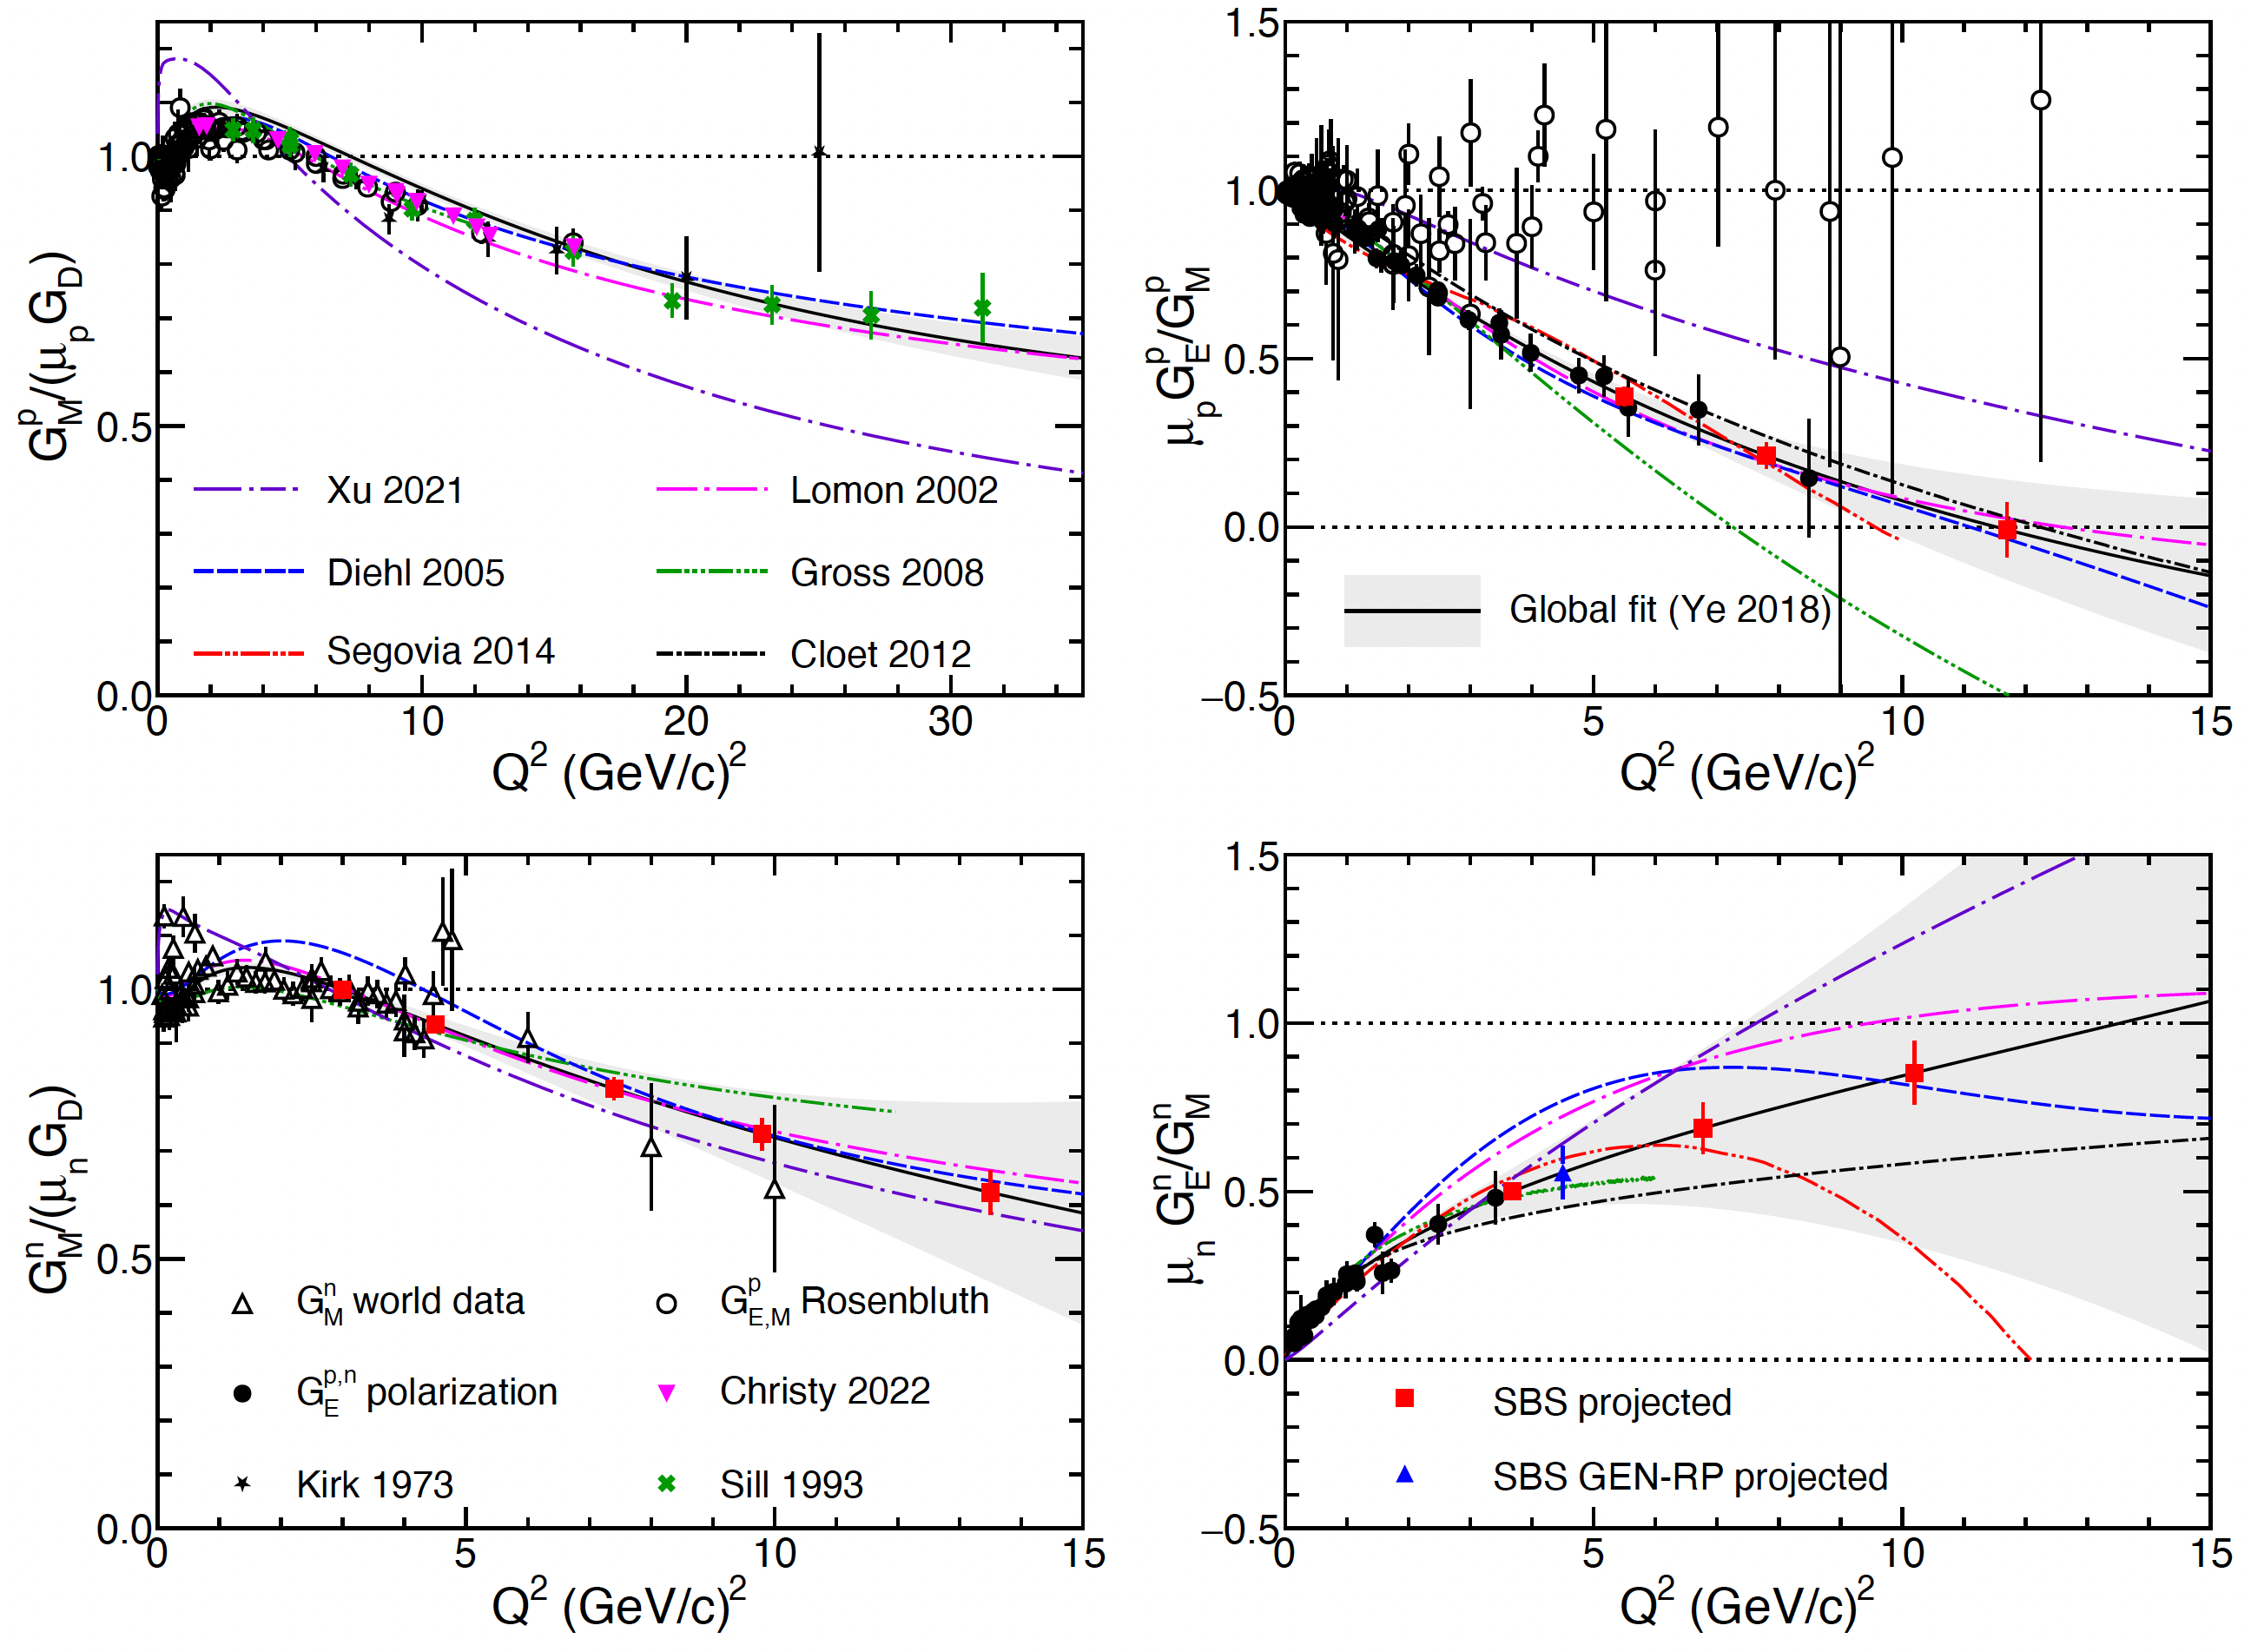

Form Factors of the Nucleon: Current status
[*] Plots from: F. Gross et al., “50 Years of Quantum Chromodynamics,” Dec. 2022. arXiv: 2212.1107

Slide 16
Form Factors of the Nucleon: Current status
SBS Form factor program in Hall A measures unprecedentedly high Q²
  GMp – completed
  GMn - completed
  GEn-II – completed
  GEn-RP - completed
  GEp – in progress
[*] Plots from: F. Gross et al., “50 Years of Quantum Chromodynamics,” Dec. 2022. arXiv: 2212.1107

Slide 17
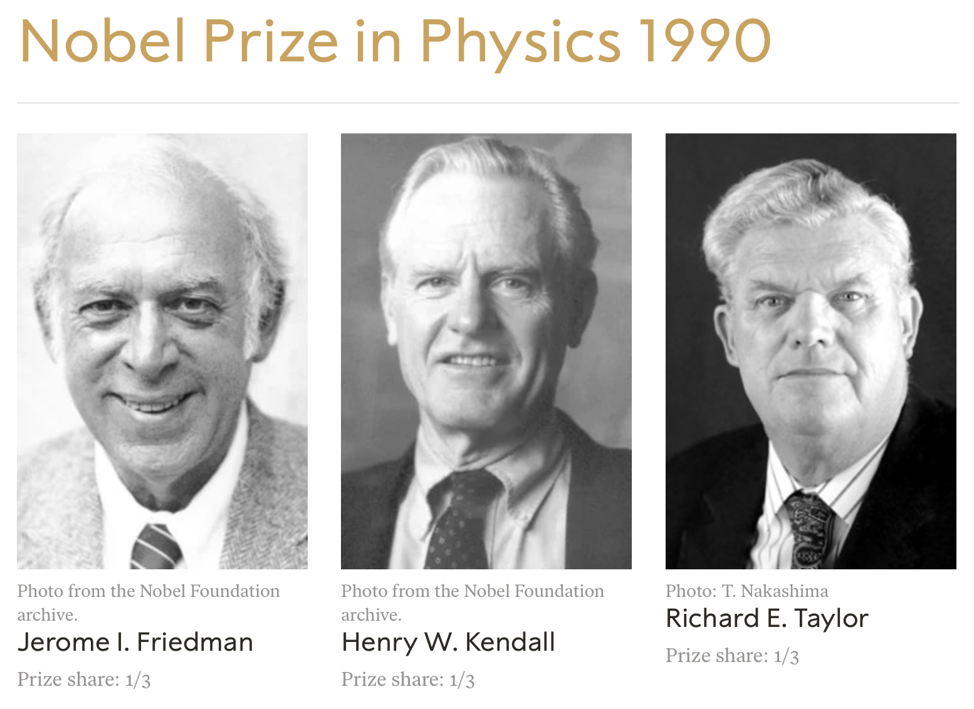
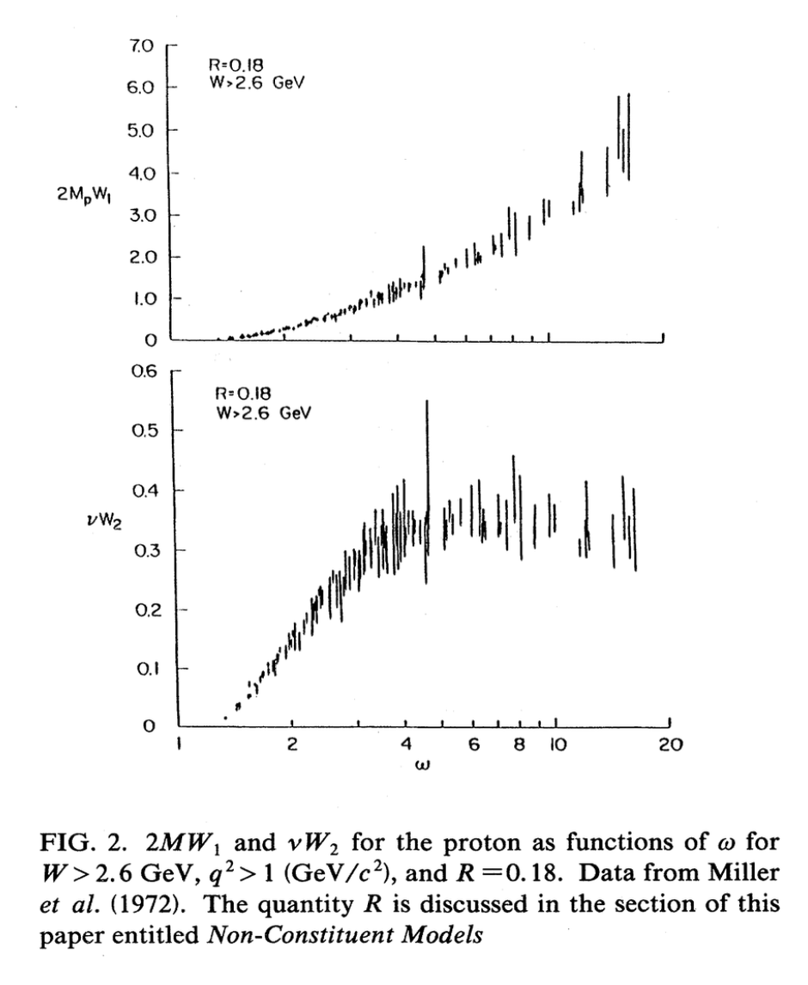
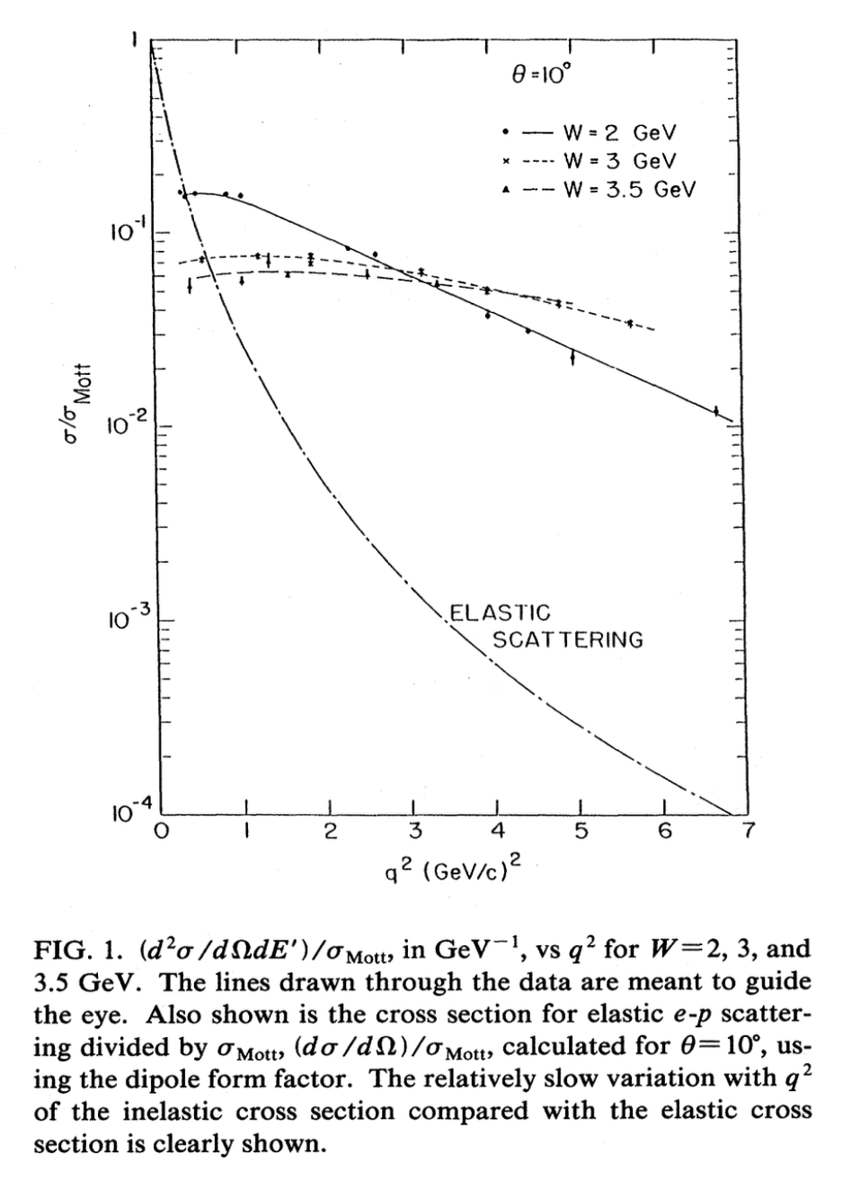
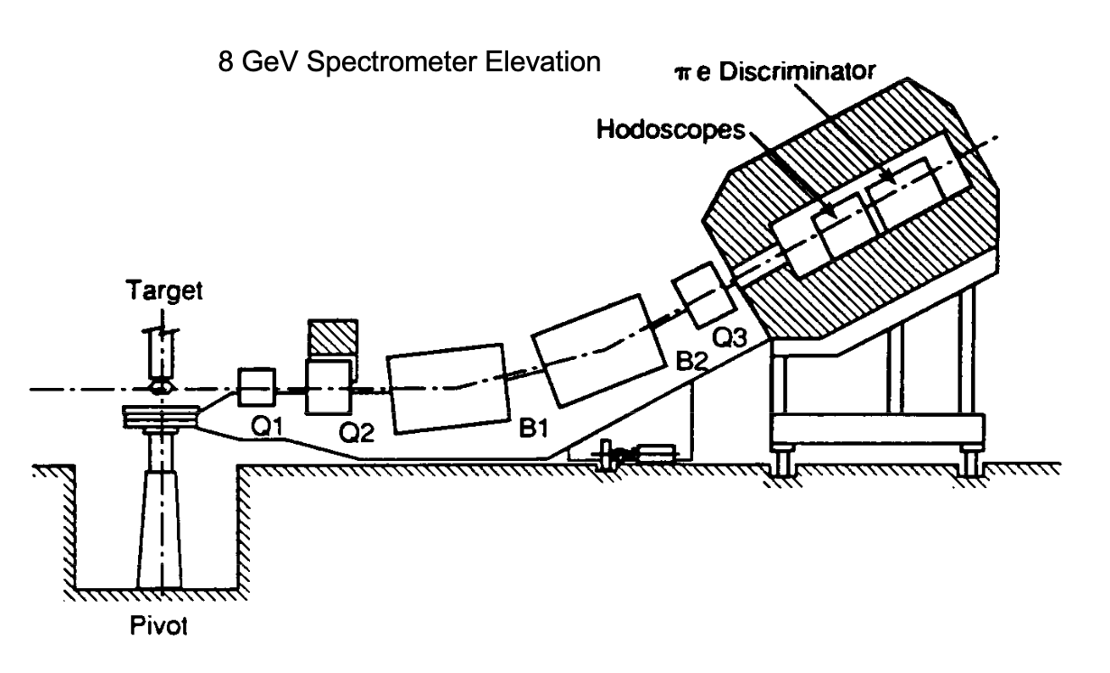
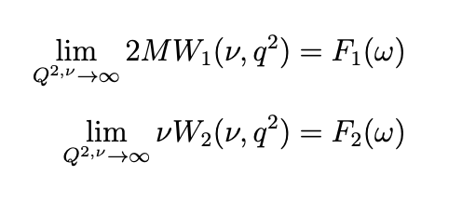
Deep Inelastic Scattering (DIS)
Dependence on ω in the limit Q², ν → ∞
Weak dependence on Q²

Slide 18
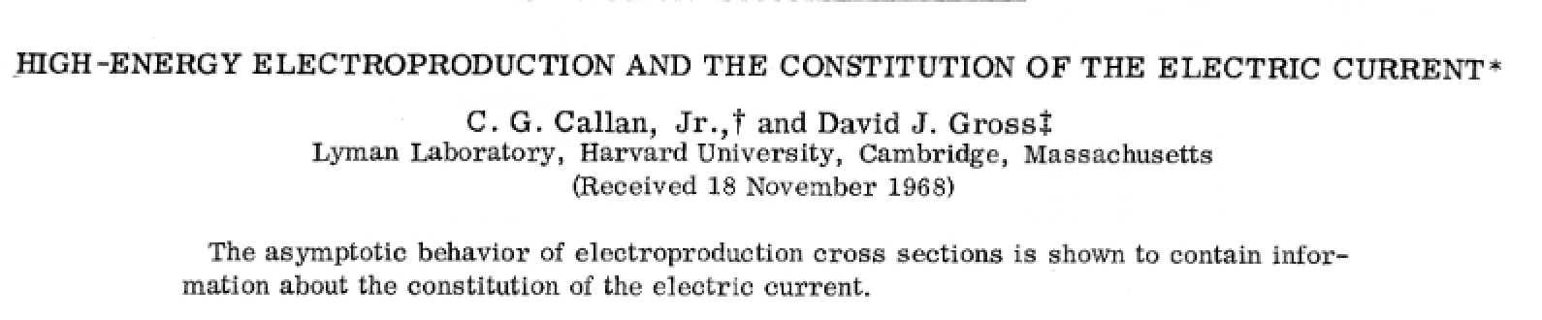
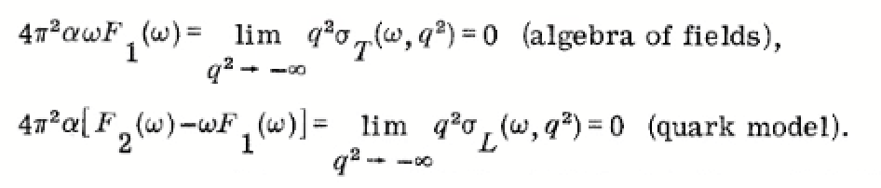

The Quarks are here!
Callan Gross relation 2xF₁ = F₂

Slide 19


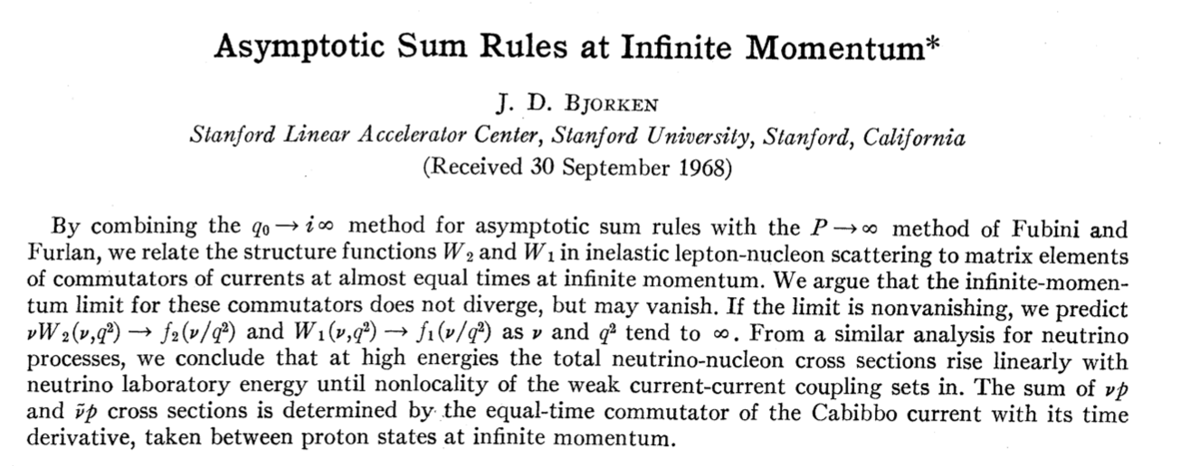
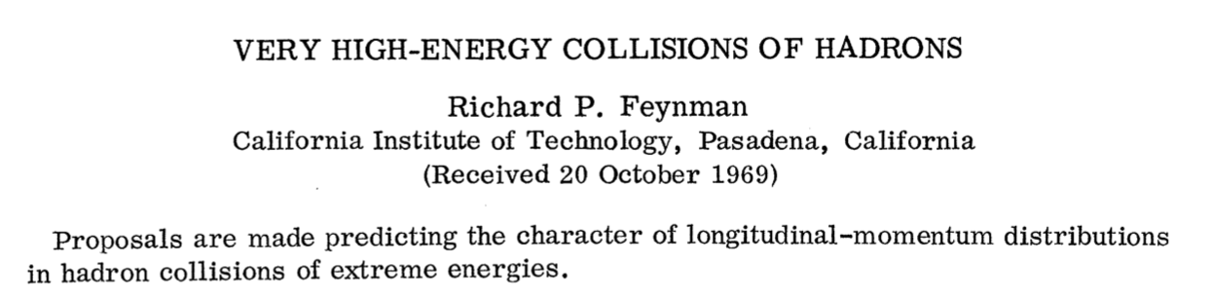
Quark Parton Model
Nucleon consists of partons (quarks and gluons)
Partons carry a fraction x_{Bj} of the nucleon’s longitudinal momentum in the infinite momentum frame
Probability of finding a parton with a momentum between x and x + dx is f(x)dx
f(x) is process independent
Nucleon longitudinal structure can be given as an incoherent sum of the interactions of the various “free partons” under impulse approximation
Richard Feynman
James Bjorken

Slide 20
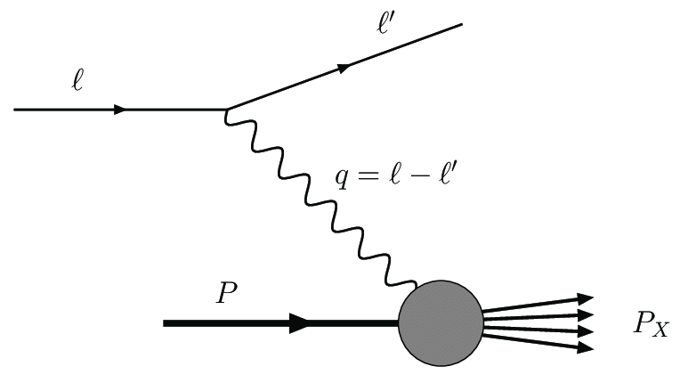
DIS Formalism
Consider the situation in which not everything is detected—e.g. only the scattered electron
Can still write a general cross section formula based on the form factor arguments of elastic scattering
Since ν and Q² are no longer independent, the structure functions are now a function of both
Observation of scaling behavior:
  The cross section did not fall with Q², but tended to depend on a single variable

Slide 21
Deep Inelastic == Elastic scattering from points?
Bjorken
What if deep inelastic scattering is just scattering off of point particles within the nucleus?
Consider the Dirac point scattering formula, writing it in a Lorentz invariant form
Lorentz invariants
Now sum over the distributions of the partons:

Slide 22
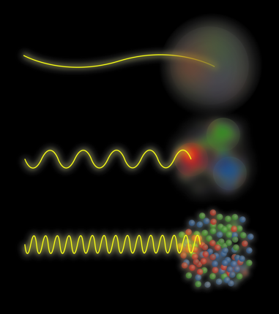
Deep Inelastic == Elastic scattering from points?
Now identify form factors in terms of partons!

Slide 23

Proton
=
Valence quarks
+
Sea quarks
+
Gluons +…?

Slide 24
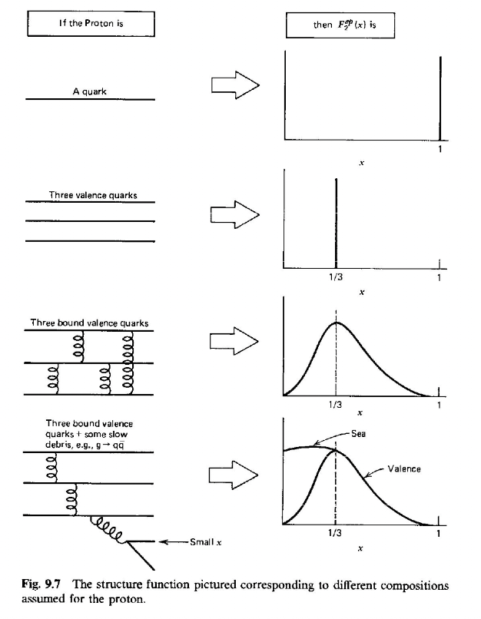

Proton Structure

Slide 25
How can we measure the parton distributions?
Measure hard scattering processes for which cross section calculations can be easily made.
Deep Inelastic Scattering is the work horse here
Compile data from many experiments with different sensitivities and produce a global fit

Slide 26
How can we measure the parton distributions?
Measure hard scattering processes for which cross section calculations can be easily made.
Other processes
Compile data from many experiments with different sensitivities and produce a global fit
Semi-Inclusive deep inelastic scattering
W asymmetry
Drell-Yan

Slide 27
Global fit constraints
2 up valence quarks
1 down valence quark
0 net strange valence quarks
Momentum conservation
Adopt a convenient fitting form:
Make other assumptions

Slide 28
Common Initial Assumption
Neutrons and protons are charge symmetric
In most processes on the proton, there is a e² term giving u quarks twice the weight as d quarks
Considering only protons, you initially have 2x more u quarks than d quarks
This assumption
  Allows the use of data with neutrons
  gives us better access to the d quark distributions
Some fits have dropped this assumption and found some room for charge symmetry violation, but not much and the χ² distributions were basically flat

Slide 29


Main Experimental Toolbox
space
space
time
time
DEEP INELASTIC SCATTERING
Lepton scatters from hadron
Exchange of virtual photon
Excited states of the hadron (or more)
Doesn’t differentiate between quark and antiquark
DRELL YAN PROCESS
Quark from hadron annihilates with antiquark from another hadron
Virtual photon is created
Decays into a lepton + antilepton
Unique sensitivity to the anti-quark distributions

Slide 30



What is the Drell-Yan process?
..bel prize winning
Two prominent features observed
Shoulder between 3 – 4 GeV
Underlying continuum (DY dimuons)
Phys.Rev.Lett. 25 (1970) 1523-1526

Slide 31



Explanation by Drell and Yan
Underlying continuum explained in the framework of the parton model
parton annihilates
with an anti-parton
Model explained only part of the cross section
Phys.Rev.Lett 25.902 (1970)

Slide 32
Leading Order Drell Yan cross-section formula
Higher order diagrams accounts for ~50% of the cross section
space
time
Drell-Yan cross section
Charge weighted summation over all quark flavors
Fine structure constant
PDF of a quark of flavor i in the beam
Center of mass energy squared
momentum fraction of quark in the beam
PDF of anti quarks of flavor i in the target
momentum fraction of the anti-quark in the target

Slide 33
Leading Order Drell Yan cross-section formula
Higher order diagrams accounts for ~50% of the cross section
space
time
Acceptance of the spectrometer can be chosen to study antiquark distributions
Term negligible compared to the first term

Slide 34


Accessing the anti-quark distributions
Detector acceptance tuned to study the antiquark distributions
of the target
Detector acceptance chooses x_{target} and x_{beam}
Fixed target high x_{F} ( x_{beam} – x_{target} )
Valence beam quarks at high-x.
Sea target quarks at low/intermediate-x.
x_{target}
x_{beam}
Ratio of cross sections of p-p and p-A reactions is the key to probing the sea structure

Slide 35

DIS & DY – complementary!
NA3
E605
E772
McGaughey, Moss, Peng Ann.Rev. Nucl.Part.Sci.49 (1999) 217

Slide 36

Semi-Inclusive Deep Inelastic Scattering (SIDIS)
Measurements in which another meson/hadron is tagged along with the initial scattered e⁻
  e⁻ + p(n) → e⁻ + 𝜋 ⁻ + X
  e⁻ + p(n) → e⁻ + 𝜋 ⁺ + X
Favored vs unfavored Fragmentation Functions shed light on the flavor of the initial struck quark and the fragmentation process

Slide 37

NLO Contributions to SIDIS

Slide 38

End of Lecture 1

