Slide 1
Hadron Spectroscopy II-IV: Scattering Theory
Alessandro Pilloni & Alex Austregesilo
HUGS, June 2-3-4, 2025

Slide 2
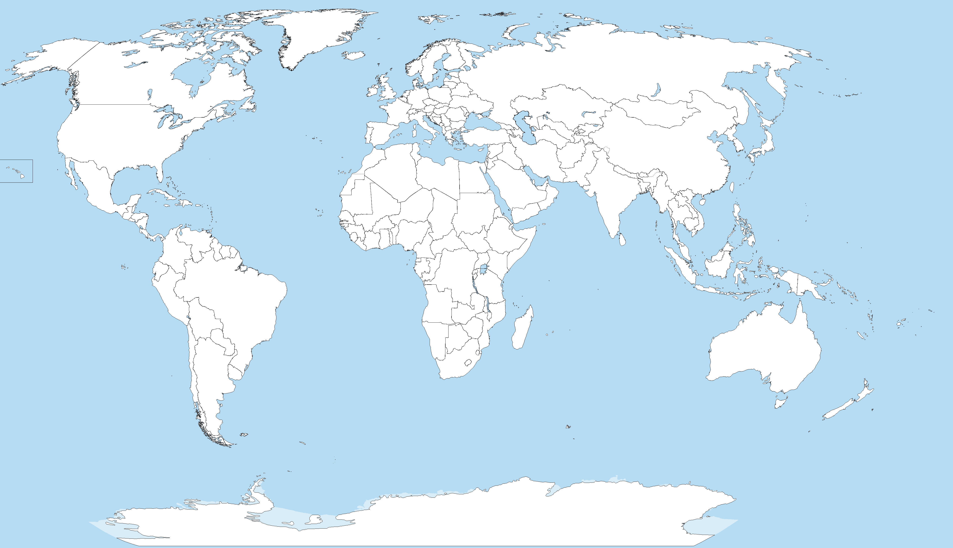
Joint Physics Analysis Center
Funded in 2013 as theory support originally for JLab exps, but grew up much larger
Creates bridges between theorists and experimentalists
40+ researchers affiliated during a decade
Running
Planned
A. Pilloni – Hadron Spectroscopy
Notes:
Controlla la parte su Regge

Slide 3
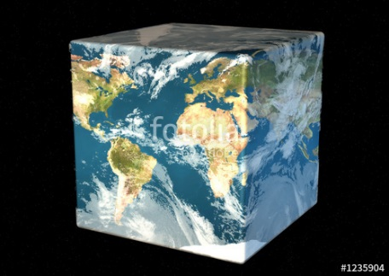
The Richness of the Spectrum
Meson
Baryon
Glueball
Hybrids
Tetraquark
Molecule
Experiment
Data
Amplitude analysis
QCD
Lattice QCD
With great statistics comes great responsibility!
Peter Parker, PhD
For theorists, this is an experimental business
For experimentalists, this is grandma’s recipe
A. Pilloni – Hadron spectroscopy

Slide 4
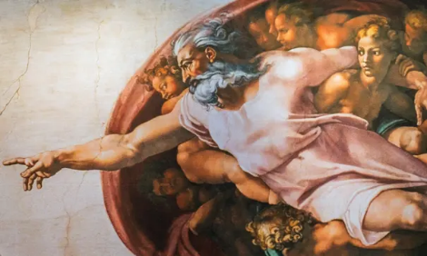
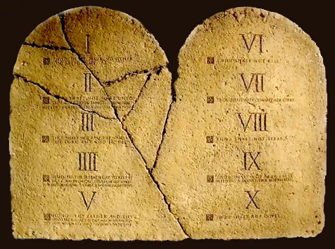
Top-down approach
You are given a model/theory
$$f(s)$$
You calculate the amplitude
You compare with data. Or you don’t.
Predictive power ✓
Physical interpretation ✓ (within the model! ✗) Biased by the input ✗
A. Pilloni – Hadron spectroscopy

Slide 5
From quarks to hadrons
Alex said that a meson is made of just a $q\overline{q}$ pair, but we know from parton model that sea quarks exist,
Who is right?
We can rephrase the question:
«How many quarks in a meson wave function?
$$\left.\left|π\right.\right\rangle =\left.c_{1}\left|q\overline{q}\right.\right\rangle +\left.c_{2}\left|q\overline{q}\right.g\right\rangle +\left.c_{3}\left|q\overline{q}\right.q\overline{q}\right\rangle +…$$
This requires: a) building a hamiltonian (frame dependence);
b) truncating it;
c) dealing with scheme dependence, renormalization…
far from rigorous.
A. Pilloni – Hadron spectroscopy
Notes:
2 slides su Zc, a Bes e a Belle
2 slide su tetraquark model: dall’hamiltoniana di Jaffe al calcolo delle masse
1 slide su molecular models, dove sono i carichi? (non in Tornqvist, si in Hanhart, vedere Braaten, citare Nefediev)
2 slides su decay channels, dove si dovrebbe vedere, e a seconda del modello, vedere qualche plot
1 slide su Y(4260), tetraquark? C’è lo strano (si vede la f0)
1 slide su Zc a cleo (anche il neutro)

Slide 6
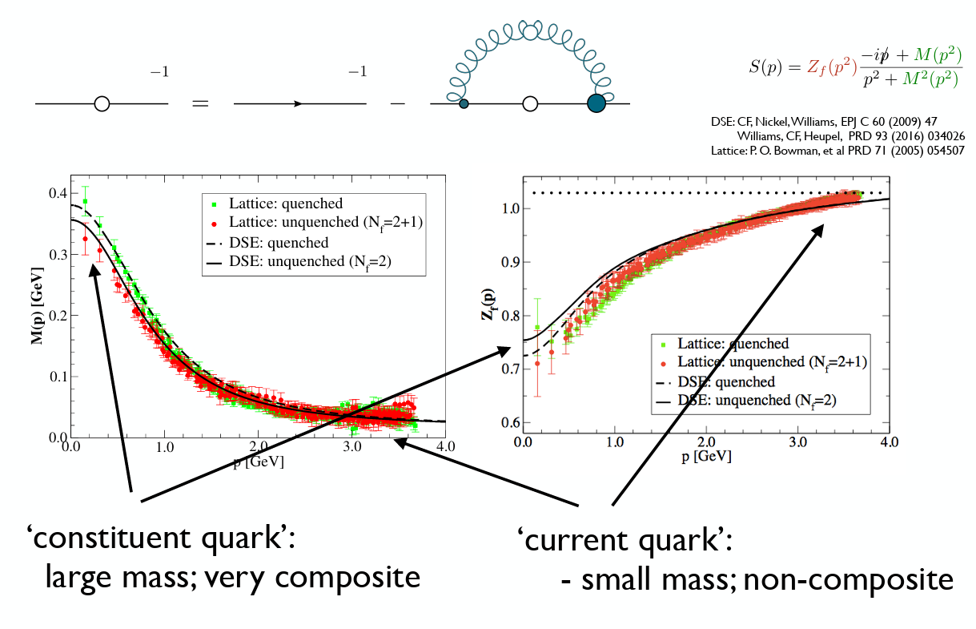
From quarks to hadrons
We do a better job if we reabsorb most of the QCD interactions in an effective quark mass, and in a residual interaction. This leads to constituent quarks with masses $O(Λ_{QCD})$
C. Fischer
A. Pilloni – Hadron spectroscopy
Notes:
2 slides su Zc, a Bes e a Belle
2 slide su tetraquark model: dall’hamiltoniana di Jaffe al calcolo delle masse
1 slide su molecular models, dove sono i carichi? (non in Tornqvist, si in Hanhart, vedere Braaten, citare Nefediev)
2 slides su decay channels, dove si dovrebbe vedere, e a seconda del modello, vedere qualche plot
1 slide su Y(4260), tetraquark? C’è lo strano (si vede la f0)
1 slide su Zc a cleo (anche il neutro)

Slide 7
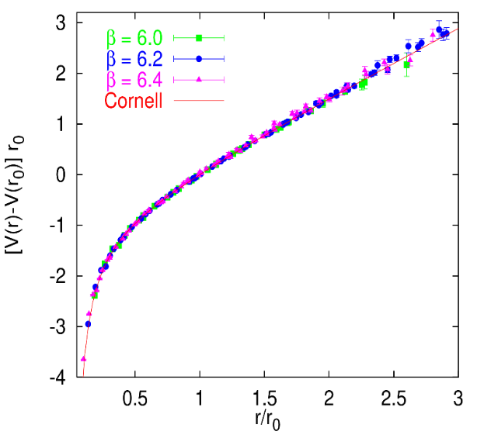
Constituent quark model
Godfrey and Isgur, PRD 32, 189 Capstick and Isgur, PRD 33, 2809
Linear rising potential
G. Bali
$$j$$
$$l$$
$$T_{ij}^{a}$$
$$T_{kl}^{a}$$
$$i$$
$$k$$
The heavier the quark, the more its mass dominates over the interaction, the more accurate the constituent picture
A. Pilloni – Hadron spectroscopy

Slide 8
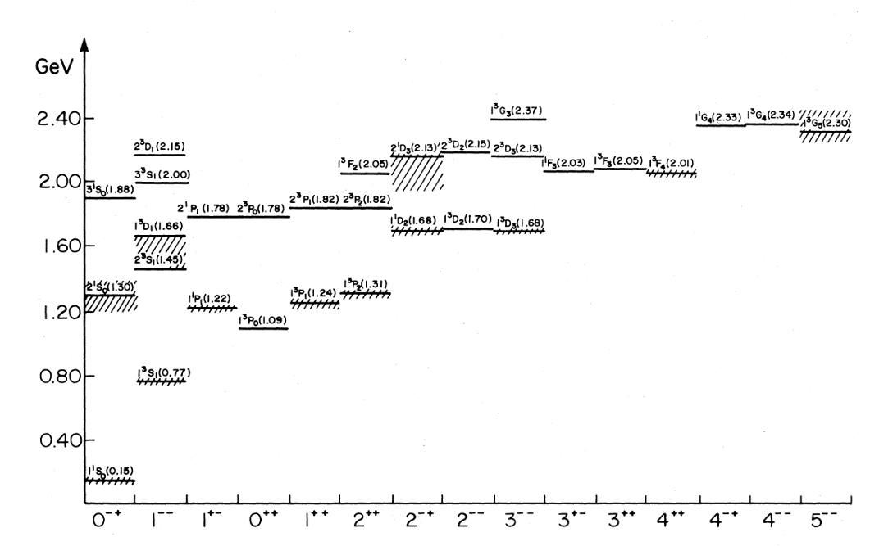
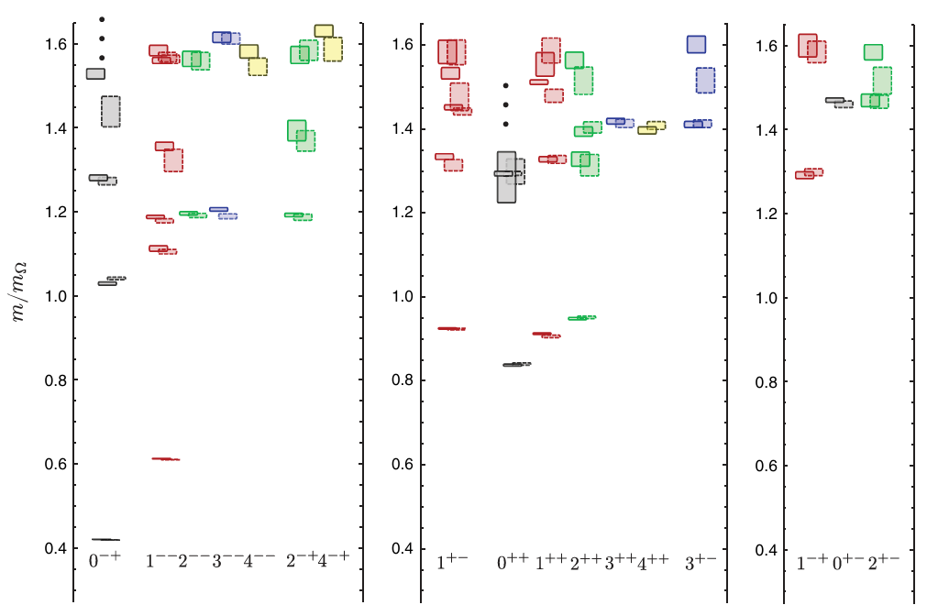
Constituent quark model vs. lattice
Example of the isovector light meson sector
Isgur and Gofrey
HadSpec
Ordering and multiplicity roughly respected (although we need to understand what the right plot means)
A. Pilloni – Hadron spectroscopy

Slide 9
From quarks to hadrons
Why are we sticking to the QM? Despite being simplistic, it remains the best tool to organize the gross features of the spectrum (mass ordering, decay hierarchies etc.)
It also allows us to define exotic hadrons
Flavor exotics: e.g. doubly charged meson, baryon with positive strangeness Ex.: $T_{cc}^{+}$ ; if OZI rule enforced, $Z_{c,b}$, $P_{c}$…
Spin exotics: $J^{PC}$ not allowed in QM Ex.: $π_{1}(1600)$
Criptoexotics: $J^{PC}$ allowed, but properties not compatible with QM expectations Ex.: $Y(4260)$, $Λ(1405)$, hybrid baryons, $X(3872)$
A. Pilloni – Hadron spectroscopy
Notes:
2 slides su Zc, a Bes e a Belle
2 slide su tetraquark model: dall’hamiltoniana di Jaffe al calcolo delle masse
1 slide su molecular models, dove sono i carichi? (non in Tornqvist, si in Hanhart, vedere Braaten, citare Nefediev)
2 slides su decay channels, dove si dovrebbe vedere, e a seconda del modello, vedere qualche plot
1 slide su Y(4260), tetraquark? C’è lo strano (si vede la f0)
1 slide su Zc a cleo (anche il neutro)

Slide 10
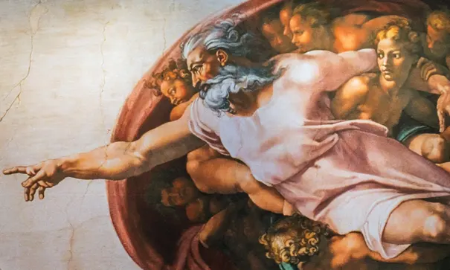
Options on the market
Quark-level calculations:
Quark models, pNRQCD, Light-cone, ...
Spectrum generally calculated as bound states of some potential
Decay rates as «overlap integrals» between two static configurations
Comprehensive picture ✓ Little scattering dynamics ✗
Hadron level calculations:
Hadron-level EFTs, phenomenological amplitudes, dispersion theory…
States as poles of scattering amplitudes
Couplings as residues at the poles
Scattering dynamics ✓ More case-by-case ✓✗
A. Pilloni – Hadron spectroscopy

Slide 11
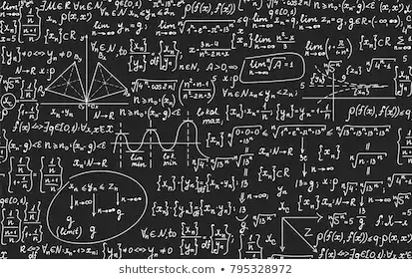
Bottom-up approach
Less predictive power ✗
Some physical interpretation ✗ Minimally biased ✓
You extract physics
You choose a set of generic amplitudes at the hadron level
You start with data
A. Pilloni – Hadron spectroscopy

Slide 12
1-particle states
The Poincaré group has 2 Casimirs (roughly mass and spin magnitude) that can be used to characterize 1-particle states, plus other internal symmetries (flavor, charge…)
The spin projection is not Poincaré-invariant, so it needs to be defined in a specific frame. For massive particles, two conventions are used:
At large times $t→±∞$, particles are far from each other, they are eigenstates of the free Hamiltonian $H_{0}$ (asymptotic states)
Canonical state:
The spin is quantized along the $\hat{z}$ direction in the particle rest frame
Then the particle is boosted to $\vec{p}$
The spin direction «stays» along $\hat{z}$
A. Pilloni – Hadron spectroscopy
Notes:
2 slides su Zc, a Bes e a Belle
2 slide su tetraquark model: dall’hamiltoniana di Jaffe al calcolo delle masse
1 slide su molecular models, dove sono i carichi? (non in Tornqvist, si in Hanhart, vedere Braaten, citare Nefediev)
2 slides su decay channels, dove si dovrebbe vedere, e a seconda del modello, vedere qualche plot
1 slide su Y(4260), tetraquark? C’è lo strano (si vede la f0)
1 slide su Zc a cleo (anche il neutro)

Slide 13
1-particle states
The Poincaré group has 2 Casimirs (roughly mass and spin magnitude) that can be used to characterize 1-particle states, plus other internal symmetries (flavor, charge…)
The spin projection is not Poincaré-invariant, so it needs to be defined in a specific frame. For massive particles, two conventions are used:
Helicity state:
The spin is quantized along the $\hat{z}$ direction in the particle rest frame
A. Pilloni – Hadron spectroscopy
Notes:
2 slides su Zc, a Bes e a Belle
2 slide su tetraquark model: dall’hamiltoniana di Jaffe al calcolo delle masse
1 slide su molecular models, dove sono i carichi? (non in Tornqvist, si in Hanhart, vedere Braaten, citare Nefediev)
2 slides su decay channels, dove si dovrebbe vedere, e a seconda del modello, vedere qualche plot
1 slide su Y(4260), tetraquark? C’è lo strano (si vede la f0)
1 slide su Zc a cleo (anche il neutro)

Slide 14
1-particle states
The Poincaré group has 2 Casimirs (roughly mass and spin magnitude) that can be used to characterize 1-particle states, plus other internal symmetries (flavor, charge…)
The spin projection is not Poincaré-invariant, so it needs to be defined in a specific frame. For massive particles, two conventions are used:
Helicity state:
The spin is quantized along the $\hat{z}$ direction in the particle rest frame
Then the particle is boosted to $|\vec{p}|\hat{z}$
A. Pilloni – Hadron spectroscopy
Notes:
2 slides su Zc, a Bes e a Belle
2 slide su tetraquark model: dall’hamiltoniana di Jaffe al calcolo delle masse
1 slide su molecular models, dove sono i carichi? (non in Tornqvist, si in Hanhart, vedere Braaten, citare Nefediev)
2 slides su decay channels, dove si dovrebbe vedere, e a seconda del modello, vedere qualche plot
1 slide su Y(4260), tetraquark? C’è lo strano (si vede la f0)
1 slide su Zc a cleo (anche il neutro)

Slide 15
1-particle states
The Poincaré group has 2 Casimirs (roughly mass and spin magnitude) that can be used to characterize 1-particle states, plus other internal symmetries (flavor, charge…)
The spin projection is not Poincaré-invariant, so it needs to be defined in a specific frame. For massive particles, two conventions are used:
Helicity state:
For massless particles the rest frame is undefined, but helicity becomes Poincaré-invariant, so no need to define a procedure
Helicity state:
The spin is quantized along the $\hat{z}$ direction in the particle rest frame
Then the particle is boosted to $|\vec{p}|\hat{z}$
Then spin and momentum are rotated
A. Pilloni – Hadron spectroscopy
Notes:
2 slides su Zc, a Bes e a Belle
2 slide su tetraquark model: dall’hamiltoniana di Jaffe al calcolo delle masse
1 slide su molecular models, dove sono i carichi? (non in Tornqvist, si in Hanhart, vedere Braaten, citare Nefediev)
2 slides su decay channels, dove si dovrebbe vedere, e a seconda del modello, vedere qualche plot
1 slide su Y(4260), tetraquark? C’è lo strano (si vede la f0)
1 slide su Zc a cleo (anche il neutro)

Slide 16
2-particle states
I can combine two canonical states in their center of mass
$$\left.\left|\vec{p},s_{1z}s_{2z}\right.\right\rangle =\left.\left|\vec{p},s_{1z}\right.\right\rangle ⊗\left.\left|−\vec{p}, s_{2z}\right.\right\rangle$$
Decomposing into definite total angular momentum, I get
$$\left.\left||\vec{p}|,JM\right.;LS\right\rangle =∫dΩ \sum_{s_{1z}s_{2z}L_{z}}{Y_{LL_{z}}\left(Ω\right)}\left\langle JM | LL_{z}SS_{z}\right\rangle \left\langle SS_{z} | s_{1}s_{1z}s_{2}s_{2z}\right\rangle$$
$$×\left.\left|\vec{p},s_{1z}\right.\right\rangle ⊗\left.\left|−\vec{p}, s_{2z}\right.\right\rangle$$
A. Pilloni – Hadron spectroscopy
Notes:
2 slides su Zc, a Bes e a Belle
2 slide su tetraquark model: dall’hamiltoniana di Jaffe al calcolo delle masse
1 slide su molecular models, dove sono i carichi? (non in Tornqvist, si in Hanhart, vedere Braaten, citare Nefediev)
2 slides su decay channels, dove si dovrebbe vedere, e a seconda del modello, vedere qualche plot
1 slide su Y(4260), tetraquark? C’è lo strano (si vede la f0)
1 slide su Zc a cleo (anche il neutro)

Slide 17
2-particle states
I can also combine two helicity states
$$\left.\left|\vec{p},λ_{1}λ_{2}\right.\right\rangle =\left.\left|\vec{p},λ_{1}\right.\right\rangle ⊗\left.\left|−\vec{p}, λ_{2}\right.\right\rangle$$
Decomposing into definite total angular momentum, I get
$$\left.\left||\vec{p}|,JM\right.;λ_{1}λ_{2}\right\rangle =\sqrt{\frac{2J+1}{4π}}∫dΩ D_{M,λ_{1}−λ_{2}}^{J∗}(Ω)×\left.\left|\vec{p},λ_{1}\right.\right\rangle ⊗\left.\left|−\vec{p}, λ_{2}\right.\right\rangle$$
where $D_{a,b}^{J}\left(Ω\right)=\left\langle Ja | e^{−i J_{z}φ}e^{−i J_{y}θ} | Jb\right\rangle$ is the Wigner D-matrix
Subtelties about how to define the phase of this state….
A. Pilloni – Hadron spectroscopy
Notes:
2 slides su Zc, a Bes e a Belle
2 slide su tetraquark model: dall’hamiltoniana di Jaffe al calcolo delle masse
1 slide su molecular models, dove sono i carichi? (non in Tornqvist, si in Hanhart, vedere Braaten, citare Nefediev)
2 slides su decay channels, dove si dovrebbe vedere, e a seconda del modello, vedere qualche plot
1 slide su Y(4260), tetraquark? C’è lo strano (si vede la f0)
1 slide su Zc a cleo (anche il neutro)

Slide 18
2-particle states
The expression for the helicity state is easier, but some relations (parity) are better understood in the LS
One can relate one with the other through
$$\left.\left||\vec{p}|,JM\right.;λ_{1}λ_{2}\right\rangle =\sum_{LS}{\left\langle Jλ | L0Sλ\right\rangle \left\langle Sλ | s_{1}λ_{1}s_{2}−λ_{2}\right\rangle }\left.\left||\vec{p}|,JM\right.;LS\right\rangle$$
where $λ=λ_{1}−λ_{2}$
Subtelties about how to define the phase of this state….
A. Pilloni – Hadron spectroscopy
Notes:
2 slides su Zc, a Bes e a Belle
2 slide su tetraquark model: dall’hamiltoniana di Jaffe al calcolo delle masse
1 slide su molecular models, dove sono i carichi? (non in Tornqvist, si in Hanhart, vedere Braaten, citare Nefediev)
2 slides su decay channels, dove si dovrebbe vedere, e a seconda del modello, vedere qualche plot
1 slide su Y(4260), tetraquark? C’è lo strano (si vede la f0)
1 slide su Zc a cleo (anche il neutro)

Slide 19
Scattering matrix and amplitudes
I can split the Hamiltonian as $H=H_{0}+V$ and define the time evolution in the interaction picture as the Scattering Operator
$$S=U_{I}\left(+∞←−∞\right)=T\exp\left(−i ∫dt V_{I}\left(t\right)\right)$$
If I sandwich between asymptotic states, I get my Scattering matrix
$$S_{fi}=\left\langle f | S | i\right\rangle$$
The modulus squared gives the probability that the state $i$ evolves in $f$
The S-matrix contains the probability that nothing happens, it can be isolated as
$$S=1+i T$$
where $T$ is the amplitude
A. Pilloni – Hadron spectroscopy
Notes:
2 slides su Zc, a Bes e a Belle
2 slide su tetraquark model: dall’hamiltoniana di Jaffe al calcolo delle masse
1 slide su molecular models, dove sono i carichi? (non in Tornqvist, si in Hanhart, vedere Braaten, citare Nefediev)
2 slides su decay channels, dove si dovrebbe vedere, e a seconda del modello, vedere qualche plot
1 slide su Y(4260), tetraquark? C’è lo strano (si vede la f0)
1 slide su Zc a cleo (anche il neutro)

Slide 20
Scattering matrix and amplitudes
The amplitude can be related to QFT correlators by the LSZ formalism,
$$\left\langle q_{1}…q_{n_{f}} | iT | p_{1}…p_{n_{i}}\right\rangle ={\left(\frac{−i}{\sqrt{Z_{O}}}\right)}^{n_{i}+n_{f}}∫d^{4}x_{1}d^{4}x_{n_{i}}d^{4}y_{1}d^{4}y_{n_{f}}e^{−i\left(p_{1}x_{1}+…+p_{n_{i}}x_{n_{i}}\right)}e^{+i\left(q_{1}y_{1}+…+q_{n_{i}}y_{n_{i}}\right)}$$
$$×{\left\langle 0 | T\left\{O\left(x_{1}\right)…O\left(x_{n_{i}}\right)O\left(y_{1}\right)…O\left(y_{f}\right)\right\} | 0\right\rangle }_{\text{amputated}}$$
The arbitrariness of the interpolating $O$ is canceled by the residue $Z_{O}$
From this expression, it is possible to derive rigorously several general properties, that any amplitude must fulfill
…at least to the level of rigor phenomelogists care about
A. Pilloni – Hadron spectroscopy
Notes:
2 slides su Zc, a Bes e a Belle
2 slide su tetraquark model: dall’hamiltoniana di Jaffe al calcolo delle masse
1 slide su molecular models, dove sono i carichi? (non in Tornqvist, si in Hanhart, vedere Braaten, citare Nefediev)
2 slides su decay channels, dove si dovrebbe vedere, e a seconda del modello, vedere qualche plot
1 slide su Y(4260), tetraquark? C’è lo strano (si vede la f0)
1 slide su Zc a cleo (anche il neutro)

Slide 21
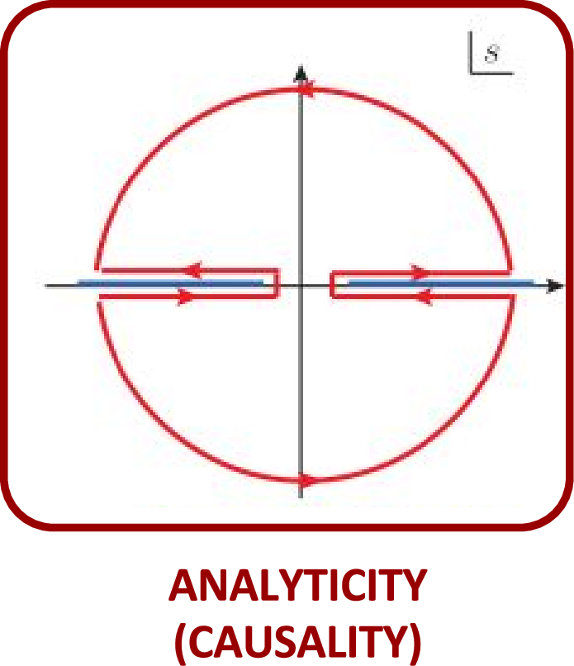
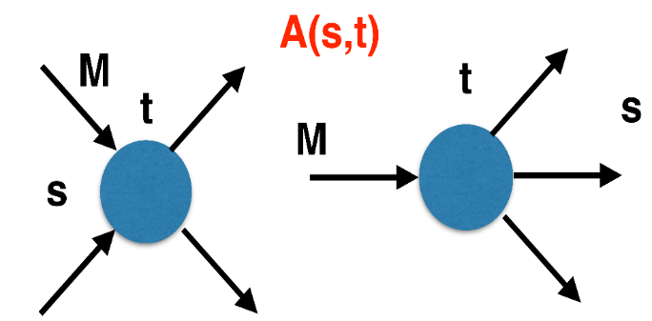
The S-Matrix principles
Future cannot change the past
100%, something will happen
The anti-particle is an anti-particle and not just a different particle
(analyticity)
(unitarity)
(crossing symmetry)
Sherlock Holmes, QFT
Analyticity
Unitarity
Crossing
Parametrize your ignorance.
Build a model.
Fit data.
Have fun.
A. Pilloni – Hadron spectroscopy

Slide 22
$S$-Matrix principles
$$t_{l}\left(s\right)=\lim_{ε→0}t_{l}(s+iε)⁡$$
Analyticity
$$\text{Im} t_{l}=ρ_{l}{\left|t_{l}\right|}^{2} ⁡$$
These are constraints the amplitudes have to satisfy, but do not fix the dynamics
They can be imposed with an increasing amount of rigor, to extract robust physics information
The «background» phenomena can be effectively parameterized in a controlled way
+ Lorentz, discrete & global symmetries
A. Pilloni – Hadron spectroscopy
Notes:
Controlla la parte su Regge

Slide 23
Analyticity
Complex analytic functions are extremely regular and smooth
Integrals are easy (Cauchy theorem)
If you know the function in a region, you can extend it in a unique way everywhere
Complex functions are characterized by its non-analyticities (poles and cuts)
Analyticity
If I turn on an interaction at $t=0$, and I want nothing happens f$or t<0$, I cannot have singularities in the upper plane
$$f\left(t\right)=\int_{−∞}^{+∞}{e^{−iωt}f\left(ω\right) dω}=2πi\sum_{>/<}{{\text{Res}}_{\text{i}} }$$
A. Pilloni – Hadron spectroscopy
Notes:
Controlla la parte su Regge

Slide 24
Spinless $2→2$ scattering
Let us consider the elastic scattering of two equal mass spinless particles
We start with 4x3 momentum components, we subtract 4 for energy-momentum conservation, we use 3 to boost to the CoM frame, we use 3 to rotate the scattering plane to xz
We are left with 2 independent variables
$$3$$
$$1$$
$$θ$$
$$2$$
$$4$$
$s={\left(p_{1}+p_{2}\right)}^{2}=4E^{2}=4{(p}^{2}+m^{2})=$ energy (squared)
$t={\left(p_{1}−p_{3}\right)}^{2}∝−2p^{2}(1−\cos{θ})=$ momentum transferred
$u={\left(p_{1}−p_{4}\right)}^{2}∝−2p^{2}(1+\cos{θ})=$ momentum transferred
$s+t+u=4m^{2}$
$$p_{1}=\left(E,0,0,p\right)$$
$p_{2}=\left(E,0,0,−p\right)$
$p_{3}=\left(E,p\sin{θ},0,p\cos{θ}\right)$
$p_{4}=\left(E,−p\sin{θ},0,−p\cos{θ}\right)$
$$A(s,t)$$
A. Pilloni – Hadron spectroscopy

Slide 25
Crossing symmetry
$$π^{+}$$
$$π^{+}$$
$$π^{+}$$
$$p$$
$$π^{+}$$
$$π^{+}$$
$$p$$
$$p$$
$$π^{−}$$
$$\overline{p}$$
$$\overline{p}$$
$$\overline{p}$$
All these processes are not independent, but are described by the same amplitude!
Simplification – Complication!
A. Pilloni – Hadron spectroscopy
Notes:
Controlla la parte su Regge

Slide 26
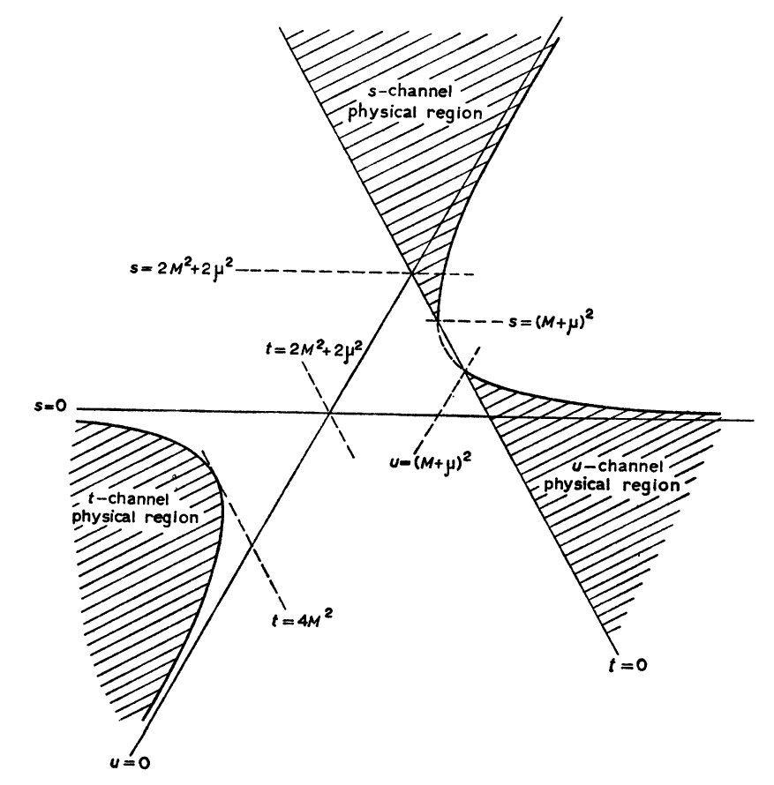
Crossing symmetry
$$π^{+}p→π^{+}p$$
$$s>0,t<0,u \text{≲} 0$$
$$s$$
In practice, one has to analytically continue from one region to another, which is not necessarily trivial
$$t$$
$$u$$
If one of the masses is larger than the sum of the other three, the decay (Dalitz) region appears in the Mandelstam triangle
$$η→π^{+}π^{−}π^{0}$$
$$u>0,t>0,s \text{> }0$$
$$π^{+}π^{−}→p\overline{p}$$
$$t>0,s<0,u<0$$
$$π^{+}p→π^{+}p$$
$$u>0,t<0,s \text{≲} 0$$
A. Pilloni – Hadron spectroscopy
Notes:
Controlla la parte su Regge

Slide 27
Unitarity
$S$ is the scattering operator ($∝$ time evolution from $−∞$ to $+∞$)
We isolate the «nothing happens» part $S=1+i A$
$$\text{Im} A_{i→f}=\frac{1}{2}\sum_{n}{A_{i→n}A_{f→n}^{†}}$$
$$SS^{†}=1$$
Below threshold there are no available states in the sum, so $\text{Im} A(s<4m^{2})=0$
If a function is nonsingular on the real axis, it admits an analytic continuation using Schwartz reflection principle, $A\left(z^{∗}\right)=A^{∗}(z)$. Above threshold close to the real axis,
$$\text{Im} A\left(s+i ε\right)=\frac{1}{2i}\left[A\left(s+iε\right)−A^{∗}(s+iε)\right]=\frac{1}{2i}\left[A\left(s+iε\right)−A(s−iε)\right]>0$$
So a cut opens on the real axis at threshold
A. Pilloni – Hadron spectroscopy
Notes:
Controlla la parte su Regge

Slide 28
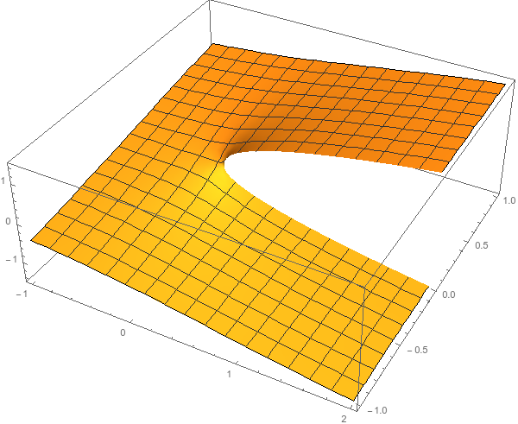
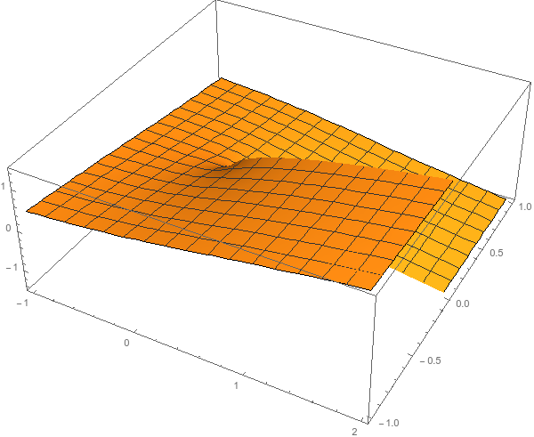
Unitarity
$$\text{Im} A_{i→f}=\frac{1}{2}\sum_{n}{A_{i→n}A_{f→n}^{†}}$$
I have different values of $A$ across the real axis
$$i\sqrt{e^{iπ}}=−1$$
$$i\sqrt{e^{iπ}}=1$$
$$i\sqrt{1}=i$$
Example: $i\sqrt{E}$
$$i\sqrt{e^{2iπ}}=i$$
$$i\sqrt{e^{2iπ}}=−i$$
$$i\sqrt{1}=−i$$
...but I can decide to get the negative solution
A. Pilloni – Hadron spectroscopy
Notes:
Controlla la parte su Regge

Slide 29
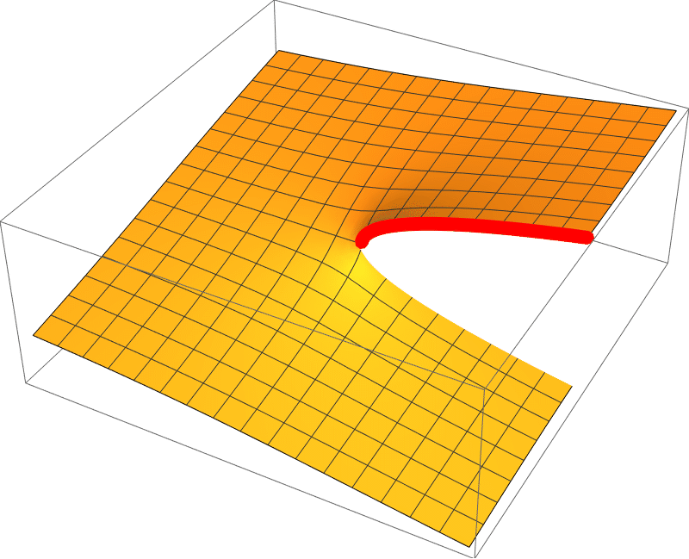
Unitarity
$$\text{Im} A_{i→f}=\frac{1}{2}\sum_{n}{A_{i→n}A_{f→n}^{†}}$$
I sheet
II sheet
A. Pilloni – Hadron spectroscopy
Notes:
Controlla la parte su Regge

Slide 30
All together
$$Im s$$
$A\left(s,t\right)$ for complex $s$
and fixed $t$
Protected by analyticity in the s-channel
$$u>4m^{2}⇒s<−t$$
$$s>4m^{2}$$
Data
$$Re s$$
Left-hand cut
Right-hand (unitarity) cut
Possibly bound state poles
Protected by analyticity in the u-channel
A. Pilloni – Hadron spectroscopy
Notes:
Controlla la parte su Regge

Slide 31
Partial waves in $2→2$ scattering
$$3$$
$$\text{Im} A_{i→f}=ρ\left(s\right)∫dΩ_{n}A_{i→n}A_{f→n}^{†}$$
$$1$$
$$θ$$
$$2$$
Sum runs over 2-body PS
$$4$$
Legendre polynomial
$$A\left(s,t\right)=\sum_{l}{A_{l}\left(s\right)P_{l}(\cos{θ})}$$
$$\text{Im} A_{l}\left(s\right)=ρ\left(s\right){\left|A_{l}\left(s\right)\right|}^{2}$$
Phase space (known)
Partial wave
Since $P_{l}\left(\cos{θ}\right)∝{\left(\cos{θ}\right)}^{l}{∝\left(\frac{t−u}{4p^{2}}\right)}^{l}$, we must have $A_{l}\left(s\right)∝p^{2l}$ (barrier factor)
Partial waves diagonalize unitarity: each one statisfy a separate equation Each partial wave has definite orbital angular momentum = spin
A. Pilloni – Hadron spectroscopy

Slide 32
Partial waves in $2→2$ scattering
$$\text{Im} A_{i→f}=\frac{1}{2}∫dΩ_{n}A_{i→n}A_{f→n}^{†}$$
$$3$$
$$1$$
$$θ$$
$$2$$
Wigner D-matrix with $φ=0$
$$4$$
$$A_{λ_{1}λ_{2}λ_{3}λ_{4}}\left(s,t\right)=\sum_{J}{A_{λ_{1}λ_{2}λ_{3}λ_{4}}^{J}\left(s\right)d_{λ_{1}−λ_{2},λ_{3}−λ_{4}}^{J}(θ)}$$
If particles carry spin, the Legendre polynomial is generalized to the Wigner-D. Being orthogonal, they also diagonalize unitarity
A. Pilloni – Hadron spectroscopy

Slide 33
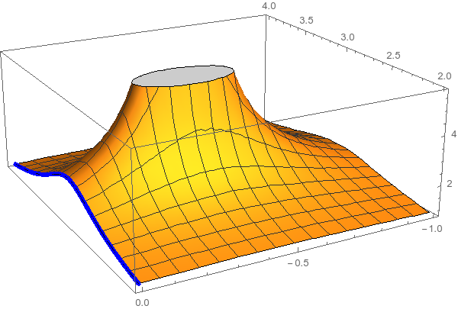
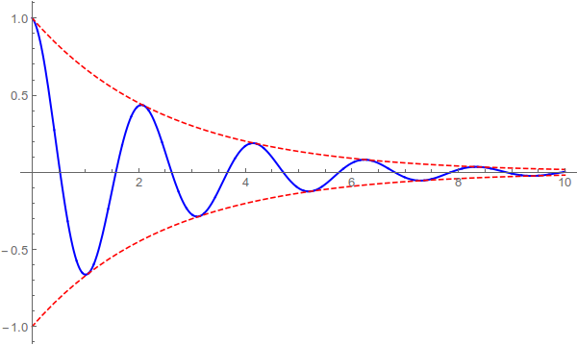
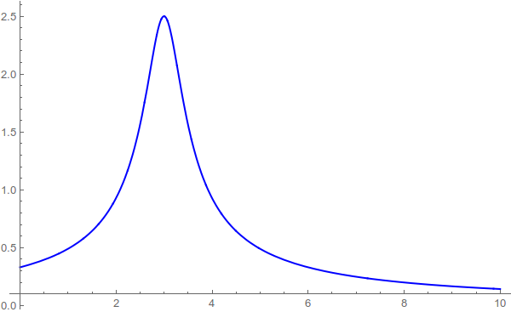
Resonances = Unstable states
$$ψ(t)=e^{−i E_{0} t} e^{− \frac{Γ}{2} t }$$
$$ψ(E)=\frac{1}{E−E_{0}+i\frac{Γ}{2}}$$
The function explodes for value of energy $E=E_{0}−i\frac{Γ}{2}$
Resonances are poles in the complex energy plane
$ψ_{out}\left(r\right)∼e^{i k z}+\frac{f\left(E,θ\right)}{r} e^{ikr}$
Excited states are unstable
They manifest as resonant peaks
A. Pilloni – Hadron spectroscopy

Slide 34
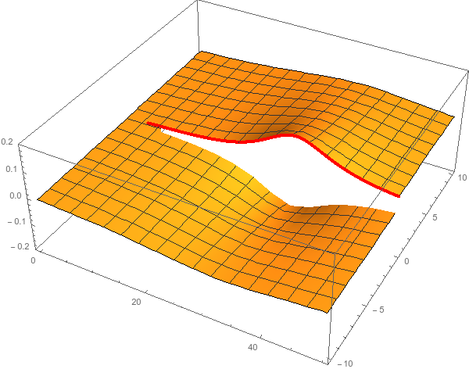
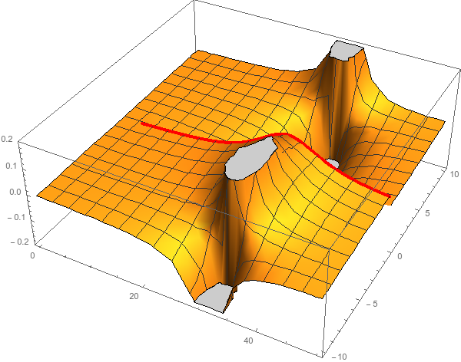
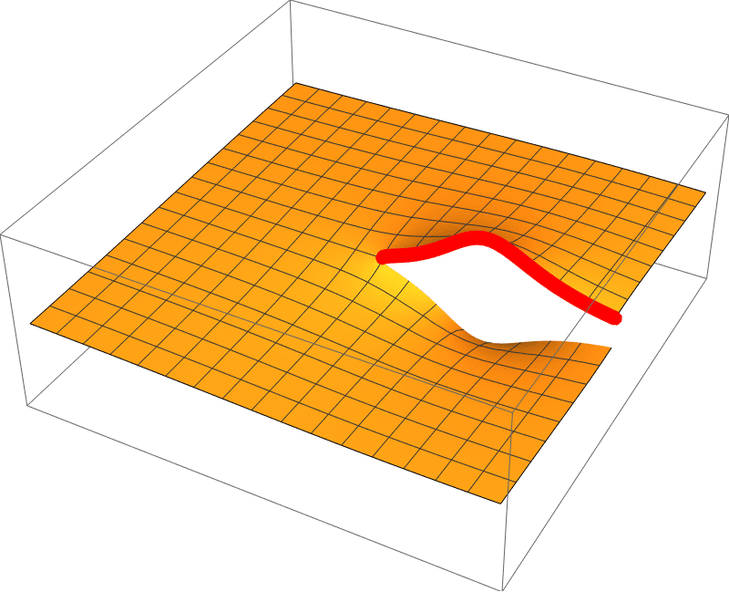
Unitarity & Pole hunting
Unitarity creates a branch cut on the real axis, two sheets continuosly connected
I sheet
II sheet
Finding resonances means writing analytic amplitude, and hunting for poles in the complex plane
A. Pilloni – Hadron spectroscopy
Notes:
Controlla la parte su Regge

Slide 35
The Breit-Wigner
$$A_{i→f}\left(s\right)=\frac{g_{i}g_{f}}{m^{2}−s−i \sum_{f}{g_{f}^{2}ρ_{f}(s)}}$$
$$=\frac{1}{\sqrt{ρ_{i}(m^{2})ρ_{f}(m^{2})}}\frac{Γ\left(m^{2}\right) \sqrt{BR_{i}BR_{f}}}{m^{2}−s−i m Γ(s) }$$
Usually one calls $m$ the BW mass and $Γ\left(m^{2}\right)=g^{2}ρ(m^{2})$ the BW width and states $\sum_{f}{BR_{f}}=1$. If the resonance is narrow, the energy dependence of the width can be neglected, $Γ\left(s\right)≃Γ(m^{2})$
However:
Unitarity is a property of PW and not of a single resonance
The amplitude does not have a pole at $s=m^{2}−i m Γ(m^{2})$
If the resonance is narrow and far from threshold this is ok
A. Pilloni – Hadron spectroscopy
Notes:
Controlla la parte su Regge

Slide 36
You shall not sum!
The simplest ansatz for a PW amplitude is the Breit-Wigner
What if I have two resonances? Can I add two BWs?
$$A_{l}\left(s\right)=\frac{g^{2}}{m^{2}−s−i g^{2}ρ(s)}$$
$$A_{l}\left(s\right)=\frac{g_{1}^{2}}{m_{1}^{2}−s−i g_{1}^{2}ρ(s)}+\frac{g_{2}^{2} e^{iα}}{m_{2}^{2}−s−i g_{2}^{2}ρ(s)}$$
Unitarity is broken, $\text{Im} A_{l}\left(s\right)≠ρ\left(s\right){\left|A_{l}\left(s\right)\right|}^{2}$
Unitarity is saturated, $\text{Im} A_{l}\left(s\right)=\text{Im}\frac{m^{2}−s+i g^{2}ρ(s)}{{\left|m^{2}−s−i g^{2}ρ\left(s\right)\right|}^{2}}=ρ\left(s\right){\left|A_{l}\left(s\right)\right|}^{2}$
But that’s precisely what experimentalists do!
Phases take partially into account the modifications of unitarity due to inelastic channels. However, when we shoot for precision, we need better ansätze
Of course they are not stupid, this works if the two resonances are well isolated. Unfortunately we have no simple alternative solution that can work in all situation, we have to proceed case by case and we live on different timescales
A. Pilloni – Hadron spectroscopy
Notes:
Controlla la parte su Regge

Slide 37
The $1→3$ decay chains
Each set of angles is defined in a different reference frame
A. Pilloni – Hadron spectroscopy

Slide 38
What do we know?
A. Pilloni – Hadron spectroscopy

Slide 39
$Λ_{c}^{+}→p K^{−}π^{+}$
Belle, PRL117, 011801
The dynamics in the Dalitz is extremely rich Resonances appear in all subchannels
$$Λ_{c}^{+}→\left\{\begin{matrix}K^{∗0} p \\ Δ^{++}K^{−} \\ Λ^{∗0}π^{+}\end{matrix}\right\}→pK^{−}π^{+}$$
Each chain prefers a variable choice A proper amplitude analysis is mandatory
A. Pilloni – Hadron spectroscopy

Slide 40
Isobar model in the helicity formalism
The natural choice for the amplitude looks
with the cross section given by the trace with the spin-density matrix
No! The helicities have not the same meaning in the different chains!
A. Pilloni – Hadron spectroscopy

Slide 41
Wigner rotations
Let’s analyze the process in the decay plane
$${\vec{p}}_{2}$$
$${\vec{p}}_{0},Λ′$$
$${\vec{p}}_{2}$$
$${\vec{p}}_{1},λ$$
$${\vec{p}}_{0},Λ$$
$${\vec{p}}_{3}$$
Boost in the ${\vec{p}}_{12}$ direction
$${\vec{p}}_{1},λ′$$
$${\vec{p}}_{3}$$
(23) rest frame
(12) rest frame
Helicities are not Lorentz invariant A boost disaligned with the momentum mixes (rotates) the helicities
↓
Additional $d$-functions: Wigner rotations
A. Pilloni – Hadron spectroscopy

Slide 42
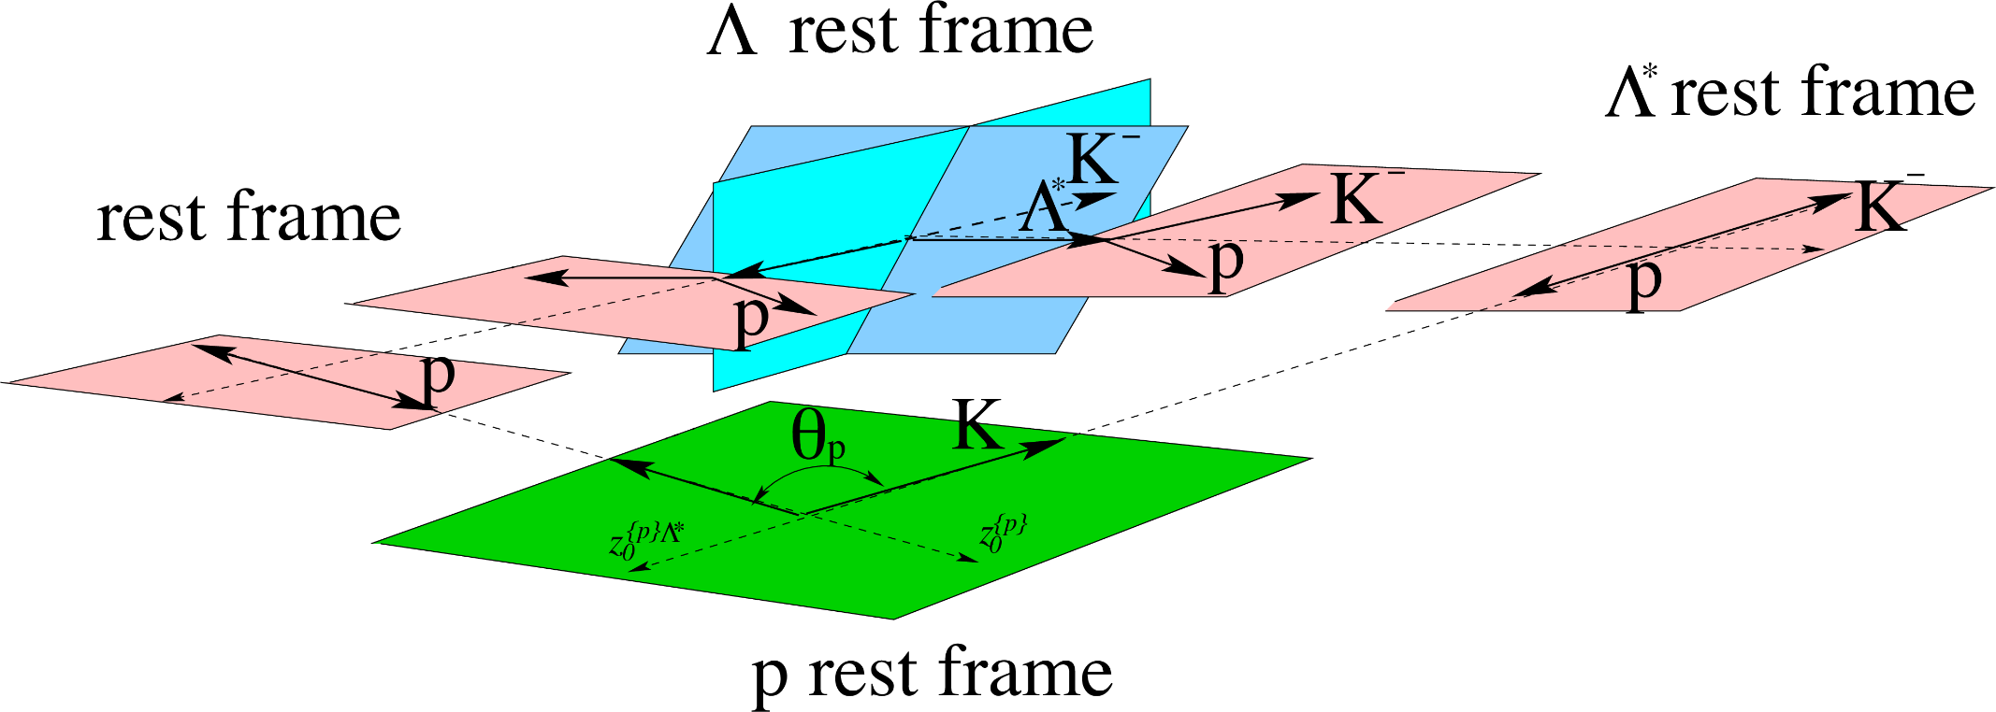
Wigner rotations
c
$$Δ$$
$$Δ$$
$$\text{π}$$
$$\text{π}$$
$$Δ$$
The new rotation is about the $y$ axis, the angle is defined in the rest frame of the $p$ or $Λ_{c}$
A. Pilloni – Hadron spectroscopy

Slide 43
Take home
Model building (at quark or hadron level) to get predictions
Reaction theory to extract info from data
S-matrix principles to build practical amplitudes to fit data
Spin introduces (kinematical) complications: tedious but doable
Now: two examples from dispersion theory/analytic models
A. Pilloni – Hadron spectroscopy
Notes:
2 slides su Zc, a Bes e a Belle
2 slide su tetraquark model: dall’hamiltoniana di Jaffe al calcolo delle masse
1 slide su molecular models, dove sono i carichi? (non in Tornqvist, si in Hanhart, vedere Braaten, citare Nefediev)
2 slides su decay channels, dove si dovrebbe vedere, e a seconda del modello, vedere qualche plot
1 slide su Y(4260), tetraquark? C’è lo strano (si vede la f0)
1 slide su Zc a cleo (anche il neutro)

Slide 44
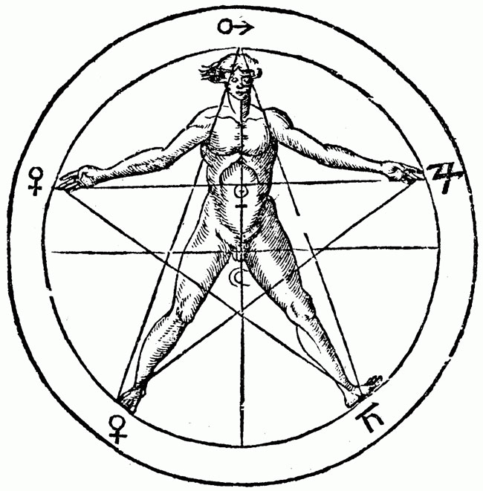
The $P_{c}(4312)$ pentaquark
$$u$$
$$c$$
$$\overline{c}$$
$$u$$
$$d$$
A. Pilloni – Hadron spectroscopy
Notes:
2 slides su Zc, a Bes e a Belle
2 slide su tetraquark model: dall’hamiltoniana di Jaffe al calcolo delle masse
1 slide su molecular models, dove sono i carichi? (non in Tornqvist, si in Hanhart, vedere Braaten, citare Nefediev)
2 slides su decay channels, dove si dovrebbe vedere, e a seconda del modello, vedere qualche plot
1 slide su Y(4260), tetraquark? C’è lo strano (si vede la f0)
1 slide su Zc a cleo (anche il neutro)

Slide 45
Bound and virtual states
Decreasing the potential strength, the pole reaches threshold
The pole jumps on the 2nd sheet (dineutron), it becomes a virtual state
Example from $pn$ scattering Bound state on the real axis 1st sheet (deuteron)
$$V(r)$$
$$\text{Im} E$$
$$r$$
$$V$$
Deuteron
$$\text{Re} E$$
$${}_{}^{1}S$$
Deuteron pole
Dineutron pole
$${}_{}^{3}S$$
A. Pilloni – Hadron spectroscopy
Notes:
Controlla la parte su Regge

Slide 46
Coupled channels
$ρ_{ψp}(s):$ +
$ρ_{ΣD}(s):$ +
$ρ_{ψp}(s):$ −
$ρ_{ΣD}(s):$ +
$ρ_{ψp}(s):$ −
$ρ_{ΣD}(s):$ −
$ρ_{ψp}(s):$ +
$ρ_{ΣD}(s):$ −
I sheet
II sheet
III sheet
IV sheet
Virtual state
$$J/ψ p$$
$$Σ_{c}^{+}\overline{D^{0}}$$
?
?
Bound state
Compact state
Diving under the first cut one access the II sheet, where generally bound states appear
Diving under both cuts one access the III sheet, where generally compact states appear
Diving twice one access the IV sheet, where virtual states appear poles only relevant close to the higher threshold
Data live above the real axis on the I sheet
A. Pilloni – Hadron spectroscopy
Notes:
Controlla la parte su Regge

Slide 47
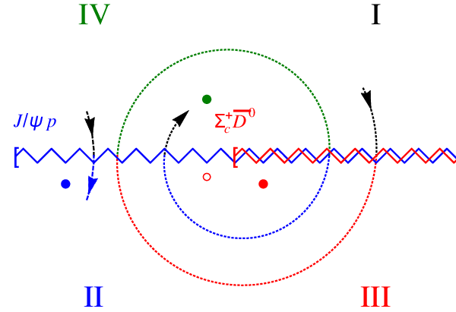
Coupled channels
Virtual state
Bound state
Resonance
A. Pilloni – Hadron spectroscopy
Notes:
Controlla la parte su Regge

Slide 48
New pentaquarks discovered
The lowest $P_{c}(4312)$ appears as an isolated peak at the $Σ_{c}^{+}{\overline{D}}^{0}$ threshold
A detailed study of the lineshape provides insight on its nature
Bottom-up: DON’T YOU DARE describing everything!!! Focus on the peak region
A. Pilloni – Hadron spectroscopy
Notes:
Controlla la parte su Regge

Slide 49
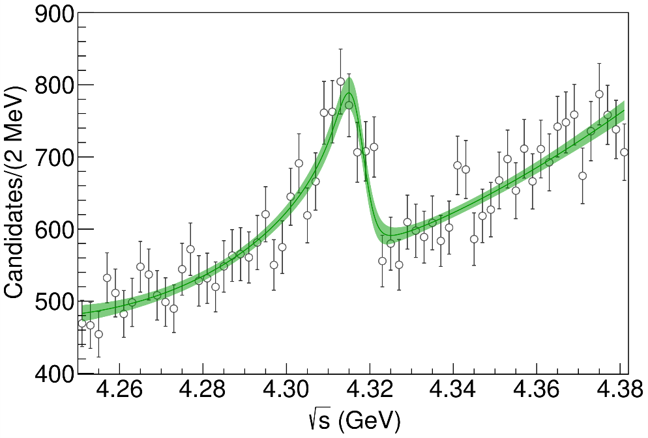
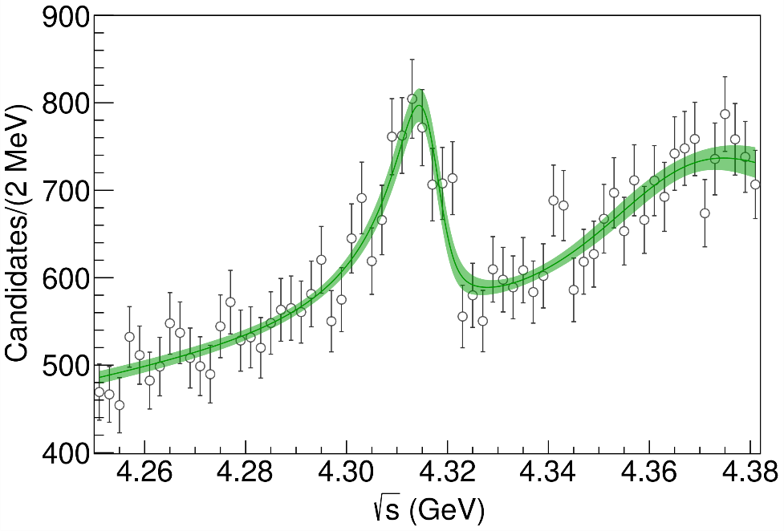
Minimal(istic) model for $P_{c}(4312)$
( data)
Fernandez-Ramirez, AP et al. (JPAC), PRL 123, 092001
Effective range expansion We can set $c_{ii}=0$ to reduce to the scattering length approximation
$$c_{ii}=0$$
Finite $c_{ii}$
A. Pilloni – Hadron spectroscopy
Notes:
2 slides su Zc, a Bes e a Belle
2 slide su tetraquark model: dall’hamiltoniana di Jaffe al calcolo delle masse
1 slide su molecular models, dove sono i carichi? (non in Tornqvist, si in Hanhart, vedere Braaten, citare Nefediev)
2 slides su decay channels, dove si dovrebbe vedere, e a seconda del modello, vedere qualche plot
1 slide su Y(4260), tetraquark? C’è lo strano (si vede la f0)
1 slide su Zc a cleo (anche il neutro)

Slide 50
Minimal(istic) model for $P_{c}(4312)$
Effective range expansion We can set $c_{ii}=0$ to reduce to the scattering length approximation
$$c_{ii}=0$$
Finite $c_{ii}$
A. Pilloni – Hadron spectroscopy
Notes:
2 slides su Zc, a Bes e a Belle
2 slide su tetraquark model: dall’hamiltoniana di Jaffe al calcolo delle masse
1 slide su molecular models, dove sono i carichi? (non in Tornqvist, si in Hanhart, vedere Braaten, citare Nefediev)
2 slides su decay channels, dove si dovrebbe vedere, e a seconda del modello, vedere qualche plot
1 slide su Y(4260), tetraquark? C’è lo strano (si vede la f0)
1 slide su Zc a cleo (anche il neutro)

Slide 51
Minimal(istic) model for $P_{c}(4312)$
Effective range expansion We can set $c_{ii}=0$ to reduce to the scattering length approximation
Points to a virtual state
$$c_{ii}=0$$
Finite $c_{ii}$
A. Pilloni – Hadron spectroscopy
Notes:
2 slides su Zc, a Bes e a Belle
2 slide su tetraquark model: dall’hamiltoniana di Jaffe al calcolo delle masse
1 slide su molecular models, dove sono i carichi? (non in Tornqvist, si in Hanhart, vedere Braaten, citare Nefediev)
2 slides su decay channels, dove si dovrebbe vedere, e a seconda del modello, vedere qualche plot
1 slide su Y(4260), tetraquark? C’è lo strano (si vede la f0)
1 slide su Zc a cleo (anche il neutro)

Slide 52
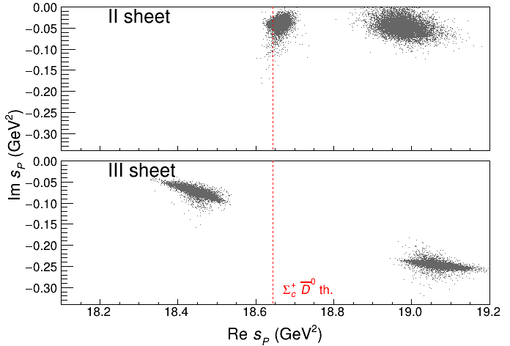
Minimal(istic) model for $P_{c}(4312)$
Effective range expansion We can set $c_{ii}=0$ to reduce to the scattering length approximation
Points to a virtual state
Doesn’t point to a resonance
$$c_{ii}=0$$
Finite $c_{ii}$
A. Pilloni – Hadron spectroscopy
Notes:
2 slides su Zc, a Bes e a Belle
2 slide su tetraquark model: dall’hamiltoniana di Jaffe al calcolo delle masse
1 slide su molecular models, dove sono i carichi? (non in Tornqvist, si in Hanhart, vedere Braaten, citare Nefediev)
2 slides su decay channels, dove si dovrebbe vedere, e a seconda del modello, vedere qualche plot
1 slide su Y(4260), tetraquark? C’è lo strano (si vede la f0)
1 slide su Zc a cleo (anche il neutro)

Slide 53
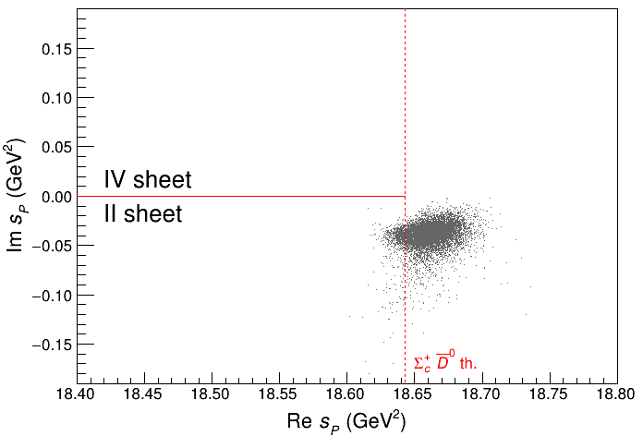
Minimal(istic) model for $P_{c}(4312)$
Effective range expansion We can set $c_{ii}=0$ to reduce to the scattering length approximation
Points to a virtual state
Doesn’t point to a resonance
$$c_{ii}=0$$
Finite $c_{ii}$
A. Pilloni – Hadron spectroscopy
Notes:
2 slides su Zc, a Bes e a Belle
2 slide su tetraquark model: dall’hamiltoniana di Jaffe al calcolo delle masse
1 slide su molecular models, dove sono i carichi? (non in Tornqvist, si in Hanhart, vedere Braaten, citare Nefediev)
2 slides su decay channels, dove si dovrebbe vedere, e a seconda del modello, vedere qualche plot
1 slide su Y(4260), tetraquark? C’è lo strano (si vede la f0)
1 slide su Zc a cleo (anche il neutro)

Slide 54
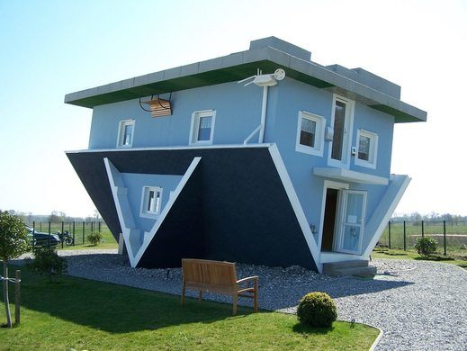
The lightest scalars
$$0^{++}$$
A. Pilloni – Hadron spectroscopy
Notes:
2 slides su Zc, a Bes e a Belle
2 slide su tetraquark model: dall’hamiltoniana di Jaffe al calcolo delle masse
1 slide su molecular models, dove sono i carichi? (non in Tornqvist, si in Hanhart, vedere Braaten, citare Nefediev)
2 slides su decay channels, dove si dovrebbe vedere, e a seconda del modello, vedere qualche plot
1 slide su Y(4260), tetraquark? C’è lo strano (si vede la f0)
1 slide su Zc a cleo (anche il neutro)

Slide 55
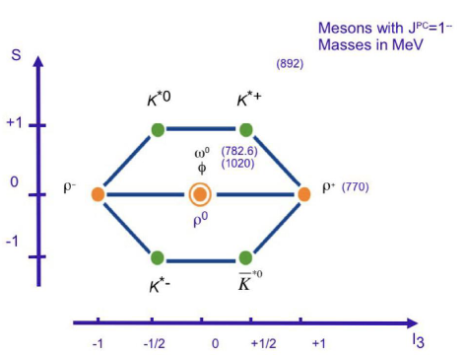
The light vector nonet
$$L=0, S=1$$
$$d\overline{s}$$
$$u\overline{s}$$
$$φ$$
$$2m_{s}$$
$$u\overline{u}+d\overline{d}$$
$$s\overline{s}$$
$$K^{∗}$$
$$m_{s}+m_{q}$$
$$d\overline{u}$$
$$u\overline{d}$$
$$u\overline{u}−d\overline{d}$$
$$ρ,ω$$
$$2m_{q}$$
$$s\overline{u}$$
$$s\overline{d}$$
A. Pilloni – Hadron spectroscopy

Slide 56
The light scalar nonet/1
$$L=1, S=1$$
$$0^{++}$$
$$κ^{0}$$
$$κ^{+}(700)$$
$$a_{0},f_{0}$$
$$??$$
$$f_{0}(980)$$
$$σ(500)$$
$$a_{0}^{−}$$
$$a_{0}^{+}(980)$$
$$κ$$
$$??$$
$$a_{0}^{0}$$
$$σ$$
$$??$$
$$κ^{−}$$
$$\overline{κ^{0}}$$
A. Pilloni – Hadron spectroscopy

Slide 57
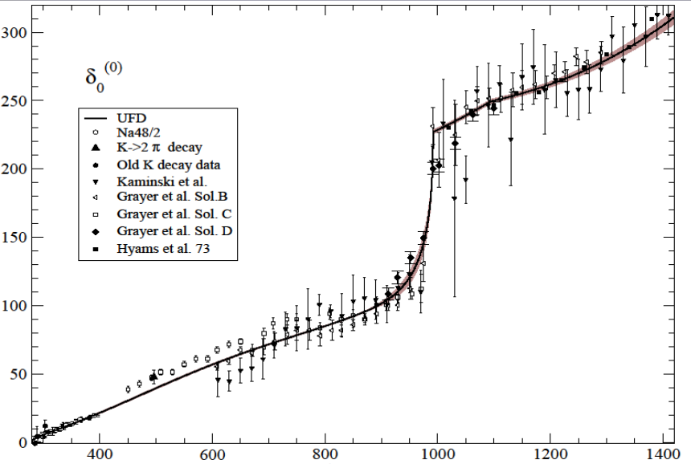
But where is the $σ$?
$$f_{0}(980)$$
The Adler zero is a zero of the $S$-wave amplitude due to chiral symmetry In UχPT it most often generate a pole identified as the $σ$
$$σ???$$
$ππ$ scattering shift for $L=0,I=0$
Really, really need amplitude analysis to get something meaningful about the $σ$
A. Pilloni – Hadron spectroscopy

Slide 58
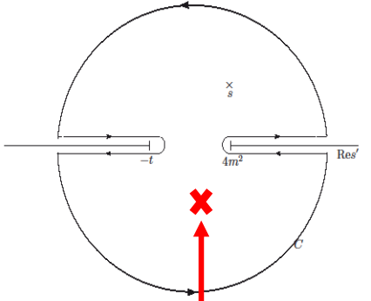
Roy equations (sketched)
1) You use the analytic properties of the amplitude and write Cauchy theorem
2) You use crossing symmetry to rewrite the integral of the left-hand cut as an integral of the right-hand cut
3) You expand the amplitude in partial waves
$$T\left(s,t\right)=\sum_{l}{t_{l}\left(s\right)P_{l}(\cos{θ})}$$
The dispersive integral helps the analytic continuation
A. Pilloni – Hadron spectroscopy

Slide 59
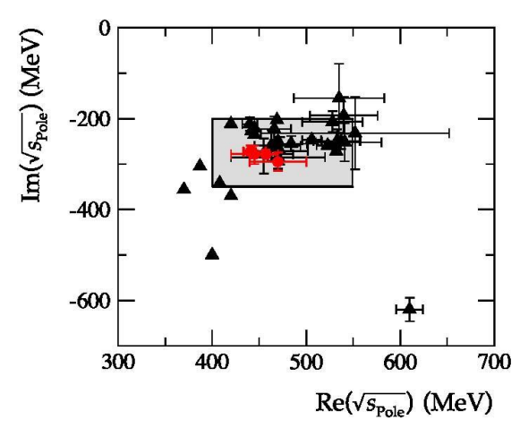
Results
Colangelo, Gasser, Leutwyler, NPB603, 125 (2001)
Caprini, Colangelo, Leutwyler, PRL 96, 132001 (2006)
Garcia-Martin, Kaminski, Peláez, Ruiz de Elvira, PRL107, 072001(2011)
Moussallam, EPJC71, 1814 (2011)
Masjuan, Ruiz de Elvira, Sanz-Cillero, PRD90, 097901 (2014)
Peláez, Phys.Rept. 658 (2016)
Descotes-Genon, Moussallam, EPJC48, 553 (2006)
Peláez, Rodas, arXiv:2010.11222
A. Pilloni – Hadron spectroscopy

Slide 60
QUESTIONS?

Slide 61
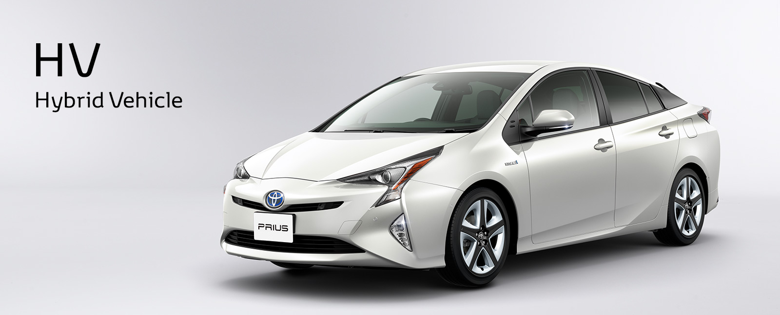
The hybrid $π_{1}$
A. Pilloni – The pole hunter
Notes:
2 slides su Zc, a Bes e a Belle
2 slide su tetraquark model: dall’hamiltoniana di Jaffe al calcolo delle masse
1 slide su molecular models, dove sono i carichi? (non in Tornqvist, si in Hanhart, vedere Braaten, citare Nefediev)
2 slides su decay channels, dove si dovrebbe vedere, e a seconda del modello, vedere qualche plot
1 slide su Y(4260), tetraquark? C’è lo strano (si vede la f0)
1 slide su Zc a cleo (anche il neutro)

Slide 62
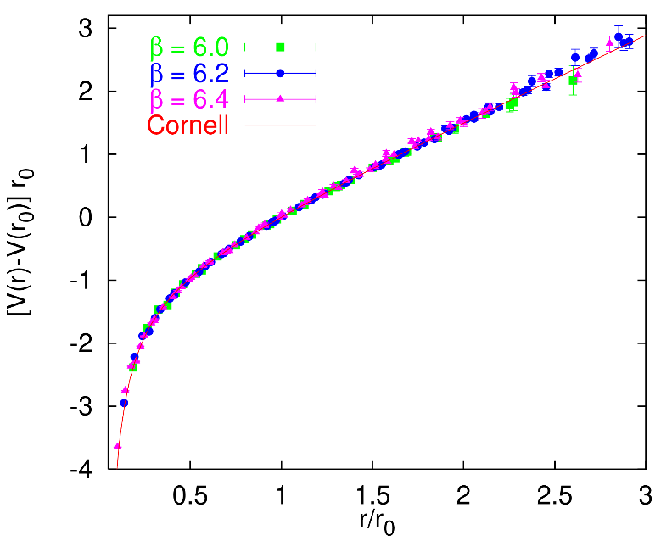
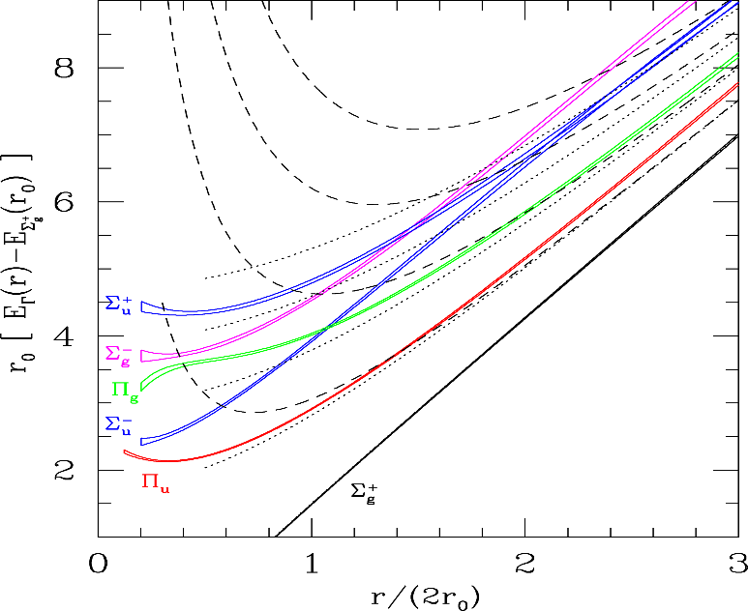
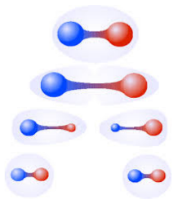
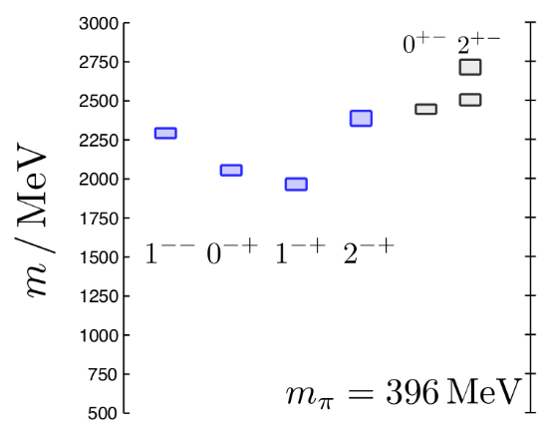
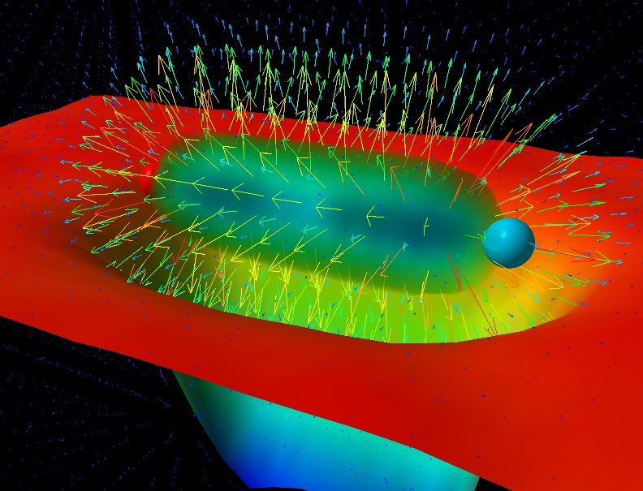
Learning about confinement
If quarks were infinitely heavy, gluonic field is confined in a string
Linear rising potential
What is a constituent gluon?
vibration of the string? → degenerate $J^{PC}={\left(0,1,2\right)}^{−+},{\left(0,1,2\right)}^{+−}$
excitation of a quasiparticle? → degenerate $J^{PC}={\left(0,1,2\right)}^{−+},1^{−−}$
G. Bali
C. Morningstar
J. Dudek
excitation of a quasiparticle! → degenerate $J^{PC}={\left(0,1,2\right)}^{−+},1^{−−}$ says Lattice QCD...
What about real data?
D. Leinweber
A. Pilloni – Hadron spectroscopy
Notes:
Controlla la parte su Regge

Slide 63
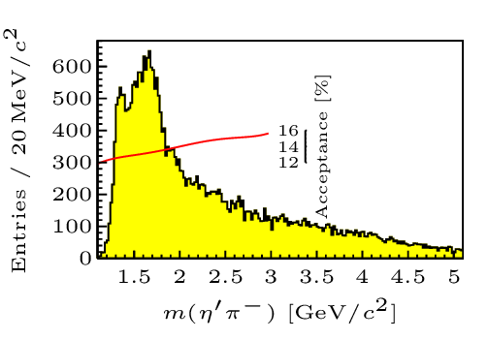
Hybrid hunting
J. Dudek
Excited gluon, $$J^{PC}=1^{+−}$$ mass $∼1.0\text{−}1.5 \text{GeV}$
$$\overline{r}$$
$$\overline{g}$$
$$r$$
excitation of a quasiparticle? → degenerate $J^{PC}={\left(0,1,2\right)}^{−+},1^{−−}$
$$g$$
Look for a $π_{1}$ state with $J^{PC}=1^{−+}$
decaying into $\left\{\begin{matrix}η π \text{and} η^{′}π \\ ρ π→3π \\ b_{1}π→5π\end{matrix}\right.$
Small signal in data
A. Pilloni – Hadron spectroscopy
Notes:
2 slides su Zc, a Bes e a Belle
2 slide su tetraquark model: dall’hamiltoniana di Jaffe al calcolo delle masse
1 slide su molecular models, dove sono i carichi? (non in Tornqvist, si in Hanhart, vedere Braaten, citare Nefediev)
2 slides su decay channels, dove si dovrebbe vedere, e a seconda del modello, vedere qualche plot
1 slide su Y(4260), tetraquark? C’è lo strano (si vede la f0)
1 slide su Zc a cleo (anche il neutro)

Slide 64
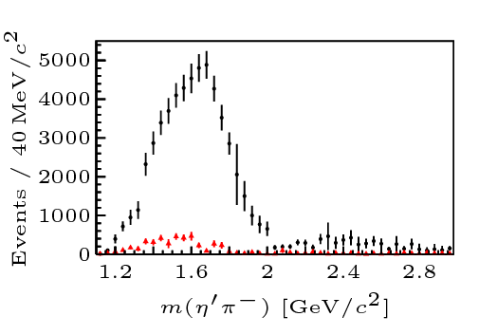
Two hybrid states???
Neither lattice nor models predict two $1^{−+}$ states in this region!
A hybrid meson ($8$) cannot decay into $ηπ$ in the SU(3) limit
Tetraquark ($10⊕\overline{10}$)? Requires doubly charged
A. Pilloni – Hadron spectroscopy
Notes:
2 slides su Zc, a Bes e a Belle
2 slide su tetraquark model: dall’hamiltoniana di Jaffe al calcolo delle masse
1 slide su molecular models, dove sono i carichi? (non in Tornqvist, si in Hanhart, vedere Braaten, citare Nefediev)
2 slides su decay channels, dove si dovrebbe vedere, e a seconda del modello, vedere qualche plot
1 slide su Y(4260), tetraquark? C’è lo strano (si vede la f0)
1 slide su Zc a cleo (anche il neutro)

Slide 65
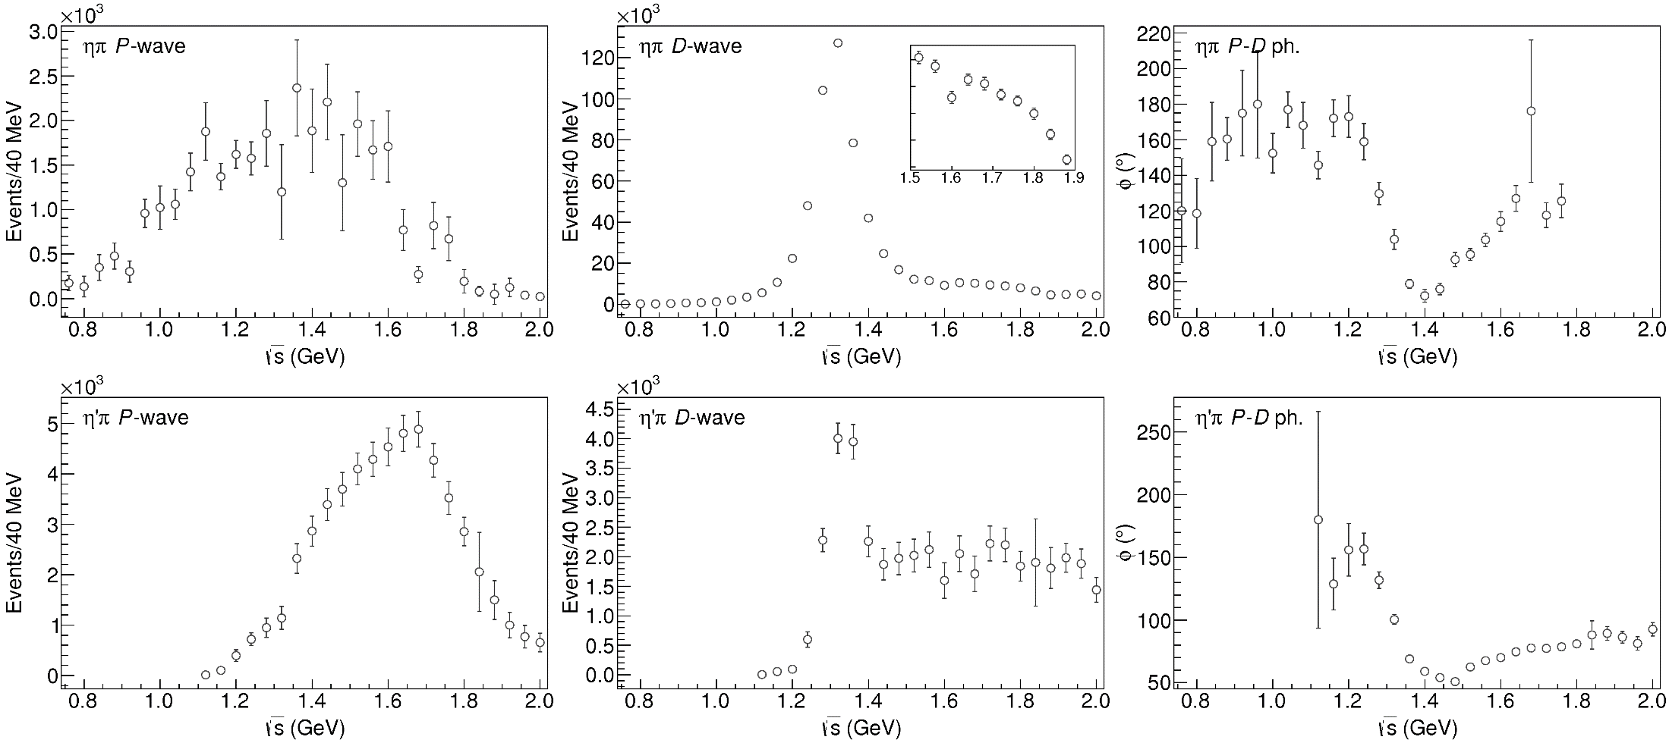
Data in $η^{(′)}π$
( data)
$$π_{1}\left(1400\right)?$$
$$a_{2}\left(1320\right)$$
$$a_{2}^{′}\left(1700\right)$$
$$π_{1}\left(1600\right)?$$
$$a_{2}\left(1320\right)$$
$$a_{2}^{′}\left(1700\right)$$
$$J^{PC}=1^{−+}$$
$$J^{PC}=2^{++}$$
A. Pilloni – Hadron spectroscopy
Notes:
Controlla la parte su Regge

Slide 66
Amplitudes for $η^{(′)}π$
We build the partial wave amplitudes according to the $N/D$ method
Jackura, Mikhasenko, AP et al. (JPAC & COMPASS), PLB
Rodas, AP et al. (JPAC), PRL
$$a\left(s\right)=\frac{n\left(s\right)}{D\left(s\right)}$$
$$D(s)$$
$$n(s)$$
The $n\left(s\right)$ → background physics, process-dependent, smooth
The $D(s)$ contains all the Final State Interactions constrained by unitarity → universal
A. Pilloni – Hadron spectroscopy
Notes:
Controlla la parte su Regge

Slide 67
Coupled channel: the model
A. Rodas, AP et al. (JPAC) PRL122, 042002
Two channels, $i,k=ηπ, η^{′}π$ Two waves, $J=P,D$ 37 fit parameters
1 K-matrix pole for the P-wave
2 K-matrix poles for the D-wave
Left-hand scale (Blatt-Weisskopf radius) $s_{R}=s_{0}=1 {\text{GeV}}^{2}$
$α=2$, 3rd order polynomial for $n_{k}^{J}(s)$
A. Pilloni – Hadron spectroscopy
Notes:
Controlla la parte su Regge

Slide 68
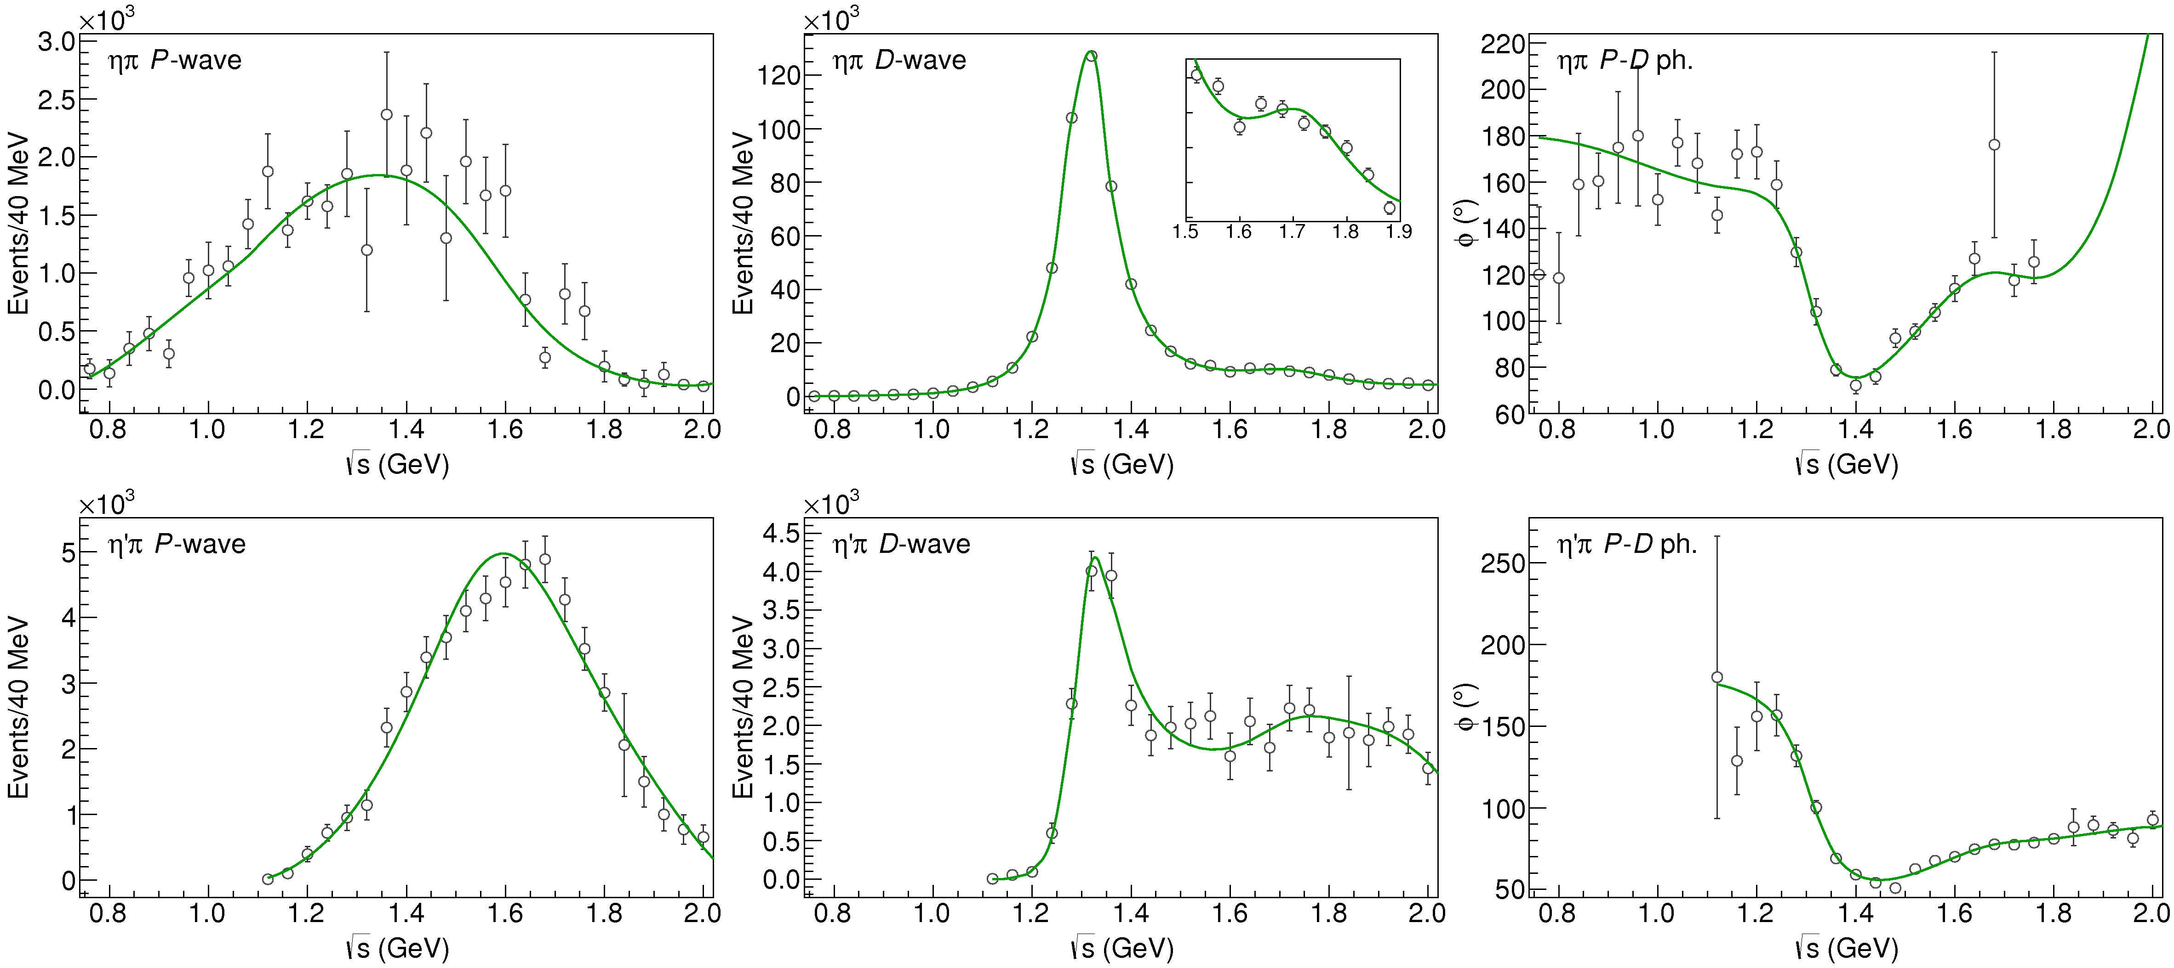
Fit to $η^{(′)}π$
( data)
$$π_{1}\left(1400\right)?$$
$$a_{2}\left(1320\right)$$
$$a_{2}^{′}\left(1700\right)$$
$$π_{1}\left(1600\right)?$$
$$a_{2}\left(1320\right)$$
$$a_{2}^{′}\left(1700\right)$$
$$J^{PC}=1^{−+}$$
$$J^{PC}=2^{++}$$
A. Pilloni – Hadron spectroscopy
Notes:
Controlla la parte su Regge

Slide 69
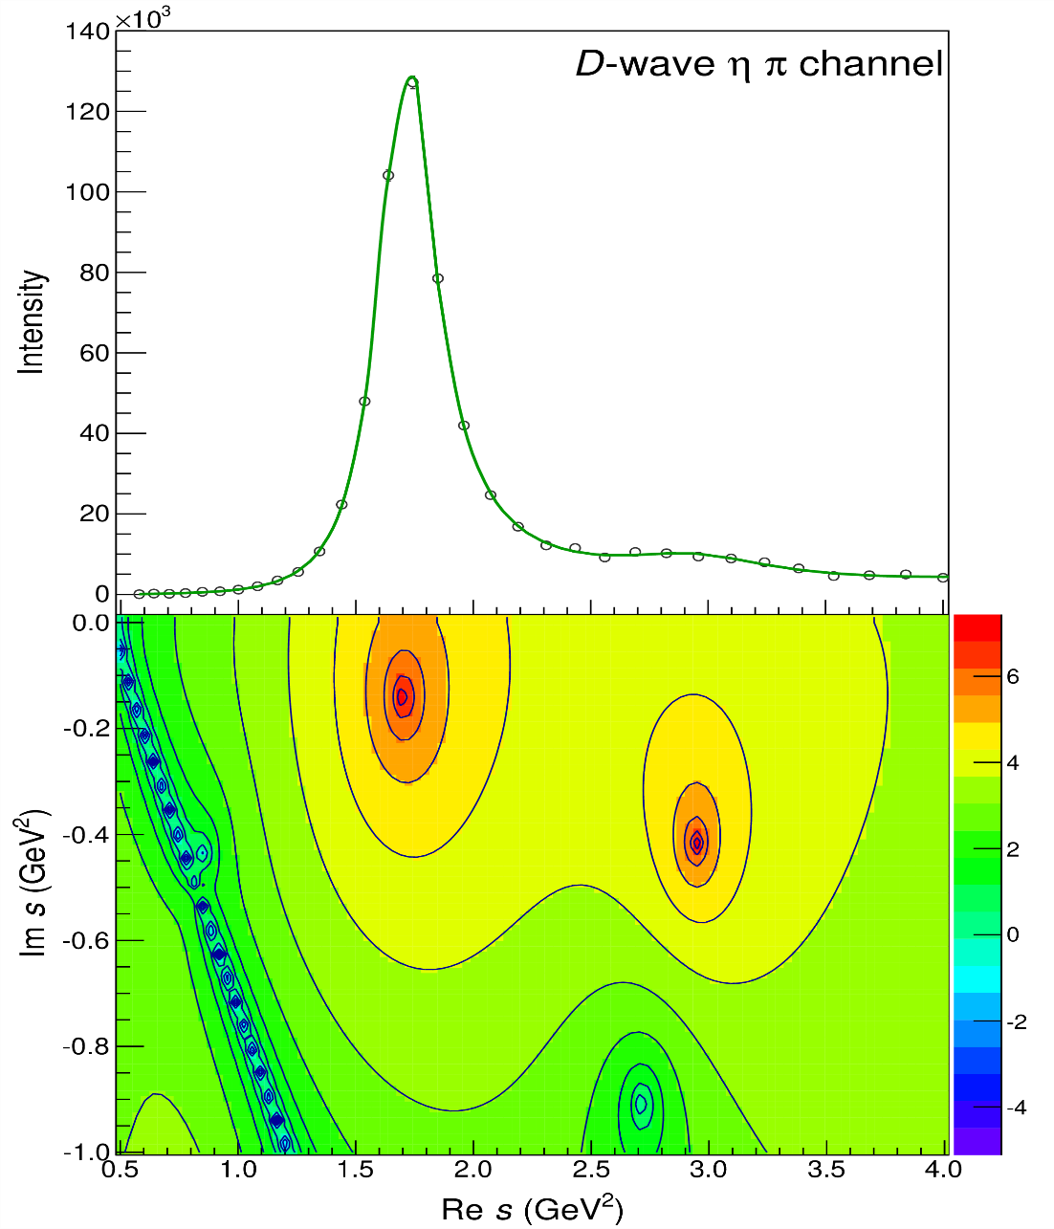
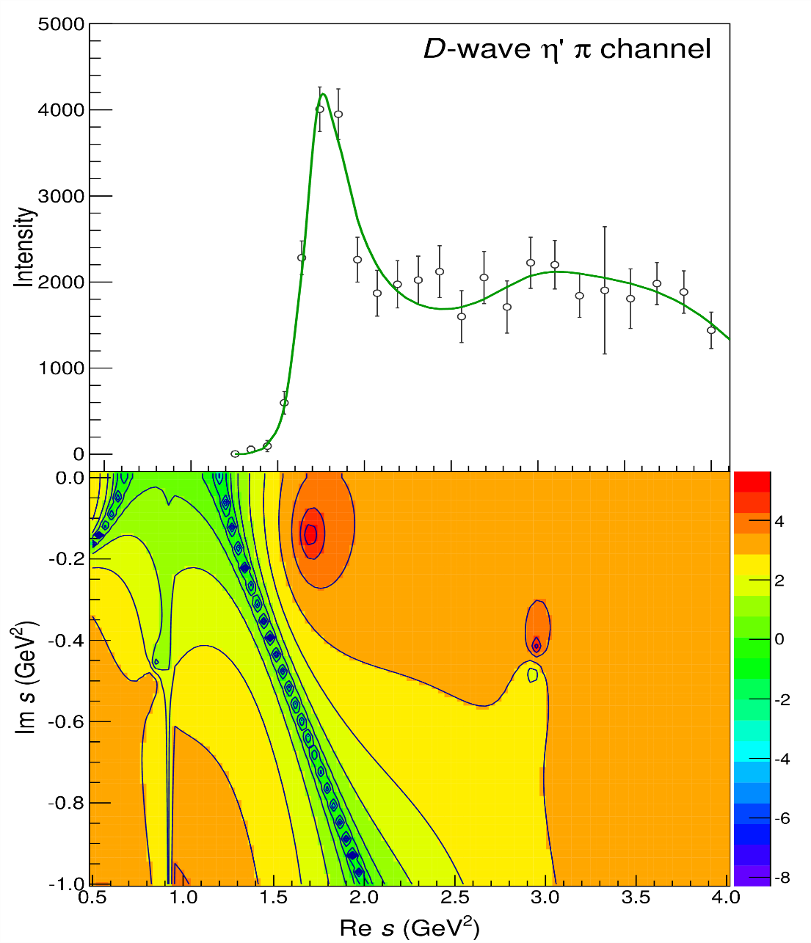
Pole hunting
$$a_{2}^{′}\left(1700\right)$$
$$a_{2}^{′}\left(1700\right)$$
$$a_{2}\left(1320\right)$$
$$a_{2}\left(1320\right)$$
A. Pilloni – Hadron spectroscopy
Notes:
Controlla la parte su Regge

Slide 70
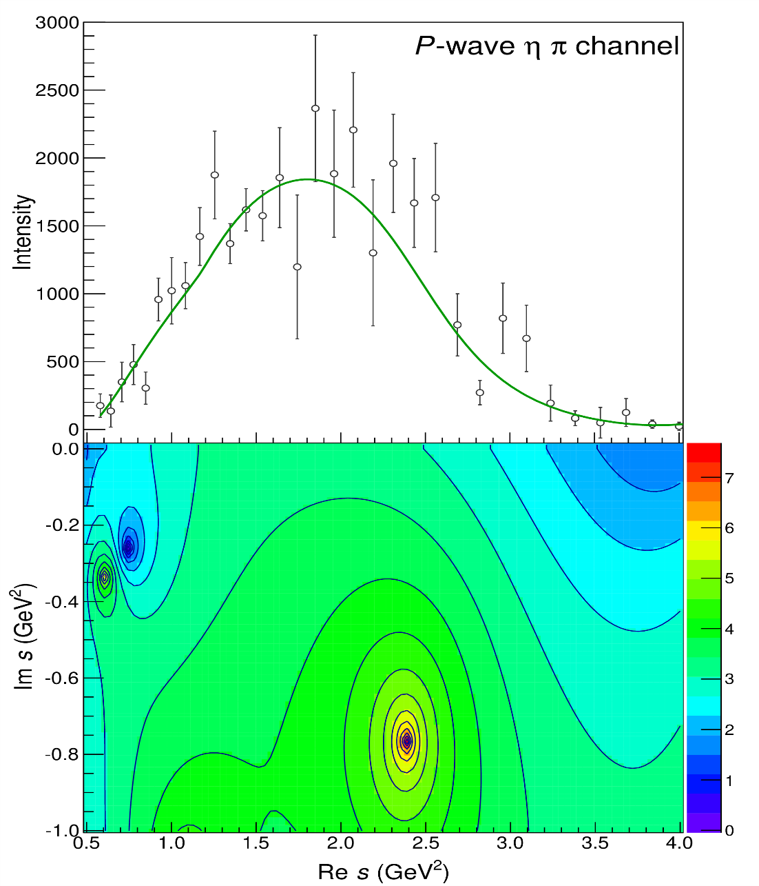
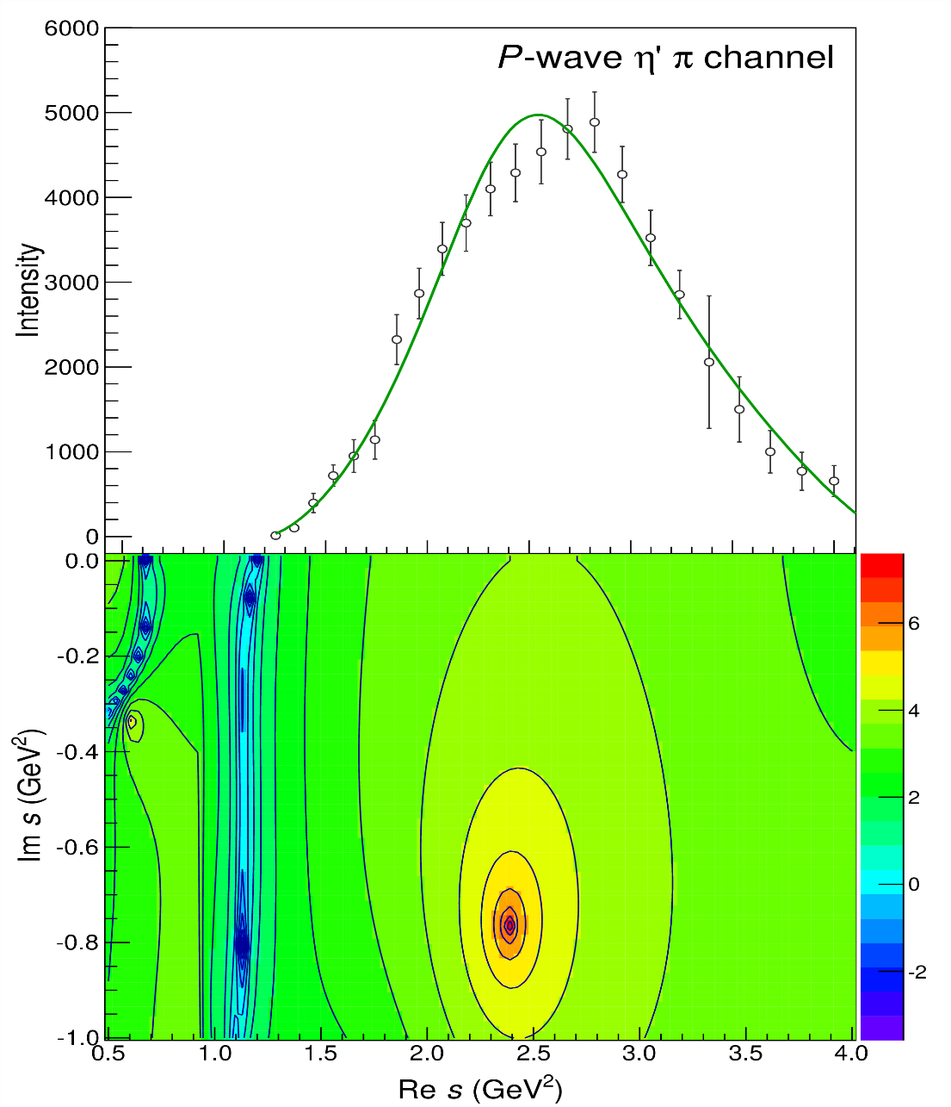
Pole hunting
$$π_{1}$$
$$π_{1}$$
A. Pilloni – Hadron spectroscopy
Notes:
Controlla la parte su Regge

Slide 71
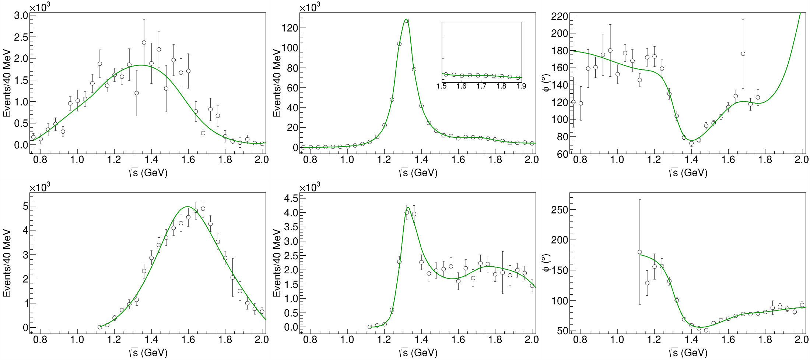
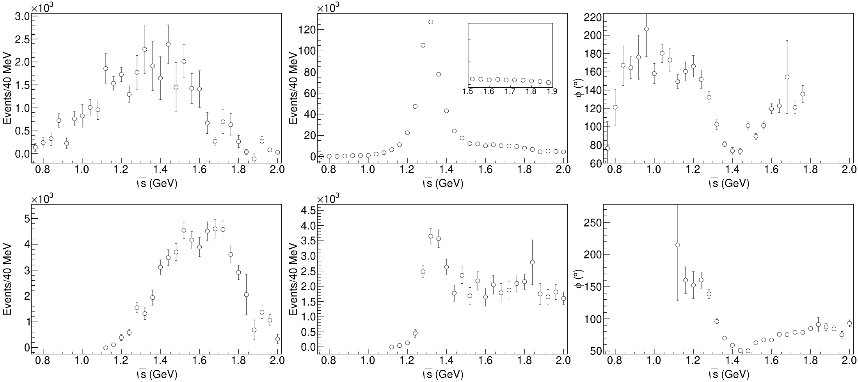
Statistical Bootstrap
A. Pilloni – Hadron spectroscopy
Notes:
Controlla la parte su Regge

Slide 72
Correlations
Denominator parameters uncorrelated with the numerator ones ✓
Denominator parameters uncorrelated between P- and D-wave ✓
Production (numerator) parameters
K-matrix «bkg» parameters
K-matrix «pole» parameters
K-matrix «bkg» parameters
A. Pilloni – Hadron spectroscopy
Notes:
Controlla la parte su Regge

Slide 73
Statistical Bootstrap
For each fit, we search poles: two clusters in D-wave: $a_{2}\left(1320\right)$ and $a_{2}^{′}\left(1700\right)$
A. Pilloni – Challenges in Hadron Spectroscopy
Notes:
Controlla la parte su Regge

Slide 74
Statistical Bootstrap
Only one stable cluster in $P$-wave: a single $π_{1}$
A. Pilloni – Challenges in Hadron Spectroscopy
Notes:
Controlla la parte su Regge

Slide 75
Systematic studies
For each class, the maximum deviation of mass and width is taken as a systematic error Deviation smaller than the statistical error are neglected Systematic of different classes are summed in quadrature
A. Pilloni – Hadron spectroscopy
Notes:
Controlla la parte su Regge

Slide 76
Bootstrap for $s_{R}=1.8 {\text{GeV}}^{2}$
Our skepticism about a second pole in the relevant region is confirmed:
It is unstable and not trustable
A. Pilloni – Hadron spectroscopy
Notes:
Controlla la parte su Regge

Slide 77
Final results
Agreement with Lattice is restored
That’s the most rigorous extraction of an exotic meson available so far!
A. Pilloni – Hadron spectroscopy
Notes:
Controlla la parte su Regge

Slide 78
An isoscalar $η_{1}$?
There is a recent claim by BESIII in $J/ψ→γ η η′$ of resonant activity in P-wave
Not enough information to perform a similar analysis but… stay tuned!
BW parameters:
$$M=1855±9_{−1}^{+6} \text{MeV}, \\ Γ=188±{18}_{−8}^{+3} \text{MeV}$$
A. Pilloni – Hadron spectroscopy
Notes:
2 slides su Zc, a Bes e a Belle
2 slide su tetraquark model: dall’hamiltoniana di Jaffe al calcolo delle masse
1 slide su molecular models, dove sono i carichi? (non in Tornqvist, si in Hanhart, vedere Braaten, citare Nefediev)
2 slides su decay channels, dove si dovrebbe vedere, e a seconda del modello, vedere qualche plot
1 slide su Y(4260), tetraquark? C’è lo strano (si vede la f0)
1 slide su Zc a cleo (anche il neutro)

Slide 79
The scalar glueball
$$0^{++}$$
A. Pilloni – Hadron spectroscopy
Notes:
2 slides su Zc, a Bes e a Belle
2 slide su tetraquark model: dall’hamiltoniana di Jaffe al calcolo delle masse
1 slide su molecular models, dove sono i carichi? (non in Tornqvist, si in Hanhart, vedere Braaten, citare Nefediev)
2 slides su decay channels, dove si dovrebbe vedere, e a seconda del modello, vedere qualche plot
1 slide su Y(4260), tetraquark? C’è lo strano (si vede la f0)
1 slide su Zc a cleo (anche il neutro)

Slide 80
Glueballs
The clearest sign of confinement in pure Yang-Mills The worst state to search in real life
Morningstar and Peardon PRD60, 034509
Gregory et al. JHEP1210, 170
A. Pilloni – Hadron spectroscopy

Slide 81
How to identify a glueball
You don’t. Since it mixes with light isoscalars, there is no model-independent way of saying which state is (mostly) the glueball. Only suggestions:
There is one too many wrt QM. Indeed, $f_{0}\left(1370\right),f_{0}\left(1500\right),$ $f_{0}\left(1710\right)$
A glueball couples to photons only throughout mixing, so radiative widths should be small
Their production is enhanced in gluon-rich processes, as $J/ψ$ radiative decays
It couples equally to mesons of all flavors (?)
$$c$$
However, an argument based on chiral symmetry claims the coupling proportional to quark mass
$$J/ψ$$
$$\overline{c}$$
G
A. Pilloni – Hadron spectroscopy

Slide 82
$J/ψ→γ π^{0}π^{0} and→γ K_{S}^{0}K_{S}^{0}$
We consider the $S$ and $D$ wave by BESIII to use the information about their relative phase.
The D-wave is populated by two almost elastic resonances: the $f_{2}(1270)$ and $f_{2}′(1525)$
$f_{2}(1270)$
$f_{2}′(1525)$
A. Pilloni – Amplitude analysis of $J/ψ→γ π^{0}π^{0}$

Slide 83
Same model as before
A. Rodas, AP et al. (JPAC) EPJC82, 1, 80 (2022)
Two/three channels, $i,k=ππ, KK$, $ρρ$ Two waves, $J=S,D$ 40-56 parameters
3 K-matrix pole for the S-wave
3 K-matrix poles for the D-wave
A. Pilloni – Hadron spectroscopy
Notes:
Controlla la parte su Regge

Slide 84
$J/ψ→γ π^{0}π^{0} and→γ K_{S}^{0}K_{S}^{0}$
The fit is decent, but it’s struggling in getting the $f_{2}′$ right Being quasi-elastic, it’s too constrained
Fit quality and local description improve when a third $ρρ$ channel is added
( data)
A. Pilloni – Hadron spectroscopy

Slide 85
Pole extraction
A. Pilloni – Hadron spectroscopy

Slide 86
Looking at the residues
Despite the large systematics, the $f_{0}\left(1710\right)$ couples to kaons more than the $f_{0}\left(1500\right)$
Also, the $f_{0}\left(1710\right)$ couples to the initial gluon-rich state more than the $f_{0}\left(1500\right)$
Both these fact suggest a sizeable glueball component for the $f_{0}\left(1710\right)$
A. Pilloni – Hadron spectroscopy

Slide 87
How theorists think of experiments
All the information about hadrons is collected by the Particle Data Group
$$G$$
Changing beam and target, you can change the font
P
D
What theorists see…
What experimentalists present…
A. Pilloni – Hadron spectroscopy

Slide 88
Bound and virtual states
The amplitude close to threshold can be expanded as
$$A\left(E\right)=\frac{1}{\frac{1}{a}+\frac{1}{2}r_{0}k^{2}−ik+O\left(k^{4}\right)}$$
$a$ is the scattering length
$r_{0}$is the effective range
The sign of $a$ controls whether we have a bound or virtual state
A. Pilloni – Hadron spectroscopy
Notes:
Controlla la parte su Regge

Slide 89
Coupled channels
For coupled channels, $2→2$ unitarity gets easily generalized from
$$\text{Im} A_{l}^{−1}\left(s\right)=−ρ\left(s\right)=−\left(\begin{matrix}ρ_{1}(s) & 0 & 0 \\ 0 & ρ_{2}(s) & 0 \\ 0 & 0 & ⋱\end{matrix}\right)$$
With two channels, a simple form is given by Flatté,
$$A_{l}^{−1}\left(s\right)∝det {\left(K^{−1}−i ρ\left(s\right)\right)}^{−1}∝m^{2}−s−i g_{1}^{2}ρ_{1}\left(s\right)−g_{2}^{2}ρ_{2}\left(s\right)$$
Having two channels, I have two Riemann sheets for each phase space function, so 4 Riemann sheets
A. Pilloni – Hadron spectroscopy
Notes:
Controlla la parte su Regge

Slide 90
Minimal(istic) model with ANN
Ng, et al. (JPAC), PRD 105, L091501
Same conclusion reached if the analysis is performed with a Deep Neural Network
The peak region has the largest impact for the decision
Highest probability for a virtual state in the IV sheet
A. Pilloni – Hadron spectroscopy
Notes:
2 slides su Zc, a Bes e a Belle
2 slide su tetraquark model: dall’hamiltoniana di Jaffe al calcolo delle masse
1 slide su molecular models, dove sono i carichi? (non in Tornqvist, si in Hanhart, vedere Braaten, citare Nefediev)
2 slides su decay channels, dove si dovrebbe vedere, e a seconda del modello, vedere qualche plot
1 slide su Y(4260), tetraquark? C’è lo strano (si vede la f0)
1 slide su Zc a cleo (anche il neutro)

Slide 91
Reference frames
M. Mikhasenko, AP et al. (JPAC), to appear
The 5 variables of each chain can be expressed in terms of the variables of another chain
A. Pilloni – Hadron spectroscopy

Slide 92
Isobar model in the decay plane
The natural choice for the amplitude looks
$ζ_{2(1)}^{1}$ is the angle between $π$ and $Λ_{c}$ in the $p$ rest frame
$ζ_{3(1)}^{1}$ is the angle between $K$ and $Λ_{c}$ in the $p$ rest frame
${\hat{θ}}_{2(1)}$ is the angle between $K$ and $p$ in the $Λ_{c}$ rest frame
${\hat{θ}}_{3(1)}$is the angle between $π$ and $p$ in the $Λ_{c}$ rest frame
A. Pilloni – Hadron spectroscopy

Slide 93
Isobar model in the decay plane
The natural choice for the amplitude looks
All the angles are polar: no azimuthal phases all these functions can be expressed in term of the Mandelstam variables $σ_{1}=m_{Kπ}^{2},$ $σ_{2}=m_{pπ}^{2},$ $σ_{3}=m_{pK}^{2}$
Now all the spins are aligned correctly
$ζ_{2(1)}^{1}$ is the angle between $π$ and $Λ_{c}$ in the $p$ rest frame
$ζ_{3(1)}^{1}$ is the angle between $K$ and $Λ_{c}$ in the $p$ rest frame
${\hat{θ}}_{2(1)}$ is the angle between $K$ and $p$ in the $Λ_{c}$ rest frame
${\hat{θ}}_{3(1)}$is the angle between $π$ and $p$ in the $Λ_{c}$ rest frame
A. Pilloni – Hadron spectroscopy

Slide 94
Isobar model out of the decay plane
Now that everything is aligned with the $K^{∗}$ chain, we can use the Euler angles of chain 1 for the full thing
In this form it is straightforward to check that, for unpolarized $Λ_{c}$, the cross section does not depend on the 3 Euler angles
A. Pilloni – Hadron spectroscopy

