Slide 1
SoLID Collaboration Meeting July’25 Pre-R&D and Test Beam Plan
July-07-2025
Klaus Dehmelt - TJNAF

Slide 2
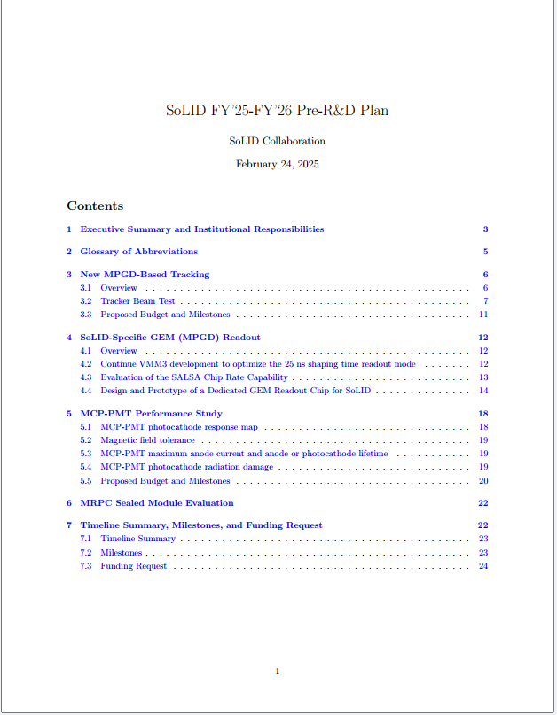
Pre-R&D Activities

Slide 3
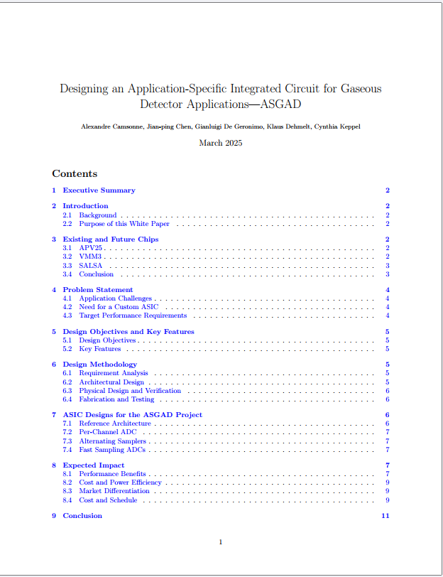
Pre-R&D Activities + MPGD ASIC White Paper → Submitted

Slide 4
Pre-R&D Activities - Scope
GEM readout → more general MPGD readout
Tracking options
MCP-PMT
→ to be combined with a Detector Beam Test in Hall C

Slide 5
Pre-R&D Activities – MPGD Readout
MPGD readout
VMM tests
Two test boards ordered
Six SoLID prototype boards constructed
Evaluation board developed → spy on data with small subset of detector data
Issue with external trigger, waiting for new firmware
Can check pedestal width
S/N of detector with source or cosmics
Monitor direct readout signals for 12 channels
Prototype development for data performance; testing of direct output with detector and X-ray source
Investigating the production of modified VMM
Drop the low gain
Add high gain setting
Inquiring design time + production costs

Slide 6
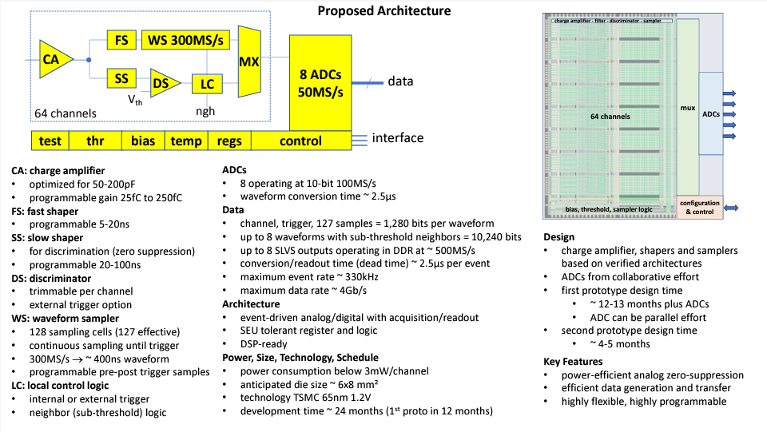
Pre-R&D Activities – MPGD Readout

Slide 7
Pre-R&D Activities – Tracking Options
Default configuration: Triple – GEM à la MOLLER
Alternative configuration: μRWell and derivatives

Slide 8
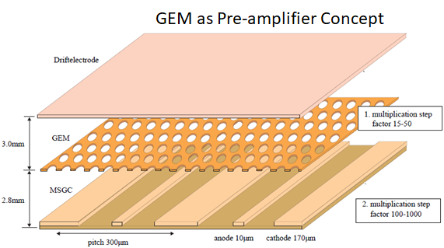
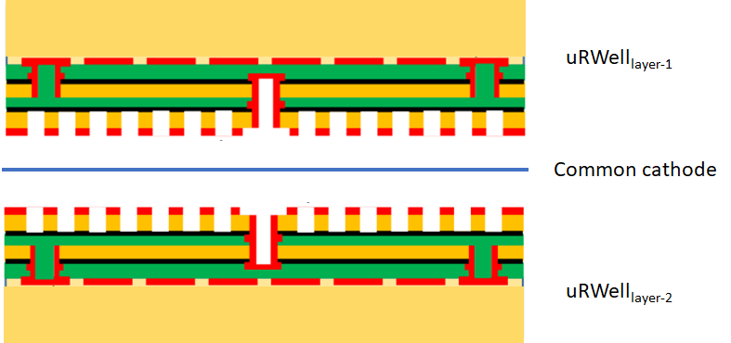
Pre-R&D Activities – Tracking Options
Alternative configuration: μRWell and derivatives

Slide 9
Pre-R&D Activities
MPGD readout
Tracking options
SoLID_preRD_Fall2024 → Proposed Milestones and Budget
Budget uncertainties postponed this endeavor

Slide 10
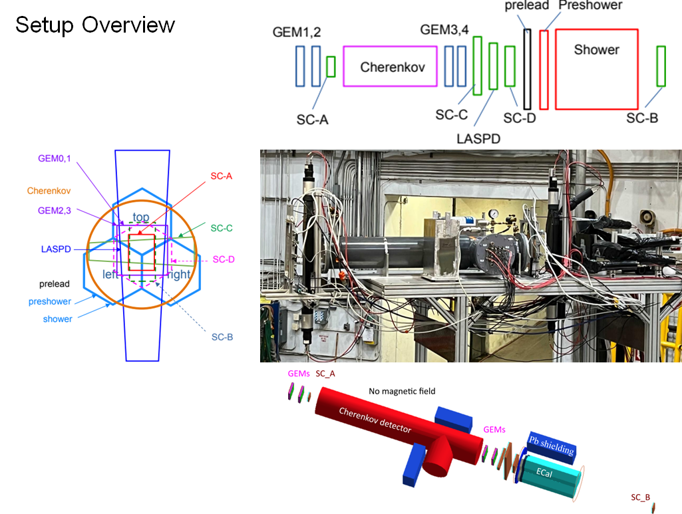
Pre-R&D Activities – Past Activities

Slide 11
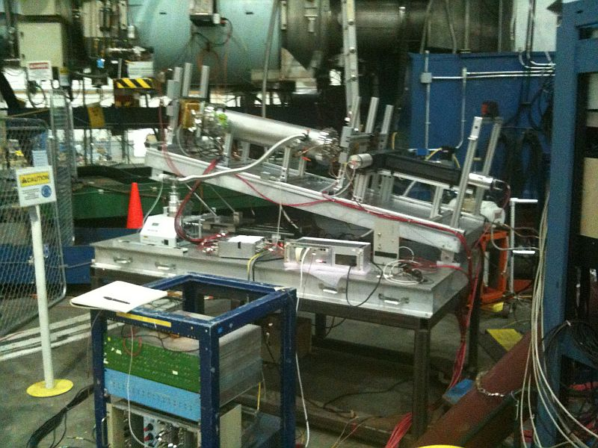
Pre-R&D Activities And Test Beam Plans – Hall C
Perform a sector test with SoLID
sub-detectors
Focus on new MPGD
technologies

Slide 12
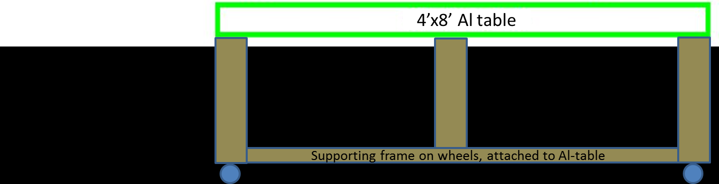
Pre-R&D Activities And Test Beam Plans – Hall C

Slide 13
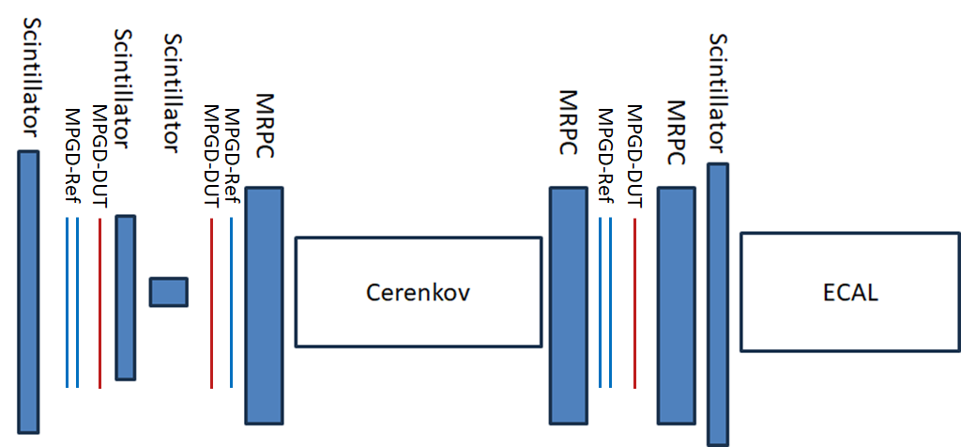
Pre-R&D Activities And Test Beam Plans – Hall C

Slide 14
Pre-R&D Activities – Planned Future Activities – Hall C
Detectors under Test (DUT)
Trackers
Hybrid μRWell – strips → status TBD
Hybrid μRWell – pads → status TBD
μRGroove → two prototype trackers in production – SBU
General reference trackers – GEMs → status TBD
RO electronics – VMM3/APV25 → appropriate?
MRPC – sealed → in HMS?
Kinematics: Angle, distance from target
What particle will we track?
Electrons: need high rates to get clean electrons
e⁺/e⁻ from photons?
Minimum ionizing π: low energy → multiple scattering?
Reducing soft background.
Soft Moller electrons in front: Absorber or magnetic field (sweep) → NPS magnet
Distance from target
Anticipated beam current:
Need 100 nA for tune-up, 5 μA for low-rate tracking.
Will useful data be obtained at higher rates?
Are there other tests beyond tracking that may interfere?

Slide 15
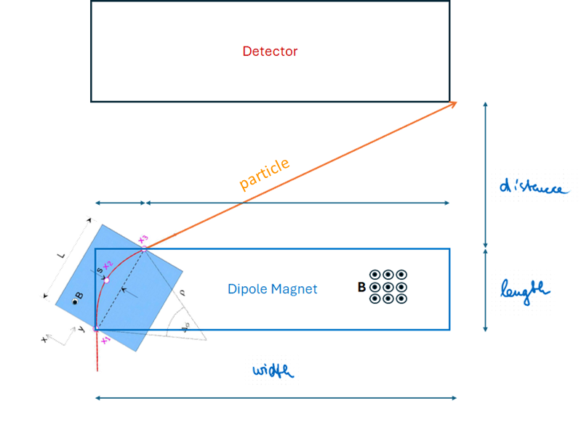
Pre-R&D Activities And Test Beam Plans – Hall C
Background reduction
Remove Møller electrons → sweeping magnet
Dipole magnet
Aperture, gap, field strength
Accommodated around detector setup

Slide 16
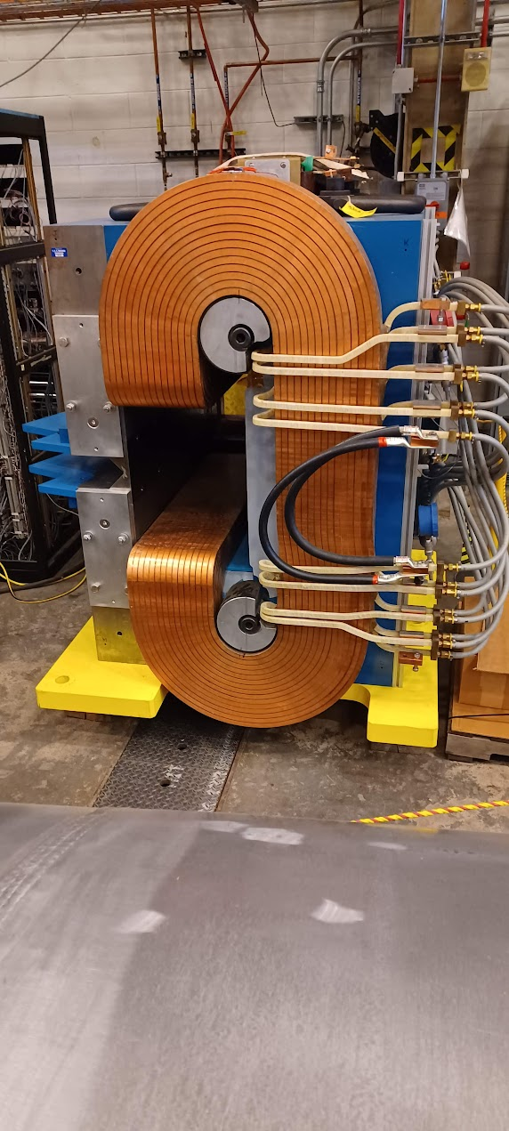
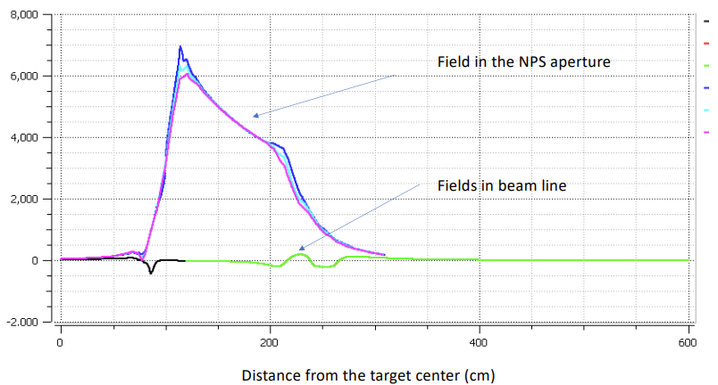
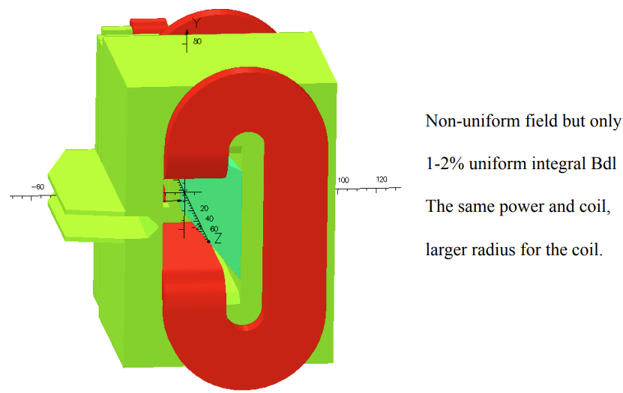
Pre-R&D Activities – Planned Future Activities – Hall C
Possible use of sweeping magnet – NPS magnet
Magnetic rigidity $B∙dl=0.58 T∙m$
Documentation available, field-map integrated in GEANT4 (Ye Tian)

Slide 17
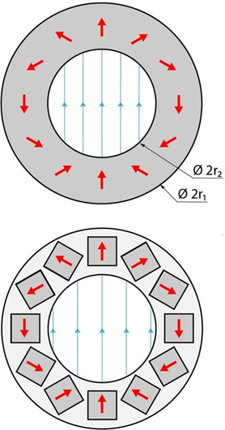
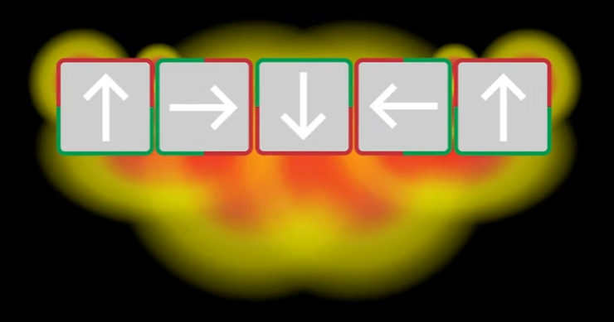
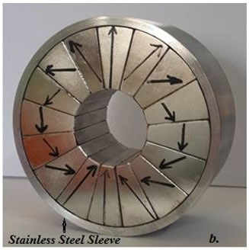
Pre-R&D Activities – Planned Future Activities – Hall C
Looking into alternative to NPS magnet → permanent magnet array
Magnetic rigidity should be $B∙dl=0.58 T∙m$ as for NPS magnet
Halbach Array
Magnetic array producing a high magnetic field utilizing permanent magnets
Magnets arranged with spatially rotating magnetic field vector → focusing and augmenting the magnetic field on one side, while cancelling it out on the other
Non-trivial → needs investigations

Slide 18
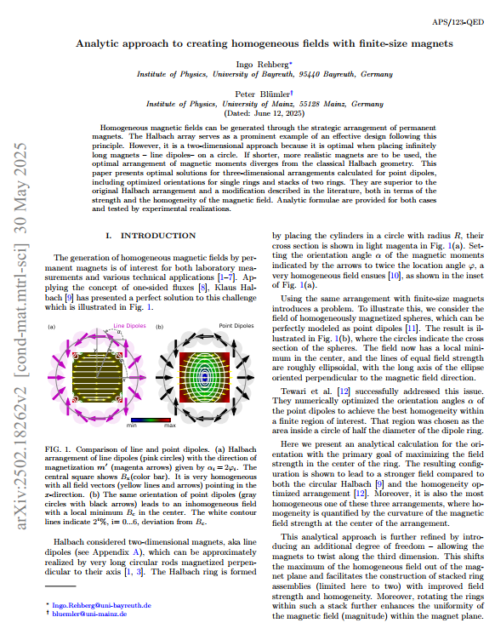
Pre-R&D Activities – Planned Future Activities – Hall C
Looking into alternative to NPS magnet → permanent magnet array
Magnetic rigidity should be $B∙dl=0.58 T∙m$ as for NPS magnet
Halbach Array
Magnetic array producing a high magnetic field utilizing permanent magnets
Magnets arranged with spatially rotating magnetic field vector → focusing and augmenting the magnetic field on one side, while cancelling it out on the other
Non-trivial → needs investigations

Slide 19
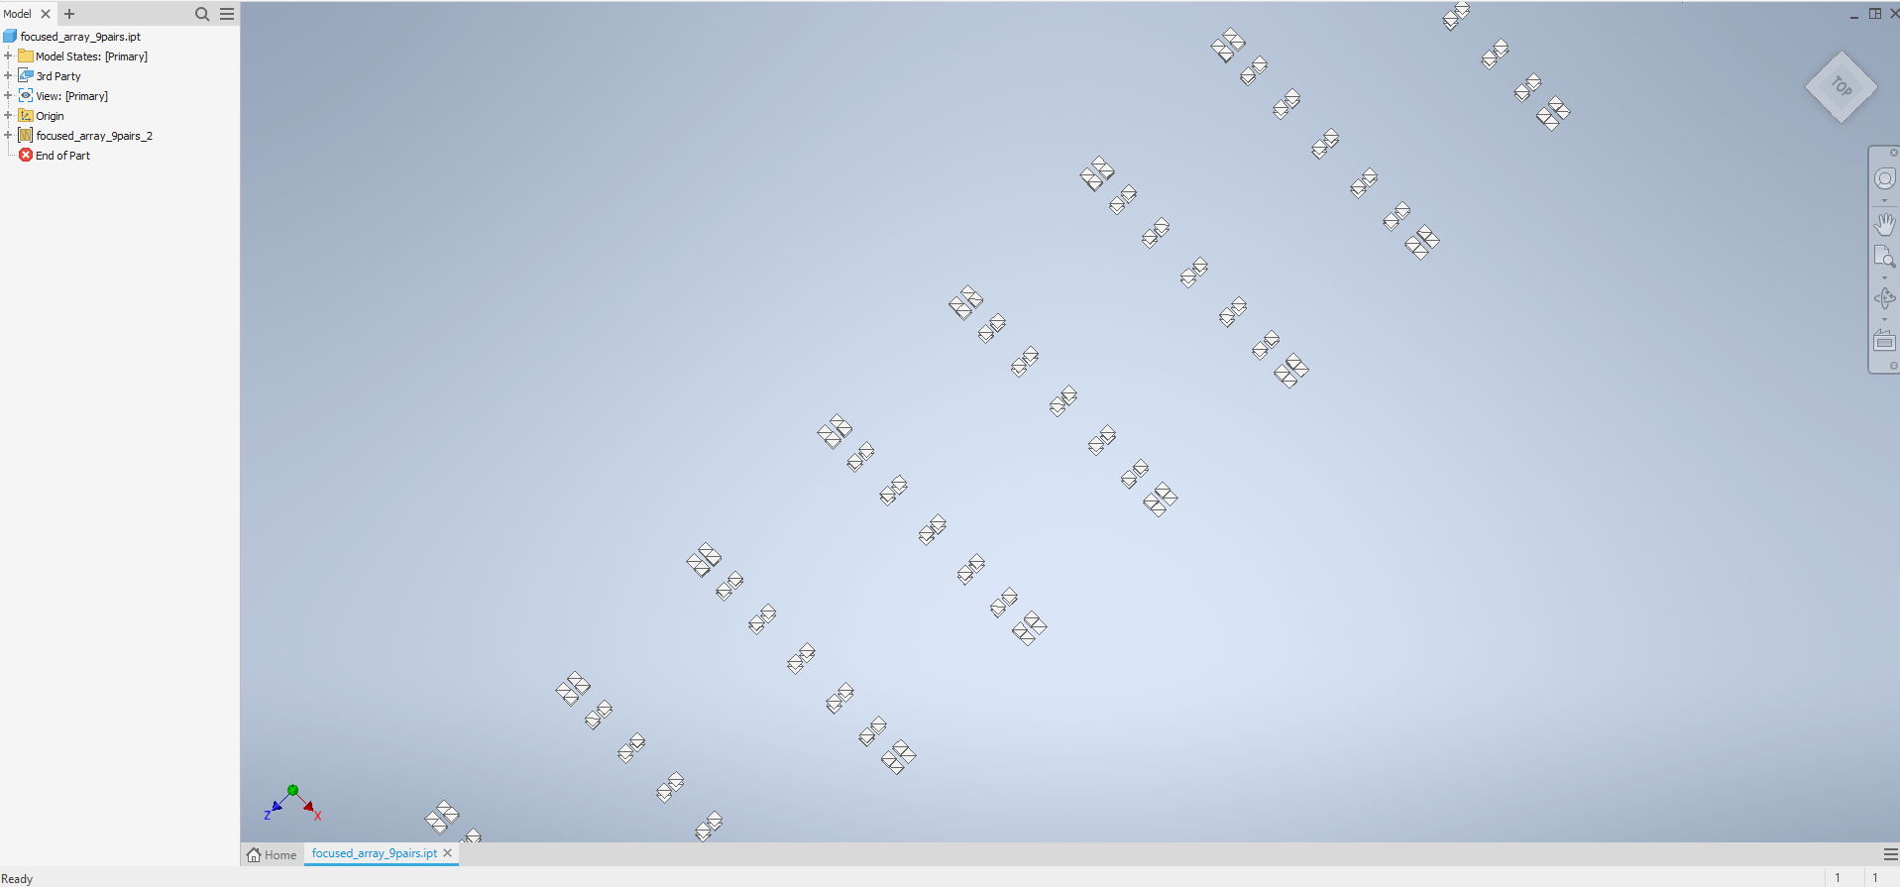
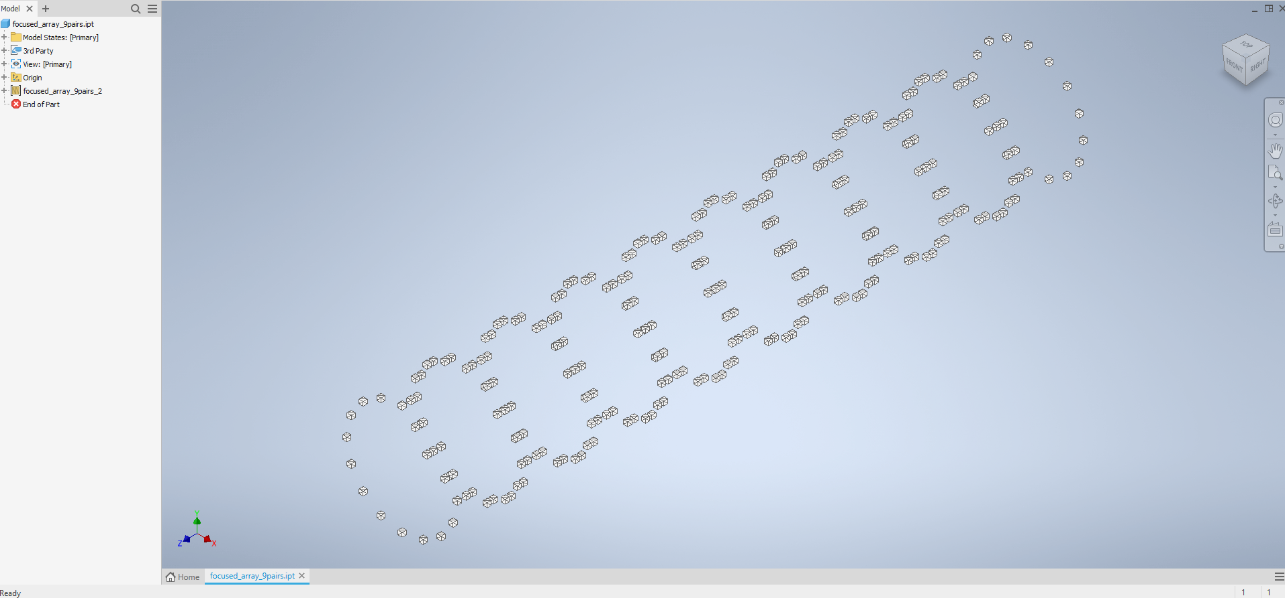
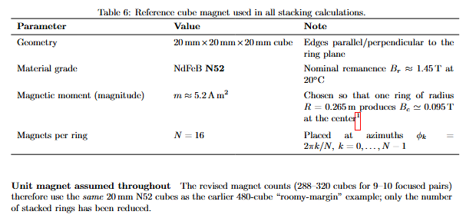
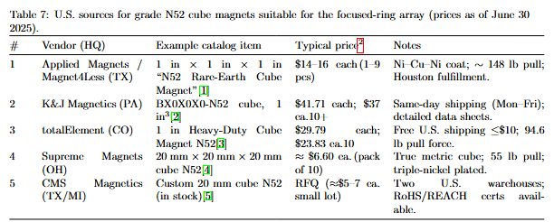
Pre-R&D Activities – Planned Future Activities – Hall C

Slide 20
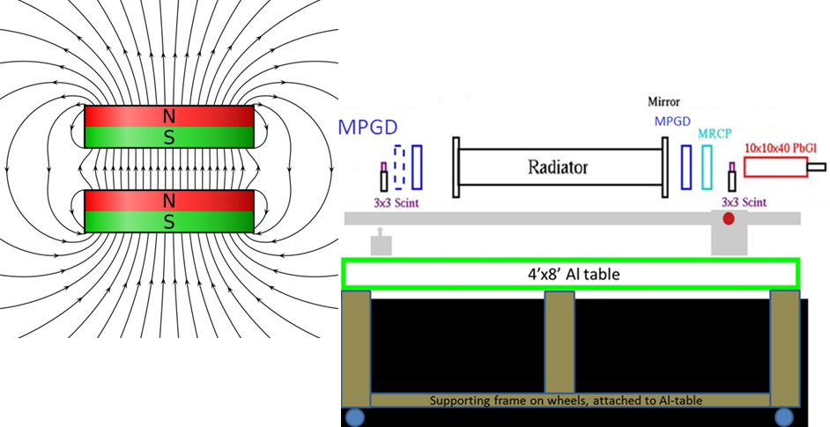
Pre-R&D Activities And Test Beam Plans – Hall C
NPS magnet or Halbach Array
Detailed information available
Need to investigate configuration

Slide 21
Pre-R&D Activities And Test Beam Plans – Hall C
# | Experiment | Topic | Start | End | Pass Change/Rescaling | Run Time/Days
1. | E12-22-001 | Transverse structure of the hadrons (N to Delta) | 1/28/2026 | 2/20/2026 |  | 24
2. | PR12-23-001 | Transverse structure of the hadrons (Polarizability) | 2/21/2026 | 3/22/2026 | 03/05 PC | 28
3. | E12-06-107 | Color Transparency | 3/28/2026 | 5/03/2026 | 03/23 – 03/27 (5 days) | 37
4. | E12-24-001 E12-06-104 | Nuclear Dependence σ_{L}/σ_{T} in SIDIS | 5/4/2026 | 6/21/2026 | 5/20 PC; 6/04 PC | 45

Slide 22
Prospective
Configurations for Hall C experiments to be specified for parasitic beam tests
Exact details will be worked out ~ August
No funding from NP in FY’25 → what funding is available in FY’26
What can we start with in FY’26?
What is already now/then (Fall/Winter 2025) available?

Slide 24
HMS/SHMS Configuration – PR12-22-001 (# 1.) – N to Delta
Setting | SHMS θ (deg) | SHMS P (MeV/c) | HMS θ (deg) | HMS P (MeV/c)
1a | 7.29 | 952.26 | 18.77 | 532.53
2a |  |  | 25.17 | 527.72
3a |  |  | 33.70 | 506.61
4a |  |  | 42.15 | 469.66
5a |  |  | 50.44 | 418.56
6a |  |  | 54.47 | 388.38
7a |  |  | 12.37 | 527.72
Setting | SHMS θ (deg) | SHMS P (MeV/c) | HMS θ (deg) | HMS P (MeV/c)
1c | 10.37 | 941.61 | 24.40 | 562.00
2c |  |  | 30.47 | 556.95
3c |  |  | 38.52 | 534.79
4c |  |  | 46.47 | 496.06
5c |  |  | 54.17 | 442.64
6c |  |  | 57.85 | 411.16
7c |  |  | 12.69 | 543.24
Setting | SHMS θ (deg) | SHMS P (MeV/c) | HMS θ (deg) | HMS P (MeV/c)
1b | 8.95 | 946.93 | 22.01 | 547.54
2b |  |  | 28.24 | 542.61
3b |  |  | 36.52 | 520.95
4b |  |  | 44.64 | 483.08
5b |  |  | 52.68 | 430.78
6b |  |  | 56.53 | 399.92
7b |  |  | 12.46 | 535.98
Setting | SHMS θ (deg) | SHMS P (MeV/c) | HMS θ (deg) | HMS P (MeV/c)
1d | 11.63 | 936.28 | 26.24 | 575.96
2d |  |  | 32.16 | 570.80
3d |  |  | 40.01 | 548.17
4d |  |  | 47.73 | 508.64
5d |  |  | 55.18 | 454.17
6d |  |  | 58.71 | 422.13
7d |  |  | 12.47 | 548.17
Run group a: 6 μA beam current
Run group b-d: 15 μA beam current
N. Sparveris

Slide 25
HMS/SHMS Configuration – PR12-23-001 (# 2.) – Polarizability
75 μA beam current
on 10 cm LH2
Kinematic Group | Spectrometer | Particle detected | Angles (°) | Momentum range (MeV/c)
General Runs | HMS | Protons | 11.3° – 56.5° | 494 – 993
 | SHMS | Electrons | 11.2° – 20.5° | 736.3 – 1783
Elastic ep Calibration Runs | HMS | Protons | 50° – 63° | 495 – 994
 | SHMS | Electrons | 19° – 33° | 924 – 1797
N. Sparveris

Slide 26
HMS/SHMS Configuration – PR12-06-107 (# 3.) – Color Transparency
80 μA beam current
D. Dutta
Q² [(GeV/c)²] | HMS Angle (electron) | SHMS Angle (hadron)
8.0 | 25.90° | 22.73°
10.0 | 33.30° | 17.86°
12.0 | 44.30° | 13.32°
14.0 | 35.00° | 14.00°
16.4 | 48.05° | 10.00°

Slide 27
HMS/SHMS Configuration – PR12-14-002 (# 4.) – R-dependence
80 μA beam current
D. Gaskell
Spectrometer | Role | Angular Range (degrees) | Momentum Range (GeV/c)
HMS | Electron arm | 50° – 63° | 0.495 – 0.994
SHMS | Hadron arm | 19° – 33° | 0.924 – 1.797

