Slide 1
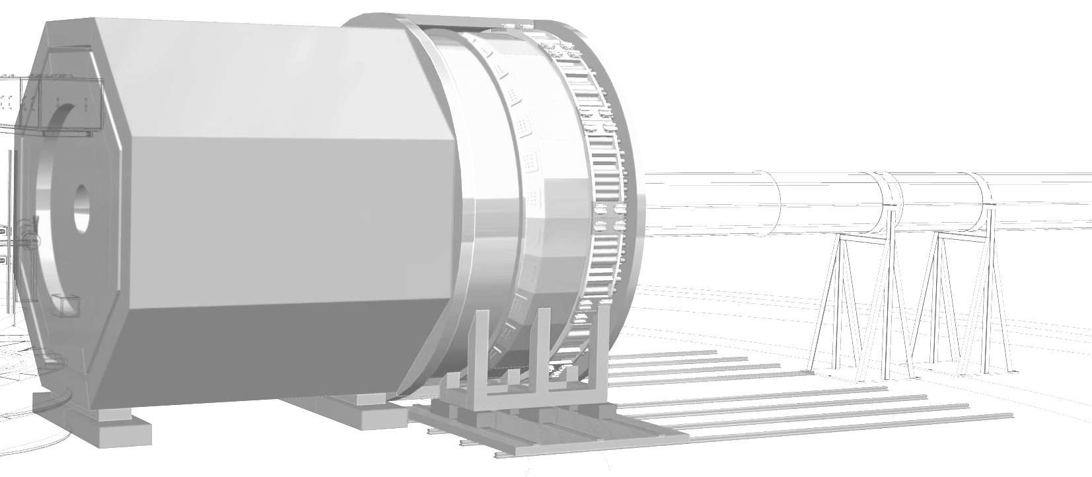



GEMs for SoLID
UVa GEM Team
Dr. Huong Nguyen, Research Assistant Professor and Co-PI
Dr. Asar Ahmed, Post-doc
Vimukthi Gamage, Graduate RA/Electrical engineer
Bhasitha Dharmasena, Graduate RA/Mechanical engineer
Jacob McMurtry, Graduate RA
Vidura Vishvanath, Graduate RA
Nithya Kularathne, Graduate RA/ computer scientist
Eric Fernandez, mechanical technician
Larry St.John, electrical technician
Former members:
Dr. Kondo Gnanvo, former research scientist
Nilanga Liyanage
University of Virginia

Slide 2
UVa GEM R&D and fabrication program
UVa team has worked on the SoLID GEM design over the last ~15 years
  Several iterations of conceptual and CAD models for all layers
UVa team has successfully developed, built and operated some of the largest GEMs in the world.
  SBS XY GEMs: 50 modules each with area 50 cm x 60 cm built: 48 of them operational: 96 % yield.
  SBS UV and XW GEMs: 6 modules, each with 150 cm x 40 cm built: all 6 operational: 100% yield
  Prad/LAD GEMs: 7 modules, each with 125 cm x 55 cm built, four already built, both operational, 100% yield. Three more being built now.
  MOLLER GEMs: Trapezoidal modules ~ 50 cm x 40 cm: three built already, 14 more to be built this year.
  Many prototype GEMs of 50 cm – 100 cm size built for EIC, Hall B, Hall D R&D.
Tested many ideas for SoLID benefiting from EIC R&D

Slide 3
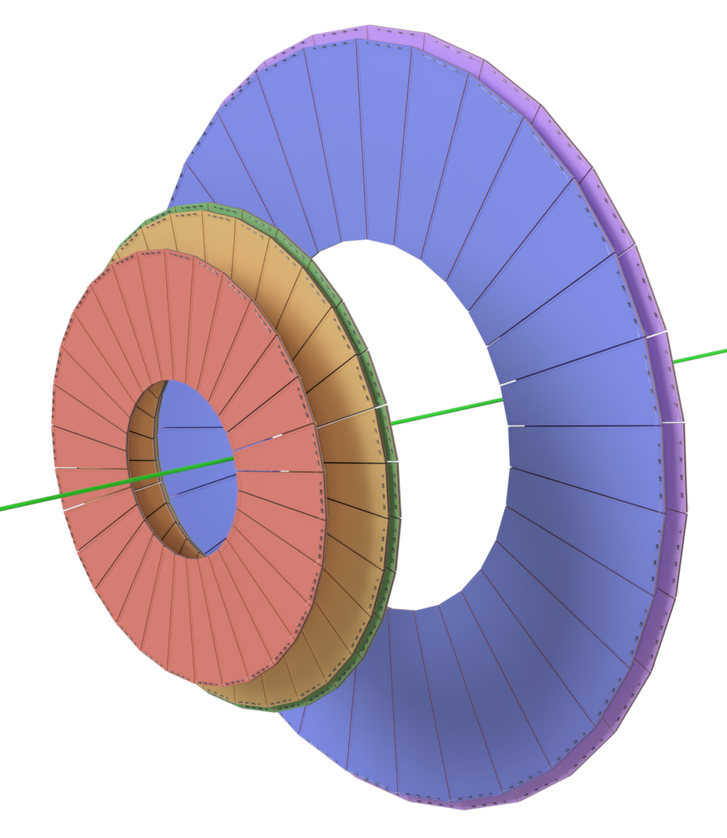
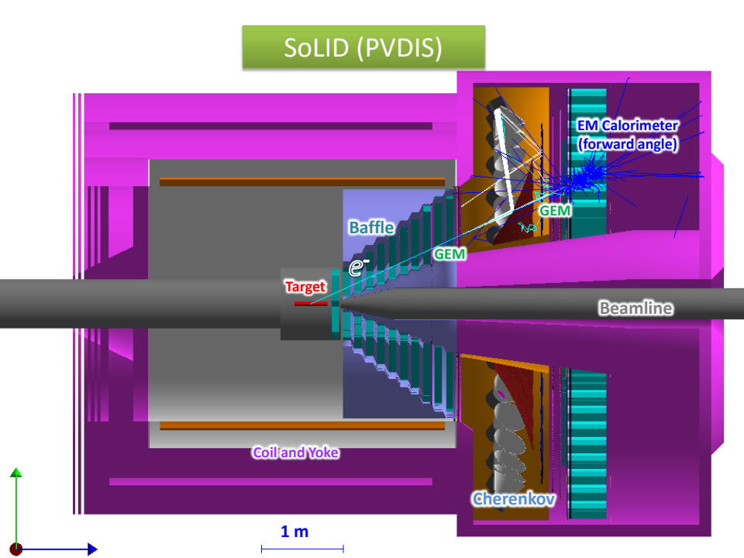
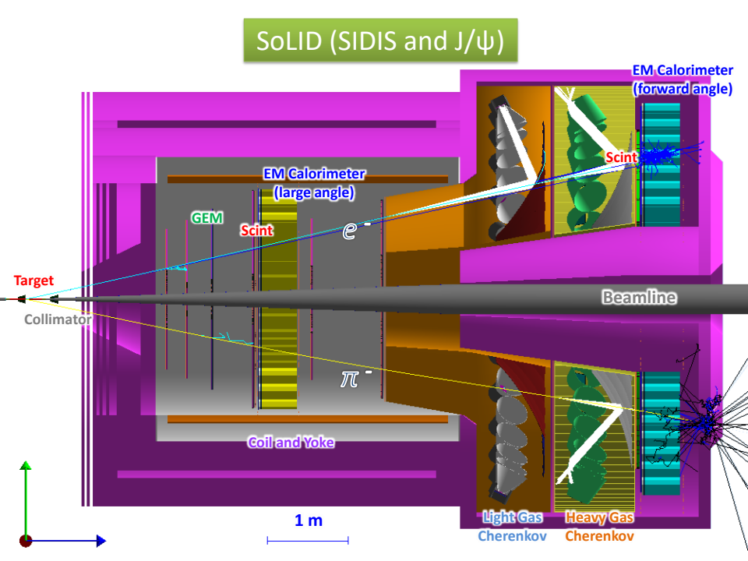
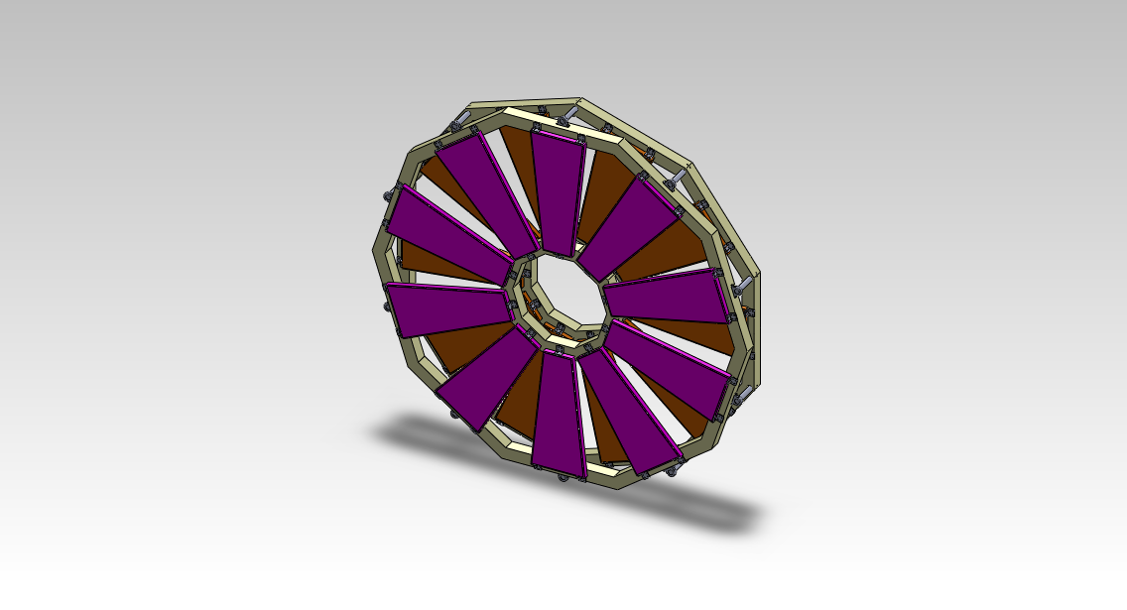
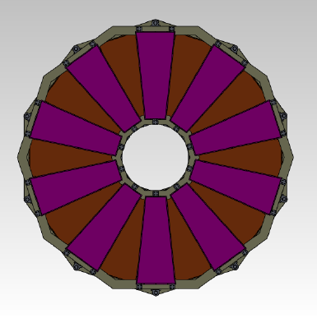
GEM Overview

Slide 4
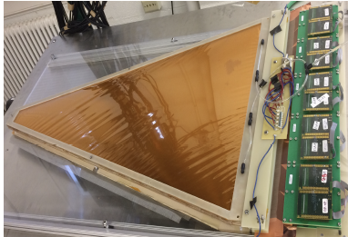
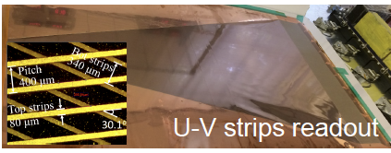
GEM Requirements: for all experiments
Good position resolution
  100 μm ( 1 mm) in azimuthal (radial) direction.
    2D U-V readout with 12-degree or 24-degree stereo angle between strips
    400 μm (600 μm) strip pitch for layers 1-3 (5-6)
    The high occupancy at layer #1-3: split each readout strip into two or more channels
    Total number of channels ~ 275 k - 300 k (with 15% spares)
92 % overall GEM-module efficiency.
modules with a trapezoidal geometry
All readout electronics located at the outer edge: Given radiation exposure map.
Side frames need to be very narrow: minimize material thickness in active area (especially for SIDIS, J/Ψ)
All requirements follow from tracking and neutron/radiation dose simulation to meet SoLID conditions.

Slide 5
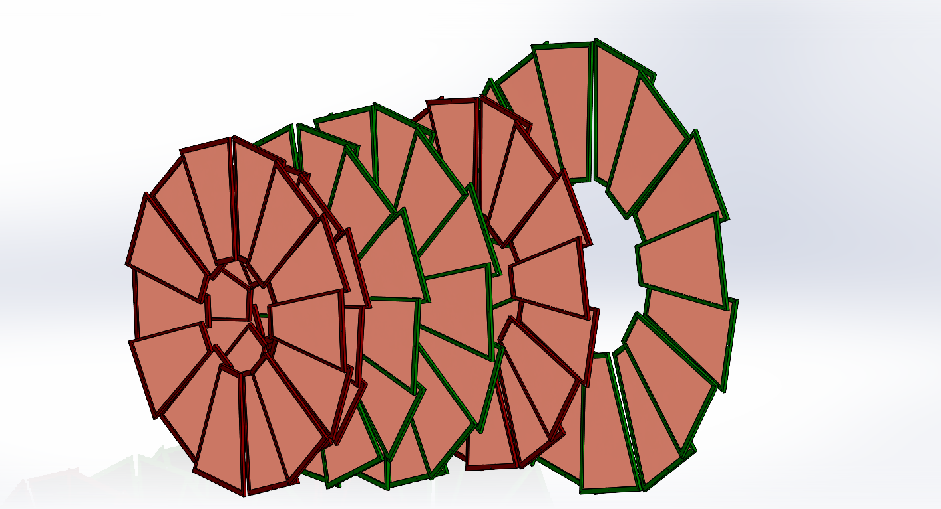
GEM configuration – Under optimization for SIDIS
Plane | Z (cm) | R_{I} (cm) | R_{O} (cm) | Length (cm)
1 | -175 | 36 | 87 | 51
2 | -150 | 21 | 98 | 77
3 | -119 | 25 | 112 | 87
4 | -68 | 32 | 135 | 103
5 | 5 | 42 | 100 | 58
6 | 92 | 55 | 123 | 68
Total active area ~ 21 m²

Slide 6

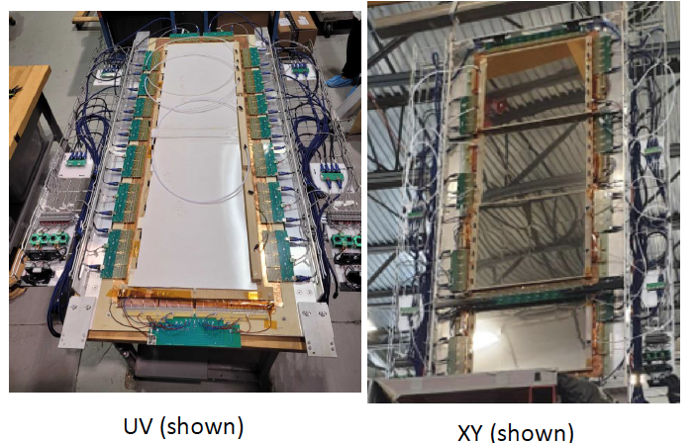


SBS GEM trackers: gaining GEM operation experience under conditions exceeding SoLID requirements
  50 cm x 60 cm GEM modules for SBS rear tracker: 48 modules – 40 in beam
  150 cm x 40 cm large GEM modules for SBS front tracker: 6 modules – all in in beam
Active areas larger than the largest SoLID GEM detectors needed

Slide 7
SBS GEM trackers: gaining GEM operation experience under conditions exceeding SoLID requirements
SBS GEM trackers have been running well for over 3 years in GMn, nTPE, Gen-II, GEn-RP and Gep-V experiments.
In GEp-V: up to 35 uA on 30 cm LH2 target: luminosity ~ 5 x 10^{38;} orders of magnitude higher than proposed SoLID SIDIS run and comparable to what is needed for the PVDIS run
In SBS all this without baffles and direct line of sight to target: GEM hit rates achieved in SBS are much higher than the worst case predicted for SoLID

Slide 8
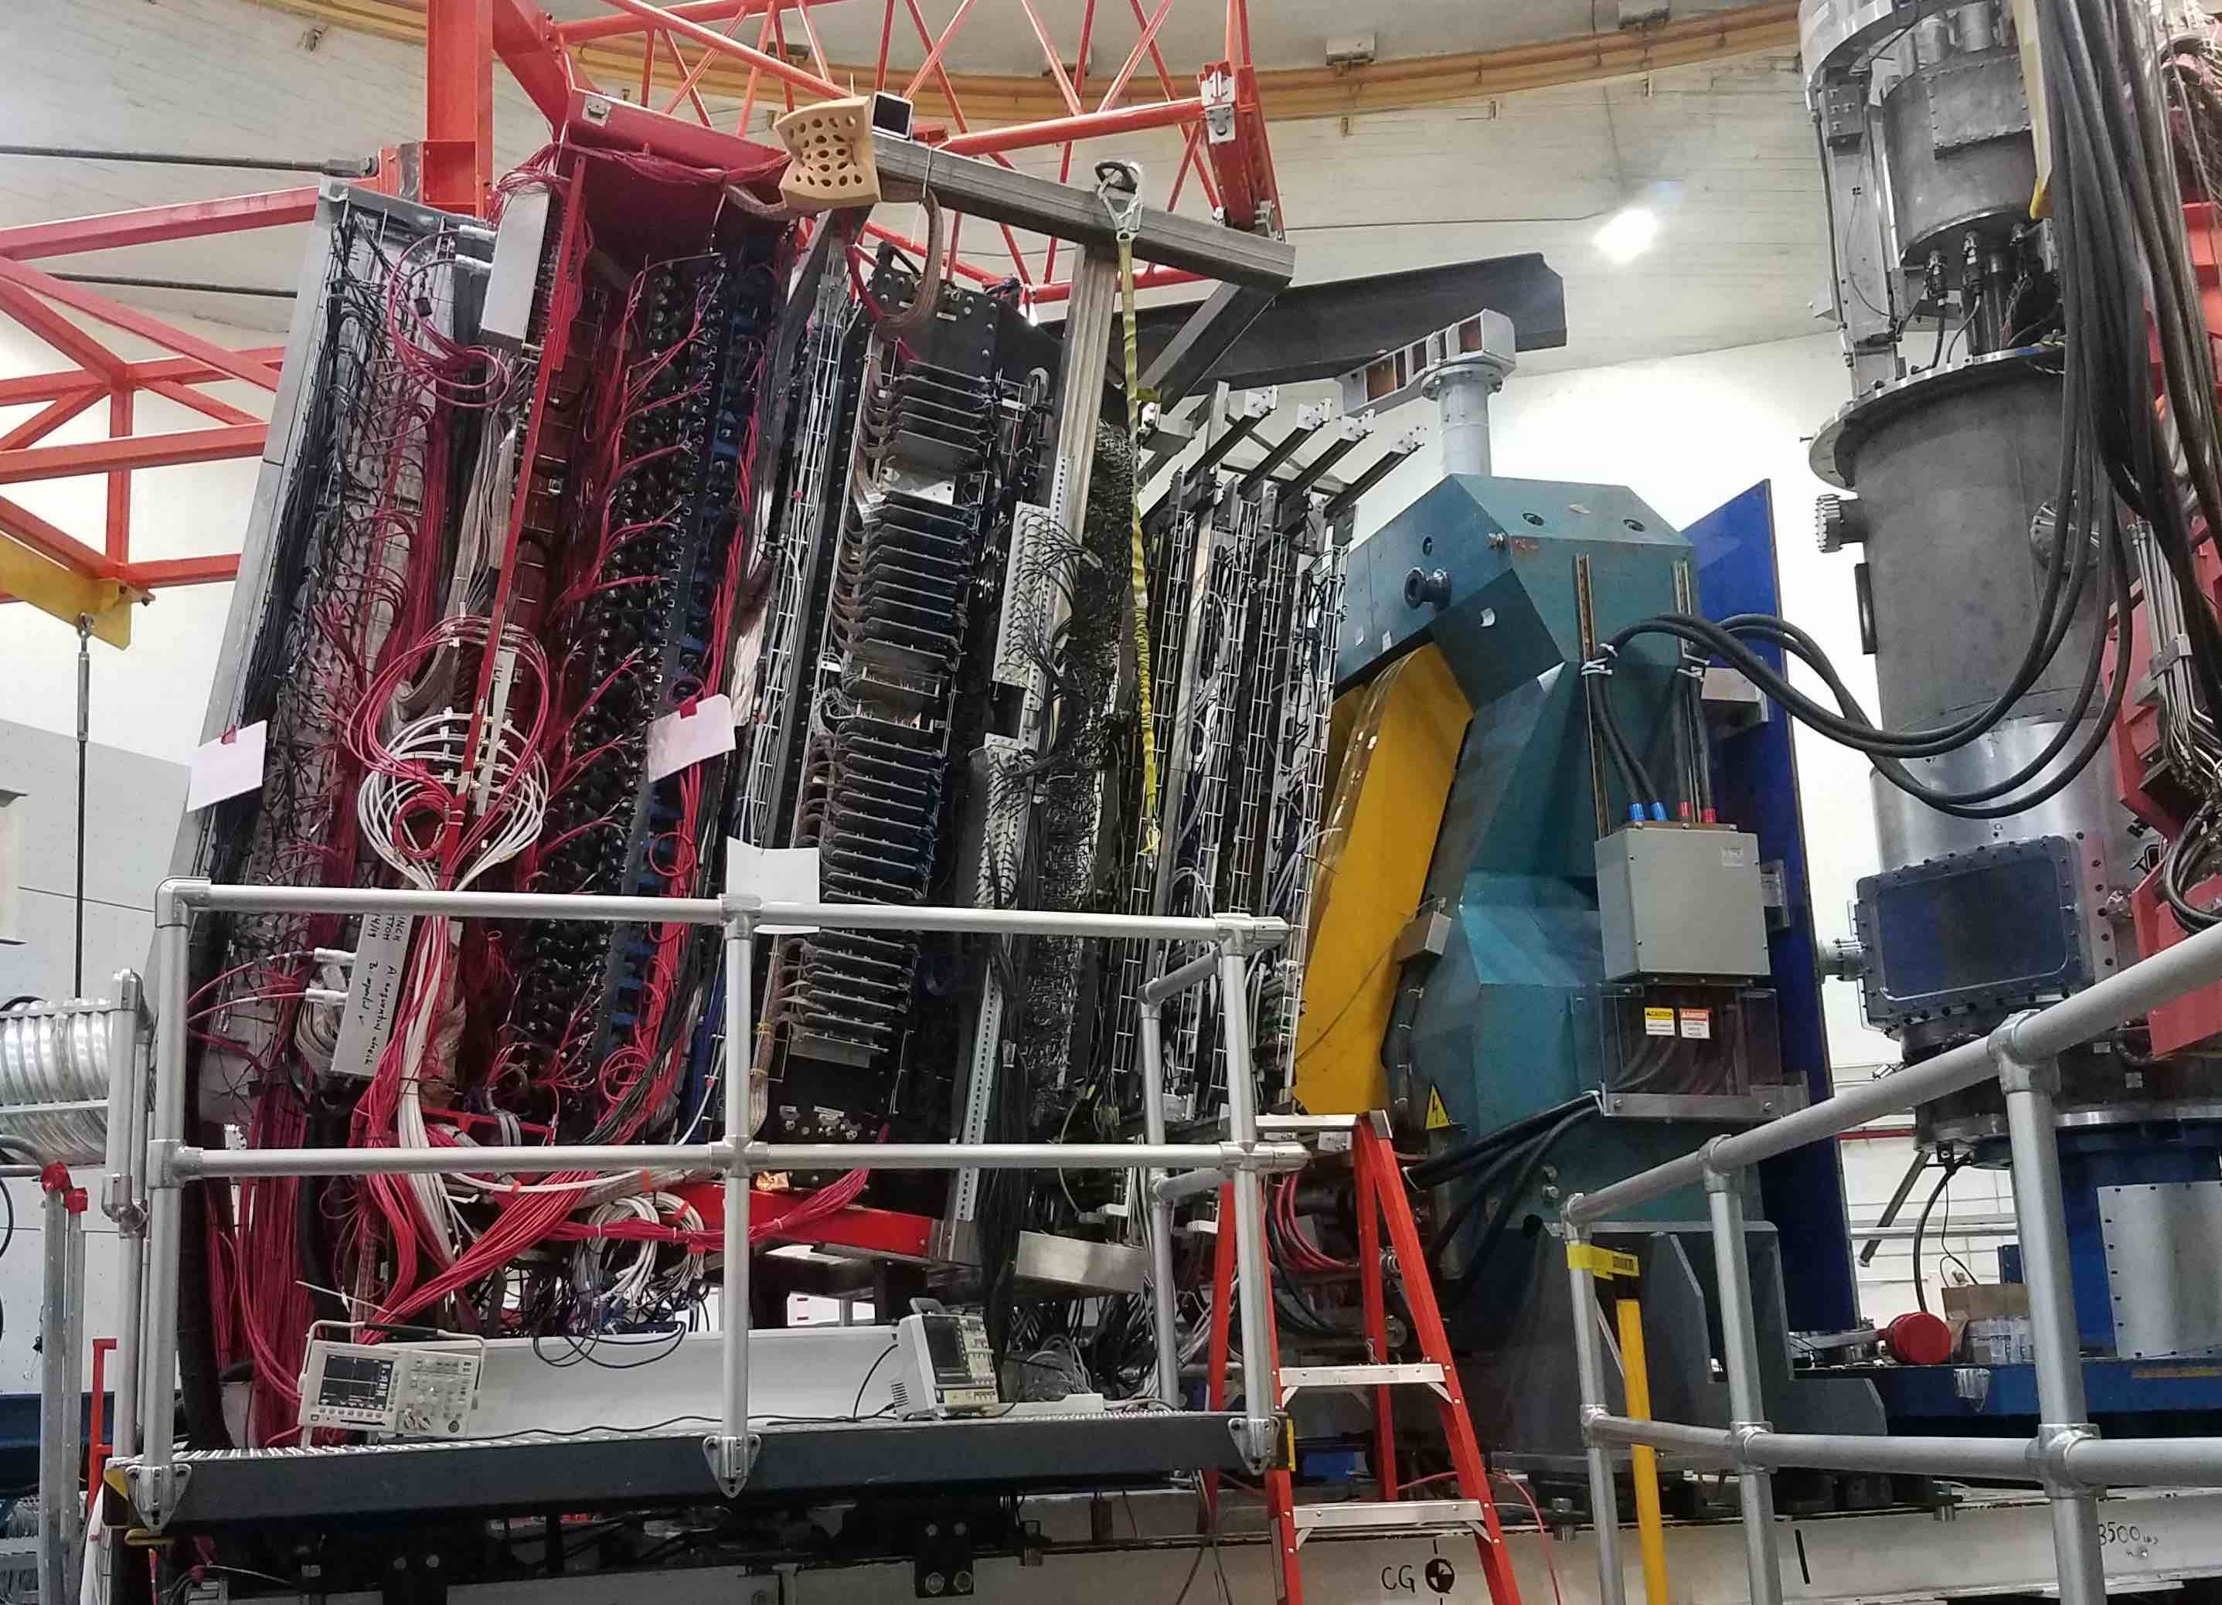
UVa 200 cm x 60 cm GEM layer
UVa 150 cm x 40 cm GEM layers
Bigbite Magnet
Scattering Chamber

Slide 9
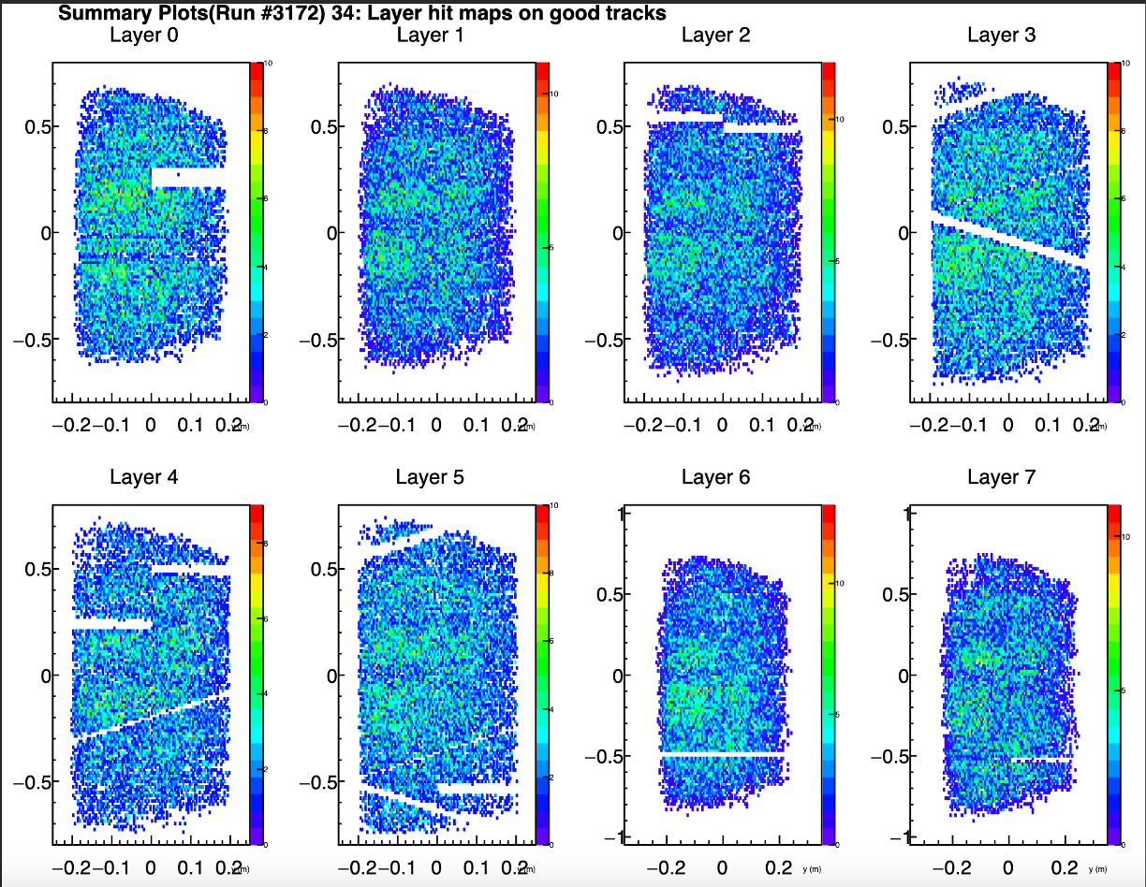
Lesson Learned from SBS GEM Trackers
Overall performance of SBS Front & Back Trackers
The SBS GEM tracking system includes:
  Forty-six (46) GEM modules
  Front trackers: 6 GEM layers of 40 x 150 cm
and 2 GEM layers of 60 x 200 cm
  Back trackers: 8 GEM layers of 60 X 200 cm
The SBS GEMs are operating at rate much higher than any other experiment in the world
  A few dead areas caused by dead high voltage sectors and faulty electronics
  Since the beginning of the GEp, only about 7 sectors out of 1560 sectors were lost
  Later-developed GEM modules used in front trackers are significantly more robust than the earlier versions used in back trackers.
Hit map on 8 GEM layers of the front tracker

Slide 10
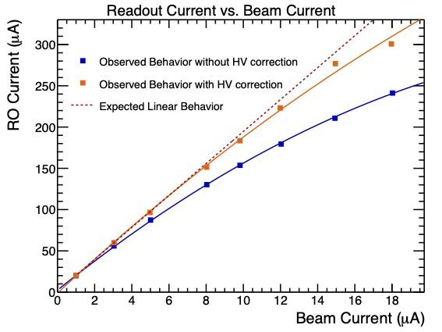
Lesson Learned from SBS GEM Trackers
Operating GEMs in High Rate Environment
High rate conditions lead to the drop voltage on GEM protective resistors →Lower the field strength in GEM holes →Lower GEM gain
Solution: Applied HV correction to compensate the voltage drop on protective resistors →Restore the field strength in GEM holes →restore detector gain
I_{K}
Cathode
R₀
R₁
GEM1
I_{G1B}
R₂
I_{G2T}
R₃
GEM2
I_{G2B}
R₄
I_{G3T}
R₅
GEM3
I_{G3B}
Readout plane
I_{RO}
The slope of the plot is
proportional to the gain
With HV corrections, the RO current is near linear to the beam current →indicating no loss in GEM gain

Slide 11
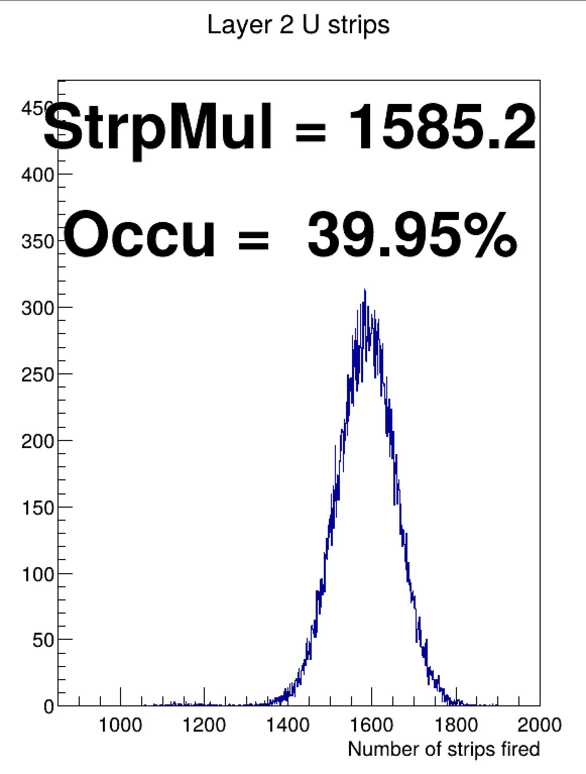
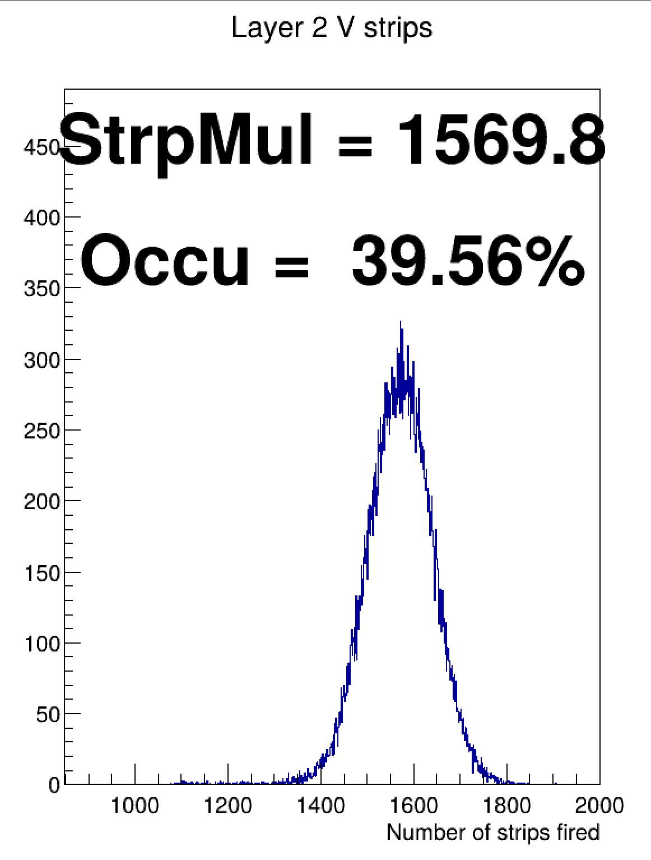
Lesson Learned from SBS GEM Trackers
Detector Occupancy in High Rate Environment
GEM modules with shorter readout strips and improved robustness are used in the front tracker
At 25 uA, the raw occupancy on the front tracker reaches between 30% to 50%
This high occupancy imposes challenge to the tracking analysis
  High detector occupancy → Large number of 2D hit combinations →Increase difficulty in track finding
The GEMs are handling unprecedented rates very well.
The total integrated rates and occupancies are an order of magnitude than in any other experiment ever in the world

Slide 12
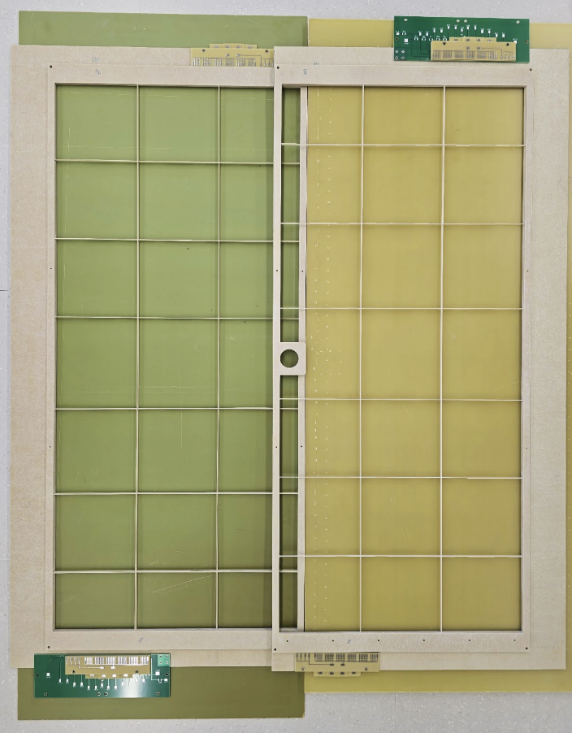
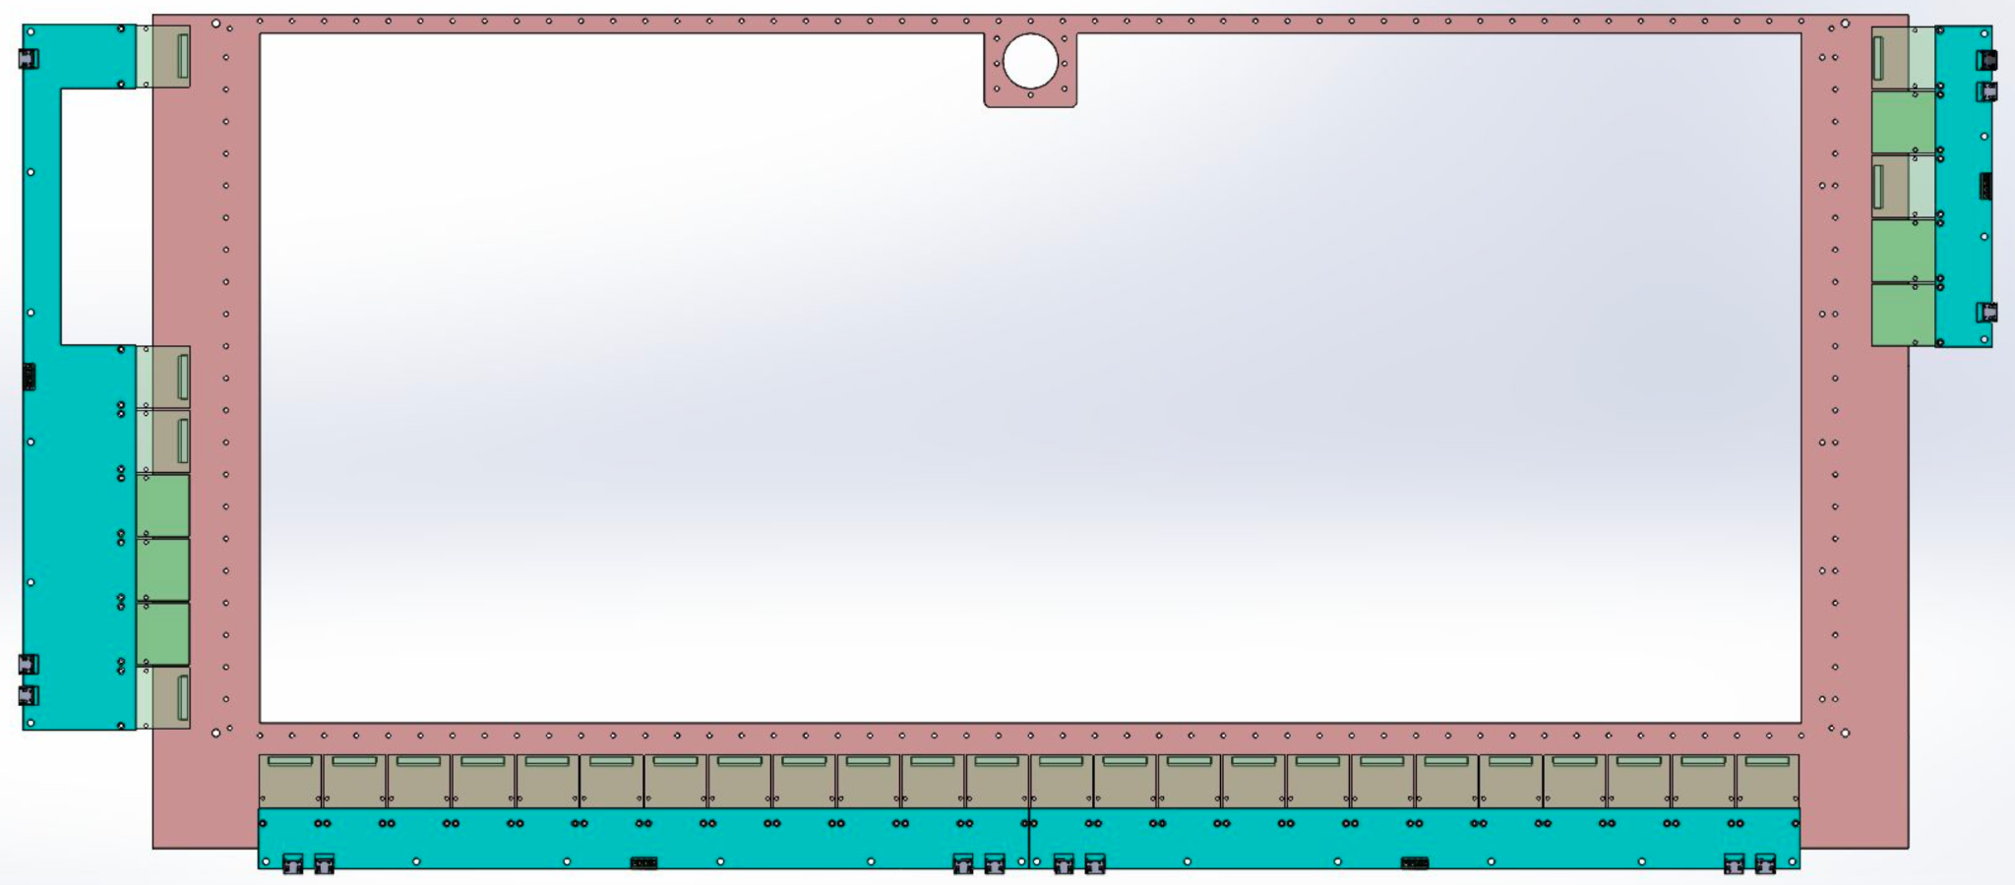
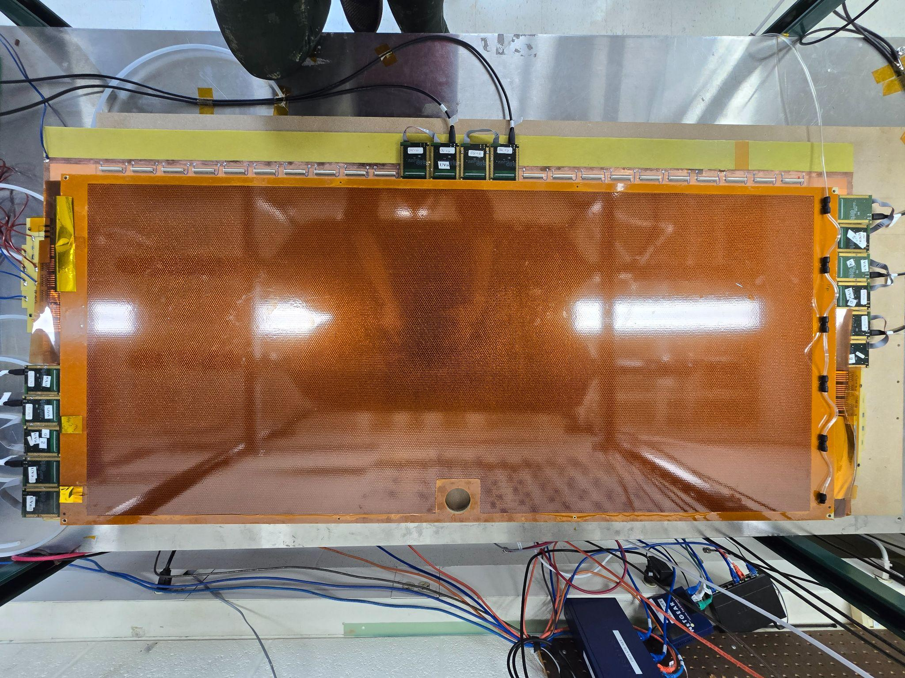
Post-SBS MPGD Activities at UVa
GEM Trackers for LAD and PRad-II/X17 Experiments
Design, fabricate & characterize large-size (55 cm x 120 cm) GEM modules for LAD and Prad-II/X17 experiments
  Completed one module for LAD
  Work-in-progress for completing four modules, forming two tracking layers (120 cm X 102 cm) to improves vertex reconstruction and GEM efficiency uncertainty for PRad-II/X17
55 cm
120 cm
Improvement: MPD-based readout system to handle 25kHz event rate
  VTP-MPD system used in SBS program, 4 KHz event rate > 90% live time, 15 APVs per MPD module
  Bottleneck on MPD limited data bandwidth with 1.25 Gbps
  Reduce the APV load per MPD 15 APVs => 3 APVs for PRad-II/X17

Slide 13
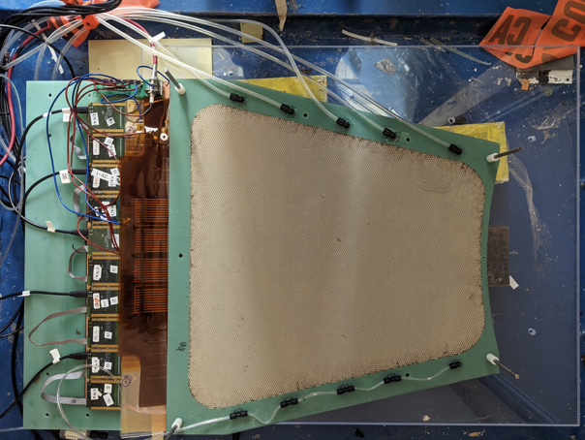
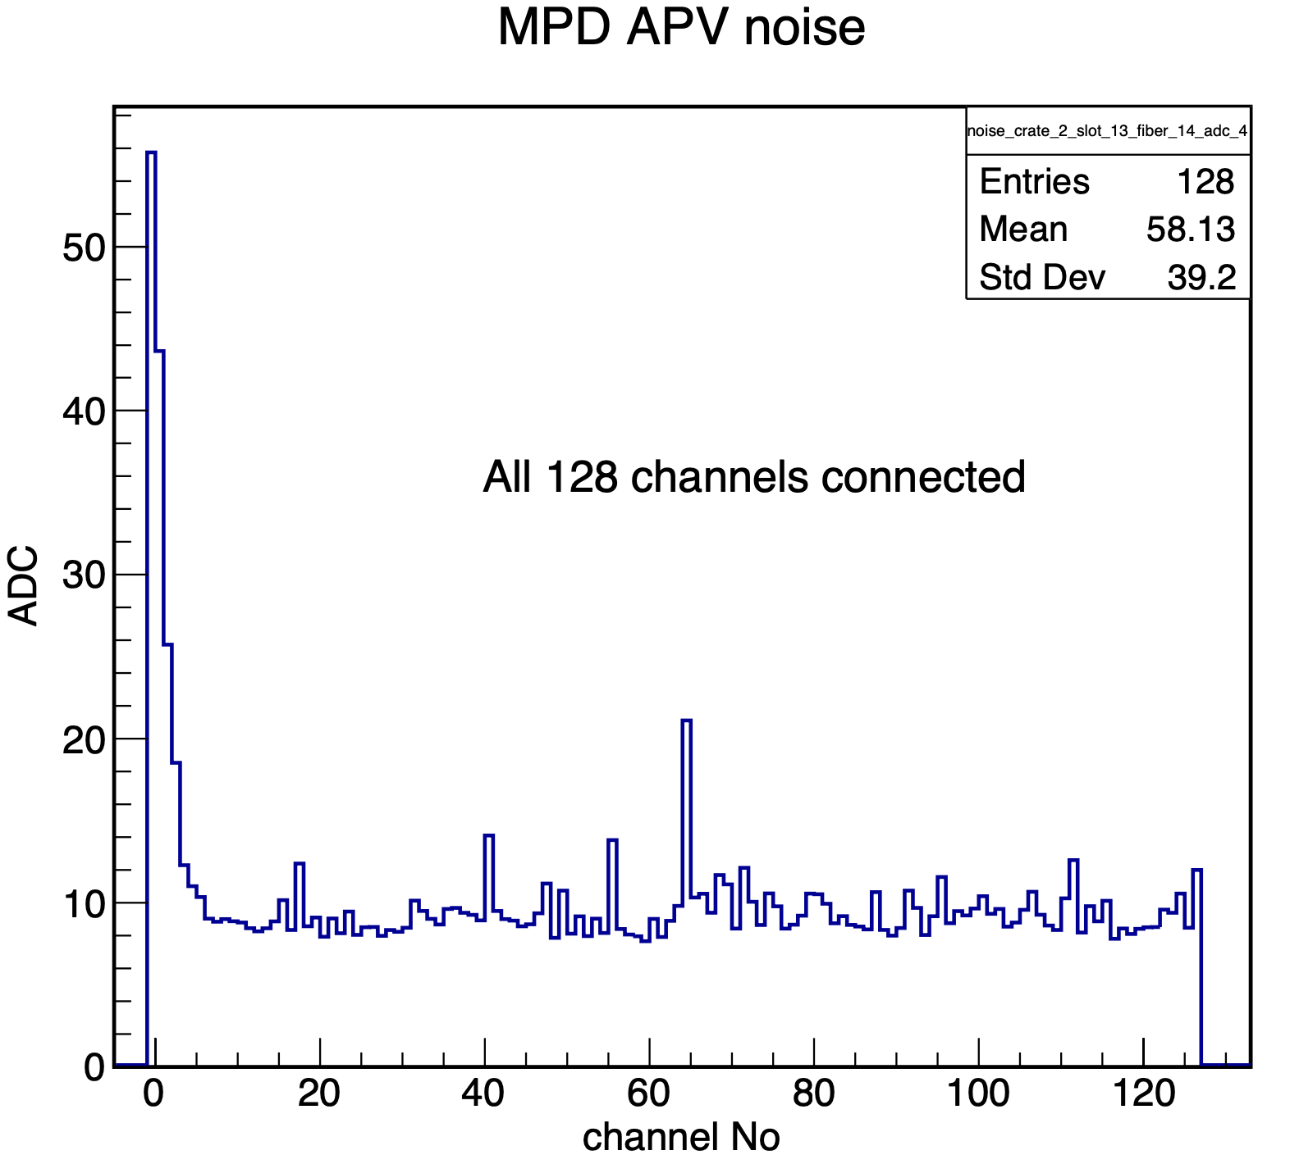

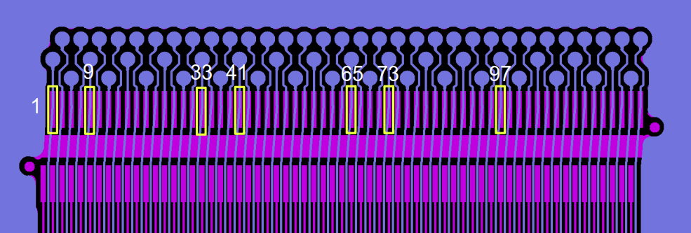
Post-SBS MPGD Activities at UVa
GEM Trackers for MOLLER Experiment
Design, fabricate & characterize sixteen trapezoid GEM modules with active area of 2000 cm² for MOLLER tracking system
  Completed two modules
  Will continue the work on fourteen modules after completing GEM modules for PRad-II/X17
Improvement: Modification in RO design for noise suppression
  Due to crosstalk from APV header, higher noise levels on the first seven channels in each APV chip were observed during SBS experiments
  Redesign the readout board so that the noisy channels are not connected to a detector readout strip
Prototype RO design
Production RO design

Slide 14
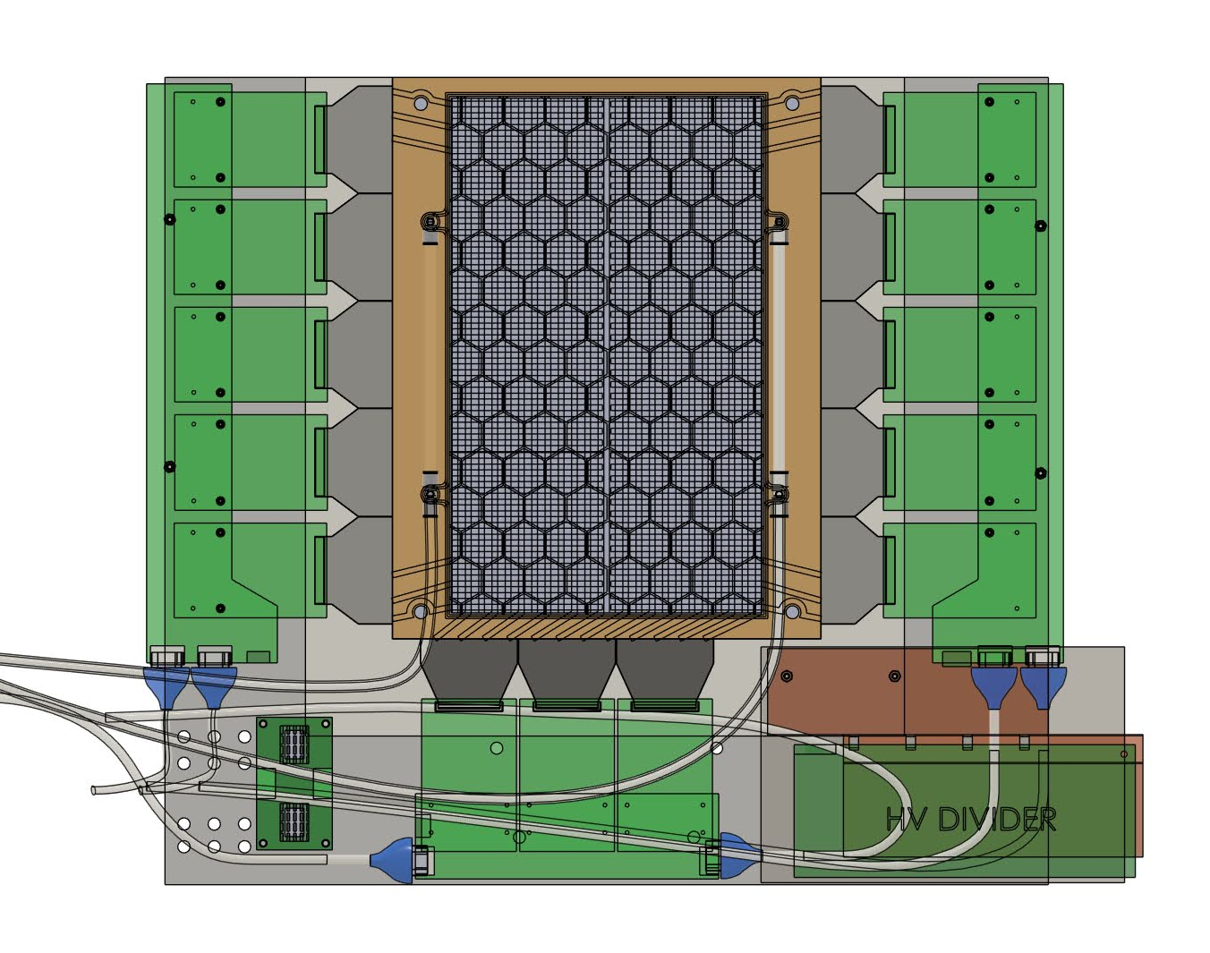
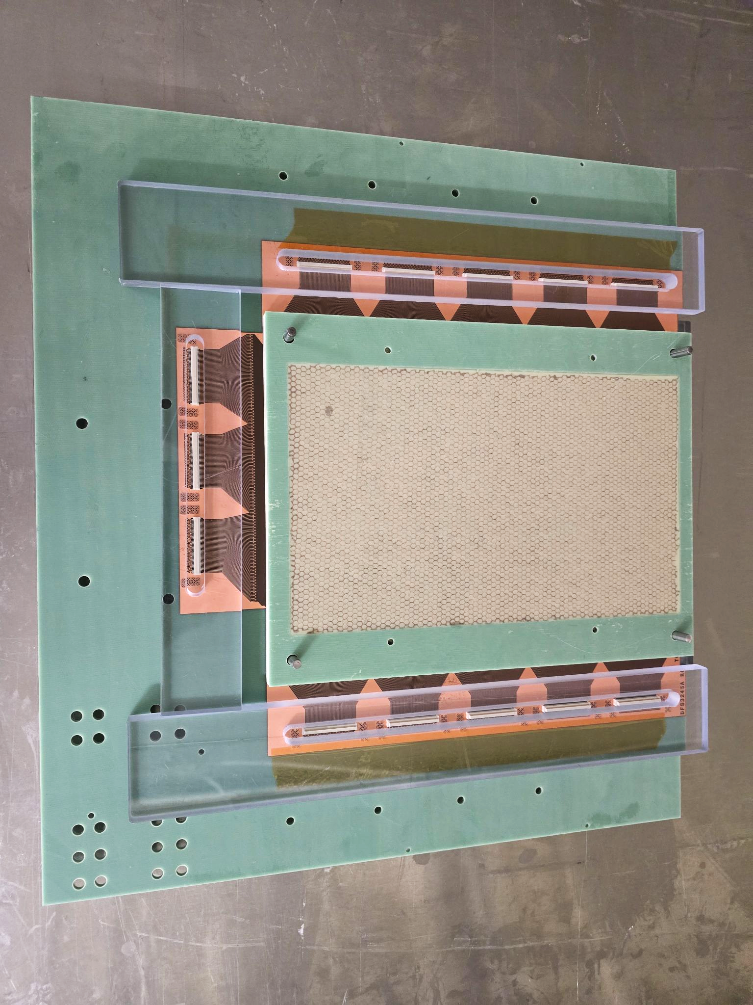
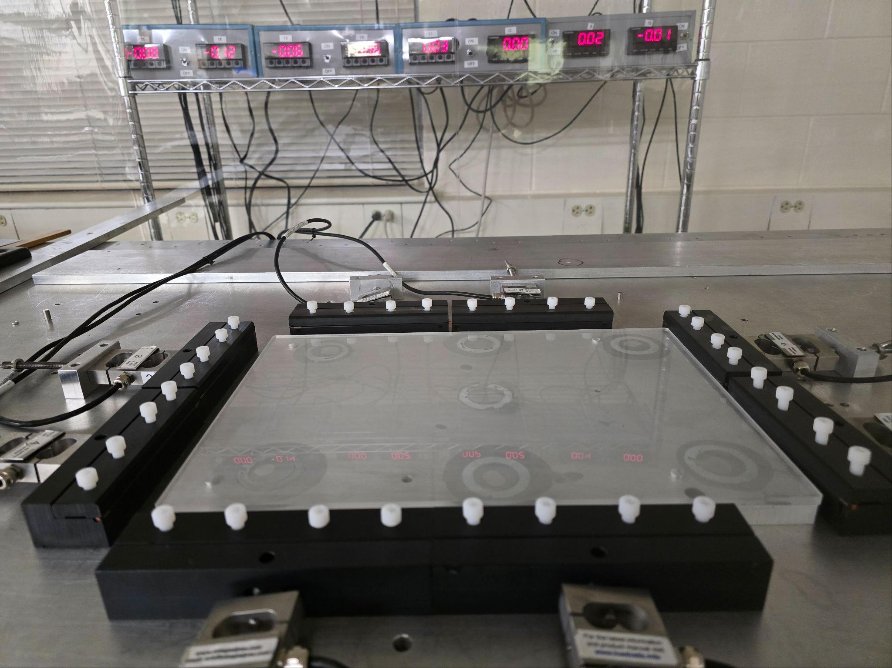
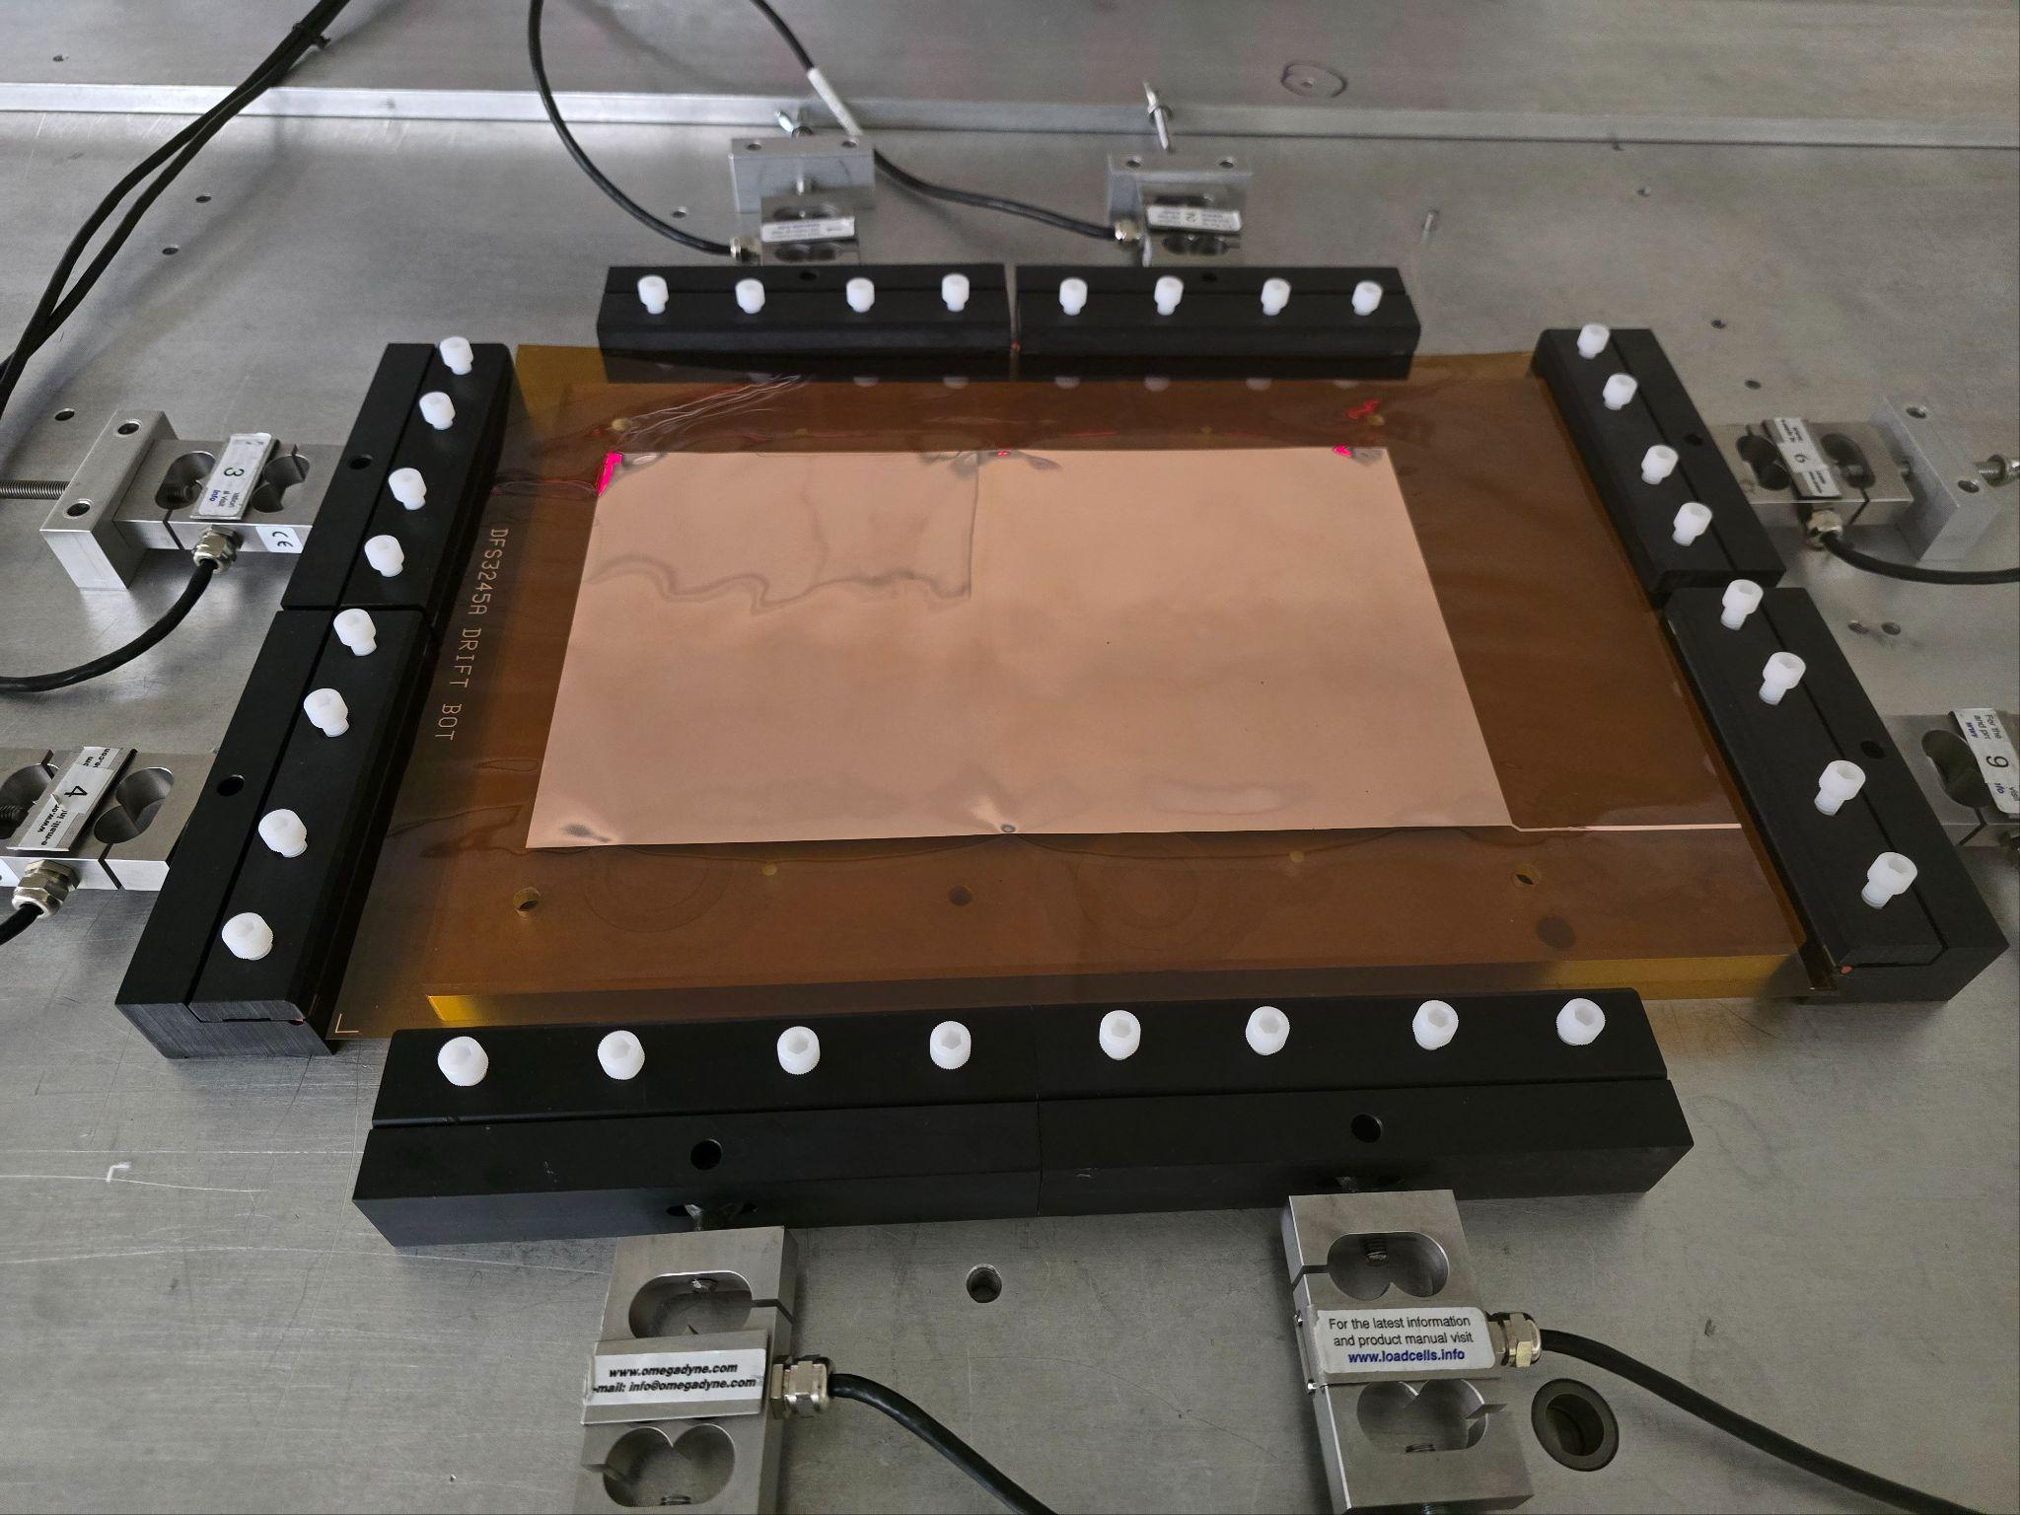
Post-SBS MPGD Activities at UVa
GEM Polarimeters for MOLLER Experiment
Design, fabricate & characterize four GEM modules with active area of 560 cm² for MOLLER Polarimeters
  Completed three modules
Significant: The new team of technicians and the machine shop at UVA are working very efficiently
  Completed building the HV testing & assembly systems in 3 weeks
3D Modeling of GEM module
Foil stretching system
Stretching Cathode foil
Assembly station

Slide 15
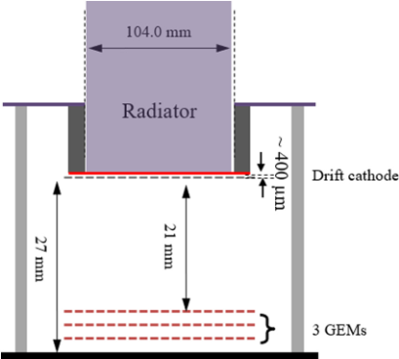
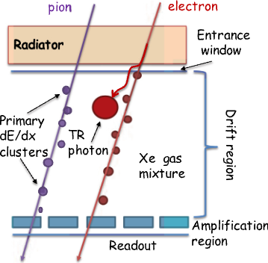
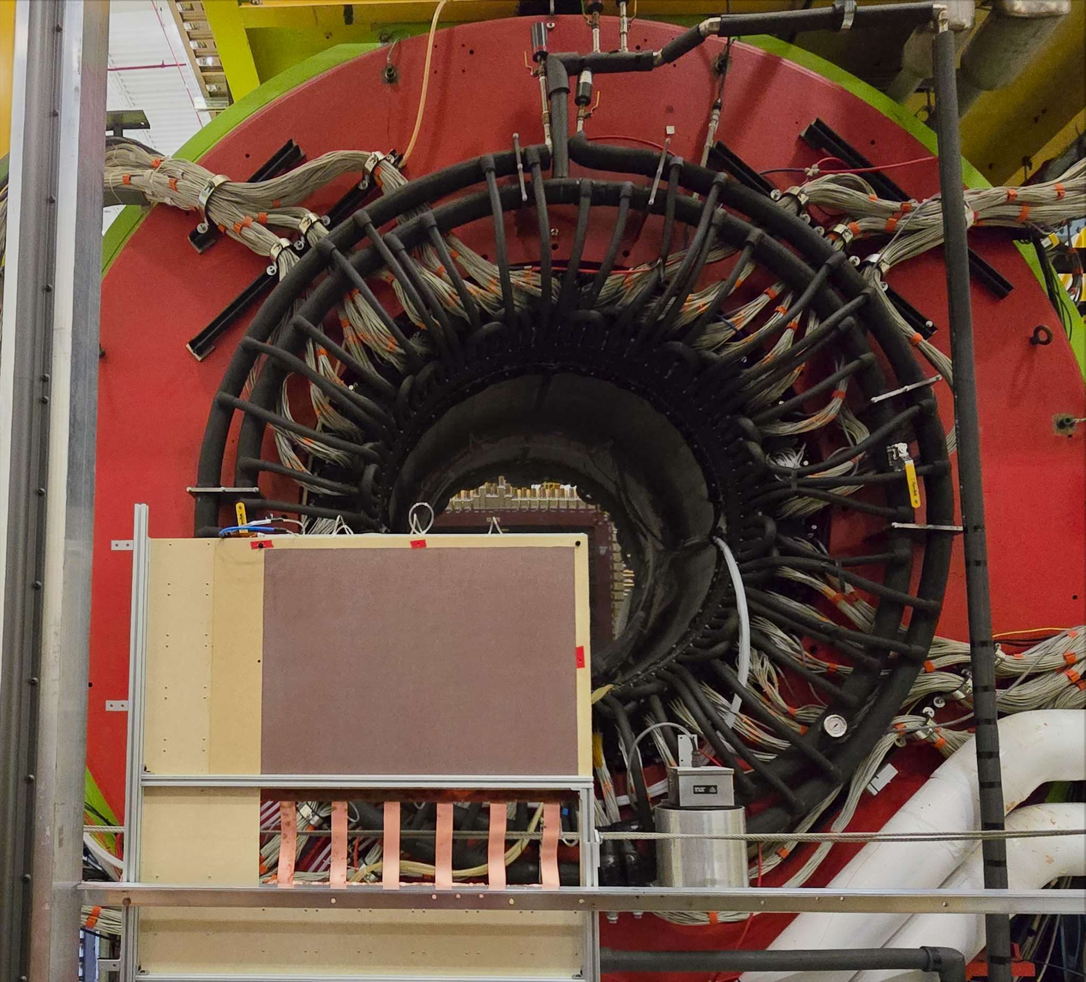
Post-SBS MPGD Activities at UVa
GEM TRD for GlueX Experiment
Designed & fabricated GEM-TRD prototype (52 cm x 72 cm)
  Used for electron identification or hadron suppression, particularly in high-luminosity experiments at JLab and EIC
  Being tested with electrons in Hall D with different gas mixtures
Plan to complete full detector within two years
  Current prototype covers a quarter of the full proposed GlueX detector
  Working on the mechanical design of the full detector & option for cathode foil materials, operating gas to enhance detector performance

Slide 16
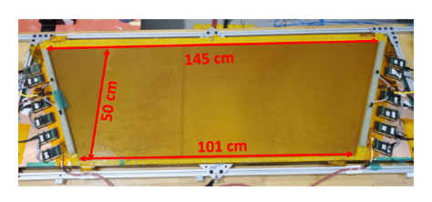
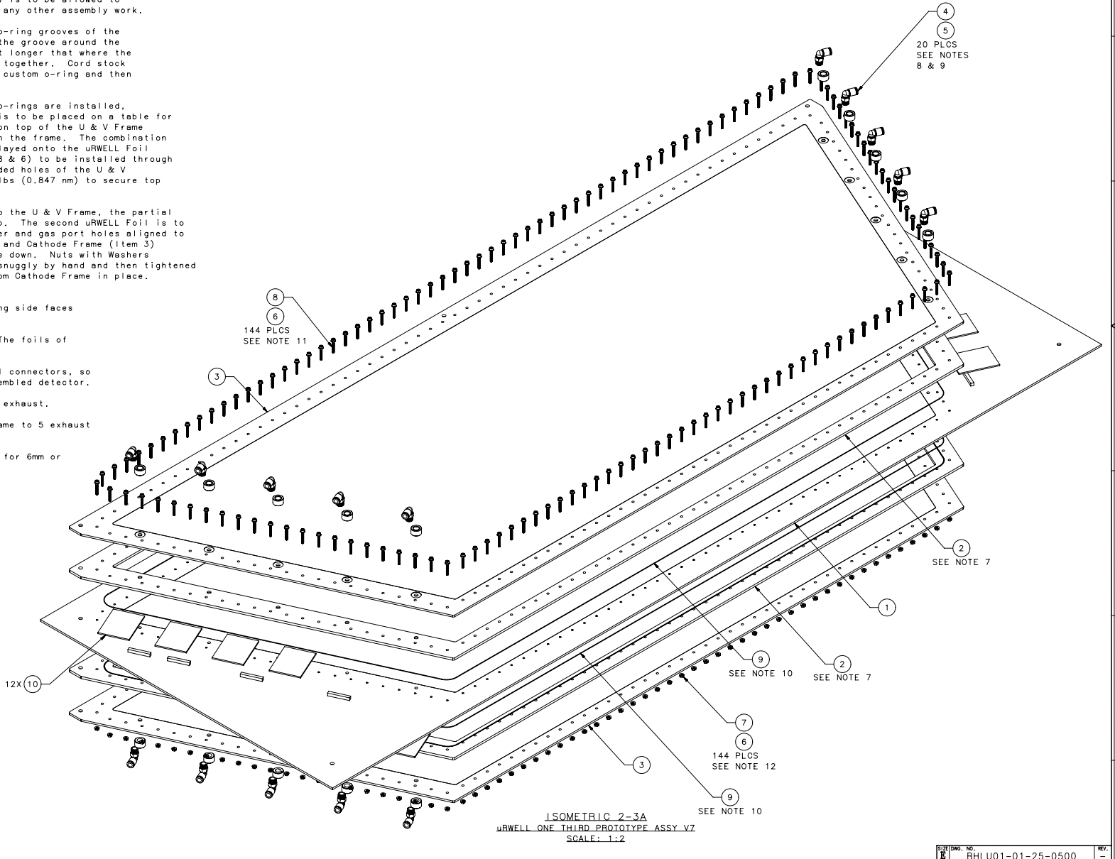

Post-SBS MPGD Activities at UVa
Involvement in R&D on Large-area µRWELL for CLAS12 Upgrade (Stage I)
Large-area μRWELL first prototype with 2D-strip readout
  Active area: 50 cm x (101 cm x 145 cm)
  U/V readout layers to avoid long RO strips
  Detection efficiency of the bottom readout layer is significantly lower than top readout layer
  Prototype reached 90% efficiency in Ar/C4H10 (90:10)
Building a new version of the large detector as a pair of 1D detectors coupled together
  Each with the same trapezoidal active area (145 cm × 101 cm) × 50 cm
  U and V readout layers are positioned back-to-back with one another.
(Picture from Rafayel Paremuzyan)
(Drawings from Christopher Guthrie)

Slide 17
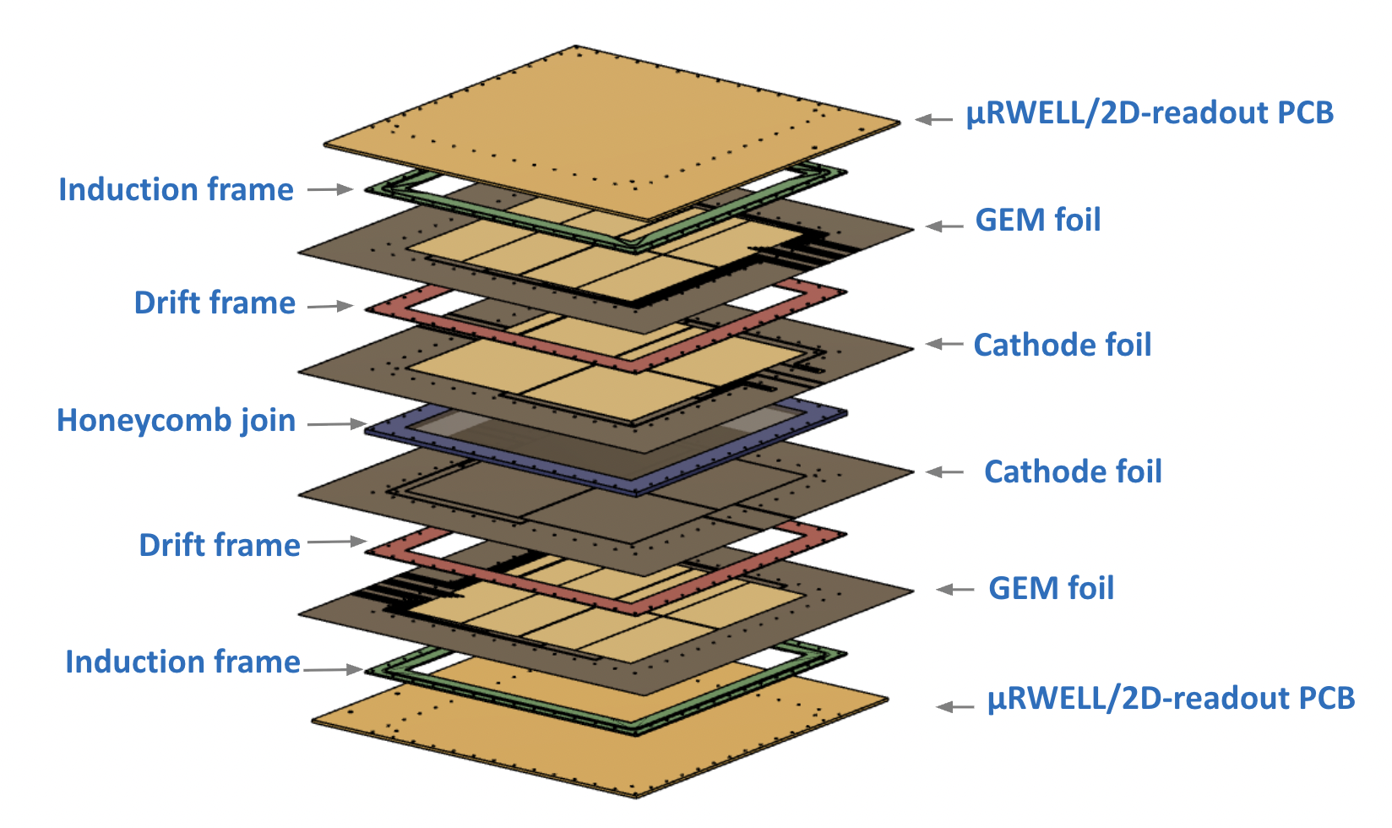
Post-SBS MPGD Activities at UVa
Involvement in R&D on Double-Sided Thin-gap GEM-uRWELL Detector for EIC
Two thin-gap GEM-μRWELL hybrid detectors are coupled face-to-face
  Narrow drift gap (1mm) to provide good spatial resolution even for large track angle
  Hybrid GEM-µRWELL amplification to ensure sufficient gain at moderate operating HVs
  Active area of 30cm × 30cm
  Expected to have one-hit detection efficiency above 99%
Received all detector’s components
Procured all required apparatuses for assembly process
Plan to work with JLab MPGD’s team on final assembling and characterization on October 2025

Slide 18
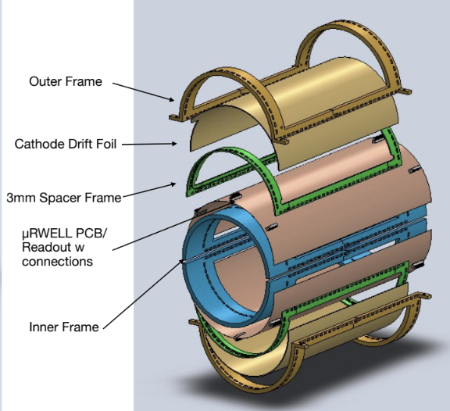
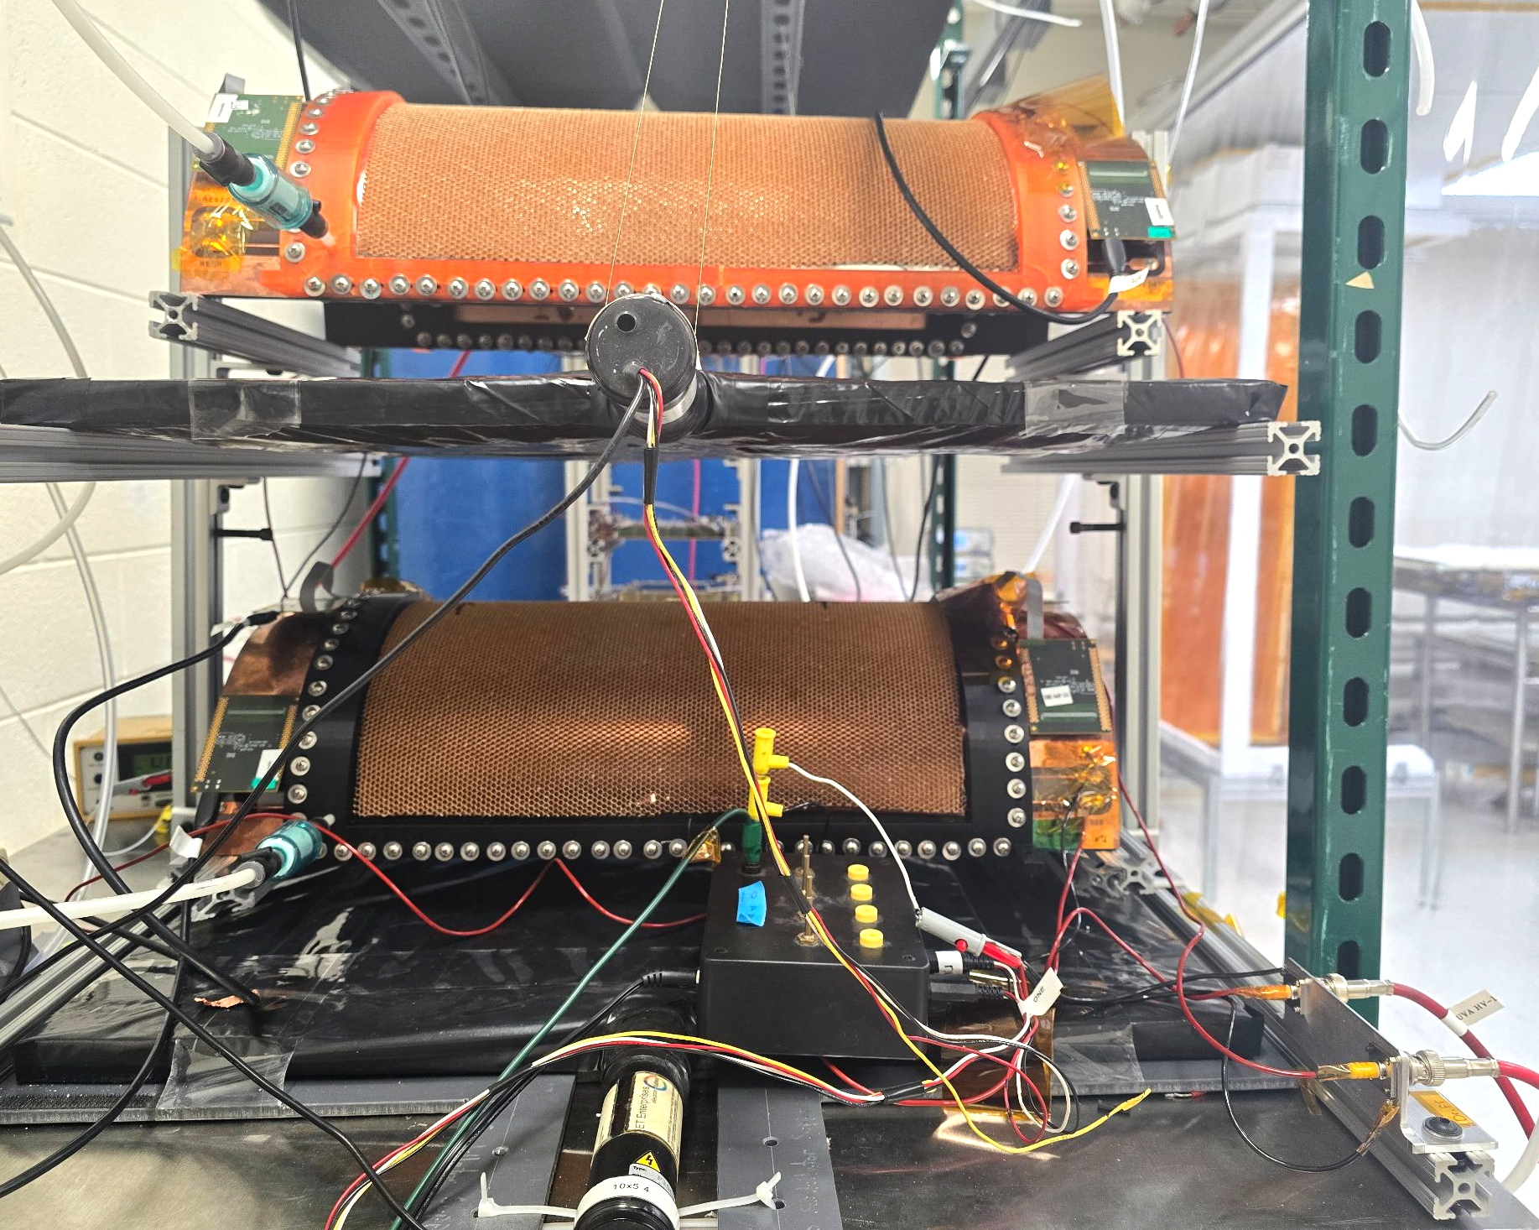
Post-SBS MPGD Activities at UVa
Involvement in R&D on Cylindrical µRWELL Detector for EIC
The cylindrical detector is made of two half-cylindrical chambers:
  Total active area: ~2500 cm²
  Two different readout strip structures for two chambers: Straight Strips & Zigzag Strips
(Drawing from Pietro Iapozzuto)
Cosmic test setup at UVA
Detector was tested with Cosmic at UVa with ArCo2 (80%/20%) and in Hall D test beam with different gas mixtures
Detector is scheduled to be tested again with Cosmic at UVa with ArCo2 (80%/20%) and Ar/C₄H₁₀ (90:10) gas mixture in September 2025

Slide 19
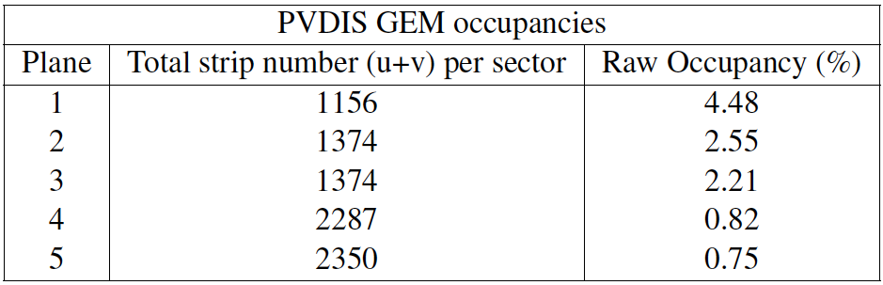
We are currently running with occupancy rates of 35%-50% in the Gep-V experiment of SBS
achieved occupancies much higher than what is projected for SIDIS

Slide 21
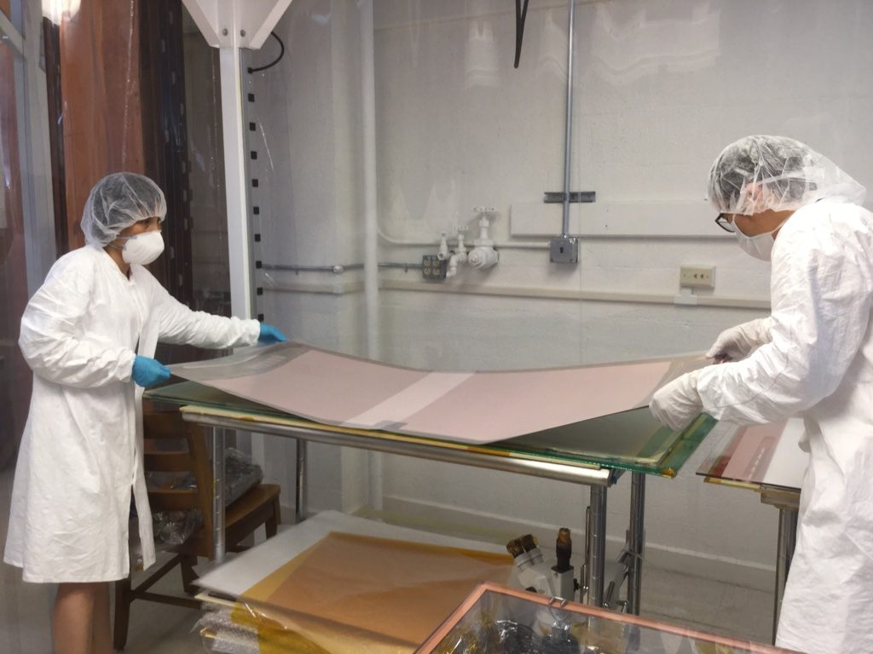
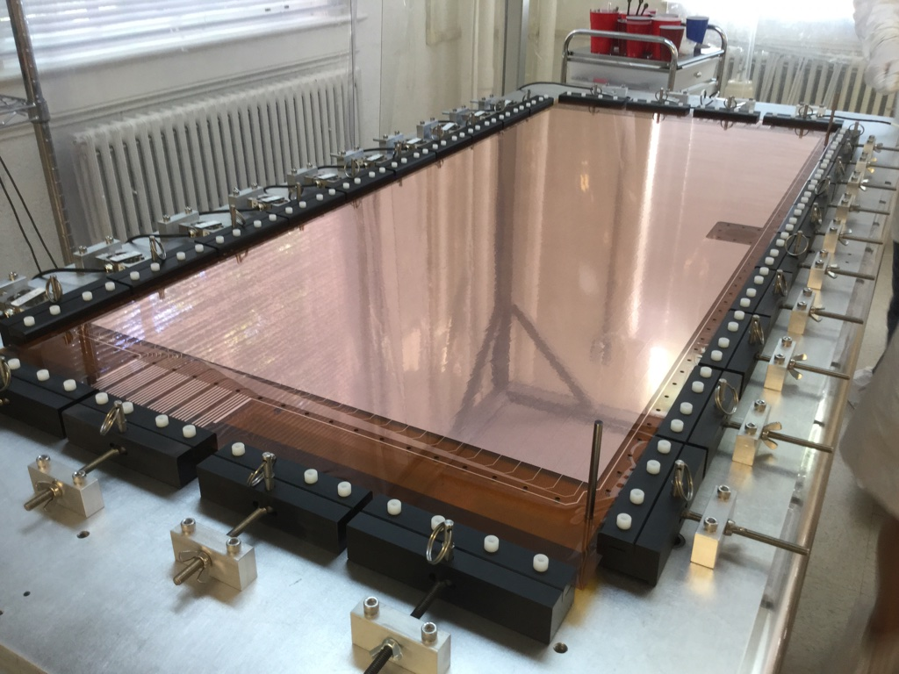
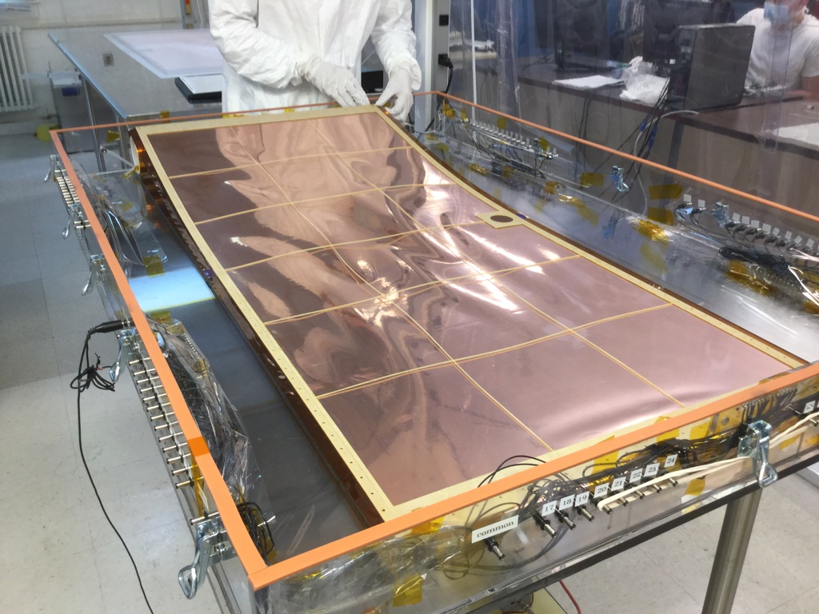
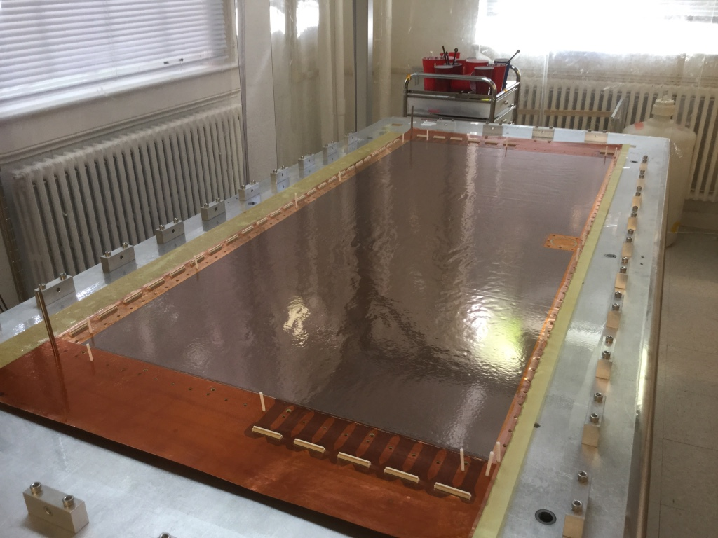

Slide 22
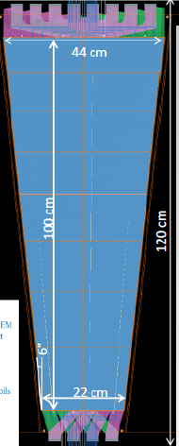

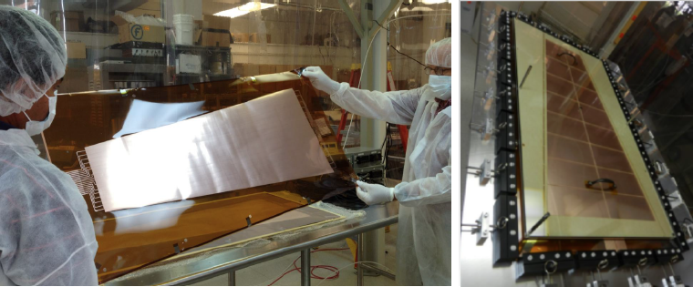

Slide 23
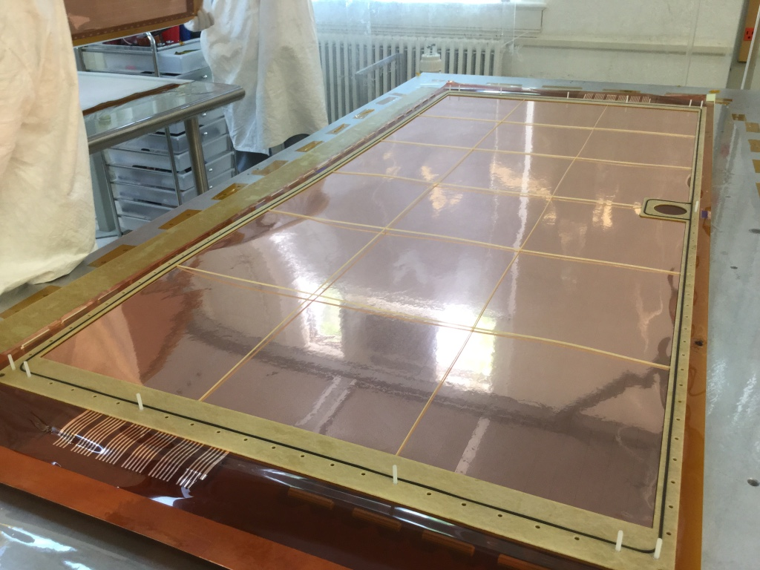
123 cm x 55 cm active area
GEM detectors for pRad experiment
under construction at UVa

Slide 24
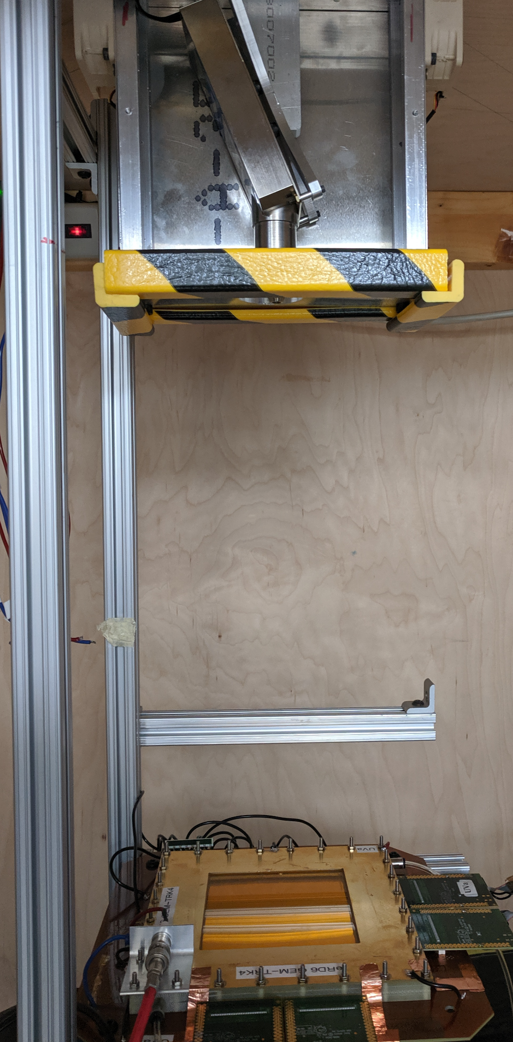
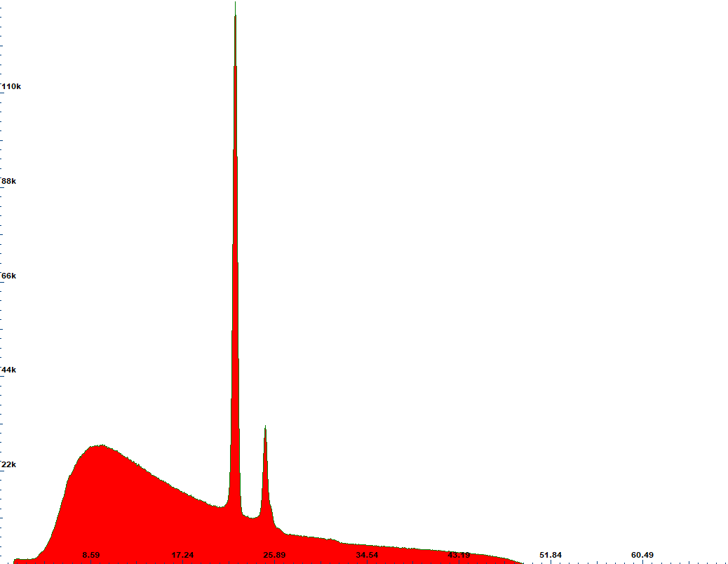
Studying the Change of GEM Electric Fields in High-rate Environment
Setup for studying drifting of electric field in GEM modules due to high-rate
  X-Ray tube is used to create high-rate environment in the lab
  10x10 cm2 GEM module is placed 40 cm away from X-Ray source
  50x60 cm2 GEM module is placed 70 cm away from X-Ray source
  Generated photon beam:
    Energy range: up to 50 keV
    Output flux: up to 300 MHz/cm2 on the surface of GEM
    0.5% of x-rays are converted into MIPs
  Charge deposition equivalent to a MIP rate of 20 MHz/cm2 can be reached
  Measurements :
currents in and out of electrodes
voltage a GEM foils and drift, transfer, and induction regions
  Readout current analogous to the gain
X-ray spectrum - Ag target 50 keV
Test Setup with X-ray gun

Slide 25
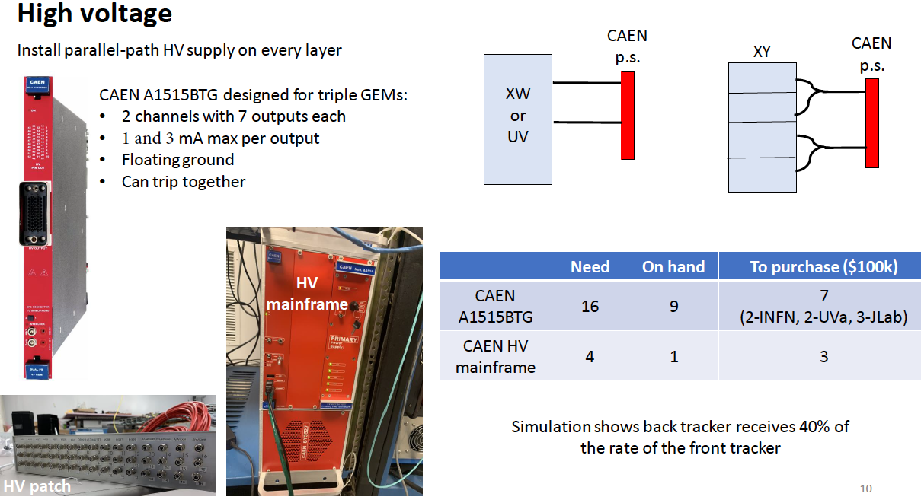
GEM: Proven Technology
All SBS GEMs were upgraded to parallel power supplies: work starting this week
Cost per module ~ $ 14 k: could power 1 – 4 modules depending on the exposure
The components and fabrication methods to be used for SoLID GEMs were used by the UVa group for the successful fabrication of GEMs for PRad and SBS experiments.
These GEMs worked very well in beam with stable performance, high efficiency and good resolution; meeting or exceeding design parameters.
Hall A (and INFN + UVa) has purchased 16 modules
SoLID will need ~ 30 to 40 more depending on the rates (to be evaluated with simulation)
              Alternate approach: Build an active divider
                CERN GEM electronics group has a design.
                Cheaper, but need to make sure no extra noise.
                Need support from Jlab electronics group

Slide 26
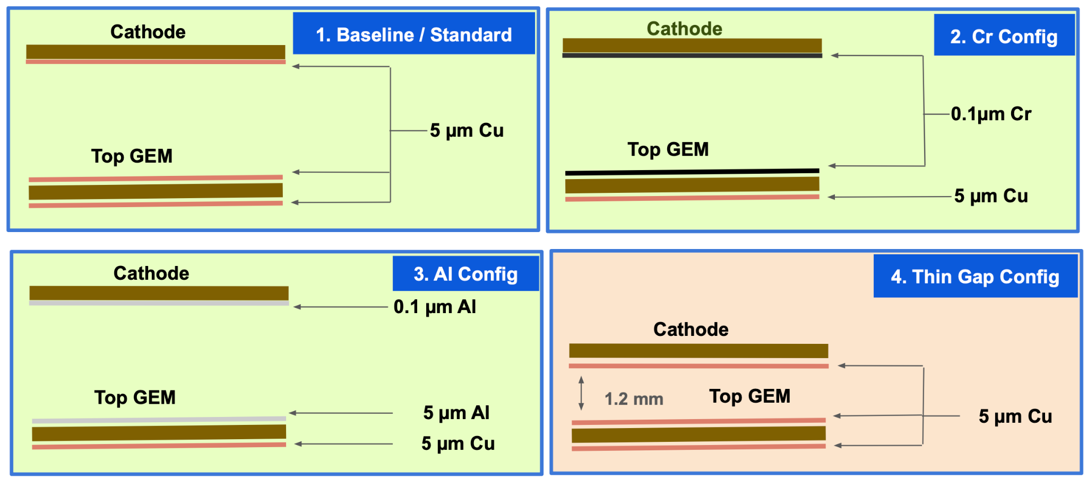
Geant4 Simulation on Optimizing GEM Foil/Detector Structure
Effort to reduce the photon conversion rate on GEM detectors
Simulation on different GEM foil/detector structure
3 mm COMPASS Structure

Slide 27
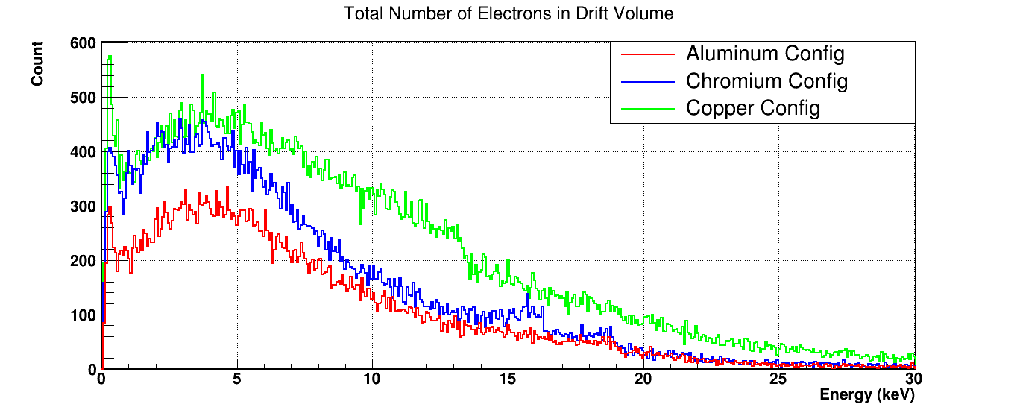
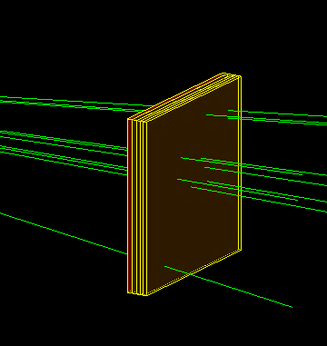
Geant4 Simulation on Optimizing GEM Foil/Detector Structure
Prototypes of different configurations completed
Under test using x-ray
Similar setup in Geant4
Simulation results shows an improved results on Cr/Al cathode foils
UVA x-ray

Slide 28
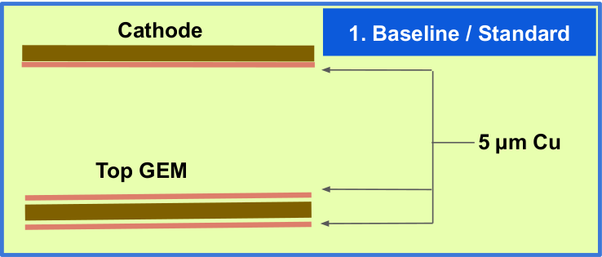
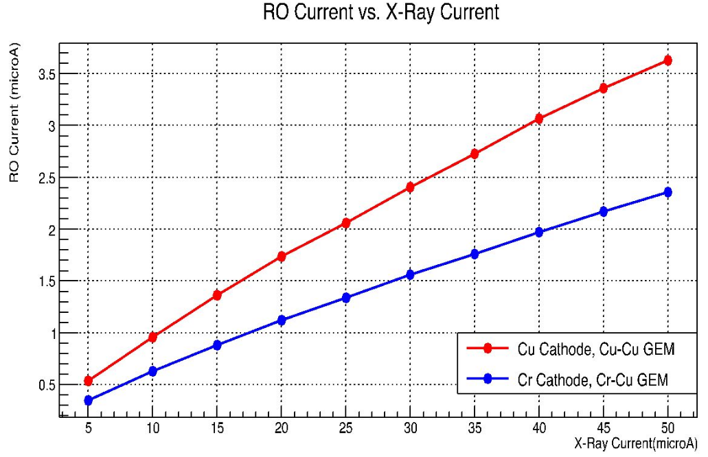
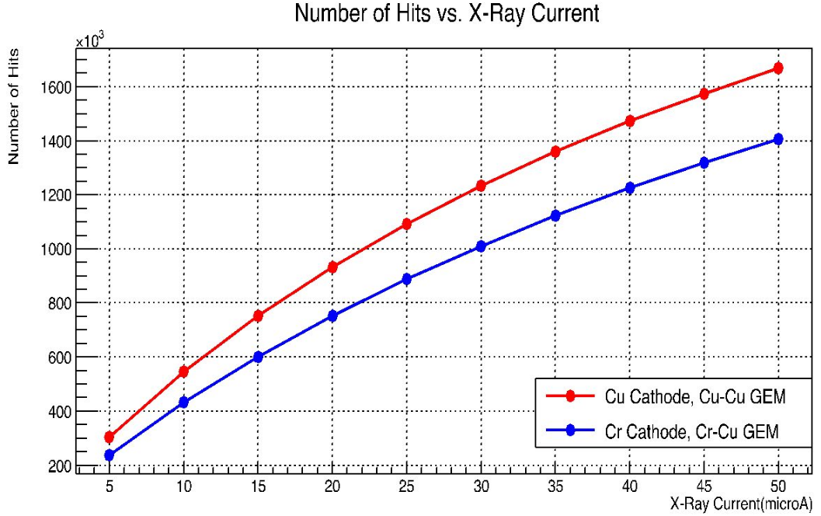

Geant4 Simulation on Optimizing GEM Foil/Detector Structure
Photon conversion – cathode foil, drift region (thin-gap)
Experimental measurements
  Current from readout board
  cluster count under a fixed amount of time
Significant photon-converted cluster count reduction: 16% for Cr GEM detectors
RO Current
Cluster Count

Slide 29



Geant4 Simulation on Optimizing GEM Foil/Detector Structure
Photon conversion – cathode foil, drift region (thin-gap)
Experimental measurements
  Current from readout board
  cluster count under a fixed amount of time
Significant photon-converted cluster count reduction: 30% for Thin-Gap GEM detectors
Simulation study on-going – Garfield / Geant4
See Kondo’s Monday talk on thin-gap beam test results
RO Current
Cluster Count

Slide 30
Back up

Slide 31


Slide 32


Slide 33


Slide 34


Slide 35

Full size prototype of µRWELL detector

Slide 36

Large area uRwell prototype under testing at Jlab

Slide 37
Backups

Slide 38

However, we need to be careful – SoLID occupancy is not uniform, hot-spots at small radius
u strips
v strips

