Slide 1
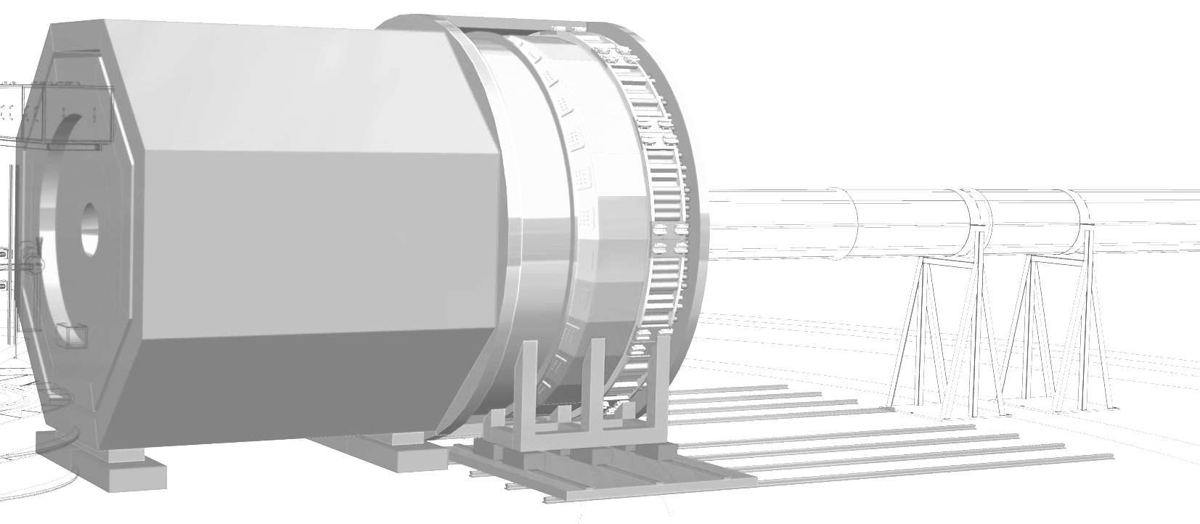

SoLID Update
SoLID Collaboration Meeting
@ Jefferson Lab
July 7-8, 2025
Jian-ping Chen
Jefferson Lab

Slide 2
Outline
Progress Since January 2025 Collaboration Meeting
SoLID Large-Angle Options
SoLID pre-R&D Activities
Physics Development
Plan for the Next Steps

Slide 3
Progress Since May 2024 Collaboration Meeting
Project Status
    Long Range Plan: Strong Endorsement, Recommendation 4
    (Recommendation 1 in QCD Town Meeting)
    Submitted SoLID Whitepaper as Input
    DOE Facility Review: Readiness: A – Ready to be launched
    waiting for across field evaluation and report
    (no new project approval before the Facility Review Report)
    Submitted One-pager Write-up as Input
    NSAC Subcommittee on International Benchmarking
    Submitted One-pager Write-up as Input
    4. JLab cost sharing plan; Options to start with partial detector: forward and large-angle
    Worked with Hall A and Physics Division on the options
    Forward option costs too high
    Large-angle cost is about the same amount as JLab cost sharing
    Physics with large-angle option
    Presentation/discussion with DOE/NP
    DOE wants SoLID to get CD0 first

Slide 4
SoLID-LD : New Cost Sharing Proposal
Start with the Large angle Detector section of the planned SoLID spectrometer
Existing Polarized Helium target with Longitudinal and Transverse pol
Magnet
  CLEO magnet at JLab
  Low current testing completed
GEMs 4 out of 6 planes
Large Angle Ecal
    Pre-shower and SPDs
    440 out of the 1800 modules.
DAQ
Infrastructure
Physics:
Inclusive DIS at high Q² and large X. Coverage of 15 to 24 deg
Inclusive charged pion production
Run at the highest luminosity (10³⁷) possible with polarized helium target and cover the large 2π acceptance to make precision asymmetry measurements.
  Hall B limited to luminosity of 10³⁴ for polarized helium
  Hall C has small acceptance spectrometers

Slide 5
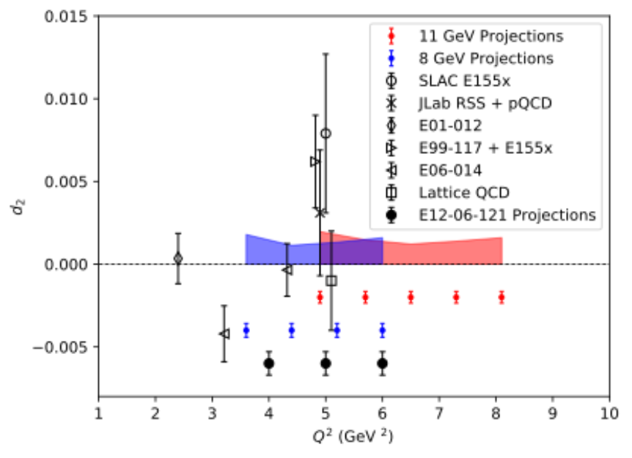
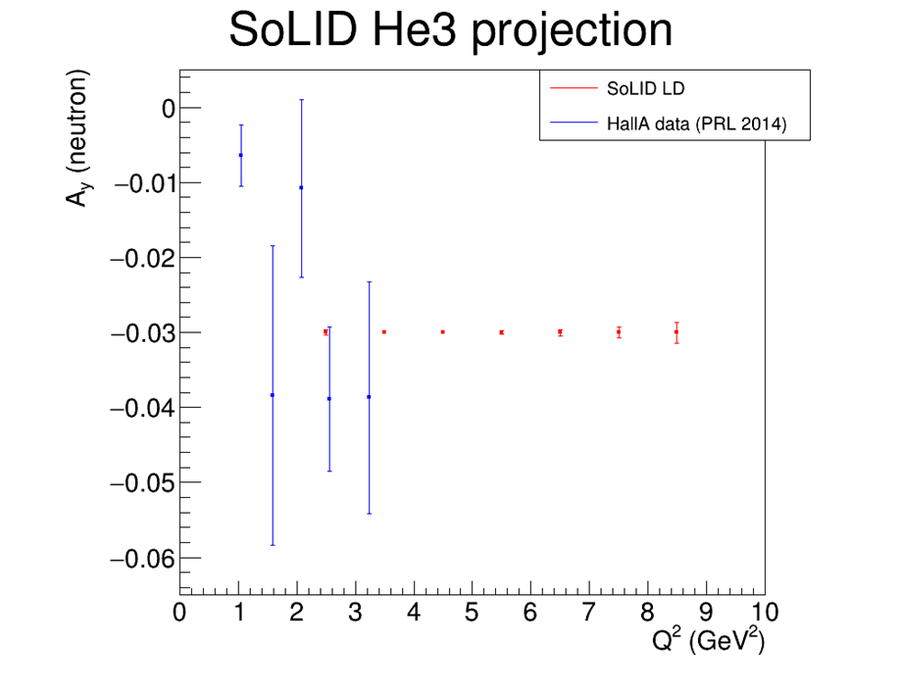
SoLID-LD Physics
Allows for commissioning of DAQ, magnet and LD detectors
Approved experiments
Run-group experiment d₂^{n}
Run-group experiment A_{y}^{n}
Part of SIDIS experiments – charged pion productions with both L/T polarizations (TMDs)
Propose new experiments
Precision g₁^{n}/A₁^{n}
Inclusive charged pion production
  Study gluon and constraint on TMDs
  Test new formalism of JLab theory group
d₂^{n}
SoLID-LD
SoLID-LD
Hall C E12-06-121
A_{y}^{n}

Slide 6
Progress Since May 2024 Collaboration Meeting
Pre-R&D Activities:
1. 2nd DOE-funded Detector Beam Test in Hall C: analysis complete,
Radiation damage for pre-shower? (Ye Tian)
Write-up almost ready? (Xiaochao Zheng)
2. DAQ and GEM Readout Test (Alexandre Camsonne)
3. New beam test for next run period (Klaus Dehmelt)
4. New pre-R&D plan
GEM readout (Alexandre Camsonne)
Tracking Options (Nilanga/Klaus)
In discussions with DOE/Medium Energy
5. Magnet test: as part of JLab contribution (Whit Seay)

Slide 7
Progress Since May 2024 Collaboration Meeting
Progress in Subsystems
Engineering/Design/Magnet (Whit Seay)
Software (Zhongling Ji)
GEM/Tracking (Nilanga Liyanage)
LGC (Michael Paolone)
HGC (Zhiwen Zhao)
ECal (Xiaochao Zheng)
Detector (MRPC/ECal) R&D from China Side (Zhihong Ye)
Physics:
Inclusive π Production (Jianwei Qiu)
Impact Study on Polarized PDFs from SIDIS He3 by JAM Group
(Chris Cocuzza)
Future Run-group Proposal: Polarized Sea (Chim Him Leung)
New Proposal: DDVCS with SoLIDμ (Zhiwen Zhao)
Run-group proposal: SIDIS Cross Section (Ye Tian)

Slide 8
Plan for the Next Steps
SoLID Collaboration with Strong Support from JLab, work with DOE/NP to Move SoLID Forward
Be ready when time comes
With JLab Support
Magnet test
Beam test
……
pre-R&D Activities
GEM readout (Alexandre Camsonne)
Tracking options (Nilanga Liyanage)
Beam test with (near complete set of) prototype detectors with focus on tracking (Klaus Dehmelt)
Continue subsystem/software development
Software development, synergy with EIC (Zhongling Ji)
AI/ML for PID
Stream Readout?
…….

