Slide 1
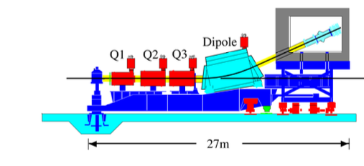
NPS Optics Optimization at High Momentum: Milestones and Next Steps
Thank you to the spokespersons and experts:
Tanja Horn, Charles Hyde Mark Jones, Holly Szumila-Vance
Christine Ploen, Joshua Crafts

Slide 2
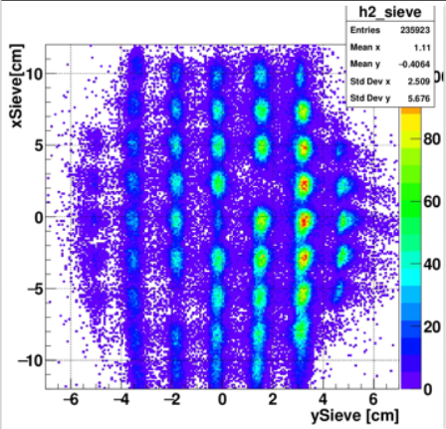
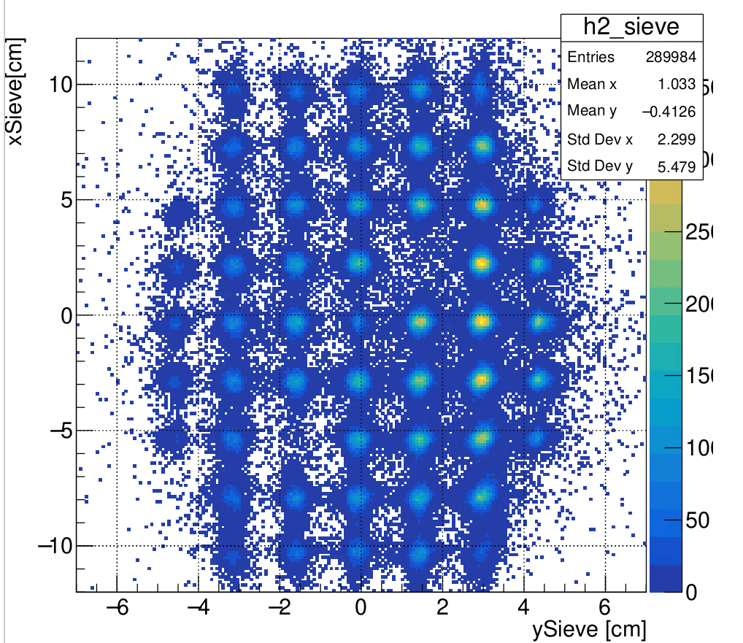
Motivation: Saturation in HMS Dipole
At high momentum, HMS dipole saturation causes nonlinearities and the low-momentum transport matrix does not accurately reconstruct the physics variables, requiring precision tuning of matrix elements for angular and delta components.
Below: Effects of using low momentum matrix elements on high momentum data
Below: Same data, optimized (angular) matrix!
New Fit Matrix Sieve Results
FitOpt2018 Matrix Sieve Results
OPTIMIZATION

Slide 3
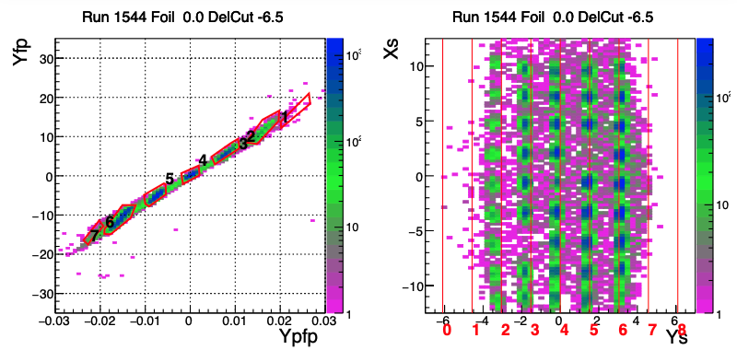
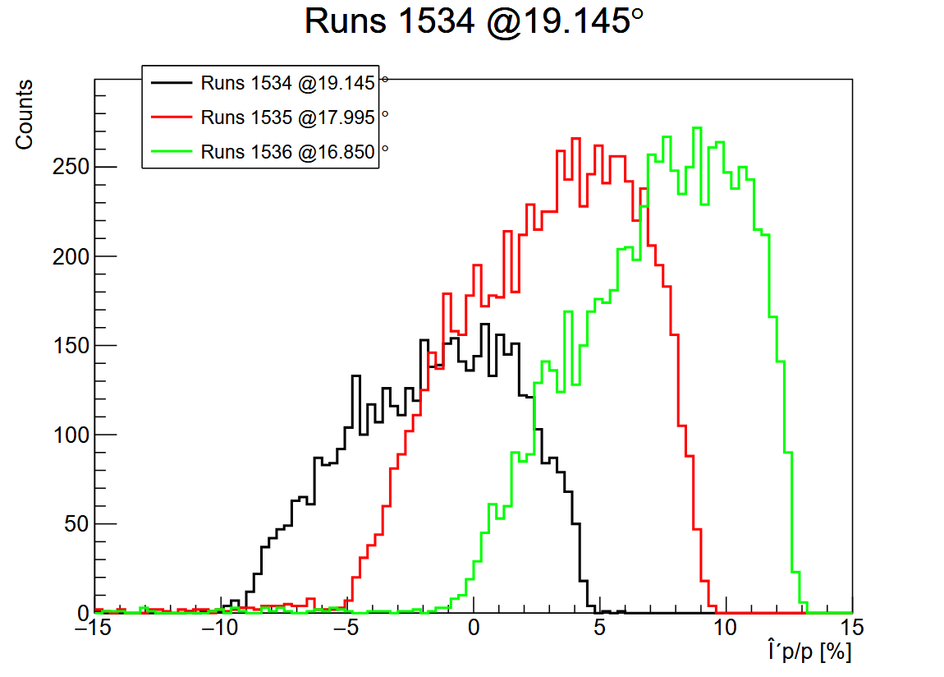
Two complementary optimization branches:
Angular :
Data: Sieve slit on extended carbon foils
Method:
Select sieve holes
Reconstruct physics variables with 6th-order polynomials
Optimize coefficients using SVD
Delta :
Data: Elastic delta-scans on LH2 (vary angle)
Method:
Get missing mass (Mp) from simulation
Reconstruct delta via SVD
Relies on completion of angular optimization

Slide 4
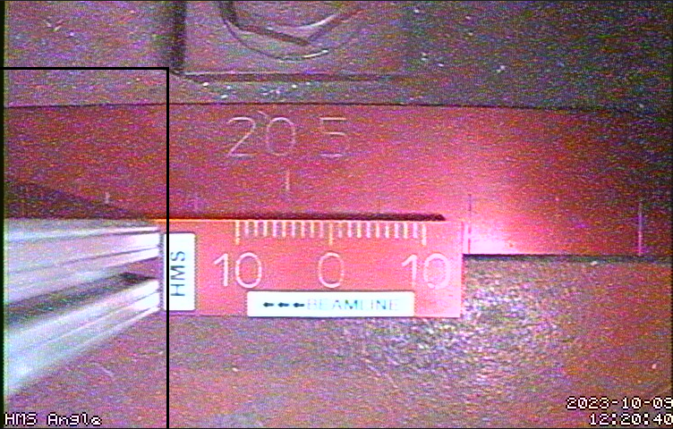
Prerequisites for Delta: Angular Optimization
Angular optimization completed at specific HMS momenta and implemented in delta scan replays
HMS detector angles verified (via camera image) and implemented in replay and optimization code
Kinematic (old name) | Central P | Student | Angle 1 Sieve | Angle 2 Sieve | Angular Optimization
x50_2 | -6.667 | Christine | C 0.5% +/- 8cm | C 0.5% +/- 8cm +/- 3cm | Matrix Elements
x36_3 | -6.117 | Josh | C 0.5% +/- 8cm | C 0.5% +/- 8cm +/- 3cm | Matrix Elements
x60_3 | -5.878 | Christine | C 0.5% +/- 8cm | C 0.5% +/- 8cm +/- 3cm | Matrix Elements

Slide 5
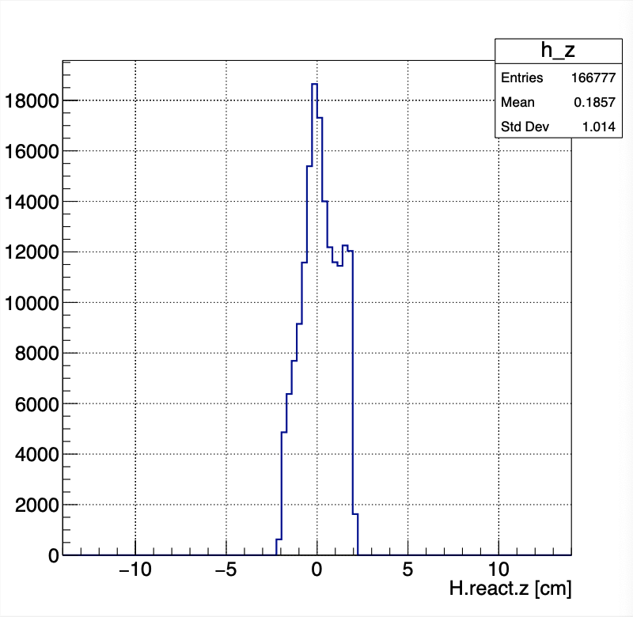
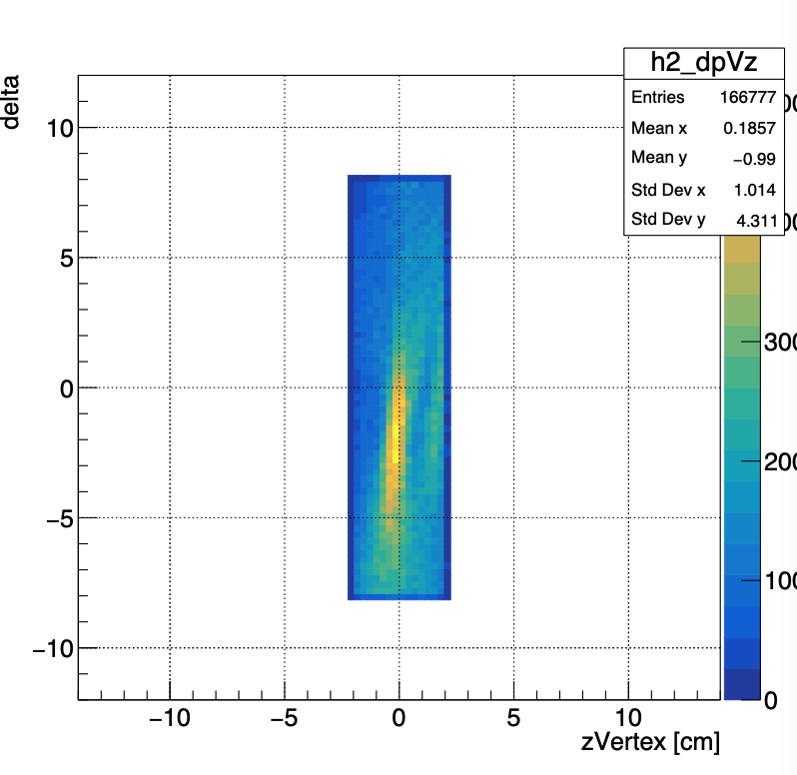
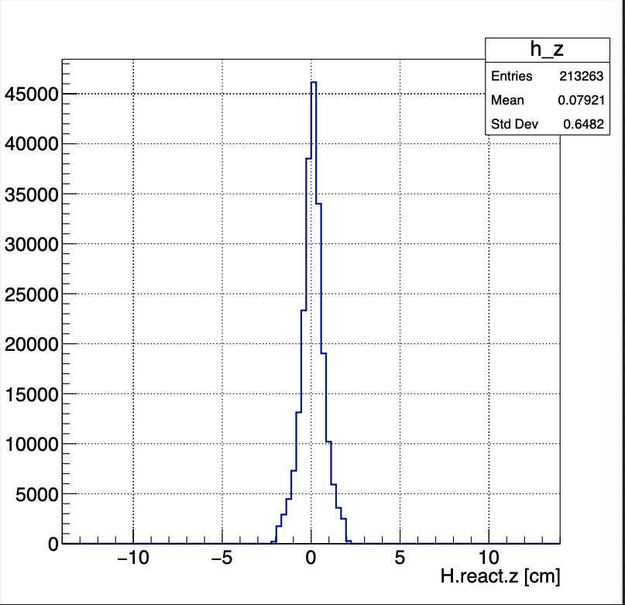
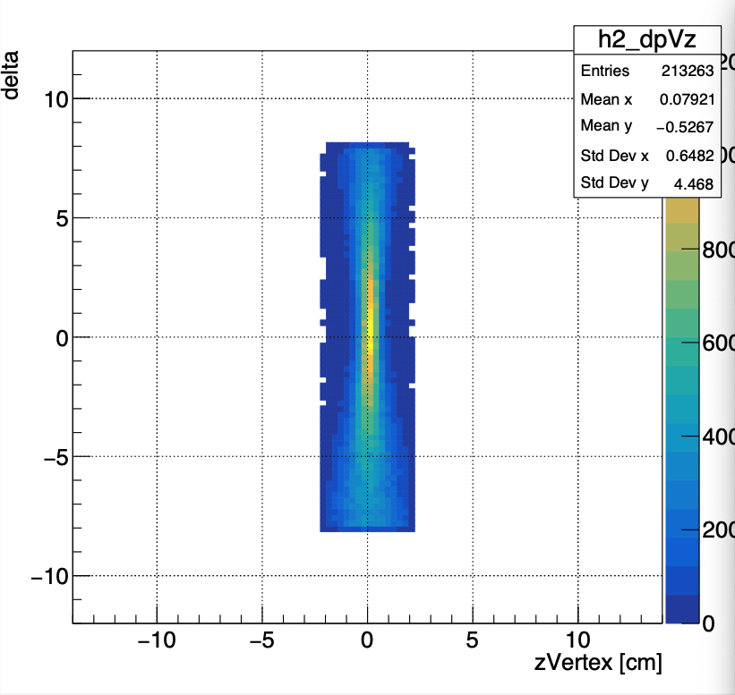
Prerequisites for Delta: Angular Optimization
Coeff2018
Milestones
Graphical cuts around sieve holes from optics runs at various HMS angles for all high momenta
Polynomial fit to 6th order using SVD, iterative refinement
Histograms and sieve hole data replays as quality checks
Git commit of angular matrices and zero-order offsets for replay (Pass1 and onward)
Future opportunity - rerun software using exact beam position (H.react.x) instead of the average, and exact location of carbon foil targets
New Fit
-6.667 GeV/c, Run 1544:
Z vertex resolution much improved!

Slide 6
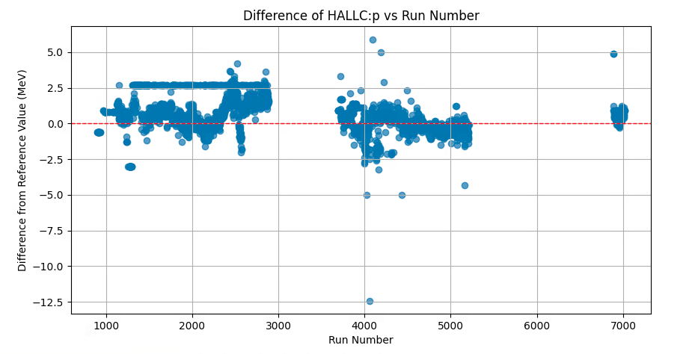
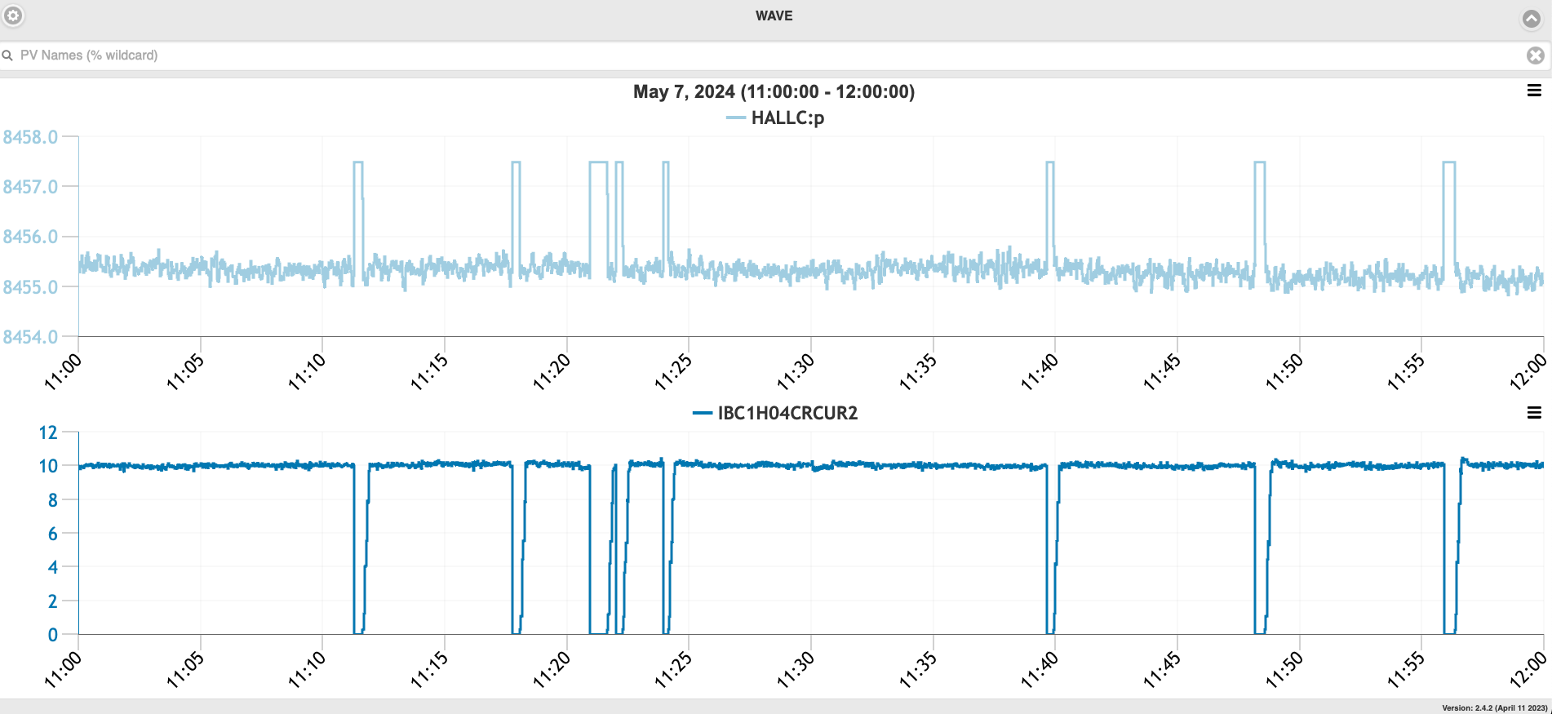
Prerequisites for Delta: Calibrating Beam E HALLC:p values
Beam trip HALLC:p values
Left: HALLC:p readback is an artificial value during beam trips
Right: Those incorrect readbacks, when used as the reference HALLC:p value, appear as straight lines. Here, I had plotted the autologged HALLC:p values from the start of run, with no cuts or averaging.
For Reliable Values of HALLC:p
Use HALLC:p from replay root files or
RCDB/autolog ➡️ get timestamps ➡️ mySampler on cdaq
30 s time slices for each run
Not all epics readbacks are correct
cut 1: HALLC:p > 50 MeV (removes random zeros)
cut 2: current > 2 uA (IBC3H00CRCUR4) (removes beam trips)

Slide 7
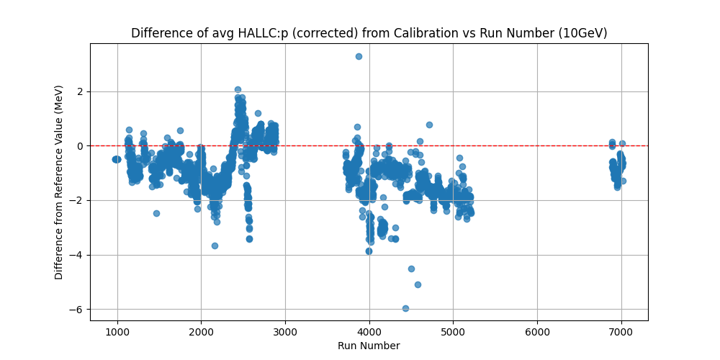
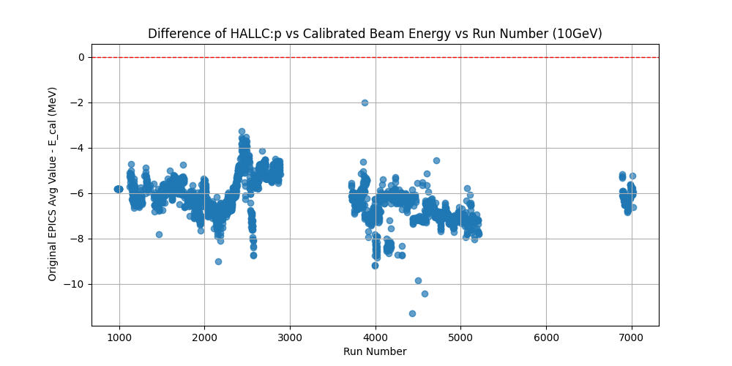
Prerequisites for Delta: Beam Energy Calibration @ 5 Pass
Top Right: Corrected HALLC:p Results: E_{b} - HALLC:p_{cor} vs Run
Red line is E_{b} from beam energy measurement
HALLC:p_{cor} = $\frac{\text{E}\text{b}}{\text{HALLC}\text{:}\text{p}\text{0} }$·HALLC:p_{avg} $− 0.5·δ\text{E}\text{SR}$
= 1.00063 · HALLC:p_{avg} $− 0.5·0.0026$
Scale factor from calibration
Bottom Right: Uncorrected HALLC:p: E_{b} - HALLC:p vs Run
Red line is E_{b} from beam energy measurement

Slide 8
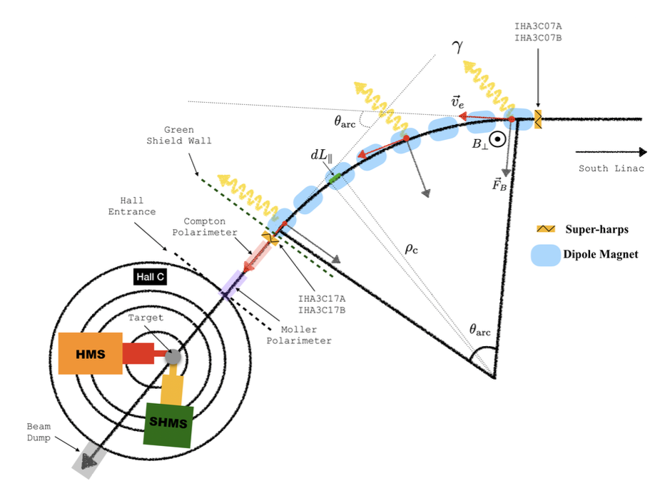
Prerequisites for Delta: Beam E Synchrotron Subtraction
Layout of Hall C Beamline Arc:
8 dipoles
Effective length = 3m each dipole
8 x 4.2875°/dipole ($θ\text{arc}$) + 3.2°_{dipole 3C04} = 37.5° net bend
Bending radius $ρ$_{arc} = 40.09 m
Super harps for beam position before/after dipole chain
Synchrotron Loss in circular accelerator:
$δ$E_{SR}= 88.46 ·E⁴ ·$θ$_{arc}/($ρ$_{arc}·360°)
88.46 is a derived empirical constant
Formula is for full 360°, scaled by $θ$_{arc} /360°
@ 5 pass:
Total SR Loss = 2.6 MeV
40.09 m
34.3°

Slide 9
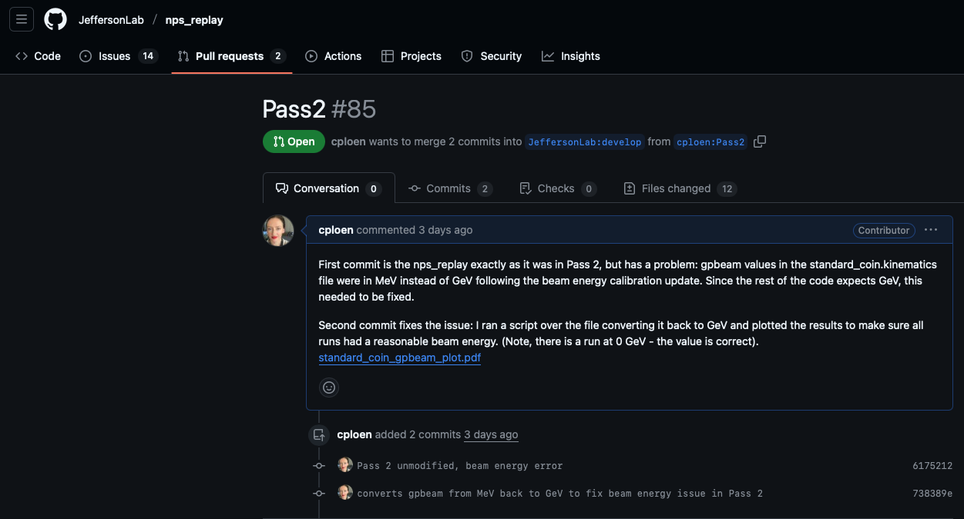
Prerequisites for Delta: Putting it Together
Update to standard_coin.kinematics & inclusion of relevant EPICS variables
Pull request: Pass 2 + Fix
Replayed delta scans with optimized matrix, correct Beam E & HMS Angle

Slide 10
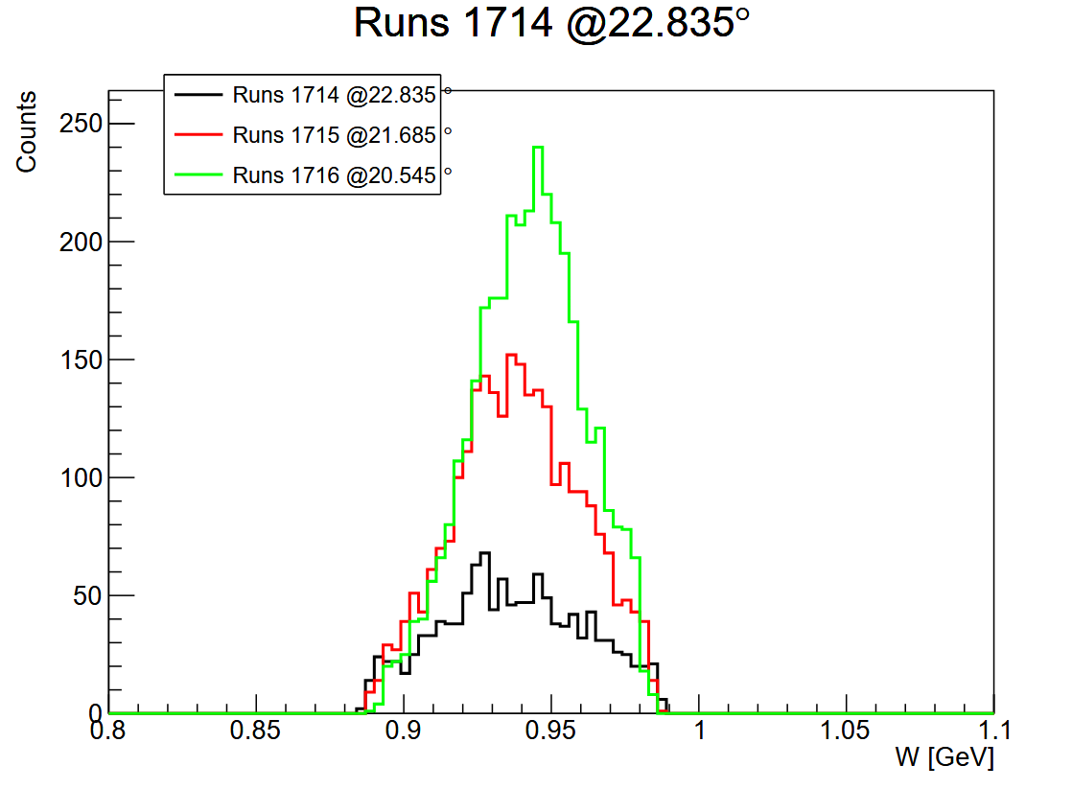
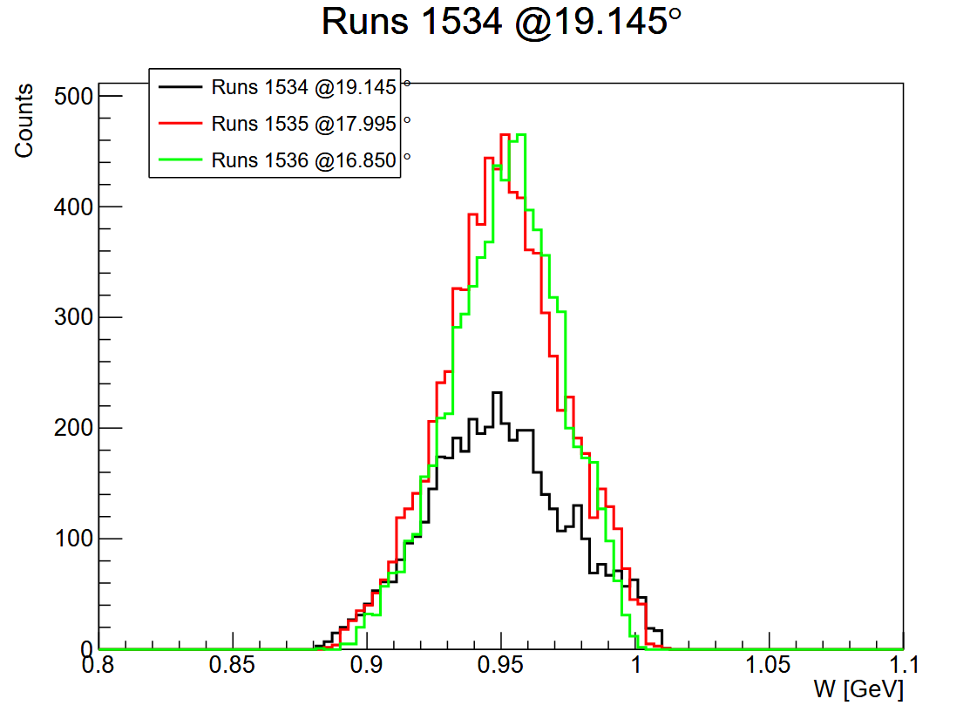
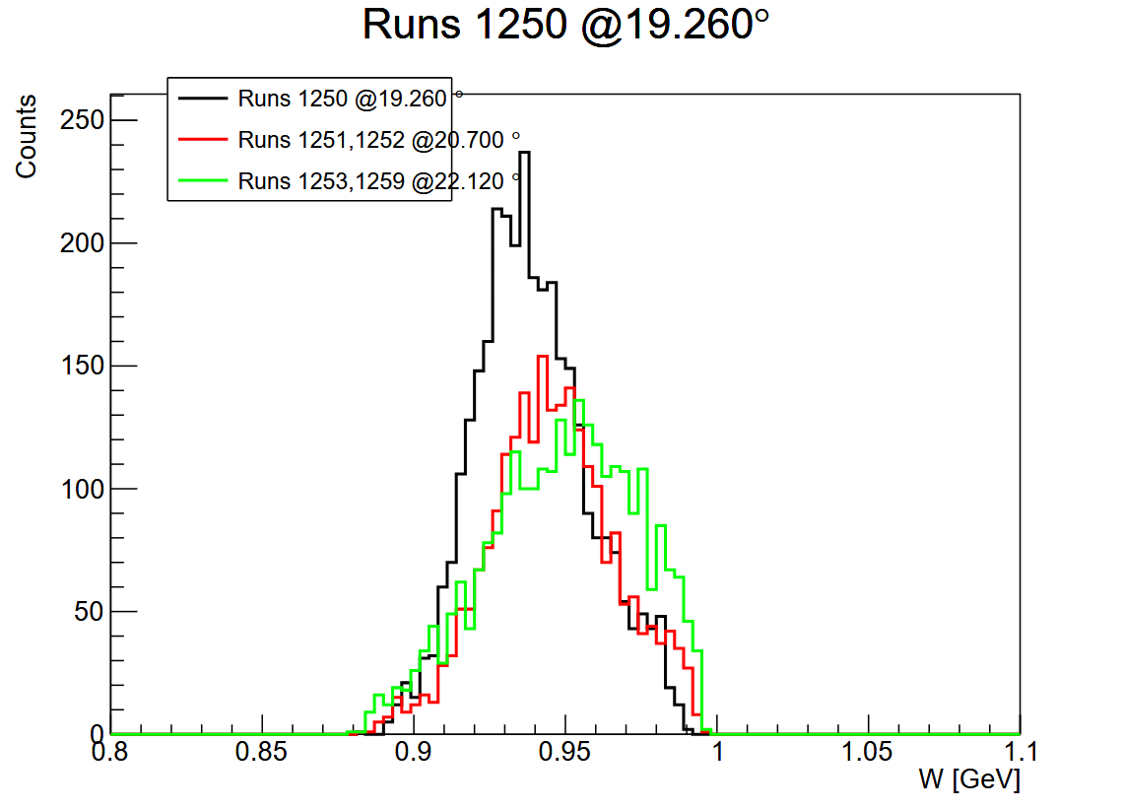
W Before Optimization
Elastics: W = M_{p}
This is the constraint used to calibrate delta
we want these peaks to line up.
-5.878 GeV/c
-6.667 GeV/c
-6.117 GeV/c
Why is high momentum so good? Inherited delta opt from the -6.59 Ge/c ME (Jacob Murphy’s work!)

Slide 11
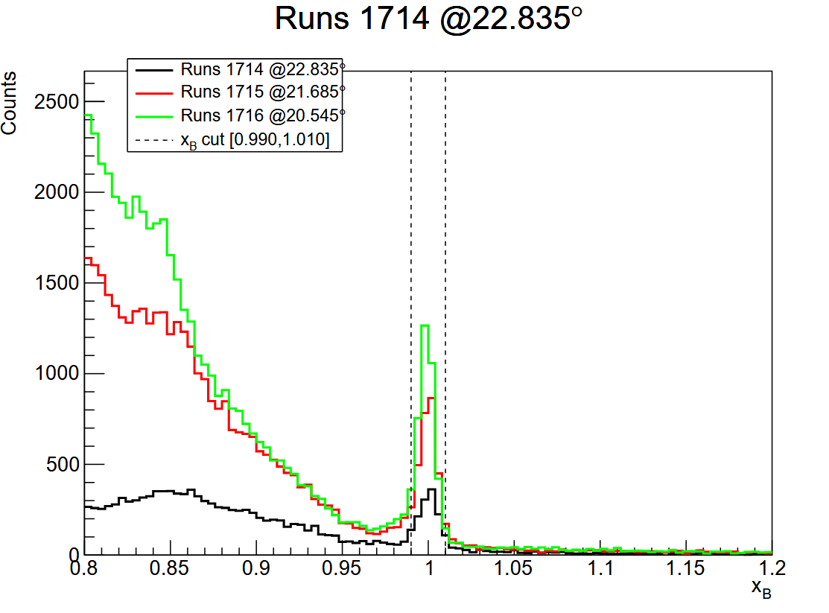
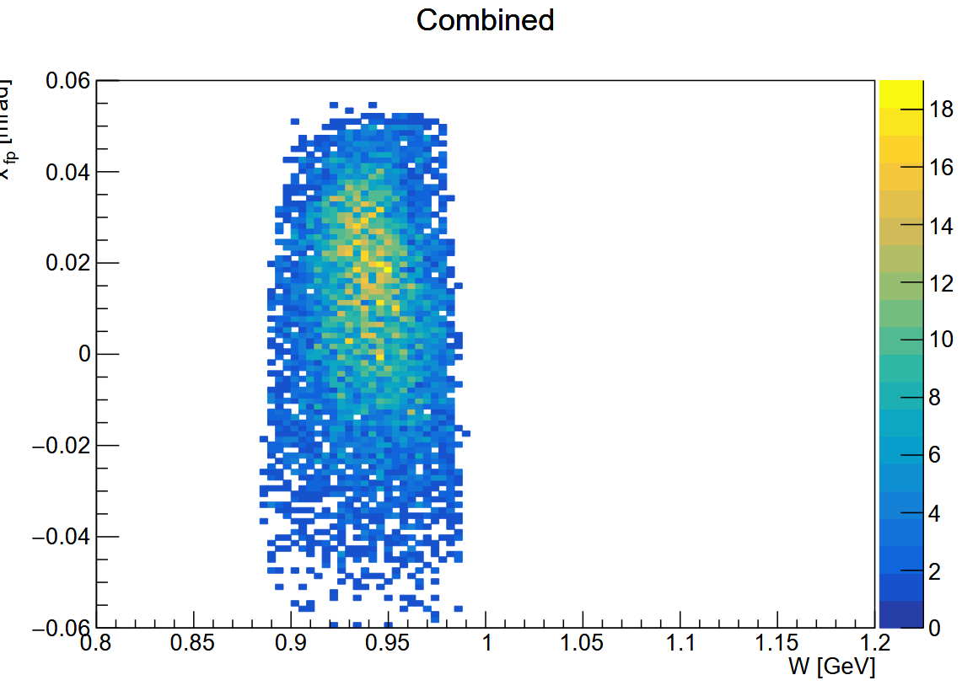
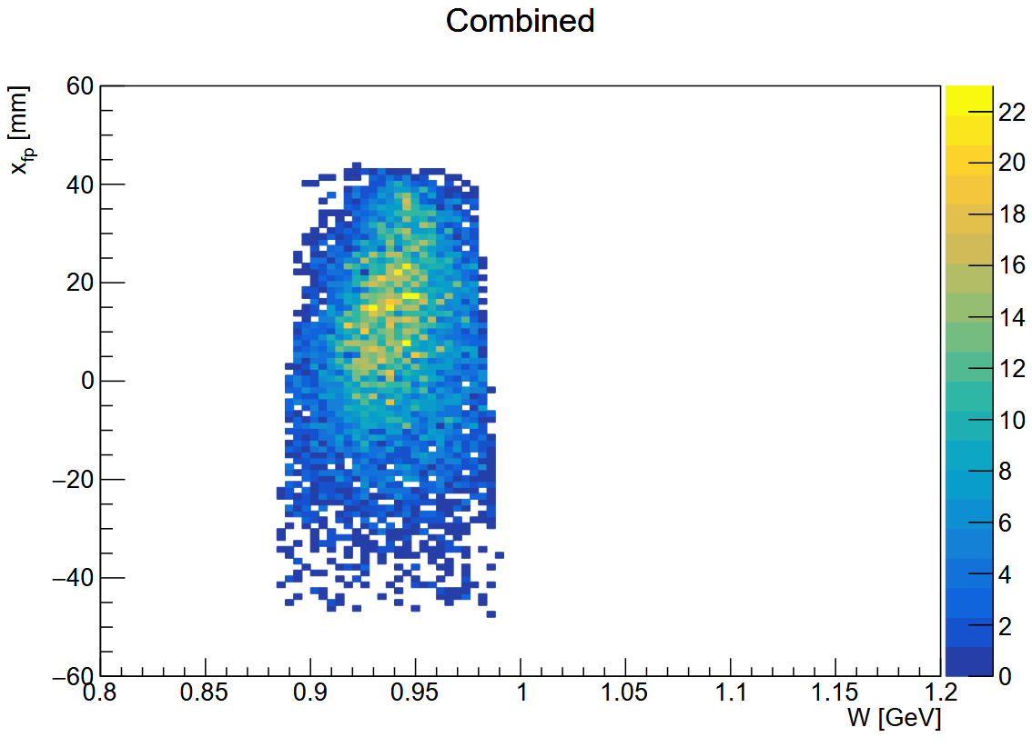
W vs Focal Plane Variables Before Optimization: -5.878 GeV/c
xfp, xpfp vs W
Some correlation shown, esp in xfp:
Should be more or less straight for no correlation.
We don’t have a lot of events, but enough to optimize .
Might need even tighter cut on xB to get rid of all inelastics.
cut on xB
xpfp vs W
xfp vs W

Slide 12
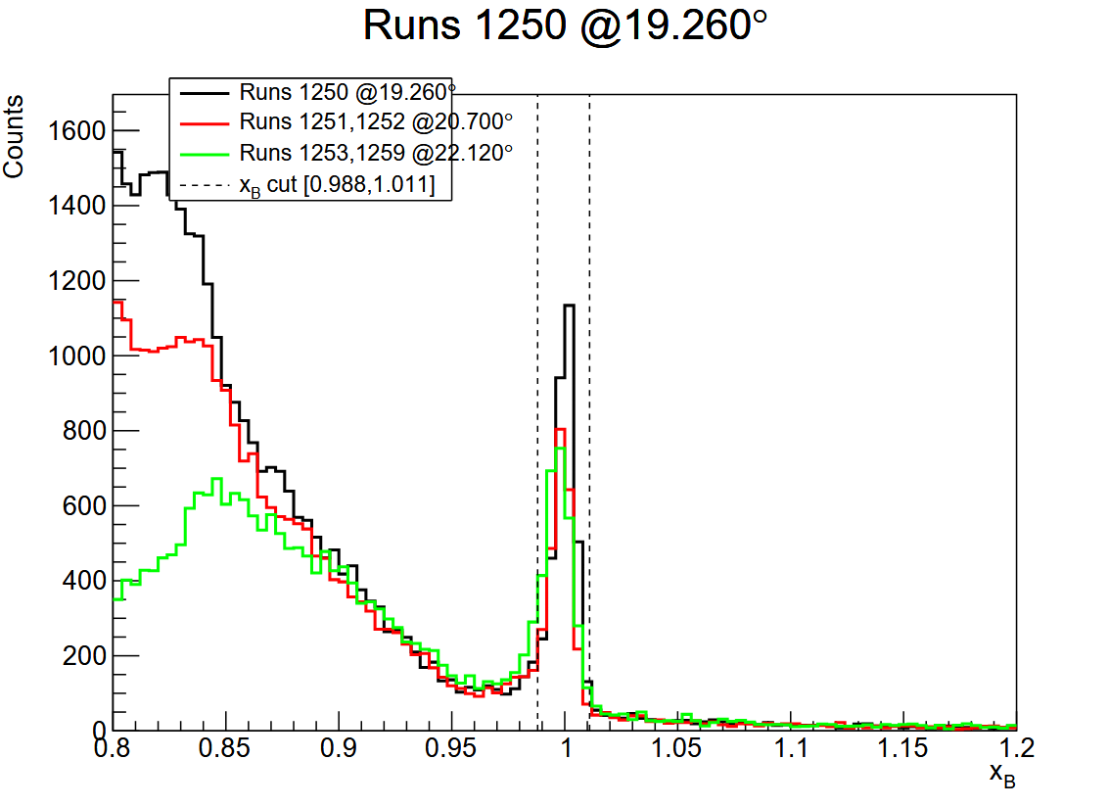
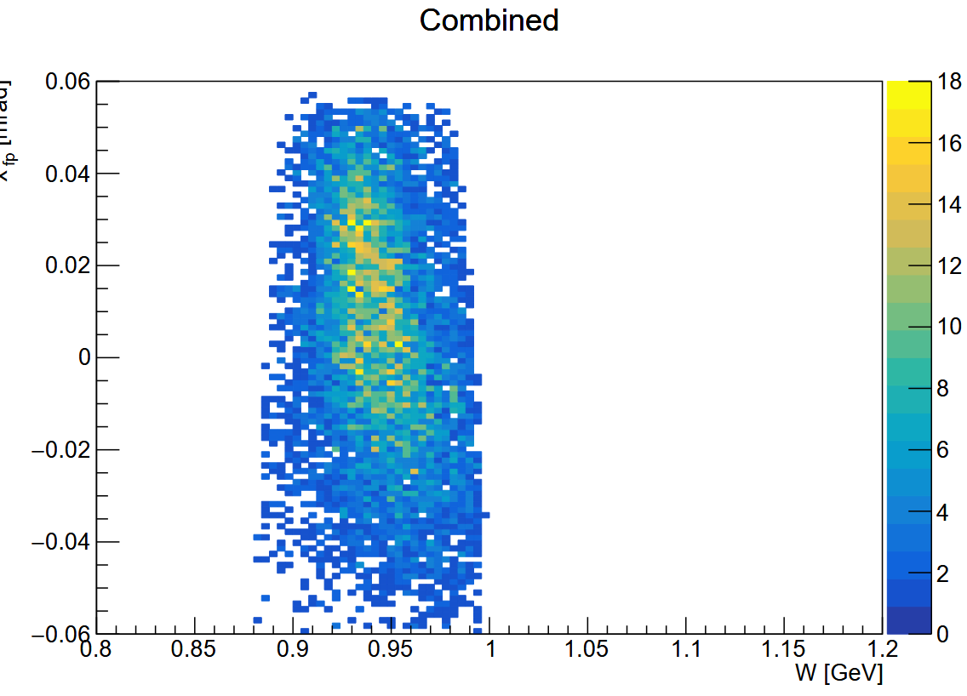
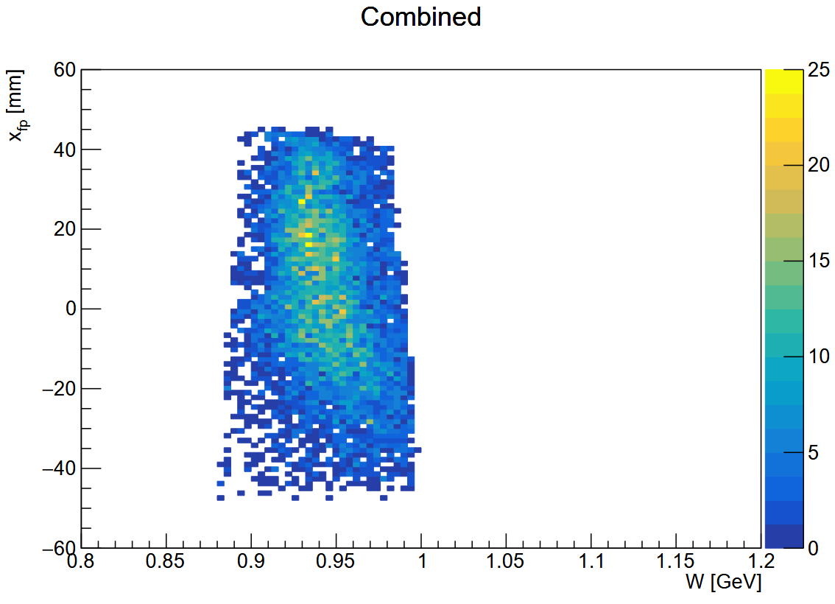
W vs Focal Plane Variables Before Optimization: -6.117 GeV/c
xfp, xpfp vs W
Here we see the curvature a little more clearly.
Should be more or less straight for no correlation
We have even more events for these runs
Might need even tighter cut on xB to get rid of all inelastics.
cut on xB
xpfp vs W
xfp vs W

Slide 13
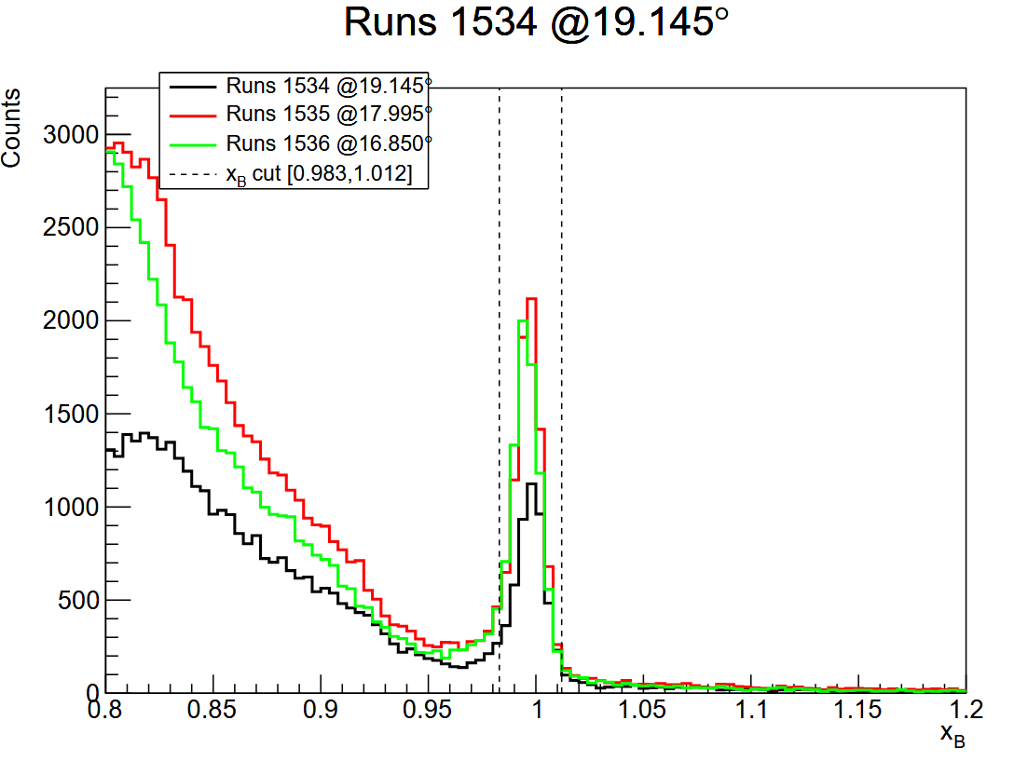
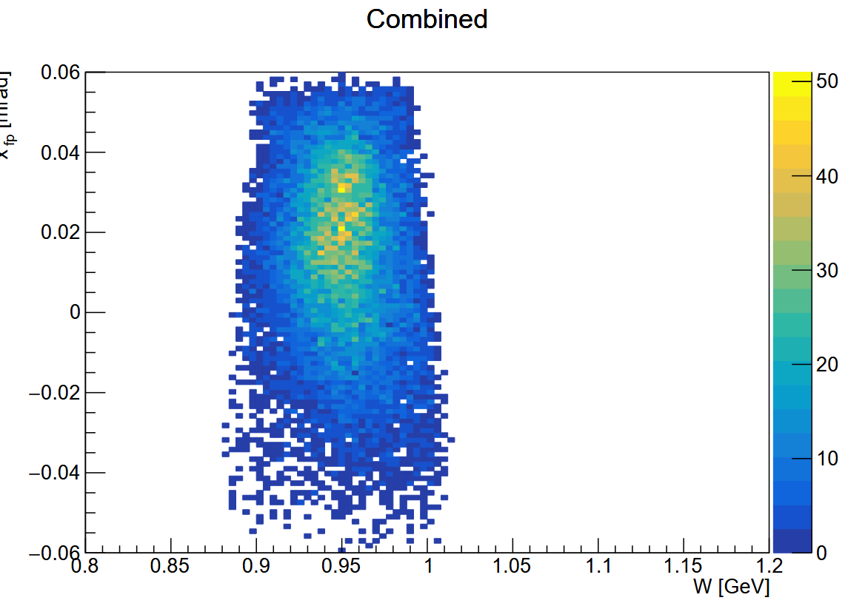
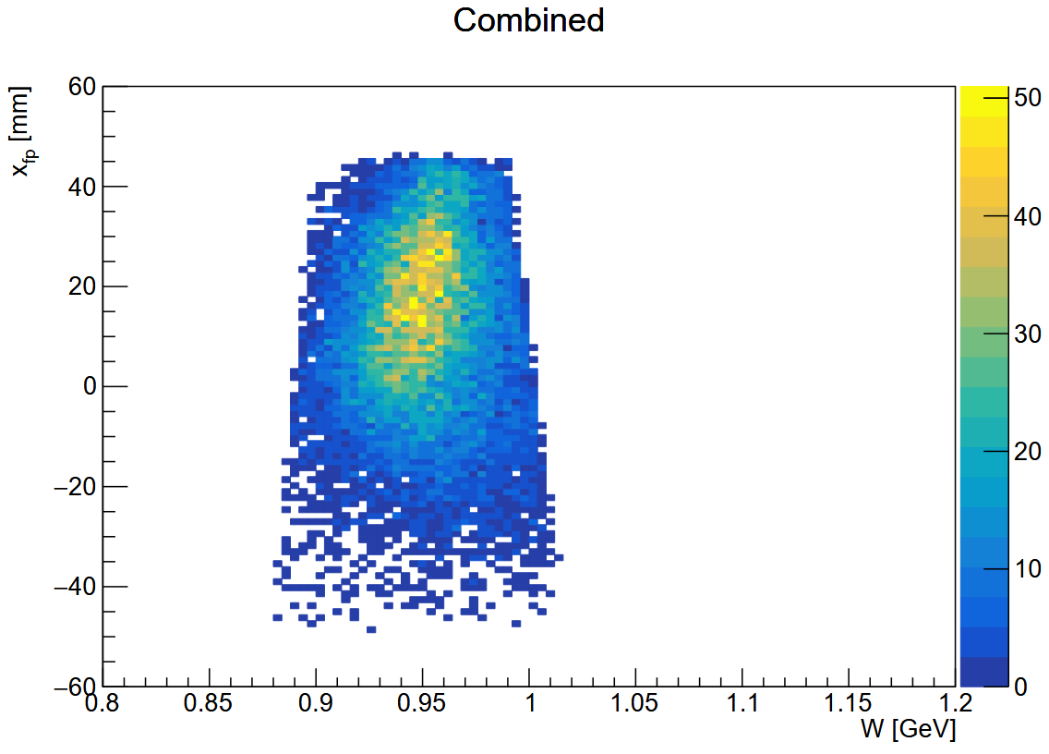
W vs Focal Plane Variables Before Optimization: -6.667 GeV/c
xfp, xpfp vs W
Here we see some curvature in xfp.
Should be more or less straight for no correlation
We have the most events for these runs!
Might need even tighter cut on xB to get rid of all inelastics.
cut on xB
xpfp vs W
xfp vs W

Slide 14
Next Steps: SIMC Fit for M_{p,} SVD, and Analysis
SIMC: simulation and fit M_{p} from tight cut on elastic peak
replay without 0 order offsets
SVD fit results for delta-reconstruction
Coefficient behavior (compare to previous)
W vs. Physics Variables After Optimization
Fine tuning out remaining discrepancies, full replay test, GitHub PR with fully updated matrix elements and offsets
Validation against data: reconstructed M_{p} agreement across HMS angle, plots of focal plane variables

Slide 15
Thank You!

Slide 16
Extras: Beam Energy Calibration Workflow Overview
Obtain an average HALLC:p value for each run (no beam trip values or error readbacks).
Calculate HALLC:p/BeamE_{cal} with good value from time of calibration.
Scale the HALLC:p values with this factor.
Subtract synchrotron loss.
Update standard_coin.kinematics and submit nps_replay pull request.

Slide 17
Extras: Delta Optimization Workflow Overview
Obtain optimized coefficients for xptar, yptar, ytar physics variables via sieve slit/carbon foil data analysis (SVD)
Determine HMS Theta from camera and implement in nps_replay.
Calibrated and implement precise beam energy in nps_replay.
Replay delta scan runs without offsets (contained in hms_flags file).
Simulate elastics with simc to obtain W
Use simc results, tight cuts on xB to obtain new delta coefficients via SVD
Check plots, especially alignment of W

