Slide 1


DVCS Radiative Corrections
NPS Collaboration Meeting
5-6 May 2025
Charles E. Hyde
M. Vanderhaeghen, et al., Phys Rev C 62, 025501 (2000)
I.Akushevich and A. Ilyich, Phys Rev D 85, 053008 (2012)
A.Afanasev, I.Akushevich, et al, Phys Rev D 66 (2002) (EXCLURAD)
(BHRADGEN)

Slide 2
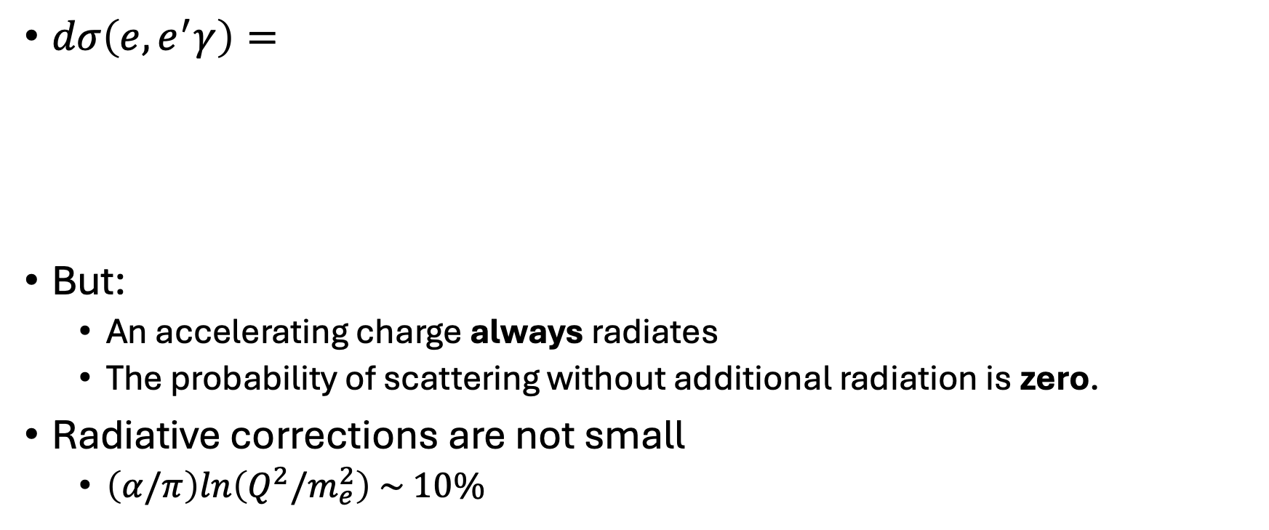

The Born Approximation for $ep→ epγ$
2
2
$dσ\left(e,e^{′}γ\right)=$
But:
  An accelerating charge always radiates
  The probability of scattering without additional radiation is zero.
Radiative corrections are not small
  $\left(α/π\right)ln\left(Q^{2}/m_{e}^{2}\right) \sim 10\%$
≈

Slide 3
External and Internal Radiative Corrections
External Radiation
The scattered electron loses energy by radiation from target nuclei before and after the scattering vertex.
The radiation is strongly peaked in the direction of propagation
  The photon energy distribution is ~1/k_{𝛾}
Internal Radiation
Real and virtual radiation happens in the Coulomb field of the vertex nucleus

Slide 4
Virtual Radiative Corrections
The corrections to the BH and VCS amplitudes are not identical.
Vertex, Self-Energy, and Vacuum Polarization corrections to BH
Vertex and Vacuum Polarization corrections to VCS
  VCS Self energy graphs are higher order and not included here

Slide 5
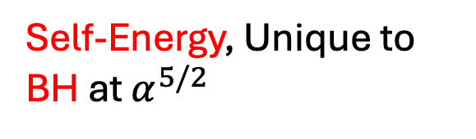
Virtual Radiative
Corrections
Intrinsically different for BH & VCS
BH
Self-Energy, Unique to BH at $α^{5/2}$
BH
BH
VCS
Vacuum-Polarization
BH: 1/[1+ Π(t)]
VCS: 1/[1+ Π(Q²)]
Notes:
Corrections are intrinsically different

Slide 6
Real Radiative Corrections
For exclusivity, we cut off radiative tail ≤ pion threshold
In the soft-radiation approximation, real-radiative effects factorize from nucleon vertex
BH
VCS

Slide 7

Integral of Soft Bremsstrahlung
M. Vanderhaeghen et al:
Integrate over ‘second photon’ momentum d³l in frame `S´:
$P’+l =0= q+P–q’$
Note that real radiation increases the measured cross section compared to Born prediction

Slide 8
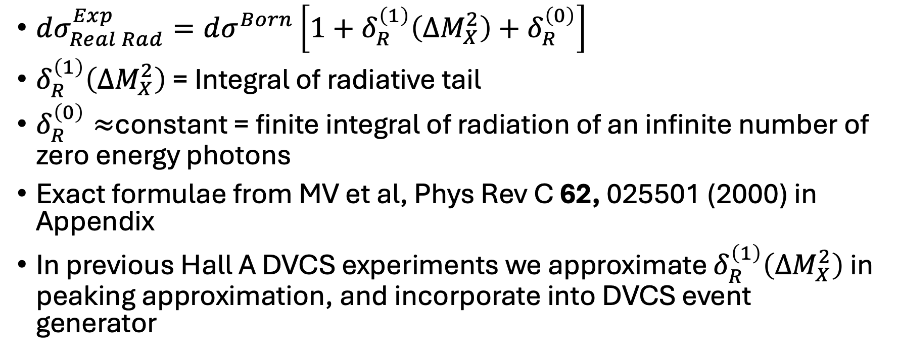
Radiative Tail and Radiative Renormalization Terms
$dσ_{Real Rad}^{Exp}=dσ^{Born}\left[1+δ_{R}^{\left(1\right)}\left(ΔM_{X}^{2}\right)+δ_{R}^{\left(0\right)}\right]$
$δ_{R}^{\left(1\right)}\left(ΔM_{X}^{2}\right)$ = Integral of radiative tail
$δ_{R}^{\left(0\right)}≈$constant = finite integral of radiation of an infinite number of zero energy photons
Exact formulae from MV et al, Phys Rev C 62, 025501 (2000) in Appendix
In previous Hall A DVCS experiments we approximate $δ_{R}^{\left(1\right)}\left(ΔM_{X}^{2}\right)$ in peaking approximation, and incorporate into DVCS event generator

Slide 9
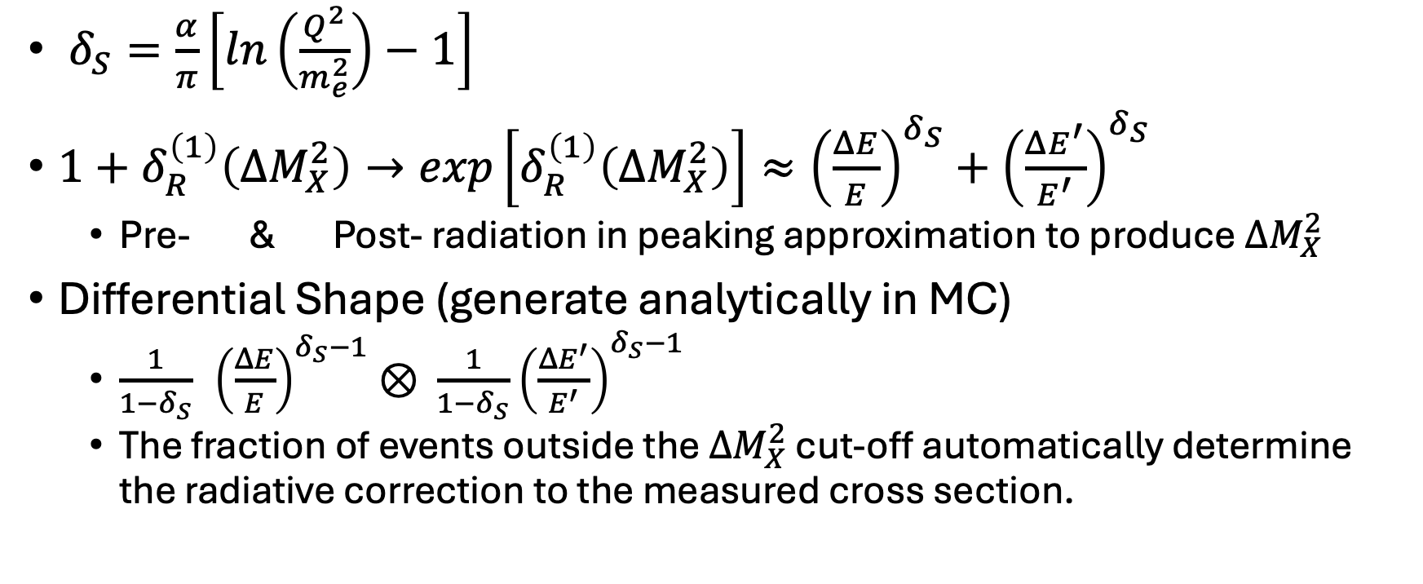
Radiative tail in peaking approximation
$δ_{S}=\frac{α}{π}\left[ln\left(\frac{Q^{2}}{m_{e}^{2}}\right)−1\right]$
$1+δ_{R}^{\left(1\right)}\left(ΔM_{X}^{2}\right)→exp\left[δ_{R}^{\left(1\right)}\left(ΔM_{X}^{2}\right)\right]≈{\left(\frac{ΔE}{E}\right)}^{δ_{S}}+{\left(\frac{ΔE^{′}}{E^{′}}\right)}^{δ_{S}}$
  Pre- & Post- radiation in peaking approximation to produce $ΔM_{X}^{2}$
Differential Shape (generate analytically in MC)
  $\frac{1}{1−δ_{S}} {\left(\frac{ΔE}{E}\right)}^{δ_{S}−1}⊗ \frac{1}{1−δ_{S}}$ ${\left(\frac{ΔE^{′}}{E^{′}}\right)}^{δ_{S}−1}$
  The fraction of events outside the $ΔM_{X}^{2}$ cut-off automatically determine the radiative correction to the measured cross section.

Slide 10

Example of $δ_{R}^{(0)}$
φ_{γγ} dependence of δ_{R}⁽⁰⁾ : (very small)
  Not in MC, put in by hand at end, together with virtual corrections
E00-110 Kin-3:
  Variation < ±0.005

Slide 11
Analytic Approximation to Virtual Radiative Corrections
These formulae do not include self-energy and proton radiation terms included in Vanderhaeghen et al code. 2-4% discrepancy from full calculations. Hall A publications include numerically exact calculation from code.
Correction to VCS is independent of structure of VCS amplitude:
Correction to
BH is different!

Slide 12
Vacuum Polarization in Virtual Radiation
VCS:
BH:

Slide 13
Correction to Cross section does not factorize (P. Guichon version of code)
Each term, VCS, BH, Interference,
  different radiative corrections.

Slide 14
Actual Practice in Hall A DVCS analysis
Use Guichon, Vanderhaeghen code to calculate numerical virtual radiation correction.
  Code uses a highly simplified GPD model e.g. H_{f}(x_{B} ,t) = q(x_{B} /2)F₁(t) to give relative weight to BH and DVCS in calculation.
  Relatively easy to compare pure BH, pure DVCS, and full calculation (not done).
  Hard to change GPD model.
Note that Virtual Radiative corrections lower the predicted cross section, and therefore partially compensate the Real Radiative correction.

Slide 15
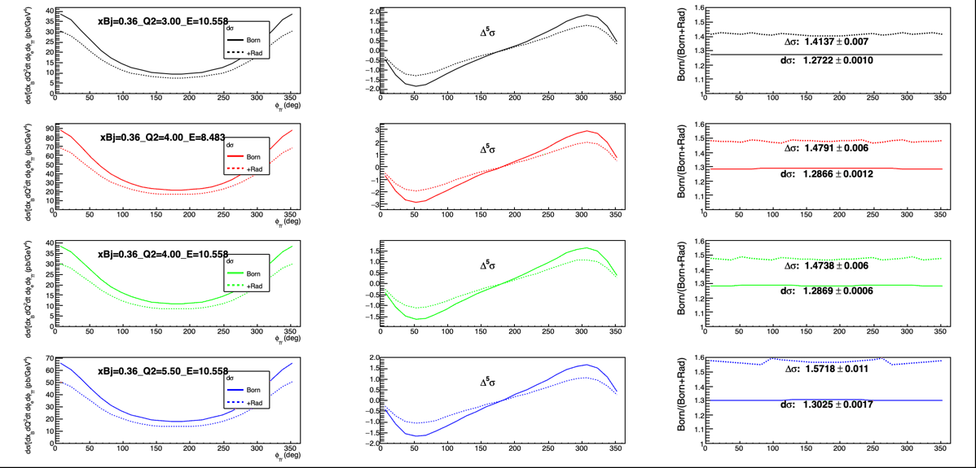
Resurrected code after ~5 years dormancy
Calculations for three NPS x_{B}=0.36 settings
Corrections different for d𝜎 and 𝛥𝜎
Notes:
Correction to helicity-dependent cross section much bigger than unpolarized cross section.

Slide 16
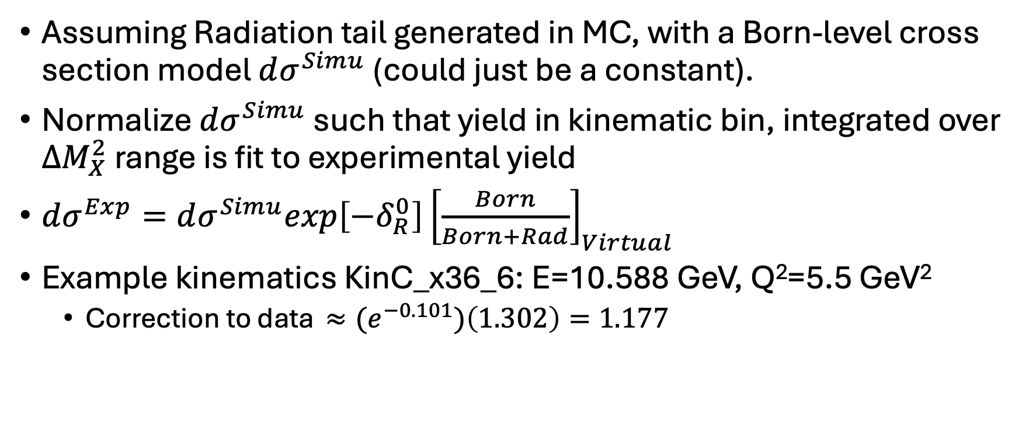
Radiative Correction to Experimental Yields, to obtain “Born” Cross sections
Assuming Radiation tail generated in MC, with a Born-level cross section model $dσ^{Simu}$(could just be a constant).
Normalize $dσ^{Simu}$ such that yield in kinematic bin, integrated over $ΔM_{X}^{2}$range is fit to experimental yield
$dσ^{Exp}=dσ^{Simu}exp\left[−δ_{R}^{0}\right]{\left[\frac{Born}{Born+Rad}\right]}_{Virtual}$
Example kinematics KinC_x36_6: E=10.588 GeV, Q²=5.5 GeV²
  Correction to data ${≈(e}^{−0.101})\left(1.302\right)=1.177$

Slide 17
Table of Correction Factors for all NPS Settings to follow…
Comparisons with other methods would be a good idea.

Slide 18
Appendix
Some exact formulae

Slide 19
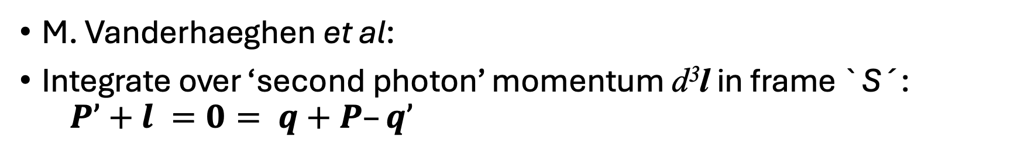
Integral of Soft Bremsstrahlung
M. Vanderhaeghen et al:
Integrate over ‘second photon’ momentum d³l in frame `S´:
$P’+l =0= q+P–q’$

Slide 20
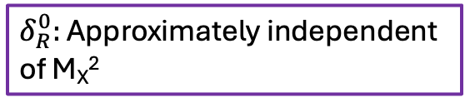
Finite part of Real Radiative Correction
Radiative Tail
$δ_{R}^{0}:$ Approximately independent
of M_{X}²
All variables are external:
At detector, not vertex
Soft approx.:
Q²_{vertex} ≈ Q²_{detected}

