Slide 1


NPS refurbishment and preparation for next run group
NPS Collaboration Meeting
5-6 May 2025
Charles Hyde, ODU
Bogdan Wojtsekhowski, JLab
(David Hamilton, Glasgow)

Slide 2
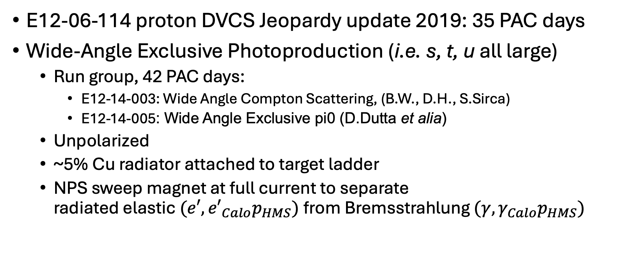
NPS Run Group 2?
E12-06-114 proton DVCS Jeopardy update 2019: 35 PAC days
Wide-Angle Exclusive Photoproduction (i.e. s, t, u all large)
  Run group, 42 PAC days:
    E12-14-003: Wide Angle Compton Scattering, (B.W., D.H., S.Sirca)
    E12-14-005: Wide Angle Exclusive pi0 (D.Dutta et alia)
  Unpolarized
  ~5% Cu radiator attached to target ladder
  NPS sweep magnet at full current to separate
  radiated elastic $(e′, {e′}_{Calo}p_{HMS})$from Bremsstrahlung $(γ, γ_{Calo}p_{HMS})$

Slide 3
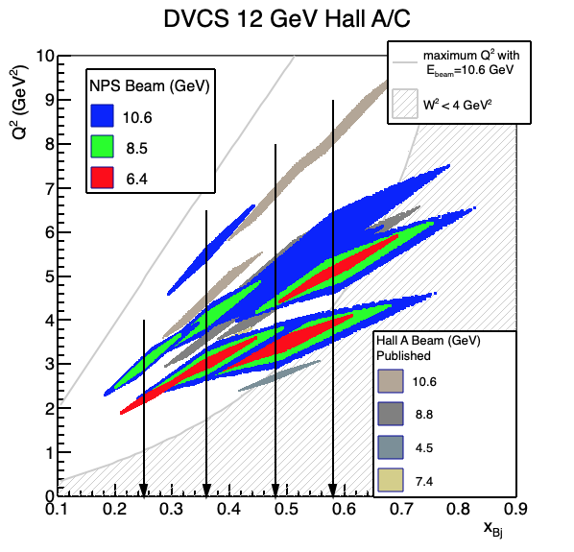
DVCS Jeopardy Proposal (proton only)
“Fill in the gap”,
x_{B} = 0.60: Two beam energies at two high Q² points.

Slide 4
WACS: Two NPS Configurations
Large reach in s and t
NPS Calo & Sweep on beam-side of SHMS carriage
NPS Calo & Sweep on wide-angle side of SHMS carriage
42 days total

Slide 5
NPS Refurbishment
Mandatory (?)
  Where is it all?
  Check all crystals, PMTs, bases
  Upgrade HV isolation on HV/Signal distribution boards
  Redesign temperature sensor interface to avoid radiation damage (longer leads?)
Potential upgrades?
  Upgrade bases to 1 KV (currently 800 V?)
  Reconfigure LEDs
  Cable tray for longitudinal calo motion
  Spare PMTs?
    Test samples for lifetime

Slide 6
Who will do the work?
JLab, ODU, Glasgow??, everyone welcome!!!
Comments from Bogdan W.
  2-May-2025 email:
    “Just tell that Bogdan will do NPS preparation in coordination with ODU.”
  12-April-2025 email:
    Yes, I hope to start work on NPS after completing the current SBS run (high Q2 GEp experiment). So, it will be in September 2025

Slide 7
Slides from 2024 Meeting
No updates

Slide 8
Some issues of concern
PMT lifetime
Temperature sensor interface
HV distribution boards
Mechanical access to Crystal assemblies
Ease of longitudinal motion (on platform cable bundle)

Slide 9
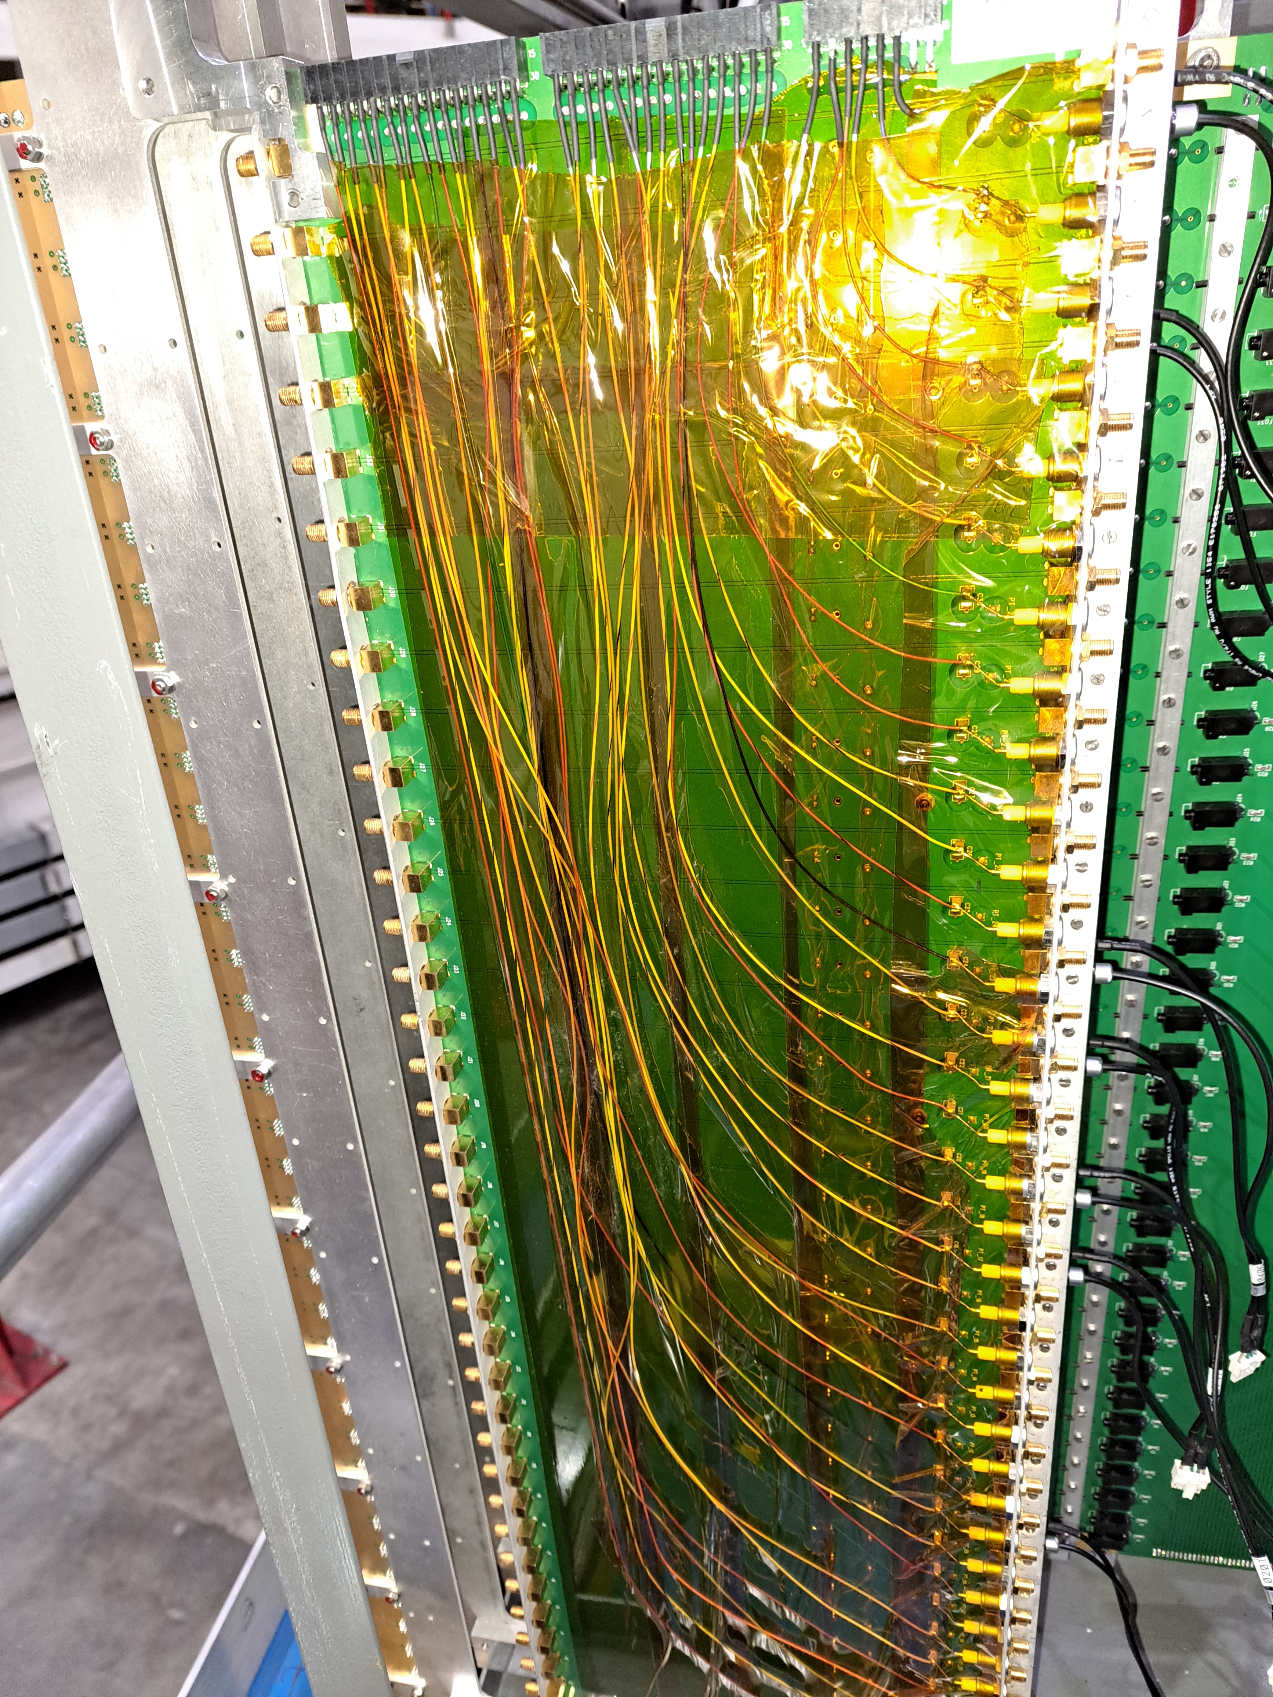
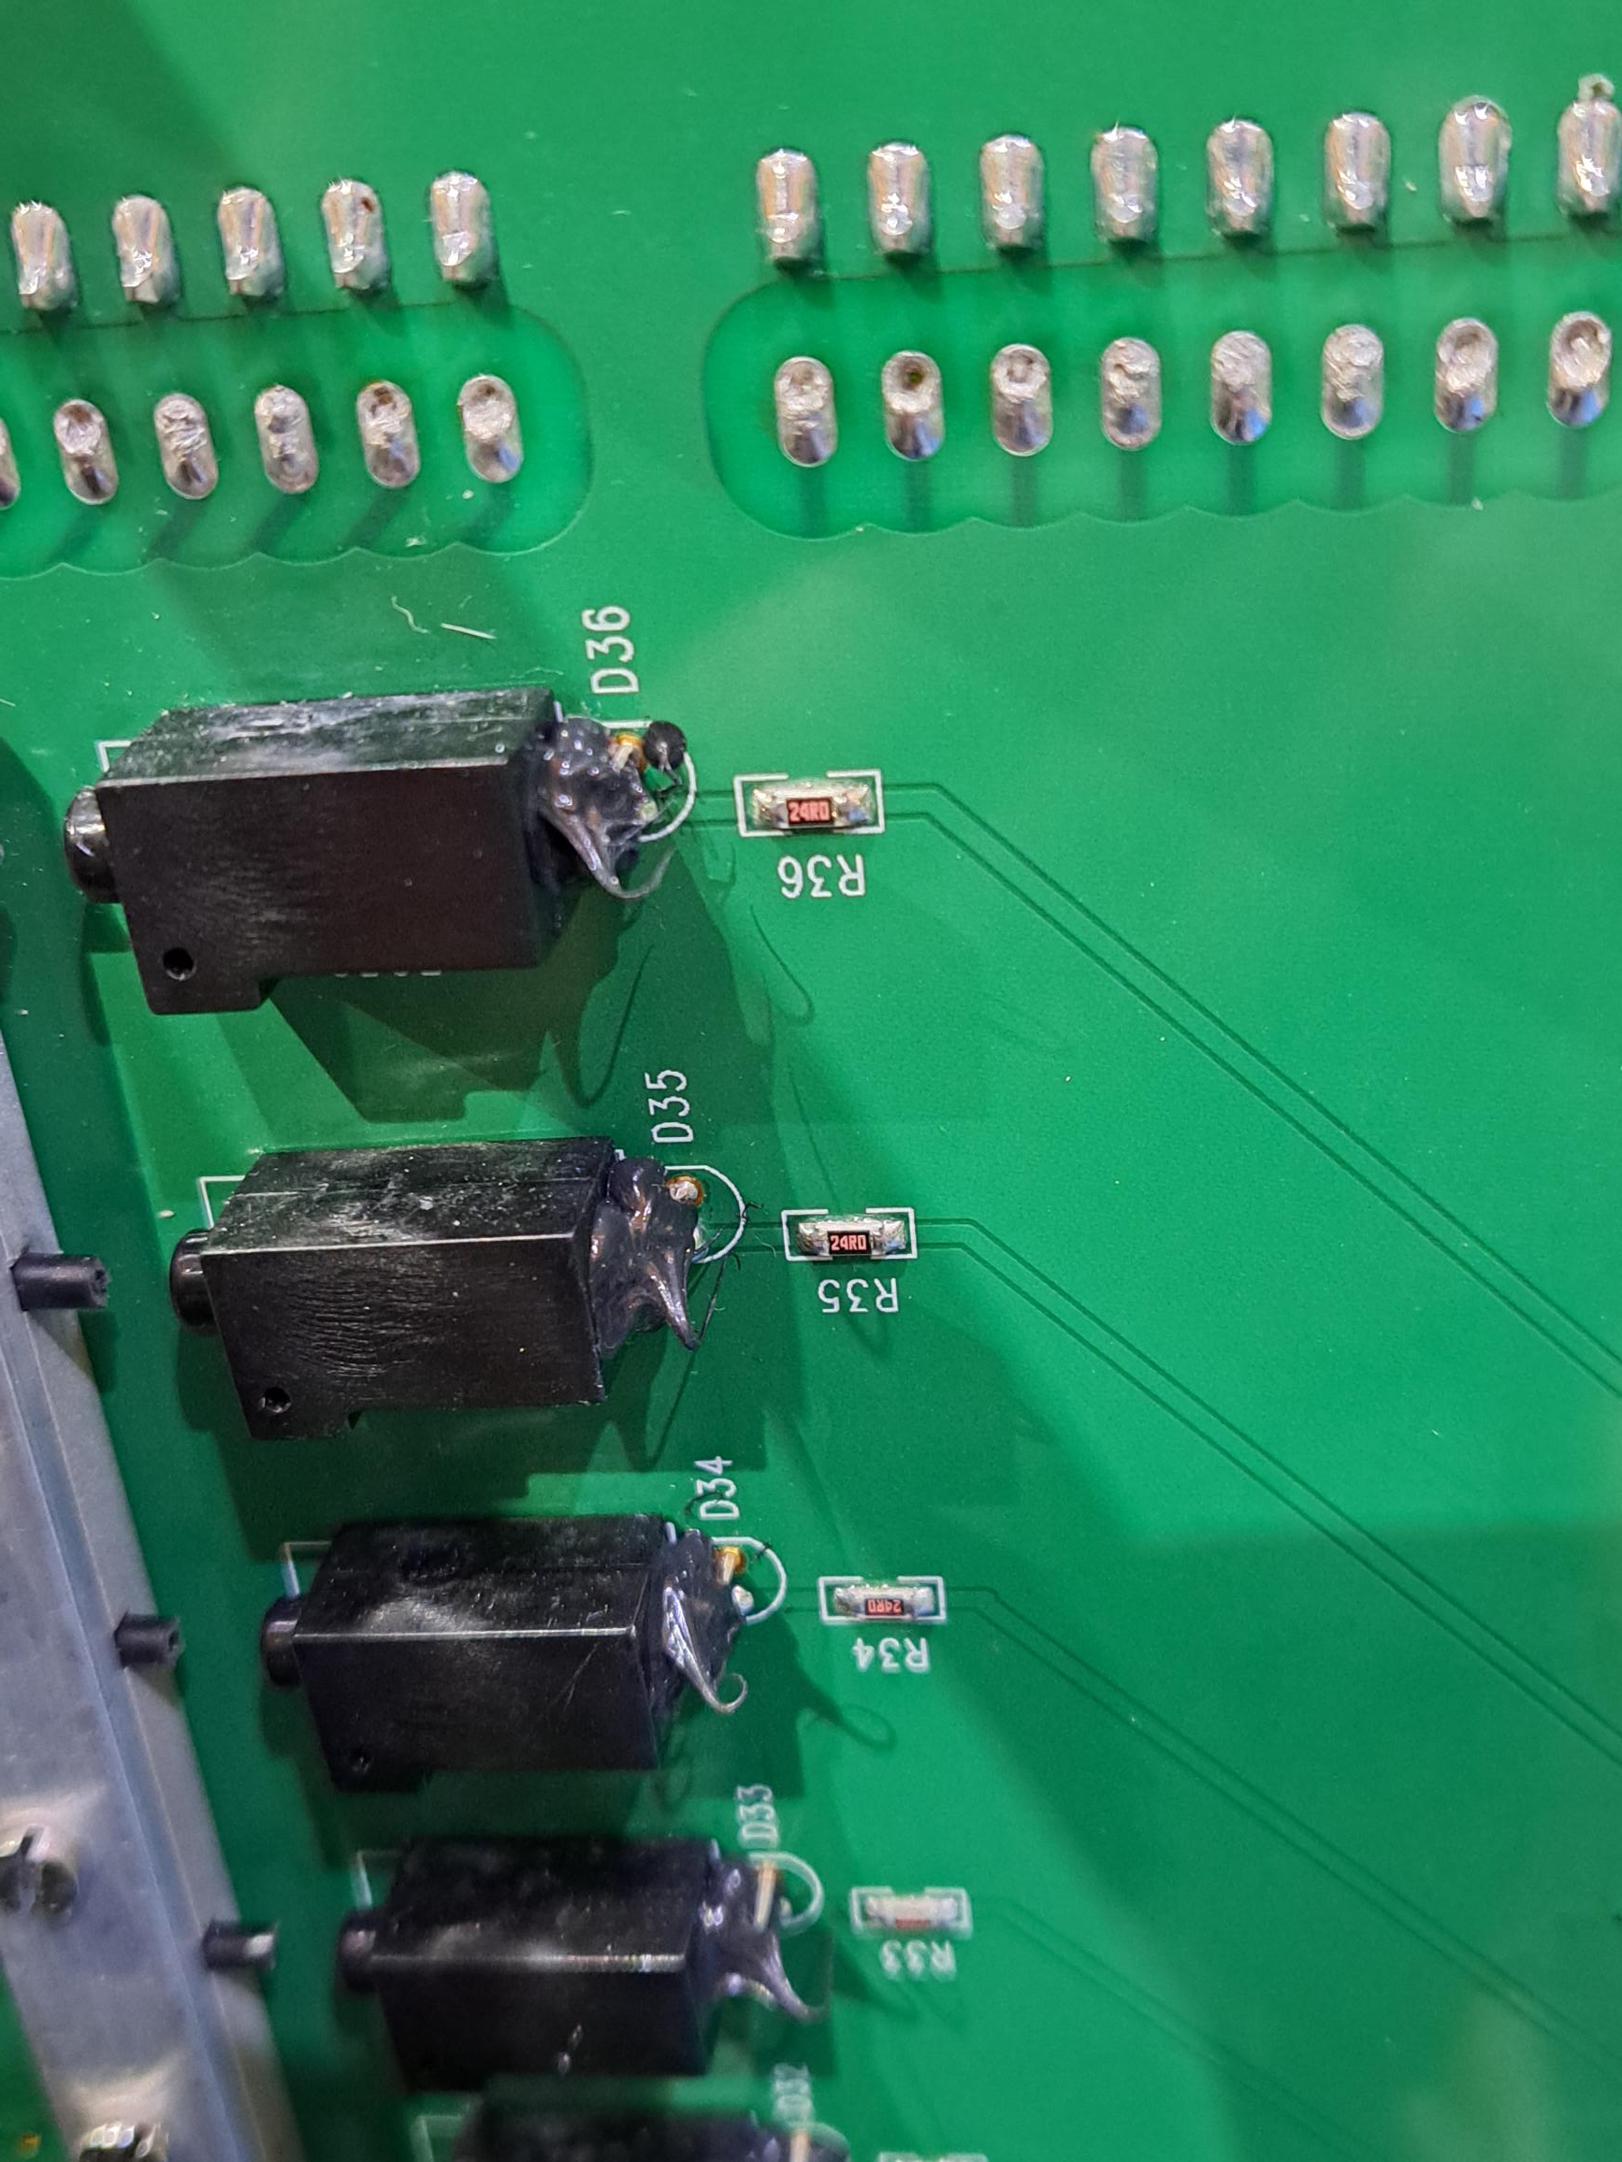
Distribution Boards,
Patch cables to PMTs
HV Issues
  HV connections shorted (Boards too thin…)
  All HV connections bypassed
  Many of isolation capacitors fell off, trapped in cover
Patch cables had many failures (displacement of central pin on SMC connectors).
  All is well after ~first month of operations
LED/Fiber system
  Delicate, (only) 70% of connections operational
Redesign/Rebuilt signal, HV, LV, LED connection and mechanics or leave well-enough alone?
LED

Slide 10
HAMAMATSU R4125
PMT Lifetime
Fermilab study:
  https://lss.fnal.gov/archive/1997/pub/
  Pub-97-092.pdf, or NIM A v406 (1998) 103—116
  12 PMTs tested, illumination level: 100 𝛍A anode current
  Gain stable up to anode charge of 100 Coulomb.
  Gain decrease to 50% after anode charge of 1000 Coulomb.
NPS, Crystals closest to Calorimeter (very rough estimate)
  (8 months) ⊗ (60%) ⊗ (10 𝛍A) ≈ 115 Coul
    Get exact recorded anode charge.
Probably could run another 100 PAC days without catastrophic failure
  Ran 3 generations of DVCS experiments in Hall A and only replaced 16 (out of 200) PMTs

Slide 11
PMT options
Test ~10 NPS PMTs to > 100 Coul
Buy ~100 spare PMTs (3 columns)
Do nothing.
Other PMT issues/options
Rebuild bases with improved low-voltage filtering
  Or just leave alone, everything is fine with LV regulators removed

Slide 12
Temperature Sensors
Crystal temperature stability monitoring
  Gain variation –2% / °C
~most of front face sensors failed
  Sensors are fine, interface-card between sensors and Keysight has active electronics—NOT rad hard. Solutions:
    Long lead wires to move interface to more shielded location:
    Noise? Calibration Drift?
    Find a Rad-Hard interface (CERN?)
    Buy lots of spares

Slide 13
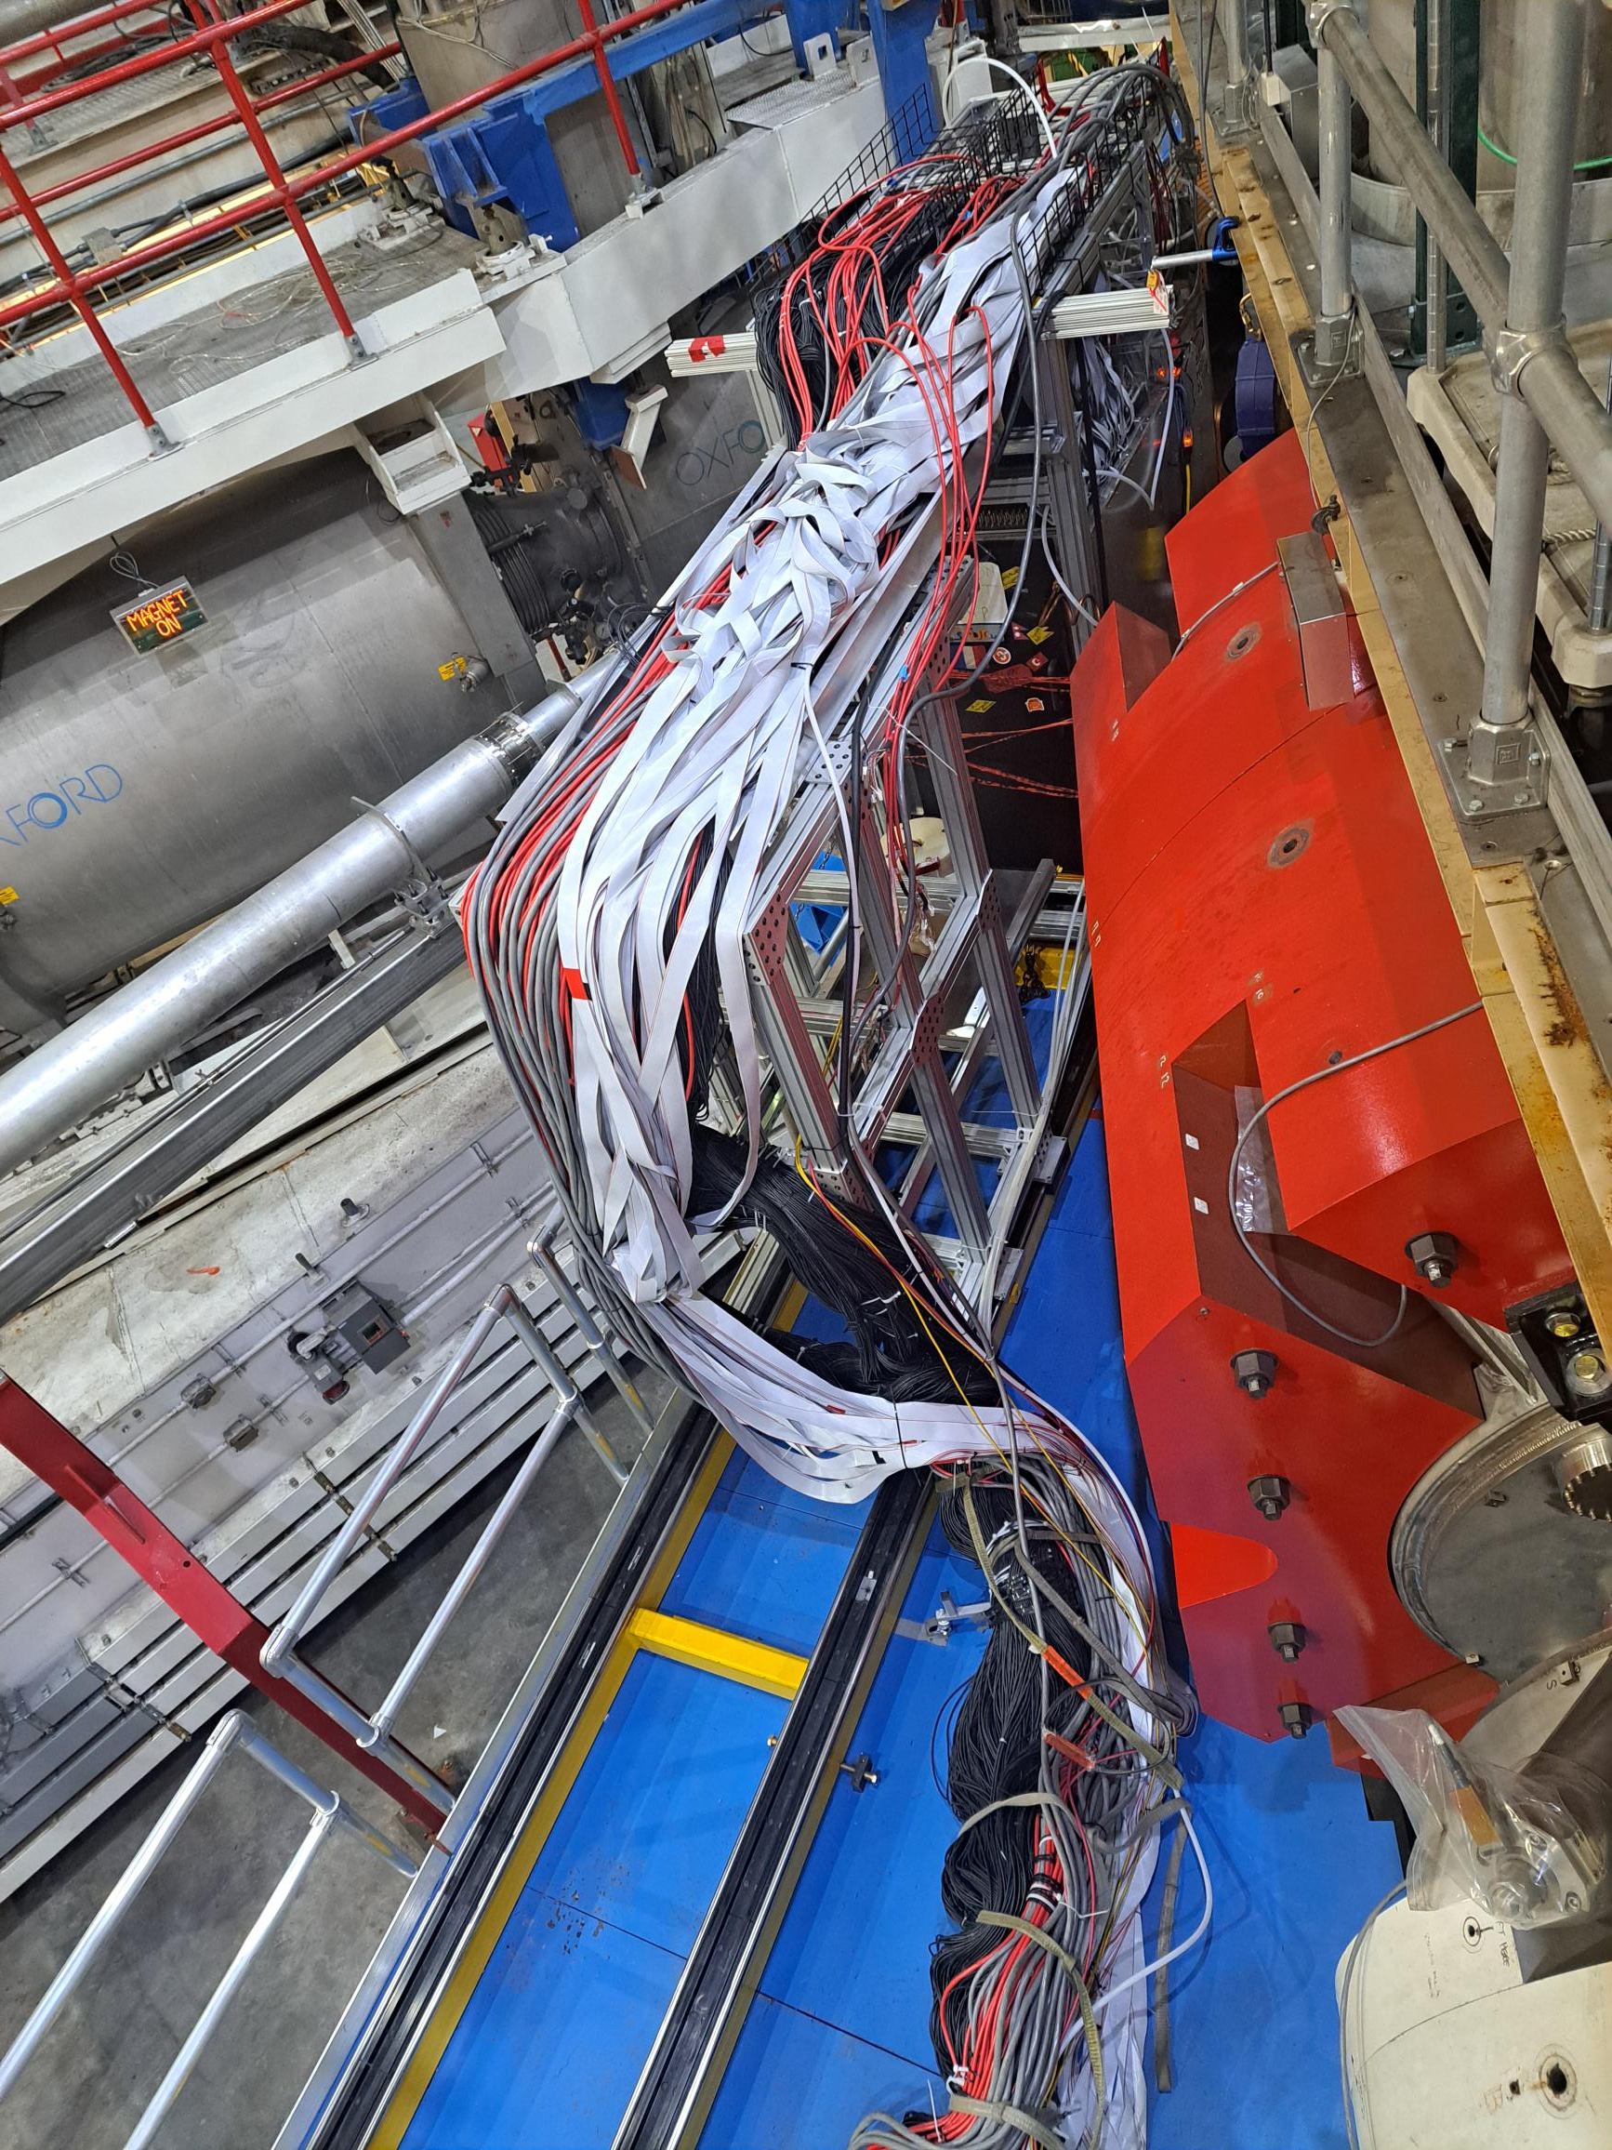
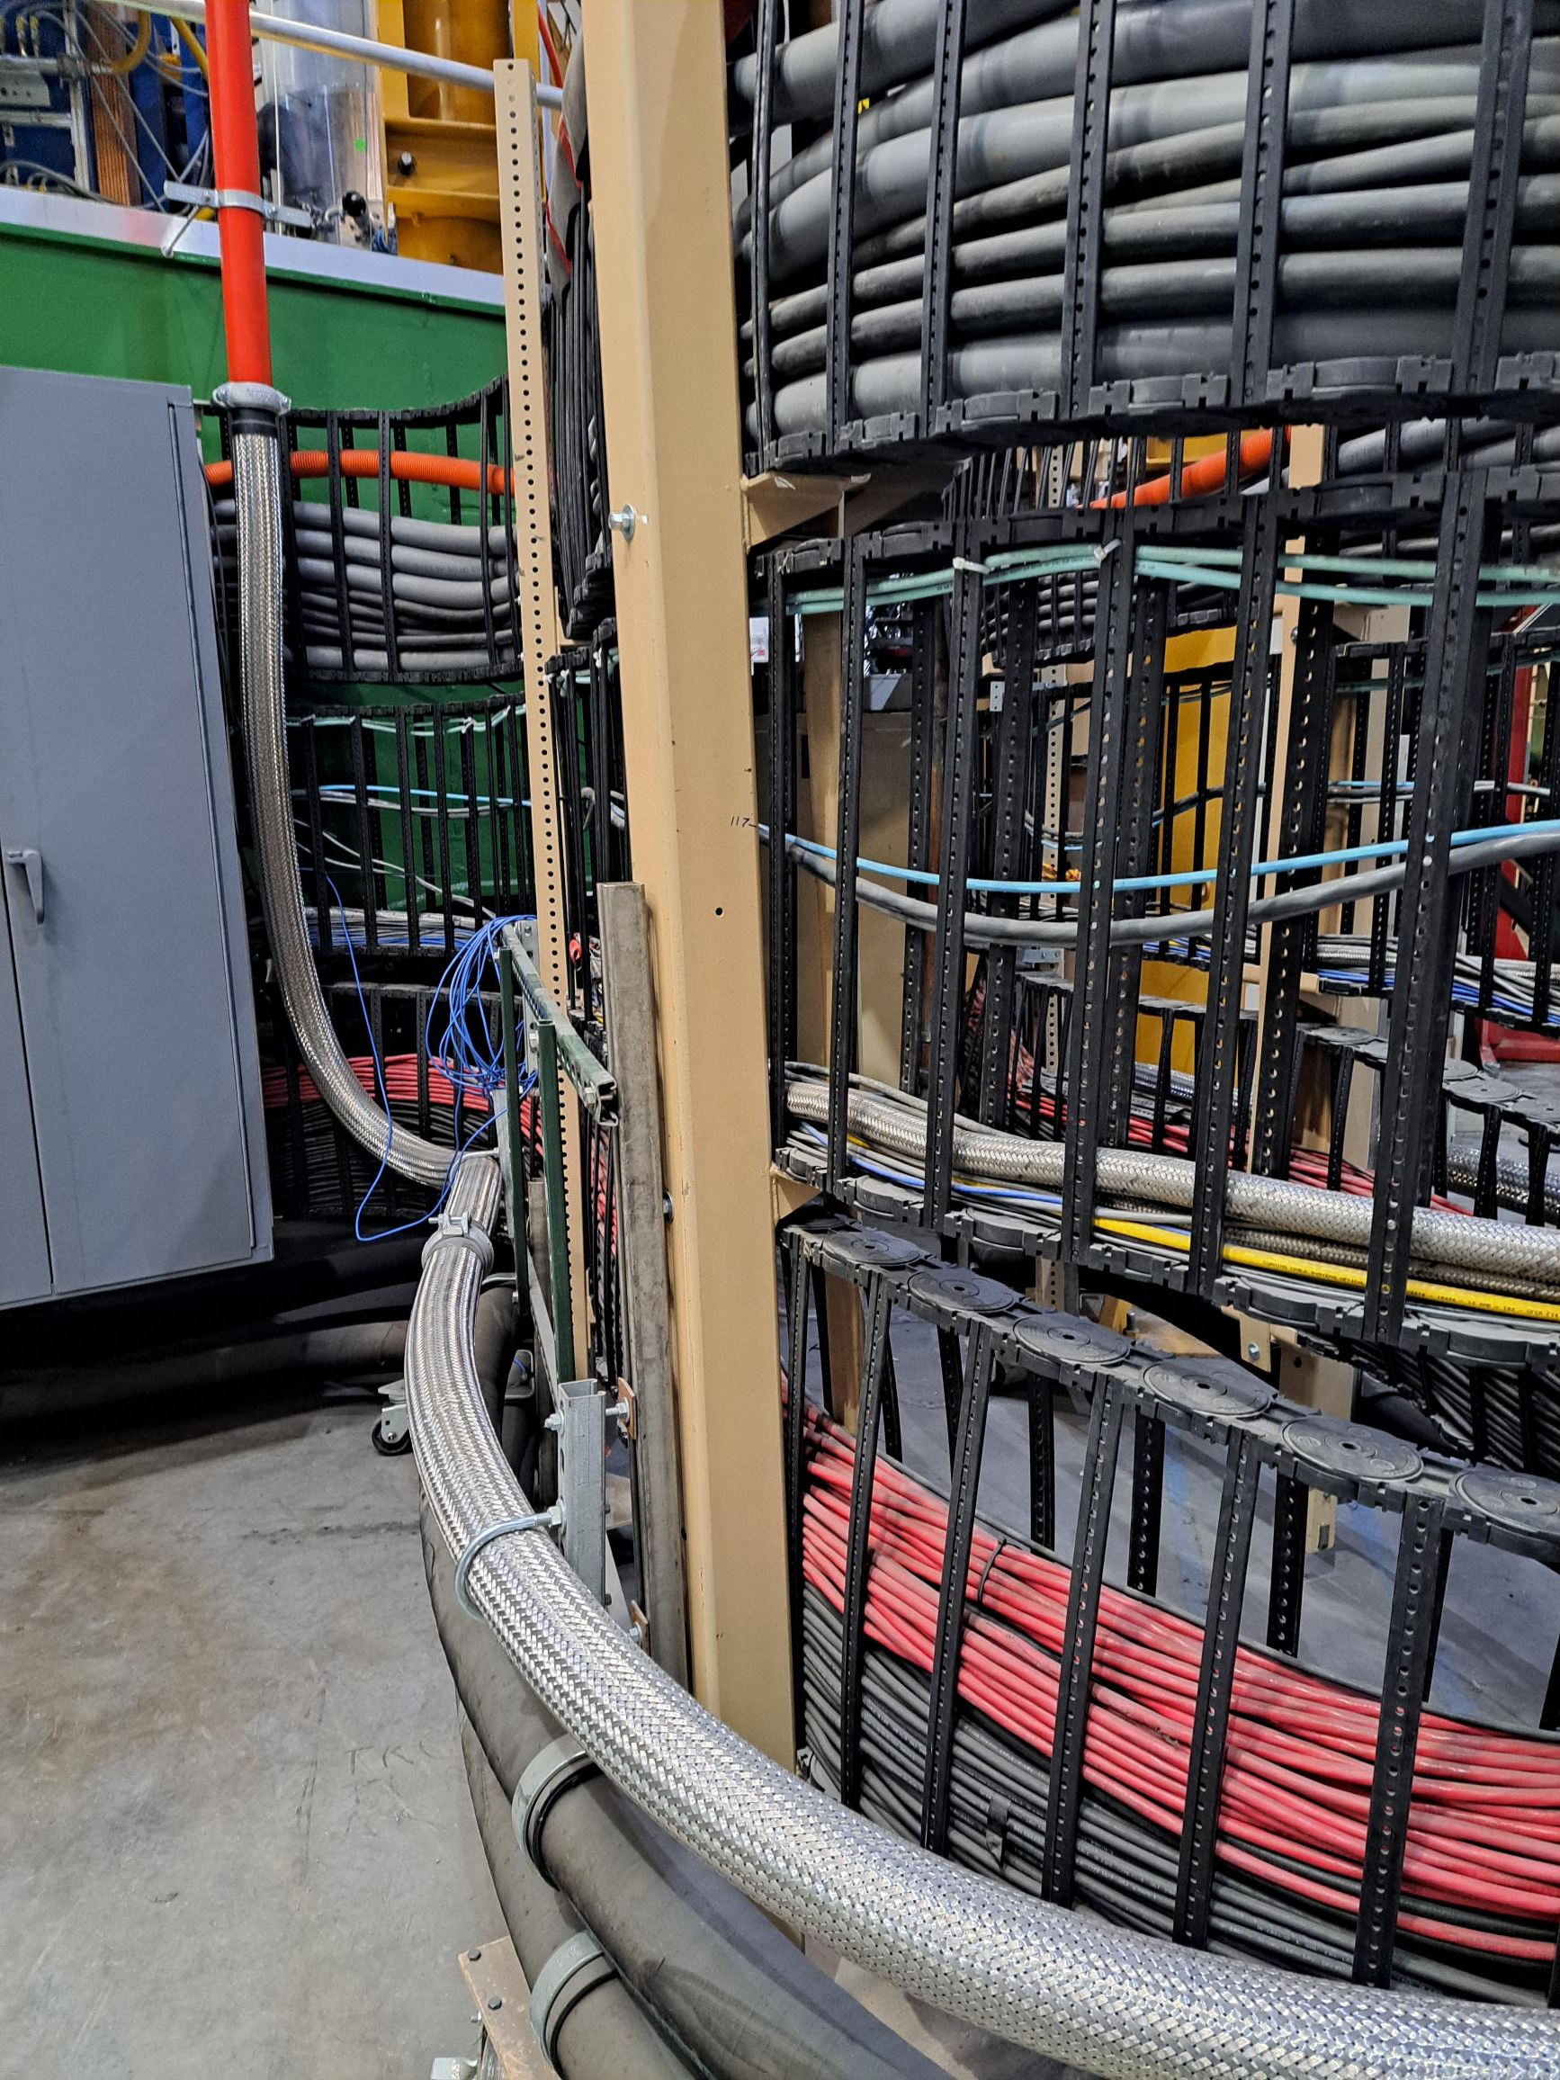
Mechanics
Distribution boards, PMT+Crystal repair/replacement
Cable bundle
  Required crane to move Calo forward/back.
  Scheduling challenges.
Build a vertical axis cable tray?
Hall C Pivot

Slide 14
Other?

