Slide 1
Hall A/C Collaboration Meeting ’25 Status of SoLID and Pre-R&D Activities
June-18-2025
Klaus Dehmelt – TJNAF
On behalf of the SoLID Collaboration

Slide 2
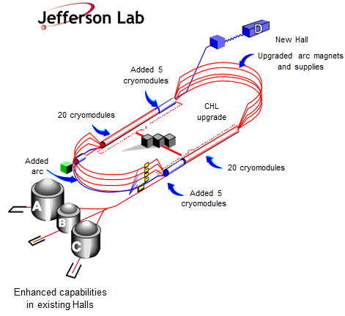
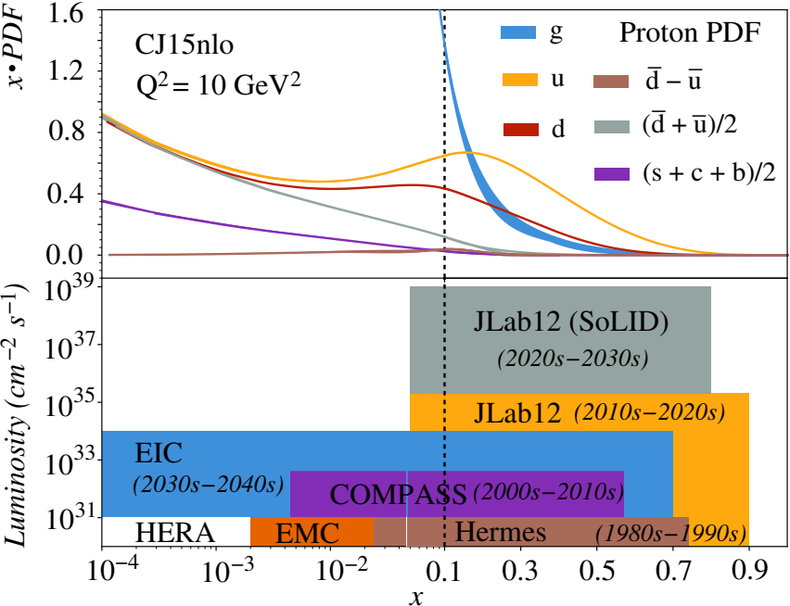
Solenoidal Large Intensity Device – SoLID Hall-A
SoLID will explore QCD landscape ⇨ Complementary to research at other facilities, e.g., EIC
SoLID will maximize the CEBAF-12-GeV science return by combining high L and large acceptance
SoLID ⇨ core part of JLab 12-GeV program (possible future upgrades)

Slide 3
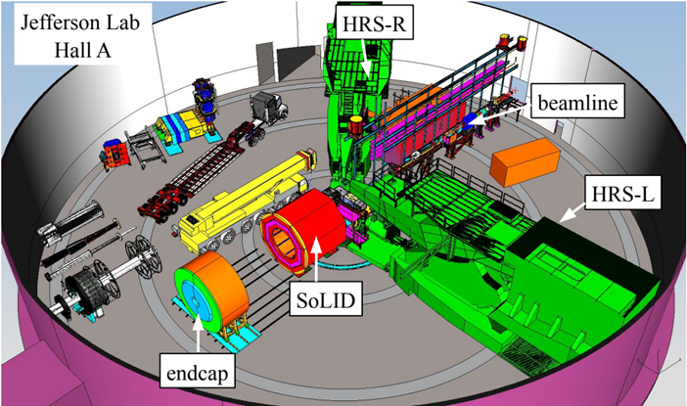
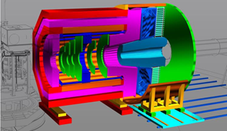
SoLID – The Apparatus
Proposed apparatus in Hall-A

Slide 4
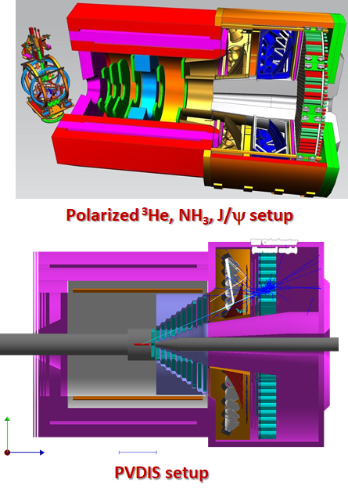
SoLID – The Apparatus
Three Science Pillars with Two configurations
Precision tomography in 3-D momentum space
Proton mass, mass radius, gravitational form factors
Standard model test, BSM, QCD via
parity violating Deep Inelastic Scattering

Slide 5
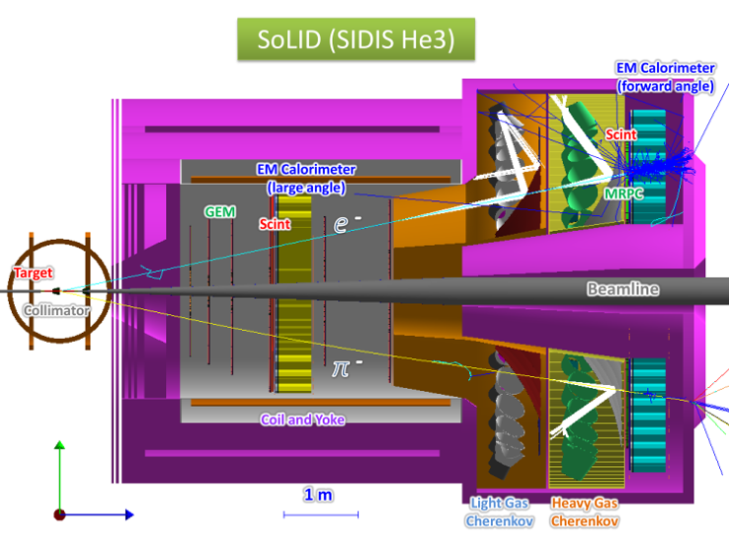
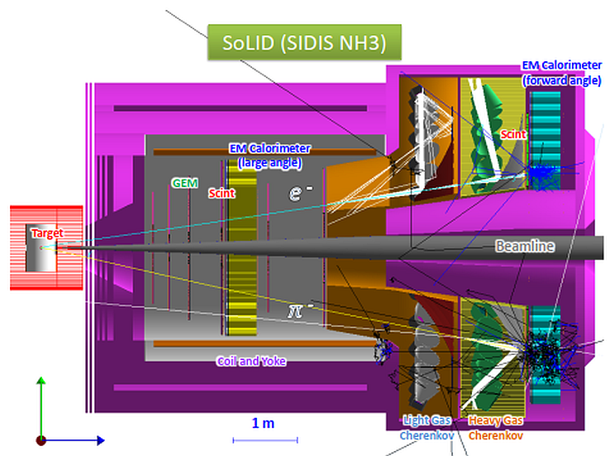
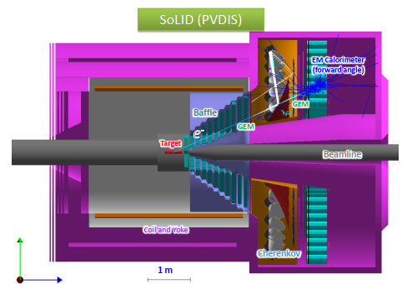
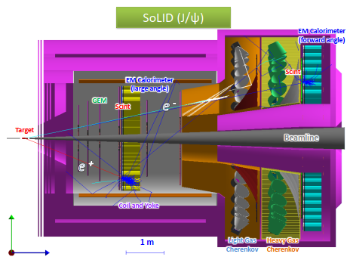
SoLID – The Apparatus
State of the Art Detectors
MPGD – GEM, optionally tracker based on
μRWell/μRGroove
Shashlik EMCal
High-Performance Cherenkov detectors
Pipelined DAQ, streaming readout
Rapidly advancing computational
facilities
First implementation of self-driving detector
Design considers large scale deployment of
ML/AI
Solenoid (CLEO-II magnet)

Slide 6
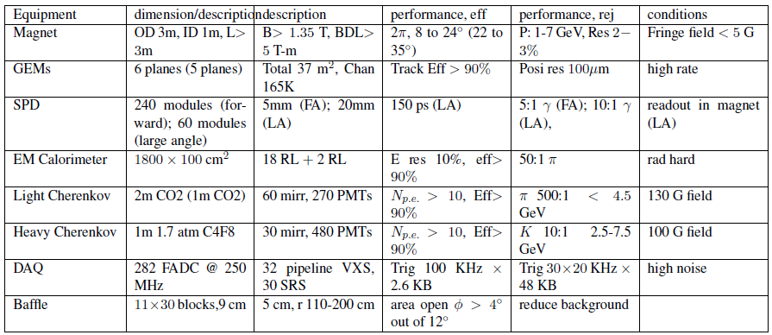
SoLID – The Apparatus

Slide 7
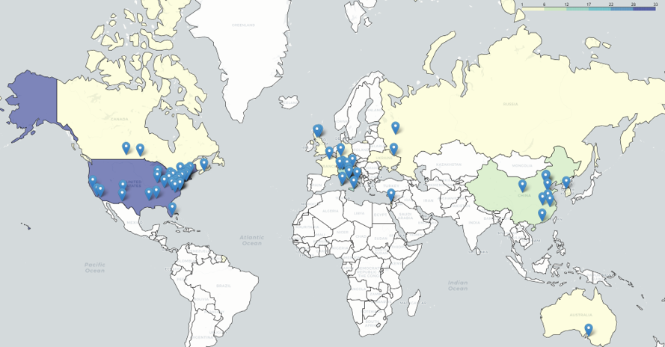
SoLID – The Collaboration
270+ collaborators
70+ institutions
13 countries
4 continents
Website
https://solid.jlab.org/

Slide 8
SoLID – The Development
Rich and diverse physics program ⇨ started in 2010
Total of 6 PAC approved SoLID experiments
High Rating
5 A
1 A⁻
3 SIDIS (3-D structure)
1 PVDIS (BSM)
1 Threshold J/ψ (gluon force)
1 Beam-Normal asymmetry A_{n} (test beyond parton model)
Plus 1 conditional approval Plus 6 run-group experiments (3-D and spin structure)
See Ye Tian’s presentation later today
See Michael Nycz’s presentation later today

Slide 9
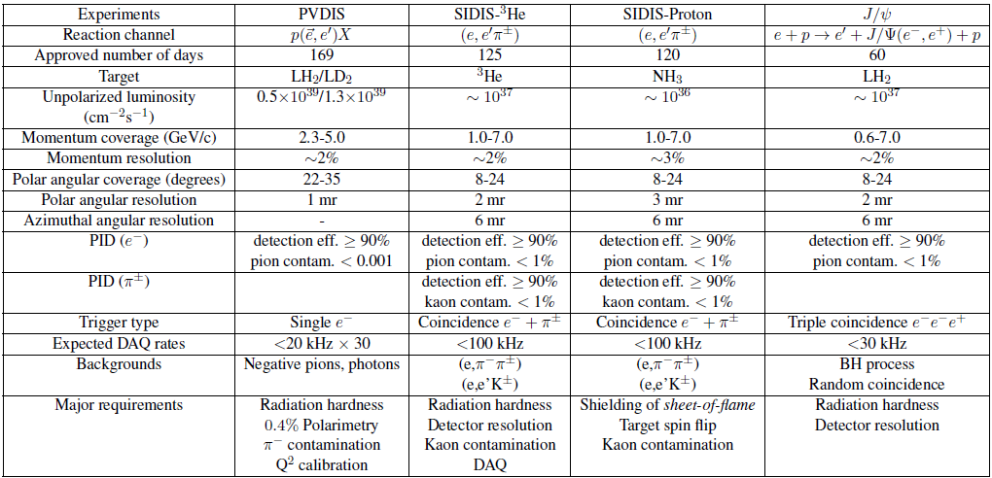
SoLID – The Development

Slide 10
SoLID – The Development
Pre-conceptual design, Pre-R&D, reviews, and current status
2014: pCDR submitted to JLab with cost estimation, updated in 2017, 2019
Director’s Reviews in 2015, 2019 and 2021
2020: SoLID MIE (with updated pCDR/estimated cost) submitted to DOE 2020-now: DOE funded pre-R&D activities
2021: DOE Science Review for SoLID, positive feedback
2023: Long Range Plan, SoLID highlighted, one of the recommendations
2024: Facility Review: Ready to Launch
2025: pre-R&D proposal submitted to DOE
White Paper for MPGD – ASIC development submitted to DOE

Slide 11
Long Range Plan 2023

Slide 12
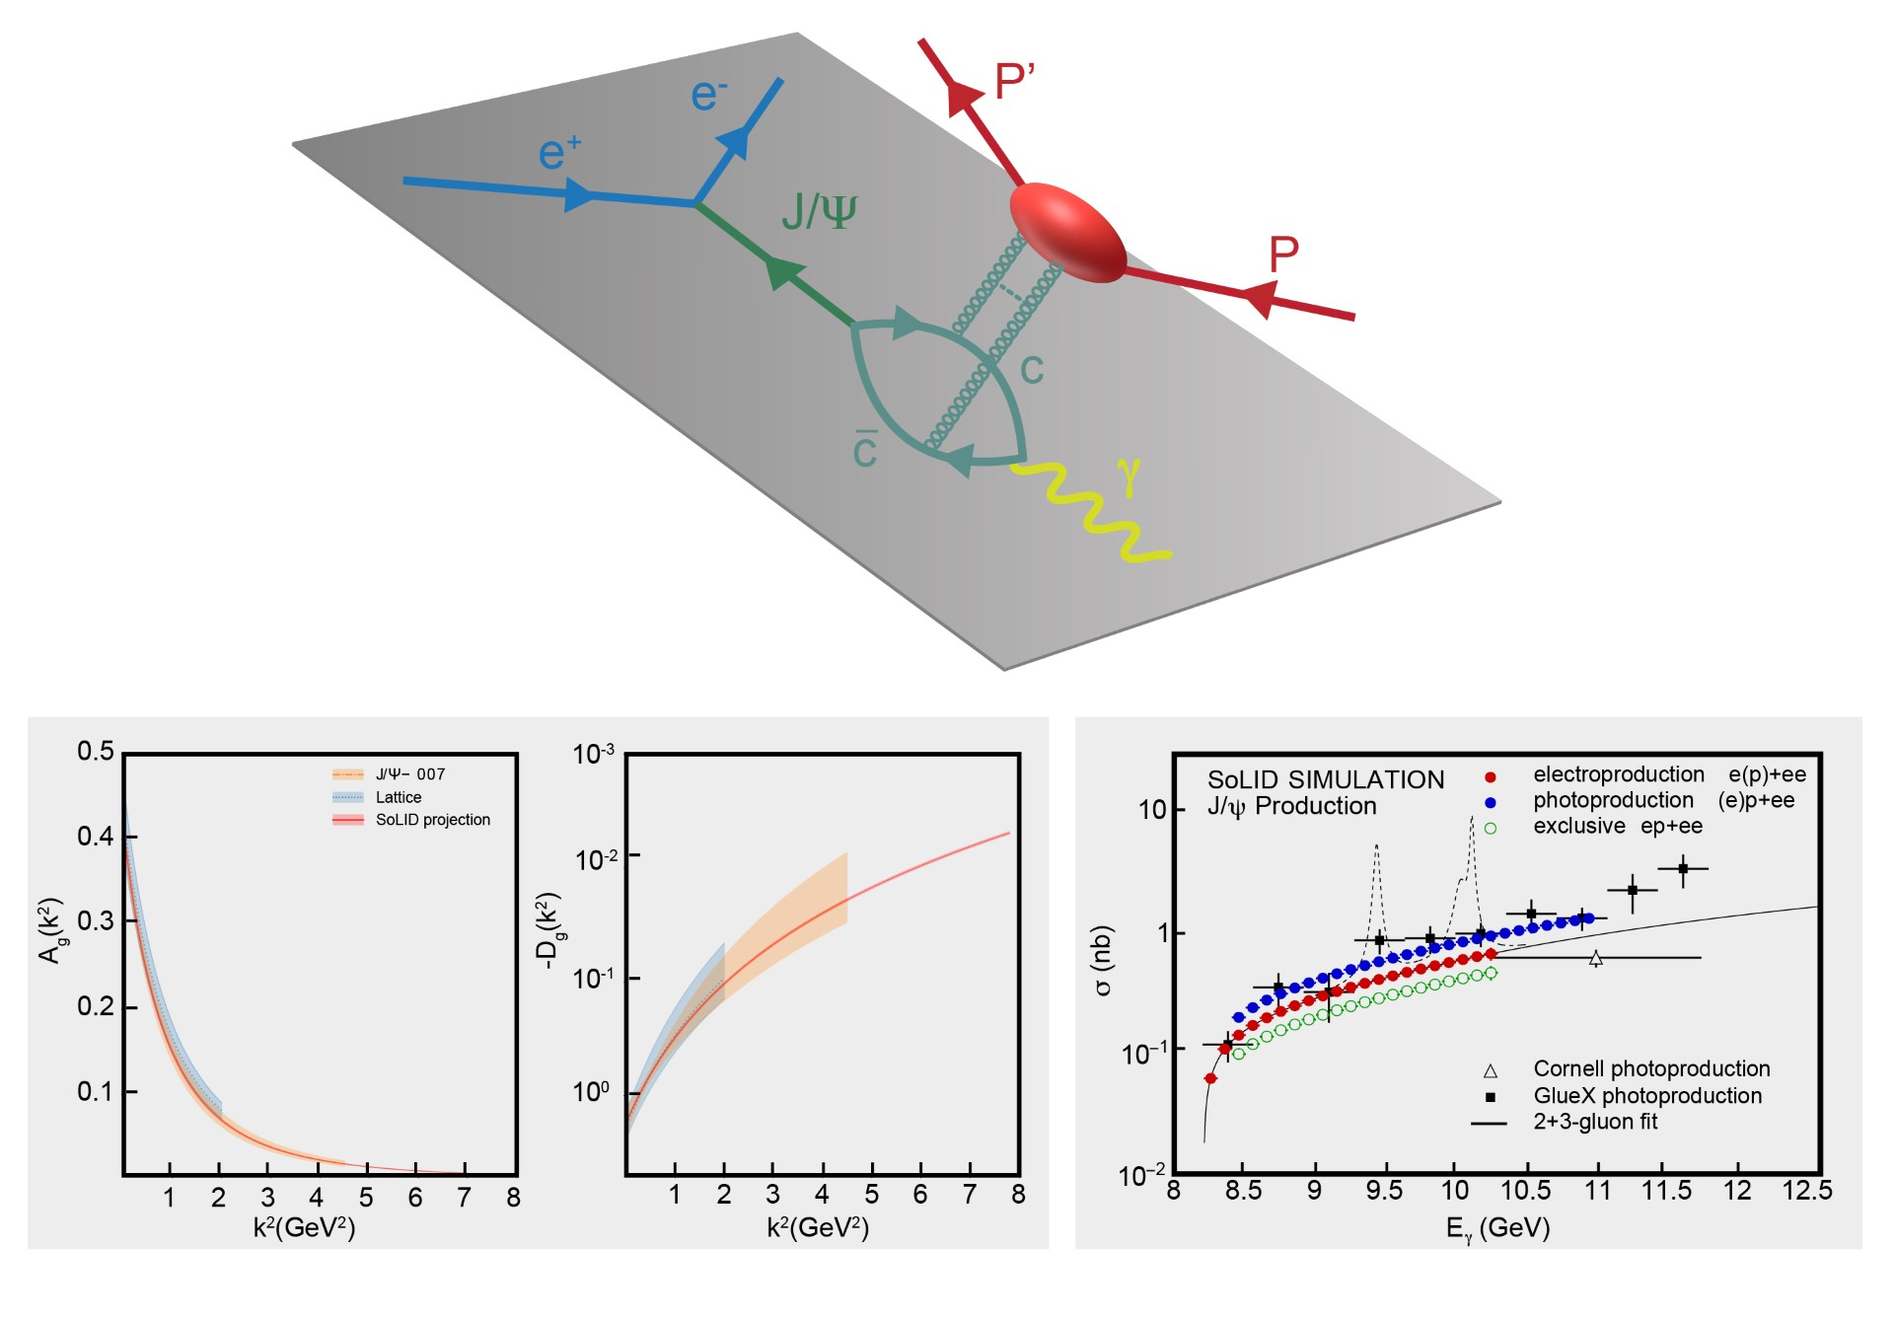
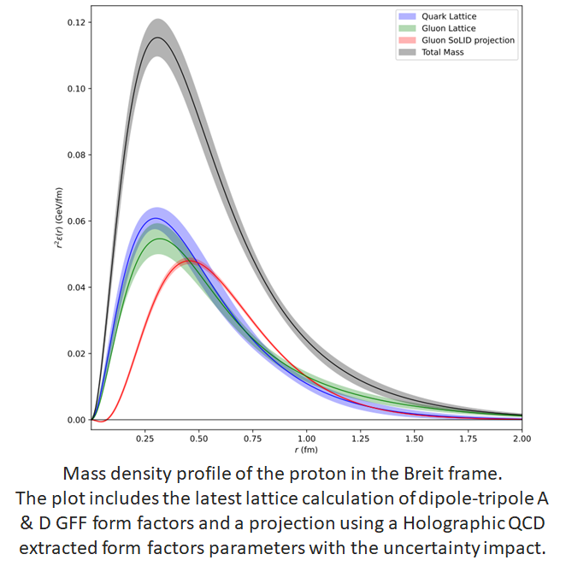
Proton Mass, Gravitational Form Factors, and Mass and Scalar Radii
The simulated total electro- (red) and photo- (blue) production of J/ψ on a proton (far right panel).
Each data point represents the integral of the measured differential cross section as a function of the Mandelstam variable ‘t’,
from which the A and D gluonic gravitational form factors would be extracted with the precision shown by the red band.
Also plotted is our present knowledge of these form factors from experiment J/ψ-007 (orange), together with the lattice QCD calculations (blue).

Slide 13
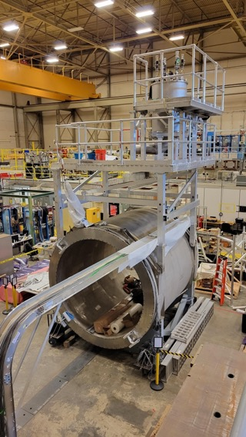
Realization of SoLID – Ongoing Activities at JLab Now
Proposed ~$30M “redirect” to support SoLID project (JLab Operations to take on more dependencies – magnet, some infrastructure,…)
Two Capital Equipment projects already in place
Magnet refurbishment and testing
Data acquisition
Working with DOE research to identify pre-R&D opportunities
Supporting electronics testing and trigger development
Supporting optional tracker technology
Physics AD meets with DOE research (Gulshan Rai) monthly
Pre-R&D plan white paper submitted early March ’25
Submitted white paper for MPGD ASIC development
Staff continuing to assist in development
SoLID has gone through its Science Review but did not yet
obtain CD-0

Slide 14
Pre-R&D Activities – MPGD Readout
MPGD readout
VMM tests
Two test boards ordered
Six SoLID prototype boards constructed
Evaluation board developed → spy on data with small subset of detector data
Issue with external trigger, waiting for new firmware
Can check pedestal width
S/N of detector with source or cosmics
Monitor direct readout signals for 12 channels
Prototype development for data performance; testing of direct output with detector and X-ray source
Investigating the production of modified VMM
Drop the low gain
Add high gain setting
Inquiring design time + production costs

Slide 15
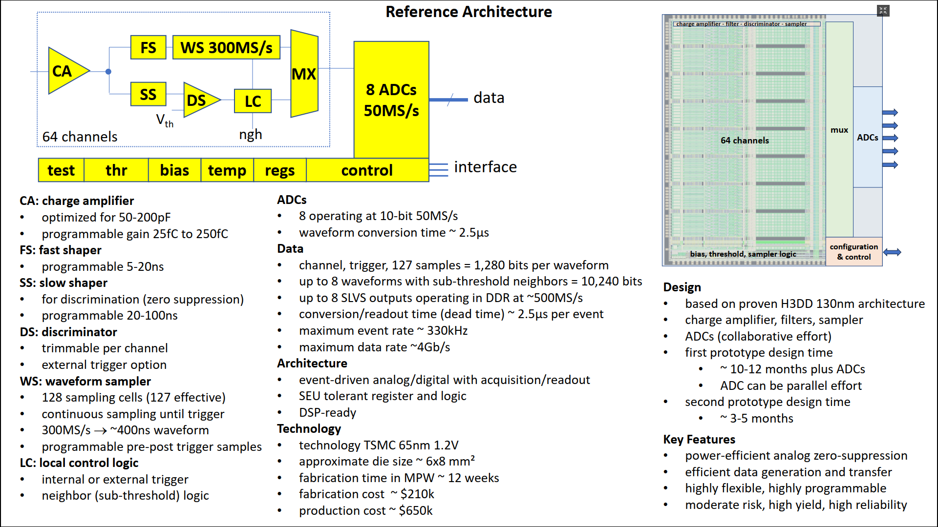
Pre-R&D Activities – MPGD Readout

Slide 16
Pre-R&D Activities – Tracking Options
Default configuration: Triple – GEM à la MOLLER
Alternative configuration: μRWell and derivatives

Slide 17
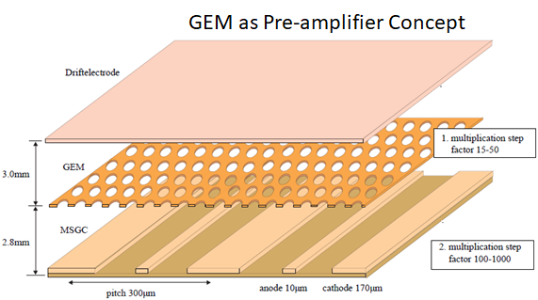
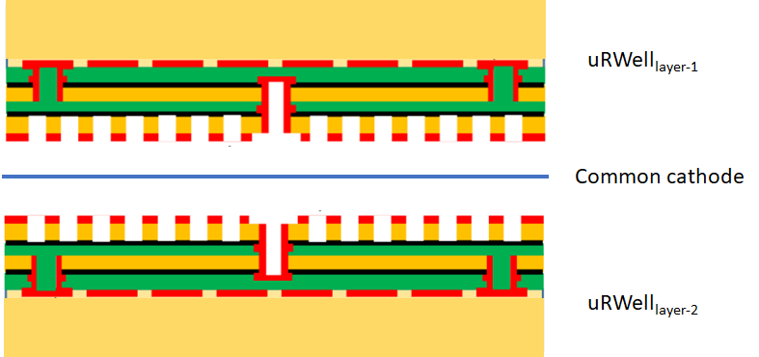
Pre-R&D Activities – Tracking Options
Alternative configuration: μRWell and derivatives

Slide 18
Pre-R&D Activities
MPGD readout
Tracking options
SoLID_preRD_Fall2024 → Proposed Milestones and Budget
Budget uncertainties postponed this endeavor

Slide 19
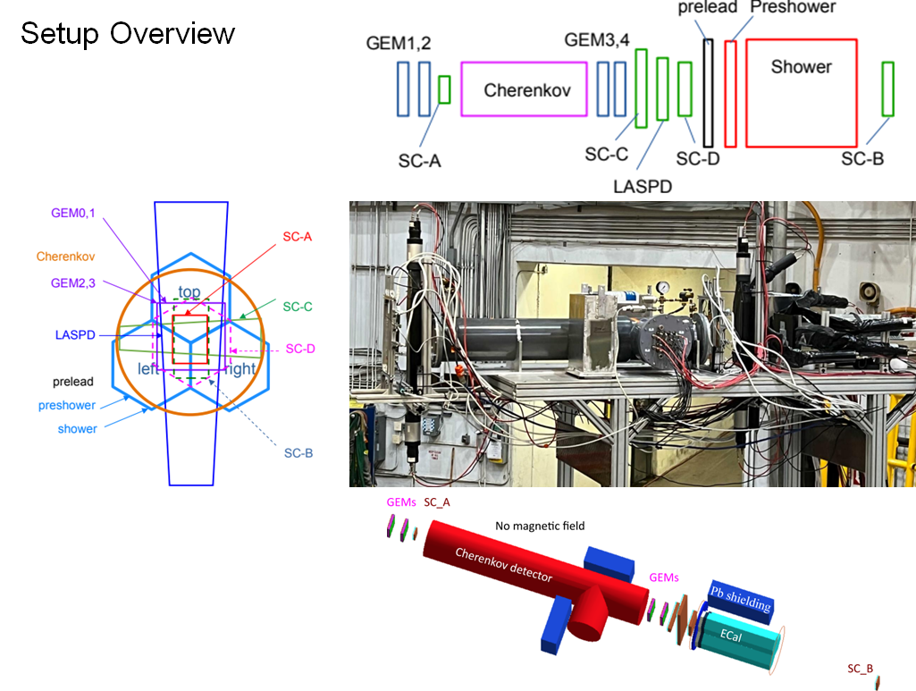
Pre-R&D Activities – Past Activities

Slide 20
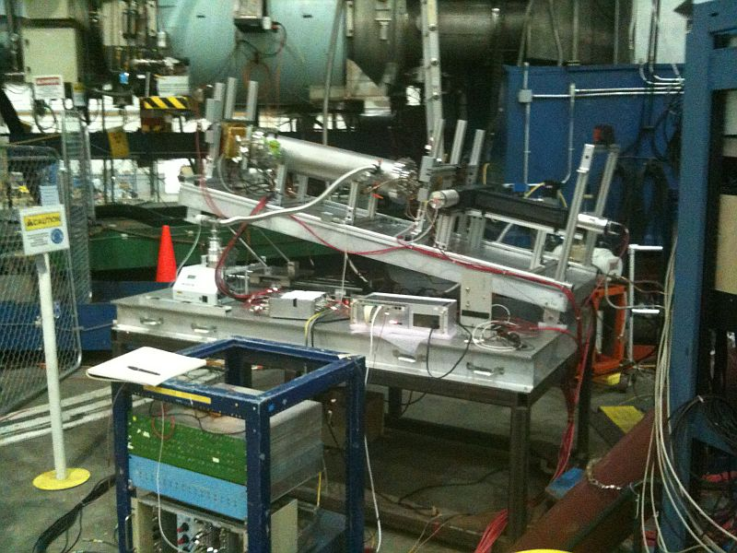
Pre-R&D Activities And Test Beam Plans – Hall C
Perform a sector test with SoLID
sub-detectors
Focus on new MPGD
technologies

Slide 21
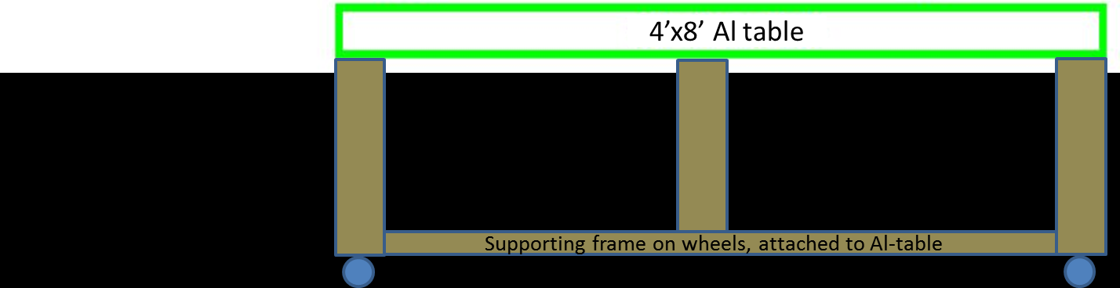
Pre-R&D Activities And Test Beam Plans – Hall C

Slide 22
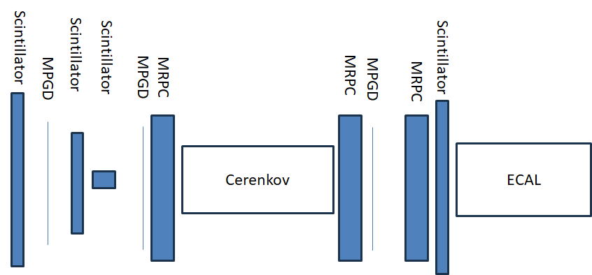
Pre-R&D Activities And Test Beam Plans – Hall C

Slide 23
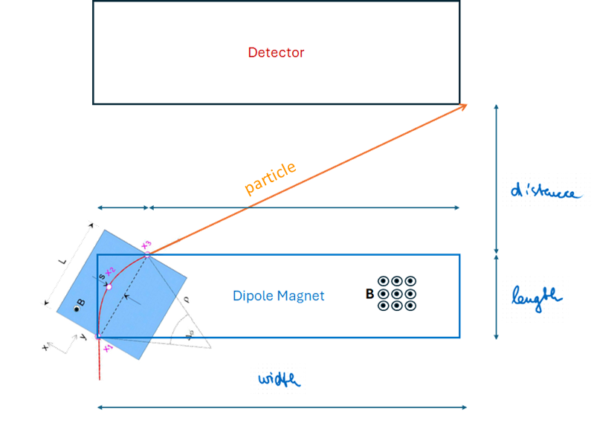
Pre-R&D Activities And Test Beam Plans – Hall C
Background reduction
Remove Møller electrons → sweeping magnet
Dipole magnet
Aperture, gap, field strength
Accommodated around detector setup

Slide 24
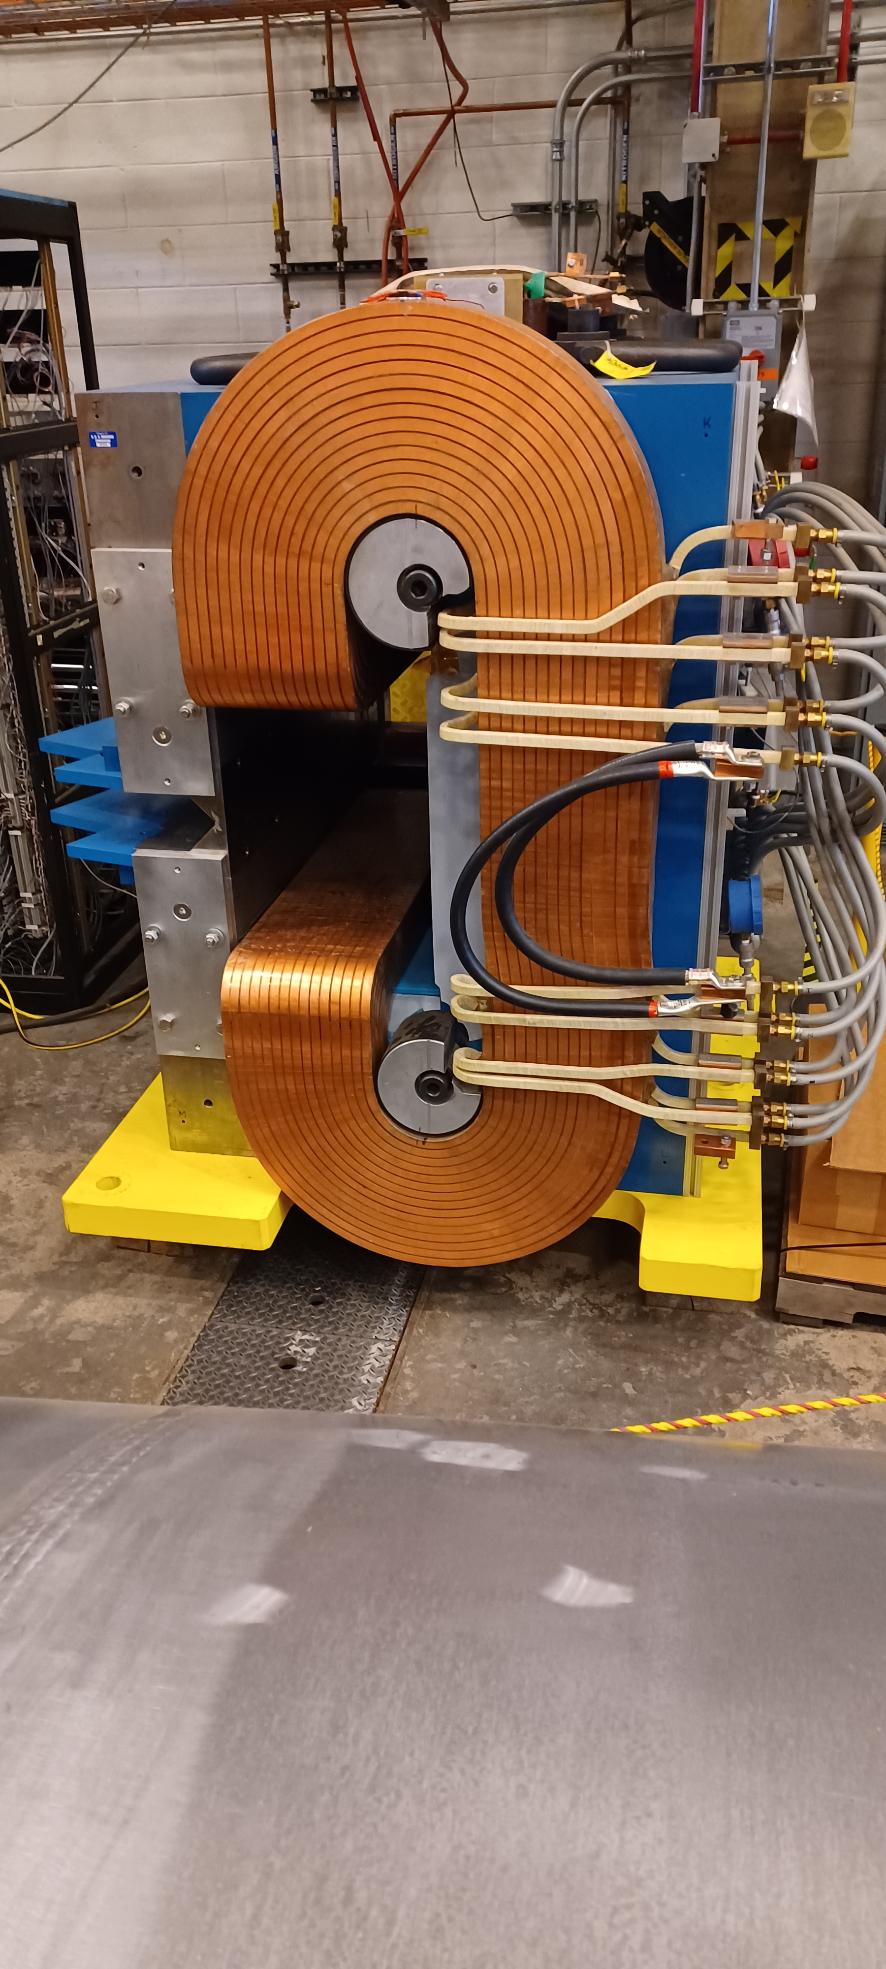
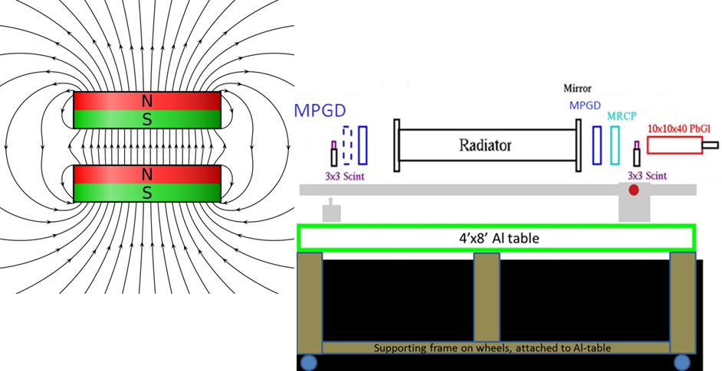
Pre-R&D Activities And Test Beam Plans – Hall C
NPS magnet
Detailed information available
Need to investigate configuration

Slide 25
Pre-R&D Activities And Test Beam Plans – Hall C
# | Experiment | Topic | Start | End | Pass Change/Rescaling | Run Time/Days
1. | E12-22-001 | Transverse structure of the hadrons (N to Delta) | 1/28/2026 | 2/20/2026 |  | 24
2. | PR12-23-001 | Transverse structure of the hadrons (Polarizability) | 2/21/2026 | 3/22/2026 | 03/05 PC | 28
3. | E12-06-107 | Color Transparency | 3/28/2026 | 5/03/2026 | 03/23 – 03/27 (5 days) | 37
4. | E12-24-001 E12-06-104 | Nuclear Dependence σ_{L}/σ_{T} in SIDIS | 5/4/2026 | 6/21/2026 | 5/20 PC; 6/04 PC | 45

Slide 26
Summary and Conclusion
SoLID collaboration looks back a decade of hard planning and executing activities
SoLID collaboration developed a mature pre-conceptual design
SoLID is a core part of JLab’s 12-GeV program and beyond
SoLID is prominently highlighted in the 2023 NSAC LRP
SoLID has strong support from Jefferson Lab
Pre-R&D topics
MPGD readout
Tracking options
MCP-PMT
Submitted to G. Rai ⇨ budget constraints postpone the pre-R&D projects
Test beam plan
Concept available – basic set of detectors available – run schedule FY26 available (subject to change)
Detailed requirements and requests to be worked out
Resources to be identified and finalized

Slide 28
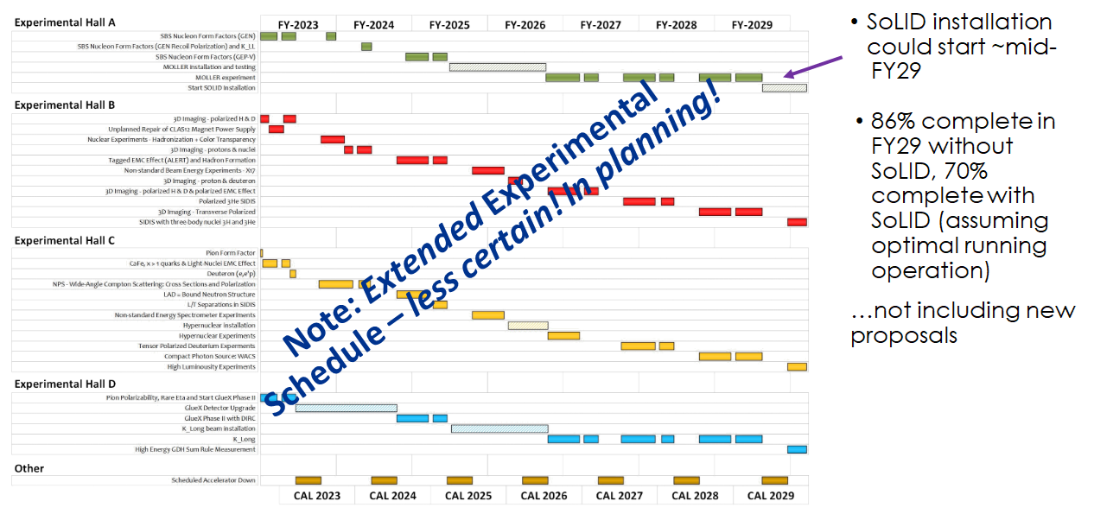
SoLID – The Development

Slide 29
Pre-R&D Activities And Test Beam Plans – Hall C

Slide 30
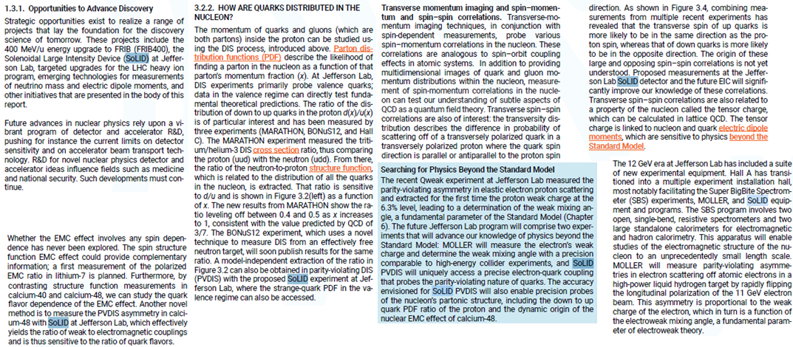
Long Range Plan 2023
SoLID mentioned 24 time in the LRP 2023

Slide 31
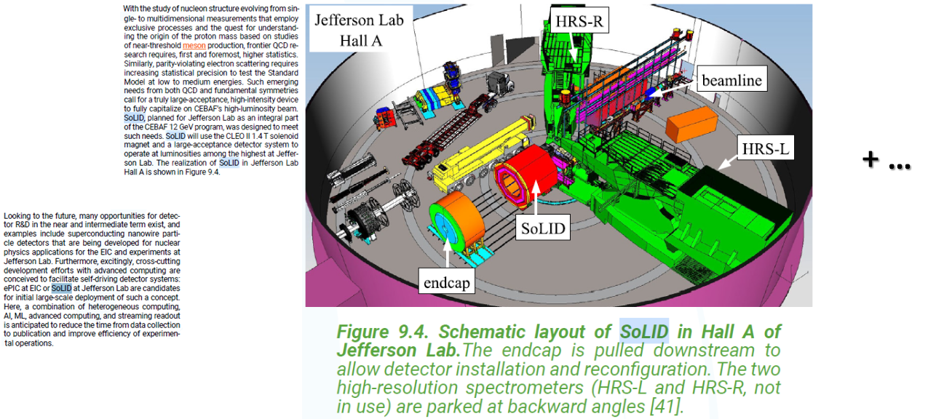
Long Range Plan 2023
SoLID mentioned 24 time in the LRP 2023

