Slide 1

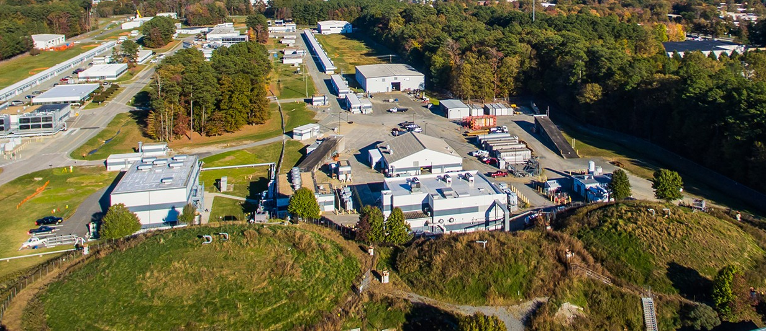
The GEp-5 Experiment
Measuring the Proton Electric Form Factor in Hall A at
Don Jones
for the GEp collaboration
Hall A Summer Collaboration Meeting
June 2025

Slide 2
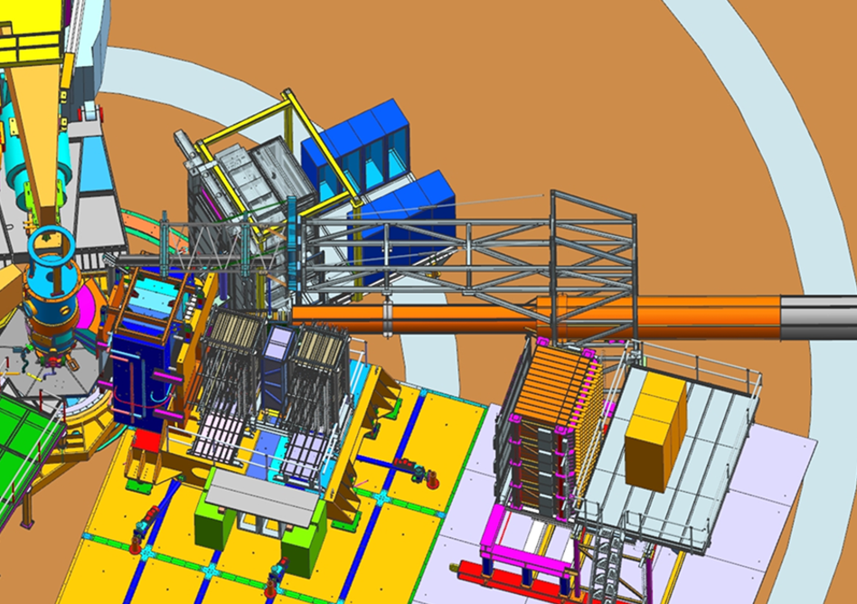
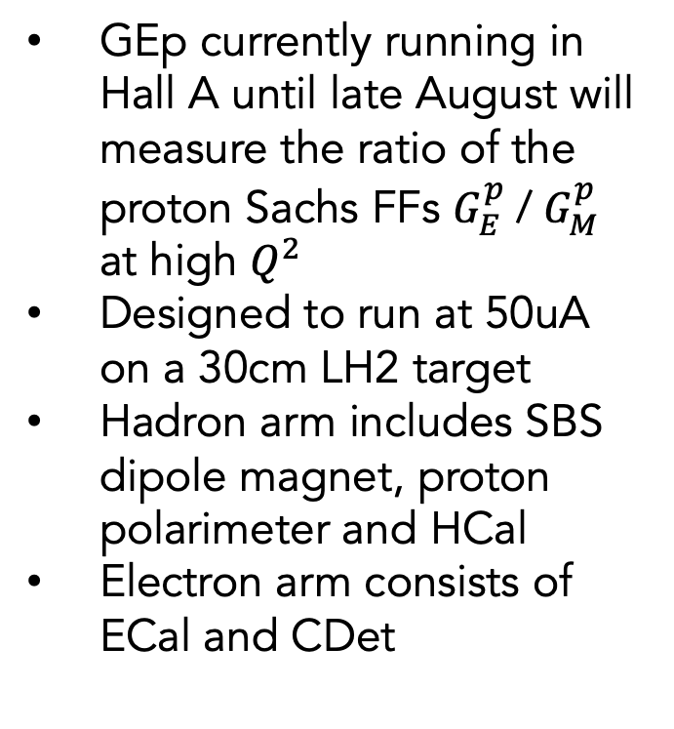
GEp-5 experiment overview
GEp Spokespersons: E.Cisbani, M.Jones, N.Liyanage, L.Pentchev, A.Puckett, B.Wojtsekhowski
Experimental layout in the model
GEp currently running in Hall A until late August will measure the ratio of the proton Sachs FFs $G_{E}^{p}$/ $G_{M}^{p}$ at high $Q^{2}$
Designed to run at 50uA on a 30cm LH2 target
Hadron arm includes SBS dipole magnet, proton polarimeter and HCal
Electron arm consists of ECal and CDet
Electron arm
beam
Hadron arm

Slide 3
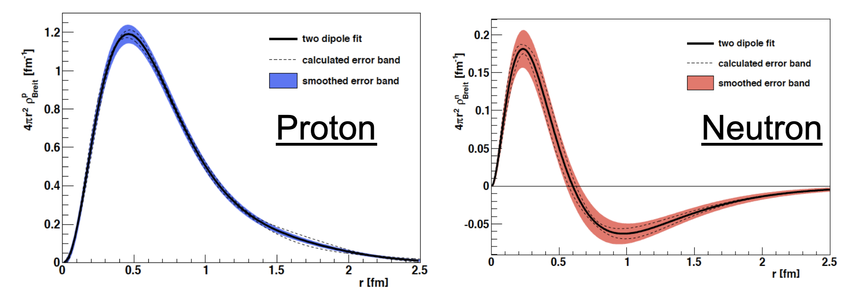
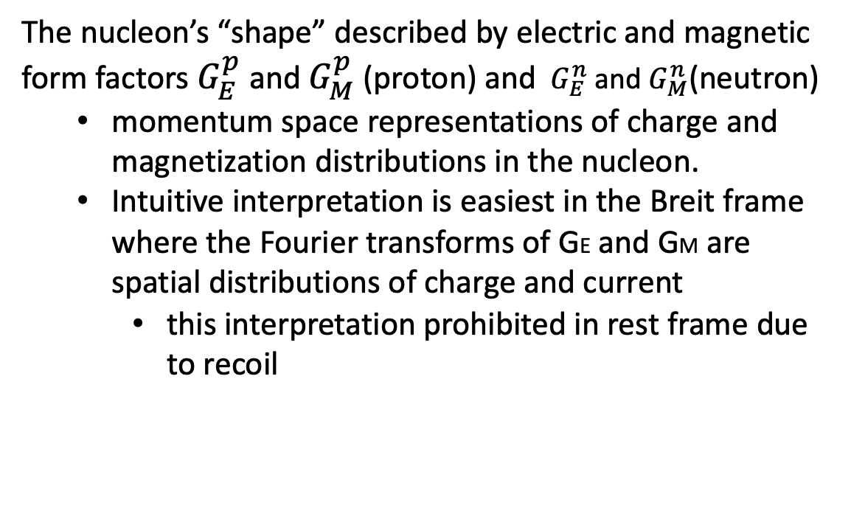


Sachs Form Factors
The nucleon’s “shape” described by electric and magnetic form factors${ G}_{E}^{p}$and $G_{M}^{p}$(proton) and ${ G}_{E}^{n}$and $G_{M}^{n}$(neutron)
  momentum space representations of charge and magnetization distributions in the nucleon.
  Intuitive interpretation is easiest in the Breit frame where the Fourier transforms of GE and GM are spatial distributions of charge and current
    this interpretation prohibited in rest frame due to recoil
$$G_{E}^{p}$$
$$G_{E}^{n}$$
C. Crawford et al. PRC 82 (2010) 045211

Slide 4
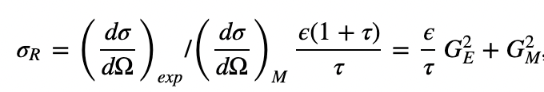
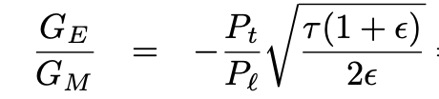
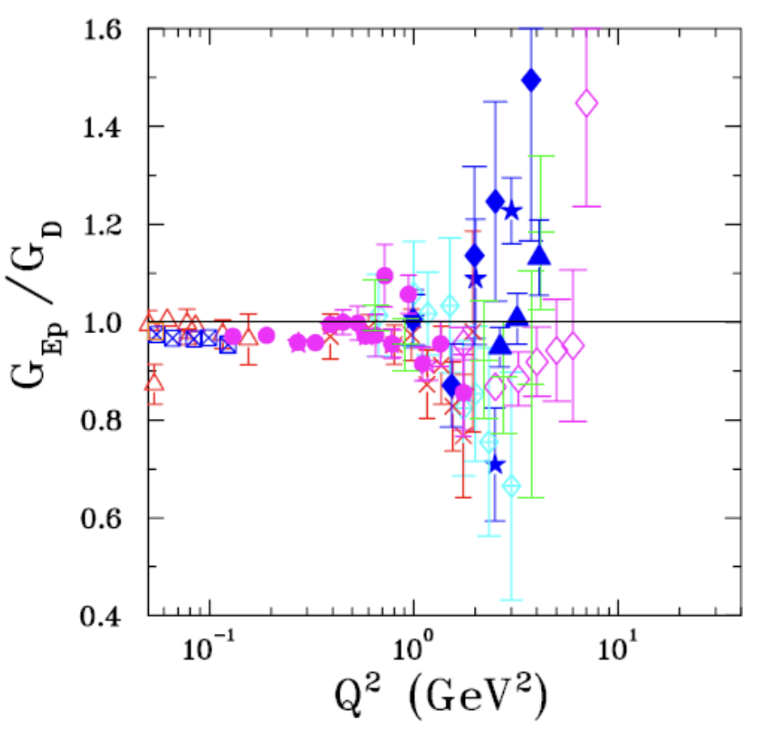
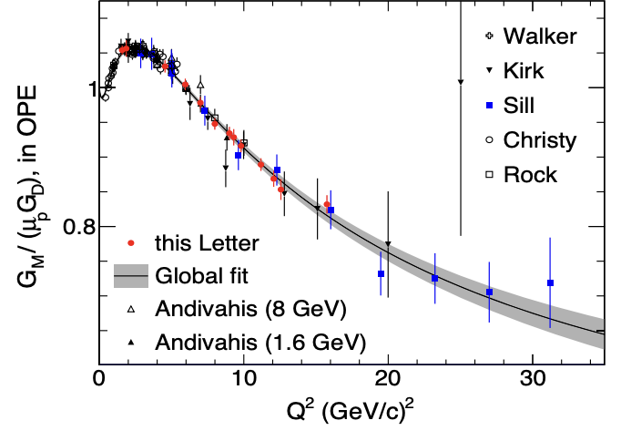
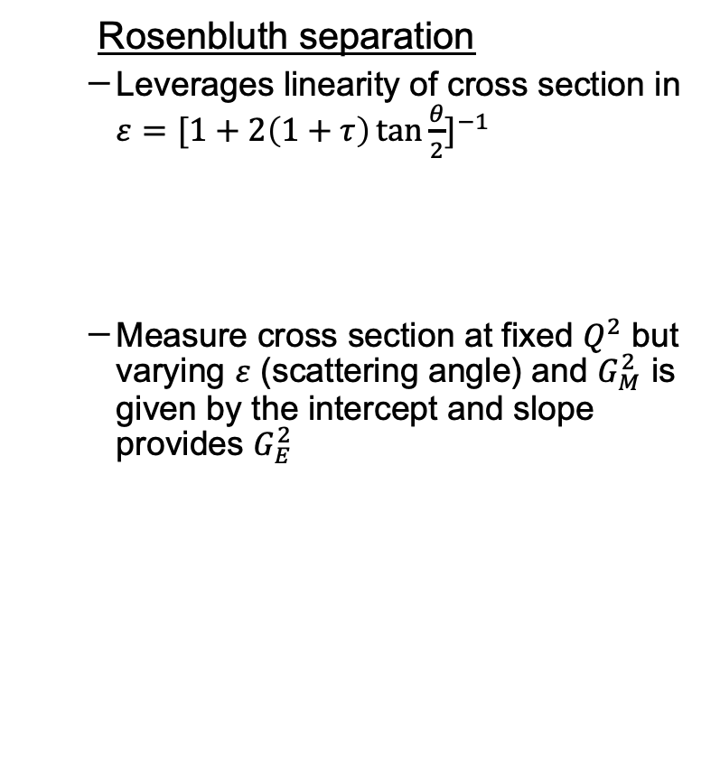
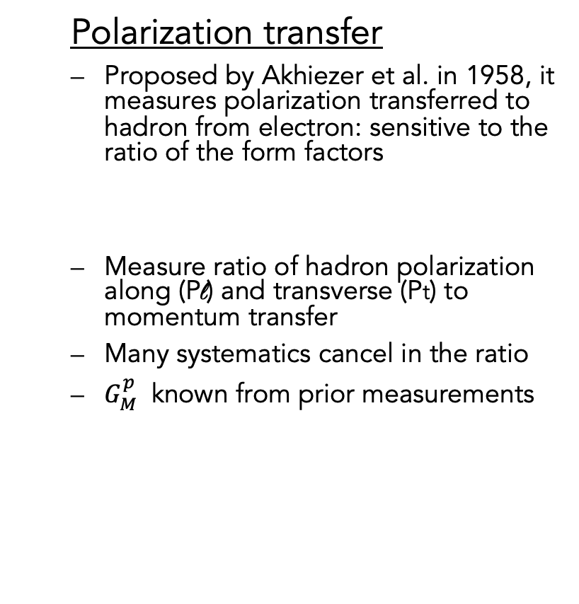
Measuring Form Factors
  Rosenbluth separation
  Leverages linearity of cross section in $ε={[1+2\left(1+τ\right)\tan{\frac{θ}{2}}]}^{−1}$
  Measure cross section at fixed $Q^{2}$ but varying $ε$ (scattering angle) and $G_{M}^{2}$ is given by the intercept and slope provides $G_{E}^{2}$
  Polarization transfer
  Proposed by Akhiezer et al. in 1958, it measures polarization transferred to hadron from electron: sensitive to the ratio of the form factors
  Measure ratio of hadron polarization along (Pl) and transverse (Pt) to momentum transfer
  Many systematics cancel in the ratio
  $G_{M}^{p}$ known from prior measurements
4

Slide 5
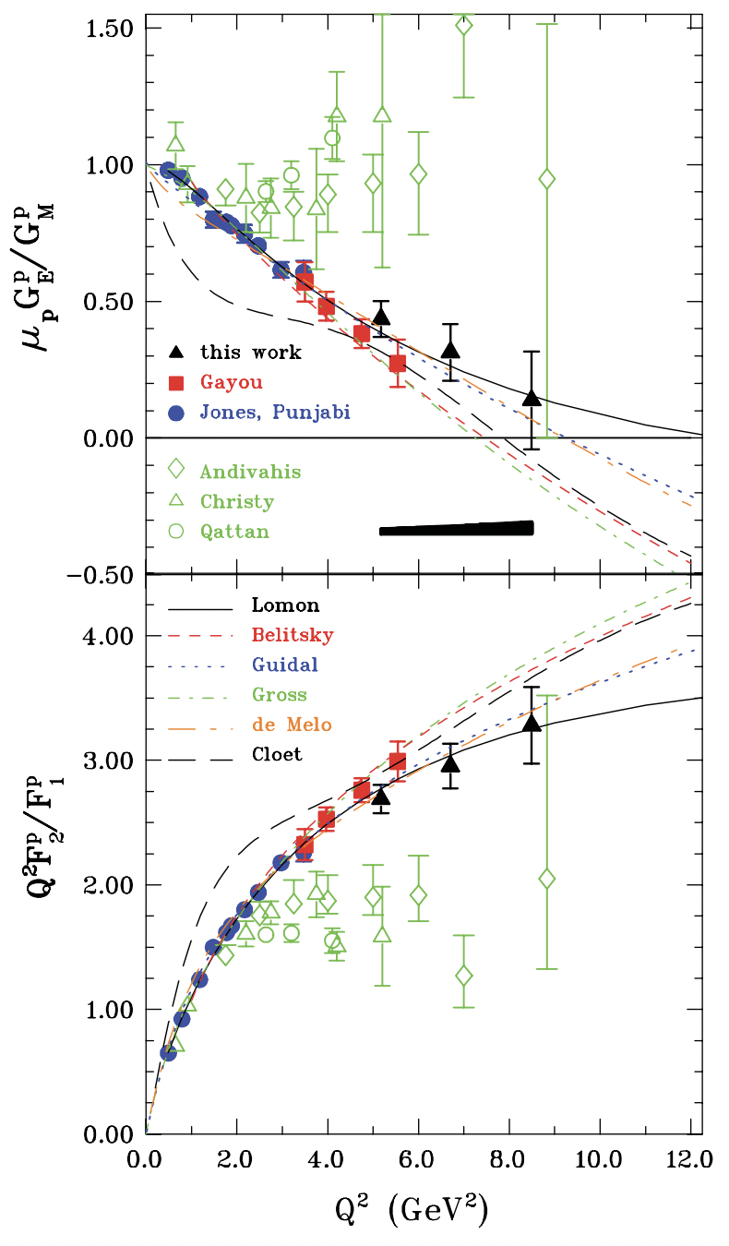
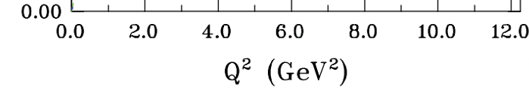
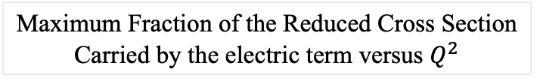
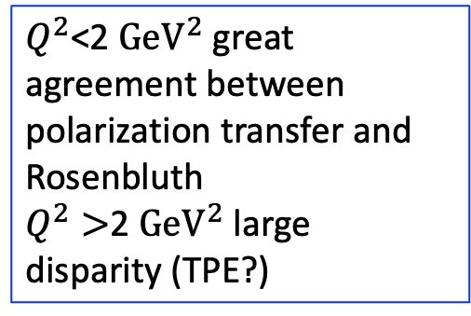
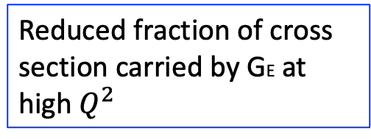
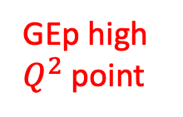
Issues with Rosenbluth Separation Technique
PRL 104, 242301 (2010)
Maximum Fraction of the Reduced Cross Section
Carried by the electric term versus $Q^{2}$
$Q^{2}$<2 ${\text{GeV}}^{2}$ great agreement between polarization transfer and Rosenbluth
$Q^{2}>$2 ${\text{GeV}}^{2}$ large disparity (TPE?)
GEp high
$Q^{2}$ point
Reduced fraction of cross section carried by GE at high $Q^{2}$
Also large $ε$–dependent radiative corrections required
5

Slide 6
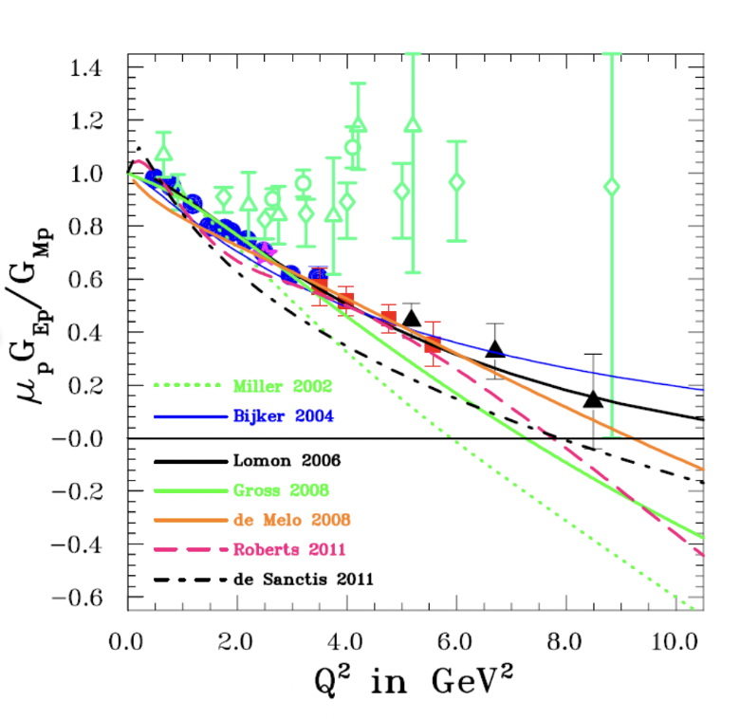
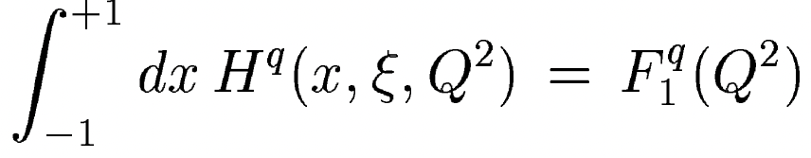
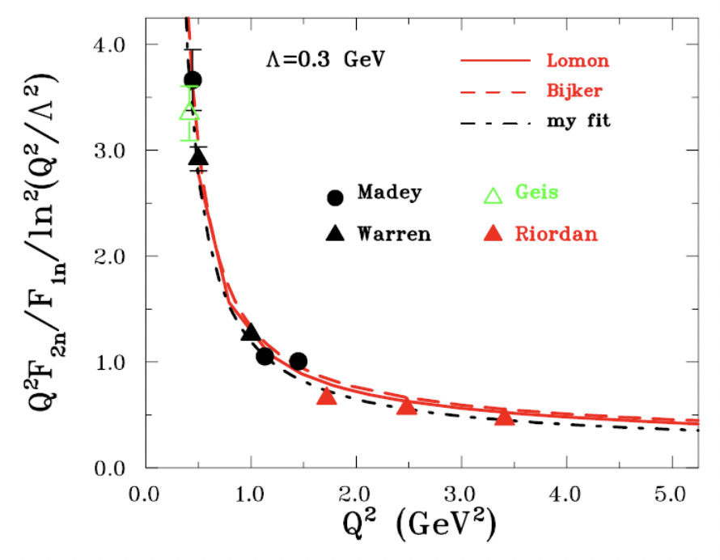
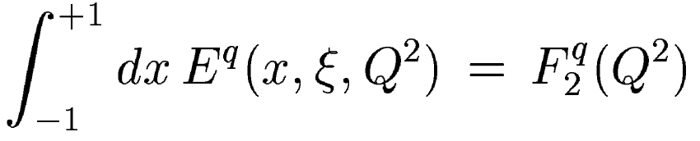
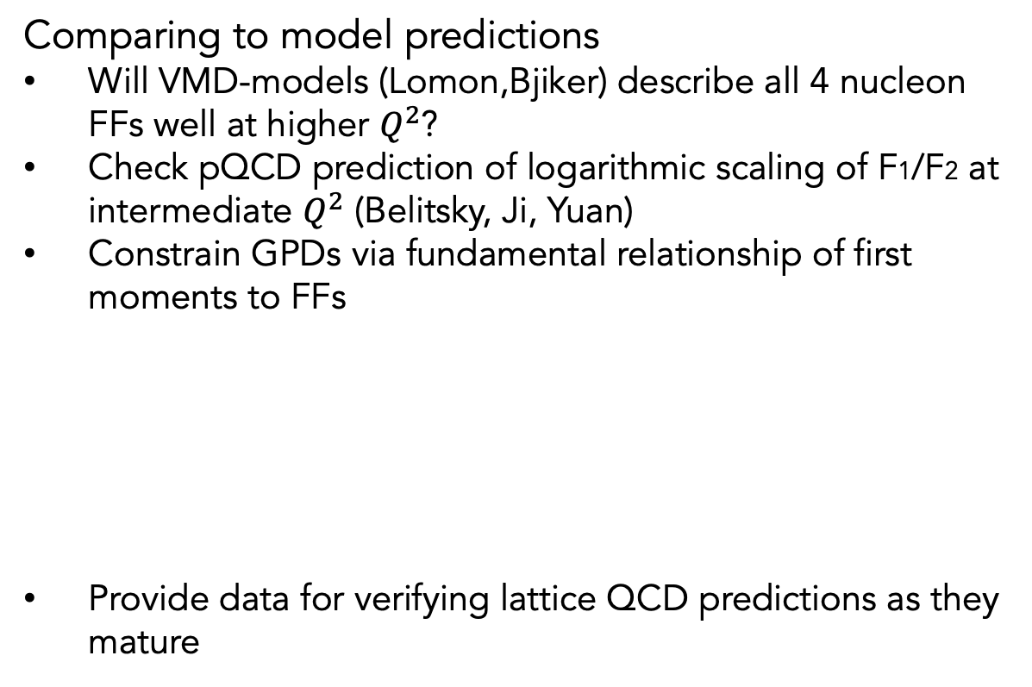
Motivation for measuring form factors
Comparing to model predictions
Will VMD-models (Lomon,Bjiker) describe all 4 nucleon FFs well at higher $Q^{2}$?
Check pQCD prediction of logarithmic scaling of F1/F2 at intermediate $Q^{2}$ (Belitsky, Ji, Yuan)
Constrain GPDs via fundamental relationship of first moments to FFs
Provide data for verifying lattice QCD predictions as they mature
proton
neutron

Slide 7
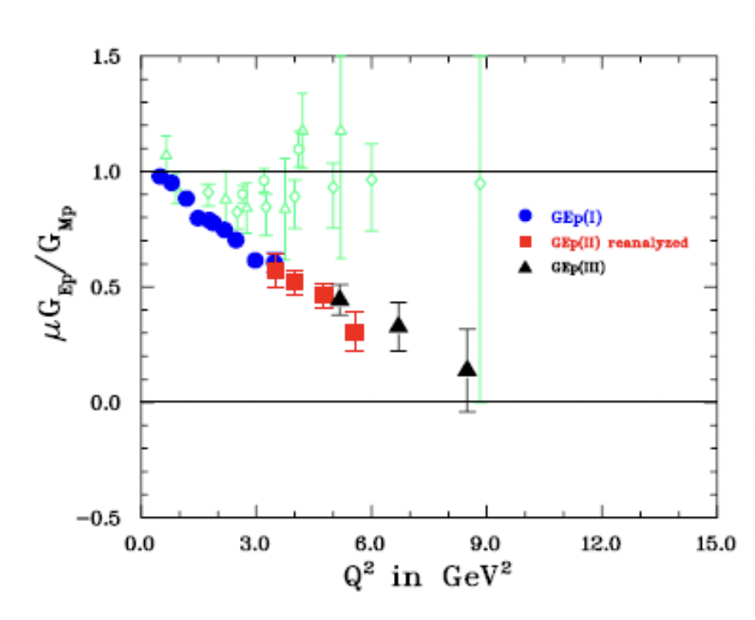
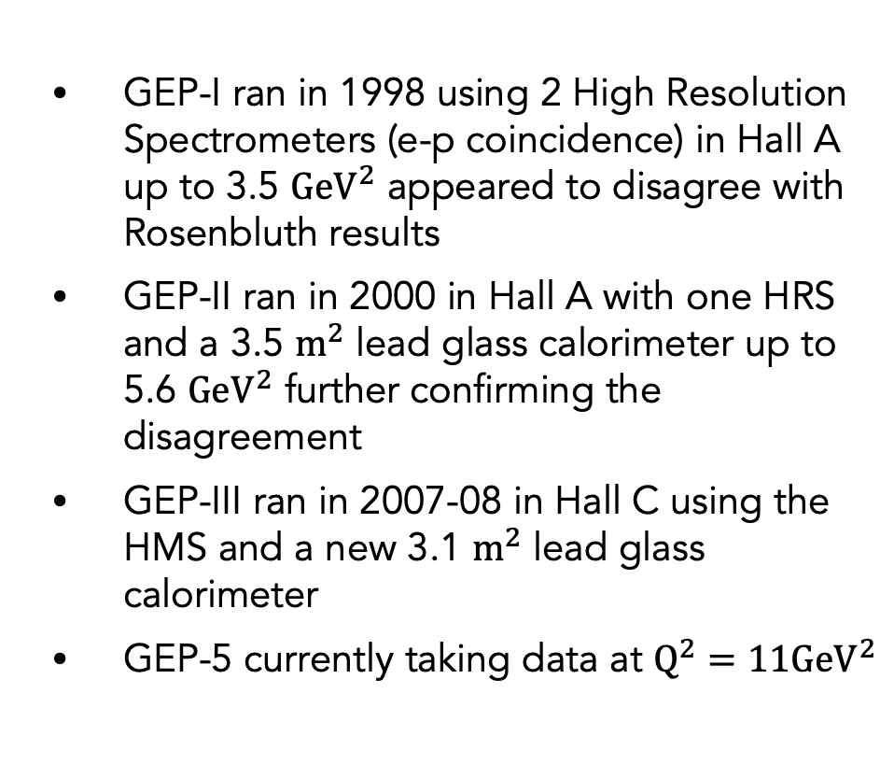
GEP historical measurements at JLab with polarization transfer
GEP-I ran in 1998 using 2 High Resolution Spectrometers (e-p coincidence) in Hall A up to 3.5 ${\text{GeV}}^{2}$ appeared to disagree with Rosenbluth results
GEP-II ran in 2000 in Hall A with one HRS and a 3.5 ${\text{m}}^{2}$ lead glass calorimeter up to 5.6 ${\text{GeV}}^{2}$ further confirming the disagreement
GEP-III ran in 2007-08 in Hall C using the HMS and a new 3.1 ${\text{m}}^{2}$ lead glass calorimeter
GEP-5 currently taking data at ${\text{Q}}^{2}=11{\text{GeV}}^{2}$
M.K. Jones et al. P.R.L. 84, 1398 (2000)
V. Punjabi et al. P.R. C 71, 055202, 2005
O. Gayou et al., Phys.Rev. Lett., 88 (2002) 092301
A.J.R. Puckett et al. Phys. Rev. Lett. 104, 242301 (2010)
7

Slide 8
Proposed error bars
2, 11, 32 PAC days

Slide 9
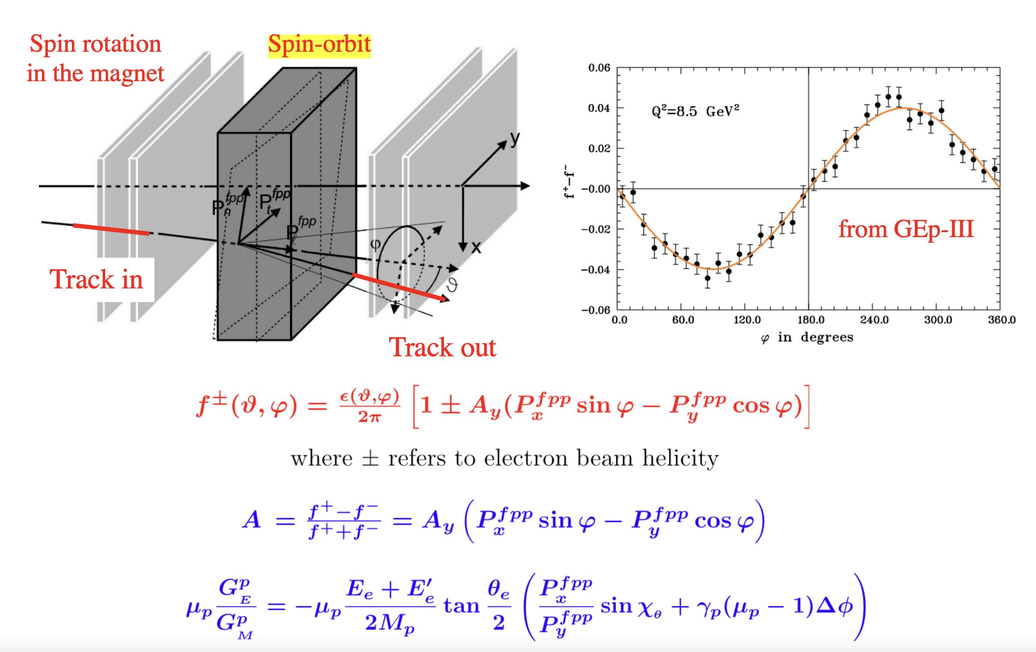
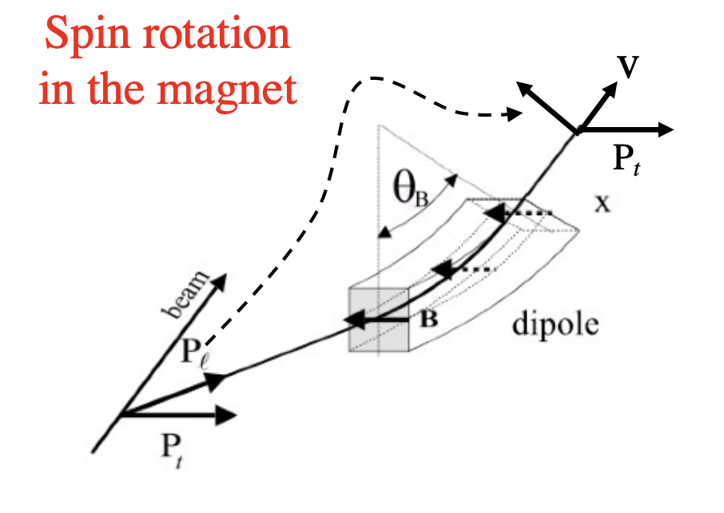
Focal Plane Polarimeter
A_{Y} analyzing power vs.
inverse proton momentum
p will be ~7 GeV/c
precession
angle
fringe field
correction

Slide 10
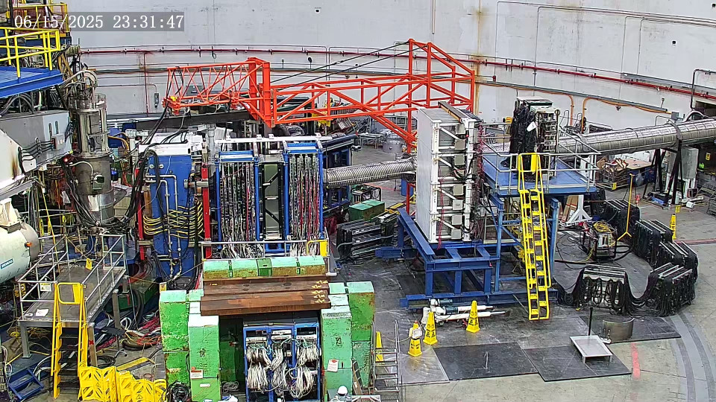
Camera image of GEP in Hall A beam right

Slide 11
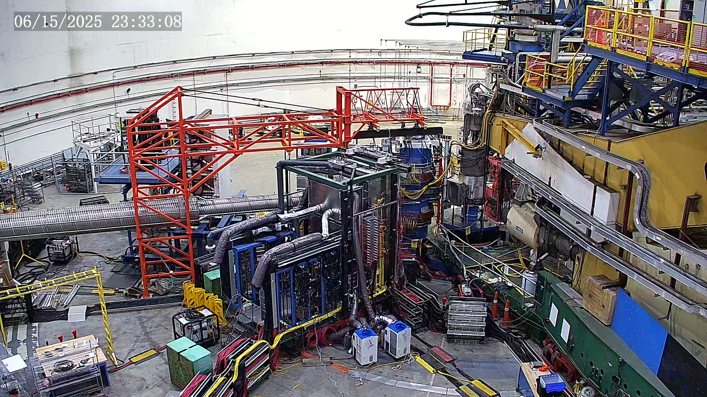
Camera image of GEP in Hall A beam left

Slide 12
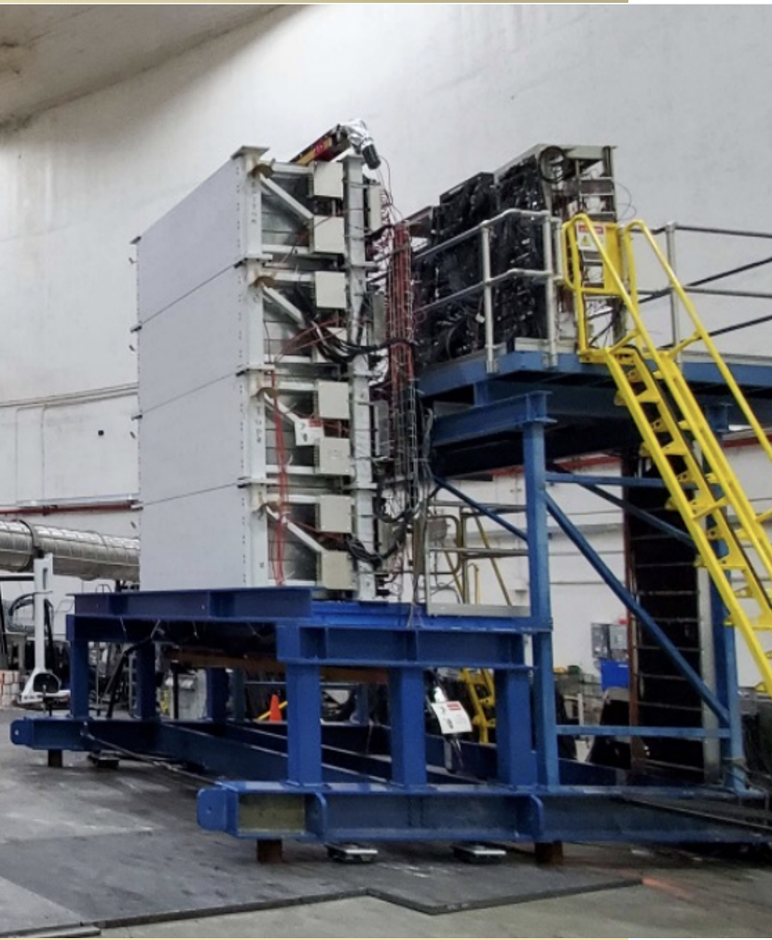
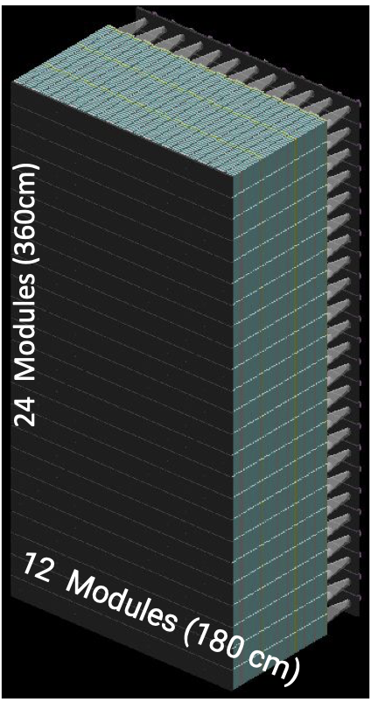
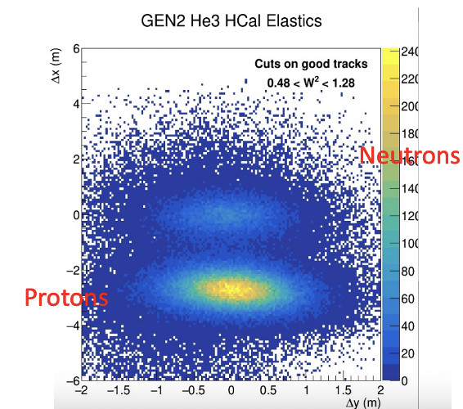
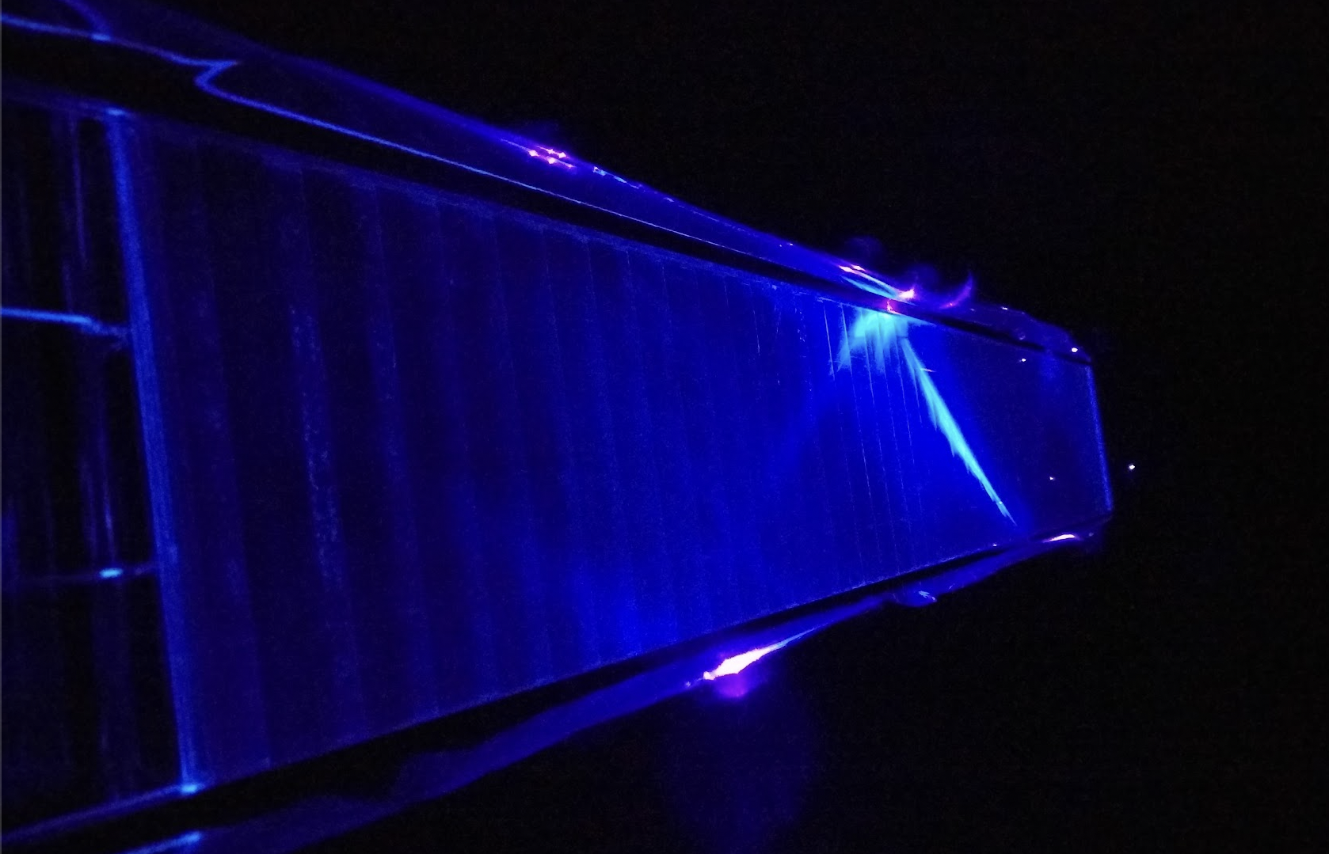
HCAL design
Single module with blue LED

Slide 13
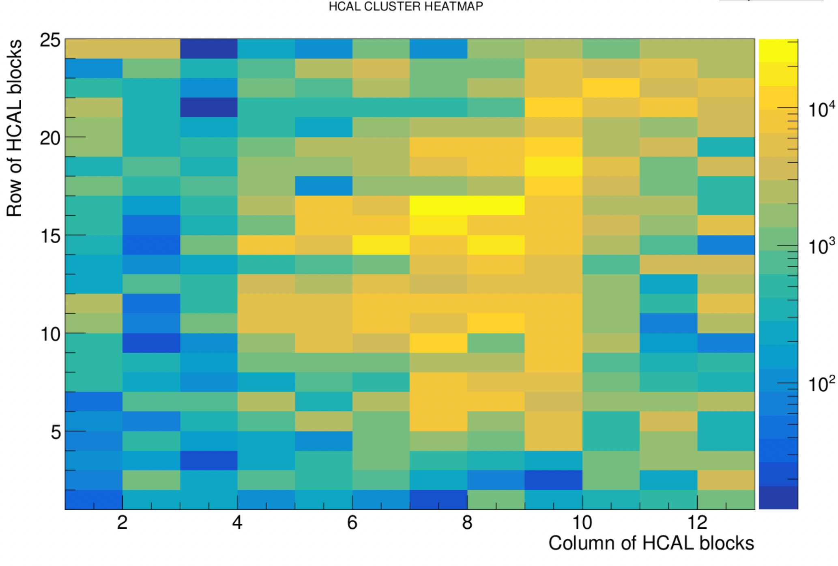
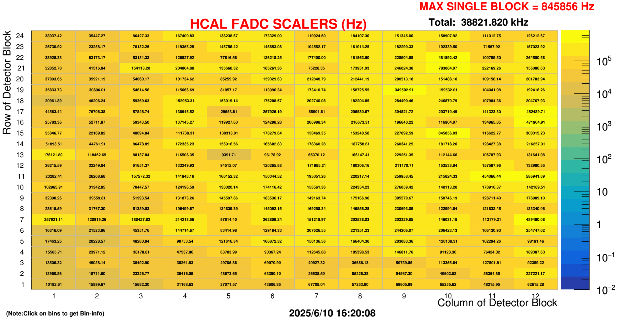
HCAL during GEp
Plots from highest kinematics runs (5th pass beam) showing fADC scalers and CLUSTER heatmap

Slide 14
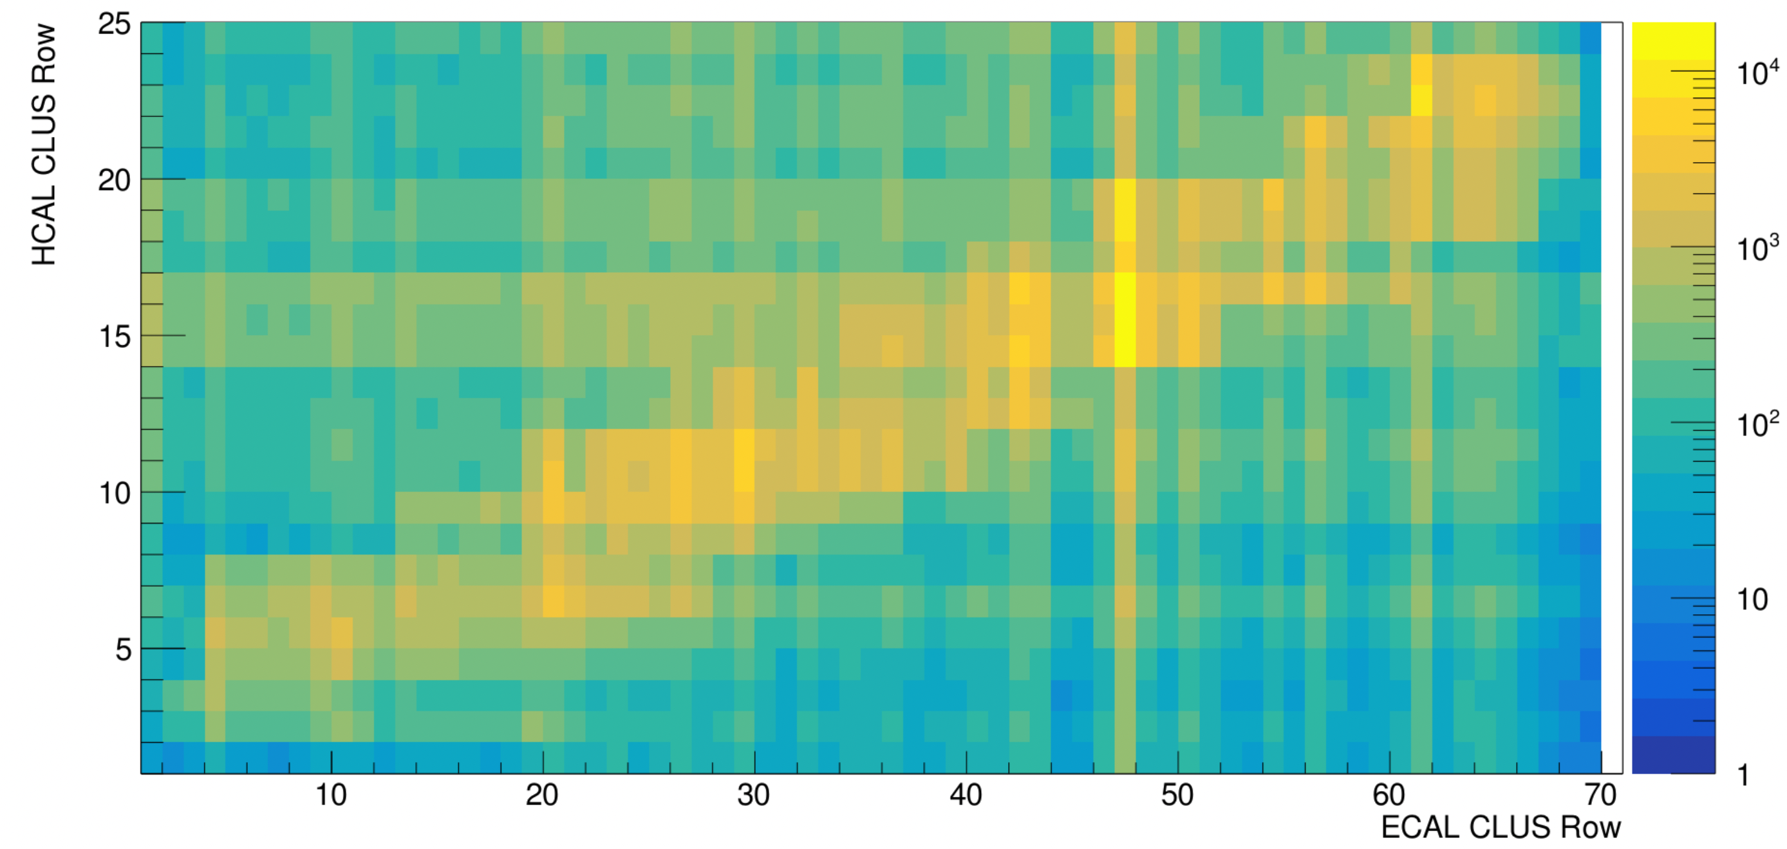
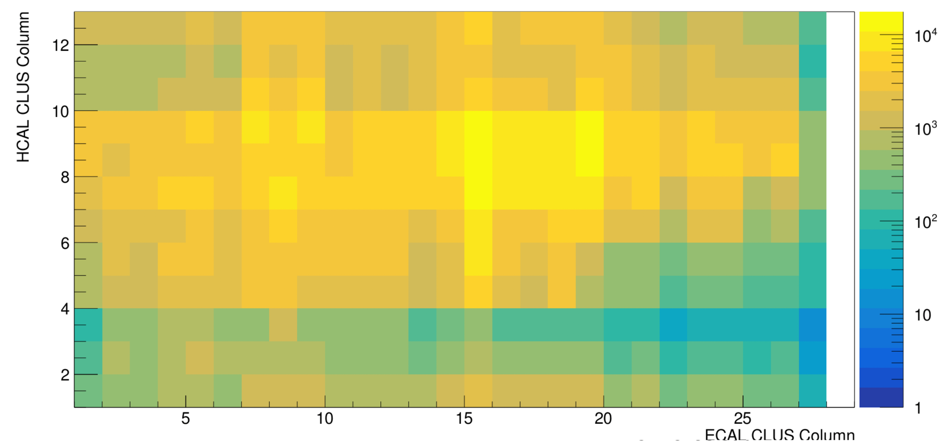
HCAL during GEp
Cluster position correlation between ECAL and HCAL

Slide 15
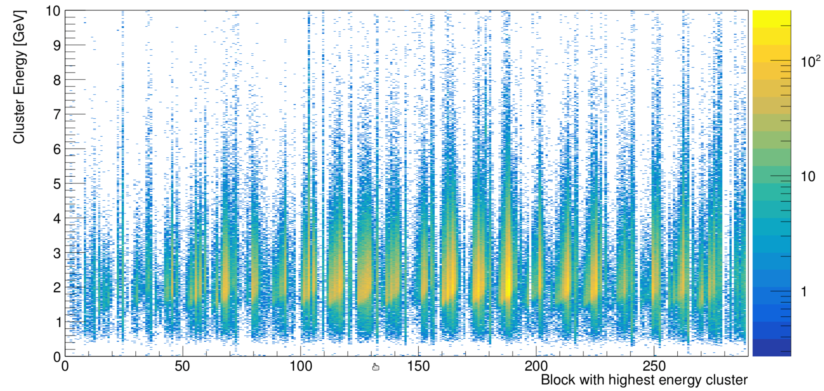
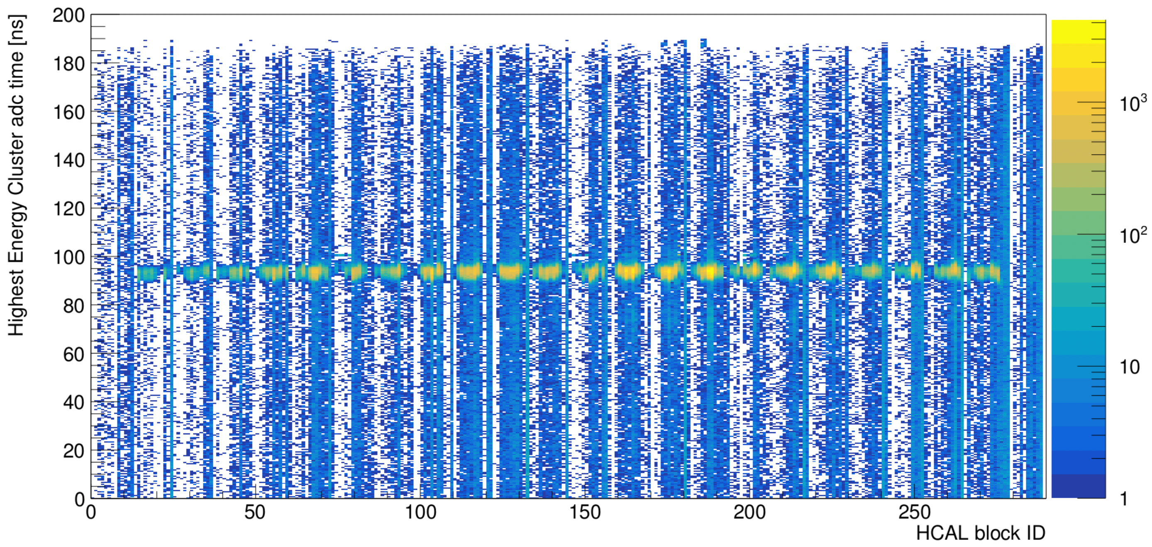
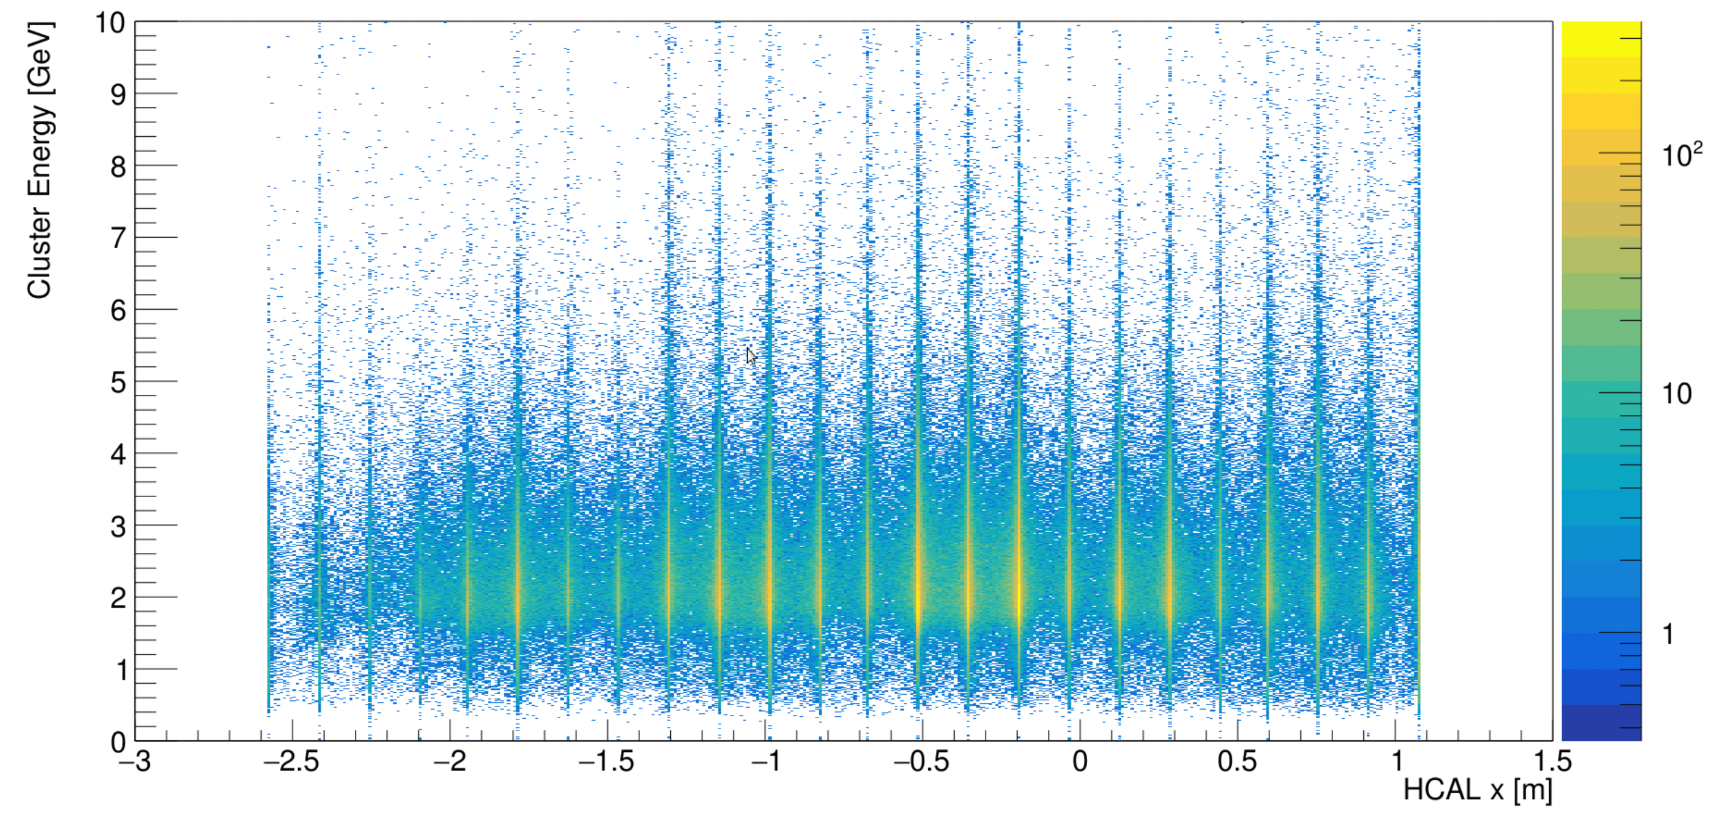
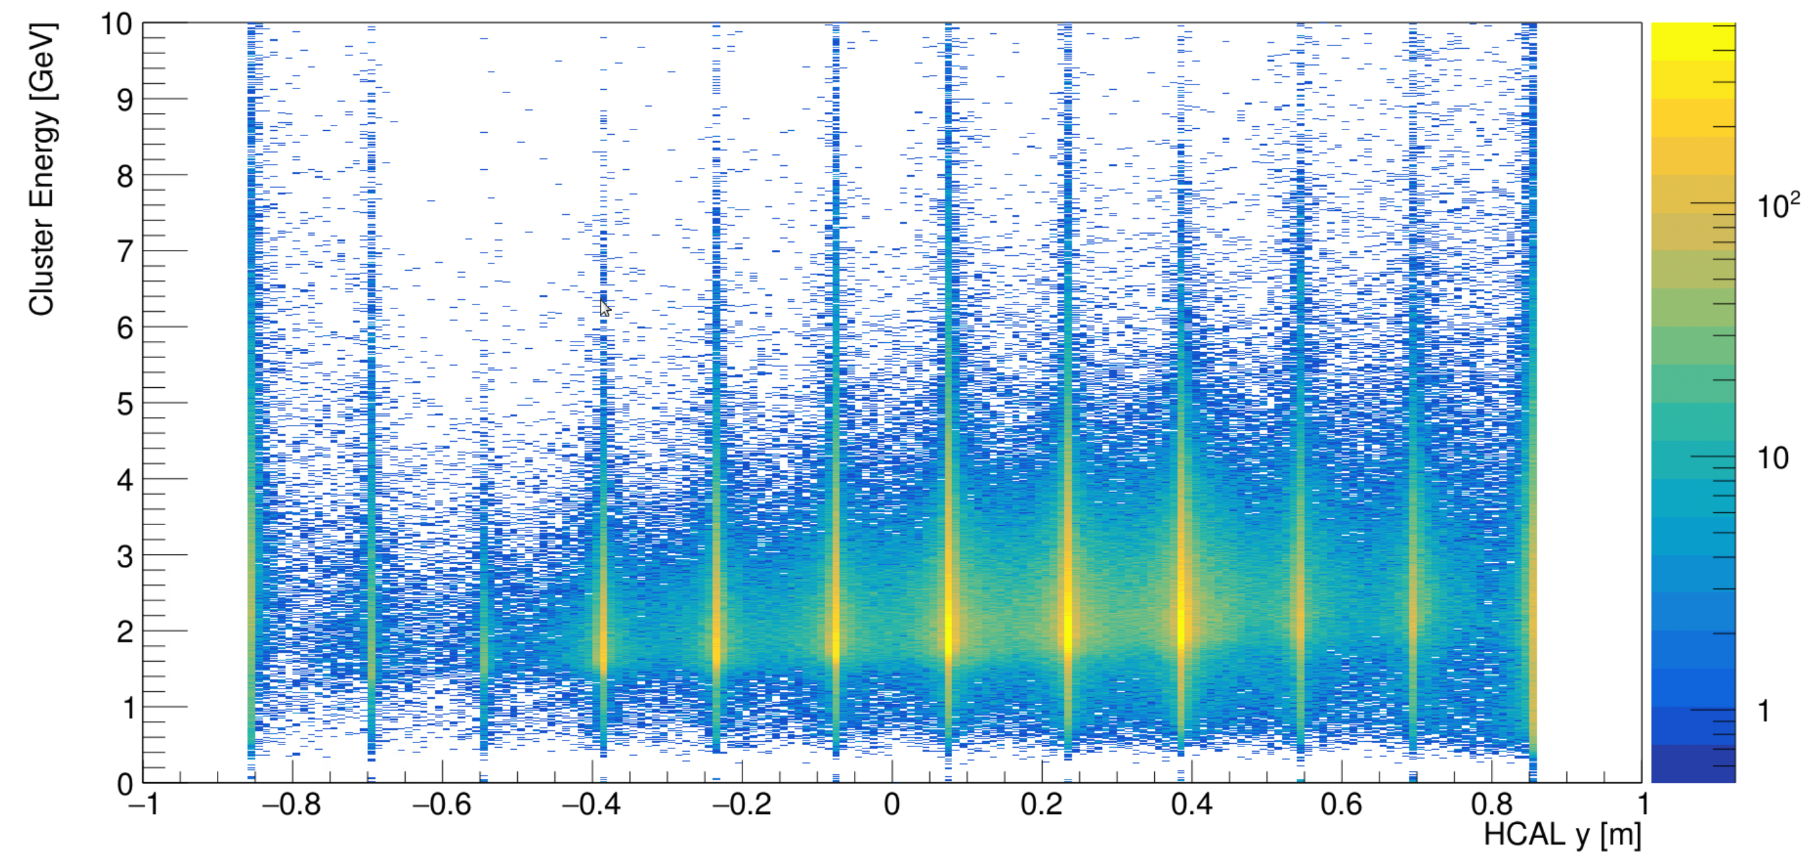
HCAL during GEp
Cluster Energy and timing for HCAL blocks
Energy vs Block
Time vs Block
Cluster Energy and positions in HCAL (x: vertical, y: horizontal distance)
Energy vs X
Energy vs Y

Slide 16
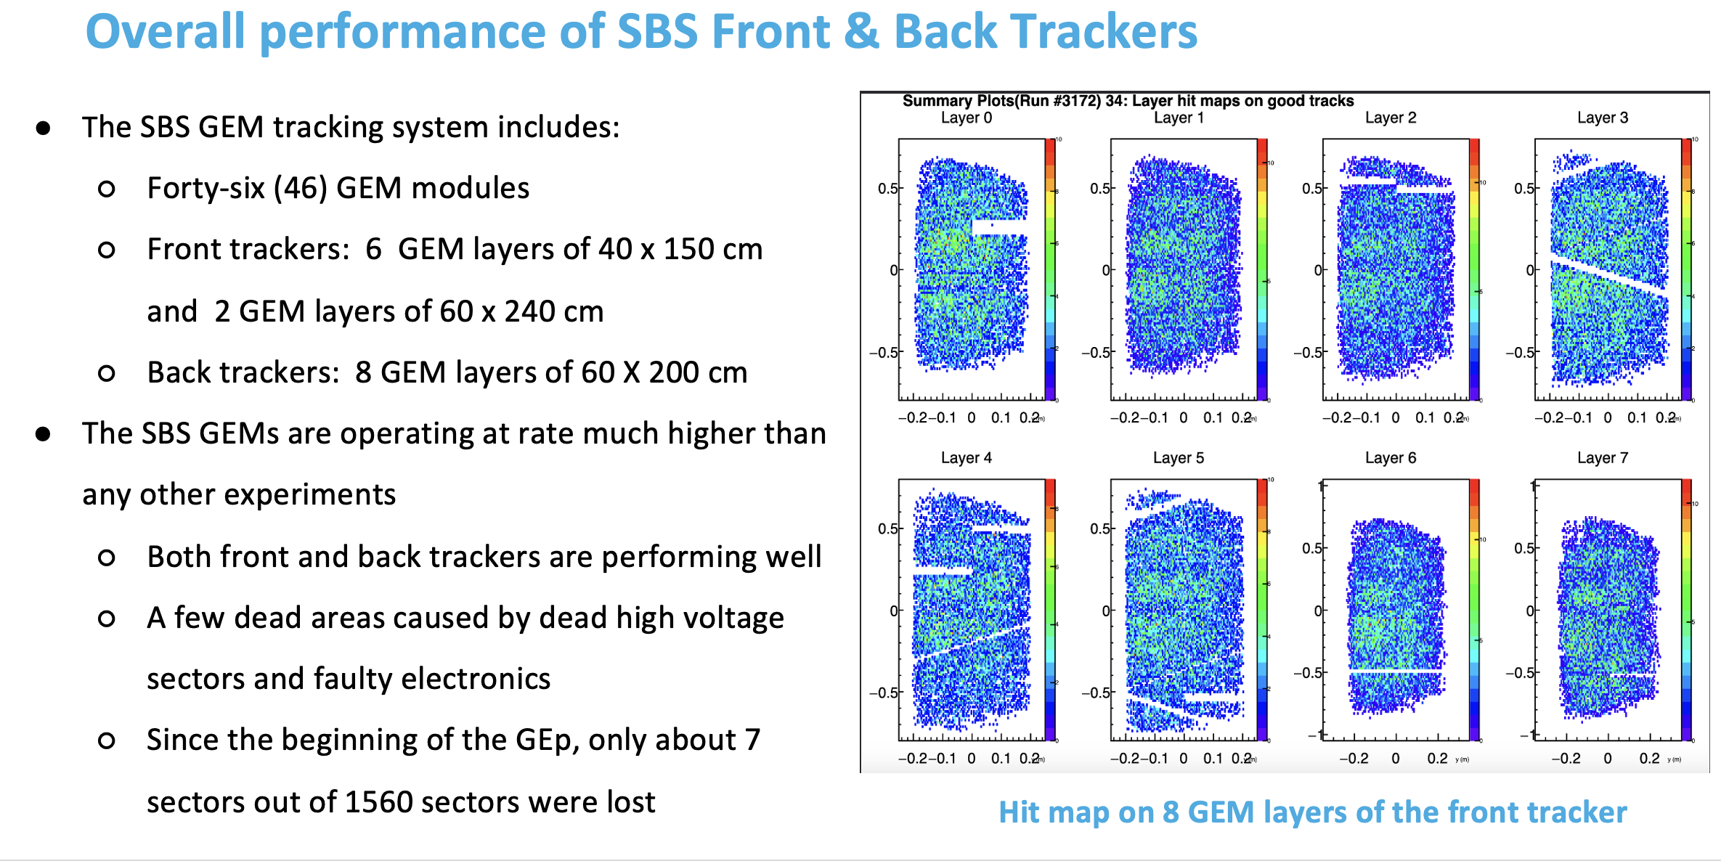
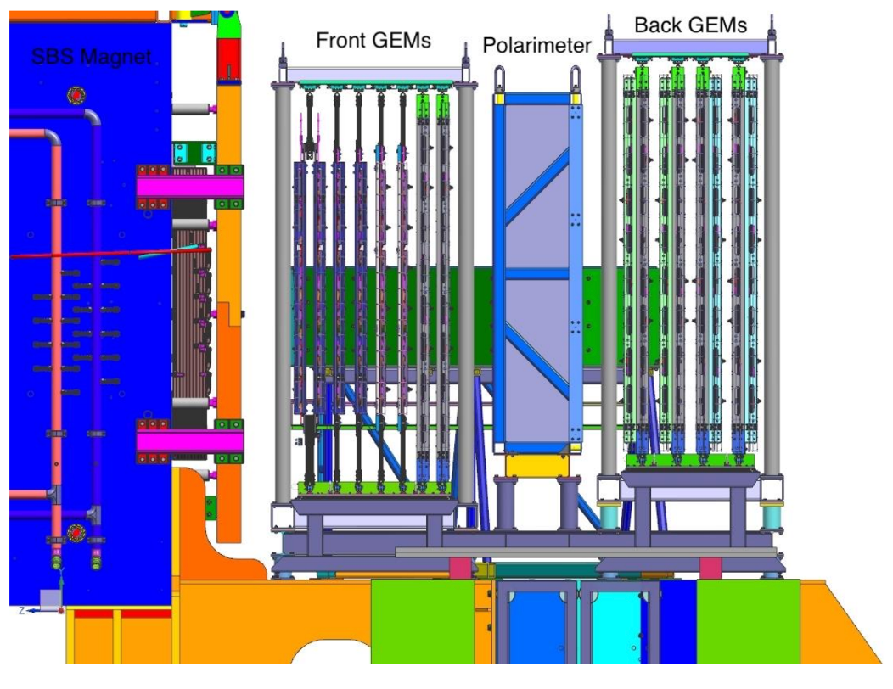
GEM tracker status

Slide 17
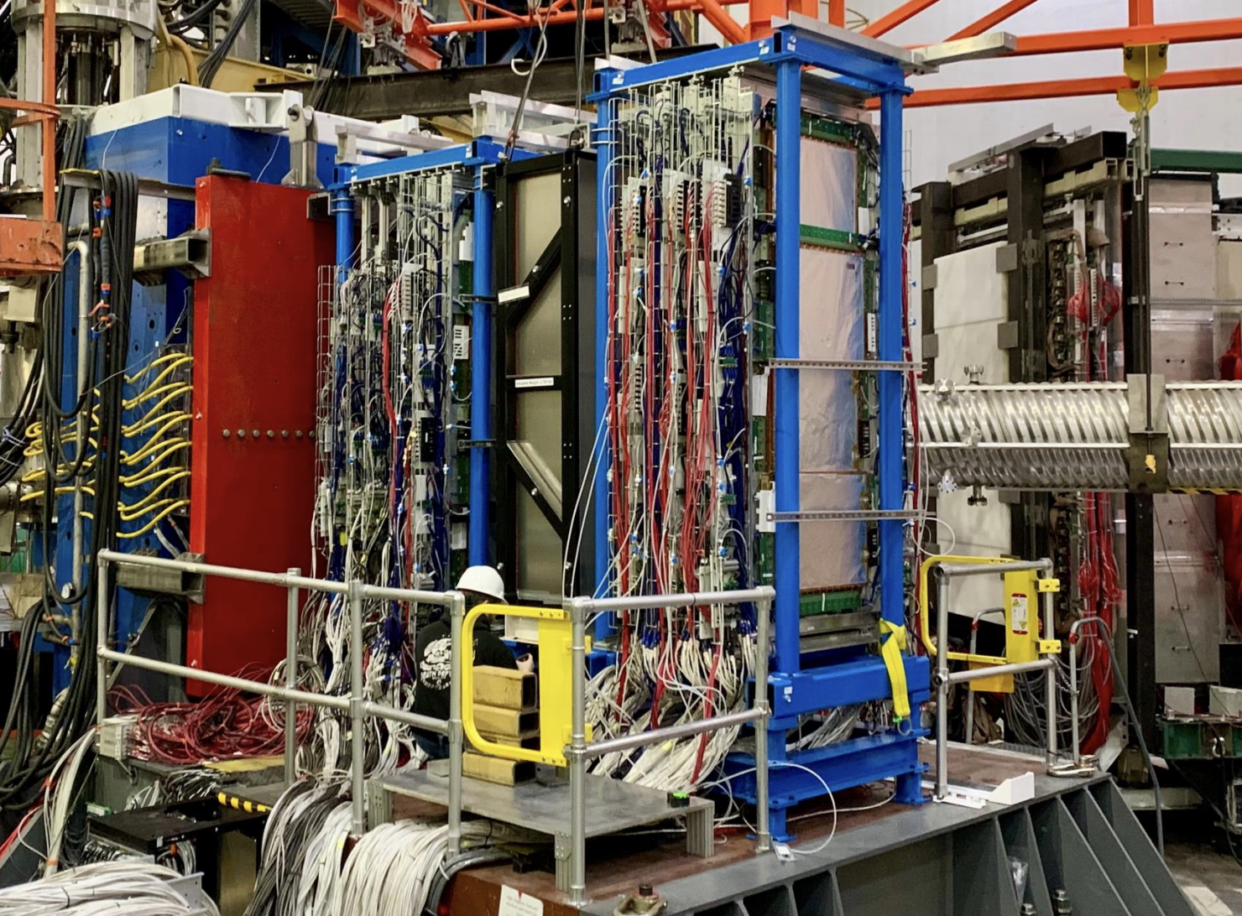
GEM tracker status

Slide 18
GEM tracker status

Slide 19
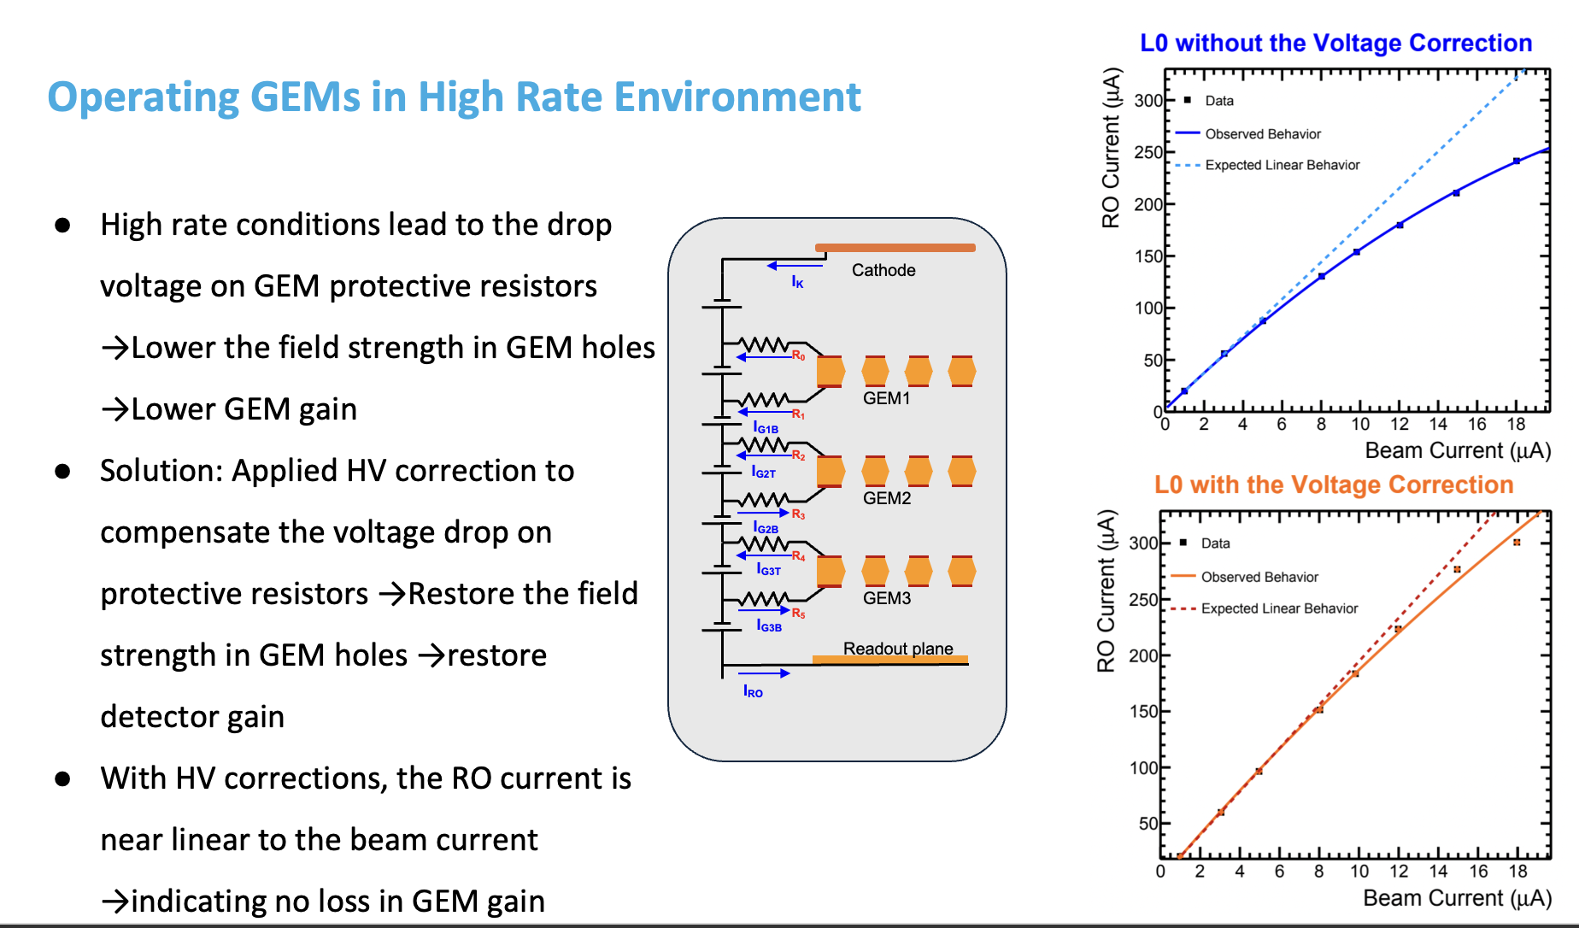
GEM performance
The slope of the plot is
proportional to the gain

Slide 20
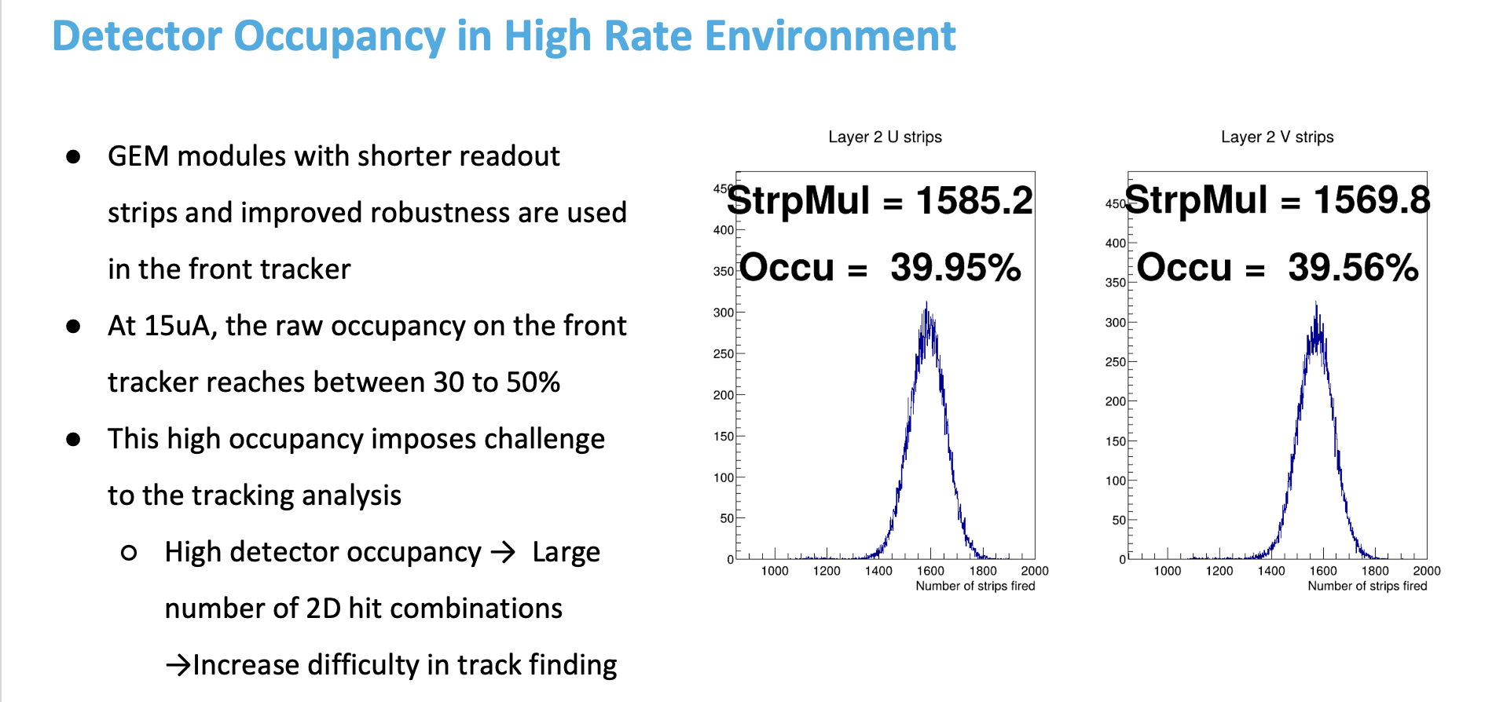
GEM performance
The GEMs are handling unprecedented rates very well.
The total integrated rates and occupancies are an order of magnitude than in any other experiment ever in the world

Slide 21
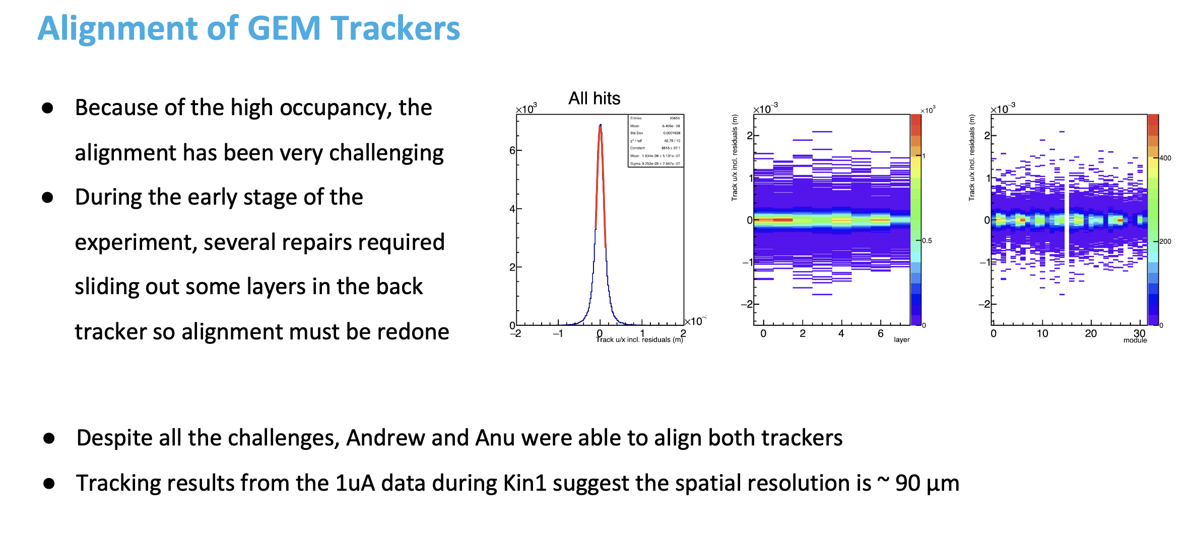
GEM performance

Slide 22
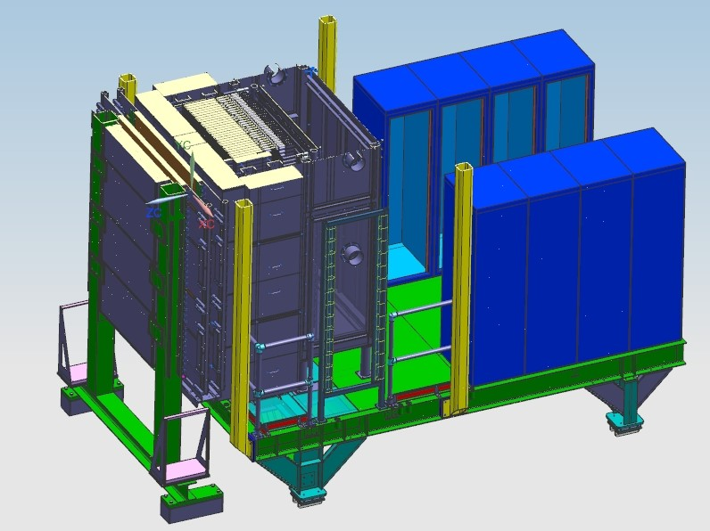
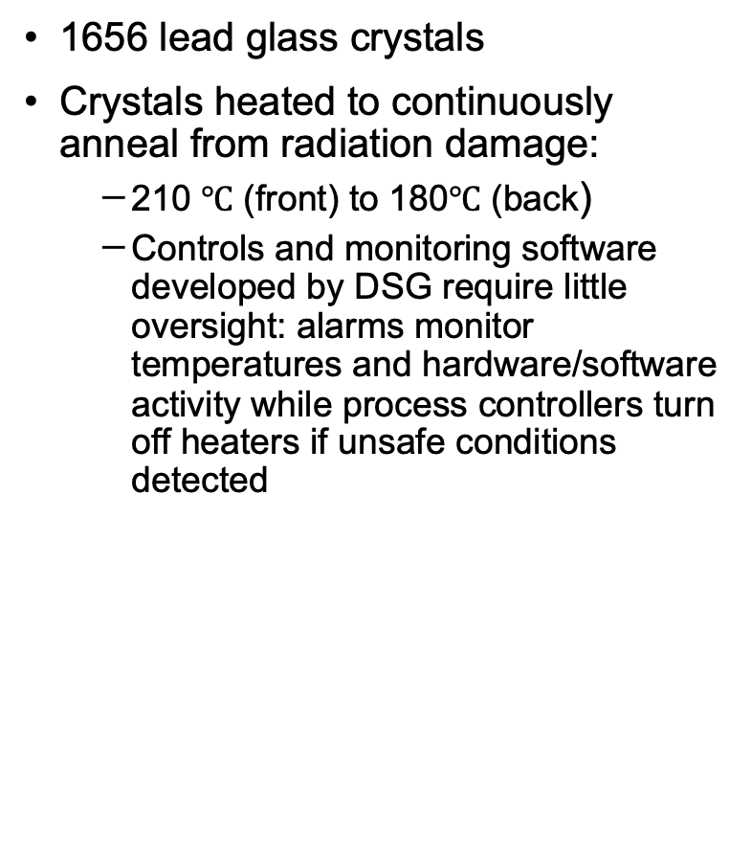
ECal design
1656 lead glass crystals
Crystals heated to continuously anneal from radiation damage:
  210 $℃$ (front) to 180$℃$ (back)
  Controls and monitoring software developed by DSG require little oversight: alarms monitor temperatures and hardware/software activity while process controllers turn off heaters if unsafe conditions detected
Front end electronics
ECal
Oven wall
CDet
22

Slide 23
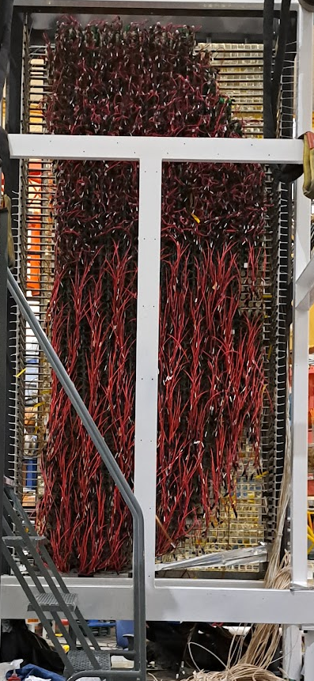
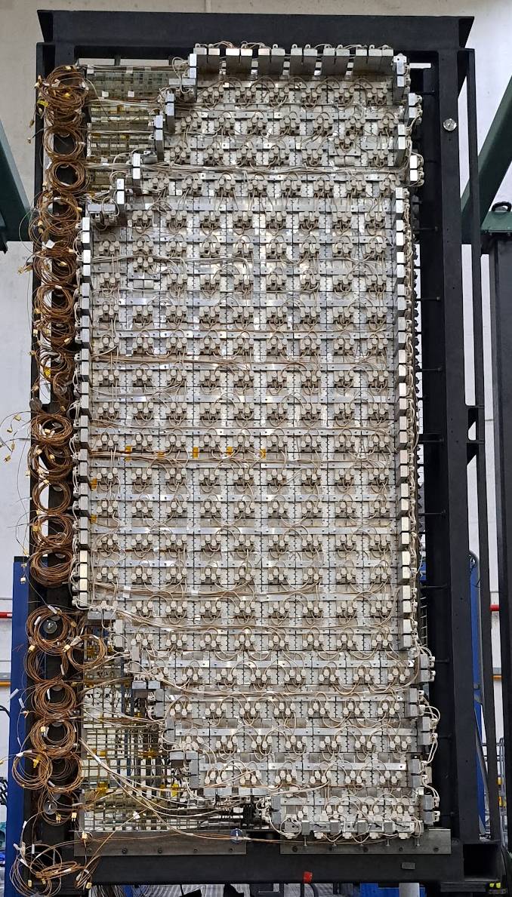

ECal design
During installation
1656 lead glass crystals
Purpose of ECal is to reduce trigger rate with tight conditions based on position and energy
Crystals heated to continuously anneal from radiation damage:
  210 $℃$ (front) to 180$℃$ (back)
  Controls and monitoring software developed by DSG require little oversight: alarms monitor temperatures and hardware/software activity while process controllers turn off heaters if unsafe conditions detected
Back side
Front side
23

Slide 24


ECal design
ECal as installed in the Hall
1656 lead glass crystals
Purpose of ECal is to reduce trigger rate with tight conditions based on position and energy
Crystals heated to continuously anneal from radiation damage:
  210 $℃$ (front) to 180$℃$ (back)
  Controls and monitoring software developed by DSG require little oversight: alarms monitor temperatures and hardware/software activity while process controllers turn off heaters if unsafe conditions detected
Rear enclosure cooled with 3 16000BTU air conditioners to keep it below 50 $℃$
24

Slide 25



ECal timing
Started with the relative time difference among all the ECal channels with cosmic data, and then improved it with beam data.
Accommodate for the time difference between ECal and HCal in order to line up their timing windows for coincidence.
Coincidence matching is now implemented between ECal and HCal to reduce trigger rate.
ECal cluster time
Signal time vs Channel
HCal cluster time

Slide 26


ECal gain matching
Number of Good Events per block for ep calibration
Starting estimate for gain matching used endpoint of ep inelastic spectrum to find approximate HV settings
After collecting enough elastic events, re-calibrated ECal and obtain more accurate gain factors.
Several rounds of elastic calibrations have allowed for us to iterate upon the calibration in attempt to maximize the trigger efficiency.
Energy spectrum (GeV) vs ECal blocks.

Slide 27





ECal elastic ep calibration
Apr 15
Apr 17
Calibration with electron E/p from elastic events in Kin 1 (3 pass) , we currently achieve an energy resolution of ~11.5%, we hope to get closer to the expected ~5-6% resolution with further iterations of elastic calibration
Before
After
Before
After
Apr 29
May 5
Before
After
After
Before

Slide 28

ECal-HCal coincidence trigger

Slide 29


CDet Readout/Detector Performance
Latency = 3216 ns, Window = 52 ns
Clear peak in timing spectra – established at low current running
Using trigger reference signal in additional vfTDC module – reasonable vtTDC timing calibration achieved; resolution ~10’s of ps (still work in progress)
Updated vfTDC firmware to use block readout to solve deadtime/livetime issues
Reasonable HV/threshold values determined with HV scan at lower currents (still a few ”missing” bars at upper edge of second layer of CDet, as well as a few “hot” bars that have HV disabled)
LE Time (ns)
Hit Rates for All CDet Bars

Slide 30


ECal Position Correlations
Observe clear correlation between CDet X-position of hit paddle and determined ECal X-position of best cluster
Signal-to-noise ratio ~0.15 per layer after all timing and multiplicity cuts applied
At 20uA on LH2, approximately 800 raw CDet TDC hits per event; filtering implemented in SBSCDet class to use LE timing and Time-Over-Threshold cuts -> reduction to ~30 TDC hits per event.
Working in progress -> identify CDet “clusters” based on hits in adjacent paddles.

Slide 31
GEp is at the frontier on several fronts
We are running in a new regime
GEMs have not been run at these levels before
For a short period the experiment was generating 2.4GB/s at 22uA:
  2x what we proposed
  Temporarily had to pause data taking and then revert to 15uA because Computing couldn’t write it to tape fast enough
  With higher trigger thresholds and improved GEM parameters we were able to reduce this by 2x.
  Firmware upgrade being developed for GEM region of interest readout which is expected to further reduce data generation by 3x
Recall that we want to get to 50uA but that depends on well calibrated detectors with tight trigger conditions…
But to get calibration data (very rare ep elastic events) you need fairly well calibrated detectors or very loose cuts and lots of computing power
10 seconds of data (20 GB file) takes the farm almost 24 hours to analyze/decode. Fortunately, you can do thousands in parallel.
We are generating data locally so fast that we cannot complete track analysis before the local copies disappear forcing all tracking analysis to be on the batch farm.

Slide 32

Are we measuring polarization yet?
Very preliminary slide from A. Puckett

Slide 33


Conclusion
The GEp experiment is currently running in Hall A under challenging conditions that push the boundaries on several fronts.
We are currently taking data at our highest Q-squared point at $Q^{2}$=11.1${\text{GeV}}^{2}$
The successes and challenges of this experiment will inform future experiments especially those with high rate tracking requirements.
This has been a huge effort with so many individuals and institutions involved. I would like to acknowledge this great group!
THANK YOU

Slide 34

Increasing difficulty with each iteration
Need large statistics, max luminosity and solid angle
Max luminosity -> large background
Large solid angle -> small bend -> huge background
Critical to this experiment is the maturing technology of high rate tracking with GEMS
Q² increases from 8.5 to 11.1 GeV² but higher beam energy 10.7 vs. 6 GeV => a factor of 5-6 of the FOM loss, but the SBS larger solid angle helps.
34

