Slide 1
Revealing the Transition Region of QCD with the Proton’s g₂ Structure Function
-
C12-24-002
Jefferson Lab PAC 53
6/16/2025
David Ruth, Jian-Ping Chen, Nathaly Santiesteban, Karl Slifer

Slide 2
Experiment Overview
Hall: C
Goal Observables:
g₂ Spin Structure Function
$\overline{d_{2}}$ Polarizability
$Δ_{2}$ Hydrogen Hyperfine Splitting Contribution
$\overline{g_{2}}$ Twist 3 Effects
g_{T} PDF
Needed Equipment:
Solid Transversely-Polarized Target
Chicane Magnet
Beamline Instrumentation
Detectors: SHMS
Beam Current: 85 nA
Beam Energies: 4.4 GeV, 8.8 GeV
Target Material: NH₃ (Ammonia)
Q² Range: 0.22 – 2.2 GeV²
W Range: 1078 – 2400 MeV
Requested Days: 26
Current Status: C2 (Conditional Approval)
PAC52 Report Conditions:
“The impact of this new setup on the detector resolution and its subsequent effect on the physics results has not been thoroughly addressed. A full Monte Carlo simulation of the new setup and detector is needed.” (✅ Complete)

Slide 3
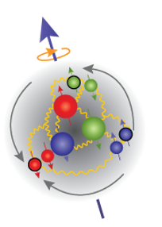
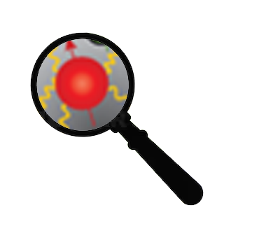
QCD
?
Low
Q²
High
Partons Combine to Form Nucleon
Confinement
Effective Theories: χPT
Can’t use Twist Approx.
Quark/Gluon Correlations
Lattice QCD
Higher Twists
Individual Partons
Asymptotic Freedom
Perturbative QCD
Leading Twist

Slide 4
How to study QCD and higher twist in the transition region?
In unpolarized systems, F₁ / F₂ structure functions describe quark-gluon distribution:
In a spin-½ polarized system, g₁/g₂ describe the spin distribution :
Nucleon Spin Structure
Quark-Gluon Correlations

Slide 5
g₂ Structure Function enables direct tests of QCD and higher twist
Higher Twist:
Benchmarking (Lattice) QCD:
Small
$$g_{2}\left(x,Q^{2}\right)=g_{2}^{WW}\left(x,Q^{2}\right)−\int_{x}^{1}{\frac{∂}{∂y}\left[\frac{m_{q}}{M}h_{T}\left(y,Q^{2}\right)+ζ\left(y,Q^{2}\right)\right]\frac{dy}{y}}$$
Twist-3
Function of g₁
Weighted integrals (moments) of the spin structure functions can be directly calculated by effective theories:
Polarizabilities describe nucleon’s ensemble response to an external field
B-Field
$$\overline{d_{2}}= \int_{0}^{x_{th}}{x^{2}[{2g}_{1}\left(x,Q^{2}\right)+{3g}_{2}\left(x,Q^{2}\right)]dx}$$
Proton
Proton

Slide 6
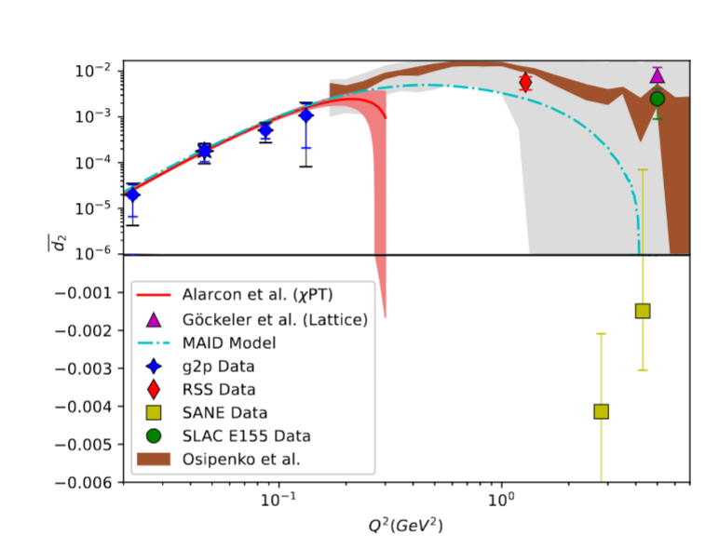
“Color Polarizability” d₂
$$\overline{d_{2}}= \int_{0}^{x_{th}}{x^{2}[{2g}_{1}\left(x,Q^{2}\right)+{3g}_{2}\left(x,Q^{2}\right)]dx}$$
At high Q²: color polarizability / “color Lorentz force”
Interesting differences in existing data motivate further study
Upcoming lattice predictions in this region need experimental benchmark!

Slide 7
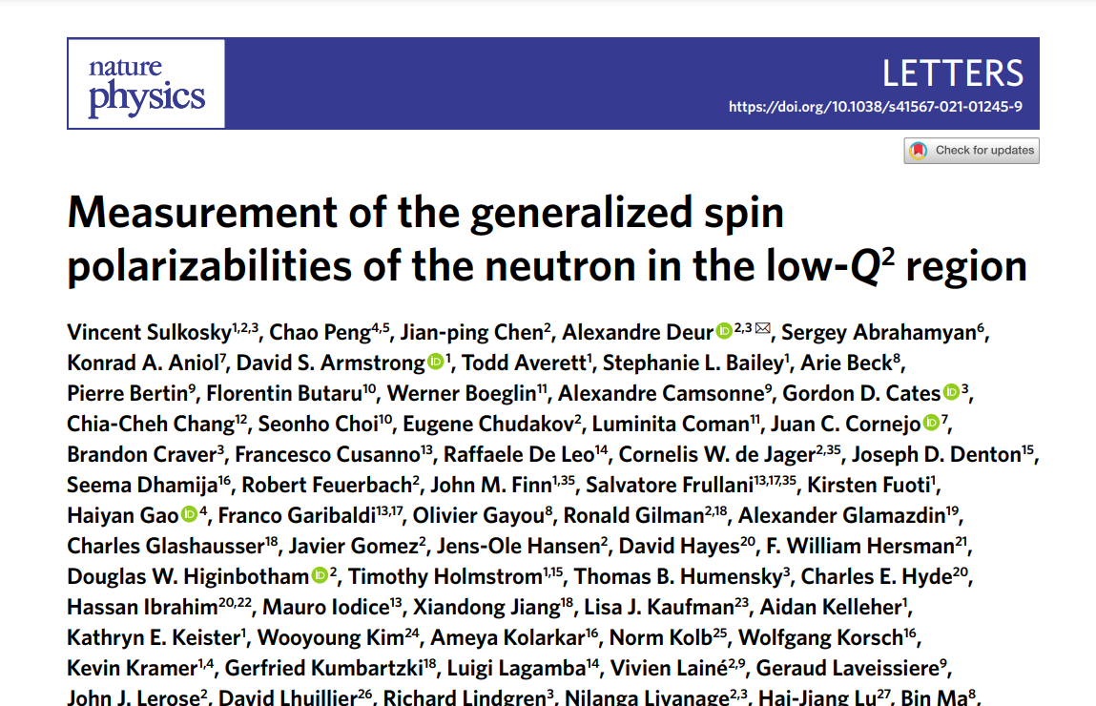
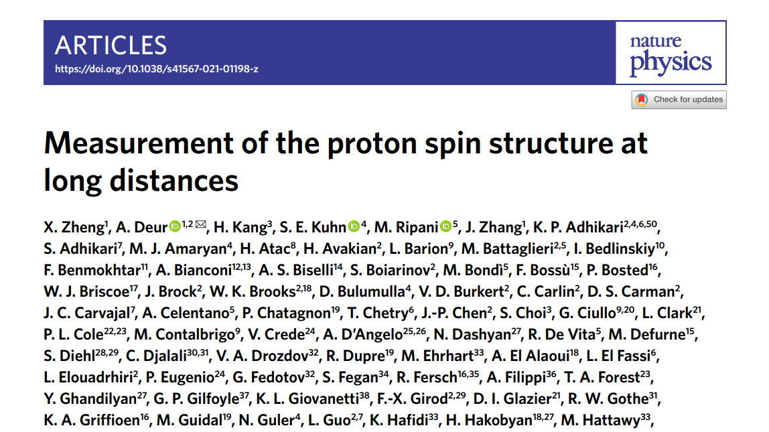
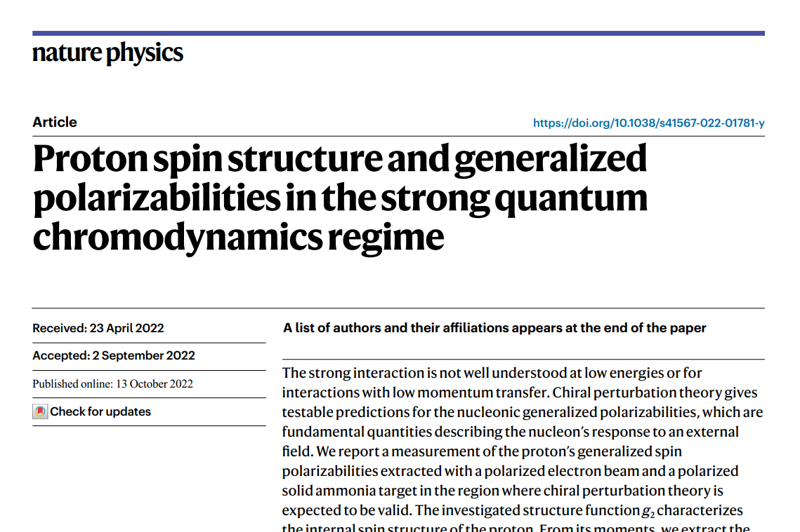
Recent Successful JLab Program
Highly successful program to measure SSF
Three different experiments published recent SSF results in Nature Physics
2007 JLab Review: DOE Milestone to “measure g₁ and g₂ over an enlarged range of x and Q²”

Slide 8
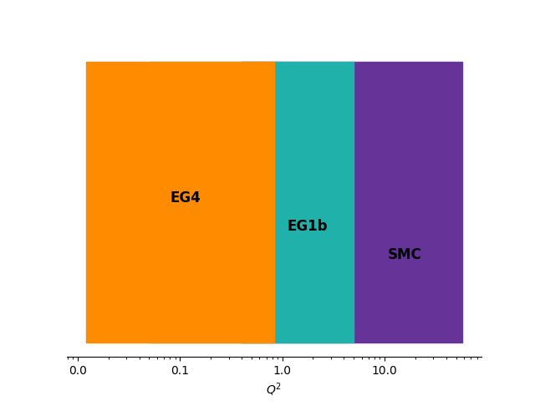
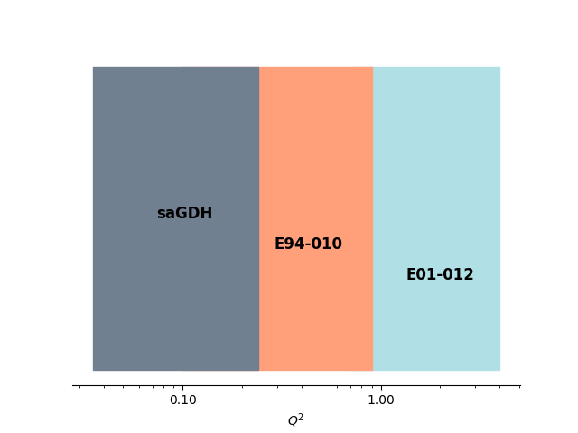
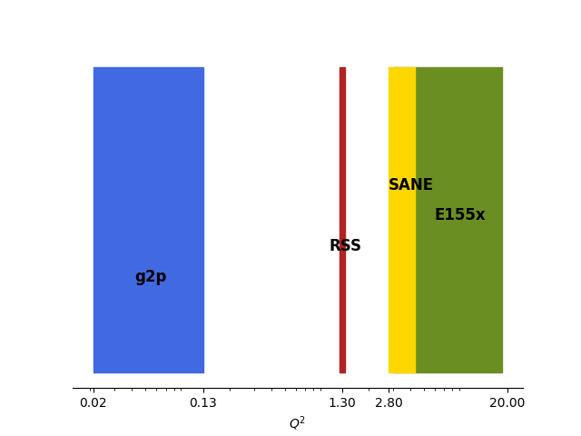
Proton
Neutron
g₁
g₂

Slide 9
Transition Region g₂ has Strong scientific motivation:
Needed as a Benchmark for Lattice QCD
Unique Sensitivity to Twist-3 Effects
Should be Easier than 3 previous Hall A/C measurements at JLab:
Much higher rates than the higher Q² experiments
Smaller out-of-plane angle than the low Q² data
g₂
This
Proposal

Slide 10
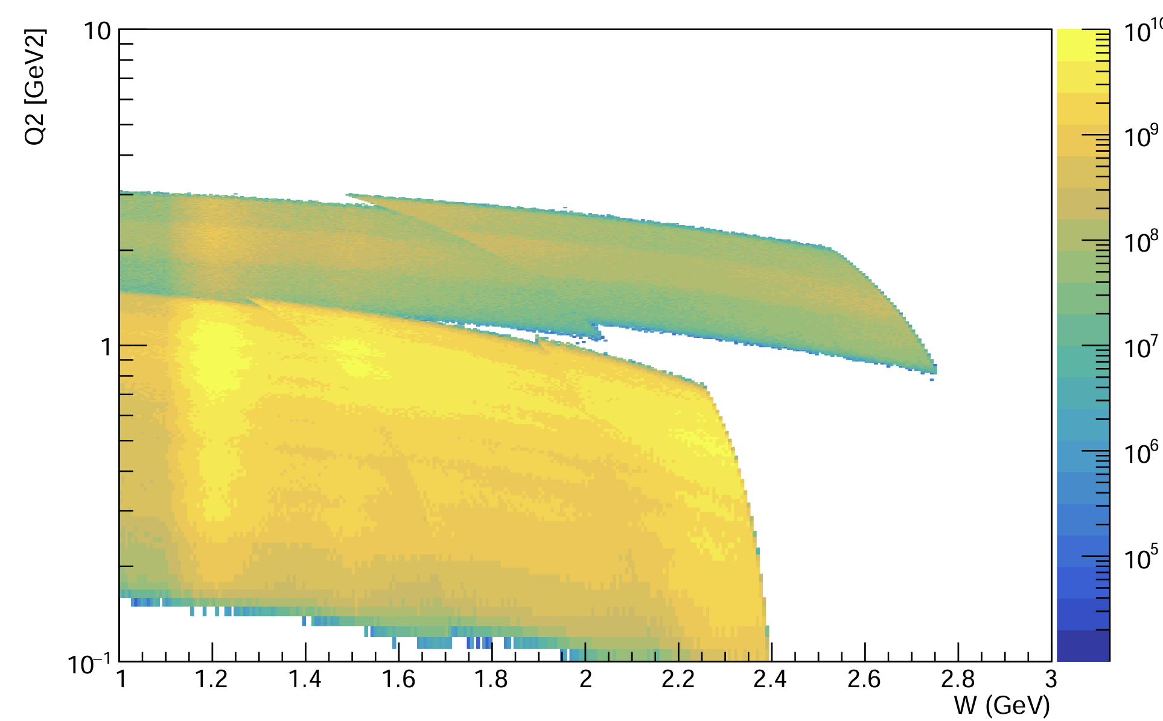
Proposed Experiment
8.8 GeV Beam
4.4 GeV Beam
Measure proton g₂ in the resonance region for a full order of magnitude in Q² range from 0.2 GeV² - 2.2 GeV²
Use a transversely polarized NH₃ target and the SHMS spectrometer in Hall C
Low current (85 nA) beam at 4.4 and 8.8 GeV beam energies
Collect the first transition region measurement of the proton’s g₂, and extract its moments and higher twist effects

Slide 11
Experimental Setup
SHMS
Moller
Polarimeter
Fast Raster
Slow
Raster
Slow
Raster
Chicane
1
Chicane
2
BPMs/Harps
5T Transverse
Target
BCMs
Dump
Standard equipment package, plus:
5T polarized target
Chicane Magnet
Low current beamline configuration
Slow Raster
Nearly identical to the successful setup for previous Hall A/C experiments RSS, EG4, g2p

Slide 12
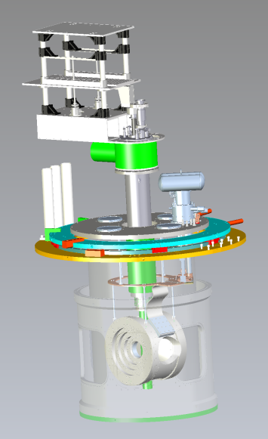
Polarized Target
NH₃ (Ammonia) target
Transversely Polarized with Dynamic Nuclear Polarization (DNP)
Since previous experiments:
New Target Group magnet more optimized for transverse running!
Several polarized target experiments already approved in Hall C – possibility for cooperation on scheduling!

Slide 13
Chicane Magnet
See R. Bodenstein, JLAB-TN-25-023
The transverse target field needs pre-bending of the beam
Chicane design (J. Benesch) would replace two existing 1m dipoles
Further BMAD optimization performed by R. Bodenstein
Chicane will be needed for SoLID and any other experiment with transverse polarized target

Slide 14
Simulation Study
✅
✅
✅
✅
Monte-Carlo simulation performed with all effects included & accounted for:
Raster
Chicane
Target Field
Spectrometer Optics
Transverse target field calculation:
Field Map
Iterative Runge-Kutta procedure
Chicane optimization: BMAD and Optim
Standard Hall C analysis cuts
Systematic impact on observable now included
z
All following plots are for the worst case kinematic setting at the lowest Q².
Target field/chicane effects are smaller for all other settings.
Thanks to Jefferson Lab Staff Scientists
Dave Gaskell, Jay Benesch, and Ryan Bodenstein for their help!

Slide 15
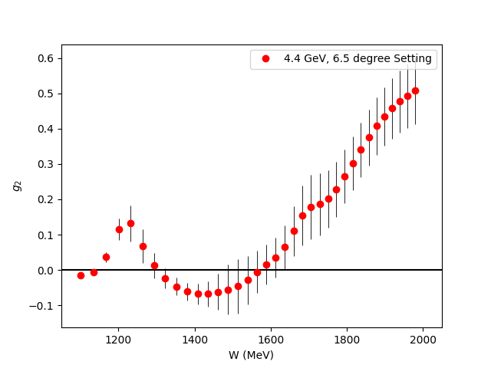
Resolutions
Without Target Field/Chicane
With Target Field/Chicane
Planned Bin Size: > 30 MeV
Resolution w/ Target: 10-20 MeV
There should be no issue resolving the resonances of g₂p

Slide 16
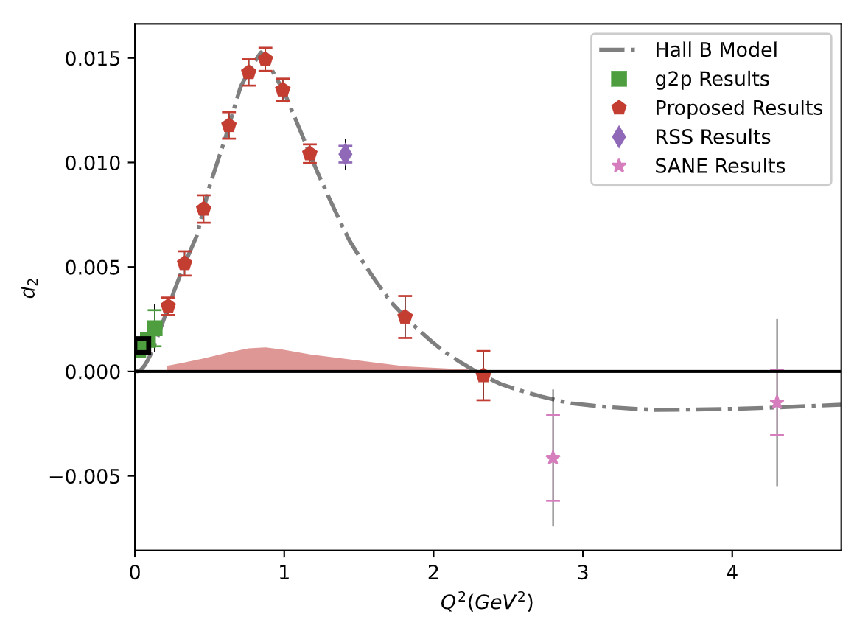
Resolutions
$$θ$$
$$θ$$
$$φ$$
$$φ$$
Without Target Field/Chicane
With Target Field/Chicane
Planned Scattering Angle Bin Size: ~1.0 - 2.5º
Resolution w/ Target: ~0.96º
There should be no issue resolving the features of the moments

Slide 17
Impact on Coverage
Without Target Field/Chicane
With Target Field/Chicane
Effects on the kinematic coverage are small and well-understood

Slide 18
Systematic Impact
Without Target Field/Chicane
With Target Field/Chicane
Around a 2% or less effect from the resolution on the XS
Included in new systematics calculation

Slide 19
Simulation Conclusions
PAC52 Conditional: “The impact of this new setup on the detector resolution and its subsequent effect on the physics results has not been thoroughly addressed. A full Monte Carlo simulation of the new setup and detector is needed.” (✅ Complete)
Resolutions enlarged by the target field and are close to the desired bin size, so a full simulation was indeed necessary
We have fulfilled PAC52’s condition and the impact of the target and chicane is now well understood and accounted for

Slide 20
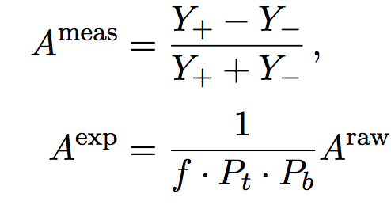
g₂ Extraction Method
Measure Asymmetry and Cross Section:
Form Polarized XS Difference:
Extract g₂
$$A_{⊥}^{Raw}=\frac{σ^{↑⇒}−σ^{↓⇒}}{σ^{↑⇒}+σ^{↓⇒}}$$
$$\frac{d2σ}{dΩdE′}=\frac{(ps)N}{N_{in}ρ(LT)ε_{det}}\frac{f}{ΔΩΔE′ΔZ}$$
Spin-Dependent Effects
Unpolarized
Scattering
$${∆σ}_{⊥} =2A_{⊥}^{exp}σ_{0}$$
Input from
Hall B Data
$$g_{2}\left(x,Q^{2}\right)= \frac{K_{1}y}{2}\left[Δσ_{⊥}\left(K_{2}+\tan{\frac{θ}{2}}\right)\right]+ \frac{g_{1}\left(x,Q^{2}\right)y}{2}$$

Slide 21
Beam Time Required
Source | Time (PAC Days)
Q² = 0.22 GeV² | 0.1
Q² = 0.33 GeV² | 0.2
Q² = 0.46 GeV² | 0.3
Q² = 0.62 GeV² | 0.8
Q² = 0.77 GeV² | 1.1
Q² = 0.89 GeV² | 1.8
Q² = 1.03 GeV² | 2.3
Q² = 1.25 GeV² | 4.6
Q² = 1.84 GeV² | 0.9
Q² = 2.2 GeV² | 0.9
Total Physics Days | 13
Overhead Days | 13
Only
26 Days
To measure 10 Q² settings of g₂ with high precision…
covering a full order of magnitude of the transition region!

Slide 22
Projected Systematics
Source | %
Acceptance | 4-6
Packing Fraction | 3
Charge Determination | 1
Tracking Efficiency | 1
PID Efficiencies | < 1
Software Cut Efficiency | < 1
Resolution/Simulation | < 2
Energy | 0.5
Deadtime | < 1
XS Total | 5-7
Target Polarization | 5
Beam Polarization | 3
Radiative Corrections | 3
Parallel Contribution | 2
Const Q² Adjustment | < 1
S.F. Total | 8.5-9.8
Dominating systematics are target polarization and acceptance

Slide 23
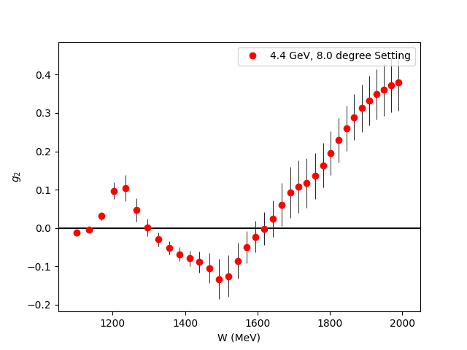
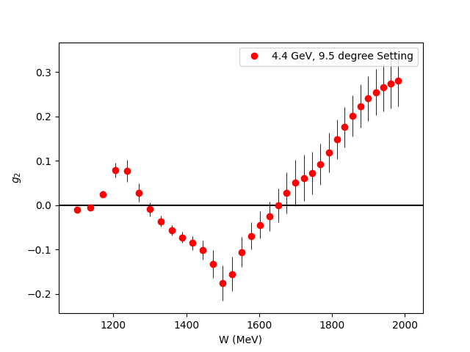
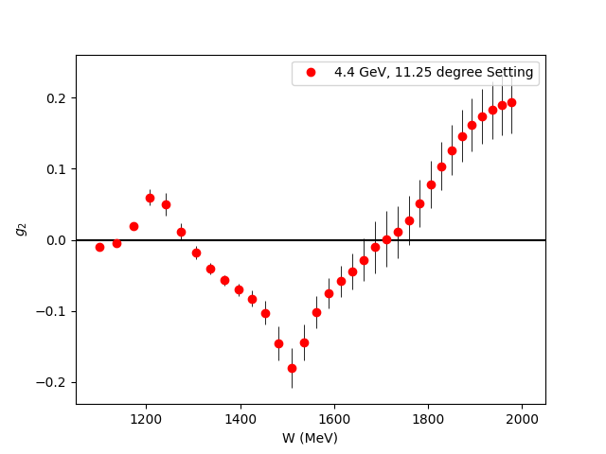
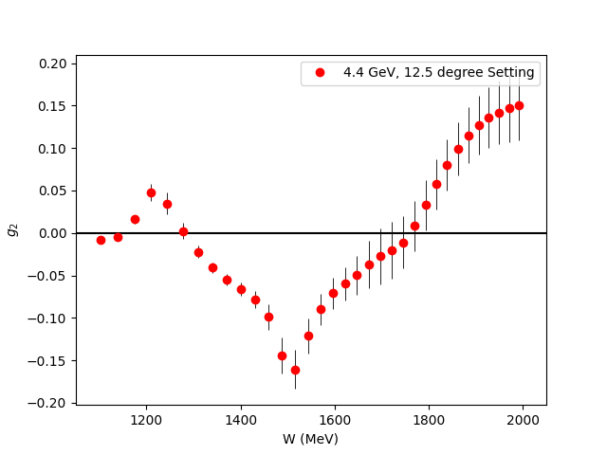
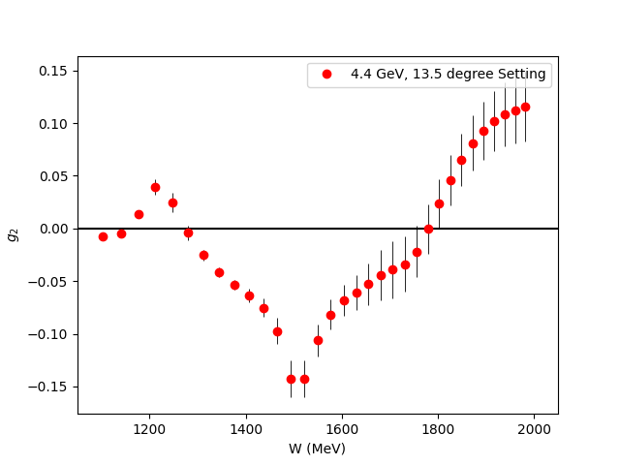
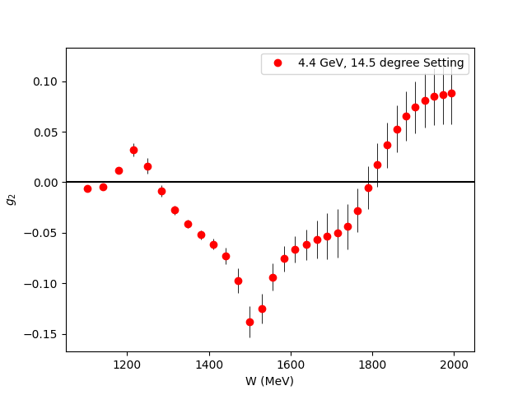
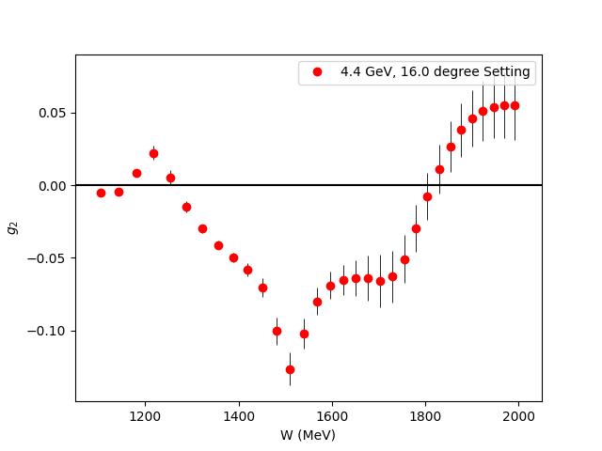
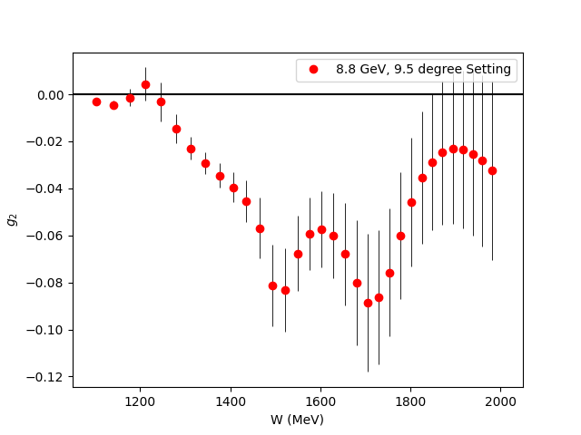
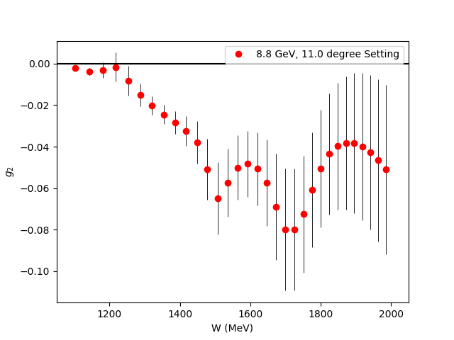
Projected g₂ Uncertainties
Fills the last major Q² spectrum gap for the nucleon spin structure functions
Covers almost the entire transition region

Slide 24
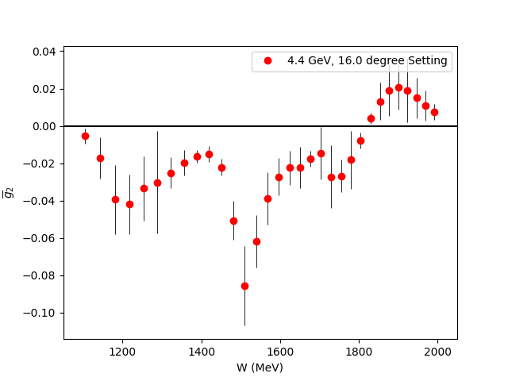
$\overline{g_{2}}$ (Twist 3 Extraction)
Small
$$g_{2}\left(x,Q^{2}\right)=g_{2}^{WW}\left(x,Q^{2}\right)−\int_{x}^{1}{\frac{∂}{∂y}\left[\frac{m_{q}}{M}h_{T}\left(y,Q^{2}\right)+ζ\left(y,Q^{2}\right)\right]\frac{dy}{y}}$$
$\overline{g_{2}}$ (Twist-3)
Utilize CLAS Hall B Results
for g₁ in same regime
Direct extraction of Twist 3 effects
in the regime they contribute most significantly

Slide 25
Projected $\overline{d_{2}}$ Uncertainties
Can benchmark Lattice QCD in the regime where Perturbative QCD starts failing
New Lattice calculations expected in next few years!
Results should discover maximum and zero crossing of this unique polarizability!

Slide 26
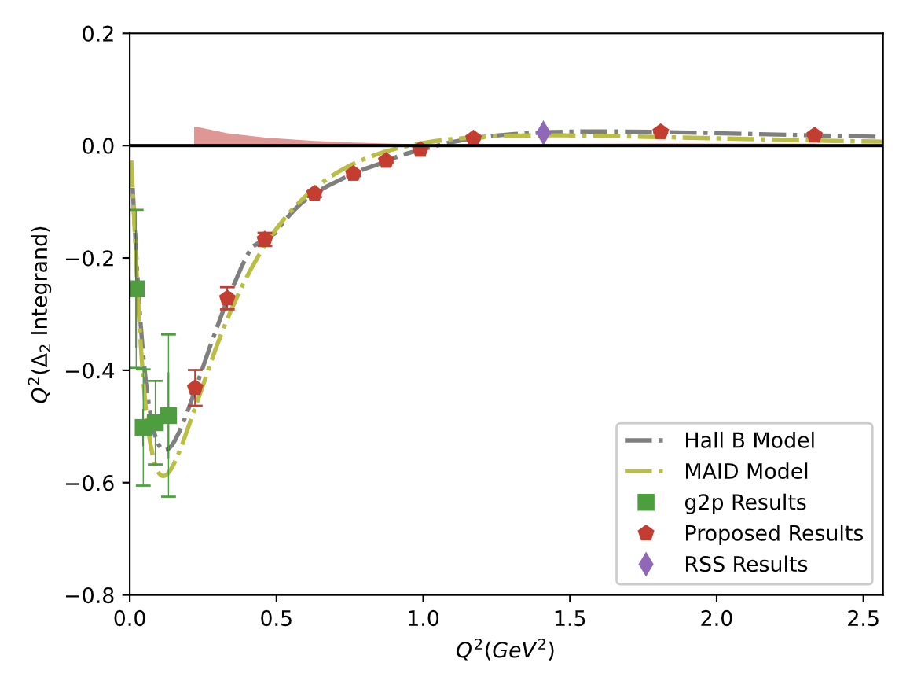
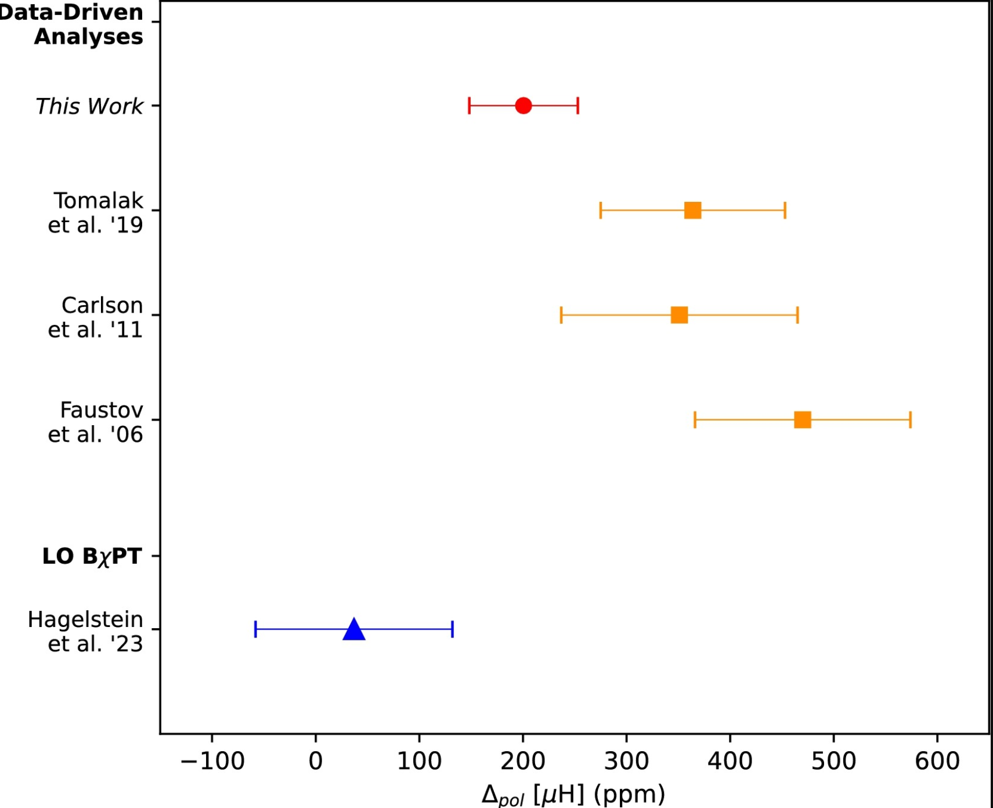
Hyperfine Splitting Impact
$$Δ_{2}=−24M_{p}^{2}\int_{0}^{∞}{\frac{dQ^{2}}{Q^{4}}}\int_{0}^{x_{th}}{\tilde{β_{2}}\left(x , Q^{2}\right)g_{2}\left(x , Q^{2}\right)dx}$$
Transition region accounts for 30% of $Δ_{2}$
These results can cut the error in this region to $1/6$ of the current error
$Δ_{pol}={c(Δ}_{1}+Δ_{2})$ accounts for 81% of the current two-photon Hyperfine Splitting uncertainty
Opportunity to study or maybe eliminate a long-standing tension between theory and experiment for $Δ_{pol}$!
Ruth
et al. ‘24
$$Δ_{pol}$$

Slide 27
What do past PACs and theorists have to say…?
“A clear case of ‘low-hanging fruit’ with a wealth of opportunities to address long-standing open questions.”
– PR12-23-007 Theory Report
“The PAC recognizes the significant importance of measuring the fundamental proton structure function g₂ for the proton. The presented physics case and the proponents’ approach to the future measurement are solid.”
– PAC52 Report
“Scientifically sound, with a clear rationale and a well-designed experimental plan”
– PR12-24-002 Theory Report

Slide 28
Summary
In 26 PAC Days, we will measure and publish fundamental observable g₂ across an order of magnitude range of the transition region Q² = 0.22 – 2.2 GeV² and:
Study Twist-3 with $\overline{g_{2}}$
Reduce error on the leading uncertainty in Hydrogen Hyperfine Splitting and study a long-standing tension
Fill the last major gap in the nucleon spin structure function Q² spectrum
Benchmark Lattice QCD with $\overline{d_{2}}$
Study other truncated moments
Let’s make it happen!

Slide 29
Backup Slides

Slide 30
Hyperfine Contribution
Running Integral from $\int_{Q_{min}^{2}}^{∞}{dQ^{2}}$
$$Δ_{2}=−24M_{p}^{2}\int_{0}^{∞}{\frac{dQ^{2}}{Q^{4}}}\int_{0}^{x_{th}}{\tilde{β_{2}}\left(x , Q^{2}\right)g_{2}\left(x , Q^{2}\right)dx}$$
The leading error in theoretical calculations of the hydrogen HFS comes from these spin-structure function dependent integrals!
The subject of an ongoing tension between theory and experiment
The transition region accounts for ~30% of the integral!
Running Integral
$Q_{min}^{2}$ (GeV²)

Slide 31
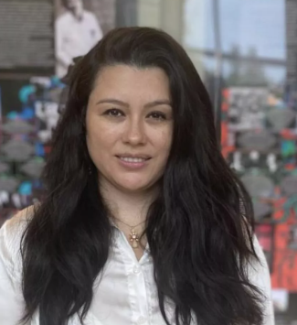
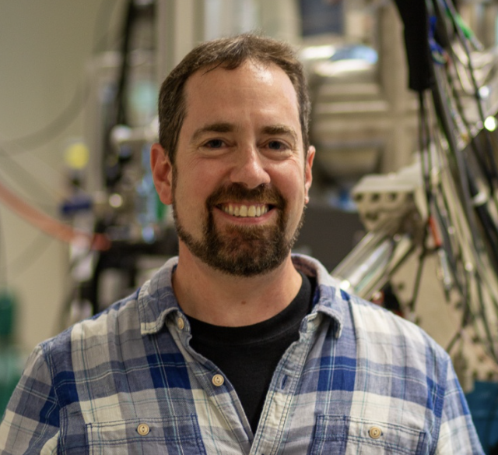
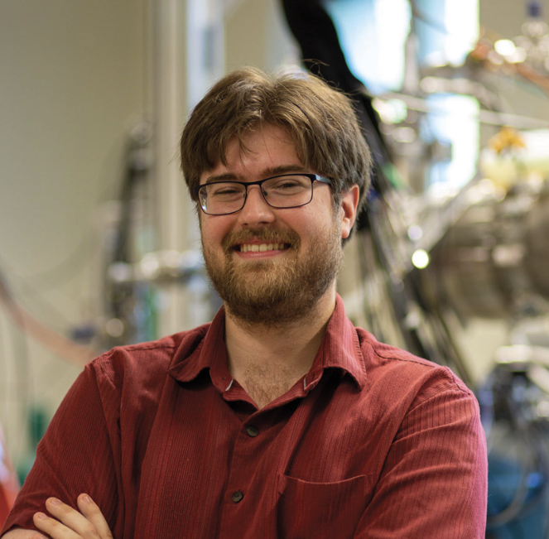
Collaboration
Jian-Ping Chen
Nathaly Santiesteban
Karl Slifer
David Ruth
Polarized Target
Experts
g2p Analysis
SANE Analysis
RSS Analysis
W. Armstrong
J. Maxwell
Z.E. Meziani
M. Jones
K. Slifer, A. Arora, M. Farooq, N. Santiesteban, H. Chinchay, Z. Wolters, O. Olokunboyo, A. Zec, E. Long, J.P. Chen, D. Ruth, C. Keith, J. Maxwell. D. Meekins, J. Brock, D. Keller, I. Fernando, S. Covrig Dusa
D. Ruth
J.P. Chen
K. Slifer
K. Slifer
M. Jones
O. Rondon
Notes:
.

Slide 32
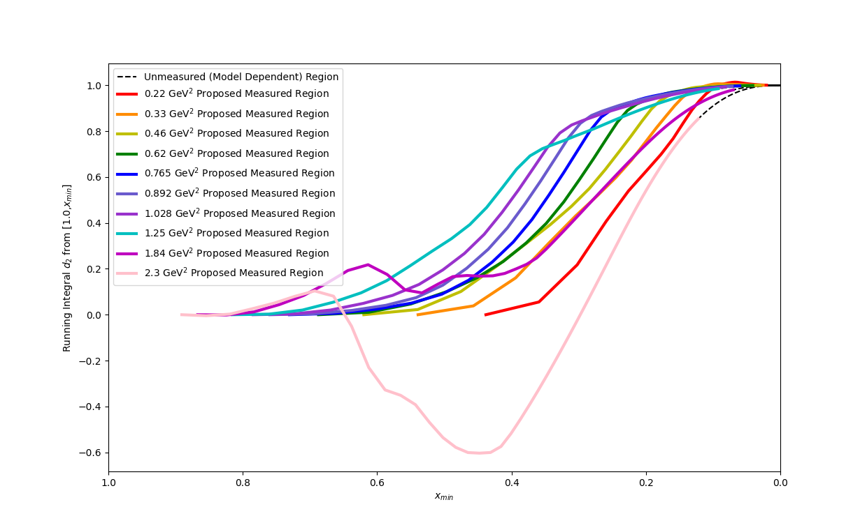
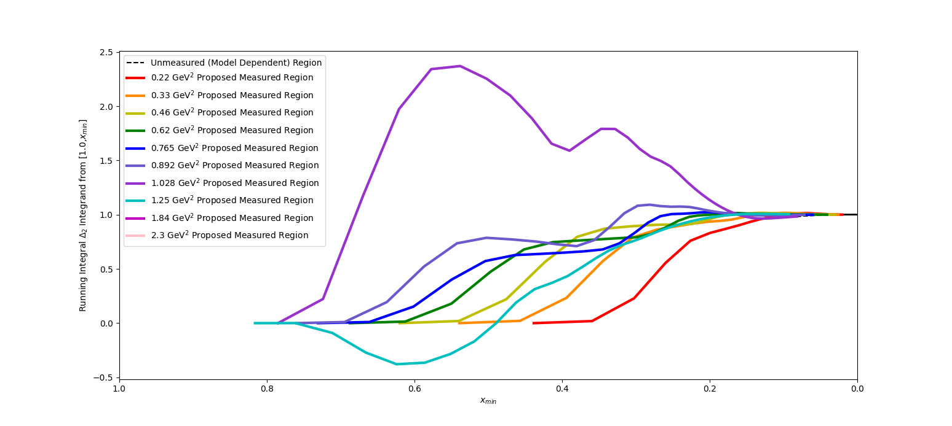
Running Integrals as % Total Value ($\int_{x_{min}}^{1}{dx}$)
Running Integral (% Total)
Running Integral (% Total)
$\overline{d_{2}}$
$Δ_{2}$
x_{min}
x_{min}
Integrals are saturated in the measured region (flat slope)
Therefore, the low-x regime is irrelevant to these integrals

Slide 33
Rates Table
E₀ (GeV) | Scattering Angle (deg) | P₀ (GeV) | Target Q² (GeV²) | Proton Rate (Hz) | Rate (kHz) | Time (h)
4.4 | 6.5 | 3.607 | 0.22 | 77 | 40.0 | 1
 |  | 2.661 |  | 65 | 25.1 | 1
 |  | 1.963 |  | 69 | 18.9 | 1
 | 8 | 3.607 | 0.33 | 41 | 21.4 | 1.3
 |  | 2.661 |  | 28 | 11.5 | 1.9
 |  | 1.963 |  | 30 | 8.3 | 1.8
 | 9.5 | 3.607 | 0.46 | 18 | 9.1 | 2.3
 |  | 2.661 |  | 14 | 5.9 | 3.0
 |  | 1.963 |  | 15 | 4.3 | 2.8
 | 11.2 | 3.607 | 0.62 | 7 | 3.7 | 6.0
 |  | 2.661 |  | 6 | 3.0 | 6.5
 |  | 1.963 |  | 7 | 2.2 | 5.9
 | 12.5 | 3.607 | 0.765 | 4 | 2.0 | 9.1
 |  | 2.661 |  | 4 | 1.9 | 8.5
 |  | 1.963 |  | 4 | 1.5 | 7.6
 | 13.5 | 3.607 | 0.892 | 2 | 1.3 | 16.5
 |  | 2.661 |  | 3 | 1.3 | 13.7
 |  | 1.963 |  | 3 | 1.1 | 12.1
 | 14.5 | 3.607 | 1.028 | 1 | 0.8 | 23.2
 |  | 2.661 |  | 2 | 1.0 | 17.4
 |  | 1.963 |  | 2 | 0.8 | 14.9
 | 16 | 3.607 | 1.250 | 0 | 0.4 | 50.8
 |  | 2.661 |  | 1 | 0.6 | 32.7
 |  | 1.963 |  | 1 | 0.5 | 26.6
8.8 | 11 | 7.213 | 2.3 | 0 | 0.5 | 33.3
 |  | 5.321 |  | 0 | 0.8 | 19.0
 | 14 | 7.213 | 3.44 | 0 | 0.1 | 101.8
 |  | 5.321 |  | 0 | 0.2 | 31.6
Total PAC Days:
13.0

Slide 34
Overhead
Overhead | Number | Time Per (hr) | (hr)
Target Anneal | 26 | 2.0 | 52.0
Beamline Survey | 10 | 8.0 | 80.0
Target Swap | 2 | 4.0 | 8.0
Target T.E. | 6 | 4 | 24.0
Target Field Ramp | 10 | 1.0 | 10.0
Carbon, Dummy, Empty runs | 28 | 0.5 | 14.0
Pass Change | 2 | 4.0 | 8.0
Momentum Change | 28 | 0.5 | 14.0
Moller Measurement | 10(+1 shift) | 4.0(+8.0) | 48.0
Pair-Symmetric Background | 2 | 4.0 | 8.0
Optics Calibration | 2 | 16.0 | 32.0
BCM Calibration | 2 | 4.0 | 8.0
Total: 12.7 Overhead Days (305.5)

Slide 35
Burkhardt-Cottingham Sum Rule
$Γ_{2}= \int_{0}^{x_{th}}{g_{2}\left(x,Q^{2}\right)dx}$ = 0
“Superconvergence” Sum Rule for an amplitude whose imaginary part is g₂
Assuming convergent dispersion relations for g₂(𝜈) and 𝜈g₂(𝜈), arises naturally from subtraction of VVCS amplitudes:
$Im S_{2}\left(ν,Q^{2}\right)= \frac{2π}{ν^{2}M}g_{2}(x,Q^{2})$
$S_{2}\left(ν,Q^{2}\right)=\frac{2}{π}\int_{ν_{th}}^{∞}{\frac{ν Im S_{2}}{ν^{′2}−ν^{2}}dν^{′}}$
$νS_{2}\left(ν,Q^{2}\right)=\frac{2}{π}\int_{ν_{th}}^{∞}{\frac{ν^{′}Im S_{2}}{ν^{′2}−ν^{2}}dν^{′}}$
B.C. Integral converges to 0 in both QED and Perturbative QCD, and follows from Wandzura-Wilczek relation (Altarelli et al [1994], R. L. Jaffe [1990 Review])

Slide 36
Reliability of the Chicane
Chicane is a new installation, not a refurbishment of the old chicane
Design is fundamentally similar to numerous similar projects by the JLab staff, nothing untested or uncertain about it
Dr. Benesch is the longest serving member of the TAC and has designed resistive and superconducting magnets since 1976
Design is “Proof of Principle” only in sense that mm scale refinements still need to be made
Staff scientists are very confident that chicane will be carefully built and tested and will work well, but will need some time to commission

Slide 37
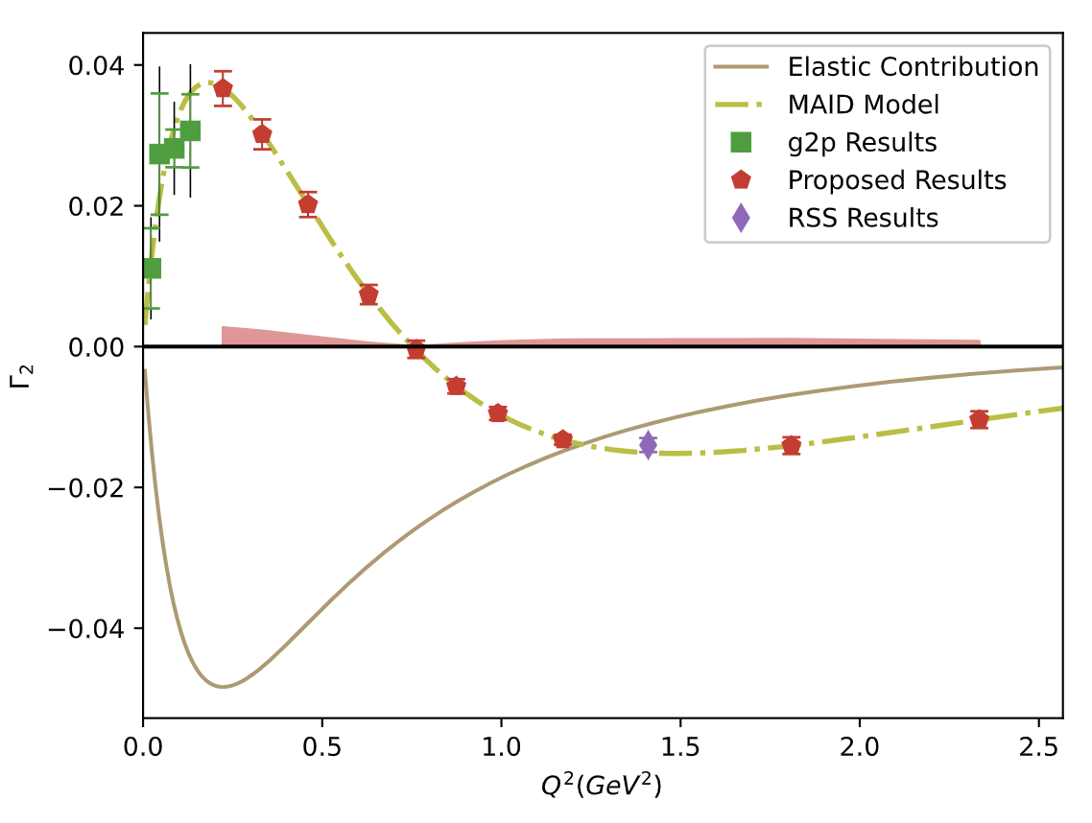
Projected $Γ_{2}$ Uncertainties
Having data in the regime where twist-2 assumption fails helps us better understand the small-x regime
If B.C. Sum Rule is followed, then we directly measure how the low-x part transitions from $g_{2}^{WW}$into a more complex form!

