Slide 1
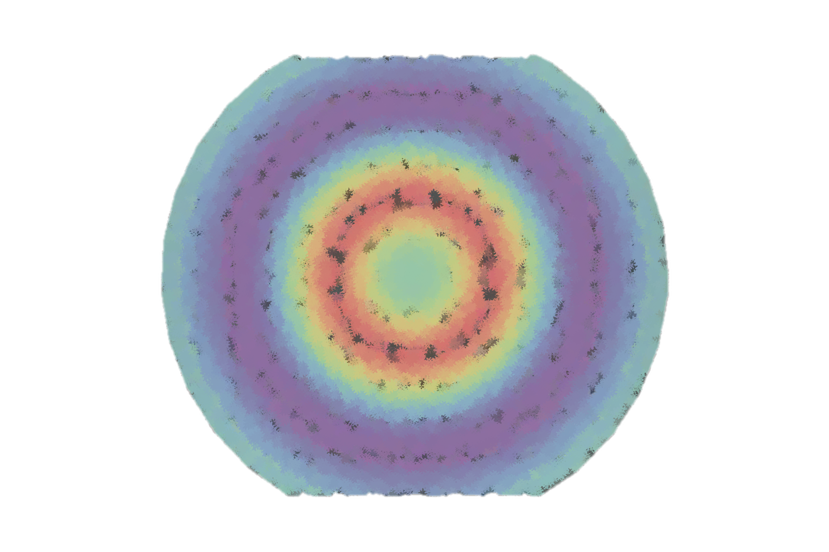
The strange mechanical structure of the proton in hall c
Henry Klest
Argonne National Laboratory
On Behalf of the Hall C Phi Collaboration
hklest@anl.gov

Slide 2
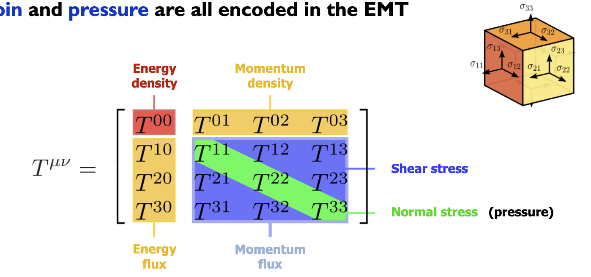
Proton mechanical structure
Proton mechanical structure is defined by analogy to GR via the QCD energy-momentum tensor (EMT)

Slide 3
Gravitational form factors
Proton gravitational form factors (GFFs) encode information about the matrix elements of the QCD energy-momentum tensor
EMT Matrix Elements

Slide 4
Gravitational form factors
Proton gravitational form factors (GFFs) encode information about the matrix elements of the QCD energy-momentum tensor
Form factors
Fourier transforms of spatial distributions

Slide 5
Gravitational form factors
Proton gravitational form factors (GFFs) encode information about the matrix elements of the QCD energy-momentum tensor
Form factors
Fourier transforms of spatial distributions
“Gravitational”
Describing the energy-momentum tensor
I.e. what would be seen from proton-graviton scattering

Slide 6
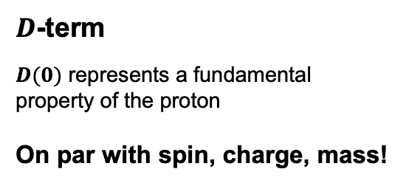
Gravitational form factors
Proton gravitational form factors (GFFs) encode information about the matrix elements of the QCD energy-momentum tensor
$D$-term
$D(0)$ represents a fundamental property of the proton
On par with spin, charge, mass!

Slide 7

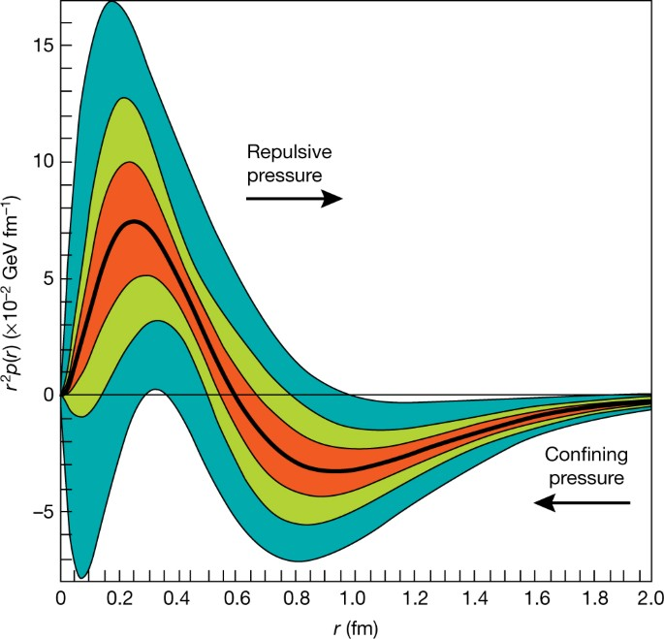
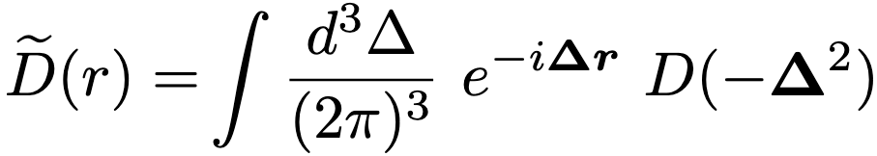
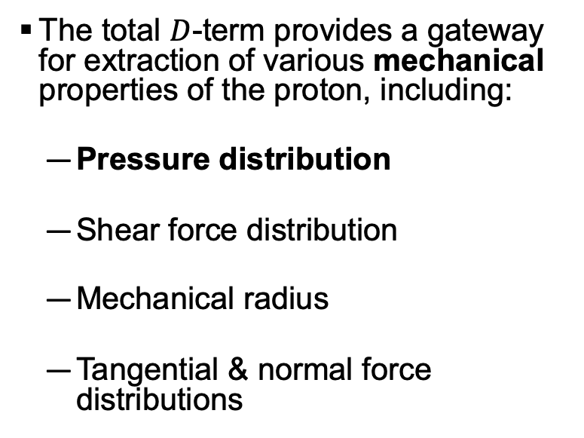
Mechanical properties
The total $D$-term provides a gateway for extraction of various mechanical properties of the proton, including:
  Pressure distribution
  Shear force distribution
  Mechanical radius
  Tangential & normal force distributions
Pre-Jlab 6 GeV Data
Jlab 6 GeV Data
Jlab 12 GeV Data (Projected)

Slide 8
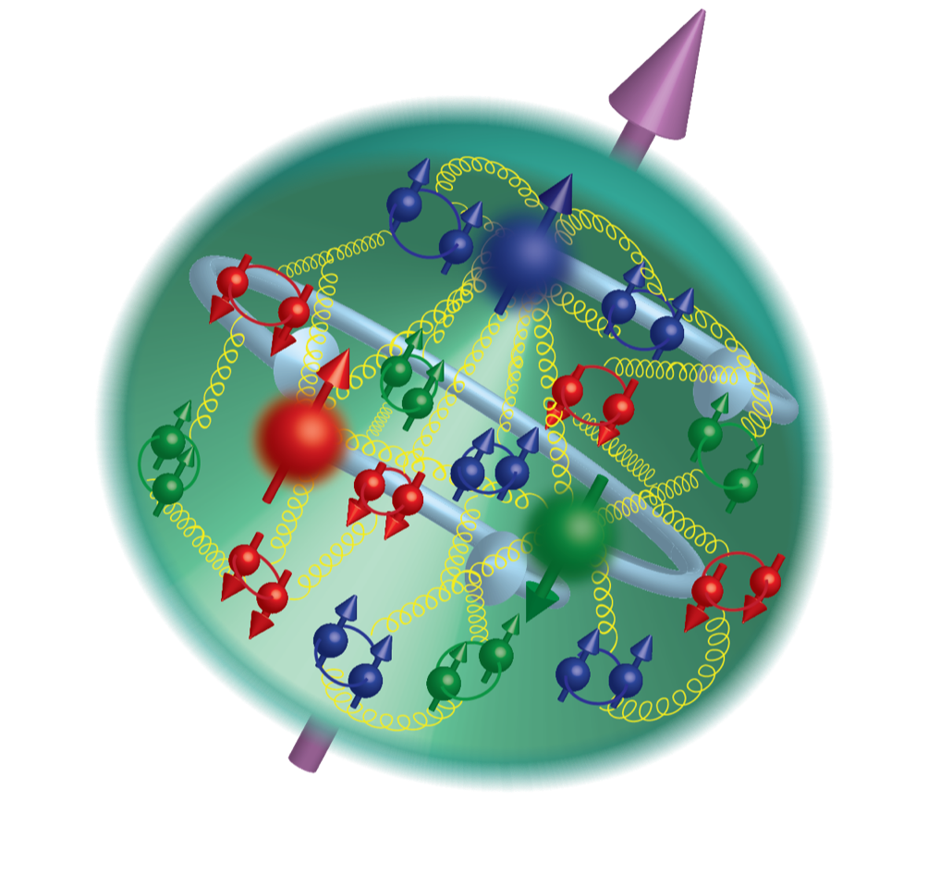
Aside: Under PRessure
Proton:
10³⁰ atmospheres!?
At r = 0.3 fm

Slide 9
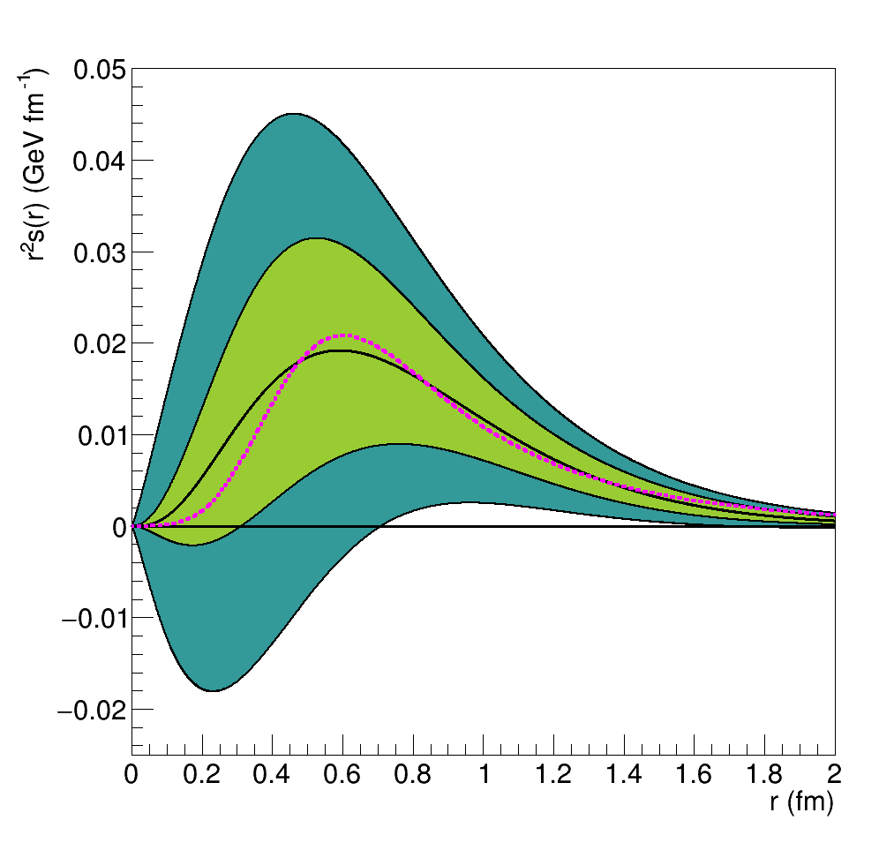
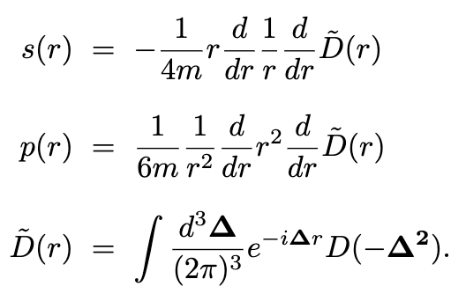
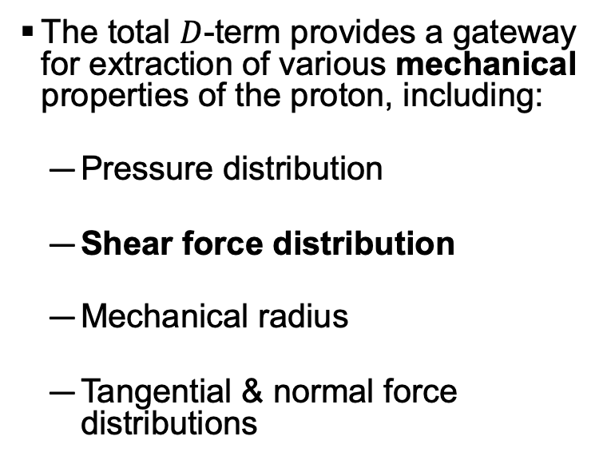

Mechanical properties
The total $D$-term provides a gateway for extraction of various mechanical properties of the proton, including:
  Pressure distribution
  Shear force distribution
  Mechanical radius
  Tangential & normal force distributions
Pre-Jlab Data
Jlab 6 GeV Data
$χQSM$ Prediction

Slide 10
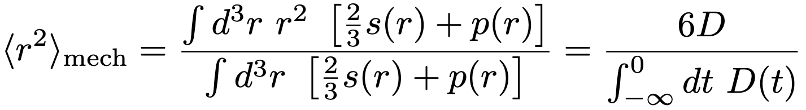
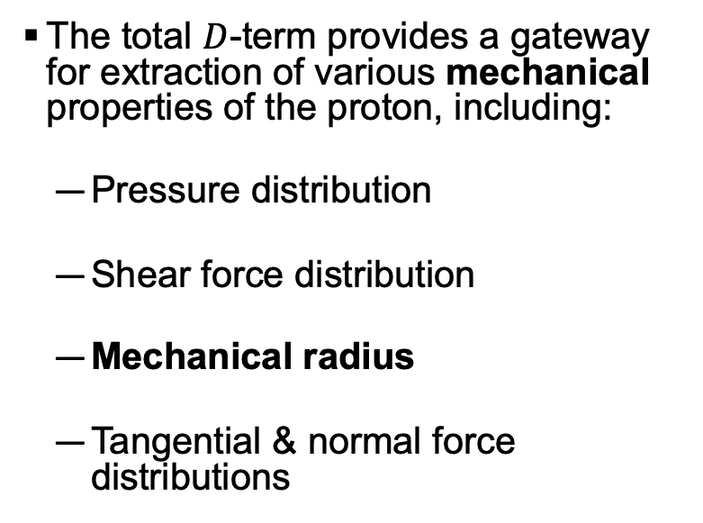
Mechanical properties
The total $D$-term provides a gateway for extraction of various mechanical properties of the proton, including:
  Pressure distribution
  Shear force distribution
  Mechanical radius
  Tangential & normal force distributions

Slide 11
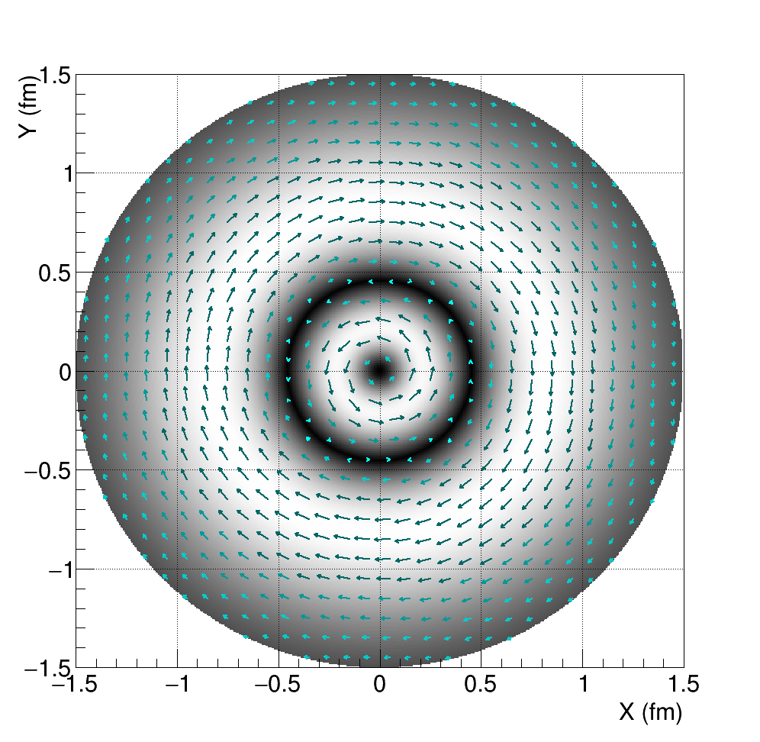
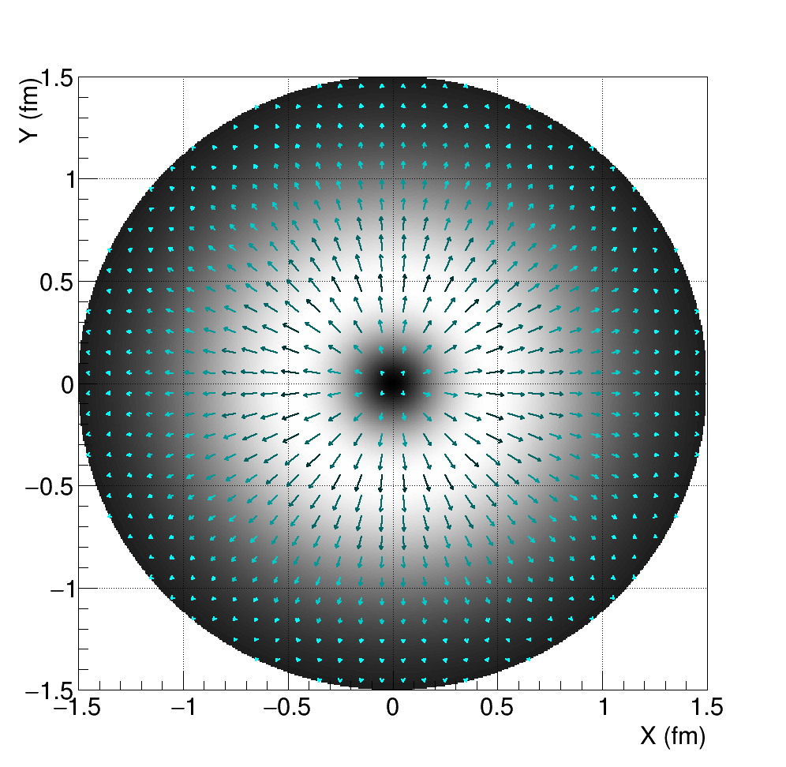
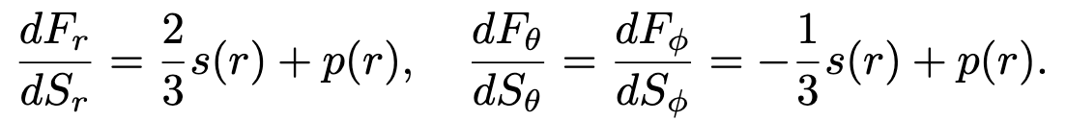
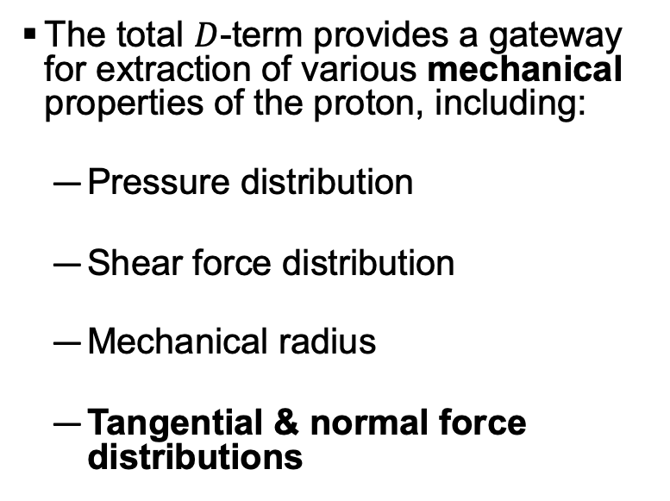
Mechanical properties
The total $D$-term provides a gateway for extraction of various mechanical properties of the proton, including:
  Pressure distribution
  Shear force distribution
  Mechanical radius
  Tangential & normal force distributions
Tangential force
Normal force

Slide 12
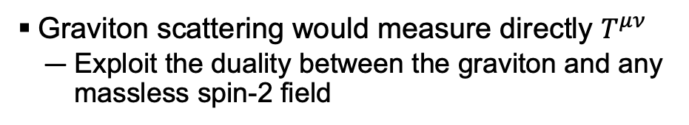

How do we measure this stuff?
Graviton scattering would measure directly $T^{μν}$
  Exploit the duality between the graviton and any massless spin-2 field
𝐷-term is a contribution to the generalized parton distributions (GPDs)
  Measured in hard exclusive reactions like Deeply Virtual Compton Scattering (DVCS), Deeply Virtual Meson Production (DVMP)
Extractions of 𝐷-term can go through GPDs, or use models to bypass them depending on the process
Deeply Virtual Compton Scattering
Graviton exchange $≈$

Slide 13
How do we measure this stuff?
The total 𝐷-term is related to the partonic 𝐷-terms by a sum rule:
Different exclusive processes provide access to the different partonic 𝐷-terms!

Slide 14
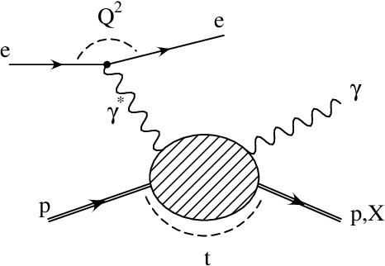
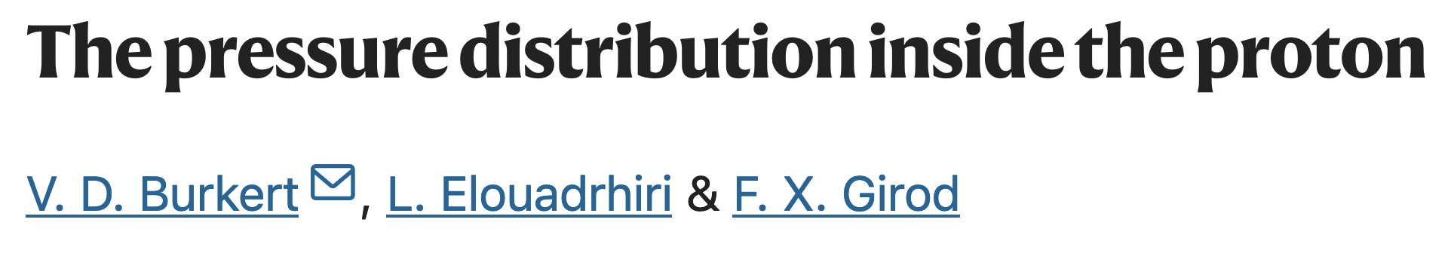
Up & Down quarks:
Accessible via DVCS cross section & beam-spin asymmetries

Slide 15
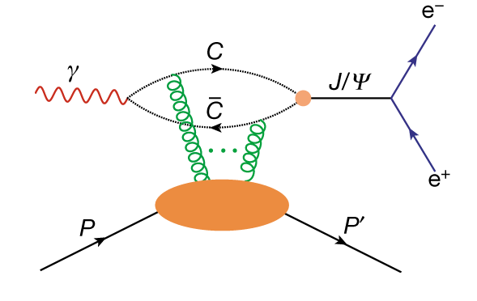
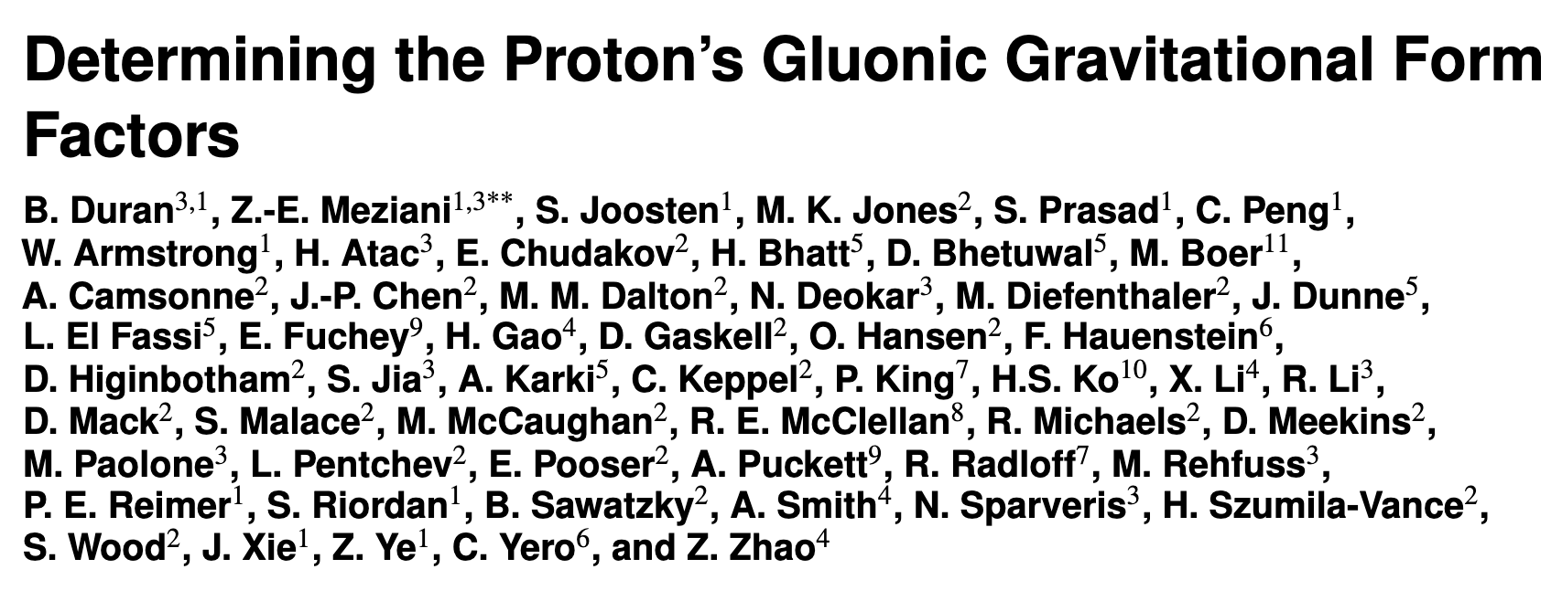
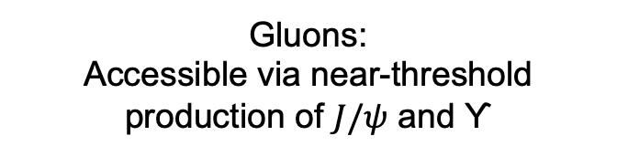
Gluons:
Accessible via near-threshold production of $J/ψ$ and ϒ

Slide 16
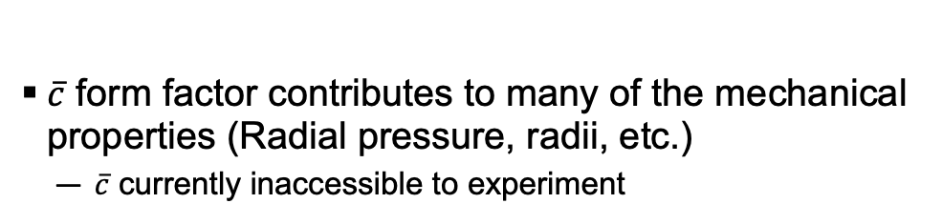
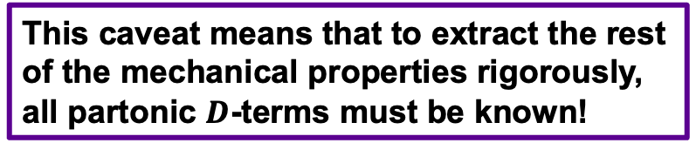
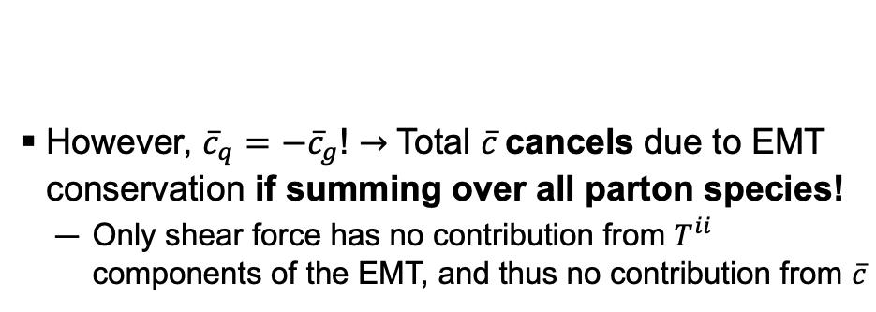
$\overline{c}$ Caveat
$\overline{c}$ form factor contributes to many of the mechanical properties (Radial pressure, radii, etc.)
  $\overline{c}$ currently inaccessible to experiment
However, ${\overline{c}}_{q}=−{\overline{c}}_{g}$! $→$Total $\overline{c}$cancels due to EMT conservation if summing over all parton species!
  Only shear force has no contribution from $T^{ii}$ components of the EMT, and thus no contribution from $\overline{c}$
Pressure defined as:
Pre-Jlab 6 GeV Data
Jlab 6 GeV Data
Jlab 12 GeV Data (Projected)
This caveat means that to extract the rest of the mechanical properties rigorously, all partonic $D$-terms must be known!

Slide 17
Since we need all terms in the sum rule to extract pressure, mechanical radius, force distributions…
Strange quarks: Can we just neglect them…?

Slide 18
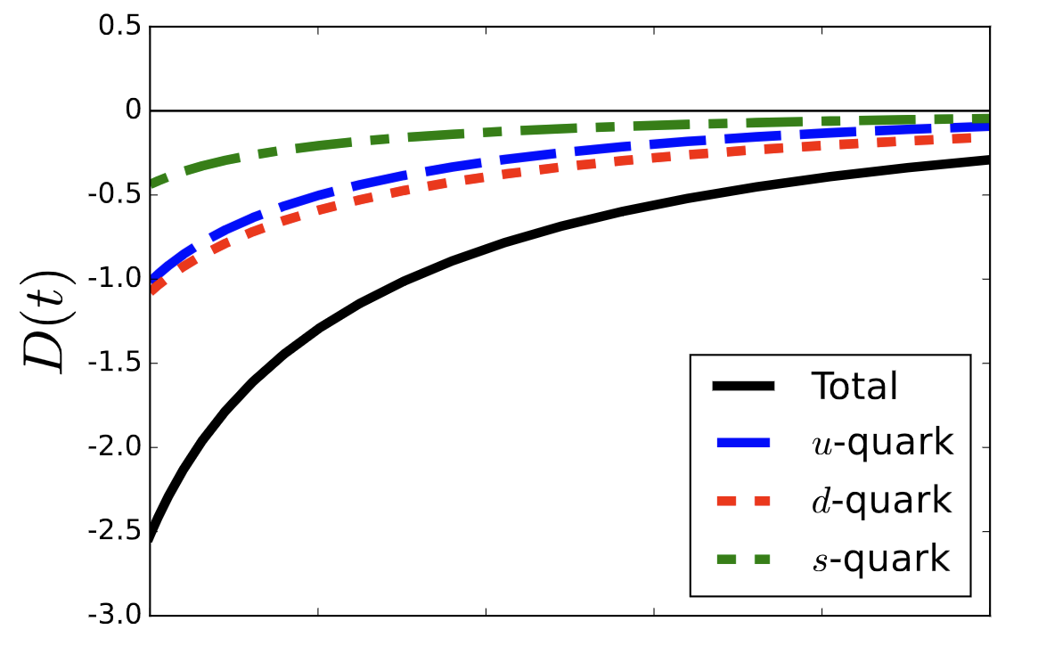
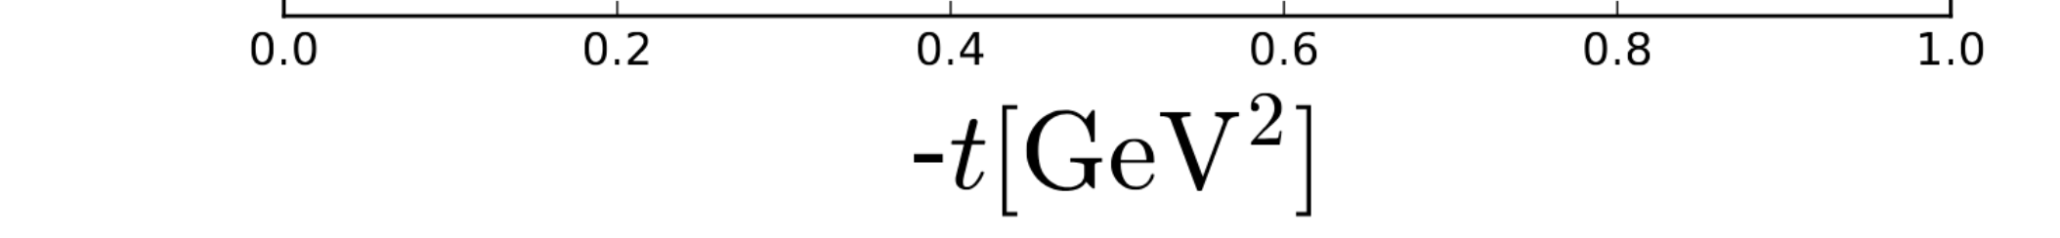
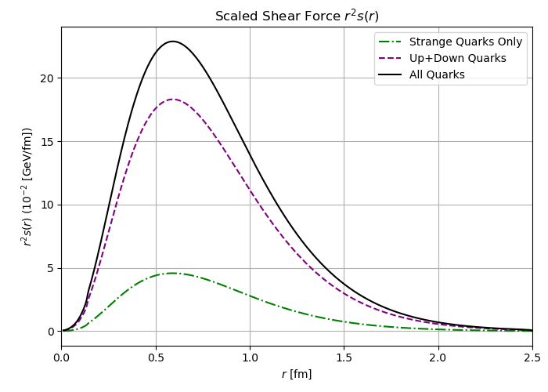
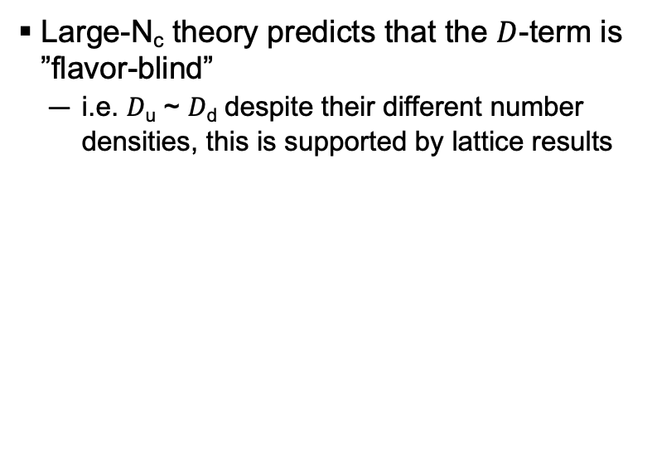

theory predictions
ArXiv: 2307.00740
Large-N_{c} theory predicts that the $D$-term is ”flavor-blind”
  i.e. 𝐷_{u} ~ 𝐷_{d} despite their different number densities, this is supported by lattice results
$$χQSM$$
Extending this argument, could 𝐷_{u} ~ 𝐷_{d} ~ 𝐷_{s}?
Chiral quark soliton model: 𝐷_{u} ~ 𝐷_{d} ~ 2𝐷_{s}
This would make 𝐷_{s} a non-negligible contributor to the total 𝐷-term, and thus necessary for a full extraction of many of the mechanical properties of the proton!

Slide 19
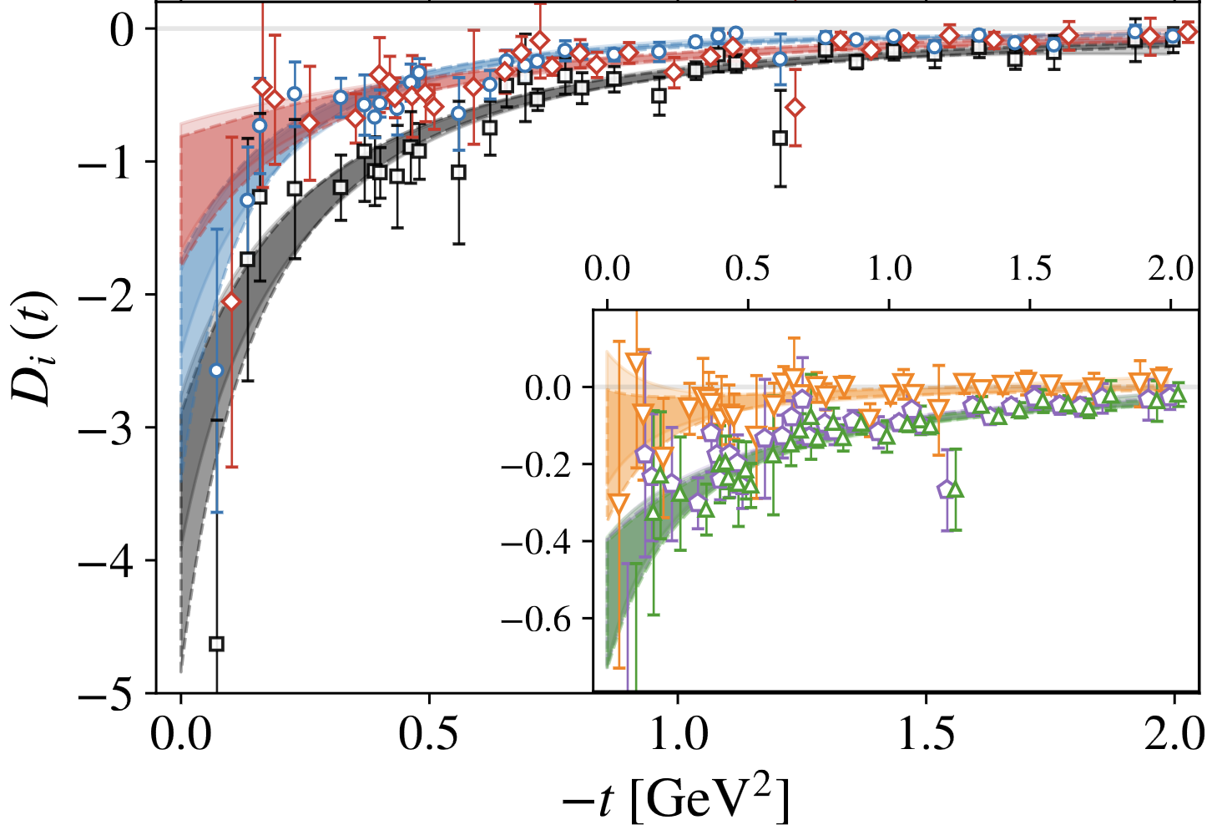
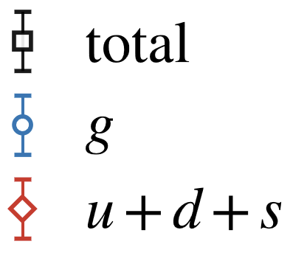
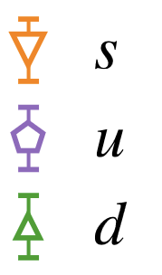
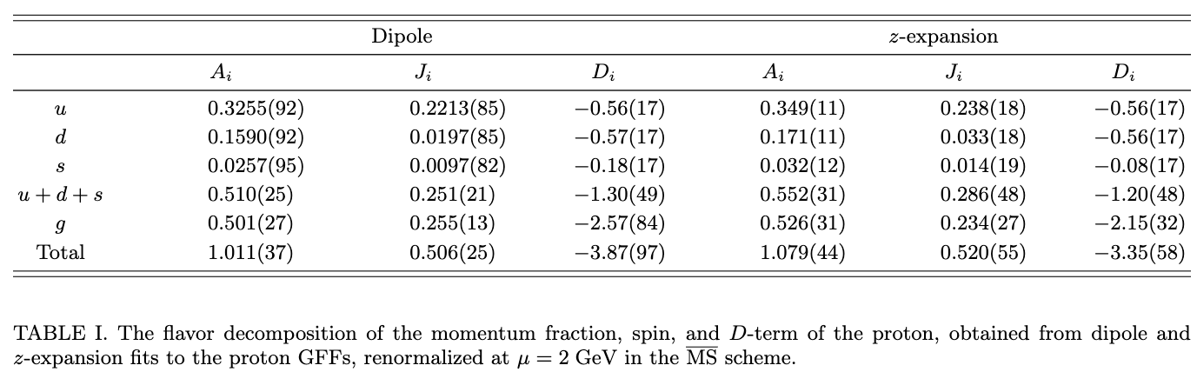
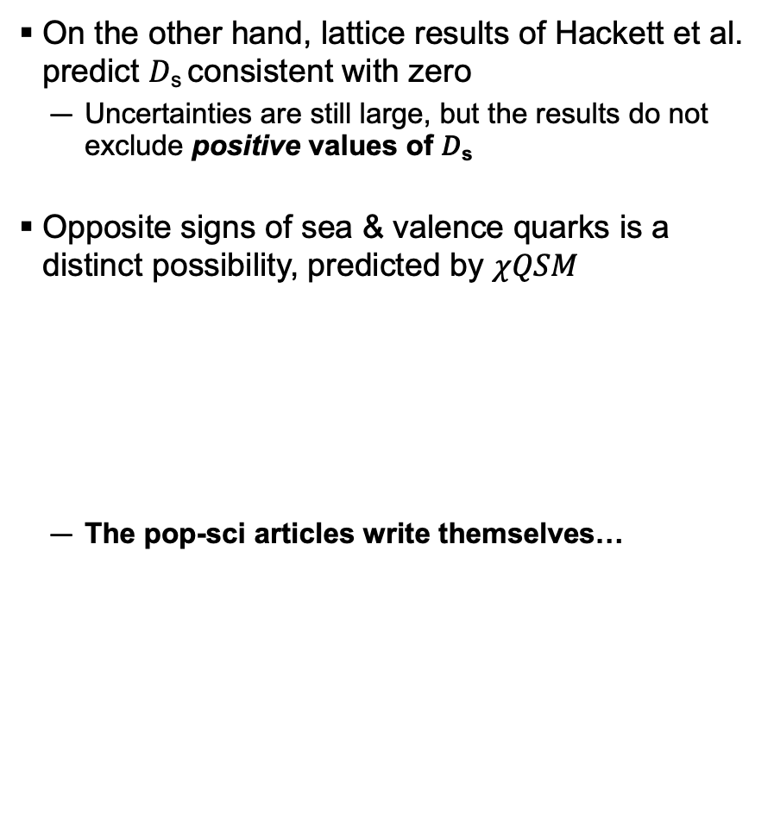
theory predictions
On the other hand, lattice results of Hackett et al. predict 𝐷_{s} consistent with zero
  Uncertainties are still large, but the results do not exclude positive values of 𝐷_{s}
Opposite signs of sea & valence quarks is a distinct possibility, predicted by $χQSM$
  The pop-sci articles write themselves…
𝐷_{s} > 0 would mean that strange quarks feel forces in opposite direction to up & down quarks!

Slide 20
Variety of theory predictions giving very different values for 𝐷_{s}, let’s measure it!
But how…?

Slide 21

Variety of theory predictions giving very different values for 𝐷_{s}, let’s measure it!
But how…?
Exclusive $φ$ in Hall C!

Slide 22
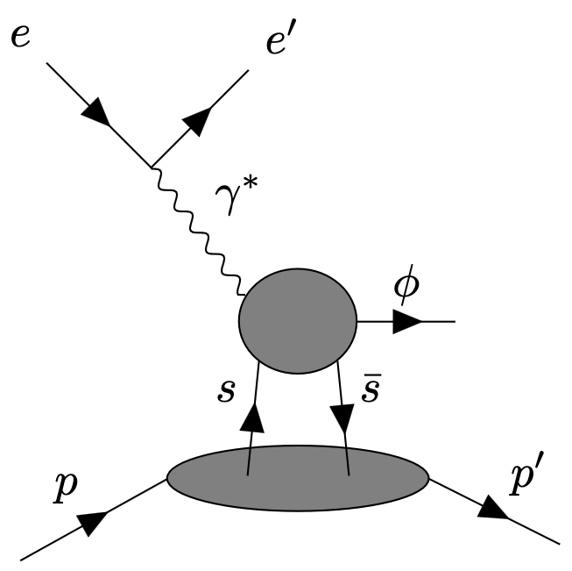
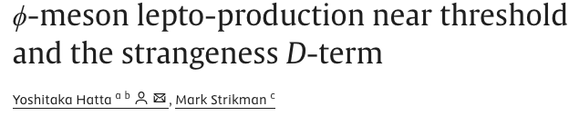
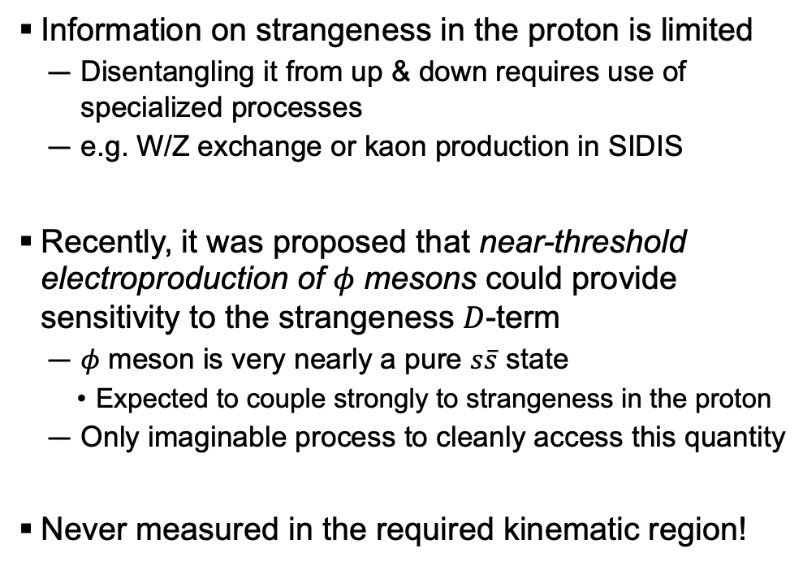
Accessing the strangeness d-term
Information on strangeness in the proton is limited
  Disentangling it from up & down requires use of specialized processes
  e.g. W/Z exchange or kaon production in SIDIS
Recently, it was proposed that near-threshold electroproduction of 𝜙 mesons could provide sensitivity to the strangeness 𝐷-term
  𝜙 meson is very nearly a pure $s\overline{s}$ state
    Expected to couple strongly to strangeness in the proton
  Only imaginable process to cleanly access this quantity
Never measured in the required kinematic region!

Slide 23
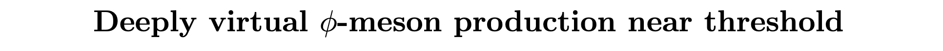

Deep near-threshold 𝜙 kinematics
Near-threshold = invariant mass of final-state hadrons W ~ M_{𝜙} + M_{p} ~ 1.96 GeV
Small momentum transfer to proton = Low-|t|
  Strong sensitivity to strangeness $D$-term!
Q²
W
|t|
Y. Hatta, HK, K. Passek-K., J. Schoenleber

Slide 24
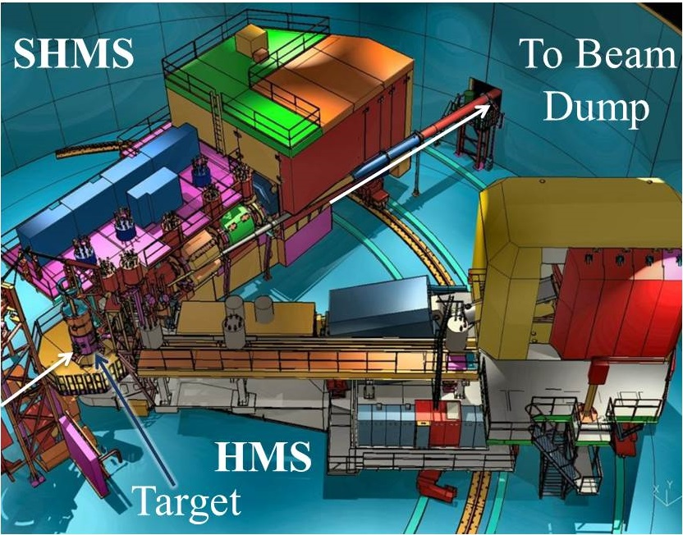
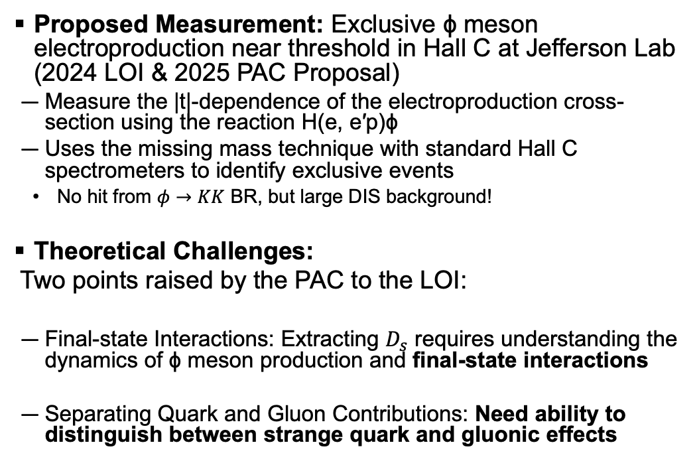
The strangeness d-term in hall c
2501.01582
Proposed Measurement: Exclusive ϕ meson electroproduction near threshold in Hall C at Jefferson Lab (2024 LOI & 2025 PAC Proposal)
  Measure the |t|-dependence of the electroproduction cross-section using the reaction H(e, e′p)ϕ
  Uses the missing mass technique with standard Hall C spectrometers to identify exclusive events
    No hit from $φ→KK$ BR, but large DIS background!
Theoretical Challenges:
  Two points raised by the PAC to the LOI:
  Final-state Interactions: Extracting $D_{s}$ requires understanding the dynamics of ϕ meson production and final-state interactions
  Separating Quark and Gluon Contributions: Need ability to distinguish between strange quark and gluonic effects
Scattered e⁻
Scattered proton
^{e-}
Hall C Phi Collaboration, "Studying the Strangeness D-Term in Hall C via Exclusive ϕ Electroproduction," JLab PAC 52 LOI (2024)

Slide 25
The strangeness d-term in hall c
2501.01582
Proposed Measurement: Exclusive ϕ meson electroproduction near threshold in Hall C at Jefferson Lab (2024 LOI & 2025 PAC Proposal)
  Measure the |t|-dependence of the electroproduction cross-section using the reaction H(e, e′p)ϕ
  Uses the missing mass technique with standard Hall C spectrometers to identify exclusive events
    No hit from $φ→KK$ BR, but large DIS background!
Theoretical Challenges:
  Two points raised by the PAC to the LOI:
  Final-state Interactions: Extracting $D_{s}$ requires understanding the dynamics of ϕ meson production and final-state interactions
  Separating Quark and Gluon Contributions: Need ability to distinguish between strange quark and gluonic effects
Scattered e⁻
Scattered proton
^{e-}
Jobs for theorists…
Hall C Phi Collaboration, "Studying the Strangeness D-Term in Hall C via Exclusive ϕ Electroproduction," JLab PAC 52 LOI (2024)

Slide 26
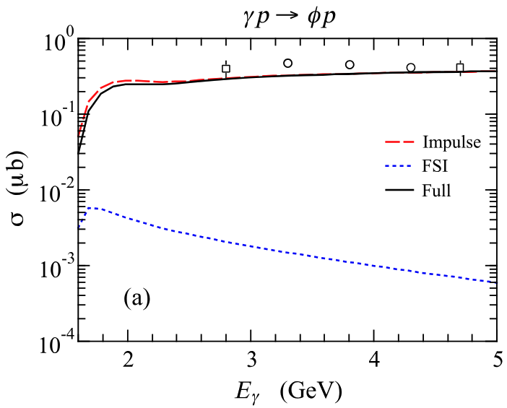
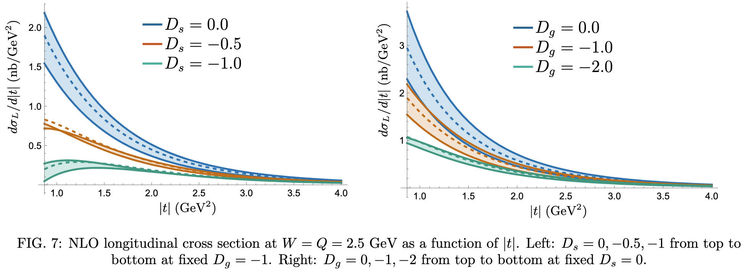
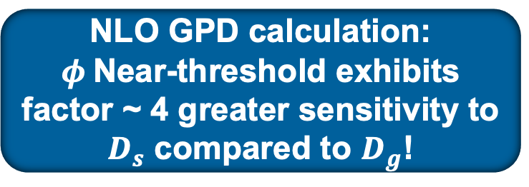
Theorists have been busy!
NLO GPD calculation: $φ$Near-threshold exhibits
factor ~ 4 greater sensitivity to $D_{s}$ compared to $D_{g}$!
FSI negligible
Great for a global fit!
S.H Kim et al. (2108.12039)
Hatta, HK, Passek, Schoenleber (2501.12343)
This is the green light for our experiments to measure $D_{s}$, so let’s go!

Slide 27

Kinematics
75 $μA$ on 10 cm LH₂ target
Measure proton in HMS, electron in SHMS
  SHMS: $θ_{e′}=13°, p_{e′}=6.7$GeV
  HMS: $θ_{p′}=32°, p_{p′}=1.1$GeV
Challenging kinematic constraints from NLO GPD predictions
  $$\left|t\right|≪Q^{2}, W \sim W_{th.}, ξ>0.4$$
Very hard to go to higher Q²
DIS background scales as Q⁴ while this process scales as ~Q^{9.5}
Q² ~ 3.4 GeV² W ~ 2.25 GeV |t| ~ 0.95 GeV²

Slide 28

Experimental measurement
GPD Model wants $dσ_{L}/d|t|$
  Use the Hall C spectrometers to get $e+p→e′+p′+φ$ by measuring the scattered electron and proton and inferring the $φ$ via missing mass
    Infer $σ_{L}$ from $σ_{e}$ and existing world data on $R$
Large and irreducible DIS background!
  However, missing mass resolution of the Hall C spectrometers is good enough to fit + subtract background

Slide 29
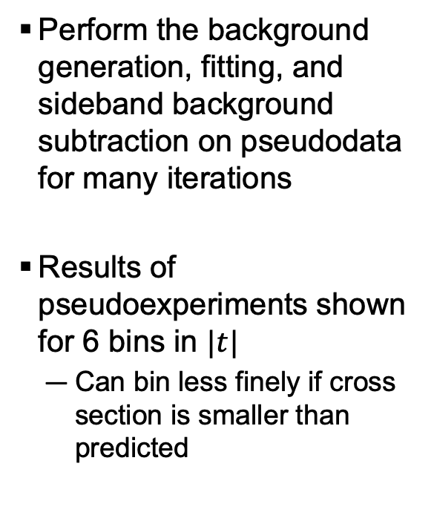
Signal Extraction
Perform the background generation, fitting, and sideband background subtraction on pseudodata for many iterations
Results of pseudoexperiments shown for 6 bins in $|t|$
  Can bin less finely if cross section is smaller than predicted

Slide 30
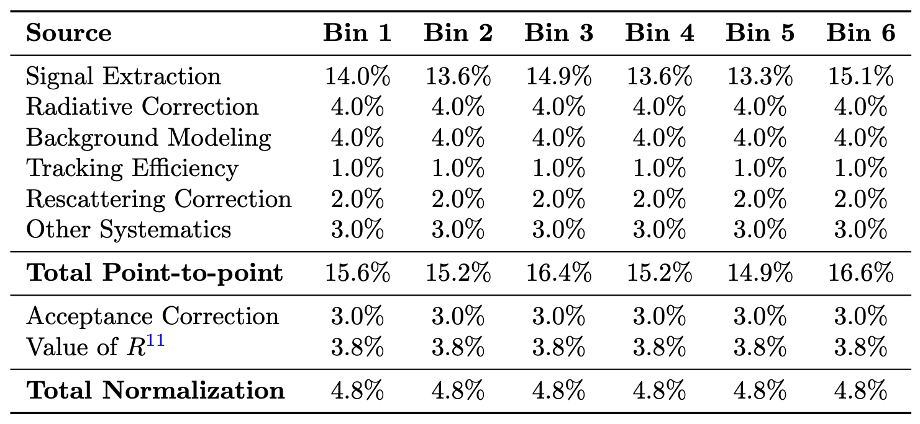
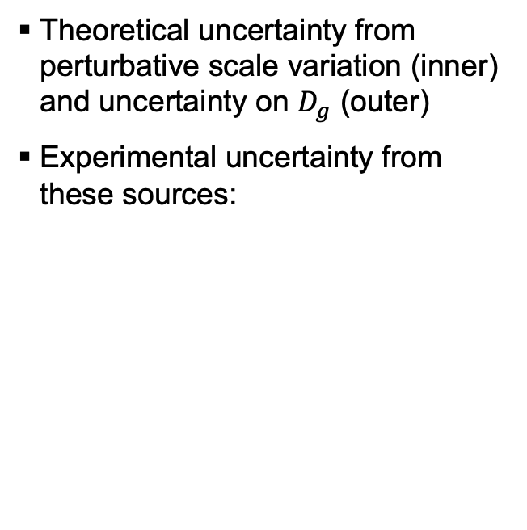
Cross section projections
Theoretical uncertainty from perturbative scale variation (inner) and uncertainty on $D_{g}$ (outer)
Experimental uncertainty from these sources:
Dominated by signal extraction!

Slide 31
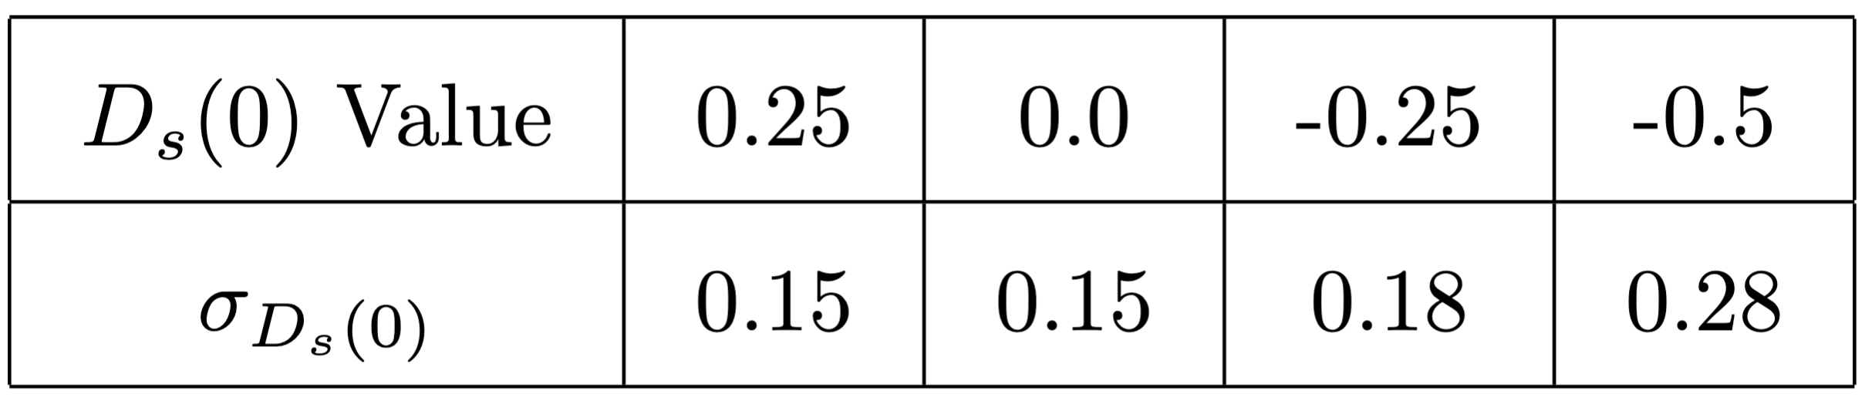


How well can we extract D_{s}?
Jitter datapoints and fit to theory predictions at different values of $D_{s}$
Resolution depends strongly on size of cross section (which itself depends on $D_{s}$)
Anticipate resolutions of 0.1 to 0.2 on $D_{s}(0)$
  Similar to lattice uncertainty!
  Precise enough to validate or invalidate the claim that $D_{s}≈D_{u,d}$

Slide 32

What can we learn?
Using these resolutions on${ D}_{s}(0)$ and the standard functional form, can estimate the (model dependent) sensitivity to the strangeness shear force distribution
First ever measurement for sea quarks! Terra incognita…

Slide 33

What else can we learn from this data?
Huge dataset of $H\left(e,e^{′}P\right)X$ at fixed kinematics!

Slide 34

What else can we learn from this data?
Erratum: Factor of 10 too few statistics used in the proposal plot!
Corrected version:
First measurement of $η′$ electroproduction!
Unexpectedly large $η^{′}$ mass is generated by the QCD chiral anomaly,
What can electroproduction teach us?

Slide 35

What else can we learn from this data?
Erratum: Factor of 10 too few statistics used in this plot (but systematics dominate in both cases)
Most differential measurement of near-threshold $ω$ electroproduction!
Connection to the proton mass radius?
Wang et al. PhysRevD.103.L091501

Slide 36


What else can we learn from this data?
Erratum: Factor of 10 too few statistics used in the proposal plot!
Corrected in this version
Comparison of $η$ and $η′$:
What is the role of the chiral anomaly in electroproduction?
$→$ Naïve cross section ratios neglecting the anomaly
Eides, Frankfurt, Strikman PhysRevD.59.114025
$→$ With the anomaly included

Slide 37






What else can we learn from this data?
Beam Spin Asymmetries for all!
(Kind of)
$$φ$$
$$η′$$
$$ω$$
$$η$$

Slide 38



Can we do u-channel?
$u$-channel: baryon takes most of the virtual photon momentum
Instead of $H\left(e,e^{′}P\right)X$, can we do $H\left(e,e^{′}K\right)X$ or $H\left(e,e^{′}π\right)X$ with our dataset?
  HMS Aerogel would likely be able to cover $π/K$ separation
    Kaons are below Cherenkov threshold, pions reasonably far above it
$φ$ Experiment HMS momentum range

Slide 39

We can do u-channel!
Near-threshold, u-channel hyperon production is accessible if $K^{+}$ can be efficiently ID’d
Likely requires refurbishment of HMS aerogel
  Move SHMS aerogel to HMS?
Note, PYTHIA6 resonance region cross sections are unreliable (especially in u-channel)
  However, SIMC acceptance is correct, so these hyperons are well within our acceptance

Slide 40
We can do u-channel!

Slide 41


Measuring the proton polarization in $H\left(e,e^{′}P\right)X$?
In the HMS, $φ$ DVMP requires only the four scintillator planes and drift chambers
Can we replace the calorimeter with a polarization analyzer?
  HRS graphite analyzer optimal for ~1 GeV protons?
See how polarization is transferred in $\vec{e}p→e\vec{p}+ω,η(η^{′}?φ?X?)$
  Under s-channel helicity conservation, produced $ω$takes all the photon polarization$→$ Proton should remain totally unpolarized
    CLAS data analyzing $ω$decay products suggest $ω$ electroproduction strongly violates SCHC, unnatural parity exchanges occur
  For $η/η′$ production, situation is opposite $→$ Proton should take all of photon’s polarization
  For $φ$ production, a measurement of non-zero recoil polarization could be a sign of intrinsic strangeness
  Validity of SCHC can be studied by measuring the recoil polarization!
  At large W & M_{X}, can study proton recoil polarization in DIS!
    (Background to DVMP)

Slide 42

Conclusion
To put proton mechanical structure on solid ground, need to measure the strangeness 𝐷-term
  Only places in the world capable of this measurement are CEBAF Halls A & C
35 days in Hall C with HMS/SHMS, one setting!
  32 days of physics for small $φ$ cross section
  Huge general-purpose dataset of ${H(e,e^{′}p/π}^{+}/K^{+}$)
  $ω,η,η^{′}$ DVMP, beam-spin asymmetries, $u$-channel, (recoil polarization?) come for free! $→$ Analyzers needed!
SoLID promises greatly improved precision on $D_{s}$ and cross check of our results (+ SBS?)

Slide 43













>50 Collaborators
If you want to be a part of this experiment, Let me know!
Send me an email! hklest@anl.gov

Slide 44
backup

Slide 45

PID Strategy
In SHMS:
  Electron ID’d with standard calo+Cherenkov conditions
In HMS:
  Proton ID’d as slow TOF between scintillator planes, no Cherenkov signals
  Kaon ID’d as fast TOF between scintillator planes and no Cherenkov signals
    Timing w.r.t the RF may also provide some separation at larger momenta
  Pion ID’d as fast TOF + Aerogel signal, but no gas Cherenkov signal
  Positron ID’d as fast TOF, Aerogel signal, plus gas Cherenkov signal

Slide 46

U-channel pion production
Pythia6 seems to have exclusive $π^{+}n$ events, but no other nucleon resonances pop out of the $M_{X}$ distribution
  Limited by cut on W in the generator & lack of resonances

Slide 47



Getting $dσ_{L}/d|t|$
With $dσ_{e}/d|t|$, need R to get $dσ_{L}/d|t|$
  Fit the world data to get an idea (and uncertainty) on this quantity within our phase space ($Q^{2}\sim 3.4$GeV²)
World data suggests $R\left(Q^{2}\right)$ not $R\left(Q^{2}, W, |t|\right)$
Use CLAS12 parameterization to scale nearby world datapoints

Slide 48

Getting $D_{g}$
Sensitivity of cross section to D_{g} isn’t as large as D_{s}, but large uncertainties on D_{g} can still rain on our parade
  Average the results of lattice + Hall C data + Guo/Yuan Bayesian analysis to reduce the overall uncertainties by a bit
  Hopefully there will be more results soon (CLAS12?)
  Can also include some theoretical values in here if they seem realistic
In the end, it’s obvious that a global fit to both D_{g} and D_{s} is the way to go here…

Slide 52




Theory predictions
Hatta, HK, Passek, Schoenleber (2501.12343)
New predictions available from Hatta et al. using GPD framework in the near-threshold region
  Typical issue for GPDs near-threshold is final-state interactions
  FSI calculated to be 2-3 orders of magnitude smaller than production cross section for $φ+p$ in photoproduction (S. H. Kim et al.)
Theoretical uncertainty on cross section from this approximation is ~10% or less for $ξ>0.3$!
  Focus on high $ξ$
“Threshold Approximation” – Keep only j = 1
Error < 5%

Slide 53

Theory predictions
Hatta, HK, Passek, Schoenleber (2501.12343)
Predictions available at NLO for $\frac{dσ_{L}}{d|t|}$!
  Requires our experiment to have an L/T separation (or modelling of $R$) for comparison

Slide 54


Theory predictions
Hatta, HK, Passek, Schoenleber (2501.12343)
Theory uncertainty from $\frac{Q}{2}<μ<2Q$ scale variation
Near-threshold $φ$ exhibits
factor ~ 4 greater sensitivity to $D_{s}$ compared to $D_{g}$!

Slide 55





Theory predictions
Hatta, HK, Passek, Schoenleber (2501.12343)
$$ξ\sim 0.5$$
$$A_{g}\sim A_{u,d}≫A_{s}$$
$$D_{g}\sim D_{u,d}\sim D_{s}?$$
Theory uncertainty from $\frac{Q}{2}<μ<2Q$ scale variation

Slide 56

Theory predictions
Hatta, HK, Passek, Schoenleber (2501.12343)
Near-threshold $φ$ exhibits
factor ~ 4 greater sensitivity to $D_{s}$ compared to $D_{g}$!
This is the green light for our experiments to measure $D_{s}$, so let’s go!
Theory uncertainty from $\frac{Q}{2}<μ<2Q$ scale variation

