Slide 1

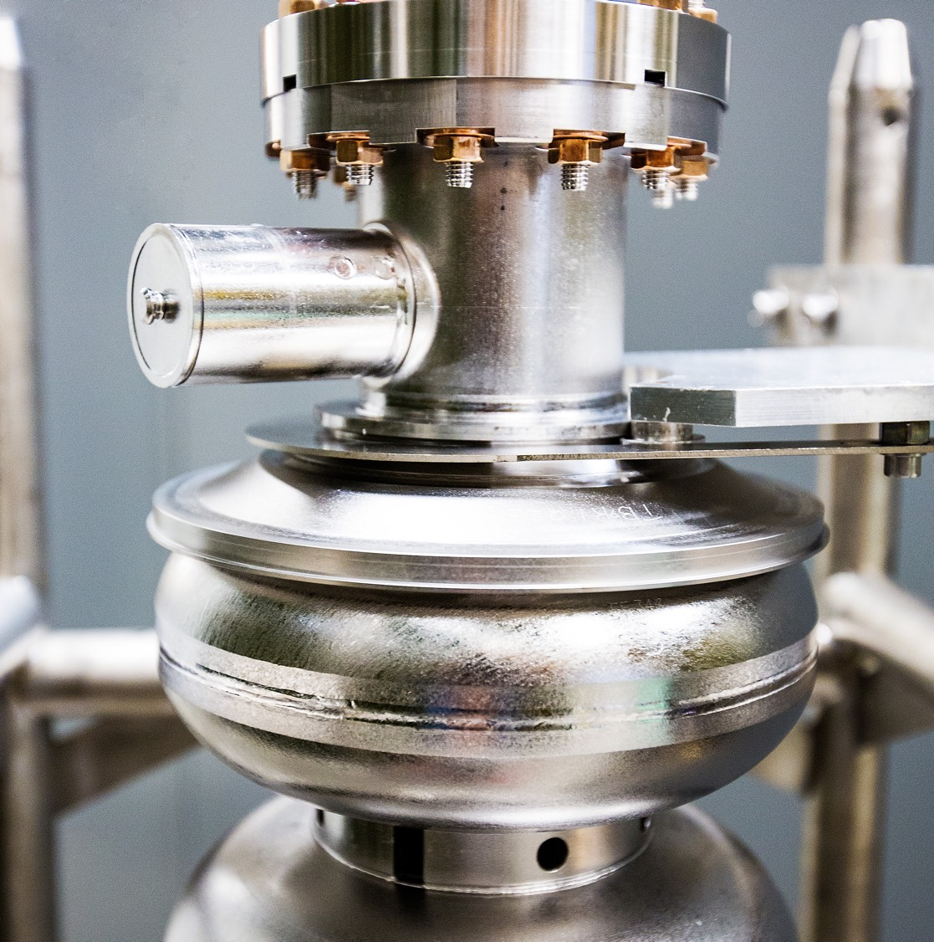
Accelerator Update
2025 Summer Hall A/C Collaboration Meeting
06/172025
Eduard Pozdeyev
Director of Accelerator Operations
Notes:
Tip: Keep titles under 60 characters for readability
To change the photo: Right-click on photo and select change photo

Slide 2
Outline
Present (FY25 Run) performance
Energy Reach projections
Moller-related activities and progress
Notes:
Guidelines: 6-8 bullets per slide; Use sentence fragments for bullets

Slide 3
2025 Run
22 weeks of Physics + 2 weeks of beam restore
E = 11.7 GeV (energy gain per linac 1060 MeV)
Beam power up to 900 kW
  Operational requested power, so far, ~200 kW
Polarized beam to Halls A, B, C, D
Late start of the run due to LOTO pause in 2024 and technical delays in early 2025
Issues with the halo to Hall B while running Hall A in May
  Hall A laser amplifier and orbit adjustment in Hall B
Good running after issues were resolved
Average reliability is 82% (March 19th - June 8th)
  Reliability was 76% in FY23-24 Run and 72.5% in FY22-23 Run

Slide 4
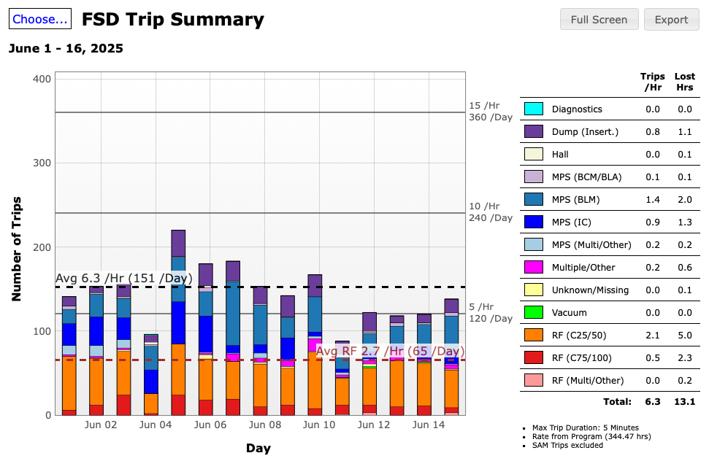
2025 Run: Trip Rate

Slide 5
2025 Run and 2026 SAM: Plans
Increased beam intensity
  Hall A ~20-25 uA @ 5 pass, possibly higher
  Hall C up to 80 uA @ 4 pass
  High power test runs before increased intensity to the Halls
Concern: impact of hot summer weather on accelerator operations
End of run
  Hall A 8/25/2025
  Hall B,C,D 9/3/2025
2026 Physics Run (tentatively)
  Beam Restore begins in January 2026
  Physics beings in end of January – beginning of February
  20 + 2 weeks of running

Slide 6
CPP Energy Reach Plan and Impact
Cryomodule deliveries for SAM 2026 and beyond (per year)
  One C75 -> C20 CM swap (increase in energy margin by ~35-40 MeV)
  One C100 CM refurbishment (20-30 restoration)
Plasma processing of C75 CMs
This assumes funding on same level as FY24
Expected RF Trip Rate during FY26 run 2 - 3 trips/hour @ 1060 -1070 MeV, 100 uA, 5 pass
  Trip rate will be somewhat higher due to losses
No margin in case of CM failure
Possible increased trip rate towards the end of the run
RF trip rate will be reduced to 2 per hour in FY27 if all contributions add up

Slide 7
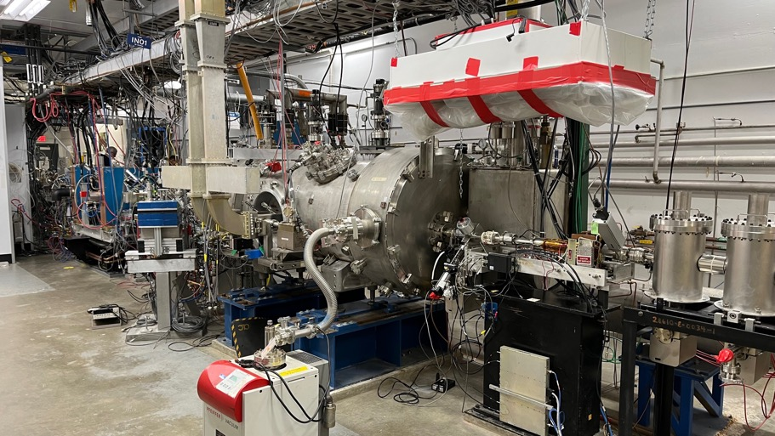
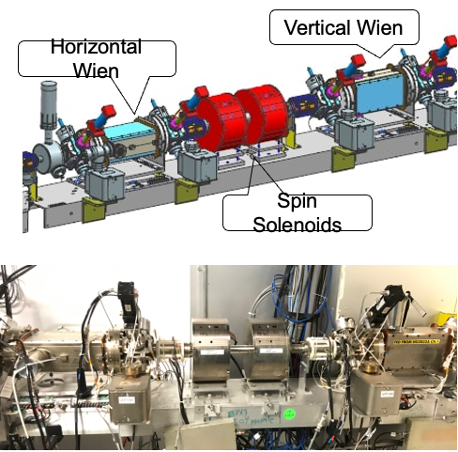
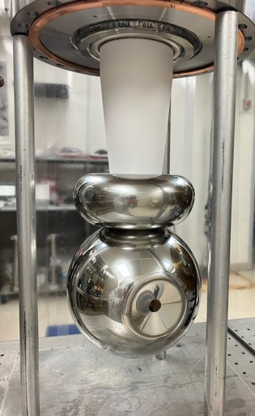
New Injector
New injector, including 200 kV gun, was commissioned in FY24.
Significant improvements of the gun and transport solenoids were done over last SAM.
200 keV spin manipulation and feedback system
Encouraging initial results for Parity Quality (MOLER) Beam. Work to quantify gains ongoing.
Courtesy of Riad Suleiman

Slide 8
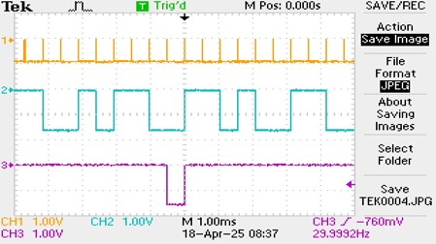
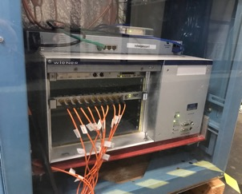
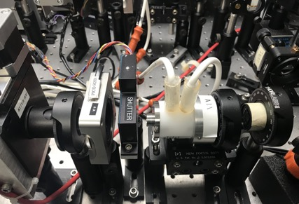
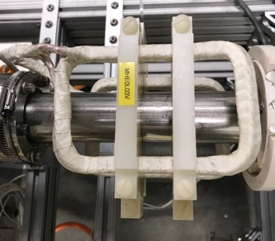
Helicity Generation and Orbit Control System
Helicitiy Generation Board,
  13 built
  JLab Fast Electronic Group
Helicity Decoder Board
  20 boards tested
  Ohio U., JLab Fast Electronic Group, JLab AD
UVA Prototype RTP HV Driver
  https://doi.org/10.48550/arXiv.2106.09546
New JLab RTP HV Driver
  Steven Covert and Jim Kortze
  Prototype tested in November 2024
  Building two production units
Intensity Attenuator HV Driver and Helicity Magnets Control
Courtesy of
Riad Suleiman

Slide 9
MOLLER-Focused Beam Studies
Completed initial studies in Injector with encouraging results: small helicity-correlated beam asymmetries, good transmission, Wiens slow helicity reversal, charge and position feedbacks, and longitudinal beam polarization feedback using Wien
Study Fast Feedback (FFB) System to reduce position and energy line-harmonics noise (system was routinely used in 6 GeV era but rarely after 12 GeV upgrade):
  Start Hall A April 2025 physics run with FFB ON for routine operations
  Measure beam noise using MOLLER parity data acquisition system
  Measure beam noise using special accelerator data acquisition system
Measure adiabatic damping with accelerator tools (raytrace)
Test Beam Modulation
Test Polarization Feedback
Measure Compton Polarimeter background rates
Courtesy of
Riad Suleiman

Slide 10
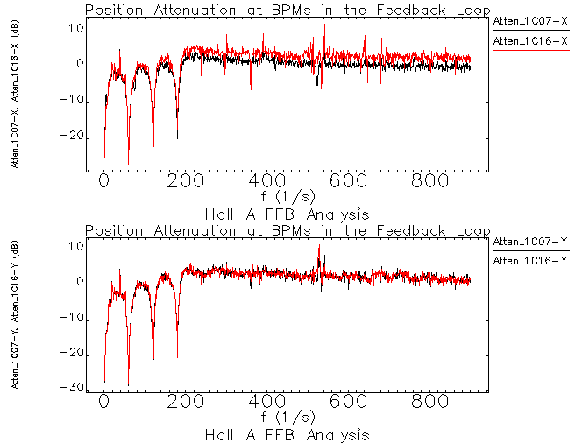
Fast Feedback Works As Designed
Courtesy of
Nick Sereno

Slide 11
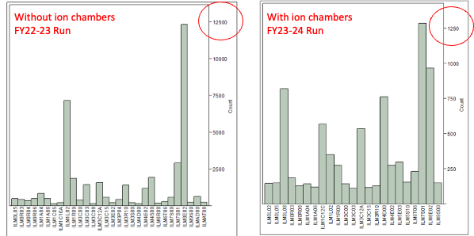
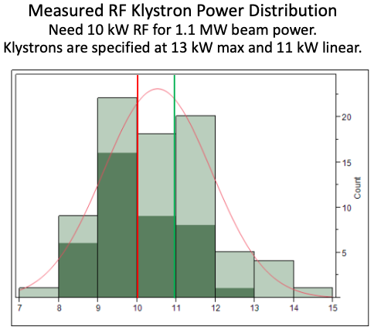
Improvements to Enhance CEBAF Performance
Additional IDX (ion chamber loss monitors) to improve tuning and reduce beam losses
Power of C100 klystrons was increased by up to 10%
QL of C100 CMs was optimized for high beam current
Fast acquisition DAQ (LabJack) for BPMs to measure spectrum of beam orbit oscillations at several locations around the machine
Courtesy of Jay Benesch
Number of fast MPS trips caused by BLMs.
Number of trips in 7S01 are decreased by an order of magnitude after installation of diagnostics IDXs.
Klystron voltage was increased
by 0.5-1 kV, increasing output
RF power by 1 kW/klystron
(in average).

Slide 12
Conclusions
The machine operates well after issues related to late start and technical problems were addressed. Average reliability is 82%, exceeding previous years.
Continuing CPP Energy Reach effort and other improvement pay off. Expected RF trip rates are below a few per hour with MOLLER beam parameters
  No margin
  It is to the lab to implement CPP Update that includes extension of CPP and additional vacuum work
MOLLER systems and beam studies are making significant progress

