Slide 1
Hall C User Group: User Board Election Results
17th June 2025

Slide 2
Election Results
69 votes out of 151 users
Very close result, thank you to all of the nominated candidates
And thank you to all of the voters!
Of the 5 candidates, the following two received the most votes and have agreed to take up a position on the User Board:
Debaditya Biswas (Virginia Tech)
Dien Nguyen (University of Tennessee)

Slide 3
Outgoing Members
The two newly elected members replace:
Stephen Kay (University of York)
Marie Boer (Virginia Tech)
These members will rotate out at the next meeting of the User Board

Slide 4
Hall C User Group: Proposed Bylaws Updates
17th June 2025

Slide 5
Proposed Updates
Additional recommendation for “good standing” in the Hall C community
Related to shift scheduling/taking
Elections
Codification of User Board election process
As a reminder with proposed changes, we are not a collaboration. Generally, we cannot enforce rules. Rather, we comment upon expectations of the user group.
Current bylaws - https://hallcweb.jlab.org/DocDB/0012/001233/001/HallCByLawsCoC_final.pdf

Slide 6
1. Shift Scheduling
During current run, shift takers noticed that cancelled shifts were no longer counting for shift credit
This was not the case previously
Unclear if this was intentional, or something changed in shift scheduler
In signing up for shifts, users have often already made significant contributions of their time and resources
This is true whether people have travelled to the lab from afar or not
As such, we propose an addition to the bylaws to reflect this contribution

Slide 7
1. Shift Scheduling
Propose adding this to the existing bylaws under:
I. Recommendations for “good standing” in our community
5. When signing up for shifts, users are committing their time and resources to assist on an experiment. This contribution should be recognised by experimental spokespeople, even if unforeseen circumstances lead to shifts being cancelled. We strongly encourage that any shifts that are cancelled less than 8 weeks in advance still count for “full credit” when determining eligibility for authorship on experiments. We also encourage spokespeople to set out their stance on credit for cancelled shifts prominently on the shift signup page, especially if it deviates from this recommendation.
Note, this could also be inserted directly below recommendation 2 which discusses shifts (therefore shunting other recommendations down).

Slide 8
Discussion on Proposed Change 1

Slide 9
2. User Board Elections
Currently, the bylaws have the following to say on elections –
The UB consists of six members elected for a period of (3) three years in staggered terms. The UB shall have two new individuals elected annually by the members of the Organization as Board Members, to replace Board Members who retire from office at the time of such election. Any member of the user organization can nominate candidates. Members that agree to be nominated and run for election will be asked to provide a brief candidate statement. The election will be conducted by email: a reasonable number of candidates will be proposed by the UB, and members may vote for their favorite candidates.

Slide 10
2. User Board Elections
Statement is open to interpretation, no strict requirement on format of election for example
During recent election, comment was received with regards to interpretation of this section as it relates to conducting the vote
Namely, concern was raised that the vote required the selection of two candidates from the available list
Voting for one (or zero) candidates was not allowed
This was chosen deliberately by the board member organising the election due to their interpretation that two candidates need to be replaced

Slide 11
2. User Board Elections
Propose two potential changes:
The election will be run by the UB secretary and conducted by email: a reasonable number of candidates will be proposed by the UB, and members may vote for their favorite candidates. The final format and conduct of the election is at the discretion of the UB secretary.
The election will be conducted by email: a reasonable number of candidates will be proposed by the UB, and members may vote for their favorite candidates. The election will be held in such a format that users may vote for up to two candidates. Users may elect to only cast a vote in favour of one candidate or none at all should they choose to do so.

Slide 12
Discussion on Proposed Change 2

Slide 13
As a reminder… The bylaws of the Organization may be repealed or amended from time to time by a bylaw or a new by-law, by a majority of the UB and sanctioned by an affirmative vote of at least 2/3 of the votes cast in favor of the by-law by the members by email

Slide 14
Hall C User Group: Working Group Updates
17th June 2025

Slide 15
Spectrometer Performance and Future Upgrades – Stephen Kay
Main activity remains the Quarterly Analysis Meetings
Next meeting – July 9th!
DocDB Page here!
As a reminder, you do not need to be on the User Board to run a working group!
I will keep running the QAM (for now) even though I’m rotating off the board this year
A quick rundown of this year’s quarterly meetings

Slide 16
Spectrometer Performance and Future Upgrades – Stephen Kay
Quarterly Analysis Meeting VIII
Overview of the BCM calibration procedure from Nathan Heinrich
Quarterly Analysis Meeting IX
DC and tracking updates from Mark Jones
Hall C computers update from Hanjie Liu
Analysis Pipeline k-Analysis Manager Proof of Concept from Casey Morean

Slide 17
Spectrometer Performance and Future Upgrades – Stephen Kay
Quarterly Analysis Meeting X
SHMS Proton Absorption Geant4 from Alicia Postuma
Beam Energy Calibration for NPS from Christine Ploen
Deuteron-Electro-Disintegration Experiment Analysis – HeeP Elastics Update from Pramila Pokhrel
As a reminder, all meetings are recorded and I take notes
Available via the DocDB
Can click the link for each QAM heading if you download these slides!

Slide 18
Spectrometer Performance and Future Upgrades – Stephen Kay
Last but not least, the SHMS NIM paper!
Available on the arXiv now
Prepping for submission to NIM:A

Slide 19
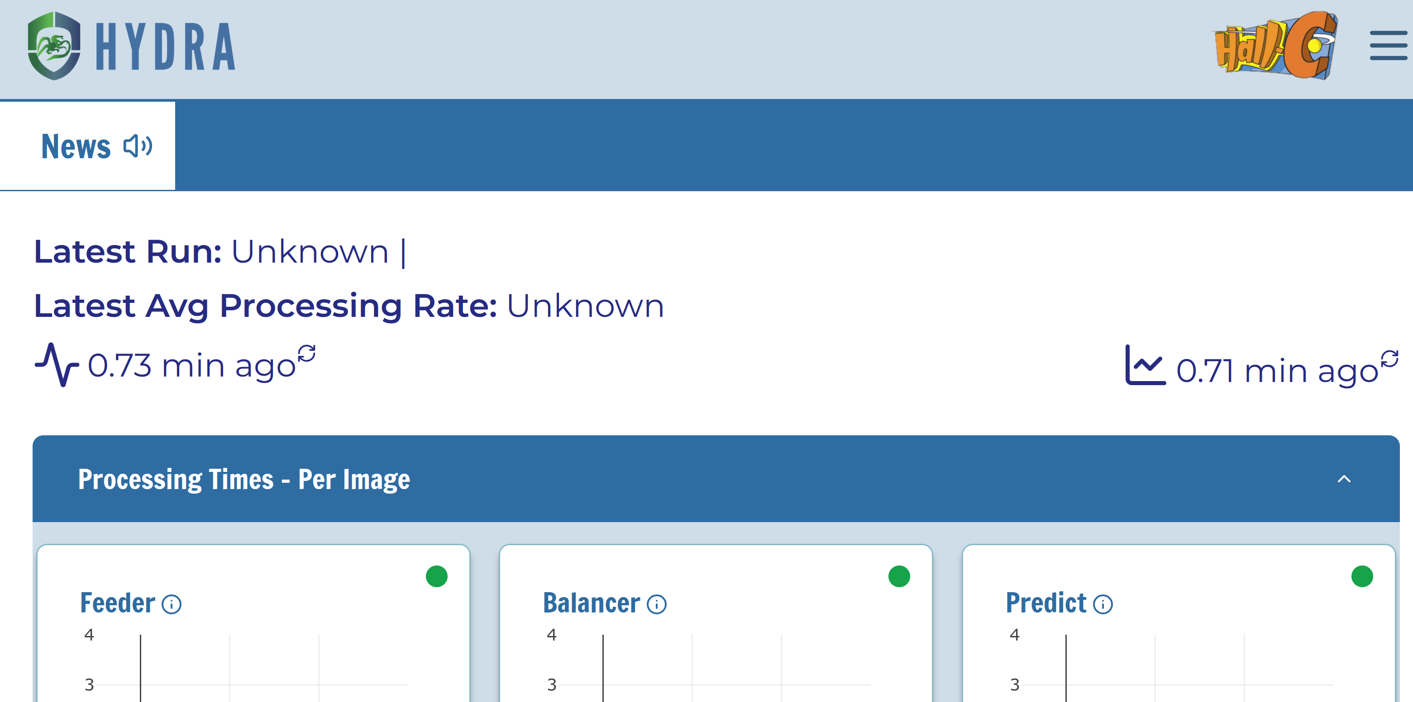
AI4HallC Working Group
Tanja Horn, CUA
Overview
AI/ML has become ubiquitous in nuclear physics in the last few years and new possibilities have been emerging. This is an opportune time for Hall C to take advantage of these developments in computing technologies and statistical methods and define its path forward. The main goal of the Hall C AI/ML Working Group will be to provide a forum for discussion for anyone interested in defining this path, exploring possible applications of AI/ML in Hall C, and connecting to data scientists.
Status
Main discussion forum are the AI4HallC Meetings – three meetings so far where major needs were identified and discussed
At the last meeting, several ongoing efforts from the community were presented, e.g.,
Computer vision techniques, LLMs, and unsupervised learning applied to HC data.
Implementation of Hydra in Hall C
Jupyter notebook tutorial
Next meeting: planned for later this year
Hydra User Guide

Slide 20
AI4HallC Working Group Broader View
Tanja Horn, CUA
Ongoing and Prospective Areas of AI that might be of interest to Hall C members
AI and Lattice QCD: The Theory Center, a leader in Lattice QCD, is actively addressing the critical slowing-down of Lattice QCD simulations through AI. Supported by SciDAC and leveraging Exascale Computing, these efforts have the potential to substantially improve the accuracy of Lattice QCD simulations.
AI-Assisted Detector Design (AID2E): The ePIC detector at the upcoming Electron-Ion Collider might be the first detector using AI for design, construction, and operation. The AID(2)E collaboration addresses currently the use of AI to aide to the detector design.
Quantum Chromodynamics Nuclear Tomography (QuantOM): aims to analyze data from Deep Inelastic Scattering (DIS) experiments conducted at Jefferson Lab and the upcoming Electron Ion Collider. The DIS data analysis is performed on an event-level by leveraging nuclear theory models and accounting for experimental conditions.
EXCLusives with AI and Machine learning (EXCLAIM): the main goal is to develop a framework to implement AI/ML techniques emerging from the phenomenology of high energy exclusive scattering processes from nucleons and nuclei.
Femtoscale imaging: anticipated opportunity in strategic areas of AI at JLab
Femtoscale imaging of quarks, gluons, and their interactions at CEBAF and the upcoming EIC.
Applying AI to the unique challenges of Nuclear Physics, including multidimensional correlations within vast datasets, will advance core AI methodologies and benefit other sciences and society.
Possibly new opportunities in hadron structure visualization/intuition building?

Slide 21
Discussion

