Slide 1
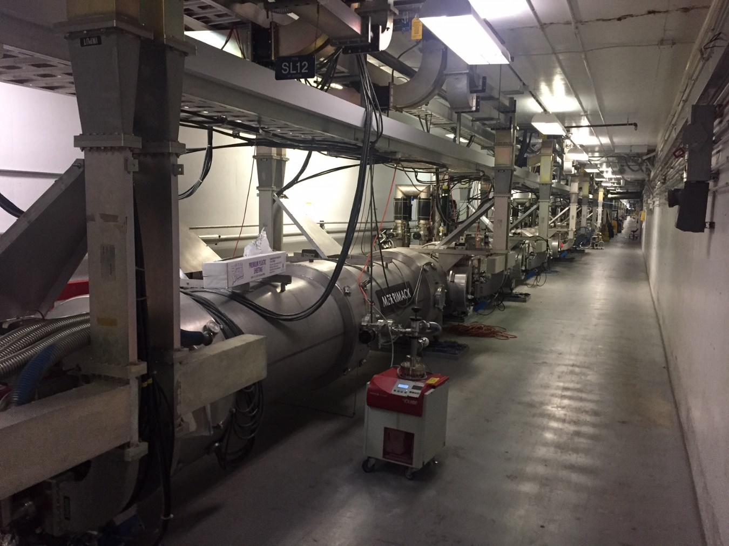
SRF Commissioning Summary SAM ‘24
M. Drury, et al

Slide 2
1L22 (C100-8R) Summary
 | QextFPC | QextFP | Emax (MV/m) | Limit | One Hour Run Gradient (MV/m) | FE Onset (MV/m) | 500 mR/hr gradient (MV/m) | 1 R/hr gradient (MV/m) | 30 W Gradient (MV/m) | Original SRF DRVH | Emaxop (MV/m) (SRF DRVH) | Qo at Emaxop | Qo at 19.2 MV/m
C100-RI-066 | 2.2E+07 | 2.3E+12 | 22.0 | Quench | 21.6 | 11.4 | 15.0 | 15.4 |  | 15.4 | 20.0 | 1.7E+10 | 1.4E+10
C100-RI-072 | 1.3E+07 | 1.5E+12 | 24.0 | Admin | 24.0 | 11.2 | 13.1 | 13.5 | 19.7 | 13.5 | 19.0 | 9.0E+09 | 7.4E+09
C100-RI-024 | 1.6E+07 | 1.8E+12 | 22.0 | Quench | 21.5 | 13.1 | 17.6 | 18.3 |  | 21.5 | 20.0 | 7.7E+09 | 8.9E+09
C100-RI-069 | 1.2E+07 | 1.6E+12 | 20.4 | Quench | 19.9 | 11.4 | 13.5 | 13.6 | 18.4 | 13.6 | 15.5 | 8.8E+09 | 5.8E+09
C100-RI-063 | 1.3E+07 | 2.3E+12 | 24.0 | Admin | 24.0 | 19.3 | N/A | N/A | 21.8 | 21.8 | 20.0 | 8.9E+09 | 8.9E+09
C100-RI-065 | 1.3E+07 | 1.4E+12 | 24.0 | Admin | 24.0 | 17.3 | 20.9 | 21.5 | 22.0 | 21.5 | 16.0 | 9.1E+09 | 9.3E+09
C100-RI-059 | 1.8E+07 | 1.5E+12 | 22.8 | Warm window | 22.8 | 16.5 | 22.4 | N/A |  | 22.8 | 18.0 | 1.4E+10 | 1.6E+10
C100-RI-045 | 1.5E+07 | 1.3E+12 | 24.0 | Admin | 24.0 | 11.6 | 13.4 | 15.3 | 22.1 | 15.3 | 20.0 | 9.9E+09 | 9.2E+09
 |  |  | 128 |  | 127 |  |  |  |  | 101.8 | 104.0
Cavity | Final Gradients 5/20/24 | Original SRF DRVH | Emaxop (MV/m) (SRF DRVH) | Current Gradients | Comments
1 | 16.0 | 15.4 | 20.0 | 16.8
2 | 10.5 | 13.5 | 19.0 | 19 | Bypassed KRRP
3 | 16.0 | 21.5 | 20 | 19.1
4 | 8.0 | 13.6 | 15.5 | 15.3
5 | 17.5 | 21.8 | 20.0 | 20.2
6 | 19.0 | 21.5 | 16.0 | 15.8
7 | 9.8 | 22.8 | 18.0 | 18.1
8 | 9.8 | 15.3 | 20 | 20.1
Totals | 74.6 | 101.8 | 104.0 | 101.1 | 26.5
With Cavity 2 bypassed - increase of 13.2 MV over final gradients from May 24
With Cavity 2 operational - increase of up to 26.5 MV over final gradients from May 24

Slide 3
2L05 (C75-03) Summary
 | QextFPC | QextFP | Emax (MV/m) | Limit | One Hour Run Gradient (MV/m) | FE Onset (MV/m) | 100 mR/hr gradient (MV/m) | 1 R/hr gradient (MV/m) | 50 W Gradient (MV/m) | Unit Test Gradient (MV/m) | Emaxop (MV/m) (SRF DRVH) | Qo at Emaxop | Qo at 19.1 MV/m | Qo at 15 MV/m
1 | 1.2E+07 | 1.1E+13 | 21.0 | Admin | 21.0 | 16.4 | N/A | N/A |  |  | 21.0 | 5.4E+09 | 5.8E+09 | 6.5E+09
2 | 1.6E+07 | 4.2E+13 | 21.0 | Admin | 21.0 | 17.2 | 21.0 | N/A |  |  | 21.0 | 4.7E+09 | 5.1E+09 | 5.8E+09
3 | 1.9E+07 | 1.9E+13 | 18.3 | Quench | 17.9 | 12.2 | 15.3 | 17.2 |  |  | 17.2 | 4.2E+09 |  | 4.5E+09
4 | 1.5E+07 | 1.3E+13 | 17.4 | Quench | 17.0 | 13.8 | N/A | N/A |  |  | 17.0 | 4.6E+09 |  | 4.6E+09
5 | 1.6E+07 | 9.6E+12 | 18.9 | Quench / MP | 17.4 | 9.7 | 12.3 | 13.8 |  |  | 13.8 | 5.5E+09 |  | 4.9E+09
6 | 1.7E+07 | 2.1E+13 | 21.0 | Admin | 21.0 | 16.6 | 20.8 | N/A |  |  | 21.0 | 5.8E+09 | 5.9E+09 | 6.2E+09
7 | 2.6E+07 | 2.1E+13 | 18.0 | Quench / MP | 17.0 | 8.0 | 9.5 | 10.7 |  |  | 10.7 | 5.8E+09
8 | 2.1E+07 | 1.1E+13 | 11.1 | BLVAC | 11.1 | N/A | N/A | N/A |  |  | 11.1 | 7.4E+09
 |  |  | 72.1 |  | 70.5 |  |  |  |  |  | 65.3
Cavity 3 Emaxop derated to 17.2 MV/m ( 1 R/hr level)
Cavity 5 Emaxop derated to 13.8 MV/m ( 1 R/hr level)
Cavity 7 Emaxop derated to 10.7 MV/m ( 1 R/hr level)
Cavity | Final Gradients 5/20/24 | Emaxop (MV/m) (SRF DRVH) | Current Gradients | Comments
1 | 6 | 20 | 14.0
2 | 5.9 | 19 | 18.0
3 | 6.6 | 20 | 17.2
4 | 0.0 | 15.5 | 10.0
5 | 6.1 | 20 | 0.0 | bypassed - tuner
6 | 4.0 | 16 | 18.0
7 | 6.0 | 18 | 10.7
8 | 7.9 | 20 | 11.0
Totals | 20.9 | 73.0 | 48.6 | 27.7
With Cavity 5 bypassed - increase of 27.7 MV over final gradients from May 24
With Cavity 5 operational - increase of up to 36.6 MV over final gradients from May 24

Slide 4
1L09 Summary (C75-04)
 | QextFPC | QextFP | Emax (MV/m) | Limit | One Hour Run Gradient (MV/m) | FE Onset (MV/m) | 100 mR/hr gradient (MV/m) | 1 R/hr gradient (MV/m) | 50 W Gradient (MV/m) | Unit Test Gradient (MV/m) | Emaxop (MV/m) (SRF DRVH) | Qo at Emaxop | Qo at 19.1 MV/m
1 | 2.7E+07 | 6.5E+12 | 18.4 | Quench | 18.0 | 16.2 | N/A | N/A | N/A |  | 18.0 | 4.2E+09
2 | 2.9E+07 | 1.5E+13 | 16.0 | Quench | 16.0 | 9.0 | 10.6 | 11.8 | 15.0 |  | 11.8 | 5.8E+09
3 | 1.7E+07 | 1.1E+13 | 21.0 | Admin | 21.0 | 13.0 | 16.2 | 18.9 | 20.7 |  | 18.9 | 5.0E+09 | 4.9E+09
4 | 2.6E+07 | 1.0E+13 | 21.0 | Admin | 21.0 | 16.0 | 19.2 | N/A | N/A |  | 21.0 | 4.2E+09 | 4.5E+09
5 | 1.6E+07 | 7.2E+12 | 18.7 | Quench | 18.2 | N/A | N/A | N/A | N/A |  | 18.2 | 5.5E+09
6 | 1.3E+07 | 9.9E+12 | 18.0 | Quench | 17.5 | 15.5 | 17.3 | N/A | N/A |  | 17.5 | 5.6E+09
7 | 1.7E+07 | 1.3E+13 | 17.3 | Quench | 16.8 |  |  |  |  |  | 16.8 | 5.0E+09
8 | 1.3E+07 | 1.1E+13 | 16.2 | Quench | 15.3 | 9.8 | 11.0 | 12.6 | 14.0 |  | 12.6 | 3.2E+09
 |  |  | 72.1 |  | 70.7 |  |  |  |  |  | 66.3
Cavity 2 Emaxop derated to 11.8 MV/m (1 R/hr level)
Cavity 3 Emaxop derated to 18.9 MV/m ( 1 R/hr level)
Cavity 4 Emaxop GSET to zero until tuner fix
Cavity 5 still needs FE numbers
Cavity | Final Gradients 5/20/24 | Emaxop (MV/m) (SRF DRVH) | Current Gradients | Comments
1 | 0 | 18.0 | 0.0
2 | 0.0 | 11.8 | 0.0
3 | 0.0 | 18.9 | 0.0
4 | 0.0 | 21.0 | 0.0 | bypassed - tuner
5 | 0.0 | 18.2 | 0.0
6 | 0.0 | 17.5 | 0.0
7 | 0.0 | 16.8 | 0.0
8 | 0.0 | 12.6 | 0.0
Totals | 0.0 | 66.3 | 0.0 | 0.0
With Cavity 4 bypassed - increase of 55.9 MV over final gradients from May 24
With Cavity 4 operational - increase of up to 66.3 MV over final gradients from May 24
Zone awaiting transformer replacement

