Slide 1



RGH plans for di-hadrons
Anselm Vossen
Matthew McEneaney

Slide 2
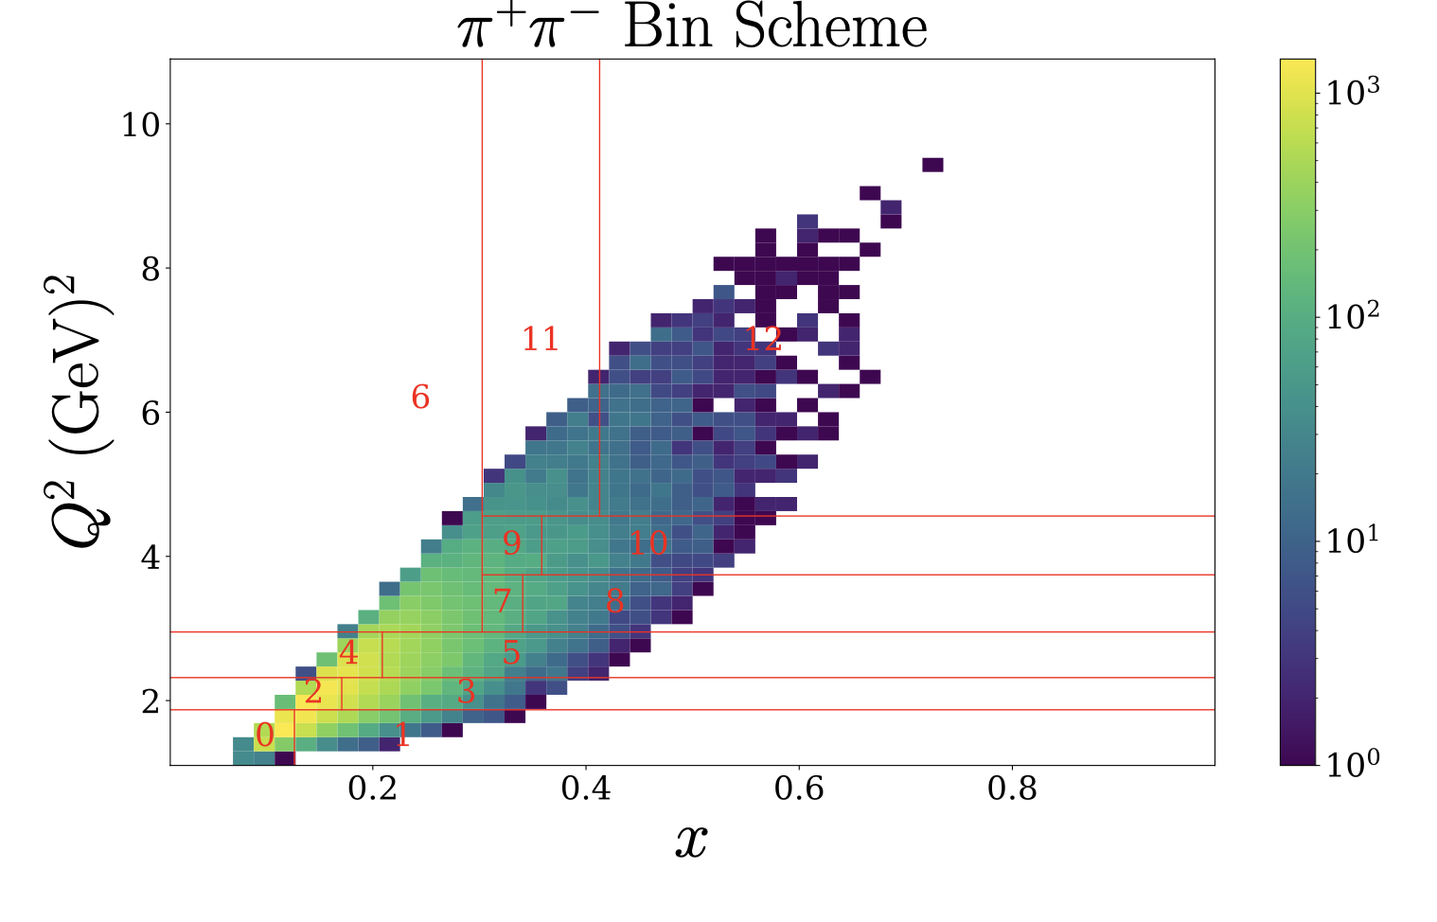
X-Q2

Slide 3
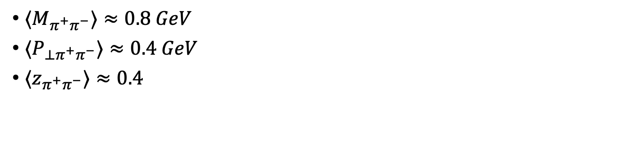

Invariant Mass, $p_{⊥}, z$
$⟨M_{π^{+}π^{−}}⟩≈0.8 GeV$
${⟨P}_{⊥π^{+}π^{−}}⟩≈0.4 GeV$
${⟨z}_{π^{+}π^{−}}⟩≈0.4$

Slide 4
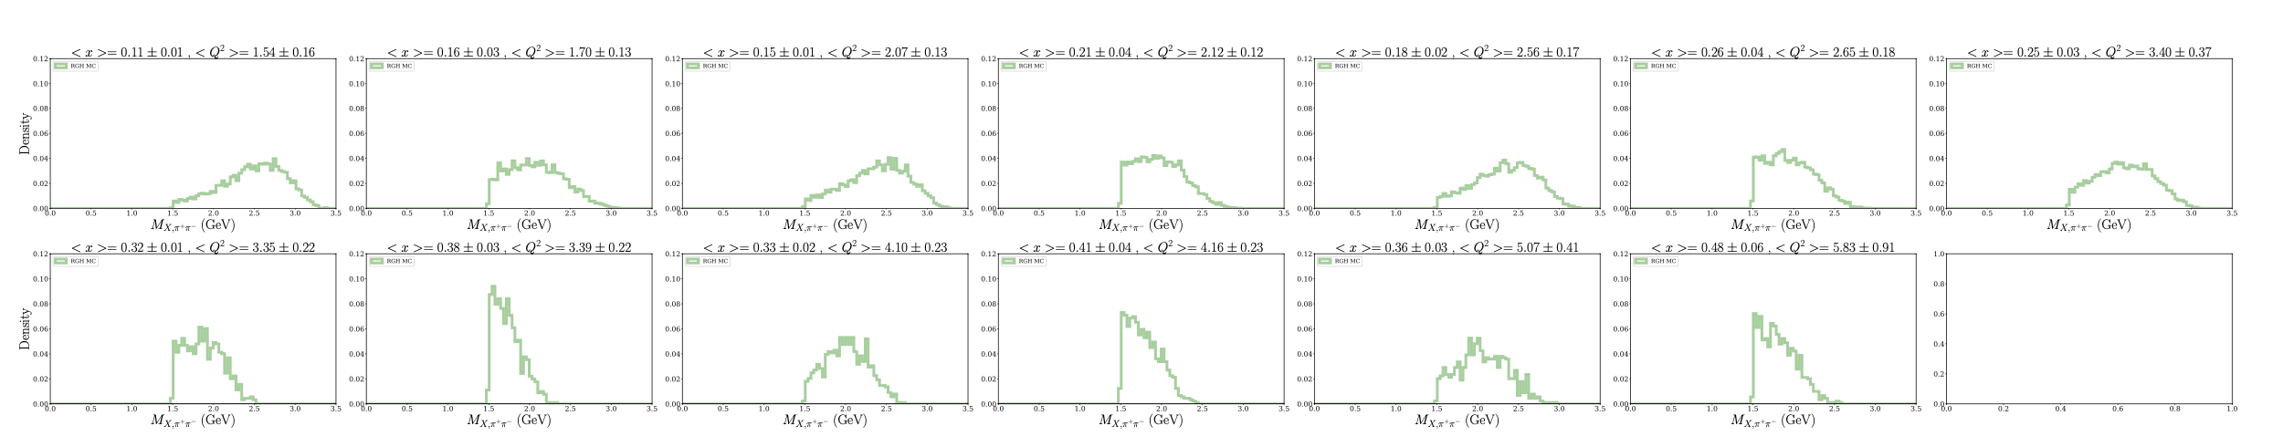

Missing mass
$\left\langle M_{X}\right\rangle ≈2 GeV$

Slide 5


RGH Simulation: Uncertainty Projections (100 days proton)
Projected uncertainties are computed assuming target polarization $P=0.85$and an asymmetry value of $A=0.2$
$$σ_{i} =\frac{1}{P}⋅\sqrt{\frac{1−{\left(PA\right)}^{2}}{N_{RGH,i}}}⋅\frac{1}{3/17}$$
Dilution factor for $NH_{3}$

Slide 6
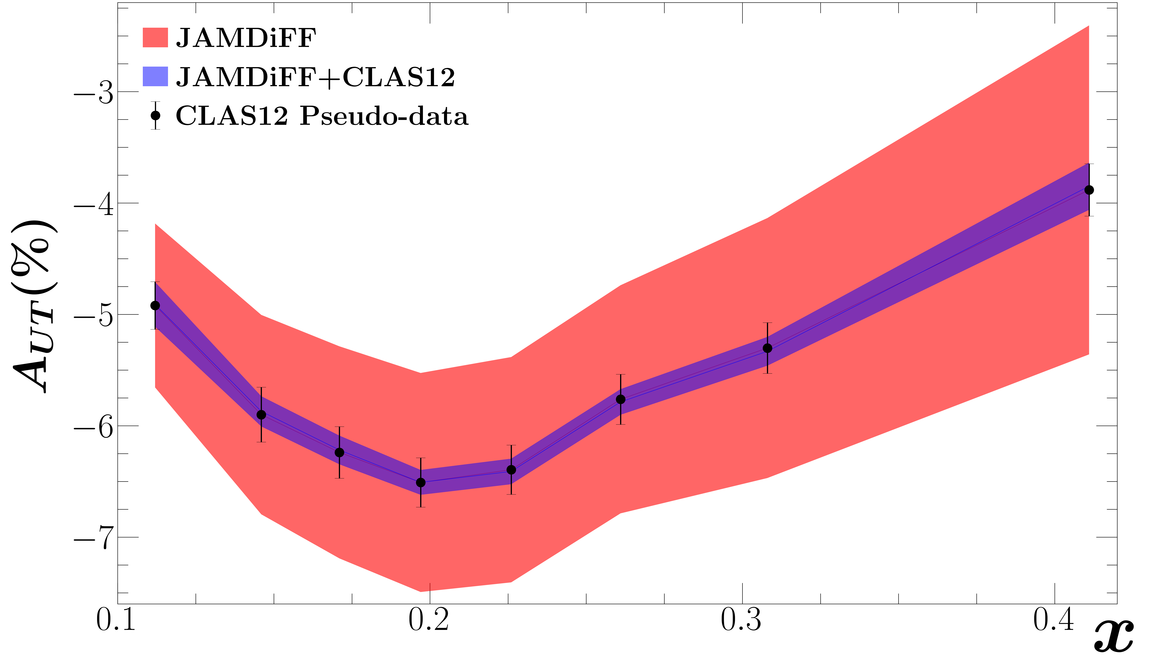
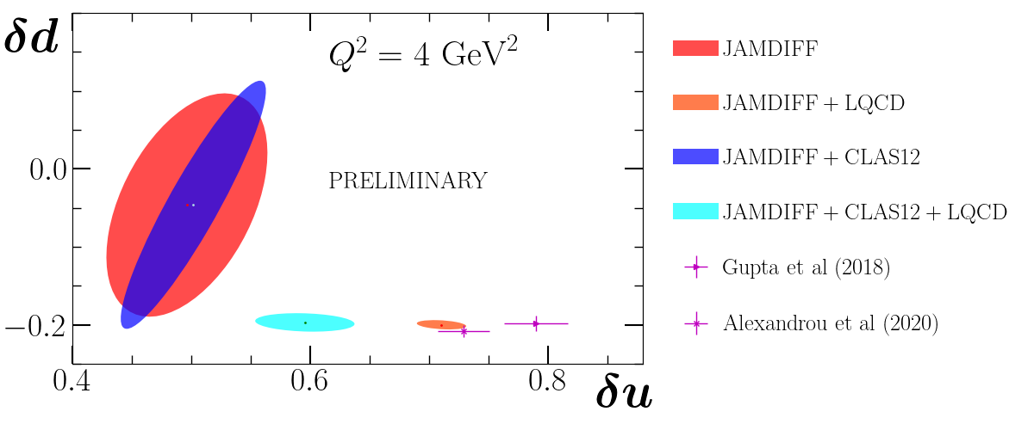
Impact Study using JAM by Yorgo Sawaya (Temple)
The tensor charges, before and after
including CLAS12 pseudo-data.
Data vs. predictions for the SSA $A_{UT}$before and after including CLAS pseudo-data in the fit.
From Yorgo’s poster at POETIC

Slide 7


RGH Simulation: Uncertainty Projections, Deuterium, 25 days
Projected uncertainties are computed assuming target polarization $P=0.20$ and an asymmetry value of $A=0.2$
$$σ_{i} =\frac{1}{P}⋅\sqrt{\frac{1−{\left(PA\right)}^{2}}{N_{RGH,i}}}⋅\frac{1}{3/20}$$
Dilution factor for $ND_{3}$
Old projection values from Harut Avakian shown here
Deuterium is not promising

Slide 8
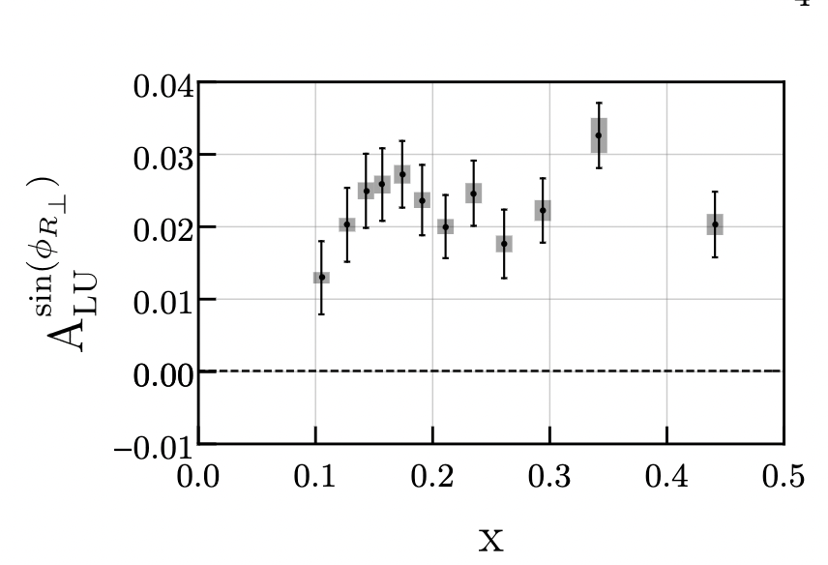
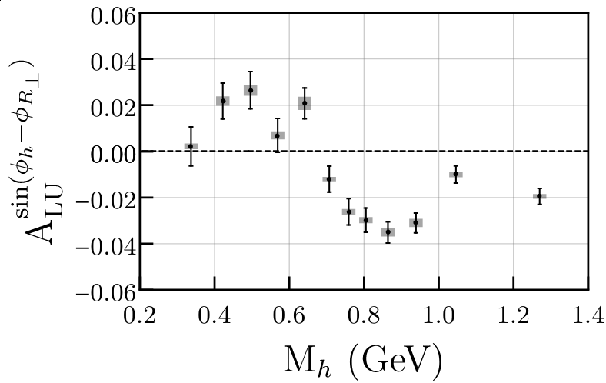



Di-hadrons from existing CLAS data (BSA)
First extraction of $e(x)$
Further constrains from $F_{UL}$ and $F_{LL}$
First signal for $G_{1}^{⊥}$
  Interesting resonance structure consistent
  with models
  (e.g. Luo, Sun, Xie, Phys.Rev.D 101 (2020) 5, 054020)
$$∝e⋅H_{1}^{∠}$$
Phys.Rev.Lett. 126 (2021) 152501
C. Dilks/T. Hayward
$$∝f×G_{1}^{⊥}$$

Slide 9
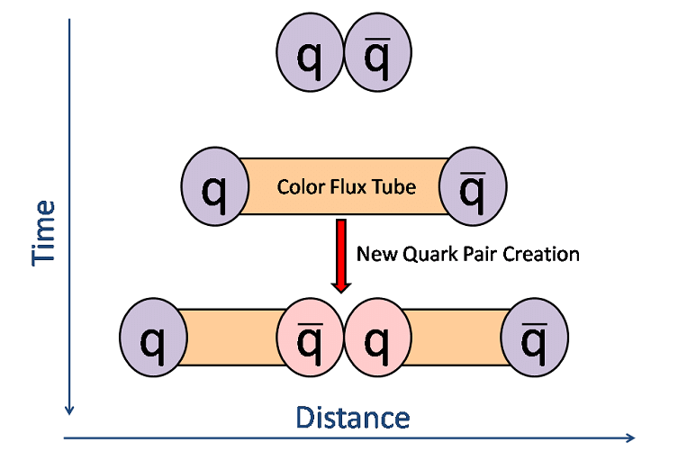
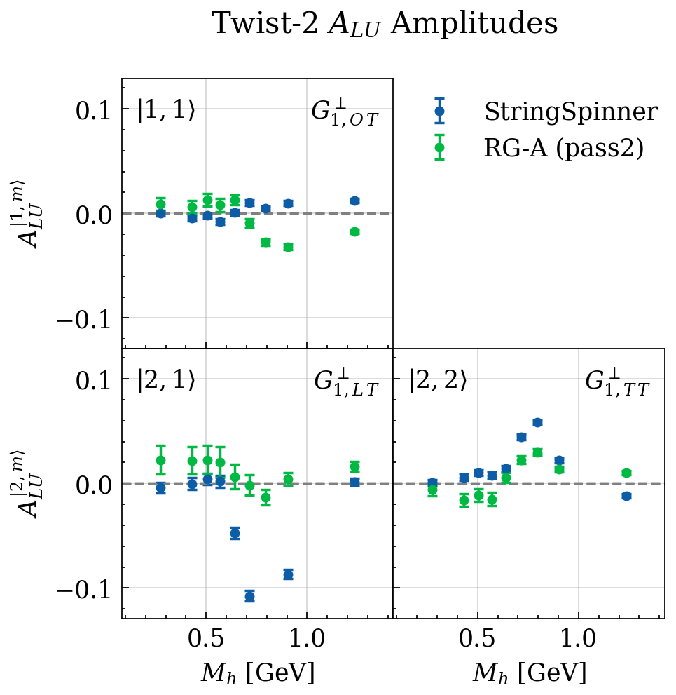
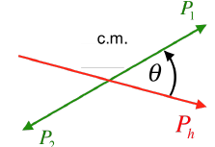

Compare Partial Wave Decomposition in MC and Data
Comparing to Polarized Lund model here (StringSpinner $3P_{0} model$, A. Kerbizi et al, Comput.Phys.Commun. 272 (2022))
G Matousek

Slide 10
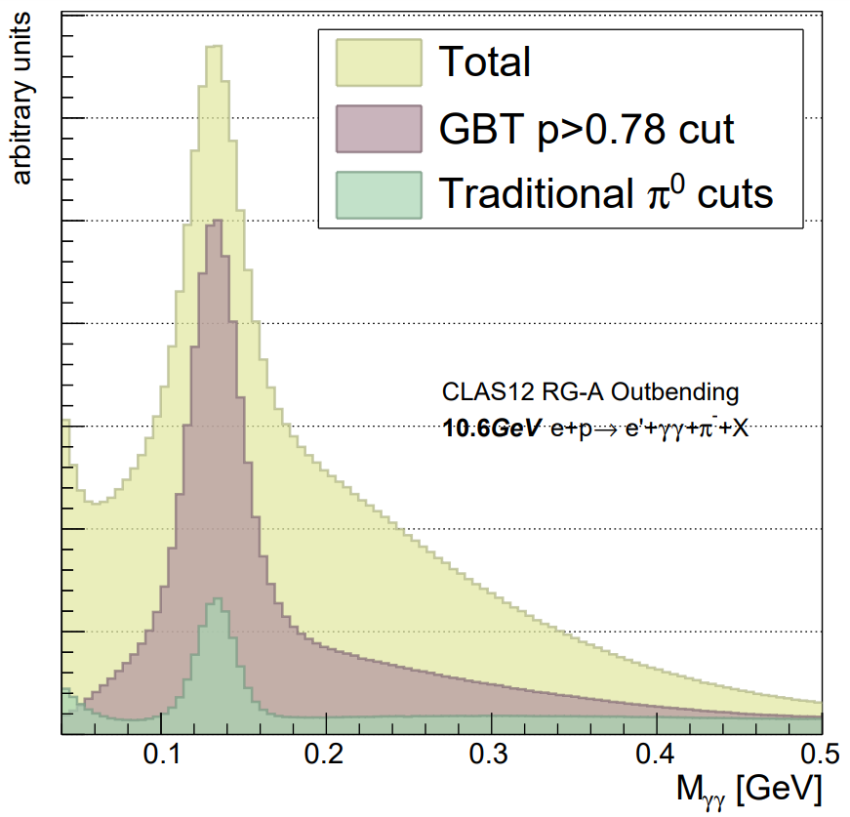
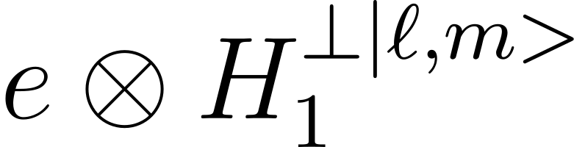
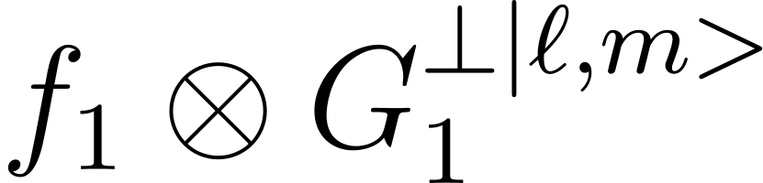
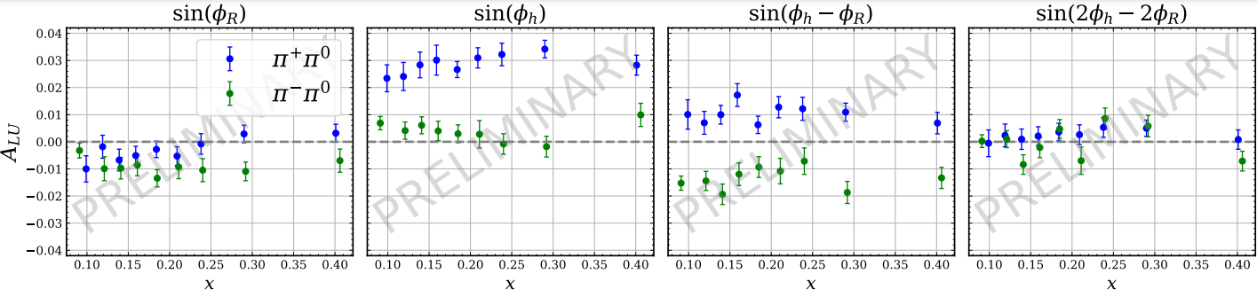
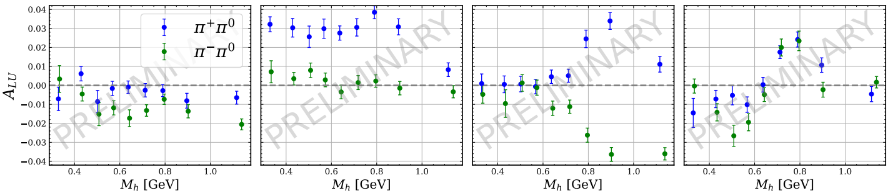
Dihadron Production ep→e𝜋±𝜋⁰(X)
Nearest-neighbor GBDT model to reduce 𝛾 background
Negative sin(𝜙_{R}) asymmetry for 𝛑-𝛑0 → e(x) extraction
Strong positive sin(𝜙_{h}) asymmetry for 𝛑+𝛑0 → u quark dominated channels (seen in 1h SIDIS frequently)
Isospin symmetries of G₁ DiFF observed in sin(𝜙_{h} - 𝜙_{R})
Strong enhancement near resonant region
PRELIMINARY
Slide by G. Matousek

Slide 11
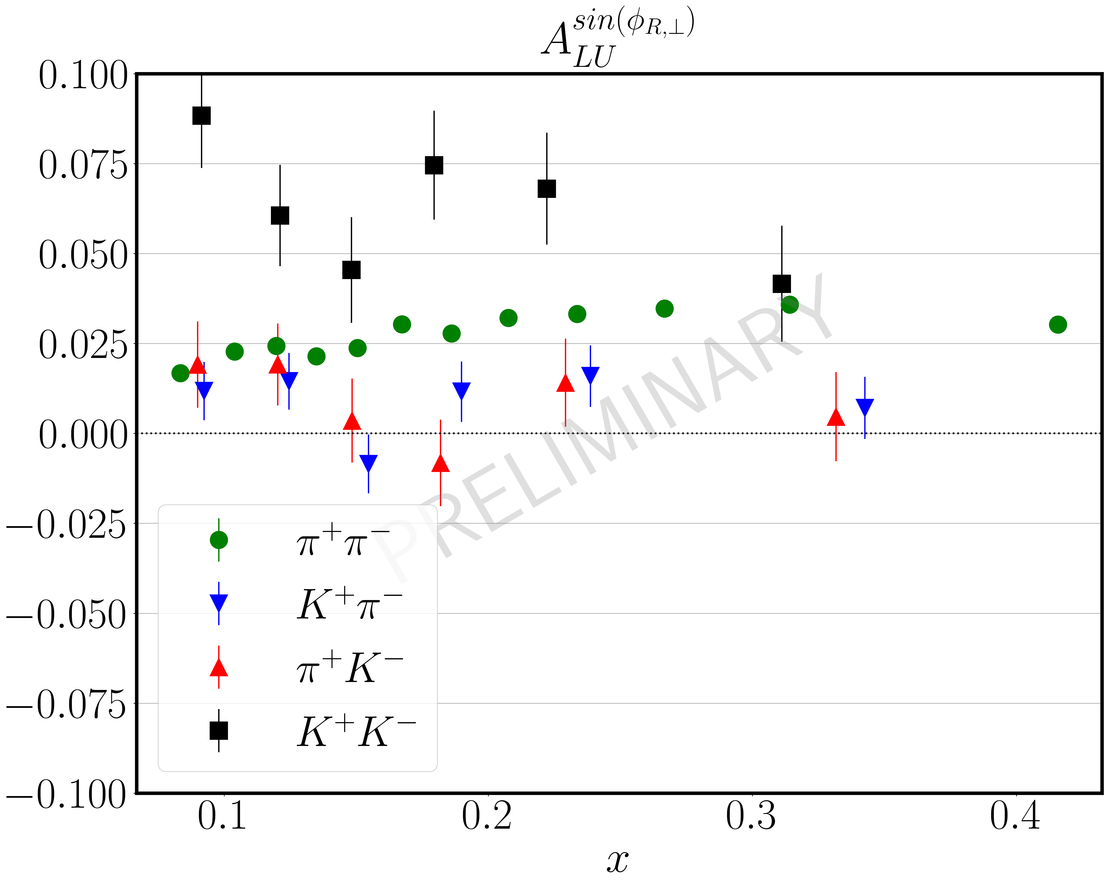

Kaons
Connor Pecar
Kaon $≫$ Pions
  Assuming $u−$quark dominance →FF effect?
  Twist3 FF relevant?
  Or $e\left(x\right)$ for strange quarks

Slide 12
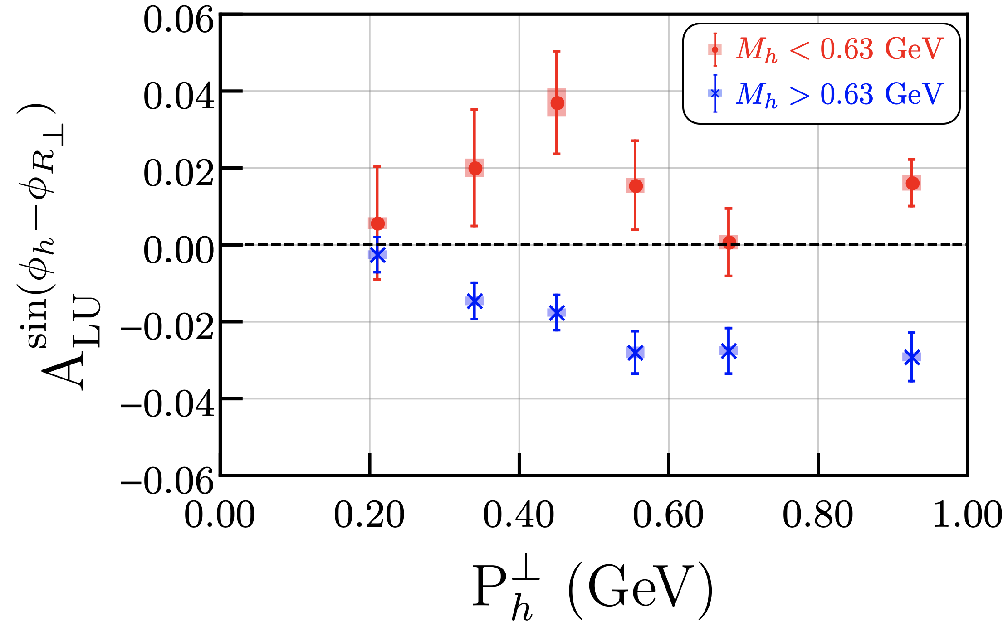


Asymmetries sensitive to $G_{1}^{⊥}$
$sp−$interference term larger for kaons than for pions
Not true for all interference terms (not shown)
$M_{KK}>m_{φ}$ can account for $p_{⊥}$ dependence

Slide 13
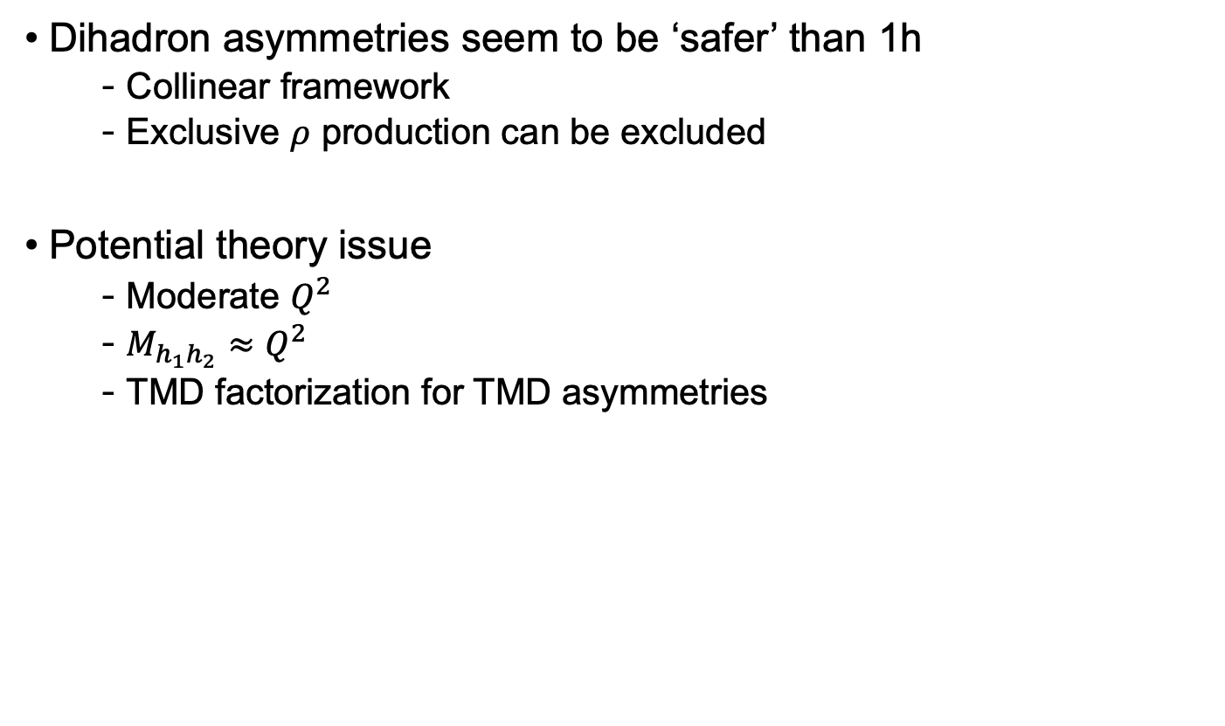
Talking points
Dihadron asymmetries seem to be ‘safer’ than 1h
  Collinear framework
  Exclusive $ρ$ production can be excluded
Potential theory issue
  Moderate $Q^{2}$
  $M_{h_{1}h_{2}}≈Q^{2}$
  TMD factorization for TMD asymmetries

