Slide 1
Studies of exclusive hadron SSAs with Transversely polarized target*
Harut Avakian
Theory discussion on RGH , March26, 2025
  Why measurements of exclusive hadrons are critical?
    Access to OAM and GPD E, GPD H,H_{T}
    Understanding of the impact of diffractive VMs on studies of the 3D structure and PDF, Sivers in particular
  Challenges in interpretation of exclusive rhos
    separation of exclusive rhos from semi-exclusive rhos
    separation of transverse rho from longitudinal rhos
    separation of transverse photon contributions from longitudinal
  Proposal to measure exclusive diffractive VMs and pions with transversely polarized target
  Summary
*) RGH run group addition

Slide 2
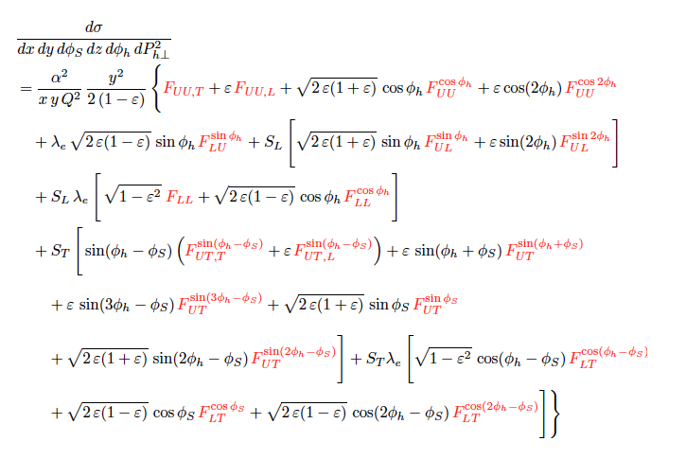
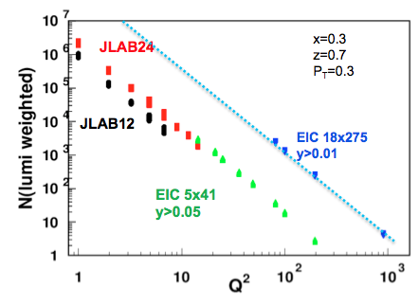
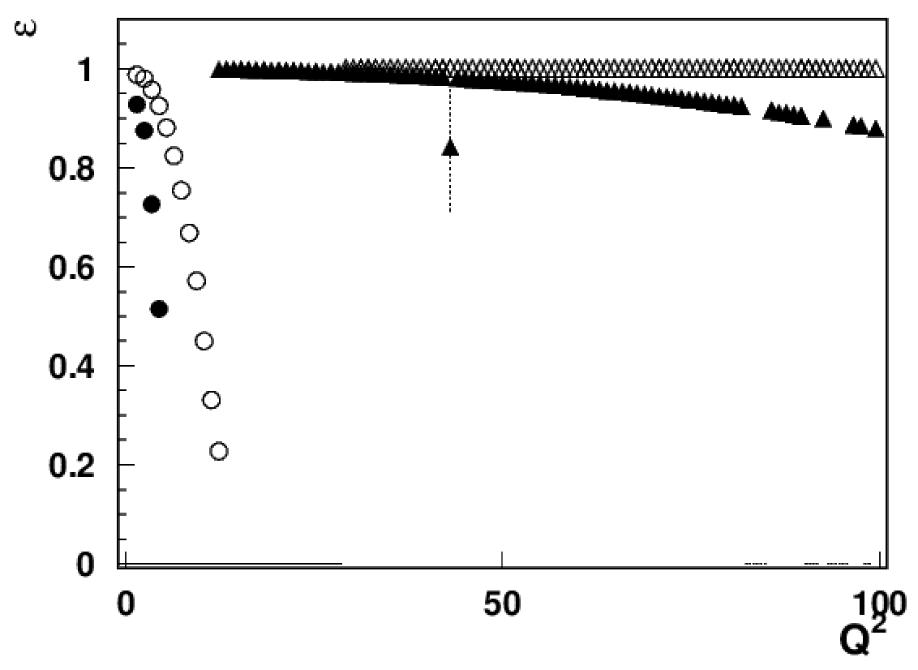

Structure functions and depolarization factors
At large x fixed target experiments are sensitive to ALL Structure Functions
At higher energies (EIC), observables surviving the ε→1 limit (F_{UU}, F_{UL}, Transversely pol. F_{UT})
x-section for eN→e’hX
EIC18x275
GK:1310.1472
EIC5x41
x-section from Bacchetta et al, 1703.10157
JLab24/HERMES
E*H
Combination of statistics and depolarization factors defines measurable SFs
Understanding of Longitudinal structure F_{UU,L} ^{sin(φ−φ} _{S}⁾ (likely dominated by rho) will be critical for interpretation of the Sivers effect of inclusive charged pions
JLAB12
x=0.3

Slide 3
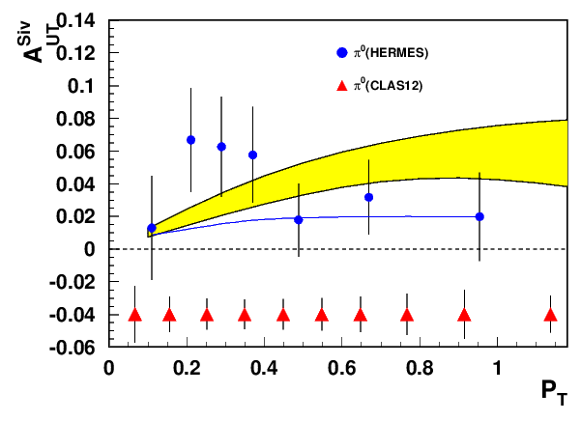
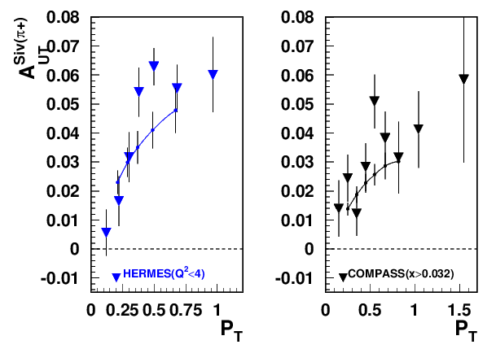
Sivers effect: P_{T}-dependence
Significant Sivers effect measured so far for charged hadrons
CLAS12 RGH experiment with Transversely polarized target
JAM3D
Pavia
Sivers effect, one of the most exciting and complicated measurements (with several overlapping azimuthal modulations, VM and longitudinal photon contributions will be critical to understand)
Neutral pion measurements, with less impact from VMs and longitudinal photons, will be critical for validation of Sivers measurements
Higher statistics + neutral pions would allow extraction of connecting asymmetries with TMDs with minimum dependence on TMD FF (AUT~(4*f_{1T}^{u}+f_{1T}^{d})/(4f₁^{u}+f₁^{d}) )

Slide 4
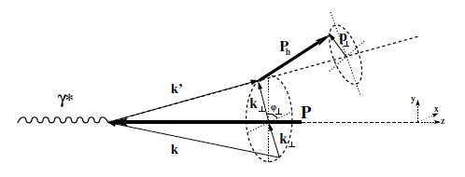
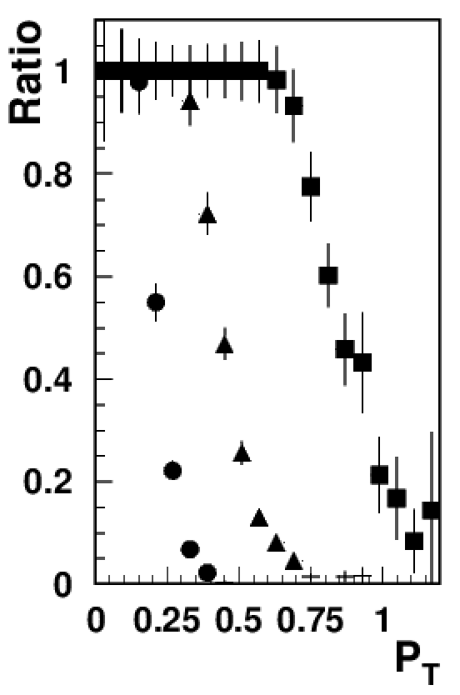
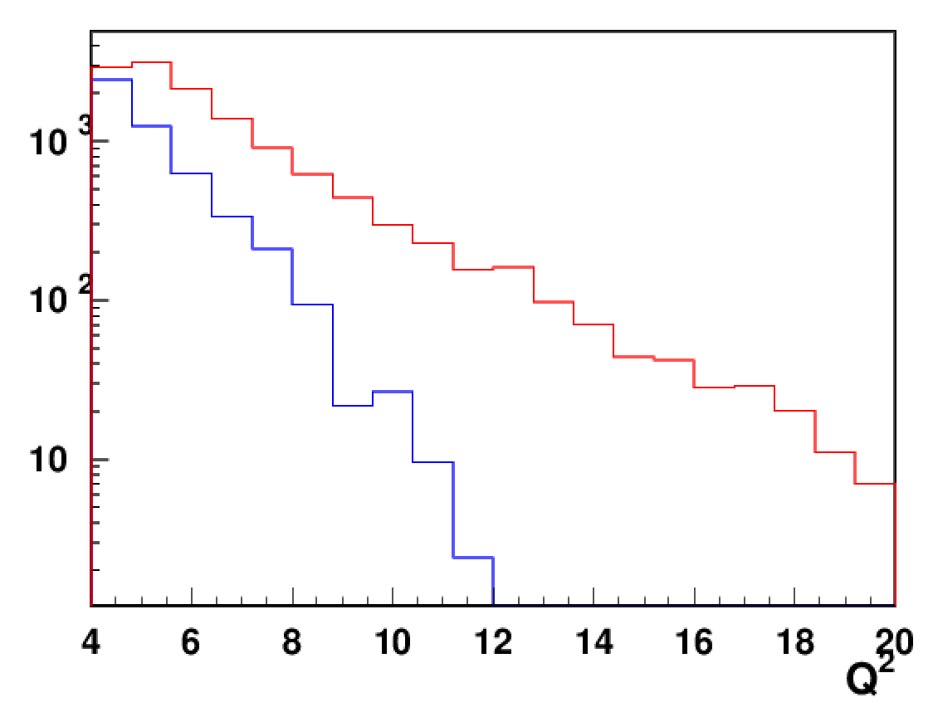
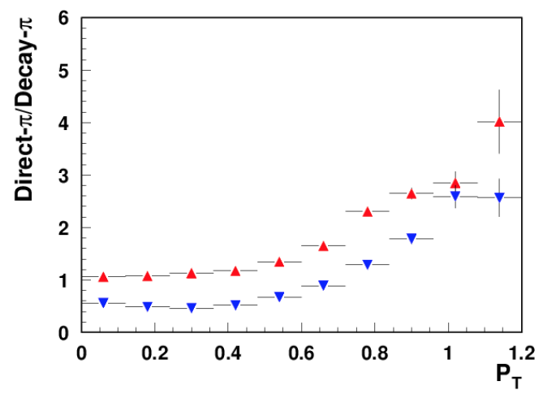
From JLa12 to JLab24 Larger Q² at large P_{T}
JLab12
P_{T}/(zQ)<1
P_{T}/(zQ)<0.5
Events in the same time interval in CLAS12 acceptance
P_{T}/(zQ)<0.25
JLab12
JLab24
Cleaner pion sample at large P_{T}
π+
JLab12 data within applicability of “theory” limited, need 22 GeV to increase the the Q² range, allowing detailed separation of higher twist SFs, needed for understanding the QCD within existing phenomenology
π−

Slide 5
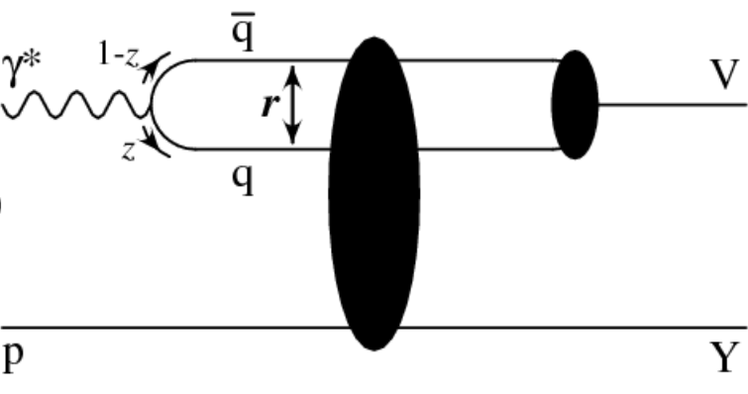
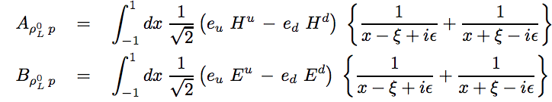
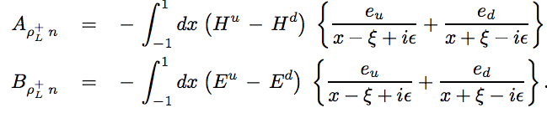


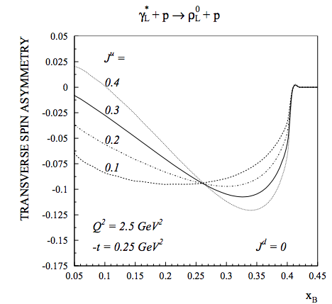
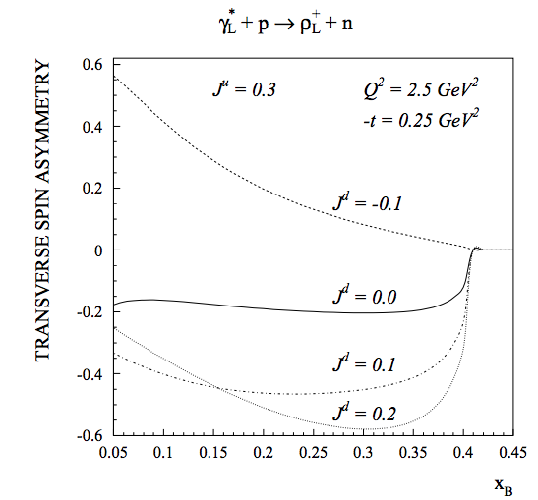
Theory predictions for transverse SSAs for rho
Goeke et al: hep-ph/0106012
ρ_{+L}(sensitive to J_{u}-J_{d})
ρ_{0L}(sensitive to 2J_{u}+J_{d})
Significant SSAs predicted, sensitive to OAM contributions
Notes:
Lorenz invariant amplitudes

Slide 6






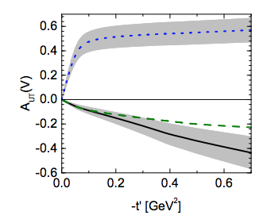
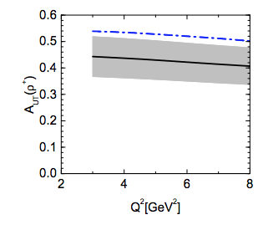

Theory predictions for transverse SSAs for rho
Goloskokov&Kroll 0809.4126
Opposite signs from HERMES!!
Significant SSAs for VMs
Notes:
Lorenz invariant amplitudes

Slide 7
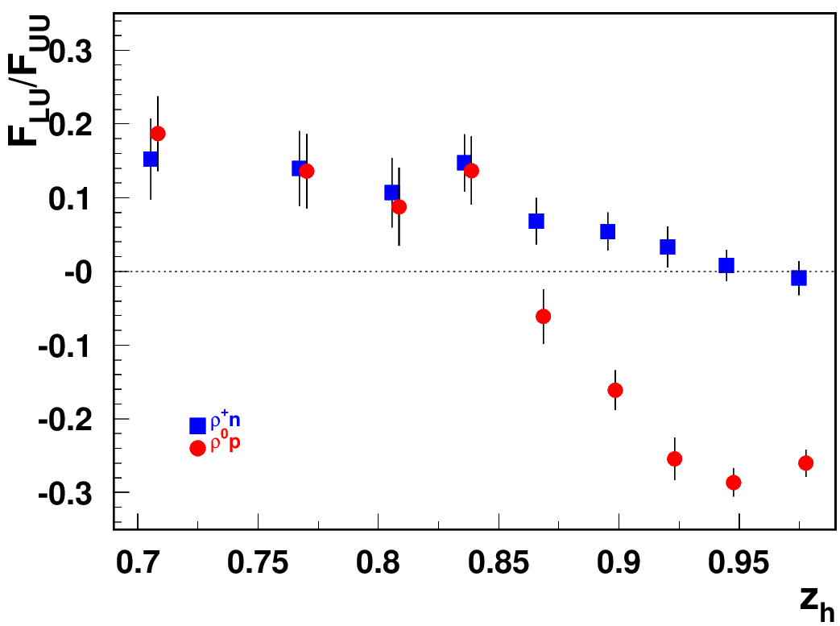
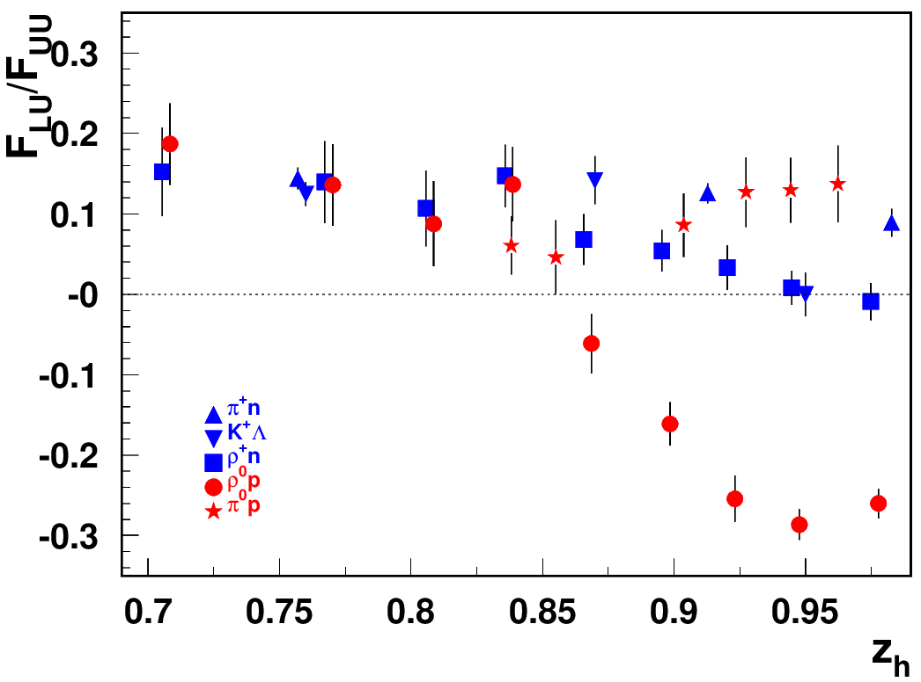
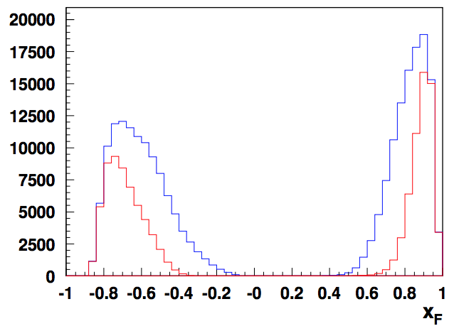
“diffractive” VMs: rapidity gap
Beam SSA for exclusive states
ep→e’pρ⁰
ρ⁰
p
t<1
t<0.5
Significant rapidity gap between protons (backward) and rho (forward)
What is the fraction of VMs in DDIS?
What is the relative fraction of VMs as a function of W and Q²?
Identify kinematics of “diffractive” ρ⁰ by comparison with ρ⁺
Diffractive VMs (ρ⁰)

Slide 8
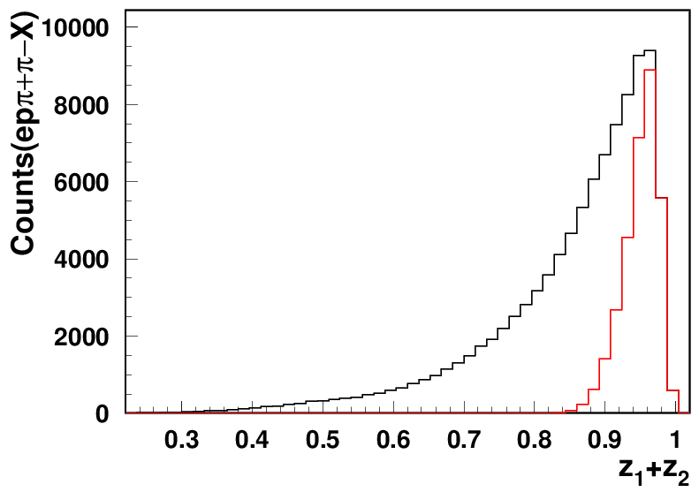
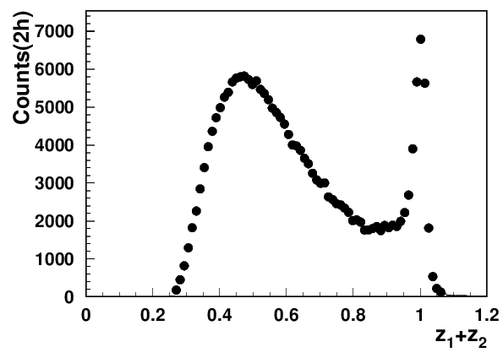
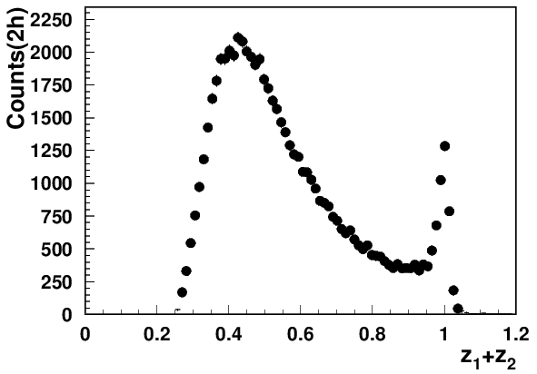
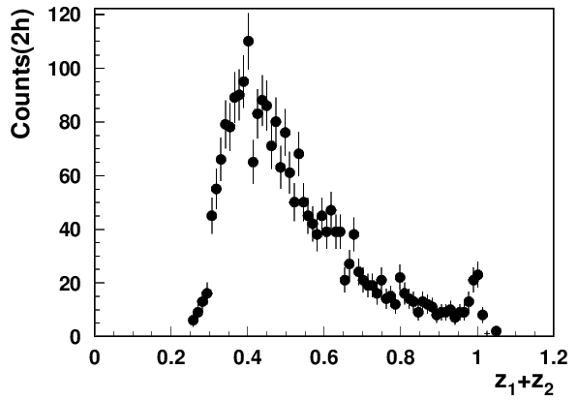
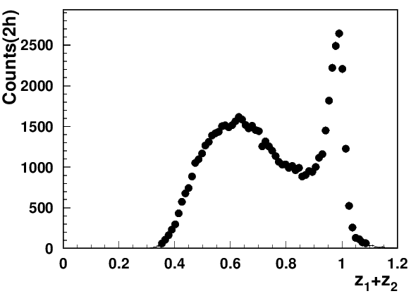
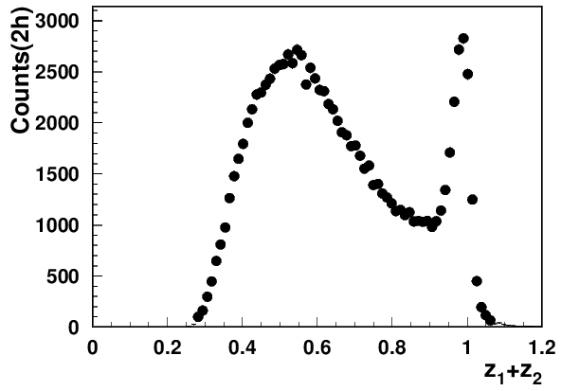
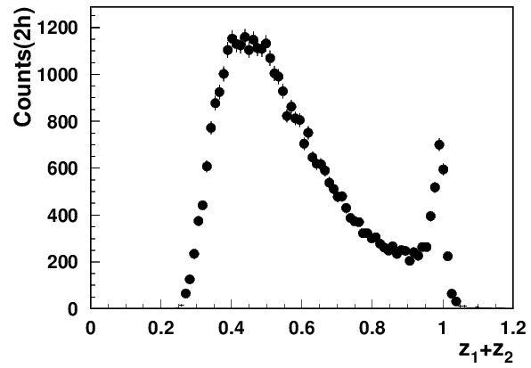
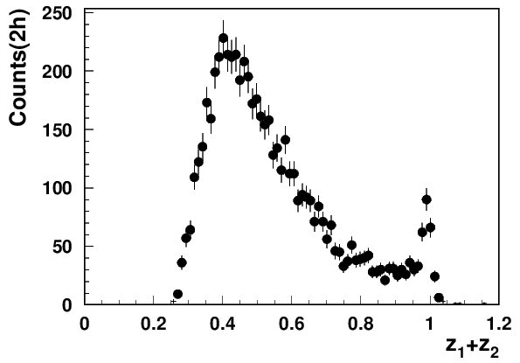
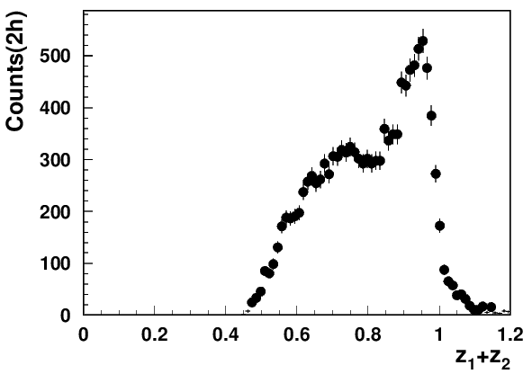
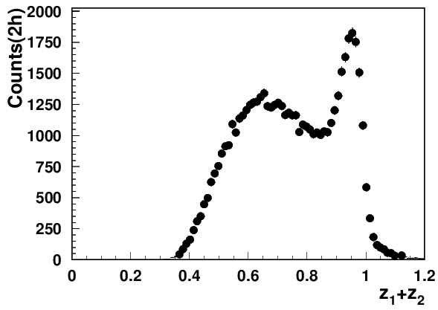
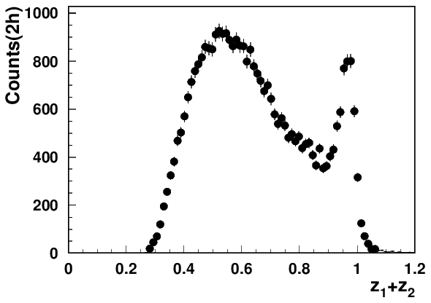
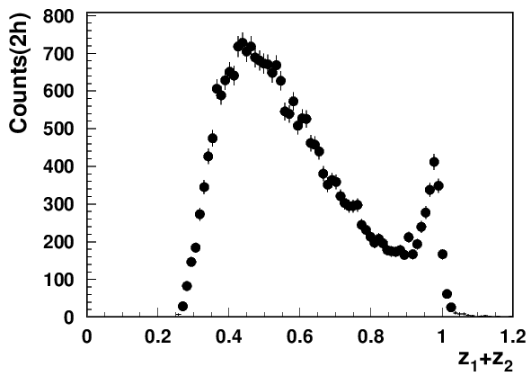
Exclusive dihadrons from CLAS12
all exclusive ρ
Q²=2 GeV²
Q²=3 GeV²
Q²=4 GeV²
x=0.2
longitudinal ρ
Q²=2 GeV²
Q²=3 GeV²
Q²=4 GeV²
Q²=5 GeV²
GK: arXiv:0708.3569
x=0.3
Q²=2 GeV²
Q²=3 GeV²
Q²=4 GeV²
Q²=5 GeV²
x=0.4
at lower x need higher z
The exclusive rho contributions in SIDIS drop with Q² (~1/Q²)
At large z=z₁+z₂ the transverse photon contributions to ρ_{L} suppressed
Notes:
Lorenz invariant amplitudes

Slide 9


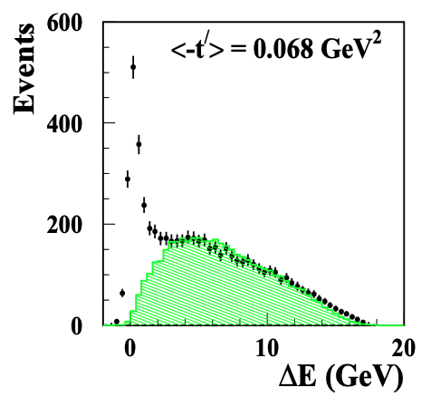
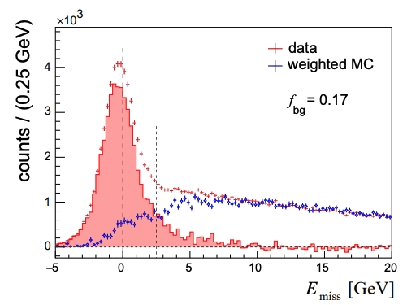
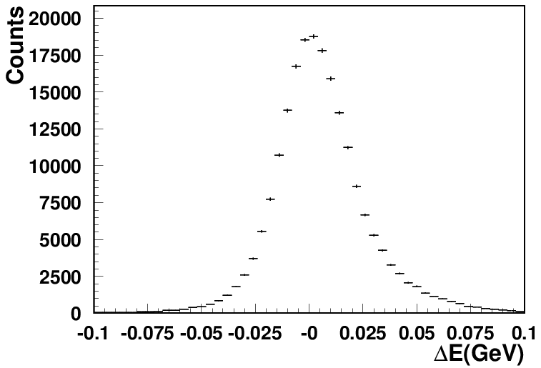
CLAS12 Experiments involved: Exclusive rhos
Exclusivity condition defined by the missing Energy:
CLAS12 (width <0.1GeV)
HERMES(width ~0.6GeV)
COMPASS(width ~2GeV)
~20% of data
hep-ex/0004023
Guarantying the “exclusivity” requires good resolutions (get worse at higher energies)
Subtraction procedure relays on normalization, based on exclusive limit of LUND-MC
All distributions have tails, indicating the RC may not be negligible
Extraction of SDMEs, will require validation in the multi-D space (significant samples)

Slide 10
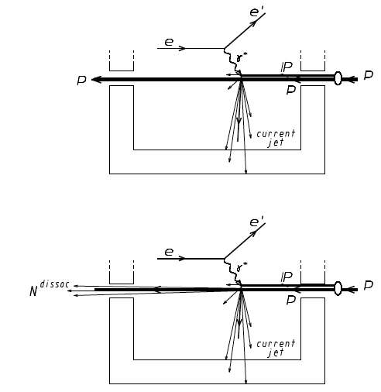
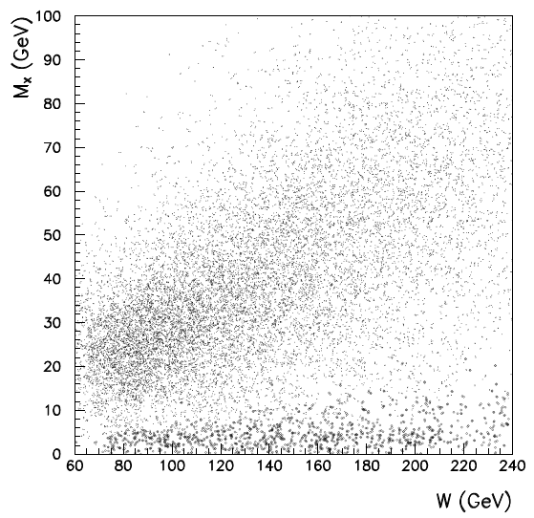
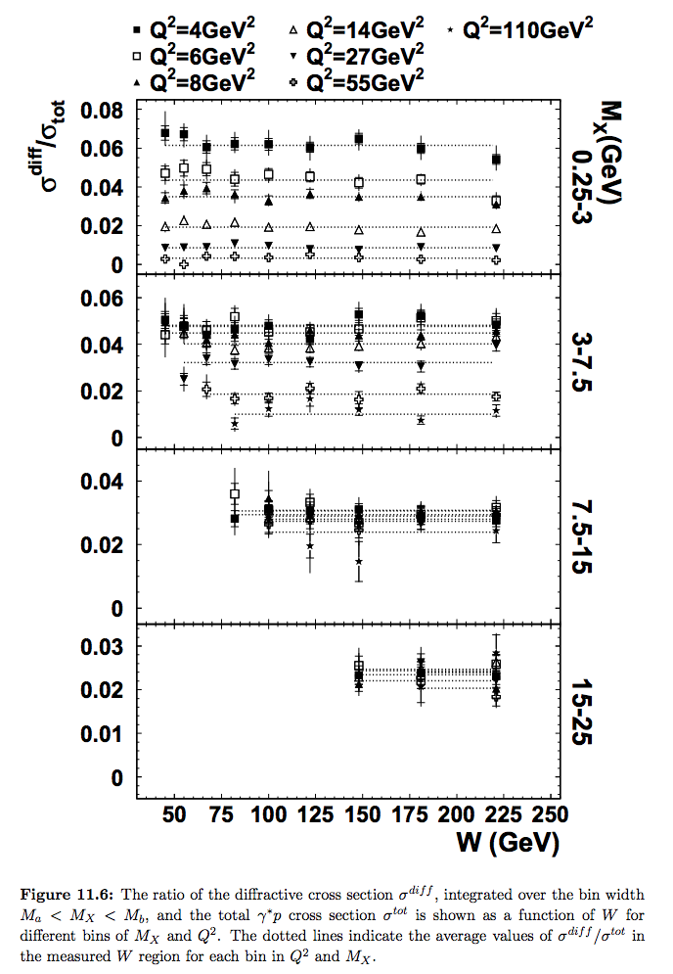



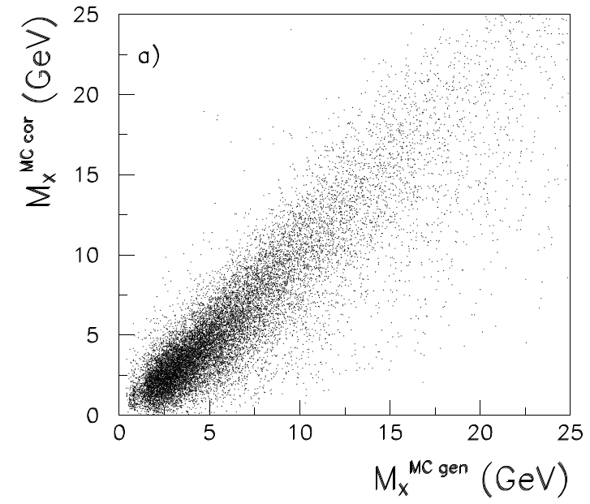
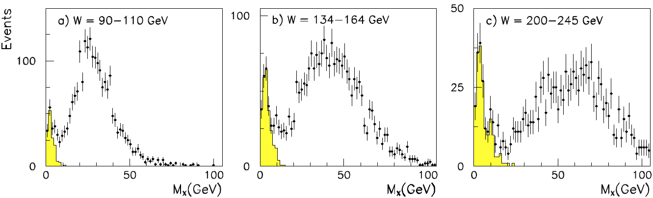


Measured x-section: DDIS vs DIS
M_{X} in DDIS →mass of the particle[s] in the current fragmentation
~1/Q²?
ZEUS
Week increase with W in photoproduction
Strong increase in electroproduction (longitudinal rho?)
Eur. Phys. J. C 6, 43{66 (1999)
Electromagnetic radiative effects were corrected (less than 10% and independent of W).
For η_{max} < 1.5 the contribution from nondiffractive scattering is expected to be negligible
No dependence of DDIS/DIS on W, decrease with Q² indicating the VMs can be the main contributor
At lowest M_{X} seem to be ~1/Q², at higher M_{X} there seem to be no Q²-dependence

Slide 11
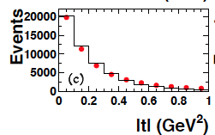
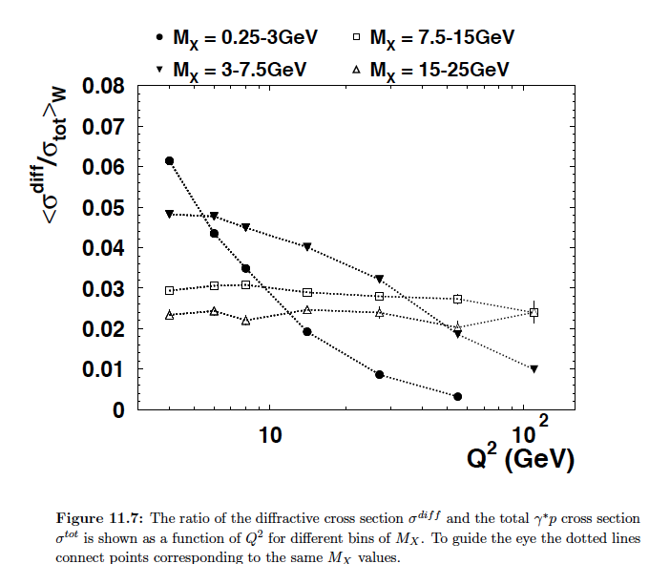
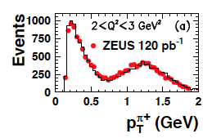
More plots from ZEUS
ZEUS diffraction 1/Q^2 atlow M_X
ZEUS rho (0708.1478)

Slide 12



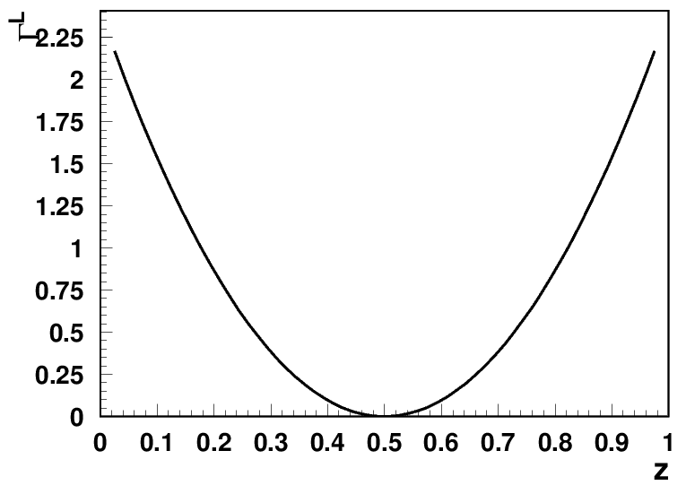
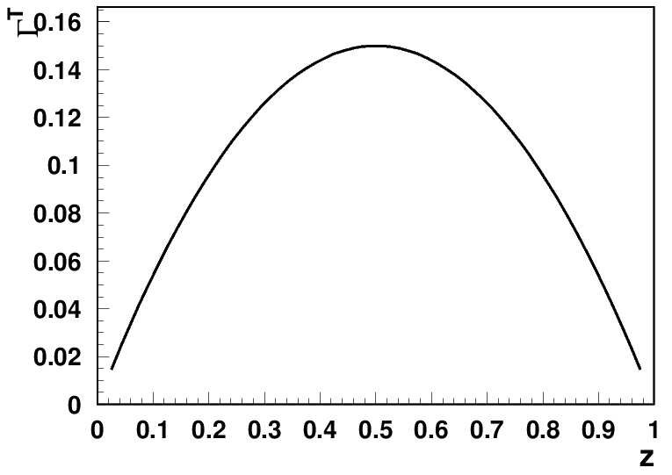
VM contributions
Yuri Kovchegov
in 80% cases one of the pions has <20% of the total momentum
Asymmetric decays of longitudinall rho lead to much smaller acceptance
Similar but inverted distributions for e+e- decays

Slide 13
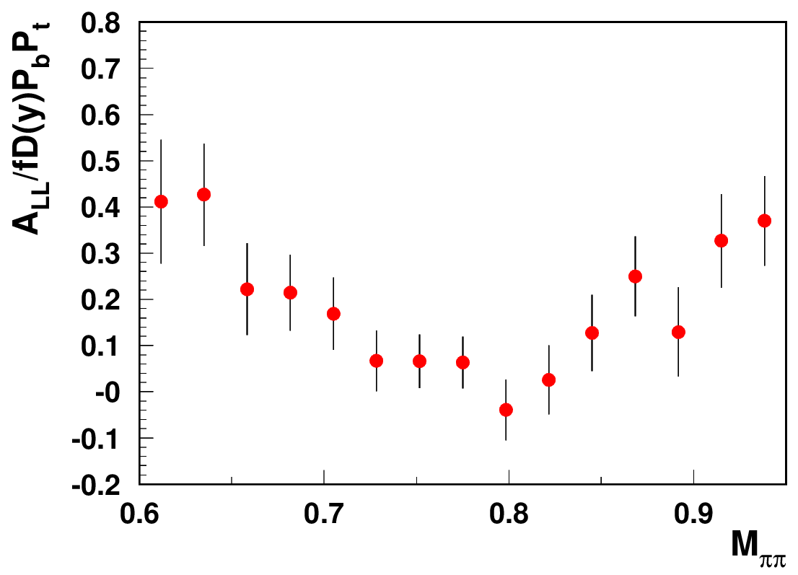
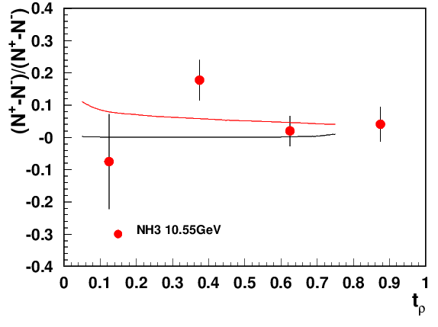
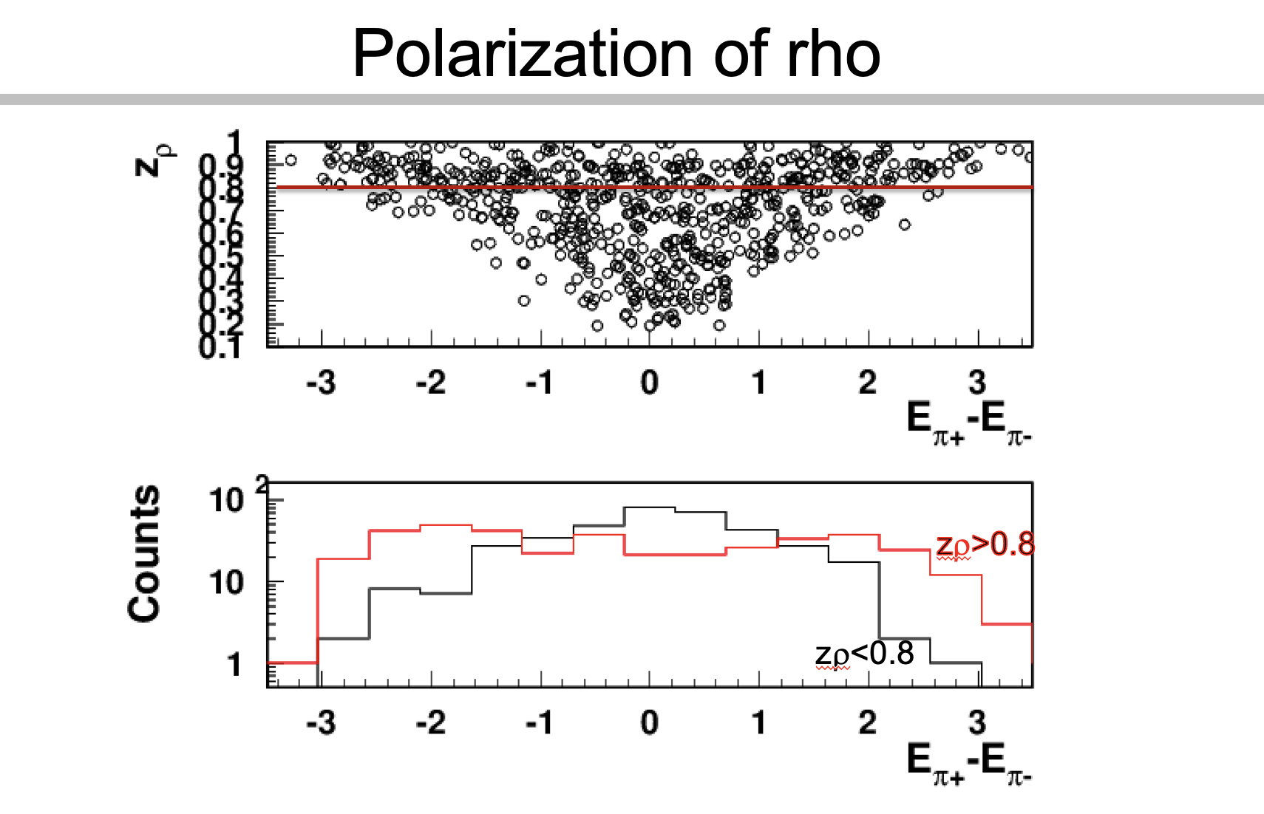
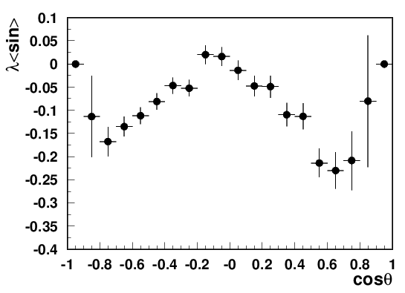
Studies of ρ⁰ impact with longitudinally polarized NH₃ target
CLAS12 Preliminary
ep->e’p’π⁺π⁻
Need clear separation of hydrogen from NH₃
and diffractive exclusive ρ0s from exclusive π+π−
DSA is P-even, SSA is P-odd
longitudinal photon cross section is P-odd
→ contribution appears only in the SSA, a P-odd observable, and does not appear in DSA
ep->e’p’ρ⁰
With x10 less statistics than RGC, RGH can provide a significant measurement of ρ0 SSAs
Beam SSA (RGC summer)

Slide 14
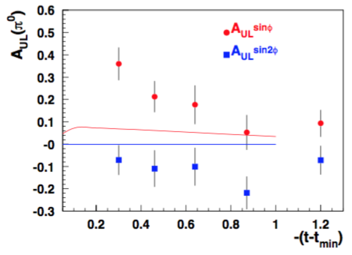
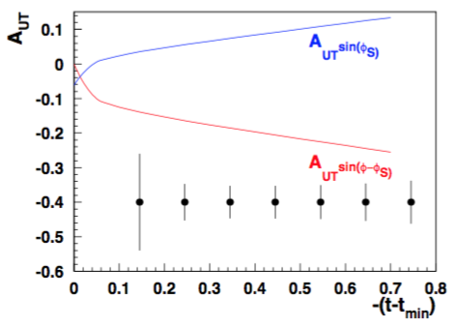
CLAS12 A_{UL}:exclusive rho0 and pi0
Comparing CLAS12 data with Goloskokov-Kroll
GK:ArXiv:0906.0460
GK:ArXiv:1310.1472
Sivers SSA (GPD-E) or exclusive rho
predictions from Goloskokov&Kroll
CLAS12, is currently the only place for measurements of exclusive processes, requiring combination of high statistics, good resolution and multiple observables

Slide 15



HERMES A_{UL}:”exclusive” pions
https://arxiv.org/pdf/hep-ex/0212039
https://arxiv.org/pdf/hep-ex/0112022
SSA significant at small x, low Q² and relatively large t

Slide 16



CLAS12 exclusive pions from RGC
NH3
C
Normalizing carbon and NH3 for MX below 0.8 and subtracting to get the dilution factor as a function of the variable of interest

Slide 17


CLAS12 A_{UL}:exclusive pions
Comparing pi+ (Harut) and pi0 (Samy) SSAs with each other and Goloskokov-Kroll
Both SSA significant and positive confronting HERMES and GK, difference in pi0 and pi+ is expected to come from the pion pole (GPD E~), means from longitudinal photon
Longitudinal photon produces very large SSAs for rho0s, serving a significant background for “exclusive” pi+

Slide 18


CLAS12 A_{UT}:exclusive rho0 and pi+
Significant transverse asymmetries predicted for exclusive pi+
GK:ArXiv:1310.1472
GK:ArXiv:0906.0460
Sivers SSA (GPD-E) or exclusive rho
predictions from Goloskokov&Kroll
Exlusive processes help in understanding of longitudinal photon contriutions
CLAS12, best positioned formeasurements of exclusive processes, requiring combination of high statistics, good resolution and multiple observables

Slide 19
SUMMARY
Measurements of exclusive ρ,π+,π0 with transversely polarized target will be crucial for completeness of the measurements of 3D structure, including GPDs and TMDs
  Exclusive processes sensitive to longitudinal photon contributions
  Significant transverse single-spin asymmetries were predicted for exclusive hadrons
  CLAS12 has significant advantage compared to higher energy experiments in resolution and statistics, required for proper separation of exclusive VMs from semi-exclusive VMs, and separation of transverse rhos from longitudinal
  Measurements of Target and beam SSAs and DSA is critical to ensure separation of diffractive rho from other exclusive and semi-exclusive processes
  The diffractive VM contributions, violate the factorized picture of SIDIS based on the dominance of the leading twist contributions, and detailed understanding of exclusive rho contributions in the multi-D space will be critical to address the challenges of phenomenology ( “rho-subtracted SIDIS”)
Submit a proposal to study SSAs for exclusive VMs with tranversely polarized target
→run group extension to RGH (involved Duke, MSU, Argonne, Duquesne)

Slide 20
support slides

Slide 21




Exclusive ρ contributions to π: P_{T}-dependence
COMPASS→“Positive trend”
“ρ-free” SIDIS
0.1<P_{T}<0.3, 0.4<z<0.6
π− and π+ show similar behavior
COMPASS→“Positive trend” also reproduced when additional proton in TFR detected (red)
The same sign and size of π+ and π- SSA indicates the rho0 may not be properly subtracted(require detailed MC studies, which require proper SDMEs)
While VM contributions are ~20% in multiplicities in SSA they can be >100%
Detection of the target proton introduces much smaller bias on the inclusive charged pion SSA, than the exclusive rho contributions

Slide 22
Sivers predictions from JAM for CLAS12
At large x, and z we should be able to measure significant SSAs for pi- for the first time!!!

Slide 23
Sivers predictions from JAM
PT-dependence of Sivers SSA can be affected by rho0 production

Slide 24
CLAS12 A_{UT}:exclusive rho0 and pi+
Significant transverse asymmetries predicted for exclusive pi+
GK:ArXiv:0906.0460
GK:ArXiv:1310.1472
large contribution in Pi production since
their contributions are enhanced by the chiral condensate which appears in the wave function for a (ground state) pseudoscalar meson.
Sivers SSA (GPD-E) or exclusive rho
predictions from Goloskokov&Kroll
Exlusive processes help in understanding of longitudinal photon contriutions
CLAS12, best positioned formeasurements of exclusive processes, requiring combination of high statistics, good resolution and multiple observables

Slide 25
Validating longitudinal rho
simple tests to make sure we deal with exclusive longitudinal rho0 coming from longitudinal photons:
1) 1/Q^6 dependence of the x-section
2) 0 A_LL
3) Significant SSAs, different from rho+ (and pi+/pi0/K^+ any final state dominated by u-quarks)
…............

Slide 26


rho0 ALU
LL-interference?

Slide 27


asymmetric decays
Longitudinal rho decays asymmetrically
more than 10% of longitudinal rhos, lost to misID
Longitudinal rhos, because of asymmetric decays are most sensitive to acceptance, PID,…. require maximum attention

Slide 28




CLAS12 A_{UL}:exclusive pions
Significant positive SSA
to be cross checked!!!

Slide 29


A_{LL} for samples:Q²-dependence
0.27<x<0.33
ep→e’π+X
ep→e’π−π+-X
ep→e’π0-X
Understanding evolution properties of g₁(x.kT), and possible impact of rhos
Where the Q²-dependence at low Q² comes?

Slide 30








Experiments (EMC, NMC)

Slide 31




Experiments (ZEUS)
https://arxiv.org/pdf/0708.1478v2
what about fixed x?

Slide 32
Experiments (EMC, NMC)

Slide 33

Response from theory

Slide 34




A_{LL} studies of exclusive ρ⁰ : HERMES
A_{1ρ}=0.23 ± 0.14±0.02
1D plots can be really misleading need multi-D
For a proper extraction of multiplicities and spin-azimuthal modulations of exclusive ρs, clean separation is needed for ρ⁰, and longitudinally polarized ρ⁰ signal, in particular
At low P_{T}, where the background is smaller, the asymmetry indeed tend to be negative
Accounting of ρ⁰ will change the phenomenology of helicity distributions

Slide 35
Excluding the “diffractive” rho from SIDIS
Depending on how we exclude the exclusive rho we can have several versions of experimental samples of inclusive hadrons, each with their own bias:
1) Standard SIDIS (eN→ehX, h=π,K,..) within the full accessible kinematics, corrected for acceptance and RC, measured in the multidimensional space
  →eπX biased with respect to theory by presence of contributions from diffractive rho, contributing to ~20% of counts, in low P_{T}, with contributions to SSA ~10 times higher
2) Standard SIDIS (eN→eπX) within the full accessible kinematics, corrected for acceptance and RC, measured in the multidimensional space, with subtracted in multi-D bins for rho0 contributions (“rho-subtracted SIDIS”)
  →requires measurements of pions from diffractive rho in multidimensional space, means detailed studies of SDMEs of rhos, requiring good precisions and huge statistics, develop MC (ex. HEPGEN) also for all polarization observables, extensive validation needed, little known RC
SIDIS subsamples (eN→epπX, eN→eππX) within the full accessible kinematics, allowing clear eliminiation of rho0 contributions using cuts on missing masses of epX or eππX
(“rho-free SIDIS”)
  →biased by the presence of additional hadron in TFR (epX) or CFR (eppX), may need a new phenomenology
  requires measurements of dependence on M_{X} to understand the bias,
  Theory should be able to evaluate the bias from the presence of an additional hadron

Slide 36





SDMEs from photoproduction
JLab/GlueX, S. Adhikari et al, Phys.Rev.C 108 (2023), 055204: ArXiv:2305.09047
-t~0.2
GlueX preliminary
-t~0.8
While at small t (dominant part of the statistics) the transverse rhos dominate, at large t the contribution from transverse photons going to longitudinal rho becomes more significant

Slide 37








SDMEs from photoproduction
JLab/GlueX, S. Adhikari et al: https://arxiv.org/pdf/2305.09047
vanish after φ-integration
vanish after φ-integration
vanish after φ-integration
The SDMEs for transverse photons with sin²θ (to transverse rho?) at Q²>0 seem to be smaller (detailed comparison vs Q²).

Slide 38


SDMEs from photoproduction
JLab/GlueX, S. Adhikari et al: https://arxiv.org/pdf/2305.09047
COMPASS more consistent with JLab
The SDMEs for transverse photons with cos²θ (to longitudinal rho?) at Q²>0 different, in particular r₀₀¹ (relevant for BM).

Slide 39

Understanding exclusive rhos and SDME validations
corr. with r₁₋₁⁵ , r₁₋₁⁶ ,r₀₀⁵ (Hermes, COMPASS)
corr. with r₁₋₁⁸ ,r₀₀⁸ (Hermes, COMPASS)

Slide 40

Understanding exclusive rhos and SDME validations
corr. with r₁₀⁵ (Hermes) no corr (COMPASS)
corr. with r₁₋₁⁸ (Hermes) no corr (COMPASS)

Slide 41

Using e+e- to estimate vector mesons
The invariant mass of dihadrons is contaminated by other vector mesons, with shape not changing significantly with hadronization fraction to spin-1 vs spin-0 mesons
decays of π and η are kinematically separeated from ω and ρ⁰
π⁰→ γe+e- →1.10⁻²
η→ γe+e- →7.10⁻³
ρ→ e+e- →4.72+/−0.05 10⁻⁵
ω→ e+e- →7.36+/−0.15 10⁻⁵
φ→ e+e- →2.97+/−0.15 10⁻⁴
π⁰
η
ω
ρ
Vector meson per electron can be independently estimated from ep→e’e+e-X
Significant fraction of VM may affect DY studies.

Slide 42




Single pions
P_{B}P_{T} +=0.75+/-0.03
P_{B}P_{T}-=0.66+/-0.03
Double spin asymmetries consistent for 2 target polarizations, and with world data
25% of total RGC

Slide 43




DSA from NH3: understanding dilution
Solid line→ epπx,
dashed→ old extraction from SIDIS eπx,
circles → averaged over all helicities of lepton/proton eπx
comparable with RGA
average kinematics identical in data/mc (black circles)

Slide 44


Plots suggested for release
e’pπ+X
e’πX
eπ+X
b2b A_{LL} more significant than SIDIS A_{LL}, indicating different weight for different PDFs
SIDIS A_{LL} consistent with expectations
epπ+X
b2b A_{LU} can be measured with RGC, with preliminary results indicating ~ the same size as A_{LU}

Slide 45



RGC: target SSA in exclusive rho
Using the sample ep→e’pπ+π−X
First look at exclusive ep→e’pπ+π− A_{UL} in rho region
Work in progress to remove bck

Slide 46



Exclusive rho: impact on π+ A_{UL} SSAs
significant
mixed
Exclusive rho: A_{UL} SSA
pions from rho0 decays
All pions
At large z the impact of rho may be significant, even if rho itself may not have significant SSA!!!
significant>0

Slide 47


