Slide 1
RGH Kinematics Overview

Slide 2
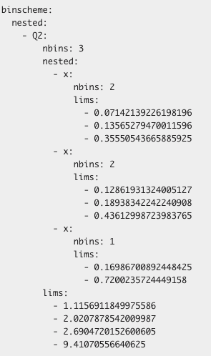
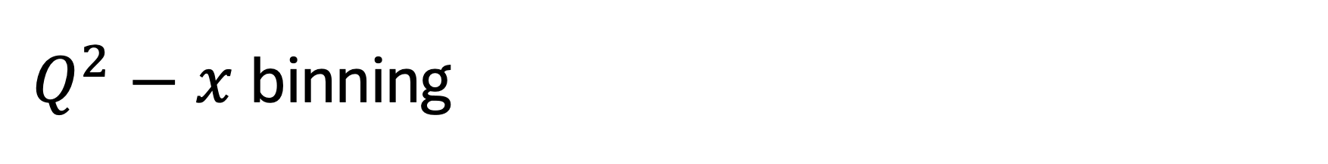
$Q^{2}−x$binning

Slide 3
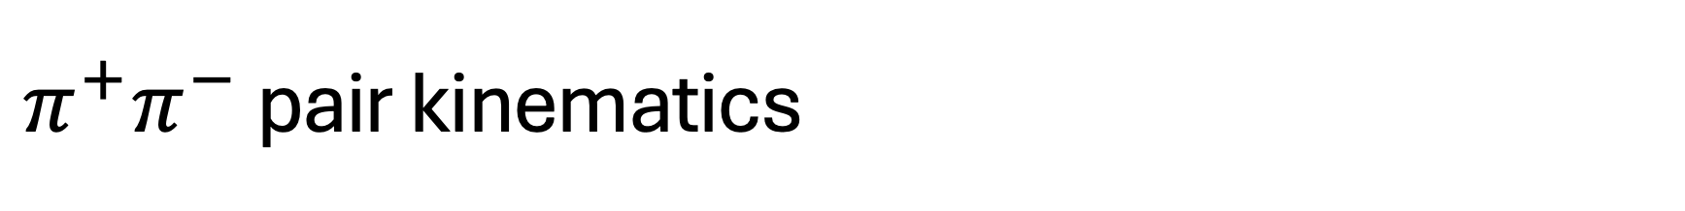
$π^{+}π^{−}$ pair kinematics

Slide 4
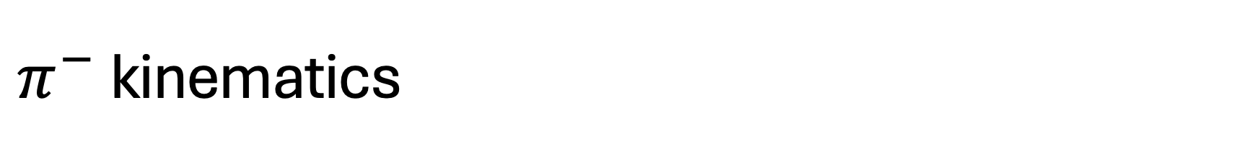
$π^{−}$ kinematics

Slide 5
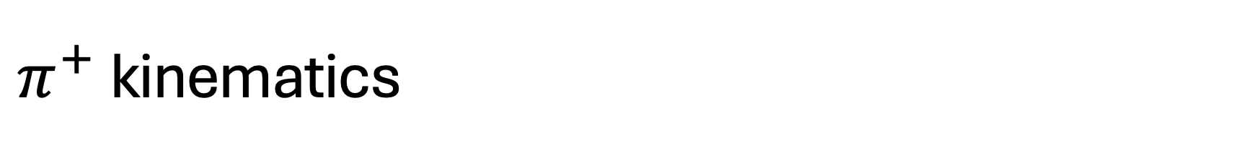
$π^{+}$ kinematics

Slide 6
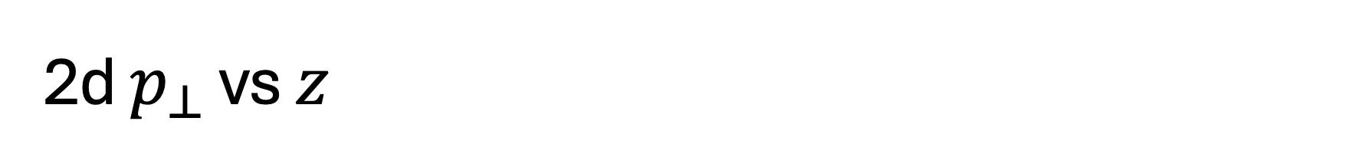
2d $p_{⊥}$ vs $z$

