Slide 1
The development of the very low noise receiver technology for the LHC transverse feedback and diagnostics
Xavier Buffat, Gerd Kotzian, Martin Söderén, Viera Stopjaková and Daniel Valúch*
IQ award ceremony, 2025 LLRF workshop, Newport News, USA 14.10.2025
* daniel.valuch@cern.ch

Slide 2
LHC transverse feedback system (ADT)
4 pickups in the tunnel per beam per plane (16 total)
Digital signal processing
4 E-field kickers per beam per plane (2 μrad, 10kV peak, 6 meters total)
Fully remote and automatic operation and setting up

Slide 3
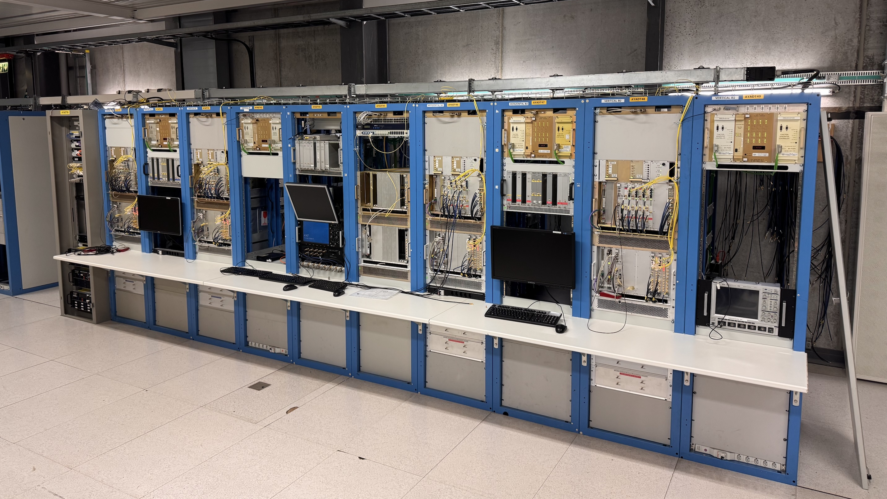
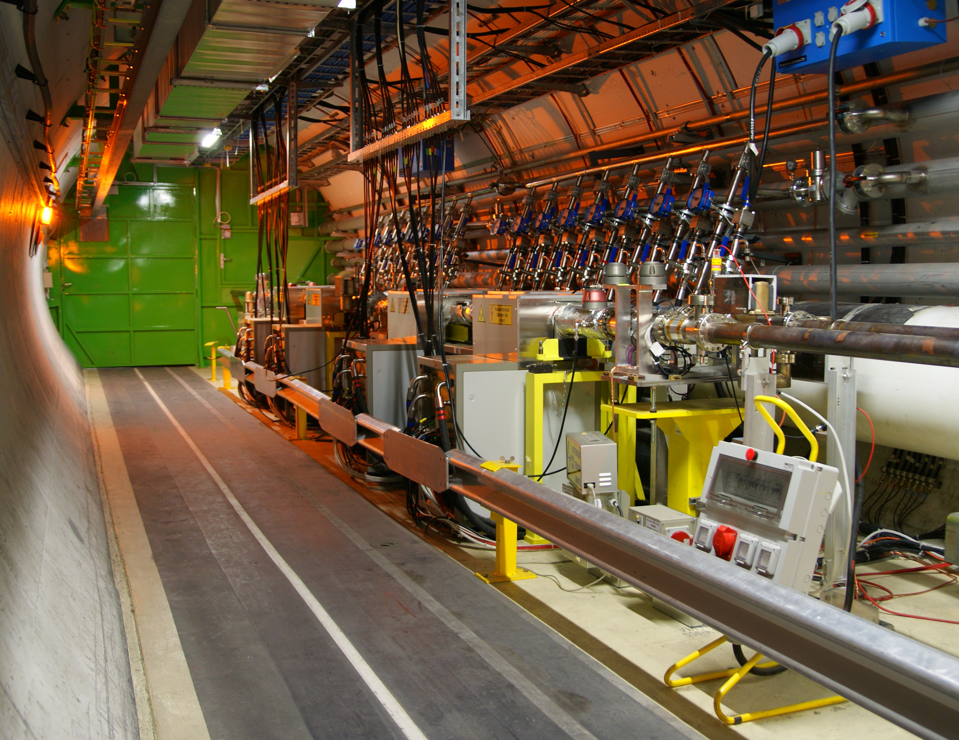
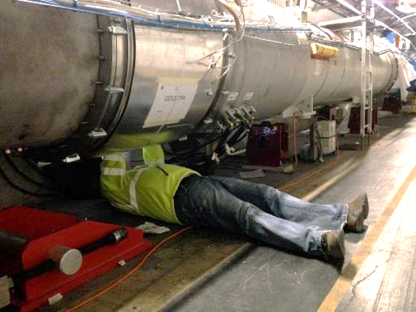


LHC transverse feedback system (ADT)
LLRF surface
800 m
400 m
Pickups underground in the arcs
Tetrode amplifiers and kickers underground in the RF zone

Slide 4
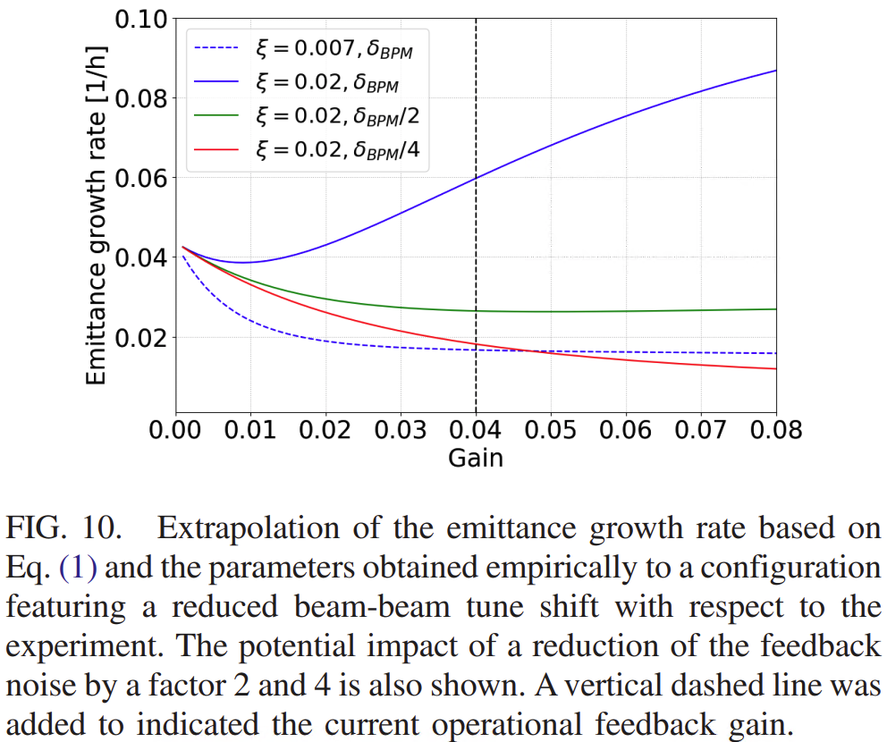
Past performance and motivation for upgrade
The TFB performance during the LHC Runs I and II* was greatly sufficient for the LHC operation. Nevertheless:
Recent studies showed that the TFB noise floor in the LHC must be reduced by at least factor of two in order to operate the machine with large beam-beam tune shift as foreseen in the High Luminosity LHC [2] and suppress the risk of loss of Landau damping by noise [3].
Improvement by factor of 4 is required to recover an emittance growth rate in the order of 2% per hour as in the present LHC.
Also, the future feedback system foreseen to suppress the LHC Crab Cavity noise in HL-LHC [4] relies on improved noise performance of the upgraded TFB.
[2] Buffat, X. et al: “Modeling of the emittance growth due to decoherence in collision at the Large Hadron Collider, in Phys. Rev. Accel. Beams 23, 021002 (2020)
* LHC Run I (2009-2013), LHC Run II (2013-2018)

Slide 5
New receiver architecture for ultra low noise BPMs
We need to use as much energy from the sensor as possible
We must eliminate any additional noise sources (hardware but also digital signal processing...)
We must be clever and (super-)optimize everything...
Sensor
Signals
Information

Slide 6
New receiver architecture for ultra low noise BPMs
An example of one possible way to convert almost 50% of available signal power from sensor 800m away to information...

Slide 7
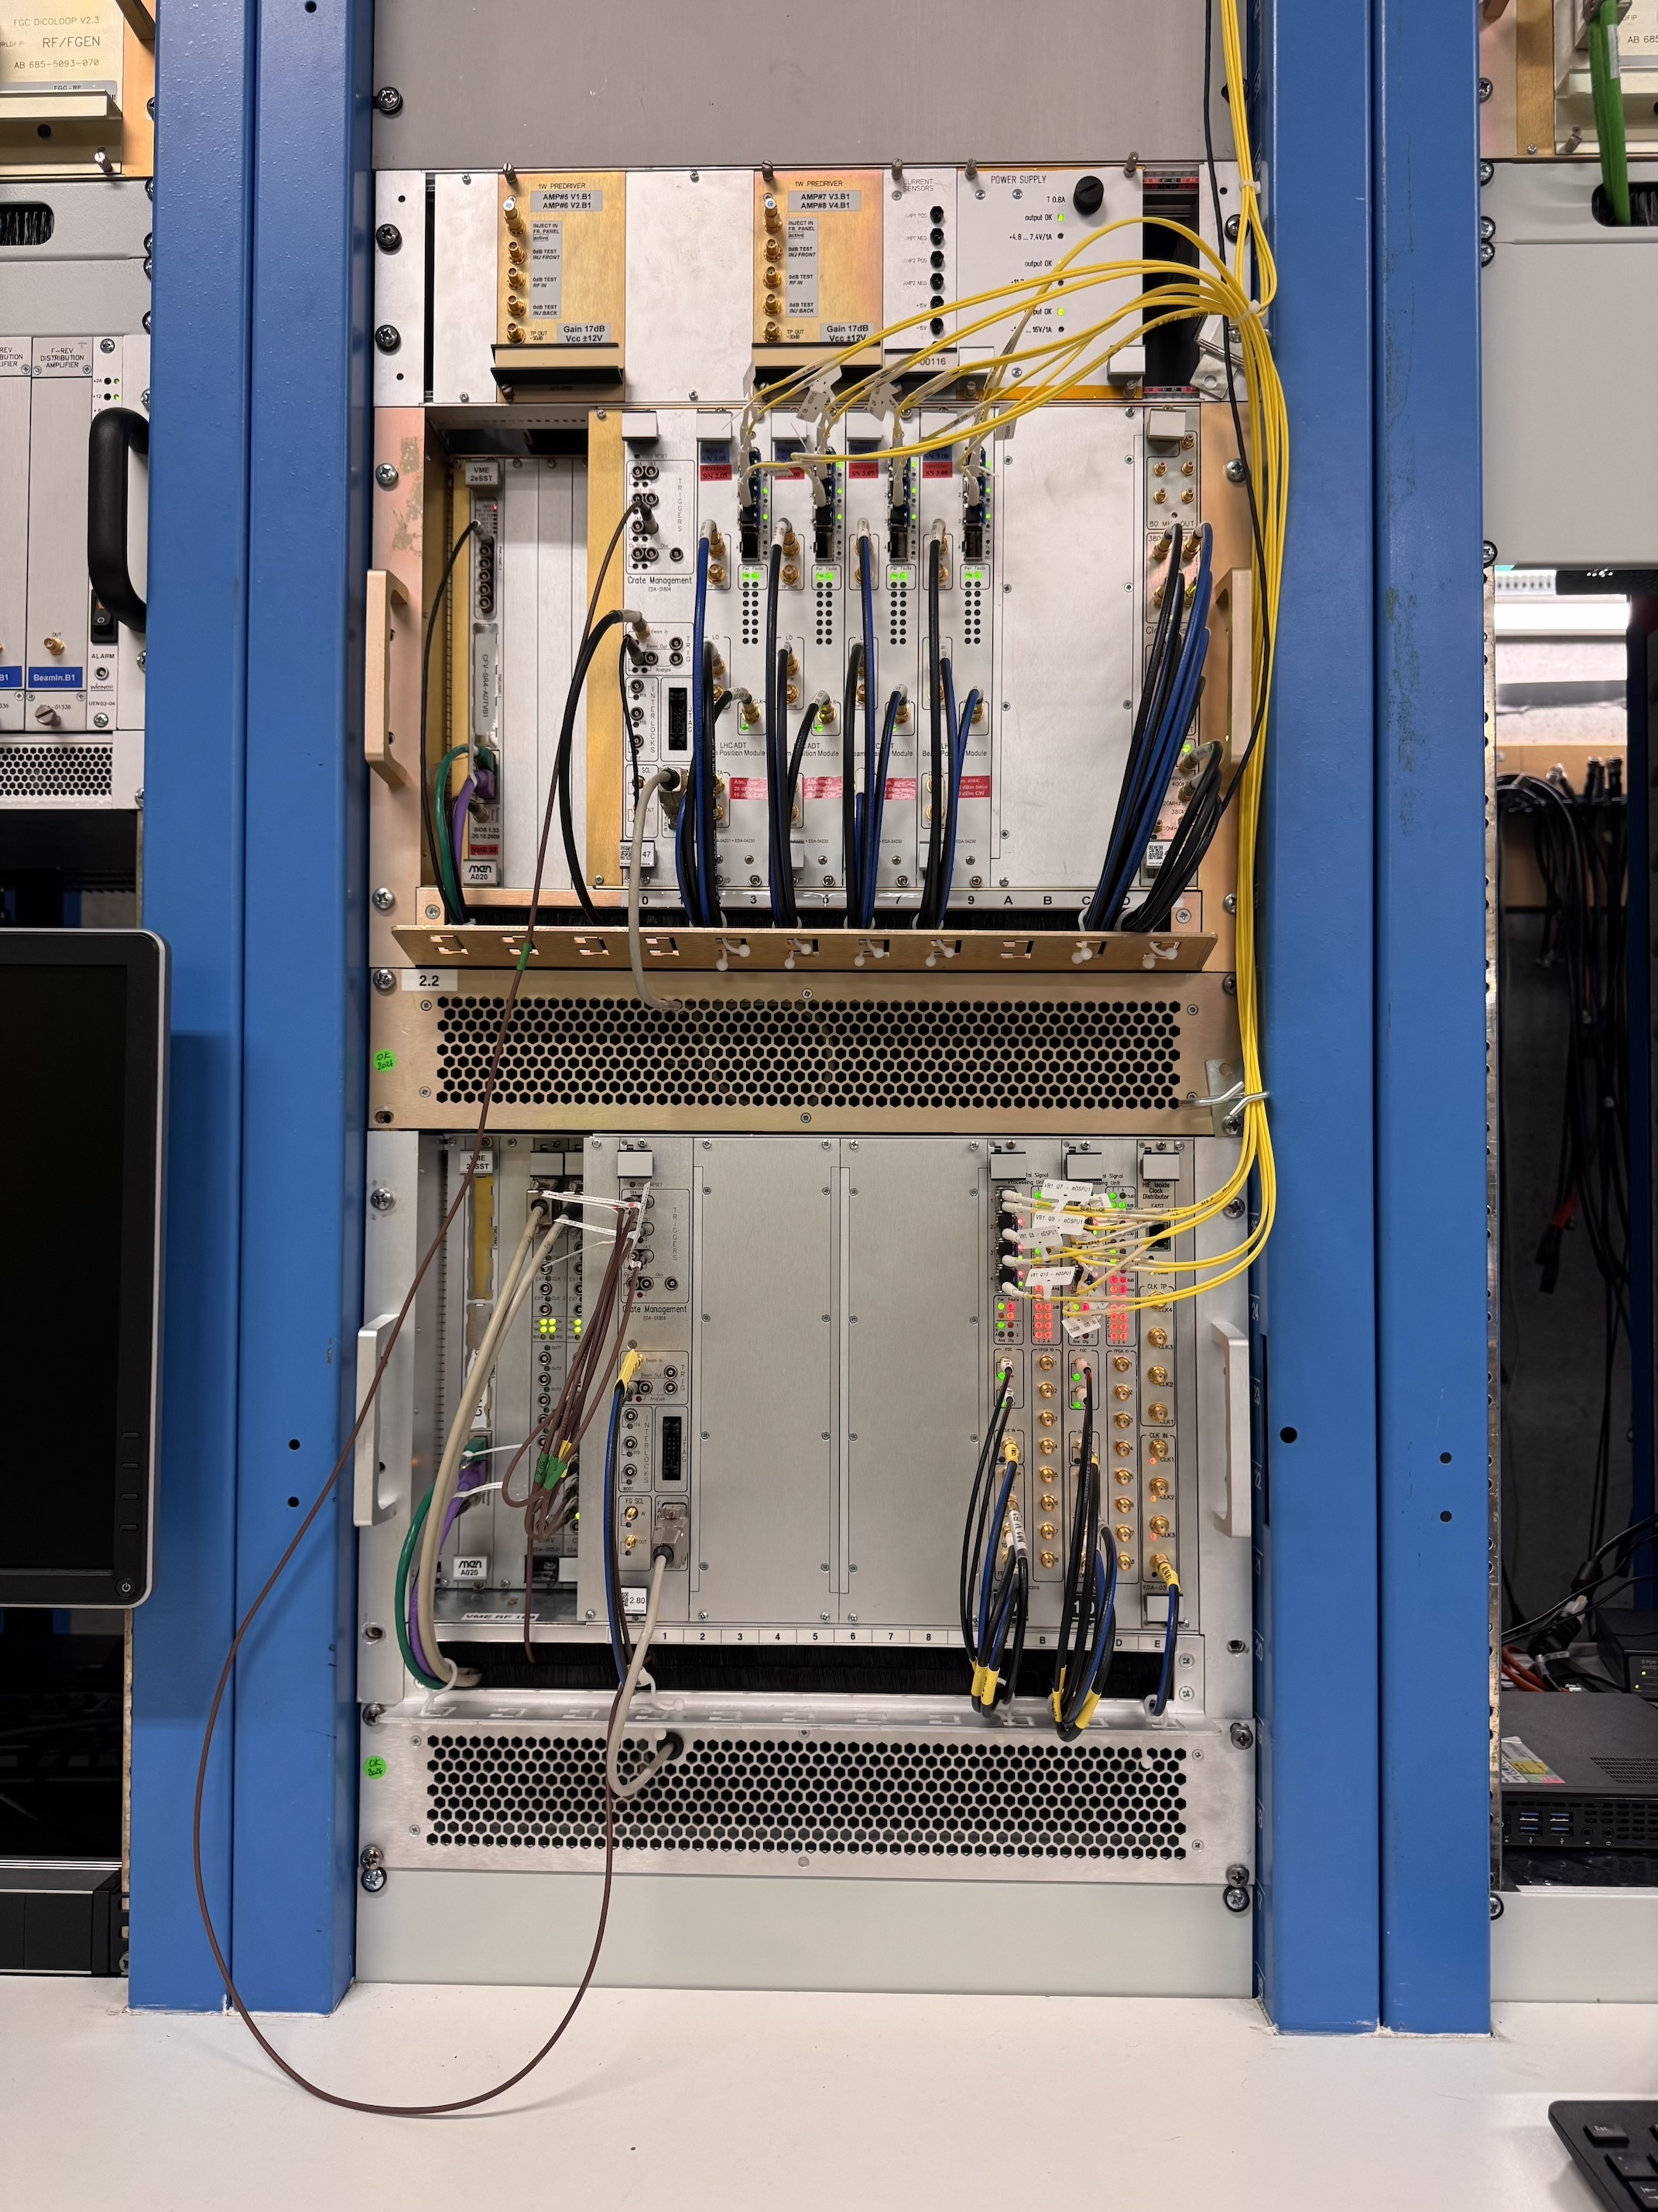
New receiver architecture for ultra low noise BPMs
Daniel Valuch, Viera Stopjakova: New Generation of Very Low Noise Beam Position Measurement System for the LHC Transverse Feedback
DOI 10.18429/JACoW-IPAC2022-TUPOST007
Detailed presentation at the last LLRF workshop 2022
Gerd Kotzian, Martin Söderén, Viera Stopjaková, Daniel Valúch: Very Low Noise Receiver Technology for Digital Beam Position and Phase Measurement
https://indico.psi.ch/event/12911/contributions/38423/
LLRF system for one beam and one plane of LHC transverse feedback

Slide 8
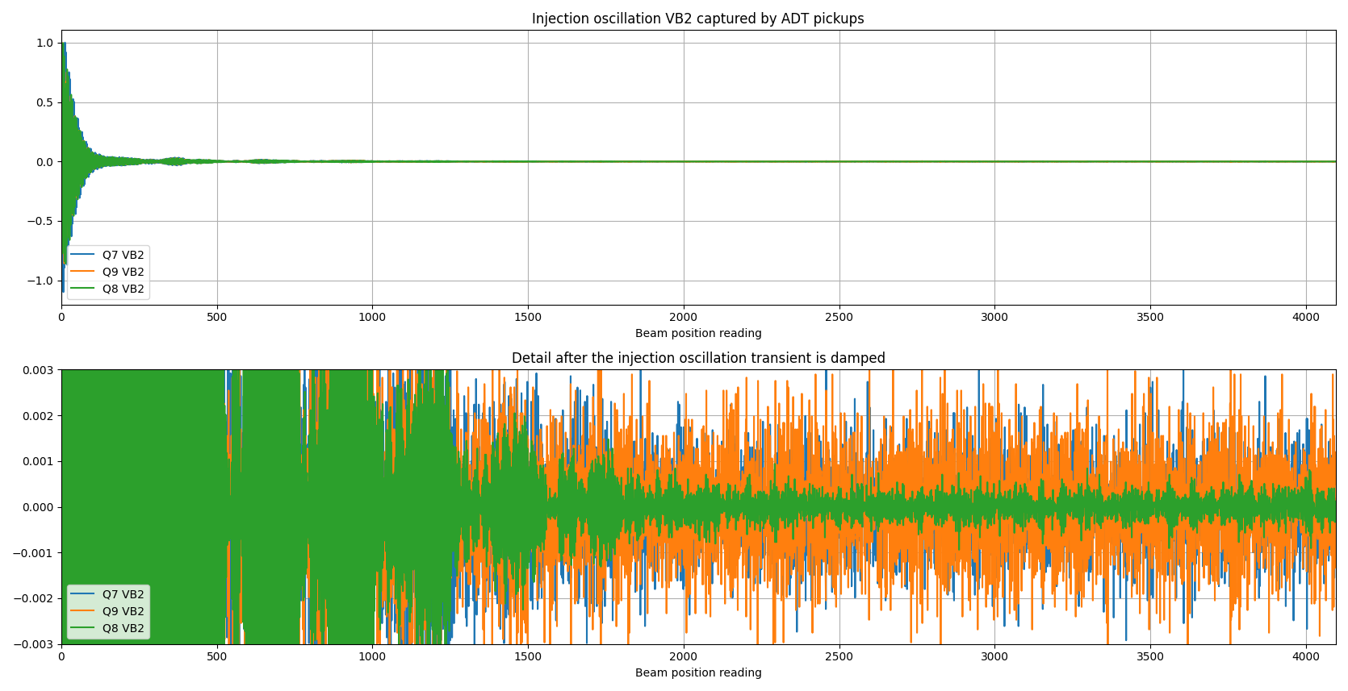
First injection with the new, very low noise BPMs
New front end (Q8)
Old front end (Q7)
Old front end (Q9)

Slide 9
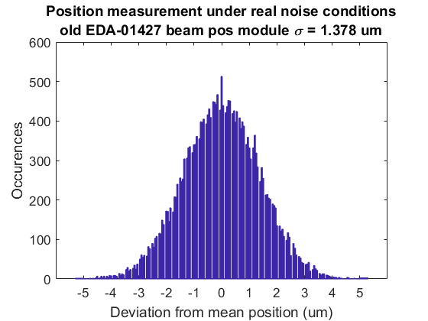
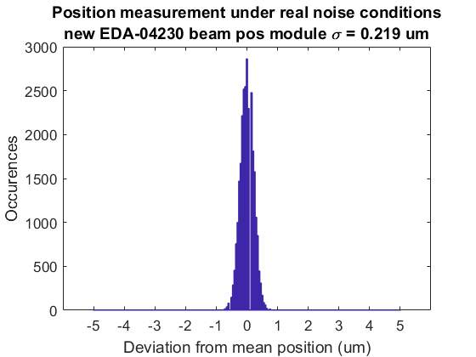
What is the significance of this plot for what can we do with LHC transverse feedback?
0.219 μm measurement noise corresponds to:
0.00025 beam σ at injection
0.001 beam σ at flat top

Slide 10
The innovation – inspiration – progress cycle
Engineers and accelerator physicists discussing:
We need A to be able to do B
Imagine we would have A, then we could try to do B
We have A, can we do something interesting with it?
Imagine we could have A, what can we do with it?

Slide 11
Beam position measurement → digital Signal processing units → digital
8 bunches, 32k turns
We have a very precious information in our FPGAs.
Can we use it?
How do we make it (easily) available?
1 bunch, 4k turns
Memory
Memory
3564 bunches, 73 turns

Slide 12
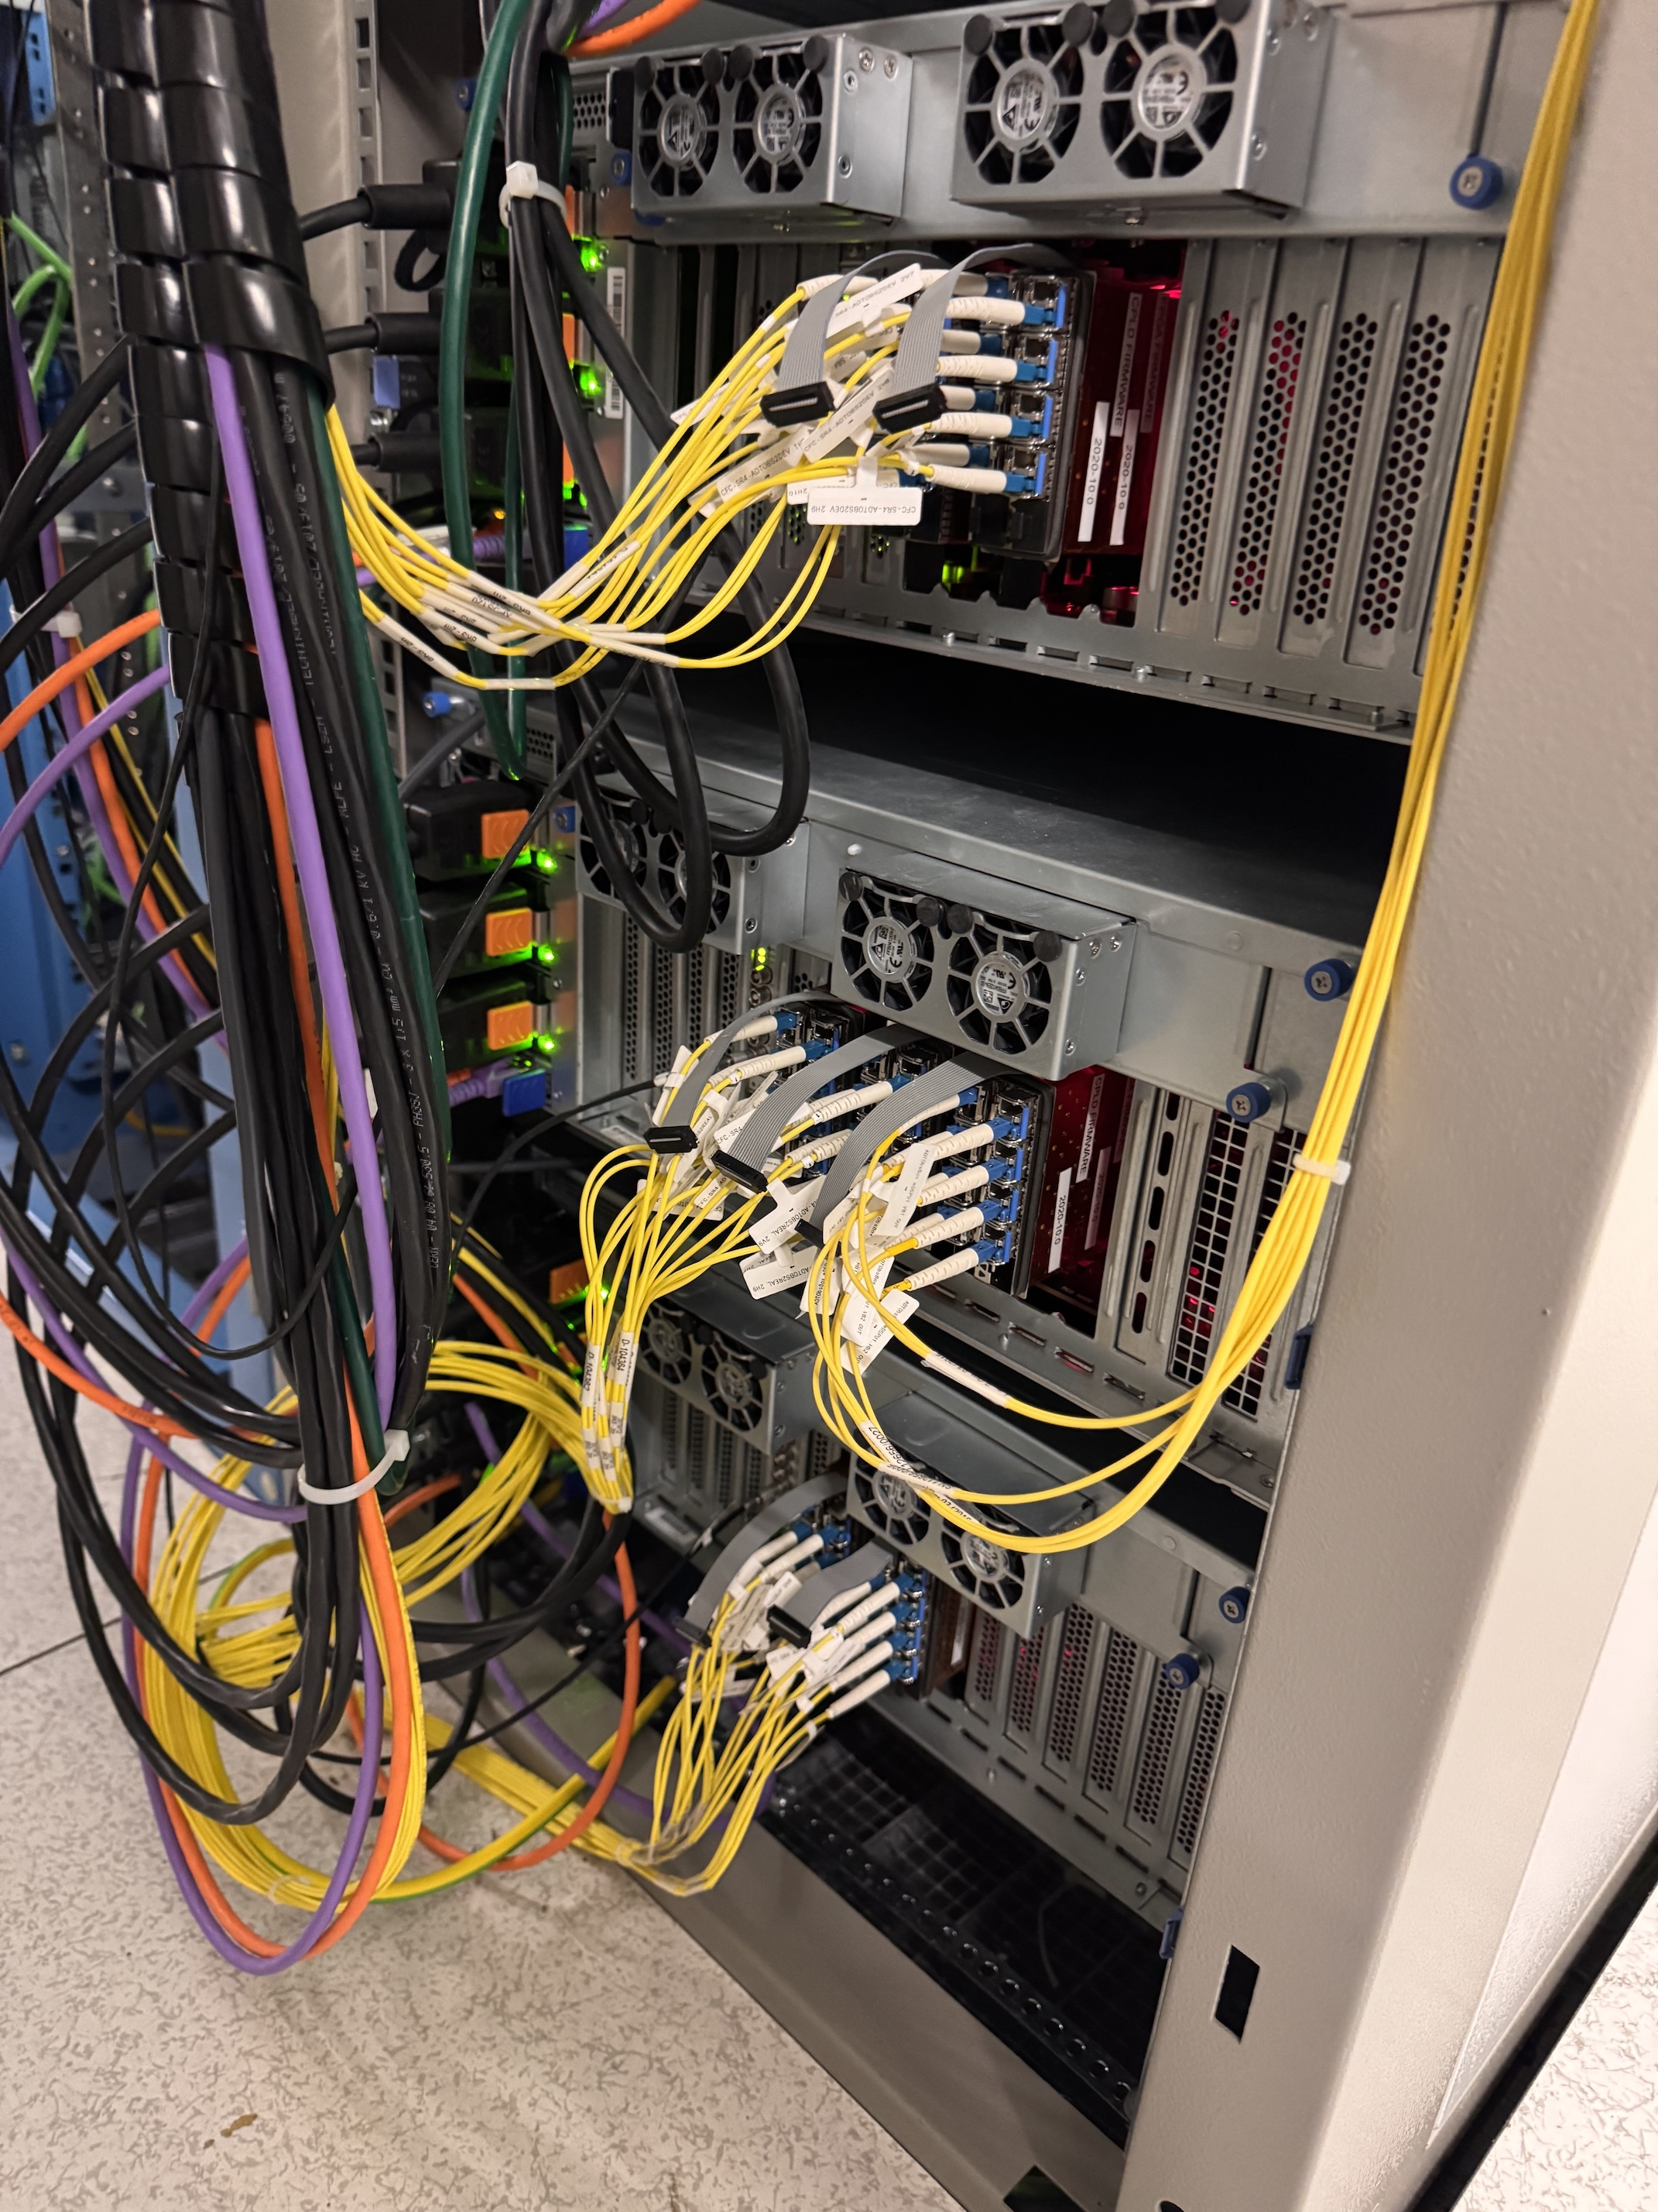
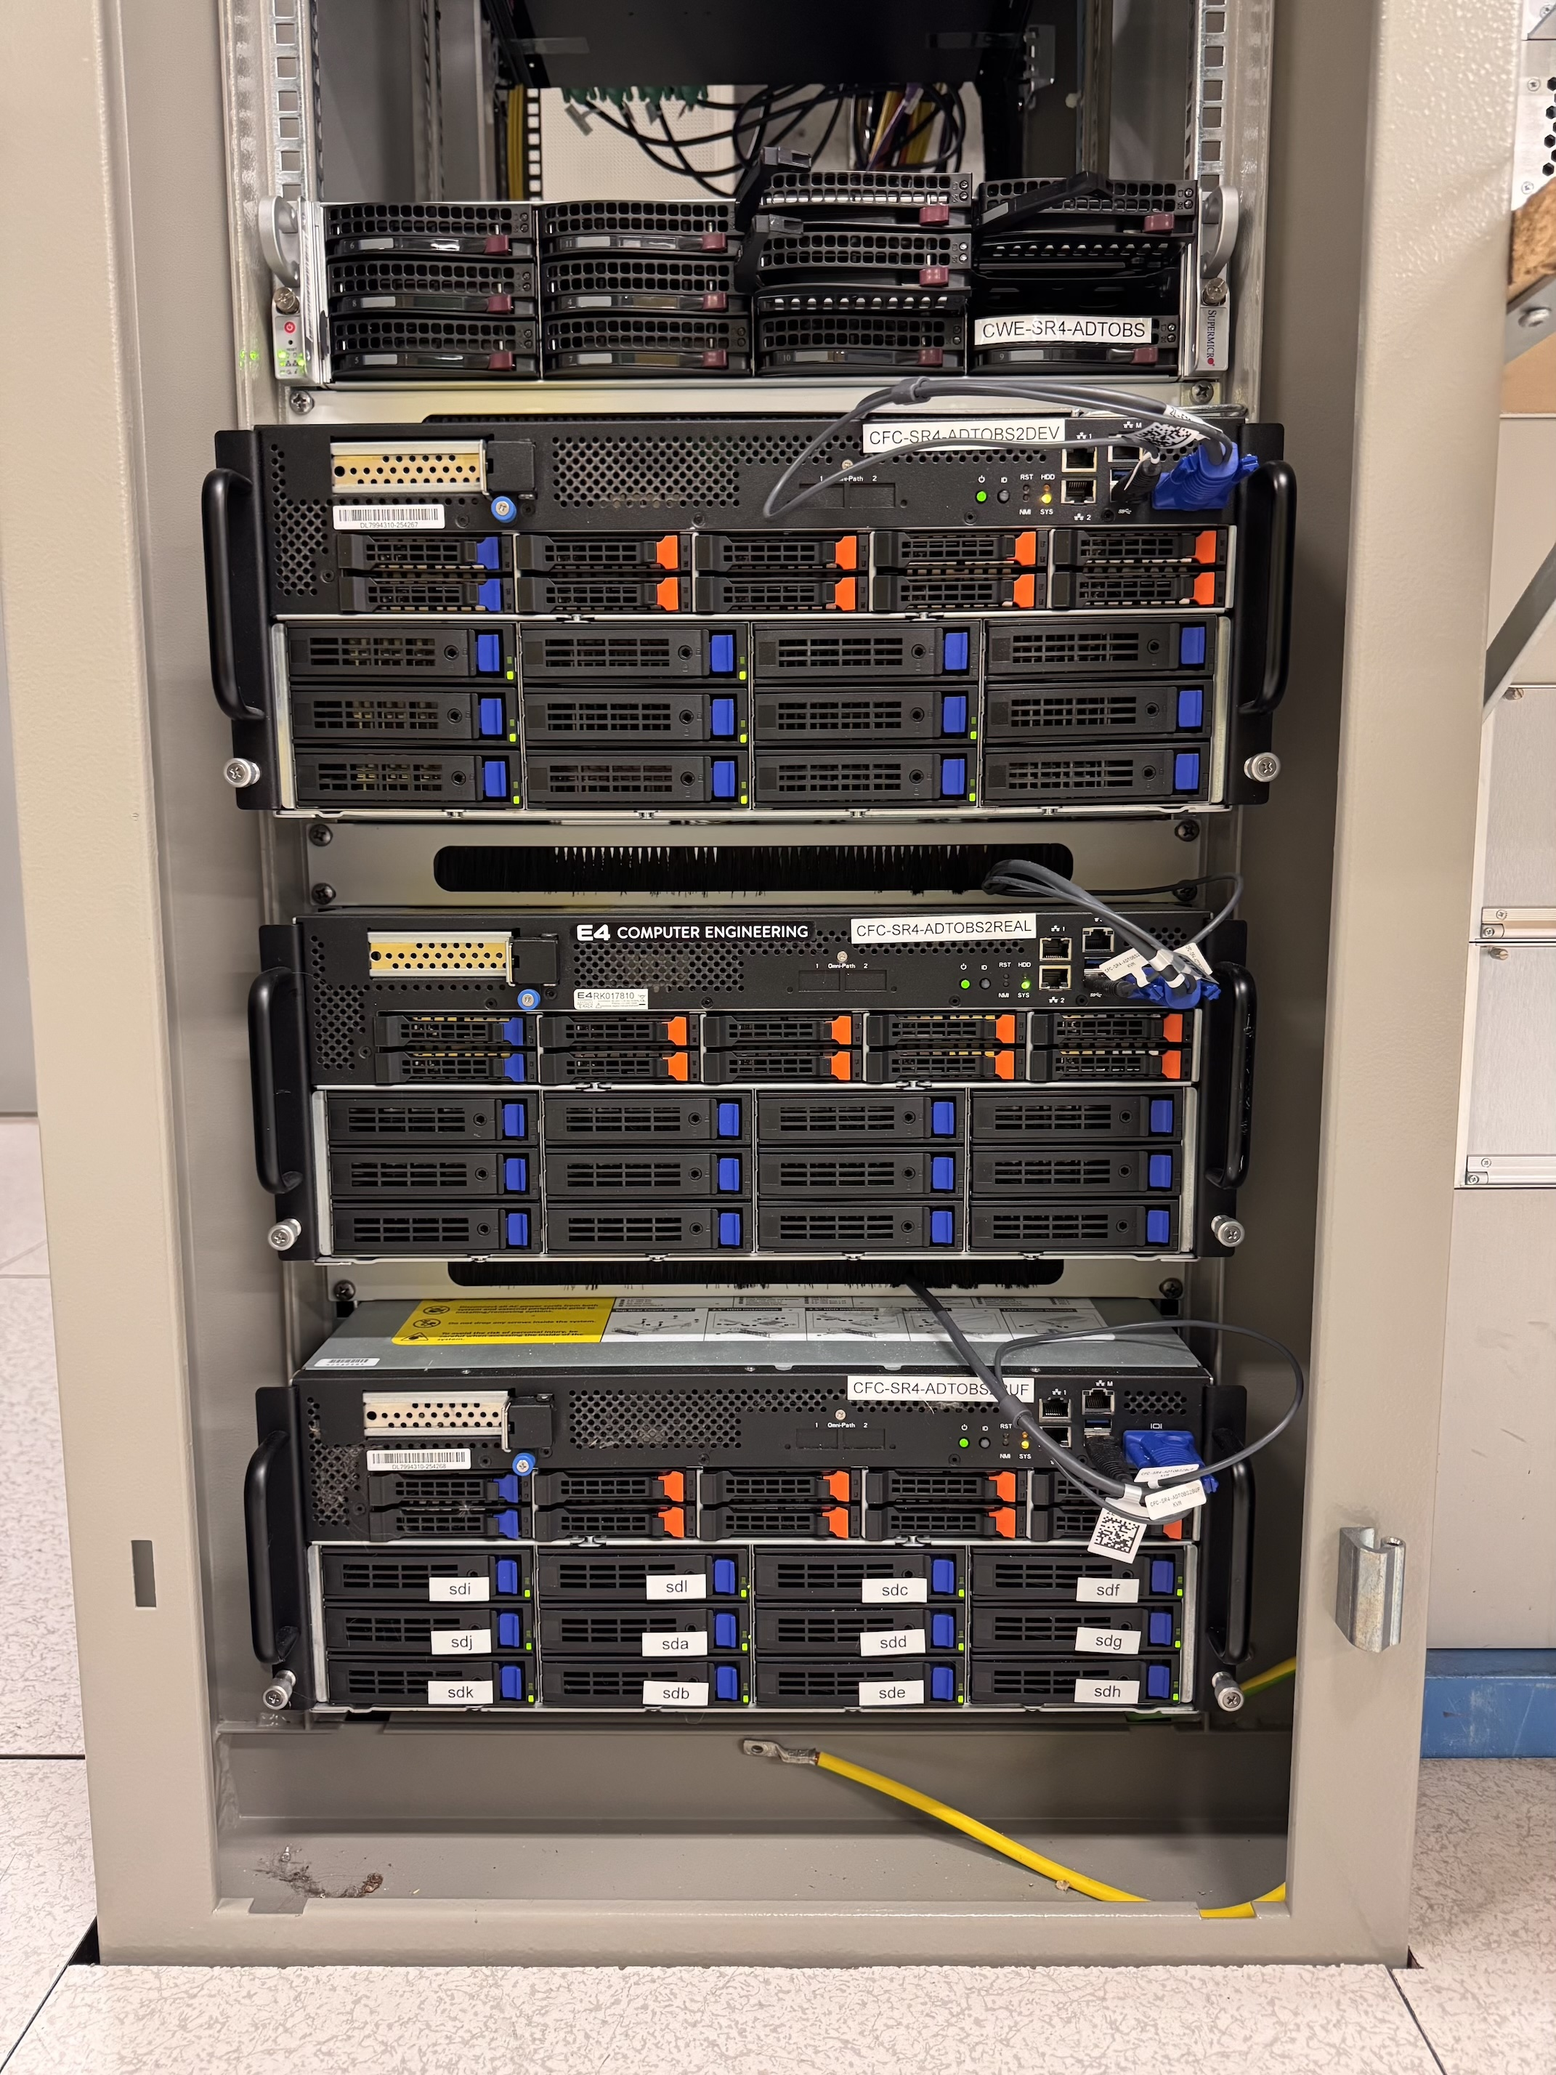
Beam position measurement → digital Signal processing units → digital
Onboard memory is extremely limited in size. We need to change the strategy...
20x

Slide 13
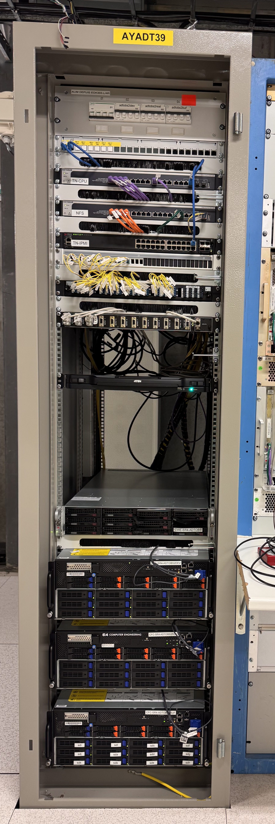
Observation system (ADTObsBox)
Three very powerful servers:
Real time processing (Spongebob) 48 cores, 768 GB RAM
On demand buffers (4k – 128k turns) available for subscription or auto-saving
Real time transverse activity analysis, real time transverse instability detection
Injection analysis, damper performance analysis
All beam measurements (chromaticity, tune, external vibrations, ground motion etc.)
Storage (Patrick) 48 cores, 144 TB ultra high throughput solid state drives
24 - 48 hour circular buffer at full rate (20 Gbps) and full resolution for all 16 pickups and 8 signal processing units
Dedicated post mortem buffers
Development (Squidward) 48 cores, 384 GB ram, 48 TB SSD

Slide 14
Observation system (ADTObsBox)
Some further reading on the technology:
Martin Söderén: ADTObsBox - Experiment-scale data analysis of the transverse positional data in the LHC https://indico.cern.ch/event/932857/
Martin Söderén: Online Transverse Beam Instability Detection in the LHC. High Throughput Real-Time Parallel Data Analysis, master thesis https://repository.cern/records/3d13v-7jm17
Martin Söderén and Daniel Valuch: Low Latency, Online Processing of the High-Bandwidth Bunch-By-Bunch Observation Data From the Transverse Feedback System in the LHC
EPJ Web Conf., 245 (2020) 01036 DOI: https://doi.org/10.1051/epjconf/202024501036

Slide 15
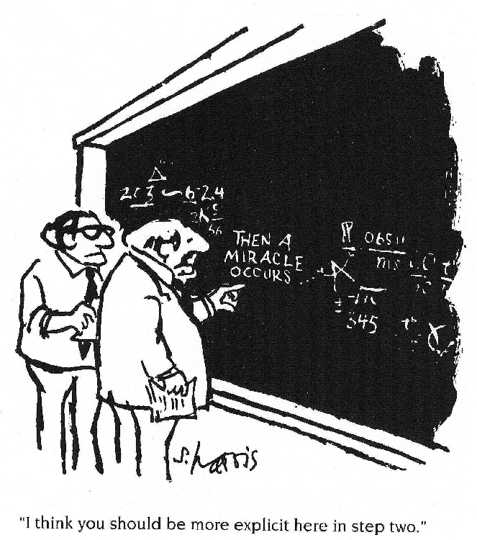
Now we have all the (high quality) data. What can we do with it?
I think you should be more explicit here in step two.

Slide 16
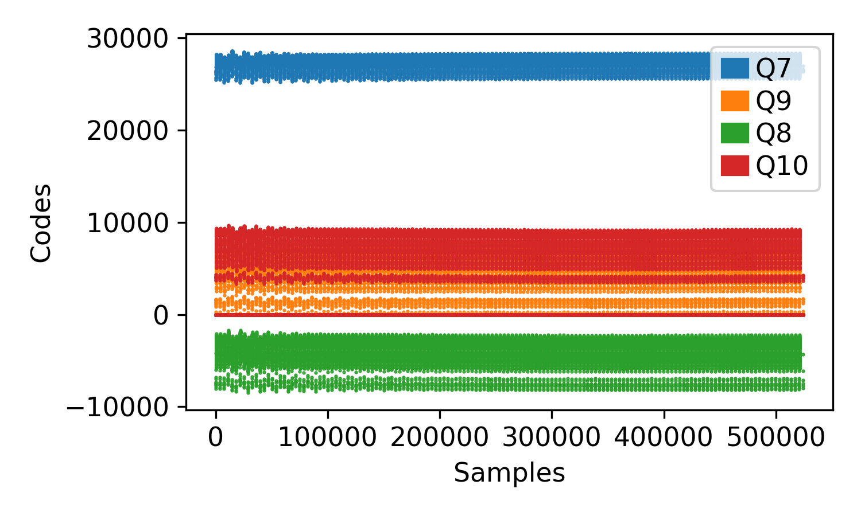
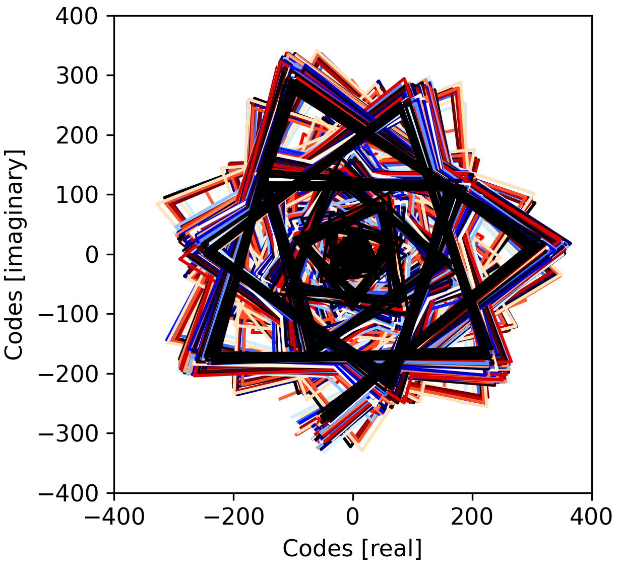
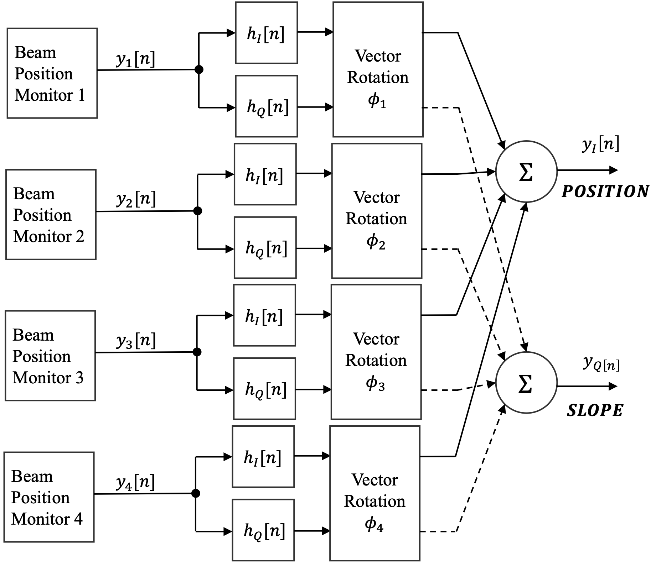
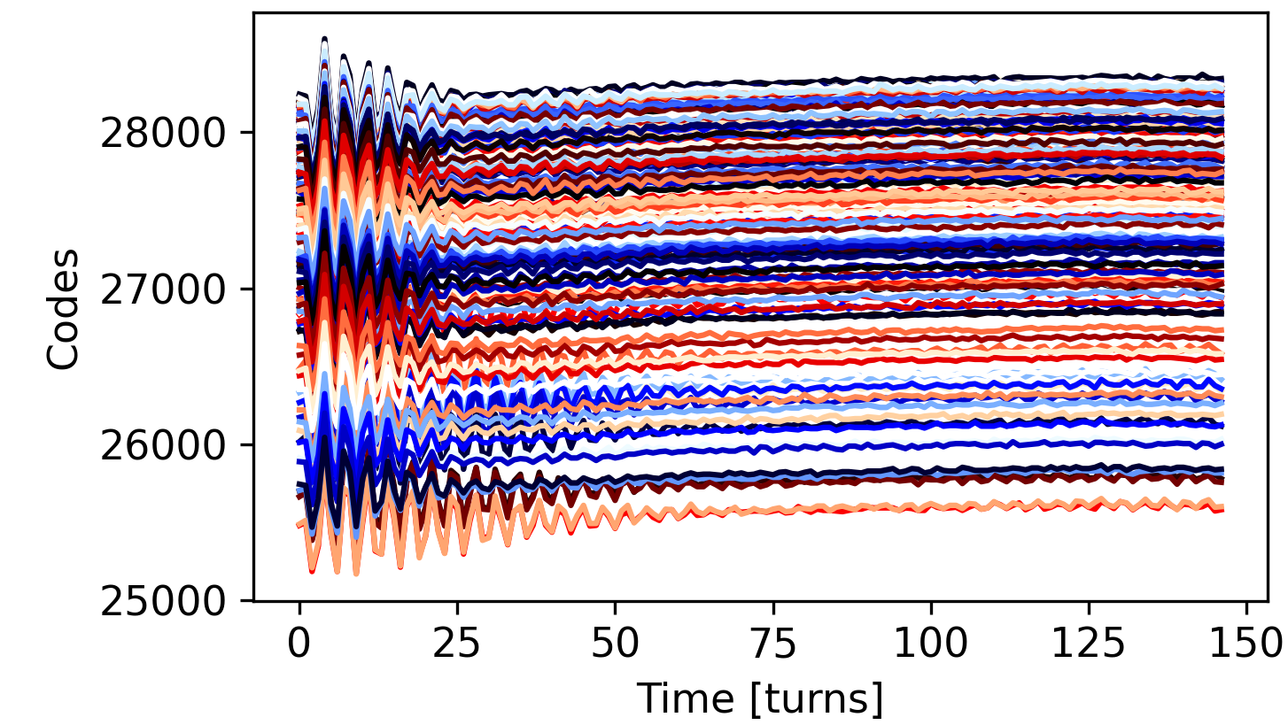
Now we have all the data, what can we do with it?
1. Record as little as 0.05 σ movement
4. Do all the magic…
3. Reconstruct the transverse phase space
2. Split data for individual bunches

Slide 17
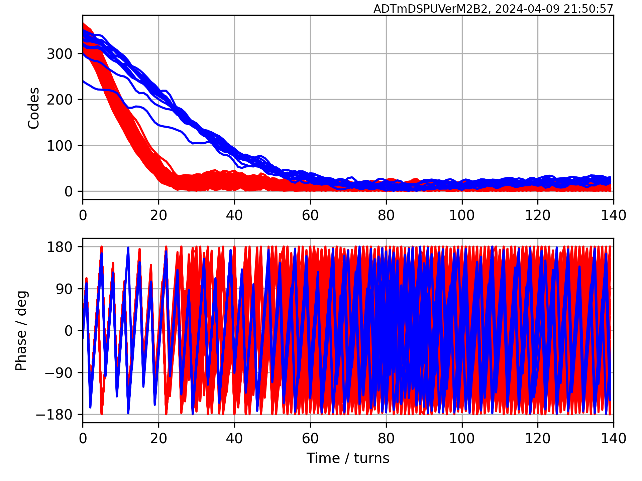
Now we have all the data, what can we do with it?
Reconstructed transverse phase space
Mag{ }
Arg{ }

Slide 18
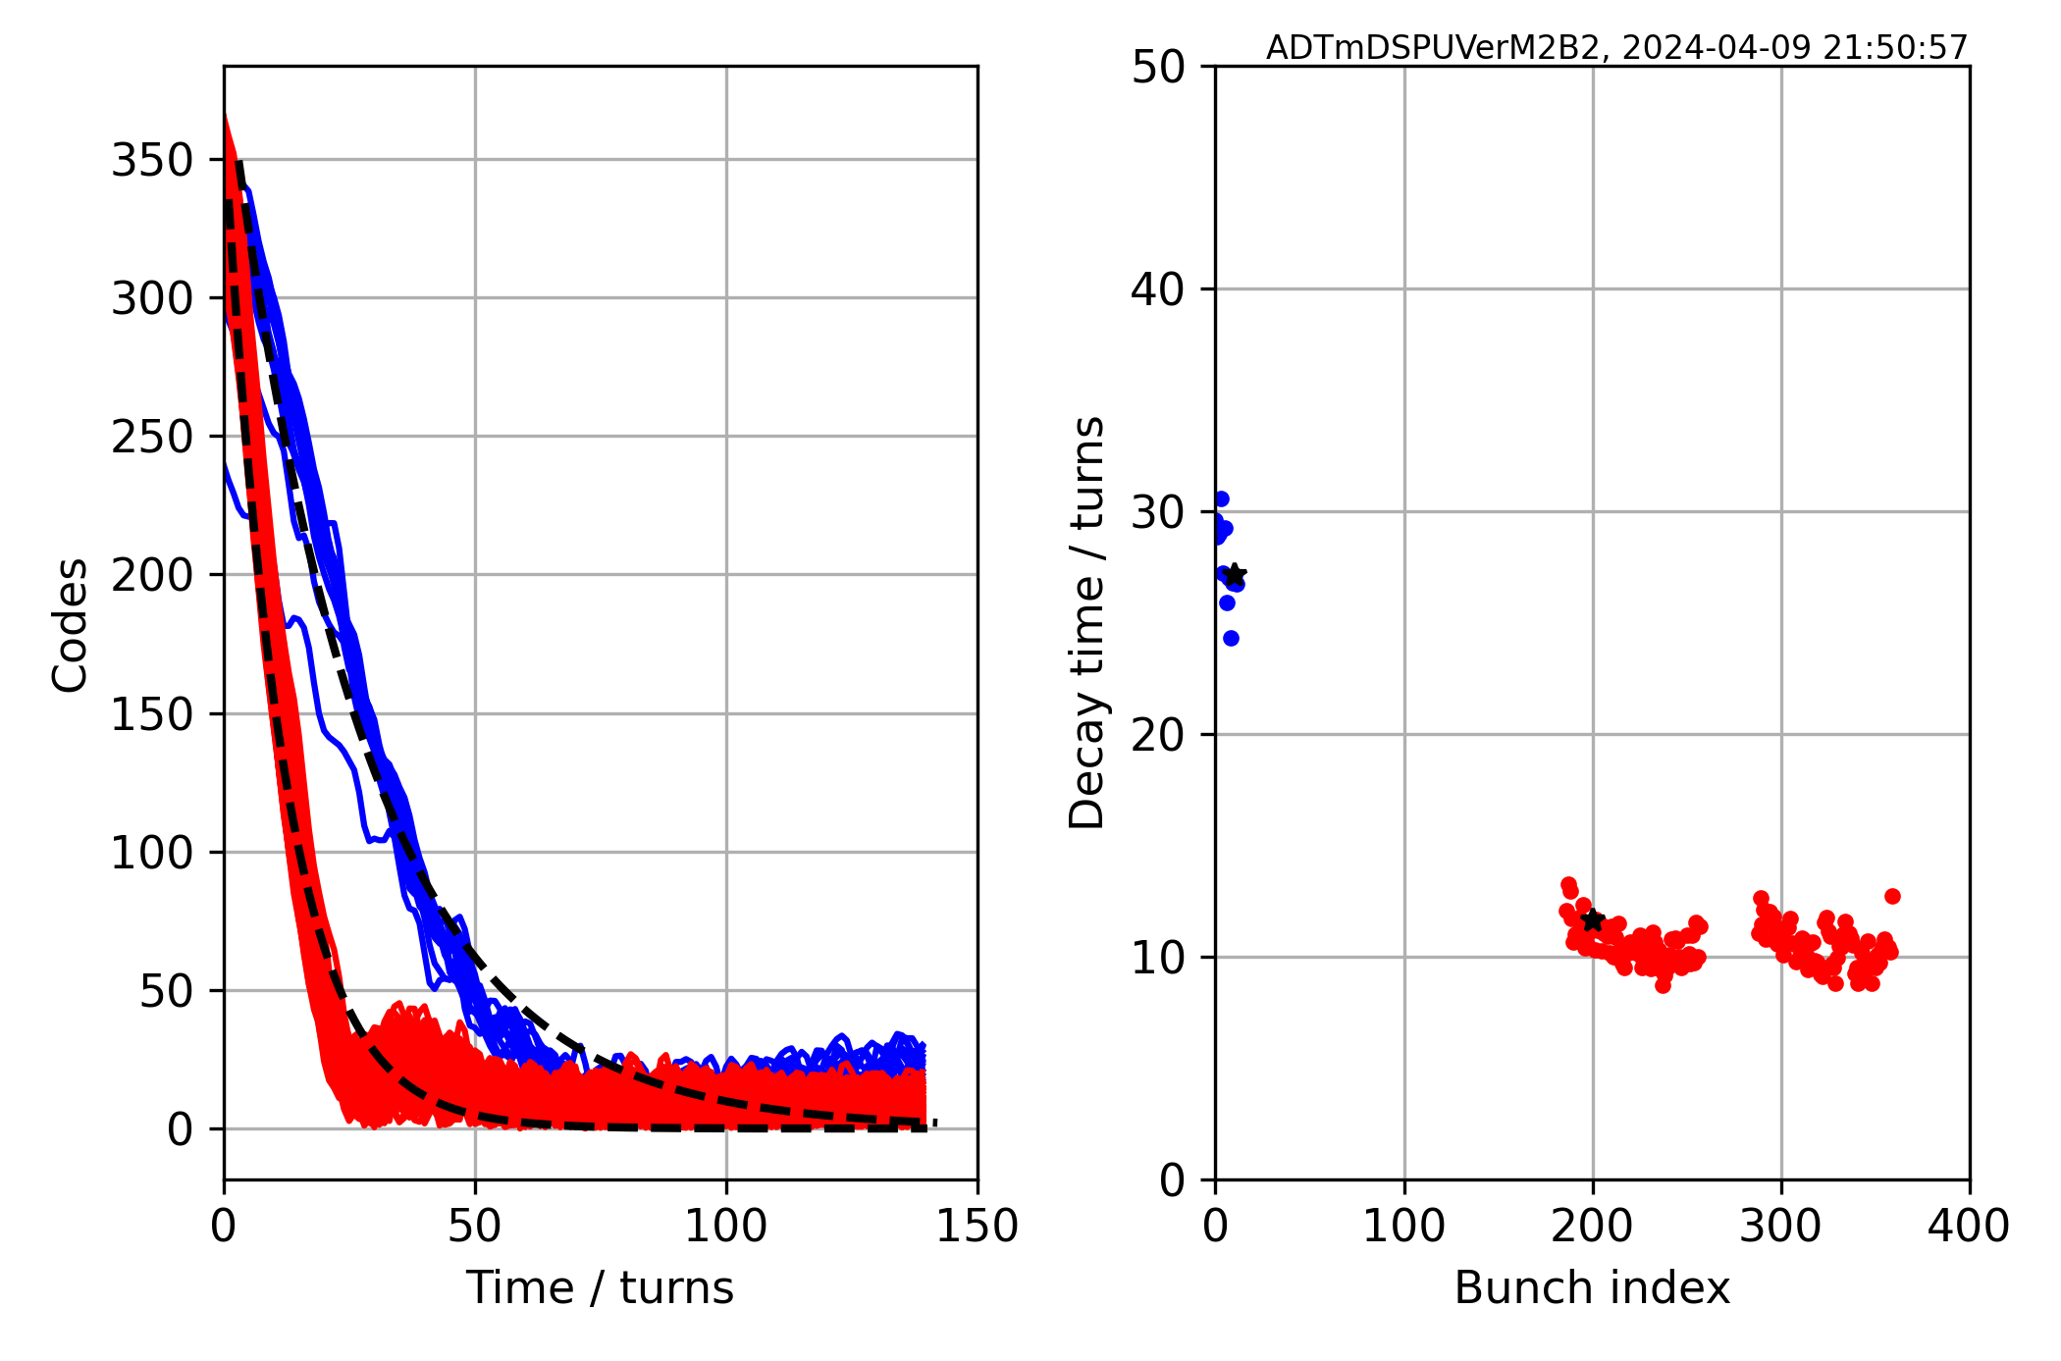
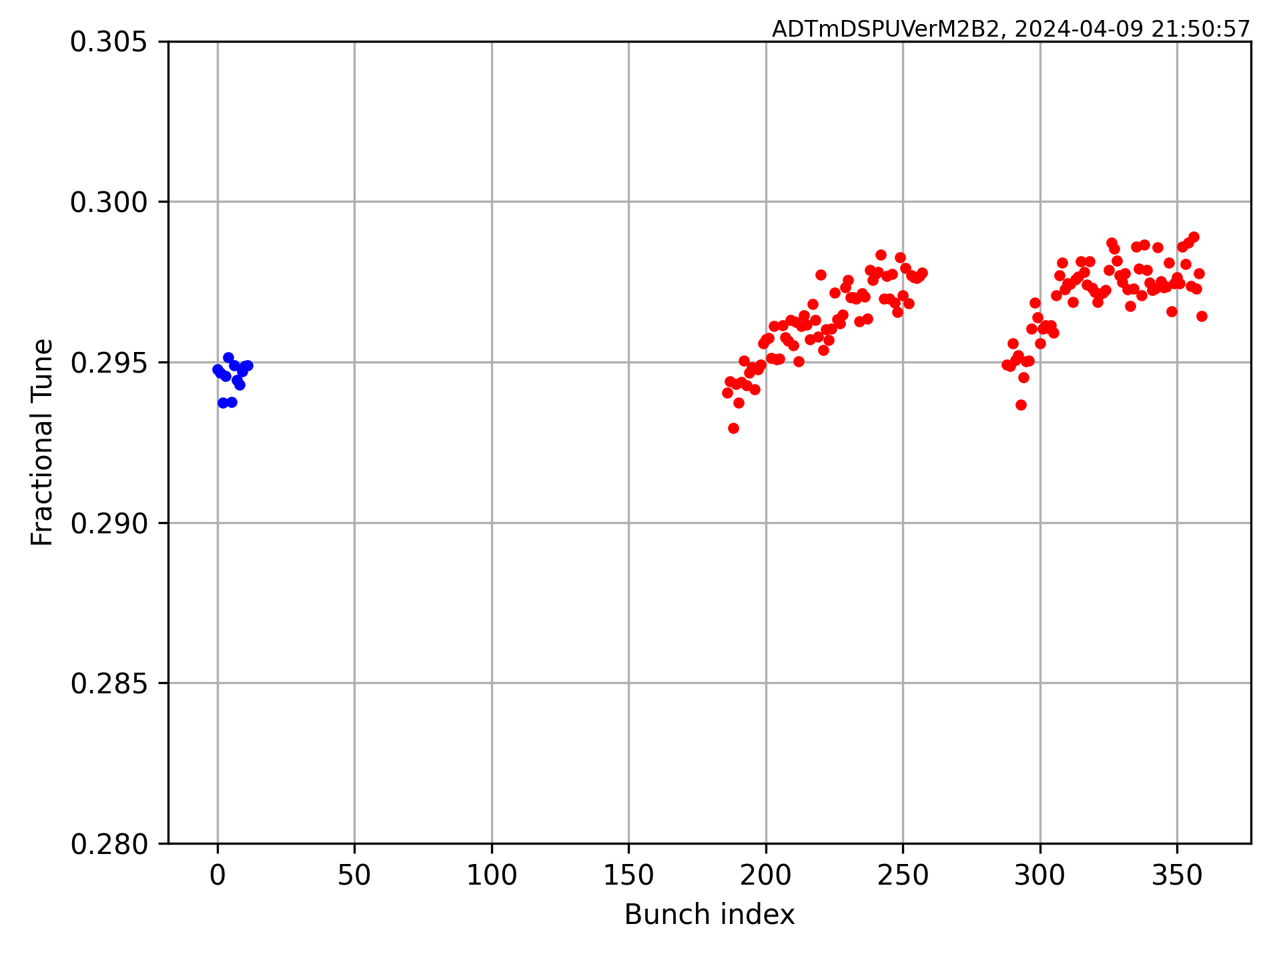
Accelerator parameter extraction
Bunch by bunch damping time
Bunch by bunch tune

Slide 19
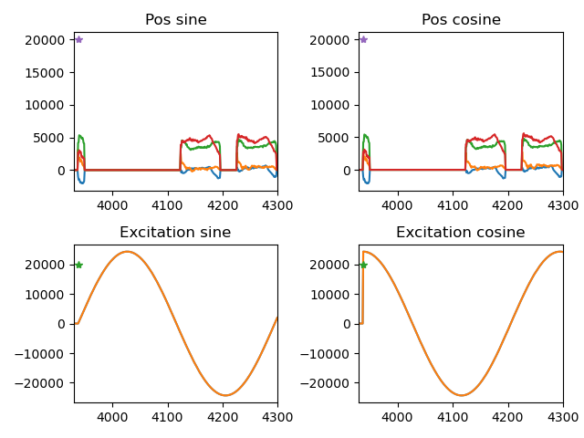
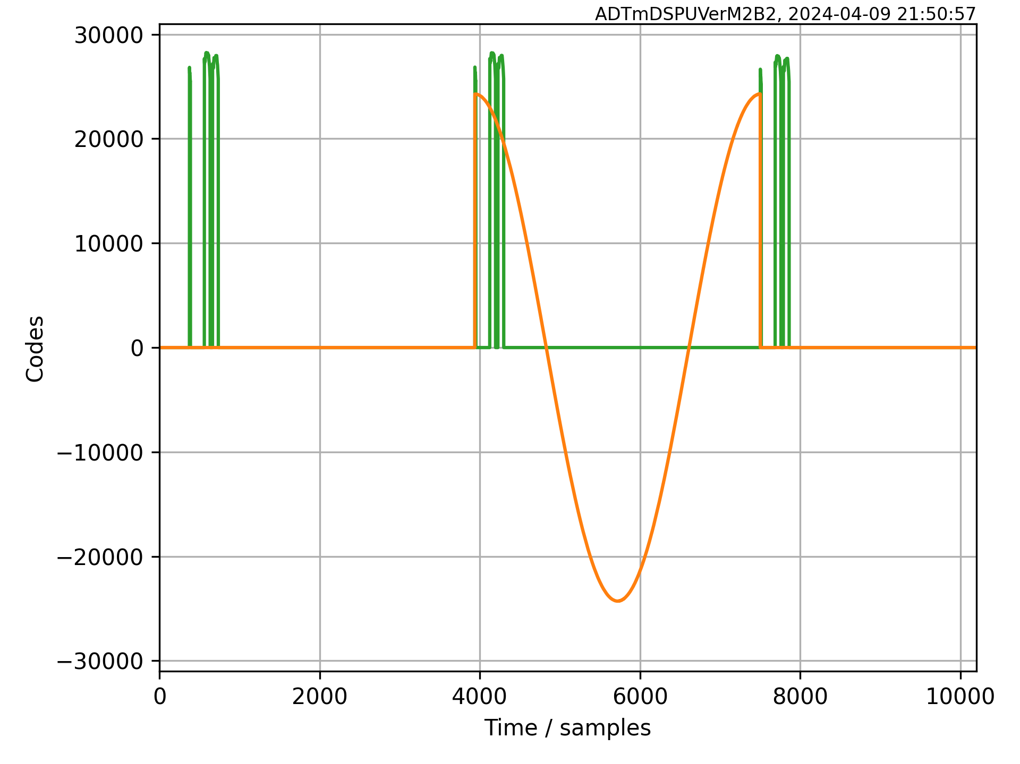
Transverse feedback parameter extraction and setting up
Single turn, quadrature excitation by TFB itself (sin, then cos)
Beam response recorded by TFB itself

Slide 20
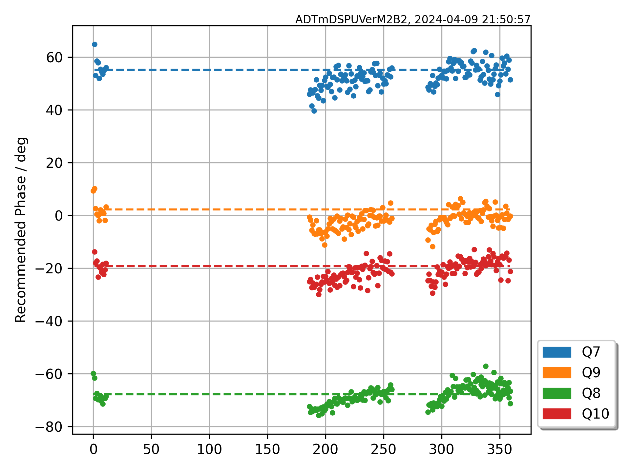
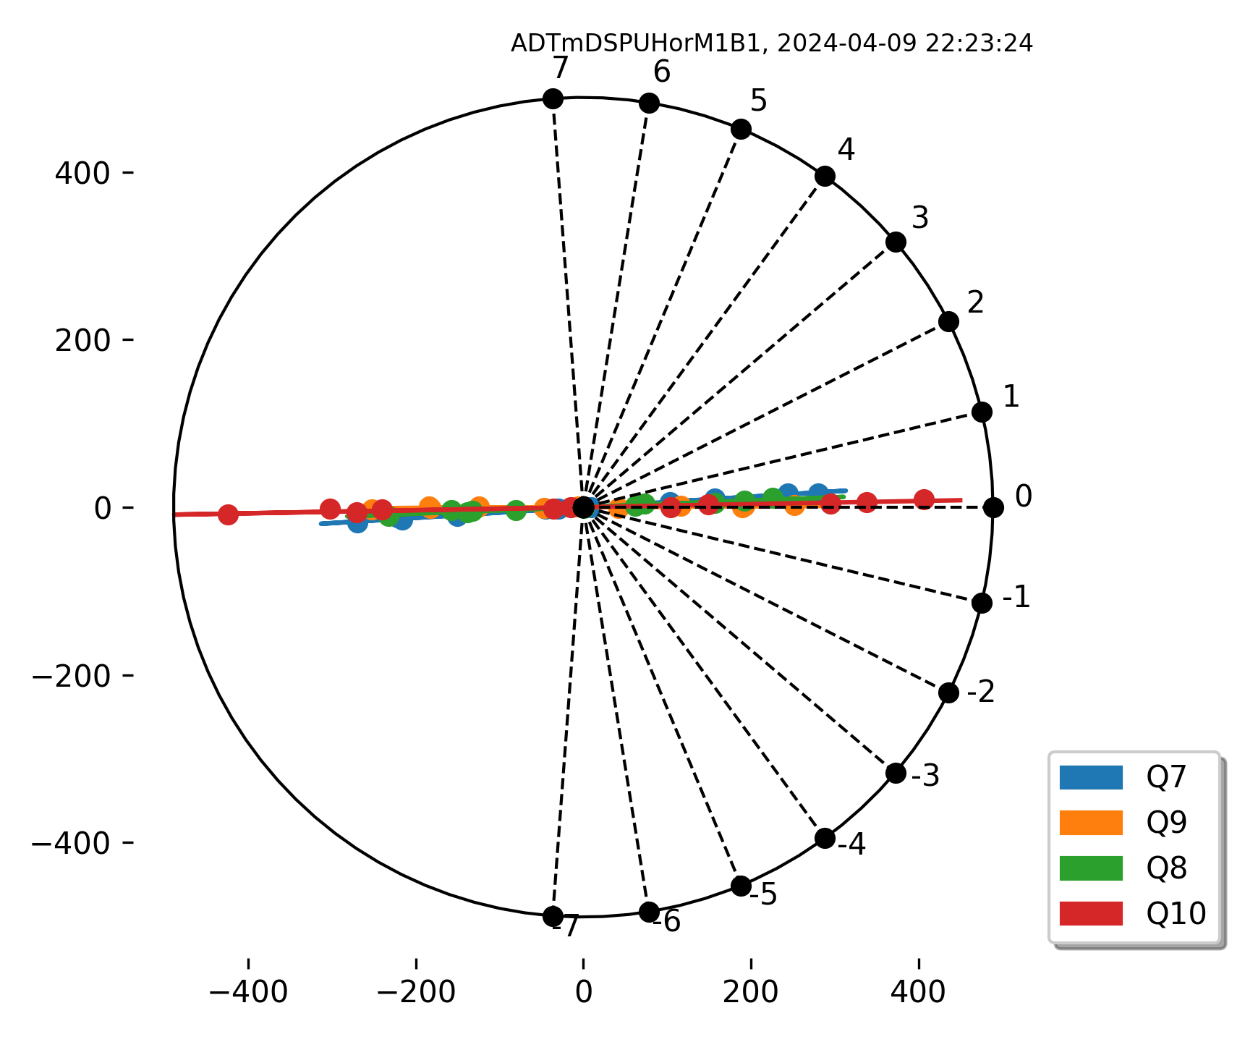
Transverse feedback parameter extraction and setting up
Using only the TFB itself doing negligible excitation (e.g. 0.05σ), without any external instruments, we can do a full TFB setting up, or a routine TFB performance check. Recommended feedback phase (left) or loop delay (right).
clk ticks

Slide 21
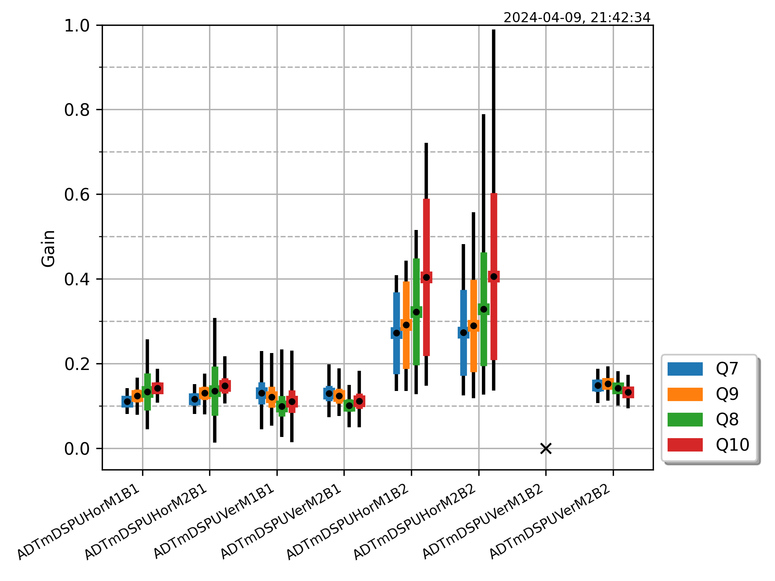
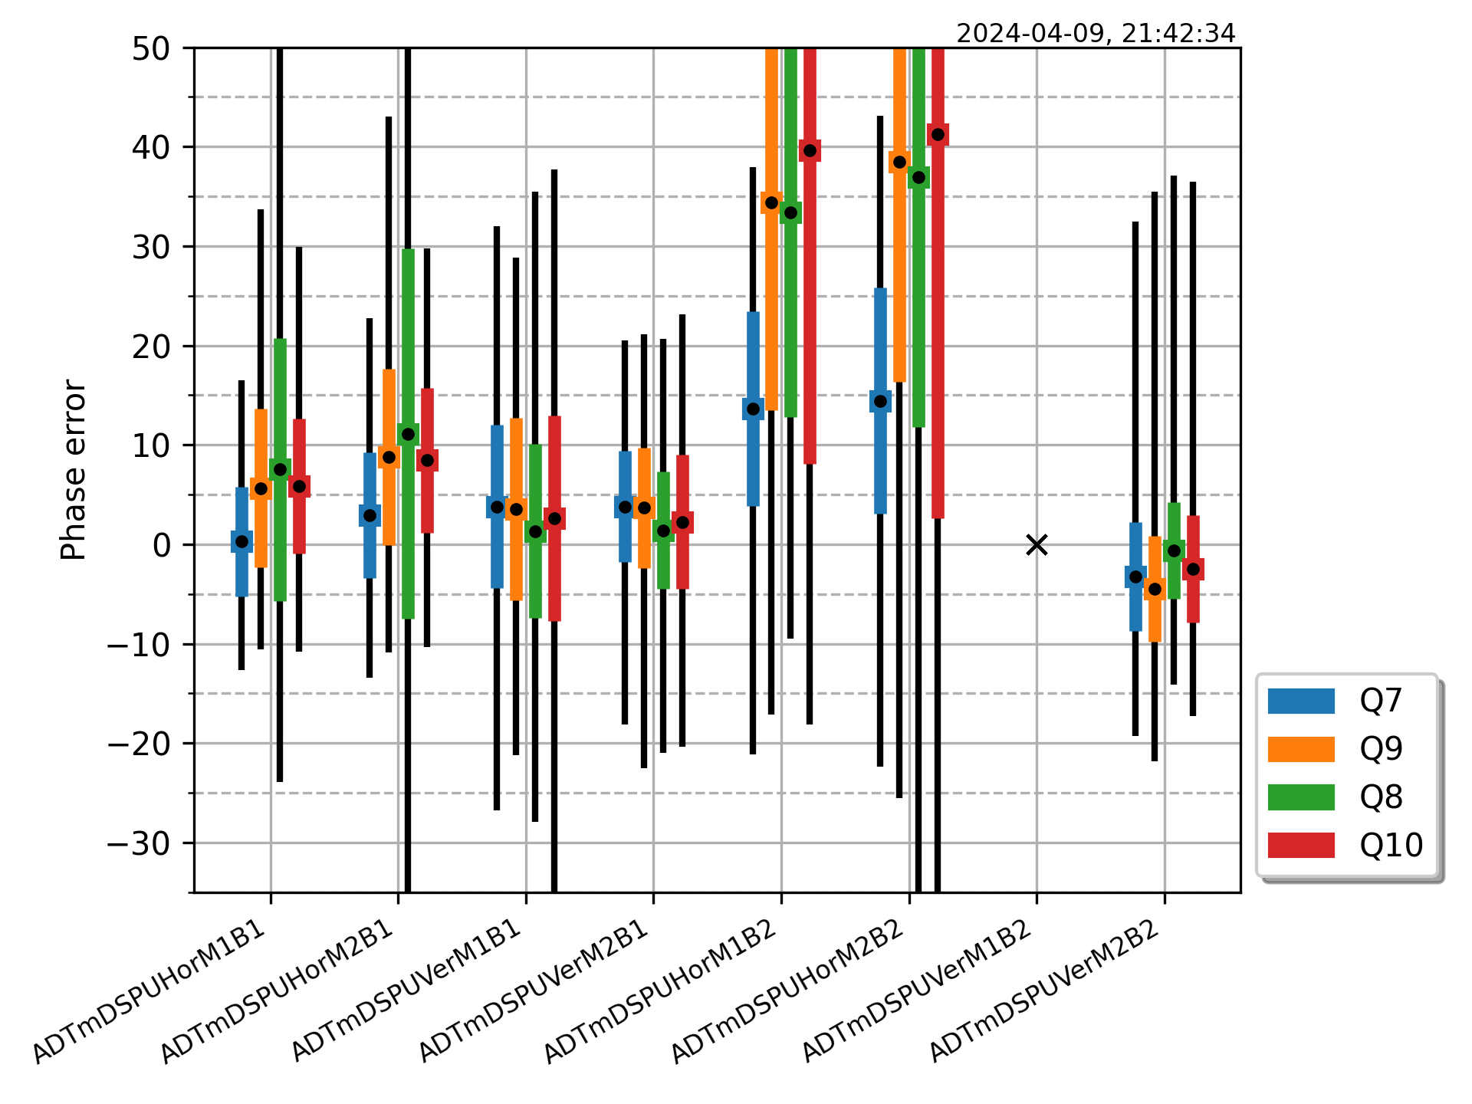
Transverse feedback parameter extraction and setting up
Using only the TFB itself doing negligible excitation (e.g. 0.05σ), without any external instruments, we can do a full TFB setting up, or a routine TFB performance check. Measured real gain (left) or loop phase (right).

Slide 22
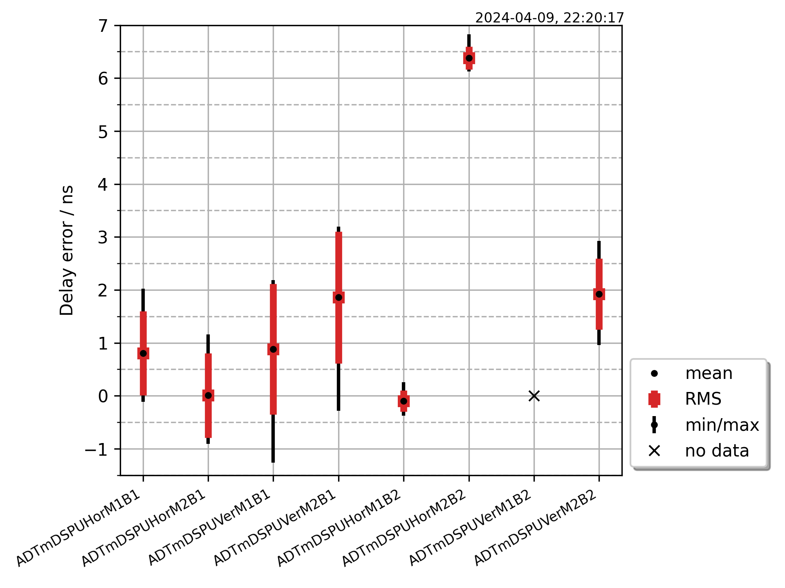
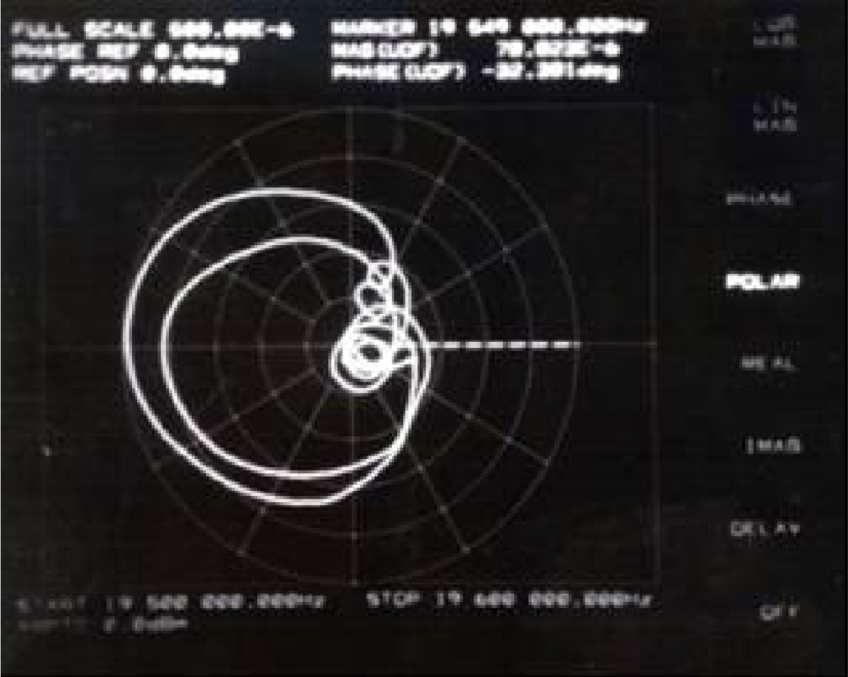
Transverse feedback parameter extraction and setting up
Using only the TFB itself doing negligible excitation (e.g. 0.05σ), without any external instruments, we can do a full TFB setting up, or a routine TFB performance check. Measured real loop delay error.
Not that long time ago…

Slide 23
Signal processing techniques with transverse feedback data
150 pages of really excellent reading in a PhD. thesis to be published in ~1 week
Gerd Kotzian: Signal Processing Techniques For Transverse Feedback Systems In Hadron Accelerators
https://doi.org/10.17181/18yah-3wd51
Being published in PRAB these days:
G. Kotzian, X. Buffat, J. Komppula, V. Stopjakova, and D. Valuch, “Modern signal
processing techniques for efficient transverse feedback systems operation in hadron
accelerators,” Phys. Rev. Accel. Beams, pp. –, Sep 2025.
https://doi.org/10.1103/szv9-nfd5

Slide 24
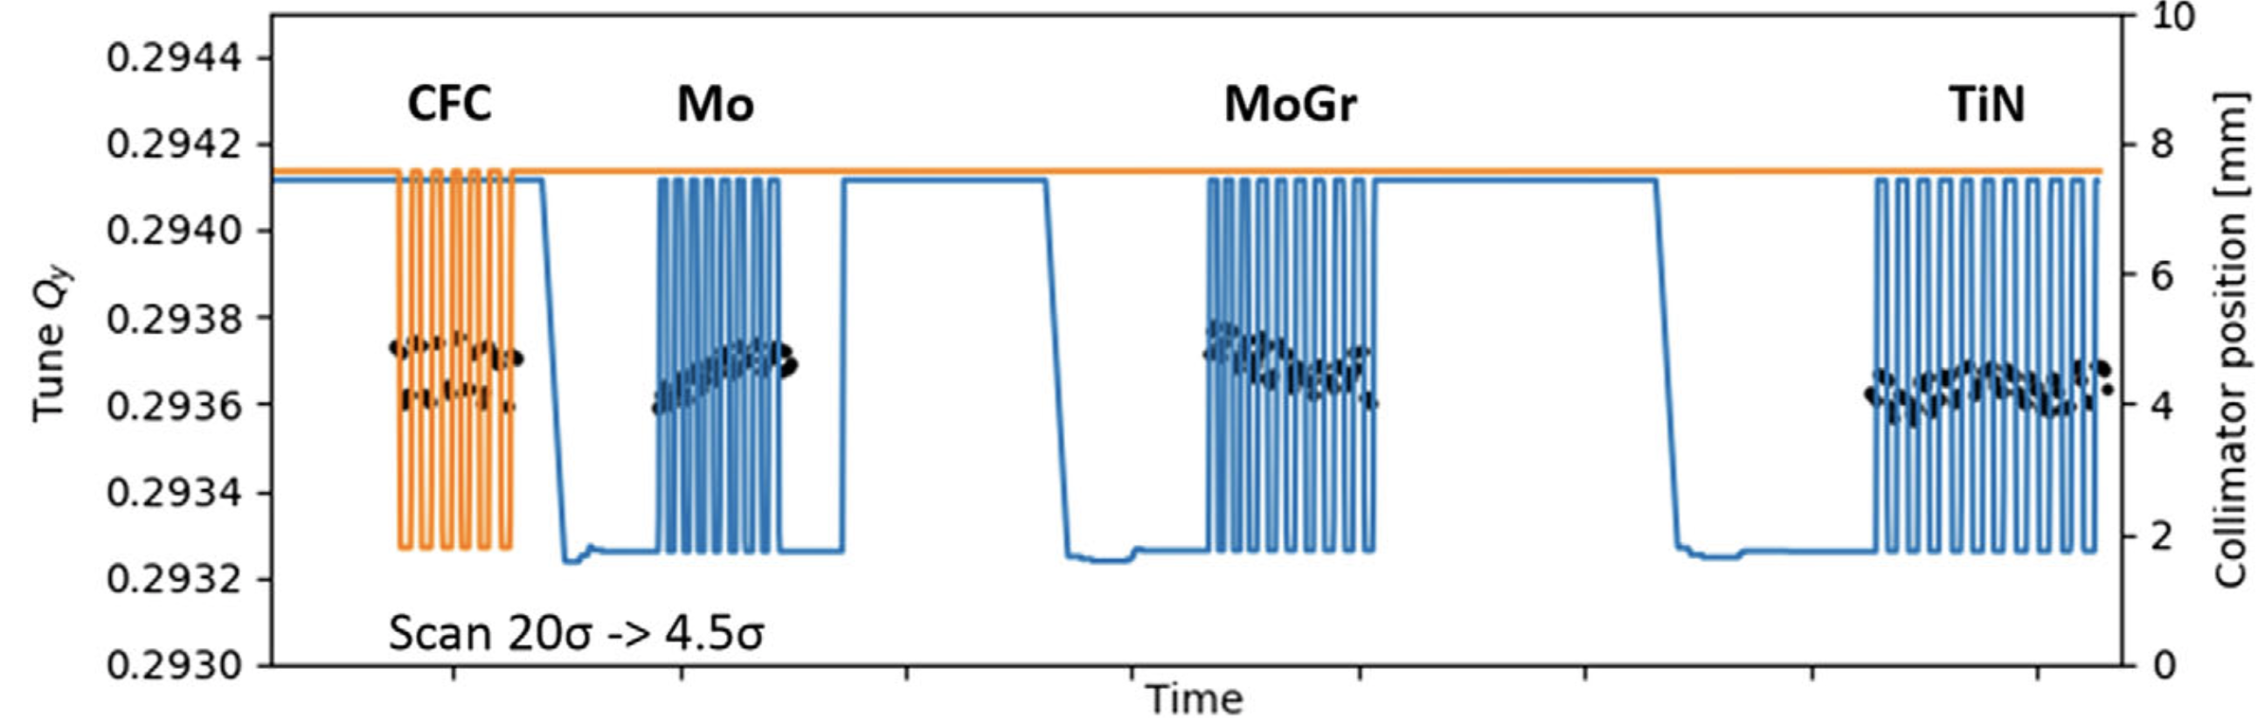
Low noise BPMs with high-performance computing allow for much more than a transverse feedback
Very high resolution tune measurement (<1e-4) using ADT-AC dipole and ADT observation systems to calculate impedance of new, very low impedance collimators.
David Amorim et al.: Transverse beam stability with low-impedance collimators in the High-Luminosity Large Hadron Collider: Status and challenges DOI 10.1103/PhysRevAccelBeams.23.034403

Slide 25
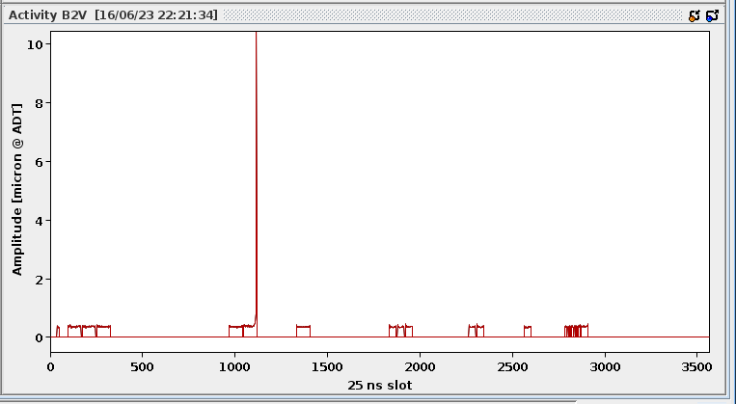
Low noise BPMs with high-performance computing allow for much more than a transverse feedback
Real time transverse activity monitoring and a very early detection onset of instability detection
Activity data is also permanently stored in accelerator logging
Quiz:
Which bunch became unstable?

Slide 26
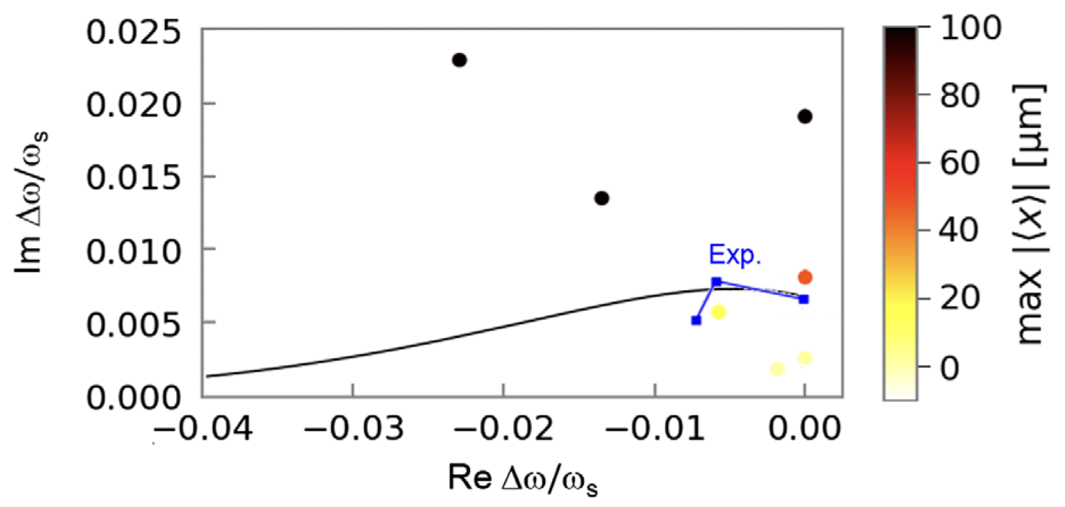
Low noise BPMs with high-performance computing allow for much more than a transverse feedback
Transverse feedback can be made a source of controlled machine impedance – Proof-of-Principle Direct Measurement of Landau Damping Strength at the Large Hadron Collider with an Antidamper
TFB makes beam unstable by adding impedance (1000’s turns time constant)
Real time transverse activity monitor in ObsBox measures instantaneous osc. amplitude (0.0x σ)
When target reached, ObsBox lowers the gain automatically to sustain constant oscillation amplitude
Sergey Antipov et al.: Proof-of-Principle Direct Measurement of Landau Damping Strength at the Large Hadron Collider with an Antidamper DOI 10.1103/PhysRevLett.126.164801

Slide 27
Conclusions
State of the art electronics allows us to measure RF signals with great precision and accuracy.
With very low noise BPM electronics we can see useful things with motion already below <10⁻³ beam σ
Transverse feedback signal processing can generate sophisticated excitation signals.
Together with very powerful digital processing hardware (FPGA, or microprocessors) and signal processing techniques we gain an access to extremely valuable data – beam parameters, accelerator parameters, TFB parameters and many more.
Such tools are gamechanger for accelerator operation – accelerator and beam physics, TFB system operation and diagnostics and many more

Slide 28
Thank you!
We thank very much the IQ award committee for acknowledgement of our work and receiving the prize.
Maybe we have inspired someone to try out things at other accelerators. Please let us know if you explore some of the techniques in your machine.

Slide 29
Thank you!
We thank very much the IQ award committee for acknowledgement of our work and receiving the prize.
Maybe we have inspired someone to try out things at other accelerators. Please let us know if you explore some of the techniques in your machine.
And finally, a personal note...
It was a great privilege and pleasure to work on these things with you – Gerd, Martin, Viera, Xavier. Without you, this would have never been possible. Thank you!

Slide 30
More references
[1] D. Valuch and V. Stopjakova, “New Generation of Very Low Noise Beam Position Measurement System for the LHC Transverse Feedback”, in Proc. 13th Int. Particle Accelerator Conf. (IPAC'22), Bangkok, Thailand, Jun. 2022, pp. 849-852. doi:10.18429/JACoW-IPAC2022-TUPOST007
[2] Buffat, X. and Herr, W. and Pieloni, T. and Valuch, D., “Modeling of the emittance growth due to decoherence in collision at the Large Hadron Collider, in Phys. Rev. Accel. Beams 23, 021002 (2020)
[3] S.V. Furuseth and X. Buffat, “Loss of transverse Landau damping by noise and wakefield driven diffusion, in Phys. Rev. Accel. Beams 23, 114401 (2020)
[4] P. Baudrenghien and T. Mastoridis, “Transverse emittance growth due to RF noise in the high-luminosity LHC crab cavities, in Phys. Rev. ST Accel. Beams 18, 101001 (2015)
[8] LHC Beam Position Module, digital board https://edms.cern.ch/item/EDA-04230-V3-1/0
[9] LHC Beam Position Module RF front end https://edms.cern.ch/item/EDA-04231-V3-0/0

