Slide 1


Slide 2
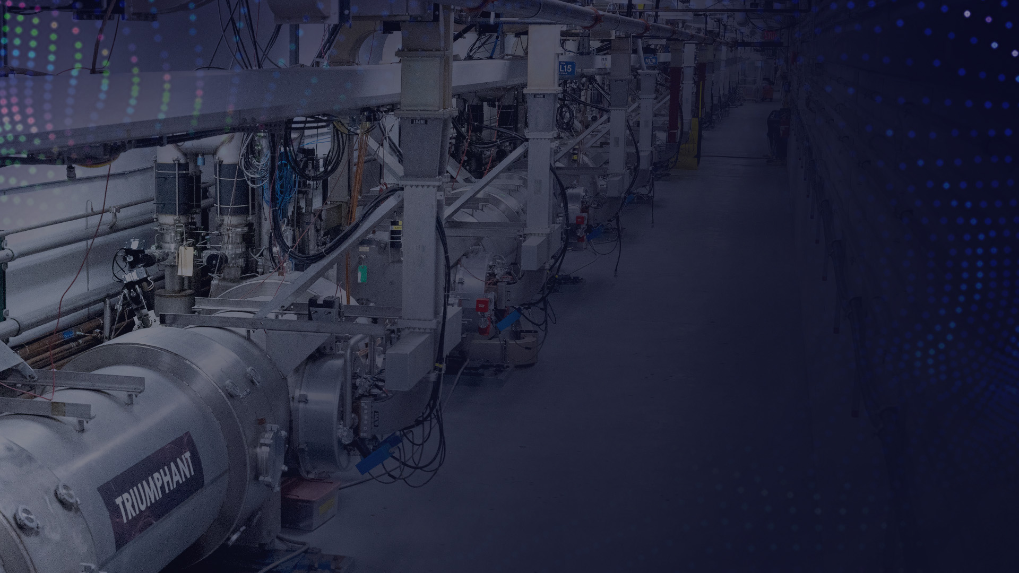
Local Organizing Committee
Kathy Azevedo
Jennifer Carter
Sarah Crouse
Curt Hovater
James Latshaw
Tomasz Plawski
Josh Settle

Slide 3
Scientific Program Committee
Alessandro Ratti (Chair), Lawrence Berkeley National Laboratory
Tim Berenc, Argonne National Laboratory
Brian E. Chase, Fermi National Accelerator Laboratory-ret
Mark Crofford, Oak Ridge National Laboratory
Larry Doolittle, Lawrence Berkeley National Laboratory
Zheng Gao, Institute of Modern Physics (IMP)
Zheqiao Geng, Paul Scherrer Institute
Mariusz Grecki, Deutsches Elektronen-Synchrotron
Wolfgang Hofle, European Organization for European Research (CERN)
Curt Hovater, Thomas Jefferson National Accelerator Facility
Xiao Li, Institute of High Energy Physics (IHEP)
Toshihiro Matsumoto, The High Energy Accelerator Research Organization (KEK)
Chang-Ki Min, Pohang Accelerator Laboratory
Luca Piersanti (INFN-LNF)
Tomasz Plawski, Thomas Jefferson National Accelerator Facility
Kevin Smith, Brookhaven National Laboratory
Dmitry Teytelman, Dimtel, Inc.
Yubin Zhao, Shanghai Institute of Applied Physics
Zeran Zhou, University of Science and Technology of China (USTC)

Slide 4
By The Numbers
Registered Participants:112
  Early Registrations: 36
  Late Registrations: 58
  Students: 5
  Exhibitors: 13

Slide 5
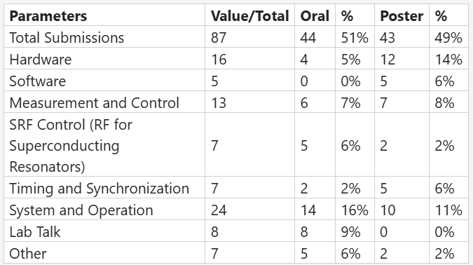
Submitted Abstracts

Slide 6
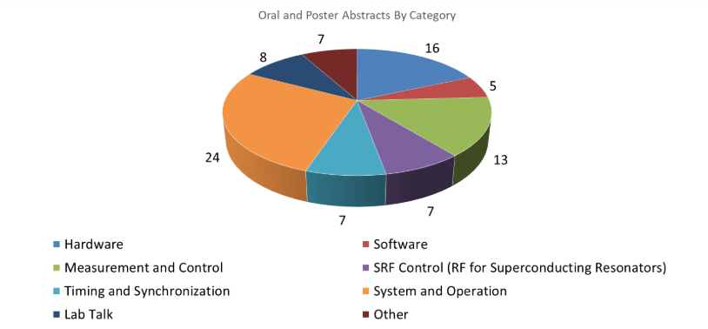
Abstracts by Category

Slide 7
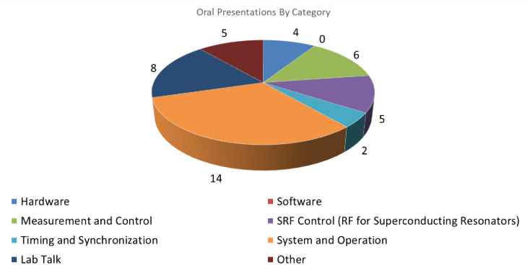
Oral Presentations by Category

Slide 8
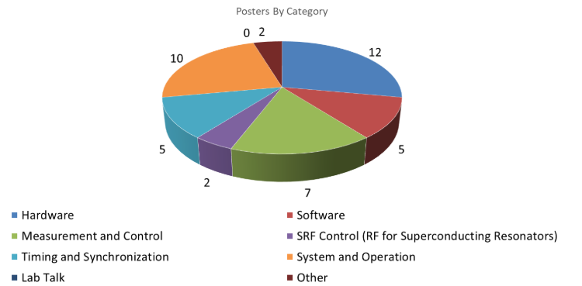
Posters by Category

Slide 9
Participants by Country
Germany:2
  South Korea: 1
  France: 1
  China: 11
  Italy: 6
  Spain: 1
  Japan: 2
  Slovenia: 1
  Poland: 5
  Sweden: 1
  Switzerland: 4
  USA: 64

Slide 10
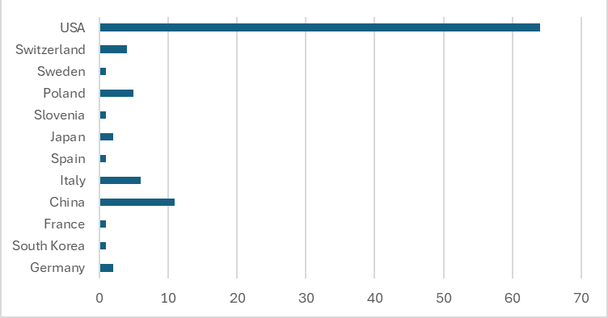
Participants by Country

Slide 11
Participants by Region
  America: 64
  Asia: 14
  Europe: 21

Slide 12

Participants by Organization - USA

Slide 13
Participants by Organization – UK & Europe

Slide 14
Participants by Organization- Asia

Slide 15
Participants by Country

Slide 16
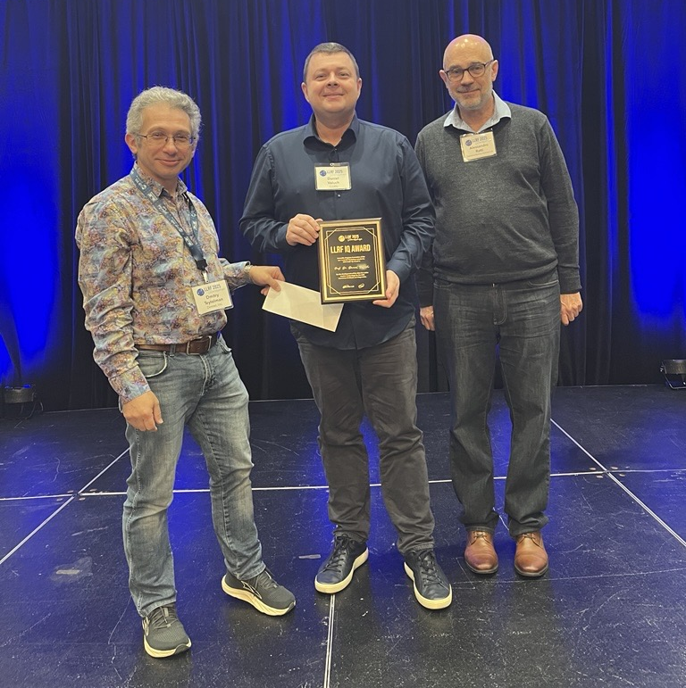
IQ Award
  Dr. Daniel Valuch

Slide 17












SPECIAL THANKS TO OUR SPONSORS

