Slide 1
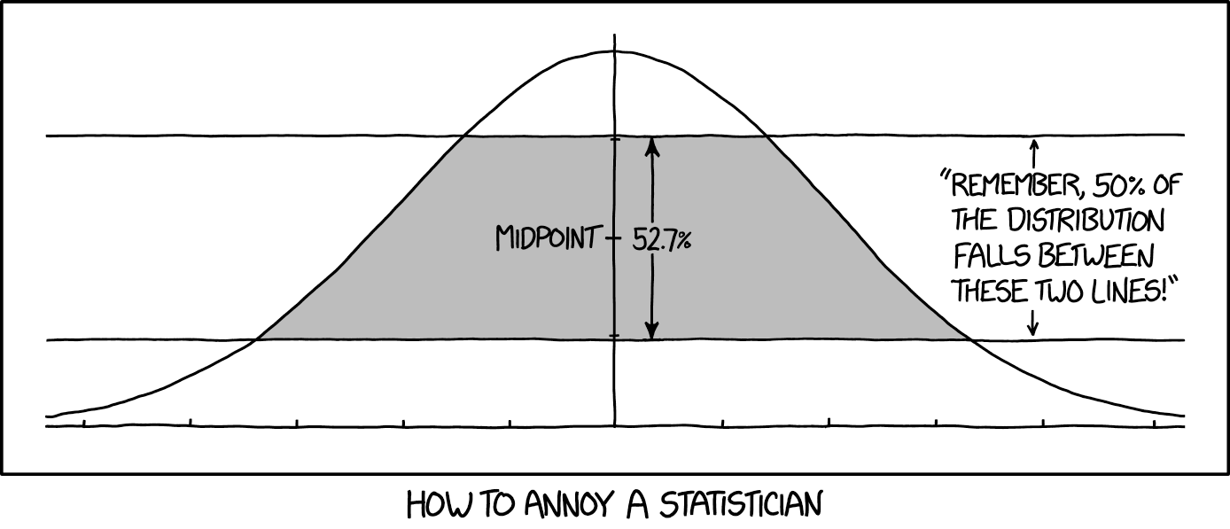
High Crimes and Misdemeanors in Data Analysis
Image from https://xkcd.com/2118/
Douglas W. Higinbotham

Slide 2
All Models Are Wrong
“The most that can be expected from any model is that it can supply a useful approximation to reality: All models are wrong; some models are useful.” - George Box (1919 – 2013)
“An ever increasing amount of computational work is being relegated to computers, and often we almost blindly assume that the obtained results are correct.” - Simon Širca & Martin Horvat
TODAY’S TALK IS TO GET YOU TO THINK OUTSIDE THE BOX! ASK QUESTIONS! INTERRUPT!

Slide 3
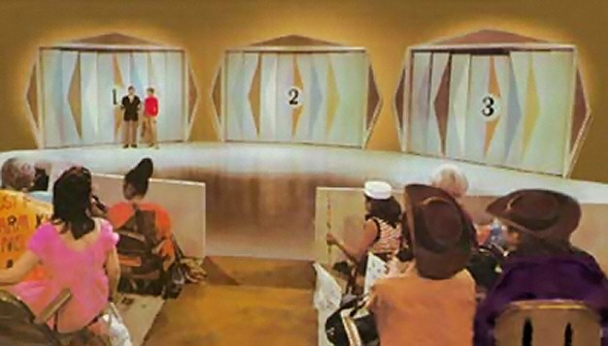
Let’s Make A Deal
Behind Two of the Doors Are Goats …
Behind One of the Doors Is A Fabulous Prize!

Slide 4
Monty Hall Problem
Door #1
Door #2
Door #3

Slide 5
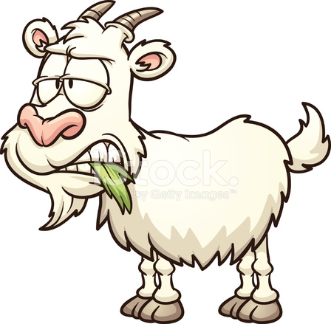
Monty Hall Problem
Door #1
Door #2
Door #3
Right
Wrong

Slide 6
Monty Hall Problem
Door #1
Door #2
Door #3
Right
Wrong

Slide 7
Monty Hall Problem
Door #1
Door #2
Door #3

Slide 8
Probability Says Switch
Your human reaction is to stay with your original choice.
I setup the problem before I even arrived today (i.e. you have 1/3 chance to pick correctly at the start)
My opening a door is NOT random, so the remaining door has a 2/3 chance to be the winner!
If you are still not convinced trying reading https://en.wikipedia.org/wiki/Monty_Hall_problem
The is actually a great problem to set up as a Monte Carlo simulation.

Slide 9
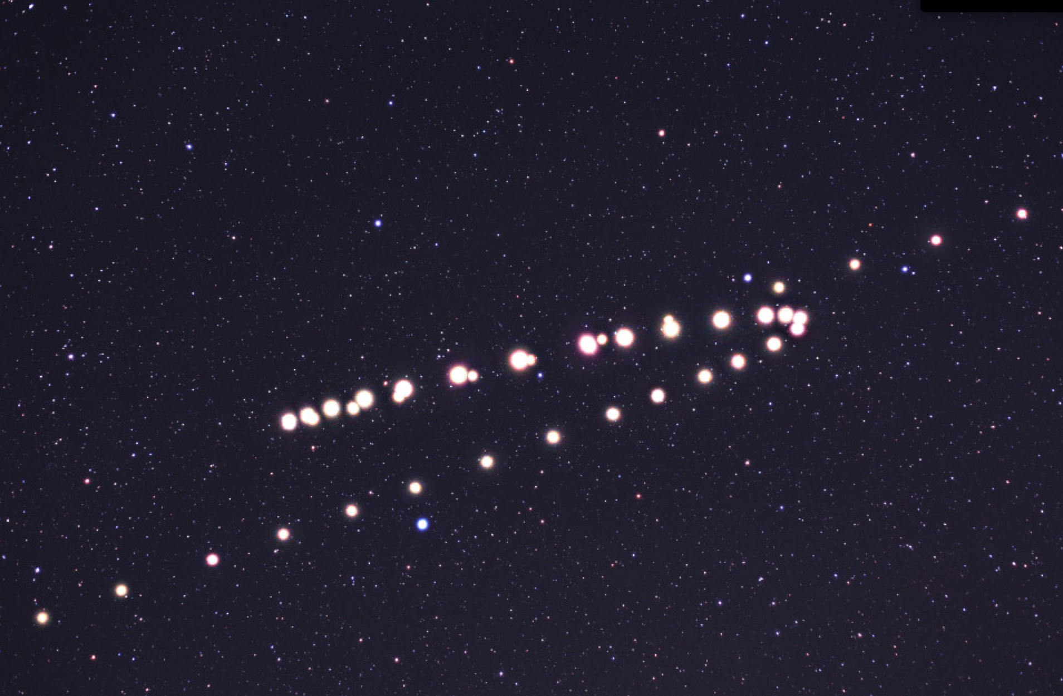
Retrograde Motion of Mars As Seen From Earth

Slide 10
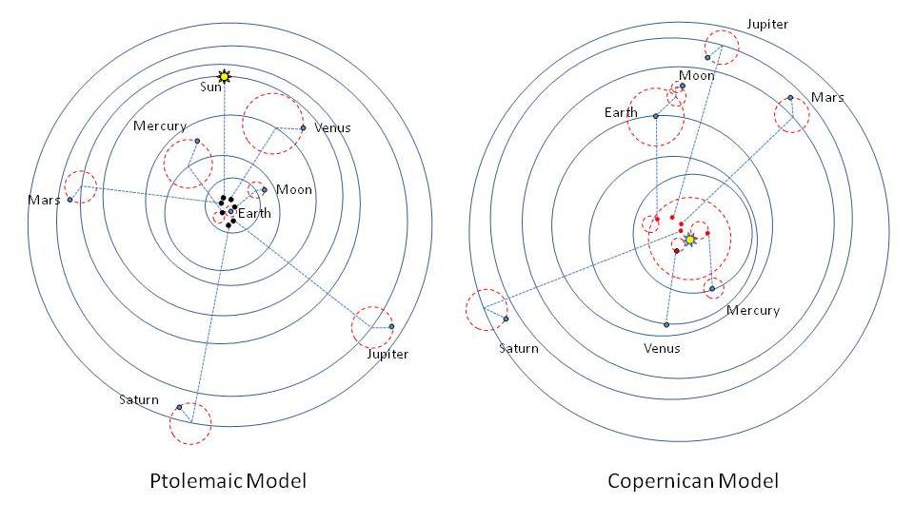
Earth vs. Sun Centered Models

Slide 11
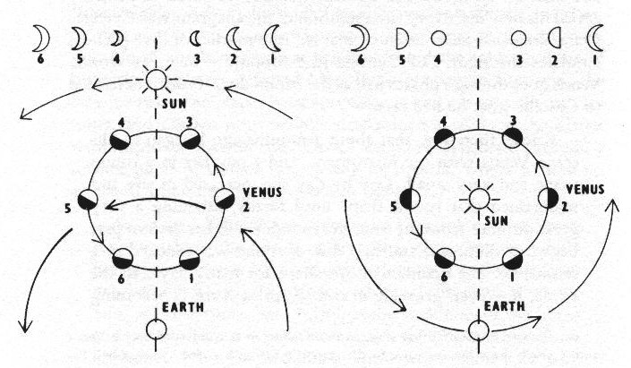
Phases & Elliptical Orbits
At first, with orbits as perfect circles, Ptolemaic models were better at predicting the orbits of the planets then Copernican models.
It was the phases of the Venus (Galileo 1610) along with the elliptical orbits of Kepler (1609) [ fitting the “naked eye” data of Brahe (1574) ] that proved to be the downfall of the Ptolemaic model.
Illustration based on work of Galileo Galilei in Sidereus Nuncius (Starry Messenger) 1610.

Slide 12
Occam's Razor
William Occam (1287 – 1347)
One can always explain failing explanations with an ad hoc hypothesis, thus in Science, simpler theories are preferable to more complex ones. (e.g. the Sun centered vs. Earth centered)
Layman’s version of Occam’s Razor is “the simplest explanation is usually the correct one”
In statistical versions of Occam's Razor, one uses a rigorous formulation instead of a philosophical argument. In particular, one must provide a specific definition of simple:
  F test, Akaike information criterion, Bayesian information criterion, etc.
  In statistical modeling of data too simple is under-fitting and too complicated is over-fitting.

Slide 13
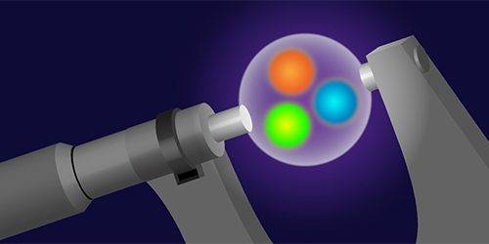
A Puzzle Caused By Tenacious Graduate Students
Randolf Pohl, Aldo Antognini, et al., Nature 466 (2010) 213–216.
The signal was nearly not found as they had been scanning frequencies assuming a large radius.
Figure by APS/Alan Stonebraker
13

Slide 14
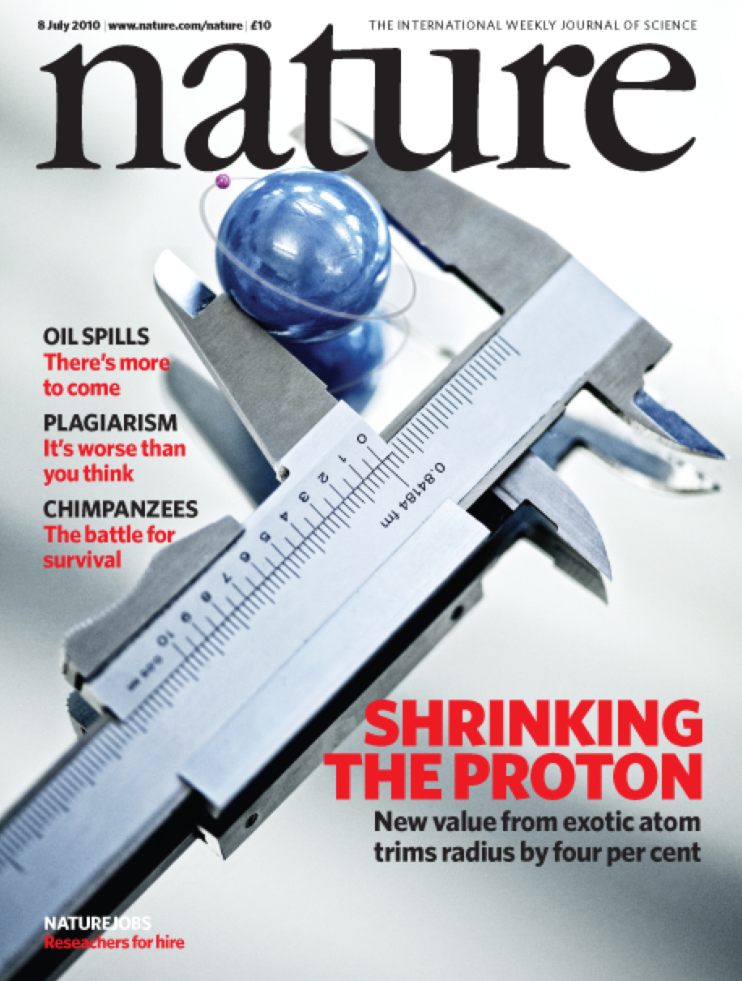
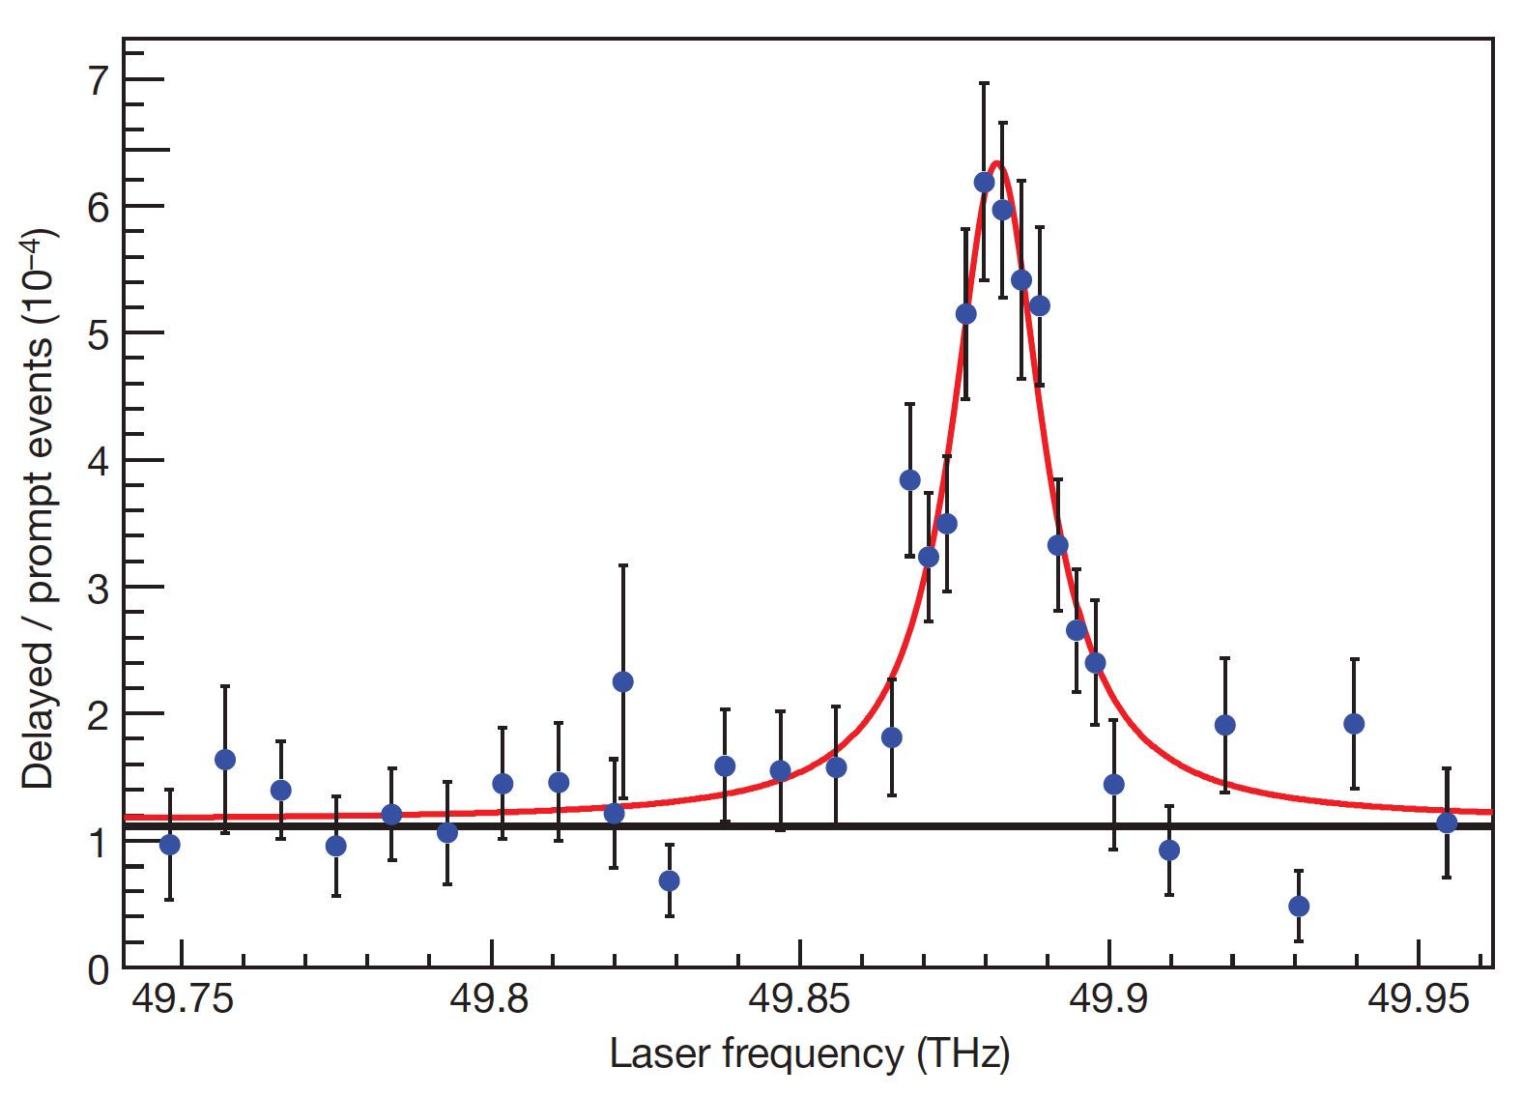
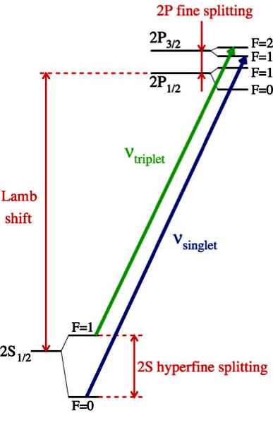
Muonic Hydrogen Data
High precision results from Muonic Lamb shift data give a proton radius of 0.84 fm.
This result contradicts many other extractions which have determined the proton radius to be ~0.88 fm.
E_{2p} – E_{2s} = 209.98 – 5.2262 r_{p}² + 0.0347 r_{p}³ meV
14

Slide 15

Back in 2011 MANY Possible Explanations
eH theory wrong ?
μH experiment wrong ?
Lamb shift difference of
310 ± 2 μeV
Beyond Standard Model
eH experiment
+ ep scattering wrong ?
- R∞
- 2γ corrections
- low-Q² extrapolation
μH theory wrong ?
- 2γ corrections
- missing QED or EW corrections
- soft hadronic corrections
15

Slide 16
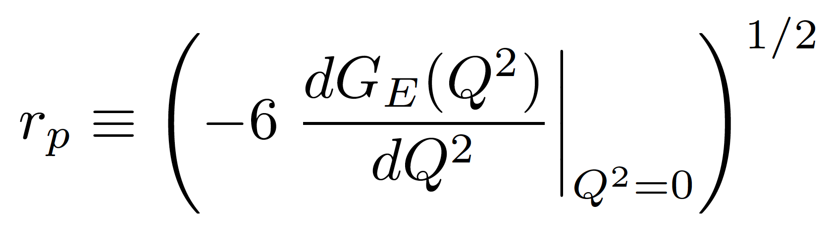
Charge Radius of the Proton
Proton G_{E} (charge form factor) has no measured minima and it is too light for the Fourier transformation to work in a model independent way.
Thus for the proton we make use of the fact that as Q² goes to zero the charge radius is proportional to the slope of G_{E}
This definition of r_{P} has been shown to be consistent with the radius extracted from the muonic hydrogen data.
M. I. Eides, H. Grotch and V. A. Shelyuto, Phys. Rept.342 (2001) 63. http://doi.org/10.1016/S0370-1573(00)00077-6
Gerald A. Miller, Phys. Rev. C 99 (2019) 035202. https://doi.org/10.1103/PhysRevC.99.035202
For electron scattering this will be an extrapolation problem.
16

Slide 17
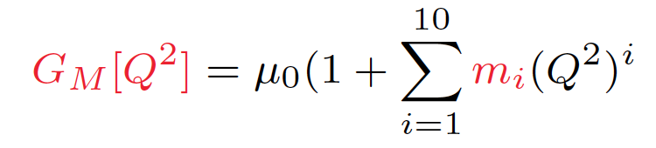
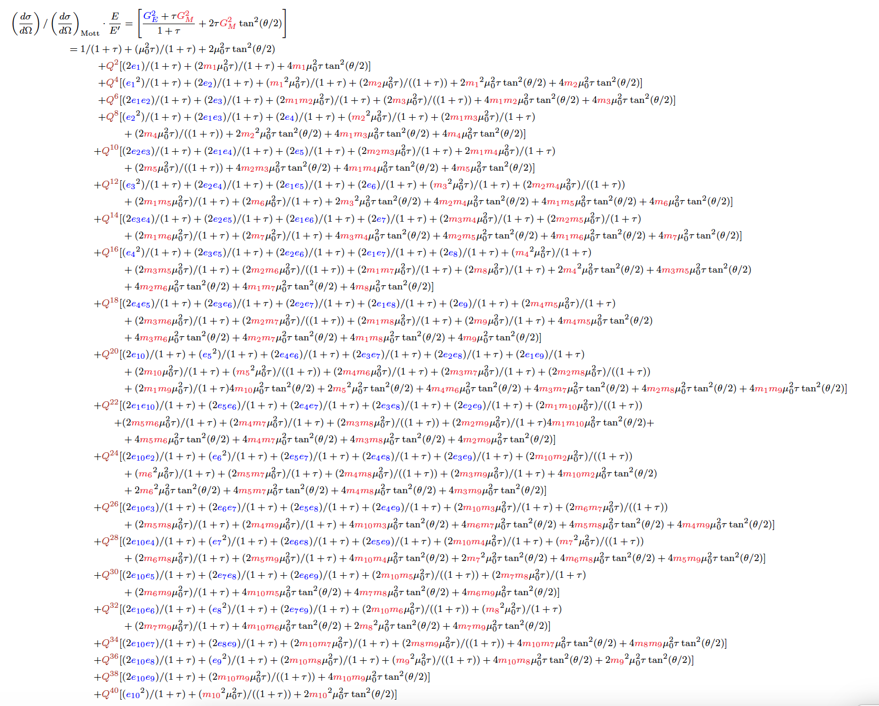
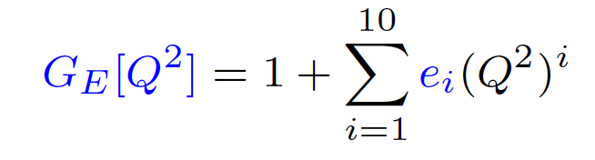
The Mainz 2014 0.88 fm Proton Radius Comes From A 51 Parameter Regression
plus 31 floating normalizations

Slide 18
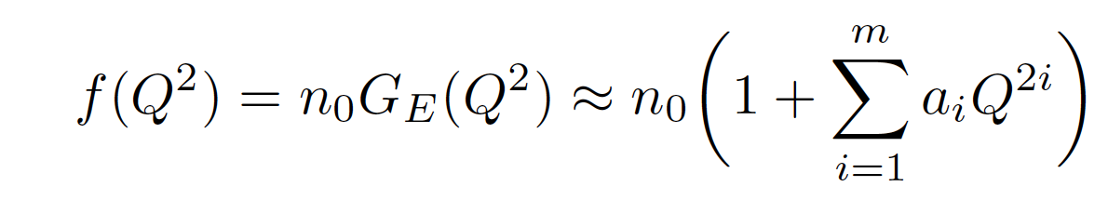
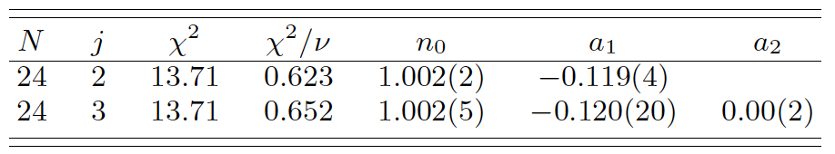
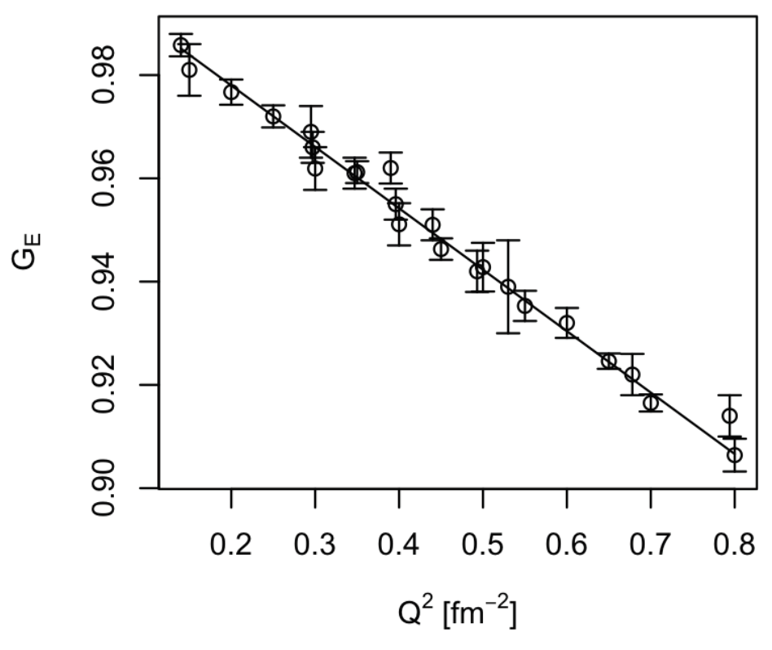
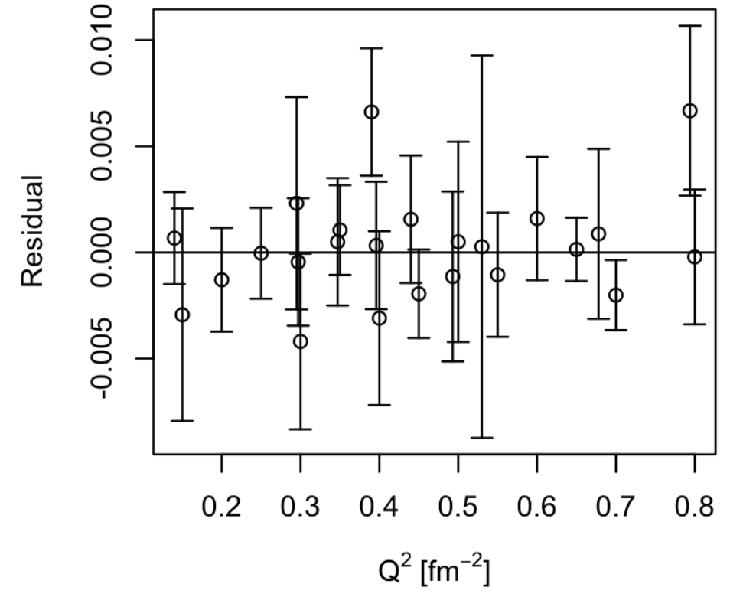
Simple Real World Example
(where the JLab high school intern didn’t get the expected result)
Using the data from G. G. Simon, C. Schmitt, F. Borkowski, and V. H. Walther, Nucl. Phys. A333 (1980) 381 and
J. J. Murphy, Y. M. Shin, and D. M. Skopik, Phys. Rev. C9 (1974) 2125.
Textbook test, an F-test, rejects fitting with the more complex j=3 (j=m+1) function, that does NOT mean a₂ = 0.
Pohl et.al’s 0.84 fm radius would predict an a₁ value of - 0.1176 since radius = sqrt(-6a₁)
Analysis done with very talented high school intern: https://doi.org/10.1103/PhysRevC.93.055207

Slide 19
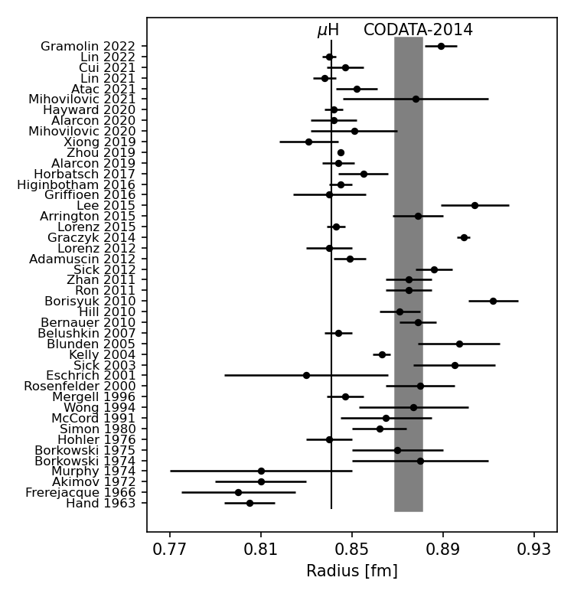
Radii from Electron Scattering
Gramolin 2022: https://doi.org/10.1103/PhysRevD.105.054004
Lin 2022: https://doi.org/10.1103/PhysRevLett.128.052002
Cui 2021: https://doi.org/10.1103/PhysRevLett.127.092001
Lin 2021: https://doi.org/10.1016/j.physletb.2021.136254
Atac 2021: https://doi.org/10.1140/epja/s10050-021-00389-9
Mihovilovic 2021: https://doi.org/10.1140/epja/s10050-021-00414-x
Hayward 2020: https://doi.org/10.1016/j.nuclphysa.2020.121767
Alarcon 2020: https://doi.org/10.1103/PhysRevC.102.035203
Xiong 2019: https://doi.org/10.1038/s41586-019-1721-2
Zhou 2019: https://doi.org/10.1103/PhysRevC.99.055202
Alarcon 2019: https://doi.org/10.1103/PhysRevC.99.044303
Horbatsch 2017: https://doi.org/10.1103/PhysRevC.95.035203
Higinbotham 2016: https://doi.org/10.1103/PhysRevC.93.055207
Griffioen 2016: https://doi.org/10.1103/PhysRevC.93.065207
Lee 2015: https://doi.org/10.1103/PhysRevD.92.013013
Arrington 2015: https://doi.org/10.1063/1.4921430
Lorenz 2015: https://doi.org/10.1103/PhysRevD.91.014023
Graczky 2014: https://doi.org/10.1103/PhysRevC.90.054334
Lorenz 2012: https://doi.org/10.1140/epja/i2012-12151-1
Adamuscin 2012: https://doi.org/10.1016/j.ppnp.2012.01.014
Sick 2012: https://doi.org/10.1016/j.ppnp.2012.01.013
Zhan 2011: https://doi.org/10.1016/j.physletb.2011.10.002
Ron 2011: https://doi.org/10.1103/PhysRevC.84.055204
Borisyuk 2010: https://doi.org/10.1016/j.nuclphysa.2010.05.054
Hill 2010: https://doi.org/10.1103/PhysRevD.82.113005
Bernauer 2010: https://doi.org/10.1103/PhysRevLett.105.242001
Belushkin 2007: https://doi.org/10.1103/PhysRevC.75.035202
Blunden 2005: https://doi.org/10.1103/PhysRevC.72.057601
Kelly 2004: https://doi.org/10.1103/PhysRevC.70.068202
Sick 2003: https://doi.org/10.1016/j.physletb.2003.09.092
Eschrich 2001: https://doi.org/10.1016/S0370-2693(01)01285-0
Rosenfelder 2000: https://doi.org/10.1016/S0370-2693(00)00316-6
Mergell 1996: https://doi.org/10.1016/0375-9474(95)00339-8
Wong 1994: https://doi.org/10.1142/S0218301394000255
McCord 1991: https://doi.org/10.1016/0168-583X(91)96079-Z
Simon 1980: https://doi.org/10.1016/0375-9474(80)90104-9
Hohler 1976: https://doi.org/10.1016/0550-3213(76)90449-1
Borkowski 1975: https://doi.org/10.1007/BF01409496
Borkowski 1974: https://doi.org/10.1016/0550-3213(75)90514-3
Murphy 1974: https://doi.org/10.1103/PhysRevC.9.2125
Akimov 1972: http://www.jetp.ac.ru/cgi-bin/dn/e_035_04_0651.pdf
Frerejacque 1966: https://doi.org/10.1103/PhysRev.141.1308
Hand 1963: https://doi.org/10.1103/RevModPhys.35.335

Slide 20
Types of Scientific Papers https://xkcd.com/2456/

Slide 21
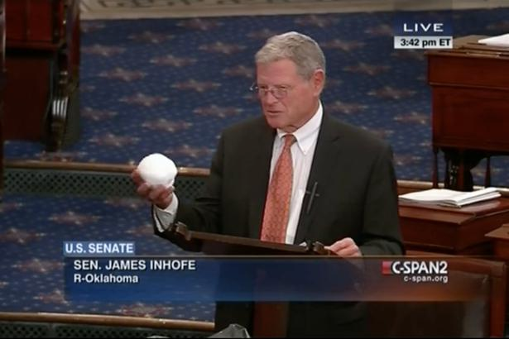
Warning: Danger of Confirmation Bias
In psychology and cognitive science, confirmation bias is a tendency to search for or interpret information in a way that confirms one's preconceptions, leading t statistical errors.
https://www.youtube.com/watch?v=3E0a_60PMR8
And of course we also have tweets: https://twitter.com/realDonaldTrump/status/1090074254010404864

Slide 22
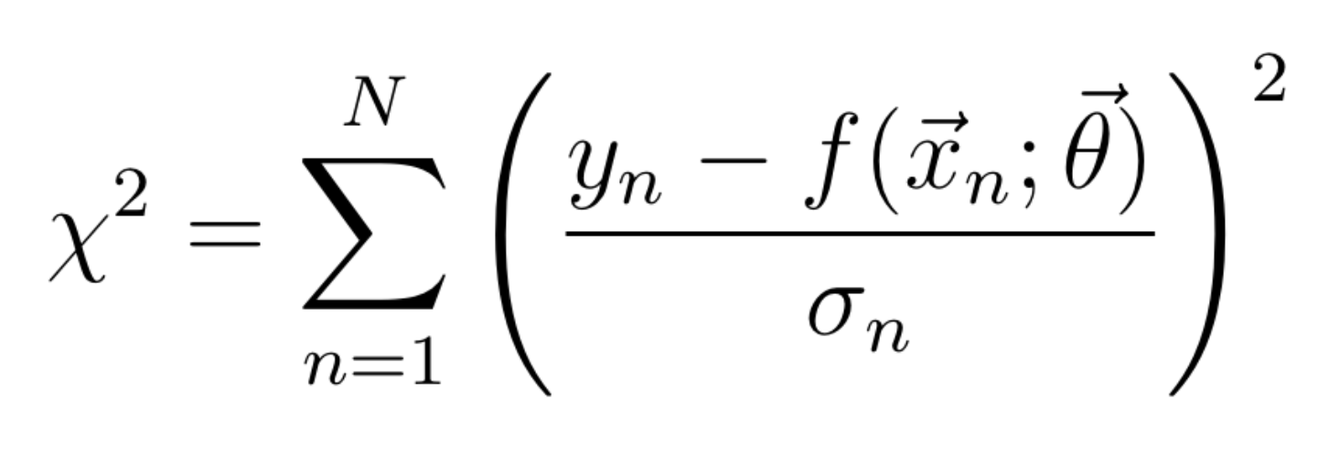
What’s a nuclear physicist need to know about fitting?!
Where you have data y with uncertainness 𝛔_{n} at different values of x_{n} fit to a function f with parameters 𝛳.
Just fit until you get total χ² divided by number of degrees of freedom < 1 and your good, right?!
What could possibly go wrong!?
What if the weights (sigma’s) are underestimated or overestimated?
What if I have the wrong model?
What if the data aren’t normally distributed?
How do you get the number of degrees of freedom if you do a non-linear regression?
What if average reduced χ² is good, but one over-fits one area and under-fits another?
What are the number of degrees of freedom in a non-linear model? (see https://arxiv.org/abs/1012.3754 )
It is not trivial and just getting a reduced χ² ~ 1 does not mean you have a good result!

Slide 23
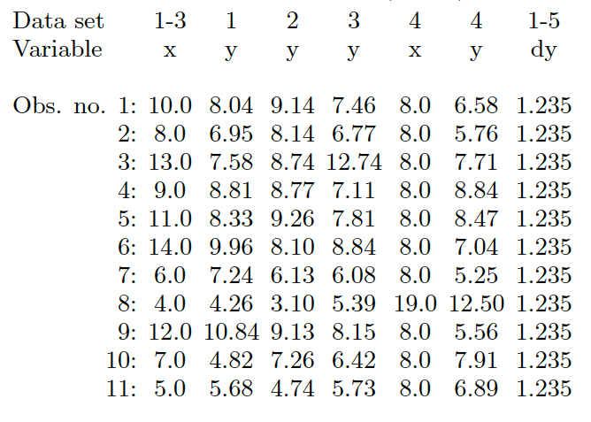
Anscombe's Quartet
F. J. Anscombe, The American Statistician 27 (1973) 17 with added dy terms.

Slide 24
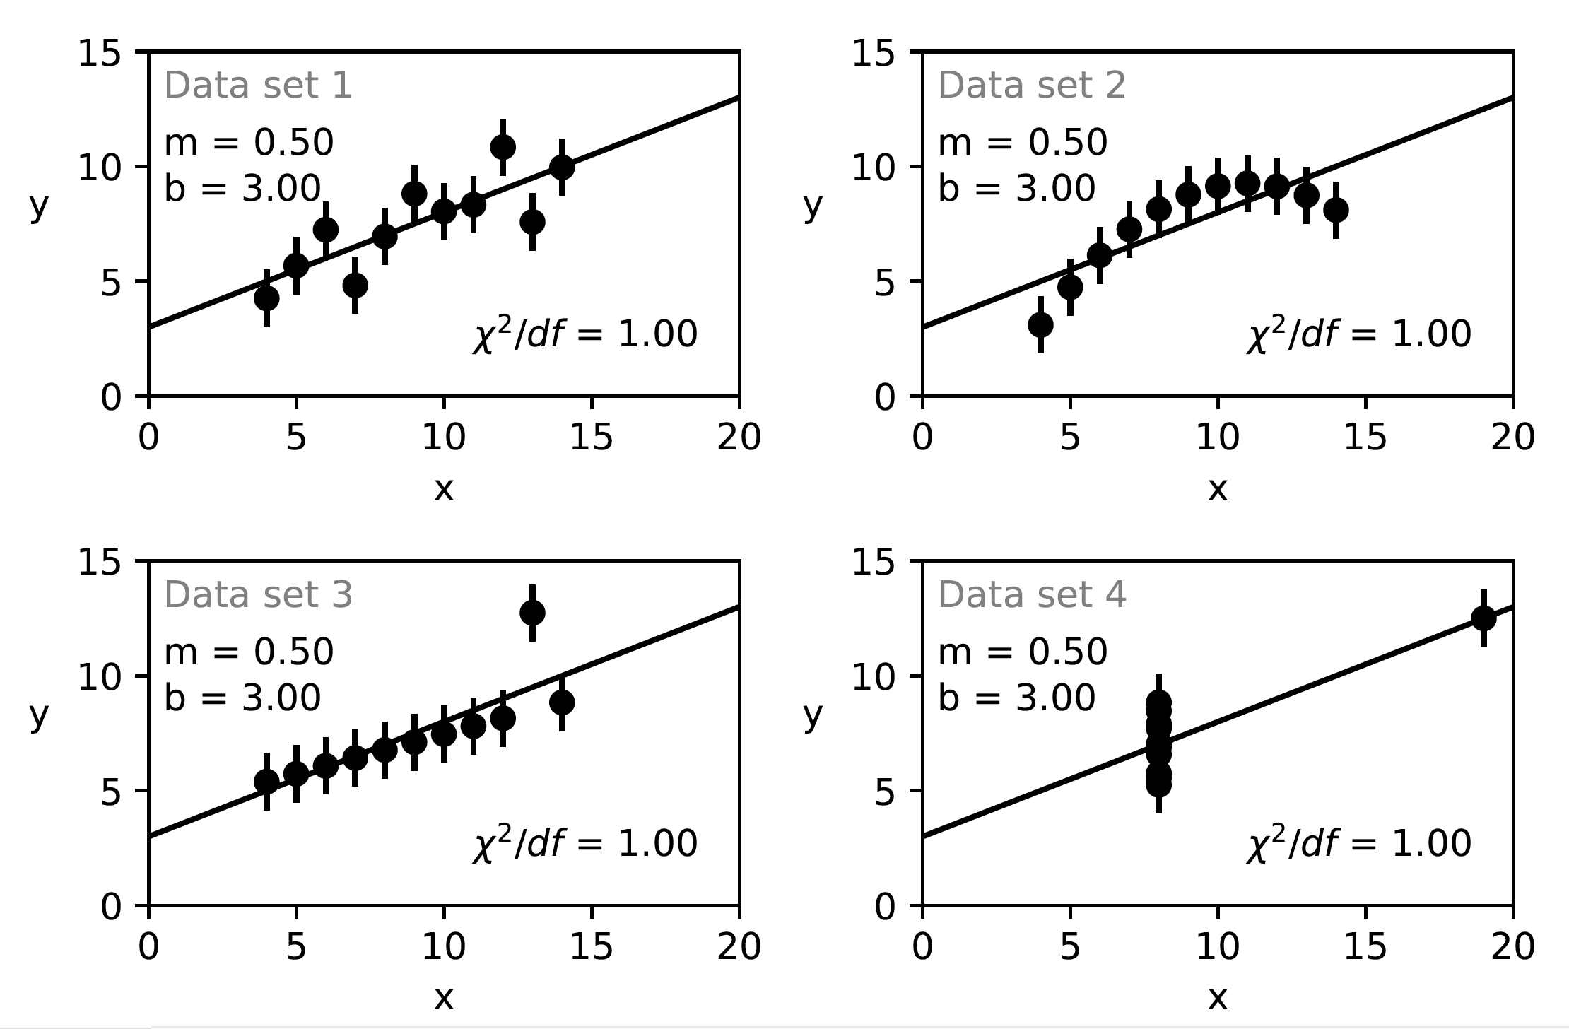
When fit with a linear function, Slope, Intercept, 𝝌², etc. are all the same.
NOTE: Standard error assumes that the data are normally disturbed about the fit function.
Details in appendix of https://doi.org/10.1103/PhysRevC.102.015205 and https://arxiv.org/abs/1812.05706

Slide 25
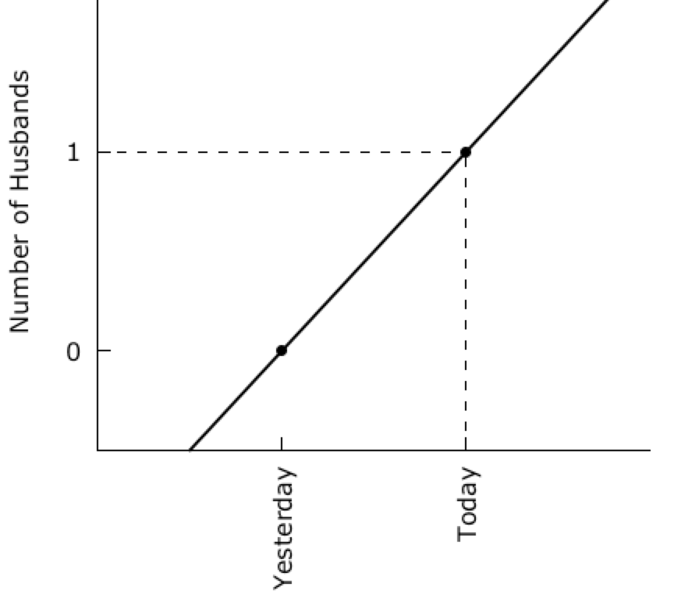
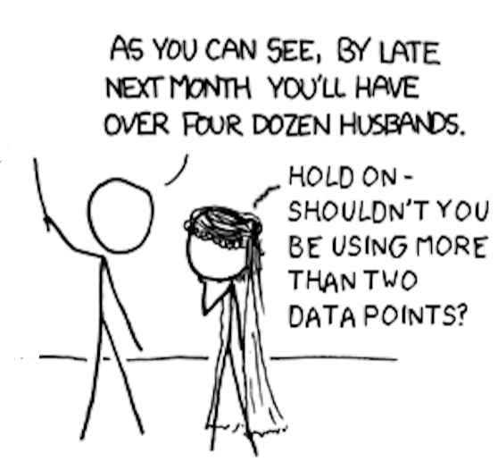
“My Hobby: Extrapolating” from XKCD
Based on https://xkcd.com/605/

Slide 26
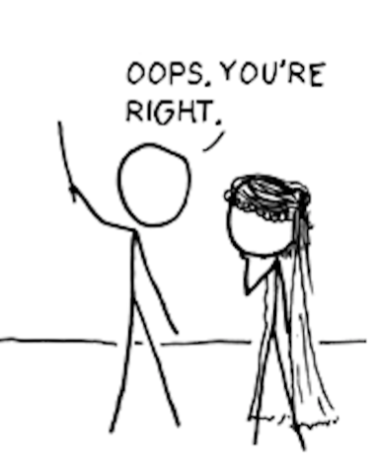
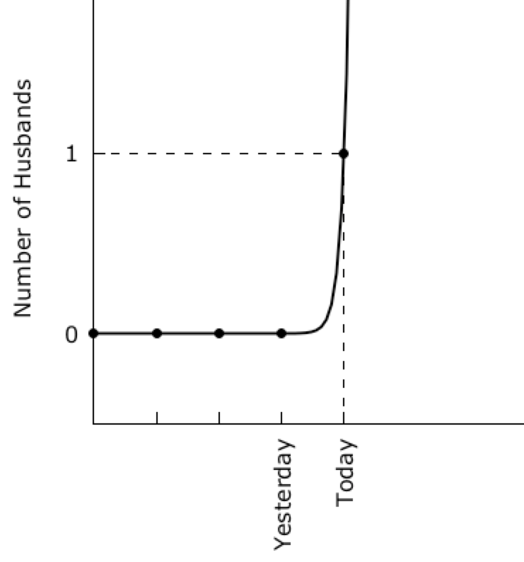
“My Hobby: Extrapolating” from XKCD
#
# gnuplot overfitting of xkcd Husband Data
# modified from https://xkcd.com/605/
# by
# Douglas W. Higinbotham
#
set terminal wxt enhanced font "verdana,12" size 900,450
set nokey
set xtic rotate 90
set ytic 0,1,1
set border 3
set xtics nomirror
set ytics nomirror
set multiplot layout 1,2
set ylabel "Number of Husbands"
f(x)=f0+f1*x
g(x)=g0*exp(g1*x)
fit f(x) '1.dat' using 1:3 via f0,f1
fit g(x) '2.dat' using 1:3 via g0,g1
set arrow from 0,1 to 2,1 nohead dashtype 7 lc 'black'
set arrow from 2,-0.5 to 2,1 nohead dashtype 7 lc 'black'
set xrange [0:3]
set yrange [-0.5:2]
plot '1.dat' using 1:3:xtic(2) lt 7 lc 'black' ,f(x) lw 2 lc 'black'
unset arrow
set xrange [-2:6]
set arrow from -2,1 to 2,1 nohead dashtype 7 lc 'black'
set arrow from 2,-0.5 to 2,1 nohead dashtype 7 lc 'black'
plot '2.dat' using 1:3:xtic(2) lt 7 lc 'black' ,g(x) lw 2 lc 'black'
unset multiplot
pause -1
Based on https://xkcd.com/605/

Slide 27
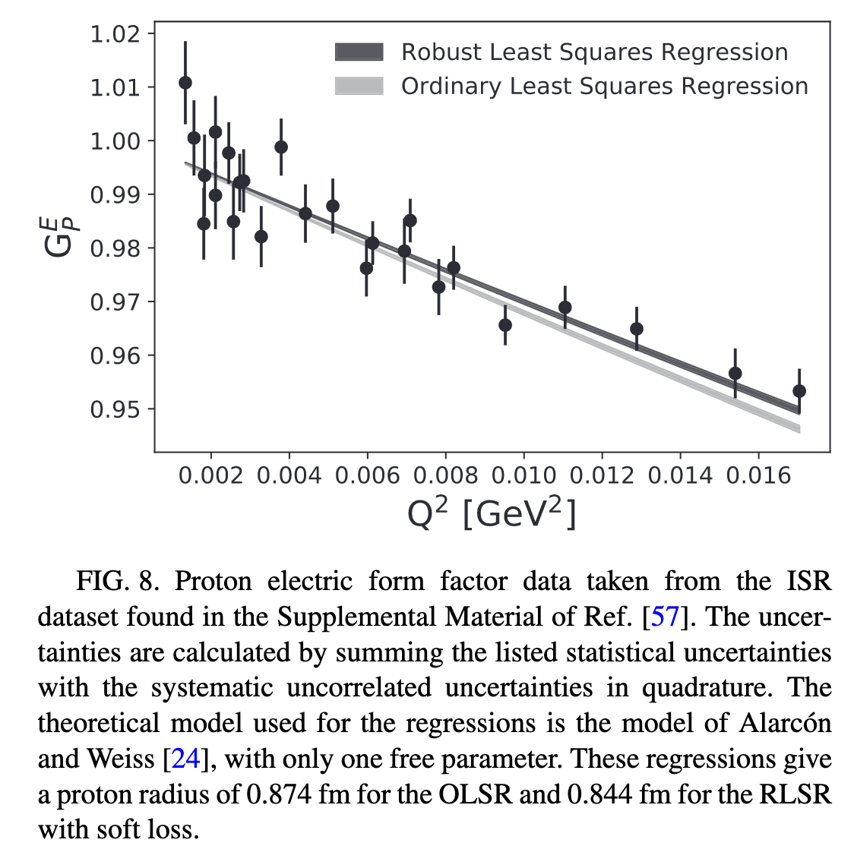
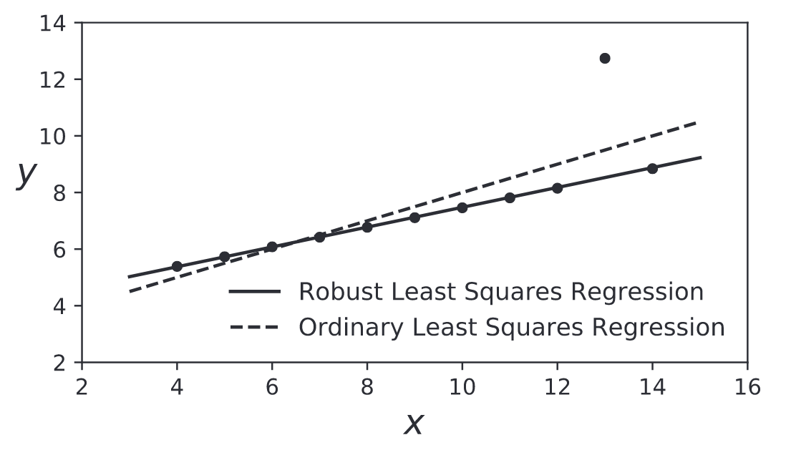
Robust Regressions https://doi.org/10.1103/PhysRevC.102.015205
Ordinary Least Squares Regressions are easily “pulled” by a single point.
Robust regressions tend to follow the global trends.

Slide 28
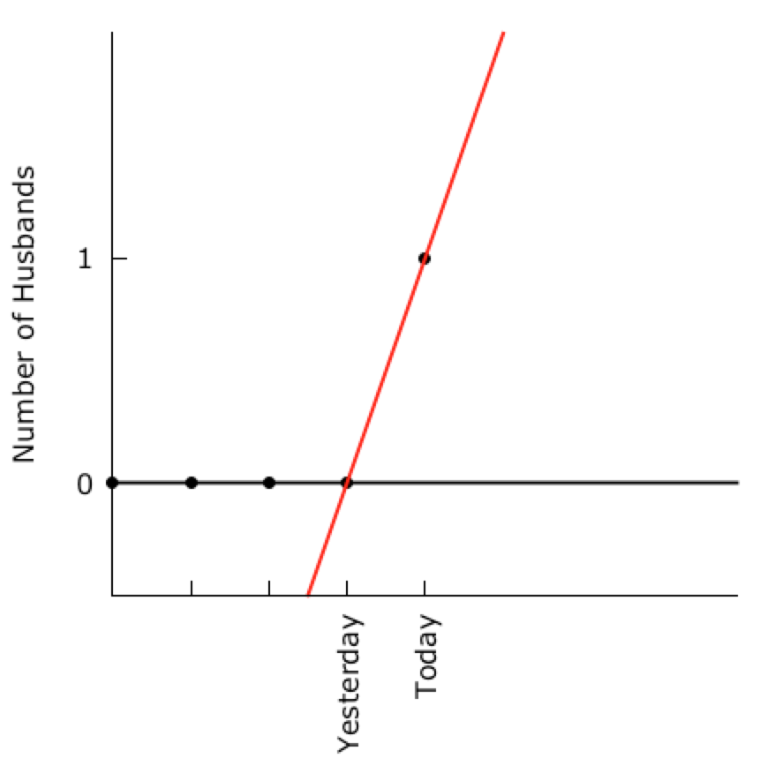
Robust Linear Regression
OOPS, It Was Just An Outlier
Based on https://xkcd.com/605/

Slide 29
Is There Some Way To Avoid The Extrapolations?!
Recent Global Fit
  Z. Ye et al., Phys. Lett. B 777 (2018) 8.
  Used world data
  Fixed the Radius to the current CODATA value
Recent Theory Work
  Jose Alarcon and Christian Weiss, Phys. Lett. B 784 (2018) 373-377
  Dispersively Improved Chiral Effective Theory
  Proper analytic behavior of the Form Factors
  Work was Expanded In Radius (i.e. the radius is there unknown parameter.

Slide 30
The Goldilocks Method
Take the global fit of Zhihong Ye and fix the radius to different values
  Values 0.80 to 0.90 fm (completely did the regression for each radius)
  Different radii slight change the normalization (i.e. floating normalizations)
  z-expansion
  world data
Ask Alarcon & Weiss to fix the radius to different values in their model.
  Generate many different curves for different radii
  Each curves has all the proper physical properties.
Compare
  Is there a curve where the global fit and the theory agree? (i.e. are just right)
  If so, what is the radius of that curve?

Slide 31
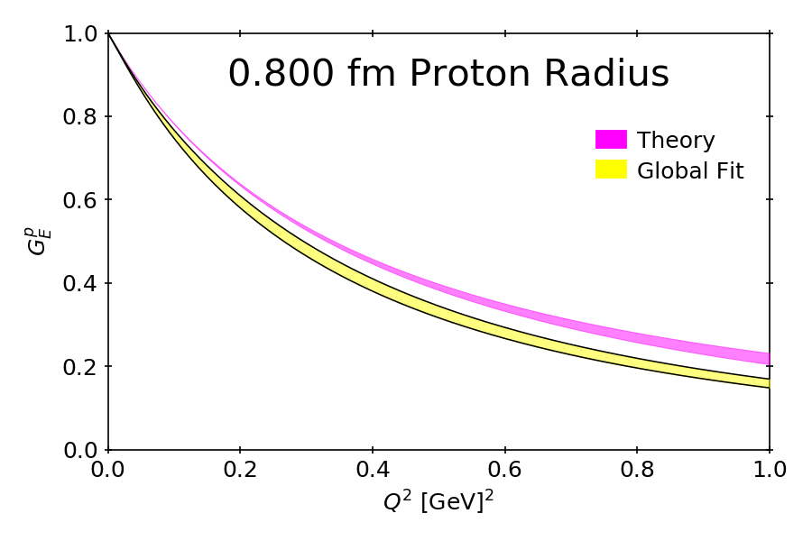

Slide 32
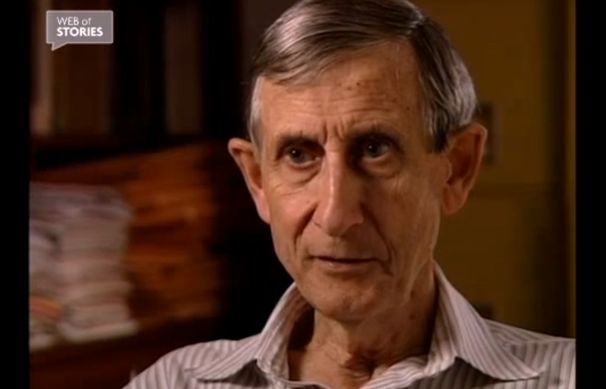
Fermi’s Rejection of Dyson’s Work
https://www.webofstories.com/people/freeman.dyson/94?o=SH
Also written as a Nature article: https://www.nature.com/articles/427297a

Slide 33

The Five Parameter Elephant
“Drawing an elephant with four complex parameters”
by Jurgen Mayer, Khaled Khairy, and Jonathon Howard, Am. J. Phys. 78 (2010) 648.
https://www.johndcook.com/blog/2011/06/21/how-to-fit-an-elephant/

Slide 34
Statistical notes on the problem of experimental observations near an unphysical region
What happens when everyone knows that the neutrino mass must be positive?!
https://doi.org/10.1103/PhysRevD.44.299
Image being the student who walks into the professor’s office with the negative results.
Now image the sum of the effect of everyone being pushed to report the “physical” result instead of quoting unbiased results.
The solution is of course to report both, but if you can only do one publish what you actually measured!!

Slide 35
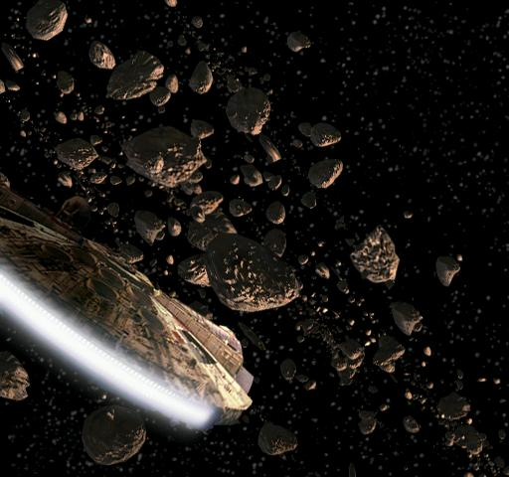
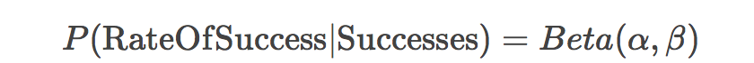
Bayesian Priors (The Star Wars Example)
https://www.countbayesie.com/blog/2015/2/18/hans-solo-and-bayesian-priors
C3PO can calculate the odds of a pilot navigating an asteroid field (20,000:1)
But Han Solo is one of the best pilots in the galaxy. (i.e. C3P0 ignored a Bayesian Prior)
So C3PO actually correctly predicts that average pilots will not successfully navigate the field while incorrectly predicting Han’s chances. (estimated as 75% in the article)
Ignoring A Bayesian Prior Can Lead To Wrong Conclusions

Slide 36
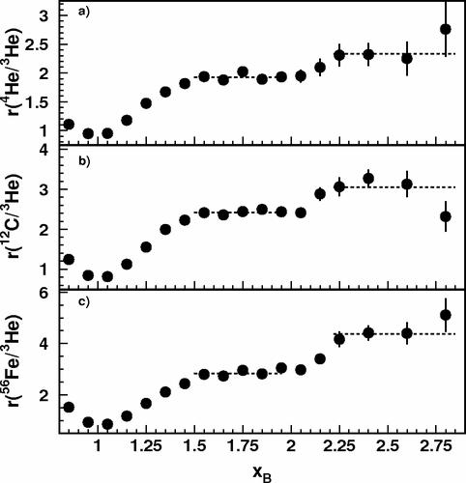
CLAS x_{B} > 2 Three Nucleon Plateau
I used to show this plot at conferences and tell a story about 2 and 3 nucleon correlations.
https://doi.org/10.1103/PhysRevLett.96.082501
Then when the Hall C preliminary results only agreed with the xB < 2 data, I thought hard about what was going on . .

Slide 37
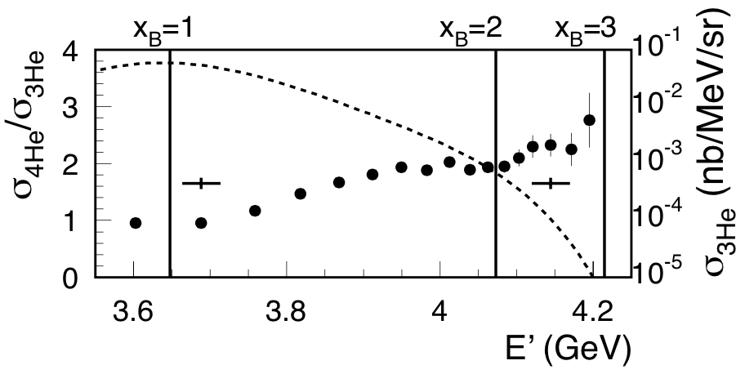
Plotting CLAS Results vs. E’ instead of x_{B}
D. H. and O. Hen, Phys. Rev. Lett. 114 (2015) 169201. (a PRL from checking a result on the back of an envelope )
https://doi.org/10.1103/PhysRevLett.114.169201

Slide 38
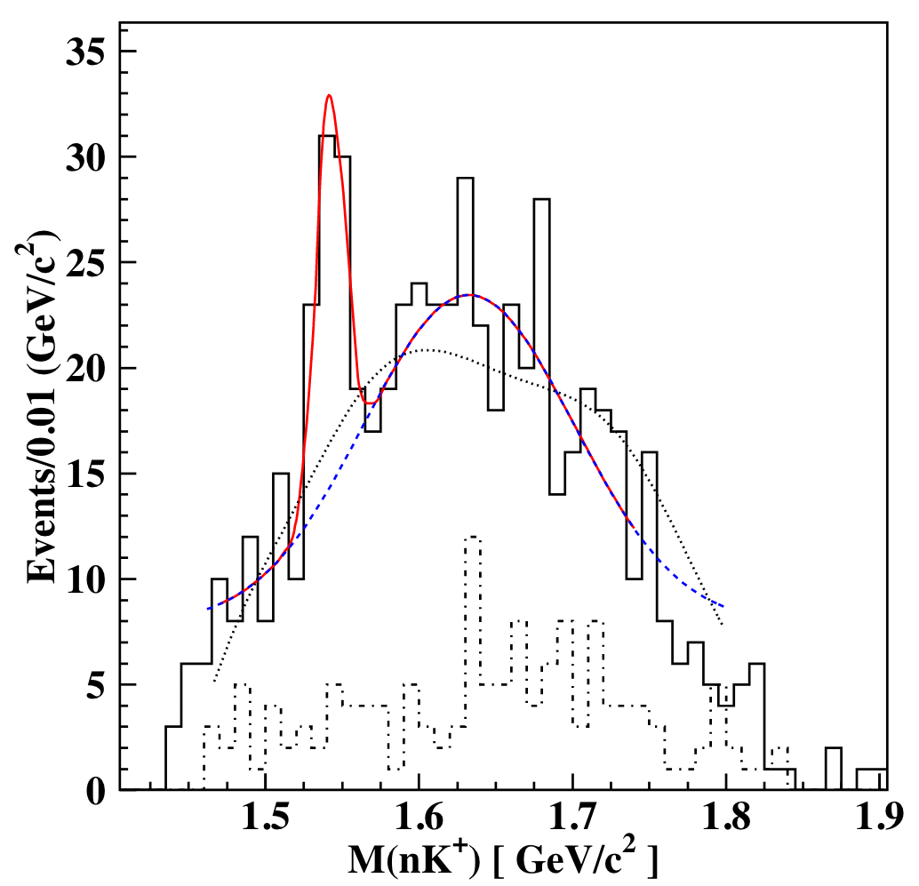
And with over 300 citations, the CLAS Pentaquark
Shown is the data claiming the observation of a light pentaquark particle.
https://doi.org/10.1103/PhysRevLett.91.252001
Cuts were made until a peak they were searching for was emphasized and the crime was then quoting an error as if it was a frequentist result. This is known as the ”look elsewhere effect” where where an apparently statistically significant observation may have actually arisen by chance because of the sheer size of the parameter space to be searched.
This can be taken into account but dramatically reduces statistical significance.
What was good science was repeating the experiment and using the same cuts and not seeing a peak.

Slide 39
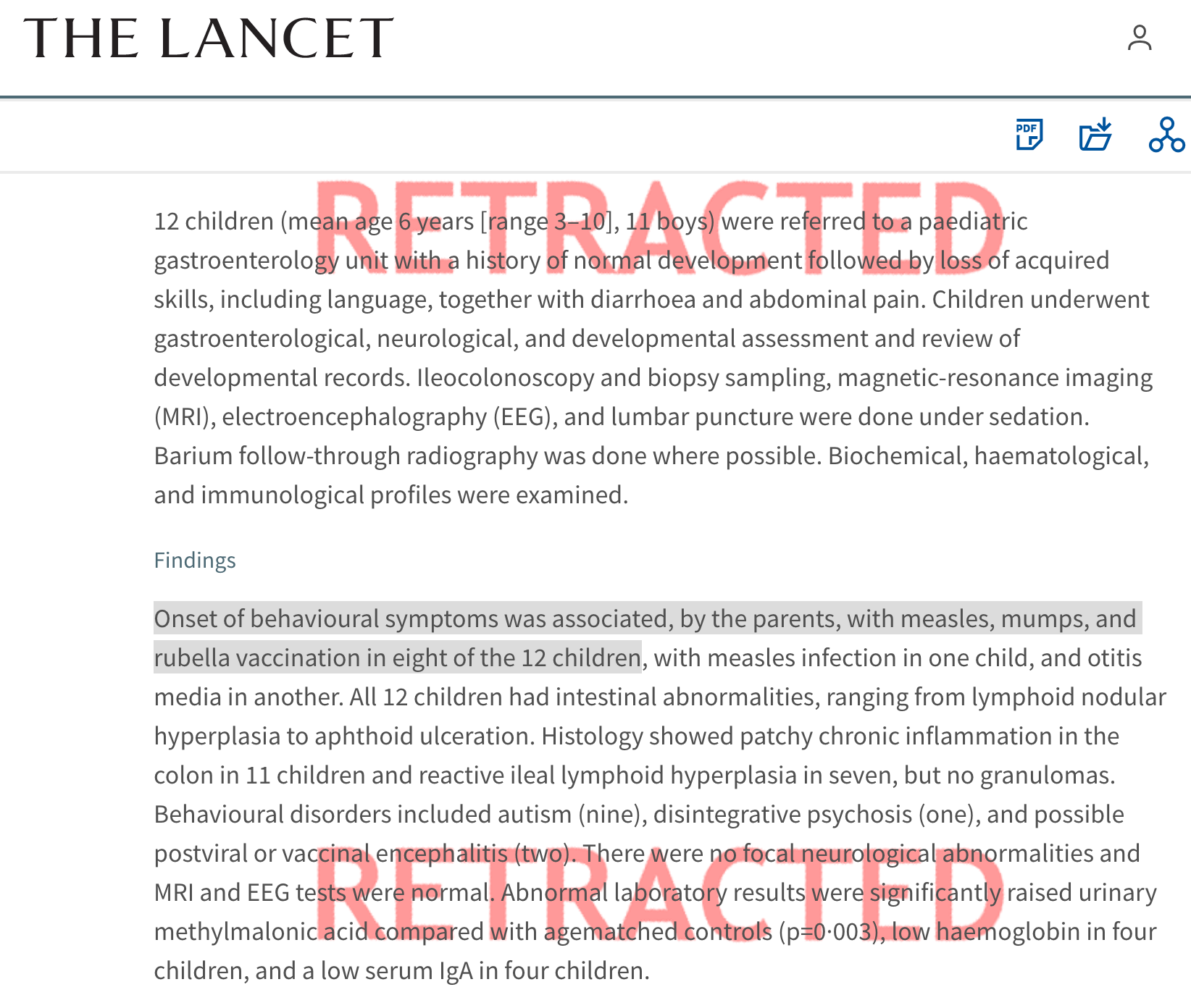
And the high crime…
The LANCET is a top tier medical journal and this is a highly cited article (>1.4k citations).
https://doi.org/10.1016/S0140-6736(97)11096-0
The red retracted was added by the journal, but the damage has been done.
MANY people know the news story of the original publication, but few know it has been retracted.
This author’s work led to a decline in vaccination rates in the United States, United Kingdom and Ireland and a corresponding rise in measles and mumps resulting in serious illness and deaths.
“A lie can travel half way around the world while the truth is putting on its shoes.” – attributed to Mark Twain but that too is a lie

Slide 40
Further Reading & Source For Python & R Software
To Explain or Predict? ( Descriptive, Predictive and Explanatory Modeling )
  https://projecteuclid.org/euclid.ss/1294167961
The Interpretation of Errors – Fredrick James (most of you use MINUIT, so please read!)
  http://seal.cern.ch/documents/minuit/mnerror.pdf
Data Analysis Textbooks
  Data Reduction and Error Analysis – Philip Bevington
  Statistical Methods in Experimental Physics – Fredrick James
  Computation Methods in Physics – Simon Širca
  Probability for Physicists – Simon Širca (https://www.springer.com/us/book/9783319316093)
Anaconda Open Source Software (https://www.anaconda.com/download)
And one of my favorites: https://en.wikipedia.org/wiki/How_to_Lie_with_Statistics
  This book shows you the lies
  Though it is old, you can see example after example that is discussed in this book on social media sites!

Slide 41
And just for fitting fun!
https://twitter.com/dwhiginbotham/status/1043837703991832577
and the source code: http://doi.org/10.5281/zenodo.1436555

Slide 42
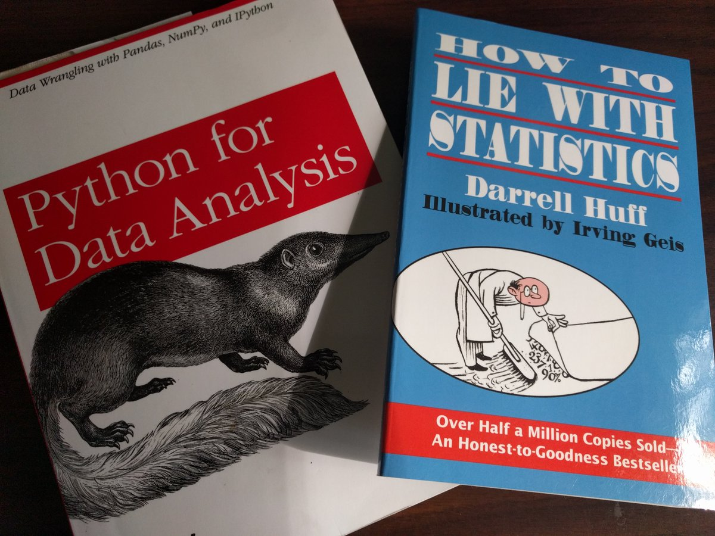

Slide 43
BACKUP SLIDES

Slide 44
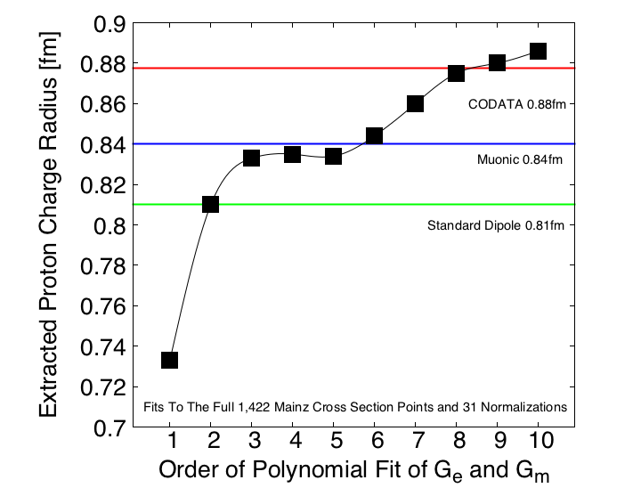
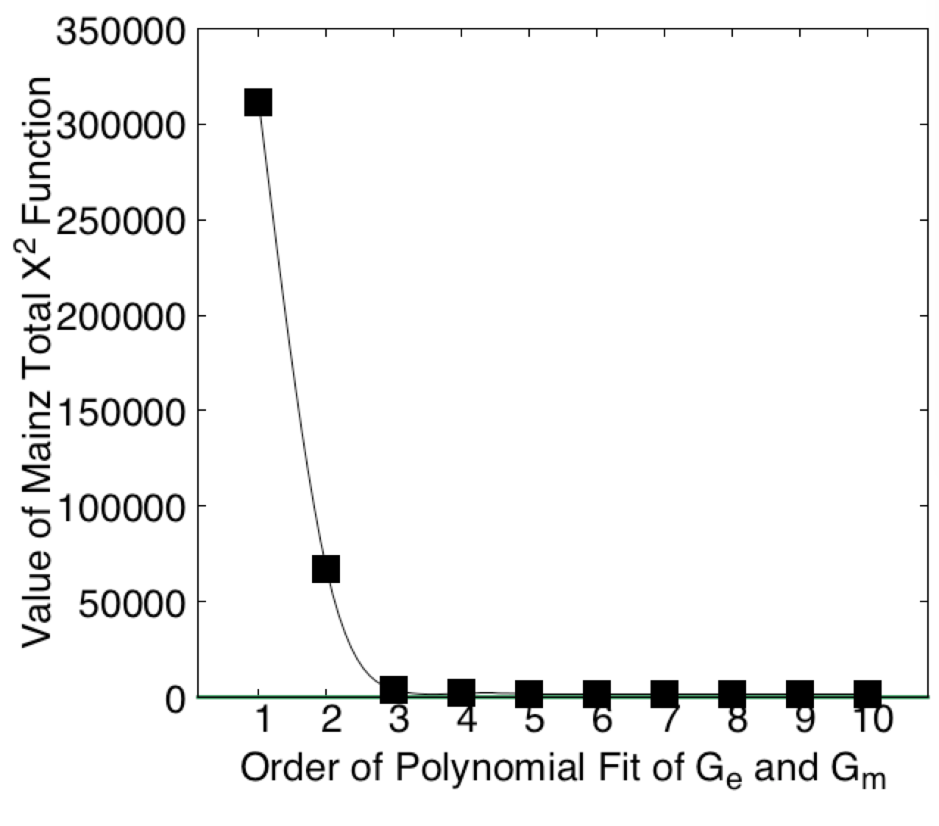
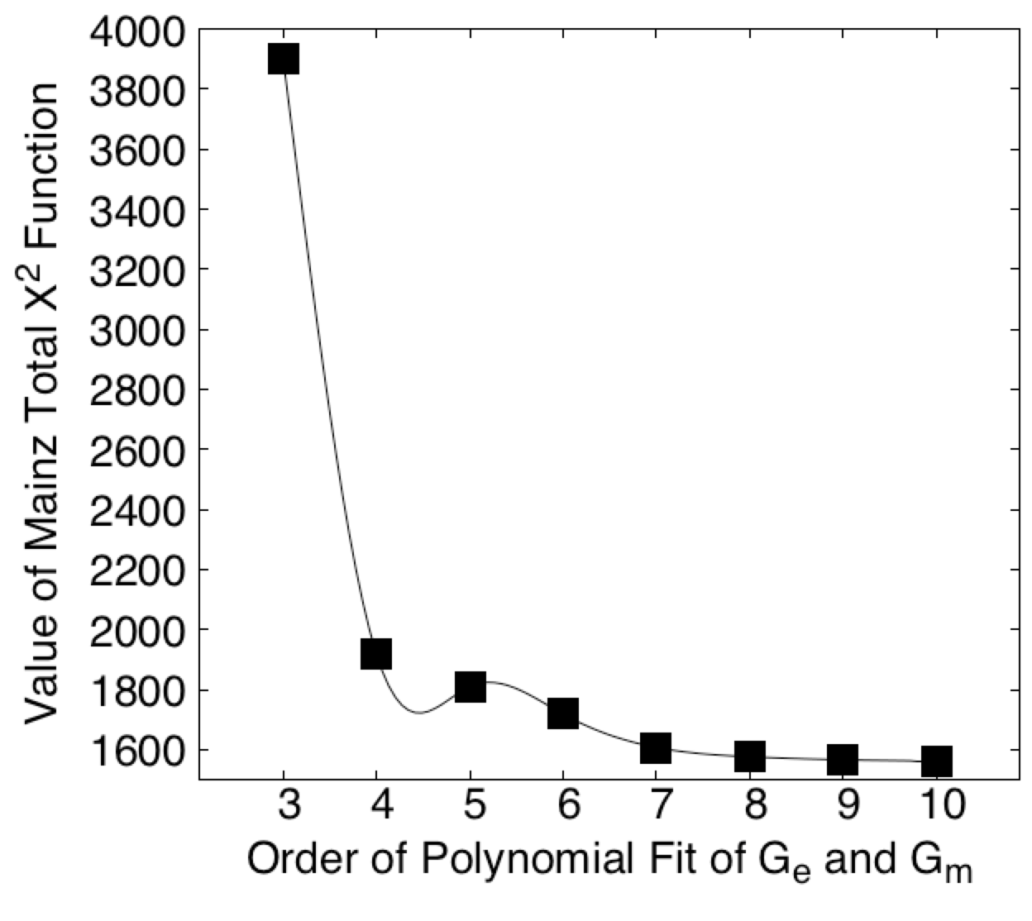
Proton Radius vs. Order of Polynomial Fits
Fits to the full 1422 points of the Mainz 2014 Data Using A Python Regression Code That Reproduces The PRC Results
Fits all include the Mainz’s 31 normalization parameters.
Even with 51 parameters (x2 10 & 31 norms) reduced chi2 never gets to unity.
If uncertainty estimates are increased by 0.001, then 4th order reduced chi2 less then unity.
( see the Dos and don’ts of chi-square - http://arxiv.org/abs/1012.3754 )

Slide 45
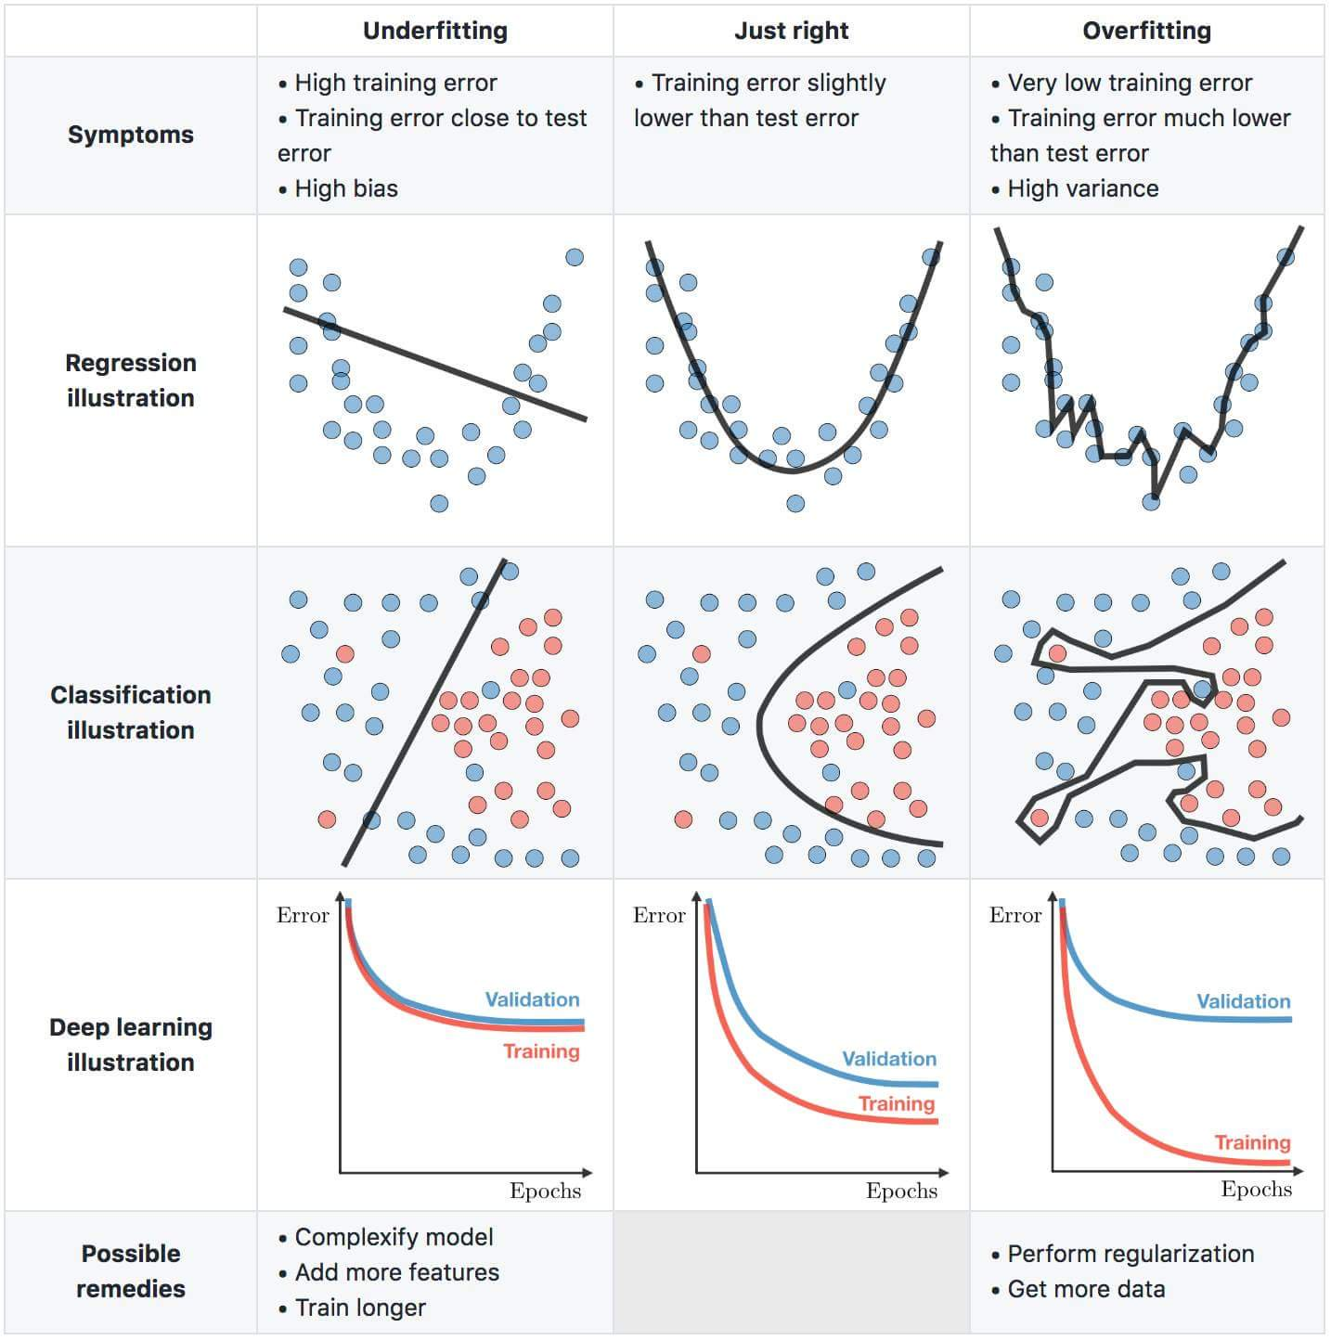
Important Concept In Machine Learning Classes

Slide 46
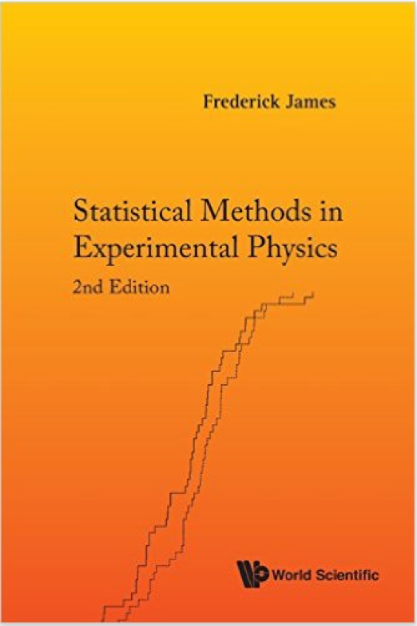
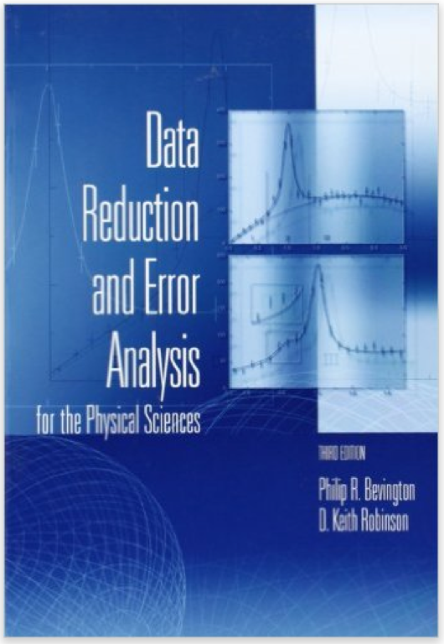
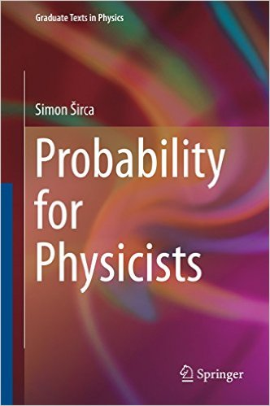

Slide 47
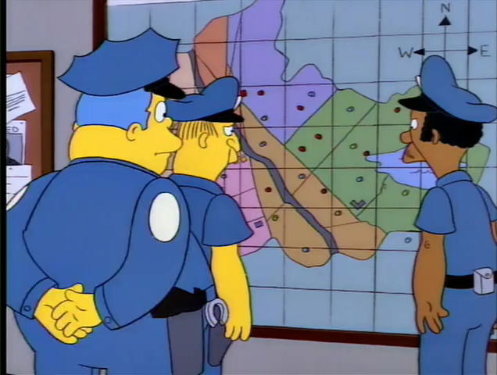
Too Many Free Parameters

Slide 48
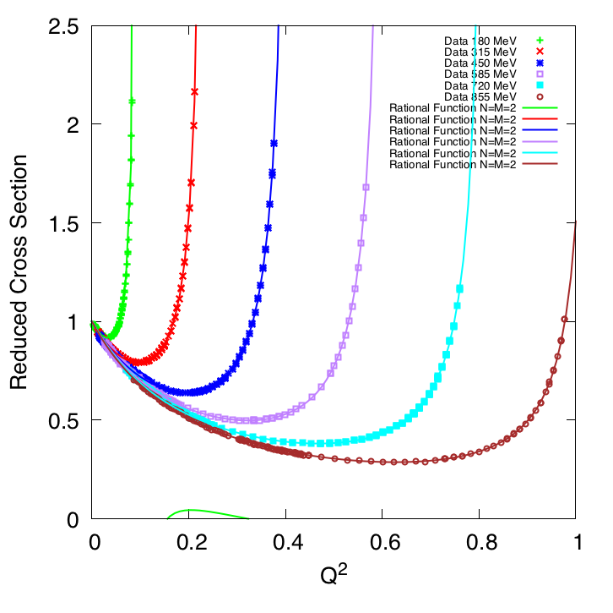
Mainz 2014 1422 Data Points Plotted vs Q²
Absolutely beautiful data!
Elastic Cross Section / Mott Cross Section
1 fm⁻²
[ GeV/c² ]
25.7 fm⁻²
NOTE: Q² = Q²(E,theta) has a kinematic max., Q²_{max}(E,180º), which these rational function fits nicely reproduce.

Slide 49
J. M. Alarcón, DWH, C. Weiss, and Zhihong Ye, Phys. Rev. C 99 (2019) 044303 an open access: https://doi.org/10.1103/PhysRevC.99.044303
49

Slide 50
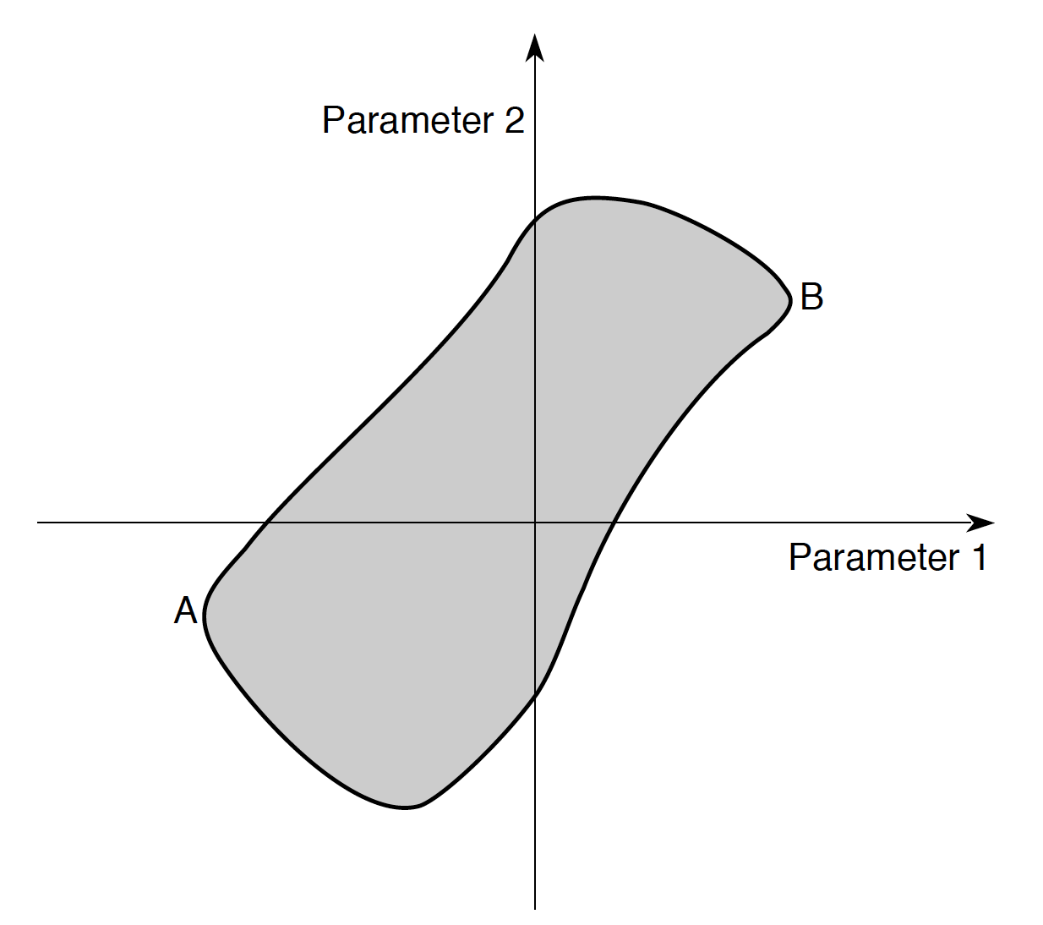
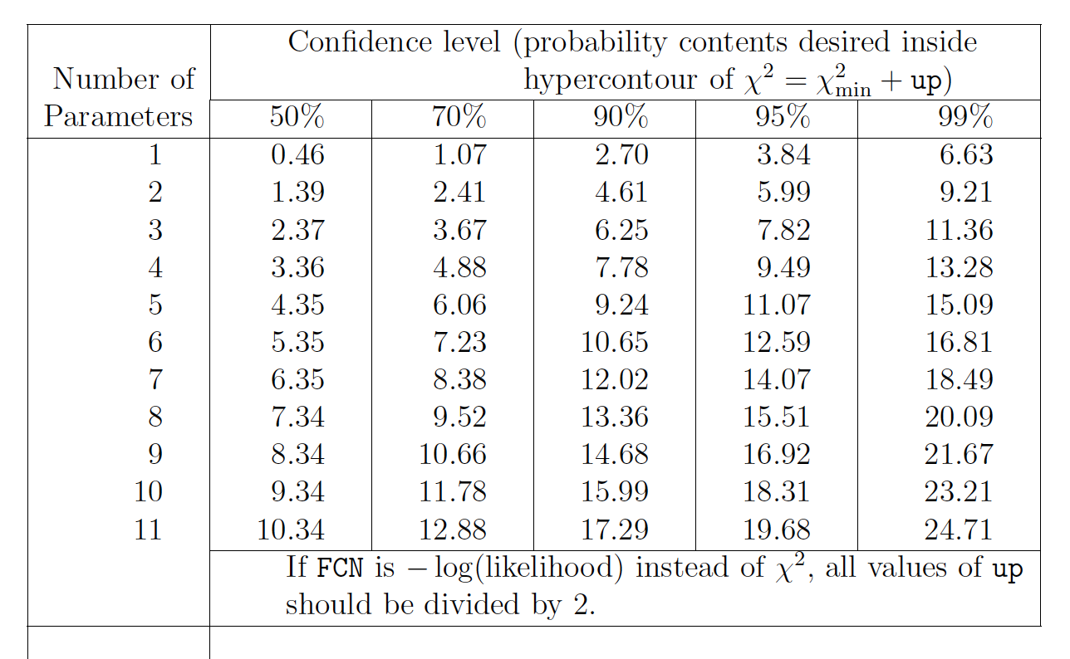
Multivariate Errors
As per the particle data handbook, one should
be using a co-variance matrix and calculating the
probably content of the hyper-contour of the
fit. Default setting of Minuit of “up”(often call Δχ2 )is one.
Also note standard Errors often underestimate true
uncertainties. (manual of gnuplot fitting has an
explicate warning about this)
The Interpretation of Errors in Minuit (2004 by James)
http://seal.cern.ch/documents/minuit/mnerror.pdf
In ROOT: SetDefaultErrorDef(real #)
Default is 1 and doesn’t change unless you change it!
USE PICKING A COIN EXAMPLE

Slide 51



This discussion can also be found in PDG book
http://pdg.lbl.gov/2014/reviews/rpp2014-rev-statistics.pdf page 29
Rectangular confidence region for parameter 1 & 2
Optimal Confidence Region
( this is only a 39% CL )
Confidence region for parameter 1
( shown for 68% CL )
THNK CAREFULLY ABOUT WHAT YOUR FIT IS DOING AND DON’T JUST BLINDLY USE THE DEFAULTS

