Slide 1


TracePro Modeling and Design of a Laser Calibration System for the ePIC pfRICH Detector
Zakia Sultana Tithi(MSU)
Wenliang Bill Li (MSU)
Azmoun Bob (BNL)

Slide 2
Presentation Overview
Introduce the pfRICH detector and laser calibration system goals
Explain the laser system configuration and optical coverage
Describe TracePro modeling approach and irradiance mapping
Outline future improvements using TracePro simulations
Summarize key conclusions

Slide 3
Introduction to pfRICH:
The pfRICH laser detector is an in-situ pulsed UV laser calibration system that delivers light via fibers and diffusers to the pfRICH photosensors, ensuring sub-100 ps timing precision and uniform light-yield.​
Objective Of the Laser based calibration system​
Verify uniform light coverage across sensor disk
​
Cross-check single-photoelectron timing (<100 ps)​
Track long-term stability: gain &timing drifts​
​

Slide 4
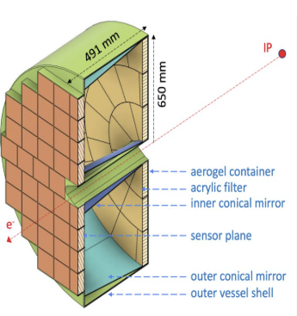
Configuration Of pfRICH Laser :​
Aerogel radiator tiles​
​
Inner & outer truncated-cone mirror segments​
Circular photosensor array​
​
Acrylic UV-blocking filter​
​
Fast timing readout electronics​
​
Figure 1: pfRICH detector layout

Slide 5
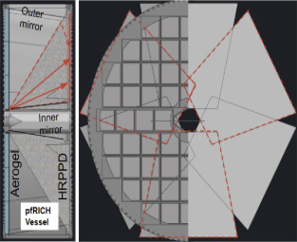
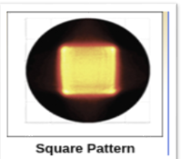
Optical Coverage Map​
Six 50° square-engineered diffusers around the detector edge​
Square diffusers produce broad, uniform beams in both axes​
Overlapping light cones ensure full sensor-area illumination​
Direct illumination only—no mirror reflections needed for calibration​
Fiber splitter network delivers equal laser pulses to each diffuser​
​

Slide 7
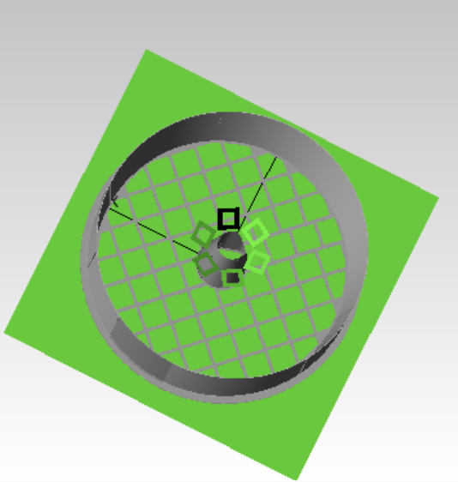
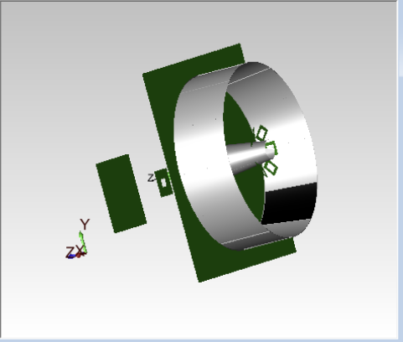
TracePro Modeling & Irradiance Mapping​
Imported full pfRICH geometry: aerogel, diffusers, mirrors & sensor plane​
​
Set the diffuser light spread to 50 ° in square pattern
​
Ran ray‐trace to generate irradiance heat-maps at the sensor plane​
​
Overlaid simulated coverage on measured irradiance graph​
Mirror cone
Diffusers
Fig : Importing pfRICH geometry

Slide 8
Validating the Model & Saving Time:
​
​
Make sure the virtual version matches reality​
​
Catch any dark spots or hot patches in software​
​
Skip extra prototypes and speed up construction​
​

Slide 9
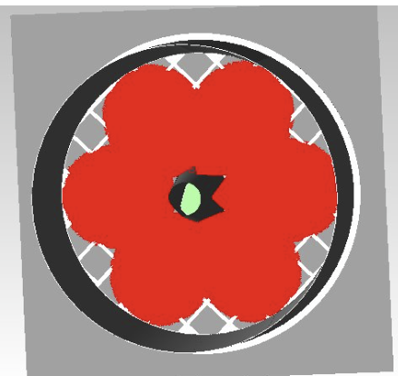
Array of 6 Tilted Fiber Sources: ​
Six fiber sources with 50° flat-top diffusers
Tips tilted at 24.23° for overlap
This setup adequately covers the active area

Slide 10
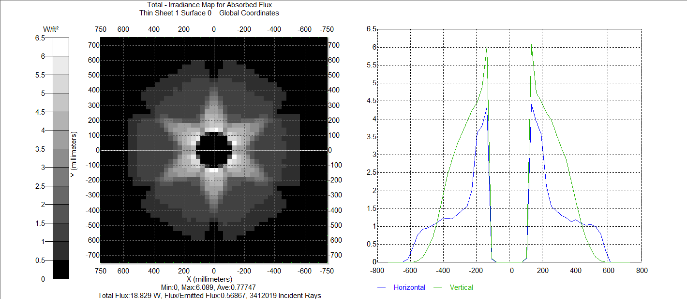
Irradiance Map Profile :​
Heat map (left) shows absorbed light distribution across sensor plane
Lighter areas represent higher irradiance
Star-shaped pattern from overlapping light cones of six square diffusers
Graph (right) displays horizontal and vertical irradiance profiles through sensor center
Profiles peak near center and gradually drop toward edges
Confirms effective and fairly uniform illumination at 24.23° diffuser tilt
Fig : Irradiance profile (24.23°)

Slide 11
Exploring “What-If” Scenarios :​
Change one setting at a time (diffuser angle, light split, filter thickness)​
​
Let the software redraw the light pattern for each case​
​
Quickly see which option lights the whole disk most evenly​
​

Slide 12
Angle Scan: Irradiance Patterns​
Angles tested: 0°, ±5°​
​
Heat‐map overlay: shows shift in bright/dark zones​
​
Uniformity metric: best at +5° tilt​
​
Hotspot check: minimal at optimal angle​
​

Slide 13
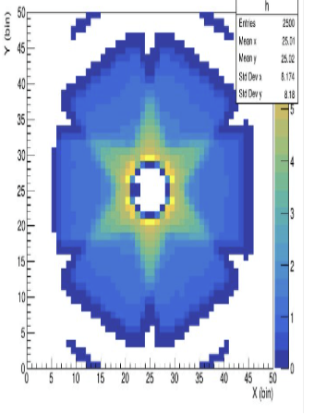
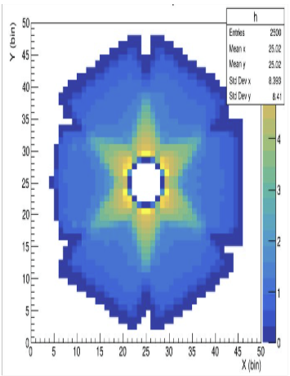
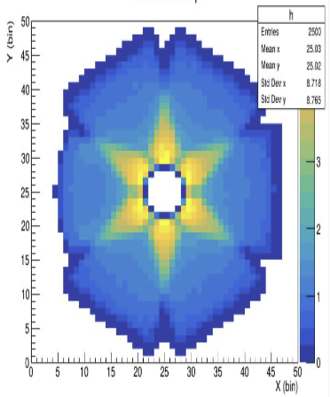
Analysis and Optimal Angle Selection :
Result of angle change
19.23°
24.23°
29.23°
19.23° shows uneven illumination with noticeable dark zones
24.23° provides the most uniform light coverage and minimal hotspots
29.23° introduces some bright hotspots, reducing uniformity

Slide 14
Sensitivity & Reliability Analysis :
Perform multiple simulations with randomized variations in key parameters
Parameters include diffuser angle, light intensity, material properties, alignment errors
Assess how variations affect irradiance uniformity and sensor coverage
Identify critical parameters with the highest impact on system performance
Evaluate design robustness against real-world uncertainties and manufacturing tolerances
Guide design improvements and tolerance specifications based on simulation insights

Slide 15
Conclusion :
Developed a TracePro optical model for the pfRICH laser calibration system
Simulated irradiance patterns for various diffuser tilt angles to optimize uniform sensor coverage
Validated design approach by comparing simulations with measured light maps
Identified 29.23° as the optimal diffuser angle for covering more photosensor area.

Slide 16
Future Directions with TracePro Modeling
Detailed geometry modeling: include sensor edges, mounts, cable shadows for realism
Material property refinement: use accurate wavelength-dependent optical data
Polarization effects: simulate light polarization impact on sensor response
Time-resolved simulations: model laser pulse timing and photon arrival jitter
Thermal effects: incorporate temperature-dependent optical property changes

