Slide 1
Pushing Boundaries in Accelerator Physics: A Decade of R&D at Jefferson Lab
07/10/2025
Gabriel Palacios Serrano
Gabrielp@jlab.org

Slide 2
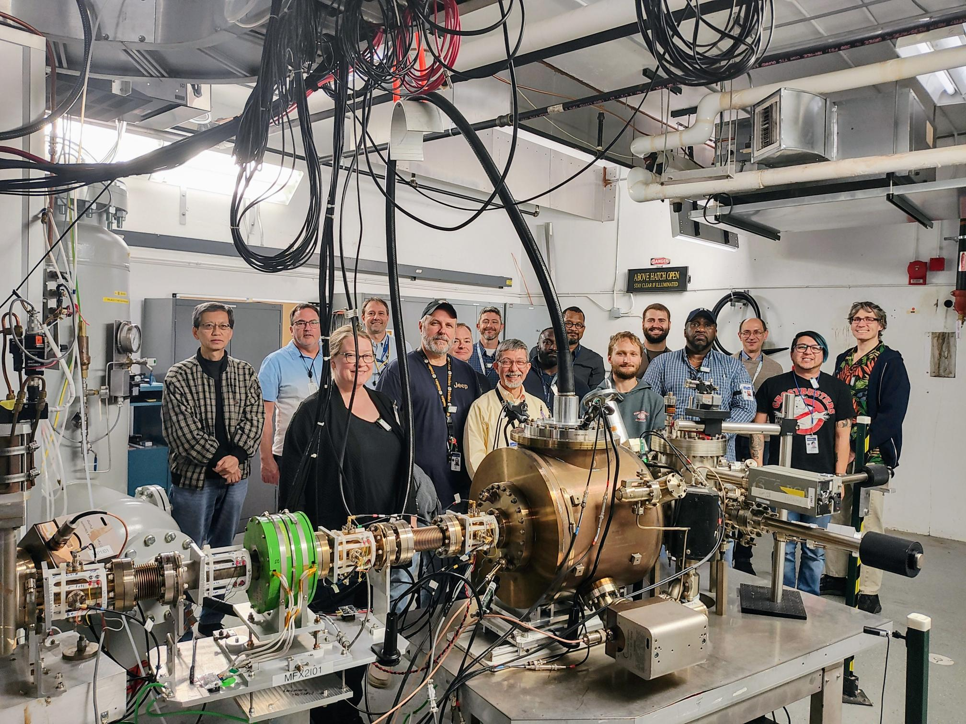
Summary
Introduction
Motivation
Devices
Challenges
Methodology
Solutions
Side quests
Acknowledgements
The end
It takes a village!

Slide 3
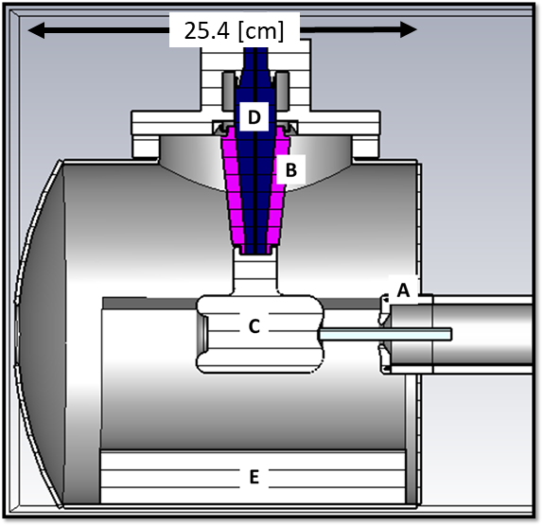
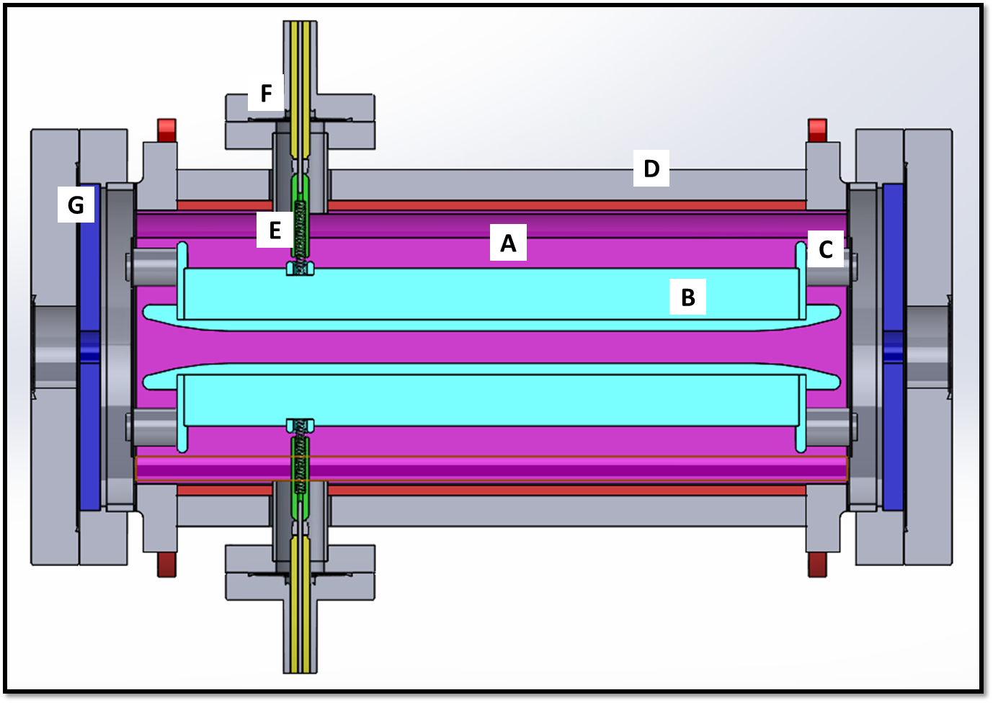
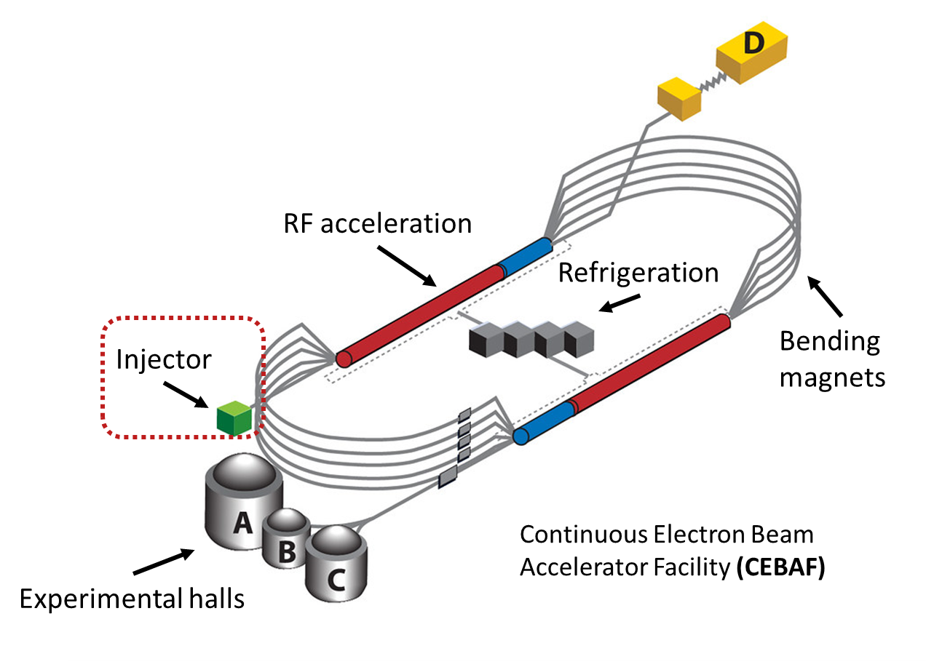
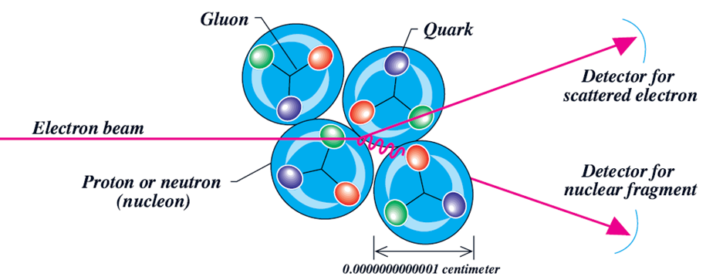
Introduction: Photogun and Wien spin rotation
Wien spin rotator
polarization
Laser
e-beam
42 [cm]
Polarized photoelectron gun

Slide 4
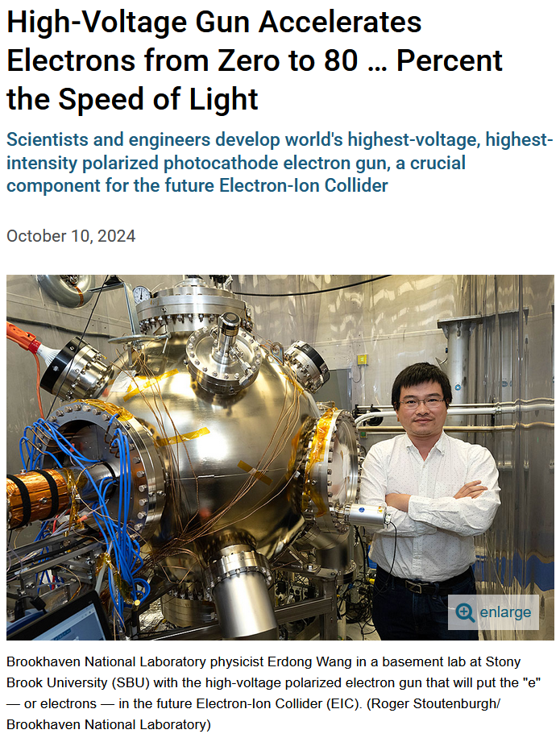
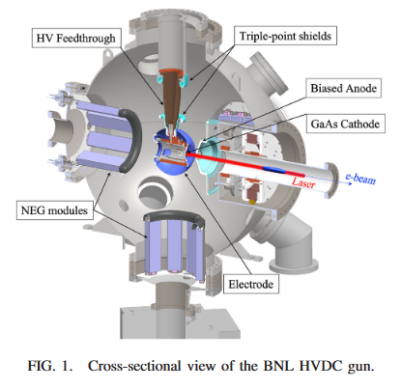
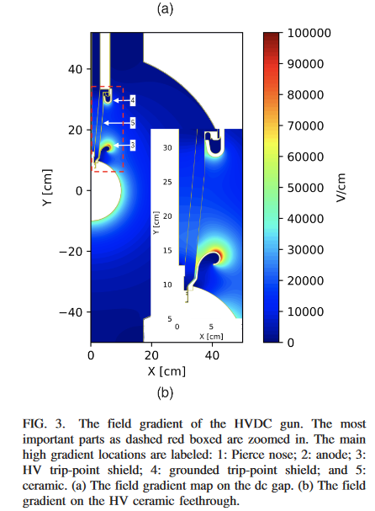
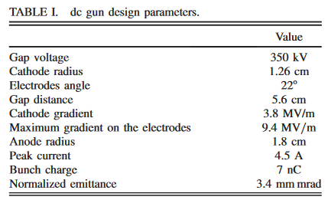
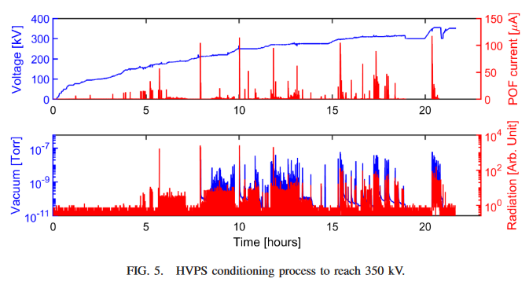
Introduction: The bigger EIC picture
ERDONG WANG et al. PHYS. REV. ACCEL. BEAMS 25, 033401 (2022)

Slide 5
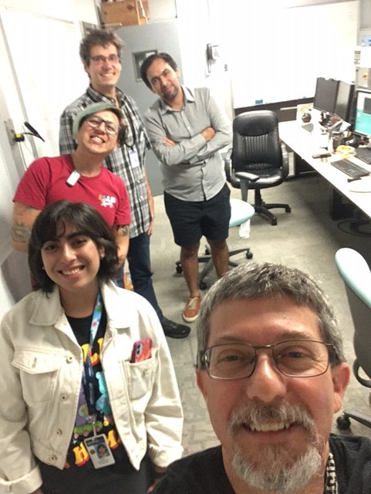
Introduction: The importance of outreach
Accelerator Physics Education Outreach with Mexican Universities
Program sponsored by Jefferson Science Associates (JSA).
Cristhian Valerio (Summer 2009)
The program's first participant, now an assistant professor at the University of Sinaloa and a longtime JLab collaborator.
Max Bruker, JLab staff scientist
Gabriel Palacios (Summer 2013)
JLab staff scientist
Valeria Ramirez (Summer 2022)
Fulbright, UVA graduate student 2023
Carlos Hernandez-Garcia
JLab senior scientist
UITF Control Room, JLab (Summer 2022)

Slide 6
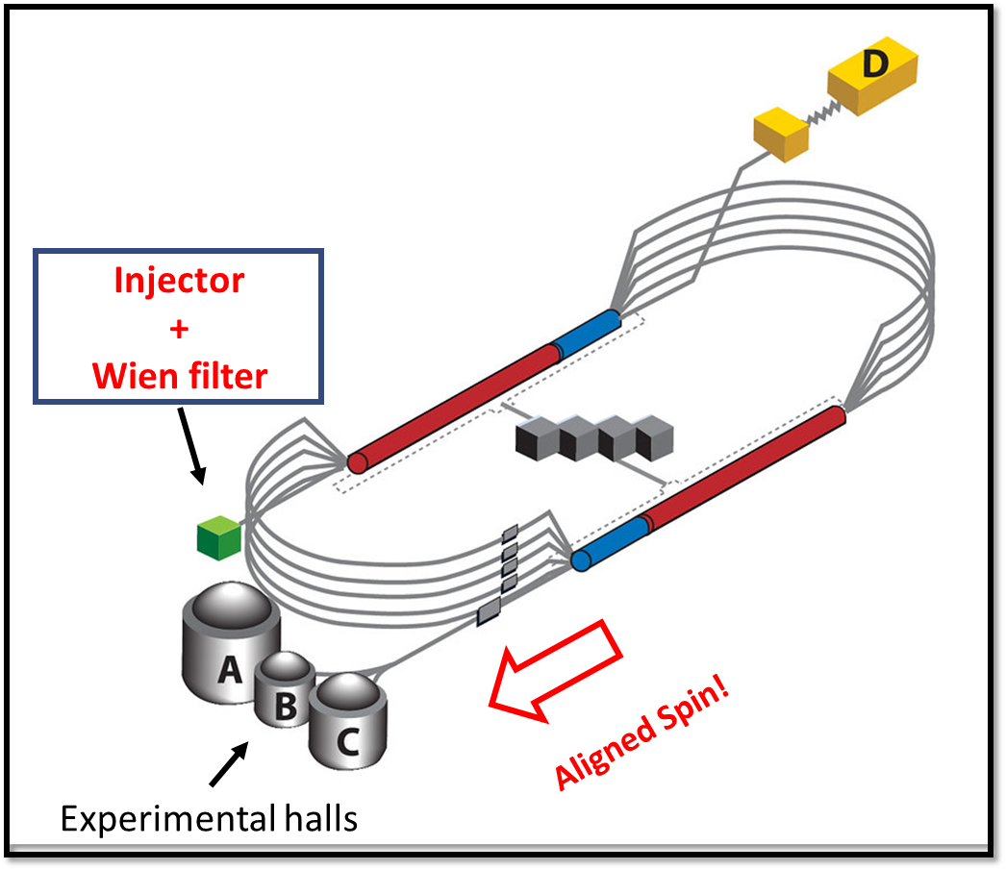
Motivation: More and more voltage!
Objective: Upgrade the Jefferson Lab Continuous Electron Beam Accelerator Facility (CEBAF) polarized photoelectron source with compatible spin rotator from 130 keV to 200 keV.
Why?*:
  parity-violating electron scattering experiments
  discovering the quark structure of nuclei
  understanding the spin and flavor dependence of valence parton distributions
  And discover the three dimensional structure of nuclei by measuring generalized parton distributions with high precision.
Challenges (stay tunned):
  Higher voltage
  field emission
  Arcing
  insulator failure
  vacuum degradation
  beam quality
  unwanted photoemission
  photocathode damage
  catastrophic device failure!
Thomas Jefferson Nation Accelerator Facility (2019)
Photogun
+
Wien spin rotator
5.5 pass, 12 GeV, 90% polarization
2X 7/8 mi (1.4 km) Linacs plus recirculating arcs
* P. A. Adderley, et al. The Continuous Electron Beam Accelerator Facility at 12 GeV. Phys. Rev. Accel. Beams 27, 084802 – Published 15 August, 2024

Slide 7
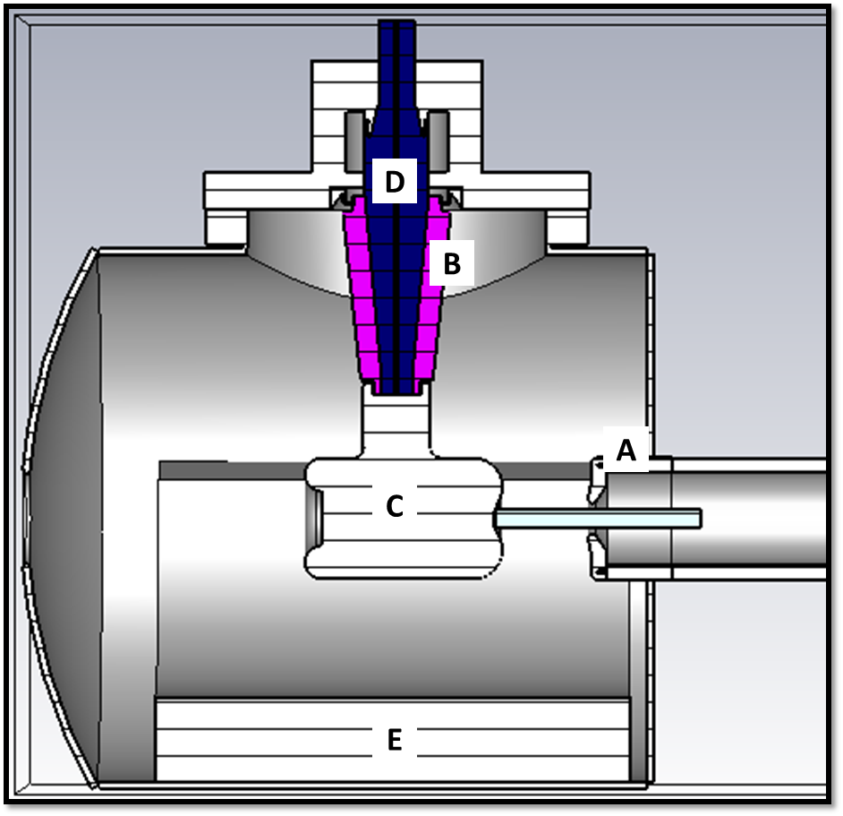
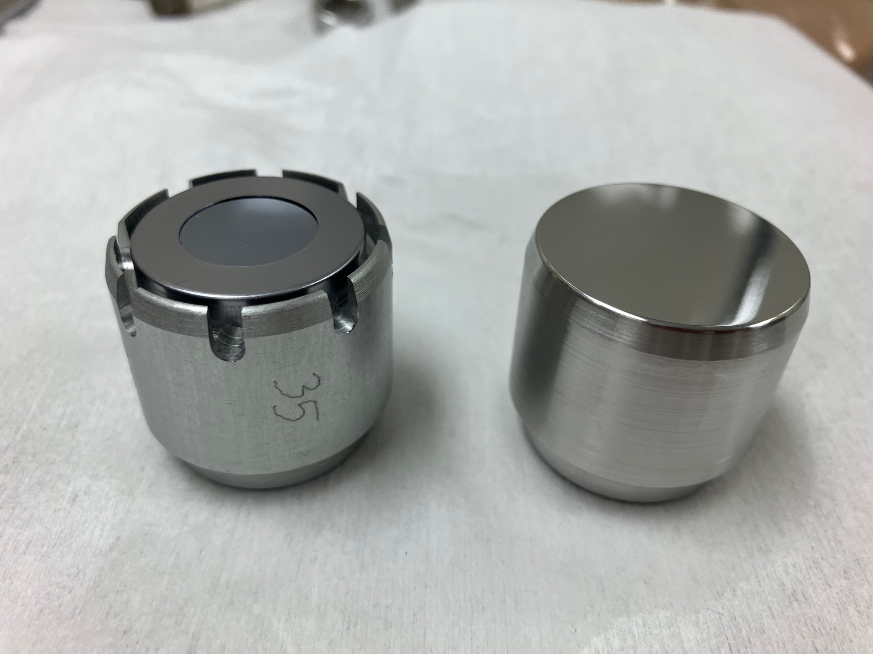
Devices: Polarized photoelectron gun
The polarized electron beam is produced by illuminating a GaAs photocathode mounted on the biased electrode inside a vacuum enclosure.
The increased bias produces cathode regions with undesirably high electric field, prone to field emission that can lead to arcing or even catastrophic failure of the device. An “electrostatic shield” is implemented to address these issues.
25.4 [cm]
Laser
e-beam
Longitudinal cross section of the previous CEBAF photogun with un-doped ceramic insulator. Vacuum chamber with (A) anode structure, (B) tapered ceramic insulators with (C) cathode electrode attached. HV conductor surrounded with (D) vulcanized rubber, (E) grounded non-evaporable getter vacuum pumps.
GaAs Photocathode holder “Puck”

Slide 8
Devices: Wien spin rotator
In the Wien filter, mutually orthogonal homogeneous electric and magnetic fields rotate the spin polarization angle of the electrons (with orthogonal velocity to the applied fields) that traverse the device axis longitudinally.
The existing Wien filter spin rotator must be modified to ensure compatibility with higher beam energy, increasing its operating bias, but preventing field emission and beam trajectory modifications
polarization
e-beam
42 [cm]
E
Longitudinal cross-section of the existing 130 keV Wien filter with (A) vacuum chamber, (B) electrode plates, (C) mounting insulators, (D) magnetic shield, (E) spring guide, (F) HV feedthrough, and (G) magnetic mirrors.
v
B

Slide 9
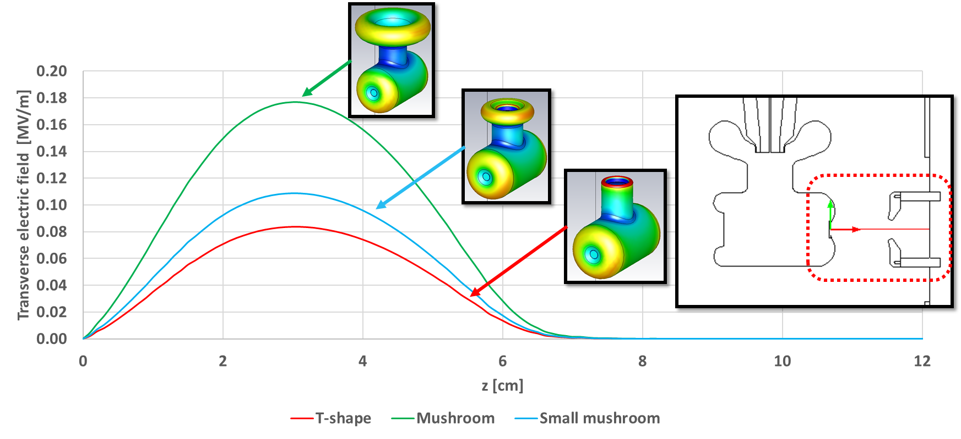
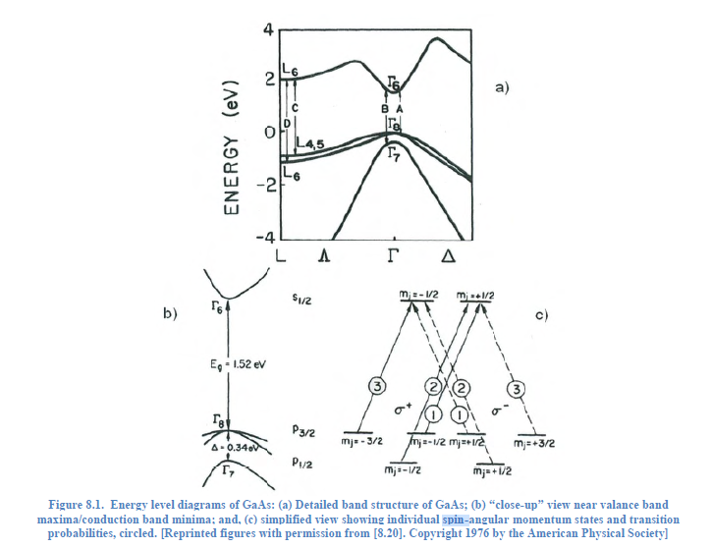
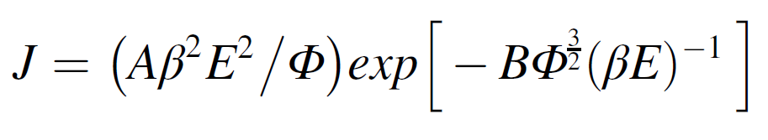
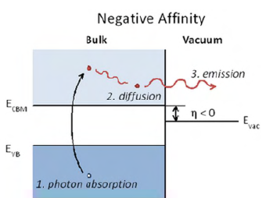
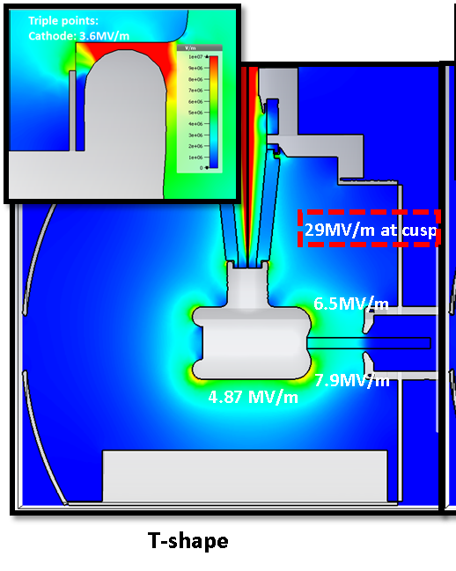
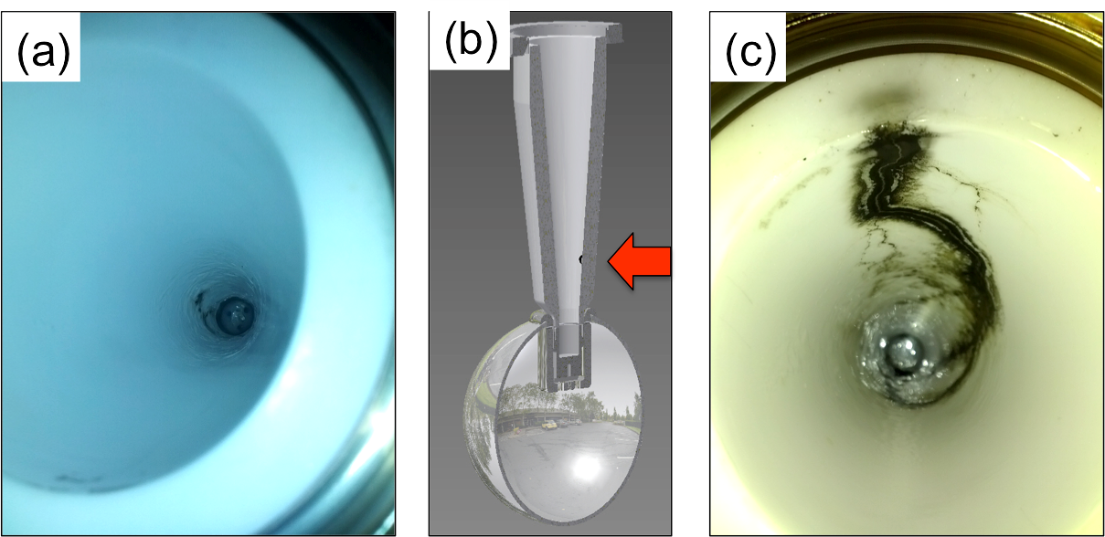
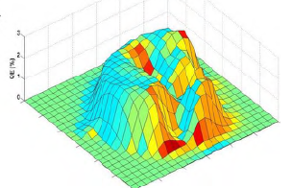
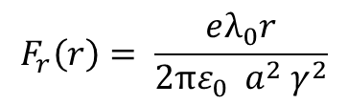
Challenges: Photogun
Field emission, Fowler-Nordheim:
Space charge:
An Engineering Guide To Photoinjectors
Triveni Rao, David H. Dowell
$$F_{r}\left(r\right)= \frac{eλ_{0}r}{{2πε_{0} a}^{2} γ^{2}}$$
Photoemission and back-bombardment:
And also spin!
C. Hernandez-Garcia, et al., IEEE Transactions on Dielectrics and Electrical Insulation Vol. 23, No. 1; February 2016

Slide 10
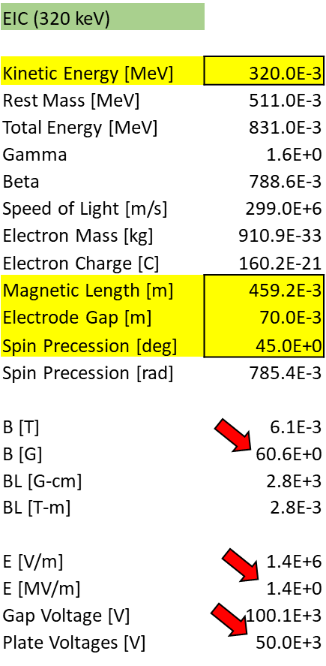
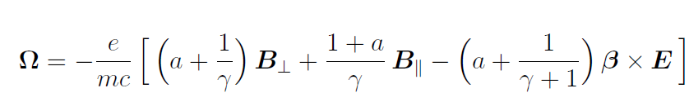
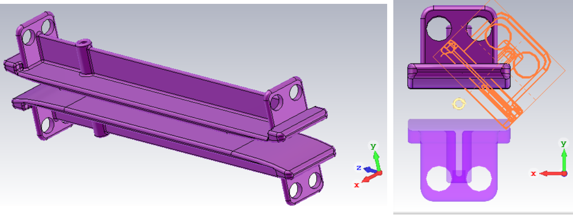
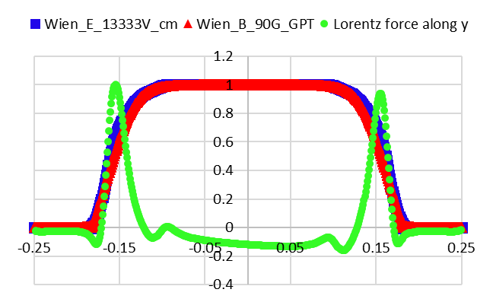



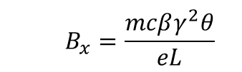
Challenges: Wien spin rotator
Thomas-BMT describes the spin change with respect to time:
$\frac{ds}{dt}=s×$ $\text{Ω}$
(!)
So, the angle of rotation:
In our case:
Plus the equilibrium condition:
$$q \left(E+v×B\right)=0$$
That preserves: $E_{y}=− v_{z} B_{x}$
  $$B_{x}=\frac{mcβγ^{2}θ}{eL}$$
$$where Ω=\frac{dθ}{dt}$$

Slide 11
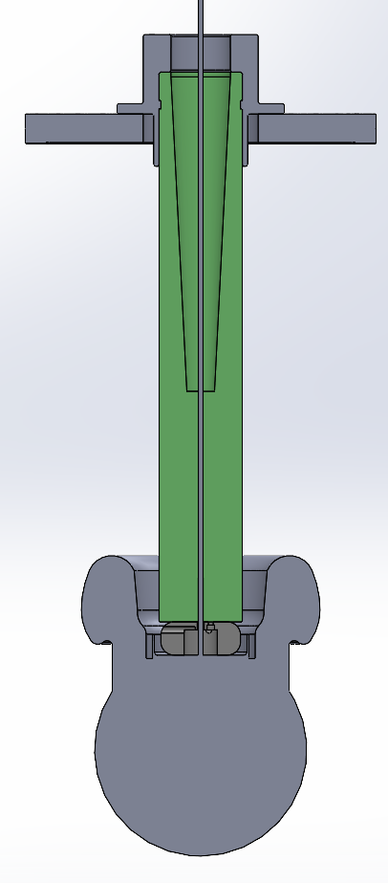
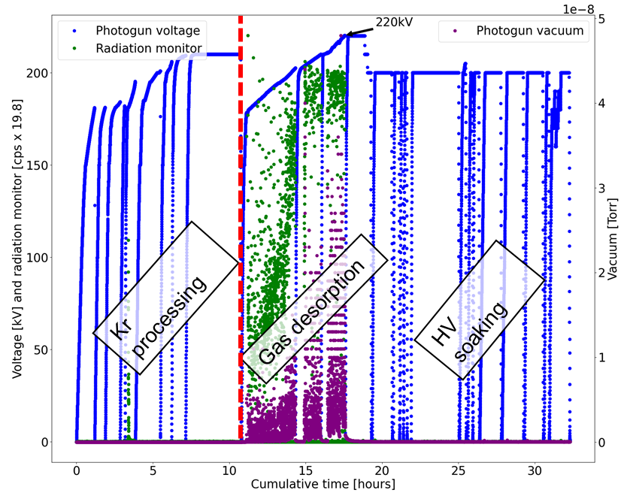
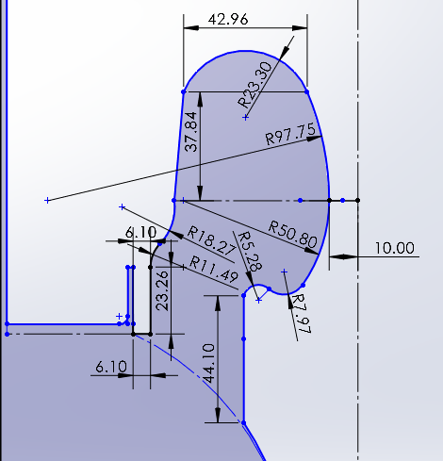
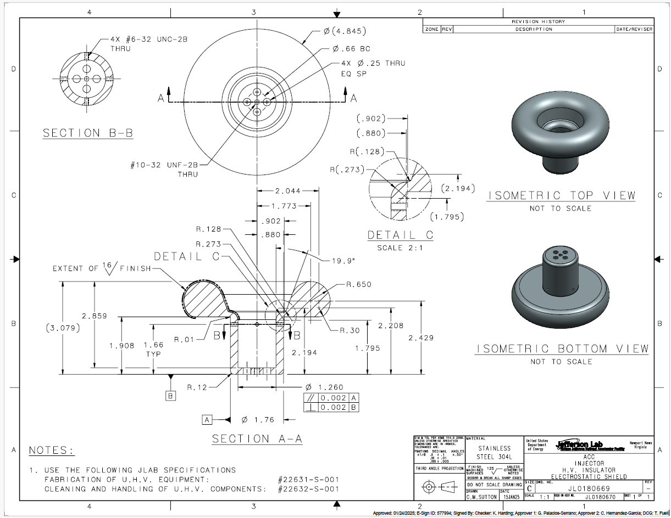
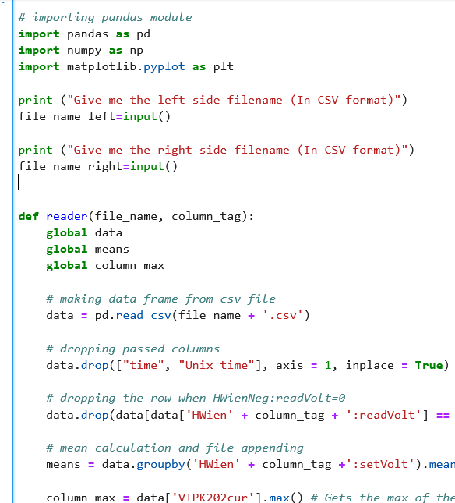
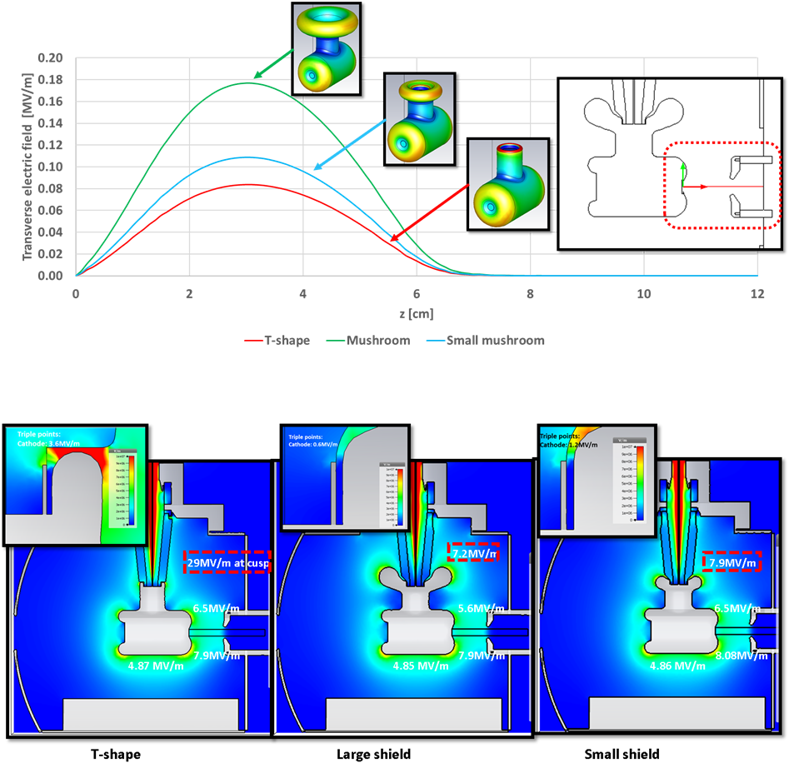
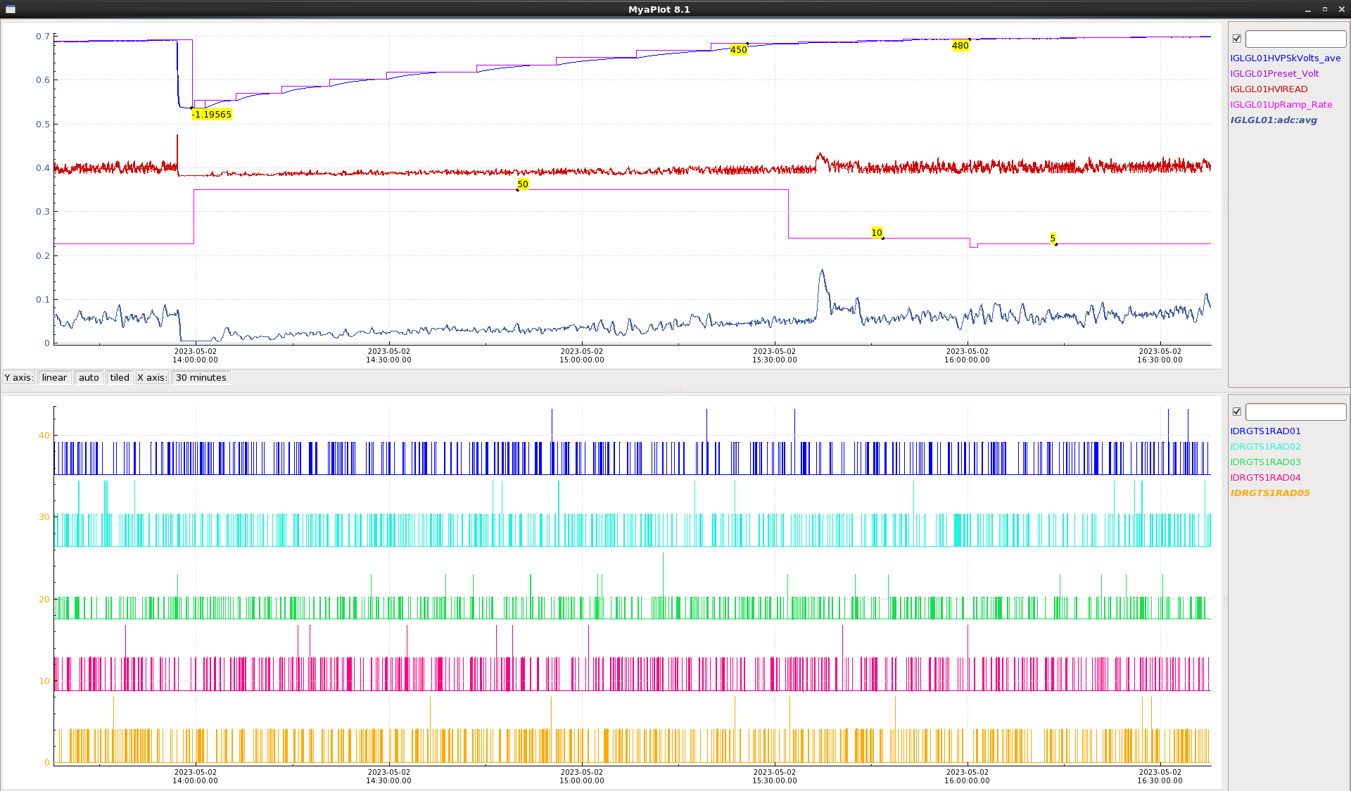

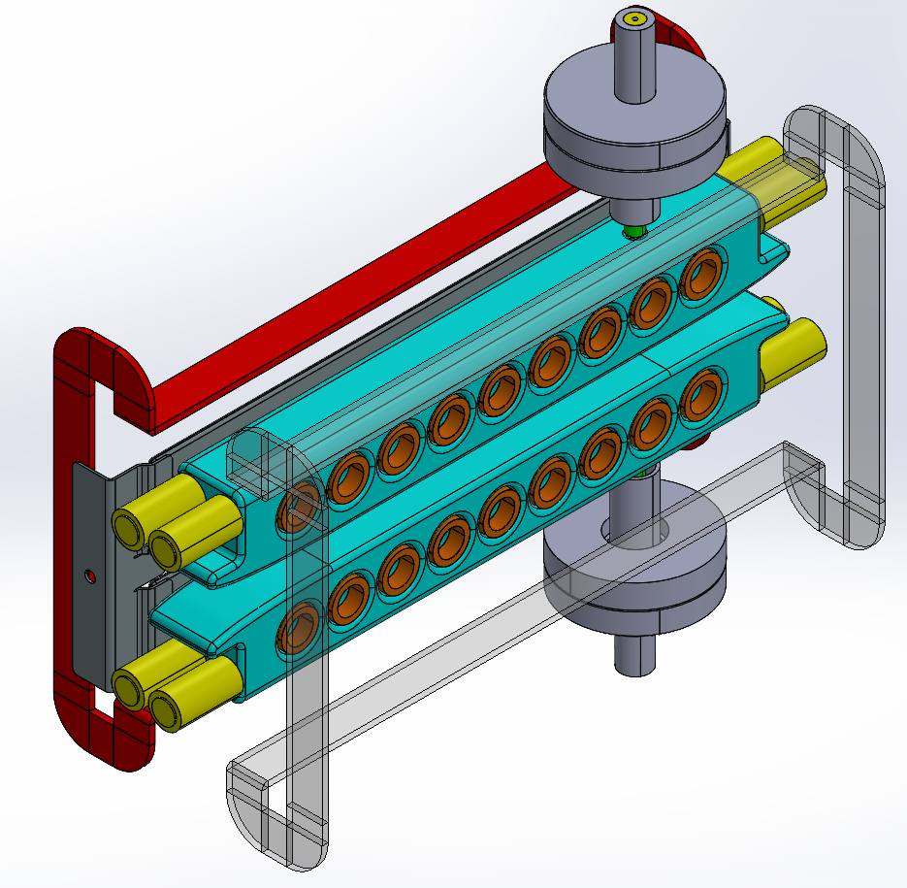
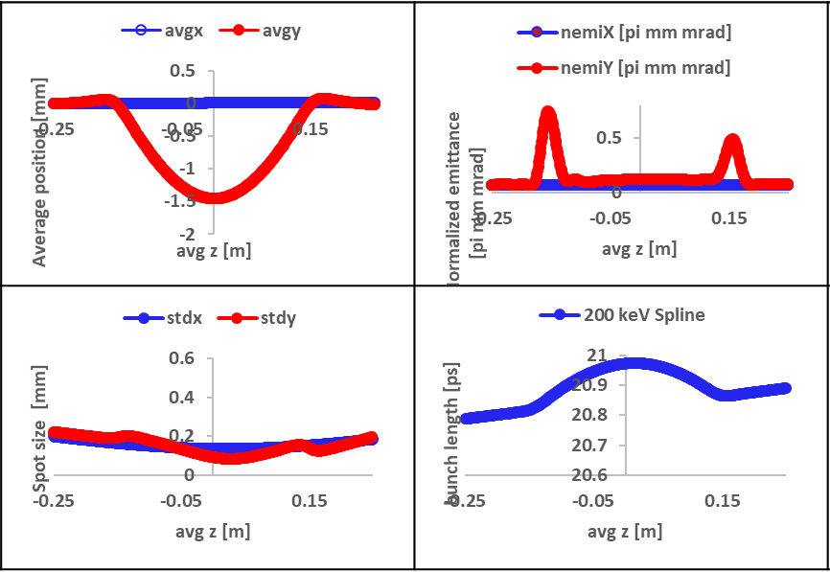
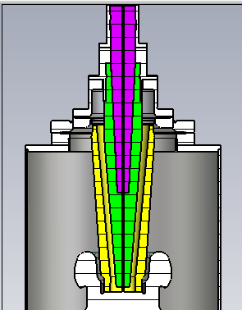
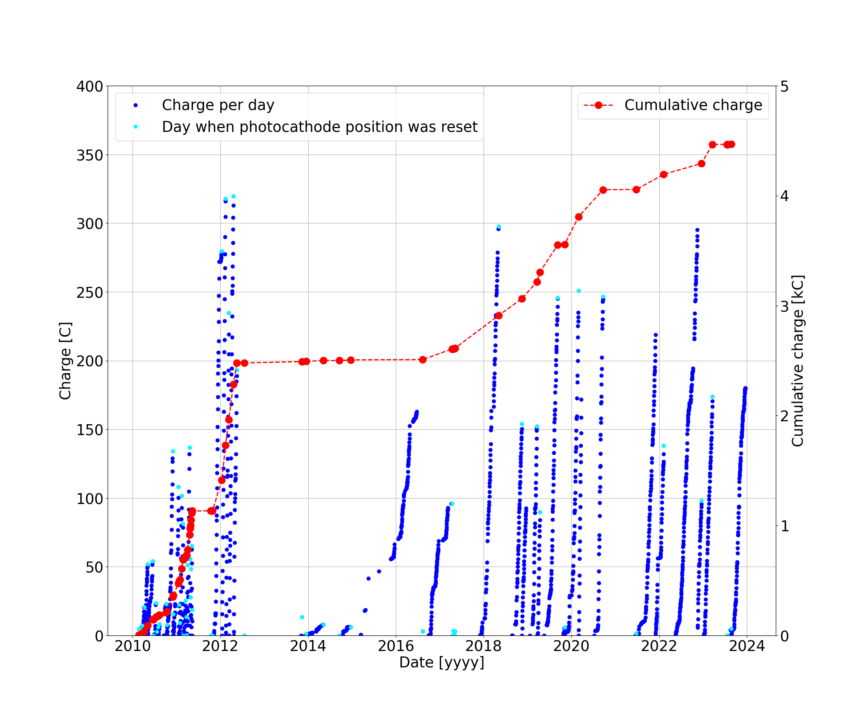
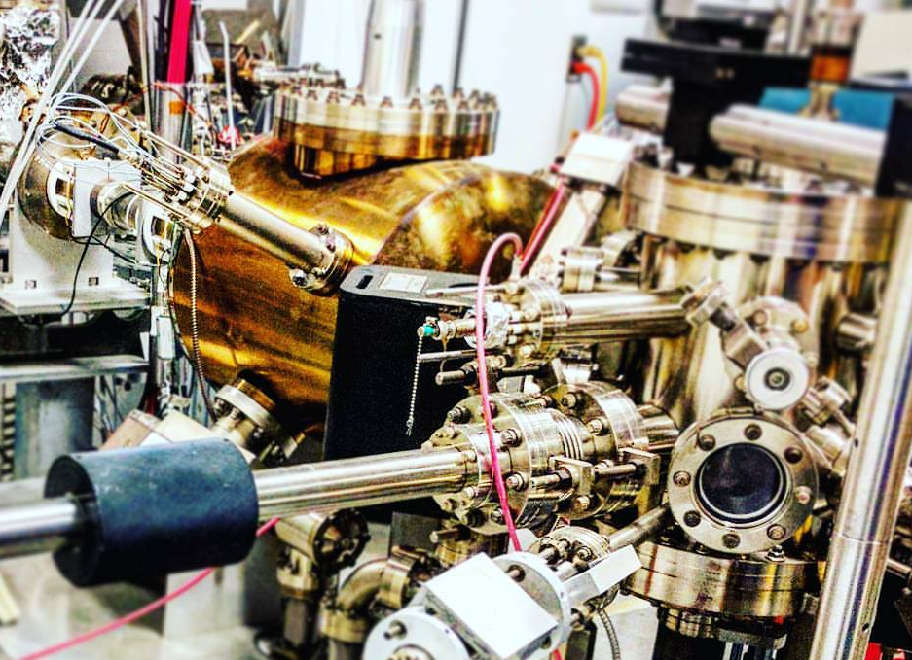
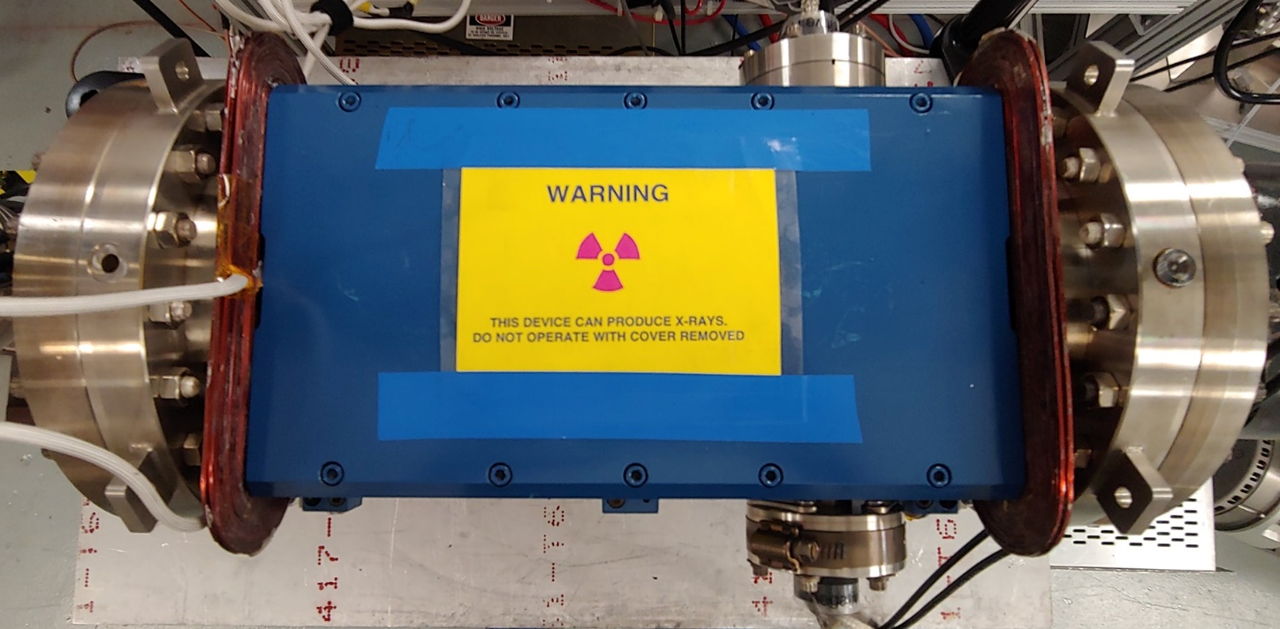
Methodology
Modeling and design
Simulations
Data processing and analysis
Hardware implementation
High Voltage evaluation
Data processing and analysis
Final device

Slide 12
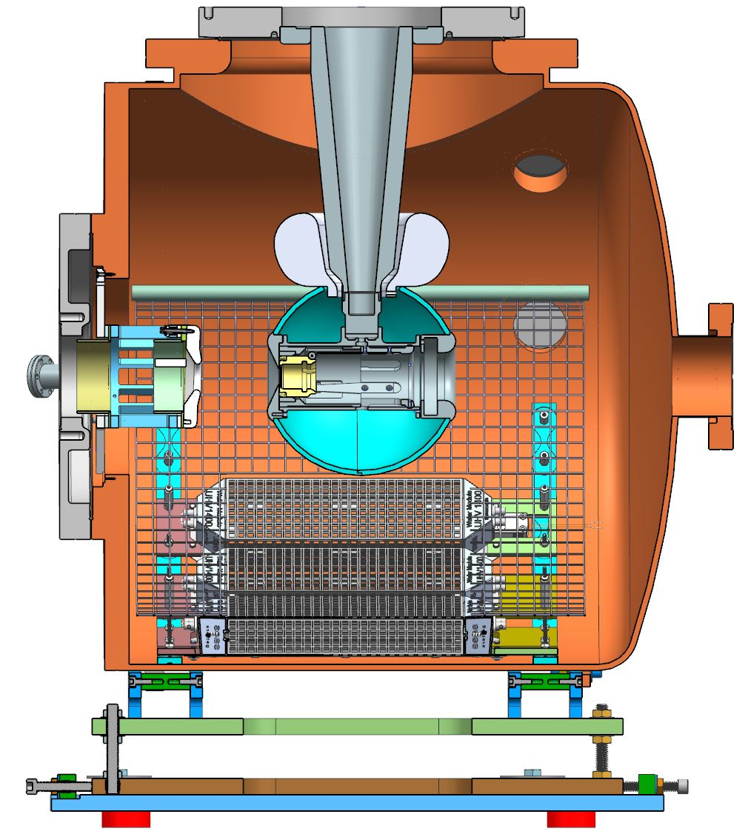
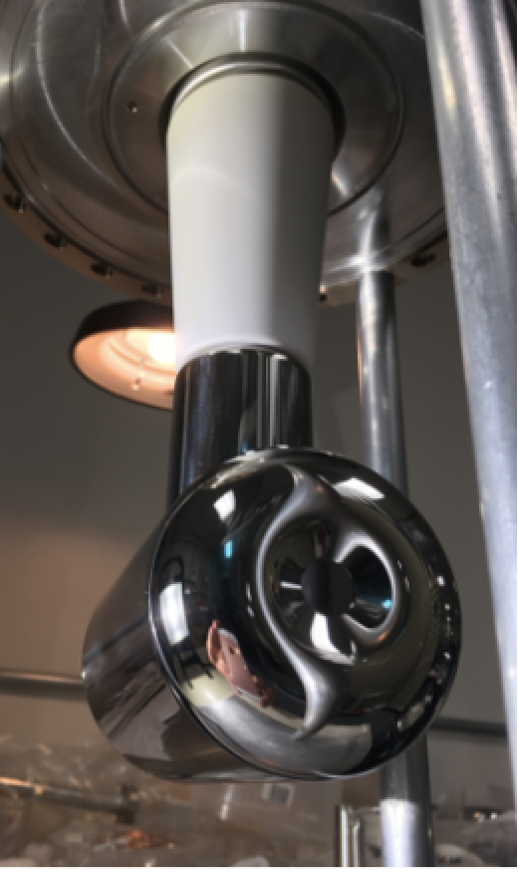
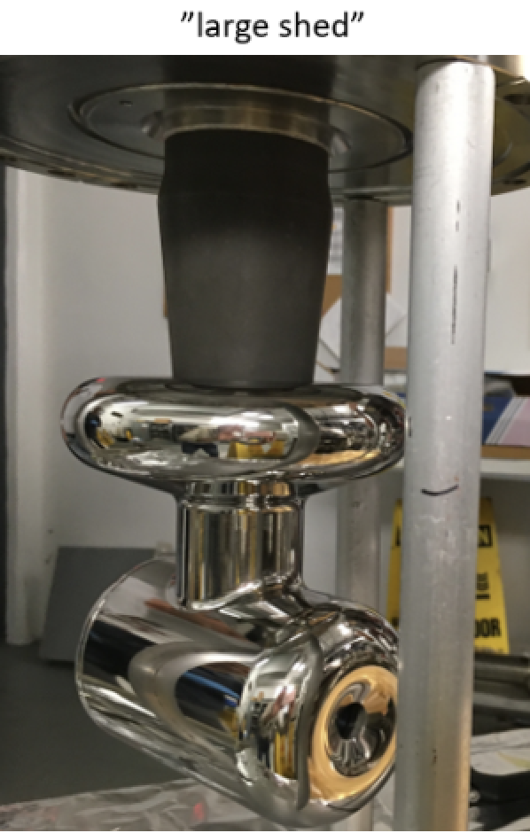
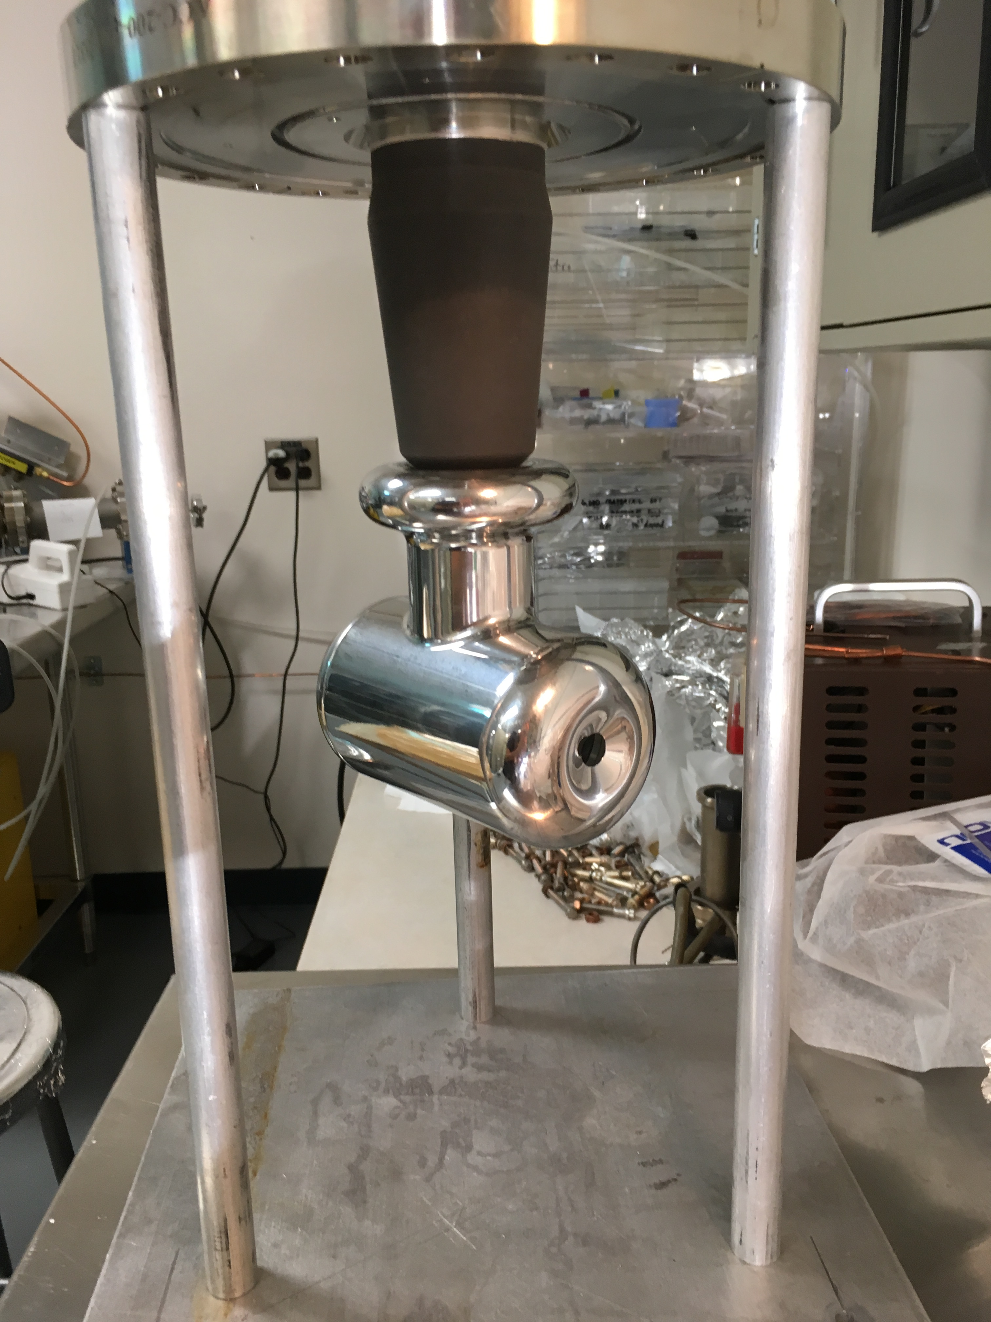
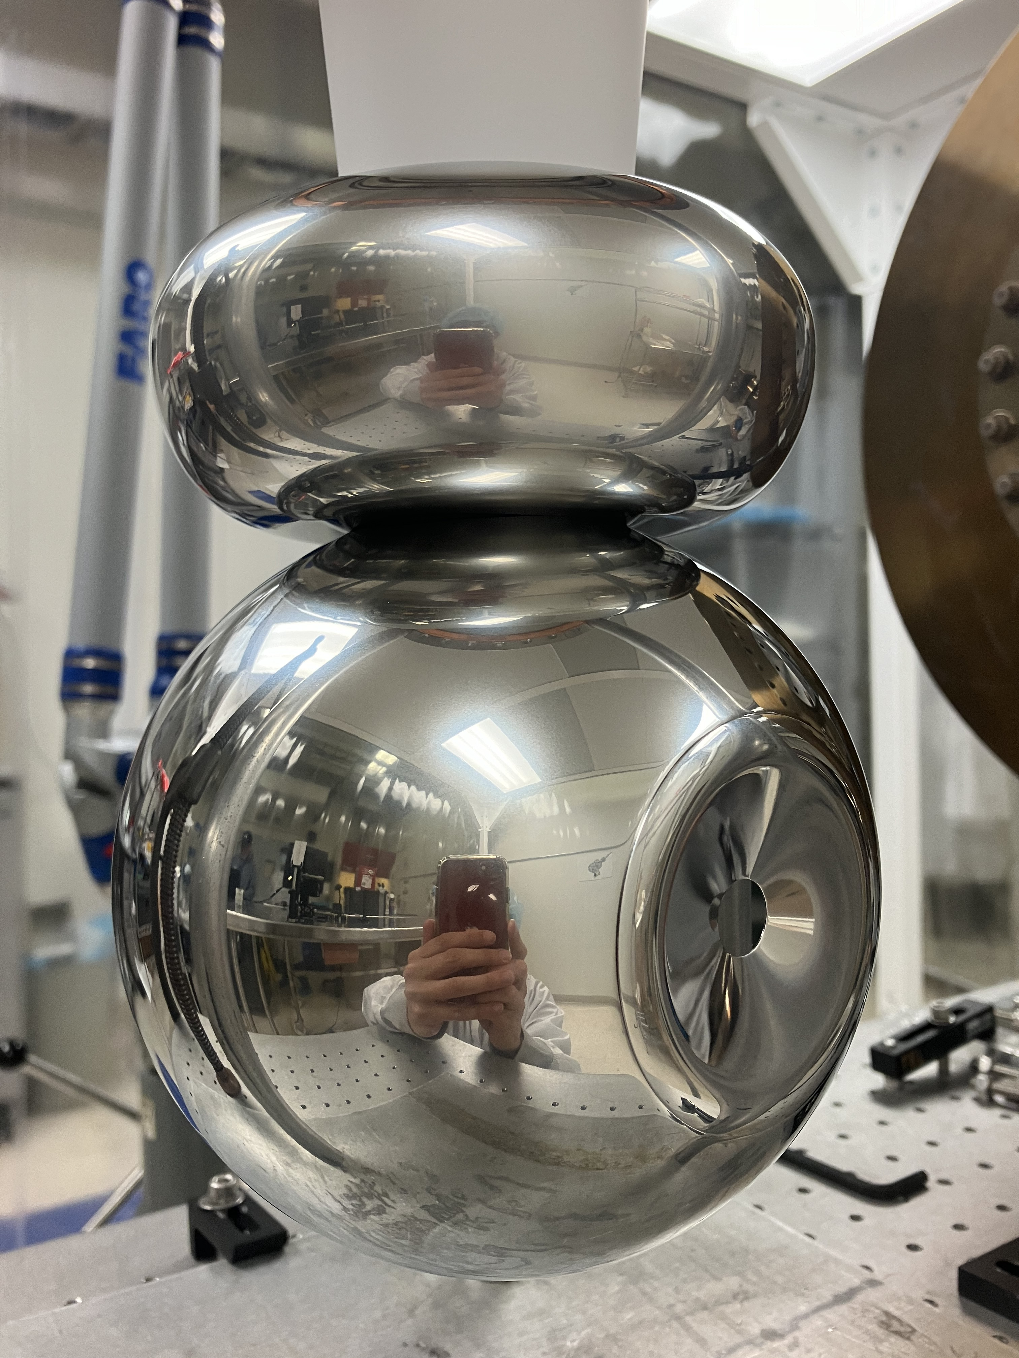
Solutions: 200 keV R30-4 photogun
2011-2018
2018-19
9/2019
2025
Tee no shed
Large shed
Small shed
R30-4
Model made by JLab ME group
200 keV “R30-4” CEBAF photogun 3D model cross-section

Slide 13
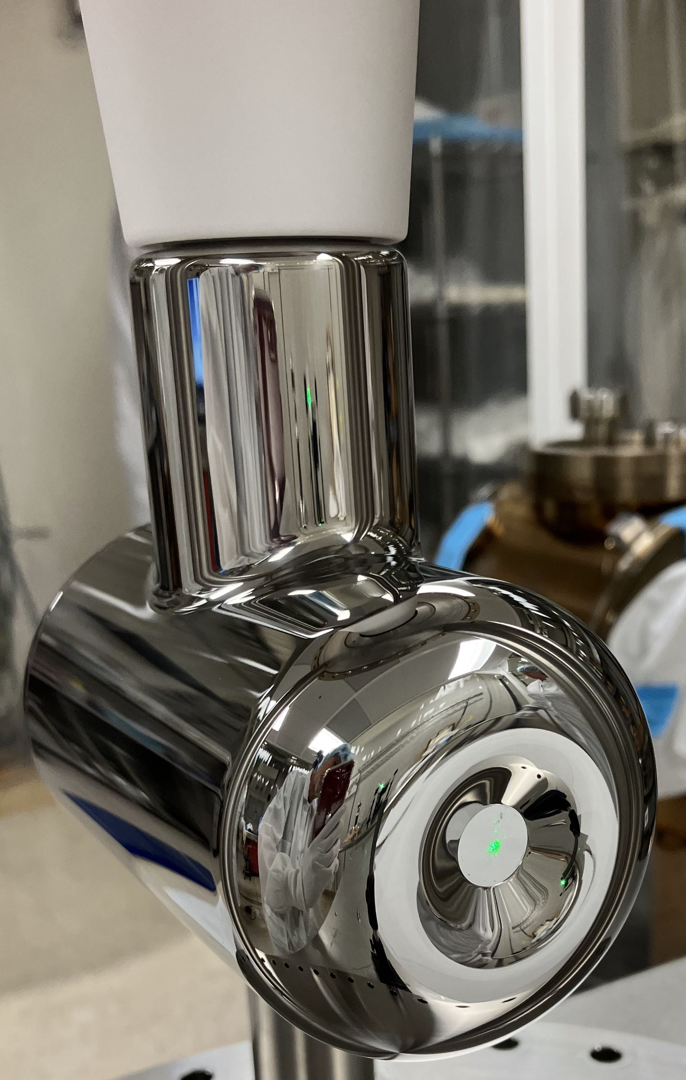
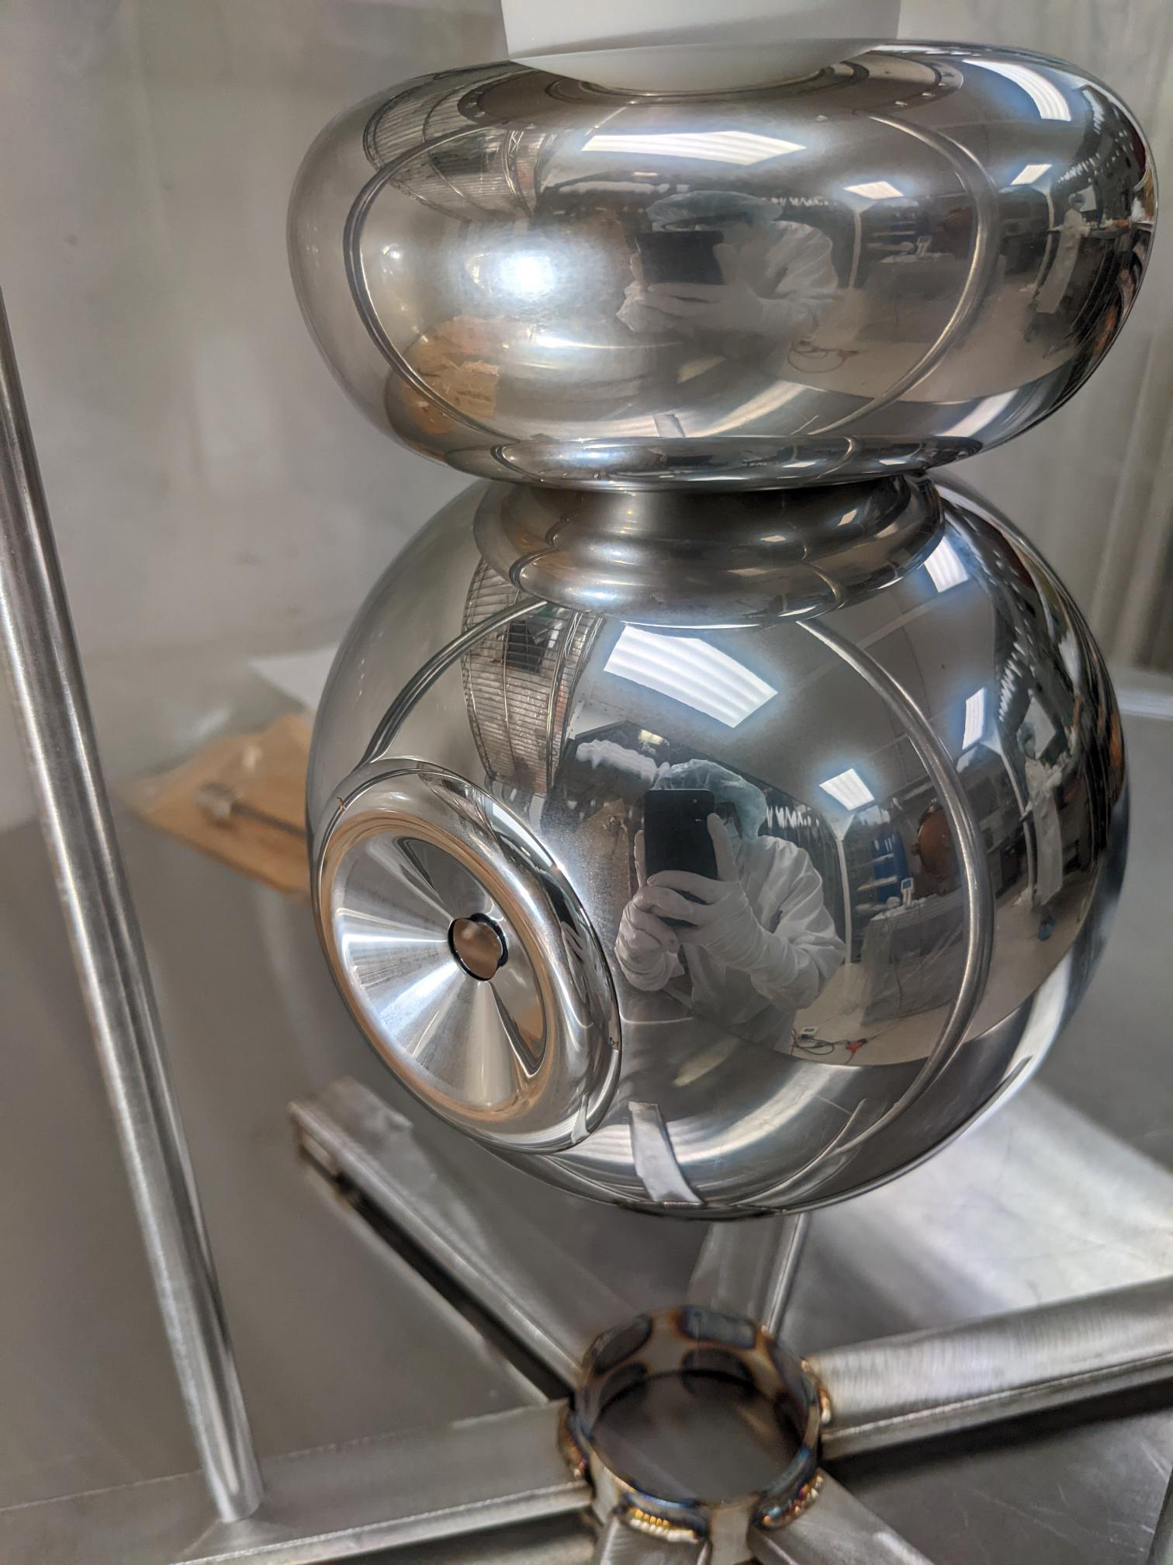
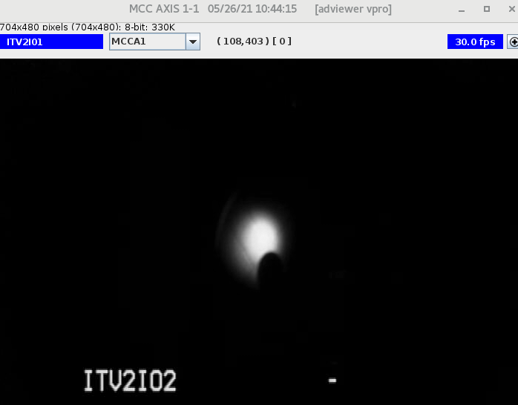
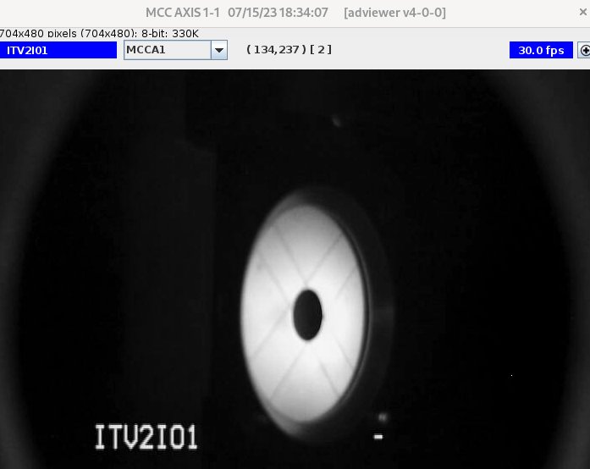

Solutions: 200 keV photogun
  R28 gun
  R30-3 gun
  R30-4 gun
25˚ focusing
electrode
25˚ focusing
electrode
16˚ focusing
electrode
  130 keV beam May-26-2021
  200 keV beam Jul-15-2023
  200 keV beam Aug-30-2024
MFX2I01 turned off
MFX2I01 turned off
MFX2I01 turned off

Slide 14




Solutions: 200 keV Wien spin rotator
200 keV U-Wien at JLab test bed
Positive Config
Wien filter polished electrode plates

Slide 15






Side quests

Slide 16




Good results

Slide 17



Acknowledgements
To Center for Injectors and Sources, and to all Jefferson Lab staff.
Particularly to Carlos Hernández García and Matthew Poelker,
and to all of you for your attention!

Slide 18


Gabriel Palacios Serrano
Fin.

Slide 19
Extras

