Slide 1
JLUO Meeting: News from Jefferson Lab
David J. Dean
Deputy Director for Science and Technology
Presented To:
JLUO Group at the APS Conference
March 17, 2025

Slide 2
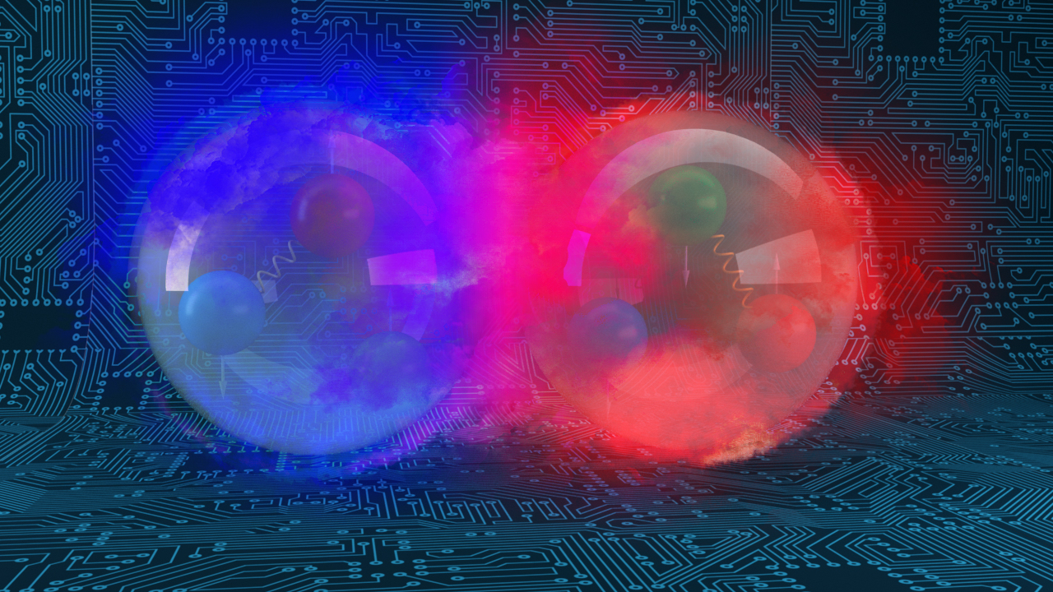
Outline…
Broad Strategy Discussion
  Executing an excellent science program
  Actively planning for the future
Other News
AI Strategy (if there is time)

Slide 3
Laboratory strategy incorporates three key areas
Nuclear Physics
Computational & Data Science
Accelerator Science & Technology
Nuclear Physics
  CEBAF serving our user community in the quark sector
  EIC serving our user community in the gluon sector
Computational and Data Science
  Delivering HPDF to accelerate scientific discovery and innovation
  Developing a related R&D program
Accelerator Science and Technology
  Innovation for reliable SRF accelerators, and training the next generation of accelerator scientists

Slide 4
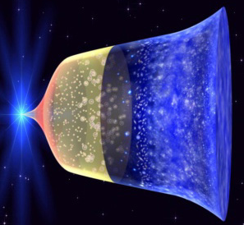
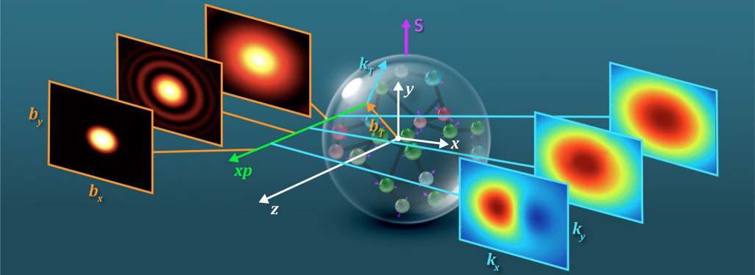
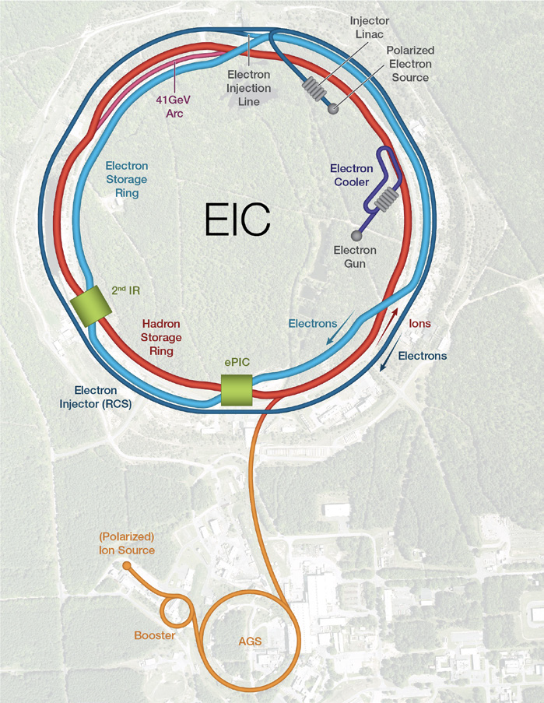
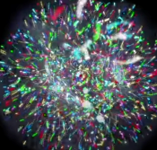
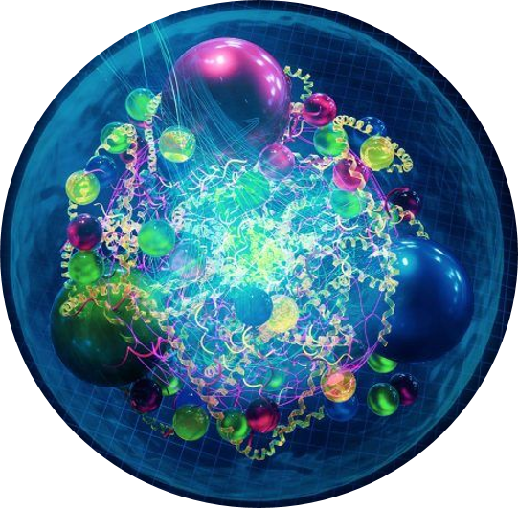
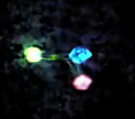
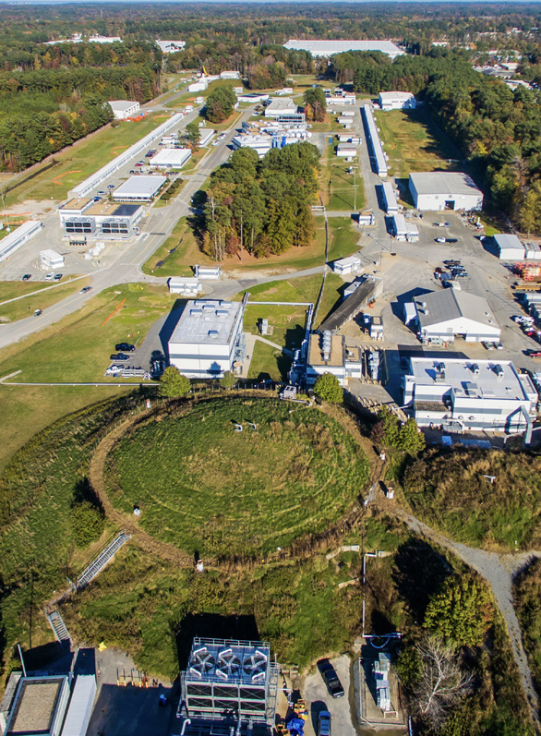
Nuclear Physics: Key scientific challenge
Position
Momentum
Gluons
Direction of Proton
How do quarks and gluons make up protons, neutrons, and, ultimately, atomic nuclei?
The ability to reduce everything to simple fundamental laws does not imply the ability to start from those laws and reconstruct the universe. -- More is different, P. W. Anderson [Sci 177, 393 (1972)]
Quarks

Slide 5
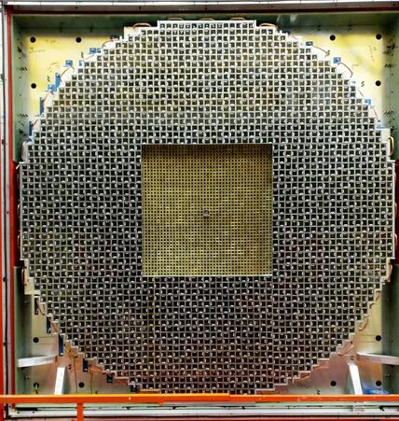
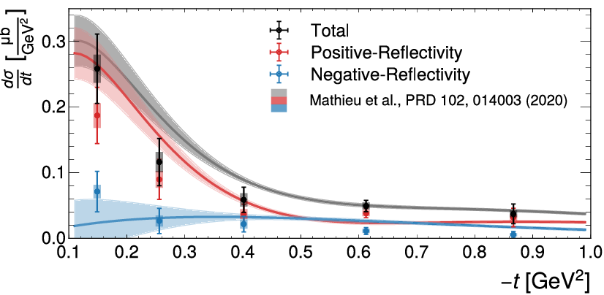
Full steam ahead on CEBAF science
Electromagnetic form factors
Proton properties – Example: Electromagnetic form factors
Quark and gluon distributions in the proton
Proton properties in the nucleus and in medium modifications of GPDs
Quark and gluon distributions in other hadrons (pions, Kaons)
Exotic particles (pentaquarks, glue-balls,…) and molecular states
Theory developments to guide and interpret experimental results
Photoproduction of γp→a₂(1320)⁰p
Major upgrade to GlueX detector
Removed 400 Lead Glass modules
Inserted 1600 PbWO₄ modules
Submitted to PRL
- 2x resolution increase
- Additional Radiation hardness

Slide 6
CEBAF Accomplishments During Last Year’s Run
Hall A
  39 PAC Days Completed with major reconfirmation from pol. ³He to cryo-target during run
  Completed Polarized ³He GEN Experiment (E12-09-016)
  Completed GEN Recoil Polarization Experiment (E12-17-004)
  Completed K_{LL} Experiment (E12-20-008)
  Unfortunately, due to beam dump problems the short, A_{LL} experiment (E12-20-008) was canceled.
Hall B
  104 PAC Days Completed
  Completed Run Group D (E12-06-106 and A). [ color transparency & TMD measurements ]
  Partially Completed Run Groups K (E12-16-010, A, and B) and E (E12-06-117)
Hall C
  116 PAC Days Completed
  Partially Completed Neutral Particle Spectrometer (NPS) Run Group (E12-13-010, E12-13-007, E12-22-006, E12-23-014)
Hall D
  4 opportunistic calendar days
  Installation of new calorimeter during most of the run period
  Opportunistically extracted beam to Hall D for short beam test in March ‘24
  Test went very smoothly, checking out beamline and detector performance
TOTAL OF 259 PAC DAYS RUN, 5 Experiments Completed, and 8 Experiments Partially Completed

Slide 7
CEBAF Run Schedule
CEBAF has now run at an energy of 1047 MeV/linac for two run periods
Next run will increase to 1060 MeV/linac, this plus the ~100 MeV from the injector means:
    10.7 GeV max energy to Halls A, B, C
    11.8 GeV energy to Hall D
Budget expectation was for ~25 weeks of physics running in FY25&F26
Full year CR, that was just approved, likely means less but it will be many weeks before the labs knows its FY25 budget.
Beam is being tuned up right now with physics starting very soon!

Slide 8
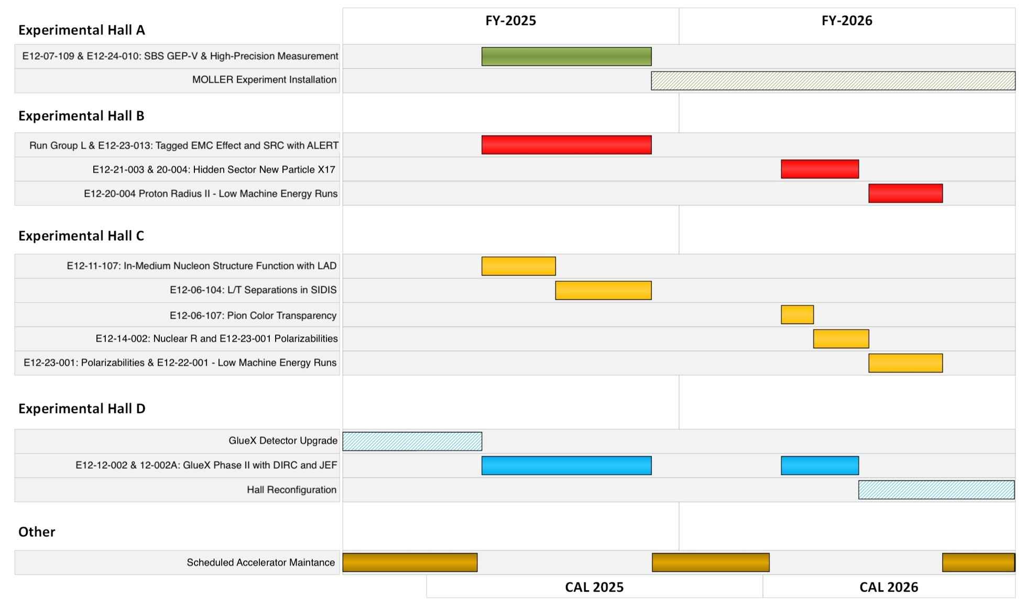
Short Term Schedule

Slide 9
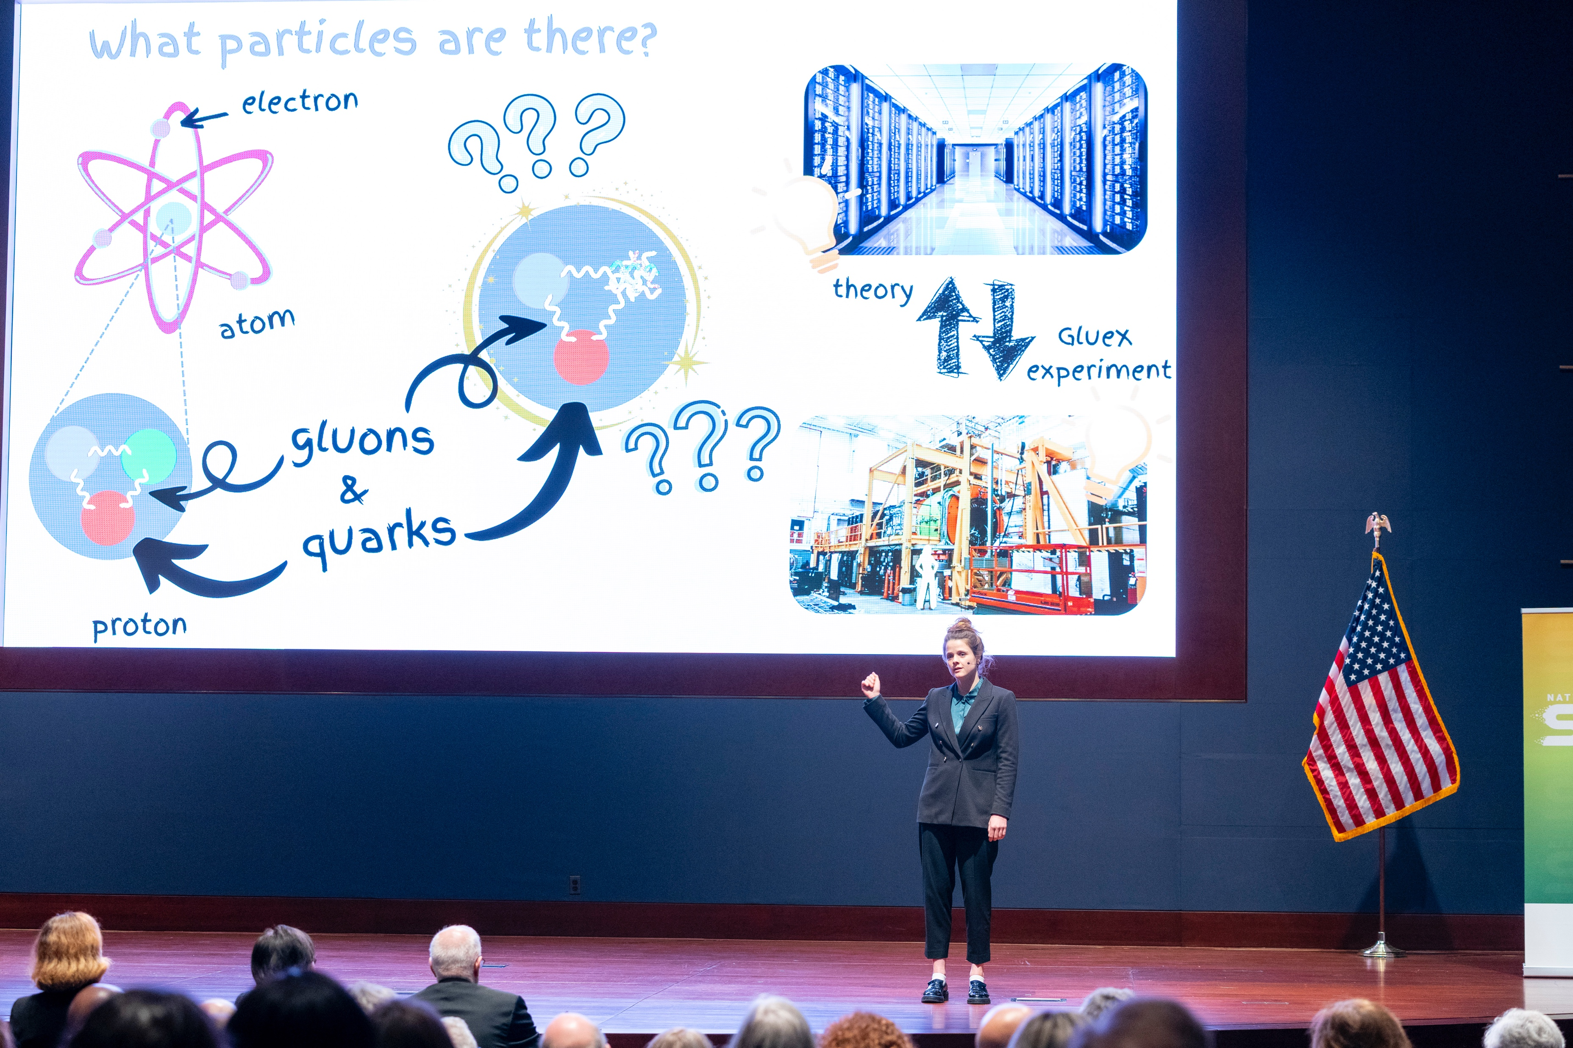
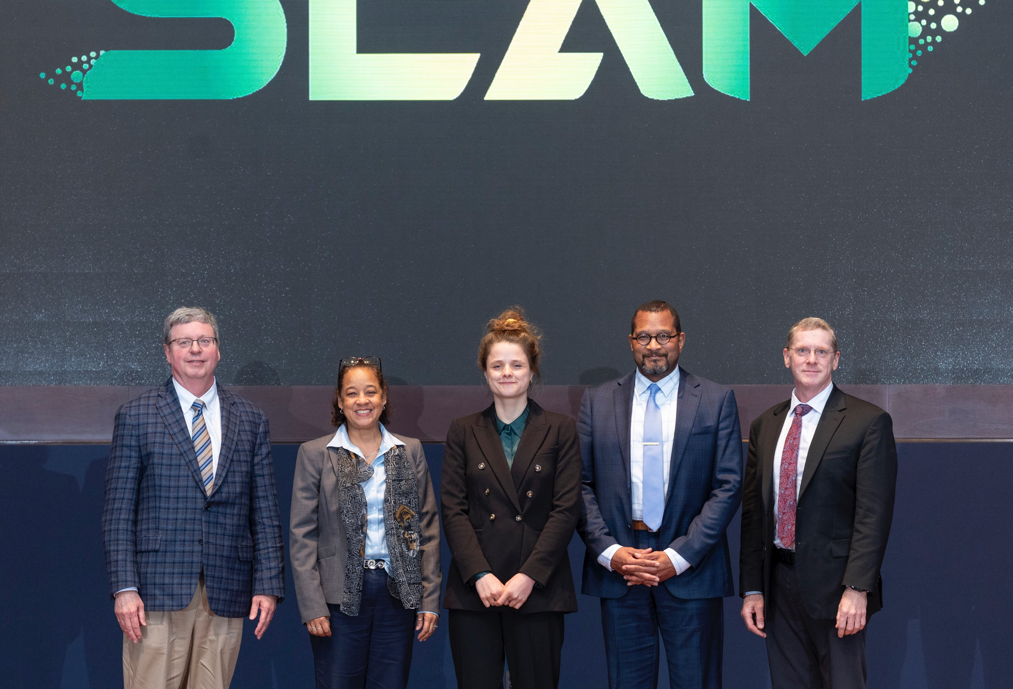
Preparing the next generation: Pia Jones-Petrak (NL SLAM)
TJNAF enables 1/3 of all US PhDs in nuclear physics; These are among the best people in the world and are well prepared for driving the future.

Slide 10
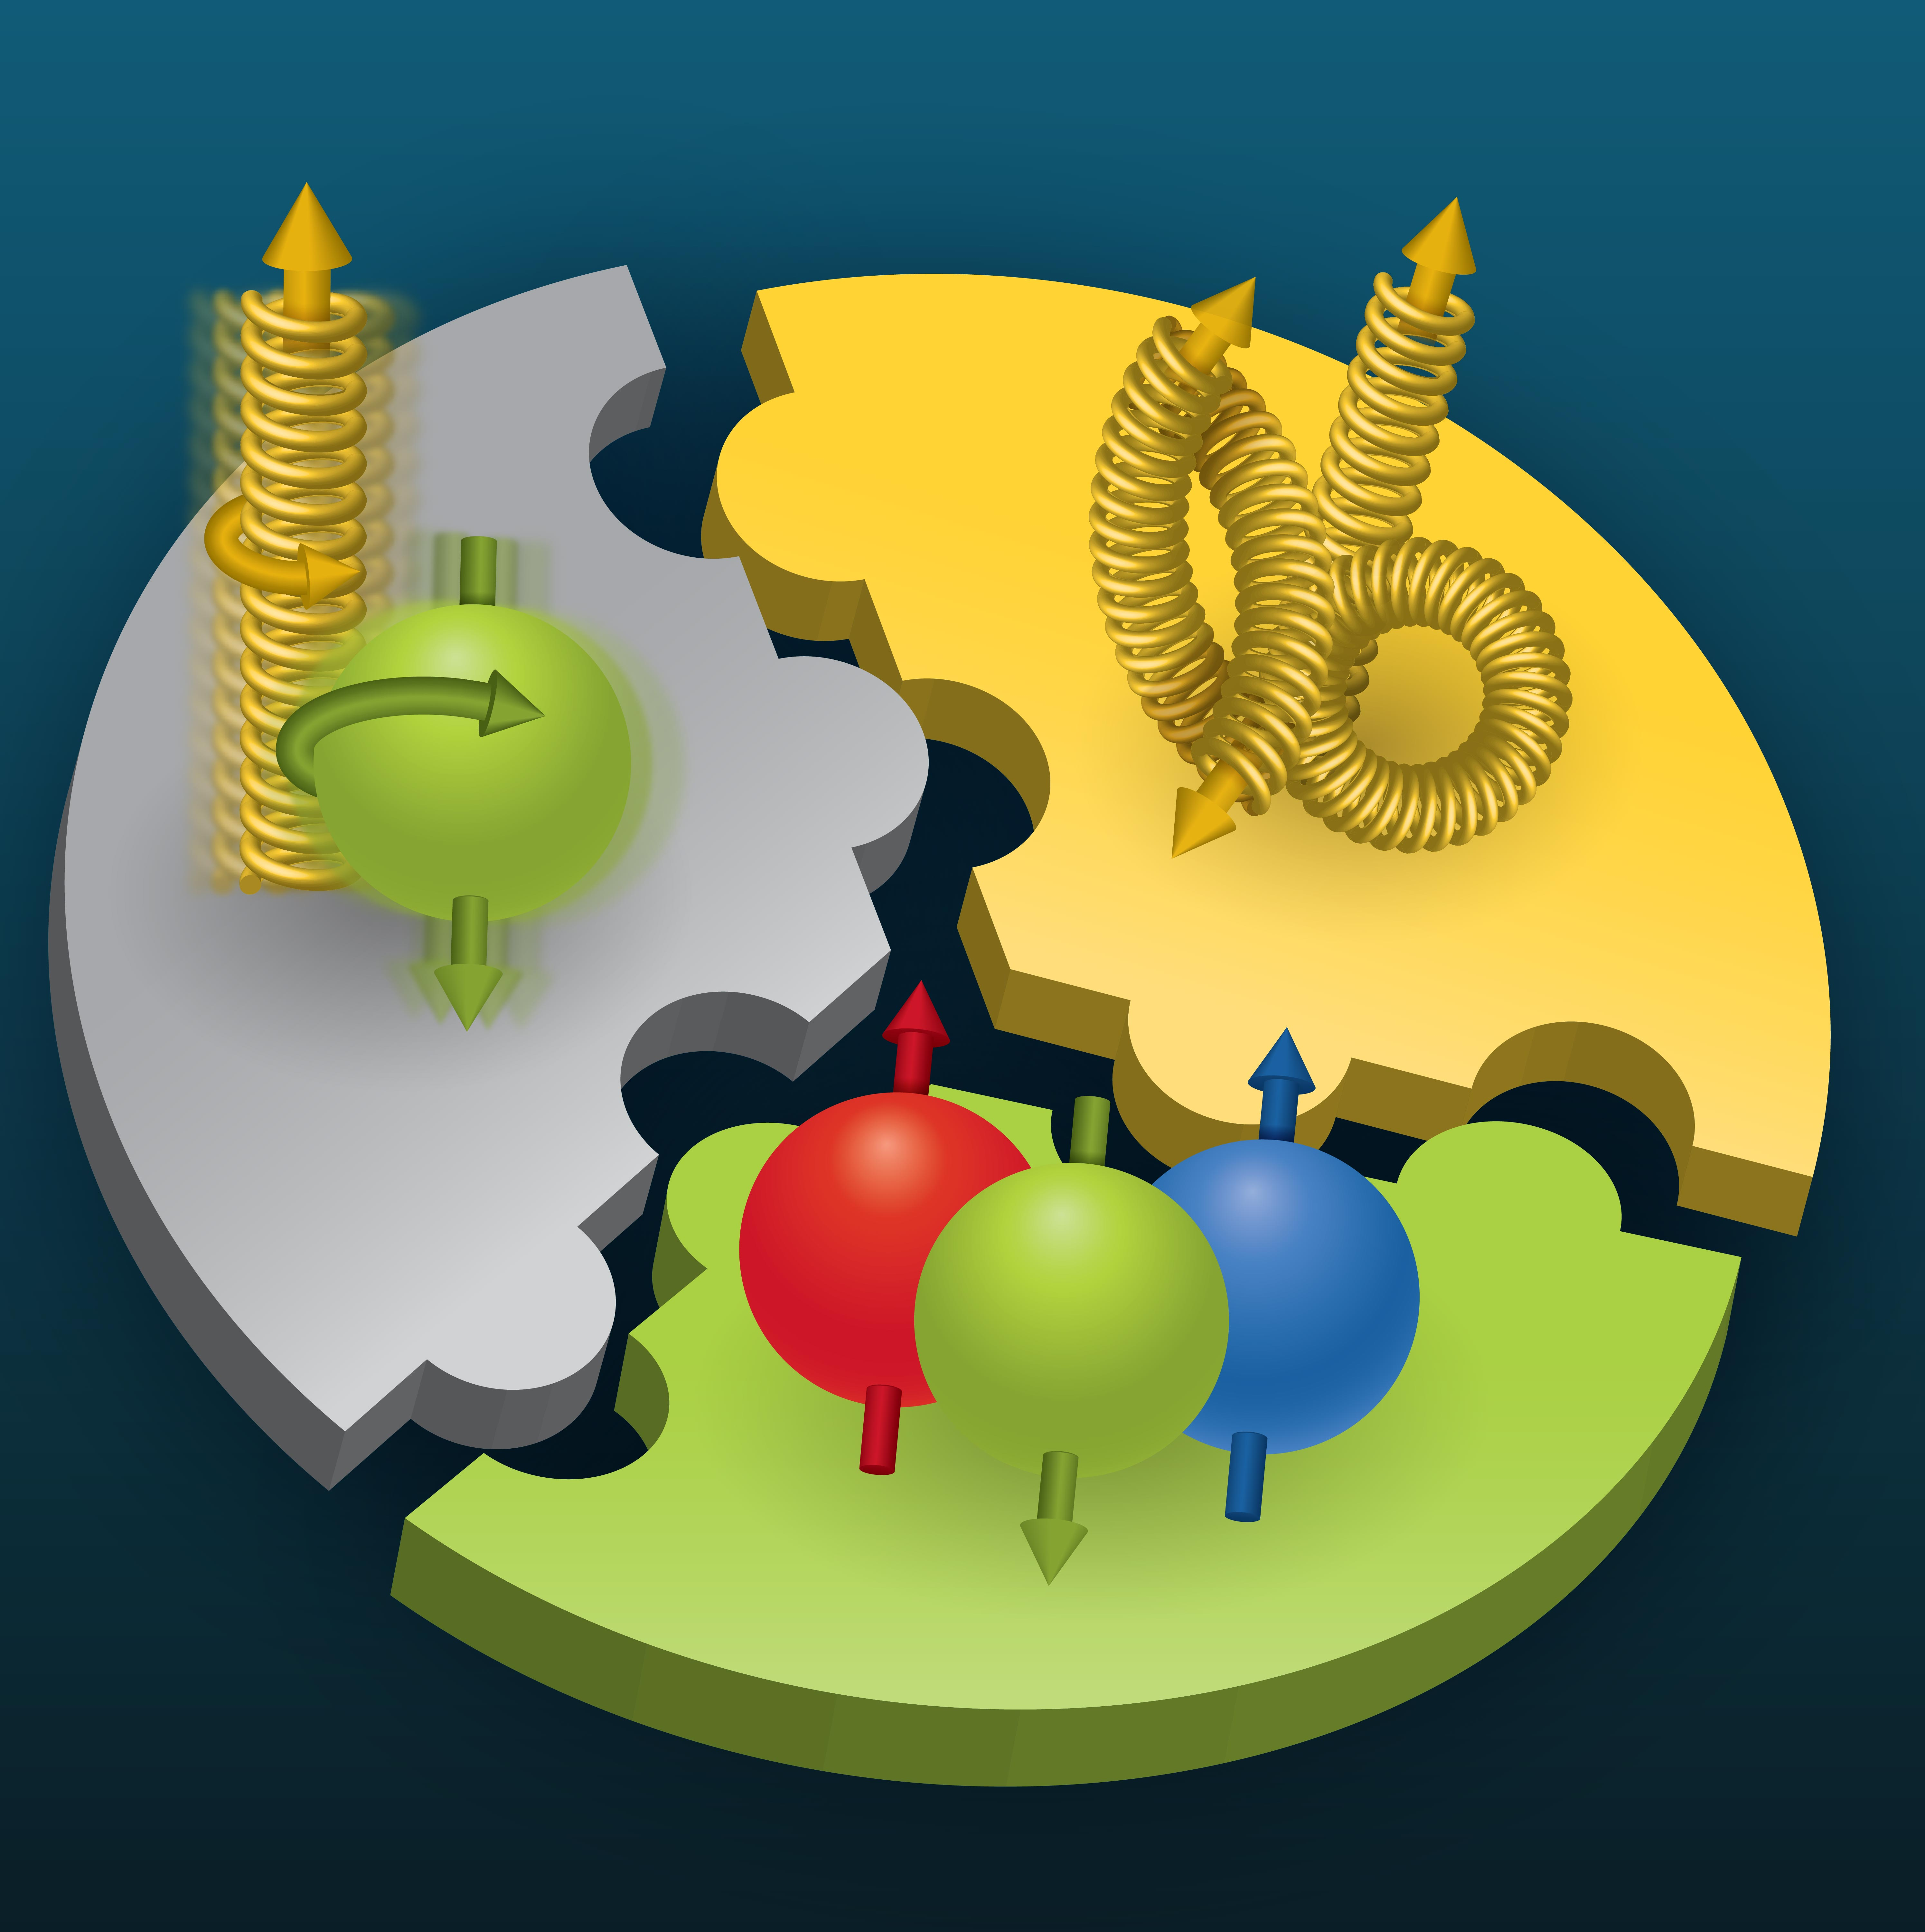
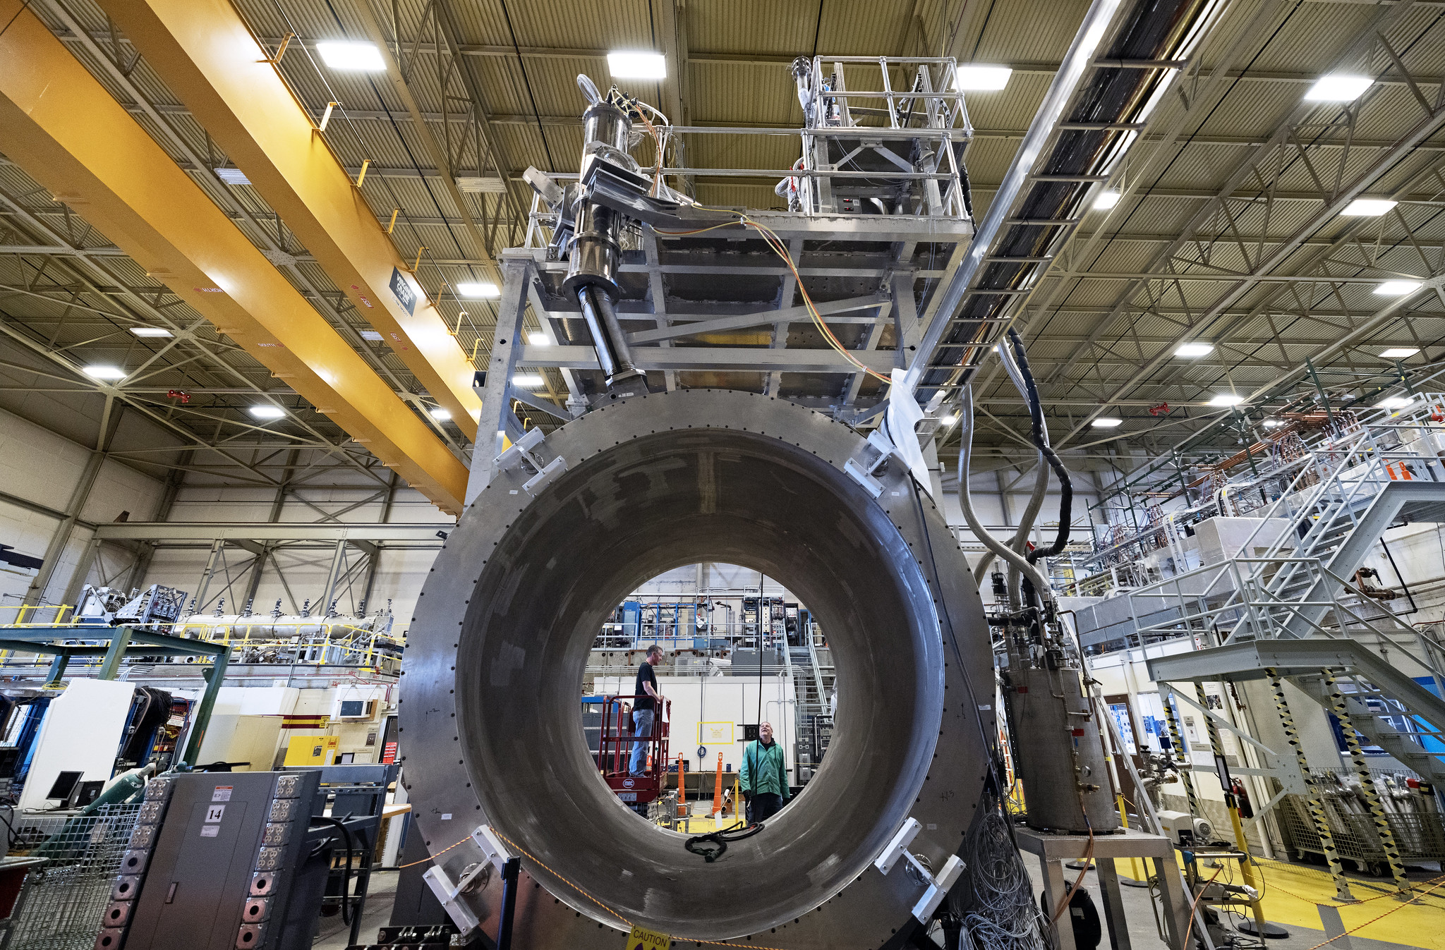
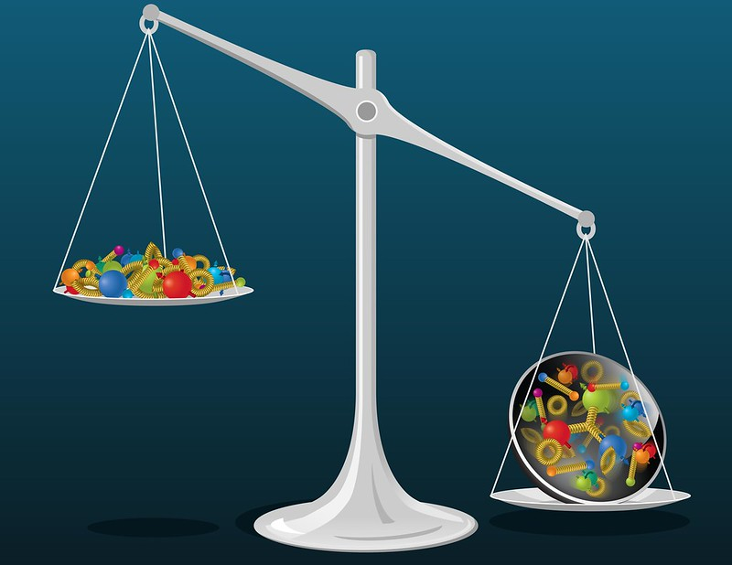
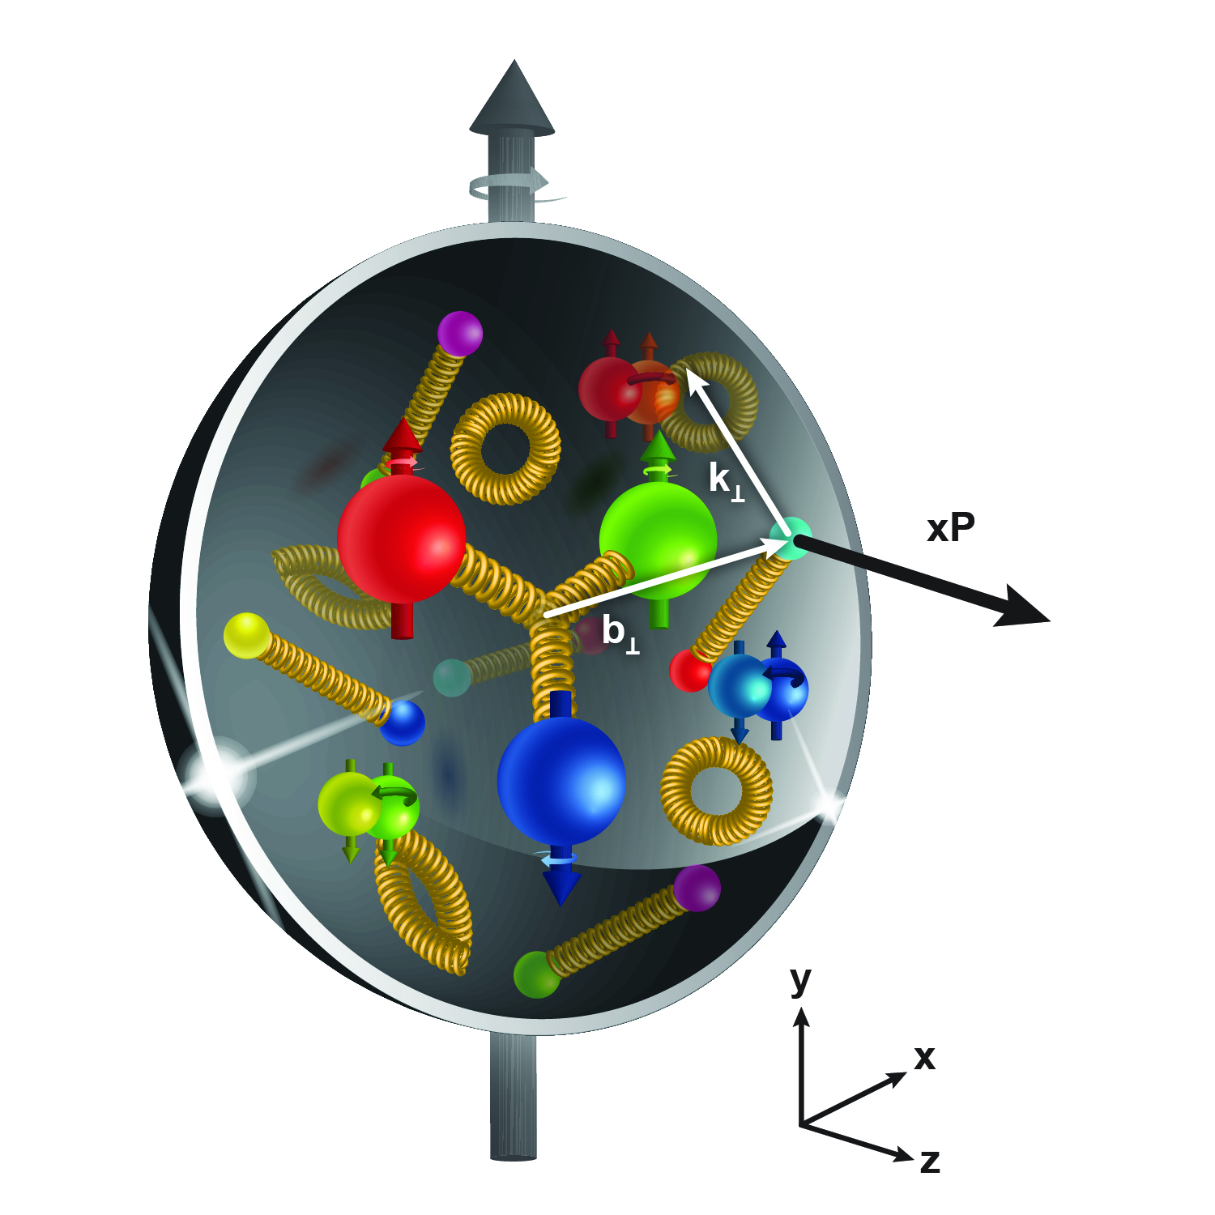
The next large scale detector: SoLID
SoLID will maximize the science return of the 12-GeV CEBAF upgrade by combining high luminosity (10³⁹ e/cm²/s) with large acceptance (full azimuthal)
How do quarks and gluons contribute to the proton spin?
SoLID captures the full luminosity of CEBAF to answer these questions in the quark sector
How do quarks and gluons contribute the proton mass?
How are quarks and gluons distributed inside the proton?
Two science pillars of the SoLID (proton spin and mass): high-luminosity valence quark tomography and precision J/𝜓 production near threshold (EIC in the sea/gluon region, both needed!)
Parity violating deep inelastic scattering: tests of Standard Model & search for new physics

Slide 11
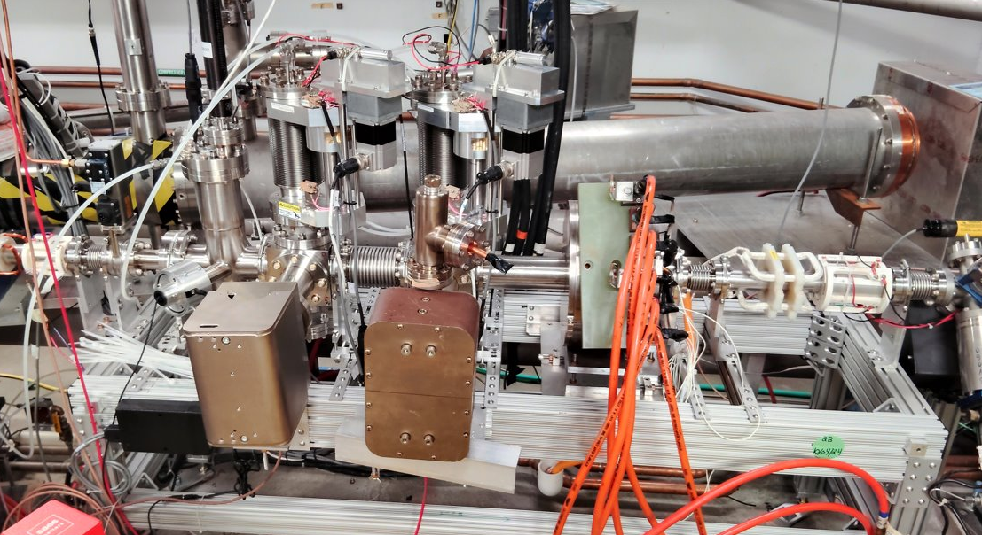
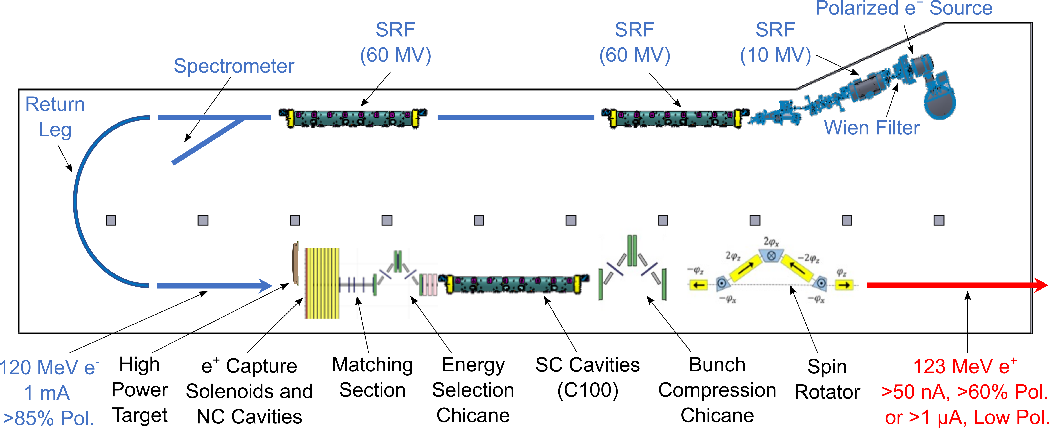
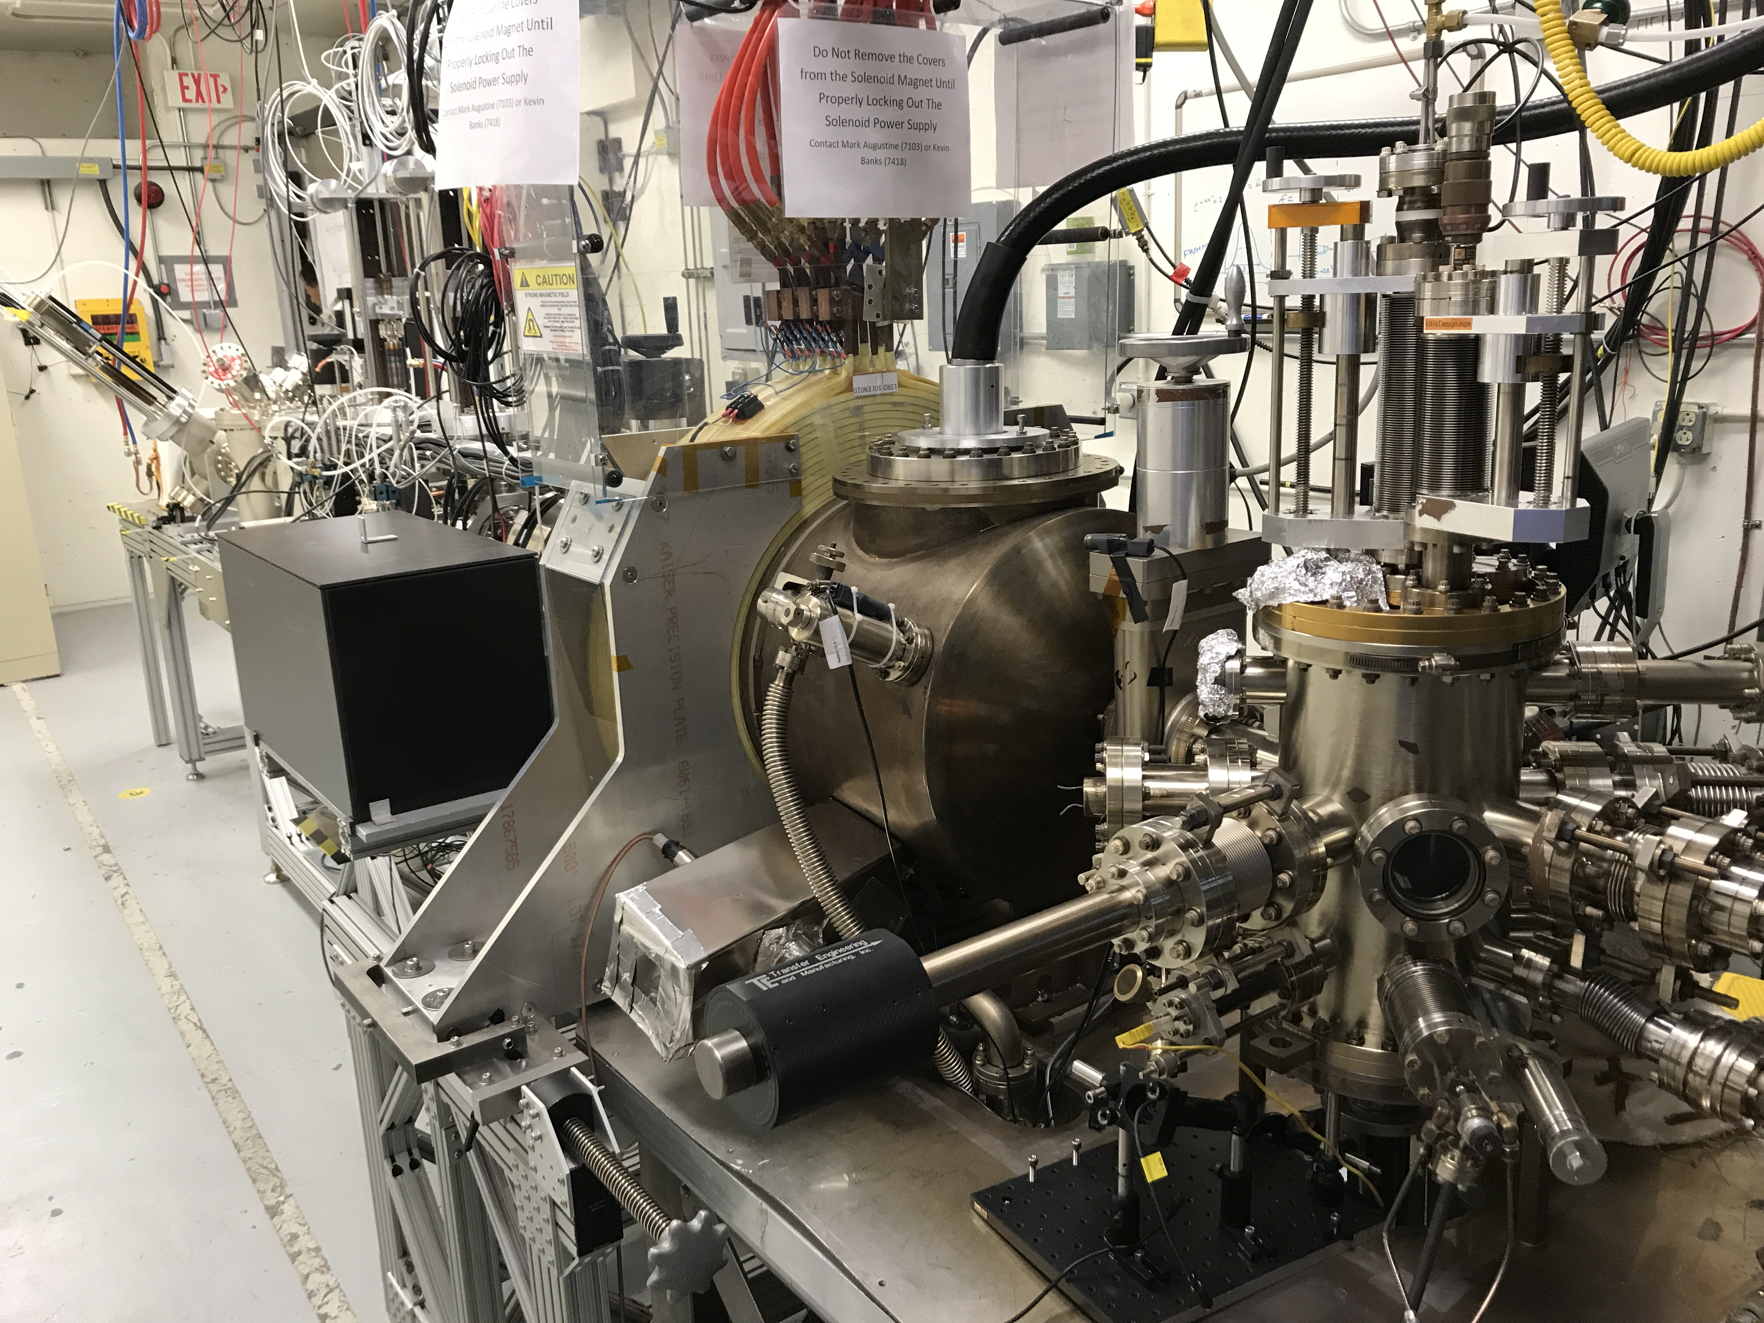
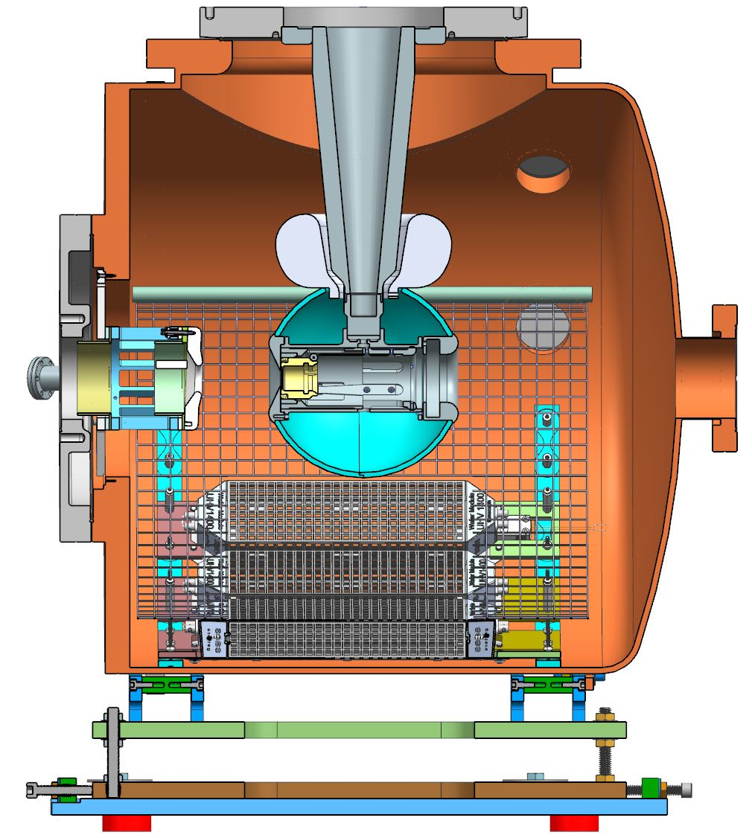
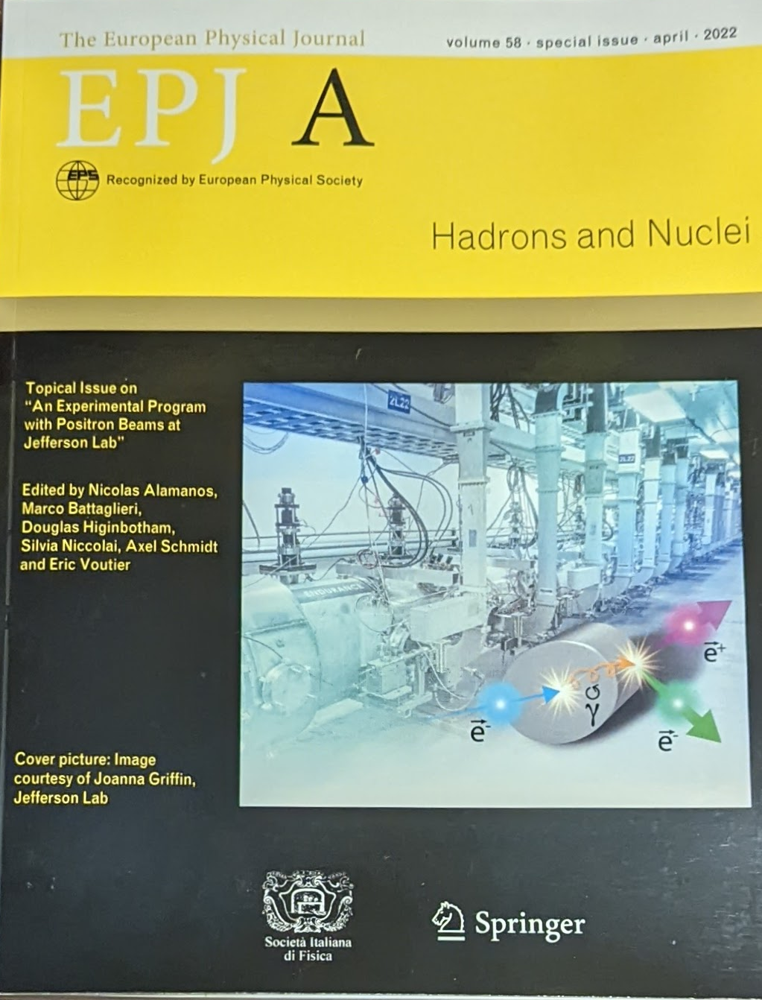
Future Upgrade paths: Positrons
JLAB NP R&D
2.5 FTE Accelerators including Grunder fellow
Support Degrader (former LDRD) to quantify CEBAF acceptance
LDRD program
2-year - test improvements for high-intensity (mA) polarized photogun
3-year - strategic hire of positron model integrator role
NP FOA
2-year - NP Futures concept of Tungsten Solid Target, CFD, Prototype Testing
2-year (SBIR) concept of GaInSn Liquid Target, Prototype Testing at LERF
HEP FOA
3-year – US-Japan collaboration with SLAC/KEK to exchange e+/e- source concepts
Target Test Area
mA e‒ Photogun
High current e‒ source
(<10 mA @ 10 MeV)
Up to 90% polarization
Long life time
2 years of PAC approved experiments

Slide 12
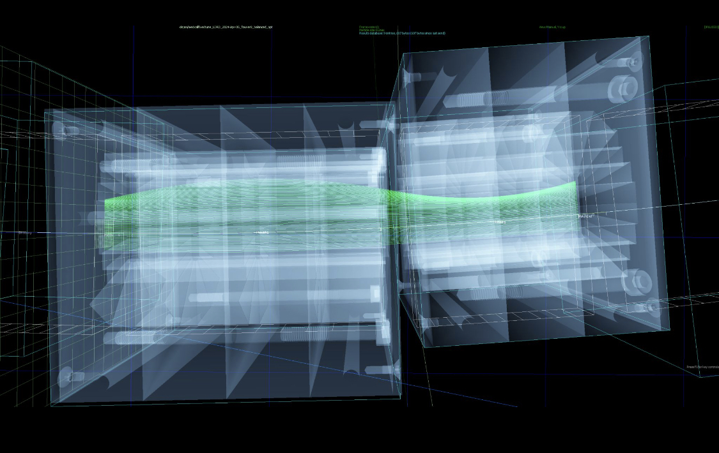
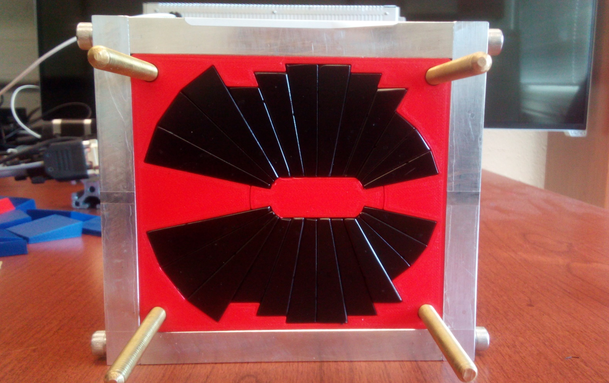
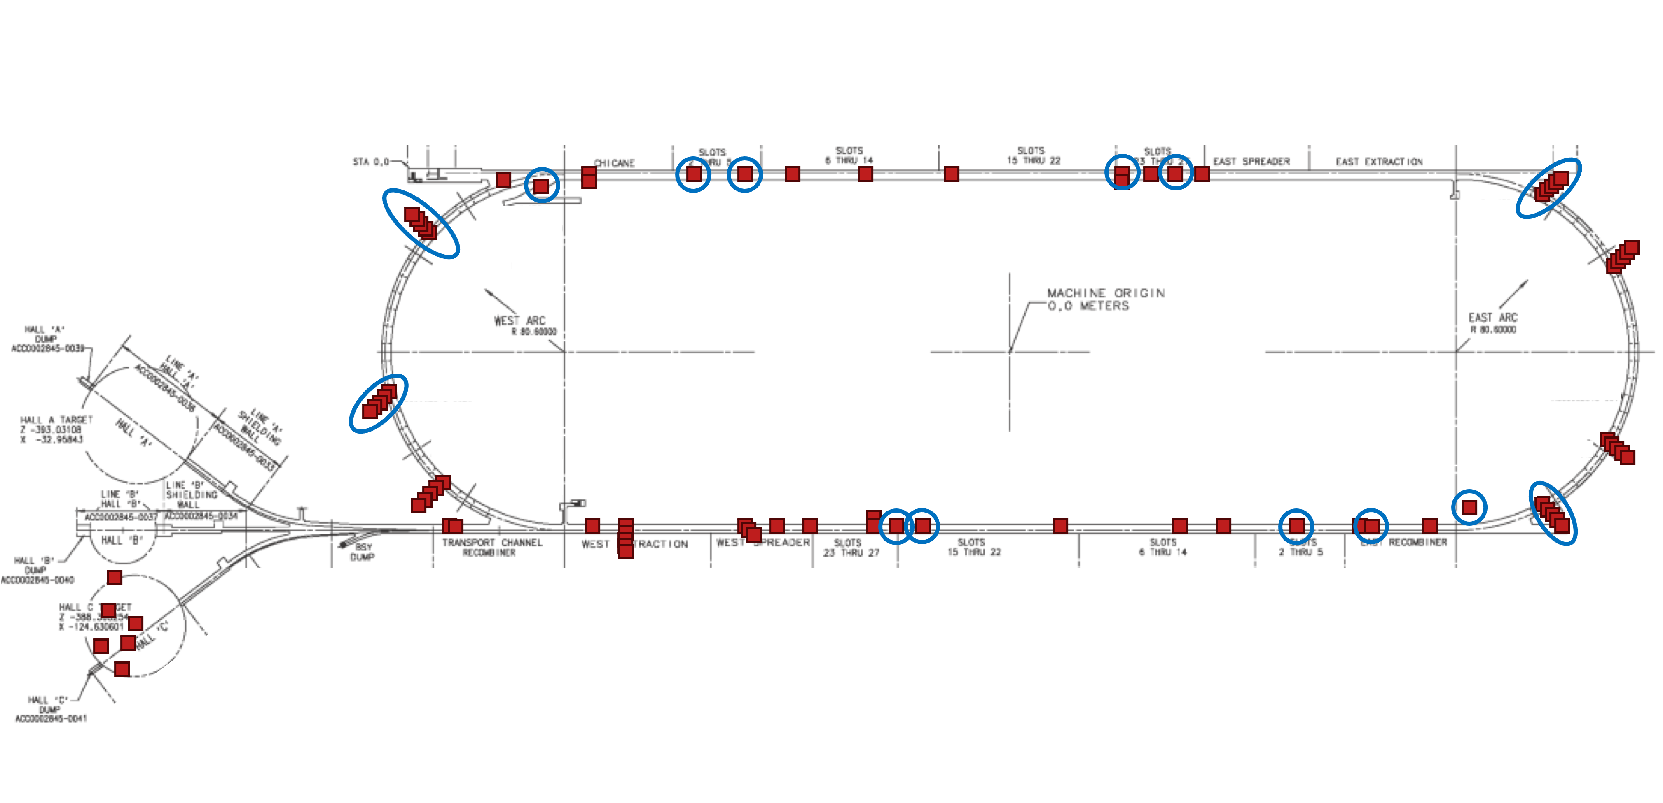
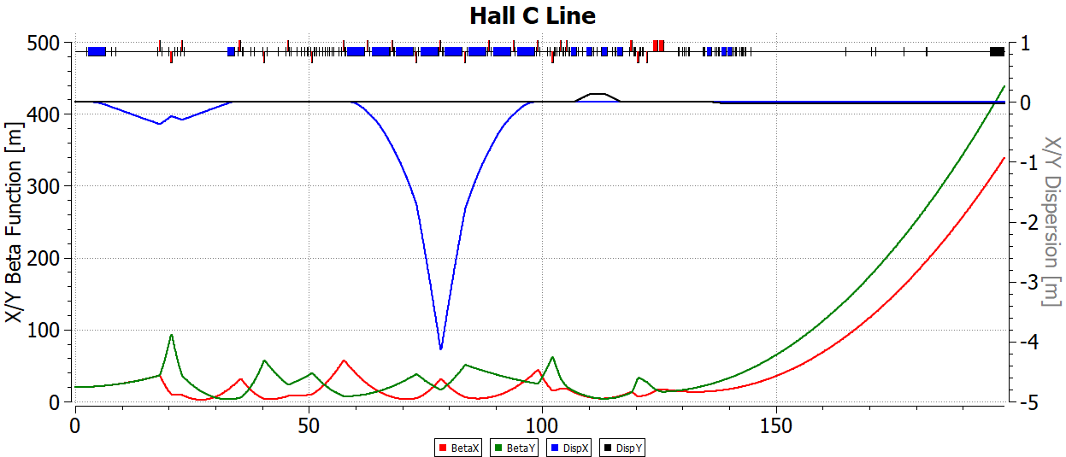
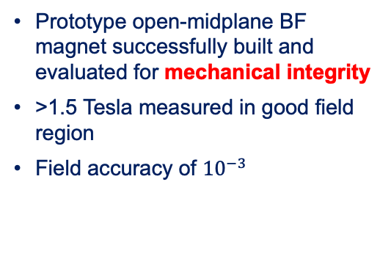
22 GeV upgrade: formulating the baseline (pre TDR/CDR)
All in time for the next LRP
1
2
Prototype open-midplane BF magnet successfully built and evaluated for mechanical integrity
>1.5 Tesla measured in good field region
Field accuracy of ${10}^{−3}$
Imported a vendor's magnet mechanical design and overlaid it on the beam orbits to make sure there is clearance
Stephen Brooks
Installation map in CEBAF – 30 installation locations of varying dose and radiation type (gamma vs. neutron)
3
4
Construction of a full-length permanent magnet (LoI to DOE)
Installed/analyzed Dosimetry
Hall C - possible location of the Test
Location to install samples
Resiliency studies of permanent magnet materials in a radiation environment at CEBAF resembling their intended operational one (LDRD project started Oct. 1, 2023)

Slide 13
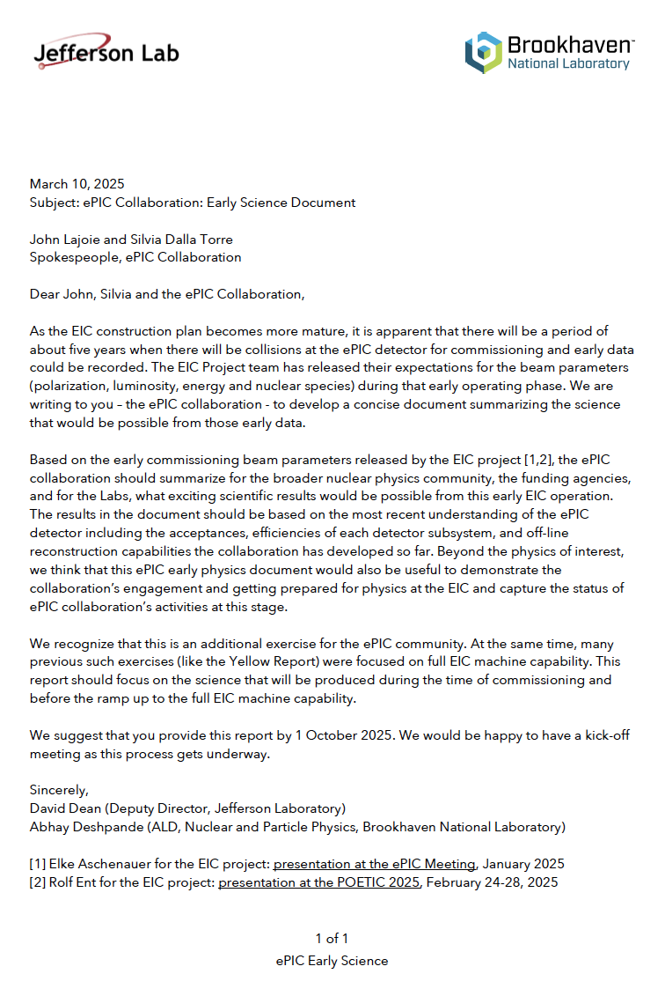
EIC Partnership: Refine EIC Project
Project is executing CD-3A procurements
OPA Review in January recommended CD-3B
Resource Review Board has generated a lot of interest and international commitment
Project is developing a subproject approach in moving to CD-2/3
Dean and Deshpande recently charged the ePIC collaboration to identify exciting early science results…
”Identify for the broader scientific community, the funding agencies, and the Labs, what exciting scientific results would be possible from this early EIC operation.”
J. Yeck overview talk at OPA review (January)…it is evolving quickly

Slide 14
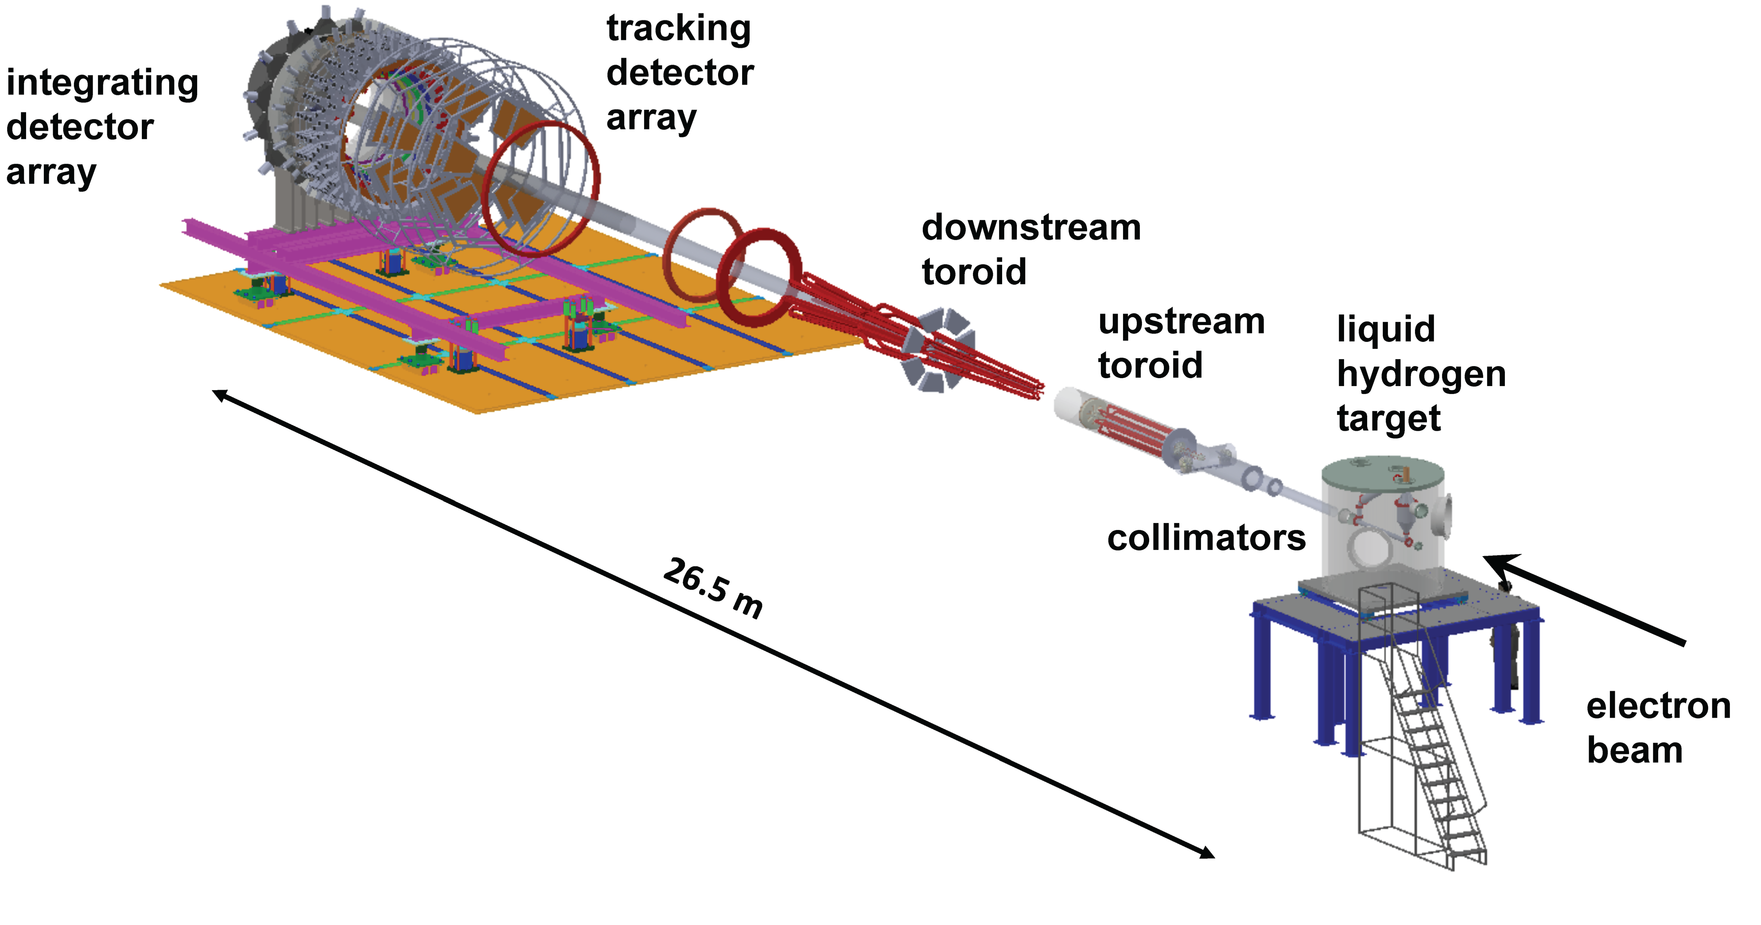
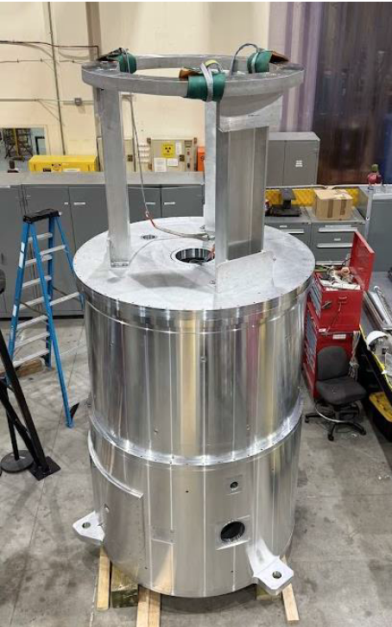
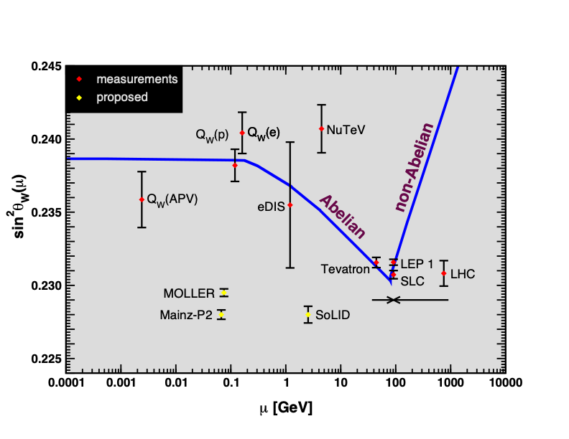
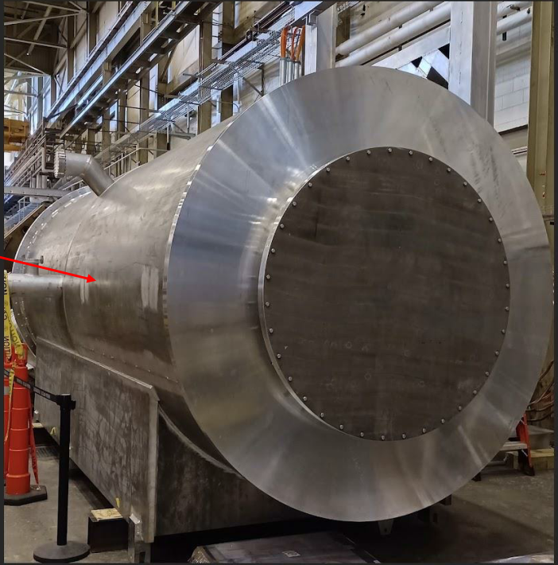
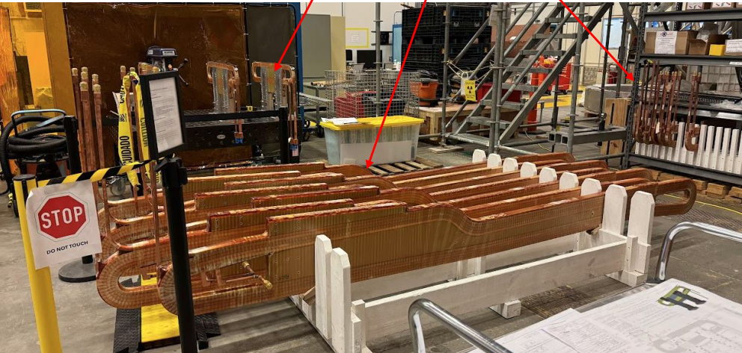
MOLLER: World-leading Measurement of Lepton-Lepton Electroweak Reaction
The most precise measurement to date of the parity violating asymmetry, A_{PV}, in electron-electron scattering, and thus the weak charge of the electron.
Experiment requires extremely high signal rate and very low noise (Parity violation will be measured to 26 ppb)
Probes NEW physics at the ~20 TeV energy scale
Target Scattering Chamber
Only e-e measurement: SLAC E158
Large drift pipe
11 GeV 65 μA 90% pol
All coils for downstream magnet at JLab
JLab Measurements
CW e- : E_{max}, =12 GeV GeV, Pol.~ 90%
MOLLER: improve QW(e) by a factor of 5

Slide 15
Looking ahead: the next 3-6 months
The CR will impact operations budgets
  Realized. DOE recognizes the value of the User Facilities
What’s next and how to get there
  Reliability of CEBAF – Performance prioritized over energy reach. Develop a 7-year funding profile to execute (underway).
  EIC partnership -- Develop the early science program; deliver TJNAF CD-3A scope
  SoLID (~$100M MIE) – Shovel ready; continue R&D to reduce risk
  HPDF and JLDC – Progress to CD-1 and JLDC design/build
  Pursue AI Strategy implementation (part of LDRD Call)

Slide 16
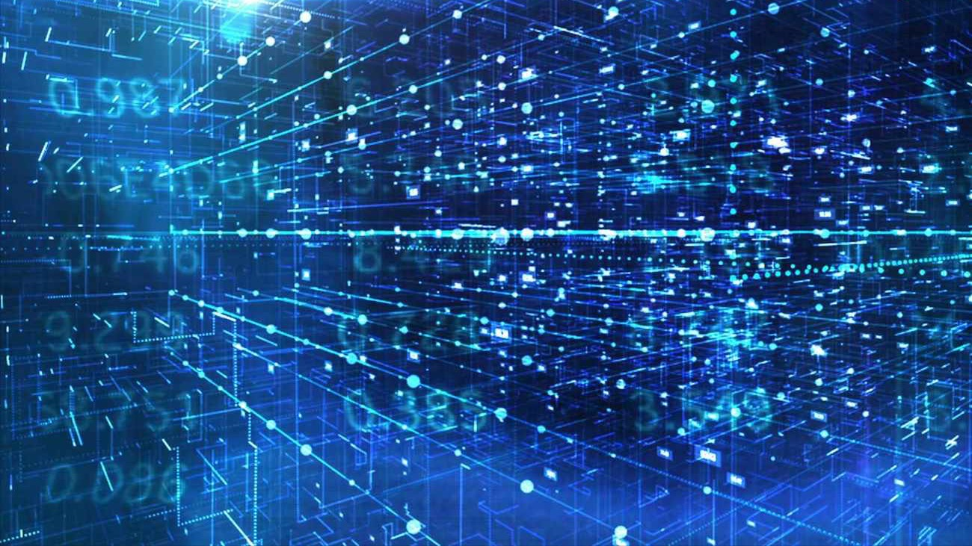
Discussion

Slide 17
JLab is a recognized leader at the intersection of AI and Nuclear Physics
This is a HOT topic. We must pursue it or be left behind.
The good news: a lot is funded already and we have expertise
Jefferson Lab organized the first workshop on "AI for Nuclear Physics" in 2020,
  which led to a colloquium article on the topic, currently cited 138 times.
Jefferson Lab staff have since presented on AI applications in Nuclear Physics at various conferences and workshops.
Staff recently co-led and were members of SC-wide AI/ML application working groups
AI is integrated into multiple areas, including detector control and monitoring, event reconstruction, data analysis, detector design, Lattice QCD simulations, and solving inverse problems in nuclear theory.
Notable examples include:
  Deep Learning Based Superconducting Radio-Frequency Cavity Fault Classification.
  AI-Driven Experiment Calibration and Control, demonstrated on drift chambers in GlueX.
  Hydra: Computer Vision for Data Quality Monitoring, deployed in Halls A–D.
  CLAS12 Track Reconstruction with AI, enhancing track reconstruction efficiency for CLAS12.
  Deep Learning for Deep Inelastic Scattering Kinematics, demonstrating AI's potential for physics analysis.
  Neural-network analysis of Parton Distribution Functions from Ioffe-time pseudodistributions.
  QuantOm, an AI-driven workflow for imaging quarks and gluons at CEBAF and the EIC, bridging experiment and theory. .

Slide 18
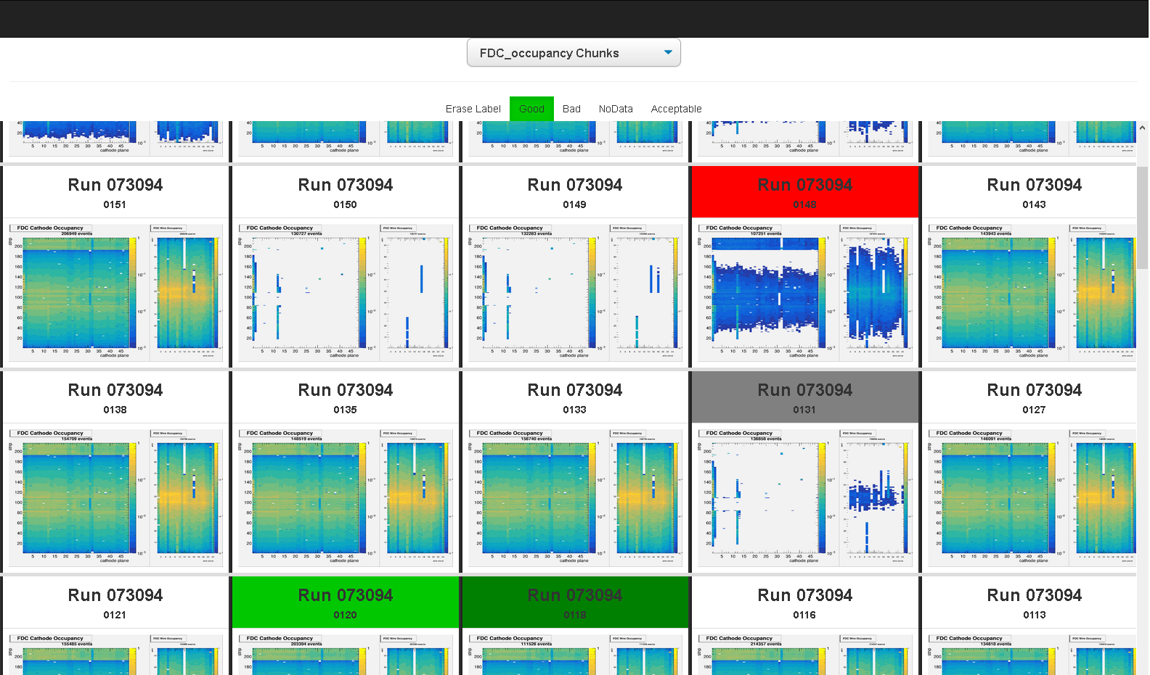
AI Example: Application of HYDRA across HALLS
Hydra is an AI based system that performs online monitoring.
Uses the same plots developed for human shift takers to monitor data quality during an experiment.
Classifies images in near real time and can alert the shift crew of significant problems as they occur.
User friendly interface via a web browser allows the shift crew and detector experts to monitor experiments from anywhere in the world.
Britton, Jeske, Lawrence, Rajput

Slide 19

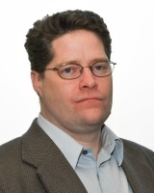

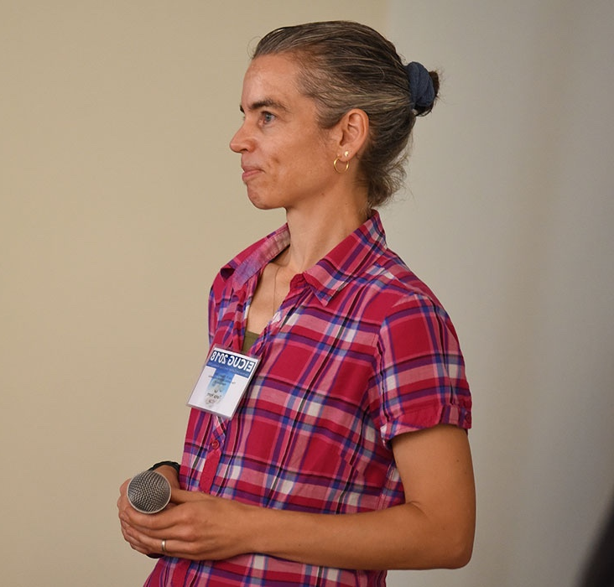
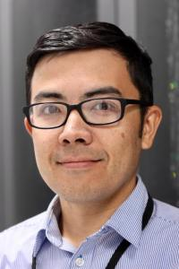
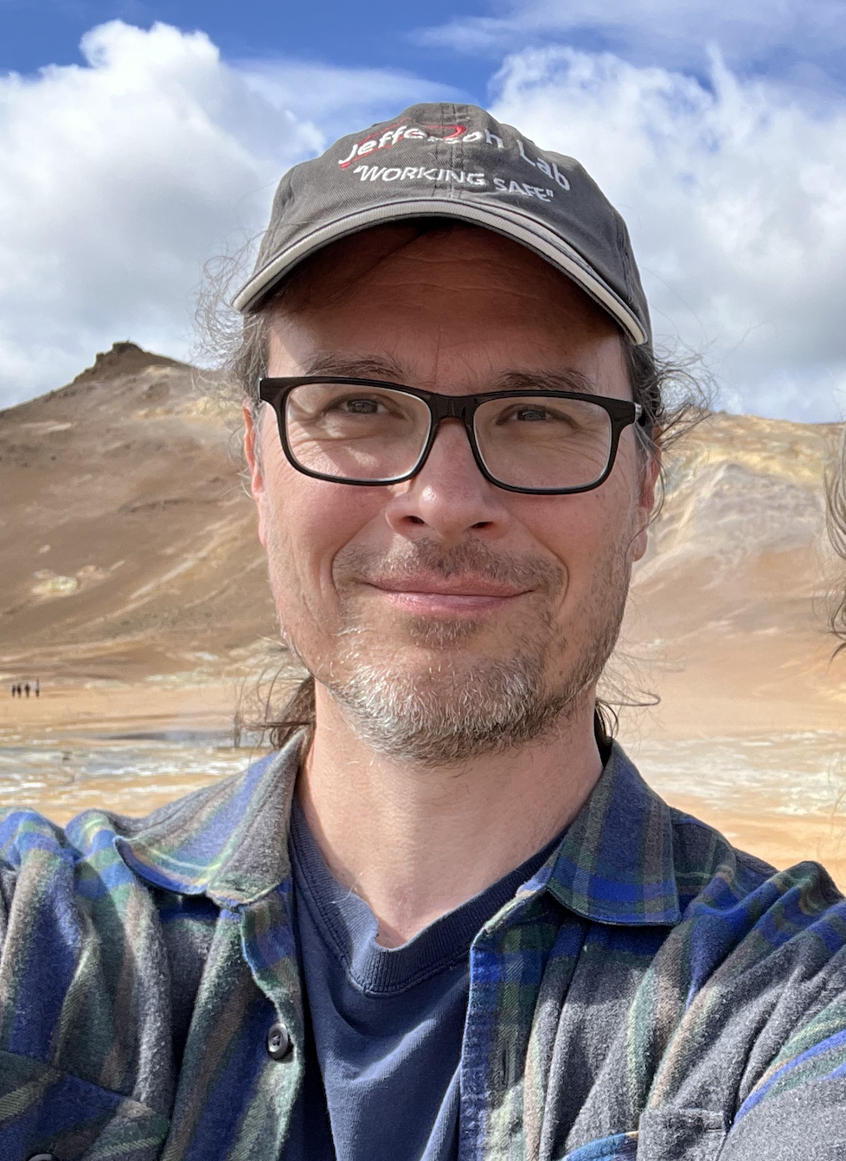
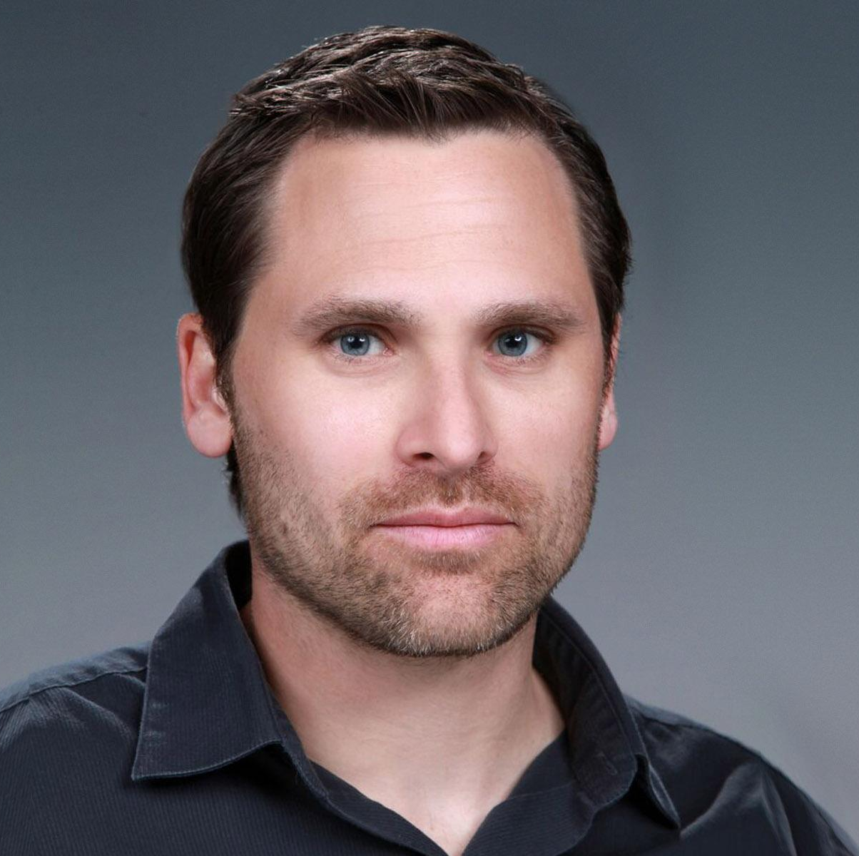
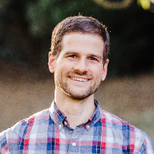
Lab wide committee developed an actionable strategy
Laura Biven*
Eric Christy
Markus Diefenthaler*
Tanja Horn
Nobuo Sato
David Lawrence
Malachi Schram
Christopher Tennant

Slide 20
Cross cutting team developed a strategy for AI at the Lab
Jefferson Lab’s innovations in AI and data infrastructure lead to
world-leading advances in nuclear physics and scientific computing.
Vision
Data as a Catalyst for AI Innovation
Femtoscale Imaging
Integrated Compute-Detector Systems for Streaming Data
HPDF: Multiscale Data Management Orchestration
HPDF: Reconfigurable Optimization and Design
Autonomous Accelerator Operations
Scientific Opportunities
FAIR Data Interoperability Prototypes
Demonstrate capabilities of streaming readout, AI, and distributed data management for femtoscale imaging
MCC demonstration to showcase measurable improvements in accelerator operations
Strategic Thrusts
R&D projects for automated, optimized resource scheduling

