Slide 1
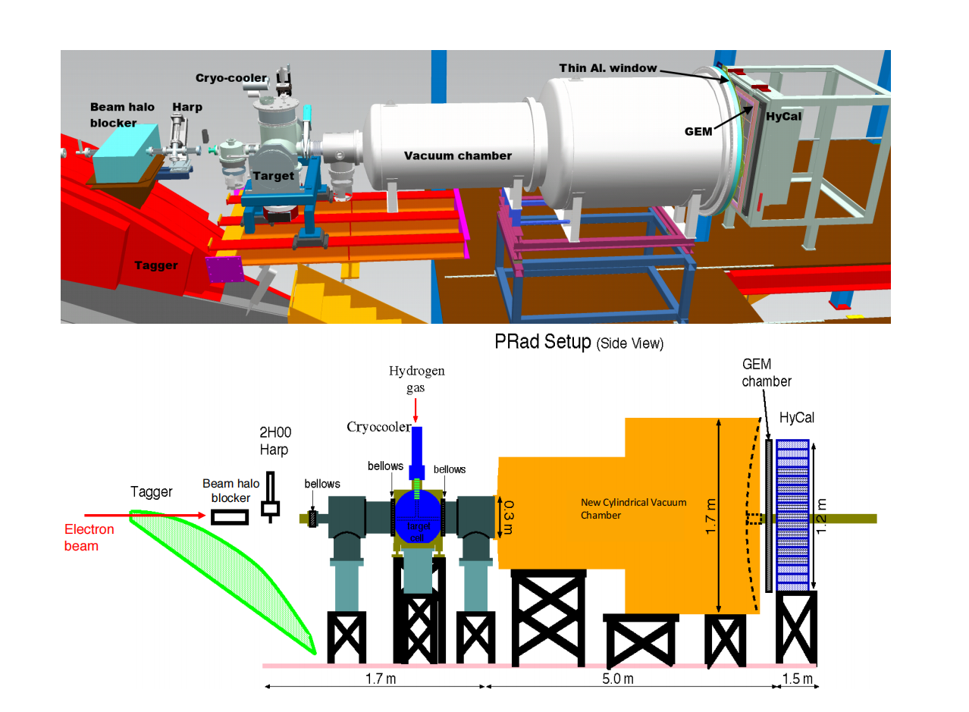
A Blind Analysis for PRad-II Experiment
Figure 1: Schematic diagram of PRad Setup
Duke University
YINING LIU 03/03/2025
Page 1

Slide 2
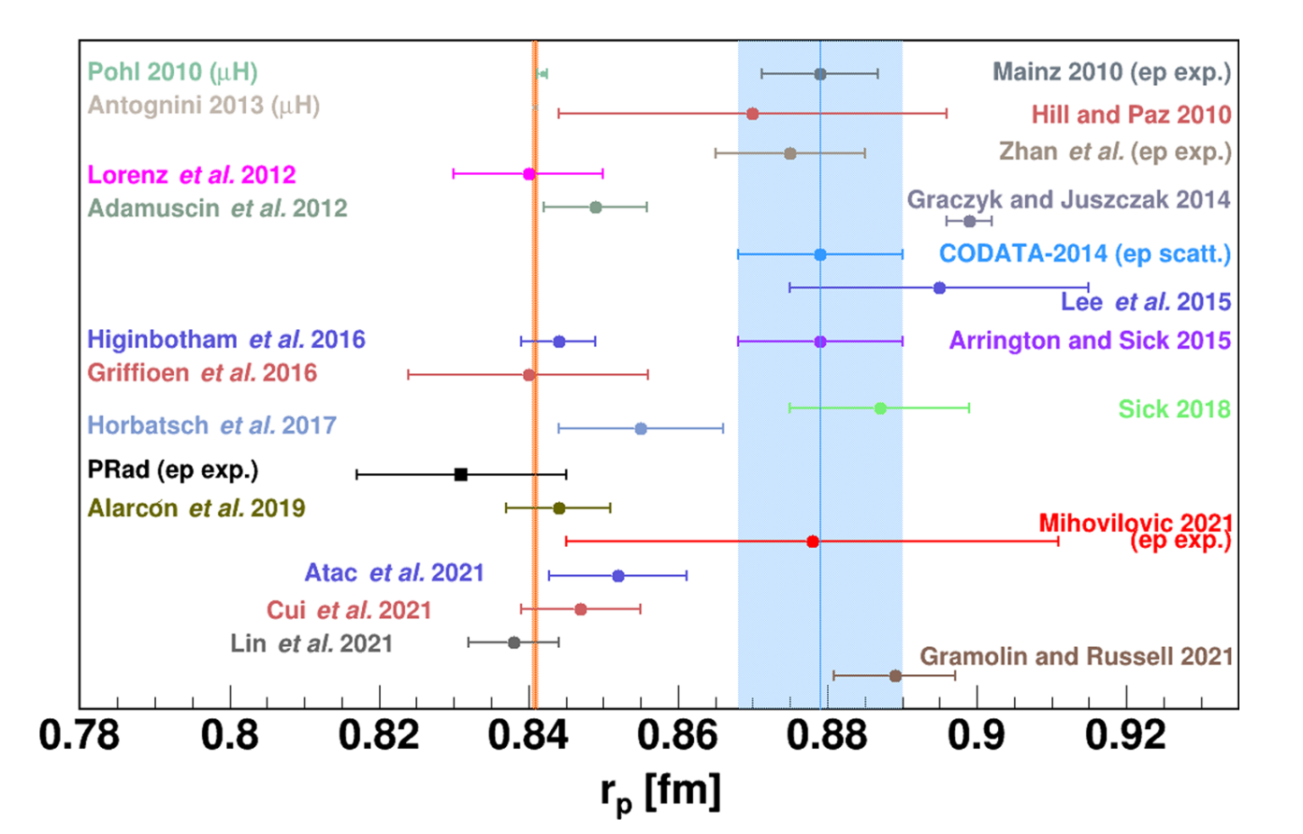
Result of the PRad Experiment
Xiong et al., Nature 575, 147–150 (2019).
PRad:
Two independent analyses
No blind analysis
Page 2

Slide 3
Why do we need a blind analysis?
We presented on how to carry out a blind analysis for
PRad-II during the PRad-II C1 review
• Goal of this study:
Test the proposed approaches and apply the blind analysis for
PRad-II to enhance objectivity.
Page 3

Slide 4
Goal: Blind analysis for extraction of r_{p} for PRad-II
Plan A
(Proposed in PRad-II C1 review)
Blinding
Event Reconstruction
Calibration
Event Selection
(Analysis started here)
Event Reconstruction
We are here: got the super-ratio and beginning the iteration in simulation
Elastic e-p
differential cross section
e-p / e-e Ratio
(Need GEM Efficiency Correction)
Background
Subtraction
Proton Electric Form Factor
Proton Charge
Radius Extraction r_{p}
Unblind the Analysis
True Radius r_{p}
Page 4

Slide 5
GEM Efficiency Study (e-e case)
RMS Value for difference between 2 sets(%) | e-e: ~0.0498
Statistics: 100% Beam Energy: 2.143(GeV)
Page 5

Slide 6
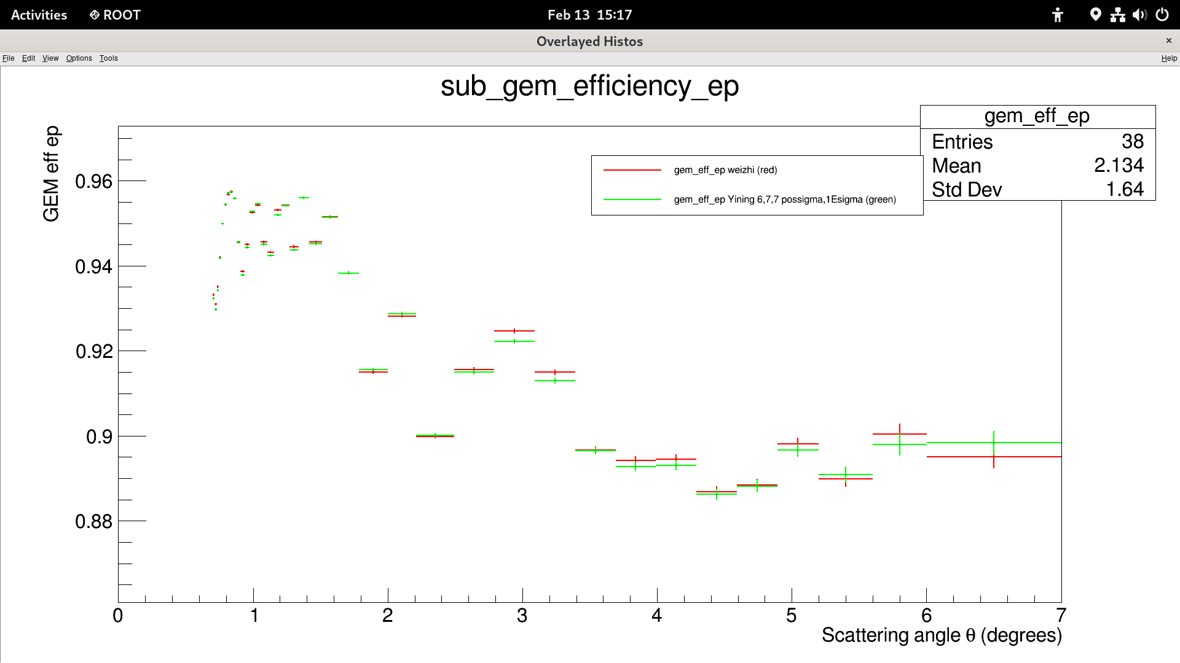
GEM Efficiency Study (e-p case)
RMS Value for difference between 2 sets(%) | e-p: ~0.106
Statistics: 100% Beam Energy: 2.143(GeV)
Page 6

Slide 7
Goal: Blind analysis for extraction of r_{p} for PRad-II
A New Plan to Blind at the GEM LEVEL
Event Reconstruction
Calibration
Event Selection
Blinding?
Blinding the GEM events to get the blinded ep/ee ratio
GEM Efficiency
Background
Subtraction
e-p / e-e Ratio
Elastic e-p
cross section
Proton Electric Form Factor
Proton Charge
Radius Extraction r_{p}
True Radius r_{p}
Unblind the Analysis
Page 7

Slide 8
Goal: Blind analysis for extraction of r_{p} for PRad-II
Plan B (Proposed in PRad-II C1 review)
Event Reconstruction
Calibration
Event Selection
Blinding on RC in the generator?
to extract the elastic e-p differential cross section
GEM Efficiency
Background
Subtraction
e-p / e-e Ratio
Elastic e-p
cross section
(starts here)
Proton Electric Form Factor
Proton Charge
Radius Extraction r_{p}
True Radius r_{p}
Unblind the Analysis
Page 8

Slide 9
Conclusion
•Blind analysis helps reducing bias when performing
the analysis.
•Propose a new blinding plan on GEM level to
extract a blinded ep/ee ratio.
•Apply and test the blinding mechanism (Plan A or Plan
B or the new Plan) to PRad Data and then proceed
such approaches to PRad-II.
This study is in collaboration with Weizhi Xiong, Jingyi Zhou, Chao Peng, and Haiyan Gao and partly supported by the Dept of Physics of Duke and Nuclear Physics, the Office of Science of the DOE under Contract No. DE-FG02-03ER4123
Thank you!
Page 9

Slide 10
Back-Up Slides

Slide 11
Case Study and Example: MUSE Experiment
Page 4
citation: https://indico.lns.tohoku.ac.jp/event/255/contributions/2094/attachments/788/1103/Talk_MUSE_LEES2024_MichaelKohl.pdf

Slide 12
Goal: Blind analysis for extraction of r_{p} for PRad-II
Plan A
(Proposed in PRad-II C1 review)
Blindings
Event Reconstruction
Calibration
Event Selection
(Analysis started here)
Event Reconstruction
Elastic e-p
differential cross section
Background
Subtraction
e-p / e-e Ratio
Proton Electric Form Factor
Proton Charge
Radius Extraction r_{p}
Unblind the Analysis
True Radius r_{p}
Page 5

Slide 13
Event Selections
1. Matching hits between GEMs and HyCal.
Remove Dead Modules on HyCal.
edges of HyCal modules cut.
2. For selecting both e-p and e-e events,
Apply angle-dependent expected
energy cuts based on kinematics.
(Cut sizes depend on detector’s resolution)
e-p scattering
e-e scattering
Page 6

Slide 14
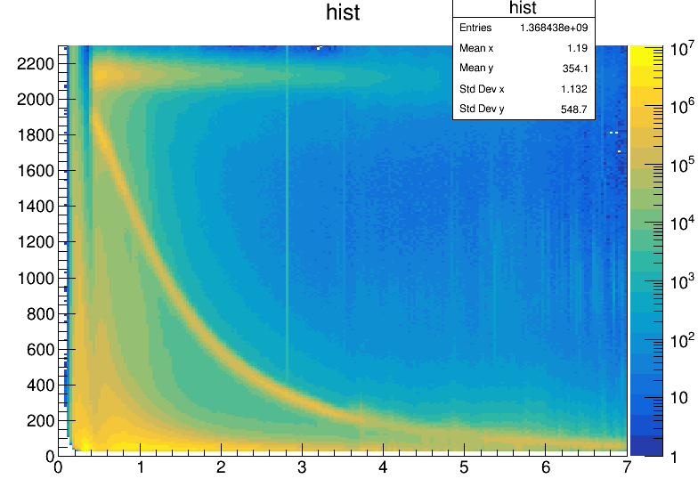
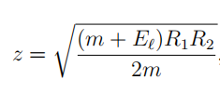
Event Selections
3. In addition to 2, we apply additional cuts
to find the double-arm e-e events:
• Co-planarity:
• Reconstructed Vertex z:
( R_{1,2} is the transverse distance between the
hit position on the detector and the beam-line
of the scattered electron.)
• Elasticity :
e-p scattering
e-e scattering
Page 7

Slide 15
Background Subtraction
a) Full Target run: H₂ gas was filled directly into the target cell
b)Empty Target run: H₂ gas was flled directly into the chamber
Page 8

