Slide 1
JLab Hall B PRad II and X17 Engineering Status
March 2025
Bob Miller
Chris Guthrie

Slide 2
Outline
Beam Line Drawings at:
wiki.jlab.org/Hall-B/engineering/hallb_eng_wiki/index.php/Main_Page
Hall-B engineering
PRad II and X17 Upstream of the Tagger Magnet
PRad II from Tagger Magnet to Hycal
Upstream Collimators
PRad II Veto Scintillator
PRad II Veto Scintillator Positions
X17 from Tagger Magnet to Hycal
PRad II and X17 Vacuum Tank Window
GEM Detectors
GEM Gas System
Hycal Collimators
Hycal to Beam Dump
Design and Engineering Status
A1
A2
B1
B1

Slide 3
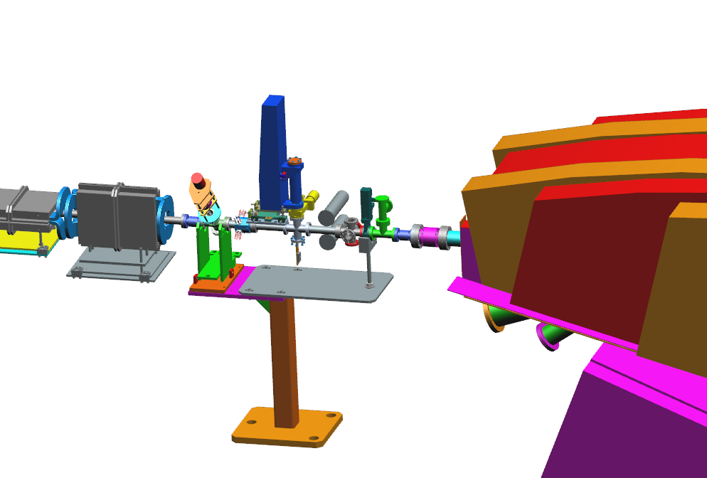
PRad II and X17 Upstream of the Tagger Magnet
Radiator Foils and Collimator Block
Halo
Counters
Valve and Gauges
Harp
A1
A2
B1
B1
Raster Magnets
Tagger Magnet

Slide 4
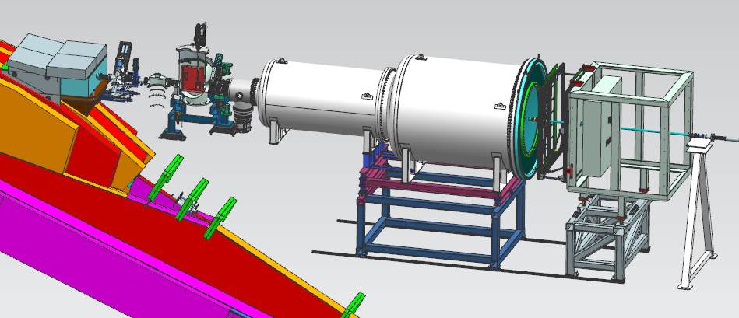
PRad II from Tagger Magnet to Hycal
Collimator Box
Harp
PRad Target
Veto Scintillator
Vacuum Tanks
GEM Detectors
Hycal
A1
A2
B1
B1
PRad II Target to Hycal Lead Tungstate Counters is 6.2 Meters

Slide 5
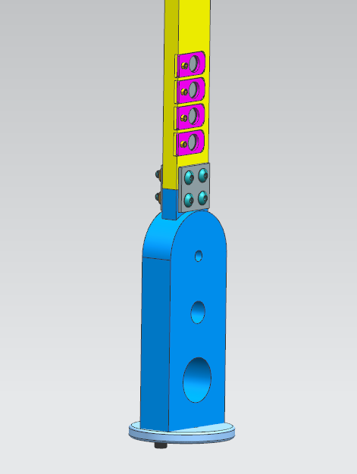
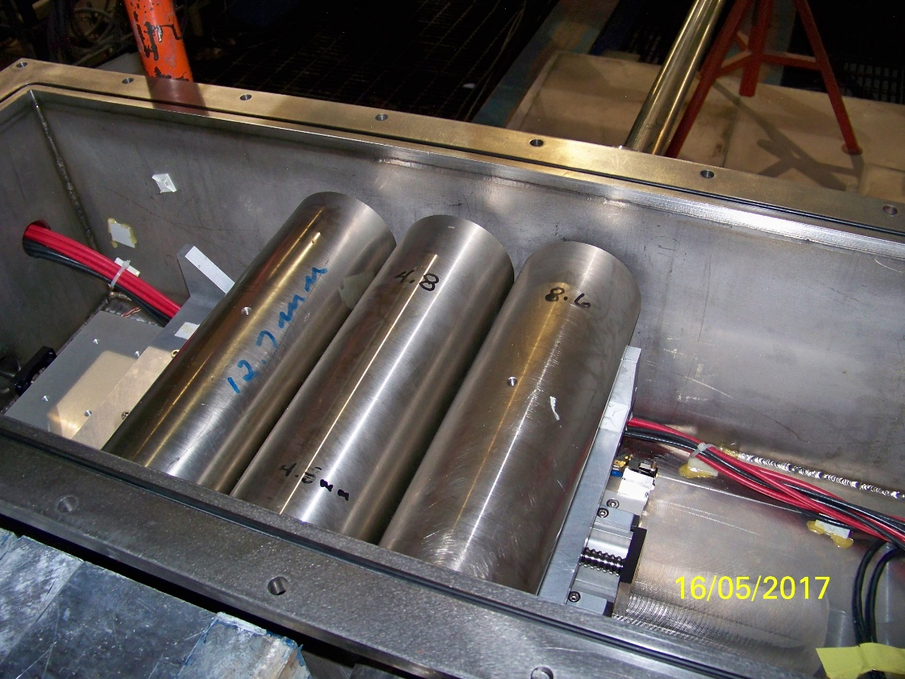
Upstream Collimators
20 mm Thick Tungsten Collimator on Radiator Stick
Tungsten Collimators in Collimator Box Downstream of the Tagger Magnet

Slide 6
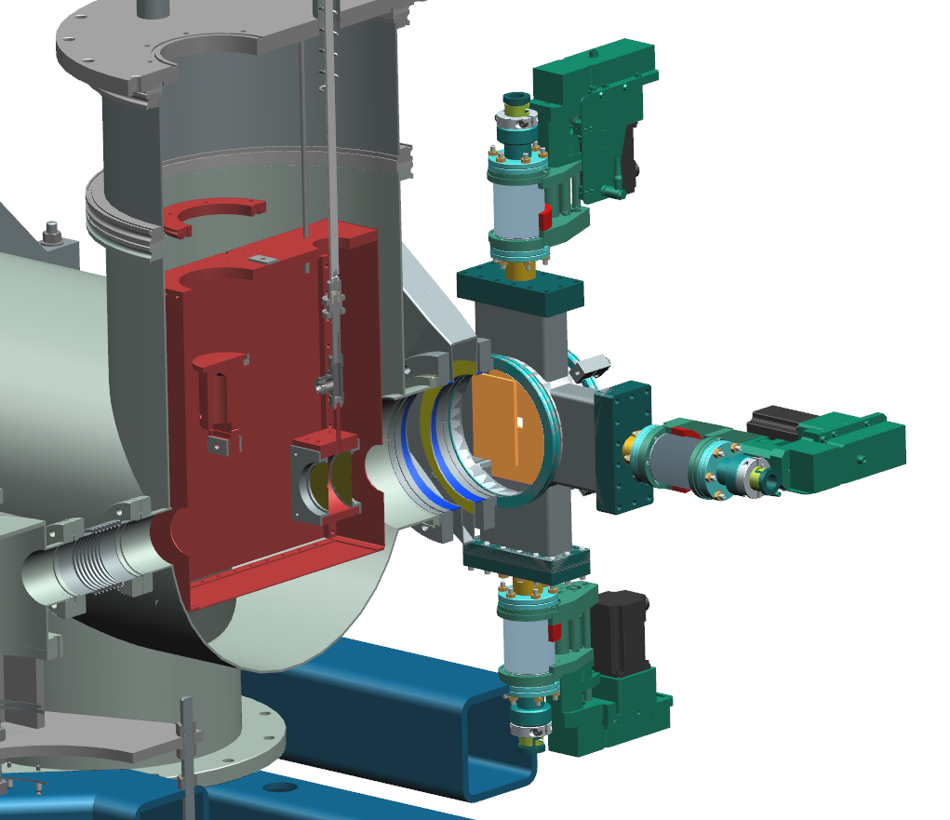
PRad II Veto Scintillator
Four scintillator paddles
Mounted to the downstream side of the target
Each paddle can move in and out independently
A1
A2
B1
B1

Slide 7
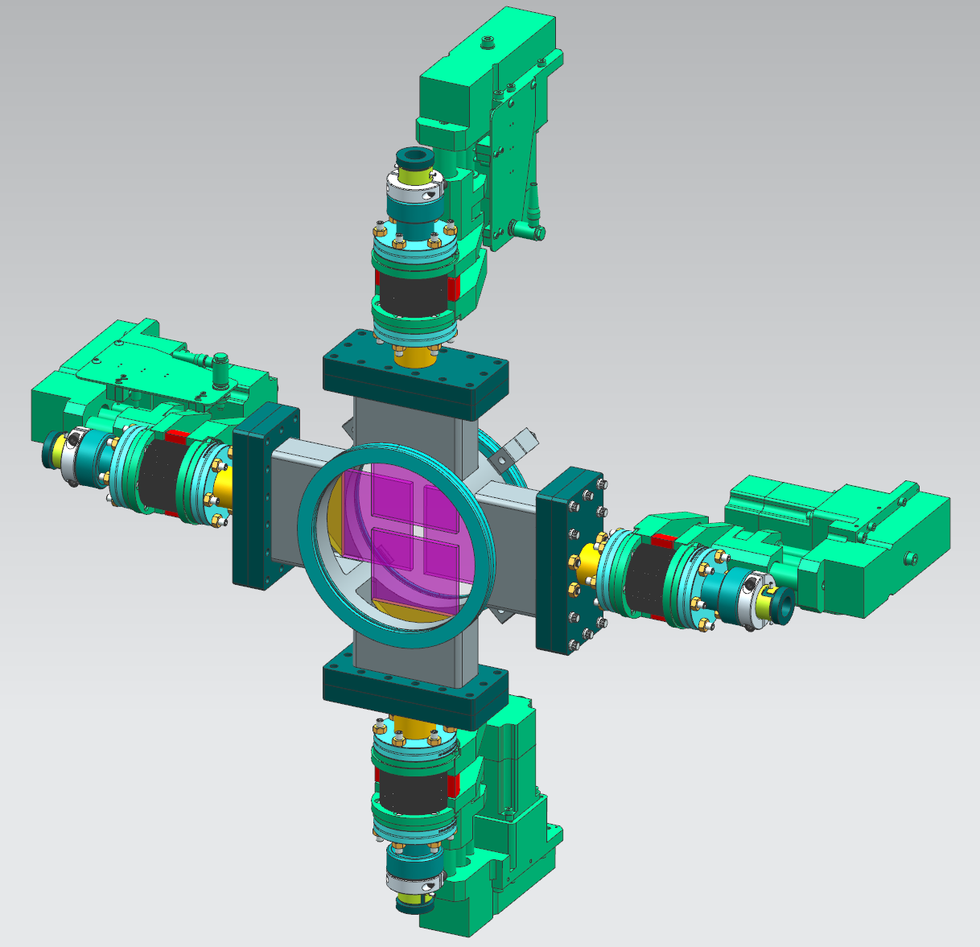
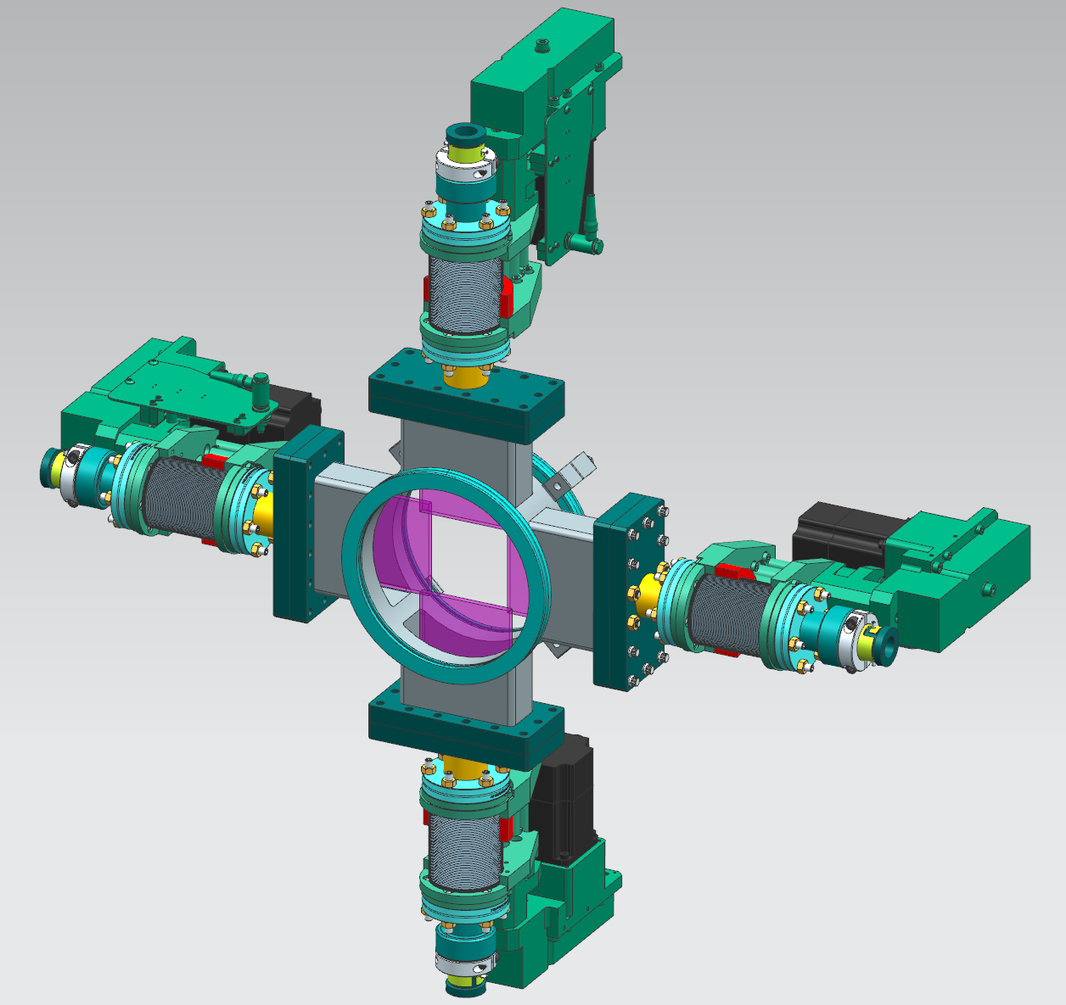
PRad II Veto Scintillator Positions
A1
A2
B1
B1
Scintillators in for Hycal Calibration
- opening for 2.92 degree calibration cone
Scintillators Retracted for PRad II Operation - opening for 12.7 degree acceptance cone

Slide 8
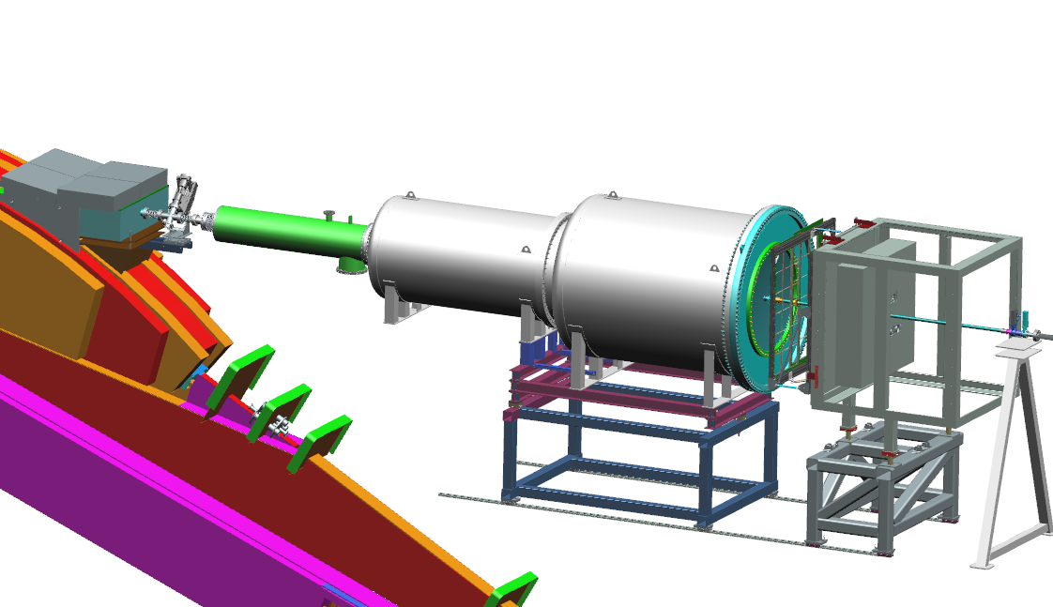
X17 from Tagger Magnet to Hycal
Collimator Box
Target & Harp
Vacuum Tube
Vacuum Tanks
1 Meter Window
GEM Detectors
Hycal
X17 Target to Hycal Lead Tungstate Counters is 7.5 Meters
A1
A2
B1
B1

Slide 9
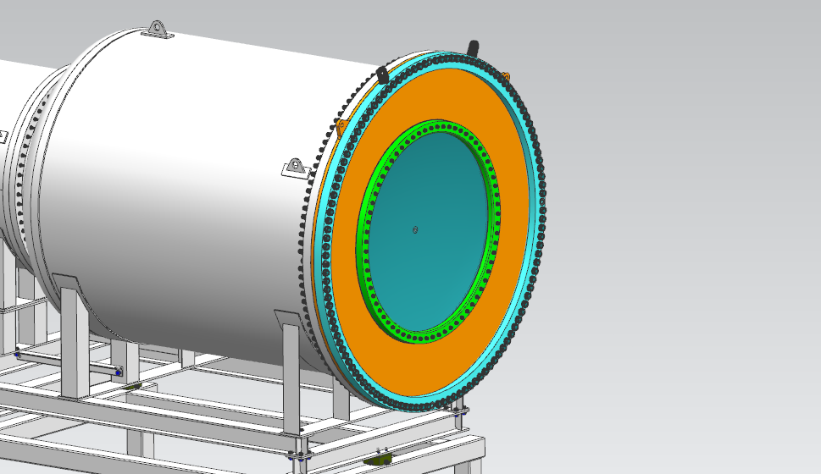
X17 Vacuum Tank Window
Window Adapter in Orange
1 Meter Diameter Window
0.020” Thick Aluminum
15 mm Diameter Window at Center
30 micron Thick Aluminum
A1
A2
B1
B1

Slide 10
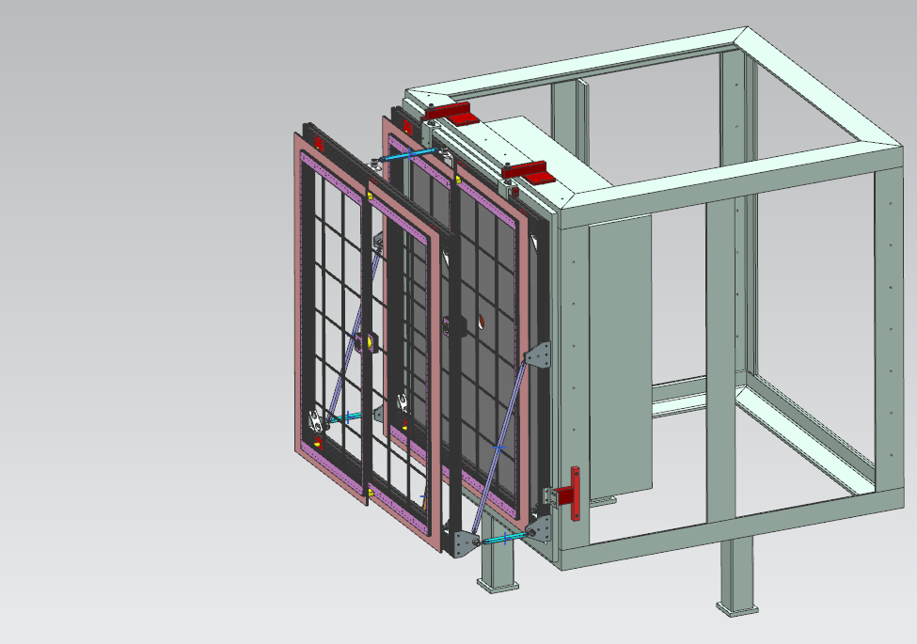
GEM Detectors
Downstream GEM Mounted to Hycal as in PRad I
Upstream GEM Mounted to Downstream GEM via Steel Links
GEMs are Spaced 40 cm Apart – Upstream Plane to Upstream Plane

Slide 11
GEM Gas System
Modify Hall B MVT gas system to supply argon/CO2 to GEMS
Supplies 70/30 argon/CO2, mixture can be adjusted
Supplies maximum of 500 sccm of mixture, distributed to 4 GEM modules
GEM pressure controlled by oil bubblers
Overpressure protection supplied by separate oil bubblers
N2 supply for flushing and conditioning the GEMS

Slide 12
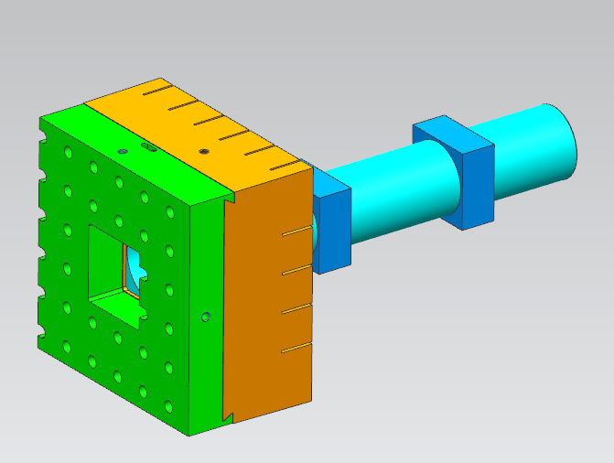
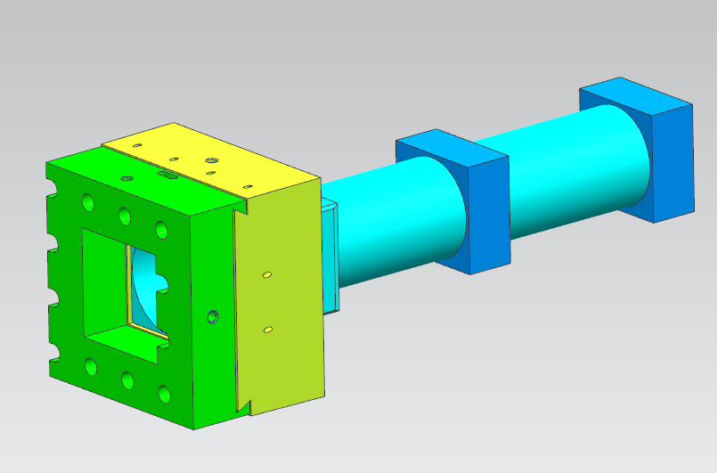
Hycal Collimators
PRad II Collimator
Covers 4 x 4 Crystals
60 mm Thick Tungsten
Used for PRad 1
X17 Collimator
Covers 6 x 6 Crystals
73 mm Thick Tungsten

Slide 13
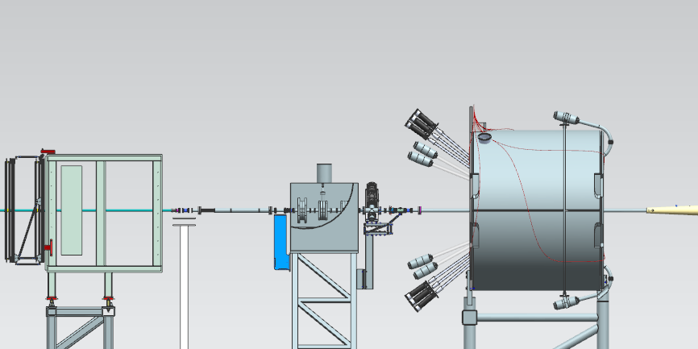
Hycal to Beam Dump
Hycal
Helium Filled Kapton Tube
Beam Position Monitor
Harp
Vacuum Tubes to Beam Dump

Slide 14
Design and Engineering Status
Conceptual designs of all components are complete
Working on detailed designs and drawings
as drawings are completed, parts will be ordered
Working with Procurement and vendors to order long lead time items such as scintillator and harp actuators, and tungsten shielding
Working with the Hall Work Coordinator on installation procedures

