Slide 1
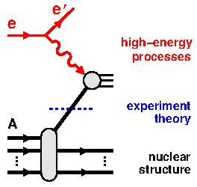
Measurement of Tensor Observables and Deuteron Structure Function
Summer School “Light-ion physics in the EIC era:
From nuclear structure to high-energy processes’’
Chhetra Lama
25/06/2025

Slide 2
Measurement of Tensor Observables and Deuteron Structure Function
C12-13-011: The b₁ experiment
C12-15-005: A_{zz} for x>1
30 Days in Jlab Hall C
A⁻ Physics Rating
44 Days in Jlab Hall C
A⁻ Physics Rating
RunGroup Spokespersons
Chen, Day, Higinbothan, Kalantarians, Keller
Long, Rondon, Slifer, Solvignon
Courtesy:Karl Slifer
b1 and Azz polarized target experiment

Slide 3
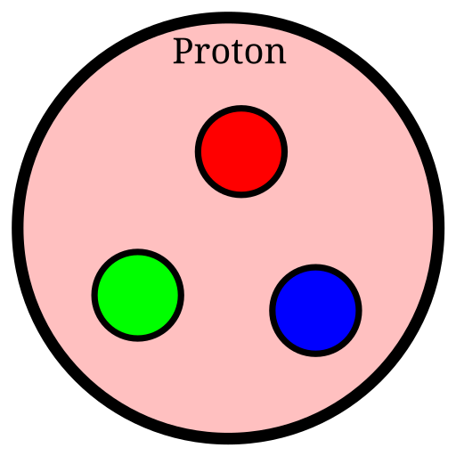
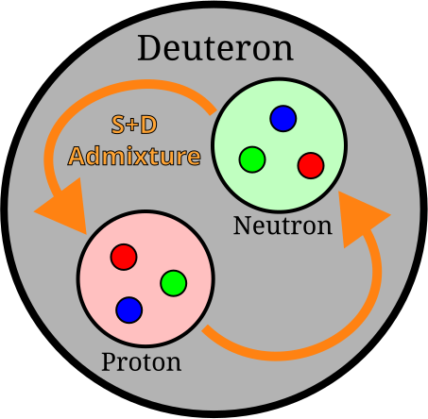
Protons & Deuterons
Proton
Deuteron
Spin-1 System
Spin- ¹System
2
Proton-Neutron bound state
Simplest nuclear system: nucleon interaction effects
m = ±1, 0
Three valence quarks + gluons and sea quarks
No nucleon-nucleon interactions
m = ±
$$\frac{1}{2}$$
S. Kumano, IOP Proc. Tens. Pol. Targ. (2014)
Courtesy:Allison Zec
b1 and Azz polarized target experiment
Achieving High Deuteron Tensor Polarization To Probe Nuclear Structure

Slide 4
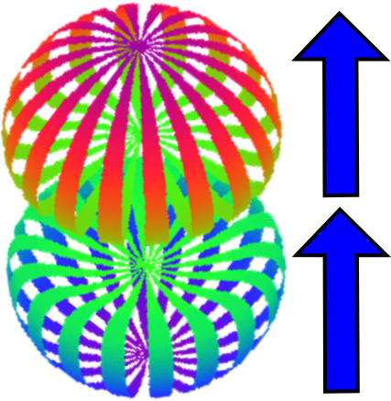
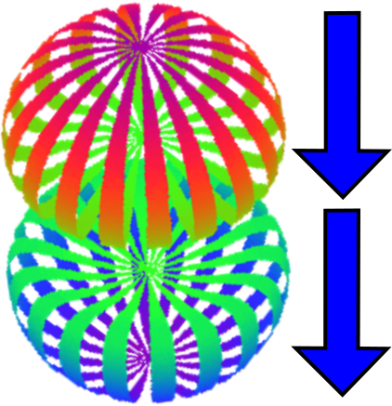
What Deuterons Do That Protons Don’t
Proton
Deuteron
Spin-1 System
Spin- ¹System
2
m = +1 m = −1
m = + ¹
m = − ¹
m = 0
2 2
Vector and Tensor Polarization
“Typical” Vector Polarization
P_{z} = p₊ − p₋
J Forest, et al, PRC 54 646 (1996)
P_{zz} = (p₊ + p₋) − 2p₀
Courtesy:Allison Zec
b1 and Azz polarized target experiment

Slide 5
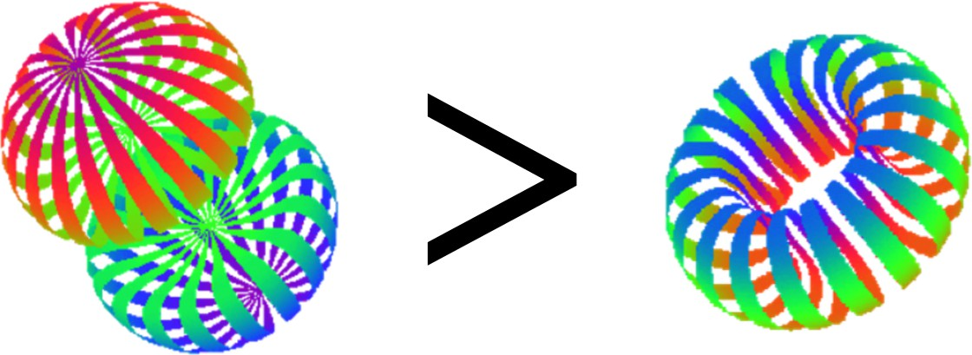
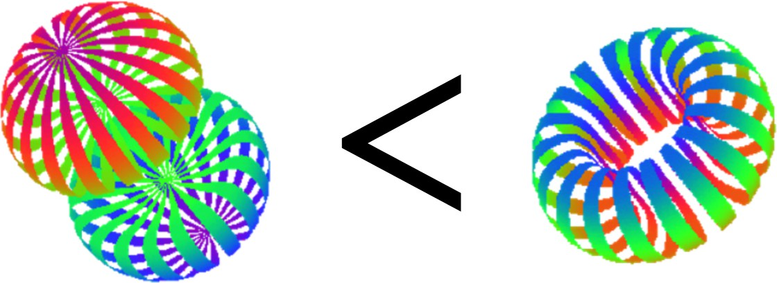
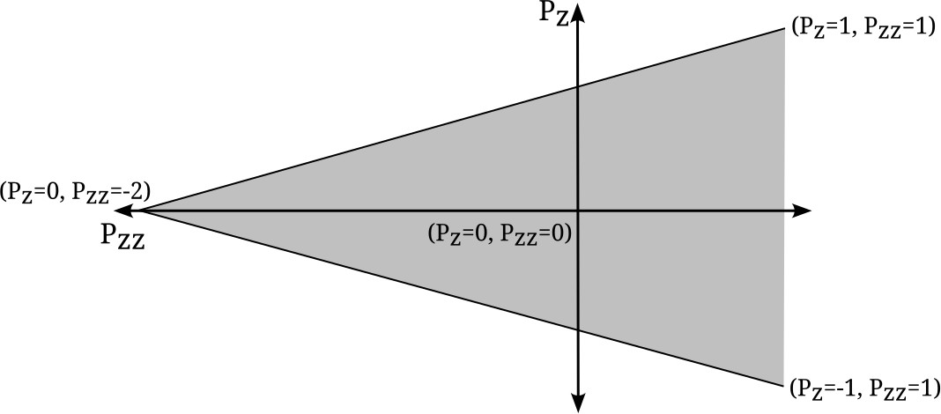
Tensor Polarization Properties
If. . .
Then. . .
0 < P_{zz} ≤ 1
P_{zz} = 0
−2 ≤ P_{zz} < 0
P_{z} ranges from -1 to +1
P_{zz} ranges from -2 to +1
In deuterons both P_{z} and P_{zz} can be nonzero simultaneously
Courtesy:Allison Zec
b1 and Azz polarized target experiment
5 / 43

Slide 6
Tensor Polarization Properties
If. . .
Then. . .
0 < P_{zz} ≤ 1
P_{zz} = 0
−2 ≤ P_{zz} < 0
A high-luminosity tensor-polarized target has promise as a novel probe of nuclear physics
Courtesy:Allison Zec
b1 and Azz polarized target experiment
Achieving High Deuteron Tensor Polarization To Probe Nuclear Structure
5 / 43

Slide 7
Tensor Observables
Here ${\text{σ}}_{0}$ is unpolarized cross section, $h_{e}$ is electron beam helicity,
$A_{||}, A_{T}^{ed}$, $A_{V}^{d} and A_{zz}$ are symmetries dependent on the polarization angle
W. Leidemann, E.L. Tomusiak, H. Arenhovel, Phys. Rev. C 43 1022 (1991)
b1 and Azz polarized target experiment

Slide 8
Tensor Observables
Here ${\text{σ}}_{0}$ is unpolarized cross section, $h_{e}$ is electron beam helicity,
$A_{||}, A_{T}^{ed}$, $A_{V}^{d} and A_{zz}$ are symmetries dependent on the polarization angle
If we integrate over beam helicity, then the first term will disappear
W. Leidemann, E.L. Tomusiak, H. Arenhovel, Phys. Rev. C 43 1022 (1991)
b1 and Azz polarized target experiment

Slide 9
Tensor Observables
Here ${\text{σ}}_{0}$ is unpolarized cross section, $h_{e}$ is electron beam helicity,
$A_{||}, A_{T}^{ed}$, $A_{V}^{d} and A_{zz}$ are symmetries dependent on the polarization angle
If we integrate over beam helicity, then the first term will disappear
W. Leidemann, E.L. Tomusiak, H. Arenhovel, Phys. Rev. C 43 1022 (1991)
b1 and Azz polarized target experiment

Slide 10
Tensor Observables
Here ${\text{σ}}_{0}$ is unpolarized cross section, $h_{e}$ is electron beam helicity,
$A_{||}, A_{T}^{ed}$, $A_{V}^{d} and A_{zz}$ are symmetries dependent on the polarization angle
If we integrate over beam helicity, then the first term will disappear
If we flip between vector polarization sign then $A_{V}^{d}$ disappear
W. Leidemann, E.L. Tomusiak, H. Arenhovel, Phys. Rev. C 43 1022 (1991)
b1 and Azz polarized target experiment

Slide 11
Tensor Observables
Here ${\text{σ}}_{0}$ is unpolarized cross section, $h_{e}$ is electron beam helicity,
$A_{||}, A_{T}^{ed}$, $A_{V}^{d} and A_{zz}$ are symmetries dependent on the polarization angle
If we integrate over beam helicity, then the first term will disappear
If we flip between vector polarization sign then $A_{V}^{d}$ disappear
W. Leidemann, E.L. Tomusiak, H. Arenhovel, Phys. Rev. C 43 1022 (1991)
b1 and Azz polarized target experiment

Slide 12
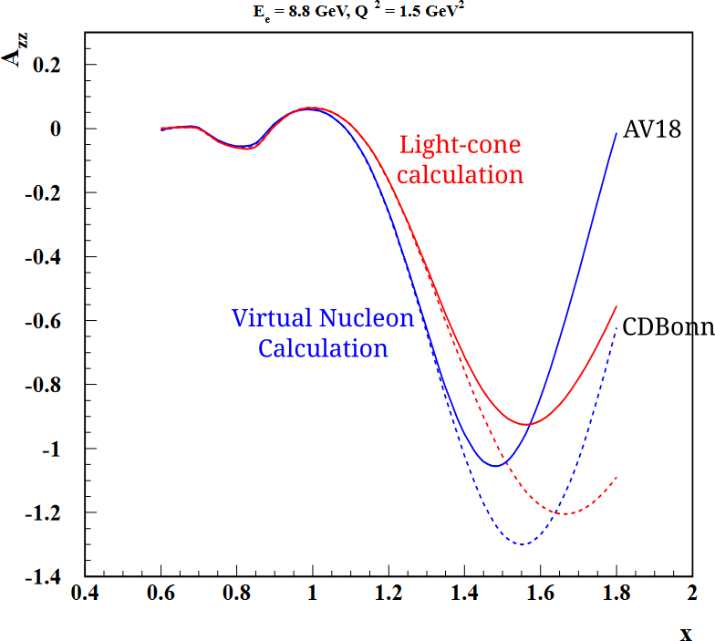
Tensor Asymmetry and Structure Function
For 0.8 ≤ x ≤ 1.8
σ_{p} =polarized cross section
σ₀ =unpolarized cross section
$\frac{2}{fP_{zz}}$($\frac{σ_{p}}{σ_{0}}$-1)
A =
zz
for x ≤ 0.5
b₁ =−$\frac{3}{2}$F₁A_{zz}
Currently no quasielastic data available
Difficult to measure with just vector polarized deuterons
M. Sargsian, M. Strikman arXiv:1409.6056
E. Long et al, JLab C12-15-005
Above: Two theory models: AV18 (solid) and CDBonn (dashed) for two different calculation frameworks predicting the quasielastic value of Azz .
Courtesy:Allison Zec
b1 and Azz polarized target experiment
Achieving High Deuteron Tensor Polarization To Probe Nuclear Structure

Slide 13
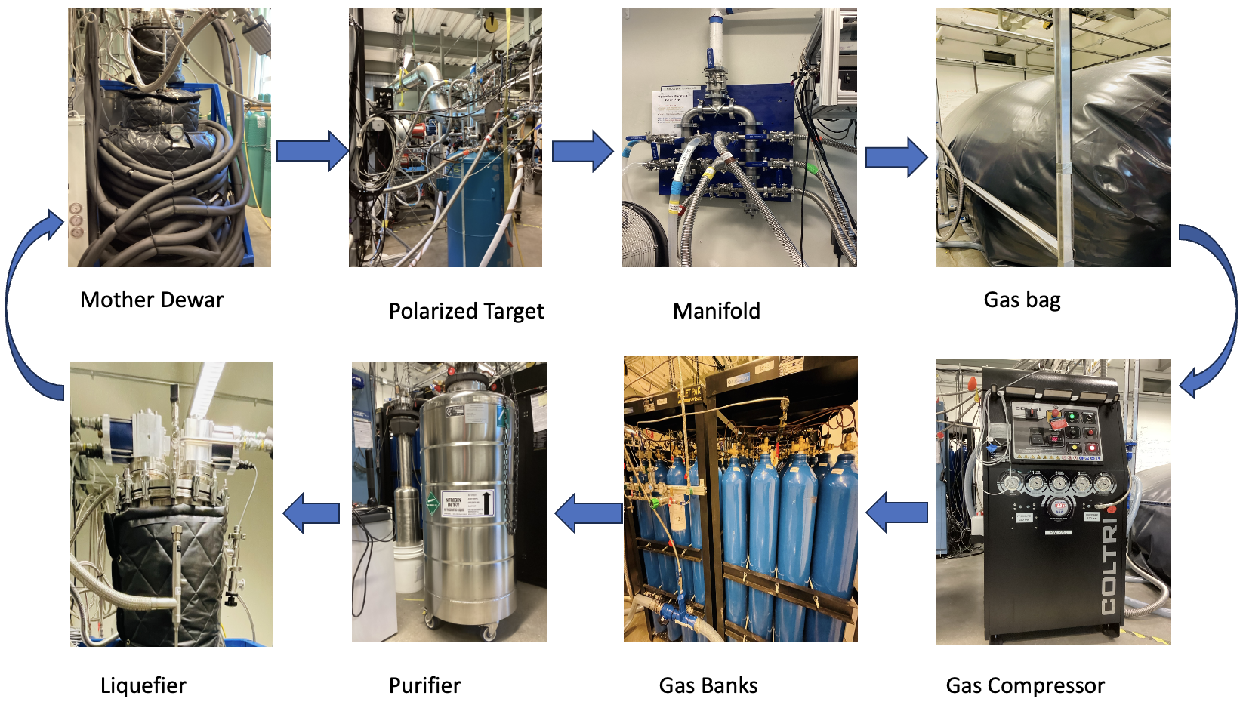
Tensor Enhancement @UNH DNP Lab
Experimental setup for the cooldown at the UNH Polarized Target lab
b1 and Azz polarized target experiment

Slide 14
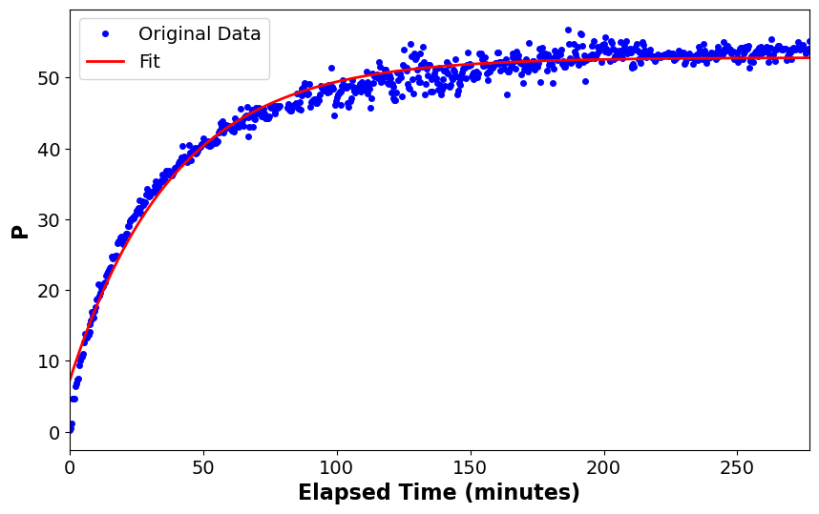
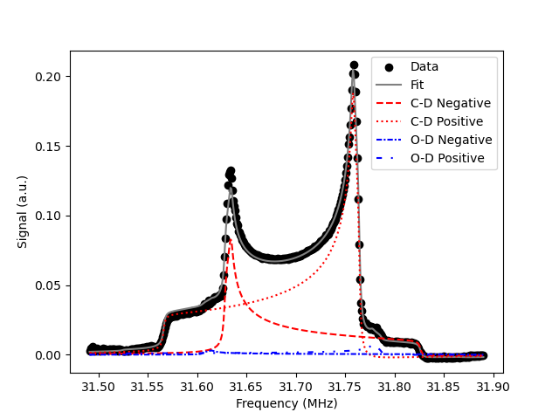
Tensor Enhancement by Holeburning
Polarization
P_{z} = p₊ − p₋
P_{zz} = (p₊ + p₋) − 2p₀
Courtesy:M.McClellan
P_{max}= 53% and tau= 38.57 mins
Data from UNH Lab
b1 and Azz polarized target experiment

Slide 15
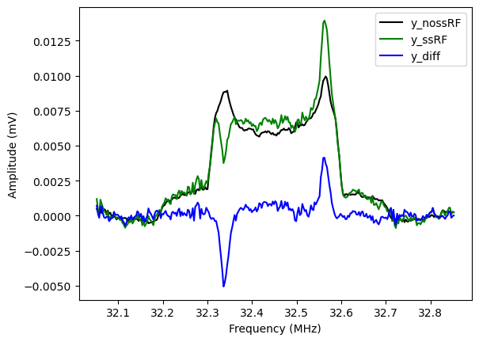
Holeburning Continued
Multiple applications of holeburning we achieved 16% tensor polarization on d-butanol.
We are currently working on improvements to our equipment design so that our system will perform even better.
Our goal is to achieve 30% tensor polarization using this technique.
b1 and Azz polarized target experiment

Slide 16
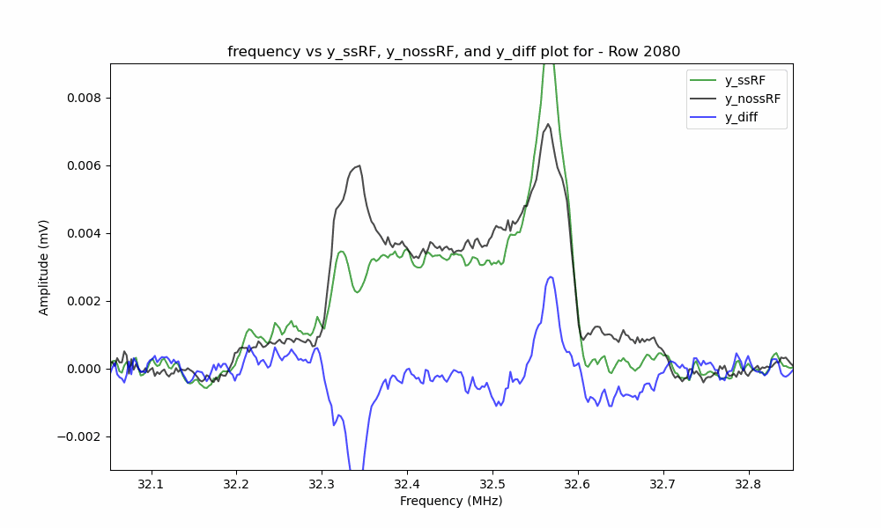
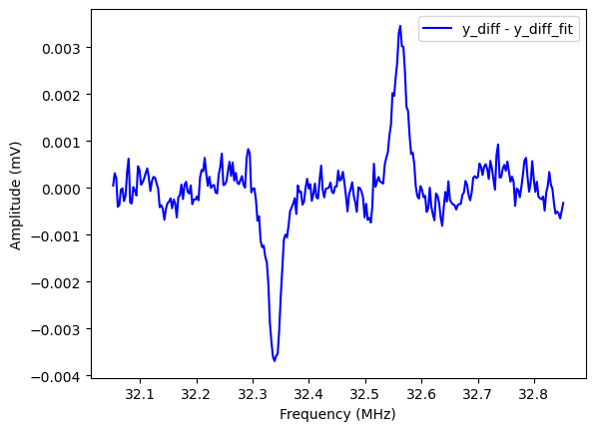
Holeburning Relaxation Time
Livetime animation of Holeburning
Difference in ssRF-nossRF
b1 and Azz polarized target experiment

Slide 17
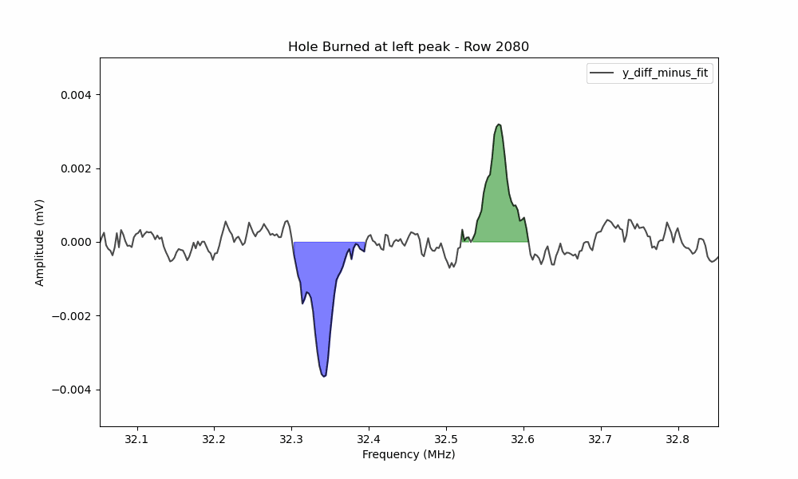
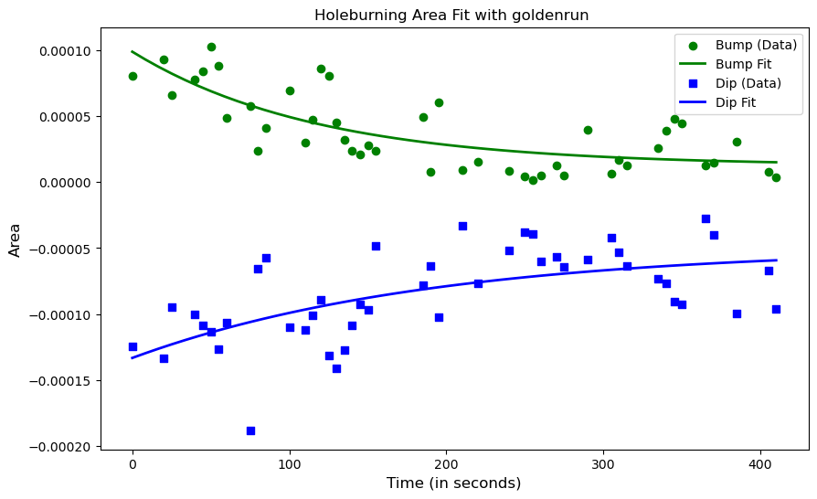
Holeburning Relaxation Time Continued
Corresponding area
Area curve fitting
b1 and Azz polarized target experiment

Slide 18
Summary
Tensor polarized targets present new opportunities for high-luminosity experiments such as b₁ and A_{zz}
DNP tried-and-true method for target polarization going on
UNH NPG has demonstrated tensor polarization capability
NPG group at UNH
b1 and Azz polarized target experiment
Achieving HighDeuteron Tensor Polarization To Probe Nuclear Structure

Slide 19
Question?
Thank you!
Any Questions will be Welcome!

